Slide 1
Demography and Demographic Methods for Public Health
Nadia Diamond-Smith, PhD, MSc
Assistant Professor
Global Health Sciences/Department of Epidemiology and Biostatistics, UCSF

Slide 2
Introductions
A little about you (some demographics if you like)
Area of focus
Area of interest within demography

Slide 3
Outline of Today’s Lecture
  Course information
  What is demography?
    Why is understanding demographic methods useful for epidemiologists/public health experts?
  Demographic theory and population growth
  Population pyramids!

Slide 4
Welcome: Class info
10 week course
Mondays 10:30am-12
No pre-requisites, assumed basic math skills, use of excel, knowledge of fundamentals of public health
Letter grade or pass/fail

Slide 5
General format
Short presentations about homework from the week before (~15 mins)
Lecture on topic of the week (me or guest lecturer) (~45 mins)
  Theory
  Methods
Discussion of reading (~30 mins)
  ~2-3 readings are listed in the syllabus to be read before each class.
  Everyone should post 2-3 questions about the reading by 5pm the night before class (Sunday evening) on the website
    These questions will be used to direct the discussion

Slide 6
Labs
5 labs
Everyone choose 2 countries that you will use for the 5 labs
Data on website
Labs are due by 9pm the night before class on the website
Each class will start with everyone briefly sharing their lab graphs
  Point out 1-2 interesting findings or comparisons between your countries

Slide 7
Final Project
Apply one of the methods learned in class to an existing data set to explore a question of interest to you
Potential types of projects:
Use life tables to look at people’s probability of migrating from Mexico to the US by age group, and expected number of years someone of each age group will spend living in Mexico or the US
Explore changes over time in total fertility rate and cohort childlessness by age group in a country of choice using Human Fertility Database Data
Project changes in population size of sub-groups in a population (for example, ethnic groups or women with asthma in the US) under different assumptions about future changes in fertility, mortality and migration
Use Demographic and Health Survey Data to explore if there is an urban penalty or advantage for child health outcomes in a country of choice

Slide 8
Final projects
Due: Friday Dec 1 via email to Nadia
5 pages, double spaced, mostly focus on methods, data analysis and findings
  Short background/intro, at least 5 references
Nov 27: 10 min powerpoint presentations of final project
Nov 6: Send Nadia a few sentence description of your project and the data you will use
  Have gotten access to that data source

Slide 9
Grading
Completion of each lab/homework (5% each x 5=25%)
Reading questions (25%)
A short final paper (<=5 pages) (35%)
Presentation of the findings from labs and final project (15%)

Slide 10
Topics covered in the course
Intro to demography and theory, Population Growth (today)
Fertility
Mortality: Guest Lecturer Magali Barbieri, UC Berkeley
Data sources, quality of data and indirect methods; Aging
Family Demography: Guest lecturer Kristen Harknett, UCSF
Migration and Urbanization; life tables
Disability and work: Guest lecturer Amal Harrati, Stanford University
Residential Segregation: Guest lecturer Joan Casey, UC Berkeley/UCSF
Sex Ratios and In-depth case study on demography and HIV
Final class is presentations

Slide 11
Outline of Today’s Lecture
  Course information
  What is demography?
    Why is understanding demographic methods useful for epidemiologists/public health experts?
  Demographic theory and population growth
  Population pyramids!

Slide 12

What is Demography?
  “Demography is the scientific study of human populations, primarily with respect to their size, their structure and their development”
  Demography =
  demos = people
  +
  graphos = study

Slide 13
Why is demography important for health?
“The everyday activities of all human being, communities, and countries are interrelated with population change, patterns and levels of use of natural resources, the state of the environment, and the pace and quality of economic and social development”
  -Programme of Action of the UN International Conference on Population and Development, Cairo, 1994
  Demographic situation Health care supply and demand

Slide 14
Differences between Demography and Epidemiology (Wallace, 2001)
Epidemiology
Demography
Historically more clinical: medicine, basic science, pathology
Somewhat less global and comprehensive
More appropriate for clinical, individual and programmatic decision making
Uses randomized experiments, tests interventions
Common Areas: Sociology, Economics, psychology
More global and comprehensive, but topically narrower
More appropriate for population policy
Relies on natural experiments, large datasets (censuses, etc.)

Slide 15
Commonalities between demography and epidemiology
Quantitative
Appreciation of role of human behavior and social institutions
  Both often consider differences in health or health related factors based on wealth, SES, urban/rural, race/ethnicity, gender, vulnerable sub-groups, etc.
Look at relationship between vital events and health and disease
Concerned with prediction

Slide 16
How Demography is used in Public Health
Comparing the health of one population with that of another
Monitoring changes in the health of a given population
Identifying and quantifying the health inequalities within populations (e.g. across social groups and geography)
Provide projections that inform priorities for health service delivery and planning
Inform debates on priorities for research and development
Analyzing the benefits of health interventions for use in cost-effectiveness analyses

Slide 17
Outline of Today’s Lecture
  Course information
  What is demography?
    Why is understanding demographic methods useful for epidemiologists/public health experts?
  Demographic theory and population growth
  Population pyramids!

Slide 18
Demographic Theory
John Graunt
  Natural and Political Observations Made upon the Bills of Mortality (1662)
  Laid the foundation for human statistical and census methods
  Developed first life tables
  Also a father of epidemiology

Slide 19
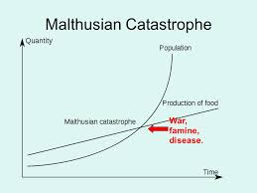
Demographic Theory
Thomas Robert Malthus
An Essay on the Principle of Population (1798)
  Population will grow geometrically
  Food production will grow arithmetically
  Famine and starvation
  UNLESS births are controlled!

Slide 20
Demographic Transition Theory
First proposed by Warren Thompson 1929
Formal theory proposed by Frank Notestein in 1940s and 50s
5 stages
  1. High births and death (Pre-industrial)
  2. Mortality drop, births high (most developing countries today)
  3. Fertility falls
  4. Low births and low deaths
  5. Below replacement level fertility

Slide 21
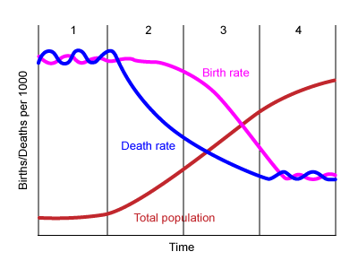
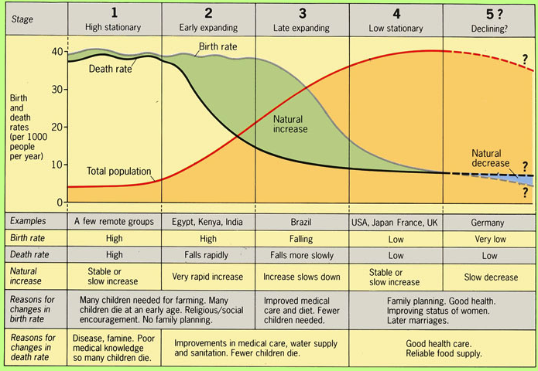
Demographic Transition Theory

Slide 22
Population Growth: balancing equation
Demographic Balancing Equation
P=population
t=time
B=births
D=deaths
I=in migration
O=out migration

Slide 23
Exponential population growth
r=rate of growth
t=time
P= population at each time period

Slide 24
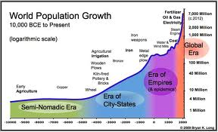
Historical Population Growth
Until about 1000 B=D
Then food supply, trade, etc. increased and B>D, slowly at first, then rapidly

Slide 25
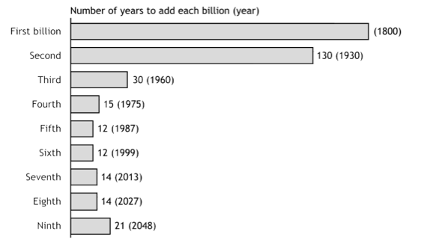
Number of years to add each billion
First and second billion: Population Reference Bureau; Third through ninth billion: United Nations.
(2005). World population prospects: the 2004 revision (medium scenario).

Slide 26
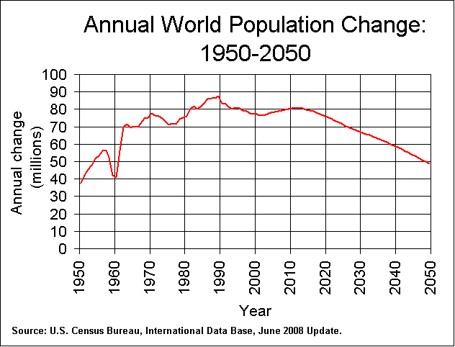

Slide 27
Outline of Today’s Lecture
  Course information
  What is demography?
    Why is understanding demographic methods useful for epidemiologists/public health experts?
  Demographic theory and population growth
  Population pyramids!

Slide 28
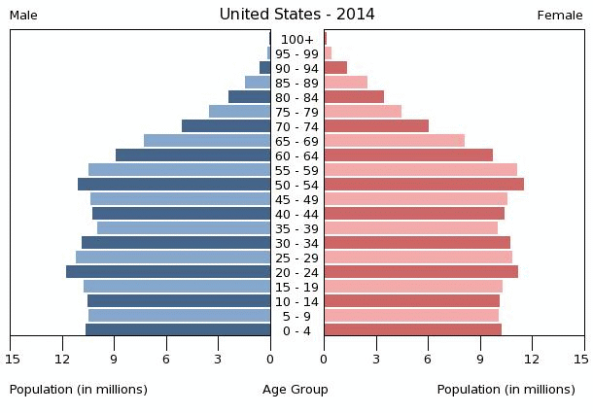
Population Pyramid: USA

Slide 29
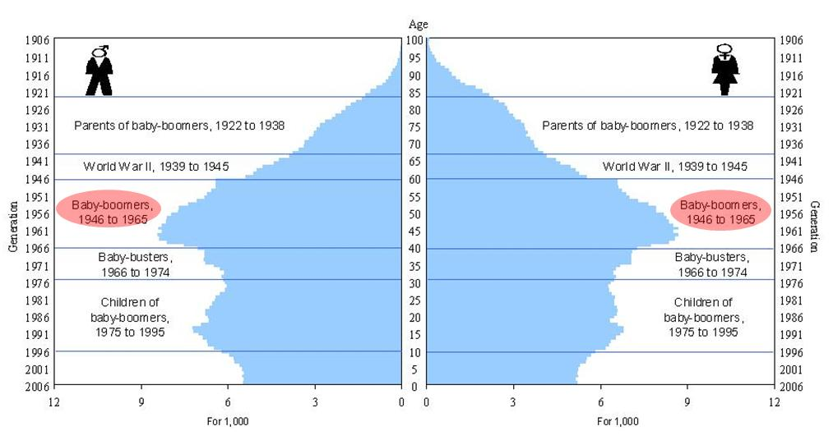
History in Pop Pyramids: US

Slide 30
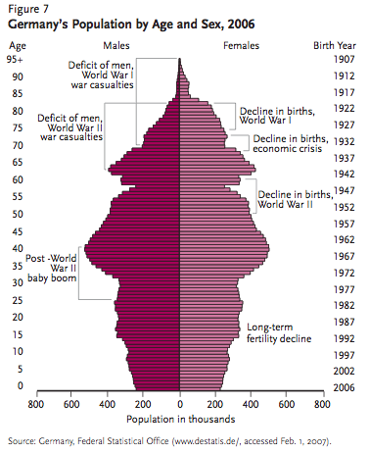
Notes:
Famine: 1866-68
15 months between two wars (1939-40 was the first one) between finland and soviet union.

Slide 31
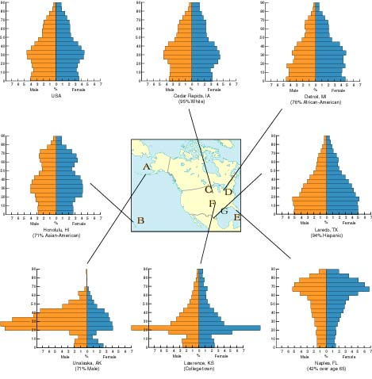
Guess the state
Alaska
Florida
Notes:
Lower right: florida
Middle bottom: kansas
Lower left: alaska
Middle right: texas
Top middle: iown
Left middle: hawaii

Slide 32
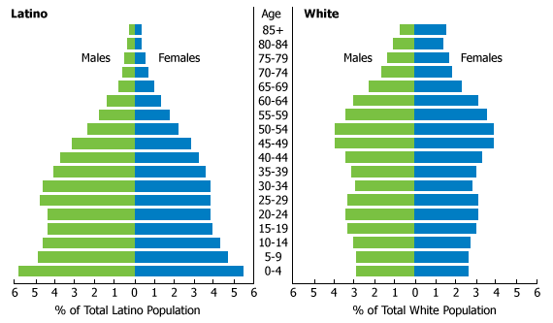
Difference by ethnic group: US

Slide 33
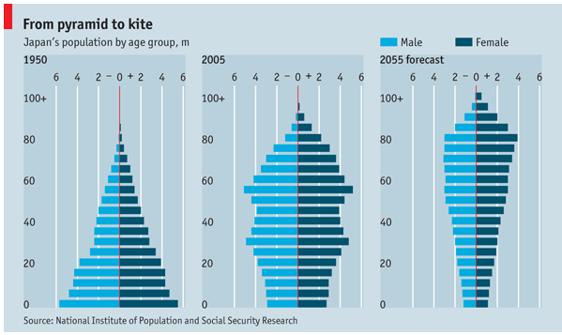
Change over time: Japan

Slide 34
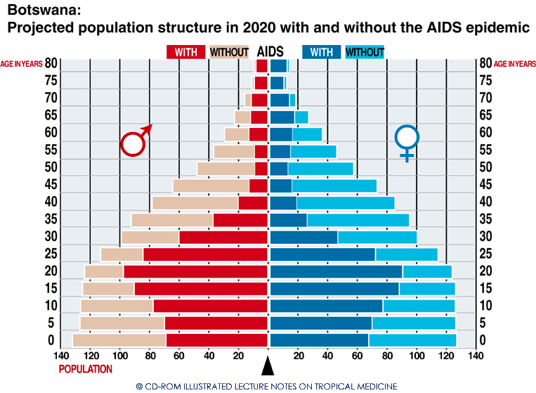
Botswana

Slide 35
Choose some countries!
For many lab assignments throughout the term, we will use data from 2 of the same countries to look at different demographic trends
Please choose two countries, on different continents, to use for the remainder of the course
Naomi: Mexico, Ethiopia
Branden: Trinadad, Iran
Sankari: China, Argentia
Obi: Nigeria, Japan
Shahad: Turkey, Mongolia

Slide 36
Tips on graphs
Always label your axes
  Units, what it is
Always have a title that makes it clear without reading anything else what you are showing
If comparing two graphs, make sure the axes have the scale
Have a key
Think carefully about when a line graph vs bar graph might be useful

Slide 37
Thank you!
Questions?
Notes:
Final boiler plate language: 2 versions
Through its singular focus on health, UCSF is leading revolutions in health.
UCSF is driven by the idea that great breakthroughs are achieved when the best research, the best education and the best patient care converge.

