Slide 1
Disease Occurrence I
Main Points to be Covered
Incidence versus Prevalence
The 3 elements of measures of incidence
Cumulative vs. person-time incidence
Concept of censoring
Calculating cumulative incidence
  Kaplan-Meier method
  Life table method
  [next week] Cumulative incidence function
Underlying assumptions: no secular trends, losses unrelated to outcome, no (or independent) competing events
Notes:
In addition to the distinction between incidence and prevalence, introduced in class last week, we will be presenting the difference between two important and widely used ways to measure incidence called cumulative incidence and person-time incidence. The reading for this week emphasizes the 3 elements in measuring disease incidence. Understanding those 3 elements and focusing on how they are used (or not used) can eliminate confusion about the frequently erratic use of terminology in the clinical research literature. We will go on this week to show in detail how one of these measures, cumulative incidence, is usually calculated using the Kaplan-Meier method.

Slide 2
Measuring Disease Occurrence
Occurrence of disease is the fundamental outcome measurement of epidemiology
Occurrence of disease is typically a binary (yes/no) outcome
  Note: Continuous changes related to disease, e.g., changes in blood pressure, are also relevant but not the focus of this course
Occurrence of disease involves time
Notes:
Last week with the overview of study design we emphasized the importance of viewing each of the basic types of study design as occurring in the setting of a study base moving through time, either an explicit cohort or a hypothetical cohort. The central idea is that study design cannot be thought about correctly without including the element of time. Movement of persons through time is what defines a cohort. Turning now to how disease occurrence is measured, time will remain at the center. To understand the different measures of disease occurrence you must pay attention to how time enters into the measure.
Time plays a role even in the measure of prevalence when the distinction is made between point and period prevalence, a topic covered in the next few slides.

Slide 3
Prevalence versus Incidence
Prevalence counts existing disease diagnoses, usually at a single point in time
Incidence counts new disease diagnoses during a defined time period
Fundamental distinction in epidemiology
Notes:
The difference between incidence and prevalence is a fundamental distinction in epidemiology. As we noted last week, prevalent cases of a disease will over-represent those with longer duration or survival. This can potentially introduce significant bias into a study of a disease and its risk factors. The amount of the difference between incidence and prevalence is related to the time period during which incidence is measured and the average length of duration of the disease condition. In some instances prevalence may look numerically similar to incidence and in others the two measures will be very different.

Slide 4
Prevalence vs Incidence
Prevalence
  Burden of disease -> public health planning
Incidence
  Trends over time -> public health implications
  Fundamental for studies of causality
  Exclude prevalent cases to focus on causes of disease, separate from causes of “survival with disease”
Notes:
Prevalence is important from the public health perspective of examining the burden of a disease in a population. Incidence is also important to public health in determining trends over time in controlling a disease, but it is the fundamental measure for studies of causality. Causality means the study of what causes various diseases. To understand disease etiology it is necessary to distinguish between causes of the disease and causes of extending disease survival. Using only incident cases of a disease achieves this by removing any differences in survival time or duration of the disease. Using prevalent cases introduces differences in survival time which could be related to the factors being investigated as causes of disease per se.

Slide 5
Two Types of Prevalence
Point prevalence - number of persons with a specific disease at one point in time divided by total number of persons in the population
Period prevalence - number of persons with disease in a time interval (eg, one year) divided by number of persons in the population
  Prevalence at beginning of an interval plus any incident cases
Risk factor (exposure) prevalence may also be important
Notes:
This distinction is often not made because most prevalence estimates that you will encounter in the clinical research literature are point prevalence. Period prevalence has its uses, however. It is, for example, helpful for planning the delivery of health services to know how many persons in a given time period may need those services. A way to think about period prevalence is as the point prevalence at the beginning of a defined time interval plus whatever incident cases occur during that interval.
The concept of prevalence is not unique to disease outcome. The prevalence of a risk factor is also important from a public health perspective. For example, a risk factor (exposure) may have a modest association with a disease outcome (say, a risk ratio less than 2), but be a very common exposure. In that instance even a small risk ratio may have great public health importance if a large proportion of the population is exposed. A good example is the risk associated with second hand smoking. We will cover this subject in more detail later in the course when we discuss measures of disease association, but in general the size of the risk ratio of an exposure can be useful as a gauge of its potential role in etiology of a particular disease, but the prevalence of the exposure in the population will determine how large its attributable risk on the disease – and on public health - will be.

Slide 6
Example of Point Prevalence
NHANES = National Health and Nutrition Examination Survey, a probability sample of all U.S. residents, conducted 1988 to 1994
During NHANES, blood samples drawn and tested for antibodies against HIV
  Prevalence of HIV infection = 0.18%
    McQuillan et al., JAIDS, 1997
Notes:
NHANES III was carried out over a long time period, 6 years between 1988 and 1994, but each person’s blood was drawn at a single point in time, so this is an example of point prevalence. Of course, testing all of those blood samples together as if they were all drawn at a single point in time does make an assumption that the point prevalence wasn’t changing during the time it took to carry out the entire NHANES III study. This certainly would have been a poor assumption had NHANES III taken place in the early 1980’s when HIV was first introduced into the U.S. and was spreading rapidly. The concept illustrated is that point prevalence is not a function of the length of time it takes to conduct the study. It is a function of the time period represented by the measurement. A single blood sample represents one point in time. Although it may take a while to gather all of the samples, most prevalence studies do not take 6 years, and the assumption of not much change in the prevalence being measured during the period of carrying out the study is usually reasonable. The prevalence of many common chronic conditions does not change rapidly in a population as large as the entire U.S.
This particular estimate of HIV prevalence was undoubtedly too low, as the authors acknowledged, because NHANES does not get a good sample of some of the groups at high risk for HIV infection, especially injecting drug users and probably gay men.

Slide 7
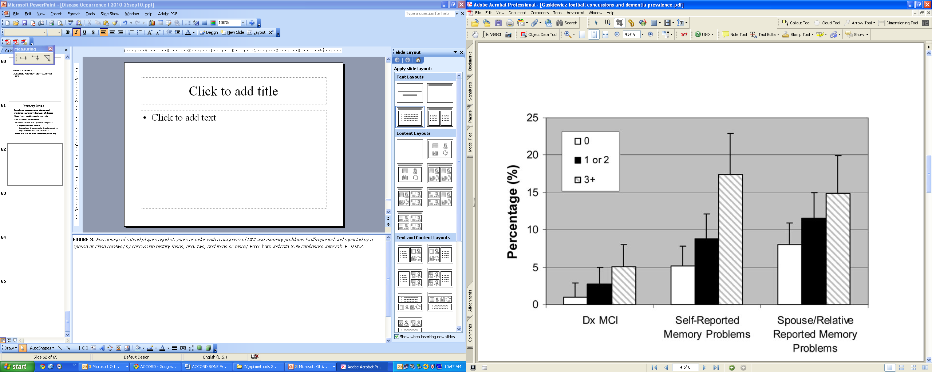
Point Prevalence: Concussion and Cognitive Impairment in Retired Football Players
FIGURE 3. Percentage of retired players aged 50 years or older with a diagnosis of MCI and memory problems (self-reported and reported by a
spouse or close relative) by concussion history (none, one, two, and three or more). Error bars indicate 95% confidence intervals. P 0.007.
Guskiewicz et al.Neurosurgery 2005
Notes:
This is a general health questionnaire completed by 2552 retired professional football players. Average 54 years old and an average playing career of 6.6 years. Second questionnaire focusing on memory and issues related to mild cognitive impairment (MCI) was then completed by a subset of 758 where were >=50 years old. Retired players with three or more reported concussions had a fivefold prevalence of MCI diagnosis and a threefold prevalence of reported significant memory problems compared with retirees without a history of concussion.
This is an example of a study using point prevalence.

Slide 8
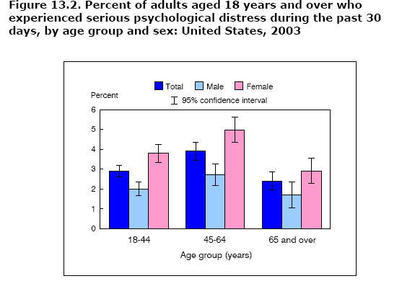
Period Prevalence: National Health Interview Survey (NHIS)
Notes:
The National Health Interview Survey is carried out every year (so it doesn’t take as long as the NHANES), but again the point is not how long it takes to conduct the NHIS but the time period the measurement represents. In this case the measurement of disease prevalence is for a specified time period, 30 days, so it is an example of period prevalence, albeit not a particularly long period. The same question might have been asked for the past six months and a different prevalence estimate would have been obtained. The point prevalence question would have been whether the person was experiencing serious psychological distress at the time the interview was conducted, a proportion that could not be greater and presumably would have been lower than reported for the 30-day period. Here period prevalence might have served a role in reducing bias if the study directors thought that persons experiencing serious psychological distress at the moment would be less likely to answer the question truthfully (or answer it at all).
One can begin to see how a very short-lived condition will have different prevalence depending on whether point or period prevalence is being examined and on the length of the time period if period prevalence is being examined.

Slide 9
How to report prevalence
Prevalence should always be stated as a number between 0 and 1 (e.g., 0.03) or as a percentage (e.g., 3%)
Avoid statements such as:
  “Prevalence was 0.13 per 1000 persons”
  Easily confused with a report of incidence
  Prefer: “Prevalence was 0.013% or 0.00013”

Slide 10
Incidence

Slide 11
The Three Elements in Measures of Disease Incidence
E = an event = a binary outcome
    (occurrence of disease)
N = number of at-risk persons in the population under study
T = time period during which the events are observed
Notes:
Turning now to incidence, understanding the 3 elements of 1) an event, 2) a number of persons at risk, and 3) a time period during which the disease events are observed is essential to understanding the different measures we will be discussing. If you always pay close attention to how these 3 elements are being used (or not used), you should have no trouble in understanding what kind of incidence measure is being presented. The binary event we are generally examining is the occurrence of a disease or death, but this framework applies to measuring incidence in any clinical study with a binary outcome (such as successfully quitting smoking).
Not all reports of disease occurrence you encounter in the literature will explicitly identify these three elements for you. It is necessary in those cases to look closely at what is being reported and uncover any elements that are not made explicit. We will look at some examples in the slides that follow.

Slide 12
Two Measures of Incidence
The proportion of individuals who experience the event in a defined time period (E/N during some time T) = cumulative incidence = incidence proportion
The number of events divided by the amount of person-time observed (E/NT) = incidence rate or density (not a proportion)
Notes:
This is an important distinction because the two types of incidence are related to different types of analyses. Both are perfectly valid measures of incidence as both include E, N, and T. We will be exploring some of the properties of these two measures, the assumptions they make, and how they are used in research studies. Both measures account for the variation in time that subjects are observed, but they do so in different ways.
We will use “cumulative incidence” to describe the proportion of individuals who experience an event in a defined time period, but “incidence proportion” is also acceptable.

Slide 13
Disease Occurrence Measures:
A Confusion of Terms
Terminology is not standardized and is used carelessly even by those who know better
Key to understanding measures is to pay attention to how the 3 elements of number of events (E), number of persons at risk (N), and time (T) are used
Even the basic difference between prevalence and incidence is often ignored
Notes:
We will present terms for the types of incidence that we will stick to. We think they make the distinctions that the best epidemiological writing on the subject make and that they should be preferred. Precise use of this terminology allows us to speak to each other accurately, avoid misunderstanding, and get the right answers in our research projects. Unfortunately, we need to warn you that in reading the clinical research literature you will often find these terms used in other ways and often used without making distinctions that we think are important. This extends all the way to making the basic distinction between prevalence and incidence we have been discussing. When we reach the distinction between the two main ways of measuring incidence, there is even more confusion over what is being reported in the literature.

Slide 14
Incidence or Prevalence?
HIV/AIDS infection rates drop in Uganda
KAMPALA, Sept. 10 (Kyodo) - Infection rates of the HIV/AIDS epidemic among Ugandan men, women and children dropped to 6.1% at the end of 2000 from 6.8% a year earlier, an official report shows…
The report says the average rate of infection for urban areas fell from 10.9% to 8.7%. In rural areas, the average was 4.2%, not much different from the 4.3% average a year earlier.
Notes:
Use of the word “rate” should imply that incidence is being measured. Reports like that cited above are common. What is reported as an infection rate is not in fact incidence but prevalence. It is not immediately clear that the figures of 6.1% and 6.8% are not incidence because it might be possible (although very unlikely) to have one-year incidence rates (e.g., 6 to 10 per 100 person-years) of HIV infection that high in Africa. However, one would have to be an expert in this subject matter to know this.
In fact, all of the figures are prevalence as they are the proportion of women who tested positive in successive years in 15 Ugandan hospital clinics. The proportion testing positive is prevalence as it does not take into account whether the women had all been tested the year before and whether the positives were only among those testing HIV negative the year before.
Since this is a news service report, it isn’t clear whether the originating researchers used the language of infection rates or whether that was introduced by the reporting. But in any case you will see this same inappropriate use of rate in much of the clinical research literature.

Slide 15
“Rate” should be avoided when describing prevalence.
Although you may encounter “prevalence rate,” including in our text, rate should be reserved for measuring incidence.
In general, a rate is a change in one measure with respect to change in a 2nd
Notes:
Rate is a mathematical concept that has broad application in many fields of science. Although it is used in medicine for reporting the change in a measure of disease occurrence (the number of new diagnoses among a number of persons) with respect to a change in time, it can be change in one measure with respect to a second measure which is not necessarily time. For example, traffic fatalities per passenger-mile traveled is a rate. Mathematically, a rate is the first derivative of a function and it is usually called the hazard of a function (hence the term proportional hazards model for a type of regression model used with longitudinal data).
Here we are pointing out that rate should be restricted to use as a term for incidence but not prevalence. We will later go on to make a further distinction between a person-time incidence rate and cumulative incidence.

Slide 16
Problem: How would you measure incidence in a cohort study?
Disease incidence is the occurrence of new cases over time.
But how to account for the role of time?
Notes:
Cohort studies typically start with individuals free of the disease being studied and then attempt to identify every new diagnosis of the disease during the follow-up time of the cohort. Therefore, the fundamental outcome measure in a cohort study is disease incidence, the occurrence of new cases over time. But “over time” is a key phrase. Just counting the cases is not enough to measure incidence. The amount of time during which the diagnoses were made has to be included in the way incidence is defined.

Slide 17
Cohort Study Design
CE
CE
Cohort
Initial Cohort
(N = 1000)
Cohort at the end
of Follow-Up
(N = 989)
Time
Minimum loss to follow-up (1%)
Notes:
The problem gets a bit more complicated when it is recognized that not all of the subjects in most cohorts are followed for the same amount of time.
Here is the schematic that we showed you earlier for cohort study design. If you consider the x-axis here, “Time” is really “Follow-up time.” But, most cohort studies enroll subjects during a time period, so not everyone starts on the same date. However, studies often have one end date. With this combination, it is unlikely to have a cohort where 989/1000 of the participants have the same follow-up time.
The next slide illustrates how a cohort study might look with “Calendar Time” on the x-axis.

Slide 18
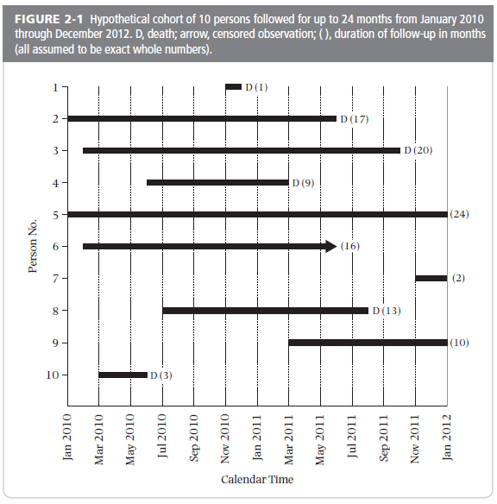
Cohort with Calendar Time
Notes:
This is the hypothetical example of a 10 person cohort study given in your text book. This has “Calendar Time” on the x-axis. This illustrates the ways that follow-up time can differ among individual participants in a cohort study even when the study has one “end date.”
Having identical and complete follow-up on all subjects is the exception to the norm. A typical cohort study may take months to years to recruit all of the participants. Since many observational studies have a single ending date, subjects enrolled at the end of the recruiting process are going to have less follow-up time in the study than those enrolled at the beginning, even without having any subjects drop out, die, or be lost to follow-up. When those latter categories are also taken into account, there is usually great variation in how long different persons are observed in a cohort study.
18

Slide 19
Two Measures of Incidence
Cumulative incidence
Incidence rate
Notes:
These are the two measures of incidence that we defined earlier in the lecture.

Slide 20
Cumulative Incidence
Definition: The proportion of individuals who experience the event in a defined time period (E/N during some time T) = cumulative incidence
Example: Diabetic Medications and Fracture: “The cumulative incidence of a first fracture among women reached 15.1% at 5 years with rosiglitazone, 7.3% with metformin, and 7.7% with glyburide.”
Notes:
If the measure is a proportion of persons, it is unitless since it has to vary between 0 and 1. In other words it is a probability. But because it is unitless, the time element T has to be explicitly added; for example, the proportion of persons diagnosed during a one-year period. This is a common error in the literature. The time period for cumulative incidence is often missing.
In this example from the ADOPT trial, the investigators have calculated cumulative incidence over 5 years for first fracture in 3 different groups of the women participating in the trial: those assigned to rosiglitazone, metformin and glyburide. The incidence is reported as a proportion without units. This example is a randomized trial but cumulative incidence can be reported in a similar fashion for observational cohort studies. (Kahn et al. 2008 Diabetes Care 31:845-51)

Slide 21
Incidence Rate
Definition: The number of events divided by the amount of person-time observed (E/NT) = incidence rate or density (not a proportion)
Same example, Diabetic Medications and Fracture, now presented as incidence rates: “The incidence of a first fracture among women was 2.74 per 100 person-years with rosiglitazone, 1.54 per 100 person-years with metformin, and 1.29 per 100 person-years with glyburide.”
Notes:
If the measure is a number of events divided by some number of persons at risk during some period, it is not a proportion (not a probability) because the denominator multiplies persons by time (100 persons followed for 2 years gives the same denominator as 200 persons followed for 1 year). The value of the fraction will change with the denominator and the units of the denominator are arbitrary. That is, if an incidence is presented as events per person-years, those person-years could be converted to person-months, or person-days, or even person-minutes with corresponding changes in the incidence rate (even though they all mean the same thing). And none of those fractions is constrained to be between 0 and 1—they can exceed 1. The concept of an incidence rate is not intuitive to everyone at first glance, but we will spend much more time on it later.
The example is from the same ADOPT trial, but now the fracture results are presented as incidence rates. The incidence outcomes includes units, in this case first fractures per 100 person-years. (Kahn et al. 2008 Diabetes Care 31:845-51)

Slide 22
Counterintuitive Idea #2
The denominator for incidence does not have to be a count of individual persons
Notes:
We have just introduced the idea of a measure that uses the product of time and persons as the denominator, a concept called person-time. We will explore person-time rates in more depth next week, but for now it is sufficient to note that this at first seem a somewhat counterintuitive idea. As we will try to show later on, however, it is the most fundamental measure of disease occurrence.

Slide 23
Measures that are sometimes loosely called incidence
Count of the number of events (E)
  eg, there were 84 traffic fatalities during the holidays
Count of the number of events during some time period (E/T)
  eg, traffic accidents have averaged 50 per week during the past year
Neither explicitly includes the number of persons (N) giving rise to the events (N at risk)
Notes:
Incidence requires that we know how many events occurred (E) during what time period (T) among how many persons (N) at risk. One could argue that some of these examples implicitly include a number of persons, and this is why we say that they are loosely called incidence. For example, traffic accidents in San Francisco County for the past year has an implied number of persons, which is the average county population during the year, so by naming a geographic location a number of persons at risk is implied. The “holidays” may refer to a specific 3-day holiday weekend, thus giving the implied time period. These inferences about N and T can be reasonable depending upon the context, but the point we are making is that all three E, N, and T need to be accounted for, preferably explicitly, in order to have a true measure of incidence. Both of the examples above may contain incidence rates with a defined N and a defined T, but the first only makes E, the number of events explicit, and the second only makes E and T explicit.
Cancer rates, for example, are typically reported a number of cases per 100,000 population. The number of cases is E, N is 100,000, but T is not always explicit. The rates are usually reported as “annual”, so T is one year, but the reader may not always be aware of the 3 elements that make up the rate.

Slide 24
CDC: Chickenpox rates drop in four states as inoculations become common
SF Chronicle, Thursday, September 18, 2003
The number of chickenpox cases in four states dropped more than 75 percent as inoculations became more common in the last decade, according to a federal study released Thursday.
The total number of cases in Illinois, Michigan, Texas and West Virginia dropped from about 102,200 in 1990 to about 24,500 in 2001, the Centers for Disease Control and Prevention said. At the same time, the percentage of infants receiving chickenpox shots rose from less than 9 percent in 1996 to as much as 83 percent in 2001, the CDC said.
What additional data would provide more useful estimate of incidence?
Notes:
In this example, the number of events (E) is given, the time period (T) is described (two one-year periods – 1990 and 2001), and a population of persons is specified (four states). The story says that the number of cases dropped more than 75% and that is perfectly accurate, but the headline says that rates dropped. What is missing in order to compare rates between these two one-year time periods is the number of persons living in those four states in the two time periods. Since the two one-year incidence periods are 11 years apart, it is a reasonable bet that the population of the four states changed during 11 years. How much, or in which direction, one can’t be certain, but most likely the population increased. If the population increased a lot, then the difference in incidence rates between the two years is even greater than the change in the number of cases. So the press release is probably not qualitatively incorrect (unless those 4 states lost a lot of population), but it would have been even more informative if the incidence rates rather than the counts had been reported. This is information knowable from census data— and a good use of census data.
To take it a step further, since chicken pox is largely a disease of childhood, it would be even more informative to know what had happened to the size of the population of children during that period and what the rates were among children. It is perhaps not so clear that the population size of children increased. If the population of children decreased, then the drop in the number of cases, reported here, does not translate into the same drop in the rates of chickenpox among children.

Slide 25
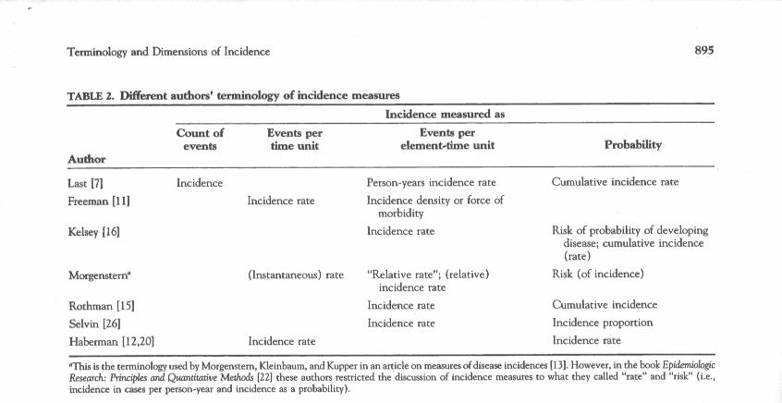
E
E/T
E/NT
E/N
Notes:
Having introduced the idea of two kinds of incidence measures, here we return to a comment we made earlier about the lack of a standard vocabulary for measures of incidence even among epidemiological text books. I have added the E’s, N’s, and T’s to this table in order to show how focusing on those 3 elements can clarify what is being measured despite the differences in terminology among these authors. Note, however, that when events per person-time unit is being measured, most authors call this an incidence rate (with one of these author calling it an incidence density).
We favor the terminology used here by Rothman, who calls E/NT incidence rate and E/N cumulative incidence. These terms make the most sense. We are not, however, opposed to the term incidence proportion as synonymous with cumulative incidence. A rate captures the number of cases occurring over time and is not tied to any specific time period. It may help to think of rate in another context, such as the velocity (rate) of an automobile. If you take a trip across California, your average velocity, a rate, is not determined by how long you have been driving. Cumulative incidence essentially adds up (hence the word “cumulative”) all incident cases over a fixed period of time.

Slide 26
Disease Incidence Key Concept
Numerator is always the number of new events in a time period (E)
Examine the denominator (persons or person-time) to determine the type of incidence measure
Notes:
Looking at whether the denominator is a number of persons or the product of persons times time will tell you whether you are looking at cumulative incidence or at an incidence rate. If you are looking at cumulative incidence, the authors should have given the time at which it was calculated (43% at 3 years). If the events are described as “per person-years” (or person-any time period), an incidence rate is being reported. If some percent of persons is said to have experienced the outcome, the measure should be cumulative incidence and a time should be specified. But relying on this is less certain as some authors will at times describe a person-time incidence rate as a percent although this is technically incorrect.

Slide 27
Cumulative Incidence
Perhaps most intuitive measure of incidence since it is just proportion of those observed who got the disease
Proportion=probability=risk
Over a specific time period
Estimated with Kaplan-Meier, life table, or cumulative incidence function
Notes:
Both measures of incidence, cumulative incidence and incidence rate, are valid. They make some different assumptions and are associated with different analytic techniques, but both are very useful. Cumulative incidence is probably the most intuitive because it is just the proportion of persons who got the disease. It is easy to understand but, again, it only has meaning when a time period is attached to it. The probability of cancer in a one-year period is quite different from the lifetime probability of cancer.
Incidence based on a person-time denominator is a little less intuitive but it is actually the more fundamental measure of disease occurrence. We will return to incidence rate using person-time next week. For now, we will spend the rest of this session on understanding the cumulative incidence measure and the methods used to estimate it.
Of the two methods for calculating cumulative incidence, the life table method is older but is now seldom used except in actuarial tables of life expectancy and a few similar settings with large numbers of persons. The Kaplan-Meier method is very similar and has become the usual method for estimating cumulative incidence, so we will focus on this approach.

Slide 28
Calculating Cumulative Incidence
With complete and equal follow-up, cumulative incidence is just number of events (E) divided by the number of persons (N) = E/N
Outbreak investigations, such as of gastrointestinal illness, typically calculate “attack rates” (misnomer) with complete follow-up on a “cohort” of persons who were exposed at the beginning of the epidemic.
Notes:
The simplest situation in which to calculate cumulative incidence is if all of the persons are followed for the same length of time. In that case the cumulative incidence is simply the total number of events divided by the total number of persons. In long term cohort studies this never happens, but in the time limited outbreak investigations typical of a CDC investigation of gastroenteritis, it may well happen.
Unfortunately, the term “attack rate” has traditionally been used to describe the proportion of persons who develop illness. As we have been arguing, this is an incorrect use of “rate,” since the denominator is just the number of persons investigated. Another example of how terminology in the literature can be confusing.

Slide 29
Denominator with complete and equal follow-up
On June 24, 1996, the Livingston County (New York) Department of Health (LCDOH) was notified of a cluster of diarrheal illness following a party on June 22…. Plesiomonas shigelloides and Salmonella serotype Hartford were identified as the cause of the outbreak… 98 attendees were interviewed. 56 (57%) of 98 respondents had illnesses meeting the case definition. MMWR, May 22, 1998
Proper terminology: Cumulative incidence of illnesses meeting the case definition (i.e. diarrhea) XX days after party attendance was 57%.
Notes:
And here is an example of such a CDC outbreak investigation. Here the cumulative incidence of diarrheal illness in their cohort of 98 following the party was 57% (56/98). No time period is explicitly mentioned, but technically this is cumulative incidence over a few days following the party. Complete follow-up is possible because the time period is very short.
A similar situation could be found in a clinical trial, which you will recall is formally a type of cohort study. A very well run clinical trial of a non-fatal condition with relatively short follow-up time might achieve the same amount of follow-up time on everyone enrolled if everyone was followed for a specified time period such as one week. But it is a rare study that has exactly the same amount of follow-up on each subject.

Slide 30
Cumulative incidence with differing follow-up times
In nearly all cohort studies, participants have different follow-up times.
Notes:
30
Having identical and complete follow-up on all subjects is the exception to the norm. We’ll look at the example from the text to illustrate this.

Slide 31
Follow-up times differ: Staggered entry
Notes:
This is the hypothetical example of a 10 person cohort study given in your text book. This illustrates the ways that follow-up time can differ among individual participants in a cohort study.
Having identical and complete follow-up on all subjects is the exception to the norm. A typical cohort study may take months to years to recruit all of the participants. Since many observational studies have a single ending date, subjects enrolled at the end of the recruiting process are going to have less follow-up time in the study than those enrolled at the beginning, even without having any subjects drop out, die, or be lost to follow-up. When those latter categories are also taken into account, there is usually great variation in how long different persons are observed in a cohort study.
31

Slide 32
Follow-up times differ: Censoring (lost and administrative)
Notes:
This example also introduces the concept of censoring by illustrating how the individuals in the study started at different times and dropped out before the end of the study. Here the times persons enter and leave the cohort are being shown on a calendar time scale. The solid black bars represent the length of time each person was followed in the study. D = death, which is the event of interest. Of the participants who did not die during the follow-up time, participant #6 was lost to follow-up or refused to participate further in the study. The textbook identifies this person with an arrow and calls this a “censored observation.” However, it would be more accurate to say that all of those who did not die during follow-up were censored. The others (#5, 7, 9) continued until the study was ended. This is often called administrative censoring, indicating that the reason follow-up ended was that the study ended. In terms of the statistical model for analysis it doesn’t matter why a person is censored. Each person is considered to either have the event or be censored. The reason for censoring will matter when considering threats to validity and possible bias in the study results.
In today’s lecture, we are going to discuss how to account for these different amounts of follow-up time when estimating incidence in a cohort study. These methods can account for different amounts of time followed, but they assume that losses are random, i.e. not related to the outcome. These methods can’t overcome problems of bias when losses to follow-up are not random. Having individuals who are lost to follow-up is a major threat to the validity of conclusions about incidence. As we stressed last time, losses to follow-up are a primary problem threatening the validity of cohort studies. This includes the validity of randomized trials which can be viewed as cohort studies with assigned exposure.
32

Slide 33
Two Ways Censoring Occurs
1) Loss to follow-up, or drop-out (refuse, move, can’t be found)
2) End of study (alive and hasn’t experienced outcome) = Administrative Censoring
With all-cause mortality as the outcome, each subject either experiences the outcome or is censored. No competing events.
Notes:
Follow-up ends with the period of study observation, and subjects who are still being followed at that time but have not been diagnosed with the outcome are administratively censored as of the last date of follow-up. They therefore contribute the entire amount of their time in the study to the disease free follow-up time. This time will not be exactly the same for all administratively censored subjects because they will not all have been enrolled on the same date. In the previous figure from the text book, there are actually 3 persons who are administratively censored, subjects 5, 7, and 9. Subject 7 only has 1 month of follow-up because he or she was enrolled late in the cohort, but because follow-up was ended only by the end of the study, that person was administratively censored, just as subject 5, who was enrolled at the earliest possible date, was administratively censored. Thus, there are two ways of being censored: a) loss to follow-up (ie drop out); or b) administrative censoring

Slide 34
Cumulative incidence with differing follow-up times
In nearly all cohort studies, participants have different follow-up times.
Staggered entry
Loss to follow-up (aka drop-out)
Competing event
Notes:
34
To summarize, these are several ways that participants can have different follow-up times in a cohort study. Participants may start at different times in the accrual process of the study. If the end date for all participants is the same, those who start later will have less follow-up time. Or, some participants may have less follow-up time because they drop out before the end of the study. Note that we do not have to consider competing events since our outcome is all-cause mortality but in studies with another outcome, this can also contribute to differing follow-up times.

Slide 35
Example: Cumulative Incidence versus “Proportion with Outcome”
Previous example: “The cumulative incidence of a first fracture reached 15.1% at 5 years with rosiglitazone, 7.3% with metformin, and 7.7% with glyburide.” Takes into account different follow-up times. We’ll see how to do this in the next slides.
“Among the 1,840 women, 111 reported a first fracture: 60 (9.3%) of those treated with rosiglitazone, 30 (5.1%) of those treated with metformin, and 21 (3.5%) of those treated with glyburide.” The numbers of cases reported in this sentence is useful but the proportions are not. Does not take into account different follow-up times.
Notes:
Returning to our example from the ADOPT trial, the cumulative incidence reported took into account the follow-up time for participants in the trial. We will talk about how to do this in a minute.
The second bullet is a report on the number of women who experienced a fracture in each of the treatment groups. Providing the number of cases is informative, but adding the proportion (e.g. 9.3% of the rosiglitazone group) is not. Note that this proportion is different from the cumulative incidence (15.1%) for this treatment group. The raw proportion does not take follow-up time into account. Depending on the drop out rate, rate of events, etc., this proportion of events/number of baseline participants can be more or less misleading. Note the difference between the cumulative incidence reported for the glyburide group 7.7% and the “simple” proportion 3.5%. Cumulative incidence should be reported, not the raw proportions.

Slide 36
Calculating cumulative incidence with differing follow-up times
The Problem: Since rarely have equal follow-up on everyone, can’t just divide number of events by the number who were initially at risk
The Solution: Kaplan-Meier and life tables are two methods devised to calculate cumulative incidence among persons with differing amounts of follow-up time
Notes:
Since cumulative incidence has to be defined as per some time period, it is incorrect to say, when follow-up times vary by individual, that the cumulative incidence in a cohort study that ran for 3 years was the proportion with the diagnosis divided by the number enrolled in the study. So the problem is how to calculate cumulative incidence when persons are followed for different times.
The two methods of solving this problem of calculating the cumulative incidence for different amounts of follow-up are called the Kaplan-Meier and the life table method. The life table approach is much older but is seldom seen in the medical literature these days because the Kaplan-Meier method has become the standard. We will focus on the Kaplan-Meier method although for large datasets life tables give the same answer. The textbook illustration of life tables is a bit misleading because, for the sake of showing the computations, the authors use a small number of observations that results in quite different estimates from the Kaplan-Meier method. The main difference is that life tables use uniform time periods in which to estimate the proportion who experience the outcome whereas the Kaplan-Meier method looks at time periods defined by when an outcome event occurs. For sizable data sets these two approaches smooth out and give virtually identical answers.

Slide 37
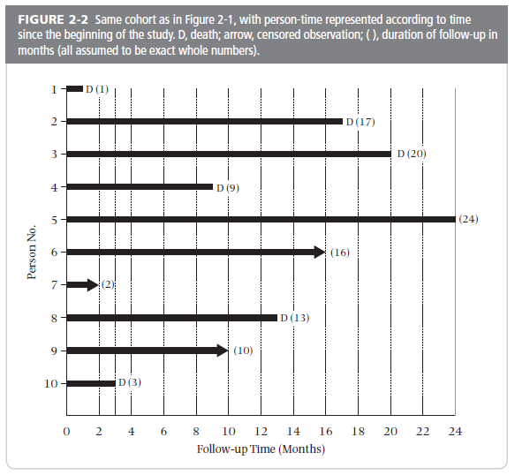
Change time scale to “follow-up” time
Notes:
To resolve the problem of different starting times, the analyst “shifts all the starting time to the left.” For the analysis, each person is going to be started at the same time zero. This graph from your text, shows how the data look when all of the different calendar starting times are reassigned the same follow-up starting time. Note that the time axis is now follow-up time rather than calendar time. This use of follow-up time, rather than calendar time, applies to Kaplan-Meier and life table methods.
It should be clear that by assigning everyone the same starting time you are making the assumption that there are no calendar time trends that will affect your estimate of incidence. You have dropped calendar time, and hence trends associated with calendar time (often called “secular trends”), out of the analysis.
37

Slide 38
Kaplan-Meier estimate of cumulative incidence
Also called “product limit estimator.” Original article is in the optional reading.
Calculate the cumulative probability of event (and survival) based on conditional probabilities at each event time.
Requires date outcome occurred on each individual or date last observed (i.e. date censored)
Analysis is performed by dividing the follow-up time into discrete pieces
  calculate probability of survival at each event (survival = probability of no event)
Notes:
The Kaplan-Meier (KM) method is also called the “product limit estimator.” It was first described in 1958. The original article is included in the optional reading for the course. It’s one of the most cited articles of all time. Kaplan EL, Meier P. Nonparametric estimation from incomplete observations. J Am Stat Assoc 1958;53:457-81.
The essence of the KM method is having the date each outcome in the cohort occurred. Those dates divide the follow-up time of the cohort into a number of discrete pieces. The proportion surviving (probability) is calculated for each discrete piece and the overall cumulative probability of surviving is calculated by multiplying together the individual probabilities.
Every member of the cohort has to be assigned a date first seen and a date last seen or a date diagnosed with the condition being studied. The date last seen can simply be the end of the study.

Slide 39
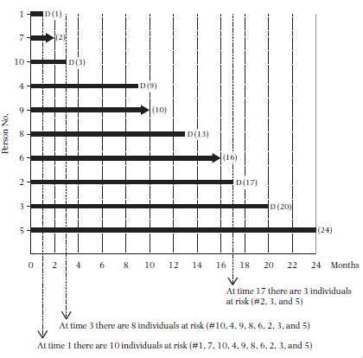
Conceptually, sort the follow-up times from shortest to longest
Notes:
To perform the Kaplan-Meier estimation, conceptually think of ordering the previous table of participant experience, already “shifted to the left,” by order of follow-up time.
39

Slide 40
Calculating Cumulative Probability
Probability of 2 independent events occurring is the product of the probabilities for each occurring alone
  If event 1 occurs with probability 1/6 and event 2 with probability 1/2, then the probability of both event 1 and 2 occurring = 1/6 x 1/2 = 1/12
Probability of living to time 2 given that one has already lived to time 1 (i.e. conditional on survival to time 1) is independent of the probability of living to time 1
Notes:
In order to calculate cumulative incidence, you need to understand or least accept on faith the following. It is a fundamental theorem of probability that the cumulative probability of two independent events is the product of their individual probabilities. So the probability of flipping two heads in a row with a fair coin is ½ x ½ = ¼ . The Kaplan-Meier method of calculating the cumulative probability of the disease outcome is to treat each separate discrete piece of time as an independent trial. There was some probability of the outcome during the first time period; there was another probability of the outcome during the second time period. The probability of the outcome during both time periods together is the product of the individual probabilities.
Students sometimes balk at treating the two time periods as independent events. They say, “How can they be considered independent when it is many of the same persons in each time period”? The answer is that the probability in the second time period is conditional on a given person already having lived through the first time. So the probability of the outcome in the second period is the probability conditional on not having experienced the outcome up until that point in time. A similar mistake is made by gamblers who think that because a coin has come up tails four times in row the probability of heads on the next toss is better than ½. It isn’t.

Slide 41
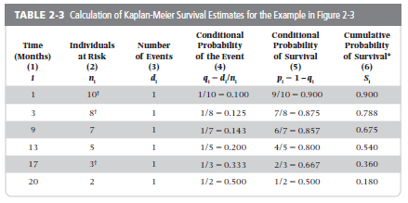
Cumulative survival calculated by multiplying probabilities for
each prior failure time: e.g., 0.9 x 0.875 x 0.857 = 0.675 and
0.9 x 0.875 x 0.857 x 0.800 x 0.667 x 0.500 = 0.180
Notes:
Deaths occurred at 6 different times during follow-up, so there are 6 discrete pieces of time (in this example from the text D = death whereas in the cohort graphic D = disease diagnosis). The probability of the event is the number of deaths at each point in time (just 1 here, but it is possible to have more than 1 at the same time) divided by the number in the cohort at that time. So at 1 month of follow-up there was a death and at that time all 10 original members of the cohort were still in follow-up. The probability of death was 1/10 and the probability of survival was 1 – 1/10 = 9/10. When the second diagnosis occurs at 3 months of follow-up, only 8 persons are still in follow-up because 1 person was lost to follow-up at 2 months of follow-up. The probability of death was 1/8, of survival was 7/8, and the cumulative probability of survival was 9/10 x 7/8 = 0.788. Why not calculate a probability of survival when the 1 person was lost at 2 months? Because the probability of survival for the 9 would be 9/9 = 1 and 1 times the previous cumulative survival leaves it unchanged.
41

Slide 42
Kaplan-Meier Cumulative Incidence of the Outcome
Cannot calculate by multiplying each event probability (=probability of repeating event)
  (in our example, 0.100 x 0.125 x 0.143 x 0.200 x 0.333 x 0.500 = 0.0000595)
Subtract cumulative probability of surviving from 1; e.g., (1 - 0.180) = 0.82
Proportion, so time is not intrinsic to the units. Time period has to be added for number to be interpretable. 2 year cumulative incidence.
Notes:
The cumulative probability is calculated with the survival probabilities because it is only survival (not having the event) that happens repeatedly. To use the probability of the event each time you would be calculating a probability of repeated diagnoses, not what you want. At the end of multiplying together all of the individual survival probabilities to get the cumulative probability of 0.18, the cumulative probability of death can be obtained by subtracting from 1. 1 – 0.18 = 0.82.
NB: Cumulative incidence cannot be interpreted without specifying the time period. The cumulative incidence of death for the whole U.S. population at 1 year is about 0.8% but at 100 years it is greater than 99.9%. For our example it is cumulative incidence at 2 years because the longest follow-up on any participant was 24 months (2 years).

Slide 43
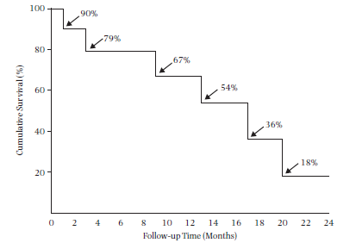
Kaplan-Meier plot of the text example (Survival curve)
Notes:
This is the Kaplan Meier plot of the textbook example that we just reviewed.
Note that the K-M plot is a step function. It’s not correct to connect the dots with straight lines. K-M curves that appear smoother are in fact step plots, just like this one, but with events occurring more frequently relative to the time scale so the curve appears smooth.
While classically K M plots show survival (ie falling curve), they can just as easily show incidence (ie climbing curve). In fact, we prefer the climbing curves in that they are more intuitive to most observers. In other words, KM natively estimates probability of no event but we are typically interested in probability of event, and we can estimate and plot either one.
43

Slide 44
Examples of Kaplan-Meier Plots
Used in observational studies and experimental trials
Can be presented as cumulative incidence or cumulative survival

Slide 45
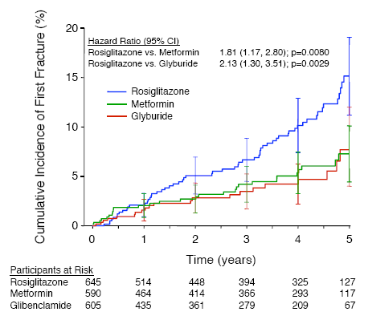
“The cumulative incidence of a first fracture reached 15.1% at 5 years with rosiglitazone, 7.3% with metformin, and 7.7% with glyburide.”
Notes:
Figure1—Kaplan-Meier estimates of the cumulative incidence of fractures at 5 years in women. Bars represent 95% CIs. (Kahn et al. 2008 Diabetes Care 31:348-51)
Here is a Kaplan-Meier curve showing incidence of the outcome, rather than survival without the outcome. This is the Kaplan-Meier curve for the cumulative incidence of first fracture in women, the trial data that we showed you earlier in today’s lecture. The cumulative incidence would have been calculated by first calculating “survival without fracture,” and using that to calculate fracture incidence.
This plot includes standard error bars at each year. 95% confidence intervals can also be calculated for Kaplan-Meier curves.
The numbers below the graph indicate the number of participants that were still being followed, by treatment group, at each of the time points. This gives the reader a better sense of the follow-up time and the reliability of the estimates at the later time points.

Slide 46
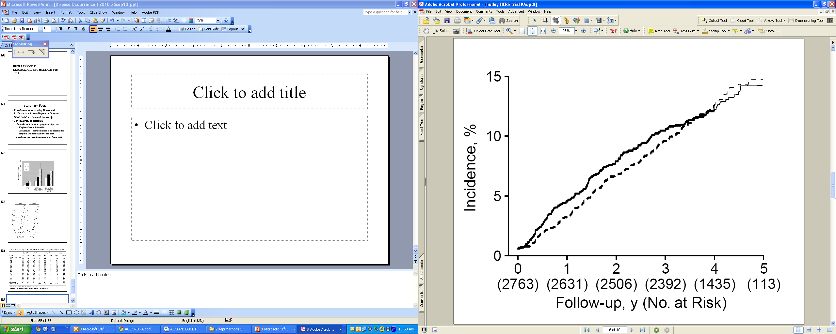
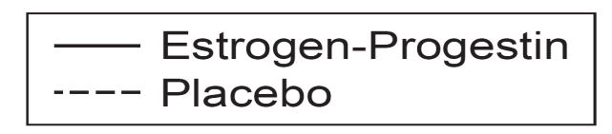
Cumulative incidence of primary CHD events in the HERS trial
Log rank P value = 0.91
The number of women observed at each year of follow-up and still free of an event are provided in parentheses, and the curves become fainter when this number drops below half of the cohort.
Hulley et al JAMA 1998
Notes:
Figure 3.—Kaplan-Meier estimates of the cumulative incidence of primary coronary heart disease (CHD) events. The number of women observed at each year of follow-up and still free of an event are provided in parentheses. The authors have also made the curves lighter at the point where less than half the cohort is still being followed; this is an interesting visual technique but not conventional.
This is an interesting example of how much can be learned from the KM curves. These two curves converge by the end of follow-up indicating no difference in CHD events between the treated (estrogen-progestin) and placebo arms. This is reflected in the p-value for the Log rank test used to compare the two curves, something we’ll get into more in the Disease Association lectures. However, it looks like the treatment group has a higher cumulative incidence of the outcome at intermediate points. Indeed, if the trial had been stopped after one year, the results would have shown a negative effect of the treatment. Such a post hoc evaluation can only be “hypothesis generating” but this was one of the first clues that hormone therapy might have negative, rather than the assumed positive, effects on cardiovascular health in women.

Slide 47
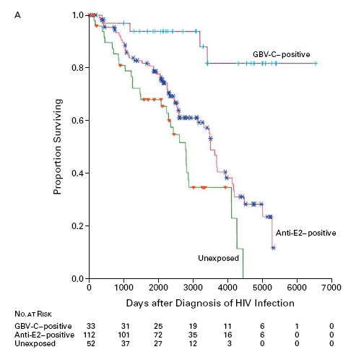
Cumulative survival after diagnosis of HIV infection in three groups of patients
Tillmann, NEJM 2001
Notes:
Here is a graph showing a Kaplan-Meier analysis of cumulative survival after diagnosis of HIV infection in three groups of patients: the top line represents patients positive on an assay for GBV-C RNA (evidence of active infection; GBV-C has also been designated hepatitis G virus); the middle group are positive on an assay for antibodies to a surface protein of GBV-C (designated E2; evidence of prior infection); and the third group was negative on both GBV-C assays (no evidence of infection). As usual, notice that the lines are graphed in a stepwise fashion. This is because there is a discrete jump in the cumulative incidence each time a death occurred. Very large steps occur when very small numbers are observed at risk, illustrated by the last three large downward steps of the unexposed group. The numbers below the x-axis are useful as they show the reader how many persons were observed in each group as time progressed. Only 3 were left in the unexposed during that last portion of the K-M function, each drop representing 1 person dying. No confidence intervals are shown, but the small numbers at risk and large drops indicate that the survival estimate is quite uncertain for those time points. Hence, the tail of the curve does not give precise information. To read cumulative survival for a group from the graph, pick a time point, such as 3000 days, draw a line straight up to intersect the survival curve and then a horizontal line that intersects the y-axis. Where it intersects the y-axis is the estimate of the proportion surviving at that time of follow-up (about 60% in these data for the antibody positive group and less than 40% for the unexposed group). The tick marks on each survival curve represent times at which a person was censored, so they provide useful information on the amount and pattern of follow-up time in each group. They do not, however, necessarily represent drop outs or losses to follow-up as subjects started at different points in time and would have different follow-up times even if they all continued to the end of the study. If the cumulative incidence of death had been plotted instead of the cumulative incidence of survival (always an option), the graph would have started in the lower left-hand corner at 0 and moved up toward 1 (inverting the curve pictured).

Slide 48
Time Element in Cumulative Incidence
KM plot provides cumulative incidence for every time element - full disclosure on incidence.
However, if you cannot show a plot and you must say cumulative incidence in words, then YOU MUST ADD A TIME ELEMENT.
For example, 5% cumulative incidence of cancer recurrence over 1 year, or over 5 years.
Notes:
Failure to add a time element is one of the most common problems in reporting incidence.

Slide 49
Cumulative Incidence:
Underlying Assumption #1
To calculate cumulative incidence with different follow-up times, we “shifted everyone to the left” and used follow-up time rather than calendar time.
This assumes the probability of the outcome is not changing over calendar time.
  i.e., no temporal/secular trends affecting the outcome.
If this assumption is not correct, you can still do the calculation, but the result typically no longer has a meaningful interpretation.
Notes:
This assumption does not mean that the probability of the outcome is the same during all of the follow-up time. Remember that by moving everyone to the left to start at study time zero, you are guaranteeing that one-year of follow-up in follow-up or study time will be different calendar times for individuals who were enrolled in the study on different dates. So this concept requires that the probability isn’t changing over calendar time. It may well change over study observation time (FOLLOW-UP TIME on the previous graph) as for many diseases risk increases with age. Moving everyone to the left allows the proportion with disease to change with additional follow-up time. It could either increase or decrease over time. But if the first year for subject 1 and subject 2 happens to be in two different calendar years in which something happened to alter disease risk, then treating them as if risk is the same during year 1 of follow-up would be incorrect (eg, two Russians living in Chernobyl, one enrolled in a cohort study the year before the nuclear disaster and the other in the year the disaster occurred, would not have the same disease risk).
If the assumption is not correct, even though you can do the calculation, what you get has no meaningful or relevant time period or population. If the assumption is not correct, your answer is simply the average over disparate time periods. This average may be useful to you but remember that it represents neither of the time periods per se.

Slide 50
Text book example: Follow-up times differ
Notes:
50

Slide 51
Change time scale to “follow-up” time
Notes:
By assigning everyone the same starting time you are making the assumption that there are no calendar time trends that will affect your estimate of incidence. You have dropped calendar time, and hence trends associated with calendar time (often called “secular trends”), out of the analysis.
51

Slide 52
Underlying secular trends
True biological/clinical changes in incidence
  Rapid changes in HIV incidence at start of epidemic
  Changes in incidence of hip fracture
Changes in methods of diagnosis (measurement)
  Adding A1C to diagnostic criteria for diabetes
  Widespread use of mammography for breast cancer screening
More important in a study with longer follow-up time
Notes:
For many studies it is reasonable to assume that incidence is not changing over the time of the study follow-up. For one thing the difference in calendar time may be just a matter of months rather than years, so it would take a very rapidly changing trend to be important in a time frame of months. For some situations, though, this may be a dubious assumption. For example, if one were enrolling subjects to study a new infectious disease during its introductory epidemic period (HIV, SARS, ebola, etc.), temporal trends might affect incidence estimates significantly. Changes in methods of diagnosis can cause a change in incidence that is essentially an artifact of the new diagnostic approach. This may occur with estimates of diabetes incidence as the new guidelines, using A1C to diagnose, are implemented. Improved screening can also cause an increase in incidence. A “blip” in incidence results from identifying some cases early that would have eventually been diagnosed without screening. A sustained increase can occur when screening essentially shifts the diagnosis of breast cancer to cases that never would have come to attention, such as the increase in “in situ” cases of breast cancer with mammographic screening.

Slide 53
FIG. 1. Observed cumulative incidence of any fracture among 1,964 Rochester, MN, residents after first recognition of diabetes mellitus in 1970–1994
How long was the accrual period?
How long was follow-up for fractures?
OK to summarize with one estimate of fracture incidence?
Melton et al. JBMR 2008.
Notes:
Follow up time starts with diagnosis of diabetes. So, in this study, participants were “left shifted” for a period of up to 24 years. They were followed for as long as 30 years. Was it a good idea to shift all of these patients to the left and come up with one estimate of fracture incidence?

Slide 54
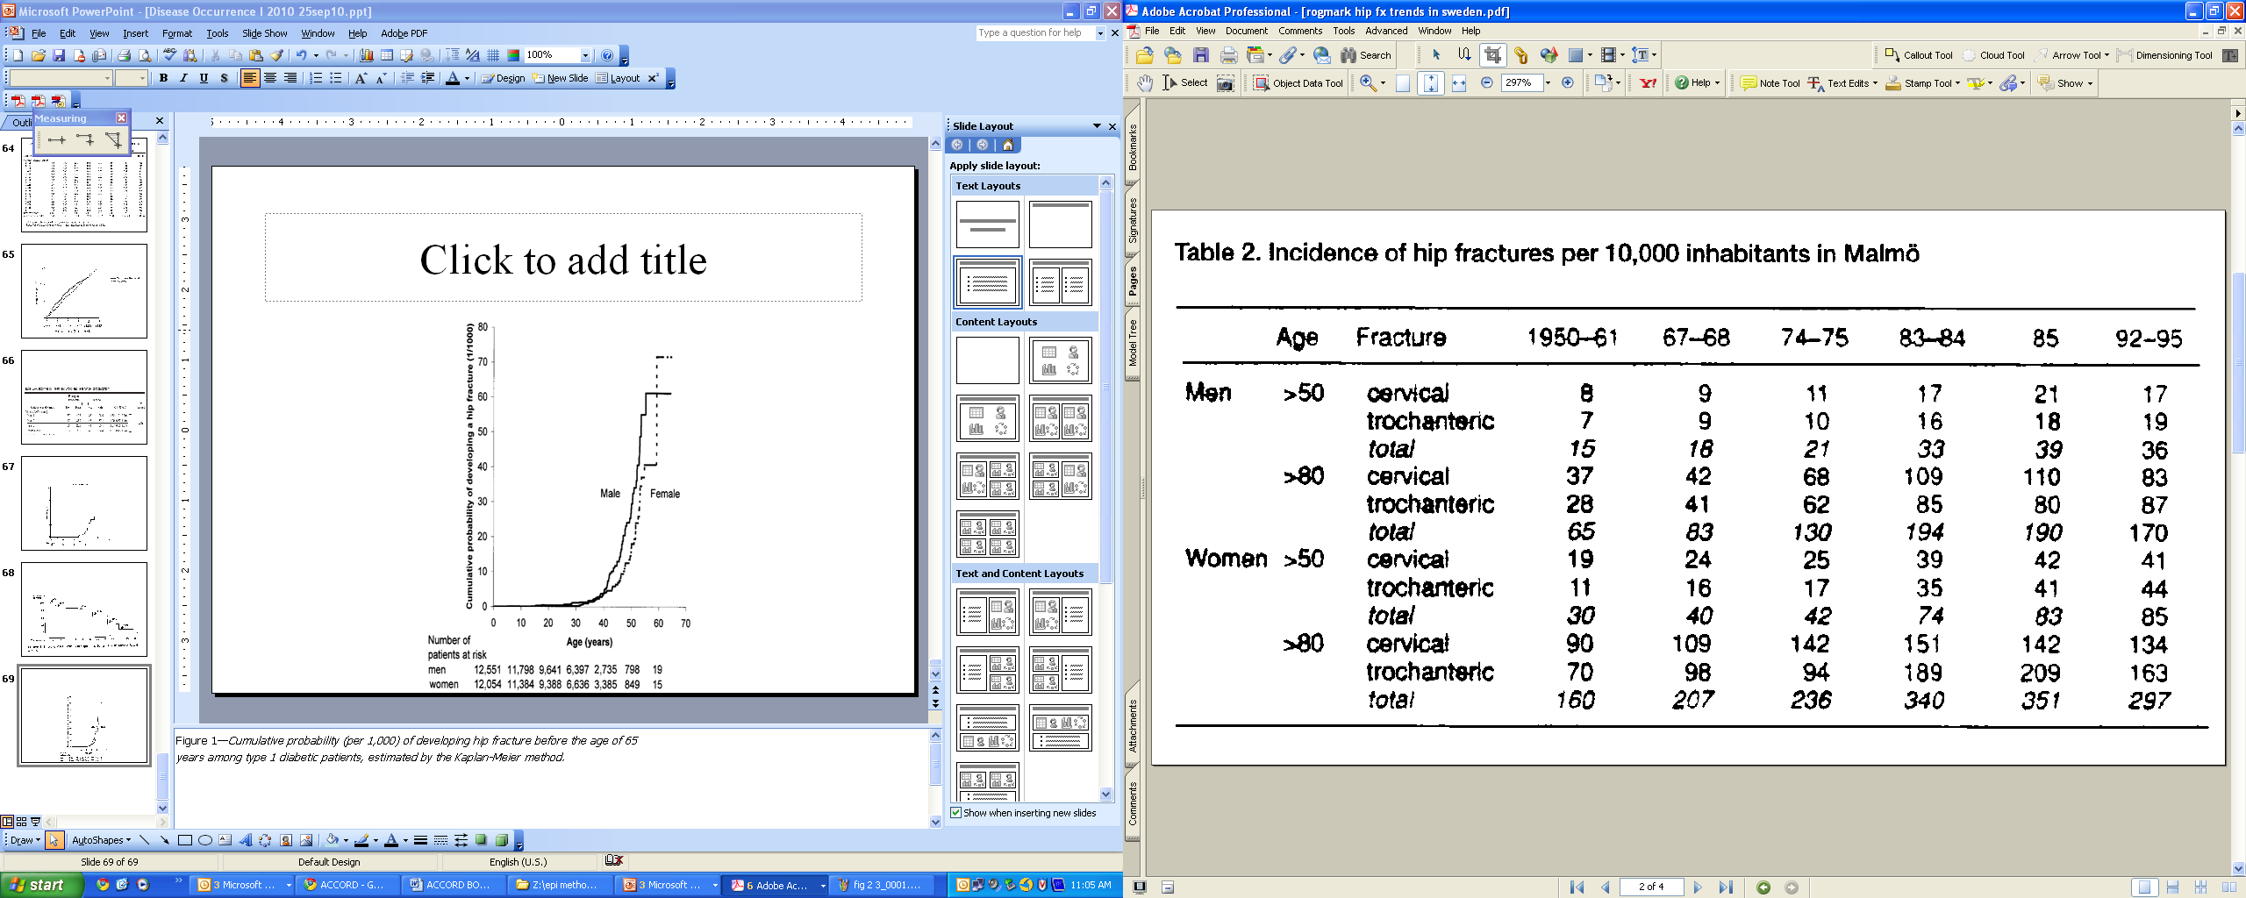
Hip fracture trends in Sweden
Rogmark et al. Acta Orthop Scand 1999
Notes:
These are results from a study of trends in hip fracture incidence during the last 60 years in Sweden. They have increased steadily with some leveling off in the 1990’s. Those results were taken from 1975 – 1998, similar to the period from the Rochester study in the prior slide. The changing rates over time can lead to inaccurate conclusions about cumulative incidence. If we calculate cumulative incidence for the time period 1967-95, we would mix together periods with differing incidence of hip fracture. The resulting number would not really be representative of any of the years and certainly not for all of the years. In other words, a single number summarizing those years (1967-95) wouldn’t represent any tangible cohort of persons.

Slide 55
Cumulative Incidence:
Underlying Assumption #2
For cumulative incidence to be unbiased (i.e. valid), censoring must be unrelated to the probability of experiencing the outcome.
i.e., The experience of those who are lost to follow-up (drop out) must be the same as those who remain in the study.
Notes:
This concept takes us back to the point made in the first lecture on study design about the threat to validity of a cohort study coming from losses to follow-up (setting aside for the moment other issues such as measurement and confounding). Those persons lost to follow-up are the persons who are censored in the data analysis, so if the goal is to get an unbiased measure of incidence, those losses to follow-up cannot be related to the probability of the outcome. If members of the cohort who are leaving are either more or less likely to experience the outcome than those remaining, the resulting incidence estimate (which can only be calculated using the persons who remain) will be either too high or too low relative to the entire population.

Slide 56
Informative vs Non-informative Censoring
When the goal is estimation of incidence:
Informative censoring (aka Non-ignorable) means that losses to follow-up have different incidence of the outcome than subjects who remain in the study, and therefore introduce bias in the incidence measure
Non-informative censoring (aka Ignorable) means that losses to follow-up have the same incidence of the outcome as subjects who remain in the study, and therefore do not result in bias
Notes:
Statisticians and epidemiologists typically use the terms informative and non-informative censoring when referring to losses to follow-up. Whether losses to follow-up (drop outs) are informative or non-informative depends upon several factors but, to start, it depends upon what you want to estimate. In cohort studies, you may wish to just measure incidence (i.e., a descriptive objective) or you may also wish to evaluate determinants of incidence (i.e., an analytic objective). So far in the class we are just discussing descriptive objectives. When the goal is estimation of incidence, informative censoring means that the losses to follow-up have a different incidence of the outcome under study than those who remain in the study. To lose these people is informative. In other words, you have lost information and this leads to bias. Non-informative censoring means that the lost have the same incidence of the outcome as those who remain in the study. These losses do not introduce bias in the incidence estimates. In other words, you have lost no information due to those losses to follow-up because they are unrelated to the outcome measure you are interested in. As noted earlier, however, even non-informative censoring does lead to a loss of statistical precision.
Although we won’t cover this now, it is the case that losses to follow-up which are informative in the context of incidence estimation may not be informative in analytic work. In other words, certain things we do in the analysis may negate the informativeness.

Slide 57
Mortality after initiation of antiretroviral therapy in resource-limited countries: Differences according to intensity of follow-up
Active follow-up
Passive follow-up
Braitstein Lancet 2006
Notes:
This is an example of just how different results can be in some settings when losses to follow-up are not taken into account. In this study from resource-limited countries, the proportion of HIV-infected patients initiating antiretroviral therapy who had died appeared to be about 2% by passive follow-up. This is depicted in the lower curve. The “active” group are clinics that made efforts to call patients who did not return to clinic as well as sending visit reminders. The passive group relied on patients to return to clinic and did not undertake any calls/reminders. With active follow-up of all patients, over 6% had actually died. This is a situation where the losses to follow-up are informative.
Informative losses of follow-up are common, especially if the outcome is death and the sickest persons in the cohort are the least likely to return for study visits and the most likely to die. Whether these losses to follow-up would also bias a measure of association between an exposure variable and the outcome depends on whether those losses are also related to the exposure and other factors (such as other factors that might be controlled for). As we pointed out in the lecture on study design, bias in a measure of association only occurs when the losses are related to both the outcome and the exposure.

Slide 58
Informative or Non-informative Losses?
How do we know whether our losses to follow-up are non-informative?
Without going after them (or a sample of them), you don't.
It is a matter of opinion - between you and your reviewers - whether you believe the assumption of non-informativeness, or, if you don't believe it, if you believe the violation is at least minimal.

Slide 59
Cumulative Incidence Assumption #3 for K-M Estimation:
No, or Independent, Competing Events (CE)
No CE
  True for studies of all-cause mortality.
  For other outcomes, can be directly assessed by looking at the data
If CE do occur (and usually they do), you must be willing to depict a reality where they are eliminated and they must be independent CE
  Only way to handle CE in K-M estimation is to censor them
  Resulting estimate is unbiased (i.e. valid) only if CE independent of outcome. That is, you must assume that if you prevented the CE, you would not alter the underlying rate of the outcome of interest.
  However, hard to believe -- in most scenarios -- that if you prevent the CE, the rate of the underlying event won’t change
  Therefore, Kaplan-Meier is not recommended when CE are present
  Instead, other techniques, to be covered next week, are used.
Notes:
Another implicit assumption we must make to get a valid Kaplan-Meier estimate has to do with competing events. To get a valid K-M estimate, we must either have no competing events OR we must assume that there is a reality where competing events can be eliminated/prevented and that these competing events are independent of the outcome in question.
Let’s take these scenarios one at a time. In the example we used earlier to calculate cumulative incidence using the Kaplan-Meier method, the outcome was all-cause mortality. In this situation, there are can be no competing events. If this occurs, then, of course, there are no complications from competing events and no assumptions to be made. It may also be the case that competing events are a theoretical possibility but that none occurred. For example, you might be studying a group of adolescents for an outcome of diabetes. Here, mortality (prior to diabetes) is a competing event but it simply may not happen in your study. If this is the case, you don’t need to worry about competing events.
However, if competing events do occur – and they usually do in studies other than of all-cause mortality – then you will need to make some decisions if you want to calculate incidence by the K-M technique. If you wish to calculate incidence by the K-M technique, this means you will need to censor competing events. What this means is that you wish to make a statement about what would happen if competing events did not occur (i.e., were prevented/eliminated). Censoring means that you, the investigator, don’t directly see what happens to the subject but that you realize that they do continue to march forward and have things happen to them. Many or most observers would believe this is it is ludicrous to consider a reality where competing events are eliminated. This is not reality as we know it. That is, we live in a world of competing events.
If you nonetheless still want to go ahead and do the K-M calculation, the only way to mechanically do this is to censor observation after the competing event occurs. If you do this, the underlying assumption, for the KM estimate to be valid, is that the CE is independent of the outcome of interest. Or, in other words, what this means is that if you could prevent the competing events, the rate of the outcome of interest would not be affected. The assumption is that there are no factors which are both causing the competing event and the outcome of interest. Becoming dead by being struck by lightening is one such example of an independent competing event but most competing events are not obviously independent. In other words, this is an assumption that is not often realistic. The text makes this point on page 56 and Table 2-4 (first item in the Table) although they don’t use the term “competing event.”
Because it is difficult to justify the assumption that competing events are independent and to justify a reality where competing events don’t occur, KM is not recommended when there is any appreciable incidence of competing events. There are other methods available to estimate cumulative incidence in the presence of competing events, and we will spend some time on those next week.

Slide 60
Kaplan-Meier using STATA
Cohort: Participants diagnosed with primary biliary cirrhosis in a large health maintenance organization
Goal: Determine the cumulative incidence of death within 5 years after diagnosis of primary biliary cirrhosis.
Dataset includes 184 participants with 96 deaths. Median follow-up time was 3.6 years.
Notes:
We illustrate the use of STATA to calculate cumulative incidence with the Kaplan-Meier method with an example. The dataset we are using is a large collection of patients with primary biliary cirrhosis, an autoimmune disease of the liver. The dataset includes 184 participants. 96 deaths occurred during follow-up. Median follow-up was 3.6 years.

Slide 61
Biliary Cirrhosis Dataset
. use "M:\biliary cirrhosis dataset.dta", clear [THIS OPENS THE DATASET]
. describe
Contains data from M:\My Documents\ATCR - Teaching\Stata datasets\biliary cirrh
> osis dataset.dta
obs: 184 PBC
vars: 7 17 Mar 2002 23:36
size: 5,152
-------------------------------------------------------------------------------
storage display value
variable name type format label variable label
-------------------------------------------------------------------------------
id float %9.0g Subject identifier
time float %9.0g Follow-up time in years
d float %9.0g d Failure: 1=dead, 0=alive
treat float %9.0g treat Treatment
age float %9.0g Age at entry (years)
cirrhos float %9.0g cirrhos Cirrhosis at entry
bilirub float %9.0g Bilirubin at entry (mumol/l)
-------------------------------------------------------------------------------
Sorted by: id
Notes:
This is a dataset regarding death following a diagnosis of primary biliary cirrhosis.
This slide shows how to open a dataset and obtain a description of the contents, using the command line in STATA.

Slide 62
To calculate Kaplan-Meier estimate, we need:
A data set with one observation per person.
Each person either experiences event [death in this example] or is censored.
Need a variable for the time from study entry to date
of event or date of censoring. In this dataset = time
Need a variable indicating whether follow-up ended with the event or with censoring. In this dataset = d
Notes:
62

Slide 63
Survival Analysis in STATA
Notes:
We already opened our dataset (biliary cirrhosis dataset.dta) with the use command.
Next we tell STATA that our dataset contains survival data. If you’re using the command line, use the stset variable.
STATA will then provide some information on the dataset as survival data.

Slide 64
Notes:
sts list provides the survivor function at each time a participant fails or is censored (“net lost”). This is essentially what we did with our small dataset in the example from the text, except we did not show the work for each time a participant was censored since the survivor function does not change.
STATA provides 95% confidence intervals [95% CI] for the survivor function.
Note that 2 participants can fail at the same time, shown in the output on this slide.
This slide only shows the beginning and end of the actual output. For our example of cumulative incidence at 5 years, you could identify this from the sts list output, but those lines of output are not shown on this slide.
You will have a chance to calculate cumulative incidence using the Kaplan-Meier method in STATA in your homework.

Slide 65
Notes:
The command for above graph that specifies the axis titles is : sts graph, ytitle (“proportion surviving”) xtitle (“follow up time”)

Slide 67
All of preceding can be done in STATA 13 using
its pull-down menus.
Statistics
Survival Analysis
Setup & Utilities
Use Declare data to be survival-time data
to identify time and censoring variables and specify value
that indicates failure (eg, 1)
Statistics
Survival Analysis
Summary statistics, tests, & tables
Use List survivor and cumulative hazard functions to get
values of survival function
Use Graphs to get K-M graph
(or use pull-down Graphics—Survival analysis graphs)

Slide 68
Life table method of estimating cumulative incidence
Key difference from Kaplan-Meier is that probabilities are calculated for fixed time intervals, not at the exact time of each event
Unlike Kaplan-Meier, don’t need to know date of each event
For large data sets, the life table and the Kaplan-Meier method produce nearly the same results
Notes:
Life tables, as the name implies, were first constructed to look at the cumulative survival (mortality) of large populations over a lifetime. So they used both large numbers of persons and long time periods. They differ from a Kaplan-Meier analysis in that they don’t require knowing the exact time of each death (event). A life table also precedes by dividing time up into discrete pieces, calculating survival probabilities for each piece, and obtaining a cumulative incidence by multiplying the individual probabilities together. But the time pieces are arbitrary, not determined by the time of each death (event)—hence, the lack of a need to know the exact time of each death (event). The time intervals are set by the investigator. For a lifetime life table they are typically 5-year intervals. For a cohort study where participants are typically followed for 5-10 years, 1-year or 6-month intervals might be more typical.

Slide 69
For Life Table method:
Use follow-up time
Notes:
This is the same set of data that we used earlier to illustrate the calculation of cumulative incidence with the Kaplan-Meier method. We will use this same set of data to illustrate calculation of cumulative incidence using the life table method. As with the Kaplan Meier method, to resolve the problem of different starting times, the analyst “shifts all the starting time to the left.” For the analysis, each person is going to be started at the same time zero. Note that the time axis is now follow-up time rather than calendar time.
As with the Kaplan Meier estimation, you are making the assumption that there are no calendar time trends that will affect your estimate of incidence. You have dropped calendar time, and hence trends associated with calendar time (often called “secular trends”), out of the analysis.
Life table calculations are based on distinct time periods after the starting point. We will divide this 2 periods, each 12 months long, but it’s not necessary to have time periods of equal length. Periods should be chosen based on the principle that events occur at a uniform rate during the interval. For this example, if we were concerned a priori that event rates might be different towards the beginning of follow-up, we could divide the follow-up time into the first 6 months and the second 18 months.
69

Slide 70
First 12 months
Starting population of 10
3 deaths
2 censored
Prob death in first interval is 3/[10-(1/2)(2)] = 1/3
Prob survival is 1-1/3 = 2/3
Second 12 months
Starting population of 5
3 deaths
1 censored before 24 months
Prob death in second interval is 3/[5-(1/2)(1)]=2/3
Prob survival is 1-2/3 = 1/3
Cumulative probability of survival = 2/3 * 1/3 = 2/9 = 0.22
Notes:
This calculation with such small numbers is only for illustration. The point is to appreciate how cumulative incidence is calculated using the life table method in larger populations.

Slide 71
Life Table in STATA
Using same dataset – mortality after diagnosis of primary biliary cirrhosis
. ltable time (d), graph
Beg. Std.
Interval Total Deaths Lost Survival Error [95% Conf. Int.]
-------------------------------------------------------------------------------
0 1 184 18 7 0.9003 0.0223 0.8464 0.9360
1 2 159 19 9 0.7896 0.0308 0.7214 0.8429
2 3 131 13 9 0.7084 0.0349 0.6337 0.7707
3 4 109 9 12 0.6465 0.0375 0.5679 0.7145
4 5 88 14 7 0.5394 0.0407 0.4563 0.6153
5 6 67 7 14 0.4765 0.0424 0.3915 0.5565
6 7 46 10 12 0.3574 0.0455 0.2694 0.4461
7 8 24 3 4 0.3086 0.0472 0.2193 0.4022
8 9 17 2 3 0.2688 0.0488 0.1786 0.3671
9 10 12 1 6 0.2389 0.0517 0.1458 0.3449
10 11 5 0 3 0.2389 0.0517 0.1458 0.3449
11 12 2 0 2 0.2389 0.0517 0.1458 0.3449
-------------------------------------------------------------------------------
How do we report cumulative incidence of death at 10 years from this output?
1-0.2389 = 0.7611
Notes:
This slide illustrates the life table method in STATA. We are using the same dataset – survival after diagnosis of primary biliary cirrhosis - as we used before for the Kaplan-Meier calculation in STATA.
By default, STATA has assigned an interval of 1 time unit for the life table. Since our time variable is in years, this is a time interval of 1 year. A different interval (or intervals) can be specified.
How would we report cumulative incidence of death at 10 years from this output?
The “survival” column gives us the cumulative survival (0.2389), but we want cumulative incidence of death (failure). That is 1-0.2389 = 0.7611.
Compare this result with the estimate we obtained with the Kaplan-Meier method: cumulative incidence of 0.7625. You can see with this larger dataset that the K-M and life table estimates are very similar.
The graph produced with this command is shown on the next slide.

Slide 72
Graph of Life Table - STATA
And Kaplan-Meier survival curve
Survival after diagnosis of primary biliary cirrhosis
Notes:
Here we see the life table and KM survival curve for the same set of data (time to death after diagnosis of primary biliary cirrhosis). Note that the life table is not a step function. This is consistent with the underlying assumption that the rate is constant within each interval. The KM plot is a step function although it is difficult to appreciate in this graph because there are many events. It’s easier to see this step function in the example from the text (Figure 2-3) that we showed earlier today.

Slide 73

Advanced Topics
Instead of “shifting everyone to the left” and using follow-up time, you can have different scales of time, such as calendar time or age
Can also accommodate gaps in follow-up
For more, recommend:

Slide 74
Disease occurrence
Prevalence
Point
Period
Incidence
Cumulative incidence
Incidence rate
Kaplan-Meier
Life table
Cumulative incidence function [next week]
Notes:
Here’s a flowchart of what we’ve covered in the lecture today.

Slide 75
Summary Points 1
Prevalence counts existing disease and incidence counts new diagnoses of disease
  Point prevalence
  Period prevalence
Prevalence is a proportion
Terminology is not standardized
  “Rate” is often used incorrectly to describe prevalence

Slide 76
Summary Points 2
Incidence: consider E, N, and T
Two measures of incidence
  Cumulative incidence
  Incidence rate: based on person-time (next week)
Notes:
In the next lecture we will take up the measure of incidence based on person-time.

Slide 77
Summary Points 3
Cumulative incidence:
  Proportion of persons who experience event within a specific time
  Can calculate with Kaplan-Meier or Life table
  Assumptions: losses unrelated to outcome, no temporal trends in outcome incidence
  KM and life table also assume no (or independent) competing events. (Cumulative incidence function – next week – that does not require this assumption.)
Notes:
77

