Slide 1
Process and Teaching Philosophy
Spectrum of content
  Each week, new content described via lecture (& recommended reading)
Learning the material
  Work through the weekly problem sets (“hands on keyboard”) on your own and/or in student-run study groups
  Visit us at weekly help sessions for content questions
  Discuss the concepts at Small Group section and Journal Clubs
Philosophy
  The material cannot be learned passively, just by listening or reading
  Problem Sets, Small Groups, & Journal Clubs are focal points; they facilitate “active learning” – deeper and more persistent than passive consumption
  Learning is facilitated by engaging a variety of senses and motor functions (following “multiple intelligences” educational theory)
Notes:
Now that we are a few weeks into the course, we thought it would be useful to review the process and teaching philosophy of course.
As you know, each week the new content is spelled out via lecture and the recommended reading.
You then really learn the material by working through the problem sets both on your own, and for some of you, in groups. We are available to help with your questions by email and through the in-person drop in help sessions. Then, we discuss the concepts at Small Group section and Journal Club.
In short, our philosophy is that this material cannot be learned passively, just by listening or reading. It is too too complex. The learning must be more active for the material to stick and hence the Problem Sets, Small Group sections, and Journal Clubs are the focal point. They facilitate “active learning”, which is needed to get the deepest and most persistent learning. These activities (Problem Sets, Small Groups, and Journal Clubs) work to engage a variety of senses and motor functions, again following educational theory.
We strongly suggest that you attend and discuss the problem sets at the weekly Small Group Sections and also attend the Journal Clubs. While you might think you fully understand the problem sets by working through them on your own, it is likely you can learn even the material more deeply if you attend the Small Groups and Journal Clubs and listen to your classmates and discuss the material.

Slide 2
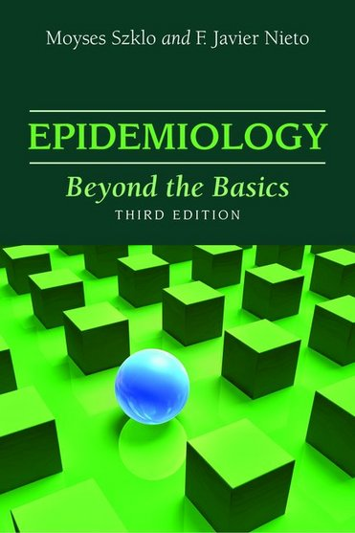
Preface
“This book was conceived as an intermediate epidemiology textbook….discusses key epidemiologic concepts and basic methods in more depth than that found in basic textbooks on epidemiology.”
As an intermediate text, it is not like reading the sports page.
It takes time to read.
Notes:
Now that you all have had a chance to get some experience with our recommended textbook, I wanted to give you some background.
We like this book because we feel it is the most contemporary and readable coverage of the topic. Yet, we realize that it is not like reading the sports page. Specifically, it is pitched as an intermediate text. It does presume some prior experience and knowledge, which we do believe is where most of you are at. As an intermediate text, it does take time to read and digest.
There are many other textbooks of epidemiology, but most of them are introductory, too simple, not contemporary, and clearly wrong in many areas of coverage.
There are also more advanced textbooks (see the course website for listings) which offer the most correct coverage but these are too advanced for where we are starting.

Slide 3
We “recommend” reading the text because it explains the material in a slightly different way
But, it is not quite as contemporary and comprehensive as it could be, especially in bias
When the text differs from lecture, the lecture trumps text
Bottomline: Despite the blemishes, we feel this is the single best available textbook for our level of coverage.
There is value added if you read the text, but you can do well if you only have time to learn our slides/notes narrative

Slide 4
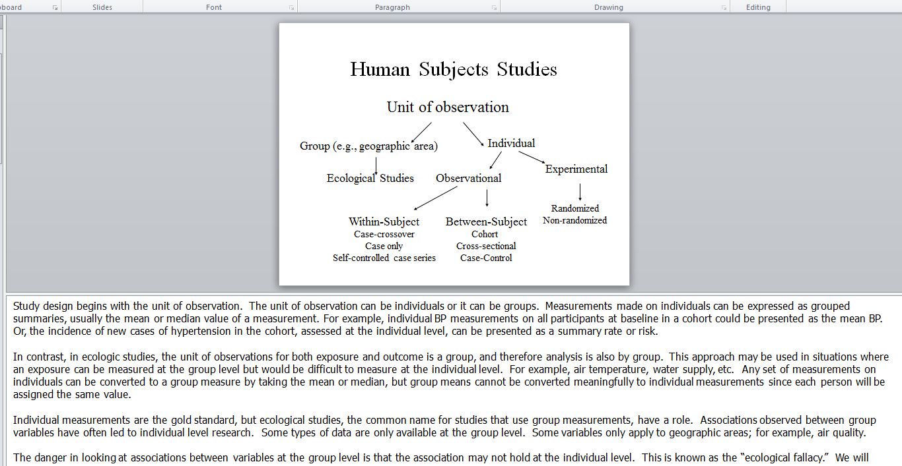
Notes:
Regarding our lecture notes, we hope that everyone has discovered our narrative in the Notes section.

Slide 5
Nature of our Problem Sets
Prototype: We give you data/scenario and ask you to comment
Complaints: too open-ended; “What am I thinking?”
  Desire for more focused questions: e.g., “Do you think this particular aspect of the data (e.g., a measurement) is wrong?”
Rationale: in the real world, you are presented with designs/data/inferences from analyses, either your own or others
  You will need to interpret them; decide if they are or are not valid
  You will need to scan the range of potential threats to validity without any focused prompting or multiple choice options.
Training your mind as a critical quantitative researcher
Not always one single best answer. If you come up with a logical / better response, you get credit (and we add it to the answer key!)
Sometimes, there is not enough data to provide an answer. If this is the case, simply state it. This, too, occurs in real-life.
Notes:
You have also had the chance to experience a few of our problem sets, and you can see a prototypical question shows you some data or a scenario and asks you to comment. Specifically, we give you some study design, data, inference, or some other scenario and then ask you to comment in some way as to whether it is valid or not valid and if not, why not.
We often get complaints that our question are too much of “what I am thinking questions” which we take too many are too open-ended, leaving students unsure what to answer. Some students complain about this and would rather have more focused questions such as “Do you think confounding is present?
The reason we give these questions is because they mimic the real world, one in which you are presented with study design, data, or inferences either that you create yourself or someone else created, and you will need to determine if they are valid. These scenarios won’t be in the form of a true/false question, or multiple choice, but rather you will need to think of all the possible ways the situation might be invalid without any prompting. This is what we call training your mind to be a critical quantitative researcher. Hence, we won’t offer any apologies for these questions – we do believe they aid in training you to become a more critical thinker.
There is also not always one single best answer. In other words, if you come up with a different answer than we have and it is correct, then you will certainly get full credit, and indeed we will include your answer on the answer key. Hence, these questions often don’t have just one answer – guess what the instructor is thinking – but rather serve to get you thinking.
Finally, sometimes there is not enough data or information to provide an answer. If this is the case, just state this. These scenarios, too, occur in real-life.

Slide 6
One Other Complaint We Sometimes Get
“Homework takes too long”
Our goal is to set the table for learning for the most engaged and interested students
To learn this material in the type of depth that is needed to perform high quality research, you will need to put in the time
But, for whatever reason, if you don’t have the time, you can still learn a lot and (likely) still pass the course
In other words, if you don’t have the time, don’t hold this against yourself or the course. Use this opportunity to simply learn as much as you can.

Slide 7
Other Observations
Virtually no one understands all of this material or gets all of the problems correct the first time
Most students get at least some points subtracted on several/many questions
  We grade all assignments manually to help point out where you have gone astray in hopes of emphasizing the learning points
Don’t be discouraged — it takes time (and often many rounds of learning) to develop a mastery of this material
By working through this challenging homework, you will become prepared for the challenging world of research
Notes:
A few other observations. We grade and take off points, not to make you feel discouraged, but instead in hopes of pointing out where you have gone astray and emphasizing the learning points.

Slide 8
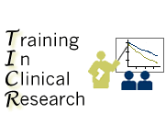
TICR Program
Professional Conduct Statement
Clarifications for this class
I will maintain the highest standards of academic honesty
I will not use answer keys from prior years
Problem Sets: I am permitted to consult with other classmates, but I will write final answers in my own words away from other classmates
Final Examination: I will neither give nor receive aid in examinations
Notes:
Finally, a reminder for what we expect for professional conduct in this course. Following the overall tenets of the TICR Program Professional Conduct Statement, we ask that you maintain the highest standard of academic honesty and not use answer keys from prior years if you happen to come across them. It is fine and, in fact, we encourage you to work with other classmates on the problem sets but please write the final answers in your own word. Finally, for the end of quarter final exam, please work on this entirely on your own without discussion with anyone else.

