Slide 1
Fertility

Slide 2
Show population pyramids

Slide 3
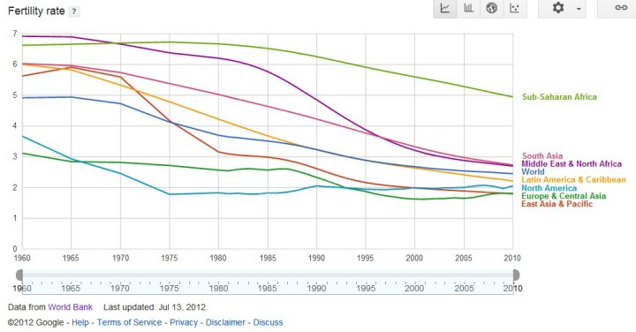
Fertility Decline: Global Differences

Slide 4
Theories of fertility decline
Why has fertility declined?
Modernization theory
  Less developed countries will eventually look like developed countries
    Assumes that today’s developed countries looked like today’s developing countries in the past
  Based in assumptions about economic development
    Family change:
      Move from extended to nuclear households
        What was it like in the past?
      Change from high to low fertility
        What was Europe like in the past?

Slide 5
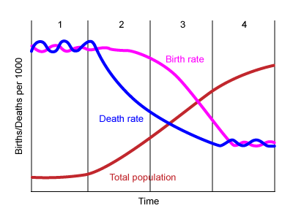
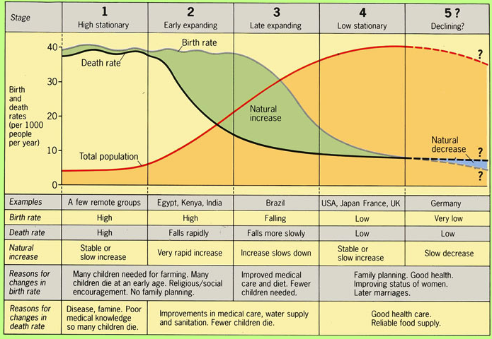
Demographic Transition Theory

Slide 6
Demographic Transition Theory and Ideational Theory
European Fertility Project: Collected data on fertility by province in Europe back as far as possible
Tried to test Demographic Transition Theory
  Looked at economic development and fertility
Found little evidence of Demographic Transition Theory
  Instead evidence of cultural, mostly linguistic, lines
Led to idea of Ideational theory
  All people want to have smaller families, once knowledge about how to do so is out, it spreads quickly
  Scientific rational for family planning programs

Slide 7
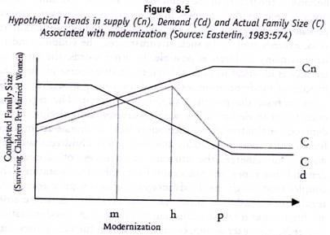
Other theories of fertility decline
Supply/Demand (Becker)
  Demand: (for children) ideal family size
  Supply: (of children) ability to control fertility

Slide 8
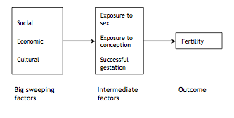
What makes fertility change?

Slide 9
Proximate determinants of Fertility (Bongaarts)
Proportion of married women/in a sexual union among all women of reproductive age
Contraceptive use and effectiveness
Duration of postpartum infecundability (or postpartum insusceptibility)
Induced abortion
Fecundability (including frequency and timing of intercourse)
Prevalence of permanent sterility
Spontaneous intrauterine mortality

Slide 10
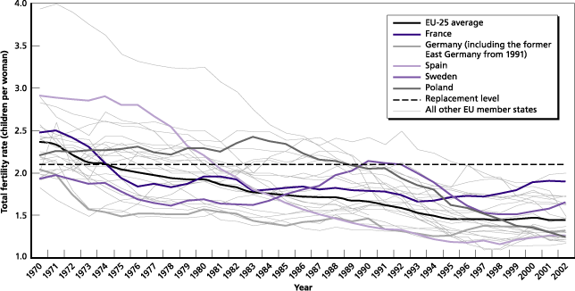
Lowest low fertility
Replacement level fertility: ~2.1
  Many countries in Europe and East Asia have fertility below replacement level

Slide 11
Why has fertility fallen so low?
Becker continued (rising cost of children)
Risk aversion
  High divorce, employment instability
Materialistic values
Changes in gender equity
  Women entering the workplace,
  Division of labor in the home

Slide 12
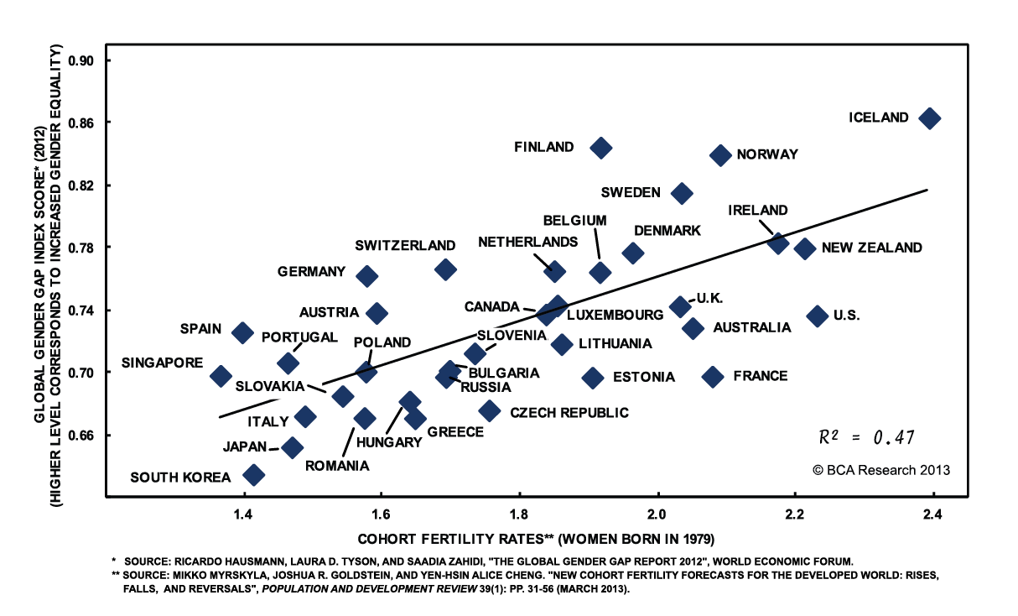
Fertility and gender inequality

Slide 13
Is low fertility a problem?
Three issues
  Negative growth
    Is negative population growth associated with negative economic growth
  Aging population
  Countries with strong sex preferences

Slide 14
Aging population
Burden on taxpayers
  If you have a strong welfare state
Burden on children to care for elderly
  Especially with low fertility, there are fewer kids to care for each aging parent
Recent data suggests that supporting the elderly is not as big of a deal as people worry it is

Slide 15
Solution to aging: Migration?
Migrants have higher fertility…at first…
Can help take pressures off other countries with higher fertility and not enough jobs
Problem with assimilation, acceptance
  An increasingly controversial issue
Plus, there are some places that people don’t want to move to (Russia?)

Slide 16
Three measures of Fertility:
Crude birth rate:
  Number of births during t/mid-year population in t
General fertility rate:
  Number of births during t/mid-year population of women aged 15–49

Slide 17
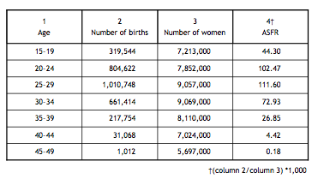
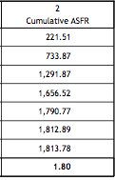
Age-specific fertility rate/total fertility rate: A synthetic Measure
Number of births to women aged x during t/mid-year population of women aged x

Slide 18
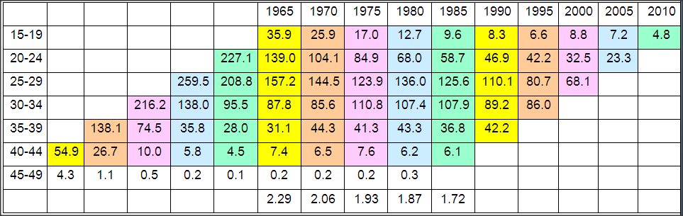
Total Fertility Rate (TFR)
The number of children a woman would have if she experienced the ASFR of a certain year for her whole life time
No woman actually actually experiences the ASFR of a certain year

Slide 19
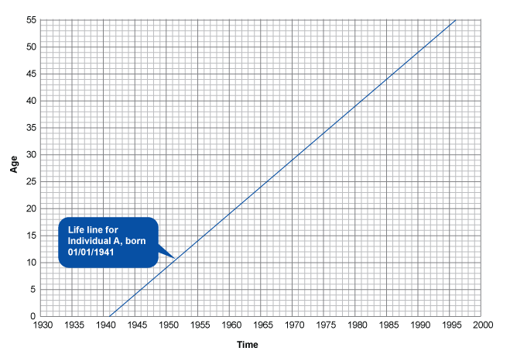
Lexis Diagrams: An individual

Slide 20
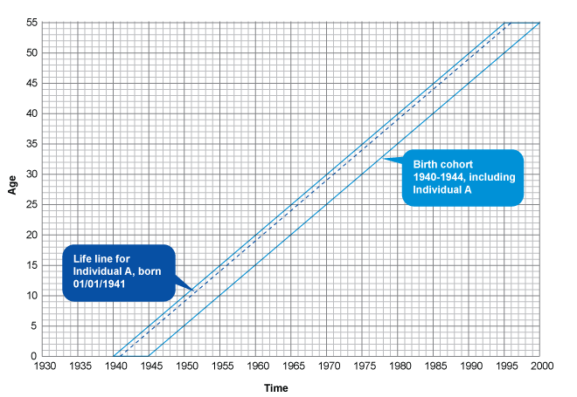
Cohort

Slide 21
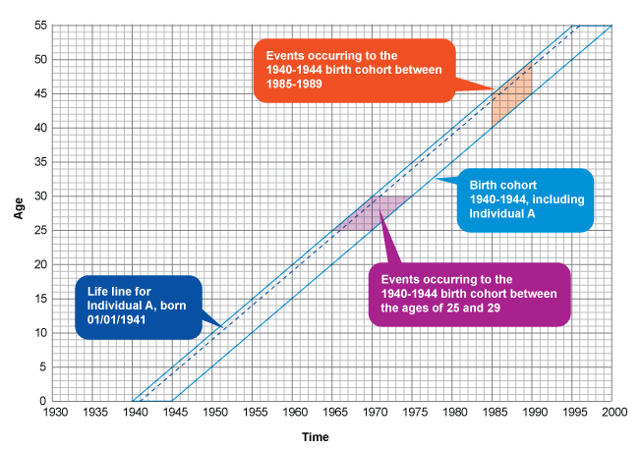
Cohort experiences

Slide 22
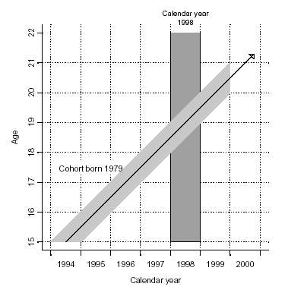
Lexis Diagram: Period vs Cohort

Slide 23
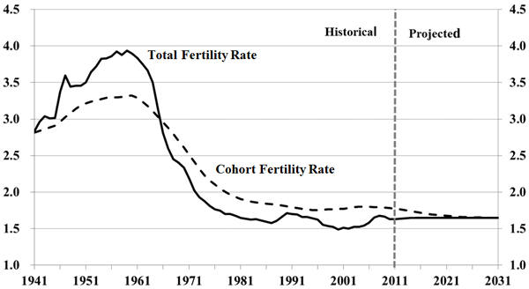
Cohort vs. Period fertility: Canada

Slide 24
Cohort vs. Period fertility: Why?
What might make this difference?
Hint: mean age at childbirth

Slide 25
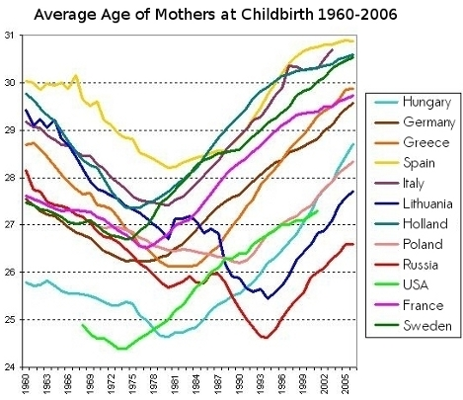
Average age of mothers over time

Slide 26
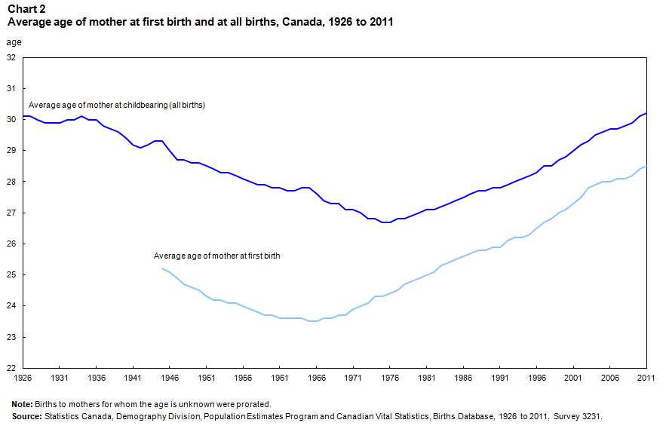
Mean age at childbirth: need to look at parity

Slide 27
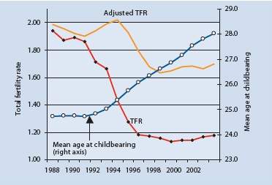
Tempo effect: Czech Republic

Slide 28
Parity Progression Ratios
Cohort measures, free of tempo effects
Proportion of women with n children who go on to have n+1 children

Slide 29
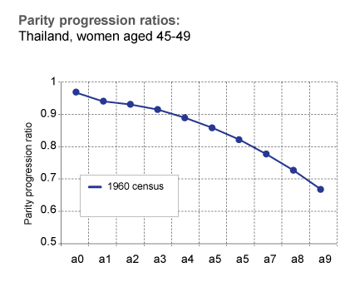
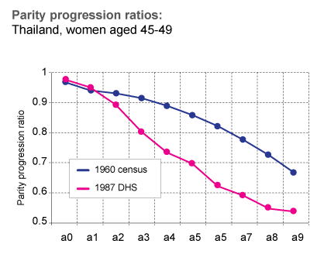
Parity Progression ratios
a0 = proportion of women with 0 children who go on to have 1
a1 = proportion of women with 1 child who go on to have 2
a2 = proportion of women with 2 children who go on to have 3
Etc….
UNFPA)

Slide 30
Period vs Cohort
Period
  Easy to collect
  Use up to date info
  Rapid changes
  CONs
    Does not reflect real life life experiences of individuals
    Tempo effects
Cohort
  Tells us about real lived experiences
  CONS
    Takes decades to collect

Slide 31
Fertility differentials

Slide 32
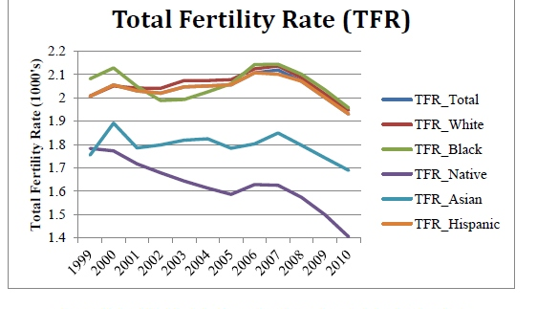
Fertility Decline: Ethnic Groups: US

Slide 33
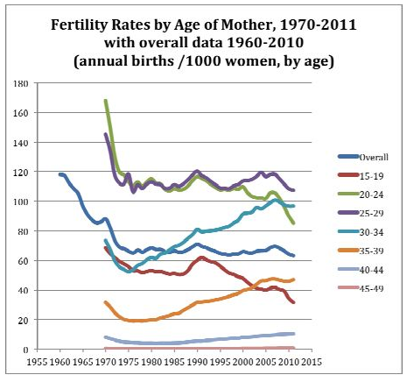
Fertility Decline: Age Groups

Slide 34
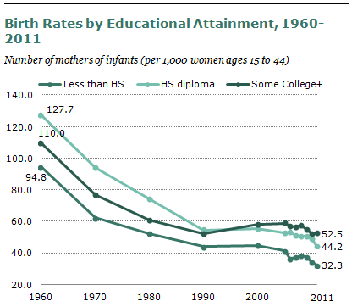
Fertility Decline: Education (US)

Slide 35
Fertility and Policy

Slide 36
Policies to decrease fertility
Family planning programs
1 child policy: china
Forced sterilizations: India, Columbia
Women’s education
Women’s labor force opportunities
Laws about age at marriage
Women’s empowerment

Slide 37
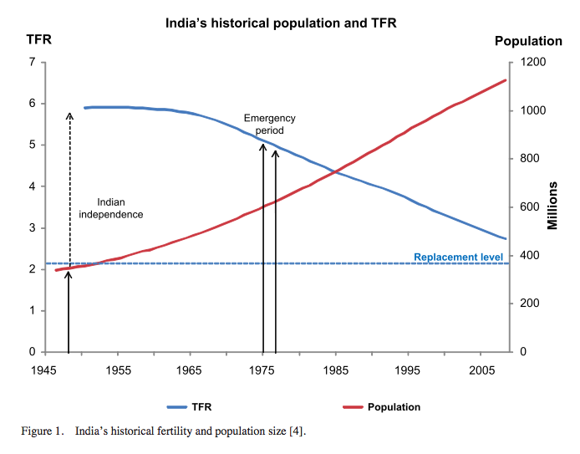
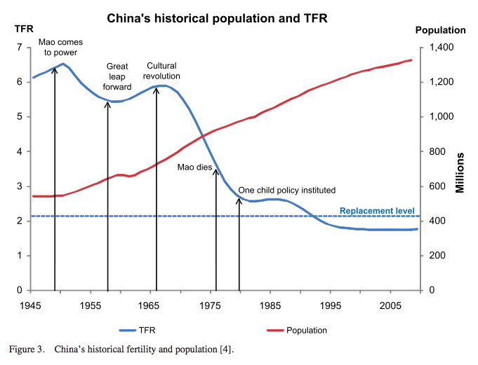
Population policies and fertility in India and China

Slide 38
Policies to increase fertility
Financial incentives
  Lump sums, periodic
  Tax rebates, credits, etc.
  Free/subsidized goods for children
Work/family incentives
  Maternity and paternity leave
  Flexible hours
  Childcare
  Anti discrimination laws
Social change to be more supportive of children and parents
  Gender equity in household, marriages
  Child friendly environments

Slide 39
Evidence on policies to increase fertility
Systematic Review (Gauthier, 2007) found
  Little conclusive evidence, some policies had positive effect, many none
  Evidence that when they did work, they mostly seemed to affect timing rather than overall completed fertility

Slide 40
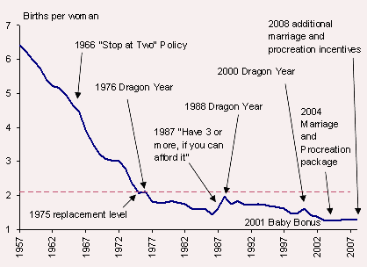
How culture and policy shape fertility: Singapore

Slide 41
Thank you!
Questions?
Notes:
Final boiler plate language: 2 versions
Through its singular focus on health, UCSF is leading revolutions in health.
UCSF is driven by the idea that great breakthroughs are achieved when the best research, the best education and the best patient care converge.

