Slide 1

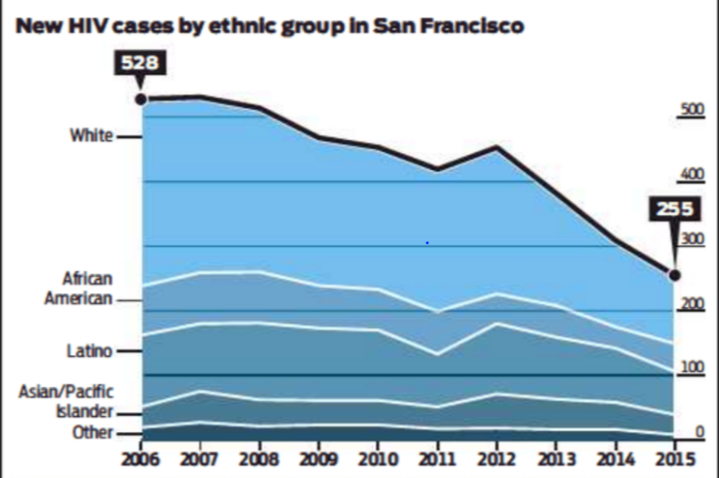
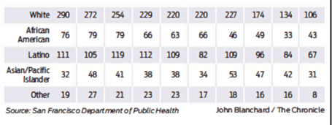
n
Notes:
Who saw this in the San Francisco Chronicle? This was on the front page. The headline states that HIV rates in SF were falling in all but African Americans in which it states in the headline that it is increasing. Here is the accompanying graphic.
Anything wrong here? These numbers which the article is calling rates formally are not rates; they are just counts of disease. What do we think is of main interest here? Is it counts or rates? Counts may be interesting to service providers in that they need to know the absolute number of people who need services. However, care of HIV infection is not done by any single service provider in San Francisco and hence tallying up the number of counts does not seem that relevant. What is likely of more interest here is whether whatever interventions that are being done across San Francisco are working to decrease the incidence of HIV. Assuming this is the research question, then rates and not counts would be needed. This is because the counts alone do not take into account changing population size, one of the most basic aspects of incidence. In general, the population of San Francisco has been increasing the past several years with new housing developments. Hence, perhaps the increase in number of HIV diagnoses in the African-Americans is simply because of population growth? On the other hand, housing costs have skyrocketed and perhaps the population of African-Americans has fallen. This would mean that the 43 cases in 2015 is even more alarming than it appears. Displaying rates would have made this clearer.

Slide 2
Disease Association I
Main points to be covered
Measures of association compare measures of disease occurrence between levels of an exposure
  Study design dictates the applicable measures of association
Cross-sectional study
  Introducing: 2 X 2 table
  Prevalence ratio
  Prevalence odds ratio
Cohort study
  Risk ratio (cumulative incidence ratio)
  Rate ratio (incidence rate ratio and hazard ratio)
  Risk difference
  Rate difference

Slide 3
Measures of Disease Association
Measuring occurrence of disease (incidence or prevalence) can be a goal by itself
  This is “description”; called a descriptive study or descriptive objective
More commonly, investigators wish to study relationships between an exposure (risk factor, predictor) and an outcome (event, condition, disease). This typically involve comparisons.
  Called an analytic study or analytic objective
  Goal is either to determine etiologic/causal relationship (aka “causation”) or simply statistical association between exposure & outcome (aka “prediction”)
Measures of association between exposure and outcome are what we use to quantitatively depict the relationships
  Study design dictates the available measures of association
  Any single study can only provide us with a statistical association
  Whether or not the statistical association represents a causal relationship, or merely a numeric prediction, requires considerations beyond the data itself
  Considerations encompassed by process termed causal inference (more later in course)
Notes:
We have reviewed basic study design and examined the different measures of disease occurrence. In the next two lectures, we will look at the measures that are used to show association between an exposure or treatment and disease. These measures are called measures of association and the type of measure available is determined by the study design. So we will come full circle in linking specific measures of disease association with study design.
Studies that focus on estimating measures of disease occurrence are called descriptive. Studies that examine the relationship between exposures and outcomes are called analytic studies. This inherently involve comparison between different levels of exposure.

Slide 4
Descriptive and Analytic Goals
Goal of research may be “descriptive” or “analytic”
Description
  How frequent/common are risk factors/exposures/conditions/diseases? How often does Y occur?
Causation
  The science of establishing causal relationships among biological, behavioral, environmental (etc.) factors among humans
  Does X cause Y?
Attribution
  What fraction of disease Y can be eliminated if a causal exposure X is eliminated?
Mediation
  Understanding the mechanisms of causation
  How does X cause Y?
Interaction
  When and for whom does X cause Y?
Prediction
  Do A, B, and C predict occurrence of Y? (e.g., diagnosis or prognosis)
Descriptive
Analytic
Everything in this course relates to designing studies that will accomplish a descriptive or analytic goal.
Notes:
Referring back to our familiar framework, we will now begin to learn the tools needed to address questions of causation and prediction. Both of these involve determining the relationship between various exposures and outcomes, what we will now define as measures of association.
But, in spite of this similarity, it is important to be aware of whether you are interested in causation or prediction because they mean different things and require different standards to derive meaning from their requisite measures of association. Causation refers to whether the presence of a given exposure in at least one person results in the occurrence of some outcome (for us, a health outcome) whereas the outcome would not occur in that person if that factor was absent. If this happens in at least one person, we refer to the factor as a “cause”. This definition implies that if we could alter such a factor (i.e., eliminate it) in at least one person, we would prevent the occurrence of the outcome. Understanding causes is extremely important because as the definition implies, it is the way that we can intervene and change health. We will further discuss this definition of causation next week.
Prediction, on the other hand, is less stringent in its requirements and its implications. The key goal in prediction is to correctly distinguish persons for the absence or presence of some outcome right now (this is called diagnosis in clinical medicine) or the occurrence of some outcome in the future (prediction of an event or prognosis after the event). The exposures that we examine do not necessarily have to be causally related to the outcome. All we care about in prediction is numerical or statistical association between the exposure and the outcome. Prediction, for example, can be used in what is called risk assessment, meaning to help identify persons who are at high risk to have an adverse health outcome. However, the factors that identify someone as being at high risk to have an adverse outcome are not necessarily going to result in a change in risk if we happen to be able to alter them. In other words, altering non-causal factors which are predictive will typically not change health outcomes. This is the basis of common mantra heard in lay language “association is not causation”.

Slide 5
Cross-Sectional Study Design:
In an Underlying Fixed Cohort
= event
= survival time after event
CE
Cross-sectional
Cross-sectional
Cross-sectional
Cross-sectional
Time
Notes:
We return once more to the text’s schematic for a cross-sectional study. This slide illustrates a cross-sectional design in a FIXED cohort. A cross-sectional study is often performed at the baseline of a fixed cohort, as part of a general description of the population. However, keep in mind that this baseline is one point in time of a larger underlying dynamic cohort. Also, a cross-sectional study can be done anytime during the life of a fixed cohort.
In a cross-sectional study, only prevalent instances of the condition/disease are being captured, not incident. Because of this, we must be cognizant of why some of the incident cases of disease lasted long enough to be prevalent in our sample and others did not.

Slide 6
Cross-Sectional Study: In a Dynamic Cohort
New Members
CE
CE
Cross-sectional
Cross-sectional
Cross-sectional
Time
Notes:
Cross-sectional study design in an underlying dynamic cohort is illustrated here. This design will also select prevalent instances, not incident cases of the outcome.
Thus, when we turn to the measure of association between an exposure and the disease outcome in a cross-sectional sample, we need to keep in mind that it is a measure based on prevalence. As pointed out earlier, examining the association of exposures/predictors with prevalent cases of disease is to look at both factors associated with disease occurrence and factors associated with disease duration (survival). These factors can be quite different, and interpretation of the measure of association using prevalent disease is complicated by this fact.

Slide 7
Measures of Association in a
Cross-Sectional Study
Simplest case is to have a dichotomous exposure and dichotomous outcome
Everyone is classified as having exposure or not and having outcome or not, making a 2 x 2 table
The proportions with disease are compared among those with and without the exposure
Note: Plethora of synonyms
  Exposure = treatment = predictor = predictor variable = risk factor = independent variable = correlate = determinant
We prefer
Notes:
The type of outcome we have been discussing is an event, which is a dichotomous variable as it either has or has not occurred. There are, of course, other outcome measures that are important in clinical/epidemiologic research, and they can be measured in various ways, such as multiple ordered categories (none, mild, severe congestive heart failure), a scale (such as a series of questions which form a quality of life scale), or a continuous measure (like blood pressure). The most basic measures of association commonly used in clinical research that we will be discussing in the next two lectures are used for an association between an exposure and a dichotomous outcome. To keep it simple, we will also focus mainly on a dichotomous exposure, but the same principles apply for a multi-level exposure.
We are using the word “exposure” for the variable whose association with the outcome the study seeks to investigate. Other terms are frequently used to describe the exposure variable, the most common being “risk factor” or “predictor” or “predictor variable.” In a clinical trial the exposure is usually a drug, device, procedure, or behavioral intervention whereas in an observational study the exposure might be an immutable characteristic such as a person’s gender or race. In a regression analysis, the outcome is called the dependent variable and the exposure or predictor variables are called independent variables. Although independent and dependent variables are widely used terms in statistics texts, they seem less intuitive to us than outcome and exposure. The term exposure is also not value-laden in terms of whether or not it is associated with the outcome or not; it is simply a generic representation. Once exposures have been evaluated, those which are found to be associated with outcome are sometimes called correlates, determinants, or causal determinants.
In some formal epidemiologic writing, some authors will use the term exposures to refer to entities that cannot be manipulated by interventions (such as age or race) and the term treatment for entities that are modifiable. We find this sometimes confusing because some things that can be manipulated, such as smoking, are not treatments in the clinical sense. Hence, we will refer to both of these constructs as exposures.
Finally, we especially do not favor the term “risk factor” because it is ambiguously used to mean either a predictive correlate or causal determinant. It is so ambiguous it has lost all meaning.

Slide 8
2 x 2 table for association of exposure and disease
Disease
Emphasizes left to right or causal thinking
No
Yes
Yes
a
b
a + b
Exposure
No
c
d
c + d
a + c
b + d
N = a+b+c+d
Note: data/tables may not always come to you arranged as above.
e.g., Stata puts exposure across the top, disease on the side
Notes:
This is a conventional schematic of a what is called in epidemiology a 2 x 2 table or a contingency table. We will illustrate basic measures of association using this table. Of course, exposures might have more than two levels and thus more than just yes/no categories, but the same principles would apply. This 2 x 2 schematic is widely used, but exposure and disease can switch position in other formulations as can the yes and no columns and rows so it is important to notice how the table you are looking at has been arranged. Our arrangement is the same as in the Szklo and Nieto text and in many other basic epidemiology textbooks. We like it because it emphasizes what we consider “forward” or causal thinking from exposure to disease. It also emphasizes cohort-like thinking, which is what we have depicted with the green arrows. Because we read from left to right, we also think of causal sequence as happening from left to right. In other words, when we use our natural instincts and read this table from left to right, it reminds us of forward or causal thinking, which is what we want it to do. Even if this is a cross-sectional study design (which is where we are starting our discussion), we are still typically trying to make the same inferences that a cohort study can. Writing exposure on the left and following exposure to outcome reminds us of the goal of our work which is to relate exposure to outcome (either in the form of causation or prediction).
Stata regrettably puts the exposure variable across the top and the outcome variable on the side. So the format we will be using in lecture for a 2x2 table would read differently than data displayed in Stata.

Slide 9
Prevalence ratio of disease in exposed vs unexposed:
A ratio measure of association
Disease
Yes
No
a
Yes
a
b
a + b
PR =
Exposure
c
No
c
d
c + d
A prevalence ratio (PR) is a point estimate of the association between exposure and disease in a cross-sectional design.
  there is a confidence interval as well (not our course’s main focus)
Notes:
To estimate a measure of association in a cross-sectional study, the proportion of the persons with disease is calculated in the group with the exposure and separately in the group without the exposure. Hence, a/a+b is the prevalence of disease among the exposed persons and c/c+d is the prevalence of disease among the non-exposed. Since this is a cross-sectional study, both are prevalences. To compare these two prevalences, we can form a ratio with one over the other to get a prevalence ratio of disease in the exposed and unexposed. If the prevalence is the same, the ratio will equal 1.0. If disease prevalence is higher in those with the exposure (placed on top in the ratio), the ratio will be greater than 1.0 and if the prevalence is lower in those with the exposure, the ratio will be less than 1.0. How much greater or less than 1.0 is a measure of the strength of the association between the exposure and the disease. This kind of relative measure of association is known as a ratio measure. A different kind of measure could have been formed by subtracting one prevalence from the other instead of forming a ratio, but it turns out this is rarely done in a cross-sectional study. We will discuss that additive scale or absolute difference scale type of measure later.
The prevalence ratio that we get from our particular study sample is an estimate of the association between the exposure and outcome of interest in the larger accessible population from which we sampled our data. We call the estimate we derive in our study sample a point estimate. A confidence interval around this point estimate provides information about sampling error or chance. By convention, 95% confidence intervals are the most common. In this course, we are focused on calculating and understanding the point estimates. We won’t be focusing much on the mechanics of calculating confidence intervals as this is in the purview of our biostatistics series, although we will expect you to know how to derive confidence intervals in Stata and how to interpret confidence intervals.

Slide 10
Prevalence Ratio
S & N text refers to Point Prevalence Rate Ratio in setting of cross-sectional studies
We like to keep the concepts of rate and prevalence separate and so prefer to use prevalence ratio
We don't recommend "point prevalence ratio" or "period prevalence ratio" because it is too bulky.
  Instead, make it clear elsewhere whether prevalence is point or period.
Notes:
This is one other place where the text language differs from the language we suggest you use. We have already discussed this, incorrect, use of rate for prevalence data. The textbook is yielding to some older usage which we think is just confusing, so we will simply call this measure a prevalence ratio.
Note also that although we differentiated between point prevalence and period prevalence earlier, we do not recommend terms such as point prevalence ratio or period prevalence ratio. These are just too bulky. Instead, call them both prevalence ratios and elsewhere be sure that your readers know whether you are referring to point or prevalence ratios.

Slide 11
Calculating a Prevalence Ratio
 | Disease | Non-disease | Total | Prevalence
Exposed | 14 | 17 | 31 | 0.45
Unexposed | 388 | 248 | 636 | 0.61
Total |  |  | 667
Prevalence ratio = 0.45/0.61 = 0.74
Notes:
Here is an example of the calculation of a prevalence ratio. As noted in previous slides, we have this 2x2 table arranged with outcome on top and exposure on the side. We prefer this schematic because it emphasizes forward thinking in the underlying cohort study base: start with exposure status and assess the experience of the outcome. However, the key point is to be aware of how a 2x2 table is set up because not everyone will follow this convention.

Slide 12
Describing a PR < 1 (e.g., PR = 0.74)
Importance of understandable interpretation
* “Those who are exposed are 0.74 times as likely to have the disease than those who are not exposed.”
  - “Marathon runners are 0.74 times as likely to have heart disease than those who do not run marathons.”
“Being exposed is associated with a lower prevalence of the outcome compared with being unexposed (PR = 0.74).”
Avoid: “The exposed have 26% less (or lower) prevalence of the disease than the unexposed.”
  - Could be misinterpreted as the difference in prevalence between exposed and unexposed. e.g., difference is in fact: 0.45 in exp – 0.61 in unexp = -0.16
We are ignoring issues of statistical significance for now and whether association is causal or just predictive
* Preferred description
Notes:
To clearly convey the results of a study, it’s essential to be able to describe the measure of association (in this case, the prevalence ratio) in words that humans can understand. Although not all readers will understand how a prevalence ratio, or other measure of association, is calculated, they can grasp the meaning of the estimate if it’s clearly communicated. We will spend a good deal of time in this course describing how to best communicate measures of association such that most humans can understand them.
Describing this prevalence ratio in words: Those who are exposed are 0.74 times as likely to have the disease (outcome) compared with those who are not exposed. Although we believe this the clearest way to state this, we admit that it may not be understood by everyone. This is why in later slides we suggest to flip the comparators to get a point estimate above 1, if at all possible.
You will sometimes see this described as those who are exposed are "26% less likely" to have the disease, but this can be confused with the absolute difference in prevalence. In other words, readers may think that this applies to the prevalence difference between the exposed and unexposed, in this example 0.45-0.61 = -0.16.
The second description (that includes the PR) is technically correct but does not add much meaning in interpretation. It gives a qualitative picture but it does not help the reader quantitatively – unless they understand what a prevalence ratio is.
As a reminder, we are ignoring issues of statistical significance (i.e., sampling error) for now and whether the association is causal or merely predictive. These issues will come later. For now, we are just describing the facts of the numerical association.

Slide 13
Describing a PR > 1 (e.g., PR = 1.5)
* “Those who are exposed are 1.5 times as likely to have the disease than those who are not exposed.”
  - “Smokers are 1.5 times as likely to have CHD than non-smokers.”
* “Prevalence of disease in exposed is 1.5 times as high as in unexposed.”
“There is a 1.5-fold higher prevalence of disease among exposed compared to unexposed.”
“Being exposed is associated with a higher prevalence of disease compared with being unexposed (PR = 1.5).” (not clear to all)
Avoid: Exposed are “50% more likely to have disease”
  - Open to misinterpretation as the difference in prevalence in the exposed and unexposed
Notes:
The first two options are the preferred way to describe a prevalence ratio greater than 1. At the bottom of the slide, we note wording to be avoided because it could be easily misinterpreted as a difference rather than a ratio measure of association.
The third option is OK but some would object, based on a concern that this could also be misinterpreted as the difference between the two prevalences rather than their ratio.

Slide 14
Tips for wording of measures of association
  “Smokers are 1.5 times as likely to have CHD than non-smokers.”
Instead of just stating the measure of association, use commonly understood words and phrases to depict what the measure of association means
Always state the contrast (i.e., the comparison)
Ratio measures > 1 are typically easier to explain and understand than ratios < 1.
  If appropriate, switch the reference group
Notes:
Remembering to include the contrast (the comparison) is especially critical for analyses where causation is the goal.

Slide 15
Re-calculating to report Prevalence Ratio > 1
 | Disease | Non-Disease | Total | Prevalence
Exposed | 14 | 17 | 31 | 0.45
Unexposed | 388 | 248 | 636 | 0.61
Total |  |  | 667
Prevalence ratio=0.45/0.61= 0.74 for exp vs unexp RECALCULATE: Prevalence ratio = 0.61/0.45 = 1.36 for unexposed vs exposed “Those who are unexposed are 1.36 times as likely to have the disease than those who are exposed.”
Notes:
Here are the data recalculated in order to report a prevalence ratio greater than 1.

Slide 16
Stata: 2x2 Table and Prevalence Ratio
Exposed Unexposed | Total
---------------------------------------------------
Cases | 14 388 | 402
Noncases | 17 248 | 265
---------------------------------------------------
Total | 31 636 | 667
| |
Risk | .4516129 .6100629 | .6026987
Point estimate [95% Conf. Interval]
---------------------------------------------
Risk ratio .7402727 | .4997794 1.096491
-----------------------------------------------
chi2(1) = 3.10 Pr>chi2 = 0.0783
. cs var_case var_exposed
Stata puts exposure across the top
STATA uses “risk” and “risk ratio” by default because it does not know better, (Stata just see %’s) but in this example the point estimate is a prevalence ratio.
Notes:
To perform this calculation in Stata, the command is cs <outcome variable> <exposure variable>. This illustrates the output for a 2 x 2 table in Stata, which regrettably puts exposure across the top and disease on the side. There is no simple way to trick Stata to do otherwise. This is unfortunate, so we do have to be aware of it when we interpret the tables. This is the same example that we showed a few slides earlier. Exposure is now across the top, so we have to calculate the prevalence in each exposure group by working down, rather than across. As you can see, the calculated prevalence ratio, 0.74, is the same result that we got in our 2x2 table arranged with outcome across the top.
Stata calls the prevalence estimates “risk” and this ratio a “risk ratio” as the program has no way of knowing whether it is being given prevalence or incidence data, so we as the users need to remember that when we have cross-sectional data, these are prevalence ratios and not risk ratios.
If these data were incident outcomes from a cohort with the same amount of follow-up on everyone (such as our example of the investigation of an outbreak of gastroenteritis following a party), a risk ratio would be correct as the description of the ratio of the two proportions.
As we noted on an earlier slide, the prevalence ratio calculated here by Stata is a point estimate of the association between exposure and disease. The point estimate for a measure of association is the single best answer based on the available data and statistical model. Stata also provides the 95% confidence interval. This indicates the range of results that are compatible with sampling error. A p value is given as well which indicates statistical significance.

Slide 17
Study Reporting Prevalence Ratios
Prevalence of hip osteoarthritis among Chinese elderly in Beijing, China, compared with whites in the United States
Abstract: The crude prevalence of radiographic hip OA in Chinese ages 60–89 years was 0.9% in women and 1.1% in men; it did not increase with age. Chinese women had a lower age-standardized prevalence of radiographic hip OA compared with white women in the
SOF (age-standardized prevalence ratio = 0.07) and the NHANES-I (prevalence ratio = 0.22). Chinese men had a lower prevalence of radiographic hip OA compared with white men of the same age in the NHANES-I (prevalence ratio = 0.19).
Nevitt et al., Arthritis & Rheumatism 2002
Notes:
This is a study comparing the prevalence of osteoarthritis (OA) in Beijing and the US. The study is reporting a ratio formed from the prevalences in two groups.
This study used age-standardization – discussed in the previous lecture - to adjust the prevalences for the different age distributions in these three populations (Beijing, SOF and NHANES).
To describe the result for men in words: “Among those 60-89 years of age, Chinese men are 0.19 times as likely to have radiographic hip OA than white men in the NHANES-I study.”

Slide 18
Vitamin D and PAD
Objective – The purpose of this study was to determine the association between the 25-hydroxyvitamin D (25(OH)D) levels and the prevalence of peripheral arterial disease (PAD) in the general United States population.
Methods and Results – We analyzed data from 4839 participants of the National Health and Nutrition Examination Survey (NHANES). After multivariate adjustment for demographics, comorbidities, physical activity level, and laboratory measures, the prevalence ratio of PAD for the lower, compared to the highest, 25(OH)D quartile (<17.8 and ≥29.2 ng/mL, respectively) was 1.80 (95% CI: 1.19, 2.74).
Often see odds ratio for cross-sectional study, but it is possible to estimate an adjusted PR, as reported here. This study used log binomial regression.
    Exposure was analyzed as quartiles. Look at this more closely on next slide.
Melamed et. al. Arterioscler Throm Basc Biol 2010
Notes:
Here is another example of the use of prevalence ratio. When we calculated a PR earlier, by hand or using Stata, we calculated what is called the unadjusted PR. We were able to used a simple 2 x 2 table for the calculations. In this example, there was need to adjust for confounding and so a multivariable regression model was used. In this example, a log binomial regression model was used to accomplish the adjustment and produce the adjusted prevalence ratio.
You might be more used to seeing an odds ratio calculated as the point estimate, calculated using a logistic regression model, in cross-sectional studies. We will talk about this later, but software can now accommodate multivariable regression models to calculate prevalence ratios. This is what we strongly advocate.
We have not yet formally introduced what adjustment is or how to do it, but we realize that some students know that adjustment is done to deal with differences in confounding variables or to evaluate mediation or effect modification. We mention "adjustment" now to illustrate that the prevalence ratio can be calculated as a measure of association with adjustment in cross-sectional studies. Students should not be concerned at this point about the mechanics of adjustment but rather focus on what measures of association are available in particular study designs and how they are communicated.

Slide 19
Example: 4 level exposure
Log binomial regression used to estimate adjusted prevalence ratios
4-level exposure: How to describe?
Notes:
This vitamin D study is an example of a four level exposure variable. To describe the measure of association between these 4 levels and peripheral arterial disease (PAD – the outcome in this study), we set one level (grouping, category) of the exposure as the reference category. In this study, the authors chose to set the highest level of serum vitamin D as the reference level. By convention, the reference level is given a prevalence ratio of 1.0 or it is just labeled as “reference” (or “Ref.’’). Other exposure levels are compared with this reference level.
†Multivariable model adjusted for: age, gender, race-ethnicity, education, current and former cigarette smoking, leisure-time physical activity, diabetes mellitus, total to HDL cholesterol ratio, body mass index, systolic blood pressure, glycohemoglobin, statin use, antihypertensive medication use, vitamin D supplement use, history of myocardial infarction, log homocysteine, elevated CRP, and chronic kidney disease.

Slide 20
Vitamin D and PAD
Compare each exposure level to the reference quartile (highest level in this study). Prevalence ratio for reference group is set to 1.0
Paper’s abstract uses term “prevalence ratio.” “the prevalence ratio of PAD for the lower, compared to the highest, 25(OH)D quartile (<17.8 and ≥29.2 ng/mL, respectively) was 1.80 ”
Clearer to say, for example: “those in the lowest quartile of 25(OH)D (<17.8 mg/mL) were 1.80 times as likely to have PAD than those in the highest quartile (>29.2 ng/mL).”
Notes:
The answer is to compare the prevalence in each exposure level to a reference category, typically either the highest or lower quartile. Here, the authors used the highest values as the reference category.
The authors could have done better with the description of the association between Vitamin D and PAD. “..the prevalence ratio of PAD for the lower, compared to the highest, 25(OH)D quartile…was 1.80..” is not that clear. It would have been better to express the observed association more clearly in words. For example, “those in the lowest quartile of 25(OH)D were 1.80 times as likely to have PAD than those in the highest quartile.”

Slide 21
Alternative measure of association in cross-sectional design: Odds Ratio
Many cross-sectional studies report an odds ratio rather than a prevalence ratio.
Odds of disease provide a legitimate statistical description but are not as intuitive as prevalence of disease.
Popularity of odds ratio (OR) is historical in case-control studies
  based on initial availability of statistical theory (and later software) to perform complex adjustment for binary outcome research via logistic regression.
Adjusted regression models to directly estimate prevalence ratio are now available and are now the preferred approach
We introduce odds (and OR) in the context of cross-sectional design because of historical popularity. OR is required for analysis of disease association in case-control studies (next week).
Notes:
The association between exposure and a dichotomous outcome in a cross-sectional study is best described with a prevalence ratio. Yet, you will probably more often see an odds ratio used to depict the relationship. The odds ratio is a legitimate description of association in cross-sectional studies, but is not easily or accurately understood by most scientists or, especially, lay observers. The reason for the popularity of the odds ratio is historical. That is, historically, the odds ratio has been a popular choice for cross-sectional results because of the availability of theory (and later software) to perform logistic regression that allowed for multivariable adjustment for multiple confounding variables. Logistic regression produces odds ratios. This technical aspect has, however, changed. Currently, it is possible to obtain adjusted regression models that estimate an adjusted prevalence ratio rather than a an adjusted odds ratio.
We introduce odds ratio in this section on cross-sectional studies because of its historical popularity, but it is not the preferred approach. Prevalence ratios are the preferred approach. Next week, we will discuss assessment of associations in the case-control design. In case-control design, the odds ratio is essential because it is all that can be directly estimated.

Slide 22
Odds
Odds are another way to express occurrence (prevalence or incidence) of an event
As a measure of occurrence per se, odds are used in:
  Betting in sports (e.g., horse racing: Secretariat had 3 to 2 odds in the Kentucky Derby)
  lotteries (although “odds of winning” presented are really probabilities)
  but rarely in biomedical research
Where odds are used in research, it is in the form of a ratio of odds
  The “odds ratio”
Notes:
Odds are an alternative way to express the occurrence of an event. Although odds are a way to measure disease occurrence, we did not introduce odds in our previous lectures on measures of disease occurrence because odds per se are rarely used. As a measure of occurrence per se, odds are used in sports, for example horse racing (where the terminology is correct). In this context, they are useful to identify the “pay out” of a bet on the race outcome. For example, with 3:2 odds (1.5 odds) on Secretariat, a bet of $1 would cash in for $2.50, giving a net gain of $1.50. More about odds and gambling in Notes on next slide.
The terminology is also used in lotteries (e.g. “odds of winning lottery 1 in 100,000”) but in this situation what is really being described is probability. While odds per se as a measure disease occurrence is rarely used in biomedical research, odds are used in biomedical research in the form of odds ratios.

Slide 23
Odds vs Probability
Odds = # events
# non-events
In contrast, probability = # events = # events
# events + # non-events # subjects
e.g.,:
  If event occurs 1 of 5 times, probability = 1/5 = 0.2
  Out of the 5 times, 1 time will be the event and 4 times will be the non-event, odds = 1 / 4 = 0.25
Notes:
Odds are most simply calculated as the number of events divided by the number of non-events. In contrast, probability is the number of events divided by the total of the number of events plus the number of non-events, which, for human subjects research, is the same as the number of events divided by the number of persons at risk. It may appear that odds are just an unnecessary complication of the familiar probability (a proportion of total subjects), but odds have some favorable mathematical properties that we will explain shortly which make them useful in clinical research.
To apply some numbers to the formulas, if the probability is 1 out of 5 = 0.2, then the odds are 1/5 / 4/5 = ¼ = 0.25. Calculating the odds without the number of subjects by the ratio of the number of events (1) by the number of non-events (4), odds = ¼ = 0.25.
For those interested in why odds are used in gambling: odds give the ratio of the event to the non event, and the ratio of the event to the non-event tells you what the pay out has to be for a fair bet. For example, if you wager 1 dollar that the toss of one die will be the number 3, the probability is 1/6 since the die has 6 sides with 1 through 6 on the sides. Since the probability is 1/6, the odds are 1/6 / 5/6 = 1/5. The expectation is that 6 rolls of the die will result in a 3 one time and other numbers 5 times (on average!). So for the payout and the amount bet to be “fair”, i.e., balanced, you would need to receive 5 dollars when the number 3 comes up one time out of six to equal the 5 dollars you will lose one at a time on the other 5 tosses. So the odds are 1/5 usually written as 1:5 or 5:1 and spoken as “five to one.” Of course, in gambling calculating the odds are usually used to ensure that the payout is not according to fair odds but odds that favor the casino.

Slide 24
Formal Definition of Odds
Formally, odds = Prob. of event
Prob. of non-event
prob. of event = # events
# subjects
prob. of non-event = # non-events
# subjects
odds = # events
# subjects = # events
# non-events # non-events
# subjects
Notes:
The formal way to describe the odds is as the probability of the event divided by the probability of the non-event. So odds are the ratio of two fractions: the number of events divided by the number of subjects (the probability of the event) and that fraction divided by the number of non-events divided by the number of subjects (the probability of the non-event). Since both fractions have the number of subjects in the denominator, they reduce to the number of events divided by the number of non-events.

Slide 25
Probability and Odds
Odds = # events
# subjects = probability of event
# non-events (1 – probability of event)
# subjects
Odds = p / (1 - p)
[ratio of two probabilities: unlike probability, can be greater than 1]
Notes:
Odds can also be directed expressed in terms of the probability of the event. So odds are the ratio of two fractions: the number of events divided by the number of subjects (the probability of the event) and that fraction divided by the number of non-events divided by the number of subjects (the probability of the non-event). So the formula for odds is p / (1 – p). Since both fractions have the number of subjects in the denominator, they reduce to our first presentation of odds as the number of events divided by the number of non-events.

Slide 26
Describing Odds
To express odds in words, think of it as frequency of the event compared to the frequency of the non-event
“For every time the event occurs, there will be 3 times when the event does not occur”
In words: “Odds are 1 to 3”
Short-hand as 1:3 or 1/3 or 0.33

Slide 27
Probability and Odds:
Going Back and Forth
odds = (probability) / (1 - probability)
probability = odds / (1+ odds)
  e.g., odds of 3 means: 3 events : 1 non-event
  3:1 can be viewed as: 4 tries and 3 will be events
  Probability is 3 out of 4 = odds / (1 + odds)
Notes:
We can go back and forth between odds and probabilities and these are equations.
On previous slide, we showed how to calculate odds, given probability of the event. To go the other direction, calculating probability given odds, divide the odds by (1 + odds). This should be intuitive based on the definitions and hence no need to memorize. For example, on adds of 3 means 3 events to 1 non-event. Or, in 4 tries, you will have 3 events. Thus, probability of the event is ¾. If we can express odds in terms of something to 1 (e.g., 3:1), then we can see how probability is odds divided total tries which is odds + 1.

Slide 28
Odds and Human Intuition
Less intuitive than probability (wouldn’t say “my odds of dying are 1 to 4”)
  unless you are a professional gambler
No less legitimate mathematically, just not easily understood
This lack of intuitive interpretation, however, is sizeable and, as we will see, one of the 3 critical reasons to avoid odds ratios if possible

Slide 29
Odds ratio
As odds are an alternative way of expressing the occurrence (e.g., probability) of an event, an odds ratio (OR) is an alternative to the ratio of two probabilities (prevalence ratio) in cross-sectional studies
Odds ratio = ratio of two odds

Slide 30
Probability and odds in a 2 x 2 table
Disease
What is p of disease
in exposed?
What are odds of
disease in exposed?
And the same for
the un-exposed?
Yes
No
2/5
2/3
1/5
1/4
Yes
2
3
5
Exposure
1
4
5
No
3
7
10
Notes:
Odds are already the ratio of two probabilities, so the odds ratio involves four probabilities: p(event) / 1 – p(event) in the exposed, and p(event) / 1 – p(event) in the unexposed that yield a single ratio. So in this example the p of the event in the exposed is 2/5, 1 – p of the event in the exposed is 3/5. Similarly, p of the event in the unexposed is 1/5 and 1- p(event) in the unexposed is 4/5. So the odds of the event in the exposed is 2/3 and the odds of the event in the unexposed is ¼. The ratio of those two odds is 2/3 / ¼ = 2.67

Slide 31
Prevalence ratio and odds ratio in a 2 x 2 table
Disease
No
PR = 2/5
1/5
Yes
= 2
Yes
2
3
5
Exposure
OR = 2/3
1/4
1
4
5
No
= 2.67
3
7
10
Notes:
Notice that the odds ratio is numerically larger than the prevalence ratio, i.e., farther away from the null value of 1.0. Unless both ratios = 1.0, the odds ratio will always be farther from 1.0 than the prevalence ratio (greater if > 1.0 and smaller if < 1.0) because the prevalence ratio is the ratio of two probabilities and the odds ratio is the ratio of two probabilities each of which has been divided by (1 – probability), a quantity that is always < 1 unless the probability is 1.0.

Slide 32
Odds ratio of disease in exposed vs unexposed
Disease
Yes
No
a
Yes
a
b
b
OR =
Exposure
c
No
c
d
d
Notes:
Here is the odds ratio for disease in a cross-sectional study, presented using our notation for a 2x2 table.

Slide 33
a
b
c
d
Odds ratio of disease in exposed and unexposed
ad
bc
OR =
=
The OR is the ratio of the odds of the outcome in the exposed over the odds of the outcome in the unexposed, as presented on previous slide.
OR is also often described as “cross-product” of the cells in a 2x2 table.
Instead of cross-product, it is better to calculate based on first principles:
odds of disease in exposed / odds of disease in unexposed
Notes:
Doing a little algebra to show how these four fractions reduce down to what is called the “cross-product” of the 2x2 table, the ratio of the products of the two diagonals. Notice that this result would not be affected by whether we arrange disease across the top of the table and exposure down the side or the other way around (as in Stata). However, it would be affected if we switching the order of yes vs no in the columns. For this reason, we don’t recommend calculating the odds ratio with a cross product. We do not understand the origins of “cross-product” approach and we do not see how it all lends to better understanding of the concepts, but we do know that it is pervasive.
Instead, we suggest to calculate odds ratios based on first principles: odds of disease among exposed divided by odds of disease among unexposed. If you use first principles to make the calculation, you will never go wrong.

Slide 34
Odds Ratio in Cross-Sectional Study
Study design affects not just the measure of disease occurrence but also measure of association
Cross-sectional design measures prevalent cases of disease, so odds ratio in a cross-sectional study is a prevalence odds ratio (POR)
  Many authors do not use “POR” but we encourage it
  Promotes clarity of thought and presentation to be as accurate as possible about measures
  Although we, in general, discourage use of OR in cross-sectional work, if you must use it, at least call it a POR
Notes:
It is useful to always keep in mind how the study design determines the spectrum of the measures of the association. Prevalence is the measure of disease occurrence in cross-sectional study designs. The measure of association, therefore, should reflect this and labeling the odds ratio a prevalence odds ratio accomplishes that goal. This is not a convention that most authors follow, as many will just call it an odds ratio without acknowledging the role measuring prevalent disease plays, but we think it aids clarity of thought and presentation to label it for what it is, a prevalence odds ratio.
Although we, in general, as stated earlier and described in more detail later, discourage use of odds ratios in cross-sectional work, if you must use it, at least call it a prevalence odds ratio.
Later on, next week, we will show how the odds ratios from different case-control sampling designs have different interpretations, so it is good to begin recognizing that not all odds ratios mean the same thing.

Slide 35
Odds ratio (Stata output)
. cs var_case var_exposure, or
Exposed Unexposed | Total
---------------------------------------------------
Cases | 14 388 | 402
Noncases | 17 248 | 265
---------------------------------------------------
Total | 31 636 | 667
| |
Risk | .4516129 .6100629 | .6026987
Point estimate [95% Conf. Interval]
---------------------------------------------
Risk ratio .7402727 | .4997794 1.096491
Odds ratio .5263796 | .2583209 1.072801
-----------------------------------------------
chi2(1) = 3.10 Pr>chi2 = 0.0783
Notes:
To get Stata to express the odds ratio, simply type in ‘or’ as an after the comma in the cs command. Shown here is the same Stata output as before but with the addition of the odds ratio (OR) to the “risk ratio”, which is really the prevalence ratio (PR) in our cross-sectional data. Notice that the OR is smaller than the PR (farther away from 1). If the PR is less than 1.0, the OR will always be farther from 1.0 (= closer to 0). Similarly, if the PR is greater than 1.0, the OR will be farther from 1.0, i.e., larger. If the PR = 1.0, the OR will also = 1.0.

Slide 36
Describing an OR < 1 (e.g., OR = 0.53)
** “Those who are exposed have 0.53 times the odds of having the disease than those who are not exposed.”
* “The exposed have 47% lower odds of the disease than the unexposed.”
“Being exposed is associated with lower odds of the outcome compared with being unexposed (OR = 0.53).”
Important to get the word “odds” into the sentence
  Helps avoid confusion with prevalence/probability
  But does not help readers better understand odds per se
Avoid: “Those who are exposed are 0.53 times as likely to have the disease as those who are not exposed.”
  - Odds ratio is not the same as prevalence ratio
Notes:
Describing this odds ratio in words. The preferred communications are in the first and second bullets. Note that we want to get “odds” into this description. Getting odds into the sentence helps avoid confusion with concepts of probability. Using odds, however, magically does not help readers understand odds.
This second bullet could be ambiguous if people thought odds were the same as probability. This is a reason to favor the first option on the slide
We want to avoid the usage in the last bullet. This last description uses the term “likely” which implies probability and a prevalence ratio, rather than an odds ratio. Odds ratios are not the same as prevalence ratios.

Slide 37
Describing an OR > 1 (e.g., OR = 1.5)
* “Those who are exposed have 1.5 times the odds of having the disease than those who are not exposed.”
* “The odds of disease in the exposed are 1.5 times as high as in the unexposed.”
“There is a 1.5 fold higher odds of disease among exposed compared to unexposed.”
“Being exposed is associated with higher odds of disease compared with being unexposed (OR = 1.5).”
Avoid: “1.5 times more likely” or “1.5 times higher risk”
Notes:
The first two descriptions are preferred for an OR greater than 1. The third description is OK but some may object; the language could be misinterpreted as a description of the odds difference. As noted on the previous slide, avoid describing the OR using the terms “likely” or “risk.” These words are not appropriate for describing a ratio based on odds.

Slide 38
Odds Ratio compared to Prevalence Ratio
If prevalence ratio = 1.0, OR = 1.0;
otherwise, OR farther from 1.0 than PR
0
1
∞
Stronger effect
OR Prev Ratio
Stronger effect
Prev Ratio OR
Notes:
This graphic illustrates the point that, unless both the prevalence ratio and the odds ratio are 1.0 (which means no difference between exposed and unexposed), the odds ratio is always farther from 1.0 than the prevalence ratio. This means that the odds ratio is a larger number if the prevalence ratio is greater than 1.0 and smaller if the prevalence ratio is less than 1.0. More on this in the next slides when we consider the favorable and unfavorable properties of the odds ratio.

Slide 39
Prevalence ratio and Odds ratio
If prevalence ratio > 1, then OR farther
from 1 than prevalence ratio:
PR = 0.4 = 2
0.2
OR = 0.4
0.6 = 0.67 = 2.7
0.2 0.25
0.8
Notes:
When the ratio of two probabilities, a prevalence ratio, is > 1.0, the OR will be larger than the PR. The OR is dividing each probability by a quantity forced to be < 1.0 (unless probability = 1.0), so each probability increases and the ratio between them also increases. The only exception occurs when the prevalence ratio is exactly 1.0. In that case, the OR will also be 1.0. This can easily be seen by modifying the example above to RR = 0.4 / 0.4 = 1.0. The OR would then be 0.4/0.6 / 0.4/0.6 = 1.0.

Slide 40
Prevalence ratio and Odds ratio
If prevalence ratio < 1, then OR farther from 1 than PR:
PR = 0.2 = 0.67
0.3
OR = 0.2
0.8 = 0.25 = 0.58
0.3 0.43
0.7
Notes:
The same phenomenon occurs when the ratio of two probabilities, a prevalence ratio, is less than 1.0 Since the OR is dividing each probability by a quantity forced to be < 1.0 unless probability = 1.0, each probability increases and the ratio between them also increases, which in this case moves the value farther away from 1.0. Values for both prevalence ratios and odds ratios less than 1 are bounded by 0. In that respect they differ from ratios with values greater than 1, which can be infinitely large.

Slide 41
What are the favorable and unfavorable properties of odds ratios?

Slide 42
Favorable property of odds ratio #1:
OR can approximate PR in some situations
Odds ratio approximates prevalence ratio if disease prevalence is low (i.e., <10%) in both the exposed and the unexposed groups
This is favorable because everyone can understand a prevalence ratio.
Notes:
The first favorable property of an OR is that it can sometimes approximate a PR. As we noted a few slides earlier, the odds ratio is only exactly the same as the prevalence ratio when they are 1.00. Otherwise, the OR is always further from 1.00 than the PR. The OR is numerically different from PR (except if they are equal to 1) but this difference is small if the prevalence of disease is low in the exposed and unexposed groups. By low prevalence, we mean less than 10%. This is often described as “OR is a close approximation to the PR” if prevalence of disease in all strata of exposure is low. This condition is also called the “rare disease assumption for odds ratios.”

Slide 43
OR ~ PR with low prevalence of disease
 | MI history | No MI history | Total | Prevalence
High BP | 9 | 491 | 500 | 0.018
Low BP | 3 | 997 | 1,000 | 0.003
PR = (9/500)/(3/1,000) = 0.018/0.003 = 6.0 OR = (9/491)/(3/997) = (0.018/0.982)/(0.003/0.997) = 6.09 OR is further away from 1.00 than the PR But, 6.0 and 6.09 are very very close. Here, OR closely approximates PR.
Notes:
This is an example illustrating our point that the prevalence ratio and the odds ratio will be very similar when prevalence is low in both exposed and unexposed.
With low prevalence of disease in both exposed (high BP) and unexposed (low BP) groups, the odds in both groups are very similar to the prevalence – and the resulting ratios are also similar.
The prevalence is simply the probability of the event. The odds is the probability of the event divided by the probability of the non-event. When prevalence (probability) of the event is low, then probability of the non-event is high. Thus, the denominator for the odds (the probability of the non-event) is close to 1.0. In this example, the probability of the non-event in the group with the highest prevalence (the exposed group) is 0.982 (1 – 0.018). The probability of the non-event in the unexposed is even closer to 1.0: 0.997 (1 – 0.003). So dividing the two probabilities by values close to 1.0 is going to have very little effect on their ratio. If either probability of the non-event had been far from 1.0 (i.e. if the probability of the event was high in either exposed group), then there would have been a substantial effect on the ratio.

Slide 44
“Bias” in OR as estimate of PR
S+N text refers to “bias” in OR as estimate of prevalence ratio
This is not “bias” in usual sense because both OR and PR are mathematically valid and use the same numbers
Hence, it is not a bias per se. It is simply that OR is not equal to PR because they are different mathematical entities.
OR can be a “close approximation” for the PR, but only if outcome prevalence is low in all exposure groups
Notes:
Despite some references (like the S+N text) doing so, it is not correct to say that the odds ratio is biased. It is preferable to reserve the word “bias” for situations where invalid or inaccurate results are being obtained because some systematic factor or factors, the sources of bias, are affecting the study and giving the wrong answer (as compared to the true answer in the source population). Since both OR and PR are mathematically valid measures, it is misleading to talk about the “bias” of the OR. The real point is that the odds ratio and the prevalence ratio are not the same estimands.

Slide 45
Favorable property of odds ratio #2:
Symmetry
Unlike prevalence ratio, odds ratio is symmetrical:
OR of event = 1 / OR of non-event

Slide 46
Example: OR is symmetrical
 | Disease | Non-Disease | Total | Prevalence
Exposed | 14 | 17 | 31 | 0.45
Unexposed | 388 | 248 | 636 | 0.61
Total |  |  | 667
OR (of event) = (14/17)/(388/248)= 0.53 OR of non-event = (17/14)/(248/388) = 1.9 1/OR = 1/0.53 = 1.9 EQUAL to OR of non-event
Notes:
This example shows the symmetry of the odds ratio.

Slide 47
Example: Prevalence ratio not symmetrical
 | Disease | Non-Disease | Total | Prevalence
Exposed | 14 | 17 | 31 | 0.45
Unexposed | 388 | 248 | 636 | 0.61
Total |  |  | 667
PR (of event) = 0.45/0.61 = 0.74 PR of non-event = (17/31)/(248/636) = 1.41 1/PR = 1 /0.74 = 1.35 NOT EQUAL to PR of non-event
Notes:
This example shows how the prevalence ratio is not symmetrical.

Slide 48
Favorable property of odds ratio #3:
OR is a lifesaver in case-control studies
As we will explain in more detail next week:
OR of exposure is all we can estimate in case-control
Odds ratio of exposure equals odds ratio of disease
  - And if disease is rare, then odds ratio of disease is a good approximation of risk ratio
Even if disease not rare, OR of exposure can be an accurate estimate of a risk ratio or rate ratio in a case-control study if the proper control sampling is done.
This allows us to get meaningful measures of association in case-control studies (the OR is a lifesaver)
Notes:
The third favorable property is the odds ratio allows us to conduct odds ratio and come away with meaningful measures of association. As we will discuss next week, the odds ratio of exposure is the only measure of association that we can directly estimate in a case-control study. If we conduct the case-control study properly, the properties of the odds ratio allows for it to be an accurate estimate of our preferred measures of associations, such as risk ratios and rate ratios.

Slide 49
Unfavorable property of odds ratio #1:
OR often does not approximate PR
Odds ratio does not approximate prevalence ratio if disease prevalence is not low in either the exposed and/or the unexposed group
Notes:
However, there are several unfavorable properties of ORs, particularly as they are used in cross-sectional studies.

Slide 50
Prevalence ratio and Odds ratio
If prevalence of disease is not low in both exposed and unexposed, PR and OR will appreciably differ.
Example, if prevalence in exposed is 0.6
and 0.1 in unexposed:
PR = 0.6/0.1 = 6.0
OR = (0.6/0.4) / (0.1/0.9) = 13.5
6.0 and 13.5 are VERY different.
OR approximates PR only if disease prevalence is low in both exposed and unexposed group
Notes:
It is important to understand this feature of the odds ratio because you will see some authors trying to convince you that the odds ratio is an approximation of the prevalence ratio or, in a case-control study, the risk ratio. It is important to know when the OR is a close approximation to the prevalence ratio or risk ratio. As we have been stressing, the odds ratio is no less valid as a mathematical expression than the prevalence ratio but its less intuitive nature leads many investigators to prefer to talk about the prevalence ratio, a more intuitive concept. This results in measures which are in fact OR’s being presented in some papers as prevalence ratios. In many instances this is not appropriate because the prevalence is not low in both the exposed and unexposed group and the OR and the prevalence ratio are quite different numerically.
In other words, if investigators are either ignorant about what an odds ratio means or simply sloppy in language, they will often display and talk about odds ratios as if they were prevalence ratios. This can result in very large misrepresentation of true meaning.
In our example, the odds ratio is not a close approximation of the prevalence ratio.

Slide 51
OR ~ PR with higher prevalence of disease
 | Fell past year | No falls | Total | Prevalence
Slow gait | 300 | 200 | 500 | 0.60
Normal gait | 300 | 700 | 1,000 | 0.30
PR = (300/500)/(300/1,000) = 2.0 OR = (300/200)/(300/700) = (0.60/0.40)/(0.30/0.70) = 3.5 OR is now much further away from 1.00 than the PR 2.0 and 3.5 are very different. Here, OR does NOT approximate PR.
Notes:
This is an example illustrating our point that the prevalence ratio and the odds ratio will be far apart when prevalence is high in the exposed and/or unexposed groups.
As we noted before, the prevalence is simply the probability of the event. The odds is the probability of the event divided by the probability of the non-event. When prevalence (probability) of the event is high, then probability of the non-event is low. Thus, the denominator for the odds (the probability of the non-event) is NOT close to 1.0. In this example, the probability of the non-event in the group with the highest prevalence (the exposed group) is 0.4 (1 – 0.6). The probability of the non-event in the unexposed is 0.7 (1 – 0.3). Dividing the two probabilities of the event by values far from 1.0 has a substantial effect on the ratio.
It is important to understand this feature of the odds ratio because you will see some authors trying to convince you that the odds ratio is an approximation of the prevalence ratio or, in a case-control study, the risk ratio. It is important to know when the OR is a close approximation to the prevalence ratio or risk ratio. As we have been stressing, the odds ratio is no less valid as a mathematical expression than the prevalence ratio but its less intuitive nature leads many investigators to prefer to talk about the prevalence ratio, a more intuitive concept. This results in measures which are in fact OR’s being presented in some papers as prevalence ratios. In many instances, this is not appropriate because the prevalence is not low in both the exposed and unexposed group and the OR and the prevalence ratio are quite different numerically.
In other words, if investigators are either ignorant about what an odds ratio means or simply sloppy in language, they will often display and talk about odds ratios as if they were prevalence ratios. This can result in very large misrepresentation of true meaning.
In this example, the odds ratio is not a close approximation of the prevalence ratio.

Slide 52
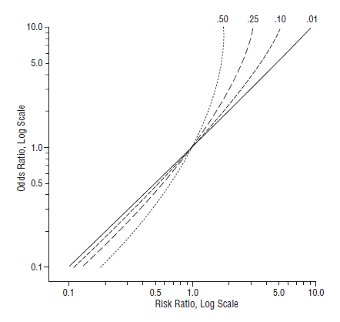
Prevalence Ratio vs Odds Ratio
Relationship between odds ratio and prevalence ratio according to 4 levels of outcome prevalence in unexposed group
Prevalence Ratio, Log Scale
Cummings 2009
Notes:
Relationship between odds ratio and prevalence ratio according to 4 levels of outcome prevalence in unexposed group (1%, 10, 25%, and 50%).
As an example, shown with the red lines, with 25% prevalence of the outcome in the unexposed group, a prevalence ratio of 2.0 is equivalent to an odds ratio >3. A prevalence ratio of 3 is equivalent to an odds ratio of nearly 10.
When prevalence begins to exceed 10% in either exposed or unexposed, then the OR begins to be considerably farther away from 1 than the PR. If you are under the belief that the OR is the same a ratio of probabilities, then this inflated number you get from the OR is going to give you a false impression of the numerical relationship between the exposure and outcome.

Slide 53
Unfavorable property of odds ratio #2:
People don’t understand them
Most humans don’t understand odds
Many scientists treat odds as if they were probabilities
  e.g., Of 151 studies in the OB/GYN literature where odds ratios were calculated, authors interpreted the odds ratio as a risk/prevalence ratio in 39 (26%) of them (Holcomb 2001)
Treating an OR like a PR especially problematic when outcomes are not rare and, therefore, OR is much inflated compared to PR
Notes:
We have already stated this, but most humans do not understand odds. This includes scientists in whom it is well documented how frequently they refer to them as they would probabilities. This leads to considerable overstatement of the magnitude of effect of various exposures on various outcomes.

Slide 54
Unfavorable Property of the Odds Ratio #3:
Non-Collapsibility
Mathematical oddity known since at least 1981 in epidemiologic methodologic literature
Virtually unheard of amongst applied researchers
Odds ratio is ‘non-collapsible’; What is non-collapsibility?
  Consider a large group of people and breaking it into smaller groups (say, based on a factor related to outcome but exposure)
  Logically, if you took the measures of association in all the smaller groups and averaged them, you would expect to get the measure of association seen in the large group of persons
  Logical expectation is seen with prevalence ratio or difference
  Logical expectation is NOT seen with odds ratio
    We say that the odds ratio is “non-collapsible”
  Especially problematic when outcome is common
Notes:
The third unfavorable property of odds is the least well appreciated. It is called “non-collapsibility”, and it refers to a mathematical oddity known in the epidemiologic methodologic literature since at least 1981 (Miettinen and Cook, 1981), but it was described in statistical literature (often called other things) before that. It has been identified for quite some time, but it is virtually unheard of amongst applied researchers. We believe this obscurity is because it is non-intuitive in terms of its mechanism and has been given a non-informative name — non-collapsibility.
The description and explanation of non-collapsibility will be more easily understood later in the course when we describe stratification. For now, let’s consider a large group of participants for whom we want to study the relationship between some exposure and some outcome. Now, let’s break up the larger group into small groups, say, on the basis of some factor that is associated with the outcome but not to exposure. Breaking up a large group into smaller groups is called stratification. If we then determine the measure of association between the exposure and the outcome in the many small groups, we would logically expect that the average of the different measures of association in the small groups to be equal to the measure of association in the large overall group. This logical expectation is seen when we are using the prevalence ratio or a prevalence difference; these measures of association are said to be collapsible.
Confusingly, the logical expectation is not seen when we are using the odds ratio. That is, the average measure of association among the different small groups is not the same as the measure of association in the large group. This does not make sense to most observers because we would expect that the measure of association in the big group to be reflected in the small groups. Note that the explanation is not because of chance. This property, which has been described as ‘paradoxical’ or ‘bizarre’, is termed “non-collapsibility”. We say that the odds ratio is non-collapsible. This happens especially when the outcome is not rare in at least some groups of persons.
Another way to think about this is when we adjust for a factor that has a number of levels, we are left a series of stratum-specific estimates. To complete the adjustment process, we then must summarize across the various strata to get one number, which we call the adjusted estimate. We typically do this by taking some type of a weighted average of the various stratum-specific estimates. One of the reasons we adjust for a factor is because it is a confounder. When we adjust for it, we fully expect for the adjusted estimate to be different than the unadjusted measure of association between exposure and disease. It stands to reason that when we adjust for a factor that is not a confounder, we do not expect the weighted average of the stratum-specific estimates to be different than the unadjusted estimates. When it is different, this is not something we want to see. This strange behavior is called non-collapsibility. If you adjust for a factor that is not a confounder and use OR as the measure of association, the adjusted OR will be farther from 1 than the unadjusted OR. Achieving a larger OR simply because of adjustment for something that is not a confounder seems unwanted. In fact, it might fool a naïve analyst into thinking confounding is present (although we will see later in the course why this is not a good way to manage confounding).
The way to remember what this term “collapsible” means is that when one adjusts for a factor which is not a confounder we expect that some weighted average of stratum-specific estimates will be equal to the measure of association in the overall population. In other words, we expect that we can collapse the many stratum-specific estimates into one number and get the estimate in the larger group. When this occurs, we say that the measure of association is “collapsible”. When it does not occur, we say that the measure of association is “not collapsible”.
Miettinen OS and Cook EF. Confounding: essence and detection. Am J Epidemiol 114:593-603, 1981.
Greenland S. Interpretation and choice of effect measures in epidemiologic analyses. Am J Epidemiol 126:761-768, 1987.
Greenland S, Robins JM and Pearl J. Confounding and collapsibility in causal inference. Stat Sci 14:29–46, 1999.
Greenland S and Morgenstern H. Confounding in health research. Annu. Rev. Public Health 22:189–212, 2001.
Hernán MA et al. The Simpson's paradox unraveled. Int J Epidemiol 40:780-5, 2011.

Slide 55
Unfavorable Property of the Odds Ratio #3:
Non-Collapsibility
Crude/Unadjusted
= 3.3
OR _{crude}
PR _{crude}
Stratified/Adjusted
= 1.9
Young
Old
OR _{young} = 4.5
OR _{old} = 4.5
PR _{young} = 3.1
PR _{old} = 1.6
Weighted average of two PR’s = 1.9, which is same as crude PR. This is said to be “collapsible.”
OR is “non-collapsible”
Notes:
Here is a numerical illustration of non-collapsibility. Here, we are stratifying (or “adjusting” or “controlling”) by age. The disease here is not rare. This terminology will be much easier to understand later in the course when we formally cover confounding but suffice it say now that the average of the two stratum-specific odds ratios (in this case, 4.5) is not equal to the crude odds ratio (3.3), despite the fact that confounding is not present. Controlling for age produced a bizarre and unwanted result. (See Extra Slides for demonstration that age is indeed not associated with exposure, among the entire population, and hence is not a confounder in these data. One needs to examine this in the entire population because examining it stratified upon disease is tantamount to adjusting for a collider, which is something we will learn more about later in the course.)
This property of the odds ratio is not exactly one we can call favorable. It is called non-collapsibility, and the problem is that it could mislead you during data analysis to think this is confounding. In other words, the stratified odds ratio looks considerably different than the unadjusted despite the fact there is no confounding.
The same problem is not seen when using a prevalence ratio, where the crude estimate is a weighted average of the two stratum-specific prevalence ratios. Prevalence ratios and risk ratios are collapsible, which is a good thing. Again, we are getting a bit ahead of ourselves in the terminology by attempting to explain collapsibility, but for now it is enough to understand that this is an unfavorable mathematical property, at least in terms of ability of humans to understand it.

Slide 56
Verdict on Odds Ratios
Gained popularity because of their unique role in case-control studies
An industry developed around odds ratios, in the form of:
  Statistical regression models (e.g., logistic regression) to deal with complex multivariable confounding
  Software to easily implement these regression models
The industry naturally also branched out/filled a need for other designs with binary outcomes, such as cross-sectional (and sometimes even cohort/RCT)
  This is where the problem resides because outcomes in these other designs often are common; OR no longer approximates PR
Solution: Statistical theory/software has now caught up; no longer need to use OR in most settings outside of case-control studies
  PR can be estimated directly instead (see Optional Reading)
Notes:
The use of odds ratios was popular in clinical research because of its fundamental role in analysis of case control studies. Logistic regression models were developed for case-control studies, adjusting for potential confounders and intermediaries. These models were included in software packages designed for statistical analysis. In many case-control studies, the outcome is rare, so that the OR provides an approximation of a prevalence ratio or risk ratio. However, the popularity of the OR and the availability of software for logistic regression helped to broaden its use into designs with binary outcomes with more common frequency of outcomes – without investigators necessarily being aware of the problems in interpretation that this entails.
Today, it is no longer necessary to use the OR in most settings outside of case-control designs. Prevalence ratio in a cross-sectional study can be estimated directly, with control for covariates as needed in multivariable regression models. We provide a practical article in the optional reading for how to do other forms of regression in Stata which produce adjusted prevalence ratios and get us away from the need to use odds ratios.
Today’s students of clinical/epidemiologic research methods should know when to use odds ratios - and when not to.

Slide 57
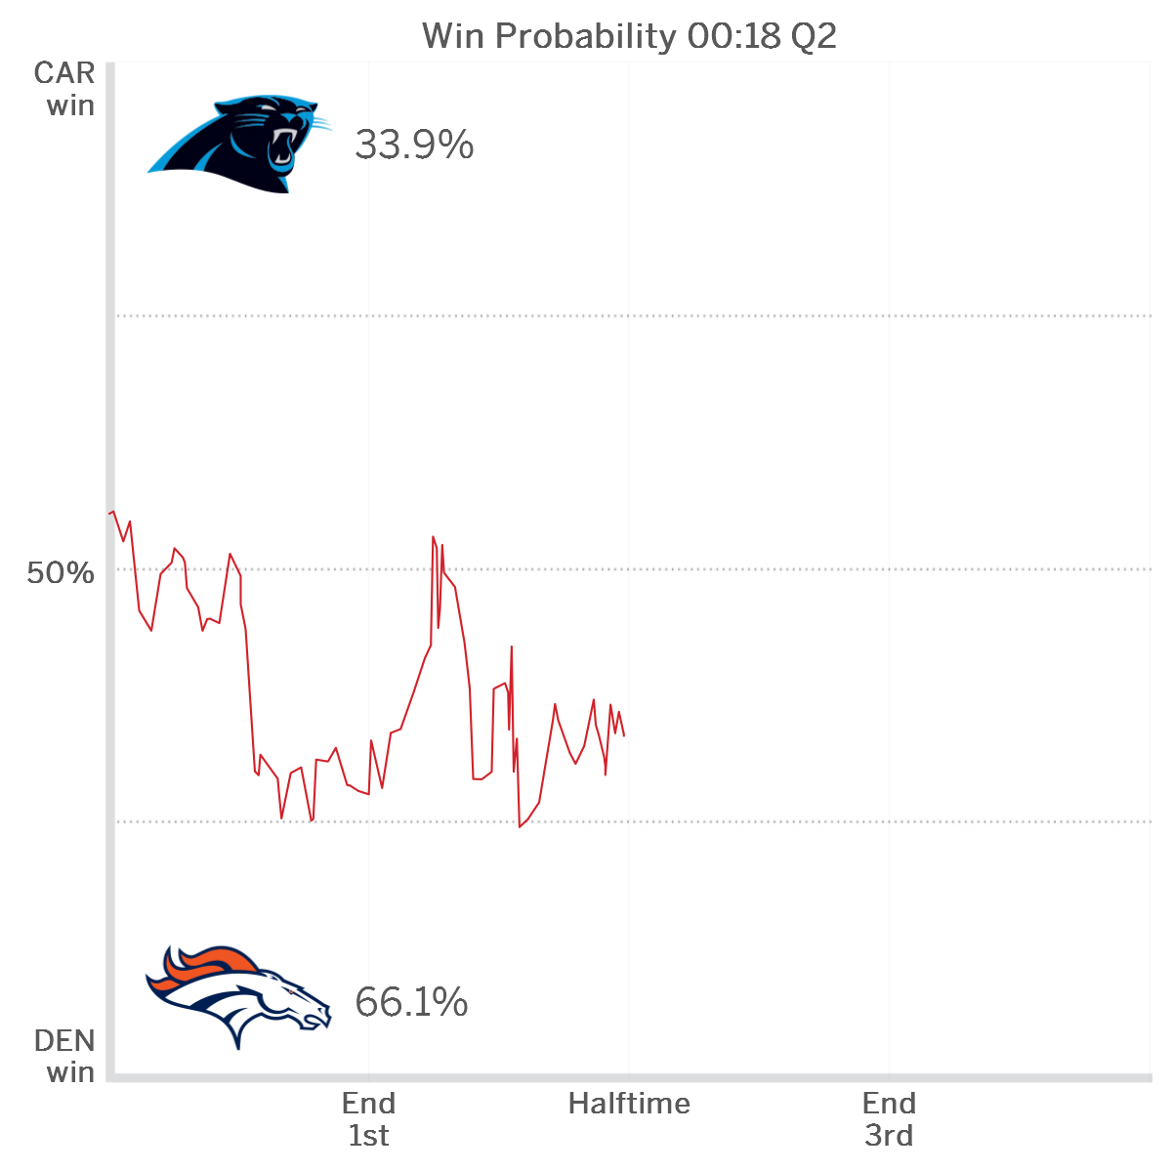
Even in sports, probability is becoming more popular whereas in the past the talk was all odds
Notes:
Interesting societal application:
How many of you have seen these plots popping up around sporting events. They start prior to a game and often continue during a game. Whereas 10 years ago, this would have all been in the language of odds, we find it interesting now that they are in the more natural language of probability. We think that this because of the same concerns that we have about odds in research, which is that most humans cannot understand them.

Slide 58
Ratio Measures of Association:
Interpreting the Magnitude
One gauge of the “strength” of an association between exposure and disease is the size of the ratio measure of association
  Note: this is not to be confused with some sort of biologic strength
Magnitude used to assess just how likely it is that bias might explain observed association. Logic: Only a large bias is capable of spuriously producing a large effect. We are confident that if such a large bias exists, we would have known about it.
In practice, many causal factors have a ratio measure (prevalence ratio, risk ratio, rate ratio, or OR) in the range of 2 to 5. Above 10 is unusual but possible (e.g. smoking or asbestos and lung cancer)
Ratio measures < 2.0 may be valid but more likely to be from bias and therefore need scrutiny (e.g., second-hand smoke risk ratio < 1.5)
Caution: If disease prevalence (incidence) not low (e.g. >10%), can’t use this same yardstick to assess the size of the odds ratio.
Notes:
Before moving on to cohort studies, it is worth spending a moment getting a feel for the meaning of the magnitude of ratio measures of association, such as the prevalence ratio. The magnitude of the measure of association is often referred to as the strength of the association or the effect size.
In practice, many causal factors have a ratio measure (prevalence ratio, risk ratio, rate ratio, or odds ratio) in the range of 2 to 5. Occasionally, measures of association may be 10 or more but these are uncommon. Smoking and lung cancer is an example (measures are between 10 and 20).
The value of looking at the size of the measure is that the larger it is, the less likely they are explained by unrecognized bias. In particular, it does not take too much bias to create a measure of association of between 1.2 and 2, such that measures less than 2 make observers skeptical and require more scrutiny. It would not be hard for a small amount of bias to cause a ratio measure of 1.1 to 2.0. This is one reason it took a very long time to convince the medical and public health community that there were risks associated with second-hand smoking or for smoking and coronary artery disease; these had risk ratios less than 1.5 in many studies. Hence, the size of the measure of association can be used as a gauge for causal inference.
However, it is important not to confuse what we are calling “strong” with any biologic significance or meaning. We will discuss this next week.

Slide 59
Measures of Association in a Cohort Study
With cross-sectional design, we can calculate a ratio of the probability of prevalent disease in two groups, but we cannot measure incidence
A cohort study allows us to calculate the incidence of disease in two or more exposure groups
Notes:
Let us now move on to measures of association in a cohort study, a design in which we can do much more than cross-sectional designs.

Slide 60
Fixed Cohort
= event = loss to follow-up CE = competing event
CE
CE
Cohort
“forward in time”
Time
Notes:
Recall that this is our schematic of a fixed cohort. We analyze it with a “forward in time” approach.

Slide 61
Measuring association between exposure & disease in a cohort
Following two groups by exposure status within a cohort:
Equivalent to following two cohorts defined by exposure
CE
Exposed
CE
CE
Unexposed
Cohort at the end
of follow-Up
Initial Cohort
Time
Notes:
One way to conceptualize measuring the association between a dichotomous exposure and disease in a cohort is to think of following two different cohorts, each of which had an enrollment criterion of exposure. For one cohort, we have exposed individuals and for the other cohort, we have unexposed individuals. This is shown in the context of a fixed cohort, but we could also do it in the context of a dynamic cohort.

Slide 62
Analysis of Disease Incidence in a Cohort
Measure occurrence of new disease separately in a sub-cohort of exposed and a sub-cohort of unexposed individuals
Compare incidence in each sub-cohort
  How?
Notes:
We have already seen that there are two ways to measure incidence in a cohort: cumulative incidence and incidence rate. So it follows that a comparison of incidence in two sub-cohorts defined by their exposure could be compared by comparing either cumulative incidence or incidence rates.

Slide 63
Measures of Disease Incidence
Recall the measures of incidence in a cohort:
  cumulative incidence (risk)
  incidence rate
    average incidence rate
    instantaneous incidence rate (“hazard”)

Slide 64
Measures of Association – Cohort Studies
Metric | Ratio (often easiest to assess strength of association) | Difference (best to depict public health impact)
Cumulative incidence | Risk ratio | Risk difference
Average incidence rate | Rate ratio | Rate difference
Instantaneous incidence rate | Hazard ratio | Hazard difference
Scale
Notes:
This schematic shows the ratio and difference measures that can be calculated from cohort studies. All of the ratios are commonly used in practice, but the difference measures are typically limited to the risk difference and, less commonly, the rate difference. We list hazard difference for completeness but it is very rarely used. We will first discuss ratio measures of association and then difference measures.

Slide 65
Risk Ratio, Rate Ratio, Hazard Ratio
Risk is based on proportion of persons with disease = cumulative incidence
  Risk ratio = ratio of 2 cumulative incidence estimates = cumulative incidence ratio = also called relative risk
Rate is based on events per person-time. Two types: “average” incidence rate and hazard. Both form a rate ratio
  Rate ratio = Incidence rate ratio = ratio of 2 average incidence rates = also called relative rate
  Hazard ratio = ratio of 2 hazard rates = also called relative hazard (also sometimes called rate ratio)
For short-hand, we prefer risk ratio, rate ratio, hazard ratio (just as we prefer prevalence ratio and prevalence odds ratio in cross-sectional study)
Notes:
There are many names for these measures of association that are used in the biomedical literature, but we prefer risk ratio, rate ratio, and hazard ratio because of their clarity of what they mean and their parallel structure.
One could add “incidence odds ratio” to this list for completeness but we will not be promoting the use of this measure of association.

Slide 66
A Note on “RR” or “Relative Risk”
“Relative risk” or “RR” is very common in the literature,
  but used loosely
  may refer to a risk ratio, a rate ratio, a prevalence ratio, or even an odds ratio
  or, may not even get defined at all
Avoid this non-specific term.
Instead, be explicit about what you mean:
  prevalence ratio, prevalence odds ratio, risk ratio, rate ratio, or hazard ratio
Notes:
Often RR is used to mean relative risk, which is taken loosely to include several different ratio measures. We prefer to define each of these measures and be explicit about what they are.

Slide 67
Measures of Association – Cohort Studies
Metric | Ratio (often easiest to assess strength of association) | Difference (for public health impact, especially of interventions)
Cumulative incidence | Risk ratio | Risk difference
Average incidence rate | Rate ratio | Rate difference
Instantaneous incidence rate | Hazard ratio | Hazard difference
Scale
Notes:
Let’s look at these 3 measures of association more closely, starting with risk.

Slide 68
Risk Ratio (Equal Follow-up; No Censoring)
 | Diarrheal Disease (w/in 3 days) Yes No |  | Total
Ate potato salad | 54 | 16 | 70
Did not eat potato salad | 2 | 26 | 28
Total | 56 | 42 | 98
Probability of disease, ate salad = 54/70 = 0.77 Probability of disease, no salad = 2/28 = 0.07 Risk ratio = 0.77/0.07 = 11 in 3 days Again, because this is cumulative incidence, stating the time element is critical. Illustrates risk ratio in cohort with complete follow-up
Notes:
Here is an example of a risk ratio from a cohort with equal follow-up on everyone (i.e., no censoring or competing events). It is the example of the outbreak of gastrointestinal illness we looked at earlier. Because the follow-up is short (let’s assume this is 3 days) and identical for everyone, the risk ratio is just the ratio of the proportion with disease in the exposed group (those who ate the potato salad) and in the unexposed group (those who didn’t eat the salad). Eleven is a large value for a risk ratio, but it is not uncommon in a context like this.

Slide 69
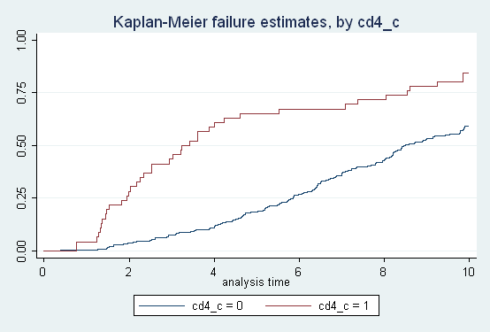
Risk Ratio in a Cohort with Censoring
CD4 = low
Cumulative incidence of AIDS
CD4 = high
Choose a time point for comparing two cumulative incidences:
At 6 years, % with AIDS in low CD4 group = 0.70 and in high CD4 group = 0.26. Risk ratio at 6 years = 0.70/0.26 = 2.69
Notes:
As we have pointed out frequently, however, complete follow-up in a cohort is not common. Instead, most cohorts have differing amounts of follow-up time on the participants and the risk of the event has to be estimated in the exposed and unexposed group using a method like the Kaplan-Meier or the lifetable or the Aalen-Johansen estimator. When we form a risk ratio, we are working with cumulative incidences, and we have to be referring to a specific point in time. As you can see from inspecting the curve, the risk ratio will be different for different points in time. If one point in time is selected, then the risk ratio becomes the ratio of the two proportions failing at that point in time. Once again, in reporting Kaplan-Meier results (or any estimate of cumulative incidence) you must always specify at what amount of follow-up time. This applies to anything we might do with cumulative incidence, such as creating a risk ratio.

Slide 70
Describing a Risk Ratio > 1 (e.g., risk ratio = 2.7)
* “Those in the low CD4 group are 2.7 times as likely to develop AIDS over 6 years than those in the high CD4 group.”
“There is a 2.7-fold higher risk of developing AIDS among those in the low CD4 group compared to the high CD4 group over 6 years of follow-up.”
“A low CD4 count is associated with a higher risk of developing AIDS compared with a high CD4 count over 6 years (risk ratio = 2.7).” (does not help the layperson)
Notes:
The preferred description is the first one, but we would consider the other two acceptable. Note that some may object to the second bullet based on a concern that it doesn’t distinguish clearly between the risk ratio and risk difference.

Slide 71
Clinical trial originally designed for 3.5 years, extended by DSMB
Risk Ratio: 1yr= 0.85 2yr=0.82 End=0.78
Notes:
To illustrate how risk ratios can be calculated at different points in time in a cohort study, we have taken the example of this clinical trial of treatment with an ACE inhibitor vs placebo to prevent cardiovascular events and death. The trial was originally planned for 3.5 years, but the DSMB recommended before that time point was reached (without knowing how the drug was performing) that the trial be extended to 5 years because it was clear that the event rate for the composite endpoint of MI, stroke, or death from CVD causes was lower than the estimate used for planning the trial. The trial went beyond 3.5 years but was stopped short of 5 years based on separation of the incidence rates in the treated and placebo groups. The abstract reports only the risk ratio at the end of the trial, risk ratio =0.78. In the text, they also report risk ratios for 1 and 2 years of follow-up. The risk ratio does change over time, as is clear from the figure; the gap between the treatment and placebo steadily widens with increasing follow-up time. The difference reached statistical significance at 2 yrs but would not have been significant at 1 yr.
Yusuf, et al. N Engl J Med 2000;342:145-53.

Slide 72
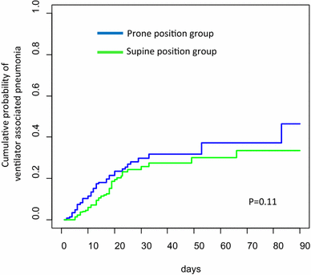
Cumulative incidence of VAP in ARDS:
Aalen-Johansen to account for CE of mortality
Risk ratio at 30 days = 0.28/0.23 = 1.2
Patients with Acute Respiratory Distress Syndrome
Notes:
This is an example of a cumulative incidence curve based on the Aalen-Johansen estimator and an estimate of a risk ratio at 30 days. The study was conducted among patients hospitalized with ARDS (Acute Respiratory Distress Syndrome) to determine the effect of prone versus supine position on the incidence of ventilator-associated pneumonia (VAP). The A-J estimator was used in this study to take into account the competing event (competing risk) of death.
From the Methods: “In order to analyze the impact of prone positioning on the risk of VAP taking into account the competing risk corresponding to death, the cumulative probabilities of VAP were estimated for each position group using the Aalen–Johansen estimator.”
Ayzac et al. Ventilator-associated pneumonia in ARDS patients: the impact of prone positioning. A secondary analysis of the PROSEVA trial. Intensive Care Med 42:871–878, 2016.

Slide 73
Describing a Risk Ratio < 1 (e.g., risk ratio = 0.78)
* “Those assigned to ramipril were 0.78 times as likely to have developed the composite outcome over 5 yrs than those assigned to placebo.”
“Being assigned to ramipril is associated with a lower risk of the composite outcome over 5 yrs compared with being assigned to placebo (Risk Ratio = 0.78).”
Avoid: “Those assigned to ramipril have 22% less risk of the composite outcome over 5 yrs than those assigned to placebo.”
  - Could be misinterpreted as the difference in risk between the two groups. In this example the difference is: 0.15 in ramipril – 0.19 in placebo = -0.04 (i.e. favoring ramipril)
Notes:
This is to describe, in words, a risk ratio less than 1.

Slide 74
Measures of Association – Cohort Studies
Metric | Ratio (often easiest to assess strength of association) | Difference (for public health impact, especially of interventions)
Cumulative incidence | Risk ratio | Risk difference
Average incidence rate | Rate ratio | Rate difference
Instantaneous incidence rate | Hazard ratio | Hazard difference
Scale
Notes:
This schematic shows the ratio and difference measures that can be calculated from cohort data. Let’s now focus on the average incidence rate and its ratio measure, incidence rate ratio, or “rate ratio”.

Slide 75
(Incidence) Rate ratio:
Comparison of “average” incidence rates
Ratio of two person-time rates
  NB: denominators of two person-time rates must be in the same units
  Stata code: strate exposure_variable
e.g., NSAIDS & Outcome of CHD death or MI
Rate NSAID use = 12.02 per 1000 person-years
Rate for non use = 11.86 per 1000 person-years
Rate ratio = 12.02/11.86 = 1.01
Ray Lancet 2002
Notes:
This is the example we looked at earlier when we were discussing forming incidence rates in a cohort with a time-varying exposure, in this case use of non-steroidal anti-inflammatory medications (NSAIDS). The basic measure of association reported was the rate ratio, the event rate during the person-time of NSAID use divided by the rate during the person-time of no use. A rate ratio is simply the ratio of two rates and thus is the analogue of the risk ratio for person-time measures of incidence. It should be clear that an incidence rate should not be compared to cumulative incidence: a ratio using one of each type of incidence measure would not be interpretable. In comparing two incidence rates, the important thing to remember is that the time units of the two measures forming the ratio must be the same. In the example above, if the first rate were per 100 person-years and the second remained per 1,000 person-years, the rate ratio would jump up to 10.1, and it would appear there was a strong association when there was, in fact, no association.
The authors correctly reported their measure of association as a rate ratio. They could have also reported a rate difference if they had chosen. It was very small, 0.16 per 1,000 person-years or 1.6 per 10,000 person-years.

Slide 76
NSAID use and CHD
Background We did an observational study to measure the effects of NSAIDs, including naproxen, on risk of serious coronary heart disease.
Methods We used data from the Tennessee Medicaid programme obtained between Jan 1, 1987, and Dec 31, 1998, to identify a cohort of new NSAID users (n=181 441) and an equal number of non-users, matched for age, sex, and date NSAID use began. The study endpoint was hospital admission for acute myocardial infarction or death from coronary heart disease.
Findings During 532 634 person-years of follow-up, 6362 cases of serious coronary heart disease occurred, or 11·9 per 1000 person-years. Multivariate-adjusted rate ratios for current and former use of NSAIDs were 1·05 (95% CI 0·97–1·14) and 1·02 (0·97–1·08), respectively.
Described as “rate ratio.” “Incidence rate ratio” (IRR) also acceptable
Notes:
Below is the language from the paper describing the regression model, Poisson regression, for estimating the “multivariate-adjusted rate ratios.”
Statistical analysis
Estimates of rate ratios adjusted for potential differences between current NANSAID users were calculated from Poisson regression models. Covariates in the model, defined at t0, included age, sex, race, residence in Standard Metropolitan Statistical Area, calendar year of t0, time elapsed since t0, reason for Medicaid enrolment (aged, disabled or blind, or uninsured, a group that became eligible under a special program initiated in Tennessee in 1994),15 coronary-artery-disease risk score, replacement estrogen use (in women), non-cardiovascular hospital admissions, and absence of regular physician care (fewer than two visits).

Slide 77
Describing a Rate Ratio > 1 (e.g., rate ratio = 1.5)
* “Those who are exposed have 1.5 times the rate of the outcome as those who are not exposed.”
* “Rate of the outcome in the exposed is 1.5 times as high as the unexposed.”
“There is a 1.5-fold higher rate of the outcome among exposed compared to unexposed.”
“Being exposed is associated with a higher rate of the outcome compared with being unexposed (Rate Ratio = 1.5).”
“Those who are exposed have a 50% higher rate of the outcome than those who are not exposed.” - With rates, not likely to misinterpret a % as the difference in rate between the two groups. This is unless reader does not understand rates.
Avoid: “Those who are exposed are 1.5 times more likely to get the outcome than those who are unexposed.” (this sounds like a risk)
Notes:
We provide two preferred descriptions for a rate ratio greater than one. The description in the third bullet is acceptable although some my object that it is not clearly describing rate ratio rather than rate difference. Note that the description should not include “more likely” or similar terms that imply a comparison of risks rather than rates.

Slide 78
Describing a Rate Ratio < 1 (e.g., rate ratio = 0.7)
* “Those who are exposed have 0.7 times the rate of the outcome as those who are not exposed.”
* “The exposed have a 30% lower rate of the outcome than the unexposed.”
  - With rates, not likely to misinterpret a % as the difference in rate between the two groups.
“Being exposed is associated with a lower rate of the outcome compared with being unexposed (Rate Ratio = 0.7).”
Avoid: “Being exposed is associated with a lower risk of the outcome…”

Slide 79
Measures of Association – Cohort Studies
Metric | Ratio (often easiest to assess strength of association) | Difference (for public health impact, especially of interventions)
Cumulative incidence | Risk ratio | Risk difference
Average incidence rate | Rate ratio | Rate difference
Instantaneous incidence rate | Hazard ratio | Hazard difference
Scale
Notes:
This schematic shows the ratio and difference measures that can be calculated from cohort data. Now, the hazard ratio.

Slide 80
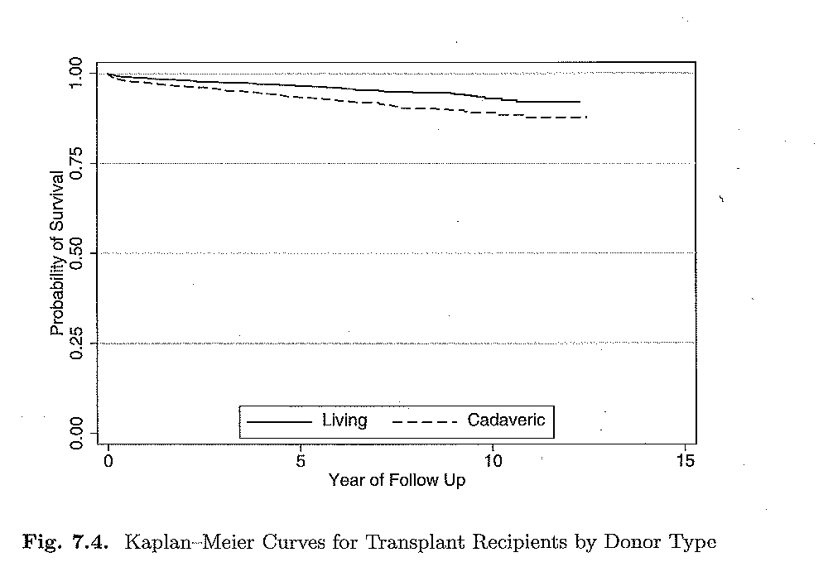
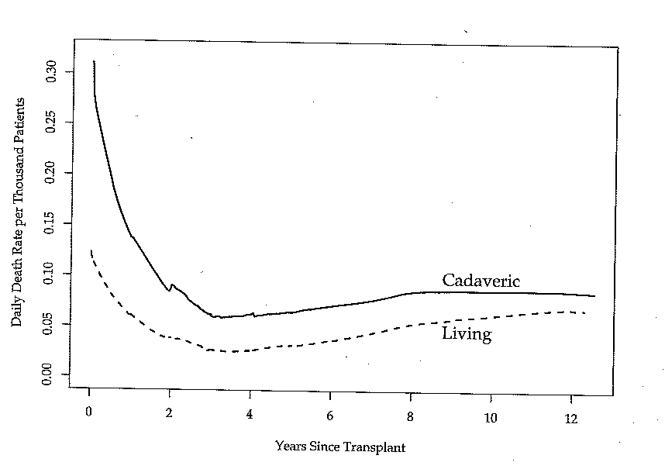
Example: Mortality after pediatric kidney transplant, stratified by donor type
How to compare hazards in 2 groups?
Survival curves
Hazard functions
From proportional hazards regression: hazard ratio = 2.06
Requires extensive math and computer calculation – averages ratio of hazards at many points in time
Vittinghoff et al. Regression Methods in Biostatistics 2012
Notes:
Here is an example from a study of mortality after pediatric kidney transplant, comparing survival in children who received a kidney from a living versus a recently deceased donor. As we saw in the lecture on disease occurrence, we can generate a smoothed hazard function from a dataset with survival data (or “time to event” data). This slide shows the survival curves and smoothed hazard functions for the two exposure levels in this study (living versus cadaveric donor). From the graphs, we can see that the survival is better in the group that received a kidney from a living donor. We have 2 broad ways to measure disease occurrence in this cohort study: cumulative incidence and incidence rate. With cumulative incidence we could calculate a risk ratio for living vs cadaveric donor. But, how would we calculate a ratio of hazards? We could use the average incidence rate for the time period of the study, but we can see from the smoothed hazard function that the rate changes over time. The ratio of average incidence rates might be misleading. So, it is better to compare the hazards (the collection of instantaneous incidence rates) at each point in time, such as each red line on the graph (but you would do this for all points in time with sophisticated math). This can be done with the proportional hazards mathematical regression model, which, in brief, forms a weighted average of the ratio of hazards over time. You cannot do this manually. You need some mathematical shortcuts and a computer to assist. This regression model is currently the “workhorse” for analysis of longitudinal studies that have individual-level “time to event” data. We do not go into any detail about this (or other) statistical models in this course, but you will learn more about proportional hazards in your Biostatistics courses. Our goal here is for you to be aware that this mathematical model provides a type of rate ratio – a hazard ratio - for analysis of disease associations in cohort studies.

Slide 81
Proportional hazards regression
Proportional hazards model compares hazards in the exposed and unexposed (or more than 2 groups)
Result is a type of rate ratio and is reported as a “hazard ratio” (or sometimes “rate ratio”)
Like logistic regression, it is another type of regression model that can adjust for confounding
Hazard ratio requires mathematical equations and computer to estimate, even for unadjusted models.
  Proportional hazards regression is one such mathematical regression but there are others
Notes:
Hazard ratios are derived by a mathematical model, the most popular of which is the proportional hazards regression model.
While we can calculate the result of an unadjusted odds ratio by hand, that is not feasible for the hazard ratio. Even without the presence of confounding, a sophisticated mathematical process is needed to calculate the hazard ratio. As we saw in last week’s lecture, the hazard is an instantaneous rate that cannot be calculated by hand from a simple formula. Rather, a plot of the hazard rate had to be done with computer-based modeling to generate a smoothed hazard function curve. The hazard ratio is a ratio of instantaneous rates and therefore requires sophisticated mathematical modeling to derive. Most often, the Cox proportional hazards model is used to derive the hazard ratio but other regression models (e.g., Weibull regression) can also be used to estimate the hazard ratio. Whatever method is used to estimate the hazard ratio, the key point here is that it has to be derived via sophisticated math from the data and cannot be directly hand calculated.

Slide 82
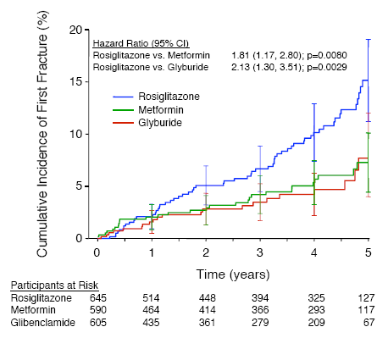
Hazard Ratio Reported
Risk ratio can only evaluate one point in time;
hazard ratio averages across all time
Notes:
Figure1—Kaplan-Meier estimates of the cumulative incidence of fractures at 5 years in women. Bars represent 95% CIs. (Kahn et al. 2008 Diabetes Care 31:348-51)
Example of hazard ratio as measure of disease association. Plot shows cumulative incidence of first fracture, but measure of disease association reported is not the risk ratio (of cumulative incidence). It is the hazard ratio for first fracture, comparing rosiglitazone to metformin (HR = 1.81) and then to glyburide (HR = 2.13).
A risk ratio can only evaluate one point in time. On the other hand, a hazard ratio averages across all time.

Slide 83
Describing a Hazard Ratio > 1 (e.g., HR = 1.8)
* “Those in the rosiglitazone group had 1.8 times the rate (hazard) of 1st fracture as those in the metformin group.”
* “Rate (hazard) of 1st fracture in the rosiglitazone group is 1.8 times as high as in the metformin group.”
“There is a 1.8 fold higher rate (hazard) of 1st fracture among those assigned to rosiglitazone compared to those assigned to metformin.”
“Assignment to rosiglitazone is associated with a higher rate (hazard) of 1st fracture compared with assignment to metformin (Hazard Ratio = 1.8).”
“Those in the rosiglitazone group have 80% higher rate of 1st fracture than those in the metformin group.”
Avoid: “Those in the rosiglitazone group are 1.8 times more likely to get a 1st fracture…”
Notes:
The preferred descriptions for the hazard ratio are similar to those for the incidence rate ratio, discussed a few slides earlier. We provide two preferred descriptions for a hazard ratio greater than one.
We prefer to use the term “rate” as opposed to hazard because it is more generally understood. A hazard is a special form of a rate.
The description in the third bullet is acceptable although some my object that it is not clearly describing rate ratio rather than rate difference. Note that the description should not include “more likely” or similar terms that imply a comparison of risks rather than rates.

Slide 84
Describing a Hazard Ratio < 1 (e.g., HR = 0.7)
* “Those who are exposed have 0.7 times the rate (hazard) of the outcome as those who are not exposed.”
* “The exposed have a 30% lower rate (hazard) of the outcome than the unexposed.”
“Being exposed is associated with a lower rate (hazard) of the outcome compared with being unexposed (Hazard Ratio = 0.7).”
Avoid: “The exposed have 30% lower risk of the outcome than the unexposed.”

Slide 85
Risk ratio vs. Rate ratio
Risk must be between 0 and 1
  Places a ceiling on risk ratio
  Thus in comparing 2 groups, high risk in unexposed group limits how large ratio can be
  e.g., risk in unexposed group = 0.7 means maximum risk ratio = 1.0/0.7 = 1.42
Rates are not restricted between 0 and 1
Example
  If exposed rate = 10/100 person-years and unexposed rate = 5/100 person-years, risk (cumulative incidence) in 2 groups after 20 years = 0.88 and 0.64.
  risk ratio would be 0.88/0.64 = 1.38
  but rate ratio = 10/5 = 2.0
Notes:
An important difference between cumulative incidence (=risk) and incidence rates is that the constraint placed on risk because it is a proportion and therefore bounded by 0 and 1. This does not apply to rates which can be greater than 1. When the ratio of two proportions is formed (risk ratio), the constraint on proportions also constrains the possible values of the ratio. As the proportion rises in the group with the smaller proportion (say, the unexposed group), a maximum risk ratio value is imposed. For example, if the cumulative incidence is 0.33 in the unexposed group, the maximum risk ratio is 3 (1.0/0.33); if it is 0.50, the maximum risk ratio is 2 (1.0/0.5); and if it is greater than 0.50, as in the example above, the risk ratio must be < 2.0. The rate ratio is not limited in the same way.

Slide 86
Risk Ratio vs. Rate Ratio
In preceding example of risk ratio (at 20 years) = 1.38 and rate ratio = 2.0, which would you report?
Are the two ratios telling you something different?
Notes:
It would be perfectly legitimate to report either ratio, or even both, but your choice would depend on your research question and what you were trying to emphasize. The two measures are telling you something different even though they use the same data.
Before we answer this question, let’s look more carefully at risk ratio versus rate ratio.

Slide 87
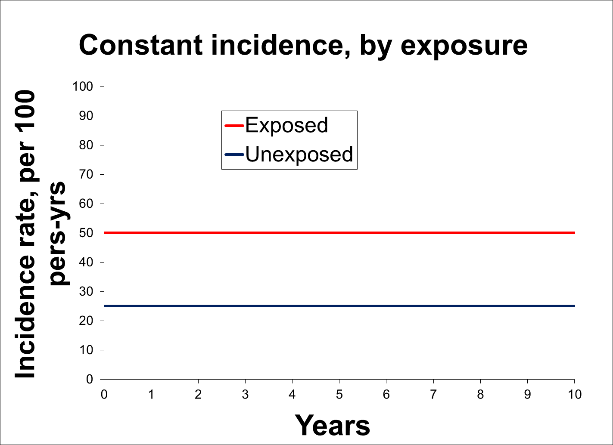
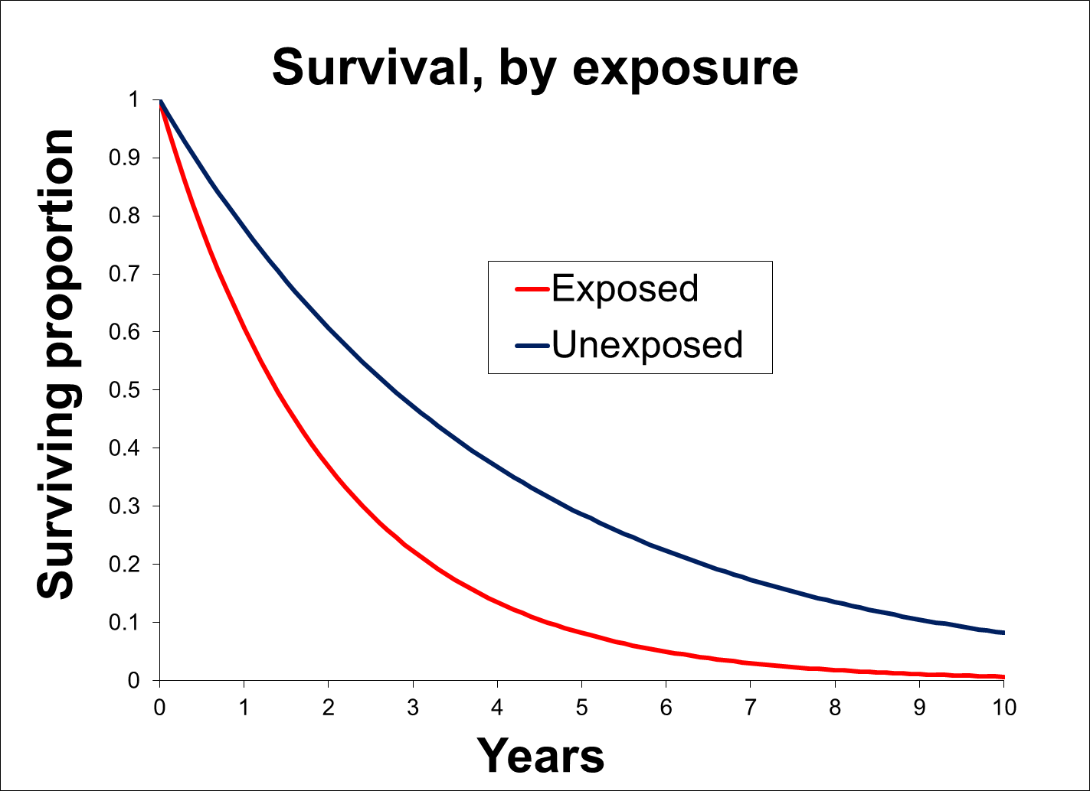
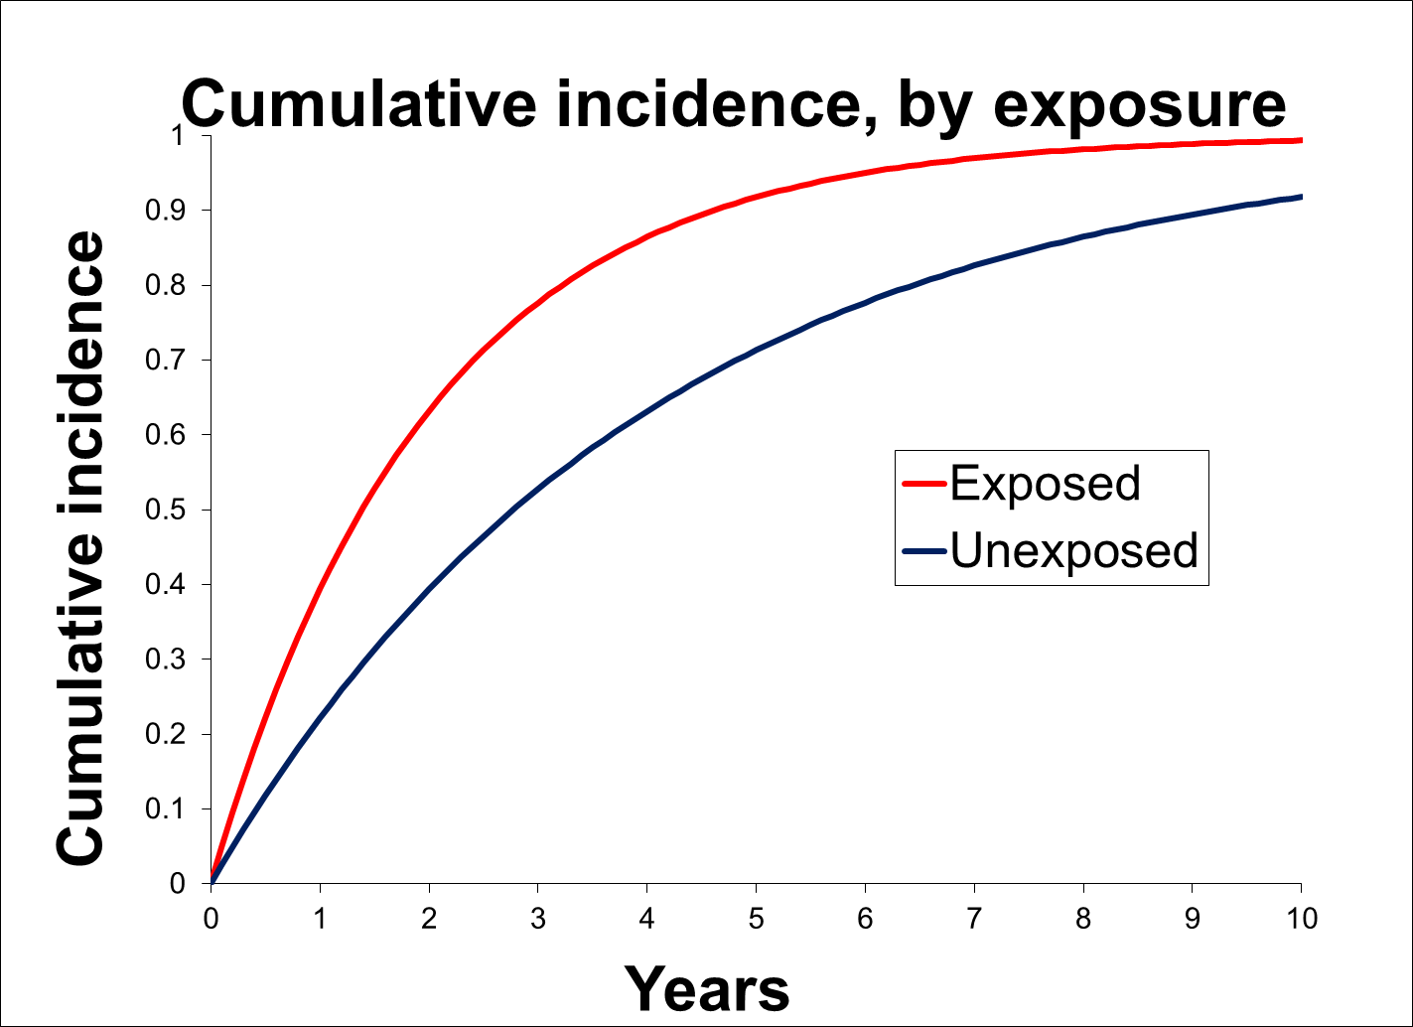
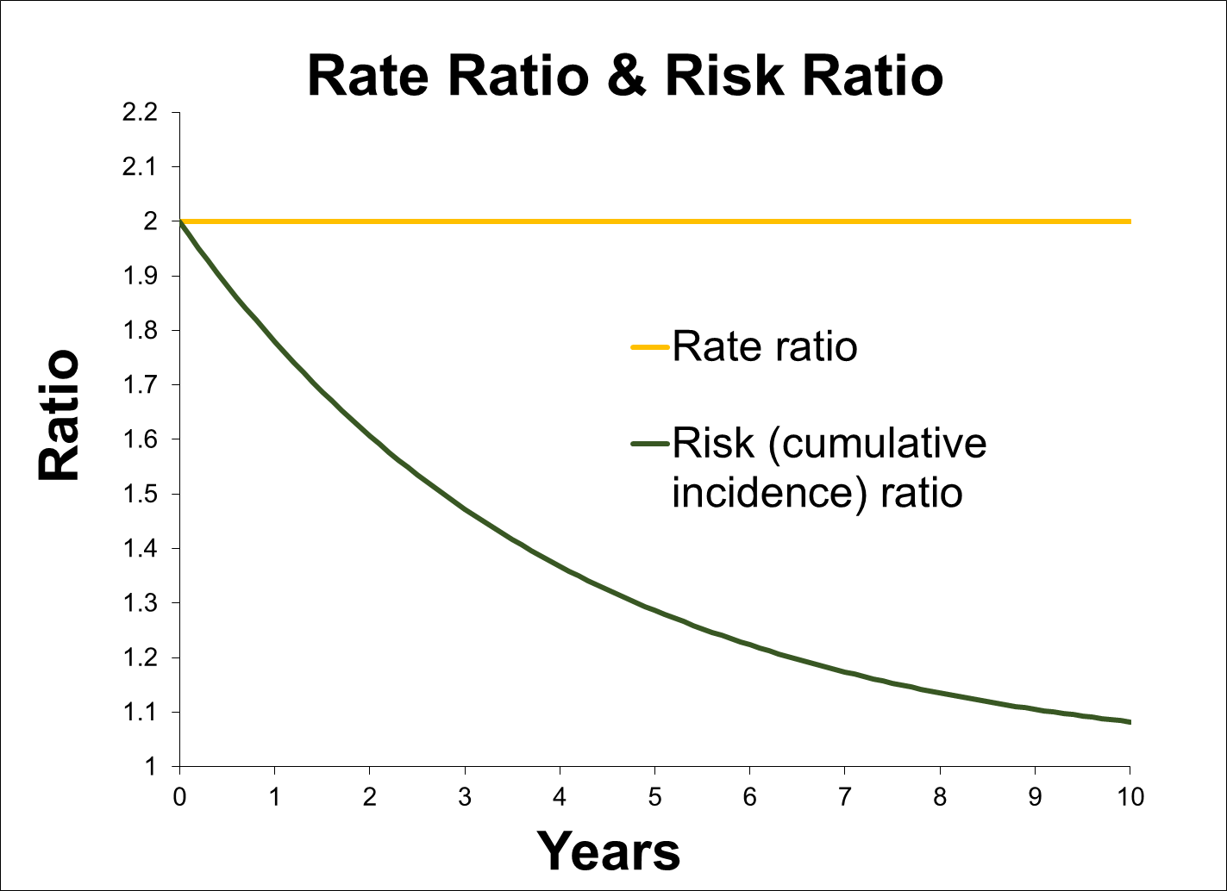
Risk Ratio and Rate Ratio with constant incidence rate
Exposed = 50 per 100 pers-yr; Unexposed = 25 per 100 pers-yr
Notes:
To illustrate the difference between risk ratio and rate ratio, this is an example with constant incident rates in the exposed and unexposed groups, shown in the upper left graph. The upper right-hand graph shows the cumulative survival curves in the two exposure groups for these constant incidence rates. These are like the graphs that we showed you in our previous lecture on disease occurrence, showing that cumulative incidence has an exponential curve when a constant incidence rate is “applied” to a closed (fixed) cohort. We can also show the cumulative incidence curve (lower left-hand graph) with the proportion who have experienced the event.
The last graph (lower right-hand) shows the rate ratio and risk ratio. The rate ratio, calculated from the two constant incidence rates, is a constant 2.0 (0.5/0.25) throughout the 10-year study. The risk ratio is calculated from the two cumulative incidences of the event, shown in the failure curve. The risk ratio decreases throughout the study and is less than the rate ratio.

Slide 88
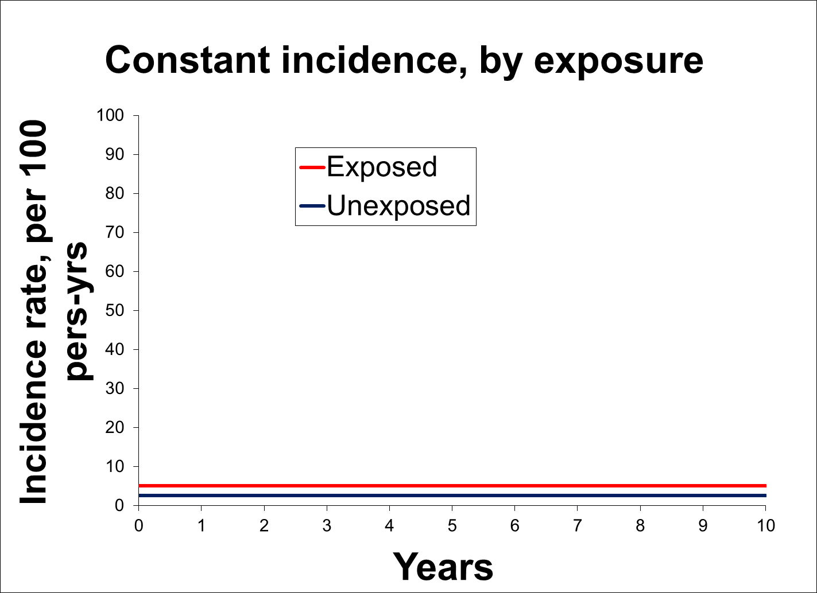
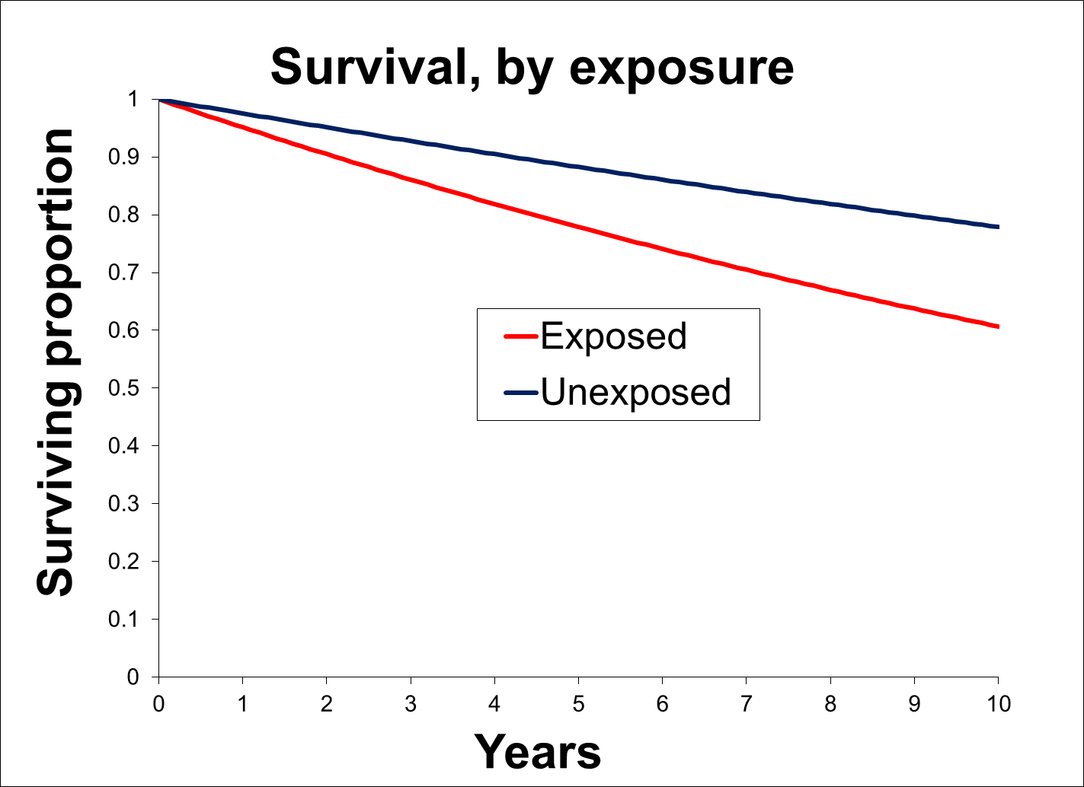
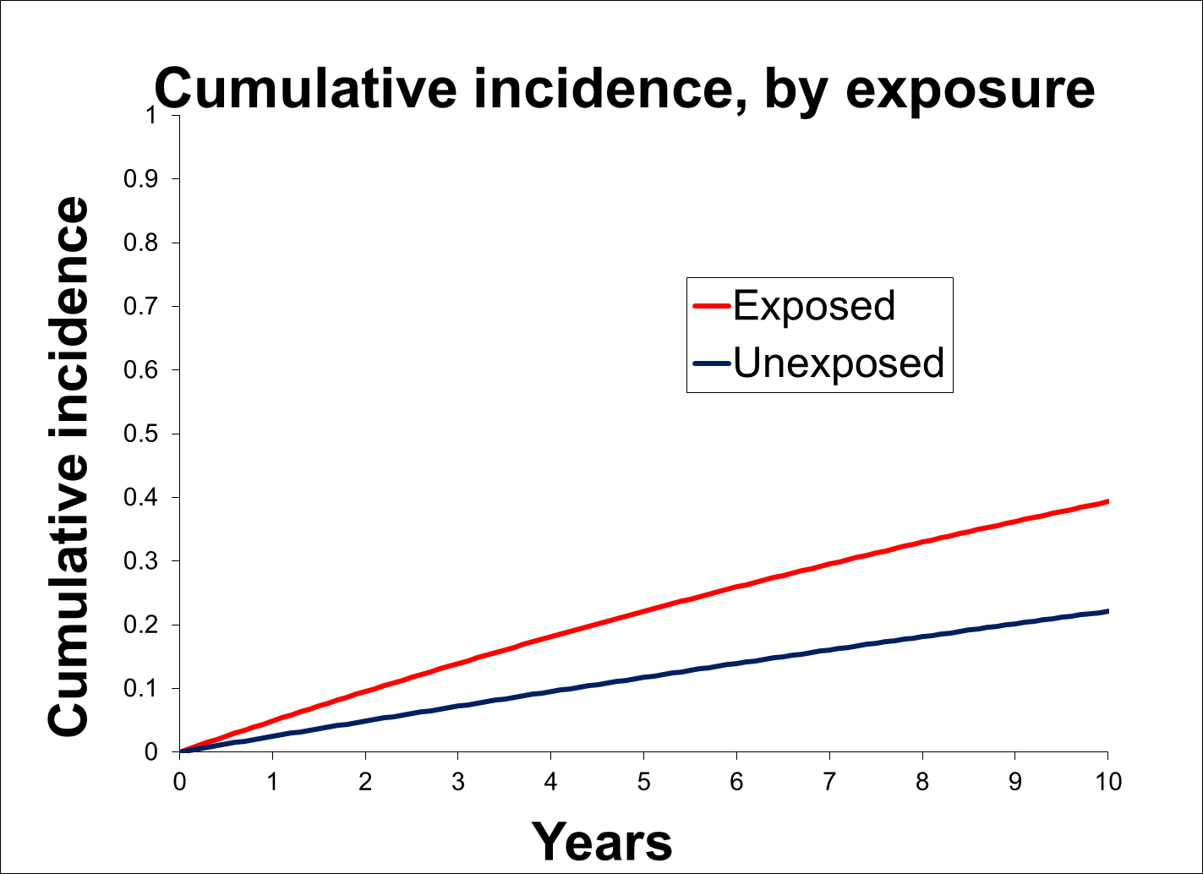
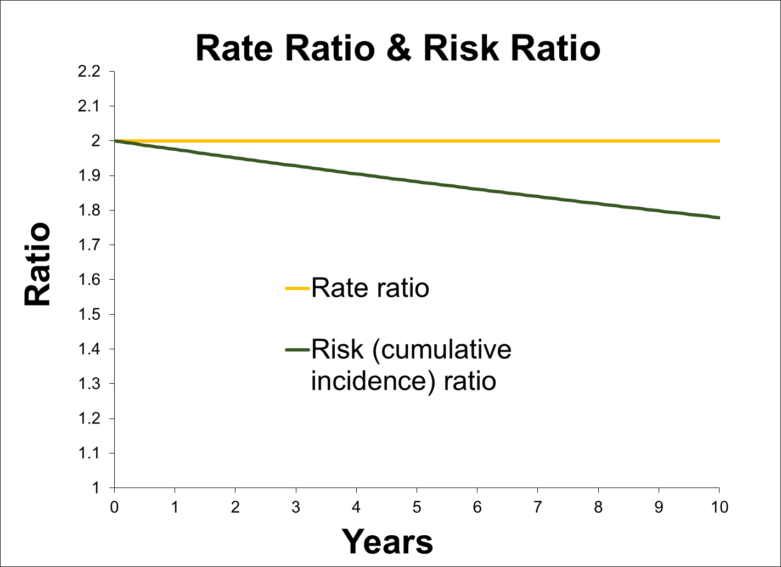
Risk Ratio and Rate Ratio with lower incidence rate
Exposed = 5.0 per 100 pers-yr; Unexposed = 2.5 per 100 pers-yr
Notes:
This illustrates that the difference between the rate ratio and risk ratio is smaller for an outcome with a lower incidence. These are the same plots (with same scale) as the previous slide, also with constant incidence rates, but now the rates are much lower (5 per 100 person-years in the exposed compared with 50 per 100 person years in the previous slide). The rate ratio is the same: 2.0 (0.05/0.025). And the risk ratio is still less than the rate ratio throughout the follow-up, but the difference is much less.

Slide 89
Risk Ratio vs. Rate Ratio
Risk ratio (aka cumulative incidence ratio)
  Compares probability of outcome, by exposure, at a certain time
  Compares whether outcome occurs by a certain time, but not how fast (in exposed versus unexposed)
  Best to use when it only matters “if” an event has occurred, not “when”; i.e., when speed to the event does not matter
    Note: Very often speed does matter in biomedical conditions
Rate ratio (or hazard ratio)
  Compares when and how fast outcome occurs, by exposure status
  Preserves the relative “force” of exposure on disease outcome.
  Rates are more fundamental measure of disease occurrence.
  Best to use when timing of event is important (“when” > “if”)
  Often, more interpretable for etiologic research
Notes:
More generally, when should you report a risk ratio versus a rate ratio? You would prefer the risk ratio if your emphasis is on how different the probability of the disease is for an exposed and an unexposed population at some certain time. This would be the case if you just cared about the bottom line – what percentages of exposed vs unexposed persons get the disease by a certain point – but you don’t care about how fast this occurred. This is often the case in prediction research and when it is not harmful to have the event in question for some prolonged period of time. An example might be prediction of who gets a flu shot at the beginning of flu season. Let’s say that a campaign to immunize people starts in August and the flu season starts on October 15. You might be interested in predicting who gets vaccinated by October 1 because it does not matter, from a health perspective, if people get vaccinated shortly after the campaign starts or on October 1 because all such vaccinated people will be in good shape once flu season starts on October 15.
If instead, your emphasis is on whether the exposure is causally responsible for the disease, the rate ratio would be preferable because it communicates the larger force on disease occurrence of being exposed compared to being unexposed. This illustrates why we refer to the rate as the more fundamental measure of disease occurrence. When we form ratio (relative) measures with rates, it is not subject to the artifact of the ceiling effect that we saw earlier with ratio measures of two proportions. (Additional note: there are other more advanced methods for causal research that employ other measures of association, such as pooled logistic regression that are used in marginal structural models. Thus, rate ratios are not the only measures of association that can be used for etiologic inference.)

Slide 90
Risk Ratio vs Rate Ratio for etiologic vs prediction research
Being exposed undoubtedly influencing occurrence of event
Rate ratio -- taken at any time -- shows this, but, in latter years, risk ratio shows only very small effect
But, if goal is simply to predict who gets the event by 10 years, then risk ratio is more telling than rate ratio
Notes:
Returning to our question of whether to report a rate ratio or a risk ratio, this illustration shows an exposure that is clearly influencing the occurrence of the outcome of interest. The incidence rate of the outcome is consistently higher in the exposed, shown in upper left. The rate ratio reflects this throughout the follow-up time of 10 years. At every time point, it is 2.0. In contrast, the cumulative incidence curves start to converge in the latter years of follow-up (lower left), and the resulting risk ratio shows only a small effect of the exposure in latter years as the risk ratio becomes close to 1.0. Thus, if the goal is to predict who will get the event by 10 years, then the risk ratio is more useful than the rate ratio, but the risk ratio at 10 years would miss the greater influence of exposure on the underlying rate of disease.

Slide 91
If regression-based adjustment for confounding (etc.) is needed
Cross-sectional design
Ratio Measure Desired | Regression Model to Use
prevalence ratio | log binomial or Poisson (with robust variance) logistic with marginal standardization (Stata margins command)
prevalence odds ratio | logistic
Notes:
Thus far, we have discussed estimating measures of association comparing exposed to unexposed individuals but without the need for any adjustment for any other factors. Although we have not gotten this far in the class, it is often the case that we wish to adjust for other variables, either to control for confounding, to evaluate for interaction or medication, or to improve statistical precision.
For your reference, this table and the next list the commonly used regression models to calculate each of the ratio measures of association we have discussed when you have to adjust for multiple factors. Shown here are techniques that can be used for cross-sectional designs. Again, just as we made a big pitch for prevalence ratios before, we will make a big pitch again here in the context of regression. The articles by Peter Cummings in the optional reading for this tell you exactly how to do this in Stata.
Again, we have not covered confounding formally yet, and we won’t be explaining these statistical regression models in the course, but even without this, it is important to begin to associate the measures of association that you desire with different regression models that produce adjusted forms of them. We will say much more about confounding and adjustment by means of stratification later in the course. Hence, we mention this now for completeness such that you know what the names for the techniques to get at the desired ratio measures that we have been discussing.

Slide 92
If regression-based adjustment for confounding (etc.) is needed
Cohort design: Some commonly used regression techniques
 | Competing Events Present |  | Competing Events Absent
 | Goal |  | Goal
 | Causation | Prediction | Causation | Prediction
Not all persons have complete follow-up | Proportional hazards (PH) -> HR; Poisson or negative binomial -> IRR; Pooled logistic -> IOR | Fine-Gray modification of PH -> sub-distribution HR | PH -> HR; Poisson or negative binomial -> IRR; Pooled logistic -> IOR | PH -> risk ratio (after some manipulation)
Everyone has complete follow-up | PH -> HR; Poisson or negative binomial -> IRR; Pooled logistic -> IOR | Log-binomial-> risk ratio; Poisson -> risk ratio; Logistic -> IOR | PH -> HR; Poisson or negative binomial -> IRR; Pooled logistic -> IOR | Log-binomial-> risk ratio; Poisson -> risk ratio; Logistic -> IOR
HR = hazard ratio; IRR = incidence rate ratio; IOR = incidence odds ratio
Notes:
For your reference, here is the list for measures of association that can be cohort studies with various regression techniques. Here, things get more complicated, but this should not be surprising because a lot more is going on with cohort studies in terms of censoring (either by drop-out or administrative censoring) and competing events.
Our main point with this slide is that you now have the tools to consider which regression model you want to use for analysis of study results. You likely do not know how to perform the regression technique, but this will come later in other courses. The factors to take into account are study design, goal of the research question (causation versus prediction), the measures of association you want to get, whether you have competing events, and complete versus differing follow-up times.
A key element to remember here is to be sure what your research question is. Is it one of etiology/causation or is it one of prediction? One common error in the literature is that when competing events are present researchers often reflexively grab for the Fine and Gray modification of the proportional hazards regression technique. We want to emphasize that Fine and Gray is appropriate for when prediction (did the event happen or not but not how fast or by what mechanism) is the goal. If competing events are present and etiologic questions are being asked, the conventional proportional hazards model, which will produce cause-specific hazard ratios, is the one to use. Note: there will be issues of potential selection bias caused by the competing events, but these need to be dealt with by techniques other than a different regression model.

Slide 93
Measures of Association – Cohort Studies
Metric | Ratio (often easiest to assess strength of association) | Difference (for public health impact, especially of interventions)
Cumulative incidence | Risk ratio | Risk difference
Average incidence rate | Rate ratio | Rate difference
Instantaneous incidence rate | Hazard ratio | Hazard difference
Scale
Notes:
Recall that when we introduced measures of association in cohort studies, we pointed out that in addition to ratio measures, there are also difference measures, i.e. on the absolute or additive scale.

Slide 94
Difference vs. Ratio Measures
Two basic ways to compare measures of occurrence:
  ratio: form a ratio of one over the other
    A “relative” measure; ratio or multiplicative scale
  difference: subtract one from the other
    An “absolute” measure; absolute or additive scale
Can take the difference of either an incidence or a prevalence measure (but rarely done with prevalence)
Example using incidence: cumulative incidence 26% in exposed and 15% in unexposed over 2 yrs
  risk difference = 26% - 15% = +11%
  risk ratio = 0.26 / 0.15 = 1.7
Notes:
Although comparing two measures of disease occurrence by a ratio or by a difference uses the same numbers, they convey different information and are used for different purposes. Risk difference is often called an “absolute measure,” as it conveys how much the one group differs from the other in the scale of 0 to 100%. A ratio measure is known as a “relative measure” since it is telling you how large the incidence is in one group relative to the other and tells you nothing about the absolute difference between them. For example, a risk ratio of 2.0 could be obtained by a cumulative incidence of 4% versus 2%, 20% versus 10%, 80% versus 40% and many other combinations.

Slide 95
Difference/Absolute/Additive Scale
Measures of Association
 |  | Measure of association
Cross-sectional |  | prevalence difference*
 |  | prevalence odds difference*
Cohort |  | risk difference
 |  | rate difference
 |  | hazard difference* incidence odds difference*
Case-control |  | Next week: none available
*rarely used
Notes:
Difference measures are also sometimes called absolute scale or additive scale measures. Again, the type of study design limits the kind of difference measure that can be calculated. This table formally shows which difference measures can be derived from the different study designs. While this is the formal list, the measures with asterisks are rarely used. Difference measures are primarily used for risks and rates and in the context of cohorts.
Note also that cohort studies can yield all of the prevalence measures (could be done at time zero or at any later time) in addition to the incidence measures. It is most common to see prevalence measures taken at time 0 of a fixed cohort.

Slide 96
Example of Absolute vs. Relative Measure of Risk
 | TB recurrence over 1 yr
Treated: | Yes | No | Total
> 6 mos | 14 | 986 | 1000
< 3 mos | 40 | 960 | 1000
Risk ratio = 0.040/0.014 = 2.9 Risk difference = 0.040 – 0.014 = 2.6%
*Complete 1-yr follow-up with no drop-out or non-TB deaths
If incidence is very low, ratio measure
can be large but difference measure small
Notes:
A ratio of about 3 seems to be telling us that treating more than 3 months does make a big difference. Most observers consider a ratio measure of 3 to be reasonably “strong”. However, because TB recurrence is a relatively rare event in treated patients, the absolute difference of 2.6%, and this value is not so impressive to most humans. Which one should we use?

Slide 97
Why use difference vs. ratio measures?
Difference measures give an absolute measure of association between exposure & outcome
  public health implication is clearer because communicated in terms of actual numbers of people:
    e.g., how many cases of disease (i.e., no. of people) might be prevented if exposure is eliminated?
  particularly useful for studies of interventions
  useful for interpretation of interaction [later in course]
Ratio measures gives a relative measure
  traditionally felt to give a better sense of strength of an association for investigation of causality/etiology
  but, in fact, not intrinsically better for this purpose (see Optional Reading by Poole)
Notes:
Difference or absolute measures are relevant because they communicate the relationship between exposure and outcome in terms of actual numbers of people. We therefore say that these absolute measures are best suited to depict the public health or clinical impact of an exposure on disease. For example, how many patients would we have to treat to prevent one case of disease? Shortly, we will look at an application of this feature known as the number needed to treat. This is particularly useful for modifiable exposures, and especially for interventions. We will also find out later in the course that the absolute or additive scale is also the best scale to evaluate most concepts of interaction.
Ratio measures provide a relative measure of comparison between groups of exposure. Traditionally, the ratio scale has been felt to the best way to assess the strength of association between exposure and outcome. The strength of association is one of the criteria considered in assessing causality in the relationship between an exposure and a disease. The rationale is that relationships that are quantitatively stronger are less apt to be caused by bias and are more apt to be real causal relationships. The origins of this traditional thinking go back to a sentinel article by Cornfield in 1959 and only recently has been challenged (see Poole in the Optional Reading). As Poole points out, there actually isn’t anything intrinsically special about the ratio scale that makes it better for assessing causal relationships. It is true that on any scale (additive or multiplicative), the larger the value the less apt it is to be caused by bias. However, it is not the case a large (i.e., strong) ratio measure has any special biologic or etiologic significance. In fact, as we will discuss next week, the magnitude of the association has more to do with complementary causes of an exposure than the exposure itself.

Slide 98
The Reciprocal of Difference Measures
(1/difference) Are Even More Interpretable
Depending on context, the reciprocal of risk difference is:
  Number needed to treat to prevent one case of disease
  Number needed to treat to harm one person (a side effect)
  Number needed to protect from exposure to prevent one case of disease
TB rifampin example: 1/0.026 = 38.5, means that you have to treat 38.5 persons for >6 months vs. <3 months to prevent one case of TB recurrence
Notes:
Taking the reciprocal of the difference measure is one of the most useful applications of the absolute difference measure. Depending on the scenario, you can calculate the number needed to treat to prevent one case of disease (e.g., “We need to treat 10 persons with new drug X to prevent 1 heart attack over a 10 year period of time”), number needed to treat to harm one person (e.g., “For every 1000 patients treated with drug Z, one additional side effect of bone marrow suppression occurred”), or number needed to protect from an exposure to prevent one case of disease (e.g. “For every 7 patients with exposure A whom we could change to being unexposed, we could prevent 1 case of lung cancer”). This is all done by taking the reciprocal of the risk difference.
From this relationship, one can also see how the absolute difference can be used in cost effectiveness analysis. For example, we might ask what are the cost implications of treating 38.5 persons an extra 3 months to prevent one case of TB. The answer will depend on the comparative cost of treating the 38.5 persons with rifampin versus the cost of managing and treating one case of TB. Those costs can be compiled and compared. Of course, the two costs may not be the only the consideration. In this example TB is a contagious disease and allowing one case of recurrence by under-treating could lead to additional infections and other cases of TB.

Slide 99
Example: Study reporting risk difference
Table 2. Return of spontaneous circulation according to intervention (among patients who suffered cardiac arrest)
Intervention | Return of Spontaneous Circulation | Risk Difference (95% CI) | p-value
Rapid Defibrillation (N=1391) | 12.9% | Reference | --
Advanced Life Support (N=4247) | 18.0% | +5.1% (3.0-7.2) | <0.001
Risk difference = 0.051; number needed to treat = 1/0.051 = 20
Stiel et al., NEJM 2004
Notes:
Here is an example of a study in the New England Journal of Medicine that reported risk differences rather than risk ratios. This shows one of their findings, the absolute increase in the percent of patients suffering cardiac arrest having a return to spontaneous circulation. Because this was an attempt to evaluate a public health intervention of making advanced life support available to the emergency responders for all such cases, the absolute percent of cases, rather than a ratio measure, was of primary interest. (If a risk ratio had been supplied, it would have been around 1.5.) Taking 1 over this difference gives a number needed to treat of 20. What this tells us is that treating 20 patients with advanced life support (as opposed rapid defibrillation alone) results in one additional person having a return to spontaneous circulation. Interpreting the 20 depends upon the context, i.e., how much it entails to implement the interventions (cost, effort, etc.) and what is the outcome. Treating 20 to save 1 life is not tremendous, but it is not bad. Obviously, a lower number would be better. The NNT is much easier to interpret than the risk ratio is for this context.

Slide 100
Example: Risk Difference
Objective: To evaluate the effectiveness and safety of screening colonoscopy to prevent colorectal cancer (CRC) in persons aged 70 to 74 and those aged 75 to 79 years.
Design: Large-scale, population-based, prospective study. The observational data were used to emulate a target trial with 2 groups: colonoscopy screening and no screening.
Participants: 1,355,692 Medicare beneficiaries (2004 to 2012) aged 70 to 79…
Results: In beneficiaries aged 70 to 74 years, the 8-year risk for CRC was 2.19% (95% CI, 2.00% to 2.37%) in the screening colonoscopy group and 2.62% (CI, 2.56% to 2.67%) in the no-screening group (absolute risk difference, 0.42% [CI, 0.24% to 0.63%]). Among those aged 75 to 79 years, the 8-year risk for CRC was 2.84% (CI, 2.54% to 3.13%) in the screening colonoscopy group and 2.97% (CI, 2.92% to 3.03%) in the no-screening group (risk difference, 0.14% [CI, 0.41 to 0.16]).
Conclusion: Screening colonoscopy may have had a modest benefit in preventing CRC in beneficiaries aged 70 to 74 years and a smaller benefit in older beneficiaries.
Garcıa-Albeniz et al. Ann Intern Med. 2017
Notes:
This is an example of an observational study that is reporting risk differences. Indeed, in this example risk differences are the main study outcome. The authors wish to convey an estimate of the effectiveness of screening colonoscopy in preventing CRC; the risk difference gives a clearer picture than a risk ratio of how much screening changes the risk of CRC (over 8 years) in each age group. Specifically, we can easily turn the risk differences into numbers needed to screen in order to assess the public health impact. (The numbers needed to screen are indeed large). Since this is an observational study and not a trial with screening randomly assigned, the determination that screening is causally related to the lower risk of CRC depends on our confidence that sources of bias have been eliminated (more on this in later lectures). Interestingly, these authors are explicit about their effort to emulate a target trial, an approach to study design that we also advocate. The authors used an appendix to their paper to describe this approach in detail. Here is the introduction to the Appendix:
APPENDIX: TECHNICAL DETAILS
As described in the main text, we emulated a hypothetical trial of colonoscopy screening—the target trial (25)—in the Medicare population. The eligibility criteria, treatment outcomes, start and end of follow-up, outcome, and statistical analysis of our target trial are described in the Methods section. In this Appendix, we provide a step-by-step description of our approach and describe its advantages. We start by specifying the target trial.
Garcıa-Albeniz et al. Effectiveness of Screening Colonoscopy to Prevent Colorectal Cancer Among Medicare Beneficiaries Aged 70 to 79 Years A Prospective Observational Study Ann Intern Med. 166:18-26, 2017.
Interestingly, the authors called this a prospective study in the title of their article, and the editors allowed them to get away with it. This study just analyzed patients in the U.S. Medicare program, using Medicare claims data. There was no dedicated prospective attention to measuring the exposure or the outcome, as most readers would think when reading a prospective study. The methodologic work is elegant, but it is hard to see why this should be called prospective. This again illustrates the meaningless nature of the terms these days.

Slide 101
Describing a difference
Example: Risk in exposed 0.9; in unexposed 0.7. Risk difference = 0.2. Over 2 yrs.
“The absolute difference in risk of the outcome over 2 yrs in the exposed compared with the unexposed was +0.2.”
“Over 2 yrs, the cumulative incidence in the exposed (0.9 or 90%) was 0.2 (or 20%) higher than the unexposed (0.7 or 70%).”
Number needed to prevent (NNP = 1/0.2 = 5)
  “Would need to change 5 persons from exposed to unexposed to prevent one case of disease over 2 years”
Notes:
In describing a risk or rate difference, clarify for your audience that you are describing a difference, not a ratio, measure of association. This can be done by using the phrase “absolute difference” in the description and/or by providing the two risks (or rates) used to calculate the difference.
“Number needed to prevent,” also called “number needed to treat,” is also a useful way to express the absolute difference. Clinical trial results are often presented this way, but this estimate can also be used to describe the results of observational studies.
Examples of “number needed” include:
We would need to get 5 smokers to quit in order to prevent 1 case of lung cancer.
Need to treat 18 older adults for hypertension to prevent 1 cardiovascular event over 5 years
Need to treat 16 older osteoporotic women with alendronate for 3 years to prevent 1 vertebral fracture; we need to treat 100 osteoporotic women to prevent 1 hip fracture.

Slide 102
Example with rates: Hormone Use and Breast Cancer - Nurses’ Health Study
Hormone use Exposure | Person years of follow-up | Breast cancer cases | Inc. Rate* | IRR (95% CI) | Rate Difference* (95% CI)
Never use | 244,606 | 529 | 21.6 | Reference | Reference
Current use | 98,385 | 254 | 25.8 | 1.19 (1.02, 1.39) | +4.2 (0.5, 7.9)
*per 10,000 person-years
Person-years needed to harm = 1/rate difference = 1/0.00042 = 2381
Need to expose women to 2,381 person-years of hormone use to yield 1 case of breast cancer
Colditz et al., Cancer Causes and Control 1992
Notes:
An example of incidence rates used to calculate rate ratio and rate difference.
In words, the rate ratio shows that “current users of hormone therapy have 1.19 times the rate of breast cancer as those who never used hormone therapy.” The rate difference shows that “the rate of breast cancer is higher in current hormone therapy users by 4.2 per 10,000 person-years compared with never-users.”
In this example, the exposure, hormone use, is associated with higher rate of breast cancer, so the reciprocal of the rate difference will be person-years needed to harm. The reciprocal is 1/0.00042 = 2,381 person-years. This means that for every 2381 years of person-time women are exposed to hormone use we will see 1 case of breast cancer. However, you will not see this too often in practice, and, instead, researchers will often convert rates into cumulative incidences (using the exponential formula) and then express actual numbers of persons needed to expose for a finite time period for some outcome to occur.

Slide 103
Example with rates:
Alendronate Use and Hip Fracture in Older Patients Using Oral Prednisolone
Cohort study
National database of patients aged 65 years or older undergoing a health evaluation (baseline) at Swedish health care facilities
Axelsson et al JAMA 2017
Notes:
This is another example of an observational study that is reporting a rate difference, based on average incidence rates. In addition to a rate difference, the authors report the hazard ratio for alendronate use and incident hip fracture in their text. Note that the authors put these incidence rates in context by providing an estimate of the follow-up time (median “time at risk” — shown on the slide — in days) and, in abstract reproduced below, providing the dates of the study follow-up (2008-2014). Below is more detail regarding the study design, from the study abstract.
DESIGN, SETTING, AND PARTICIPANTS Retrospective cohort study using a national database (N = 433 195) of patients aged 65 years or older undergoing a health evaluation (baseline) at Swedish health care facilities; 1802 patients who were prescribed alendronate after at least 3 months of oral prednisolone treatment (5mg/d) were identified. Propensity score matching was used to select 1802 patients without alendronate use from 6076 patients taking prednisolone with the same dose and treatment time criteria. Follow-up occurred between January 2008 and December 2014.
EXPOSURES Alendronate vs no alendronate use; no patients had previously taken alendronate at the time of prednisolone initiation.
Axelsson et al Association Between Alendronate Use and Hip Fracture Risk in Older Patients Using Oral Prednisolone. JAMA 318(2):146-155, 2017

Slide 104
Clinical trial originally designed for 3 years, extended by DSMB to 5 years
log rank test – not a measure of association
Yusuf et al. N Engl J Med 2000
Notes:
As we conclude our discussion of measures of association, it is important to discuss one thing that is not a measure of association.
Recall this figure earlier when we discussed risk ratios. One metric that is commonly seen attached to Kaplan-Meier plots is what is known as the log rank test statistic. It was originally developed by Nathan Mantel.
Mantel N. Evaluation of survival data and two new rank order statistics arising in its consideration. Cancer Chemother Rep. 50(3):163-70, 1966.
The authors provide a p-value in the middle of this plot (p<0.001). This is from a log rank statistical test comparing the survival distributions in the two treatment groups (ramipril and placebo) over 5 years of follow-up. Specifically, the log rank test is a test of the null hypothesis that there is no difference between the two groups in the probability of the event occurring at any time point during follow-up.
There are analogous tests available for comparing Aalen-Johansen estimates of cumulative incidence. These include:
The Pepe and Mori test: Pepe MS, Mori M: Kaplan-Meier, marginal, or conditional probability curves in summarizing competing risks failure time data? Stat Med 12:737-751, 1993. This can be derived in Stata.
Gray’s test: Gray RJ: A class of K-sample tests for comparing the cumulative incidence of a competing risk. Ann Stat 16:1141-1154, 1988.

Slide 105
Log rank test
Common method for “statistically” comparing unadjusted survival distributions.
Null hypothesis: There is no difference between the populations in the probability of the event at any time point.
It is a global test: does not assess individual timepoints in isolation.
Useful to determine if two (or more) survival distributions are statistically different, but not a measure of association. Instead, risk/rate/hazard ratios are measure of association.
Could have a very small difference between survival curves and still have a statistically significant log rank test.
Gives statistical significance but not clinical (or substantive) significance.
Stata code: sts test exposure_variable, logrank
Notes:
The log rank test is a common method for statistically comparing survival distributions, but it is not a measure of association. The null hypothesis is that the survival distributions being compared are equal. More precisely, the null hypothesis is that there is no difference between the populations in the probability of the event at any time point. The log rank test takes into account differing follow-up times, similar to Kaplan-Meier calculations. While this test is useful to determine if two (or more) survival distributions are statistically different, it does not provide an estimate of the magnitude of the association. The point estimate for the risk ratio at 5 years (0.78) provides information on the size of the association between ramipril use and CVD. Thus, the log rank test is useful but it does not tell the whole story. One can have a very small difference between survival curves and still have a statistically significant log rank test; this could happen, for example, when there is a large sample size. The log rank test tells us you about statistical significance but not clinical (or substantive) significance.
The log rank test is not unique in this regard. For example, Fishers and chi square tests are also measures of statistical significance - and are not measures of association. The p-value for a statistical test is never a measure of association.
The Stata code to derive the log rank test is:
sts test exposure_variable, logrank
As an example:
. sts test hivload_c, logrank
failure _d: aids
analysis time _t: obstime
Log-rank test for equality of survivor functions
| Events Events
hivload_c | observed expected
----------+-------------------------
0 | 32 70.94
1 | 185 146.06
----------+-------------------------
Total | 217 217.00
chi2(1) = 32.04
Pr>chi2 = 0.0000
The test statistic for the log rank test is given in the second line from the bottom. In this example, it is 32.04 The p value for the log rank test is displayed at the very end of the output. In this example, it is <0.001.

Slide 106
Summary of Measures of Association
Design | Ratio (often easiest to assess for strength of association) | Difference (for public health impact of exposure , especially of interventions)
Cross- | prevalence ratio | prevalence difference*
sectional | prevalence odds ratio | prevalence odds difference*
Cohort | risk ratio | risk difference
 | rate ratio hazard ratio | rate difference hazard difference*
 | incidence odds ratio* | incidence odds difference*
* Rarely used
Notes:
This schematic shows a summary all the possible ratio and difference measures that can be calculated from cross-sectional and from cohort data. The measures in red are most commonly in use.

Slide 107
Additional Material Slides

Slide 108
From illustration of non-collapsibility of OR
 | Exposed | Unexposed
Young | 575+925 = 1500 | 183 + 1317 = 1500
Old | 1238 + 262 = 1500 | 769 + 731 = 1500
Association between age and exposure:
PR = OR = 1.00
Age is not associated with exposure and therefore is not a confounder in the association between exposure and disease in this example.
Notes:
This slide refers to our example earlier in the lecture, illustrating non-collapsibility of the odds ratio. Here we show that age is not a confounder of the exposure-disease association in that example by demonstrating that age is not associated with exposure.

