Slide 1
Today
Where are we & where are we going
Brief Review of finding percentiles and cutoff values, CLT and 95% confidence intervals
Hypothesis testing in general
Hypothesis testing of means
Hypothesis testing of proportions
Types of error

Slide 2
Where are we & what’s next?
Week 1: Variables, tables, graphs
Week 2: Probability:
Independence → multiplicative rule
Mutual exclusivity → additive rule
Conditional probability → Bayes rule
Week 3: Binomial and normal probability distributions, how to get probabilities if you assume these distributions
Week 4: CLT for the distribution of sample means and proportions and 95% CIs for means and proportions
Week 5: Hypothesis testing in general and for comparing means or proportions and error types
Weeks 6-7: Multiple comparisons, non-parametric tests, & more
Week 8: Visualization
Weeks 9-11: Correlation, regression, & logistic regression

Slide 3
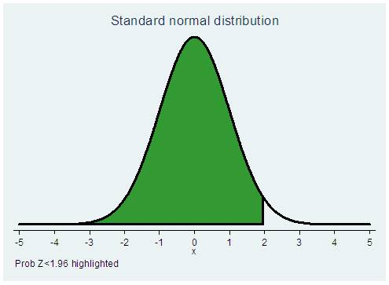
For normal distribution
  Stata calculates P(Z<z)
  If you have a z-value and you want p (PZ<z), use
  display normal(z)
  di normal(1.96)
  .9750021
  If you have a z-value and you want p [P(Z>z)], use
  display 1-normal(z)
  di 1-normal(1.96)
  .0249979
  If you have p [P(Z<z)] and you want z-value, use
    display invnormal(p)
    . di invnormal(.975)
    1.959964
  If you have p [P(Z>z)] and you want z-value, use
    display invnormal(1-p)
    di invnormal(.025)
    -1.959964
    Or use what you know about the symmetry of the distribution

Slide 4
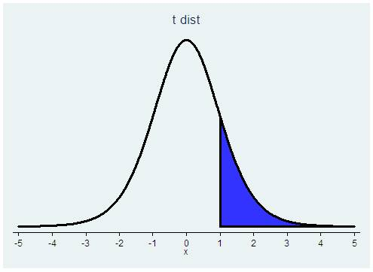
For t distribution
  Stata calculates P(T>t) for each d.f.
  If you have a t value and you want p [P(T>t)], use
  display ttail(df,t)
  di ttail(99,1.96)
  .02640356
  If you have a t value and you want p [P(T<t)], use
  display 1-ttail(df,t)
  di 1-ttail(99,1.96)
  .97359644
  If you have p [P(T>t)] and you want t-value, use
    display invttail(df,p)
    di invttail(99,.025)
    1.984217
  If you have p [P(T<t)] and you want t value, use
    display invttail(df,1-p)
    di invttail(99,.975)
    -1.984217
    Or use what you know about the symmetry of the distribution

Slide 5
Confidence intervals
Knowing the distribution of the sample means we write down
and do the math to get
If you had drawn your sample 100 times, approximately 95 of the confidence intervals would include the true population mean µ.
  The interval is random.
These intervals can be derived for any point estimate, e.g. risk ratio, rate, etc. with known distribution.
We use either z or t depending on whether the variance is known

Slide 6
Confidence intervals for proportions
As n increases, the binomial distribution approaches the normal distribution
Also, as n increases, the distribution of an estimated proportion approaches the normal distribution
  x/n = p̂ ~ N( p, √(p(1-p)/n) )
    x/n is the proportion of successes
    p is the population proportion
    √ (p(1-p)/n) is the standard deviation of x/n if X is binomial
    So we can use the normal distribution to calculate confidence intervals for p
      p̂ - 1.96 * √ (p̂(1- p̂)/n) , p̂ + 1.96 * √ (p̂(1- p̂)/n)

Slide 7
Confidence intervals for proportions
But if n is small or p is small or both then the normal approximation is not good and the intervals using the normal approximation are not good
We need to use the binomial distribution
Confidence intervals using the binomial distribution are called exact confidence intervals
Exact confidence intervals are not symmetric around p̂ (because neither is the binomial distribution for small n or small p)

Slide 8
**Hypothesis testing**
Confidence intervals tell us about the uncertainty in a point estimate of the population mean or proportion (or some other entity)
Hypothesis testing allows us to draw a conclusion about a population parameter that we have estimated in a sample
Remember, we are taking samples from the population and we never know the truth
Notes:
Note that hypothesis testing gives a yes/no answer. In many situations we might just want to describe the strength of the evidence is that the null is not true…

Slide 9
Statistical hypothesis tests
Data and comparison type | Alternative hypotheses | Parametric test Stata command
Numerical; One mean | H_{a}: μ≠ μ_{a} (two-sided) H_{a}: μ>μ_{a} or μ<μ_{a} (one-sided) | Z or t-test ttest var1==hypoth val.*
Numerical; Two means, paired data | H_{a}: μ₁ ≠ μ₂ (two-sided) H_{a}: μ₁ >μ₂ or μ<μ_{a} (one-sided) | Paired t-test ttest var1==var2*
Numerical; Two means, independent data | H_{a}: μ₁ ≠ μ₂ (two-sided) H_{a}: μ₁ >μ₂ or μ<μ_{a} (one-sided) | T-test (equal or unequal variance) ttest var1, by(byvar) ttest var1, by(byvar) unequal
Numerical, Two or more means, independent data
Dichotomous; One proportion | H_{a}: p≠ p_{a} (two-sided) H_{a}: p>p_{a} or p<p_{a} (one-sided) | Proportion test prtest var1=hypoth value* bitest var1=hypoth value
Dichotomous; two proportions | H_{a}: p₁≠ p₂ (two-sided) H_{a}: p₁ >p₂ (one-sided) | Proportion test (z-test) prtest var1, by(byvar)
Notes:
*Can be written =

Slide 10
Hypothesis testing for a mean
To conduct a hypothesis test about the mean of a population, we postulate a value for it, and call that value µ₀.
  We write this H₀ : µ = µ₀
  We call this the null hypothesis
We set an alternative hypothesis for all other values of µ
  We write this: H_{A} : µ ≠ µ₀
  We call this the alternative hypothesis

Slide 11
Hypothesis testing for a mean
We set the probability of incorrectly rejecting the null that we are willing to live with in advance, before collecting the data and doing the analysis
That probability is called the significance level
The significance level is denoted by α , and is frequently set to 0.05.
Notes:
We realize that we are only drawing a sample. If the null is true, e.g. the population mean=0, there is still a chance that we will draw a sample that looks very different from a sample with the mean=0. This chance is what we are setting by setting alpha.

Slide 12
Hypothesis testing
In hypothesis testing, a true null hypothesis might be mistakenly rejected (if the sample you drew very different from the null just by chance)
This mistake is called a Type I error
  The probability of a Type I error is chosen in advance
  This probability is called the significance level, α
  The probabiliity of obtaining a mean at or more extreme than the observed mean, given that the null hypothesis is true, is the p-value of the test.

Slide 13
Basic steps in Hypothesis testing
Before the test, set the significance level, α
  This is the probability of rejecting the null hypothesis when it is true P(Type I error) that you can live with
When you run the test, you get a probability of observing a sample mean as extreme as you did, given that the null hypothesis is true
  This probability is the p-value
If the p-value is less than α, (e.g. α=0.05 and p=0.013), then the test is called statistically significant and the null hypothesis is rejected

Slide 14
Hypothesis Testing
1. State the hypotheses
H₀ (the null) and H_{A} (the alternative) must be mutually exclusive (no overlap) and include all the possibilities
The alternative is the complement of the null

Slide 15
Hypothesis Testing
2. Determine the compatibility with the null
We determine if there is enough evidence to reject the null hypothesis (i.e. calculate the test statistic and find the p-value)
  If the null is true, what is the probability of obtaining the sample data as extreme or more extreme?
    Calculate a test statistic
    Find the probability of the test statistic if the null is true
  This probability is call the p-value

Slide 16
Hypothesis Testing
3. Reject or fail to reject
If the p-value (the probability of obtaining the sample data and corresponding test statistic if the null is true) is sufficiently small (we often use 5%) then we reject the null and say the test was statistically significant.
This 5% is α, the significance level
If we fail to reject the null hypothesis, it does not mean that we accept it.

Slide 17
Hypothesis Testing of one mean
We want to test whether a mean is equal to some hypothesized value
If we believe there might be deviations in either direction, we use a two-sided test
Two sided test:
  Null hypothesis: H₀: μ=μ₀
  Alternative hypothesis: H_{A}: μ≠μ₀
If we only care about values above or below a certain value, we use a one-sided test
One sided test:
  Null hypothesis: H₀: μ≥μ₀
  Alternative hypothesis: H_{A}: μ<μ₀
or
  Null hypothesis: H₀: μ≤μ₀
  Alternative hypothesis: H_{A}: μ>μ₀

Slide 18
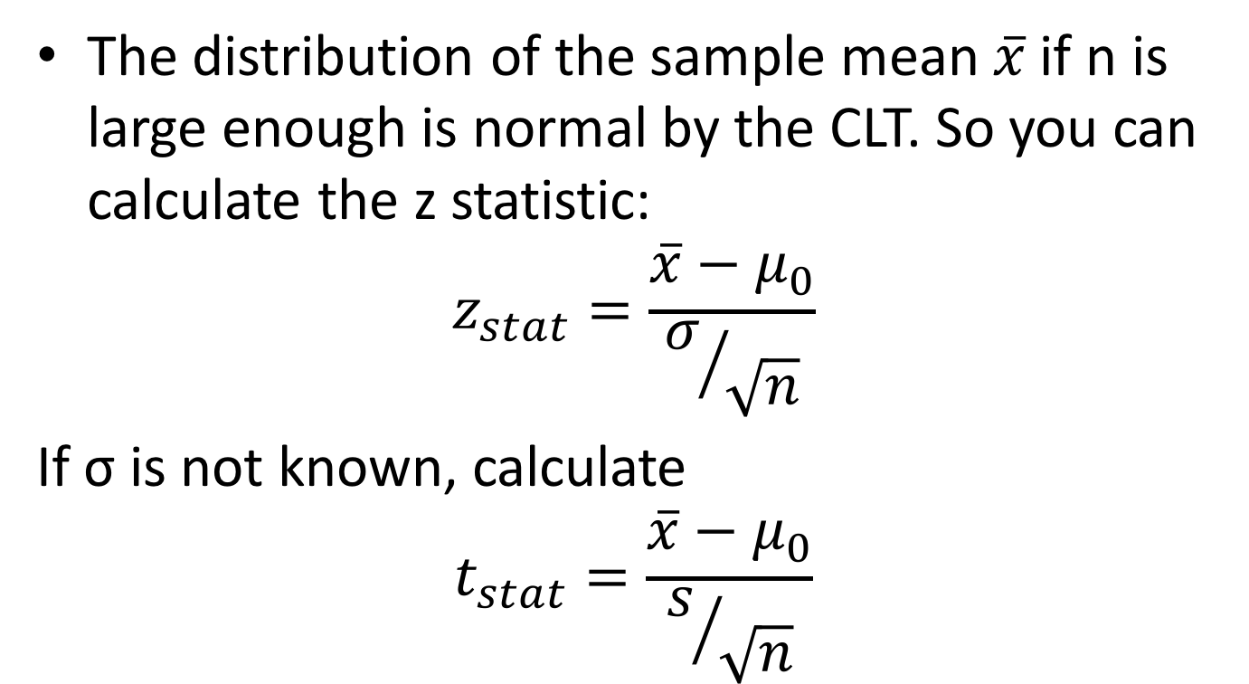
Hypothesis Testing of one mean
The distribution of the sample mean $\overline{x}$ if n is large enough is normal by the CLT. So you can calculate the z statistic:
$$z_{stat}=\frac{\overline{x}−μ_{0}}{σ/{\sqrt{n}}}$$
If σ is not known, calculate
$$t_{stat}=\frac{\overline{x}−μ_{0}}{s/{\sqrt{n}}}$$

Slide 19
Hypothesis Testing of one mean: one-sided
Non-pneumatic anti-shock garment for the treatment of obstetric hemorrhage in Nigeria
Mean initial blood loss 1413.1 ml; SD=491.3; n=83
Our question: Are these women sampled from a population that is hemorrhaging (>750 ml blood loss)?
Data adapted from Miller, S et al. Int J Gynecol Obstet (2009)

Slide 20
Hypothesis Testing of one mean: one-sided
The null hypothesis is they are not hemorrhaging
  H₀: μ≤750 H_{A}: μ>750 α=0.05
T-statistic:
p-value: P(T>12.3) with 82 d.f.
Data adapted from Miller, S et al. Int J Gynecol Obstet (2009)

Slide 21
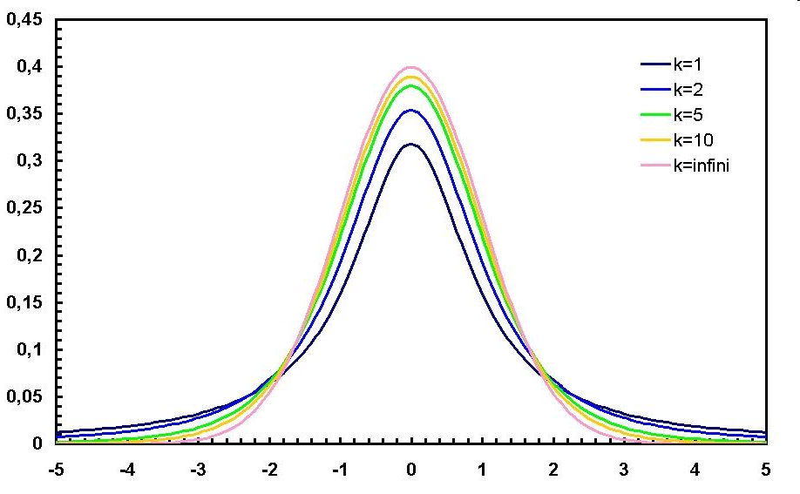
Hypothesis Testing of one mean
12.3 is off the graph
So the probability of observing a sample mean of 1413 with n=83 and SD=431 if the true mean is <=750 is very very low

Slide 22
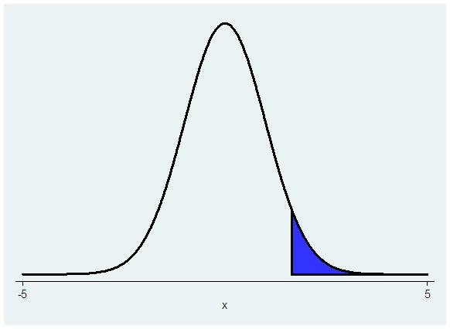
Hypothesis Testing of one mean:
one-sided
P(T>test stat)
. display ttail(82, 12.3)
1.308e-20
The p-value is <0.001, which is a lot less than 0.05, therefore we reject the null

Slide 23
Hypothesis Testing of one mean:
one-sided
Another way: Stata immediate code for ttests:
ttesti samplesize samplemean samplesd hypothesizedmean
ttesti 83 1413.1 491.3 750
One-sample t test
------------------------------------------------------------------------------
| Obs Mean Std. Err. Std. Dev. [95% Conf. Interval]
---------+--------------------------------------------------------------------
x | 83 1413.1 53.92718 491.3 1305.822 1520.378
------------------------------------------------------------------------------
mean = mean(x) t = 12.2962
Ho: mean = 750 degrees of freedom = 82
Ha: mean < 750 Ha: mean != 750 Ha: mean > 750
Pr(T < t) = 1.0000 Pr(|T| > |t|) = 0.0000 Pr(T > t) = 0.0000
→ We reject the null hypothesis
Stata gives you 3 alternative hypotheses

Slide 24
Hypothesis Testing, two sided hypothesis
Example: Do children with congenital heart disease walk at the same or a different age as compared to healthy children? Healthy children start walking at mean age of 11.4 months
  Null hypothesis: H₀: μ= 11.4 months (μ₀)
  Alternative hypothesis: H_{A}: μ≠ 11.4 months
  Significance level=0.05
  Data: Sample of children with congenital heart defects, n=9, sample mean=12.8, sample SD=2.4

Slide 25
Hypothesis Testing, two sided hypothesis
Calculate the test statistic and its associated p value
p- value is P(T>1.75) + P(T<-1.75) = 2*P(T>1.75)
  display ttail(8,1.75)*2
  .11823278

Slide 26
Hypothesis Testing, two sided hypothesis
Or run ttesti in Stata
** ttesti samplesize samplemean samplesd hypothesizedmean
ttesti 9 12.8 2.4 11.4
One-sample t test
------------------------------------------------------------------------------
| Obs Mean Std. Err. Std. Dev. [95% Conf. Interval]
---------+--------------------------------------------------------------------
x | 9 12.8 .8 2.4 10.9552 14.6448
------------------------------------------------------------------------------
mean = mean(x) t = 1.7500
Ho: mean = 11.4 degrees of freedom = 8
Ha: mean < 11.4 Ha: mean != 11.4 Ha: mean > 11.4
Pr(T < t) = 0.9409 Pr(|T| > |t|) = 0.1182 Pr(T > t) = 0.0591
  → Fail to reject the null

Slide 27
Hypothesis Testing, one or two sided hypotheses
For data already in Stata, the ttest command also works
E.g. We want to test that the mean CD4 cell count <350 among persons newly diagnosed with HIV in Uganda
  Null hypothesis: H₀: μ≥350 cells/mm³
  Alternative hypothesis (the one we are worried about – that patients come in with low CD4 cell counts):
    H_{A}: μ <350 cells/mm³
  Significance level=0.05

Slide 28
Hypothesis Testing, one or two sided hypothesis
Use ttest varname== hypothesized value
. ttest cd4count==350
One-sample t test
------------------------------------------------------------------------------
Variable | Obs Mean Std. Err. Std. Dev. [95% Conf. Interval]
---------+--------------------------------------------------------------------
cd4count | 999 329.2332 8.419592 266.1177 312.7111 345.7554
------------------------------------------------------------------------------
mean = mean(cd4count) t = -2.4665
Ho: mean = 350 degrees of freedom = 998
Ha: mean < 350 Ha: mean != 350 Ha: mean > 350
Pr(T < t) = 0.0069 Pr(|T| > |t|) = 0.0138 Pr(T > t) = 0.9931
→ We reject the null
Data set: vct_baseline_biostat200_v1.dta

Slide 29
Hypothesis testing
What if you ran a test and got z_{stat} =1.83? If your hypothesis was one-sided, you’d reject. If your hypothesis was two-sided, you’d fail to reject.
Therefore it is very important to specify your test a priori!

Slide 30
Hypothesis testing
For clinical trials, most of the time we use a two-sided hypotheses
  That way no one will suspect you of changing your hypothesis test after the fact
  On the other hand, does it really make sense to have an alternative hypothesis that a new treatment is either better or worse than the old one?
  Assuming your new therapy is better or ‘not inferior’ we may use a one-sided test

Slide 31
Hypothesis test of a proportion
Variables that are measured as successes or failures, disease or no disease, etc., can be considered binomial random variables
  x=number of successes
  n=number of “trials”
  x/n = proportion diseased
  Use the z-statistic

Slide 32
Hypothesis test of a proportion
Example: Micronutrient intake of black women in South Africa
Study: Pre-menopausal women randomly selected based on geographic location
Micronutrient intake was determined using a Quantitative Food Frequency Questionnaire developed for South Africans
Question: Do more than 10% of the women have the micronutrient intake of less than the RDA?
Data adapted from Hattingh Z. et al, West Indian Med J 2008: 57 (5):431

Slide 33
Hypothesis test of a proportion
Null hypothesis:
  10% or fewer of the women aged 25-34 have insufficient dietary folate levels (less than 268 µg, a cutoff based on RDA)
  H₀: p₀ ≤ 0.10
Alternative hypothesis:
  More than 10% of the women aged 25-34 have insufficient dietary folate levels
  H_{A}: p₀ > 0.10
Significance level set at = 0.05

Slide 34
Hypothesis test of a proportion
The data:
  158/279=56.6% had folate levels<268 µg
Using the normal approximation to the binomial distribution:
  z_{stat} = (.566-0.10)/√(0.10*0.90/279) =25.9
  The chance of observing a z statistic of this large (25.9) is very small (<0.05)
  → So we reject the null hypothesis

Slide 35
Hypothesis testing of a proportion
The stata command prtest or prtesti gives you a test of a proportion using the normal approximation
** prtesti samplesize observedp hypothp
. prtesti 279 .566 .1
One-sample test of proportion x: Number of obs = 279
------------------------------------------------------------------------------
Variable | Mean Std. Err. [95% Conf. Interval]
-------------+----------------------------------------------------------------
x | .566 .0296723 .5078434 .6241566
------------------------------------------------------------------------------
p = proportion(x) z = 25.9458
Ho: p = 0.1
Ha: p < 0.1 Ha: p != 0.1 Ha: p > 0.1
Pr(Z < z) = 1.0000 Pr(|Z| > |z|) = 0.0000 Pr(Z > z) = 0.0000

Slide 36
Hypothesis testing of a proportion
Null hypothesis:
  Fewer than 10% of the women aged 25-34 have dietary zinc levels of less than 5 mg
  H₀: p < 0.10
Alternative hypothesis:
  10% or more of the women aged 25-34 have dietary zinc levels of less than 5 mg
  H_{A}: p ≥ 0.10
Significance level = 0.05

Slide 37
Hypothesis testing of a proportion
The data: 31/279=11.1% had zinc levels of less than 5 mg
prtesti 279 .111 .1
One-sample test of proportion x: Number of obs = 279
------------------------------------------------------------------------------
Variable | Mean Std. Err. [95% Conf. Interval]
-------------+----------------------------------------------------------------
x | .111 .0188066 .0741397 .1478603
------------------------------------------------------------------------------
p = proportion(x) z = 0.6125
Ho: p = 0.1
Ha: p < 0.1 Ha: p != 0.1 Ha: p > 0.1
Pr(Z < z) = 0.7299 Pr(|Z| > |z|) = 0.5402 Pr(Z > z) = 0.2701
Using the normal approximation, we find that the data are NOT inconsistent with the null hypothesis, therefore we fail to reject the null

Slide 38
Using the binomial distribution
. bitesti 279 .111 .1
N Observed k Expected k Assumed p Observed p
------------------------------------------------------------
279 31 27.9 0.10000 0.11111
Pr(k >= 31) = 0.295225 (one-sided test)
Pr(k <= 31) = 0.767742 (one-sided test)
Pr(k <= 24 or k >= 31) = 0.548577 (two-sided test)
Or we could have used:
. di binomialtail(279,31,.1)
.29522463
This is an exact tests, rather than using the normal approximation.

Slide 39
Hypothesis testing of a proportion
Remember that if n or p are small, you may need to use an exact test – we will examine other tests (Chi-squared) in future lectures
The commands in Stata to do this are
display binomialtail(n,k,p)
or
bitesti samplesize observedp hypothp

Slide 40
Comparison of two means: the paired t-test
Paired samples, numerical variables
  Two determinations on the same person (before and after) – e.g. before and after intervention
  Matched samples – measurement on pairs of persons similar in some characteristics, i.e. identical twins (matching is on genetics)
Each person or pair has 2 data points, and we calculate the difference for each
Then we can use our one-sample methods to test hypotheses about the value of the difference

Slide 41
Comparison of two means: paired t-test
Step 1: The hypotheses (two sided)
Generically H₀: μ₁-μ₂ =δ
H_{A}: μ₁-μ₂ ≠δ
Often δ=0, no difference
So H₀: μ₁-μ₂ =0, i.e. H₀: μ₁=μ₂
H_{A}: μ₁-μ₂ ≠0, i.e. H_{A}: μ₁≠μ₂

Slide 42
Comparison of two means: paired t-test
Step 2: Calculate the test statistic

Slide 43
Comparison of two means: paired t-test
Step 3: Reject or fail to reject the null
  Is the p-value (the probability of observing a difference as large or larger, under the null hypothesis) greater than or less than the significance level, ⍺?

Slide 44
Example: BREATH Study
Comparison of two means: paired t-test
We have found that self-reported alcohol consumption decreases after ART initiation, however we suspect a high degree of under-report. We use the biomarker PEth to obtain a biological measure of alcohol use in a one-year prospective study. Looking at baseline and 3 months…

Slide 45
Comparison of two means: paired t-test
We think participants may be decreasing their alcohol use over time. The null hypothesis is that they are drinking the same amount.
  H₀: μ₂-μ₁ =0 → μ₂=μ₁ H_{A}: μ₁-μ₂ ≠0 → μ₂ ≠μ₁
Significance level=0.05

Slide 46
Graphs of the data
Comparison of two means: paired t-test
The mean of the paired difference is a new random variable

Slide 47
Comparison of two means: paired t-test
. summ peth_diff
Variable | Obs Mean Std. Dev. Min Max
-------------+--------------------------------------------------------
peth_diff | 177 -.101553 .5782935 -1.929419 1.685742
*** calculate the t statistic
di -.101553/.5782935*sqrt(177)
-2.3363133
*** calculate the p-value
. di 2*ttail(176,2.336133)
.02061082
→ So we reject the null

Slide 48
Using the ttest command
Comparison of two means: paired t-test
. . ttest peth_diff==0
One-sample t test
------------------------------------------------------------------------------
Variable | Obs Mean Std. Err. Std. Dev. [95% Conf. Interval]
---------+--------------------------------------------------------------------
peth_d~f | 177 -.101553 .0434672 .5782935 -.187337 -.015769
------------------------------------------------------------------------------
mean = mean(peth_diff) t = -2.3363
Ho: mean = 0 degrees of freedom = 176
Ha: mean < 0 Ha: mean != 0 Ha: mean > 0
Pr(T < t) = 0.0103 Pr(|T| > |t|) = 0.0206 Pr(T > t) = 0.9897
Note that mean>0 here is mean difference
Notes:
What if we wanted to use the immediate command ttesti?

Slide 49
Another way without calculating the difference
Comparison of two means: paired t-test
The command is
ttest var1==var2
. . ttest peth3_log10==peth0_log10
Paired t test
------------------------------------------------------------------------------
Variable | Obs Mean Std. Err. Std. Dev. [95% Conf. Interval]
---------+--------------------------------------------------------------------
peth3~10 | 177 1.426734 .0686534 .9133744 1.291244 1.562224
peth0~10 | 177 1.528287 .0690468 .9186077 1.392021 1.664553
---------+--------------------------------------------------------------------
diff | 177 -.101553 .0434672 .5782935 -.187337 -.015769
------------------------------------------------------------------------------
mean(diff) = mean(peth3_log10 - peth0_log10) t = -2.3363
Ho: mean(diff) = 0 degrees of freedom = 176
Ha: mean(diff) < 0 Ha: mean(diff) != 0 Ha: mean(diff) > 0
Pr(T < t) = 0.0103 Pr(|T| > |t|) = 0.0206 Pr(T > t) = 0.9897
.

Slide 50
Comparison of two independent means
The goal is to compare means from two independent samples
Two different populations
  E.g. vaccine versus placebo group
  E.g. women with adequate versus in adequate micronutrient levels
Even though the null and alternative hypotheses are the same as for the paired t-test, the test is different, it is wrong to use a paired t-test with independent samples and vice versa

Slide 51
Comparison of two independent means
So we can calculate a t or a z-score for the difference in the means and compare it to the standard normal distribution. The test statistics are:

Slide 52
Comparison of two independent means
Study of non-pneumatic anti-shock garment (Miller et al)
Two groups – pre-intervention received usual treatment, intervention group received NASG
Comparison of hemorrhaging in the two groups
Null hypothesis: The hemorrhaging is the same in the two groups H₀: μ₁=μ₂
H_{A}: μ₁≠μ₂
The data: External blood loss after entry:
  Pre-intervention group (n=83) mean blood loss =340.4 SD=248.2
  Intervention group (n=83) mean blood loss =73.5 SD=93.9

Slide 53
Comparison of two means, example
* ttesti n1 mean1 sd1 n2 mean2 sd2
ttesti 83 340.4 248.2 83 73.5 93.9
Two-sample t test with equal variances
------------------------------------------------------------------------------
| Obs Mean Std. Err. Std. Dev. [95% Conf. Interval]
---------+--------------------------------------------------------------------
x | 83 340.4 27.24349 248.2 286.204 394.596
y | 83 73.5 10.30686 93.9 52.99636 94.00364
---------+--------------------------------------------------------------------
combined | 166 206.95 17.85377 230.0297 171.6987 242.2013
---------+--------------------------------------------------------------------
diff | 266.9 29.12798 209.3858 324.4142
------------------------------------------------------------------------------
diff = mean(x) - mean(y) t = 9.1630
Ho: diff = 0 degrees of freedom = 164
Ha: diff < 0 Ha: diff != 0 Ha: diff > 0
Pr(T < t) = 1.0000 Pr(|T| > |t|) = 0.0000 Pr(T > t) = 0.0000

Slide 54
Comparison of two independent means
You can calculate a 95% confidence interval for the difference between the 2 means
If the confidence interval for the difference does not include 0, then you can reject the null hypothesis of no difference

Slide 55
Comparison of two independent means
This t-test assumes equal variances in the two underlying populations
If we do not assume equal variances we use a slightly different test statistic
    Variances not assumed to be equal, so you do not use a pooled estimate
    There is another formula for degrees of freedom
Often the two different t-tests yield the same answer, but you should not assume equivalence unless you have a good reason for it
  If the sample sizes are equal, you will get the same test statistic, just the df changes

Slide 56
Comparison of two means, example
ttesti 83 340.4 248.2 83 73.5 93.9, unequal
Two-sample t test with unequal variances
------------------------------------------------------------------------------
| Obs Mean Std. Err. Std. Dev. [95% Conf. Interval]
---------+--------------------------------------------------------------------
x | 83 340.4 27.24349 248.2 286.204 394.596
y | 83 73.5 10.30686 93.9 52.99636 94.00364
---------+--------------------------------------------------------------------
combined | 166 206.95 17.85377 230.0297 171.6987 242.2013
---------+--------------------------------------------------------------------
diff | 266.9 29.12798 209.1446 324.6554
------------------------------------------------------------------------------
diff = mean(x) - mean(y) t = 9.1630
Ho: diff = 0 Satterthwaite's degrees of freedom = 105.002
Ha: diff < 0 Ha: diff != 0 Ha: diff > 0
Pr(T < t) = 1.0000 Pr(|T| > |t|) = 0.0000 Pr(T > t) = 0.0000

Slide 57
Comparison of two independent means
When you have the data in Stata, with the different groups in different columns, use
  ttest var1==var2, unpaired
  or ttest var1==var2, unpaired unequal
More commonly you will have the data all in one variable, and the grouping in another variable. Then use
  ttest var, by(groupvar)
  or ttest var, by(groupvar) unequal

Slide 58
Comparison of two independent means
Alcohol study example
Testing whether log PEth at 6 months differs by study arm
Null hypothesis: Log PEth for cohort arm = Log PEth for comparison arm
. ttest peth_log10, by(studyarm)
Two-sample t test with equal variances
------------------------------------------------------------------------------
Group | Obs Mean Std. Err. Std. Dev. [95% Conf. Interval]
---------+--------------------------------------------------------------------
Cohort a | 181 1.406739 .0709392 .9543891 1.26676 1.546718
Min asse | 106 1.490502 .0897145 .9236671 1.312615 1.668389
---------+--------------------------------------------------------------------
combined | 287 1.437676 .0556285 .942407 1.328183 1.547169
---------+--------------------------------------------------------------------
diff | -.0837633 .1153577 -.3108244 .1432978
------------------------------------------------------------------------------
diff = mean(Cohort a) - mean(Min asse) t = -0.7261
Ho: diff = 0 degrees of freedom = 285
Ha: diff < 0 Ha: diff != 0 Ha: diff > 0
Pr(T < t) = 0.2342 Pr(|T| > |t|) = 0.4684 Pr(T > t) = 0.7658
Notes:
BREATH cohort and comparisons_v2.dta

Slide 59
Comparison of two independent means
Alcohol study example
Testing whether log PEth at 6 months differs by study arm
Null hypothesis: Log PEth for cohort arm = Log PEth for comparison arm
.
ttest peth_log10, by(studyarm) unequal
Two-sample t test with unequal variances
------------------------------------------------------------------------------
Group | Obs Mean Std. Err. Std. Dev. [95% Conf. Interval]
---------+--------------------------------------------------------------------
Cohort a | 181 1.406739 .0709392 .9543891 1.26676 1.546718
Min asse | 106 1.490502 .0897145 .9236671 1.312615 1.668389
---------+--------------------------------------------------------------------
combined | 287 1.437676 .0556285 .942407 1.328183 1.547169
---------+--------------------------------------------------------------------
diff | -.0837633 .1143724 -.3091369 .1416103
------------------------------------------------------------------------------
diff = mean(Cohort a) - mean(Min asse) t = -0.7324
Ho: diff = 0 Satterthwaite's degrees of freedom = 225.846
Ha: diff < 0 Ha: diff != 0 Ha: diff > 0
Pr(T < t) = 0.2324 Pr(|T| > |t|) = 0.4647 Pr(T > t) = 0.7676

Slide 60
Comparison of two proportions
Null hypothesis about two proportions, p₁ and p₂, H₀: p₁= p₂
H_{A}: p₁≠ p₂
If n₁ and n₂ are sufficiently large, the difference between the two proportions follows a normal distribution.
So we can use the z statistic to find the probability of observing a difference as large as we do, under the null hypothesis of no difference

Slide 61
Comparison of two proportions
Example: Proportion with PEth>=50 ng/ml
  . tab peth_50
  peth_50 | Freq. Percent Cum.
  ------------+-----------------------------------
  0 | 155 54.01 54.01
  1 | 132 45.99 100.00
  ------------+-----------------------------------
  Total | 287 100.00
  . bysort studyarm: tab peth_50
  -----------------------------------------------------------------------------------> studyarm = Cohort assessed
  peth_50 | Freq. Percent Cum.
  ------------+-----------------------------------
  0 | 97 53.59 53.59
  1 | 84 46.41 100.00
  ------------+-----------------------------------
  Total | 181 100.00
  ----------------------------------------------------------------------------------
  -> studyarm = Min assessed
  peth_50 | Freq. Percent Cum.
  ------------+-----------------------------------
  0 | 58 54.72 54.72
  1 | 48 45.28 100.00
  ------------+-----------------------------------
  Total | 106 100.00
  .

Slide 62
Comparison of two proportions
prtesti n1 p1 n2 p2
.prtesti 106 .453 181 .464
Two-sample test of proportions x: Number of obs = 106
y: Number of obs = 181
------------------------------------------------------------------------------
Variable | Mean Std. Err. z P>|z| [95% Conf. Interval]
-------------+----------------------------------------------------------------
x | .453 .0483493 .3582372 .5477628
y | .464 .0370683 .3913476 .5366524
-------------+----------------------------------------------------------------
diff | -.011 .0609238 -.1304084 .1084084
| under Ho: .0609565 -0.18 0.857
------------------------------------------------------------------------------
diff = prop(x) - prop(y) z = -0.1805
Ho: diff = 0
Ha: diff < 0 Ha: diff != 0 Ha: diff > 0
Pr(Z < z) = 0.4284 Pr(|Z| < |z|) = 0.8568 Pr(Z > z) = 0.5716

Slide 63
Comparison of two proportions
. prtest peth_50, by(month)
Two-sample test of proportions 6: Number of obs = 181
88: Number of obs = 106
------------------------------------------------------------------------------
Variable | Mean Std. Err. z P>|z| [95% Conf. Interval]
-------------+----------------------------------------------------------------
6 | .4640884 .0370687 .391435 .5367418
88 | .4528302 .0483477 .3580704 .5475899
-------------+----------------------------------------------------------------
diff | .0112582 .0609228 -.1081483 .1306647
| under Ho: .0609564 0.18 0.853
------------------------------------------------------------------------------
diff = prop(6) - prop(88) z = 0.1847
Ho: diff = 0
Ha: diff < 0 Ha: diff != 0 Ha: diff > 0
Pr(Z < z) = 0.5733 Pr(|Z| < |z|) = 0.8535 Pr(Z > z) = 0.4267
.
.

Slide 64
Types of error
Type I error – significance level of the test
α=P(reject H₀ | H₀ is true)
Occurs when we incorrectly reject the null
We take a sample from the population, calculate the statistics, and make inference about the true population. If we did this repeatedly, we would incorrectly reject the null 5% of the time that it is true if α is set to 0.05.

Slide 65
Types of error
Type II error – β = P(do not reject H₀ | H₀ is false)
Occurs when we incorrectly fail to reject the null, i.e. when we do not reject the null when the null is false
 | True state
Decision | H₀ is true | H₀ is false
Do not reject H₀ | Correct | Type II error=β
Reject H₀ | Type I error=α | Correct

Slide 66
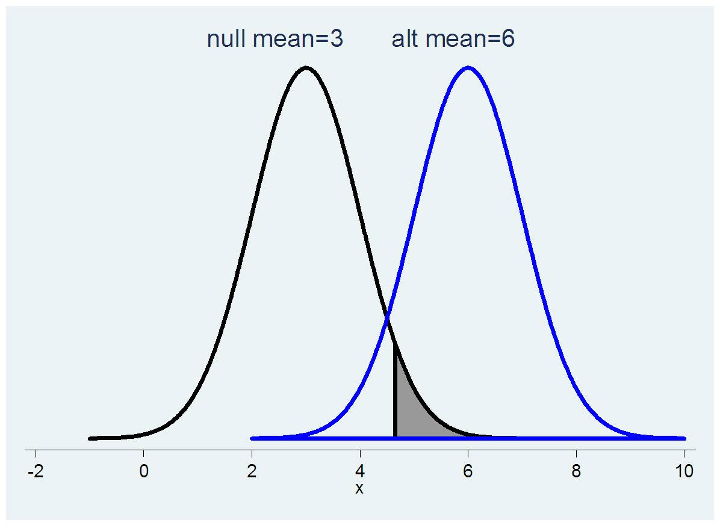
Chance of a type II error
β, chance of failing to reject the null if the alternative is true
Notes:
You can miss the effect when your test statistic is not high enough
The true mean might be 6 but if you get a sample with mean 4 you won’t reject the null

Slide 67
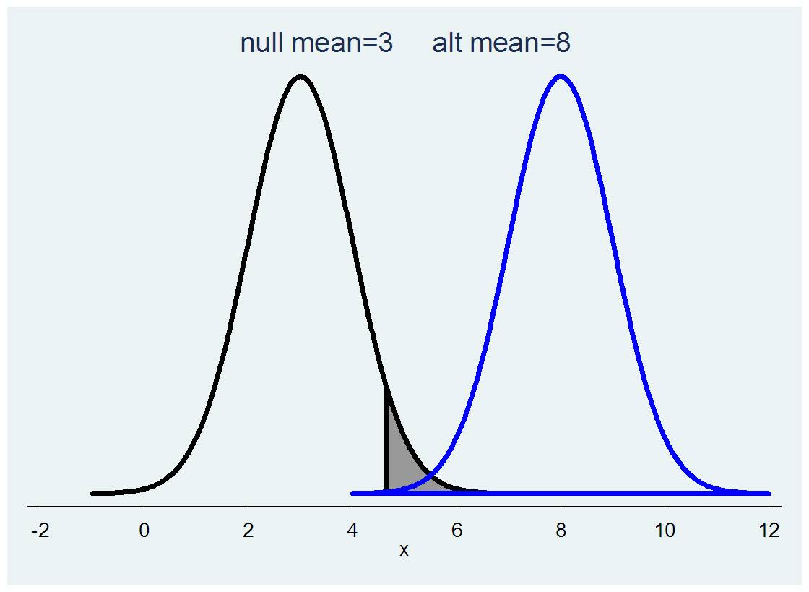
If the alternative is very different from the null, the chance of a Type II error is low
β, chance of failing to reject the null if the alternative is true
Notes:
Here there isn’t much overlap between the null and the alternative distributions so there is less chance that you’ll get a value that lies within the acceptance range of the null if the true distribution is really the alternative. The arrow is pointing to the small part of the left tail of the distribution with mu=8 that is to the left of the grey shaded rejection area.

Slide 68
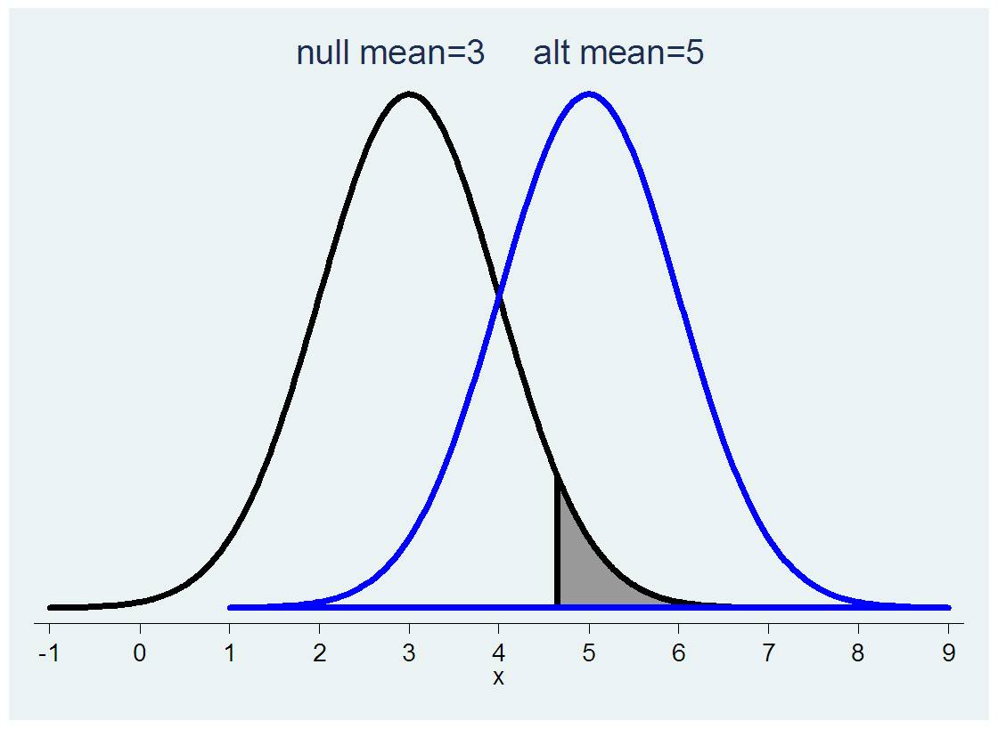
If the alternative is not very different from the null, the chance of a Type II error is high
β, chance of failing to reject the null if the alternative is true

Slide 69
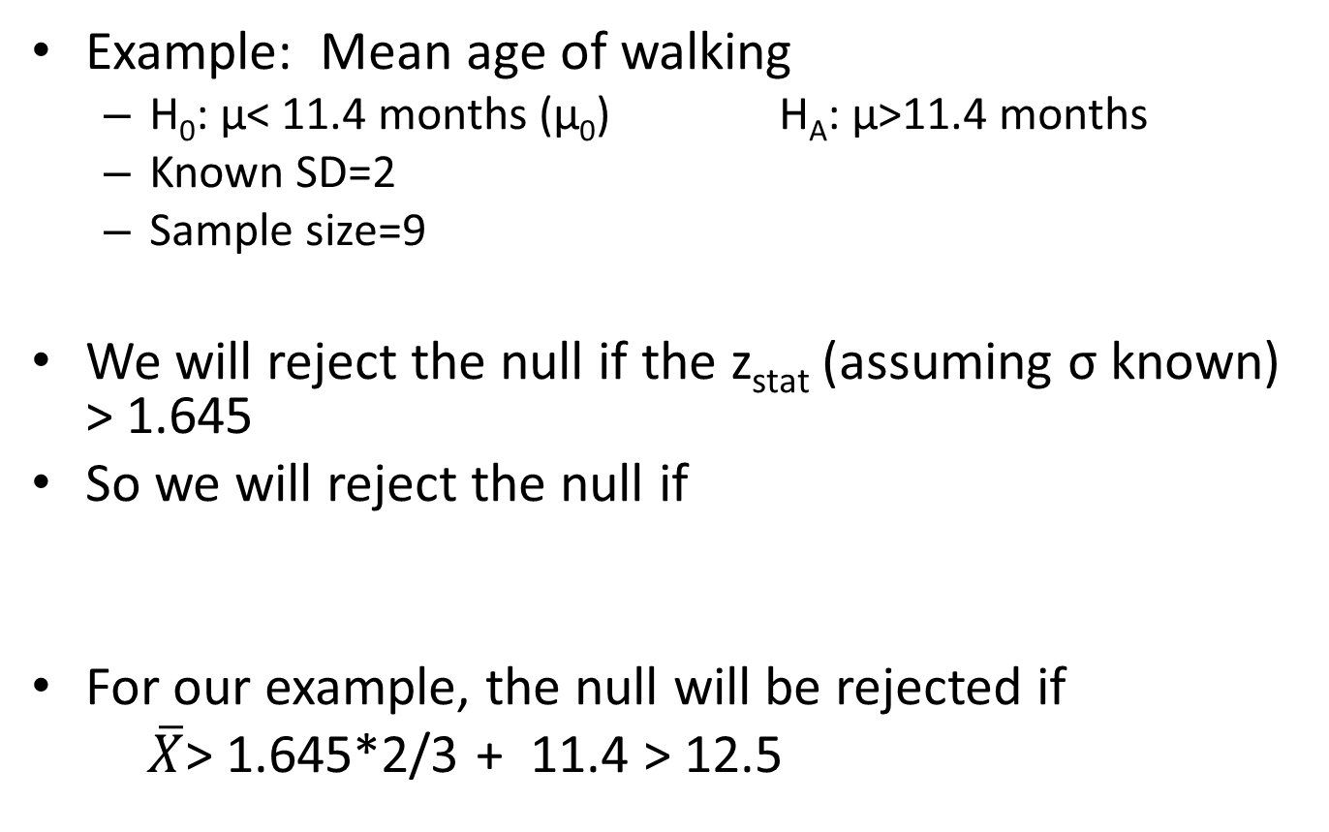
Finding β, P(Type II error)

Slide 70
Finding β, P(Type II error)
If the true mean μ is really 14 meaning the null is false, what is the probability that the null will not be rejected? Type II error?
The null will be rejected if the sample mean is >12.5, not rejected if it is ≤12.5
What is the probability of getting a sample mean of ≤12.5 if the true mean is 14? This is a z statistic.
P(Z<(12.5-14)/(2/3))
    di normal((12.5-14)/(2/3))
    .01222447
    So if the true mean is 14 and the sample size is 9, the probability of incorrectly failing to reject the null is 0.012

Slide 71
Finding β, P(Type II error)
Note that this depended on this other population mean (e.g. 14)
  The chance of failing to reject the null will increase if this true population mean is closer to the null value
What is the probability of failing to reject the null if the true population mean is 13?
  P(Z<(12.5-13)/(2/3))
    di normal((12.5-13)/(2/3))
    .22662735
    So for an alternative mean that is closer to the null value, the chances of failing to reject are higher

Slide 72
Power
1-β is called the power of a statistical test
The power of a test is the probability that you will reject the null hypothesis when you should
You can construct a power curve by plotting power versus different alternative hypotheses
You can also construct a power curve by plotting power versus different sample sizes (n’s)
  This curve will allow you to see what gains you might have versus cost of adding participants
  Power curves are not linear

Slide 73
Power
The power of a statistical test is lower for alternative values that are closer to the null value.
    When alt mean was 14, power =1-.012=.988
    When alt mean was 13, power was 1-.227=.773
The power of a statistical test can also be increased by increasing n
For a fixed n, the power of a statistical test can be increased by increasing α, the probability of a Type I error

Slide 74
Power
The balance between type I error and type II error (or power) should depend on the context of the study
When setting up a study, most investigators make sure that there will be at least 80% power.
Sample size formulas allow you to specify the desired α and β levels.

