Slide 1
Evaluating Predictions
Michael A. Kohn, MD, MPP
10/12/2017

Slide 2
Outline
Review: Using the result of a single diagnostic test to guide a binary decision
Digression: Logarithms
Minimizing Expected Regret = Maximizing Expected Net Benefit
Predicting incident outcomes vs. diagnosing prevalent disease
Calibration and Discrimination
Population Net Benefit
Decision Curves

Slide 3
Review: Using a single diagnostic test
Given
  Binary decision (e.g, treat/no treat)
  Consequences of errors, B and C
  Pre-Test Probability of Disease P(D+)
  Result r of a single diagnostic test
  P(r|D+) and P(r|D-)

Slide 4
Review: Using a single diagnostic test
Calculate post-test probability P(D+|r)
Make binary decision (Treat/No Treat)

Slide 5
Review: Steps
Convert P(D+) to Odds(D+)
  Odds = P/(1-P) (Pizza)
Determine LR(r)
  LR = P(r|D+)/P(r|D-) (WOWO)
Odds(D+|r) = Odds(D+)×LR(r)
  (Bayes’s Rule “Odds Form”)
Convert Odds(D+|r) to P(D+|r)
  P = Odds/(1+Odds) (Pizza)

Slide 6
Logarithms
10^{b} = a; b = log(a)
10² = 100; 2 = log(100)
10⁽⁻¹⁾ = 0.1; -1 = log(0.1)
10^{0.3} = 2, 0.3 = log(2)

Slide 7
a | Log(a)
1 | 0
2 | 0.30
3 | 0.5
4 | 0.60
5 | 0.70
6 | 0.8
7 | 0.85
8 | 0.90
9 | 0.95
10 | 1.00
Notes:
TN: Point out that these are approximate because this makes it look like 3 × 3 = 10.

Slide 8
log(xy) = log(x) + log(y)
log(1,000×10) = log(1000) + log(10)
log(10,000) = 3 + 1 = 4
log(10×2) = log(10) + Log(2)
log(20) = 1 + 0.3 = 1.3
Notes:
The logarithm of the product is the sum of the logarithms

Slide 9
log(x/y) = log(x) - log(y)
log(10,000/10) = log(10,000) - log(10)
log(1,000) = 4 - 1 = 3
log(10/2) = log(10) – log(2)
log(5) =1 – 0.3 = 0.7
Notes:
The logarithm of the quotient is the difference of the logarithms.

Slide 10
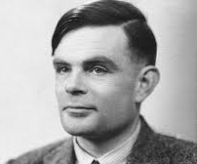

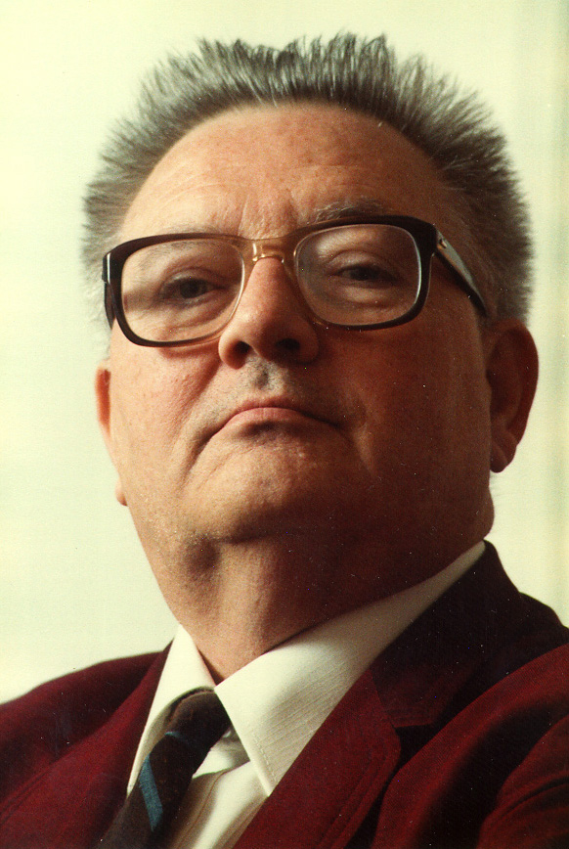
Odds(D+|r) = Odds(D+)LR(r)
log(Odds(D+|r) = log(Odds(D+)) + log(LR(r))
Notes:
Alan Turing, ET Jaynes, Tom Newman
Actually both Turing and Jaynes added a factor of 10: 10log(Odds(D+|r) = 10log(Odds(D+)) + 10log(LR(r)).
Jaynes refers to 10log(Odds) as the “evidence”. The units are decibans (Turing) or decibels (Jaynes).
If pretest probability is is 1/6, then pretest odds are 1/5, log(1/5) = -0.7 or -7 decibels. If the LR is 20, log(20) = 1.3 or 13 decibels. Post-test “evidence” = -7 + 13 = 6 decibels. Post test odds =4:1, P = 4/5 = 0.8.

Slide 11


Slide 12
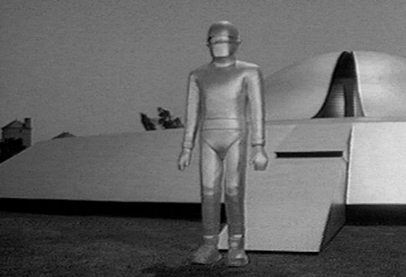
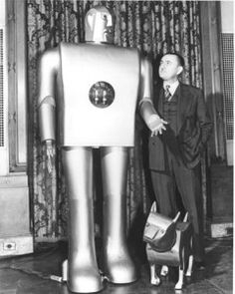

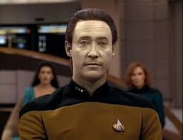
P(D+|all information)
Notes:
What if a robot does all the probability updating according to rules and gives you P(D+|X)? What do you do? Treat? No Treat?

Slide 13
Minimize Expected Regret
E(Regret) = P×B + (1-P)×C
where P = P(D+|All information)

Slide 14
Treat is better than No Treat
Treat is worse than No Treat

Slide 15
Minimize Expected Regret of Treat Relative to No Treat
E(Regret) = -P(B) + (1-P)C
Negative values (<0) are good.

Slide 16
Treat is worse than No Treat
Treat is better than No Treat

Slide 17
Maximize Expected Net Benefit of Treat Relative to No Treat
E(Net Benefit) = P(B) - (1-P)C
Positive values (>0) are good.

Slide 18
Treat is better than No Treat
Treat is worse than No Treat

Slide 19
Maximize Expected Net Benefit
E(Net Benefit) = P- (1-P)C/B
C/B = Treatment Threshold Odds
= P_{TT}/(1 – P_{TT})

Slide 20
Notes:
This shows how the expected net benefit depends on a single patient’s probability of disease, P(D+|all information).

Slide 21
Expected Net Benefit for a Patient
E(Net Benefit) = P- (1-P)×C/B
P = P(D+|X) for that patient

Slide 22
Population Net Benefit
Get P(D+|X) (e.g. from robot) for each of N patients (p₁, p₂,…, p_{N})
Record your best decision on each patient
  Treat for p_{i} > P_{TT} =C/(C+B)
Determine outcomes (D+/D-)
NB = [#Treated Appropriately –
  (C/B) (#Treated Unnecessarily) ] /N
Notes:
Assumes C/B is same for all patients. Population net benefit used for evaluating risk models / prognostic tests.

Slide 23
Prognosis vs. Diagnosis
How is predicting incident outcomes different from diagnosing prevalent disease?

Slide 24
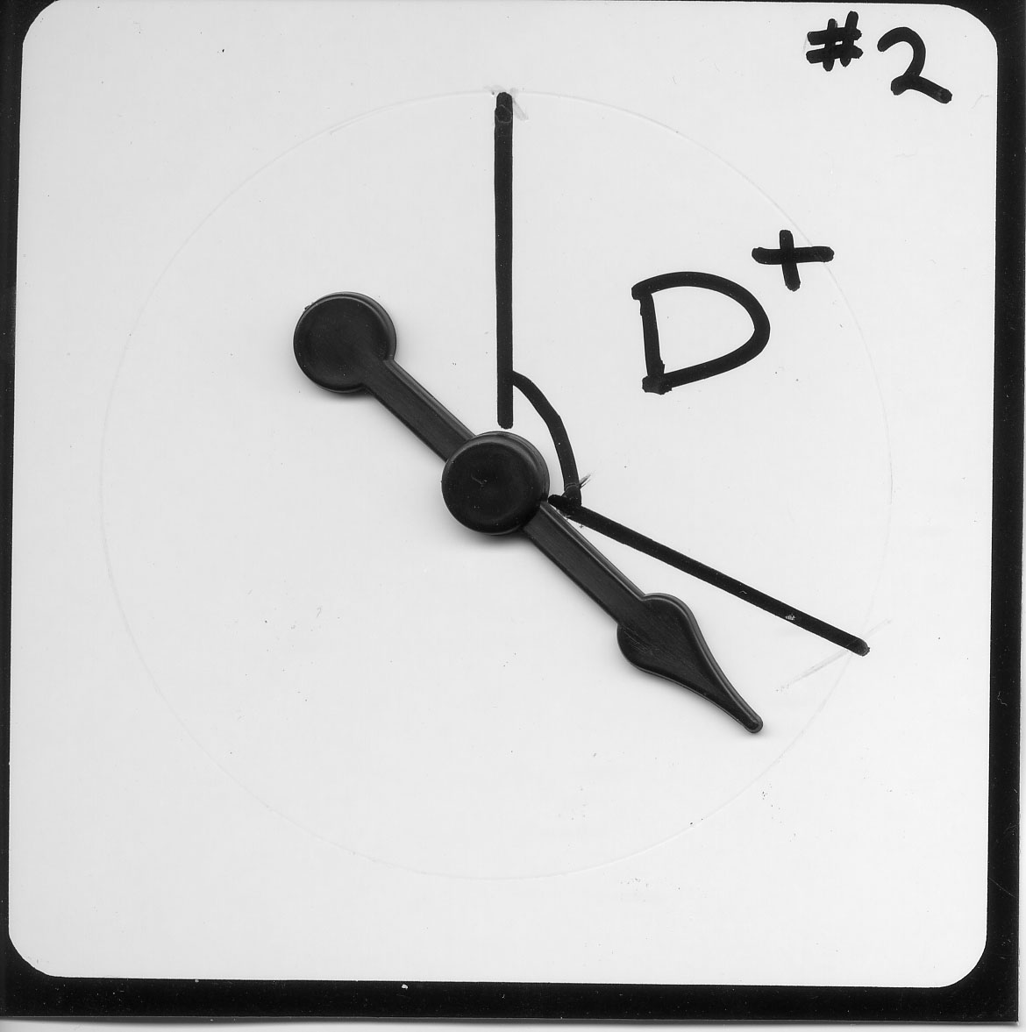
Chance determines whether you get the disease/outcome
Spin the needle

Slide 25
Diagnosis:
Chance event occurs to patient before estimation of P(D+|X)
Spin needle to see if you develop disease.
Given all information, robot estimates the probability that you have it.
Gold standard can determine true disease state.
Time frame is cross-sectional.
Notes:
Diagnostic test results are commonly expressed in categories or units particular to the test (urine dip: -, +, ++, +++; V/Q: normal, low prob, intermediate prob, high prob). The conversion to risk of D+ uses LRs from the study and the patient’s pre-test probability. Measurement of the LRs is separate from assessment of pre-test probability.

Slide 26
Prognosis:
Chance event occurs to patient after estimation of P(D+|X)
Given all information, robot estimates your risk of disease/outcome.
Spin needle to see if you develop disease/outcome.
“Gold standard” is follow-up.
Time frame is longitudinal (cohort).
How do you assess the validity of the predictions?
Notes:
Prognostic test results are commonly expressed as a risk category (10%, 20%, etc), so they already include an assessment of the patient’s pre-test probability.
TN: Might even say (for time to event data) that you spin the spinner every day.

Slide 27
Example: Mastate Cancer
Once developed, always fatal.
Can be prevented by mastatectomy.
Two (robot) oncologists separately assign each of N=300 individuals risk for developing mastate cancer in the next 5 years.

Slide 28
How do you assess the validity of the predictions?
(N = 300)

Slide 29
N = 100
Oncologist 1 assigns risk of 50%
Oncologist 2 assigns risk of 20%
Spin the needles.
33 get mastate cancer

Slide 30
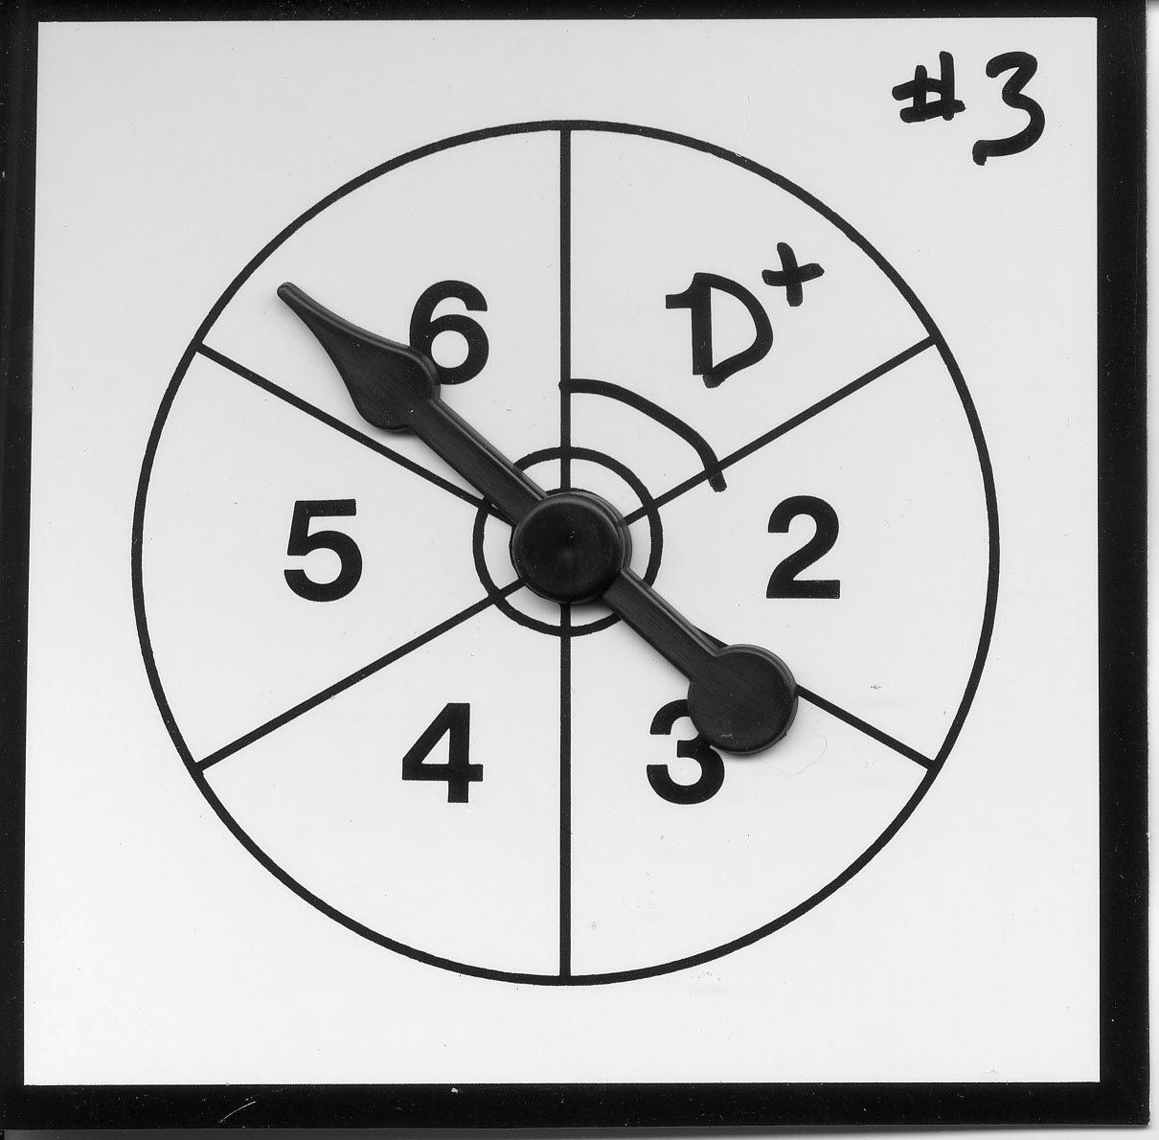
100 like this
Oncologist 1 assigns risk of 35%
Oncologist 2 assigns risk of 20%
Spin the needles.
17 get mastate cancer

Slide 31
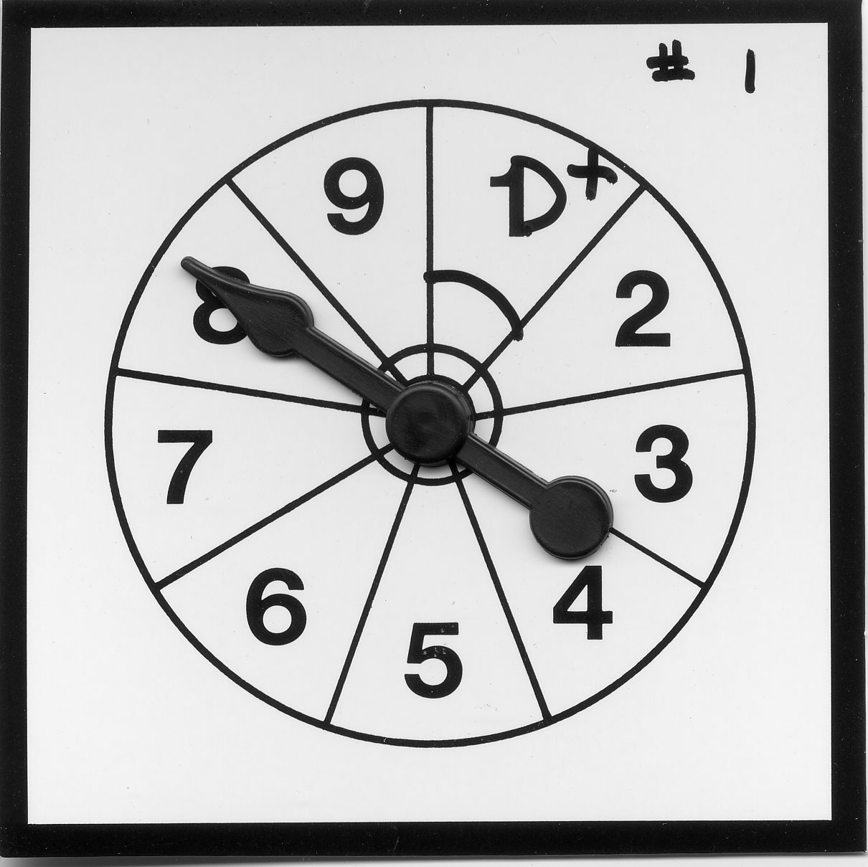
100 like this
Oncologist 1 assigns risk of 20%
Oncologist 2 assigns risk of 20%
Spin the needles.
11 get mastate cancer

Slide 32
Calibration
How accurate are the predicted probabilities?
  Break the population into groups*
  Compare actual and predicted probabilities for each group
* Maximum number of groups = number of different risk predictions.

Slide 33
Calibration Table
Oncologist 1's Predicted Risk | Observed Proportion |  | Observed - Predicted
50% | 33/100 | 33% | -17%
35% | 17/100 | 17% | -18%
20% | 11/100 | 11% | -9%
 |  | Mean (SD) | -14.7% (4%)
Oncologist 2's Predicted Risk | Observed Proportion |  | Observed - Predicted
20% | 61/300 | 20.3% | +0.333%
Notes:
Oncologist 1: Mean Bias = 14.67% SD Group Errors = 4% Calibration = SD^2 + Bias^2 = 0.023 SQRT(Calibration) = 0.152
Oncologist 2: Mean Bias = 0.333% SD Group Errors = 0 Calibration = Bias^2 = 0.0000111111 SQRT(Calibratioin) = Same as Bias
Calibration tables show predicted risk and observed risk for each risk group, but they can’t be converted into LR tables without knowing the proportion in each risk group. (In this example, 1/3 in each risk group.)

Slide 34
Calibration Plot
Mean Bias = -14.7% (Predicted risk systematically high)
Notes:
MSE = Brier Score = 0.1765 , Bias = 0.147, Variance of Individual Errors = 0.1765 – 0.147^2 = 0.155 SQRT(0.155) = 0.4 = SD of individual Errors.
SQRT(Calibration) = 0.152
TN: QUESTION for next time − are the error bars SD, SE or 95% CI
MAK: I checked. They are 95% Confidence Intervals. That appears to be the standard for calibration plots.

Slide 35
Assessing/Quantifying Calibration*
Calibration Plots with Mean Bias* and SD of Group Errors
*Overall calibration of a model is always good in the “derivation” dataset. For example, mean bias is always 0 for a logistic regression model in the dataset used to derive its coefficients.
Notes:
(SD of Group Errors)^2 + (Mean Bias)^2 = Mean-Squared Group Error = “Calibration”

Slide 36
Discrimination
How well can the test separate subjects in the population from the mean probability to values closer to zero or 1?
May be more generalizable
Often measured with C-statistic (AUROC)

Slide 37
Start with Calibration Table
Oncologist 1's Predicted Risk | Observed Proportion |  | Predicted - Observed
50% | 33/100 | 33% | 17%
35% | 17/100 | 17% | 18%
20% | 11/100 | 11% | 9%
Break into D+ and D- groups. Calculate column percentages, and …
Notes:
Calibration tables show predicted risk and observed risk for each risk group, but they can’t be converted into LR tables without knowing the proportion in each risk group. (In this example, 1/3 in each risk group.)

Slide 38
LR Table
Oncologist 1's Predicted Risk | D+ |  | D- |  | Total
50% | 33 | 54% | 67 | 28% | 100
35% | 17 | 28% | 83 | 35% | 100
20% | 11 | 18% | 89 | 37% | 100
Total | 61 | 100% | 239 | 100% | 300
Notes:
38
LR Table shows P(risk group|D+) and P(risk group|D-) . Cannot convert to Calibration Table without P(D+) (overall probability in population)
Can obtain from calibration table if we know what P(r) for all r.

Slide 39
Discrimination (Oncologist 1)

Slide 40
Discrimination (Oncologist 1)
ROC Table
Oncologist 1 | D+ | Sens | D- | 1-spec
Risk = 50% | 33 | 54% | 67 | 28%
Risk = 35% | 50 | 82% | 150 | 63%
Risk = 20% | 61 | 100% | 239 | 100%
Total | 61 | 100% | 239 | 100%
Notes:
ROC Table −
TN: I labeled columns 3 and 5

Slide 41
Discrimination (Oncologist 1)
AUROC = 0.65
Notes:
FYI: Started late due to display issues; you got to this at 9:32.

Slide 42
Discrimination (Oncologist 2)
Notes:
TN: Why not have ROC curve with AUROC = .5?
42

Slide 43
True Risk
Oncologist 1: 20%
Oncologist 2: 20%
True Risk: 11%
Oncologist 1: 35%
Oncologist 2: 20%
True Risk: 17%
Oncologist 1: 50%
Oncologist 2: 20%
True Risk: 33%

Slide 44
True Risk – Re-Calibration of Oncologist 1
Predicted Risk | Observed Proportion |  | Predicted - Observed
50% | 33/100 | 33% | 17%
35% | 17/100 | 17% | 18%
20% | 11/100 | 11% | 9%
Notes:
Note that Mean Squared Group Error = 0, “Perfect Calibration”
Remember, that to go from the Calibration Table to the LR Table (and then the ROC Table) you need the proportion in each risk group (Here, 1/3, 1/3, 1/3)

Slide 45
True Risk – Re-Calibration of Oncologist 1
New Predicted Risk | Observed Proportion |  | Predicted - Observed
50% 33% | 33/100 | 33% | 0%
35% 17% | 17/100 | 17% | 0%
20% 11% | 11/100 | 11% | 0%
Notes:
Note that Mean Squared Group Error = 0, “Perfect Calibration”
Remember, that to go from the Calibration Table to the LR Table (and then the ROC Table) you need the proportion in each risk group (Here, 1/3, 1/3, 1/3)

Slide 46
True Risk – Re-Calibration of Oncologist 1

Slide 47
True Risk Recalibration
LR Table
True Risk | D+ |  | D-
33% | 33 | 54% | 67 | 28%
17% | 17 | 28% | 83 | 35%
11% | 11 | 18% | 89 | 37%
Total | 61 | 100% | 239 | 100%
Notes:
The is the LR Table. Got here because I knew that Calibration table was tertiles. To get from here back to Calibration Table, you need overall risk in population.

Slide 48
True Risk -- Discrimination

Slide 49
True Risk -- Discrimination
AUROC = 0.65

Slide 50
The ROC curve depends only on rankings, not calibration
Re-calibration does not affect the ROC curve.

Slide 51
Using Calibration Plots to Assess Discrimination
Greater “spread” usually means better discrimination
But need to know proportion in each risk group (not always equal!)
Notes:
You can’t use the ROC curve to assess calibration, but you can use the calibration plot to assess discrimination.

Slide 52
Note that points are reversed in order between Calibration Plot and ROC Curve.
Notes:
The 0 risk group has 2/3 of the patients. (That’s why the marker is bigger.)
Points on the calibration plot correspond to segments on the ROC curve.
Note that points are reversed between Calibratioin Plot and ROC Curve segments.
There is a rough relationship between the length of the line segment and the proportion of the population in the corresponding risk group, but it’s not a direct proportion.

Slide 53
Diagnostic versus Prognostic Tests
 | Diagnostic Test | Prognostic Test
Purpose
Chance Event Occurs to Patient
Study Design
Test Result
Maximum Obtainable AUROC
Identify Prevalent Disease
Predict Incident Disease/Outcome
Prior to Test
After Test
Cross-Sectional
Cohort
+/-, ordinal, continuous → LR & P(D+) to get risk
Risk group (PV) Estimate risk directly
1 (gold standard)
<1 (not clairvoyant)
Notes:
Test result row: With diagnostic tests, we usually leave the results in the natural units of the test and use pre-test prob and LRs to convert to risk of having disease. With prognostic tests, the results are usually reported as a risk of developing outcome and therefore already incorporate pre-test prob. Diagnostic tests separate out pre-test prob. Prognostic tests combine pre-test prob.

Slide 54
Population Net Benefit
Get P(D+|X) (e.g. from robot) for each of N patients (p₁, p₂,…, p_{N})
Record your best decision on each patient
  Treat for p_{i} > P_{TT} =C/(C+B)
Determine outcomes (D+/D-)
NB = [#Treated Appropriately –
  (C/B) (#Treated Unnecessarily) ] /N
Notes:
Assumes C/B is same for all patients.

Slide 55
Population Net Benefit
[#Treated Appropriately –
  (C/B) (#Treated Unnecessarily) ] /N
TPR*×P – (C/B)×FPR*×(1-P)
P = overall proportion with the outcome
TPR* = proportion D+ treated when strategy is treat for P(D+|X) > P_{TT}
FPR* = proportion D- treated when strategy is treat for P(D+|X) > P_{TT}
Notes:
P = cumulative incidence, assumed to be fixed.
TPR* and FPR* depend on C/B. → C/(C+B) = Ptt. Ptt is the threshold predicted risk above which you treat.

Slide 56
Net Benefit
It is 3 times worse to die of mastate cancer than to have an unnecessary mastatectomy
B = 3C
Should do mastatectomy when
p_{i} > C/(C+B)
p_{i} > C/(C+3C)
p_{i} > ¼ = 25%
Notes:
Pi is the risk assigned to the individual patient. These slides may be using P inconsistently as the overall risk or cumulative incidence in the population and the assigned P(D+|X) for an individual patient.

Slide 57
Net Benefit
NB = (1/N)[TP - C/B(FP)]
= (TPR)P - C/B(FPR)(1-P)
= [Deaths Prevented
– C/B(Unnecessary Mastatectomies)]
÷ 300

Slide 58
Value of Prognostic Information
300 patients (100 per risk group)
Oncologist 1: 20%
< 25%
NO Mastatectomy
11 out of 100 die of mastate cancer, no mastatectomies
Oncologist 1: 35%
> 25%
Mastatectomy
83 out of 100 unnecessary; no mastate cancer deaths
Oncologist 1: 50%
> 25%
Mastatectomy
67 out of 100 unnecessary; no mastate cancer deaths

Slide 59
Value of Prognostic Information
Net Benefit (C/B = 1/3)
 | Total Mastatectomies | Unnecessary Mastatectomies | Deaths | Deaths Prevented | Net Benefit (x300)
No Treat | 0 | 0 | 61 | 0 | 0
Oncologist 1 | 200 | 150 | 11 | 50 | 0
Mastatectomy on everybody | 300 | 239 | 0 | 61 | -19

Slide 60
Comparing Predictions
True Risk: 11%
< 25%
No Mastatectomy
11 out of 100 die of mastate cancer; no mastatectomies
True Risk: 17%
< 25%
No Mastatectomy
17 out of 100 die; no mastatectomies
True Risk: 33%
> 25%
Mastatectomy
67 out of 100 unnecessary; no mastate cancer deaths

Slide 61
Net Benefit (C/B = 1/3)
 | Total Mastatectomies | Unnecessary Mastatectomies | Deaths | Deaths Prevented | Net Benefit (x 300) Death Equivalents
No Treat | 0 | 0 | 61 | 0 | 0
Recalibrated Risk | 100 | 67 | 28 | 33 | 11
Oncologist 1 | 200 | 150 | 11 | 50 | 0
Treat All | 300 | 239 | 0 | 61 | -19

Slide 62
Net Benefit (C/B = 1/3)
 | Unnecessary Mastatectomies | Deaths | Deaths Prevented | Net Benefit (x 300) Death Equivalents | Net Benefit
Recalibrated | 67 | 28 | 33 | 11 | 0.04
Oncologist 1 | 150 | 11 | 50 | 0 | 0
Treat All | 239 | 0 | 61 | -19 | -0.06

Slide 63
Net Benefit
(C/B = 1/3, P_{tt} = 0.25)
Recalibrated
Oncologist 1
Treat All

Slide 64
Decision Curve
 |  | Net Benefit
C:B | Ptt | Treat All | Onc 1 | Recalibrated
1:19 | 0.050 | 0.16 | 0.16 | 0.16
1:8 | 0.111 | 0.10 | 0.10 | 0.10
1:7 | 0.125 | 0.09 | 0.10 | 0.10
1:5 | 0.167 | 0.04 | 0.09 | 0.10
1:4 | 0.200 | 0.00 | 0.00 | 0.05
1:3 | 0.250 | -0.06 | 0.00 | 0.04
3:7 | 0.300 | -0.14 | -0.05 | 0.01
1:2 | 0.333 | -0.20 | -0.08 | 0.00

Slide 65
Decision Curve
Notes:
Maximum NB is cumulative incidence (P) in the population. This has led to some people using NB/P as the standardized net benefit.
Treat All always crosses horizontal axis at treatment threshold Ptt = cumulative incidence P in the population.
The range of Ptt that is relevant is much narrower than shown here.
A properly calibrated risk model never crosses the horizontal axis into the negative Net Benefit region.
Note that Oncologist 1 has the same discrimination as Recalibrated but much worse NB. However, Oncologist 1 does discriminate and is therefore better than Treat All for some C/B. Also, could be better than No Treat for some C/B. NB reflects both calibration and discrimination.

Slide 66
Decision Curve
Notes:
This ranges from B = 9C Ptt = 0.1 to B = 2C Ptt = 0.33 .

Slide 67
Comparing Predictions
Identify cohort.
Obtain predictions (or information necessary for prediction) at inception.
Provide uniform treatment to cohort or at least treat independent of (blinded to) prediction.
Determine outcomes.
Scenario: What would have happened if treatment were based on predicted risk? Would net benefit have been higher with Risk Prediction 1 or Risk Prediction 2?

Slide 68
Clinical Treatment Based On Predicted Risk
Especially relevant if outcome is something like 7-day in-hospital survival
If treatment is effective and higher risk patients are treated more aggressively:
Discrimination is DECREASED
If highest risk patients are considered futile and support is withdrawn:
Discrimination is INCREASED
Notes:
7-7 (a)iii
68

Slide 69
NLST Lung CA Mortality
Risk Prediction Model
Regression model converts the following variables* into a risk of lung cancer death within 5 years
Age
BMI
Family history of lung cancer
Pack-years of smoking
Years since smoking cessation
Emphysema diagnosis
*Sex and Race were not included in the model (?)

Slide 70
NLST Lung CA Mortality
Risk Prediction Model
External Validation:
Bias = -0.7%
SDGE = 0.25%

Slide 71
NLST Lung CA Mortality Risk Prediction Model
Both AUROC reported as 0.72 (0.69-0.75) Type III Error?

Slide 72
Binary Decision: CT Yes/No
Assume CT scanning one who will die of lung CA in the next 5 years is worth CT scanning 100 who will not die
Threshold mortality risk =1%

Slide 73
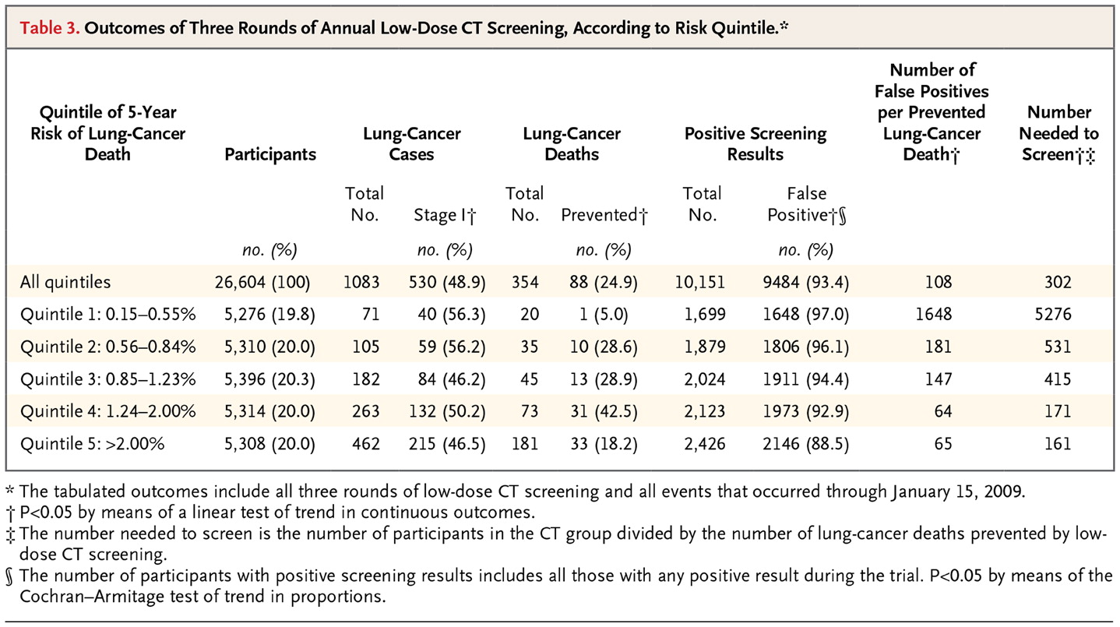

Kovalchik SA et al. N Engl J Med 2013;369:245-254.

Slide 74
Binary Decision: CT Yes/No
Assume CT scanning one who will die of lung CA in the next 5 years is worth CT scanning 100 who will not die
Threshold mortality risk =1%

Slide 75
Net Benefit of Risk Model
 | Total Scans | TP | FP | (TP - FP/100)/N
CT None | 0 | 0 | 0
CT Risk Groups 3,4,5 | 16018 | 376 | 15642 | 8.3/1000
CT w/o risk stratification | 26604 | 442 | 26162 | 6.8/1000

