Slide 1
Combining Tests
Michael A. Kohn, MD, MPP
10/19/2017

Slide 2
Outline: Combining Tests
Evaluating Predictions/Decision Curves Addendum
Independence Conditional on D+/D- (Hard!)
Recursive Partitioning / CART
Logistic Regression
  Digression: Natural Logarithms
Variable (Test) Selection
Validation separate from derivation
NLST Risk Model
Low-Risk Appendicitis Rule

Slide 3
Prediction vs. Causal Inference
  Risk factor
    Causes the disease
    Reducing it may prevent disease
    Confounding is crucial issue in observational studies
  Risk marker (i.e., prognostic factor)
    Predicts the disease
    Not concerned about unmeasured confounders
  Not all risk markers are risk factors…(e.g., CRP, CAC)
  All risk factors are risk markers (but may be weak risk markers)
  Weeks 1-6 (including this week) No Causal Inference. Week 7-9 (evaluating treatments) Causal Inference.

Slide 4
Evaluating Predictions
Model / Robot / Oncologist breaks population into groups with estimated risks.
Compare estimated risks to observed proportion with the outcome

Slide 5
Evaluating Predictions
1) Calibration plot
2) ROC Curve
Before re-calibrating
3) Net benefit calculation
4) Decision curve
After re-calibrating
5) Repeat net benefit calc/decision curve to decide what to do going forward
Notes:
I don’t like the standard calibration plot. I would prefer observed proportion with the outcome on the x-axis and Observed – Predicted on the Y axis.

Slide 6
Calibration Plot
Notes:
MSE = Brier Score = 0.1765 , Bias = 0.147, Variance of Individual Errors = 0.1765 – 0.147^2 = 0.155 SQRT(0.155) = 0.4 = SD of individual Errors.
SQRT(Calibration) = 0.152
TN: QUESTION for next time − are the error bars SD, SE or 95% CI
MAK: I checked. They are 95% Confidence Intervals. That appears to be the standard for calibration plots.
2017 TN: I think your point about horizontal vs vertical distance is an illusion due to the line not being at a 45 degree angle in this figure. For a 45 degree line they will always be the same.
An important take-home message your hinted at but maybe didn’t say directly is that calibration is most (only?) important in the vicinity of the treatment threshold. That great weatherman problem illustrates that point.

Slide 7
Decision Curve
Notes:
Maximum NB is cumulative incidence (P) in the population. This has led to some people using NB/P as the standardized net benefit.
Treat All always crosses horizontal axis at treatment threshold Ptt = cumulative incidence P in the population.
The range of Ptt that is relevant is much narrower than shown here.
A properly calibrated risk model never crosses the horizontal axis into the negative Net Benefit region.
A properly calibrated risk model ALSO never is below the “Treat All” curve.
Note that Oncologist 1 and 3 have the same discrimination as Recalibrated but worse NB. NB reflects both calibration and discrimination.

Slide 8
Decision Curve
Notes:
Maximum NB is cumulative incidence (P) in the population. This has led to some people using NB/P as the standardized net benefit.
Treat All always crosses horizontal axis at treatment threshold Ptt = cumulative incidence P in the population.
The range of Ptt that is relevant is much narrower than shown here.
A properly calibrated risk model never crosses the horizontal axis into the negative Net Benefit region.
A properly calibrated risk model ALSO never is below the “Treat All” curve.

Slide 9
Decision Curve
Notes:
This ranges from B = 9C Ptt = 0.1 to B = 2C Ptt = 0.33 .
The green recalibrated line represents the best you can possibly do. Maximal discrimination and perfect calibration.
Note that Oncologist 3 does worse (lower NB) for some misclassification cost ratios but not for all. Miscalibration may still lead to maximal NB depending on C/B (or Ptt).

Slide 10
Combining Tests
Example
Prenatal sonographic Nuchal Translucency (NT) and Nasal Bone Exam as dichotomous tests for Trisomy 21*
*Cicero, S., G. Rembouskos, et al. (2004). "Likelihood ratio for trisomy 21 in fetuses with absent nasal bone at the 11-14-week scan." Ultrasound Obstet Gynecol 23(3): 218-23.

Slide 11
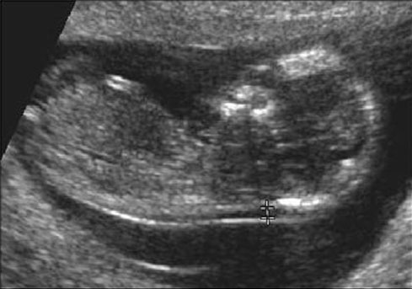
If NT ≥ 3.5 mm Positive for Trisomy 21*
*What’s wrong with this definition?

Slide 13
In general, don’t make multi-level tests like NT into dichotomous tests by choosing a fixed cutoff
I did it here to make the discussion of multiple tests easier
I arbitrarily chose to call ≥ 3.5 mm positive

Slide 14
One Dichotomous Test
Trisomy 21
Nuchal D+ D- LR
Translucency
≥ 3.5 mm 212 478 7.0
< 3.5 mm 121 4745 0.4
Total 333 5223
(212/333)/(478/5223)

Slide 15
NT Positive
Pre-test Prob = 0.06
LR(Result) = 7.0
Post-Test Prob = ?

Slide 16
Clinical Scenario – One Test
Pre-Test Probability of Down’s = 6%
NT Positive
Pre-test prob: 0.06
Pre-test odds: 0.06/0.94 = 0.064
LR(+) = 7.0
Post-Test Odds = Pre-Test Odds x LR(+)
= 0.064 x 7.0 = 0.44
Post-Test prob = 0.44/(0.44 + 1) = 0.31

Slide 17
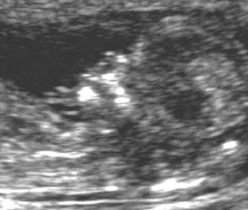
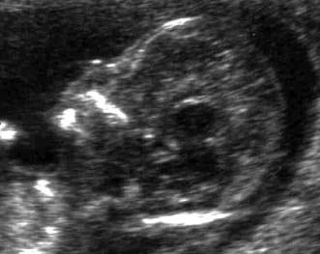
Nasal Bone Seen
NBA=“No”
Neg for Trisomy 21
Nasal Bone Absent
NBA=“Yes”
Pos for Trisomy 21

Slide 18
Second Dichotomous Test
Nasal Bone Tri21+ Tri21- LR
Absent
Yes 229 129 27.8
No 104 5094 0.32
Total 333 5223
(229/333)/(129/5223)

Slide 19
Pre-Test Probability of Trisomy 21 = 6%
NT Positive for Trisomy 21 (≥ 3.5 mm)
Post-NT Probability of Trisomy 21 = 31%
Nasal Bone Absent
LR(NBA) = 27.8
Post-NBA Probability of Trisomy 21 = ?
Clinical Scenario –Two Tests
Using Probabilities

Slide 20
Clinical Scenario – Two Tests
Using Odds
Pre-Test Odds of Tri21 = 0.064
NT Positive (LR = 7.0)
Post-Test Odds of Tri21 = 0.44
Nasal Bone Absent (LR = 27.8?)
Post-Test Odds of Tri21 = .44 x 27.8
= 12.4?
(P = 12.4/(1+12.4) = 92.5%?)

Slide 21
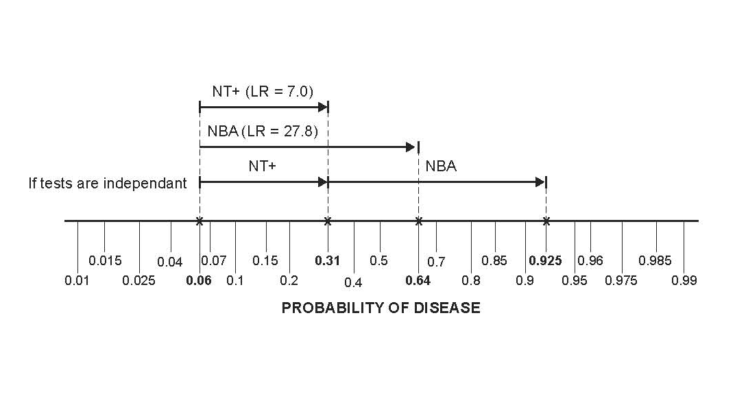
Clinical Scenario – Two Tests
Pre-Test Probability of Trisomy 21 = 6%
NT ≥ 3.5 mm AND Nasal Bone Absent

Slide 22
Question
NT “positive” and Nasal Bone Absent. What is probability of Trisomy 21?
< 92.5%
= 92.5%
> 92.5%
Cannot say

Slide 23
Answer
NT | NBA | Tri21+ | Tri21- |  | Post Test Prob*
Pos | Pos | 158 | 36 | 158/(158+36) | 81%
Pos | Neg | 54 | 442 | 54/(54+442) | 11%
Neg | Pos | 71 | 93 | 71/(71+93) | 43%
Neg | Neg | 50 | 4652 | 50/(50+4652) | 1%
Total | Total | 333 | 5223 | 333/(333+5223) | 6%
*Assumes pre-test prob = 6%

Slide 24
Question
Can we use the post-test odds after a positive Nuchal Translucency as the pre-test odds for the positive Nasal Bone Examination?
i.e., can we combine the positive results by multiplying their LRs?
LR(NT+, NBA +) = LR(NT +) x LR(NBA +) ?
= 7.0 x 27.8 ?
= 194 ?

Slide 25
Answer = No
NT | NBA | Trisomy 21 + | % | Trisomy 21 - | % | LR
Pos | Pos | 158 | 47% | 36 | 0.7% | 69
Pos | Neg | 54 | 16% | 442 | 8.5% | 1.9
Neg | Pos | 71 | 21% | 93 | 1.8% | 12
Neg | Neg | 50 | 15% | 4652 | 89% | 0.2
Total | Total | 333 | 100% | 5223 | 100%
Not 194
158/(158 + 36) = 81%, not 92.5%

Slide 26
Non-Independence
Absence of the nasal bone does not tell you as much if you already know that the nuchal translucency is ≥ 3.5 mm.

Slide 27
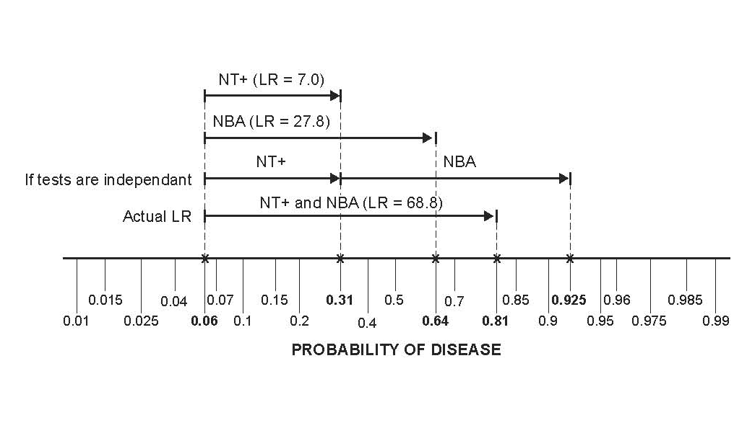
Non-Independence

Slide 28
Non-Independence of NT and NBA
In chromosomally normal (D-) fetuses, a false positive on the NT makes a false positive on the NBA more likely.
Some (but not all) of this may have to do with ethnicity. In this London study, chromosomally normal fetuses of “Afro-Caribbean” ethnicity had both larger NTs and more frequent absence of the nasal bone.
In Trisomy 21 (D+) fetuses, normal NT was associated with the presence of the nasal bone, so a false negative on the NT was associated with a false negative on the NBA.
Notes:
8-8 (d)

Slide 29
Non-Independence of NT and NBA
Of normal (D-) fetuses with NT ≥ 3.5 mm, 7.5% had nasal bone absent. Of normal (D-) fetuses with NT < 3.5 mm only 2.0% had nasal bone absent.
P(NBA+|NT+ & D-) = 0.075
P(NBA+|NT- & D-) = 0.020
Notes:
Among D- fetuses, NBA+ increases the odds of NT+ by a factor of 0.075/0.02 = 3.25.
Odds(NT+|NBA+&D-) = Odds(NT+|D-) * 3.25
They are not independent.

Slide 30
Non-Independence of NT and NBA
If independent,
P(NBA+|NT+&D-) = P(NBA+|NT-&D-) = P(NBA+|D-)
But,
P(NBA+|NT+ & D-) = 0.075
P(NBA+|NT- & D-) = 0.020
Notes:
If conditional independence, Odds(NT+|NBA+&D-) = Odds(NT+|D-), but Odds(NT+|NBA+&D-) = Odds(NT+|D-)*3.25

Slide 31
Non-Independence
Instead of looking for the nasal bone, what if the second test were just a repeat measurement of the nuchal translucency?
A second positive NT would do little to increase your certainty of Trisomy 21. If it was false positive the first time around, it is likely to be false positive the second time.

Slide 32
Reasons for Non-Independence
Tests measure the same aspect of disease.
One aspect of Down’s syndrome is slower fetal development; the NT decreases more slowly and the nasal bone ossifies later. Chromosomally NORMAL fetuses that develop slowly will tend to have false positives on BOTH the NT Exam and NBA.

Slide 33
Reasons for Non-Independence
Heterogeneity of Disease (e.g. spectrum of severity)*.
Heterogeneity of Non-Disease.
(See EBD-1 page 158.)
*In this example, Down’s syndrome is the only chromosomal abnormality considered, so disease is fairly homogeneous

Slide 34
Unless tests are independent (conditional on D+/D-), we can’t combine results by multiplying LRs.
Notes:
“Naïve Bayes” is assuming that tests are conditionally independent, so that you can multiply LRs.

Slide 35
Independence Conditional On Disease Status
In D+ patients,
a false negative on Test 1 does not affect the probability of a false negative on Test 2.
In D- patients,
a false positive on Test 1 does not affect the probability of a false positive on Test 2.

Slide 36
Conditional Independence Does Not Mean Unconditional Independence
P(T₁+ & T₂+ | D-) = P(T₁+|D-)P(T₂+|D-)
P(T₁- & T₂- | D+) = P(T₁-|D+)P(T₂-|D+)
P(T₁+ & T₂+) ≠ P(T₁+)P(T₂+)
If you don’t stratify on D+/D-, then the tests won’t be independent, because a positive on Test 1 makes the patient more likely to have disease and therefore be positive on Test 2.
Notes:
TN: While I got the point, I could not follow the equations above at the speed you went through them.

Slide 37
Ways to Combine Multiple Tests
On a group of patients (derivation set), perform the multiple tests and (independently*) determine true disease status (apply the gold standard)
Measure LR or PV for each possible combination of results
Recursive Partitioning
Logistic Regression
*Beware of incorporation bias

Slide 38
Determine LR for Each Result Combination
NT | NBA | Tri21+ | % | Tri21- | % | LR | Post Test Prob*
Pos | Pos | 158 | 47% | 36 | 0.7% | 69 | 81%
Pos | Neg | 54 | 16% | 442 | 8.5% | 1.9 | 11%
Neg | Pos | 71 | 21% | 93 | 1.8% | 12 | 43%
Neg | Neg | 50 | 15% | 4652 | 89.1% | 0.2 | 1%
Total | Total | 333 | 100% | 5223 | 100%
*Assumes pre-test prob = 6%

Slide 39
Sort by LR (Descending)
NT | NBA | Tri21+ | % | Tri21- | % | LR
Pos | Pos | 158 | 47% | 36 | 0.70% | 69
Neg | Pos | 71 | 21% | 93 | 1.80% | 12
Pos | Neg | 54 | 16% | 442 | 8.50% | 1.9
Neg | Neg | 50 | 15% | 4652 | 89.10% | 0.2
Notes:
8-7 (a)

Slide 40
Apply Chapter 4 – Multilevel Tests
Now you have a multilevel test (In this case, 4 levels.)
Have LR for each test result
Can create ROC curve and calculate AUROC
Given pre-test probability and treatment threshold probability (C/(B+C)), can find optimal cutoff.

Slide 41
Create ROC Table
NT | NBA | Tri21+ | Sens | Tri21- | 1 - Spec
 |  |  | 0% |  | 0%
Pos | Pos | 158 | 47% | 36 | 0.70%
Neg | Pos | 71 | 68% | 93 | 3%
Pos | Neg | 54 | 84% | 442 | 11%
Neg | Neg | 50 | 100% | 4652 | 100%

Slide 42
AUROC = 0.896

Slide 43
Optimal Cutoff
NT | NBA | LR | Post-Test Prob
Pos | Pos | 69 | 0.81
Neg | Pos | 12 | 0.43
Pos | Neg | 1.9 | 0.11
Neg | Neg | 0.2 | 0.01
Assume
Pre-test probability = 6%
Threshold for CVS is 2%
Notes:
8-7 (b)

Slide 44
Determine LR for Each Result Combination
2 dichotomous tests: 4 combinations
3 dichotomous tests: 8 combinations
4 dichotomous tests: 16 combinations
Etc.
2 3-level tests: 9 combinations
3 3-level tests: 27 combinations
Etc.

Slide 45
Determine LR for Each Result Combination
How do you handle continuous tests*?
Not always practical for groups of tests.
*Nuchal Translucency is really a continuous measurement.
Notes:
The “Curse of Dimensionality”. Common dimension reduction techniques from Machine Learning (Principal Components Analysis, Factor Analysis) do not appear to be appropriate to apply in this context.

Slide 46
Recursive Partitioning
Measure NT First

Slide 47
Recursive Partitioning
Examine Nasal Bone First
Notes:
Note that the probabilities at the nodes are P(D+|node), not the proportion of the population that the node represents This will help with at least one of the homework problems. 7.10 (a)

Slide 48
Do Nasal Bone Exam First
Better separates Trisomy 21 from chromosomally normal fetuses
If your threshold for CVS is between 11% and 43%, you can stop after the nasal bone exam
If your threshold is between 1% and 11%, you should do the NT exam only if NBA is negative.

Slide 49
Recursive Partitioning
Examine Nasal Bone First
CVS if P(Trisomy 21 > 5%)

Slide 50
Recursive Partitioning
Examine Nasal Bone First
CVS if P(Trisomy 21 > 5%)
Notes:
Note that the probabilities at the nodes are P(D+|node), not the proportion of the population that the node represents This will help with at least one of the homework problems. 7.10 (a)

Slide 51
Recursive Partitioning
Same as Classification and Regression Trees (CART)
Don’t have to work out probabilities (or LRs) for all possible combinations of tests, because of “tree pruning”
Notes:
Note: Random forests does not utilize pruning, but Random Forests is for machine learning, not for building clinical decision rules.

Slide 52
Recursive Partitioning
Does not deal well with continuous test results*
Results in rules or algorithms, i.e. trees, not scores or formulas
Evaluation with calibration plots, ROC curves, net benefit calculations, and decision curves more difficult
*when there is a monotonic relationship between the test result and the probability of disease
*that have a monotonic relationship with the risk of the outcome.
Notes:
Ch07.57 a(ii)

Slide 53
Logistic Regression
ln(Odds(D+)) =
a + b_{NT}NT+ b_{NBA}NBA + b_{interact}(NT)(NBA)
“+” = 1
“-” = 0

Slide 54
Natural Logarithms
10^{b} = a; b = log(a)
e^{b’} = a’; b’ = ln(a’)
ln(10) = 2.3
ln(a’) = 2.3×log(a’)

Slide 55
ln(a) = 2.3×log(a)
a | Log(a) | Ln(a)
1 | 0 | 0
2 | 0.30 | 0.69
3 | 0.48* | 1.10
4 | 0.60 | 1.38
5 | 0.70 | 1.61
6 | 0.78* | 1.79
7 | 0.85 | 1.96
8 | 0.90 | 2.07
9 | 0.95 | 2.19
10 | 1.00 | 2.3

Slide 56
ln(xy) = ln(x) + ln(y) ln(x/y) = ln(x) – ln(y)
Notes:
The logarithm of the product is the sum of the logarithms

Slide 57
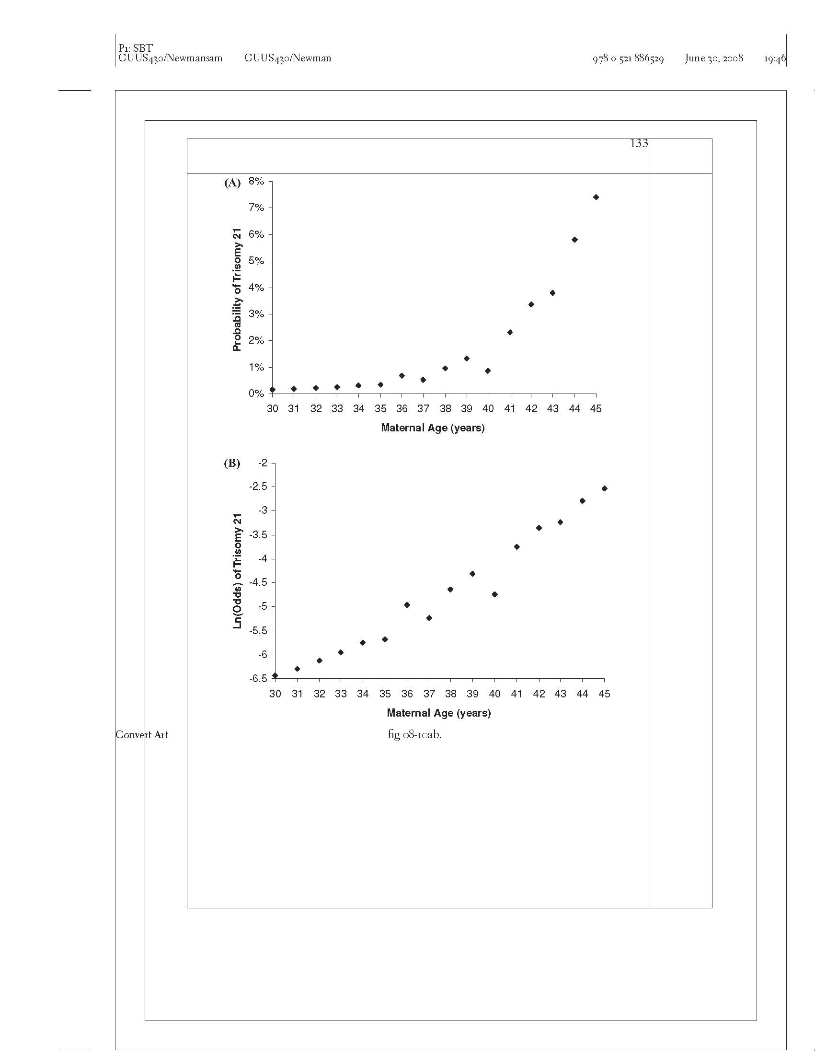
Probability of Trisomy 21 vs. Maternal Age
Notes:
TN: You could put the data source on the slide. I wonder what happened at age 40?

Slide 58
Ln(Odds) of Trisomy 21 vs. Maternal Age

Slide 59
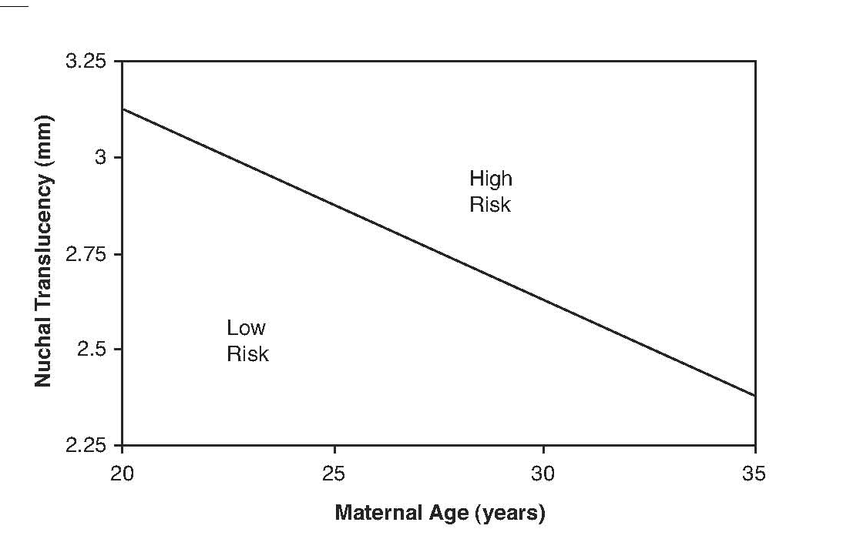
Combining 2 Continuous Tests
> 1% Probability of Trisomy 21
< 1% Probability of Trisomy 21
Notes:
Note, you couldn’t represent this with a tree.

Slide 60
Logistic Regression
ln(Odds(D+)) =
a + b_{NT}NT+ b_{NBA}NBA + b_{interact}(NT)(NBA)
Used to create risk scores, formulas,or nomograms, not trees.
Evaluation with calibration plots, ROC curves, net benefit calculations, and decision curves is natural

Slide 61
Logistic Regression Coefficients
ln(Odds(D+)) =
a + b_{NT}NT+ b_{NBA}NBA + b_{interact}(NT)(NBA)
Coefficient b_{NBA}= ln(OR_{NBA})
e^{b} = OR_{NBA}
OR_{NBA} = Odds(D+|NBA+) / Odds(D+|NBA-)
Notes:
This would be very tough for people who had never had logistic regression before.

Slide 62
Choosing Which Tests to Include in the Decision Rule
“Use well-established theory, past research, clinical observations, preliminary statistical analysis, or some sensible combination of these ….”
Stoltzfus, J. C. (2011). "Logistic regression: a brief primer." Acad Emerg Med 18(10): 1099-1104.
Notes:
Machine learning algorithms tend to use the whole dataset (all variables). In random forests, variable selection is done randomly and then all the rules are combined in an ensemble. The records are also selected randomly, which is called bootstrap aggregation. Bootstrap aggregation is different from cross-validation, because it is random sampling of records with replacement.

Slide 63
Need for Validation
Develop prediction rule by choosing a few tests and findings from a large number of candidates, based on which work the best.
Takes advantage of chance variations in the data.
Predictive ability of rule will probably decrease or even disappear when you try to validate on a new dataset.
Can be referred to as “overfitting.”

Slide 64
Need to Test the Rule in a Separate Dataset
Derivation → Validation
Training → Test
Beware of Tweaking the Rule

Slide 65
Validation Dataset
Measure all the variables needed for the model.
Determine disease/outcome status (D+ or D-) on all subjects.

Slide 66
NLST Lung CA Mortality
Risk Prediction Model
Regression model converts the following variables* into a risk of lung cancer death within 5 years
Age
BMI
Family history of lung cancer
Pack-years of smoking
Years since smoking cessation
Emphysema diagnosis
*Sex and Race were not included in the model (?)

Slide 67
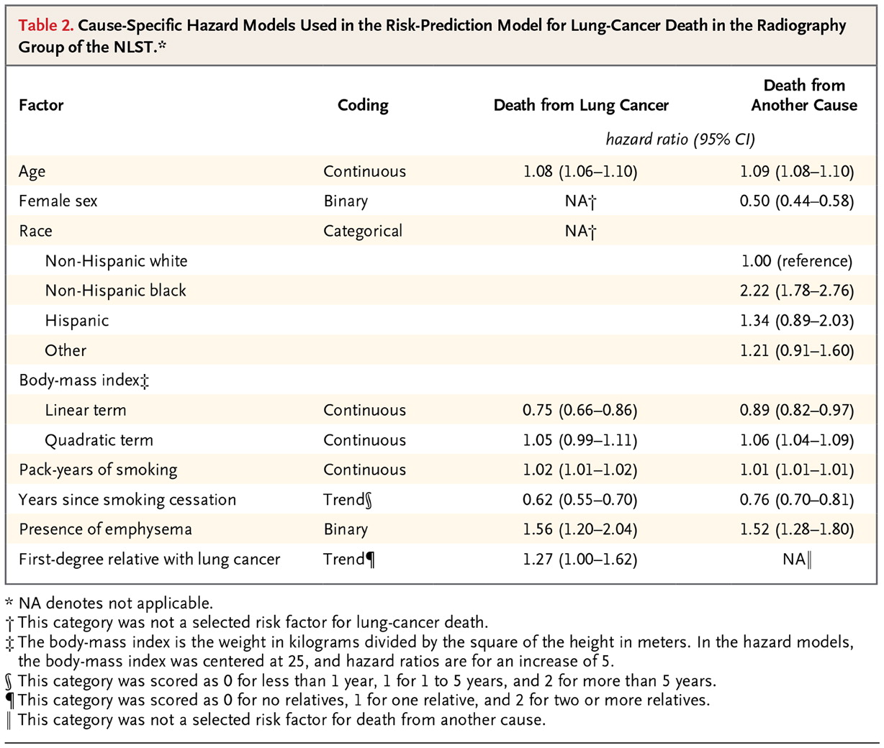

Kovalchik SA et al. N Engl J Med 2013;369:245-254.
Notes:
Hazard ratios, not odds ratios.

Slide 68
NLST Lung CA Mortality
Risk Prediction Model
Risk Group | 6.5-year Mortality Risk
ALL | 1.66%
1 | 0.4%
2 | 0.85%
3 | 1.1%
4 | 2.0%
5 | 4.0%

Slide 69
NLST Lung CA Mortality
Risk Prediction Model
Notes:
9:59 here
The distinction between goodness of fit and calibration was not clear to me. If a logistic model fits well won’t it be well calibrated? Although I’m not sure that bad fit would always show up as poor calibration.

Slide 70
NLST Lung CA Mortality Risk Prediction Model
Both AUROC reported as 0.72 (0.69-0.75) Type III Error?

Slide 71
Binary Decision: CT Yes/No
Assume CT scanning one who will die of lung CA in the next 5 years is worth CT scanning 100 who will not die
Threshold mortality risk =1%

Slide 72
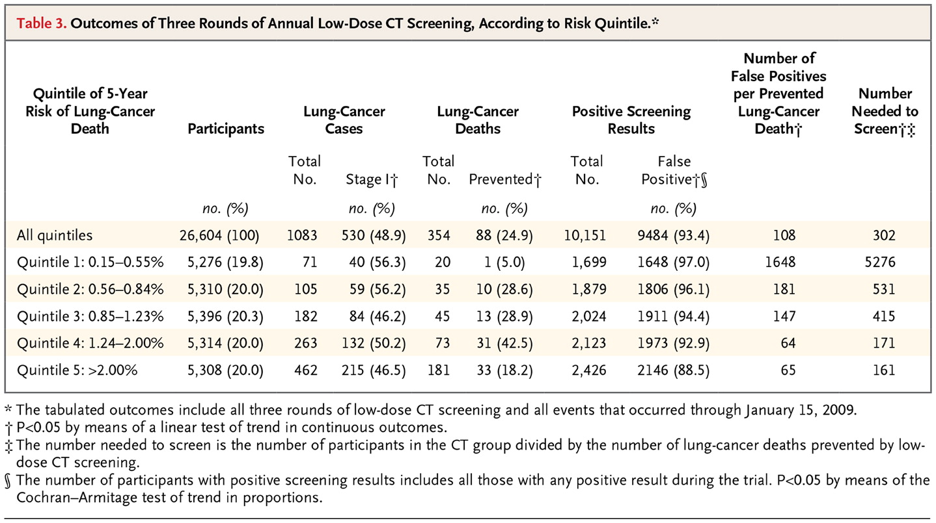
Kovalchik SA et al. N Engl J Med 2013;369:245-254.

Slide 73
Net Benefit of Risk Model
 | Total Scans | TP | FP | (TP - FP/100)/N
CT None | 0 | 0 | 0
CT Risk Groups 3,4,5 | 16018 | 376 | 15642 | 8.3/1000
CT w/o risk stratification (Treat All) | 26604 | 442 | 26162 | 6.8/1000

Slide 74
NLST Risk Model Decision Curve
Notes:
This is approximate. MAK.
TN: Do you do these in Excel? I downloaded the DCA software for Stata but have not used it yet.

Slide 75
Example of Recursive Partitioning: Kharbanda Low Risk Appendicitis Rule
Multivariable rule to determine which children to CT scan for appendicitis
Objective: Identify patients at low risk
2005: Derivation (N=425) and initial validation (N=176)
2012: Repeat validation (N=2390) and “refinement” (N=2625)

Slide 76
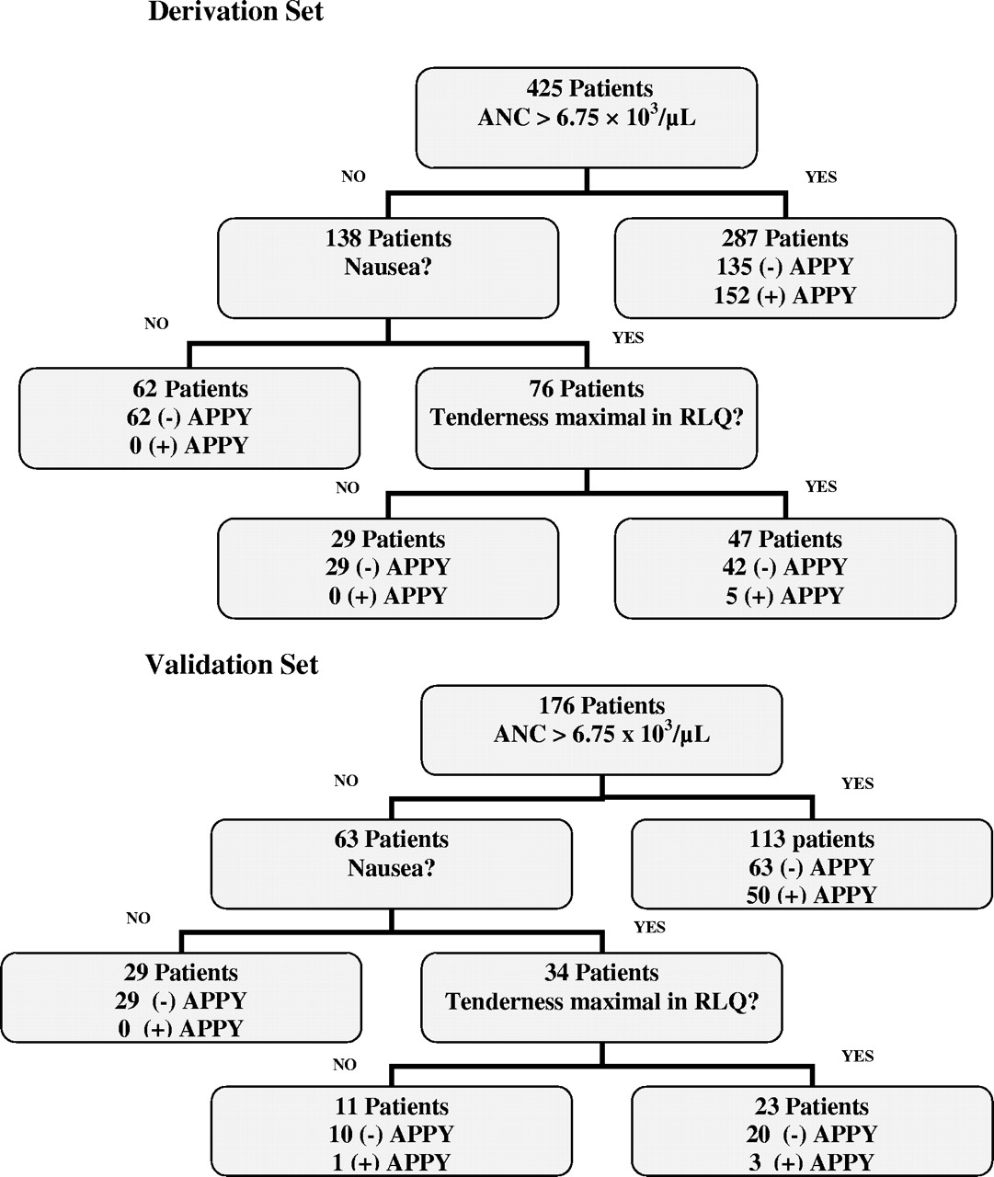
Low-risk decision tree that was created using recursive partitioning.
21% assigned to Low Risk
Low Risk Group: 0%
Higher Risk Group: 47%
Overall Risk: 37%
Anupam B. Kharbanda et al. Pediatrics 2005;116:709-716
©2005 by American Academy of Pediatrics
Notes:
Low-risk decision tree that was created using recursive partitioning. APPY indicates appendicitis.

Slide 77

Low-risk decision tree that was created using recursive partitioning.
23% assigned to Low Risk
Low Risk Group: 1/40 = 2.5%
Higher Risk Group: 39%
Overall Risk: 31%
Anupam B. Kharbanda et al. Pediatrics 2005;116:709-716
©2005 by American Academy of Pediatrics
Notes:
Low-risk decision tree that was created using recursive partitioning. APPY indicates appendicitis.

Slide 78
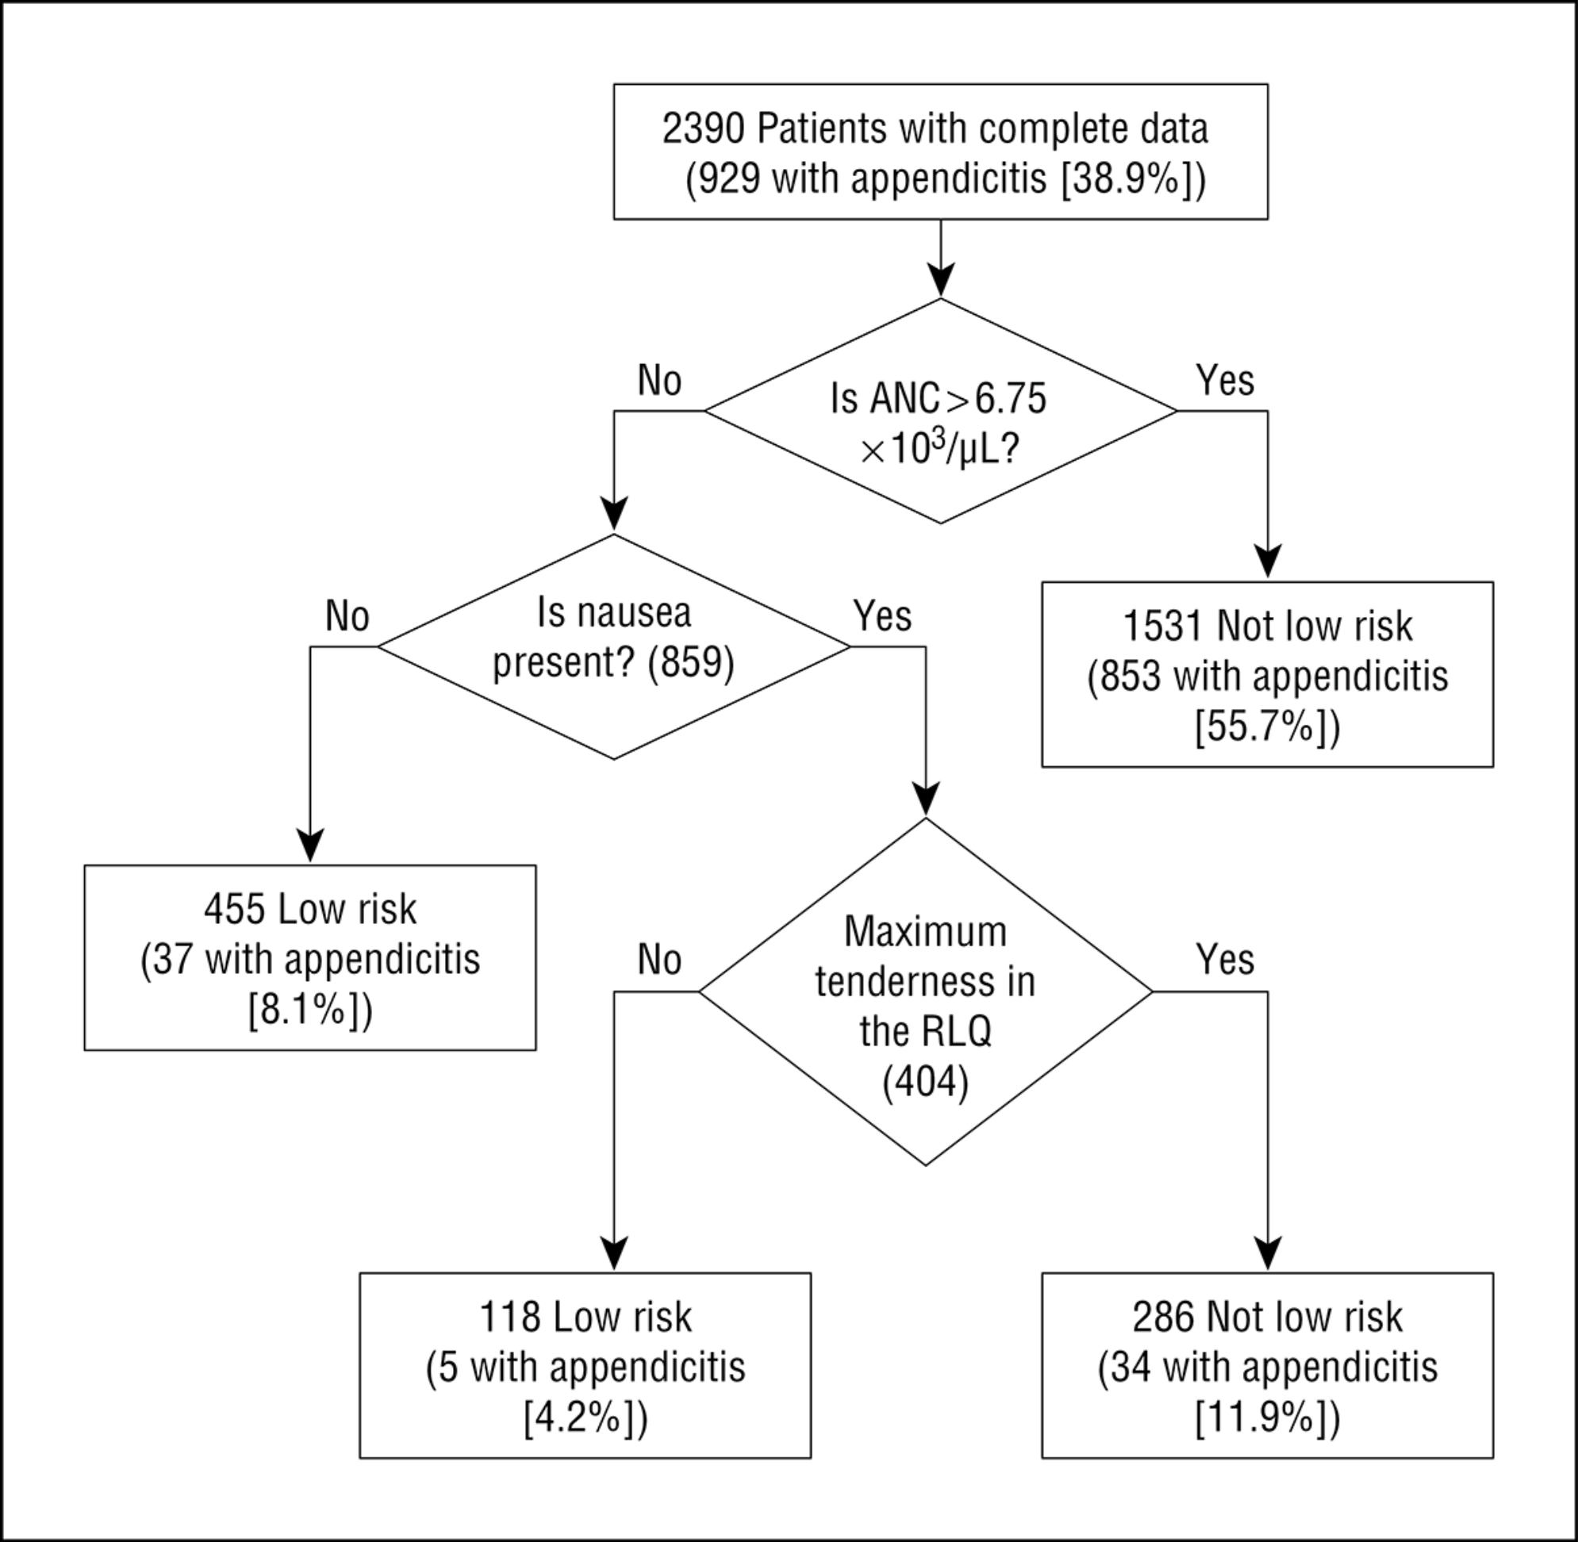
From: Validation and Refinement of a Prediction Rule to Identify Children at Low Risk for Acute Appendicitis
Arch Pediatr Adolesc Med. 2012;166(8):738-744. doi:10.1001/archpediatrics.2012.490
2012 Validation:
24% assigned to Low Risk
Low Risk Group: 42/573 = 7.3%
Higher Risk Group: 49%
Overall Risk: 39%
2005 Validation:
23% assigned to Low Risk
Low Risk Group: 1/40 = 2.5%
Higher Risk Group: 39%
Overall Risk: 31%
Figure 2. Effect of hypothetical application of the Low-Risk Appendicitis Rule. ANC indicates absolute neutrophil count (to convert count to ×10⁹ per liter, multiply by 1); RLQ, right lower quadrant.
Copyright © 2015 American Medical Association. All rights reserved.

Slide 79
Notes:
Calibration plots and ROC Curves not that useful for recursive partitioning models.
Reminder that
Points on calibration plot correspond to intervals on ROC curve
Low left on calibration plot corresponds to high right on the ROC curve

Slide 80
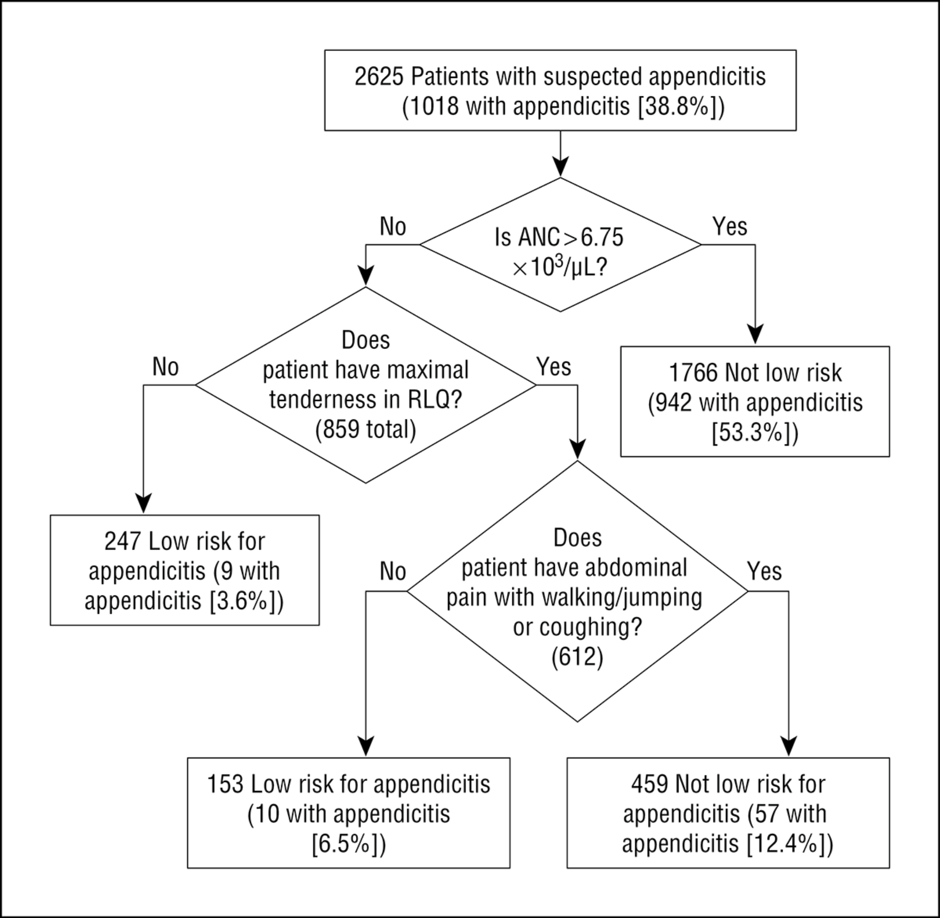
From: Validation and Refinement of a Prediction Rule to Identify Children at Low Risk for Acute Appendicitis
Arch Pediatr Adolesc Med. 2012;166(8):738-744. doi:10.1001/archpediatrics.2012.490
2012 Validation:
24% assigned to Low Risk
Low Risk Group: 42/573 = 7.3%
Higher Risk Group: 49%
Overall Risk: 39%
2012 Refinement:
15% assigned to Low Risk
Low Risk Group: 19/400 = 4.8%
Higher Risk Group: 45%
Overall Risk: 39%
Figure 3. Refined Low-Risk Appendicitis Rule and rule performance. ANC indicates absolute neutrophil count (to convert count to ×10⁹ per liter, multiply by 1); RLQ, right lower quadrant.
Copyright © 2015 American Medical Association. All rights reserved.

Slide 81
Outline: Combining Tests
Evaluating Predictions/Decision Curves Addendum
Independence Conditional on D+/D- (Hard!)
Recursive Partitioning / CART
Logistic Regression
  Digression: Natural Logarithms
Variable (Test) Selection
Validation separate from derivation
NLST Risk Model
Low-Risk Appendicitis Rule

