Slide 1
Graphics to tell a story: Oakland A’s*
2004: Moneyball published by Michael Lewis
2011: The film ‘Moneyball’ released
  The film ends with the A’s winning their 20th consecutive game in 2002.
  It’s now 2017:
Did Moneyball continue to work for the Oakland A’s?
Was Moneyball a sustainable practice?
How far did Oakland go this year?
*“Fair or Foul? The innovative Moneyball management approach can make a difference—up to a point,” Julia E. Seaman & I. Elaine Allen, Journal of Quality Progress, April, 2012.

Slide 2
Moneyball & the Oakland A’s: Background*
*Excel plot

Slide 3
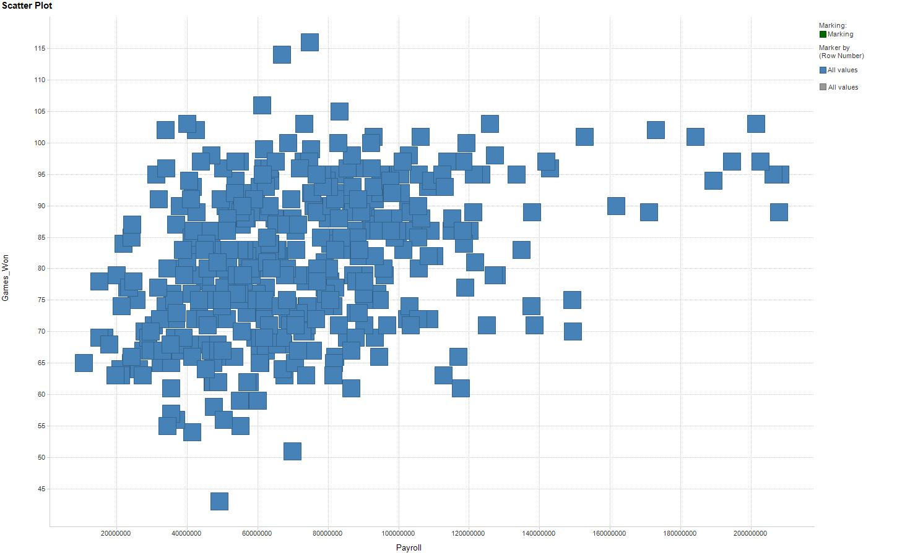
Payroll vs. Games Won*
*analysis & graphics completed with Excel & Spotfire

Slide 4
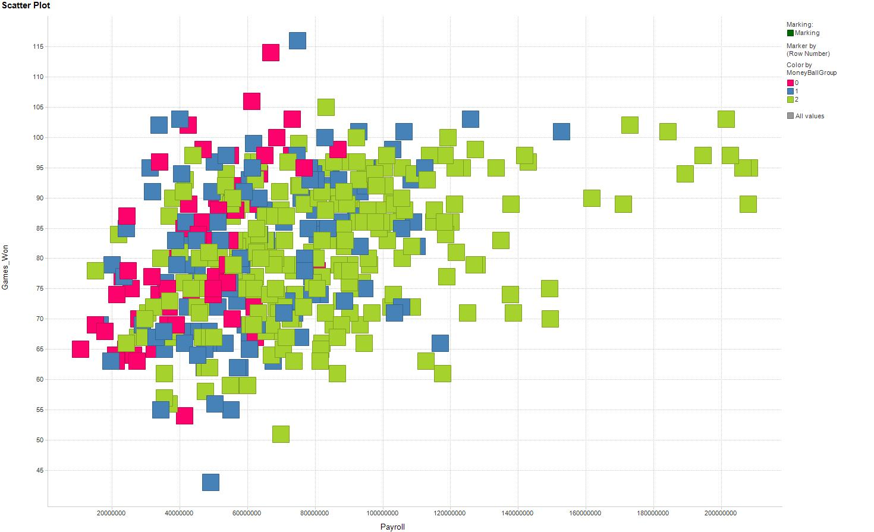
Overlay colors where Red = Pre-MoneyBall, Blue = MoneyBall, and Green is Post-MoneyBall

Slide 5
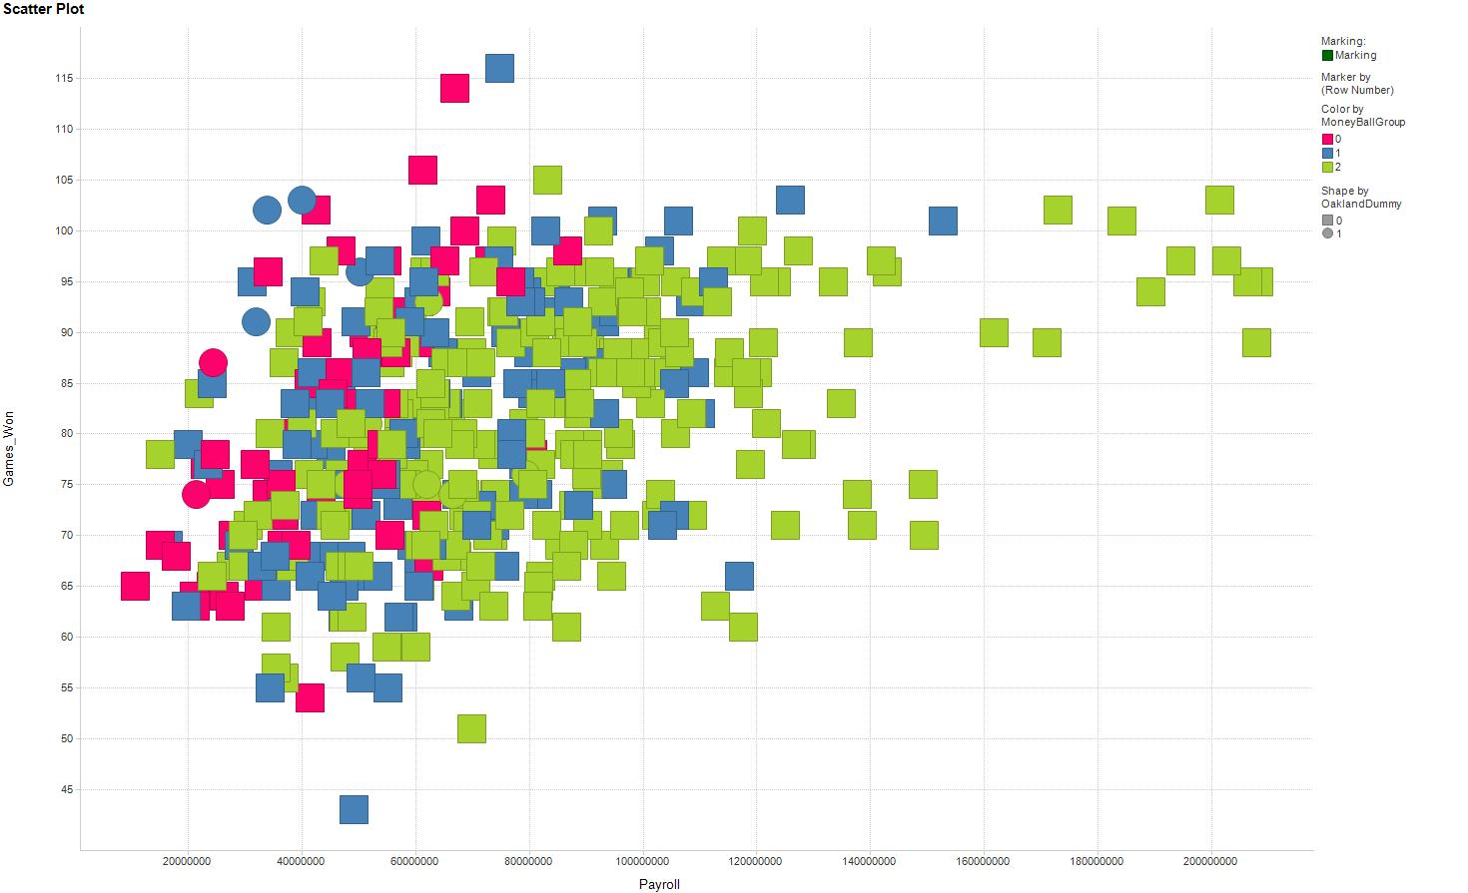
Add Circles for Oakland so BLUE Circles = Oakland & MoneyBall

Slide 6
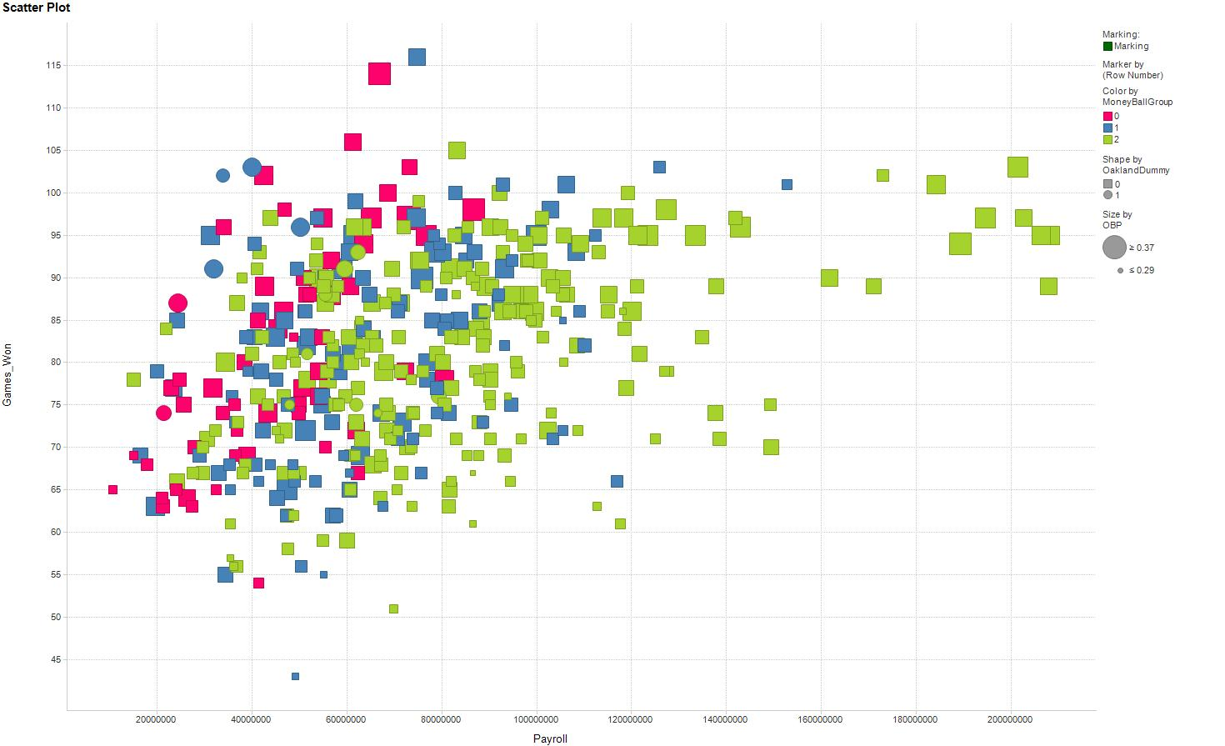
Add size to indicate the OBP for a team . . . Oakland looking good!
But did it help them get to the Post Season?

Slide 7
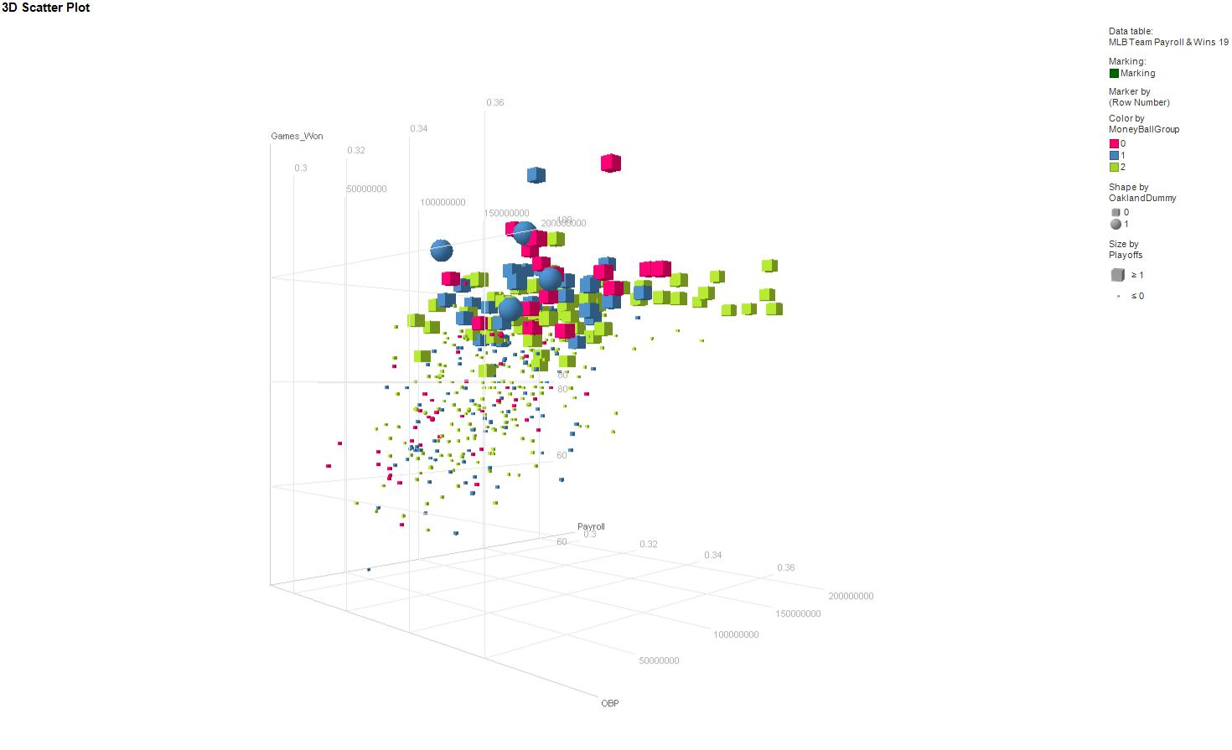
Now in 3D – Look at Oakland during the MoneyBall era getting into the playoffs…but does using only one metric (OBP) = success?

Slide 8
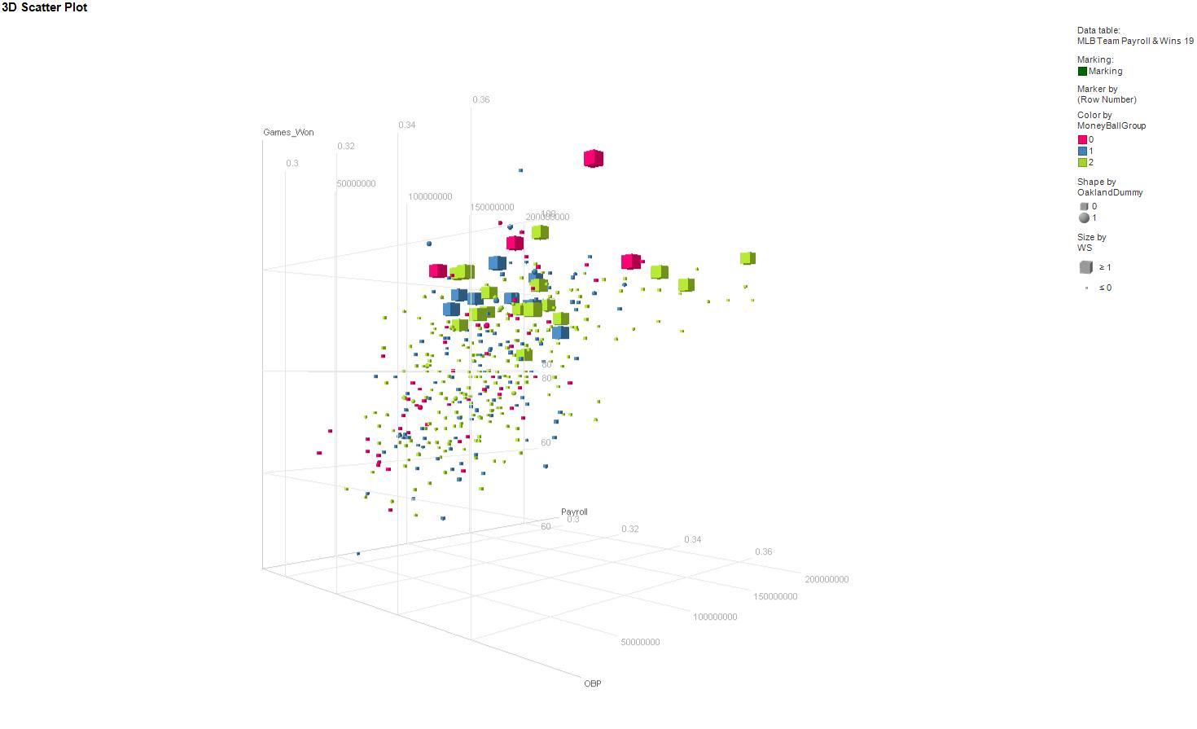
Sadly no, analytics can get you to the party but maximizing only one metric (offense) will not win you everything.

Slide 9
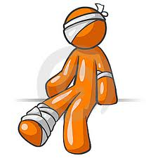
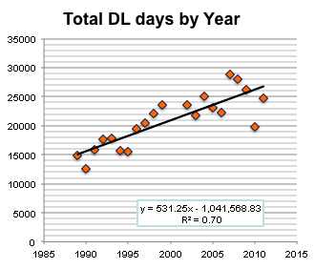
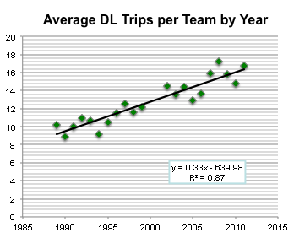
MLB & the LA Dodgers: The Injury Project
Increasing number of players injured per year
Increasing cost of injuries
Negative correlation to training

Slide 10
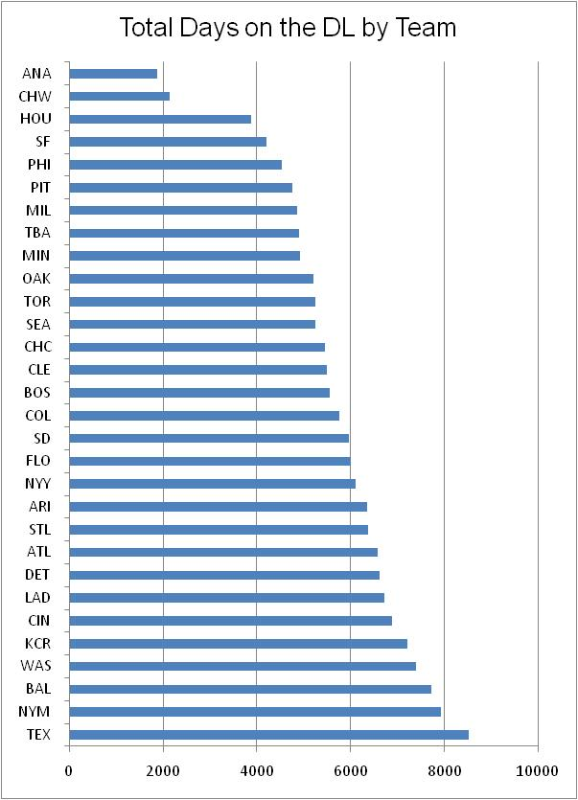
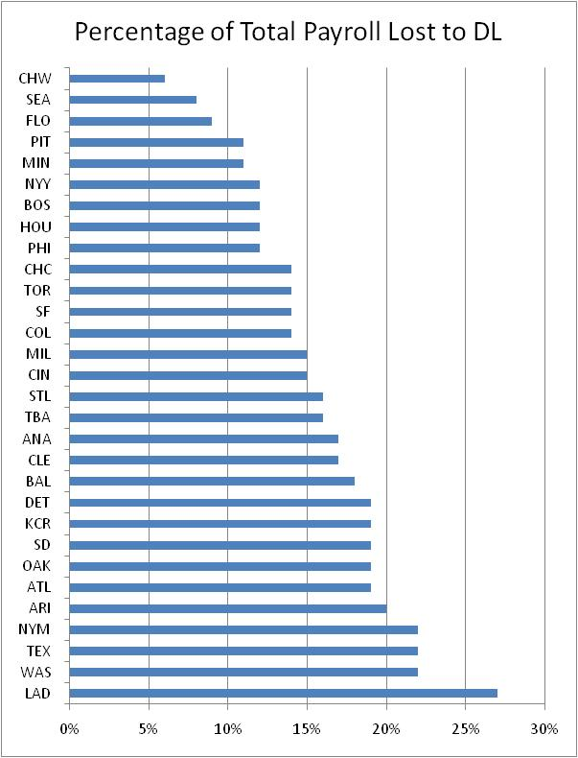
MLB & the LA Dodgers: The Injury Project

Slide 11
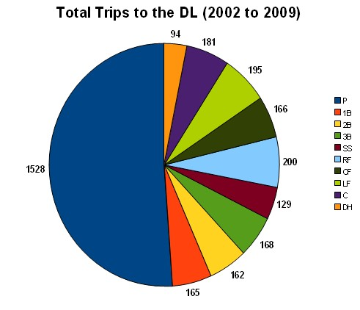
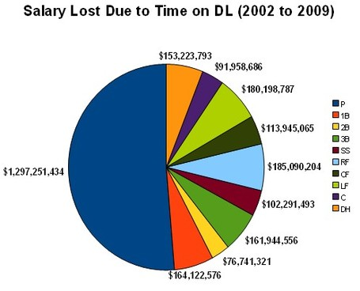
MLB & the LA Dodgers: The Injury Project
It’s all about the pitchers
Need more detailed information about injuries by position …

Slide 12
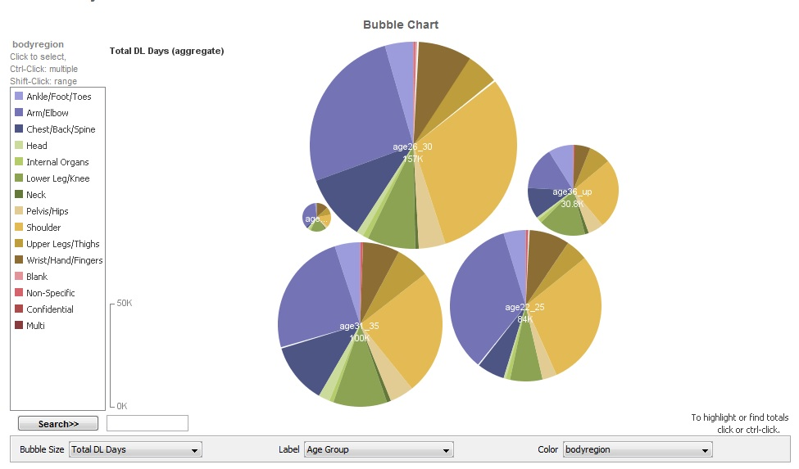
What about Age & Position: Using manyeyes
http://www-958.ibm.com/software/analytics/labs/manyeyes/#home
http://www-958.ibm.com/software/analytics/labs/manyeyes/#vis=501453

Slide 13
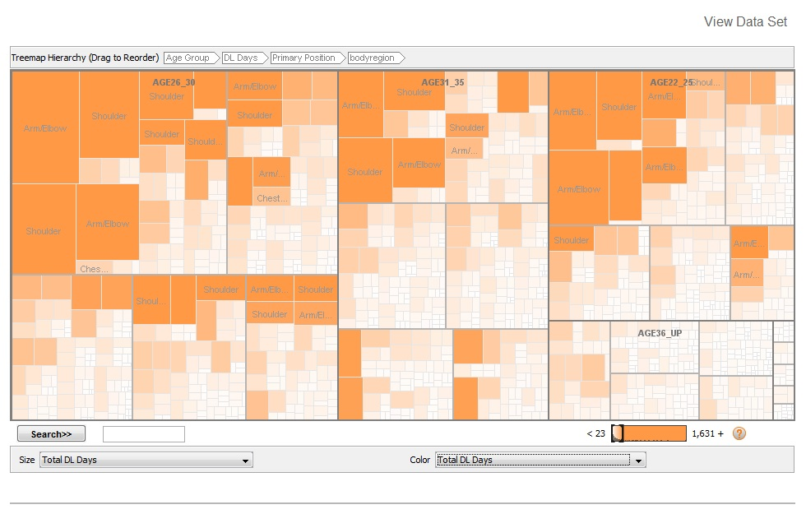
What about Age & Position: Using manyeyes
http://www-958.ibm.com/software/analytics/labs/manyeyes/#home
http://www-958.ibm.com/software/analytics/labs/manyeyes/#vis=501453

Slide 14
How to Estimate the Impact of being on the DL
Examine the team performance pre & post the time that the player is on the DL (W/L ratio). Calculate the difference with the player on the field and on the DL*
Example:
  Damian Rolls, 2004 TB: Chest contusion
  DL May 24- July 2, 39 days
  TB’s record during DL time: 25-10 (0.714)
  TB’s season 2004 record: 70-91 (0.435)
  Rolls’ DL W/L difference is -0.2795
    Tampa Bay winning percentage was almost 30% higher without Rolls
*”Better Training, Better Analytics, & More Players on the DL,” Julia E. Seaman & I. Elaine Allen, Presented at the AmerStatAsso, Montreal, 2015

Slide 15
Pitchers
Chart showing the difference between the W/L% of the team’s season and while the player was on the DL against total DL days, for pitchers.
Rank | Player | Team | Year | Pos | Date on DL | Date off DL | Total Days | WL% Dif | Injury
1 | Joey Devine | OAK | 2011 | P | 27-Sep-2011 | 2-Nov-2011 | 1 | -0.5432 | rhomboid strain
2 | Felix Doubront | BOS | 2011 | P | 22-Mar-2011 | 8-Apr-2011 | 8 | 0.4127 | forearm inflammation
3 | Jon Lieber | PHI | 2007 | P | 25-Mar-2007 | 9-Apr-2007 | 15 | 0.4065 | Strained right oblique
4 | Hector Ambriz | CLE | 2010 | P | 23-Sep-2010 | 3-Oct-2010 | 10 | -0.3519 | Right elbow inflammation
5 | Armando Benitez | SF | 2006 | P | 14-Sep-2006 | 2-Oct-2006 | 18 | 0.3387 | Right knee inflammation
6 | Yorkis Perez | BAL | 2002 | P | 16-Sep-2002 | 30-Sep-2002 | 14 | 0.3367 | Appendectomy
7 | Dennis Sarfate | BAL | 2008 | P | 17-Sep-2008 | 30-Sep-2008 | 13 | 0.3315 | Fractured clavicle
8 | Joaquin Benoit | TEX | 2003 | P | 1-Jun-2003 | 22-Jun-2003 | 21 | 0.3272 | Tendinitis in right shoulder
9 | Brad Penny | LAD | 2005 | P | 5-Apr-2005 | 24-Apr-2005 | 19 | -0.3264 | Nerve irritation - right arm
10 | Terry Mulholland | ARZ | 2006 | P | 6-Jun-2006 | 21-Jun-2006 | 15 | 0.3263 | Inner ear infection
11 | Brad Lidge | PHI | 2009 | P | 7-Jun-2009 | 26-Jun-2009 | 19 | 0.3241 | Sprained right knee
12 | Matt Ginter | CLE | 2008 | P | 7-Aug-2008 | 25-Aug-2008 | 18 | -0.3235 | Strained right forearm
13 | Dan Miceli | HOU | 2004 | P | 22-Aug-2004 | 9-Sep-2004 | 18 | -0.3210 | Conjunctivitis
14 | Mike Remlinger | CHC | 2005 | P | 21-May-2005 | 5-Jun-2005 | 15 | -0.3123 | Fractured finger - left hand
15 | Daniel Cabrera | BAL | 2008 | P | 19-Sep-2008 | 30-Sep-2008 | 11 | 0.3112 | Sprained pitching elbow

Slide 16
Position Players
Chart showing the difference between the W/L% of the team’s season and while the player was on the DL against total DL days, colored by position
Rank | Player | Team | Year | Pos | Date on DL | Date off DL | Total Days | WL% Dif | Injury
1 | Denard Span | MIN | 2011 | OF | 10-Jun-2011 | 23-Jun-2011 | 13 | -0.4111 | head concussion
2 | Jeff Kent | SF | 2002 | 2B | 21-Mar-2002 | 6-Apr-2002 | 15 | -0.4099 | Fractured left wrist
3 | Yuniesky Betancourt | KC | 2009 | SS | 11-Jul-2009 | 16-Jul-2009 | 5 | 0.4012 | Strained right hamstring
4 | Jacque Jones | MIN | 2003 | OF | 1-Jul-2003 | 17-Jul-2003 | 16 | 0.3889 | Strained left groin
5 | Chris Coste | PHI | 2007 | C | 24-Mar-2007 | 8-Apr-2007 | 15 | 0.3827 | Strained hamstring
6 | Anderson Hernandez | WAS | 2009 | 2B | 5-Apr-2009 | 13-Apr-2009 | 8 | 0.3642 | Strained left hamstring
7 | Josh Willingham | FLA | 2006 | OF | 7-Jun-2006 | 22-Jun-2006 | 15 | -0.3519 | Strained ligament - left hand
8 | Jim Thome | MIN | 2011 | DH | 2-Jun-2011 | 24-Jun-2011 | 22 | -0.3480 | quadriceps strain
9 | Gary Matthews Jr. | BAL | 2002 | OF | 25-Aug-2002 | 11-Sep-2002 | 17 | 0.3469 | Right wrist tendinitis
10 | Juan Encarnacion | LAD | 2004 | OF | 4-Jul-2004 | 19-Jul-2004 | 15 | -0.3426 | Left shoulder tendinitis
11 | Dean Palmer | DET | 2002 | DH | 24-Mar-2002 | 7-Apr-2002 | 15 | 0.3416 | Shoulder stiffness
12 | Brandon Inge | DET | 2002 | C | 12-May-2002 | 27-May-2002 | 15 | -0.3251 | Dislocated left shoulder
13 | Kevin Youkilis | BOS | 2004 | 3B | 16-Aug-2004 | 1-Sep-2004 | 16 | -0.3236 | Bruised right ankle
14 | Geoff Blum | SD | 2005 | 3B | 30-Apr-2005 | 18-May-2005 | 18 | -0.3174 | Left chest contusion
15 | Clete Thomas | DET | 2008 | OF | 4-Jun-2008 | 19-Jun-2008 | 15 | -0.3124 | Sprained right ankle

Slide 17
Team Effects?
Rank | Pos | Trips | Ave Dif WL%
1 | C | 284 | 0.0110
2 | 3B | 242 | 0.0070
3 | 2B | 248 | 0.0037
4 | SS | 206 | 0.0031
5 | OF | 804 | 0.0029
6 | P | 2443 | 0.0021
7 | DH | 60 | -0.0023
8 | 1B | 198 | -0.0046
Team | Direction | R2
ARZ | - | 0.16568
ATL | - | 0.54194
BAL | + | 0.01572
BOS | - | 0.0226
CHC | + | 0.00052
CIN | - | 0.73704
CLE | - | 0.13732
COL | - | 0.00114
CWS | - | 0.20728
DET | - | 0.00667
FLA | + | 0.00113
HOU | - | 0.63405
KC | - | 0.18294
LAA | + | 0.05581
LAD | - | 0.25082
MIN | - | 0.16924
MLW | - | 0.06054
NYM | + | 0.0149
NYY | - | 0.18393
OAK | - | 0.64791
PIT | + | 0.04208
SD | - | 0.57971
SEA | - | 0.00057
SF | - | 0.20632
STL | - | 0.32249
TB | - | 0.08225
PHI | + | 0.24191
TEX | - | 0.01923
TOR | - | 0.08326
WAS | - | 0.04226
This is a summary table of linear regressions of total DL Days and season WL%, 2002-2011 for each team. A few teams show a larger direct correlation (always negative) but most teams are very loosely affected.
Overall, teams did slightly worse while players were on DL
  Mean DifWL%= 0.003 (not significantly different)
  Teams lost most without catchers and won most without 1st Basemen.
Infield players hurt a team more than outfielders

Slide 18
Motivating Example: UCSF Project Studying Pedestrians Hit by Cars in San Francisco
Adjusting the traffic-related injury by age, gender, occupation, # of dependents and ethnicity. Map the injuries and use DALYs for San Francisco for comparisons to global, regional, state, and city trends.
  Overall Mean Disability weight for an ankle sprain = 0.064 YLD or 14 days
  A 38 year old male with a life expectancy of 77 years who sprains his ankle has a DALY of 0.03 years or 11 days
  A 66 year old male with the same injury has a DALY or 0.06 years or 22 days
Question for SF: Where are traffic lights needed?
SHORT QUIZ on San Francisco auto/pedestrian accidents:
  When do most pedestrians get hit by cars?
  What neighborhood or area are they most likely to get hit?
  What is the most likely confounding variable in getting hit by a car?
  What gender and age group(s) are most likely hit by a car?

Slide 19
Creating Disability Adjusted Player Days (DAPD)
  Disability Adjusted Player Days (DAPD) adjusted for:
    Average time lost for an injury
    Previous injuries
    Position the player plays
    Age of the player
    Expected future playing years in the MLB
    Years in position in MLB
    Years in a contract
    Team you play for
    Others?

Slide 20
Example: Creating the DAPD for a Catcher with an Ankle Sprain
  DAPD $= −\left[\frac{DCe^{−βa}}{{\left(β+r\right)}^{2}}\right]\left[e^{−\left(β+r\right)(L)}\left(1+(β+r)(L+a)\right)−(1+\left(β+r\right)a)\right]$
L = Adjust for average time lost for an injury
  mean = 44 days, median = 40 days [15 to 140]*
C = age of the player = 33 years old in this example
r = Standard discounted lifespan of 3% per year
DW = Disability weight for an ankle sprain = 0.064
Calculate β for adjustment factors:
K₁ = Adjust for expected future years the player will play this catcher reached the MLB at age 25, & probably has at most 4 more active years
K₂ = Adjust for time already played in MLB = 8 years
K₃ = Adjust for Catcher DL days mean = 49 days, median = 29 days
*based on 14 years of DL data including MLB EMR data

Slide 21
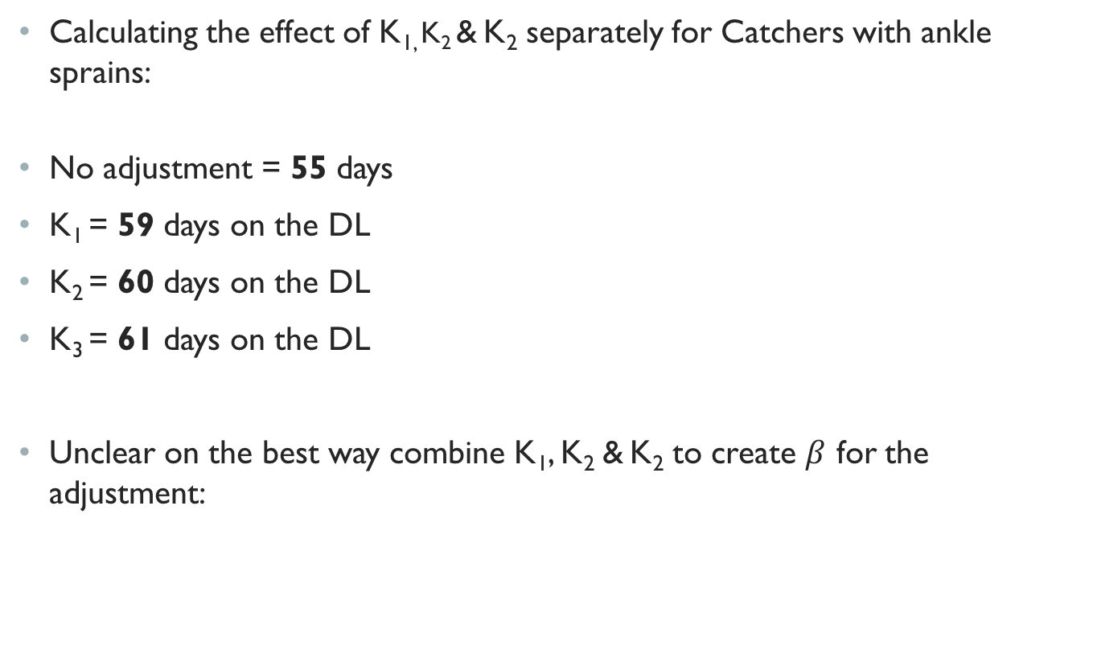
Example: Creating the DAPD for a Catcher with an Ankle Sprain
Calculating the effect of K_{1,} K₂ & K₂ separately for Catchers with ankle sprains:
No adjustment = 55 days
K₁ = 59 days on the DL
K₂ = 60 days on the DL
K₃ = 61 days on the DL
Unclear on the best way combine K₁, K₂ & K₂ to create $β$ for the adjustment:

Slide 22
Example: Sensitivity of Adjustments
Given you are a catcher, as age changes from 25 to 35, the DL days for an ankle sprain increase by .25 per year
Given you are 35 years old, as position changes, DL days change:
Given you are a Catcher, as time in the majors changes (as % of overall expected playing time):
AGE | 25 | 26 | 27 | 28 | 29 | 30 | 31 | 32 | 33 | 34 | 35
DL Days | 45.95 | 46.18 | 46.39 | 46.60 | 46.80 | 46.99 | 47.16 | 47.33 | 47.48 | 47.63 | 47.77
Position | 1B | 2B | 3B | C | DH | LHR | LHS | OF | RHR | RHS | SS
DL Days | 51 | 52 | 53 | 57 | 66 | 71 | 80 | 60 | 80 | 86 | 71
Fraction of expected MLB time | 90% | 85% | 80% | 75% | 70% | 65% | 60% | 55% | 50%
DL Days | 70.96 | 67.88 | 65.34 | 63.22 | 61.42 | 59.89 | 58.57 | 57.43 | 56.43
(DL years 1998 – 2012):
  Only one player was on the DL because of a bullet wound
  Only one player was on the DL because of insomnia
  Troy O’Leary, Russ Johnson, & Trip Cromer are the only 3 players to
  go on the DL for this.

