Slide 1
Life tables
Migration and Urbanization

Slide 2
Life tables

Slide 3
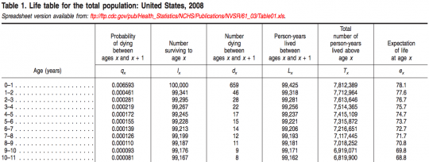
Life table: US mortality

Slide 4
Life Tables
The life table conceptually traces a cohort of newborn babies through their entire life under the assumption that they are subject to the current observed schedule of age- specific mortality rates
The life table records the passage of a cohort from birth to extinction, or when the last member has died, according to a set of fixed age specific probabilities of death/failure
As age increases, the number of survivors of the original group declines
Life Tables looks at the likelihood of an event occurring in the next time period (day, week, year) given survival to the beginning of the time period

Slide 5
Why do we use life tables?
Any question that concerns the probability of an event
To analyze any measurable process that involves a time pattern of exit from or entry into a particular state (e.g., births and deaths)
Estimate age/time specific risks
Examine changes in rates
Population growth and change (generate projections of the size and characteristics of future populations based on some initial base population.)
Compare health levels across two populations or one population over time

Slide 6
Not just life and death!
Mortality/Survival (people, cars, appliances)
Recidivism
Disability (Active Life Expectancy)
Marriage/cohabitation
Working Life (retirement, unemployment)
Contraceptive Use (effectiveness, discontinuation, switching)
Fertility (1st and higher order births, spacing, time to first sex)
Breastfeeding
Cancer survival

Slide 7
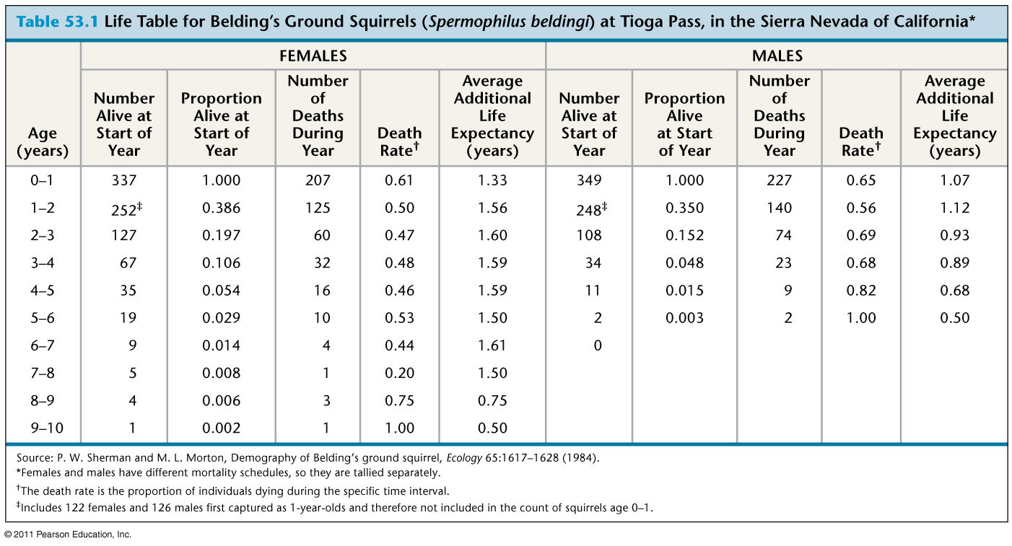
Squirrels!

Slide 8
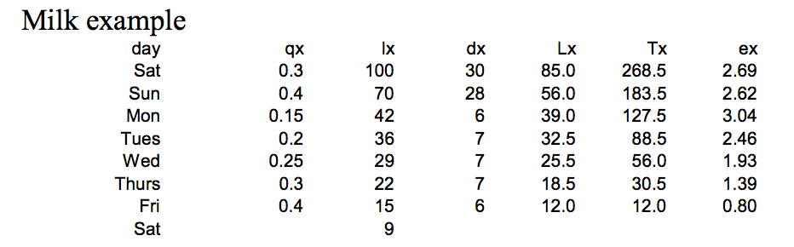
Milk being sold

Slide 9
Simplest form
Single decrement= people only go one way
Closed population
  Population growth constant
  No migration in or out

Slide 10
More advanced forms: multistate
Lets try to model marriage/divorce/death/widowhood

Slide 11
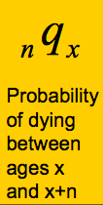
Life table notation:
The subscript before a symbol defines the width of the interval
The subscript after the symbol defines the starting point of the interval
lx, Tx and ex never have a left subscript as they refer to exact age x

Slide 12
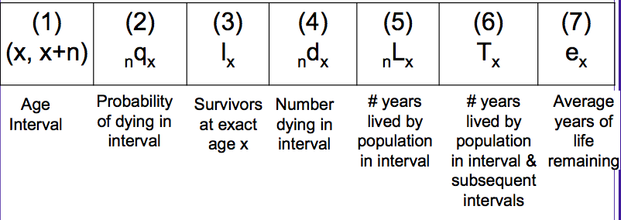
Life table

Slide 13
Practice
probability of dying between age 0 and 1
  ₁q₀
Number of deaths between age 40 and 45
  ₅d₄₀

Slide 14
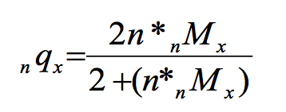
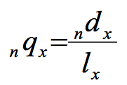
Usually start with age specific death rates (_{n}M_{x})
Can convert _{n}M_{x} to _{n}q_{x}
1)
Where n is the length of the interval (usually 5 years)
2)

Slide 15
lx= Survivors
l₀ =who are the survivors to age 0?
  Everyone born!
  The radix population, could choose anything, usually start with 100,000
l₁ = Survivors at the start of year 1?
l₁ = l₀- (l₀* ₀q₁)
Say ₀q₁ = 0.0582, how many people die in year 1?
582
How many people are alive at the start of year 1?
100,000-582= 99,418 = l₁
582 is _{n}d_{x} =deaths between age n and n+x

Slide 16
0-1 | 0.0582 | 100,000 | 582
1-2 |  | 99,418

Slide 17
L_{x}
L_{x} = The total number of person-years lived in each interval, or # in age group of stationary population
It is the sum of:
Persons who survived the interval, equivalent to the number alive at the beginning of the next interval or l_{x}+1
  They each contribute the number of years in the interval.
b. Persons who died during the interval (d_{x}) who contribute a part of the interval, depending on when they died. For most purposes, we simply assume they contributed 1⁄2 a year.

Slide 18
Lx calculations
Generally we assume linearity:
  unabridged: Lx = 0.5*(lx + lx+n)
    Every year from birth to death
  abridged: Lx = (n*0.5)*(lx + lx+n)
    Can have age groups

Slide 19
Infant/early childhood and oldest age
Because infant and early childhood deaths are closer to birth, we use:
  L₀ = 0.3*l₀ + 0.7*l₁
For the terminal category, we do not have length of interval, so we use :
∞L_{x} =l_{x}/ ∞m_{x}
for example
L₁₀₀₊ = l₁₀₀₊ / M₁₀₀₊
where ∞M_{x} substitutes for ∞m_{x} in abridged tables

Slide 20
  L₀ = 0.3*l₀ + 0.7*l₁
What is L₀ ?
0.3*100,000 + 0.7*99418
L₀=99592.6
Age group | _{n}q_{x} | l_{x} | _{n}d_{x} | L_{x} | T_{x} | e_{x}
0-1 | 0.0582 | 100,000 | 582
1-2 |  | 99,418

Slide 21
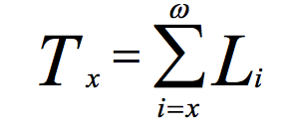
T_{x}
T_{x} is the total number of years of life lived by all members of the cohort. It is obtained by summing up all values of Lx from that age forward

Slide 22
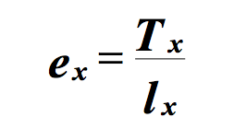
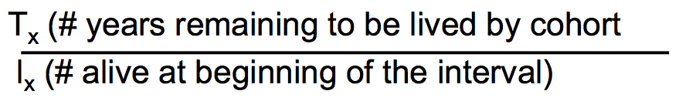
Life expectancy e_{x}
Whereas Tx provides the number of years remaining to be lived by the entire cohort, ex represents the number of years lived on average by any individual in the cohort.
Remember:

Slide 23
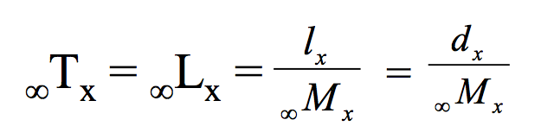
Different life expectancies
Life expectancy at birth (e₀) is the number of years that a baby born now will live if that baby experiences all the age-specific mortality rates currently operating in the population
Terminal Age Category= Because the final age category in the life table is an open ended interval, and all individuals in our cohort must die, we have variations on the usual formulas for this interval
where ∞M_{x} is the observed ASDR for the terminal age group, assumed to be equivalent to ∞m_{x}
Because everybody dies: ∞qx = 1.0

Slide 24
Migration and Urbanization
Acknowledgement: Emily Treleaven, PhD

Slide 25
Why should health researchers and providers care about migration and urbanization?
Migrant status, urban residence, and neighborhood are closely tied to health outcomes and disparities
Rapidly changing demographic and macro-economic environment affects program delivery and intervention effectiveness
Changing populations = changing health needs!

Slide 26
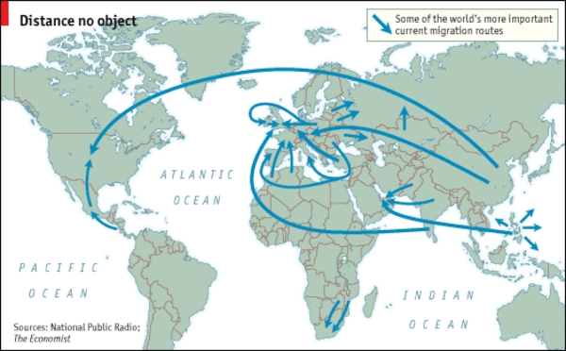
Migration

Slide 27
Definitions: Types of migration
  Movement of individuals from one place to another, crossing geographical boundary
International migration: Movement across national boundaries
Internal migration: Movement within the same country
Forced migration: involuntary forum of migration related to environmental and social factors (such as armed conflict, famine)
  Refugees
  Internally displaced persons

Slide 28
Definitions: Migration patterns
By origin and destination: Rural-to-urban, rural-to-rural, urban-to-urban
Circular: Temporary and repetitive movement between origin and destination, usually for labor
    Seasonal
Chain migration: process that occurs after a small number of pioneering groups lead the way somewhere else and others from the same community follow.
    Migrant networks
    May lead to clustering of people from a specific region into certain neighborhoods or small towns at the destination

Slide 29
Motivations for migration
Push factors: Motivations to leave origin
Pull factors: Motivations to go to destination
Family decision-making
  Altruism
  Exchange theory
  Intergenerational solidarity
  New economics of labor migration
Notes:
REMITTANCES

Slide 30
Selection factors: Socio-demographic
Age
Gender
Education
Social networks
Socio-economic status

Slide 31
Consequences for left behind
Increased income for household of origin via remittances
    Improved diet, nutritional status, and food security
    Retention in school
    Higher health expenditures
    Impacts on care-seeking behaviors
Psychosocial impacts on left behind
Physical impacts for elderly caregivers
    Differential impacts by who migrates (feminization of migration)

Slide 32
Global trends in migration

Slide 33
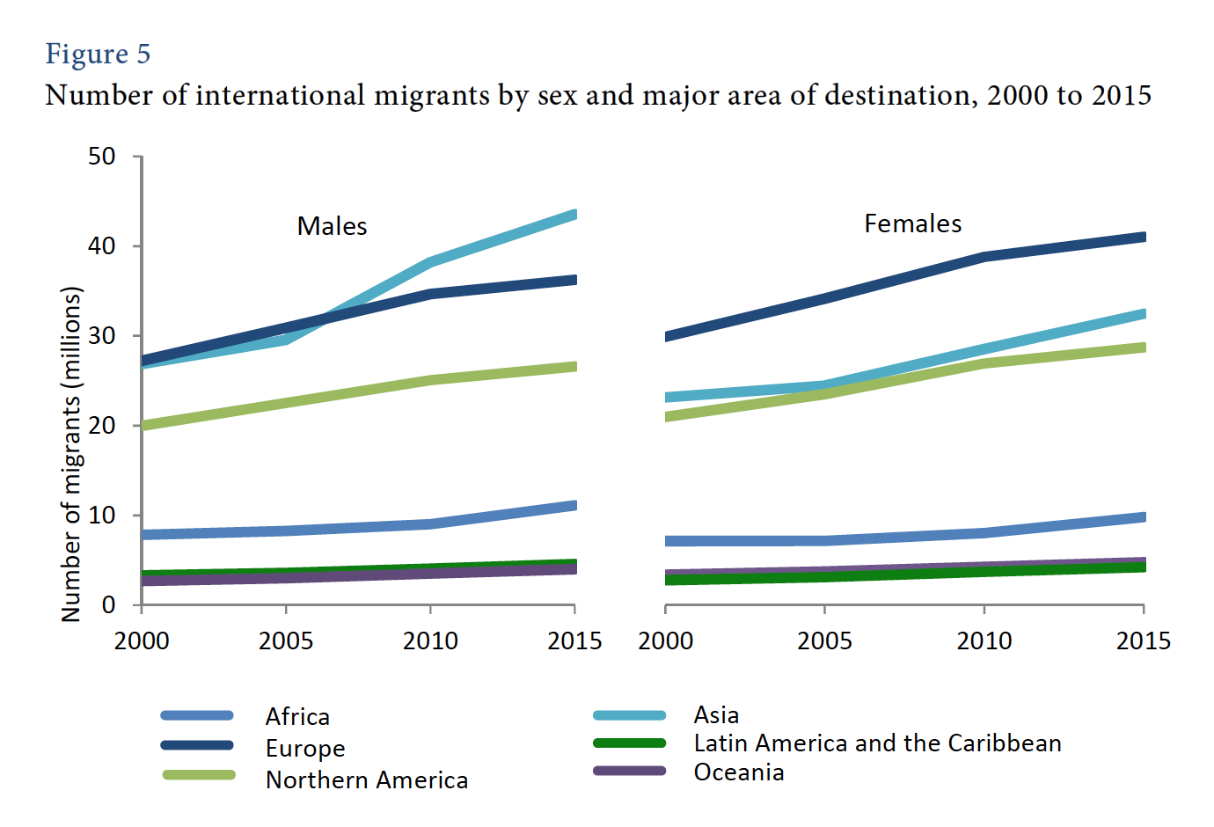
Notes:
Clear increase in overall N migrants
Notice uptick in female migrants: changing opportunities for women – increased female labor force participation
Impacts sending families when a woman migrates

Slide 34
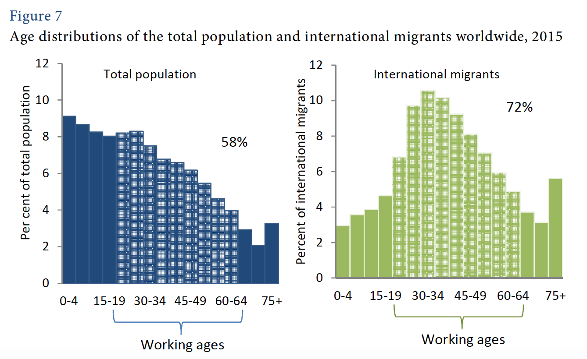
Notes:
We see that it is working age adults who comprise a large proportion of the migrant population
I couldn’t find trends for internal migration (more difficult to track in plcaes without strong record keeping/registration systems….IE many LMICs).... But it’s obviously both more costly and more difficult in terms of visas/permissions/getting somewhere undocumented to go int’l, so chldren may be more likely to migrate internallly, vs. Being left behidn in the care of other relatives when a parent migrates internationally

Slide 35
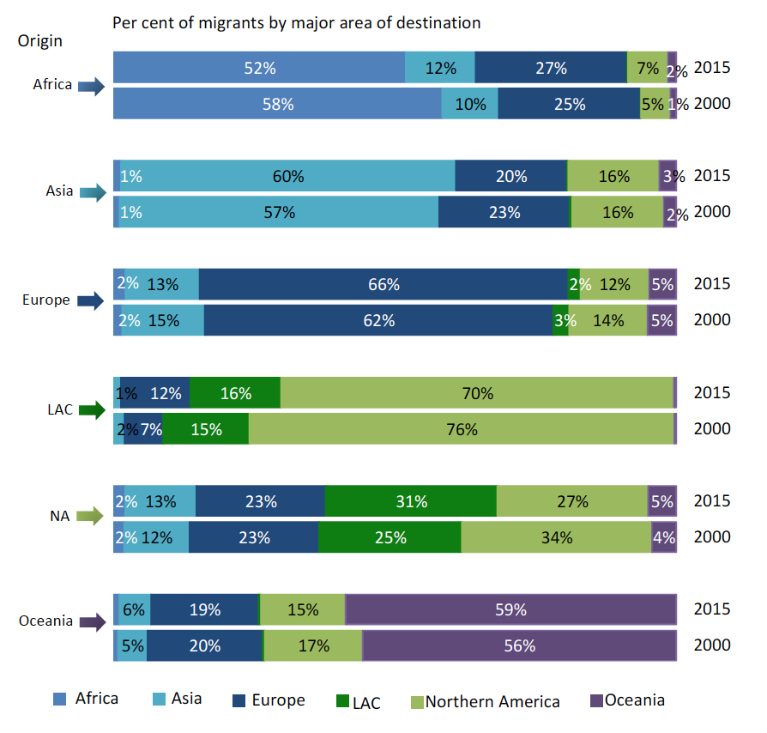

Slide 36
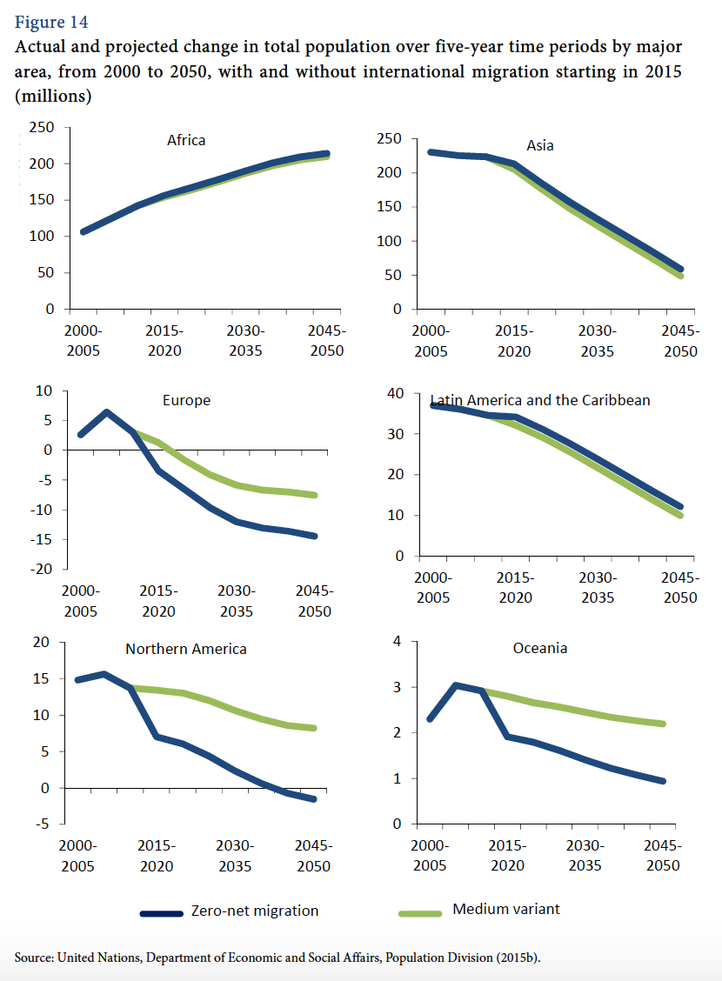

Slide 37
Theories of migration and health

Slide 38
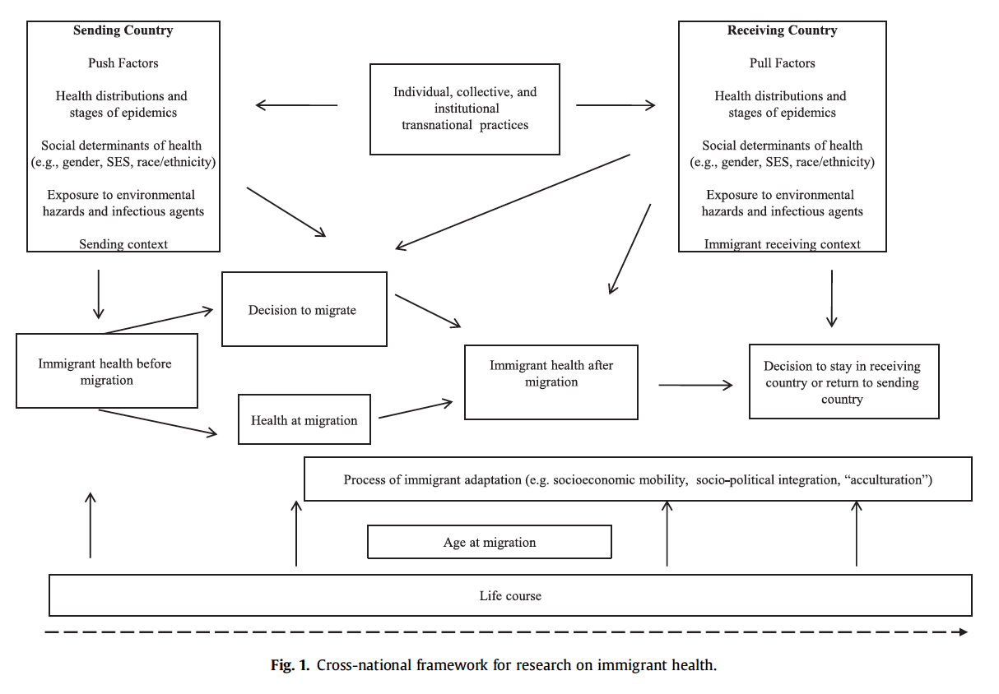
Notes:
Integrating social epidemiology into immigrant health research: A cross-national
Framework
It’s compliated!

Slide 39
Healthy migrant effect
Finding that immigrants have better health status and outcomes than the origin population in many settings (destinations)
Selection of out-migrants by health status
  Healthiest most likely to migrate
  Most likely to be successful migrants
  May be more likely to migrate further (international vs. internal)
Immigrants (at destination) may not represent the distribution of health status of the origin population

Slide 40
Salmon bias
Finding that immigrants have a mortality advantage (longer life expectancy, lower mortality rates) than origin population
Potentially due to unhealthy migrants returning to country/area of origin
    Healthiest migrants remain at destination
    Predictors of return migration are distinct (Jasso)

Slide 41
Epidemiologic paradox
First-generation immigrants to the U.S. are healthier than people of similar ethnic backgrounds born in this country
    Range of health outcomes: infant mortality, adult mortality, birth outcomes, cardiovascular, obesity, among others
    Hummer et al (2007):
        First-hour, first day, and first-week mortality rates among infants born in the U.S. to Mexican immigrant women are about 10% lower than infants of non-Hispanic, white U.S.-born women
        Infants born to U.S.-born Mexican American women exhibit rates of mortality that are statistically equal to those of non-Hispanic white women
        Infants born to U.S.-born Mexican American women fare considerably better than infants born to non-Hispanic black women, with whom they share similar socioeconomic profiles.

Slide 42
Disruption & adaptation; acculturation
Disruption:
    Migrants experience acute financial hardship immediately after migrating
    Unfamiliarity/barriers to accessing health services
Adaptation:
    Improved economic status over time
    Increased social networks
    Improved access to health care
    Acculturation: Group level or individual level process of change that occurs when two cultures are in sustained contact with each other (Berry, 1994)

Slide 43
Considerations in health research: theory
Theoretical perspectives/frameworks:
Social determinants (see Acevedo-Garcia et al. 2012)
Structural determinants
Cultural perspective (acculturation)
Intersectionality: What are the moderating effects of different characteristics with migrant status? (age, cohort, gender, SES)

Slide 44
Considerations in health research: modeling
Defining:
    Population of interest: who counts as a migrant?
    Appropriate reference group (see Ro & Fleischer)
Sampling frame: undocumented, seasonal/circular migrants
Selection bias
  Healthy migrant effect (see Ro & Fleischer)
  Salmon bias (see Hummer et al.)
Endogeneity: Common causes of migration and outcome of interest (behaviors)
Notes:
Emily trelaven

Slide 45
Urbanization

Slide 46
Definitions: Urbanization
Urban: Spatial concentration of people whose lives are organized around non-agricultural activities; function of:
    Population size
    Land area
    Ratio of population to space (density)
    Economic and social organization
Urbanization: Process of social change and reorganization into cities and towns from rural areas (usually marked by shifts from agriculture)
    % of population living in urban areas
    Rate of urbanization: Growth rate of level of urbanization
Urban transition: Predominantly rural predominantly urban
Notes:
Urban transition closely tied to migration
In most countries, a large part of the urban population actually lives in relatively small towns and villages. The urban population may also be thought of more as nonagricultural than urban in the way that we in SF or other major cities in the US or other developed countries would think of it
The urban transition represents the reorganization of human society from being predominantly rural and agricultural to being predominantly urban and non- agricultural (Firebaugh 1979)
Source: Weeks, Montgomery

Slide 47
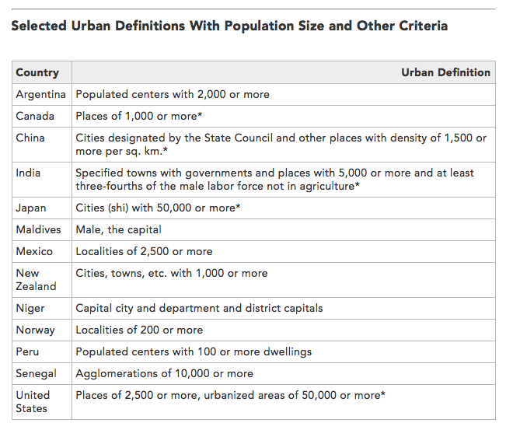
Notes:
A key consideration in examining urbanization is the wide variation in definitions of what is urban, which varies by countries
Source: Population Reference Bureau
http://www.prb.org/Publications/Articles/2009/urbanization.aspx

Slide 48
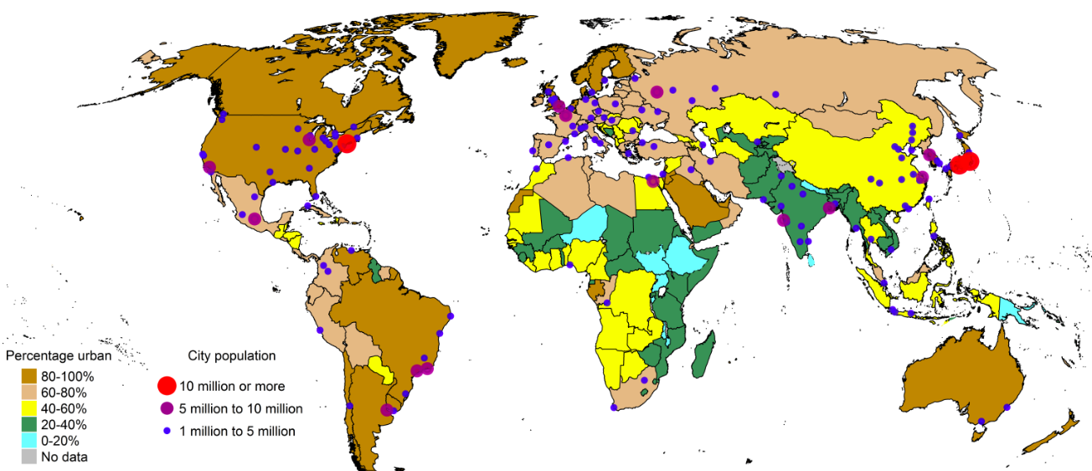
1970: % urban, urban agglomeration by size
Source: UN World Urbanization Prospects, 2014 Revision
Notes:
Not long ago, the vast majority of the world’s population was rural
1850 = 2%
1900 = 6%
1950 = 16%
In 1970s, most of the Americas, Europe already predominantly urban, with many over 80% urban

Slide 49
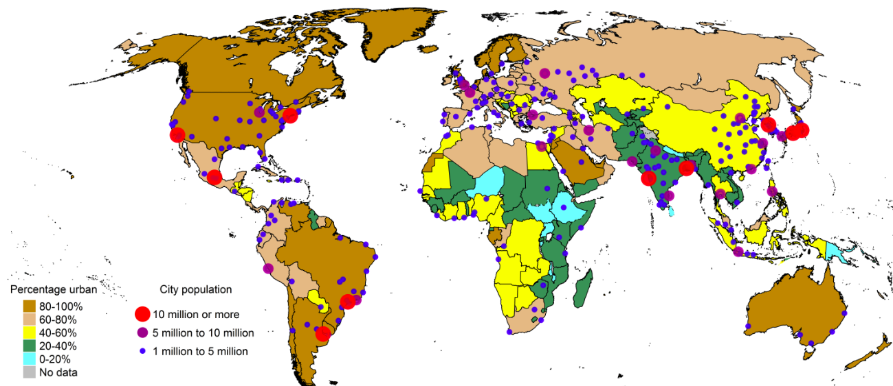
1990
Source: UN World Urbanization Prospects, 2014 Revision

Slide 50
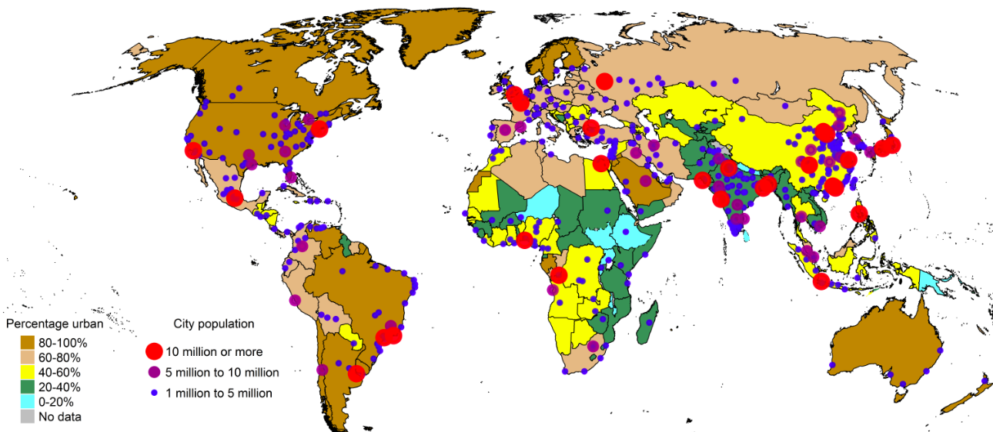
2014
Source: UN World Urbanization Prospects, 2014 Revision

Slide 51
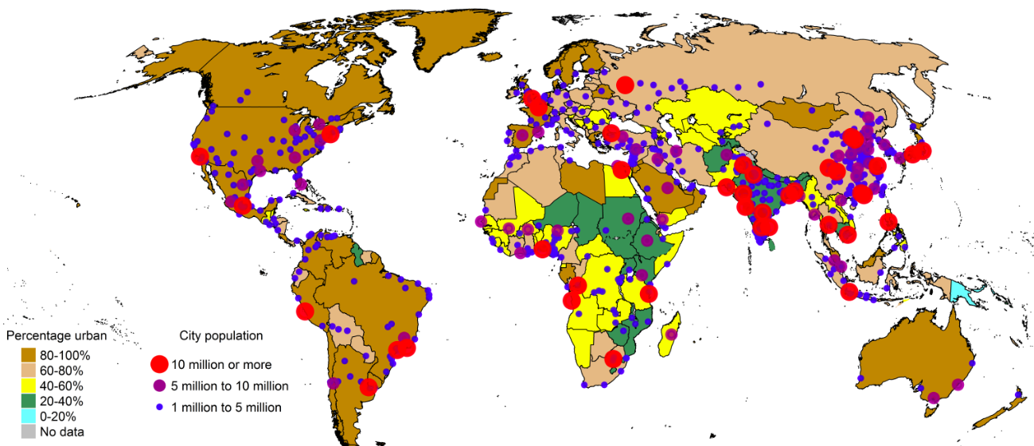
2030 (projected)
Source: UN World Urbanization Prospects, 2014 Revision

Slide 52
Global trends in urbanization
More people live in urban than rural areas (54% of world population)
North America, Latin America, Europe most urbanized
Africa, Asia least urbanized
    Fastest urbanization rates
    Largest cities now concentrated in Global South
Almost half of urban residents live in cities <500,000 population
Source: UN World Urbanization Prospects, 2014 Revision

Slide 53
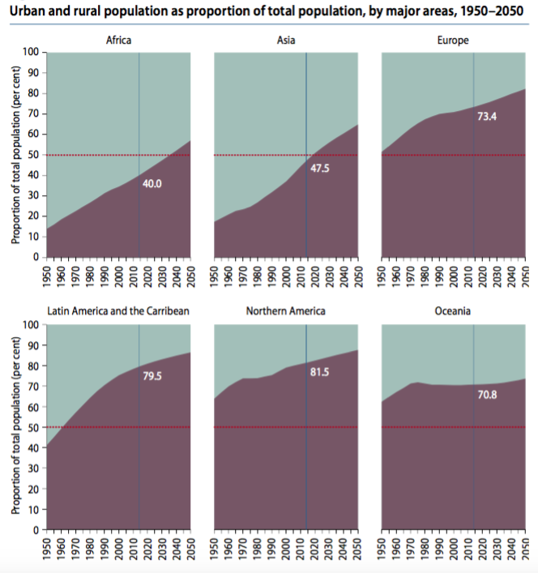

Source: UN World Urbanization Prospects, 2014 Revision

Slide 54
Population processes urbanization
1. Natural population increase
    Fertility
    Mortality
2. Migration
    Rural to urban internal migration
    Rural to urban international migration
3. Reclassification
Notes:
Natural increase = excess of births over death, so for urban areas, the population increase that occurs due to higher fertility than mortality among urbanites
City populations also increase through migration, as new residents move from rural areas to urban areas. This might be internal or international
Important from a heath policy perspective to understand what is driving population growth (or decline) in a specific urban area – ie, if migration is the major cause of growth, that might drive different planning than if it’s primarily through natural growth
- for example, distribution of population within the city will be different, so may need to allocate health services differently, and migrants may have specific health needs
- also means different age structure of population
Early cities had to be constantly replenished by migrants from the hinterlands, because they had higher death rates and lower birth rates than the countryside did, which usually resulted in an annual excess of deaths over births. The economically self-sustaining character of modern urban areas began with the transformation of economies based on agriculture (produced in the countryside) to those based on manufactured goods (produced in the city) and has expanded to those based on servicing the rest of the economy (and often located in the suburbs). Control of the economy made it far easier for cities to dominate rural areas politically and thus ensure their own continued existence in economic terms. (Weeks)
Industrial Revolution created demand for higher population in urban areas
In OECD countries in the 1800s, urban growth due to in-migration (excess mortality in cities; pre-demographic transition globally – high fertility and high mortality in both urban, rural areas)
As urbanization increased in LMICs in last few decades, natural increase was a major factor – in 1990s, accounted for 50-70% of growth in Africa, Asia & LAC
More recently, migration is playing a bigger role, as is reclassification (hard to compare over time and across countries due to changing definitions of urban)
Migration increased in these regions, esp. internal
Generally, better access to contraceptives and with higher cost of living, lower fertility in urban areas compared to rural, so migration plays a larger role in growth
Reclassification: annexation

Slide 55
Natural population growth: Urban areas
Fertility decline in urban areas vs. rural: earlier, faster
    Higher availability of contraception
    Education, income, media exposure
    Changes in marriage patterns
Notes:
In developing countries, fertility decline usually has occurred earlier and faster in urban areas than in rural areas, for a variety of reasons, and in particular because of wider availability of modern contraception. Urban areas are also associated with higher levels of income, higher levels of education, and better access to mass media (Rustein, 2002; Westoff et al., 2011).
Source: Garenne, Michel. DHS Analytical Study 42, Trends in Marriage and Contraception in sub-saharan Africa: a Longitudinal perspective on factors of fertility decline

Slide 56
Natural population growth: Urban areas
Mortality decline in urban areas
    SES
    Access to knowledge and technology
    Access to health services
        Preventive
        Curative
        Emergency
Notes:
As I’ll talk about later, mortality doesn’t necessarily decline in urban areas; in many cases, the causes become different. But on the whole, there are some factors that predict mortality decline in urban areas compared to rural

Slide 57
Rural to urban migration
After first demographic transition, migration critical for urban growth
    Age structure impacted by children/parents left behind
If primarily young adults in-migrating:
    Inflated natural increase: higher urban birth rate (reproductive age); lower death rate
Notes:
See Vries 1990, Lerch 2014

Slide 58
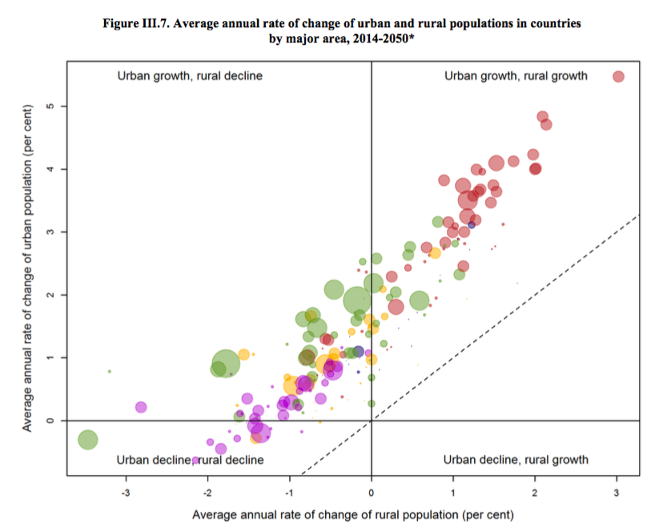
Notes:
Note NO urban decline, rural growth – everyone is urbanizing!
Some developed countries, esp. Europe and Japan are experiencing overall population decline due to below replacement fertility
Asia we see generally movement towards urban areas, and growth in those populations
Africa growth in both urban, rural
Red = Africa
Green = Asia
Yellow = LAC
Purple = North America, Europe
Source: UN World Urbanization Prospects, 2014 Revision

Slide 59
How do cities shape health?
Urban crowding
Transmission dynamics
Exposures
Built environment
Availability or lack of health services
Differences from rural areas
    Economy (cash)
    Social networks
    Diet & physical activity
Notes:
The increase from 300 million urban inhabitants in developing countries in 1950 to 2.6 billion in 2010 (United Nations 2012) has outpaced the absorption capacity of labor markets and the develop- ment of infrastructure and social services, undermining public health and exacerbating the risks of environmental hazards (Lerch).
BUILT ENVIRONMENT: the physical transformation of the physical and natural environment that humans undertake in order to create a place where they can live. It includes the infrastruc- ture for piped water and sewerage, electricity and other types of energy, roads, buildings, parks, and everything else that physically represents what we think of as a city. These neighborhoods represent the context in which much of life will be played out for its residents, and this is an interactive process in which the people help to shape the social and physical fabric of a neighborhood and, at the same time, the na- ture of the neighborhood promotes or constrains the options that people have in life.
. Asia in particular is urbanizing quickly, and is expected to be almost two-thirds urban by 2050 (United Nations Department of Economic and Social Affairs, Population Division 2014). Rather than in megacities, much of this growth is expected to take place in small and medium size cities. These cities and towns tend have higher rates of poverty than large cities, often face shortages of health workers, and lack the physical and health infrastructure to accommodate large population growth (Montgomery 2009; Montgomery and Ezeh 2005a).
PLANNING AND POLICY CHALLENGE!
Crowding, for example, tends to promote the transmission of infec- tious diseases like pneumonia, diarrhea, and tuberculosis (Unger and Riley 2007), and neighbors’ open defecation is negatively associated with child height (Spears 2013).

Slide 60
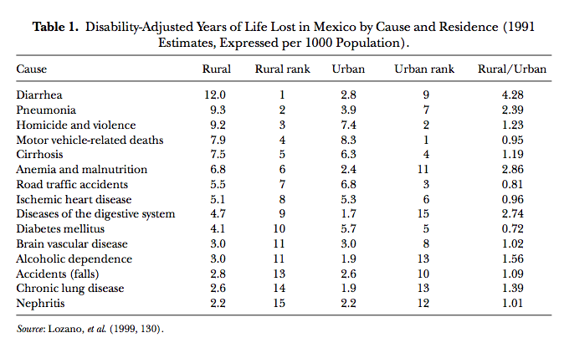
Urban vs. rural mortality causes
Notes:
Source: Montgomery & Ezeh 2005 in Handbook of Urban Health

Slide 61
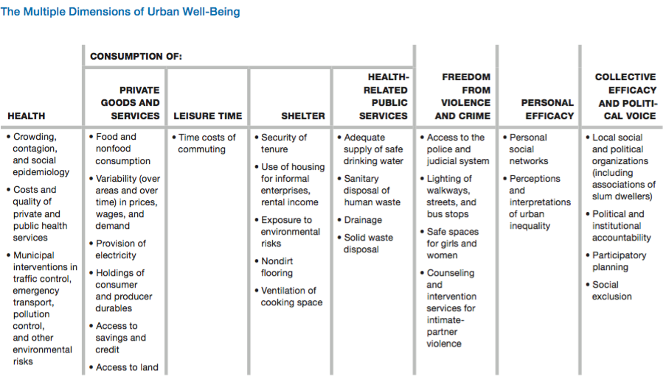
Montgomery’s framework for urban well-being
Source: Montgomery, Mark. 2009. Urban poverty and health in developing countries.
Notes:
Framework for holistic well-being
Housing characteristics, such as building materials, ventilation, security and tenure, and exposure to environmental risks shape residents’ risk of communicable diseases and other diseases. Personal efficacy, as measured by one’s social networks and perceptions of inequality, shapes access to resources needed to navigate the urban health system and acquire health knowledge. Collective efficacy, as demonstrated by the presence of organizations, political voice, and political and institutional accountability, can serve to protect residents’ health as people work together to achieve collective needs. Montgomery posits that different combinations of these physical and social inputs are associated with health outcomes, and a holistic consideration of these factors is critical in understanding urban health access, outcomes, and disparities.

Slide 62
Urban advantage vs. penalty
Urban advantage: Lower mortality in urban areas compared to rural
Urban penalty: Excess urban mortality compared to rural areas
Historically, urban penalty in developed countries
Currently, urban advantage in developing countries
Notes:
Historical evidence from Europe and North America shows that urban areas were characterized by an “urban penalty” (Kearns 1988) with mortality rates substantially higher in cities compared to rural areas, particularly for infants and children (Preston and Haines 1991; Gould 1998). These higher urban mortality rates were associated with the spread of communicable diseases due to high density, overcrowding and unsanitary conditions in cities, despite the greater availability of health facilities and higher overall incomes compared to rural areas (Gould 1998). By the 20 century this urban mortality
penalty had been transformed into an urban advantage, due largely to improvements in public health and sanitation (Preston and Haines 1991; Haines 1995).

Slide 63
Intra-urban inequality
Important to compare within urban inequalities to urban-rural inequalities
Greater variation in SES and education in urban areas
    Important predictors of access to care
Ex: Translates to greater variations in child health outcomes among urban children vs. rural
    Greater SES inequality in child mortality and malnutrition status in urban areas
    The urban poor often disadvantaged compared to rural children (vaccination, nutritional status)

Slide 64
Intra-urban health inequalities
Majority of urban growth projected to be in small & midsize cities, but….
Small or midsize cities do not enjoy the same quantity or quality of services available in the largest cities

Slide 65
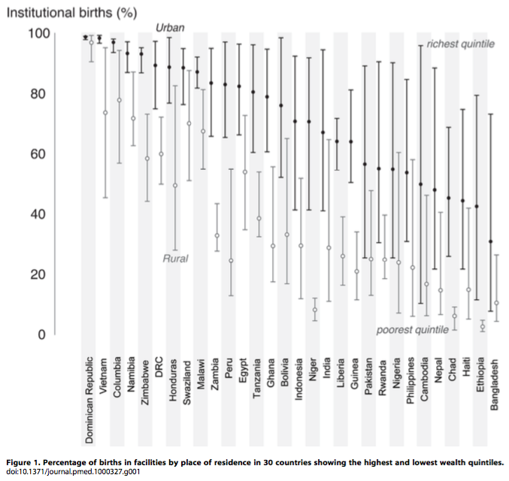
Intra-urban health inequality
Notes:
Examining the “Urban Advantage” in Maternal Health Care in Developing Countries, Mathews et al 2010 PLoS One

Slide 66
Neighborhood effects
Aggregated area or community-level factors associated with an area of residence that impact health access, outcomes, or well-being
    Education
    SES
    Social networks and social cohesion
    Social comparison
    Knowledge, attitudes, or practices
Notes:
Neighborhood poverty and neighborhood affluence associate with health (Montgomery and Ezeh 2005a).
Social comparison plays an important role in psycho-social health, and includes relative SES; where the urban poor face repeated exposure to social inequalities, this may be internalized to their detriment (Montgomery and Ezeh 2005b; Pickett and Wilkinson 2015) .
Urban poor do not always live in poor neighborhoods

Slide 67
Slums
Lacks at least one of the following (UN-HABITAT):
    Access to potable water
    Access to piped sewerage
    Housing of adequate space
    Housing of adequate durability
    Security of tenure
Other characteristics: Social exclusion; exposure to environmental hazards; poor access to health services (quality); lack of government regulation; lack of institutional support
Notes:
Slums are a clear manifestation of a poorly planned and managed urban sector and, in particular, a malfunctioning housing sector.
Concentrated urban poverty and deprivation are often characterized by residential crowding, exposure to environmental hazards, and social fragmentation and exclusion (Wratten 1995)—a cluster of conditions frequently referred to with the catch-all term of “slum-dwelling.” (Nolan)
These health problems are exacerbated by the illegality and social ex- clusion that tend to characterize slum settlements (de Snyder et al. 2011; Subbaraman et al. 2012), by poorly regulated and ineffective health services (Agarwal et al. 2007), by exposure to environmental hazards (Unger and Riley 2007), and, in the Indian case, by uncertainty regarding which level of government is responsible for protecting and promoting the health of the poorest urban residents (Nolan et al. 2014).
HOWEVER: multiple studies show that slum residents are not always poorest poor in terms of income; in megacities with large slum areas such as Mumbai and Nairobi, slum residents may include people classified as middle income
Often have thriving micro-economies
UN Habitat reports that the proportion of the urban population living in slums in the developing world has declined from 39·4% in 2000 to 29·7% in 2014, but the absolute numbers have grown and now stand at an incredible 881 million people. Slums occupy more than half of megacities like Mexico City, Mumbai, and Nairobi where urbanisation grows without adequate planning or infrastructure.

Slide 68
Slums & children’s health
Proportion of children residing in slums in Africa has decreased over time, but absolute numbers have increased (Cotton 2013)
Children in slums have outcomes equivalent to rural children after adjusting for SES, education, and access to services (Fink et al 2014)
Child mortality is significantly higher in slum than non-slum areas, but lower than rural areas (Gunther & Harttgen 2012)
Compared to urban non-slum dwelling children, children in slums have higher rates of malnutrition, diarrhea, and measles; lower rates of vaccination and vitamin A supplementation (Ferduous et al 2014)
Notes:
Cotton, Cassandra. 2013. Growing Up on the Edge: The Well-Being of Children and Youth in the Slums of Sub-Saharan Africa. Montreal: Institute for the Study of International Development. Retrieved October 26, 2015 (http://www.researchgate.net/profile/Cassandra_Cotton/publication/261358342_Growing_Up_on_the_Edge_The_Well-Being_of_Children_and_Youth_in_the_Slums_of_Sub-Saharan_Africa/links/00463533edf3fda49d000000.pdf).
Ferdous, Farzana et al. 2014. “Diarrhoea in Slum Children: Observation from a Large Diarrhoeal Disease Hospital in Dhaka, Bangladesh.” Tropical Medicine & International Health 19(10):1170–76.
Fink, Günther, Isabel Günther, and Kenneth Hill. 2014. “Slum Residence and Child Health in Developing Countries.” Demography 51(4):1175–97.
Günther, Isabel and Kenneth Harttgen. 2012. “Deadly Cities? Spatial Inequalities in Mortality in Sub-Saharan Africa.” Population and Development Review 38(3):469–86.

Slide 69
Thank you!
Questions?
Notes:
Final boiler plate language: 2 versions
Through its singular focus on health, UCSF is leading revolutions in health.
UCSF is driven by the idea that great breakthroughs are achieved when the best research, the best education and the best patient care converge.

Slide 70
References
Astone, Nan. 2009. “Urban Demography.” Retrieved (http://ocw.jhsph.edu/courses/PrinciplesPopulationChange/PDFs/PopChange-sec8_Astone.pdf).
Haub, Carl. 2009. “What Is a City? What Is Urbanization?” Population Reference Bureau. Retrieved (http://www.prb.org/Publications/Articles/2009/urbanization.aspx).
Fink, Günther, Isabel Günther, and Kenneth Hill. 2014. “Slum Residence and Child Health in Developing Countries.” Demography 51(4):1175–97.
Massey, Douglas S. and Nancy A. Denton. 1988. “The Dimensions of Residential Segregation.” Social Forces 67(2):281.
Matthews, Zoë et al. 2010. “Examining the ‘Urban Advantage’ in Maternal Health Care in Developing Countries.” PLoS Medicine 7(9):e1000327.
Montgomery, Mark R. 2009. Urban Poverty and Health in Developing Countries. Population Reference Bureau Washington, DC. Retrieved August 28, 2015 (http://www.prb.org/pdf09/64.2urbanization.pdf).
Montgomery, Mark R. and Alex C. Ezeh. 2005. “Urban Health in Developing Countries.” Pp. 317–60 in Handbook of Urban Health, edited by S. Galea and D. Vlahov. Springer US. Retrieved August 28, 2015 (http://link.springer.com.ucsf.idm.oclc.org/chapter/10.1007/0-387-25822-1_17).
Nolan, Laura B. 2015. “Slum Definitions in Urban India: Implications for the Measurement of Health Inequalities.” Population and Development Review 41(1):59–84.
United Nations Department of Economic and Social Affairs, Population Division. 2014. World Urbanization Prospects: The 2014 Revision : Highlights. United Nations. Retrieved (http://esa.un.org/unpd/wup/Highlights/WUP2014-Highlights.pdf).
Weeks, John R. 2008. Population: An Introduction to Concepts and Issues. 10th ed. Belmont, CA: Thompson-Wadsworth.

