Slide 1
Biostat 200: Lecture 9
Associations, Correlations, and Causation

Slide 2
Visualization ReCap
http://flowingdata.com/2017/01/24/one-dataset-visualized-25-ways/
https://www.gapminder.org/tools/#_chart-type=bubbles
www.Theyrule.net
http://www.informationisbeautiful.net/
www.bewitched.com

Slide 3
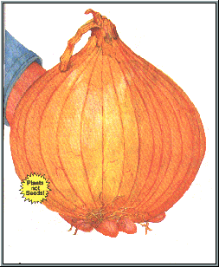
Association: Peeling the Onion
I See Dead People
What’s wrong with this statement?

Slide 4
Associations are not Causations
Everyone who ate pickles in the year 1743 is now dead.
Therefore, pickles are fatal?

Slide 5
True statement:
Palm size correlates with your life expectancy
The larger your palm, the less you will live, on average.
Try it out - look at your neighbors and you’ll see who is expected to live longer.

Slide 6
Associations are ??? Causations
Why?
Women have smaller palms and live 6 years longer on average
Don’t stop at the first association.
Ask yourself (and the data) WHY?
http://www.tylervigen.com/spurious-correlations

Slide 7
Correlation
Correlation is a examines the relationship between 2 (usually) continuous variables
  Does one increase with the other?
    e.g. Does CD4 count increase with increasing age?
Both variables are measured on the same people
Correlation assumes a linear relationship between the two variables
Correlation is symmetric
  The correlation of A with B is the same as the correlation of B with A
  Designated by ρ (rho)

Slide 8
Correlation

Slide 9
Correlation
ρ lies between -1 and 1
-1 and 1 are perfect correlations, 0 is no correlation
An estimator of the population correlation ρ is Pearson’s correlation coefficient denoted r
It is estimated by:

Slide 10
Correlation
Notes:
I’m showing you these formulae because you may see the 3rd one. It is a manipulation of the first which is the average of the product of x and y, with the sample means subjected and divided by the sample standard deviation.

Slide 11
Correlation: hypothesis testing
To test whether there is a correlation between two variables, our hypotheses are
H₀ : ρ=0 and H_{A} : ρ≠0
We need to calculate a test statistic for r
The test statistic is

Slide 12
Correlation: hypothesis testing
The test statistic follows a t distribution with n-2 degrees of freedom under the null
The assumptions
  The pairs of observations (x_{i} , y_{i} ) were obtained from a random sample
  X and Y are normally distributed

Slide 14
Correlation example
corr cd4count age
(obs=999)
| cd4count age_b
-------------+------------------
cd4count | 1.0000
age_b | -0.1133 1.0000
Note that the hypothesis test is only of ρ=0, no other null
Also note that the correlation is the linear relationship only

Slide 15
Correlation example
pwcorr var1 var2, sig obs
. pwcorr cd4count age, sig obs
| cd4count age_b
-------------+------------------
cd4count | 1.0000
|
| 999
|
age_b | -0.1133 1.0000
| 0.0003
| 999 3387
|
Notes:
Pwcorr stands for pairwise correlation. You can get the correlation for each pair of variables in the list. Sig gives you the p-value for the hypothesis test that the correlation is 0. Obs gives you the sample size included in the calculation.

Slide 16
Spearman rank correlation
(Nonparametric correlation)
Pearson’s correlation coefficient is very sensitive to extreme values
Spearman rank correlation calculates the Pearson correlation on the ranks of each variable
The Pearson correlation coefficient is calculated, but the data values are replaced by the ranks
The Spearman rank correlation coefficient is

Slide 17
Spearman rank correlation (nonparametric)
The Spearman rank correlation ranges between -1 and 1 as does the Pearson correlation
We can test the null hypothesis that ρ=0
The test statistic for n>10 is
with n-2 degrees of freedom
is compared to the t distribution
spearman cd4count age, stats(rho obs p)
Number of obs = 999
Spearman's rho = -0.1319
Test of Ho: cd4count and age_b are independent
Prob > |t| = 0.0000

Slide 18
Matrix of Pearson correlations
We can calculate a correlation matrix by listing multiple variable names
Beware of which n’s are used (use listwise option to get all n’s equal so you are testing similar relationships)
pwcorr cd4count age nsupport_b auditc, sig obs
| cd4count age_b nsuppo~b auditc
-------------+------------------------------------
cd4count | 1.0000
|
| 999
|
age_b | -0.1133 1.0000
| 0.0003
| 999 3387
|
nsupport_b | 0.0067 0.3597 1.0000
| 0.8340 0.0000
| 994 3370 3372
|
auditc | 0.0670 0.0580 0.0468 1.0000
| 0.0392 0.0009 0.0078
| 948 3242 3230 3244
|
|

Slide 19
Matrix of Pearson correlations
Using listwise option to get all n’s equal
pwcorr cd4count age nsupport_b auditc, sig obs listwise
| cd4count age_b nsuppo~b auditc
-------------+------------------------------------
cd4count | 1.0000
|
| 944
|
age_b | -0.1053 1.0000
| 0.0012
| 944 944
|
nsupport_b | 0.0107 0.3209 1.0000
| 0.7416 0.0000
| 944 944 944
|
auditc | 0.0668 -0.0075 0.0475 1.0000
| 0.0401 0.8181 0.1449
| 944 944 944 944
|
|

Slide 20
Matrix of Spearman correlations
spearman cd4count age nsupport_b auditc, pw stats(rho obs p)
+-----------------+
| Key |
|-----------------|
| rho |
| Number of obs |
| Sig. level |
+-----------------+
| cd4count age_b nsuppo~b auditc
-------------+------------------------------------
cd4count | 1.0000
| 999
|
|
age_b | -0.1319 1.0000
| 999 3387
| 0.0000
|
nsupport_b | 0.0118 0.4055 1.0000
| 994 3370 3372
| 0.7093 0.0000
|
auditc | 0.0945 0.0777 0.0447 1.0000
| 948 3242 3230 3244
| 0.0036 0.0000 0.0111
|

Slide 21
Matrix of Spearman correlations
spearman cd4count age nsupport_b auditc, stats(rho obs p)
+-----------------+
| Key |
|-----------------|
| rho |
| Number of obs |
| Sig. level |
+-----------------+
| cd4count age_b nsuppo~b auditc
-------------+------------------------------------
cd4count | 1.0000
| 944
|
|
age_b | -0.1261 1.0000
| 944 944
| 0.0001
|
nsupport_b | 0.0127 0.3546 1.0000
| 944 944 944
| 0.6971 0.0000
|
auditc | 0.0940 -0.0116 0.0431 1.0000
| 944 944 944 944
| 0.0039 0.7221 0.1859
|
|
Here if you drop the “pw” option you get all n’s equal

Slide 22
Pearson vs. Spearman
 | Pearson | Spearman
Sensitivity to outliers | more sensitive | less sensitive
Can be used with ordinal data | no | yes
Assumes data are from a normal distribution | yes | no
Detects non-linear relationship | no | yes

Slide 23
Biomarker and alcohol consumption

Slide 24
PEth Biomarker of alcohol consumption vs. days drinking (raw data vs. ranks)

Slide 25
Pearson and Spearman correlations
. pwcorr peth21_18and16 daysdrank_21, obs sig
| peth2~16 days~_21
-------------+------------------
peth21_18~16 | 1.0000
|
| 77
|
daysdrank_21 | 0.4717 1.0000
| 0.0000
| 77 85
|
-----------------------------------
. spearman peth21_18and16 daysdrank_21
Number of obs = 77
Spearman's rho = 0.7413
Test of Ho: peth21_18and16 and daysdrank_21 are independent
Prob > |t| = 0.0000

Slide 26
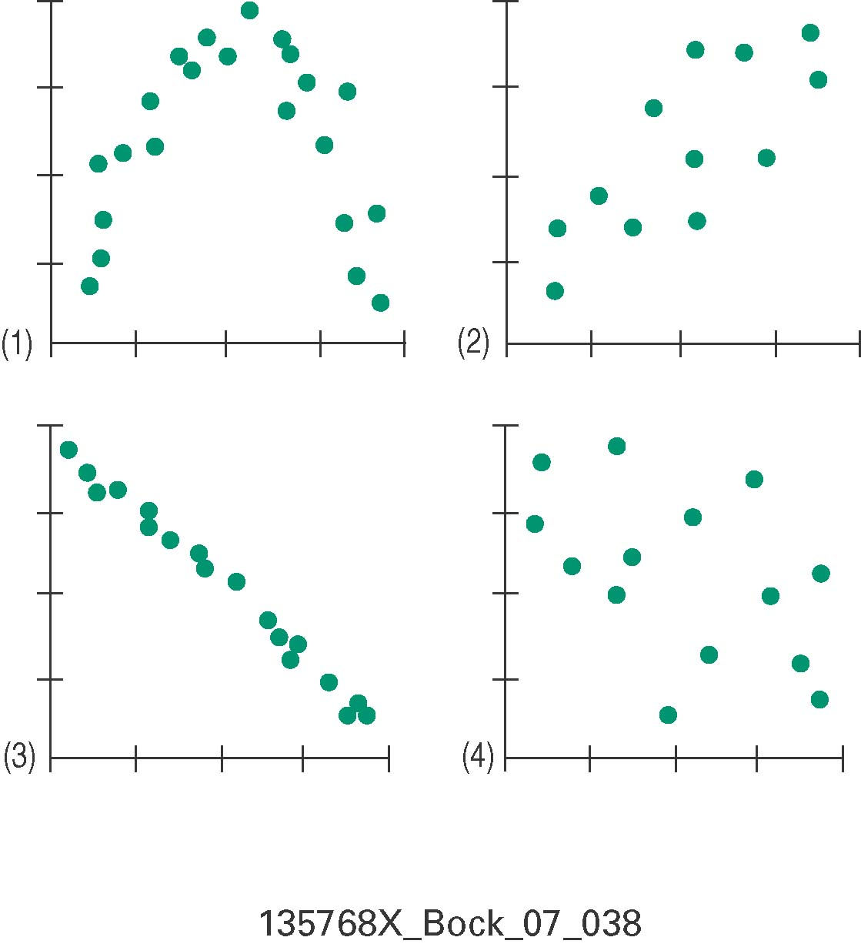
Association Identification
Which scatterplot below shows
little association?
negative association?
linear association?
moderately strong association?
strong association?

Slide 27
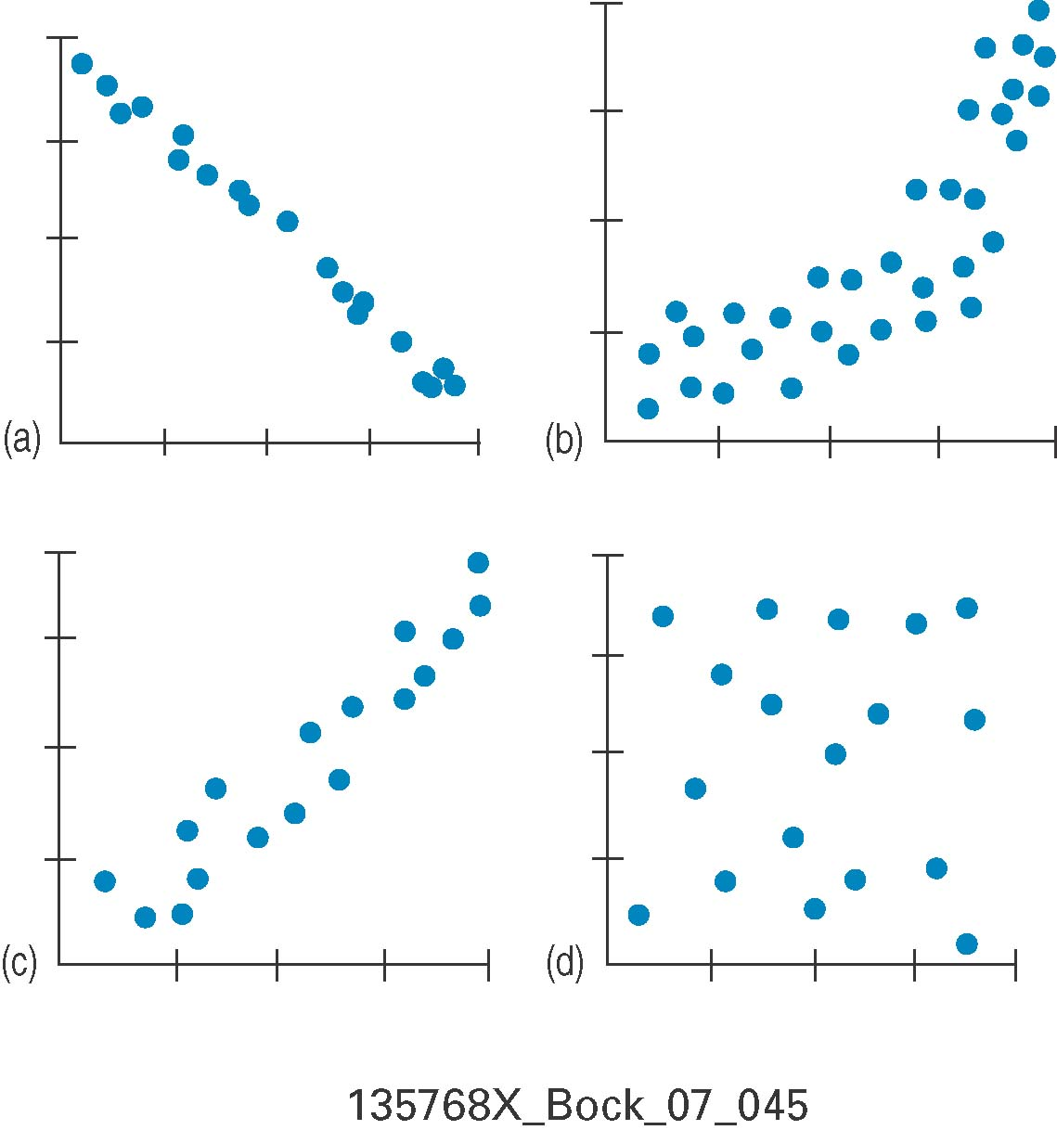
Association Identification
Matching.
Here are several scatterplots.
The calculated correlations are:
–0.977
–0.021
0.736
0.951.
Which is which?

Slide 28
Simple linear regression
Correlation allows us to quantify a linear relationship between two variables
Linear regression allows us to additionally estimate how a change in a random variable X corresponds to a change in random variable Y

Slide 29
Forced expiratory volume (FEV)
Studies in the 1970’s of children and adolescent’s pulmonary function, examining their own smoking and secondhand smoke
FEV is the amount of air expelled in the first second of exhalation; forced expiratory volume
The data are cross-sectional data from a larger prospective study
Tager, I., Weiss, S., Munoz, A., Rosner, B., and Speizer, F. (1983), “Longitudinal Study of the Effects of Maternal Smoking on Pulmonary Function,” New England Journal of Medicine, 309(12), 699-703.
Tager, I., Weiss, S., Rosner, B., and Speizer, F. (1979), "Effect of Parental Cigarette Smoking on the Pulmonary Function of Children," American Journal of Epidemiology, 110(1), 15-26.

Slide 30
twoway (lowess fev age, bwidth(0.8)) (scatter fev age, sort), ytitle(FEV) xtitle(Age) legend(off) title(FEV vs age in children and adolescents)
Notes:
Data are in fev.dta on web site

Slide 31
Correlation
. pwcorr fev age, sig obs
| fev age
-------------+------------------
fev | 1.0000
|
| 654
|
age | 0.7565 1.0000
| 0.0000
| 654 654
|
. spearman fev age
Number of obs = 654
Spearman's rho = 0.7984
Test of Ho: fev and age are independent
Prob > |t| = 0.0000

Slide 32
graph box fev, over(age) title(FEV by age)

Slide 33
egen agecat = cut(age), at(0,3,6,9,12,15,20) label
graph box fev, over(agecat) title(FEV by age group) ytitle(FEV)

Slide 34
. tabstat fev, by(agecat) s(n min median max mean sd)
Summary for variables: fev
by categories of: agecat
agecat | N min p50 max mean sd
-------+------------------------------------------------------------
3- | 39 .791 1.514 2.115 1.472385 .3346982
6- | 176 1.165 1.901 2.993 1.943727 .3885005
9- | 265 1.458 2.665 4.637 2.71723 .5866867
12- | 125 1.916 3.255 5.224 3.384576 .7326963
15- | 49 2.198 3.674 5.793 3.710143 .8818795
-------+------------------------------------------------------------
Total | 654 .791 2.5475 5.793 2.63678 .8670591
--------------------------------------------------------------------
Notes:
Note that the range for the total data is larger than the range for the grouped data

Slide 35
Simple linear regression
The method allows us to investigate the effect of a difference in the explanatory variable on the response variable.
Equivalent terms:
  Response variable, dependent variable, outcome variable, Y
  Explanatory variable, independent variable, predictor variable, correlate, X
Here it matters which variable is X and which variable is Y
Y is the variable that you want to predict, or better understand with X (we regress Y on X)
Notes:
Note that predictor variable implies causality, which is hard to show. So we try to avoid using that term unless we have longitudinal data in which the predictor variable clearly precedes the outcome variable.

Slide 36
Recall the equation of a straight line
y = α + βx

Slide 37
Simple linear regression
Population regression equation is defined as
μ_{y|x} = α + β x
This is the equation of a straight line
α and β are constants and are called the coefficients of the equation
Notes:
Beta is the coefficient of x. Alpha is the coefficient of 1.

Slide 38
Simple linear regression
α is the y-intercept of the line y=α + β x
Plugging back in to the population regression equation, α is the mean value of Y when X=0
e.g. μ_{y|0} = α + β X = α
β is the slope of the line
β is the change in the mean value of y that corresponds to a one-unit increase in X
e.g. X=3 vs. X=2
μ_{y|3} - μ_{y|2} = (α + β*3 ) – (α + β*2) = β

Slide 39
Simple linear regression
Even if there is a linear relationship between Y and X in theory, there will (usually) be some variability in the population
At each value of X, there is a range of Y values, with a mean μ_{y|x} and a standard deviation σ_{y|x}
We note this by including an error term, ε, in our regression equation
The linear regression equation is y = α + βx + ε

Slide 40
Simple linear regression
The linear regression equation is y = α + βx + ε
The error, ε, is the distance a sample value y has from the population regression line
y = α + βx + ε
μ_{y|x} = α + β x (population regression line)
so y- μ_{y|x} = ε is the error
Notes:
y is an observed value of random variable Y

Slide 41
Simple linear regression
Statistical assumptions of linear regression
  X’s are measured without error
    Violations of this cause the coefficients to attenuate toward zero
  For each value of X, the Y’s are normally distributed with mean μ_{y|x} and standard deviation σ_{y|x}
  The regression equation is correct μ_{y|x} = α + βx

Slide 42
Simple linear regression
More assumptions of linear regression
  Homoscedasticity – the standard deviation of y at each value of X is constant; σ_{y|x} the same for all values of X
  All the y_{i} ‘s are independent
    You can’t guess the y value for one person (or observation) based on the outcome of another
We do not need the X’s to be normally distributed, just the Y’s at each value of X

Slide 43
Ordinary Least Squares Regression
We estimate the coefficients of the population regression line (α and β) using our sample of measurements of y and x
The distance from a data point (x_{i} ,y_{i}) to the line at x_{i} is the error and called the residual, e_{i}
  e_{i} = y_{i} – ŷ_{i}
  ŷ_{i} is y-value of the regression line at x_{i} and is the predicted value of y at each x

Slide 44
Linear Regression Graphically
Y
Predicted
Value
Y
=
b
+
b
X
+
e
i
0
1
i
i
e
e
4
2
e
e
1
3

Y
=
a
+
b
X
i
0
1
i
X

Slide 46
Simple Linear Regression or Least Squares
The regression line equation is
The “best” line is the one that finds the α and β that minimize the sum of the squared residuals Σe_{i}²
We are minimizing the sum of the squares of the residuals, called the error sum of squares or the residual sum of squares

Slide 47
Simple linear regression example: Regression of FEV on age
FEV= α̂ + β̂ age
regress yvar xvar
. regress fev age
Source | SS df MS Number of obs = 654
-------------+------------------------------ F( 1, 652) = 872.18
Model | 280.919154 1 280.919154 Prob > F = 0.0000
Residual | 210.000679 652 .322086931 R-squared = 0.5722
-------------+------------------------------ Adj R-squared = 0.5716
Total | 490.919833 653 .751791475 Root MSE = .56753
------------------------------------------------------------------------------
fev | Coef. Std. Err. t P>|t| [95% Conf. Interval]
-------------+----------------------------------------------------------------
age | .222041 .0075185 29.53 0.000 .2072777 .2368043
_cons | .4316481 .0778954 5.54 0.000 .278692 .5846042
------------------------------------------------------------------------------
β̂ ̂ = Coef for age
α̂ = _cons (short for constant)

Slide 48
Interpretating the parameter estimates
The least squares estimate is
  ŷ = 0.432 + 0.222 x
The intercept, 0.432 is the fitted value of y (FEV) for x (age) = 0
The slope, 0.222 is the change in FEV corresponding to a change of 1 year in age. So a child with age=10 would have an FEV that is (on average) 0.222 higher than someone age 9. And the same for age 7 vs. 6, etc.

Slide 49
Simple linear regression – hypothesis testing
We want to know if there is a relationship between X and Y.
  If there is no relationship then the value of Y does not change with the value of X, and β=0.
  Therefore β=0 is our null hypothesis.
This is mathematically equivalent to the null hypothesis that the correlation ρ=0.
We can also calculate a 95% confidence interval for β

Slide 50
Inference for regression coefficients
We want to use the least squares regression line ŷ=α̂ + β̂x to make inference about the population regression line μ_{y|x} = α + β x
If we took repeated samples in which we measured x and y together and calculated the least squares estimates, we would have a distribution for the estimates α̂ and β̂
The standard error of the estimates are

Slide 51
Inference for regression coefficients
We can use these to test the null hypothesis H₀: β = β₀ against the alternative H₀: β ≠ β₀
The test statistic for this is
And it follows the t distribution with n-2 degrees of freedom under the null hypothesis

Slide 52
Inference for regression coefficients
When β₀=0 , i.e. testing H₀: β =0 this is equivalent to testing μ_{y|x} = α + 0*x = α
This is the same as testing the null hypothesis H₀: ρ=0
The regression slope and the correlation coefficient are related:
95% confidence intervals for β
( β̂ - t_{n-2,.025}se(β̂) , β̂ + t_{n-2,.025}se(β̂) )

Slide 53
Simple linear regression example: Regression of FEV on age
FEV= α̂ + β̂ age
regress yvar xvar
. regress fev age
Source | SS df MS Number of obs = 654
-------------+------------------------------ F( 1, 652) = 872.18
Model | 280.919154 1 280.919154 Prob > F = 0.0000
Residual | 210.000679 652 .322086931 R-squared = 0.5722
-------------+------------------------------ Adj R-squared = 0.5716
Total | 490.919833 653 .751791475 Root MSE = .56753
------------------------------------------------------------------------------
fev | Coef. Std. Err. t P>|t| [95% Conf. Interval]
-------------+----------------------------------------------------------------
age | .222041 .0075185 29.53 0.000 .2072777 .2368043
_cons | .4316481 .0778954 5.54 0.000 .278692 .5846042
------------------------------------------------------------------------------

Slide 54
Coefficient of Determination R²
R² = r² , i.e. just the Pearson correlation coefficient squared
R² ranges from 0 to 1, and measures the proportion of the variability in y that is explained by the regression of y on x

Slide 55
Simple linear regression example: Regression of FEV on age
FEV= α̂ + β̂ age
regress yvar xvar
. regress fev age
Source | SS df MS Number of obs = 654
-------------+------------------------------ F( 1, 652) = 872.18
Model | 280.919154 1 280.919154 Prob > F = 0.0000
Residual | 210.000679 652 .322086931 R-squared = 0.5722
-------------+------------------------------ Adj R-squared = 0.5716
Total | 490.919833 653 .751791475 Root MSE = .56753
------------------------------------------------------------------------------
fev | Coef. Std. Err. t P>|t| [95% Conf. Interval]
-------------+----------------------------------------------------------------
age | .222041 .0075185 29.53 0.000 .2072777 .2368043
_cons | .4316481 .0778954 5.54 0.000 .278692 .5846042
------------------------------------------------------------------------------

Slide 56
Evaluating the regression model
regress fev age
Source | SS df MS Number of obs = 654
-------------+------------------------------ F( 1, 652) = 872.18
Model | 280.919154 1 280.919154 Prob > F = 0.0000
Residual | 210.000679 652 .322086931 R-squared = 0.5722
-------------+------------------------------ Adj R-squared = 0.5716
Total | 490.919833 653 .751791475 Root MSE = .56753
------------------------------------------------------------------------------
fev | Coef. Std. Err. t P>|t| [95% Conf. Interval]
-------------+----------------------------------------------------------------
age | .222041 .0075185 29.53 0.000 .2072777 .2368043
_cons | .4316481 .0778954 5.54 0.000 .278692 .5846042
------------------------------------------------------------------------------
=.7565²

Slide 57
regress fev age
Source | SS df MS Number of obs = 654
-------------+------------------------------ F( 1, 652) = 872.18
Model | 280.919154 1 280.919154 Prob > F = 0.0000
Residual | 210.000679 652 .322086931 R-squared = 0.5722
-------------+------------------------------ Adj R-squared = 0.5716
Total | 490.919833 653 .751791475 Root MSE = .56753
------------------------------------------------------------------------------
fev | Coef. Std. Err. t P>|t| [95% Conf. Interval]
-------------+----------------------------------------------------------------
age | .222041 .0075185 29.53 0.000 .2072777 .2368043
_cons | .4316481 .0778954 5.54 0.000 .278692 .5846042
------------------------------------------------------------------------------
=.7565²

Slide 58
Overall Model Fit Using the F-Statistic
The F statistic compares the model to a model with just y̅ (the null model)
The statistic is
When there is only one independent variable in the model, these are equivalent tests
  F test that compares the model fit to the null model
  The ttest that β=0
  The ttest that r=0 (Pearson correlation)

Slide 59
Inference for predicted values
We might want to estimate the mean value of y at a particular value of x
What is the mean FEV for children who are 10 years old? ŷ = .432 + .222*x = .432 + .222*10 = 2.643 liters
We can construct a 95% confidence interval for the estimated mean
  ( ŷ - t_{n-2,.025}se(ŷ) , ŷ + t_{n-2,.025}se(ŷ) ), where

Slide 60
Use Stata for your prediction
Stata will calculate the fitted regression values and the standard errors
  regress fev age
  predict fev_pred, xb -> predicted mean values (ŷ)
  predict fev_predse, stdp -> se of ŷ values
You don’t have to calculate these to get a plot with the 95% CI:
twoway (lfitci fev age)
New variable names that I made up
Stands for linear fit for the line, CI for the confidence interval

Slide 61
. list fev age fev_pred fev_predse
+-----------------------------------+
| fev age fev_pred fev_pr~e |
|-----------------------------------|
1. | 1.708 9 2.430017 .0232702 |
2. | 1.724 8 2.207976 .0265199 |
3. | 1.72 7 1.985935 .0312756 |
4. | 1.558 9 2.430017 .0232702 |
5. | 1.895 9 2.430017 .0232702 |
|-----------------------------------|
6. | 2.336 8 2.207976 .0265199 |
7. | 1.919 6 1.763894 .0369605 |
8. | 1.415 6 1.763894 .0369605 |
9. | 1.987 8 2.207976 .0265199 |
10. | 1.942 9 2.430017 .0232702 |
|-----------------------------------|
11. | 1.602 6 1.763894 .0369605 |
12. | 1.735 8 2.207976 .0265199 |
13. | 2.193 8 2.207976 .0265199 |
14. | 2.118 8 2.207976 .0265199 |
15. | 2.258 8 2.207976 .0265199 |
336. | 3.147 13 3.318181 .0320131 |
337. | 2.52 10 2.652058 .0221981 |
338. | 2.292 10 2.652058 .0221981 |

Slide 62
Remember that the Cis get wider as you get farther from x̅ ;
but here n is large so the CI is still very narrow
twoway (scatter fev age) (lfitci fev age, ciplot(rline) blcolor(black)), legend(off) title(95% CI for the predicted means for each age )

Slide 63
Next Time: More and More Modeling
More linear regression
More prediction
Some non-linear regression
Logistic regression

