Slide 1
Measures of Residential Segregation
Five dimensions
  Evenness/dissimilarity
  Exposure
  Clustering
  Concentration
  Centralization

Slide 2

Evenness/index of dissimilarity
The degree to which groups (e.g., ethnic groups) are evenly spread across the city
“How many people would have to move in order to make each census tract have the same distribution as the city as a whole?”
Suppose:
b_{i} = the black population of the i^{th} areal unit, e.g. census tract
B = the total black population of the large geographic entity w_{i} = the white population of the i^{th} area unit, e. g. census tract
W = the total white population of the large geographic entity
The index of dissimilarity measuring the segregation of whites from blacks:

Slide 3
Evenness

Slide 4
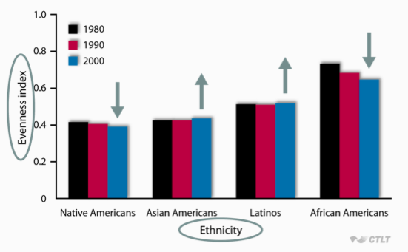
Evenness in US cities over time

Slide 5

Isolation/Exposure
Inverse of the probability that a person of one ethnic group shares a census tract with a person of a particular other ethnic group
Assume:
w_{i} = the white population of a component part (like a census tracts) of the larger geographic entity
t_{i}= the total population of a component part of the larger geographic entity
W_{i} = the total white population of the larger geographic entity
Then the isolation index for whites equals:
You are summing all the components of the area

Slide 6
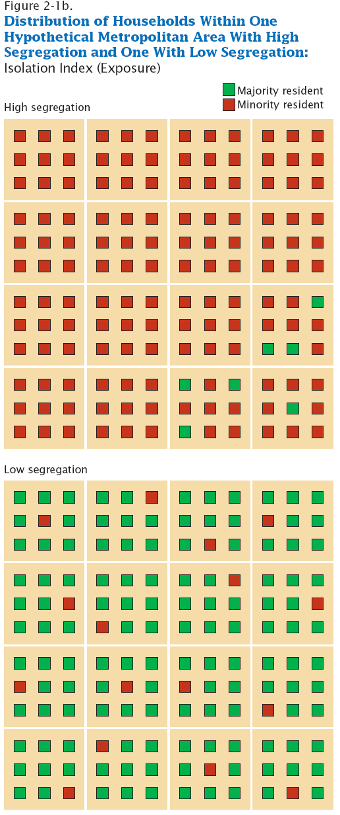
Isolation/Exposure

Slide 7
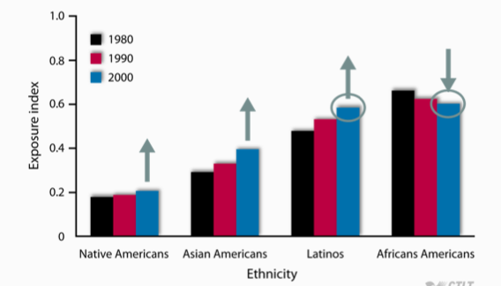
Exposure, compared to European Americans

Slide 8

Delta Index/Concentration
The proportion of geographic space occupied by census tracts with a large percentage of a particular ethnic group

Slide 9
Delta Index/Concentration

Slide 10
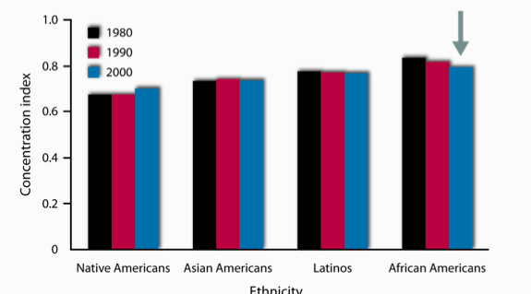
Concentration, compared to European American

Slide 11

Absolute Centralization Index
Closeness of the census tracts with a large percentage of a particular ethnic group to the central business district of the city
Ai= the land area of area i
Xi= the minority population

Slide 12
Absolute Centralization Index

Slide 13
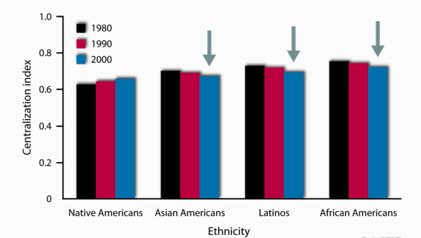
Centralization, European American comparison

Slide 14
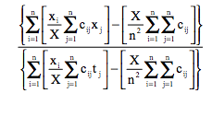
Spatial Proximity Index/clustering
The degree to which census tracts with a large percentage of a particular ethnic group are contiguous

Slide 15
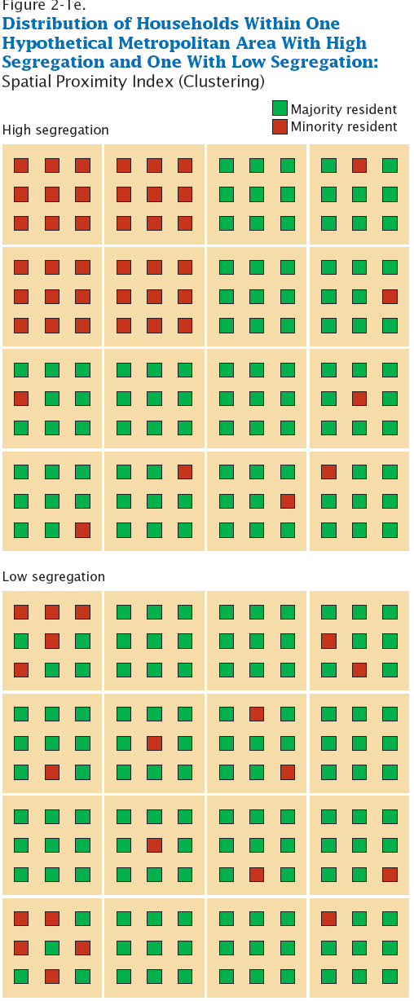
Spatial Proximity Index/clustering

Slide 16
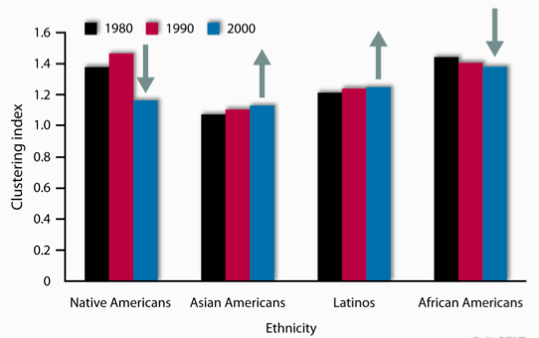
Clustering, compared to European Americans

Slide 17
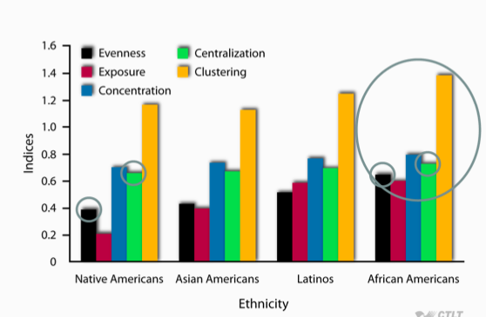
Today

