Slide 1
Biostat 200
Review & Short Topics

Slide 2
End of Semester Housekeeping
Nine Homeworks and one final lab assigned for turning in on the CLE
  Top 8 grades will be used for your overall HW grade
  This is 70% of your grade
Final Exam is posted and due on December 7th on the CLE
  Office hours today and next Tuesday, December 4th 10:30 AM – 12:00 PM in the classroom
  No virtual office hours tomorrow (DEB retreat) but contact me via email with questions or if you want to meet.
  This is 30% of your grade
What have you accomplished this semester?

Slide 3
What have you accomplished this semester? (1)
Understanding Data Types
  Nominal/Categorical
  Ordinal/Rank
  Continuous/Integer
  Continuous/Decimals
Descriptive Statistics
  Summarizing Data
  Tabulating Data
  Graphing Data

Slide 4
What have you accomplished this semester? (2)
Probability
  Union/Intersection
  Independence
  Mutually Exclusive
  Conditional (Bayes)
Distributions
  Uniform/Binomial
  Normal
  Exponential/Poisson

Slide 5
What have you accomplished this semester? (3)
Estimation & Confidence Bounds
  Standardized values
Hypothesis tests
  Normal z test
  Student’s t-test
Sample Size & Power
Non-parametric tests
Chi-squared test (McNemar’s test)
ANOVA & Multiple Comparisons

Slide 6
What have you accomplished this semester? (4)
Correlation
  Linear relationship
  Pearson or Spearman?
Simple Linear Regression
  Continuous Dependent variable
  Least Squares fit
  Slope & Intercept Coefficients
  F-test and R²
Logistic Regression
  Categorical Dependent variable
  Logit transformation
  Odds ratios coefficients

Slide 7
What have you accomplished this semester? (5)
Heteroscedasticity
Multicollinearity
Multiple Regression
  Continuous Dependent variable
  Least Squares fit
  Continuous, ordinal, or binary independent variables
  F-test and R²
Logistic Regression
  Categorical Dependent variable
  Logit transformation
  Continuous, ordinal or binary independent variables
  Odds ratios coefficients

Slide 8
Statistical hypothesis tests
Data and comparison type | Alternative hypotheses | Parametric test Stata command | Non-parametric test Stata command
Numerical; One mean | H_{a}: μ≠ μ_{a} (two-sided) H_{a}: μ>μ_{a} or μ<μ_{a} (one-sided) | Z or t-test ttest var1=hypoth val.*
Numerical; Two means, paired data | H_{a}: μ₁ ≠ μ₂ (two-sided) H_{a}: μ₁ >μ₂ or μ<μ_{a} (one-sided) | Paired t-test ttest var1=var2* | Sign test signtest var1=var2 Wilcoxon Signed-Rank signrank var1=var2)
Numerical; Two means, independent data | H_{a}: μ₁ ≠ μ₂ (two-sided) H_{a}: μ₁ >μ₂ or μ<μ_{a} (one-sided) | T-test (equal or unequal variance) ttest var1, by(byvar) unequal | Wilcoxon rank-sum test ranksum var1, by(byvar)
Numerical, Two or more means, independent data | H_{a}: μ₁ ≠ μ₂ or μ₁ ≠ μ₃ or μ₂ ≠ μ₃ etc. | ANOVA oneway var1 byvar | Kruskal Wallis test kwallis var1, by(byvar)
Dichotomous; One proportion | H_{a}: p≠ p_{a} (two-sided) H_{a}: p>p_{a} or p<p_{a} (one-sided) | Proportion test prtest var1=hypoth value* bitest var1=hypoth value
Dichotomous; two proportions | H_{a}: p₁≠ p₂ (two-sided) H_{a}: p₁ >p₂ (one-sided) | Proportion test (z-test) prtest var1, by(byvar) | Chi-square test tab var1 var2, chi exact McNemar’s for paired data: mcc var1 var2
Categorical by categorical (nxk) | H_{a} : The rows not independent of the columns |  | Chi-square test tab var1 var2, chi exact
Notes:
*Can be written ==

Slide 9
Further methods
Dependent variable (y) | Independent variable(s) type(s) (x) | Methods | Non-parametric methods
Numerical/continuous | One numerical/continuous variable | Pearson correlation; simple linear regression | Spearman rank correlation
Numerical/continuous | One categorical variable | Linear regression, t-test, ANOVA | Sign test, Signed rank test, Wilcoxon rank sum, Kruskal-Wallis
Numerical/continuous | Multiple variables/types of variables | Linear regression
Dichotomous | One categorical variable | Logistic regression (or proportion test for 2x2) | Chi-square test or Fisher exact test
Dichotomous | One numerical/continuous variable | Logistic regression
Dichotomous | Multiple variables/types of variables | Logistic regression
Notes:
Note that some people want to do a t-test when they have a dichotomous dependent variable and one numerical independent variable. However, that is switching the outcomes .

Slide 10
Short Topic 1: Transformations!
Getting Normal
Using the Linear Model
Do we need to?

Slide 11
Reasons to Transform
Variables do not fit a normal distribution and parametric tests are desired
A relationship between two variables is non-linear but transformation would allow the use of linear regression
  Errors in measurement are multiplicative rather than additive, e.g. ± 2% rather than ± 2mm
  Measurements are products rather than sums of other measurements, e.g. area, volume
  Counts follow binomial, poisson, or negative binomial distributions which are often asymmetrical unless sample sizes are large

Slide 12
Solutions
Use non-parametric methods that do not depend on the normality of the data (increasingly easy to do)
Use data transformations that shift the distribution to one that is normal
The transformation must preserve the order of the original data – we only change the spacing between data points
Right skewed data with many zeros cannot be transformed effectively since nothing can stretch out observations that have the same value

Slide 13
Example: What do I need? Homoscedasticity
How do I know I have a problem?
Plot predicted (fitted) values
versus residuals.
What is the pattern of the spread in the
residuals as the predicted values increase?
Acceptable
x
x
x
Spread constant.
Spread increases.
Spread decreases then increases.
x
x
x
Problems
Problems
x
x
x
x
x
x
x
x
x
x
x
x
x
x
x
x
x
x
x
x
x

Slide 14
Example: What do I need? Homogeneity
Attempt a transformation.
Weighted regression.
Incorporate additional covariates.
Non-linear regression.
What to do?
What to do if the spread of the residuals plotted versus X looks like this?
ε
Need another x variable.
X
or this?
ε
x

Slide 15
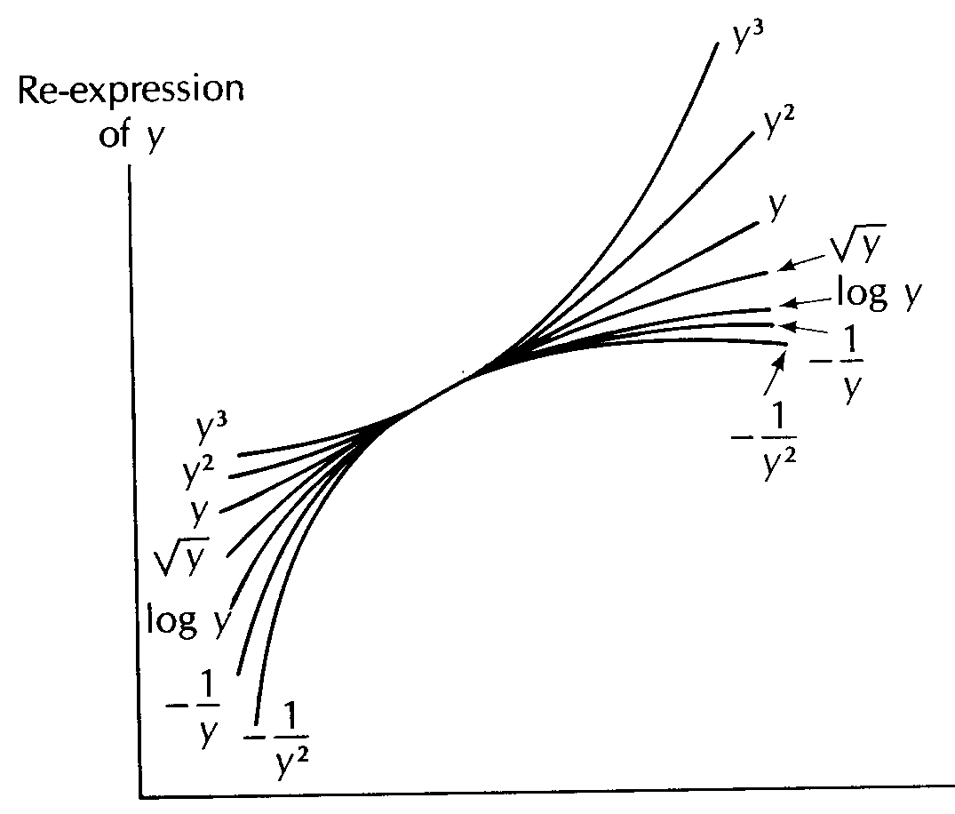
Transforming the Response to achieve Linearity
If a scatterplot of y versus x curves upward, proceed down on the scale to choose a transformation.

Slide 16
Common Transformations
Tail to the right
  Natural or common (base 10) logarithm – no zero values
  Square root, cube root, etc – zeros ok
  Inverse, -1/x, -1/x², etc – no zero values
Tail to the left
  Exponential e^{x},10^{x} (low values)
  Square, cube, etc

Slide 17
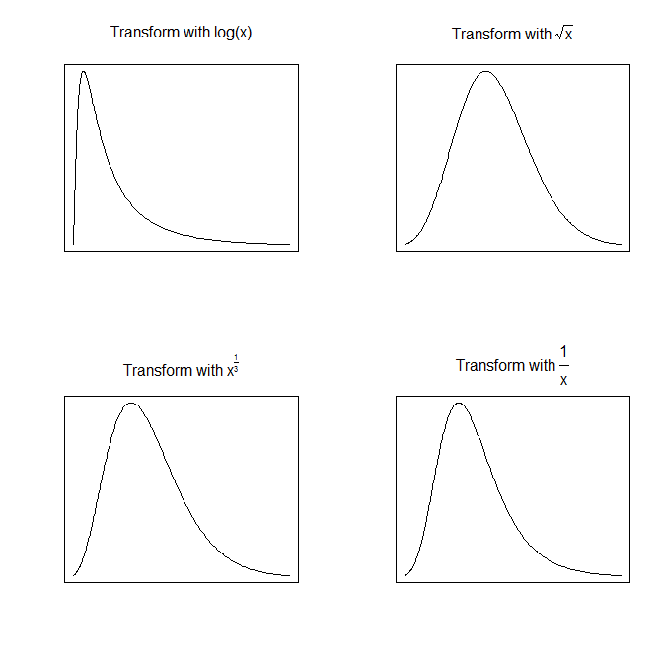
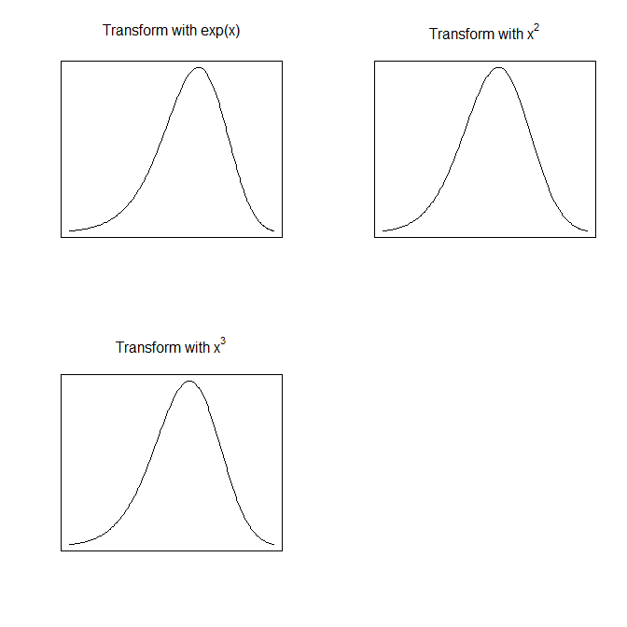
Common Transformations

Slide 18
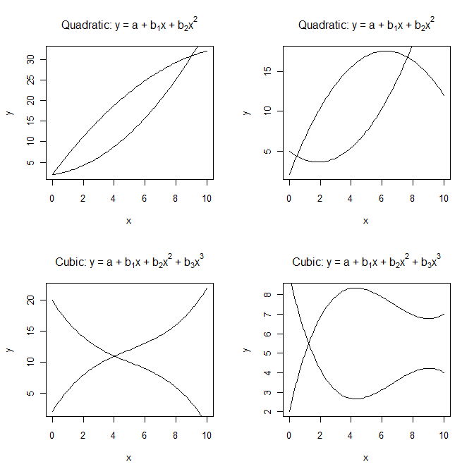
Transforming to Linear
By transforming variables before using linear regression we can fit nonlinear equations
In some cases we can express the fitted equation in terms of the original untransformed variables
Polynomial: Begin with linear and then work up to quadratic, cubic, and so on until the new terms are not significant

Slide 19
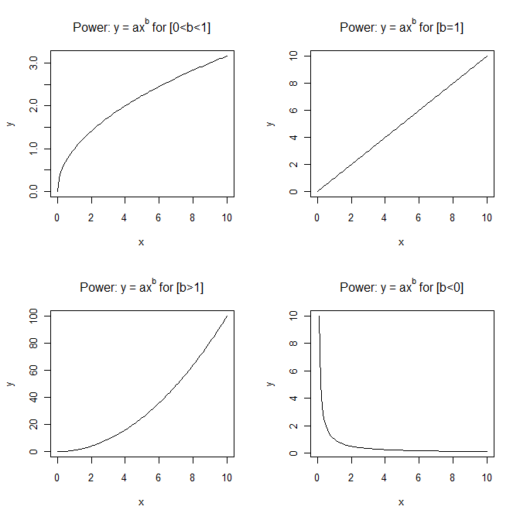
Transforming to Linear
Power Function
Log-log transformation
Use log() to transform dependent and independent variables

Slide 20
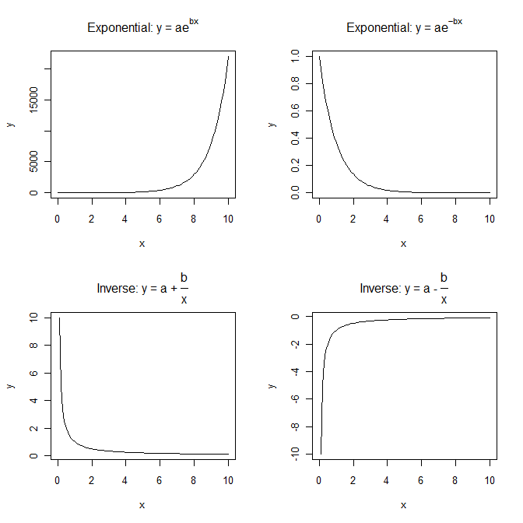
Transforming to Linear
Exponential Function:
  Semi-log transformation
  Use log() to transform dependent variable, y > 0
Inverse Function
  Reciprocal transformation – 1/x where x ≠ 0
  Used for distance models – marriage, trade, social interaction declines with distance

Slide 21
Short Topic 2: Expanding the Modeling Options
GLM – Generalized Linear Model
Linear Regression
Ordered Multinomial Logistic Regression
Logistic Regression
Unordered Multinomial Logistic Regression

Slide 22
Multinomial Logit (sometimes ordered)
Multinomial Logit strategy - Contrast outcomes with a common reference point
    Similar to conducting a series of 2-outcome logit models comparing pairs of categories
    The “reference category” is like the reference group when using dummy variables in regression
It serves as the contrast point for all analyses (use mlogit in Stata)
Example: Multinomial Logit strategy for types of graduate schools
  Analysis of 5 categories yields 4 tables of results:
      No grad school vs. MA
      No grad school vs. MBA
      No grad school vs. Prof’l school
      No grad school vs. PhD.

Slide 23
Multinomial Logit Example: Family Vacation
Mode of Travel. Reference category = Train
. mlogit mode income familysize
Multinomial logistic regression Number of obs = 152
LR chi2(4) = 42.63
Prob > chi2 = 0.0000
Log likelihood = -138.68742 Pseudo R2 = 0.1332
------------------------------------------------------------------------------
mode | Coef. Std. Err. z P>|z| [95% Conf. Interval]
-------------+----------------------------------------------------------------
Bus |
income | .0311874 .0141811 2.20 0.028 .0033929 .0589818
family size | -.6731862 .3312153 -2.03 0.042 -1.322356 -.0240161
_cons | -.5659882 .580605 -0.97 0.330 -1.703953 .5719767
-------------+----------------------------------------------------------------
Car |
income | .057199 .0125151 4.57 0.000 .0326698 .0817282
family size | .1978772 .1989113 0.99 0.320 -.1919817 .5877361
_cons | -2.272809 .5201972 -4.37 0.000 -3.292377 -1.253241
------------------------------------------------------------------------------
(mode==Train is the base outcome)
Large families less likely to take bus (vs. train)
Note: It is hard to directly compare Car vs. Bus in this table

Slide 24
Multinomial Logit Example: Family Vacation
Mode of Travel. Reference category = Car
. mlogit mode income familysize, base(3)
Multinomial logistic regression Number of obs = 152
LR chi2(4) = 42.63
Prob > chi2 = 0.0000
Log likelihood = -138.68742 Pseudo R2 = 0.1332
------------------------------------------------------------------------------
mode | Coef. Std. Err. z P>|z| [95% Conf. Interval]
-------------+----------------------------------------------------------------
Train |
income | -.057199 .0125151 -4.57 0.000 -.0817282 -.0326698
family size | -.1978772 .1989113 -0.99 0.320 -.5877361 .1919817
_cons | 2.272809 .5201972 4.37 0.000 1.253241 3.292377
-------------+----------------------------------------------------------------
Bus |
income | -.0260117 .0139822 -1.86 0.063 -.0534164 .001393
family size | -.8710634 .3275472 -2.66 0.008 -1.513044 -.2290827
_cons | 1.706821 .6464476 2.64 0.008 .439807 2.973835
------------------------------------------------------------------------------
(mode==Car is the base outcome)
Here, the pattern is clearer: Wealthy & large families use cars

Slide 25
Multinomial Logit - Stata Notes: mlogit
Dependent variable: any categorical variable
    Don’t need to be positive or sequential
    Ex: Bus = 1, Train = 2, Car = 3
      Or: Bus = 0, Train = 10, Car = 35
Base category can be set with option:
    mlogit mode income familysize, baseoutcome(3)
Exponentiated coefficients called “relative risk ratios”, rather than odds ratios
    mlogit mode income familysize, rrr

Slide 26
MLogit Example: Car vs. Bus vs. Train
Exponentiated coefficients: relative risk ratios
Multinomial logistic regression Number of obs = 152
LR chi2(4) = 42.63
Prob > chi2 = 0.0000
Log likelihood = -138.68742 Pseudo R2 = 0.1332
------------------------------------------------------------------------------
mode | RRR Std. Err. z P>|z| [95% Conf. Interval]
-------------+----------------------------------------------------------------
Train |
income | .9444061 .0118194 -4.57 0.000 .9215224 .9678581
familysize | .8204706 .1632009 -0.99 0.320 .5555836 1.211648
-------------+----------------------------------------------------------------
Bus |
income | .9743237 .0136232 -1.86 0.063 .9479852 1.001394
familysize | .4185063 .1370806 -2.66 0.008 .2202385 .7952627
------------------------------------------------------------------------------
(mode==Car is the base outcome)
exp(-.057)=.94. Interpretation is just like odds ratios… BUT comparison is with reference category.

Slide 27
Multinomial Logit: Predicted Probabilities
You can predict probabilities for each case
    Each outcome has its own probability (they add up to 1)
. predict predtrain predbus predcar if e(sample), pr
. list predtrain predbus predcar
+--------------------------------+
| predtrain predbus predcar |
|--------------------------------|
1. | .3581157 .3089684 .3329159 |
2. | .448882 .1690205 .3820975 |
3. | .3080929 .3106668 .3812403 |
4. | .0840841 .0562263 .8596895 |
5. | .2771111 .1665822 .5563067 |
6. | .5169058 .279341 .2037531 |
7. | .5986157 .2520666 .1493177 |
8. | .3080929 .3106668 .3812403 |
9. | .0934616 .1225238 .7840146 |
10. | .6262593 .1477046 .2260361 |
This case has a high predicted probability of traveling by car
This probabilities are pretty similar here…

Slide 28
Multinomial Logit: Predicted Probabilities
Similar to the logit command, you can show how probabilies change across independent variables
    Manually compute mean of predicted probabilities
    Other variables will be left “as is” (ceteris paribus) unless you set them manually before you use “predict”
. mean predcar, over(familysize)
---------------------------
Over | Mean
-------------+-------------
predcar |
1 | .2714656
2 | .4240544
3 | .6051399
4 | .6232910
5 | .8719671
6 | .8097709
Probability of using car increases with family size
Note: Values bounce around because other vars are not set to common value.
Note 2: Again, scatter plots aid in summarizing such results

Slide 29
Multinomial Logit Assumptions
Can also look at ologit (ordered outcomes) – similar setup in Stata
Multinomial logit is designed for outcomes that are not complexly interrelated
Critical assumption: Independence of Irrelevant Alternatives (IIA)
    Odds of one outcome versus another should be independent of other alternatives
    Problems often come up when dealing with individual choices…aren’t most of our choices somewhat interrelated?

Slide 30
Short Topic 3: Fixed Effects vs. Random Effects
Our regression & logistic models have been fixed effect models
  the levels of each factor were fixed in advance of the experiment
  we were interested in differences in response among those specific levels.
A random effects model considers factors for which the factor levels are meant to be representative of a general population of possible levels.
Will be covered in depth in the next Biostats class so this will give you an overview

Slide 31
Fixed Effects vs. Random Effects: where do we use it?
Panel Data – individuals are observed at several points in time and also often grouped by location/diagnosis/etc
Cross-sectional time series data where sampling may be by group but different individuals at each time point
We have variables that are changing over time and others that are fixed
In each case we have variability within and between groups and individuals (both random error and error due to individual differences)

Slide 32
Fixed Effects vs. Random Effects: Why is it important?
Fixed-effects model
Random-effects model

Slide 33
Fixed Effects vs. Random Effects: Definitions
  Effects are fixed if they are interesting in themselves or random if there is interest in the underlying population.
Fixed effects are constant across individuals, and random effects vary.
  in a growth study, a model with random intercepts and fixed slope corresponds to parallel lines for different individuals
It is also possible to have mixed effects models where you have both fixed and random effects.

Slide 34
Fixed Effects vs. Random Effects: Operationalizing
  Observations where you have uneven sampling across time
    Not all patients attend all visits
Groups of observations with uneven numbers per group
  Sampling households with zip codes but unequal numbers of households per zip
Multiple levels of variables: hierarchical models where you are interested in estimating the variability within and between levels
Many ways to estimate with Stata: xtlogit (binary outcomes) & mixed (continuous outcomes)

Slide 35
Short Topic 4: Survey Data in Stata
Most of our survey data is self contained – not going to be imputed to represent, for example, the population of the United States
Create survey, download data, analyze outcomes and make inferences
For generalizing your results (i.e.; for publication) do you need to create weights to make your survey representative?
Alternatively, is your survey weighted (by strata in sampling) or by weights after gathering the data.

Slide 36
Survey Data in Stata
Most of our survey data is self contained – not going to be imputed to represent, for example, the population of the United States
Create survey, download data, analyze outcomes and make inferences
For generalizing your results (i.e.; for publication) do you need to create weights to make your survey representative?

Slide 37
Survey Data in Stata: what are survey weights?
A value assigned to each case in the data file to make statistics computed from the data more representative of the population
The value indicates how much each case will count in a statistical procedure
  A weight of 2 means that the case counts in the dataset as two identical cases.
  A weight of 1 means that the case only counts as one case in the dataset.
  Weights can (and often are) fractions, but are always positive and non-zero.
In Stata, these are the pweights
  Design weights vs Post-stratification weights
  If you know the sampling fraction for each case, Design Weight = 1/(sampling fraction)

Slide 38
Survey Data in Stata
In Stata: svyset [pweight = xxxx] sets the data to be a survey with weights for each observation
For each additional analysis you will use this prior to analyses
  svy: command variable

Slide 39
Survey Data in Stata: Example*
Survey on genital grooming: 5488 men between 18 & 65 answered the survey
Post-data collection weights were calculated to ensure that the results were representative of non-institutionalized males.
In Stata using the respondent identifier – CaseID
*Gaither et al, 2016 Characterization of Genital Dissatisfaction in a National Sample of U.S. Men. Arch Sex Behav

Slide 40
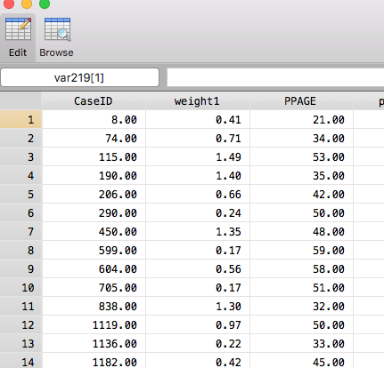
Survey Data in Stata: Example*
Weights are applied to each respondent based on age, ethnicity, education, region of the country, etc.
*Gaither et al, 2016 Characterization of Genital Dissatisfaction in a National Sample of U.S. Men. Arch Sex Behav

Slide 41
Survey Data in Stata: Example*
To tabulate the number of groomers in the dataset with and without the survey weighting
Note that the percents are close but not equal to each other
*Gaither et al, 2016 Characterization of Genital Dissatisfaction in a National Sample of U.S. Men. Arch Sex Behav

Slide 42
Survey Data in Stata: Example*
*Gaither et al, 2016 Characterization of Genital Dissatisfaction in a National Sample of U.S. Men. Arch Sex Behav

Slide 43
Survey Data in Stata: Example*
*Gaither et al, 2016 Characterization of Genital Dissatisfaction in a National Sample of U.S. Men. Arch Sex Behav

