Slide 1

Please take an i>clicker

Slide 2
Do you agree with the authors’ conclusion?
Strongly agree - A
Somewhat agree - B
Not sure - C
Somewhat disagree - D
Strongly disagree - E
Notes:
2
Here is the conclusion of today’s article, that you all know. Do you agree with the author’s conclusion? This is a 5 point “Likert” scale (named after the inventor Rensis Likert). Strongly Agree-A…to Strongly Disagree – E.

Slide 3
What is the Research Question?
Notes:
Who can succinctly state the research question?

Slide 4
Which of the “Big 6” research objectives is this?
MMR
Autism
?
Notes:
We now know that depicting the research question in a DAG is the clearest way to communicate. I was impressed the other day in Small Group Section when I heard one of you say that you don’t want to hear someone’s research question in words; you would much rather see the DAG. Did anyone draw the DAG for this research question?
Which of the “Big 6” research objectives is this?

Slide 5
What Kinds of Questions Does Clinical Research/Epidemiology Answer?
“Big 6”
Description
  How frequent/common are risk factors/exposures/conditions/diseases?
Causation (“Causal inference”)
  The science of establishing causal relationships among biological, behavioral, environmental (etc.) factors within humans. Does X cause (or prevent) Y?
  Will intervening upon X change occurrence of Y?
Attribution
  What fraction or how many cases of disease Y can be eliminated if a causal exposure X is eliminated or reduced?
Mediation
  Understanding the mechanisms of causation
  How does X cause Y?
Interaction
  When and for whom does X cause/predict Y?
Prediction
  Do A, B, and C predict concurrent presence/future occurrence of Y?
How often does Y occur?
Anything that needs to be added to the DAG?
e.g., diagnosis or prognosis
Notes:
The answer is causation.
We call these the Big 6. Just what does clinical research and epidemiology do? What kinds of questions does clinical research and epidemiology answer? Most of what clinical research and epidemiology answer can be placed into one of these 6 categories or objectives, and each is highly relevant.
The goal of creating this list is for students to be able to encounter any given research question or problem and instantly classify the work into one or more of these categories/objectives. Then, once the category/objective is recognized, this should invoke a mental checklist of what is needed methodologically to fulfill the objective (and to fulfill it well). For example, if description is the objective, is the parameter of interest prevalence, incidence, or something else? If incidence, is the parameter risk or rate and have all of pitfalls with risks and rates been addressed? This type of mental pattern recognition will instantly help students focus on key threats to validity in any of type of research.
This research question is addressed within the context of observational study design. That said, do the authors believe anything else is going on in the system that needs to be depicted in the DAG?

Slide 6
Mother’s Education
Calendar time
Sex
Birth weight
SES
Gestational age
Age
MMR
Autism
?
Unknown (and hence unmeasured) Confounders
Notes:
Yes, the authors do envision that other constructs are in play here by virtue of their control for a number of variables, but because the authors do not display a DAG we cannot be sure if they adjusted for some of the factors to manage confounding or because they were thinking that they were strong determinants of outcome only and hence they sought to improve precision. Or, perhaps they were operating under some older philosophies of adjusting for any factors that predicted exposure?
And, of course, we need to include mention of the unknown (and hence unmeasured) confounders.
We can draw the above DAG but without a lot of time in the library we cannot be sure if all of the edges exist.

Slide 7
Populations
Target Population
  Children in resource-rich regions who are alive in era where the MMR vaccine is available
Accessible Population
  Entire child population of Denmark w/ID number
Study Population
  Entire child population of Denmark w/ID #, born 1991-98
  What type of study design?
    Cohort Fixed or Dynamic?
    Inherently dynamic, but analyzed as fixed by “shifting” everyone to the left
Notes:
What are the populations for this study? The target population, unless explicitly stated by the authors (which was not the case here), can often be hard to nail down. It is the broadest population about which inferences can be reasonably made. It is unfortunate that authors do not more often explicitly state the target population because, if they don’t, readers will often have uncertainty and disagreements about what it is. And, it is hard to state what the biases are (and their magnitude) if we do not explicitly know what is the gold standard.
In this paper, in our view, the target population is children who reside in resource-rich regions (such as Denmark) in the time period where they might be exposed to the MMR vaccine. We don’t think the target population is solely Denmark because this is too narrow; we suspect the authors intended their target population to be any group of children in resource-rich environments like Denmark.
The accessible population is the population that the investigators can get their hands on. In this case, it is the entire population of children in Denmark who have an ID number.
The study population represents how the accessible population was sampled for the current research study. In this case, the authors took everyone in the accessible population who was alive from 1991-1999. Hence, the sampling is based on calendar time. This study population is a cohort study. As coming from a free living population, it is a dynamic cohort, but the author analyze it by moving everyone to the left. This means that the time element is analysis time (duration of time observed as opposed to calendar time) and it is expressed according to age.

Slide 8

Does the population-based aspect of the study enhance internal validity?
Yes - A
No - B
Notes:
8
The authors emphasized the population-based aspect of their design both in the title and in the narrative of their text. Does the population-based aspect of the study design enhance internal validity? Yes or No?

Slide 9
Does the population-based aspect of the study enhance internal validity?
Yes - A
Why?
No - B
Notes:
9
Why is the answer yes? Don’t get this confused with external validity or generalizability; the question is explicitly about internal validity. Population-based studies are great to enhance generalizability because they, in fact, cover the entire population of some geographic region in some period of time, which makes it easier to think about transporting the inference to another geographic region. However, this is not what we are asking. We are asking about internal validity. Why is internal validity enhanced?

Slide 10
For Selection Bias to occur at the “front end” of a cohort
Other factors
Other factors
Selection
MMR
Autism
or
Other factors
Selection
MMR
Autism
Notes:
You have actually seen the answer before. Remember this from the Selection Bias lecture? We said that for selection bias to occur at the front end of a cohort study, a person’s selection into a study must be influenced by/ associated with BOTH his/her exposure and outcome (e.g., disease). In a population-based study, i.e. when people are selected from the general population with no restrictions, none of these DAGS can occur (unless there is selective participation/refusal by the people, which could not happen in this study because the people did not knowingly enroll. They were just followed in a database). Therefore, there can be no selection on the front end of the cohort. In this Denmark study, the only restriction is that you needed to have a civil registration number. There may be some births without a civil registration number in the country and some basis to say there is variability in the “selection” node, but we cannot see that this could result in either of these 2 DAGs.

Slide 11
Selection Bias in a Cohort Study
1. Problems with initial sample?
Autism
+ -
No
+
-
MMR
SOURCE POPULATION
STUDY SAMPLE
Notes:
Thus, for our tally of selection bias, we do not think that there are problems with the initial sample.

Slide 12
Selection Bias in a Cohort Study – Other Mechanisms?
2. Losses to follow-up
Autism
+ -
How can we organize our thinking about whether losses to follow-up are resulting in selection bias?
+
-
MMR
?
?
SOURCE POPULATION
?
?
STUDY SAMPLE
Notes:
What is another potential mechanism for selection bias in a cohort study? As usual, we have to consider losses to follow-up (aka drop out). We are not actually told how many losses to follow there are. The losses, which are emigration, are bundled together with the deaths, and we are told that there are 5028 of these. We probably could get the national death rates and figure out how many of these were deaths, but the point is that there is some emigration or losses. So, the question is: do we think that losses to follow-up are creating selection bias? And, how can we organize our thinking about whether losses to follow-up are resulting in selection bias?

Slide 13
For Losses to Follow-up to Create Selection Bias
Under Null Conditions
Retention in study
MMR
Autism
Other factors
Other factors
Retention
Retention
MMR
Autism
MMR
Autism
Retention
Other factors
Other factors
MMR
Autism
Notes:
For losses to follow-up to create selection bias, one of these 4 DAGs would need to be operative. Do we think this is the case?

Slide 14
Selection Bias in a Cohort Study
2. Losses to follow-up (drop out – leave country)
Autism Symptoms
Autism
SES
+ -
Retention
+
-
MMR
MMR
Diagnosed
Autism
?
Link between autism and retention not likely
SOURCE POPULATION
And, authors adjusted for SES
STUDY SAMPLE
Notes:
The most plausible scenario we can think of for how MMR might be related to retention is that kids/parents with a particular SES might be more apt to both leave the country and to get/not get the vaccine. We have depicted these relationships here. We cannot, however, see how there would be a connection between autism and retention. While perhaps kids with an autism diagnosis might be more apt to leave the country (say, to get therapy), because this is after the autism diagnosis, it will not cause bias. Once autism is diagnosed, it is recorded in the databases, and the affected child’s follow-up is over and anything that occurs (such as leaving the country) is not relevant to us. The only other way we could make this connection is if those kids who were developing autism symptoms but who were not yet diagnosed are selectively moving out of the country to get treatment. We don’t think this is likely. It is hard to imagine people leaving the country for treatment if they did not have a diagnosis.
Hence, we don’t think that a DAG depicting selection bias related to losses to follow-up is likely. We continue to also show the box and arrows figure with equally shaded arrows. Now, you can see the equivalence of these two approaches of thinking about selection bias.
Note: one other possibility is that the presence of other serious illnesses might influence whether a child gets the MMR vaccine and also cause them to leave the country for better/alternative medical care. While this is possible, we believe that the associations are very weak and thus not able to cause any important bias. Also, there is still not a connection between retention and autism to complete the biasing pathway.

Slide 15
Selection Bias in a Cohort Study – Other Mechanism?
3. Competing Events (deaths)
Death from other disorders (Competing Events)
Autism
Genetic Factors
+ -
+
-
Retained in observation
MMR
MMR
Autism
?
Link between MMR and competing event not likely
SOURCE POPULATION
And we do not have evidence for the autism –competing event link either
STUDY SAMPLE
Notes:
Is there a third mechanism? Competing events are such a mechanism.
How about the deaths or the development of a short list of disorders, for example, tuberous sclerosis, which are associated with autism? These are competing events. It is conceivable that some underlying host factor, like genetic factors, is responsible for both autism and death, which are competing events. The deaths then take the kids out of observation. Is there anyway here to complete the DAG for selection bias? If MMR was causally related to death, then conditioning upon those retained in the observation would be conditioning upon a descendant of a collider, which actually produces the same effect as conditioning on a collider. Is this structure possible? Well, probably not, because we are not aware of how MMR is causing deaths. MMR has been accused of a lot of things but not overt mortality. One might say that MMR is actually supposed to prevent infectious disease and hence it must be associated with death. However, given the high penetrance of vaccination these days, there is a lot of herd immunity where even non-vaccinated persons are protected against getting the vaccine-targeted diseases. In other words, it is hard to see how MMR is causally associated with death.
Hence, we would have to make this edge disappear and conclude that the competing events are not causing selection bias. Again, equal selection probabilities means no selection bias using the box and arrows paradigm.
----
Advanced notes:
Consider if the edge from MMR to other disorders did exist by a mechanism of MMR reducing mortality. Try to figure out the direction of the resultant bias. This is hard without knowing the direction of the genetic factors association with retention and autism.

Slide 16
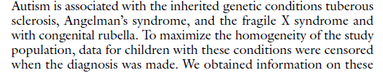
Selection Bias in a Cohort Study
4. Competing Events (genetic conditions which cause secondary autism)
Autism
3 inherited conditions (TS, AS, fragile X)
Genetic Factors
+ -
+
-
Retained in observation
MMR
MMR
Autism
?
Link between MMR and competing event not likely
SOURCE POPULATION
And we do not have evidence for the autism –competing event link either
STUDY SAMPLE
Notes:
Is there a fourth mechanism?
The authors stated autism is associated with three inherited conditions (tuberous sclerosis, Angelman’s and fragile X), and that the observation for children who developed these conditions were censored at the time the diagnosis of the condition was made. We would have to consider any autism that came forth from these conditions as secondary forms of autism and not what the authors are interested in studying in this article. Hence, when a child develops any one of these conditions they really cannot develop the primary form of autism that the authors are interested in. Hence, they do meet the definition of a competing event. It is conceivable that some underlying genetic factor might be responsible for both these 3 inherited conditions and the autism we are interested in, call it “primary autism”. If MMR is also associated with these conditions, then when we condition upon the retained individuals in the analysis, it is conditioning upon a descendant of a collider, which actually produces the same effect as conditioning on a collider. We do not, however, have any compelling reason to believe that any of these relationships are operative. We do not think the link between MMR and the competing event is likely and we have no evidence for eth autism-competing event link.
Hence, we would have to make this edge disappear and conclude that the competing events are not causing selection bias. Again, equal selection probabilities means no selection bias using the box and arrow paradigm.

Slide 17
Misclassification of Exposure:
Imperfect Sensitivity
Autism
+ -
Problems with sensitivity in measurement of exposure
+
-
MMR
Independent and non-differential
SOURCE POPULATION
MMR measurement process
Autism measurement process
Mechanism: administrative mistakes in vaccination capture
MMR_{obs}
Autism_{obs}
?
Manifestation?
Bias towards null
STUDY SAMPLE
MMR_{true}
Autism_{true}
Notes:
How about the measurements? Let’s start with exposure. If there is a problem, it is likely in the realm of sensitivity. Prior to 1996, the recording of vaccination in the kids was done through linkage with their adult caregiver. It seems to me that this may result in missing the recording of some vaccinations. It is hard to know how often did this happen, but pediatricians are busy, and we have to believe that this occurred to some extent. If it did happen, we believe this would be non-differential with respect to outcome. We also think it is independent with respect to outcome because the processes to make these measurements appear to be unrelated. If this is the case, what would have been the manifestation or direction of the bias? Towards the null.
We also now know to depict this scenario of independent non-differential misclassification of exposure in a DAG, but it is admittedly not very helpful in understanding the bias.

Slide 18
Misclassification of Exposure:
Imperfect Specificity
Autism
+ -
+
-
Problems with specificity in measurement of exposure
MMR
Independent and non-differential
SOURCE POPULATION
Mechanism: administrative mistakes in vaccination linkage
How should authors feel about biases toward the null?
Manifestation?
Bias towards null
STUDY SAMPLE
Notes:
We also cannot rule out problems in specificity, again caused by administrative mistakes in vaccination linkage. Perhaps the linkage was done incorrectly in some cases. We would term this independent with respect to other measurements and non-differential. Again, the manifestation would be biased towards the null.
It is hard to know the magnitude of this, but we don’t expect that it is large.
What could have been done to evaluate this? It would have been nice to do a small validation study of the measurement by doing a chart review and comparison with the computer database.
What about these biases toward the null? This is not what the authors want to see when they are trying later claim that they have proved the null. The answer is that they should feel a bit nervous.

Slide 19
Accuracy of Outcome Measurement
Assume prevalence is 1 in 100
Specificity = 531906/531930 = 0.99995
Sensitivity = 292/5373 = 0.054
Notes:
How about the outcome measurement? The authors used the Danish Psychiatric Central Register. How did diagnoses get in this register? In Denmark, children are referred to specialists in child psychiatry by general practitioners, schools, and psychologists if autism is suspected. Only specialists in child psychiatry diagnose autism and assign a diagnostic code, and all diagnoses are recorded in the Danish Psychiatric Central Register.
What was done by the authors to get some sense of the accuracy of the autism diagnoses? The text reads: “We performed an extensive record review for 40 children with autistic disorder (13 percent of all the children with autistic disorder) to validate the diagnosis of autism. A consultant in child psychiatry with expertise in autism examined the medical records. Thirty-seven of the children (92 percent) met the operational criteria for autistic disorder according to a systematic coding scheme developed by the Centers for Disease Control and Prevention for surveillance of autism
and used in a prevalence study in Brick Township, New Jersey. The three children who did not meet the criteria for autistic disorder were all classified as having other autistic-spectrum disorders. For two of the children, the diagnosis of autistic disorder was questionable because of profound intellectual impairment. For the third child, we did not have information about the onset of symptoms before the age of three years, which is a prerequisite for the diagnosis of autistic disorder.”
What is this entity, 37 divided by 40? This is positive predictive value.
What if we scaled this sample of 40 up to the entire study population?
Now, let’s say that the true prevalence of autism is as high as 1 in 100, a number claimed in some studies. Here is the 2x2 table. The estimated specificity is very high. Anytime you have so few cases diagnosed in such a large population, you know the specificity must be very high.
The other issue with outcome is that autism may be several different diseases. Given that there is no single diagnostic test, what is clinically said to be autism could be considered as a composite outcome. Hence, for the real autism that is caused by vaccine, the outcome as currently constituted could be considered non-specific (with attendant bias towards the null).
Note: this type of validation study with the outcome is also what they should have done with exposure.

Slide 20
Misclassification of Outcome:
If Non-Differential
Extremely minimal bias towards null
Autism
Manifestation?
+ -
+
-
Common problems with outcome sensitivity –unrelated to exposure status
MMR
SOURCE POPULATION
Rare problems with outcome specificity – unrelated to exposure status
STUDY SAMPLE
Notes:
So, there are likely common sensitivity problems but very minimal specificity problems. If the misclassification due to sensitivity is non-differential with respect to exposure, we expect a bias towards the null. However, because of the very high specificity, the degree of bias is very minimal.

Slide 21
Misclassification of Outcome:
If Differential
Our speculation: Specificity not affected differentially with respect to exposure
Autism
+ -
Less sensitive autism diagnosis among non-vaccinated perhaps because they are not “in care” as much as vaccinated or because psychiatrists were aware of vaccine-autism hypothesis
+
-
MMR
SOURCE POPULATION
MMR measurement process
Autism measurement process
MMR_{obs}
Autism_{obs}
Bias away from null, towards effect of MMR
?
MMR_{true}
Autism_{true}
Manifestation?
STUDY SAMPLE
Healthcare seeking
Notes:
However, what if misclassification of outcome was differential? What would the manifestations be?
Our guess is that specificity is not affected. Very few people without autism are getting falsely diagnosed. If there is differential misclassification of outcome, we think it would affect sensitivity. That is, we might expect less sensitive diagnosis among the non-vaccinated perhaps because they are not “in care” as much as the vaccinated kids or perhaps because psychiatrists were more likely to diagnose clinically borderline, but yet true, cases in the vaccinated as compared to unvaccinated if they were aware of the vaccine hypothesis. Were they aware of the vaccine autism hypothesis? The first paper regarding MMR and autism came out in 1998 but even before this there was general suspicion about vaccines. If this differential scenario was operative, what would the manifestation be? It would be a bias away from the null, towards a positive effect of MMR on autism. Because ultimately the analysis did not show this result, it does not threaten the final inference.
We also now know to depict differential misclassification in a DAG, which we believe is a bit more illuminating than non-differential misclassification.

Slide 22
Possible manifestation of omitting family history:
Mother’s education
Vaccinated depleted for highest risk kids
Calendar time
Non-vaccinated enriched for highest risk kids
Underestimate risk of vaccine (negative confounding)
Sex
Birth weight
Amplified by adjusting on possible IVs
Uncertain about edge and hence parent is on B list
SES
Gestational age
Is there any downside to adjusting for all these?
Age
-potentially less precision
MMR
Autism
-potential bias amplification
?
Family Hx of Autism (unmeas’d)
Unknown Confounders
U
Notes:
How about confounding? Here is a simplified DAG again (it is simplified in that we have not attempted to draw any edges between the covariates other than exposure and disease). On the top are the measured factors. Red means that we are unsure about the causal relationships existing; thus, the parents of these edges are factors that we might place on the B list. The child’s age is the only factor we feel sure about; it is the only factor on the A list. We know that age affects when you get vaccinated, and it also affects when you will get diagnosed with autism. (Note: gestational age in this study refers to the number of weeks of age the child was in utero prior to being born. It is measured in weeks, from the first day of the woman's last menstrual cycle to the date of birth. A so-called normal pregnancy can range from 38 to 42 weeks. Infants born before 37 weeks are considered premature.)
Is there any downside for adjusting for all of these B list factors? Yes, first, there might be a loss of precision. This is an issue when we are trying to show no effect because the width of the confidence interval is critical. We wonder what the confidence interval would have been without adjusting for all of this stuff (other than age). Second,
On the bottom are unmeasured factors. Here I have placed the generic “unknown confounders”, which can almost always be listed in any observational study. Yet, there is one unmeasured confounder that we do know about and should be concerned about. What is the chief and most concerning unmeasured confounder? It is family history. Why might this be the case? Family history is causally related to autism. That much is easy. The other axis is that a family who has a family history of autism, perhaps in a sibling of the index child, might be less apt to get their next child vaccinated – if they bought into the vaccine-autism hypothesis or if they had a general suspicion about all medical interventions. In other words, the vaccinated would be depleted of the highest risk children and the unvaccinated would become enriched for the highest risk children.
What is the manifestation of omitting family history? It will underestimate the risk of the vaccine. This is termed negative confounding.
Is there any data we can examine to evaluate whether parents with a family history of autism were withholding MMR for the index children? The data at the bottom of Table 2 shows that if those with family history were withholding MMR, then they should have been doing this the most when the news of the Wakefield article broke in 1998. If this were the case, the vaccinated should have been depleted of the highest risk and thus we would have expected to see a lower rate ratio in that latter period, but we don’t. In other words, we would have expected to see an elevated IRR in the early time period (early 1990’s) which would then become attenuated in 1998. This did not happen. This leads us to believe that this was not a substantial confounder.
However, what if there was general concern about vaccines throughout the study period and was causing negative confounding throughout, and that last datapoint at the bottom of page 2 is just a random blip. We will never know.

Slide 23
If FH confounding operative, would have expected attenuation of IRR in last time period (coinciding with highly publicized paper) as more high risk children went unvaccinated – but we don’t
Notes:
Is there any data we can examine to evaluate whether parents with a family history of autism were withholding MMR for the index children? The data at the bottom of Table 2 shows that if those with family history were withholding MMR, then they should have been doing this the most when the news of the Wakefield article broke in February 1998. If this were the case, the vaccinated should have been depleted of the highest risk and thus we would have expected to see a lower rate ratio in that latter (1997 – 1999) period, but we don’t. This leads us to believe that this was not a substantial confounder.

Slide 24
What if general concern by autism-affected families about vaccines throughout the study period?
Would mean that all measures suffer from negative confounding
Notes:
One caveat: perhaps negative confounding by FH was occurring throughout the time period, in which case all of the measures suffer from negative confounding.

Slide 25
Was the unadjusted (crude) measure of association reported?
Yes - A
No - B
Notes:
25
Let’s move to the results. Was the unadjusted measure of association reported?

Slide 26
Was the unadjusted (crude) measure of association reported?
No - B
Yes - A
Notes:
26
No, the unadjusted measure of association was not reported.

Slide 27
What was the unadjusted measure of association?
1.45 - B
0.85 - A
1.02 - C
Not enough information to tell- D
Notes:
27
What was the unadjusted measure of association?

Slide 28
iri 263 53 1647504 482360
| Exposed Unexposed | Total
-----------------+------------------------+------------
Cases | 263 53 | 316
Person-time | 1647504 482360 | 2129864
-----------------+------------------------+------------
| |
Incidence Rate | .0001596 .0001099 | .0001484
| |
| Point estimate | [95% Conf. Interval]
|------------------------+------------------------
Inc. rate diff. | .0000498 | .0000144 .0000851
Inc. rate ratio | 1.452863 | 1.078099 1.99046 (exact)
Attr. frac. ex. | .3117039 | .072441 .4976036 (exact)
Attr. frac. pop | .2594244 |
+-------------------------------------------------
(midp) Pr(k>=263) = 0.0052 (exact)
(midp) 2*Pr(k>=263) = 0.0104 (exact)
Notes:
This is the unadjusted analysis looking at the effect of vaccine. The tabular structure can be reconstructed from the article.

Slide 29
Should the unadjusted measure of association have been reported?
No - B
Yes - A
Notes:
29
Should the unadjusted measure of association been reported? (There is no correct answer. However, we believe that this was not just an oversight from the authors or the editors. This was an intentional omission.)

Slide 30
Explain it in words
Any way to make the confidence interval smaller?
Notes:
Here are “final” adjusted estimates. Let us focus on just the outcome of autistic disorder. Let’s walk through it. What is it in words?
The main result is in the 4th row. Rate ratio = 0.92. Who can interpret in words? What is the range of measures of association that are compatible with the observed data?
The blip at IRR of 1.38 merits mention at 6 to 11 months following vaccination.

Slide 31
Do you agree with the authors’ conclusion?
Strongly agree - A
Somewhat agree - B
Not sure - C
Somewhat disagree - D
Strongly disagree - E
Notes:
31
How about a post test?

Slide 32
Summary: Bias Scorecard
Type of Bias | No Bias | Away from Null: Protective effect of MMR |  | Towards the Null | Away from Null: Causative Effect of MMR
Selection
Measurement
Confounding
×
×
Magnitude unclear; likely small
×
Magnitude unclear
If you are trying to show/claim no positive causal association, these are not the biases you want to see
As often true in observational work, it boils down to confounding
Notes:
Here is our score card.
Recall that we don’t think there is any appreciable selection bias.
The effect of measurement error of exposure and outcome, if present, are in the opposite direction. Perhaps they cancel each other out? Or perhaps all of the bias is in the exposure, which results in bias towards the null. We suspect the magnitude is likely small.
In terms of confounding, it is hard to know. We still think the greatest threat of confounding is by unmeasured family history. This is negative confounding; it serves to underestimate any harmful effect of the vaccine. The magnitude is unclear.
What is true is that if you are trying to show/claim/conclude that there is no positive causal association, these are not the biases you want to see. They weaken your case.
And, as is often true in observational work, the validity of the inference all boils down to how well the investigator has managed confounding.

Slide 33

Conclusions
No obvious definite substantial threats to validity
But: Not easy to “prove” the null hypothesis
Better phrasing:
  “We found no strong evidence in favor of the hypothesis that MMR vaccination causes autism.”
Biases toward the null are not always “reassuring”
If you seek to convincingly show no association, optimizing measurements (including confounders) even more important than usual (avoid biases towards the null)
Notes:
What is our bottomline? We conclude that there are no obvious substantial threats to validity. This just means that the authors did not miss something obvious in terms of bias in their analysis. It does not mean there are no substantial threats to validity present.
The work illustrates how it is not easy to prove the null hypothesis of “no association”. The wording the authors used in the abstract “provides strong evidence against the hypothesis that MMR vaccination causes autism” is not technically correct. Instead, what is true is that they found no strong evidence in favor of the hypothesis that MMR vaccine causes autism.
Similarly, in this context, biases toward the null are not reassuring. Importantly, if you seek to convincingly show no association, you need to work hard to avoid biases towards the null because they weaken your argument.

Slide 34
Some Other Issues
What would be a better measure of association?

Slide 35
Some Other Issues
What would be a better measure of association?
  Risk difference and a number needed to harm
Notes:
Risk difference and a number needed to harm would be better in that they depict harm in terms of actual numbers of children. Rate difference would also be better.

Slide 36
Could there have been a better design?
Case-control
  Would have limited sample size to a manageable number for whom there could have been:
    Chart review and interviews
    More accurate measurements
    Measurement of key confounder: family history
Notes:
A case-control would have limited the number of participants we needed to study and allowed for optimization of the measurements. Of course, it would require very high percentage participation of both cases and controls.

Slide 37
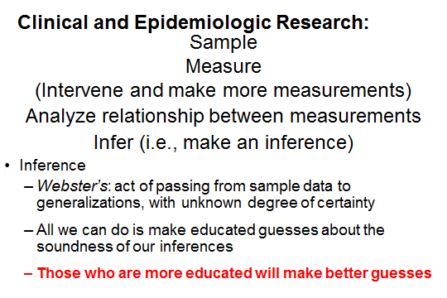
Performing and Critiquing Science
Requires:
  subject matter knowledge (~50%)
+
  methodologic knowledge (~50%)
Notes:
Finally, we hope this discussion illustrates how performing and critiquing science requires both subject matter knowledge and methodologic knowledge. In my view, it is about a 50/50 split in terms of what you need. In other words, if you are just an expert in one of these of these areas, you will have trouble being an optimal researcher. You need to understand both the subject matter and the epistemology of research methods (how we generate knowledge through research).
This also relates to some of the advice we gave earlier in which we said that all you can do is make educated guess about the soundness of your inferences. Those who are more educated – both in subject matter and methods – will make better guesses.

Slide 38
Questions?

Slide 39
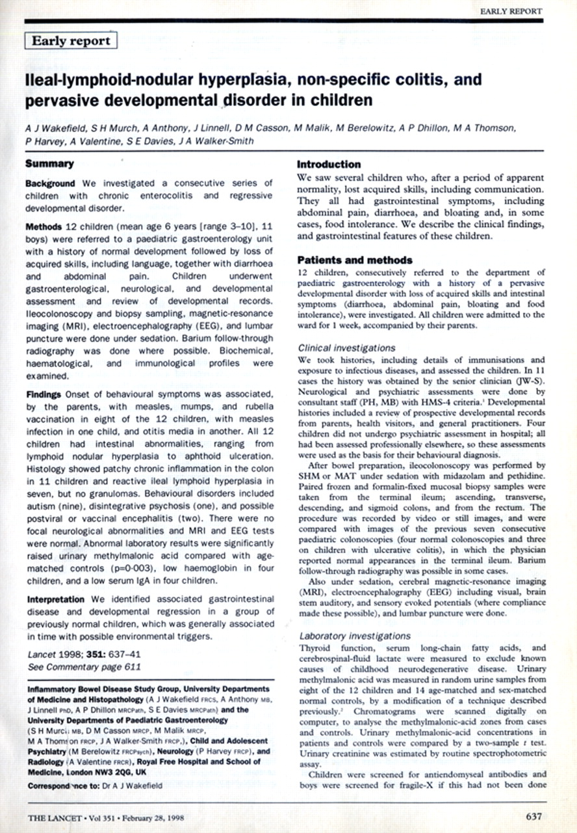
It was in response to:
Wakefield et al. Lancet Feb. 1998
Why was the NEJM study done in the first place?
Notes:
Why was this New England Journal of Medicine study done in the first place? After all, it was a “negative” study. Why would a negative study get published by the NEJM?
While the anti-vaccine movement has been around for as long as vaccines have been, the anti-vaccine movement reached a fever pitch with an article published by Andrew Wakefield and colleagues in 1998 in The Lancet journal. This was a case series of kids, mainly with autism, who were said to have developed their symptoms shortly after MMR vaccination and had intestinal findings suggestive of measles involvement.
This paper got an unusual amount of press attention and was really latched on to by the anti-vaccine groups.
It subsequently spurred on a lot of epidemiologic research, like this Madsen et al. article which we just discussed, which failed to show an association.

Slide 40
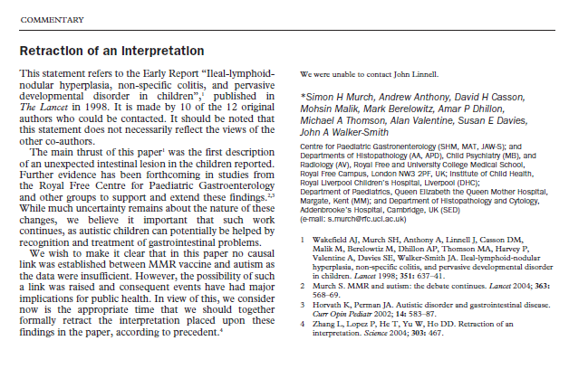
Partial Retraction – March 2004
Notes:
The world began to sense that something funny was going on when 10 out of the 12 authors offered what they called a “partial retraction”. While they did not deny the validity of the data, they did retract the nominal interpretation, which is that MMR vaccine was causally related to autism. They called it a retraction of an interpretation.

Slide 41
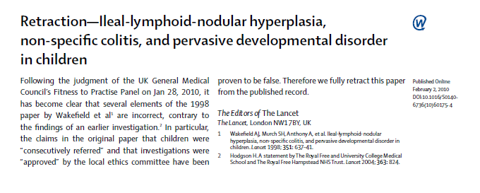
Full RetractionFeb. 2010
Notes:
The epidemiologic data continued to pile up against the hypothesis, and then an investigative reporter in London, Brian Deer, became involved and dug up many undisclosed financial conflicts for the first author, Wakefield. This led to a thorough review by the UK General Medical Council who found several procedural flaws with the original article.
This led, in Feb. 2010, to the full retraction of the article by the Lancet editors. In fact, if you try to find the article today on-line, you will see a big red “retracted” across it.

Slide 42

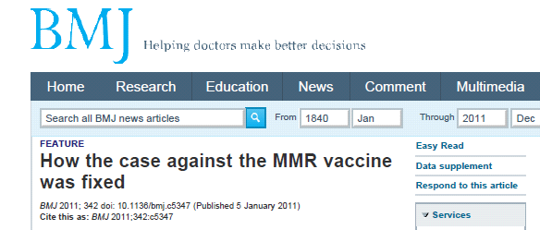
Jan. 2011
Brian Deer, Investigative Reporter:
“Wakefield’s work was indeed fraudulent, motivated by desire to make $ in lawsuits, a new diagnostic test, and alternative vaccines.”
Fiona Godlee, editor of the BMJ:
  "The original paper has received so much media attention, with such potential to damage public health, that it is hard to find a parallel in the history of medical science. Many other medical frauds have been exposed but usually more quickly after publication and on less important health issues.”
Notes:
This all came to a head in January of 2011 when the BMJ published a series of 3 articles by the investigative reporter, Brian Deer, where he concluded the Wakefield’s work was indeed fraudulent, all motivated by, they claim, a desire to make money in lawsuits, by developing new a diagnostic test, and by developing an alternative vaccine.
The BMJ editor called this one of the most damaging frauds in the history of medical science.
Given this, we can be pretty sure that the prior probability for an association between MMR and autism is essentially none. This gives us more confidence that the nominal conclusion of the Madsen article is correct. It is unfathomable how much time the scientific and public health community has needlessly spent on this issue.

Slide 43
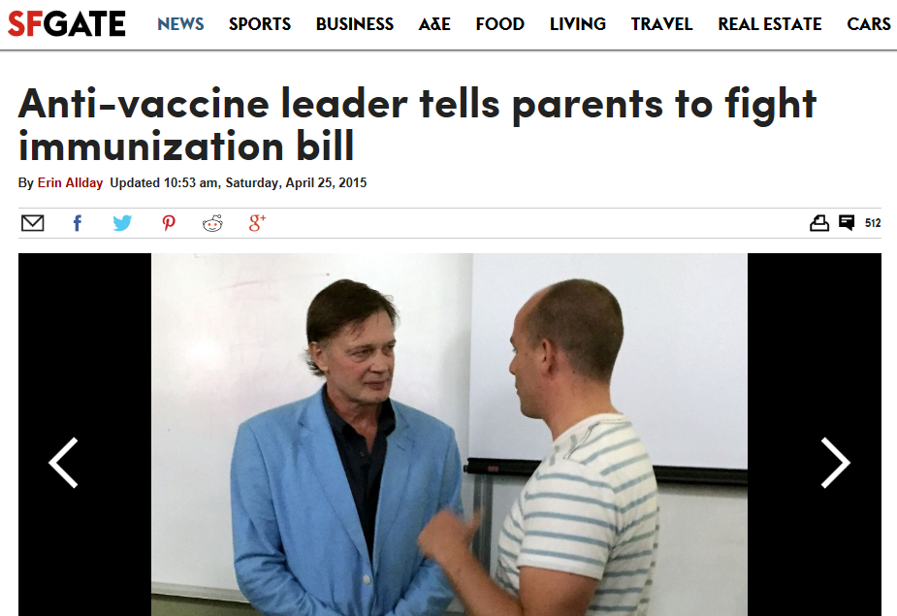
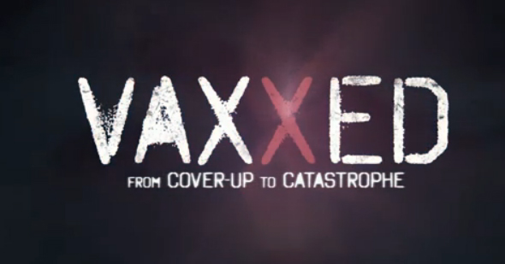
Wakefield is still active
Wakefield speaking at Life Chiropractic College in Hayward, CA in August 2015
2016 - Available on Amazon Prime
Notes:
You might have thought that the original author of all of this, Andrew Wakefield, has quietly disappeared, but, in fact, has not. He has actually moved to California, and here he is lecturing to a chiropractor school in Hayward, in the East Bay in August 2015. You can read more about it at:
http://www.sfgate.com/health/article/Former-doc-who-linked-vaccines-to-autism-tells-6222613.php
And, he has created a film documentary, called “Vaxxed”, in Spring 2016 about how he believes the CDC has fraudulently covered up data (from one study) that showed an association between MMR and autism. He claims the cover up went to the highest level of the CDC and other members of the US government, as well as the popular media. This caused quite a stir at the Tribeca Film Festival, where it was initially scheduled to show but then was pulled back. You can watch it on Amazon Prime. Wakefield claims to have a CDC whistleblower who is willing to tell all. The documentary unfortunately does not tell us enough about the culprit study for us to make our own decisions about what is going on.

Slide 44
Extra Slides

Slide 45
Selection Bias in a Cohort Study
3. Competing Events -- Nuance
Howe et al. Epidemiology 2016
Death from other disorders (Competing Events)
Autism
Genetic Factors
+ -
+
-
Retained in observation
MMR
MMR
Autism
SOURCE POPULATION
Whereas we need collider bias to create a spurious association between MMR and autism if one does not truly exist (under null), we do not need collider bias for a selection process to spuriously alter magnitude of an association that does exist (under non-null)
If edge between MMR and autism exists, then bias in risk difference will occur even if no link between MMR and competing event.
STUDY SAMPLE
Notes:
There is one nuance to the drop-out or competing event situation. That is, if the edge between MMR and autism exists, then bias in the risk difference will occur even if there is no link between MMR and the competing event. In other words, the shown DAG, which is not a picture of collider bias, will cause a bias in the risk difference. Whereas we do need to have a pattern of collider-stratification bias for a selection process to create a spurious association between MMR and autism if one does not truly exist (“under the null”), we do not need collider stratification bias for a selection process to spuriously alter the magnitude of an association that does exist (under “non-null conditions”). This is very easily understood heuristically as simply the rate of outcome occurrence in each group being diminished by some equal multiplicative factor in each exposure group. Those who are lost from the analysis have a higher rate of outcome than those who stay. The ratio measure of association is preserved but the absolute difference is diminished (and the NNT, if it had been calculated, is increased).
This nuance is not immediately relevant to this study because we do not necessarily believe that an edge from MMR to autism does exist. Indeed, we are trying to determine if one does exist. Specifically, this non-collider-based form of selection bias is not going to create a spurious association between MMR and autism if one does not truly exist. All it can do is to alter the magnitude of a risk difference if one truly did exist.
This point regarding how collider bias is not needed for selection bias is described for the first time in Howe et al. Epidemiology 2016.

Slide 46
Some Other Issues
Just how specific is the outcome?
  Autism may be many different diseases (each with similar clinical phenotype)
  Perhaps MMR causes just one of them?
    Hence measure of association for the one specific disease caused by MMR is drowned out by non-specificity of the current composite outcome

