Slide 1
What should we do with the 90 minutes currently allotted to live lecture each week?
Perhaps we should do something else with the scheduled lecture time.
Would you prefer to
Replace live lecture with recording. Use time for open discussion. - B
Replace live lecture with recording. No new additional activities. - C
Continue to have live lecture - A
Some other activity. - D
Notes:
1
Those of you who voted for “some other activity”, what did you have in mind?

Slide 2
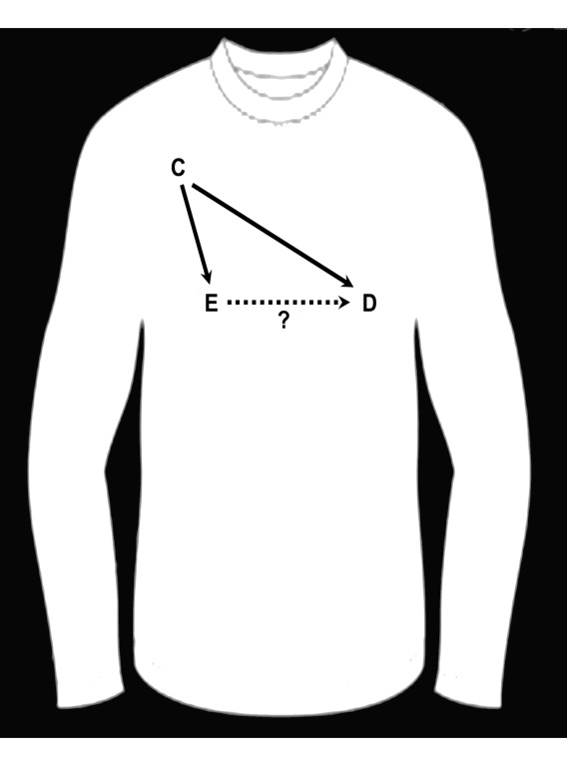
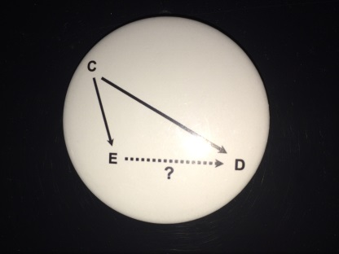
Prize Winners
Systematic Performance
  Highest % score on Problem Sets
    Kristen Krysko
    Will Zhang
Chance
  Pick name out of a hat
    Monica Ospina Romero (who also had a very high % !!)
Runners up: everyone else
Notes:
This year’s prize winners. The first prize is for systematic performance to the course participant who had the highest % score on the Problem Sets.
Sometimes it is just as good to be lucky as it is to be good and to show you that we respect the role of chance, we also are awarding a prize on the basis of chance. We picked a name out of hat and drew < > who also happened to have a very high % on the Problem Sets.

Slide 3
Experimental design is actually NOT the place that needs the most help…
Notes:
In the Optional Reading for this week, we have included recently published guidelines for reporting observational research. Who has heard of the CONSORT statement for reporting randomized trials, shown here?
Interestingly, it is not the trials researchers who really need these guidelines. The beauty of the randomized study design is that it is typically very robust to making mistakes.

Slide 4
Instead, where more help is needed is in the wild west of observational studies.
Notes:
Instead, where more help is needed is in the wild wild west of observational studies. Who remembers our first Journal Club?

Slide 5
Optional Reading for this week
Notes:
To tame the massive heterogeneity that is currently the case in observational research, the new STROBE guidelines for reporting observational studies were published a few years ago. These are slowly catching on and will likely become the standard within the next 5 to 10 years. Who has heard of the STROBE guidelines?

Slide 6
What Kinds of Questions Does Clinical Research/Epidemiology Answer?
“Big 6”
Description
  How frequent/common are risk factors/exposures/conditions/diseases?
Causation (“Causal inference”)
  The science of establishing causal relationships among biological, behavioral, environmental (etc.) factors within humans. Does X cause (or prevent) Y?
  Will intervening upon X change occurrence of Y?
Attribution
  What fraction or how many cases of disease Y can be eliminated if a causal exposure X is eliminated or reduced?
Mediation
  Understanding the mechanisms of causation
  How does X cause Y?
Interaction
  When and for whom does X cause/predict Y?
Prediction
  Do A, B, and C predict concurrent presence/future occurrence of Y?
What have we learned in this class?
How often does Y occur?
e.g., diagnosis or prognosis
Notes:
As we draw to a close, we want to remind everyone about what and how much you have learned. By now, everyone remembers the Big 6. It lists the different types of questions that epidemiology answers. In our course, we have covered description, causation, attribution, and interaction (and we are sure that interaction is fresh in everyone’s minds today). We have mentioned mediation although we really did not cover it in any depth. Finally, we did not cover prediction other than to talk about measures of association, which are used to some extent in prediction.

Slide 7
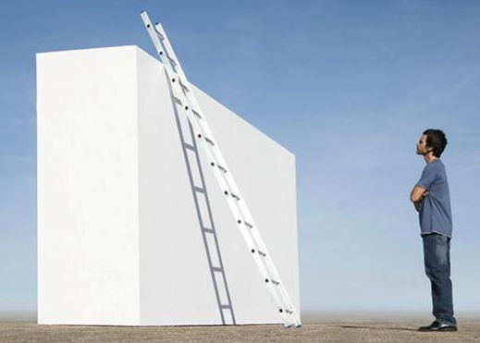
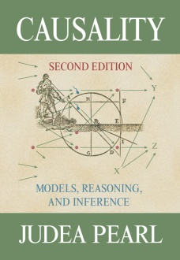
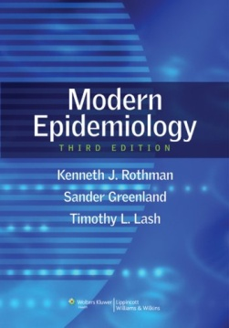
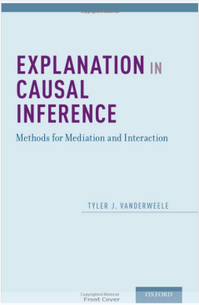


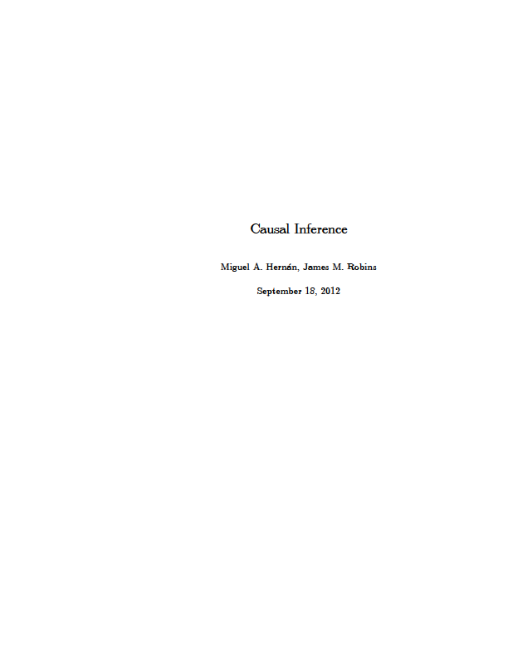
Where We Stand on the Ladder of Methodologic Sophistication
Causal Inference
Hernan & Robins
End of EPI 203
Beginning of EPI 203
Notes:
The prior slide was the topics, but where does this course leave you in terms of your depth of methodologic knowledge? This is what we call the ladder of methodological sophistication. It begins with knowledge covered in introductory textbooks like the one by Gordis. It then goes to intermediate level, and as a reminder, we do view this course as an intermediate level course in epidemiologic methods. Our accompanying text, by Szklo and Nieto, is indeed pitched as such and distinguishes itself from other introductory texts, like that by Gordis, the prototype. As an intermediate level course, we had a lot to cover and everyone should feel a great sense of accomplishment for getting this far. We did want to mention to everyone, however, that there is a world beyond our text and course in the form of advanced specialized material. Our discussion of DAG’s, interaction, and non-conditioning approaches for confounding adjustment, for example, began to take us a bit into this world. You can see what the world is like in the Rothman, Greenland, and Lash text (the blue text), the soon-to-be-released text on causal inference by the Harvard faculty, and a text on mediation and interaction by Tyler VanderWeele, also at Harvard.
Finally, because there is always something at the top of the ladder, there is a very sophisticated text on causality by Judea Pearl.

Slide 8
Epidemiologic Methods II
Winter Quarter
Course Director: June Chan
Newly revised in 2018
Notes:
For those of you who want more formal instruction, we encourage you to take our Epi Methods II course in the Winter quarter.
It goes without saying that we would encourage everyone to take more coursework. Our concise advice is that if you seek to practice clinical research at the highest level, you will need more training in epidemiology.

Slide 9
Observational Research
Getting valid inferences can be a challenge
Replete with uncertainty
  Occult selection forces
  Unclear degree of misclassification
  Unmeasured confounders
  Unbeknownst colliders
  Uncertain effect modifiers when attempting to generalize
We need the most skillful researchers performing observational research
Notes:
I am sure that we have convinced you that observational research is not simple. Getting it right can be a challenge. It is replete with uncertainty from occult forces of differential selection, unknown degree of misclassification, unmeasured confounders, and unbeknownst colliders. Finally, even if we get internal validity correct, there is the issue of uncertain effect modifiers when we thinking about transporting the inference to another population.
Given this degree of difficulty and degree of uncertainty, we hope that we have convinced you that we need the most skillful and most knowledgeable people to be doing observational research.

Slide 10
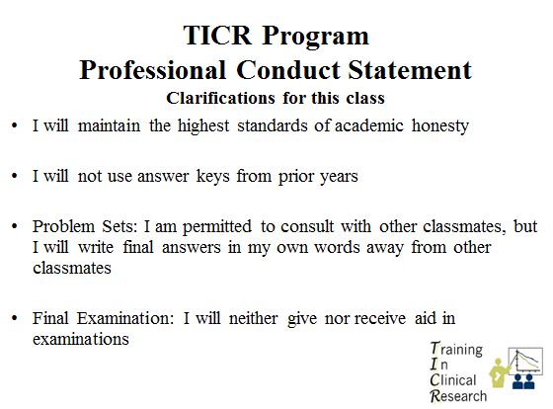
  1:30 to 3:00 pm: Last Section
    Web-based course evaluation – Bring laptop
  Later today: Distribute Final Exam (on CLE)
    Exam due next week by 4 pm (California time) Tuesday (Dec. 12)
    Upload your file on the CLE (Moodle) website (the syllabus site). Label file with your name.
    Upload a .pdf to preserve all of your formatting
    Contact Agnes.Ng@ucsf.edu if problems
    Please work independently
    The hard work for this has already been done!
Notes:
Here is the rest of the day’s schedule.
Unlike many courses where you relax all term and cram at the end to do a project or take an exam, for virtually all of you, the hard work for our course has already been done. The active learning that all of you have done each week during the term means that you have already done the hard work for this exam. So, again, congratulations to everyone for learning all of this important material.

