Slide 1
Disease Occurrence II
Main Points to be Covered
Incidence rates (person-time incidence)
“Average” incidence rate
  Calculating
  Uses
Instantaneous incidence rate (aka “hazard”)
Cumulative incidence and incidence rate
  different but related
Assumptions: cumulative incidence & incidence rate
Accommodating competing events in incidence estimates

Slide 2
Disease occurrence
Prevalence
Point
Period
Incidence
Cumulative incidence
Incidence rate
Kaplan-Meier
Life table
Cumulative incidence function [today]
Average incidence rate
Instantaneous (hazard) rate
Notes:
Here’s a flowchart of the material covered in the lectures on Disease Occurrence, including topics that we’ll cover today.

Slide 3
Rate versus Risk
Two basic measures of occurrence of new events
  Cumulative incidence = incidence proportion = Risk = Probability of event in a given time period
  Incidence rate = Rate = events per unit time
Last week we discussed the concept of cumulative incidence
  Most commonly calculated by the Kaplan-Meier method. Can also use life table or cumulative incidence function [later today].
Incidence rate of disease is less intuitive but is the more fundamental measure
Notes:
Understanding the difference between these two measures is a central concept in this part of the course. Both are important measures in clinical research that are widely used. Cumulative incidence may be more familiar because of the frequent use of Kaplan-Meier analysis in clinical studies with individual follow-up data, but incidence rates are useful in a variety of other situations where you are comparing two or more populations where at least one population does not have individual-level data or where exposures are changing within subjects over time. We will show some examples of both situations later on.

Slide 4
The Three Elements in Measures of Disease Incidence
E = an event = a disease diagnosis or death
N = number of at-risk persons in the population under study
T = time period during which the events are observed
Notes:
We introduced these three elements last week. They are the basis for any measure of disease occurrence. The difference between cumulative incidence and incidence rates lies in how time is combined with the number of persons at risk in the measure.

Slide 5
Measures of Incidence
The proportion of individuals who experience the event in a defined time period (E/N during some time T) = cumulative incidence = risk
The number of events per amount of person-time observed (E/NT) = incidence rate
  Average incidence rate (“incidence rate”)
  Instantaneous incidence rate (“hazard”)
Notes:
To refresh your memories on the basic difference between cumulative incidence and an incidence rate, cumulative incidence is a proportion because it has the number of events (E) as the numerator and has as the denominator the number of persons (N) at risk. Because of censoring, we rarely can just plug an N into the denominator. Instead, via Kaplan-Meier or life table techniques, we derive an effective N by taking into account each person’s follow-up until it is censored. In any case, the proportion can be interpreted as the percentage of N persons who develop disease in a given time period. An incidence rate also has the number of events (E) as the numerator but its denominator is different: it is the product of the number of persons x the number of time units they were observed (NT). Both measures have to account for time, but cumulative incidence accounts for it by specifying the time period during which the persons were observed. For example, 40% of subjects experienced the outcome during 3 years of follow-up. Incidence rate accounts for time by making it an element of the denominator. This gives an average incidence rate. Later in today’s lecture we’ll also consider the instantaneous hazard rate and the hazard function.

Slide 6
“Average” Incidence Rates
The numerator is the same as incidence based on proportion of persons = events (E)
The denominator is the sum of the follow-up times for each individual under study
The resulting ratio of E/NT is not a proportion--may be greater than 1
Value depends on unit of time used
  day vs month vs year vs 1000 years, etc
Notes:
If the incidence rate of the event was 35 per 100 person-years, remember that 100 person-years could mean 100 persons followed for 1 year or 50 persons followed for 2 years or 200 persons followed for 6 months or many other combinations of persons and years whose product equals 100. All 3 give 100 person years of time at risk. And in this example the time units are years but years could be replaced by days, months, decades, or any time unit and the rate would change accordingly. So the absolute value of the rate is determined by the units used in the denominator.

Slide 7
Calculating an Average Incidence Rate: Obtaining the Denominator
Method 1: If have exact entry, censoring, and event times for each person, can sum person-time for each person for denominator
Method 2: If no individual data but have the time interval and average population size, can take their product as denominator
  Some datasets only have average population size at risk
Notes:
In a cohort study, even a very large cohort study, the investigators record individual level data on when each person was enrolled and each date seen or each date when the person’s outcome status was checked (such as doing a check of the National Death Index for mortality in a cohort). In a cohort study, therefore, both cumulative incidence and incidence rates can be calculated using individual data, and there is no reason to use grouped data. One of the reasons rates are attractive is that in other settings this kind of individual level information is not available.
Since the rate is assumed to be constant during the period for which the data are collected (say, one year), using the average population size assumes that additions and losses are approximately equal during the year. If losses and additions occur uniformly throughout the year, the total amount of person-time will be the same whether it is calculated by summing each person’s individual time in the population or by multiplying the average size of the population during the year by one year. Since E remains the same for both methods and NT will be equal if the uniformity assumption is valid, the same rate is obtained by either method.

Slide 8
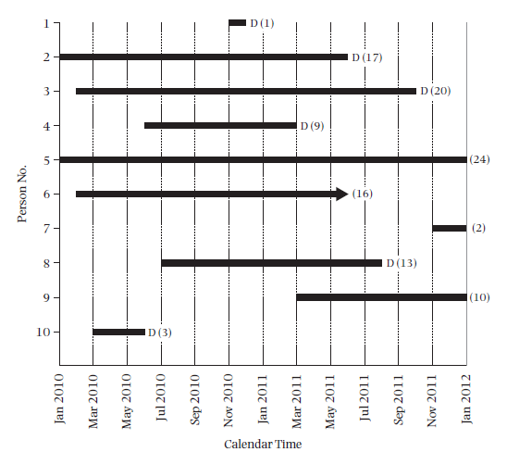
Cohort with Calendar Time
Notes:
This is the hypothetical example of a 10 person cohort study given in your text book. This has “Calendar Time” on the x-axis. This illustrates the ways that follow-up time can differ among individual participants in a cohort study even when the study has one “end date.”
8

Slide 9
Calculating an Average Incidence Rate: Obtaining the Denominator
Person Number | Months of follow-up
1 | 1
2 | 17
3 | 20
4 | 9
5 | 24
6 | 16
7 | 2
8 | 13
9 | 10
10 | 3
Total | 115 months
6 deaths (events)
Incidence rate = E/NT
6/115 person-months
6/9.583 person- years
= 0.626 per person-year
= 62.6 per 100 person-years
Notes:
Here are the calculations from the text’s example using individual level data to calculate the person-time rate. Note that the person time in months is just the sum of the number of months from the previous graphic showing how long each person was observed in the study. The text example shifts participants to the left but this is not necessary for the calculation of incidence rates. The text also calculates incidence rates separately for the first year of follow-up and then for the second year of follow-up, but this is also not necessary and usually is not done.
Since they want to present the rate in the more conventional units of 100 person-years, the total months are converted to years. The numerator is, as always, just the number of events; here, 6 deaths. The decimal point is then moved for the fraction 6/9.583 to give the rate per 100 person-years.

Slide 10
Method 2: Using average number of persons at risk during time interval
Numerator: 6 events (deaths)
Denominator: 1 person with 2 years of follow-up and 9 with “some” follow-up.
Assume 1(2) + 9 (2)(1/2) = 11 person-years
Rate = 6/11 = 0.545 per person-year
or 54.5 per 100 person-years
Average population method assumes uniform occurrence of events and of censoring during the interval (like life table)
Notes:
For the second method using the average population size at risk during the time interval, all that is required is to know how many entered the study and how many had the maximum follow-up. The average person-time is then calculated by assuming that those with less than the maximum follow-up time had 50% of the maximum.
The numerator is still 6 and the rate calculated this way is 54.5 per 100 person-years. In this example with only 10 persons the rate calculated by the average population method differs more from the rate calculated from individual data (62.6 per 100 person-years) than it will in larger datasets where the methods are usually very close. As with the text book illustration of the life table method of calculating cumulative incidence, the text uses an example with very small numbers of persons for which they do have individual level data in order to make showing the calculations simple. It has the effect, however, of making the method appear not very good as the assumption of uniform censoring during the interval clearly doesn’t hold. In very large data sets, such as census data for large geographical areas, it is usually a perfectly good assumption.
Note that this method is described as using “grouped data.” That phrase should not be confused here with an ecological study.

Slide 11
Average incidence rate based on grouped vs. individual data
Szklo and Nieto use incidence rate when based on group data (average population at risk) and incidence density when based on individual data
This terminology distinction not followed by most, and we don't favor this distinction. We call them both incidence rate.
Notes:
This distinction made by the text book is a refinement that we do not think is necessary. It is sufficient to know the difference between an incidence rate (for which we consider incidence density an equivalent term) and a cumulative incidence and to know that the rate can be calculated using individual-level data or the average size of the population at risk during a time period.

Slide 12
Incidence rate value depends on time units
Incidence rate of 8 cases per 100 person-years:
Could report as cases per 100 person-months:
(8/100 person-yrs) * (1 yr/12 mos) =
0.67 cases per 100 person-months
Or as cases per 100 person-weeks:
(8/100 person-yrs) * (1 yr/52 weeks) =
0.15 cases per 100 person-weeks
All estimates identify the same incidence rate
Usually presented with at least one non-zero integer to the left of the decimal point
Notes:
An illustration of how the value changes when the time units are changed even though the data remain the same and the interpretation remains the same. Person-years are the most conventionally used person-time denominator and are likely to be familiar, but other time units are possible. Rates are usually presented in units that leave at least one integer to the left of the decimal points. So 9 per 1,000 person-years would usually be preferred over 0.9 per 100 person-years.
Cumulative incidence does not have units since it is always between 0 and 1, and it therefore is not subject to this kind of alternative formulation. But, contrary to incidence rates, the time period of observation has to be specified to make cumulative incidence meaningful (e.g., 34% at two years of follow-up).

Slide 13
Reporting Average Incidence Rate
Person-time concept may seem unfamiliar because often erroneously described as “annual rate” or “annual rate per 100,000 persons” or “per 100,000 persons” (i.e., person-time denominator is not made explicit)
Example: “The incidence of pediatric cardiomyopathy in two regions of the United States” (NEJM, 2003)
  467 cases of cardiomyopathy in registry of 38 centers (New England, Southwest) 1996 - 1999
  denominator “population estimates…1990 census with an in- and out-migration algorithm” ages 1 - 18
  “overall annual incidence of 1.13 per 100,000 children”
Make person-time explicit: “incidence among children was 1.13 per 100,000 person-years”
Notes:
Calculating “annual” rates is a common practice as many statistics are gathered over the course of a calendar year and are repeated from year. However, this does not make them an “annual rate”. The way these rates are often reported might lead you to think they are proportions as they are frequently described as per some number of persons without making explicit that it is really per some number of person-years. The years are buried in the word annual. More careful investigators are more precise and will specify rates as per person-years.
The choice of the denominator is usually determined by a desire to have at least one integer to the left of the decimal point. So events that are relatively rare, such as the example of pediatric cardiomyopathy above, are often reported per 100,000 person-years. For the same reason cancer rates are usually reported per 100,000 person-years.

Slide 14
Average Incidence Rate - Examples
  Incidence rates are not immediately intuitive but you can develop a feel for them
  Examples
  Prostate Cancer (most common cancer in US)
  140 cases per 100,000 person-years (in men)
  Breast cancer (most common cancer in women)
  120 cases per 100,000 person-years (in women)
  Heart Attack
  50 cases per 10,000 person-years (in men)
  25 cases per 10,000 person-years (in women)
  HIV infection in homosexual men
  4 per 100 person-years

Slide 15
Waiting Time Property of Incidence Rates
“Waiting time” to an event is reciprocal of the incidence rate (1/rate)
  e.g., if rate 300 per 100 person-years, reciprocal is 1
  (300/100 person-years) = (1/3) person-year
Average waiting time between events is 0.33 person-year = 4 person-months. Or, on average, an individual will develop event every 4 mos.
Average life expectancy is waiting time for outcome of mortality.
Notes:
This property of incidence rates is useful in quantifying the time until a new occurrence of the outcome. It follows from the assumption that the incidence rate is constant during the time interval under consideration. If there are 3 events per year and the events are occurring at a constant rate, then a new event must occur on average, depending on how exactly the constant rate assumption is met, every 4 months. So waiting time = 1/ person-time rate, a property to keep in mind. From the individual perspective, a waiting time of 4 months indicates that an individual, on average, will develop the event in 4 months. A special case is the outcome of mortality. Then the average waiting time is the average life expectancy.

Slide 16
Assumption for meaningful interpretation of average incidence rate
Average incidence rates have the most utility if they are constant over time
At a minimum, this means constant over time length of the period that produced the rates
We still, in practice, use rates even if they are not constant but we should be cognizant when they are or are not constant

Slide 17
Assumption for meaningful interpretation of average incidence rate
Becomes more suspect for rates calculated over long time periods and reported for wide age ranges
If we observe 200 persons for 10 years that’s the equivalent of observing 400 persons for 5 years or 2000 persons for 1 year in terms of follow-up time (NT). Will the rate be the same?
Notes:
The assumption that the denominator of person-time units for a rate does not depend on the proportion of persons and amount of time in the calculation may result in a rate that is hard to interpret if it is based on a long period of follow-up. In the example on the slide, it would be difficult to meaningfully compare the rate from 10 years of follow-up with the rate based on 1 year of follow-up. There is no simple rule about how much time is too long for a period in which to calculate a rate since it depends on how rapidly the outcome being measured may change over time. For something that changes very little year to year, such as the overall mortality rate in the U.S., a period of time of several years might be reasonable. But for this reason one seldom sees rates calculated over, for example, a 20-year period whereas that would not be unusual for a calculation of cumulative incidence.

Slide 18
When to suspect that the rate is not constant?
When the period of study is long
  Age effect
  Cumulative effects of exposure.
  Secular trends in the environment (cohort or period effect)
When a fixed cohort is used, and the susceptible participants are depleted.
Notes:
When the period of study is long, there is more opportunity for the incidence rate to vary. Common reasons for such variation include an age effect, i.e. rates change as the population under follow-up ages. Cumulative effects of exposure are often different. For example, a year of exposure to smoking in 1000 people is likely different than 10 years of exposure in 100 people, although both examples would have a total follow-up of 1000 person-years. And there can be secular trends in the environment that affect the incidence rate. These may be cohort or period effects.
When calculating an incidence rate in a fixed cohort, the susceptible participants will develop the event and then when the susceptibles are depleted, we would expect incidence to fall. In a dynamic population (cohort), the susceptible participants are continually replenished. The average incidence rate calculated in the fixed population will be less than the average incidence rate in the dynamic.

Slide 19
Distribution of follow-up time: Puts average incidence rate in context
Useful to describe the distribution of follow-up time (e.g. median 3 years, iqr 1 to 5 yr) used in one's study prior to stating the average incidence rate calculation.
We don't need this distribution of follow up time to perform the rate calculation, but it helps to understand the context and limitations of the estimate.

Slide 20
Example: Children with End Stage Renal Disease
Mortality rate changes over time
Calendar years | Incidence rate per 100 patient-yrs
1963-72 | 11.0
1973-82 | 4.4
1983-92 | 2.0
1993-2002 | 1.8
McDonald et al. NEJM 2004
Notes:
These are average incidence rates for mortality among children with end-stage renal disease, taken from a paper that we’ll discuss later in today’s presentation [McDonald et al. (NEJM 2004)]. As is obvious from the quite different incidence rates of mortality by increasingly more recent calendar years, a single average incidence rate for all of these children would be very misleading because it would ignore how strong the temporal trends toward improved survival have been. These kind of temporal trends should always be considered whenever long-term survival is being considered and particularly when treatment may have changed over time for the disease in question.
Note: Rates are based on time from the start of renal-replacement therapy to death or the date on which the data were censored. Patients were included who were <20 y.o. at start of renal-replacement therapy and whose first treatment occurred before April 1, 2002. Patients were followed until March 31, 2002.

Slide 21
Why Use Average Incidence Rates?
To calculate incidence from population-based disease registries in a dynamic population (cohort) where the persons at risk cannot all be individually followed
      A descriptive objective
Notes:
There are a number of advantages of rates. Registries capture the events in a defined geographic region, and a good registry will capture nearly all the events. So the numerator (E) for disease outcomes with registries is readily available. But how would those events be applied to the population covered by the registry if you tried to calculate a cumulative incidence at one year? Individuals are entering and leaving the population throughout the year, but you have no ready way to record all that and link it with an outcome variable of diseased or censored, as you need to do for a Kaplan-Meier analysis. We will look at an example of how a rate is calculated in this situation using the average population at risk method.

Slide 22
(1) Calculating rate from population-based registry of diagnoses
Research question: What is the incidence rate for first diagnoses of breast cancer in Marin County (descriptive) and how does it compare with rates from other counties (analytic)?
Numerator: All new breast cancer diagnoses are reported to the SEER cancer registry
How to obtain a denominator for a rate?
Notes:
The cancer registry does an excellent job of capturing all of the new cancer diagnoses (E) for a large population. California now has a statewide cancer registry. But, how will an investigator determine the denominator for this rate?
The SEER registry is a program of the National Cancer Institute. It covers particular areas of the country. See the web page for detailed information on what areas are covered by SEER registries, what data are available, etc. In California, the SF Bay Area registry has been established the longest (since 1973). There is now a state-wide cancer registry (since 2001).

Slide 23
Large Population Incidence Rates
The study base for the breast cancer cases is the population of Marin County during the year(s) that cases were diagnosed (i.e. a dynamic cohort).
To get an incidence rate person-time denominator for a particular year by the group method requires only an estimate of the average population size during the year (=the population at mid-year). The investigator does not need individual data.
Fortunately, that population has already been enumerated in government sponsored census.
Notes:
Clearly, an investigator with access to the California breast cancer registry data is not going to have individual level data on when every new arrival entered the state and when every departure or death took place, so the problem is to obtain information that will allow calculation of a denominator. The approach is to obtain an estimate of the average population size during the time period. Multiplied by the time period, usually one year, gives a person-time denominator for the rate. Census data provide the information to form this person-time denominator.
A further advantage of using census data for forming rates from case counts collected by registries is that rates can be formed for any of the grouping variables recorded in the census, such as age groups, gender, ethnicity, income, geographic sub-regions, and many others.

Slide 24
Average population (Group data) rates versus individual data rates
If losses are perfectly uniform, total person-time calculation for the denominator (and thus the rate) is the same whether based on average population size or individual follow-up
For large populations the rate will be nearly identical calculated by either method
Notes:
In the text book example calculating the rate by individual data and by average population size results in different rates (62.6 versus 54.5 per 100 person-years), but the rates will differ very little for the large populations typically used to calculate rates from grouped data.

Slide 25
Potential Weakness of Census Data
Calculating rates from US census population data is very useful but caution is required as a full census is only done every 10 years
Interim estimates of population change are made by the Census but over 10 years denominators may become inaccurate
Other countries may conduct a census at different intervals, or may not have a reliable census
Notes:
Although not the only source of person-time denominators for calculating rates, census data are a major resource for such calculations. Researchers using census data should be aware that the possibility of bias increases with time from the last census even though estimated adjustments using the current population survey are made annually by the U.S. census. In some cases this has resulted in incorrect rates.

Slide 26
Invasive Breast Cancer Incidence Rates for Marin County versus Other California Counties, 1995-2000
Year | Marin County | Other California*
1995 | 162.1 | 145.9
1996 | 187.8 | 145.4
1997 | 176.6 | 150.9
1998 | 176.6 | 155.9
1999 | 190.7 | 157.8
2000 | 157.5 | 153.9
White, non-Hispanic women. Rates per 100,000 person-years
*Excluding 5 Bay Area Counties
Notes:
A very good example of how census data can affect inferences is seen in the rates of breast cancer in Marin County compared to the rest of California. Based on 1990 census data and extrapolations of the 1990 census the rates were significantly higher in Marin than the rest of California. It now appears since the 2000 census became available that the population grew faster in the 1990’s in Marin County than the Census estimate, so the denominators used were too small and the rates higher than they should have been. The rate for 2000 using the new census is not very different from the rest of California outside the Bay Area. Note: Rates were age adjusted to the 2000 census to account for any age differences in the underlying populations. We will discuss this technique later in the lecture.

Slide 27
Census Denominators for Incidence
Rates are Estimates
The estimates of breast cancer incidence (number of new cancers per year) most recently reported for Marin and other areas of the country were based on 1990 census information. Data from Census 2000 have enabled researchers to recalculate rates for Marin. Preliminary results show that revised incidence rates for Marin County based on the 2000 census are substantially lower than the rates calculated using 1990 census information. The discrepancy between using the 1990 and 2000 census data is due to projected population growth differing considerably from actual population growth.
Clarke et al Report from No Calif Cancer Ctr 2001
Notes:
This and previous slide from a report published in 2001 by investigators at the Northern California Cancer Center.
Clarke C, et al. “Update on breast cancer incidence patterns in Marin County and the San Francisco Bay Area, California”
Available online: http://www.nccc.org/ResearchandTraining/studies/pdf/bcr_marin2001_0904.pdf 1

Slide 28
Why Use Average Incidence Rates?
To calculate incidence from population-based disease registries in a dynamic population (cohort) where the persons at risk cannot all be individually followed
To compare disease incidence in a fixed cohort (individual-level data) with rate from a dynamic cohort (e.g. the general population) OR to compare incidences between 2 or more dynamic populations
    An analytic objective
Notes:
Another common application is age-adjusting incidence to a general population to allow a comparison between incidence in a cohort and in the general population. This allows investigation of whether the events in the cohort are more or less frequent than would be expected from a sample of the general population in the same age groups. We’ll go through an example of this next.
Incidence rates can also be used to compare disease occurrence in two or more different populations where you don’t have individual level data. Say you want to compare mortality in two different countries, but one country has a higher proportion of young people. A straight comparison of incidence rates would be misleading. The rates for each country can be age-adjusted to an external standard population distribution (such as the 2000 US census). These two rates can then be compared as a rate ratio.

Slide 29
(2a) Comparing a rate from a fixed cohort to the rate in the general population
Cohort study of petroleum refinery workers followed subjects for 36 years and found 765 deaths.
Research question: Was the mortality in these persons high, low, or just average?
  Answer: need a comparator group
How would you calculate the mortality incidence in the cohort?
Notes:
It is easy enough to calculate the cumulative incidence from the cohort data since you will have follow-up on each person, but the question of what to compare it to is difficult. Clearly survival is related to the original age distribution of the cohort as well as the 36 years of follow-up and there is no source from public data that would give individual level data with up to 36 years of follow-up.

Slide 30
Example of Using Incidence Rates for Cohort Comparisons
Cohort of petrochemical workers
  6,588 white male employees of Texas plant
  Mortality determined from 1941-1977
  137,745 person-years of follow-up time
  765 deaths
Overall death rate = 765 / 137,745 person-years =
5.6 per 1000 person-years
Question: Is this a high death rate?
Austin SG, et al., J Occupat Med, 1983
Notes:
This is a typical cohort study in which it is relatively easy, by searching the National Death Index, to determine mortality over a long period of time in the cohort. Some would call it a retrospective cohort. The problem is how to interpret the findings. Is the observed death rate high or low? A comparison is needed and one possibility is to compare it to national mortality data.

Slide 31
Cohort of petrochemical workers
Could calculate K-M estimate of cumulative incidence (for 36 years of follow-up), but what is the comparison group?
Using the incidence rate, the observed rate can be compared to the rate that would be expected if the rate from a reference population (e.g., U.S. population) is applied to the cohort
Notes:
The approach of calculating cumulative incidence in the cohort is not so helpful because there is no clear comparison group with cumulative incidence at 36 years. Instead, age-sex-race-calendar period person-time rates from U.S. population data can be applied to the amount of person-time follow-up by those groups in the cohort to produce an expected number of deaths under U.S. rates for comparison with the observed number of deaths in the cohort. U.S. population data are available from the National Center for Health Statistics. This method of applying rates from a reference population to a study population is called indirect standardization, and the measure is the ratio of observed to expected outcomes, called the Standardized Mortality Ratio when the outcome is death.

Slide 32
Standardized Mortality Ratio
Comparison of rates can be done with SMR. (This is a measure of association - to be covered in more detail in later lectures - but we skip ahead here to illustrate usefulness of incidence rates.)
If U.S. death rates for age-sex-race-calendar period groups applied to the cohort, 924 deaths were expected in the cohort versus the 765 observed.
Ratio of 765 observed/924 expected = 0.83. This is called a Standardized Mortality Ratio (SMR).
Notes:
The Standardized Mortality Ratio (SMR) is formed by the ratio of the observed number of events in the cohort and the number of events that would be expected applying age-sex-race-calendar period-specific rates from the U.S. population to the distribution of the cohort by those variables. Applying the U.S. rates gives an overall mortality that would be expected if the U.S. rates were operating in the cohort. So the ratio is an observed compared to an expected rate.
The SMR is a measure of association, and we will cover measures of association in much more detail in the next several weeks. We include SMR here to illustrate that incidence rates allow for certain measures of association to be estimated.
One problem with this analysis is what is known as “the healthy worker effect.” In this example the observed rate in the cohort of petrochemical workers was actually lower than expected if the U.S. mortality rates had been present. This is a common outcome of cohort studies of workers when they are compared to the general U.S. population because workers need to have a level of health in order to work which makes them generally healthier than the entire U.S. population in the same age groups.

Slide 33
Obtaining an expected # deaths for comparison
Group (Race, sex, age, yrs) | Workers pers-yrs in group | US death rate | Expected N deaths | Observed N deaths
W, M, 40 - 45, 1941-45 | 1,234 | 0.11/ 100 pers.-yrs | 1.36 | 1
W, M, 45 - 50, 1941-45 | 2,312 | 0.15 / 100 pers.-yrs | 3.47 | 3
---etc. | --- | ---- | --- | ---
Total | 137,745 |  | 924 | 765
Notes:
The table illustrates how U.S. population race/sex/age/calendar period-specific rates are used to produce a comparison rate to the cohort rate. For simplicity only 2 age-sex-race-calendar groups are shown and the person-years in the groups are hypothetical as that detail is not available in the paper. Since the cohort has a different age-sex-race composition from the U.S. population, one cannot just use the overall U.S. mortality rate for comparison. In addition the U.S. mortality rate has changed over time, albeit very slowly. By using U.S. mortality rates specific to groups defined by those variables and applying them to the person-years at risk in each comparable group in the petrochemical workers cohort, the expected number of deaths that would have been seen if the U.S. rates applied are calculated. The actual cohort deaths gives the observed rate. Since both have the same total person-time denominator, it cancels out in division and the ratio of the rates is just the ratio of the observed and the expected number of deaths. This is called a Standardized Mortality Ratio (SMR), which is a measure of association relating petrochemical work to death.

Slide 34
Example of using both cumulative incidence and incidence rates in the same analysis for different purposes
End stage renal disease:
Cumulative incidence
of mortality
within cohorts
defined by age at diagnosis
Standardized mortality
ratios in
renal disease children,
compared with Australian
population
Age | 5 yr | 10 yr | 15 yr
5 - 9 | 13% | 21% | 27%
10 - 14 | 12% | 21% | 30%
15 - 19 | 14% | 21% | 28%
Therapy began | 5 - 9 yrs | 10 - 14 yrs | 15 - 19 yrs
1963 - 72 | 236 | 111 | 52
1973 - 82 | 122 | 71 | 20
1983 - 92 | 30 | 37 | 19
McDonald et al., NEJM 2004
Notes:
In this paper from the New England Journal of Medicine the authors reported cumulative incidence of mortality after 5, 10, and 15 years of follow-up among children being followed for end-stage renal disease in Australia. The age groups are the ages at which the children were diagnosed with end-stage renal disease. Because this is a cohort for which they have individual level data on each child and the focus was on the long-term probability of survival, cumulative incidence is a natural presentation (here shown as cumulative probability of death in the top table).
In order to compare their data with age specific mortality from the general Australian population, they calculated person-time incidence rates for mortality in their cohorts because they could easily obtain age-specific person-time incidence rates for comparison from general population data. The values in bottom table are the ratios of the age/period-specific mortality rates in the cohort with the population rates, so they are the Standardized Mortality Ratio we just examined from the petrochemical workers cohort study. Because these are children at very high risk of dying, the ratios are very much greater than 1, but they show that the rates have declined substantially relative to national rates over several decades. Cumulative survival data like those in the top table are not available for all children in the population but mortality rates are available. Thus both methods of calculation disease incidence are useful in the presentation of the data.

Slide 35
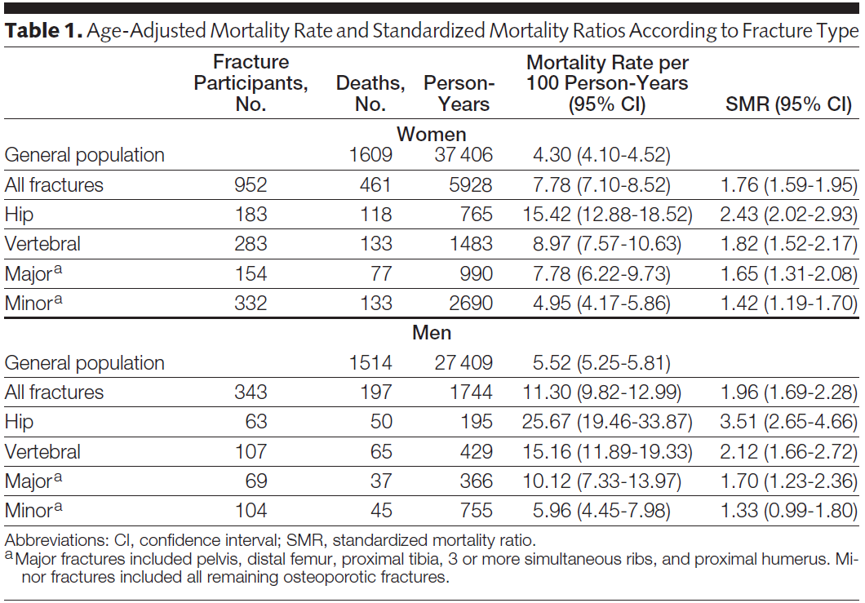
Another example of SMR:
Is mortality higher after a fracture?
Comparison for SMR is mortality rate in Dubbo research population vs mortality in general population in Dubbo, Australia
Bluic et al. JAMA 2009
Notes:
This is another example of a study comparing mortality rates in a research cohort with mortality in the general population. The investigators have data on mortality incidence after a fracture in the Dubbo Osteoporosis Epidemiology Study, a longitudinal study of 60+ year old residents of Dubbo Australia. To determine if mortality incidence is increased post fracture, they compare the cohort rate with incidence of mortality in the general population (60 and older) in Dubbo. In the entire Dubbo population 60 years and older, 1609 deaths were recorded in women and 1514 in men over 37 406 and 27 409 person-years, yielding mortality rates of 4.3 per 100 person-years (95% CI, 4.1-4.5) and 5.5 per 100 person-years (95% CI, 5.3-5.8) in women and men, respectively. Among the fracture participants, 461 deaths were observed in women and 197 in men, yielding mortality rates of 7.8 per 100 person-years (95% CI, 7.1-8.5) and 11.3 per 100 person-years (95% CI, 9.8-13.0) in women and men, respectively. SMRs were calculated using 5-year age groups. This translates into SMRs >1.
Note that these SMR are only as good as the factors that they are standardized for. In other words, we have to be concerned about residual confounding, a topic we will cover later in the course. In other words, we can’t address whether the fracture per se is causally responsible for the increased mortality. It’s possible that those who fracture are more frail in general and this frailty is the underlying cause of both more frequent fractures and increased mortality. In this case, reducing fractures would not translate into reduced mortality.
Mortality Risk Associated With Low-Trauma Osteoporotic Fracture and Subsequent Fracture in Men and Women Bluic et al. JAMA. 2009;301(5):513-521

Slide 36
(2b) Comparing hip fracture incidence in different dynamic populations
WOMEN Age-specific incidence rates per 100,000 person-yrs
Age group (yr) | Beijing† | Budapest† | Hong Kong‡ | Reykjavik
20-29 | 1.0 | 3.4 | 2.5 | 6.0
30-39 | 3.1 | 5.7 | 3.8 | 0.0
40-49 | 7.6 | 24.5 | 9.0 | 24.1
50-54 | 17.9 | 38.7 | 27.9 | 36.1
55-59 | 32.4 | 46.1 | 49.2 | 186.0
60-64 | 56.2 | 84.4 | 75.0 | 199.1
65-69 | 91.2 | 193.0 | 194.0 | 402.5
70-74 | 164.1 | 288.1 | 438.8 | 838.0
75-79 | 141.0 | 564.8 | 823.6 | 1311.1
80-84 | 224.2 | 1100.5 | 1588.1 | 1945.3
85-89 | 219.2 | 1652.6 | 2572.9 | 3791.9
90-94 | 401.0 | 2217.3 |  | 3732.9
95+ |  |  |  | 5300.4
20 and older, age-adj¶ | 39.6 | 128.2 | 168.3 | 274.1
50 and older, age-adj¶ | 96.0 | 316.0 | 428.3 | 696.6
¶ Standardized to 1990 US non-Hispanic white population
Notes:
Incidence rates for hip fracture in different countries. Hip fracture events for a specific time period (one or two years) were ascertained for numerator. Denominator based on census data. First rows are age-specific incidence rates, calculated as the number of events in the specific age group divided by the number of person years in the same age group.
How to derive one number to compare across populations? Age-adjusted incidence rates shown at the bottom for age 20+ and age 50+. Incidence rates are standardized or adjusted to a reference population (in this study, the US nonHispanic white population in 1990). See the Extra Slides for how to perform standardization, a technique you should be aware of as a means of contending with confounding, although we won’t focus on it in this class.
Schwartz et al. Osteoporosis Intl 1999.

Slide 37
Comparing Two Dynamic Populations
WOMEN | Beijing | Budapest
No. hip fx (1 yr) | 808 | 284
Total popn | 2,650,400 | 180,904
Unadjusted rate* | 20 | 157
Adjusted rate* | 39.6 | 128.2
* per 100,000 person-years
Unadjusted rates do not take into account the different age structures of the populations in Beijing and Budapest. Use “direct standardization” to adjust for age (see Extra Slides).
Notes:
We can calculate unadjusted rates of hip fracture for these populations. But, the unadjusted rates do not take into account the different age structures of the populations in Beijing and Budapest. If we want to compare these rates, we need to adjust for the age structure. We can do this with standardization, described in extra slides at end of lecture slides.

Slide 38
Why Use Average Incidence Rates?
To calculate incidence from population-based disease registries in a dynamic cohort
To compare disease incidence in a fixed cohort with a rate from a dynamic population OR to compare incidence in 2 or more dynamic populations
To estimate incidence of outcomes associated with exposures that might change over time in given individuals

Slide 39
(3) To estimate incidence of outcomes associated with exposures that might change over time in individuals
Research question: In a Medicaid database is there an association between use of non-steroidal anti-inflammatory drugs (NSAID) and coronary artery disease (CAD)?
How would you study the relationship between NSAID use and CAD?
Notes:
This is a common type of problem in cohort studies that examine exposures which can change over time, such as smoking, changes in diet, exercise, medications, etc. A database records time periods when medications were being used and time periods when they were not used. Some persons will never use the medications and some will use it continuously, but there is a large group who either initiate or discontinue use during the time under study and another group who change in both directions. The same person can go on and off the medication multiple times. It is difficult to see how you would analyze such data using the cumulative incidence approach.

Slide 40
Calculating stratified average incidence rates in cohorts
For persons followed in a cohort some exposures may be fixed (time-invariant) but some are changing (time-variant or time-varying)
  gender is fixed
  taking medications or getting regular exercise are behaviors that can change over time
Adding up person-time in an exposure category to get a denominator of time at risk accommodates exposure that change over time
Notes:
For exposures that are time-varying, adding up the total person-time of exposure and non-exposure to form two denominators is a very useful way of dealing with the problem of changing exposure groups. The numerators for each denominator then become the number of events that occurred among persons at times when they were exposed and similarly for the events among the unexposed. This approach assumes that the exposure’s effect on the event is predominately during the time the exposure is occurring. It therefore makes sense for exposures whose association with the outcome quickly disappears when the exposure is removed. This assumption would not work very well for exposures which have lasting effects long after the actual exposure is removed. For an exposure like smoking with known long-term health risks, linking events to time periods when an individual was and was not smoking would have little utility because it would be very contaminated by the long term effects of smoking.

Slide 41
Analysis of changing exposure and disease incidence
Tennessee Medicaid data base, 1987-1998: are NSAIDs associated with CAD?
Same person could both use and not use NSAIDs at different times over the 11 years
Ray, Lancet, 2002
Notes:
Here is an example from a manuscript that analyzed Medicaid recipients in Tennessee over an eleven-year period. In a prospective cohort with an exposure that can vary over time, subjects cannot be classified in groups by their amount of exposure at baseline because their future medication use cannot be known in advance. To place persons in baseline exposure groups in order to calculate and compare cumulative incidence, the changes in use that happen after baseline would be ignored, an obviously unsatisfactory approach for this research question. Calculating incidence rates during times of use and non-use that account for time of exposure is a way to deal with the problem of changing exposure over time. The assumption is that NSAID use will have an effect during usage in lowering the incidence of cardiovascular events and that effect will “wash out” when use is stopped. If the “wash out” is not thought to be immediate, a time period that approximates whatever the wash out time is thought to be can be added to avoid attributing time to non-exposure person-time before the exposure effect has been removed.

Slide 42
Analysis of changing exposure with average incidence rates
Person-time totaled for using and not using NSAIDs; CHD outcomes tallied
A person can contribute to the denominator both for use and non-use but only after a 365 day “wash out” period between use and non-use
 | Person-yrs | No. CHD | Rate per 1000 pers-yrs
Users | 275,565 | 3,313 | 12.02
Non-users | 257,069 | 3,049 | 11.86
Ray, Lancet, 2002
Notes:
The study endpoint event was hospitalization for myocardial infarction or death from coronary artery disease. Subjects with no history of prior NSAIDS use who began use after having been enrolled in the database for 365 days (in order to have data on prior illnesses) were compared with subjects not using NSAIDS. A subject who stopped using was eligible to be in the non-using group later, but to avoid any carryover effect, only after 365 days of non-use had elapsed. In this study design, the choice of the washout period is a key substantive decision and should be varied in sensitivity analyses.
Substantive note: Ideally, this is a question that should be resolved by a clinical trial, but a clinical trial of this question will likely never be done. In the absence of a randomized trial, an observational cohort study is the second best choice. Again, a prospective cohort with better measurements of all the potential confounders, in particular aspirin use, would be preferable, but to get the numbers required would mean a very large cohort followed for a number of years. Possible but very expensive. Analyzing existing data is less desirable, but it does provide an opportunity to assemble a cohort analysis on a large number over many years at minimal expense. The question that remains is whether they were able to get adequate control of confounders, a topic we will cover later in the course.

Slide 43
Participant can contribute exposed and unexposed follow-up time
No NSAID use
NSAID use
Notes:
Here is a graphical representation of how a participant can contribute follow-up time as unexposed, then exposed, and then (after a wash-out period) as unexposed.

Slide 44
Calculating Average Incidence Rates in STATA
Declare data set survival data:
. stset timevar, fail(failvar)
.strate gives person-time rate
Example: Biliary cirrhosis time to death data
.use biliary cirrhosis data, clear
.stset time, fail(d)
.strate
D Y Rate Lower Upper
96 747.04 0.1285 0.1052 0.1570
Incidence rate = 12.8 per 100 person-years
Person-time (in whatever units the data are in)
No. of Events
Notes:
Whether you are using Kaplan-Meier, life table, or calculating incidence rates, you still begin with the STATA command that declares your data to be survival (=time to an event) data and tells STATA the name of the time variable and the name of the failure (=outcome/censoring) variable.
Following the command “strate” with the name of the variable for a predictor variable that has categories, such as treated vs. not-treated, will give the rates within each category of the predictor.
Rate in the total cohort is 0.1285 per person-year. By convention, we typically express rates such that they easily to say, in this case, 12.8 cases per 100 person-years.

Slide 45
Immediate Commands in STATA
STATA has an option to use it like a calculator for
various computations without using a data set.
Called immediate commands.
Example, to calculate the person-time rate and confidence interval from events and follow-up time:
. cii #person-time units #events, poisson
e.g., 6 events occur in 10 person-years of follow-up:
    . cii 10 6, poisson
    Rate = 0.6 per person-year
    95% CI = 0.220 – 1.306
Notes:
The immediate commands in STATA obtain data not from a dataset stored in memory but from numbers that you type in. So they use STATA like a calculator. They have no effect on anything you have stored in memory. All immediate commands end in “i”.
The “cii” command can also be used to calculate other means and confidence intervals. Here it is specifying “, poisson”, referring to the Poisson distribution which is what is used for standard error generation of rates. By specifying “poisson”, that tells STATA you have count data and want the mean and 95% confidence interval of a rate.

Slide 46
Instantaneous Incidence Rate
So far, we have considered the “average” incidence rate
  calculated over a discrete period of time
  assumed to be constant over that period of time
The hazard function h(t) gives the instantaneous potential per unit time for the event to occur, given that the individual has survived up to time t.
  allows for change in rate over time
Notes:
Another way to define incidence rate is the hazard. You may be aware of this term, hazard, from proportional hazards model.
The hazard function is defined as each individual’s instantaneous probability of the event at time t, given that the person was at risk at time t. Or, in other words, conditional on the person being at risk at time t.
The hazard function can be estimated using parametric survival analysis techniques.

Slide 47
Constant Rate
Cumulative incidence
Incidence Rate
Notes:
These are the plots for a fixed (or closed) cohort with a constant incidence rate. In this situation, the average incidence rate describes the rate at any time during the study.

Slide 48
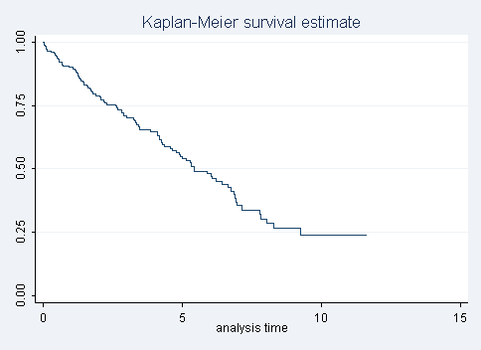
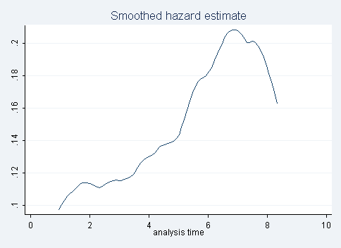
Instantaneous incidence (hazard) rate that varies
Hazard rate
K-M survival curve
10 yr cum incidence = 0.2375
Average incidence rate = 0.13 deaths per person-year
Notes:
However, in this situation, the incidence rate (hazard rate) is changing over time.

Slide 49
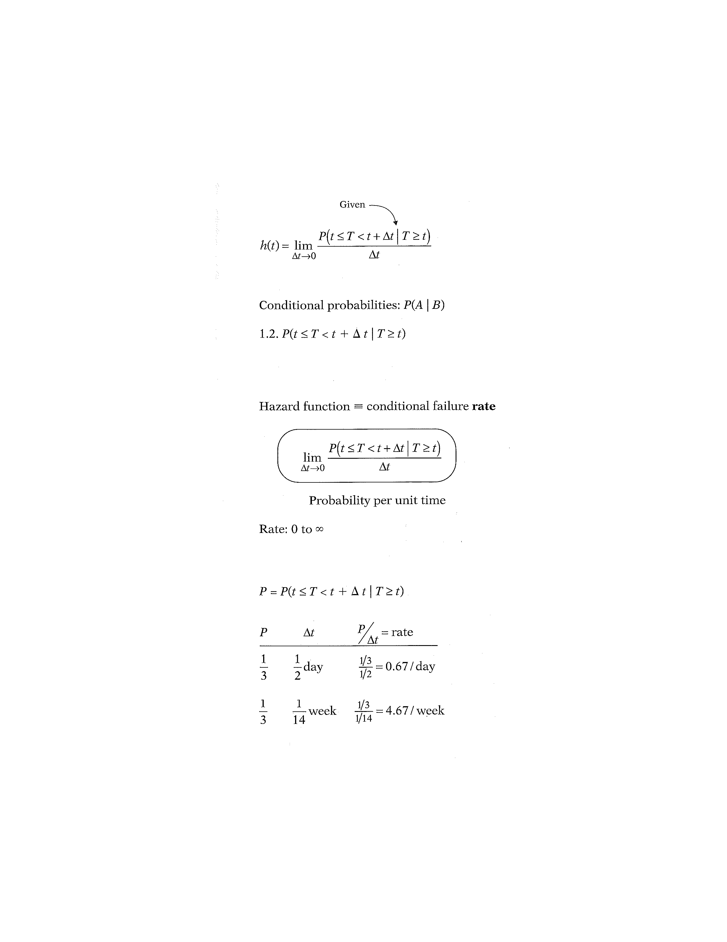
Hazard Function
(Conditional Failure Rate)
Numerator is a conditional probability, of the form:
Probability that the event will occur in the time interval between t and t + Δt, given that the survival time, T, is greater than or equal to t.
Notes:
In mathematical terms, the given part of the formula for the hazard function is found in the probability statement-the numerator to the right of the limit sign. This statement is a conditional probability because it is of the form, P of A, given B, where the P denotes probability and where the long vertical line separating A from B denotes “given” In the hazard formula, the conditional probability gives the probability that the event will occur in the time interval between t and t + Δt, given that the survival time, T, is greater than or equal to t. Because of the given sign here, the hazard function is sometimes called a conditional failure rate.

Slide 50
Denominator is time
Notes:
We now explain why the hazard is a rate rather than a probability. Note that in the hazard function formula, the expression to the right of the limit sign gives the ratio of two quantities. The numerator is the conditional probability we just discussed. The denominator is Δt, which denotes a small time interval. By this division, we obtain a probability per unit time, which is no longer a probability but a rate. In particular, the scale for this ratio is not 0 to 1, as for a probability, but rather ranges between 0 and infinity, and depends on whether time is measured in days, weeks, months, or years, etc.

Slide 51
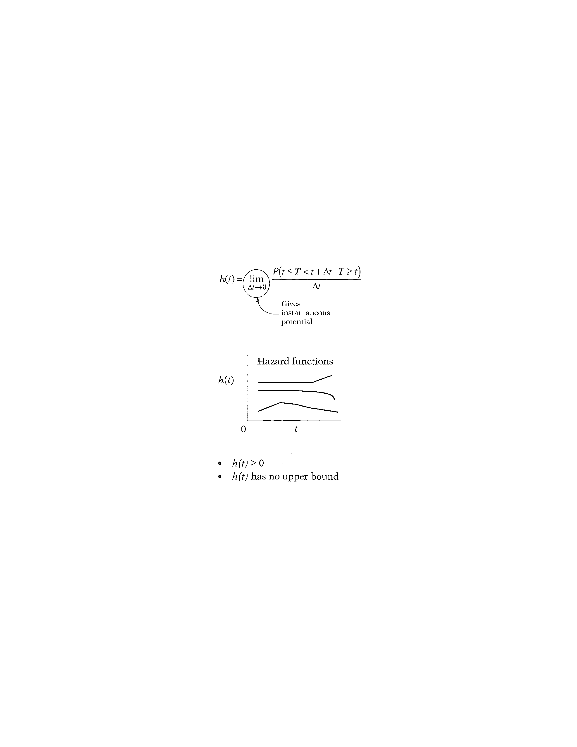
Instantaneous probability of failure (event)
Notes:
When we take the limit of the right-side expression as the time interval approaches zero, we are essentially getting an expression for the instantaneous probability of failing at time t per unit time. Another way of saying this is that the conditional failure rate or hazard function h(t) gives the instantaneous potential for failing at time t per unit time, given survival up to time t. As you can see from this formula, estimating the hazard rate at a given point in time requires calculus and cannot be easily hand calculated directly from the data – as we did for the average incidence rate.

Slide 52
Properties of Hazard Function
Notes:
As with a survivor function, the hazard function h(t) can be graphed as t ranges over various values. The graph at the left illustrates three different hazards. In contrast to a survivor function, the graph of h(t) does not have to start at 1 and go down to zero, but rather can start anywhere and go up and down in any direction over time. In particular, for a specified value of t, the hazard h(t) has the following characteristics:
° it is always nonnegative, that is, equal to or greater than zero;
° it has no upper bound.
These two features follow from the ratio expression in the formula for h(t), because both the probability in the numerator and the Δt in the denominator are non-negative, and since Δt can range between 0 and infinity.

Slide 53
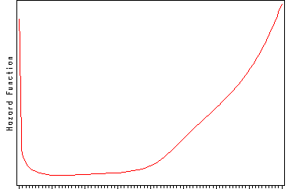
Hazard function for mortality in general population
0 Age (years) 100
Compare information provided here vs. an average incidence rate
Notes:
This graph illustrates a hazard function with a 'bathtub shape'. This graph is depicting the hazard function for survival in the general population. Hazard is high shortly after birth but drops rapidly and remains at a relatively low level during youth and middle age. Hazard starts to rise later in life and increases steadily.
Other indicators of interest, such as the survival function, are derived from the hazard. Once we have modeled the hazard we can easily obtain these other functions of interest. Hazard function is the basis for proportional hazards regression model. Useful to understand the concept of the hazard function and to be able to interpret the shape of a hazard function.
Note how much more this tells you than can be understood from an average incidence rate.

Slide 54
Incidence Rates in STATA
Death after diagnosis of primary biliary cirrhosis
Declare data set survival data:
. stset timevar, fail(failvar)
.strate gives person-years rate
Example: Biliary cirrhosis time to death data
.use biliary cirrhosis data, clear
.stset time, fail(d)
.strate
D Y Rate Lower Upper
96 747.04 0.1285 0.1052 0.1570
Average incidence rate = 12.85 deaths per 100 person-years
Notes:
This is a slide from earlier in today’s lecture, showing the calculation of the average incidence rate, using STATA, in a dataset of survival time after diagnosis with primary biliary cirrhosis.
The average incidence rate in the total cohort is 0.1285 per person-year

Slide 55
Hazard function in Stata
sts graph, hazard
K-M survival curve for same data
10 yr cum incidence = 0.2375
Different information in this plot
Average incidence rate = 0.13 deaths per person-year
Notes:
And here is the KM survival curve that we saw last week for the same data. Cumulative incidence over 10 years was 0.2375.
What will the hazard function look like?
This is the hazard function, graphed for the same dataset as previous slide. Note that the hazard rate is not constrained to follow any particular model. In this data, the hazard rate is steadily increasing until about 7 years.
Note that the incidence rate calculated on the previous slide (~0.13 deaths per person year) is an average rate over the study time period. Note how much more information is provided by the plot, showing the changes in the rate during follow-up, compared with the average incidence rate.
The KM curve also provides substantially more information than the cumulative incidence expressed as one number (e.g. 0.2375). The information is different than the hazard function. For most of us, it is difficult to make the mental leap from this cumulative survival curve to the underlying hazard rate, or vice versa.

Slide 56
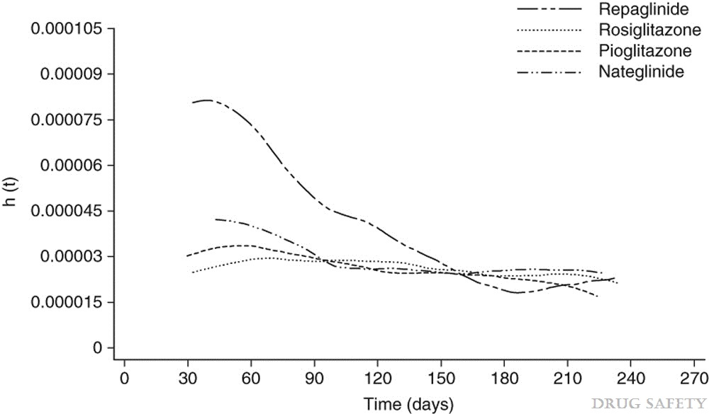
Hypoglycemia with Oral Antidiabetic Drugs
Methods: …Observation time for each patient and incidence rate (IR) per 1000 patient-years of treatment for hypoglycaemia was calculated for each drug cohort. Smoothed hazard estimates were plotted over time...
Smoothed hazard estimate of hypoglycaemia over time by drug cohort.
h(t) = hazard over time.
Vlckova et al. Drug Safety. 32:409-418, 2009.
Notes:
Aim: The aim of this study was to quantify the incidence of hypoglycaemic events and to describe the pattern of these incident events during the first 9 months of treatment with four oral antidiabetic drugs, rosiglitazone, pioglitazone, nateglinide and repaglinide, prescribed in general practice in England.
Methods: We used data collected for prescription-event monitoring (PEM) studies of rosiglitazone, pioglitazone, nateglinide and repaglinide. PEM is an observational, non-interventional cohort study. Observation time for each patient and incidence rate (IR) per 1000 patient-years of treatment for hypoglycaemia was calculated for each drug cohort. Smoothed hazard estimates were plotted over time.
Results: The total number of patients included in the analysis was 14 373, 12 768, 4549 and 5727 in rosiglitazone, pioglitazone, nateglinide and repaglinide cohorts, respectively. From these, 276 patients experienced at least one episode of hypoglycaemia. The IR was between 50% and 100% higher in patients receiving treatment with meglitinides compared with those treated with the thiazolidinediones (TZDs) [IR = 9.94, 9.64, 15.71 and 20.32 per 1000 patient-years for rosiglitazone, pioglitazone, nateglinide and repaglinide, respectively].
“The smoothed hazard plot depicted in figure 1 shows that the incidence of hypoglycaemia in patients treated with rosiglitazone was approximately constant over time. A slight decrease in hazard over time is observed in patients receiving pioglitazone. Patients treated with repaglinide experienced more hypoglycaemic episodes at the beginning of their treatment. Similarly, patients treated with nateglinide tended to have more hypoglycaemic episodes after starting the treatment but the difference was not as pronounced as it was for repaglinide.“

Slide 57
Difference between an Incidence Rate and Cumulative Incidence
Rate can be thought of as how likely an event is to happen at any moment in time
Cumulative incidence is the result of applying that rate to a fixed cohort for a specified duration
Velocity of a car vs distance traveled in a certain time
Average incidence rate is calculated by using data from a time period, but it is just an average. Estimate is meaningful if rate is constant over time (constant hazard), but less useful if changes over time.
Notes:
It may help in understanding the difference between an incidence rate and cumulative incidence to think of the rate as how likely an event, such as death or a disease diagnosis, is to occur at any given moment in time (a kind of instantaneous risk) and to think of the cumulative incidence as the result of applying that instantaneous rate to a given number of persons for a longer period of time. The longer the time period, the more the cumulative incidence will differ from the rate. The higher the rate the more quickly this difference appears. So the rate can be thought of as the most fundamental measure of disease incidence, something captured rather metaphorically by older descriptions of a rate as the “force of morbidity” or the “force of mortality.”
The cumulative incidence can only be constant as long as no new event occurs, but every time an event occurs, the cumulative incidence has to increase. Remember, cumulative incidence is among a closed cohort of persons for a specified time period.
As an analogy, consider the difference between the velocity of a car (a rate) and the distance traveled within a certain time period.

Slide 58
Illustration of Incidence Rate versus Cumulative Incidence
The mortality rate in the U.S. in 2001 was 855 per 100,000 person-years
If a fixed cohort of US citizens was followed for 5 years (and had this constant rate of death), the cumulative incidence of death can be shown to be 4.2% at 5 years; at 10 years it would be 8.2%.
Notes:
In 2001 the mortality rate was estimated at 855 per 100,000 person-years. Part of the confusion around rate is that it is often described with the use of the word “annual”, as the U.S. mortality rate is in “the annual U.S. mortality rate.” The use of the word “annual” suggests that the rate is per one year, but this is misleading. The word “annual” comes in because we calculate the rate for 2001 by using data from an entire year, but the estimate of the rate is based on the assumption that it was constant throughout the year (a reasonable approximation to reality for something that changes as slowly as the mortality rate). This assumption is saying that mortality rate is the same at any moment in time in 2001. If the rate remains constant, applying that rate to a given number of persons for a given time period produces a cumulative incidence that follows an exponential distribution. We’ll give you the formula on the next slide. The key point here is that the incidence rate and cumulative incidence diverge more over longer time periods. For a short time period, the rate (expressed per 100 person-years) and the cumulative incidence will be very close, but not identical. For a 1 year period mortality rate of 0.855 per 100 person-years produces a cumulative incidence = 0.851%, very slightly different numerically from the rate. But if the U.S. mortality rate of 0.855 per 100 person-years applies to everyone alive at this moment and stays constant for five years, the cumulative incidence of mortality at five years would be 4.2%. At 10 years the cumulative incidence would be 8.2%, both quite different from the rate. And if the rate is high the cumulative incidence will differ significantly faster. A rate of 30 per 100 person-years gives a 1-year cumulative incidence of 25.9%. Of course, in a closed cohort the mortality rate would increase over time as the cohort ages. This does not pose a problem. There are other mathematical formulas for dealing with an increasing rate. Increasing rate would cause the cumulative incidence to increase faster.

Slide 59
Relationship between Incidence Rate and Cumulative Incidence
A constant rate produces an exponential cumulative incidence (or survival) distribution
If know the constant incidence rate, can derive the cumulative incidence/survival function or vice-versa from
where S(t) = cumulative survival and
F(t) = cumulative incidence
e= 2.71828; λ = rate; t = time units
Notes:
There is a formal mathematical relationship between rate and cumulative incidence. For the special situation of a constant rate, it is represented by this formula. If the rate remains constant, applying that rate to a given number of persons for a given time period produces a cumulative incidence that follows an exponential distribution given by the formula above, where F(t) = the cumulative incidence, e = 2.71828, λ = the rate per the person-time units, and t = the number of time units. The proof for this can be found in advanced textbooks.

Slide 60
Constant Rate
Hazard Rate
Cumulative incidence
Notes:
These figures illustrate different relationships between a CONSTANT incidence rate and cumulative incidence. A constant incidence rate (top panel) produces an exponential survival curve (lower panel).

Slide 61
Effect of high and low constant incidence rates on cumulative incidence
 | Cumulative Incidence at:
Inc. Rate | 1 year | 2 years | 5 years | 20 years
1 per 100 pers.-yrs. | 0.0100 | 0.0198 | 0.0488 | 0.1813
25 per 100 pers.-yrs. | 0.2212 | 0.3935 | 0.7135 | 0.9933
Notes:
Applying the formula from the earlier slide, gives these values for cumulative incidence for a low and a high constant incidence rate over 4 time periods. Note that at one-year neither cumulative incidence differs that much from the rate (when the rate is expressed per 100 person-years), but that the high rate rapidly gives a quite different cumulative incidence while the low rate takes longer to diverge.

Slide 62
Relationship between hazard function and survival function in the special case of a
Constant Hazard Rate
where h(t) = λ
Assumes no competing events
Notes:
Here is the relationship between the hazard function and survival function, shown again, for the special case of a constant hazard rate. (This also assumes no competing events.) If the hazard function is constant-i.e., h(t) = λ, for some specific value λ-then it can be shown that the corresponding survival function is given by the following formula: S ( t) equals e to the power minus λ times t.
With this formula, you can take an average incidence rate from an article and turn it into a cumulative incidence (which is typically more understandable by readers). Two examples follow.

Slide 63
From average incidence rate to cumulative survival/incidence #1
Previous example: Biliary cirrhosis time to death data
Average incidence rate = 0.1285 deaths per person-year
S(t) = ℮(-0.1285 deaths/person-yr * 10 yr)
= 0.277 = cumulative survival over 10 yrs
Cumulative survival (10 yrs) from KM: 0.237
Values are close but not identical. Why?
Notes:
The average incidence rate = 0.1285 deaths per person-year. We are interested in a time interval of 10 years. The estimated cumulative survival over 10 years with this equation is 0.277, close to the value based on Kaplan Meier calculations (0.237).
The reason that the result from the exponential formula does not exactly match the K-M estimate is because the hazard is not truly constant (as shown on earlier slide)

Slide 64
From average incidence rate to cumulative survival/incidence #2
Breast cancer incidence rate in Marin in 2000:
157.5 cases per 100,000 person-years
What is the cumulative incidence of breast cancer, assuming this constant rate, over 20 yrs?
S(t) = ℮(-157.5 cases/100,000 person-yrs * 20 yrs) = 0.97 survival over 20 yrs
F(t) = 1 - 0.97 = 0.03 incidence over 20 yrs
Notes:
Another example. Here we want to calculate cumulative incidence of breast cancer cases in Marin over 20 years, given the incidence rate in 2000. Use previous formula to calculate survival S(t). Then calculate cumulative incidence as 1-S(t) = F(t)

Slide 65
Survival and Hazard Functions
cumulative hazard
Don’t require constant hazard function
Notes:
More generally, the relationship between S( t) and h(t) can be expressed equivalently in either of two calculus formulae shown here. The first of these formulae describes how the survivor function S(t) can be written in terms of an integral involving the hazard function. The formula says that S( t) equals the exponential of the negative integral of the hazard function between integration limits of 0 and t.
The second formula describes how the hazard function h(t) can be written in terms of a derivative involving the survivor function. This formula says that h(t) equals minus the derivative of S( t) with respect to t divided by S( t).
Note that this general formula no longer requires the hazard to be constant.
The quantity in the integral is what is called the "cumulative hazard", an entity that is used in other survival analysis contexts (which we won't discuss in this class)

Slide 66
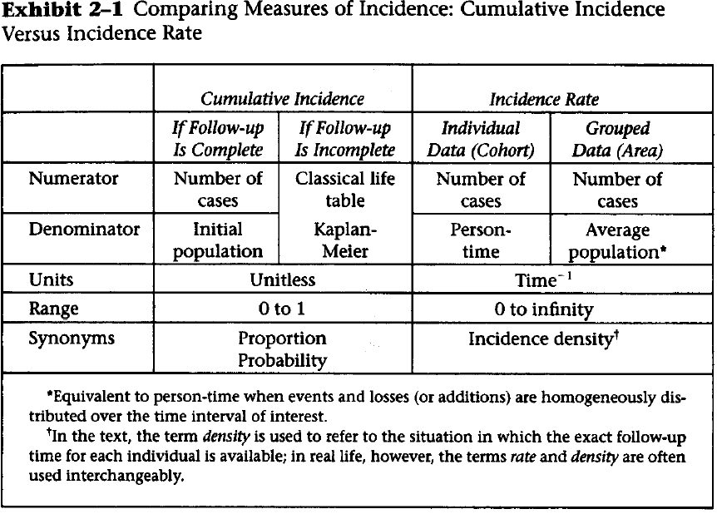
Notes:
This is a useful table from your text that summarizes the characteristics of cumulative incidence versus incidence rate. You should thoroughly familiarize yourself with this.
Note that 'incidence proportion' is a reasonable synonym for cumulative incidence.

Slide 67
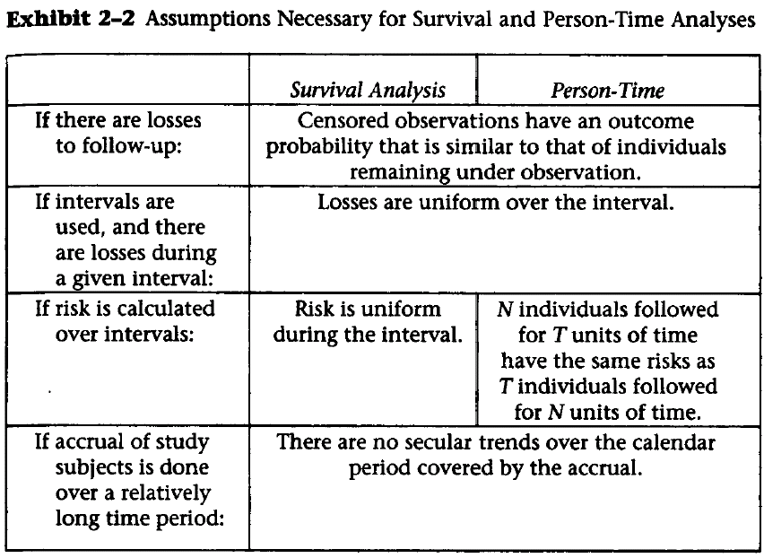
Cumulative incidence
Incidence rate
Notes:
Note that the text is here using the headings “Survival Analysis” and “Person-time” for the cumulative incidence and incidence rate approaches, respectively, to analyzing data that features time to an event. This is the graphic from the text that gives the assumptions of both methods. Note that they have the same assumptions with the exception of how the risk is calculated over intervals. Thus, the issues of informative censoring and of secular trends are important to keep in mind with both of these approaches. These potential sources of bias cannot be avoided by choosing one or the other of these methods of estimating disease occurrence.

Slide 68
Rates: What to do about
Losses to Follow-up and Competing Events
In the calculation of rates, subjects contribute person-time until they either have the event of interest (E) or:
  drop out
  are administratively censored (i.e., study ends)
  have a competing event
Thus, without any special assumptions, rates have a specific interpretation
  “Rate of the event E given that something else (drop-out; admin censoring, or competing event) has not happened first”
  This interpretation is inherently accommodating (i.e. specifically recognizing and allowing for) the presence of drop-out; admin censoring; and competing events
Notes:
Let’s talk more about the assumption that censored observation have an outcome probability that is similar to that of individuals remaining under observation. More generally, when calculating rates, how should we handle losses to follow-up and competing events.
If we step back for a moment, remember that in the calculation of rates, subjects contribute person-time until they either have the event of interest or they drop out, are administratively censored (i.e., the study ends) or they have a competing event. Thus, without making any special assumptions, rates have a specific interpretation. That is, the interpretatio is: “Rate of the event (E) given that something else (drop out; administrative censoring, or the competing event) has not happened first.
We say that this interpretation is inherently accomodating for drop out, administrative censoring, and competing events. That is, this interpretation recognizes that these events occur and allow for them).

Slide 69
Is native interpretation of rate satisfying & meaningful?
i.e., Do we want to accommodate (allow for) administrative censoring; competing events; and drop-out?
  Or, would we prefer if they never happened (were eliminated)?
Threat | Discussion | Conclusion
Administrative censoring a) those followed for entire period of study b) those with delayed entry; not followed for entire period | All studies must end, and end of a study unrelated to substance of study itself (ie just an artifact) Preferable to have followed everyone throughout entire time | a) Appropriate to accommodate b) Prefer elimination accept accommodation
Competing events | A fact of life Difficult to envision a reality without such events | Appropriate to accommodate
Drop-out | Unfortunate manifestation of studying humans Concern about how often the event occurs after drop-out Have a sense that harder work could have prevented | Prefer to eliminate
Notes:
Is this native interpretation of rate satisfying and meaningful? In other words, how do we feel about accommodation? Or, would we prefer if these things never happened, in other words, if they were eliminated?
Let’s look at all 3 of them individually. First, administrative censoring. We recognize that all studies must end, and the end of a study really has nothing to do with the events of the disease process itself. It is just an artifactual end. Given this, it is appropriate to accommodate administrative censoring.
Second, competing events. We recognize that competing events are a fact of life. It is difficult to envision a reality without such events. Thus, we are willing to and it is appropriate to accommodate competing events.
Finally, how about drop-out? Drop out is an unfortunate manifestation of studying humans. We are always wary about how often the event occurs after drop out. We also have a sense that a little harder work on our part could have prevented drop out. Because of this, we wish we could eliminate drop out and are not willing to accommodate for it.

Slide 70
In a rate calculation, what does it mean to prefer elimination of losses to follow-up?
Means that you are not satisfied with:
  “Rate of the event E given that drop-out has not happened first”
  Wise to be unsatisfied. This is a very messy statement.
You prefer to say:
  “Rate of the event E assuming drop-outs don’t occur”
But because drop-outs, in reality, do occur, we typically have to assume that we know what is happening to them
  We assume that the rate of the event of interest in the lost is the same as those who remain
  The origin of the assumption of “non-informative censoring”
Notes:
Let’s get into this latter idea a bit more. What does it mean in a rate calculation to hope for elimination of losses to follow-up (drop outs)? It means that you are not satisfied with the native interpretation of a rate, which is that “Rate of the event E given that drop-out has not happened first”. If you are unsatisfied with this interpretation of rate, you should be because it is a messy statement. What you would be prefer to be saying is that it is the rate of event e assuming drop-outs don’t occur.
Yet, in reality, drop outs do occur. One way to deal with this is to assume that we know what is happening to these losses. The most expedient assumption is to say that the event of the interest in the lost is the same as those who remain. And, so this is the origin of the original assumption:
censored observation have an outcome probability that is similar to that of individuals remaining under observation.
This is the assumption of non-informative censoring.

Slide 71
In a rate calculation, what does it mean to accommodate competing events?
Means that you are satisfied with:
  “Rate of the event E given that a competing event has not happened first”
  This is a reasonable entity.
Thus, without any effort (i.e., usual calculation), rates naturally account for competing events
  Don’t need to assume competing events do not occur
In contrast, recall that we had to assume no competing events in a K-M estimation
Another reason to appreciate fundamental nature of rates
Notes:
Now, let’s talk about competing events in a rate calculation. We said we were willing to accommodate competing events. What does it mean to accommodate competing events?
It means that you are satisfied with the native interpretation of a rate which is the rate of the event E given that a competing event has not happened first.
Given that competing events are a fact of life, this is a reasonable entity.
Thus, the good news is that without any effort – ie just the usual rate calculation, rates naturally account for competing events. We don’t have to live in a make believe world where competing events do not occur.
Recall this is in contrast to what we discussed last week in the calcuation of the K-M estimator, where we had to assume either no competing events or independent competing events.
This natural handling of rates is another reason to like rate and appreciate why they are so fundamental.

Slide 72
Why not just censor (i.e., eliminate) competing events in Kaplan-Meier calculation?
Independent competing events
  censoring means you believe in a reality where competing events don’t occur
  inferences do not pertain to our world’s reality
Non-independent competing events
  Must believe in a world where competing events don’t occur
  Must be able to state what the new rate of the event E would be if the competing event was eliminated
    An act of pure speculation
Notes:
With this definition of competing risk events in mind, why cannot we just censor individuals at the time of the competing event, like we perform censoring in Kaplan-Meier calculations? This would be akin to elimination, in which we perform the calcuation under the assumption that competing events could be eliminated.
The answer to this can be given for each of the two flavors of competing risk events. For competing risk events that are independent of the event of interest, when you censor you first must say that you believe that the event of interest can occur after death. But, of course, this is absurd because any inferences derived from such an analysis do not pertain to our world’s reality.
What if you have a non-independent competing event. Again, to censor means you want to know what happens to your event of interest assuming that competing events don’t occur. So, again, you must believe in a world where competing events don’t occur. Even if you could get your head around this altered reality, you would then need to state what the new rate of the event E would be if the competing event was eliminated. This is typically just an act of pure speculation.
So, in both scenarios – independent competing events and non-independent events – censoring does not look to be appropriate.

Slide 73
Solution for Competing Events in Cumulative Incidence Estimation
Instead of censoring, account for competing risk events explicitly as additional separate outcomes in the analysis
Technique called “cumulative incidence approach” or “cumulative incidence function” (nice descriptive name but not distinctive!)
In successive time intervals:
  calculate joint probability of a) experiencing none of the events (either event of interest or any of competing events) up through beginning of interval and b) experiencing event of interest during the time interval
  add up these joint probabilities within successive time intervals to get cumulative incidence of the event of interest
An argument could be made that this technique is all you need for cumulative incidence. It does everything that KM can do & more.
Explained in Satagopan et al. Brit. J. Cancer 2004
Notes:
Hence, the solution, instead of censoring, is to account for the competing risk events explicitly as additional separate outcomes in the analysis. This technique is called the cumulative incidence approach or cumulative incidence function. It is a somewhat unfortunate name because it does not give you much to remember it by (as compared to the Kaplan-Meier or life table approaches, which are more distinctive and less generic.)
Generally, the technique involves calculating, in successive time intervals throughout the course of follow-up, the joint probability of a) experiencing none of the events (either the event of interest or any of the competing events) up through the beginning of the time interval and b) experiencing the event of interest during the time interval. Then, one adds up the joint probabilities within the successive time intervals to get the cumulative incidence of the event of interest. This is explained in more detail in the Satagopan article, which is required reading for this week. We’ll walk through one of the examples from the article.

Slide 74
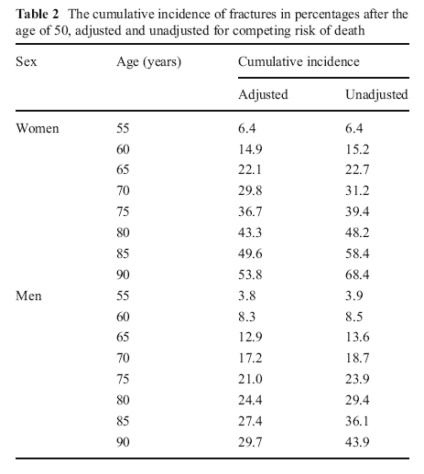
Example: Cumulative incidence of fracture in Iceland after age 50
Cumulative incidence function
KM
Siggeirsdottir et al 2013
Notes:
This is an example of a paper that reported cumulative incidence calculated with the cumulative incidence function (CIF) with death as a competing event and with the Kaplan-Meier method. The first column (“adjusted”) for Cumulative incidence presents the cumulative incidence with death treated as a competing event, using CIF. We don’t like this word “adjusting”; we would rather say “accounting for the competing event of death”. The last column provides the incidence based on the Kaplan-Meier method. The follow-up period starts at age 50 and is then reported for intervals to age 55, to age 60, etc. This nicely illustrates the difference in the estimate using CIF versus KM when there are a substantial number of competing events. For example, at age 90 for women, the cumulative incidence estimates vary by almost 15 percentage points (53.8% versus 68.4%).

Slide 75
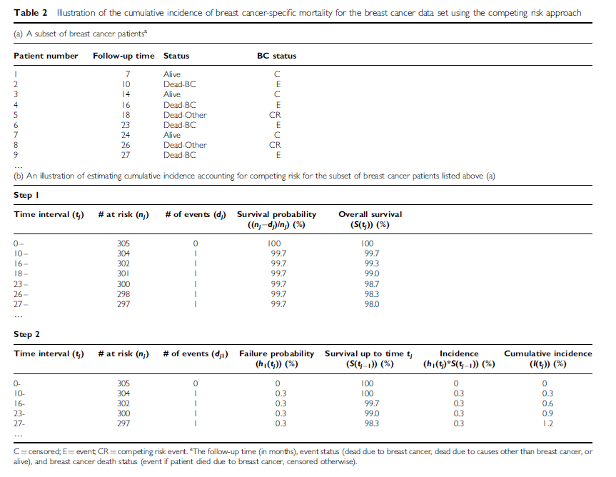
Cumulative incidence function calculation
Satagopan et al 2004
Notes:
We are going to walk through an example of calculating cumulative incidence taking into account competing events, taken from the Satagopan et al article in your reading for this week.

Slide 76
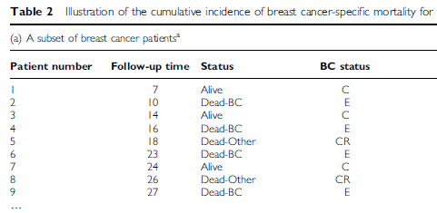
Final status of first 9 patients
Pt 1 alive at end of follow-up; Pt 2 had event of interest (BC death); Pt 5 had competing event (Other death)
Notes:
This provides the status at the end of follow-up for the first 9 participants, i.e. those with the lowest follow-up times. The first participant was followed for 7 months and was alive at that time. The second participant was followed for 10 months until death from breast cancer. Patient number 5 experienced a competing event – death due to a cause other than breast cancer – at 18 months.

Slide 77
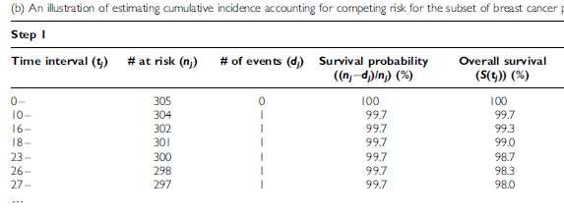
Survival without event or competing event
KM way of thinking used to calculate overall (cumulative) survival without event or competing event. Events column includes all deaths.
Notes:
The first step in the cumulative incidence function method is to calculate the cumulative survival (overall survival) for each time interval that an event or competing event occurs. The KM method of thinking is used to calculate the cumulative survival.
For example, at time interval 10-, there was one event (BC death – Pt #2). The survival probability for that interval is 303/304 = 99.7%. At time interval 18- there is a competing event (Other death – Pt #5). For time interval 18- the overall (cumulative survival) is 1.00*0.997*0.997*0.997 = 99.0%

Slide 78
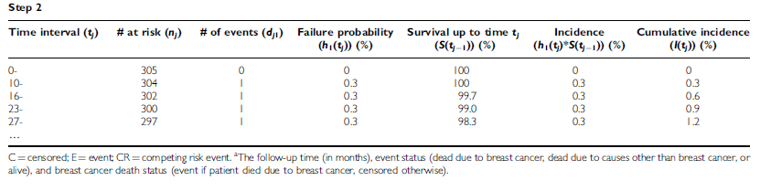
Cumulative incidence of event
F
S
1. Failure (BC death) probability for “10-” is 1/304. Survival to 10 mos is taken from previous KM calculation (overall survival) = 100%.
Failure probability for “16-” is 1/302. Survival to 16 mos is 99.7%. Etc.
2. Incidence (of BC death) in interval: F * S
For “16-”, 0.003 * 0.997 = 0.3%
3. Cumulative incidence of BC death is sum of incidence in time intervals.
At “23-” cumulative incidence is 0+0.3+0.3+0.3 = 0.9%
Notes:
Failure probability is now calculated for each time interval when an event of interest (BC death) occurred. In our example there were 4 BC deaths so failure probability is calculated for each of those intervals.
Probability of survival up to the beginning of each time interval is taken from the table on the previous slide (“Step 1”) where we calculated cumulative survival without an event or a competing event.
Now we can calculate the incidence of the event of interest in each time interval as the product of the failure probability for that interval and the probability of survival to that time interval (i.e. F * S). This is the joint probability of experiencing the event of interest in the interval given survival without the event or any competing event(s) through all previous intervals.
The cumulative incidence is just the sum of the incidence in each interval.

Slide 79
Implementing Cumulative Incidence Approach in Stata
Download user-written file “stcompet” from internet
  command: ssc install stcompet, replace
Within survival analysis dataset, instead of failure variable having only two values (0 = censor; 1=event), make sure there are additional values for each competing event type
  e.g., 0=censor; 1=event of interest; 2=competing event
stset data, with special attention towards telling Stata which is the event of interest (e.g., if “outcome” is failure variable)
  command: stset time, failure(outcome=1)
Declare competing events & calculate cumulative incidence
  command: stcompet cif=ci, compet1(2)
Tease out event of interest-specific cumulative incidence
  command: gen cuminc1 = cif if outcome==1
Notes:
Cumulative incidence function can also be implemented in Stata, but it is inexplicably not included in the base software. One has to add the function by downloading a free file that has been written by a Stata user. We won’t have time to go over this in detail now, but these notes are provided for reference.

Slide 80
Implementing Cumulative Incidence Approach in Stata
List the cumulative incidence function for event of interest
  command: sort time
  list time cuminc1 if outcome==1
Graph the cumulative incidence function for event of interest
  command: twoway line cuminc1 _t, connect(J) sort
  ytitle(Cumulative incidence) xtitle(Time)
For details
  command: help stcompet
Notes:
We won’t have time to go over this in detail now, but these notes are provided for reference. You will get a chance to work through this in your homework this week.

Slide 81
Competing Events in Incidence Estimation
Type of incidence estimate | Accommodate or eliminate competing event? | What to do?
Cumulative incidence | Accommodate | Cumulative incidence function (not K-M)
Incidence rate/hazard | Accommodate | Usual rate calculation
Notes:
Here is a summary of how to handle competing events when calculating incidence. In both the calculation of cumulative incidence and incidence rates, we typically seek to accommodate the occurrence of competing events. In others, we recognize and allow for them. We don’t try to pretend that they don’t occur. To accommodate for them, we perform what is called the cumulative incidence function or cumulative incidence approach when we seek to estimate cumulative incidence. Note: this is a different technique than K-M estimation, where natively we are calculating cumulative survival and take the complement to get cumulative incidence.
When the goal is to estimate incidence rate, there is actually nothing special to do. We just perform our usual rate calculation.

Slide 82
Incidence in Clinical Research/Epidemiology
Making the measurements
Recruitment
Sensitive and specific detection of event onset
Retaining subjects
Manipulating and summarizing the data
Practical field work
Not covered in this course
Best learned by working with experienced colleagues
Notes:
This concludes our discussion of the measurement of incidence in clinical research/epidemiology. It is important to step back and remember that we have been discussing the manipulation and summarization of data pertaining to incidence. Yet, this is only half the story. The other half is actually making the measurements, i.e., collecting the data. This means recruitment, sensitive and specific detection of event onset, and retaining subjects. We note that we ARE NOT covering this in much detail in this course. This is the important discipline of practical field work. While enormously important, we don’t especially think it can be taught in a course. In part, this is because it is very study-specific. Instead of getting this knowledge in courses, we suggest that this is best learned by working with experienced colleagues.

Slide 83
Summary
Incidence rate (or density)
  E/NT
  Not a proportion, time in denominator
Average incidence rate can be calculated with individual or average population data. Allows:
  Incidence estimates in dynamic populations, especially those that are not fully enumerated
  Comparison with population reference rates
  Accumulation of time at risk for different exposure strata
Instantaneous incidence (hazard) rate
  Hazard function – insight into changes in rate during follow-up
  Basis for proportional hazards regression
Assumptions for average incidence rate
  Uniform rate during time period; censored have same experience as those remaining
Competing Events
  Rates natively accommodate competing events
  Use cumulative incidence function to accommodate competing events

Slide 84
Extra Slides

Slide 85
Age Standardization
55062 / total US popn
Notes:
Direct standardization or adjustment will give an overall age-standardized (adjusted) rate for each population. We apply the age-specific rates from the 5-year age groups in Beijing, Budapest, etc. to the age distribution of an external population, in this case the 1990 non-Hispanic white population in the US census. This gives the number of “expected” hip fractures - IF the Beijing rates had occurred in a population with age distribution like the US. The number of “expected” hip fractures is totaled and divided by the US population to give the age-adjusted incidence rate. This is done for each population. For Beijing, the expected number of hip fractures (in women) in one year was 55,062. Divide by the total population of the U.S. (138,908,682) to get the age-adjusted rate of 39.6 per 100,000 person-years. Follow the same procedures to calculate the age-adjusted rate for women in Budapest. Then, these age-adjusted rates can be compared as a rate ratio. A rate ratio of 1.0 would mean there was no difference in the hip fracture rates in two areas, once age-differences are adjusted. In this example, the age-adjusted rates for Beijing and Budapest appear different and a rate ratio comparing these two age-adjusted incidence rates (Budapest/Beijing rates) would be > 1.00.
The actual value of the age-adjusted rate depends on the reference population. The rate is not meaningful in isolation but is intended to allow comparisons across populations with different age structures.
The unadjusted rates that we calculated on the previous slide are also shown here. For Beijing the unadjusted rate is lower than the age-adjusted rate. This is because the underlying age structure of the Beijing population is younger than the US population that was used as the “standard” population. For Budapest, the unadjusted rate is higher than the age-adjusted rate; the age structure of Budapest is older than the US population.

Slide 86
Competing Events in Cumulative Incidence
Definition: In a study of incidence of some event of interest, a “competing event” (aka “competing risk”,“competing risk event”):
  precludes the occurrence of the event of interest (e.g., death precludes all outcomes)
  or
  substantially impacts incidence of event of interest (e.g., prophylactic ovary removal in study of ovarian cancer)
“Competing” because it occurs prior to event of interest
Two flavors:
  Independent: Occurs independent of event of interest (e.g., accidental deaths in study of brain cancer incidence)
  Non-independent: Related to event of interest (i.e., occurrence influenced by factors which influence event of interest; e.g., death from COPD in study of lung cancer incidence)
Notes:
Let’s now talk about competing risks some more in the estimation of cumulative incidence. Recall that we said last week that we would return to this. This slide simply reviews the definition of competing risks, also known as competing events.
As you recall, in a study of incidence of some primary event of interest, a competing risk event is one which either precludes the occurrence of the event of interest (and the best example of this is death, which precludes all outcomes) or one which substantially impacts incidence of the event of interest. An example of this would be prophylactic ovary removal in the study of ovarian cancer. (Incidence is greatly diminished although does not go to zero).
We call these events “competing” because they occur prior to the event of interest that we are studying. They are competing with the occurrence of our events of interest.
Competing events come in two flavors. One is a competing event that occurs independent of the event of interest. When studying brain cancer incidence, accidental deaths (say from drowning) would be considered by most persons as occurring independently of the occurrence of brain cancer. The other type of competing event is actually related to the event of interest. In other words, its occurrence is influenced by factors which influence rate of event of interest. An example would be death from obstructive lung disease in a study where primary event of interest is lung cancer incidence.

