Slide 1
Biostatistics 226, Winter 2018
Course Overview
Jan 9 – Design of RCTs: How to avoid bias and achieve valid results
Jan 16 – Analyses: Baseline, Efficacy, and Safety
Jan 23 – Monitoring trials for efficacy, futility, and patient safety
Jan 30 – Cluster Randomized Trials
Feb 6 – Precision medicine I: SMART (Adaptive) Trials
Feb 13 – Precision medicine II: N-of-1 Trials
Textbook References
Lawrence Friedman, Curt Furburg, David DeMets. Fundamental of Clinical Trials, 5th edition, 2015.
e-copy is available online to UCSF community
Vittinghoff, Glidden, Shiboski, McCulloch, Regression Methods in Biostatistics. 2012.
e-copy: http://www.springer.com/us/book/9781461413523

Slide 2
Conducting Valid Trials
The Critical (and Misunderstood) Roles of Randomization and Complete Follow-Up
Society for Clinical Trials, May 15, 2016, Montréal, Québec
Presenters:
Thomas D. Cook, Department of Biostatistics and Medical Informatics, University of Wisconsin – Madison
Kevin A. Buhr, Department of Biostatistics and Medical Informatics, University of Wisconsin – Madison
T. Charles Casper, Departments of Pediatrics and Family and Preventive Medicine, University of Utah School of Medicine

Slide 3
What is a Valid Trial?
Definition …
  A valid trial is a trial that establishes, up to a predetermined level of statistical certainty, whether an experimental treatment is superior (or non-inferior) to a control treatment.
Importantly, the sole source of uncertainty allowed by this definition is statistical, by which we mean non-systematic, random variation.
Therefore, the goals of an investigator conducting a valid trial are to:
limit the impact of random variation, in particular by ensuring that the trial has sufficient sample size
eliminate (to the greatest extent possible) all other sources of uncertainty.
If any systematic sources of uncertainty remain, the validity of the trial is diminished, and whether the trial is salvageable will depend on a subjective assessment of the potential impact of the systematic error.
Alternative statement of the goal of the trial:
to establish a treatment’s effectiveness to the satisfaction of a skeptic who is not prepared to believe the treatment is effective without convincing evidence.

Slide 4

This goal explicitly puts the burden on the investigator/sponsor of the trial to conduct a trial that will be convincing, not just to themselves, but to the broader scientific community.
Study investigators & sponsors have an ethical obligation to
patients in the trial
future patients
the scientific community
to conduct a trial according to the highest possible scientific standards.
Conventions and Context
Clinical Trials
For the purpose of this course, we will consider trials in which we have
two treatments (study “arms”): control (A) and experimental (B)
a single primary outcome of interest
each subject assigned a single treatment
a statistical test of superiority (except as otherwise noted):
Is treatment B superior to treatment A?
The skeptic
The skeptic

Slide 5
RCT Inference in Five Easy Steps
Enroll a group of subjects from the target population
Randomly assign individuals to either the experimental or control arm
Ascertain outcomes for each enrolled subject
Statistically compare the two treatments
… and the final step:
If, to the desired level of statistical certainty, on average the outcomes in the experimental treatment arm are superior to those in the control arm, then conclude that the experimental treatment is superior to the control treatment.
Step 5 requires a profound leap of logic! … because …
Statistical comparisons are simply computations involving observed data from which we draw conclusions about the distributions of the underlying data.
However, claims regarding the effectiveness of treatment are inherently about causal relationships in the physical universe.
→ Statistical analysis and causation are independent, unrelated concepts.
It is by the magic of randomization that we are able to make this leap.

Slide 6
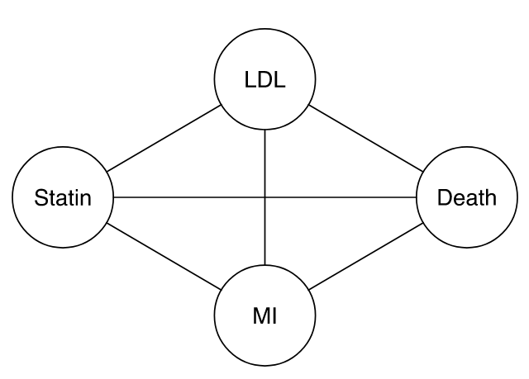
Statistics versus Causation
Consider this diagram.
For a given dataset, statistics can assess whether there are associations among these four features.
Add arrows to represent causal pathways by which treatment with a statin might provide benefit.
Statistics quantifies strengths of associations. Statistics can’t tell us anything about the direction of the causal pathways, or even that they’re causal at all!
Non-statistical evidence informs us of credibility of causality (eg, logic tells us that causes can only work forward in time; biology tells us …).

Slide 7
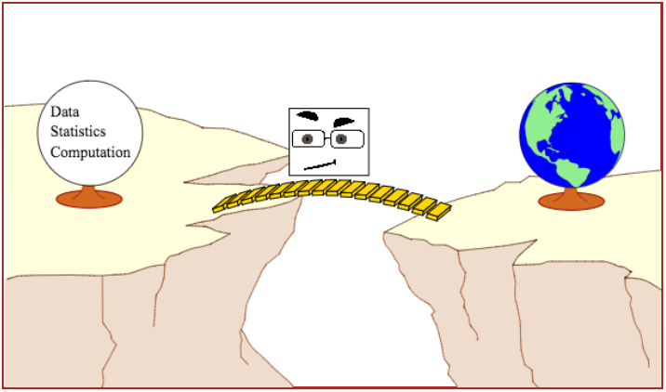
The Causal Bridge
Our skeptic is acting as the troll preventing anyone from crossing the chasm between statistical result and scientific interpretation unless their study design and conduct, combined with proper statistical analysis, allow for meaningful inference about how the world works.

Slide 8
Statistics versus Science
Statistical analyses fall into two broad categories …
Descriptive statistics, where there is no attempt to draw conclusions beyond the sample at hand.
  The mean value of variable X is 53.
  54% of our sample has Y = 2.
Statistical inference, where the goal is to gain generalizable knowledge about the distribution of Xs and Ys in the universe from which a sample has been drawn.
  The mean value of X in the population is 53 with 95% CI (42,64).
  The mean of X is larger when Y = 2 than when Y = 1.
Scientific inference also can fall into two primary categories …
Correlational or predictive inference, where the goal is to identify characteristics that vary together in the population.
  Older people have higher risk of mortality than younger people.
  People with high HDL (“good” cholesterol) are at lower risk for cardiovascular disease than those with low HDL.
Causal inference, where the goal is to infer that X causes Y.
  Statins reduce risk of cardiovascular disease relative to placebo.

Slide 9
Correspondingly,
A statistical hypothesis is a claim regarding a statistical parameter.
For example, given two groups A and B, if β is the difference between the mean response in group A and the mean response in group B, some statistical hypotheses are:
β=0
β≠0
β>0
10<β<20
A scientific hypotheses is a claim regarding the true state of nature.
For example, given two treatments, A and B and given a participant population, some scientific hypotheses are:
Treatments A and B are equally effective
Treatment A is less effective than treatment B
Treatment A is more effective than treatment B by 10 units
A valid trial aligns the statistical and scientific hypotheses.
We reject:
H₀: β=0
if and only if we reject
H₀: treatments A and B are equally effective

Slide 10
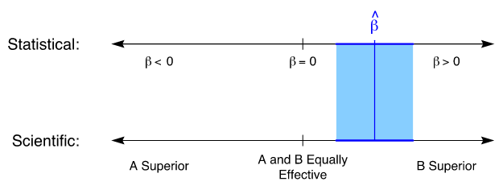
The scientific goal is to use data and statistics to assess the scientific hypotheses of interest. This requires a link between statistical and scientific hypotheses.
Suppose we construct a confidence interval for β, the “treatment effect.”
We would like for there to be a corresponding “confidence interval” for scientific hypotheses as well.
Randomization coupled with complete follow-up and
an intention-to-treat analysis is the only objective way in which
statistical and scientific hypotheses can be aligned.

Slide 11
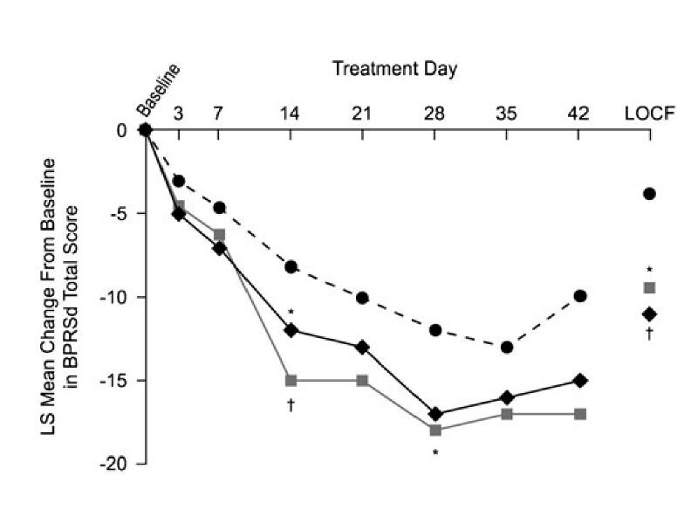
Example 1: 3-arm trial of change from baseline in BPRSd score at 6 weeks.
Ogasa et al. (Psychopharmacology, 2012)
Group Number Randomized Number (%) completing
Lurasidone, 40 mg/day 50 16 (32.0%)
Lurasidone, 120 mg/day 49 20 (40.8%)
Placebo 50 15 (30.0%)
Notes:
Comments:
1) Primary outcome observed on less than half of randomized subjects.
2) Primary analysis uses last-observation-carried-forward (LOCF) for subjects not completing study.
Because we don’t observe the 6-week outcome on all randomized subjects, our “skeptic” has no way to know whether the active treatments are really better than placebo or whether the observed differences are due to lack of adherence and follow-up.
3) The plotted trajectories are based on least squares means from an ANCOVA model, a hard-to-understand “black box”.

Slide 12
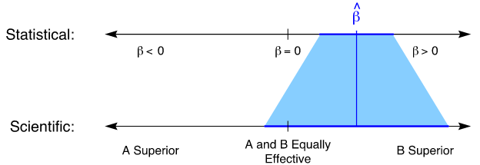
Example 1 – Hope-Based Analysis
In this example, the extent of missingness compromises the result of the trial.
This analysis might be considered to be based on hope.
We make certain assumptions:
LOCF reflects the 6-week outcome
Observations are “missing at random,” so the statistical hypotheses tested using the ANCOVA model align with the scientific hypotheses of interest.
. . . and we hope that they’re correct.
Because a skeptic has no way to verify that these assumptions are correct, she might have good reason to conclude that this is a completely failed trial.

Slide 13
Example 1 – Convincing Analysis
So, what evidence does a skeptic want to see?
A simple direct comparison of responses at 6 weeks
for all randomized subjects
analyzed according to their assigned treatment groups
regardless of their adherence to their assigned treatments.
Otherwise, skeptic must trust unverifiable assumption(s) made by the investigator and/or analyst.
Our scientific conclusions require two steps:
Statistical inference: “Are the two groups different?”
Scientific inference: “Is the difference due to an effect of treatment?”

Slide 14
STATISTICAL INFERENCE
Study populations are inherently heterogeneous with respect to prognosis. Thus, arbitrarily chosen individuals have different baseline characteristics, different prognoses, and different outcomes. → random variation
  To characterize the outcomes across the population, we might take a sample and calculate its mean and variability.
  Because of heterogeneity, the magnitude and variability of the sample mean depend on the kinds of subjects we sample.
Impacts of eligibility criteria compared with heterogeneous samples:
  Draw sample from a relatively homogeneous “healthy” subpopulation
    Outcomes (say, FEV₁%) in the two groups are larger on average and less dispersed than a sample from the full population.
    If we sampled from a subpopulation with a smaller average group difference, the observed difference is smaller.
  Draw sample from a relatively homogeneous “sicker” subpopulation
    Outcomes (FEV₁%) in the two groups are smaller on average, but still less dispersed
    If we sampled from a subpopulation with a larger average group difference, the observed difference is larger.

Slide 15
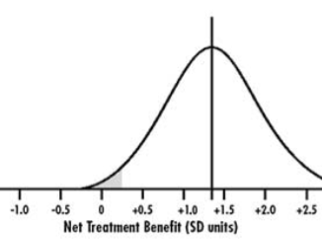
Randomization guarantees that, under H₀,
the distribution of outcomes is the same in both study arms.
This establishes the critical value corresponding with the type-1 error rate,
enabling us to test our study hypothesis and accept or reject H₀.

Slide 16
Hypothesis Testing
We want to compare mean outcomes of two arms, A and B.
  For a superiority trial, there are two hypotheses of interest:
  Null hypothesis, H₀: The arms are not different (e.g., the true average response is the same in both arms)
  Alternative hypothesis, H_{A}: The arms are different (e.g., the true average in one arm is larger than the average in the other)
  Before collecting any data, H₀ is assumed to be true and the statistical goal is to show that H₀ is false.
Typically, we set up the test to reject H₀ if the difference between the group means is large compared to their standard errors.
Statistics can only tell us if groups are or are not different.
The reason they are different is a causal question and can’t be identified statistically.
Failure to randomize can introduce confounding:
  If draw arm A (placebo) subjects from healthy subpopulation and arm B (treatment) subjects from unhealthy subpopulation, baseline health status will be associated with both arm and outcome. → “Simpson’s Paradox”

Slide 17
Is it important to Balance baseline covariates ?
Beliefs in the importance of baseline balance have led some to propose “balancing strategies” as supplements or alternatives to randomization.
Arguments in favor of balancing strategies seem to …
take it for granted that covariate balance, at least for “important” covariates, is desirable or even necessary
make unsubstantiated claims that covariate imbalance biases or invalidates statistical analysis
make the specific claim that a trial demonstrating a treatment difference in the presence of a baseline covariate imbalance is not credible: the covariate imbalance, rather than the treatment itself, might have caused the observed treatment difference
The question of interest is:
In comparison to balancing strategies, does randomization cause biased or invalid statistical analysis?
Specifically, does randomization cause detection of spurious treatment differences that would not have been observed if only we had employed a balancing strategy?
→ This is a causal question, and we can evaluate it in our causal framework.

Slide 18
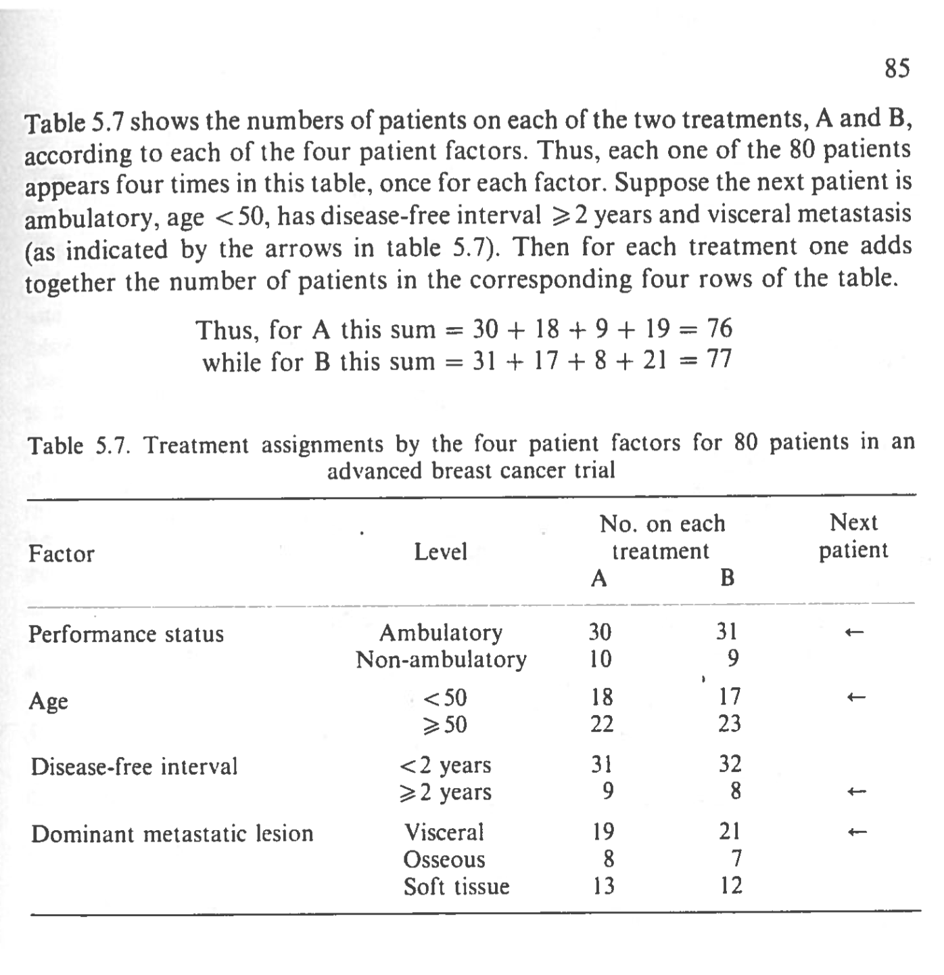
Minimization – a dynamic method of allocation to study arms that aims to achieve balance in baseline covariates without using randomization
Example from Pocock SJ. Clinical Trials – A Practical Approach, 1973, Wiley.

Slide 19
Compare Minimization with Randomization with respect to error rates
Study 100,000 simulated trials with H₀ true to determine spurious false positive (FP) rates.
  Overall, 8.5% (expected 5%)
  Randomization 4.7%; Minimization 3.8% → Difference = 0.8%
Study 100,000 simulated trials with H_{A} true and 90% power to determine spurious false negative (FN) rates.
  Overall, 0.79%
  Randomization 0.35%; Minimization 0.44% → Difference = -0.09%
Inefficiently Improving Efficiency
Normally, we use statistical techniques (eg, adjust for covariates) to improve efficiency:
We want to increase power (i.e., decrease type 2 error)
while maintaining the same level of type 1 error (e.g., nominal α=0.05)
However, minimization uses baseline covariates inefficiently:
Power does increase
But type-1 error rate decreases → The statistical test becomes too conservative.
Notes:
Does not address unmeasured covariates . Also, in the course of balancing covariates, it may — literally — cause outcome imbalance!
Depends on sample size -- > covariate-adjusted randomization
Large trials: Modeling provides better implicit matching for multiple covariates
Small trials: Minimization ensures relevant covariate combinations are represented

Slide 20
Randomization and Baseline Covariates
We’ve established that randomization ensures the validity of the trial, in spite of any random covariate imbalances.
Some Unspoken Assumptions
We’ve made two key assumptions so far:
Full exposure to interventions → All subjects fully adhere to their treatment and realize the full causal effect on their outcomes.
No Missing Data → Outcomes are available on all subjects.
Missingness
Causal comparisons:
The data are missing at random.
The data are not missing at random and missingness isn’t influenced by treatment.
Cannot claim causal association: If neither assumption holds, as we’d expect in most real-world trials, then causal bridge is cut. (e.g., Scientifically nonsignificant difference may test as statistically significant. → Cannot claim difference is causal.)
Notes:
Slide 63 -- 71

Slide 21
SCIENTIFIC INFERENCE
Two possible outcomes for Paul following intervention/not on Jan 1, 2018:
Paul receives heart transplant and dies 5 days later.
Paul does not receive heart transplant and lives at least 5 days more.
→ Did the transplant cause the death? Yes, for Paul.
Two possible outcomes for Sue following intervention/not on Jan 1, 2018:
Sue receives heart transplant and lives at least 5 days more.
Sue does not receive heart transplant and lives at least 5 days more.
→ Did the transplant have a causal effect? No, for Sue.
Causation
In our context, we say that “X causes Y” if Y would have been different if X had been different.

Slide 22
Beth is a 45 year old female with a BMI of 29 and FEV₁% of 82 at baseline.
If she’s assigned to arm A,
  her FEV₁% outcome at 6 weeks will be 79; her survival outcome will be “alive.”
If she’s assigned to arm B,
  her FEV₁% outcome at 6 weeks will be 93; her survival outcome will be “alive.”
If we could observe both arms in Beth, her treatment effect would be
  B-A absolute difference = (93-82) – (79-82) = 14
  B-A percent change from baseline = 14/82 x 100% = 17%
→ The intervention has a causal effect on Beth’s 6-week change in FEV₁% but not on her survival status.
If we were omniscient, we would see both outcomes of every member of the heterogeneous population and could identify the causal effect of treatment for every individual.
The difficulty is that we only get to see what actually happened. We can never know
  what would have happened if …
at least not for individual subjects.

Slide 23
Imagining Twins
Suppose our population is special: Every individual has a perfectly identical twin … baseline characteristics, observed and unobserved, exactly the same … even their hypothetical outcomes (“what would have happened if …”) match precisely.
We could assign Beth to A and her twin to B. The observed outcome difference between twins (93 − 79 = 14) is the causal effect (in either twin).
We could do the same for all trial participants. The average causal effect is the average difference in outcome between twins; this is equal to the mean outcome on arm B minus the mean outcome on A.
Real Purpose of Randomization
Since these don’t exist, we approximate a population of perfect twins by applying RANDOMIZATION to a twin-less population.
Randomization provides approximate balance in baseline characteristics:
  this is neither necessary nor sufficient for the validity of our inference.
  chance imbalances do not invalidate our conclusions; thus testing for balance is not needed or relevant.
This only works at the population level: RCTs study populations, not individuals. Thinking too much about individuals can lead one astray.
Notes:
Note that use of perfect twins controls for baseline covariates.
Since we sample a single population, covariates are the same in arms A and B.

Slide 24
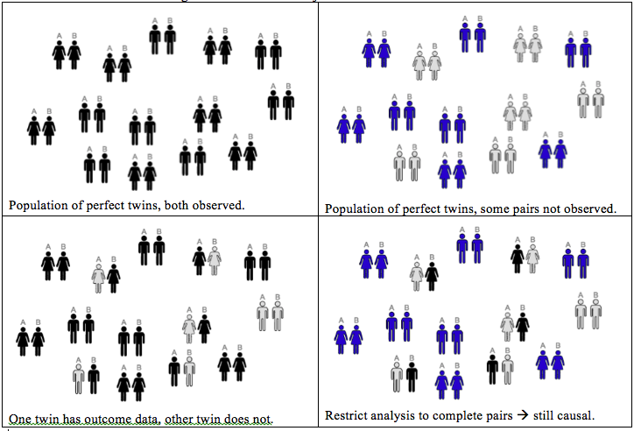
Imaginary Perfect Twins
Each individual has a “perfect twin:” All characteristics match except the intervention and the associated outcome.
Each pair generates a covariate-adjusted estimate of the treatment effect.
Mean over pairs yields trial estimate.
Notes:
Slide 65

Slide 25
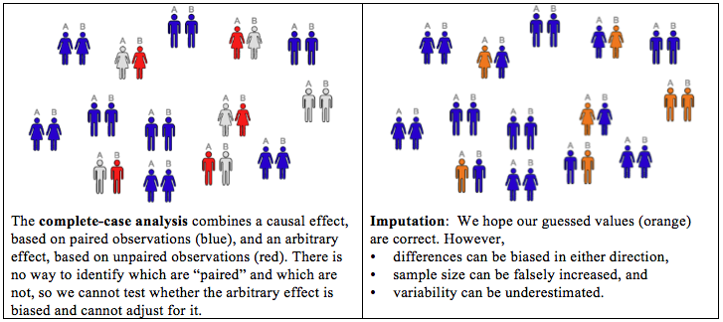
The Real World
We use randomization to approximate “perfect pairs.”
In complete data, group-wise results do this well, because difference between means equals mean of paired differences.
In contrast to ideal world, in real world we have no way to identify paired individuals. If one “twin” has missing outcome data, we cannot exclude the whole pair in order to avoid confounding of missingness with causation.
Notes:
Slide 65

Slide 26
The Effect of Missing Data
Unfortunately, virtually all trials have some degree of missing data.
The assumption is frequently made that observations are missing at random.
If this assumption is correct, the only consequence of missing data is that we have a smaller sample size and, therefore, lower power and precision. Otherwise, the analysis of the available data will give the same results as if there were no missing data.
Sometimes, it’s acknowledged that observations are not missing at random, but it’s assumed that the missingness is not influenced by treatment.
If this assumption is correct, it can change the results of the analysis, but at least the analysis still has a causal interpretation.
The problem is that, by their very nature, missing data are unobserved and it is impossible to know whether they are actually missing at random.
With non-random, treatment-dependent missingness a straightforward statistical analysis remains sound; however, its relationship to the scientific hypotheses may yield FP or FN conclusions.
We cannot conclude there is a causal association between intervention and outcome.
Notes:
Slide 65

Slide 27
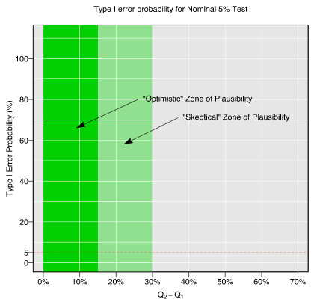
Effect of Missingness on Type 1 Error Rates
Assume for simplicity that the rates of missingness are the same in the two groups, and let’s consider two probabilities:
  Q_{A}=Pr(dead∣missing, group A)
  Q_{B}=Pr(dead∣missing, group B)
  If these two probabilities are equal, on average there is no net effect of missingness on the overall type 1 error rate.
Now consider the effect of a difference,
Q_{B}−Q_{A}, on type 1 error rate. Imagine there
are two “optimistic” (smaller differences) and
“skeptical” zones (larger differences).
The actual type 1 error rate increases as
Q_{B}−Q_{A}increases and the type 1 error rates
may be seriously inflated, even within the
“optimistic” zone.
If missingness rates exceed 15%, nearly all
reasonably sized trials can be seriously
compromised.
Notes:
Slide 72 -- 78

Slide 28
Handling Missing Data
Common approaches when data are missing:
Complete-case analysis → Not a valid causal analysis
Imputation → Hope-based: Assumptions may be incorrect
  LOCF: No causal basis
  Single imputation: Worse than complete case
  Multiple imputation
Principal Stratification → No causal basis
Joint modeling of outcome and missing indicator → No causal basis
Inverse probability methods → No causal basis
Sensitivity Analysis (“Stress Test”)
We choose a primary analysis that is based on the best assumptions (maybe complete case, maybe imputation)
We conduct a series of analyses that deviate from the best assumptions in a controlled way.
We consider our results robust, if the conclusions are unchanged over a sufficiently wide range of plausible assumptions
Notes:
Slides: Missing data, 79 – 91; Sensitivity, 92 – 103

Slide 29
Importance of Complete Follow-Up
Missingness subverts randomization. The resulting naïve complete-case comparison is no longer causal.
This affects all types of data (e.g., safety, efficacy, adverse events, laboratory measures).
The magnitude and direction of the error (the difference of the obtained effect from the real causal effect) cannot be known.
The Panel on Handling Missing Data in Clinical Trials …
  “… encourages increased use of [modern statistical analysis tools]. However, all of these methods ultimately rely on untestable assumptions concerning the factors leading to the missing values and how they relate to the study outcomes …
  … There is no ‘foolproof’ way to analyze data subject to substantial amounts of missing data.” → “Substantial” amounts of missing data might be 10 or 15%.
All this applies to the importance of complete follow-up after withdrawal from treatment (i.e., despite lack of adherence).
Notes:
Slide 104

Slide 30
Intervention Exposure: Incomplete Adherence
Unfortunately, non-adherence to assigned treatment occurs in virtually every clinical trial.
  Subjects are non-adherent if they are assigned a treatment but do not receive the intended dose.
Subjects may be non-adherent for lots of reasons:
They took one dose, didn’t like it or experienced a side effect, and stopped their study medication.
They took their assigned dose for part of the intended follow-up period, but their disease worsened and they stopped their study medication.
Study procedures became too onerous and they stopped their study medication.
→ Most of these reasons will probably result in adherence that depends on the assigned treatment.
Notes:
Slide 105

Slide 31
Intervention Exposure: Treatment-Dependent Adherence
Recall Beth. Her FEV₁% would be 79 is she received arm A (placebo), and 93 if arm B (active). Her FEV₁% causal effect is 93 – 79 = 14.
If Beth adheres to B but not to A: Since A is placebo, receipt doesn’t matter; we might still observe her causal effect of assignment of B versus A would be 93 − 79 = 14 → the same as the causal effect of receipt.
If Beth adheres to A but not to B: Beth might receive partial benefit from B … {79 if assigned treatment A; 93 83 if assigned treatment B} for a causal effect of assignment to B relative to assignment to A is 83 − 79 = 4.
  The causal effect of assignment to B versus A is, in general, different than the causal effect of receipt of B versus A, but it is still a real causal effect, and it is the object of an ITT analysis.
We would prefer to see the causal effect of receipt of B versus A but cannot.

Slide 32
Intervention Exposure:
Treatment-Dependent Adherence
Critics say non-adherence subverts the purpose of the trial. Their objection is certainly valid.
The goal of the trial is to “estimate the treatment effect” on the outcome in question.
Subjects who do not receive the treatment as intended do not benefit from it.
Therefore non-adherence prevents us from correctly “estimating the treatment effect.”
Full-Adherence Effect
What’s the real problem?
By “estimate the treatment effect” we assume they mean the “full-adherence treatment effect.”
If the goal is to estimate the “full-adherence treatment effect,” then, unless we have achieved full adherence, we’ve done the wrong experiment!
Solutions:
The “correct” experiment strictly enforces full adherence. → In humans this isn’t possible but a well run trial will come close to achieving this. Adherence information is critical to trial interpretation.
We want to recover the “full-adherence treatment effect” from a trial with incomplete adherence. However, we cannot correctly guess full-adherence values from partial-adherence values.
Conduct a Per-protocol analysis: Only analyze subjects who are fully adherent (or nearly so). This subgroup analysis …
  … induces missing data (see Slide 26). We cannot determine if differences between groups are causally related to treatment or are induced by missing data.
  … does not recover the full-adherence treatment effect.
Change the question!

Slide 33
Intervention Exposure: The Right Question
What’s the “right” answer to the non-adherence problem?
The answer is to change the question!
Unless we have full adherence, our causal conclusions can’t be conclusions about the effect of full adherence to (receipt of) treatment.
We can, however, reach valid conclusions about the effect of assignment to treatment.
After all, in randomized trials in humans, we can randomly assign people to treatments, but we can’t force them to receive treatments.
The best basis for assessing the causal effect of treatment, and that which will satisfy skeptics, is inference based on randomization.
We’ve done a randomized experiment.
If we have complete data, we can draw valid causal conclusions from our trial if we perform
  A simple direct comparison of responses
  for all randomized subjects (no missing data!)
  analyzed according to their assigned treatment groups
  regardless of their adherence to their assigned treatments.
Notes:
Slide 110

Slide 34
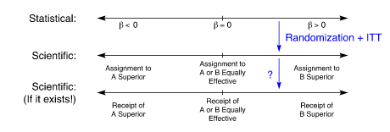
Intervention Exposure: Assignment versus Receipt
When we do not have full adherence, we actually have (at least) three sets of hypotheses:
statistical hypotheses
scientific hypotheses regarding the effect of assignment to treatment
  Randomization, complete data, and ITT analyses ensure alignment of hypotheses 1 & 2.
scientific hypotheses regarding the effect of receipt of treatment.
  Because we cannot observe full-adherence responses for some subjects, there is no objective way to ensure alignment of hypotheses 2 & 3; they can be “off” in either direction.
Notes:
Slide 112

Slide 35
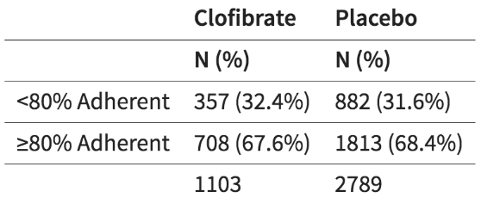
Intervention Exposure: Example 2 – Coronary Drug Project (CDP)
8341 patients enrolled between 1966 and 1969
Males, <3 months since MI
Exposures:
  5 active treatment groups (one was clofibrate) + placebo
  2:2:2:2:2:5 randomization (→ 1/3 randomized to placebo)
Primary Outcome: all-cause mortality
8.5 year total study length
Adherence rates were similar by arm, but we cannot assume (or check) non-adherence is independent of treatment.
Notes:
Slide 119

Slide 36
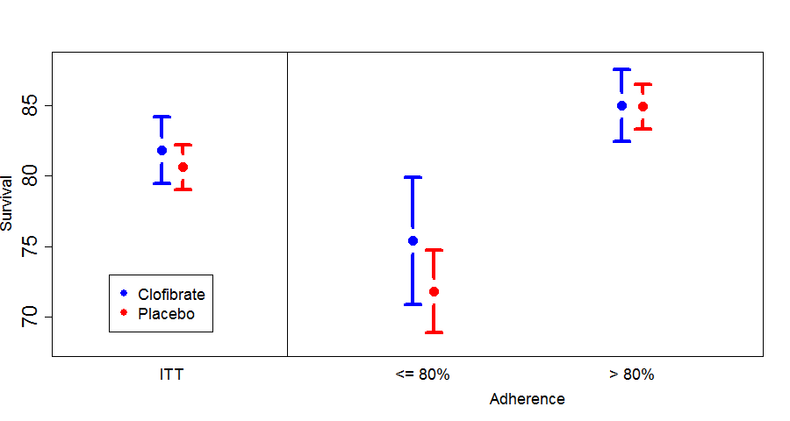
Intervention Exposure: Example 2
Regardless of arm, subjects who adhered to assigned treatment had better outcomes than those who failed to adhere.
Commonly, subjects who adhere are different than subjects who don’t.

Slide 37
Intervention Exposure: Intention to Treat
  “[According to the Intention to Treat principle,] all subjects meeting admission criteria and subsequently randomized should be counted in their originally assigned treatment groups without regard to deviations from assigned treatment.” L. Fisher et al (1990)
The real reason we use ITT is this:
  ITT is the only analytical approach that relies solely on randomization to infer the effectiveness of treatment.
We do not use ITT because the ITT estimate is more realistic or more clinically relevant or more useful to calculate.
  We use ITT because it is the only assumption-free, causal analysis we can do with the experiments we can perform. It is the only analysis that can convince our skeptic.
Notes:
Slide 114

Slide 38
Intervention Exposure: Deviations from ITT
Strict ITT Principle
A catchy phrase commonly used to refer to the ITT principal is “analyze as you randomize”. This means:
A subject is later found to be ineligible → analyze him/her anyway
A subject doesn’t receive treatment → analyze anyway
A subject receives wrong treatment → analyze in assigned (not received) group
Let’s discuss each of these cases and whether we can ever deviate from the rules …
Case #1: Ineligible
When consider removing from the analysis, adhere to the spirit of ITT by reviewing every subject for a particular set of eligibility criteria in a systematic way:
Pre-specify (a) which criteria and (b) the review process
Conduct review in a blinded way (which is often harder than it sounds)
Notes:
Slide 122

Slide 39
Intervention Exposure:
Case #2: Received no treatment
A modified ITT analysis excludes those who never started treatment.
The decision to remove a case should be made blinded to the treatment assignment.
Case #3: Randomization errors
(Refers to application of the list (e.g., transcription errors), not the list itself.)
Different treatment arm than correct assignment:
  Analyze as assigned, making note of the error for potential reporting & sensitivity analysis.
  If the wrong item from the list was taken, retain that as originally specified.
A batch of wrong treatments. Regardless of arm ...
  Keep all, or
  Remove all who could have been in the bad batch, if blinding (esp of results) is secure.
Stratified design, with wrong stratum recorded, led to “wrong” treatment
  Randomization is still valid.
  Analysis should use corrected stratum and assigned arm
Notes:
Note: There are no compelling reasons to stratify randomization: negligible power gain, and nothing that could affect the causal bridge.

Slide 40
Summary
The purpose of randomization is:
* to establish a causal relationship between YES
an intervention and outcome
* to “estimate the treatment effect” NO
* to balance the baseline covariates NO
Randomization is the only available method we have to determine whether a treatment has a causal effect on an outcome.

Slide 41
Threats to Randomized Controlled Trials
Intervention exposure: Non-adherence and lack of ITT. Randomization and intention-to-treat are tied together, and both are required for a valid causal inference.
  The only question that can be answered in a valid way, when participants are free to adhere or not, is the question of treatment assignment.
  Adherence information is critical to trial interpretation, but not to whether causal inference is possible.
Outcomes: Missing data. Can arise from incomplete follow-up, or be induced by excluding participants who are not adherent (“per protocol”).
  Exclusions compromise the causal interpretation of the analysis of a trial. Analytic methods for dealing with missing data (including complete-case analysis) do not adequately restore the pure causal relationship.
  If the study design calls for outcome assessments beyond the intervention phase, these must continue even if exposure ends early.

Slide 42
To address the study goal:
Design the trial using randomized assignments.
Execute the trial with high fidelity to the study protocol, ensuring high levels of adherence and complete outcome ascertainment.
  Example 3: VOICE Trial … http://www.nejm.org/doi/full/10.1056/NEJMoa1402269
  Example 4: Aspire Trial … http://www.nejm.org/doi/full/10.1056/NEJMoa1506110
Analyze the trial applying the intention-to-treat principle, using straightforward methods of comparing study arms.

