Slide 1
Medical Informatics for Clinical Research
Ida Sim, MD, PhD
January 9, 2018
Division of General Internal Medicine
Copyright Ida Sim, 2018. All federal and state rights reserved for all original material presented in this course through any medium, including lecture or print.
Notes:
PMI, PPRN, National Cancer Data Ecosystem – patient-donated data to research
Time for a patient-driven health information economy – Mandl and Kohane, hyperportalosis
Open Notes movement
HUGO to synch with
Ethan Basch, on PROs
Rearchitecting clinical researc hwith people-powered data partnership
www.atsdr.cdc.gov

Slide 2
Outline
Introduction
Course Goals
Overviews
  informatics vs. IT
  data-information-knowledge
  uneven future of EBM
Summary

Slide 3


Introduction: Ida Sim, MD, PhD
Position
  Professor, General Internal Medicine
  Co-Director of Biomedical Informatics, Clinical and Translational Science Institute (CTSI)
  Co-Founder, OpenmHealth.org and Vivli.org
Research areas
  mobile health
  clinical trial data sharing
  health IT for chronic care
  health information technology policy

Slide 4
Class Introductions
Name, Academic Level, Specialty
Main informatics-related interest

Slide 5
What Kinds of Questions Does Clinical Research/Epidemiology Answer? “Big 6”
Description
  How frequent/common are risk factors/exposures/conditions/diseases? How often does Y occur?
Causation (“Causal inference”)
  The science of establishing causal relationships among biological, behavioral, environmental (etc.) factors within humans. Does X cause (or prevent) Y?
  Will intervening upon X change occurrence of Y?
Attribution
  What fraction or how many cases of disease Y can be eliminated if a causal exposure X is eliminated or reduced?
Mediation
  Understanding the mechanisms of causation
  How does X cause Y?
Interaction
  When and for whom does X cause/predict Y?
Prediction
  Do A, B, and C predict concurrent presence/future occurrence of Y? e.g., diagnosis or prognosis
Notes:
Start with Big 6 questions.

Slide 6
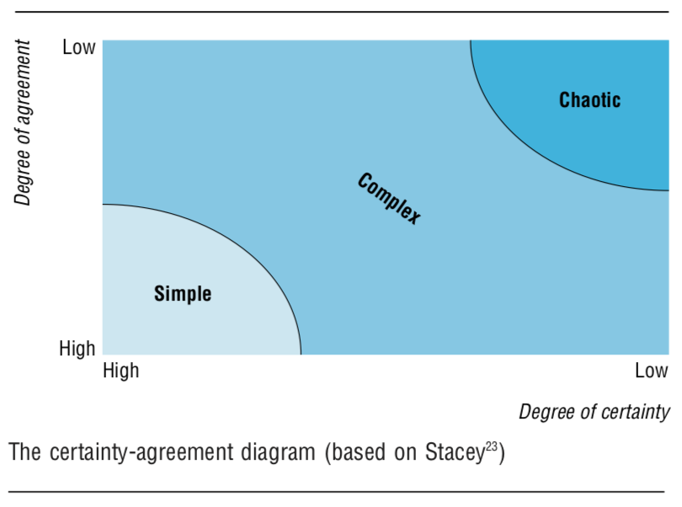
Complexity
Problems of simplicity
  1 or 2 variables, linear relationships, eg., orbiting planet, apple falling off a tree
  Use classical mechanics, linear equations
Problems of disordered complexity
  Random motion of molecules
  Use statistics, probabilities
Problems of organized complexity
  Sizeable number of variables interconnected in a complex but organized organic whole system, e.g., growth of the apple tree, opioid crisis
  What to use?
Stacey RD. Strategic management and organizational dynamics. London: Pit- mann Publishing, 1996.
Notes:
Dougnut econ, page 117

Slide 7
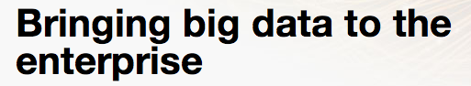
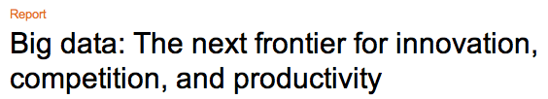

Slide 8
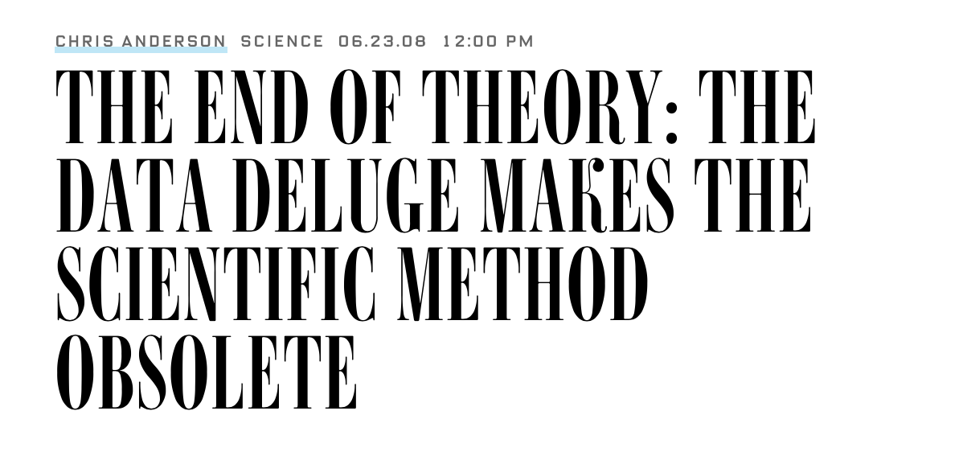
Notes:
https://www.wired.com/2008/06/pb-theory/
https://www.ncbi.nlm.nih.gov/pmc/articles/PMC4766450/

Slide 9
Health Care Quality
Doing the right thing
  based on scientific evidence
right
  without error
to the right people
  e.g., blood pressure meds by ethnicity
at the right time
  beta-blockers at hospital discharge for heart attacks
at the lowest cost
Clinician/System View
Notes:
thiazides and long-acting calcium channel blockers for blacks, Expert Rev Cardiovasc Ther. ﾊ2008;10(6):1357-1366.

Slide 10
Health Care Quality – Patient View
Stay healthy for as long as possible
Take as few medicines as possible
  they all work, with fewest side effects
  at lowest cost, for as short a time as possible
Know what makes me worse and what makes me better, so I can do the right thing for my health
Have all my questions answered
Not miss out on anything new and relevant
Feel supported in my overall health status

Slide 11
Patient-Centered Drivers of Change
Stay healthy for as long as possible Wellness
Take as few medicines as possible Individual Therapeutic Precision and Cost-effectiveness, Symptom Management
  they all work, with fewest side effects
  at lowest cost, for as short a time as possible
Know what makes me worse and what makes me better, and can do the right thing Personalized Trigger Discovery, Behavior Change Support
Have all my questions answered Readable References
Not miss out on anything new and relevant Customized Updates
Feel supported in my overall health status Social Health

Slide 12
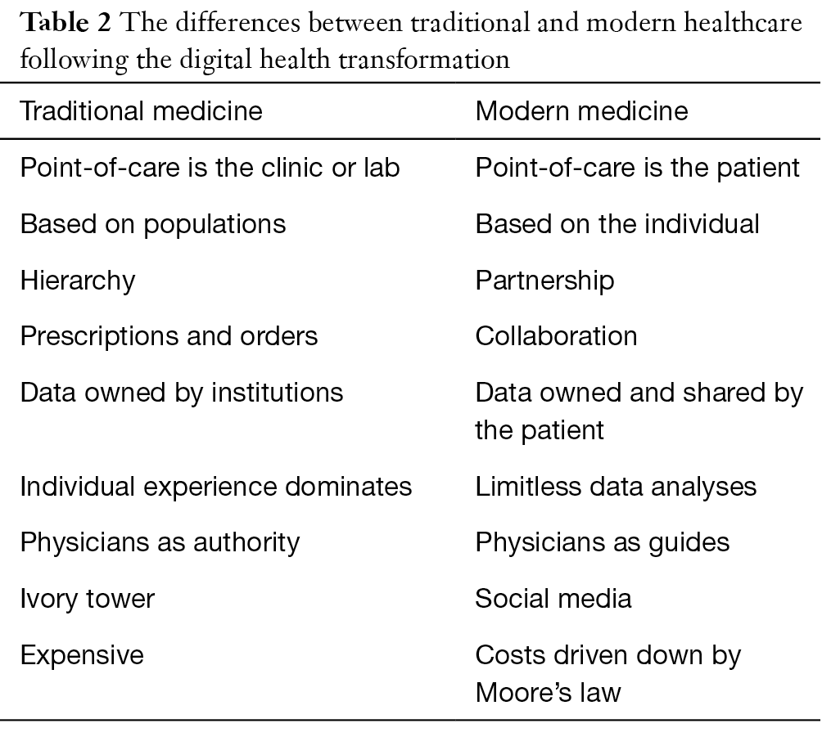
http://mhealth.amegroups.com/article/view/16494/16602
Notes:
http://mhealth.amegroups.com/article/view/16494/16602

Slide 13
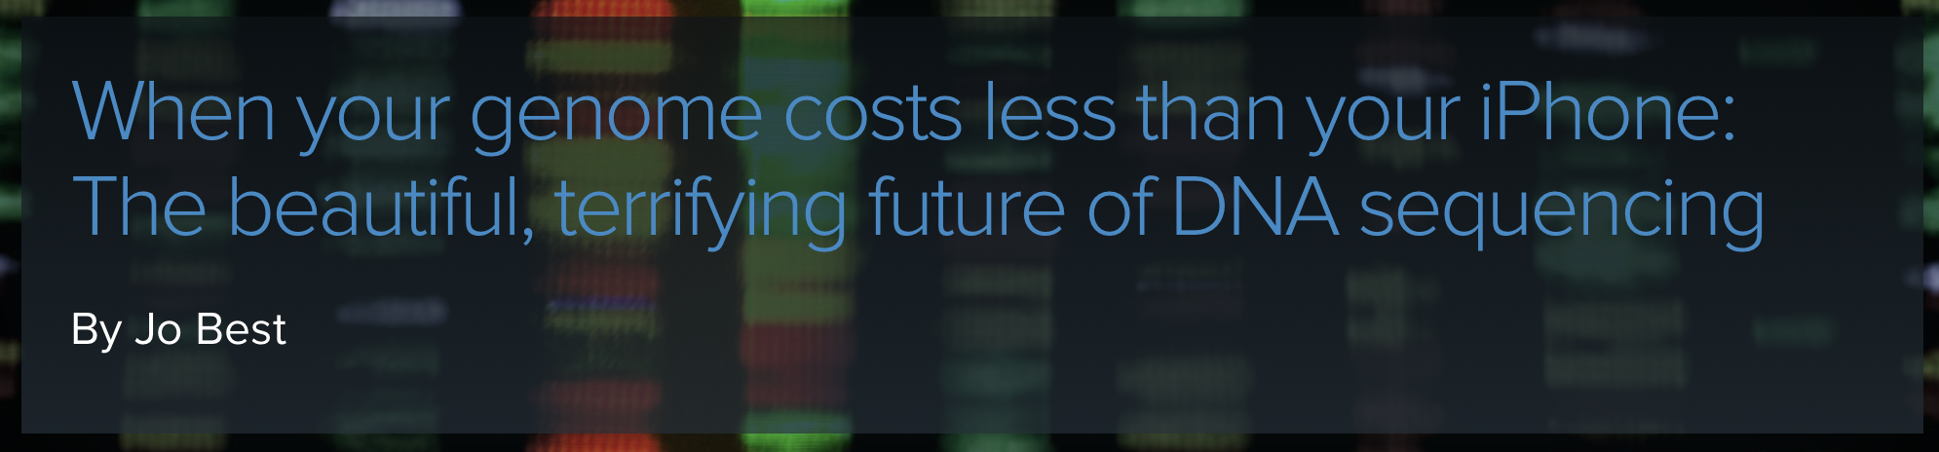
Biomedical Drivers of Change
Genotype, becoming a commodity
  whole genome sequence in 1 hour (!) and for only $100 in the next few years
Phenotype: big bottleneck to acquire from EHR and people (symptoms, side effects, behaviors)
  RNA-Seq, metabolomics, proteomics profiles coming
Exposome: e.g., physical and social environment
https://www.techrepublic.com/article/when-your-genome-costs-less-than-your-iphone-the-beautiful-terrifying-future-of-dna-sequencing/

Slide 14
Grand Convergence of Drivers of Change
alignment of incentives for quality and cost (e.g., Accountable Care Organizations (ACOs))
maturation of the Internet as connective technology
social computing usage past critical mass
ubiquity of microchips in computers, appliances, and sensors
explosion of data from everywhere and everything (Big Data)
natural language artificial intelligence

Slide 15
The Uneven Future
Tech, biomedical, and macro factors driving a radically different health(care) future
Personalization of consumer experience will be expected in health too
Goal is a “learning system” for precision medicine powered by Big Data and AI
  complexity will be the hallmark
Puts premium on intelligent analysis and application of disparate data
“The future is already here – it's just not evenly distributed.”
William Gibson
Notes:
…is already here -- it's just not evenly distributed. By this quote, William Gibson the science fiction writer meant that technological futures don't arrive at the same time everywhere for everyone. It shows up surreptitiously it seems, until all of a sudden it's everywhere.

Slide 16
Informatics and The Uneven Future
Tech, biomedical, and macro factors driving a radically different health(care) future
Personalization of consumer experience will be expected in health too
Goal is a “learning system” for precision medicine powered by Big Data and AI
  complexity will be the hallmark
Informatics is computing technology for intelligent analysis and application of disparate data
“The future is already here – it's just not evenly distributed.”
William Gibson
Notes:
…is already here -- it's just not evenly distributed. By this quote, William Gibson the science fiction writer meant that technological futures don't arrive at the same time everywhere for everyone. It shows up surreptitiously it seems, until all of a sudden it's everywhere.

Slide 17
Outline
Introduction
Course Goals
Overviews
  informatics vs. IT
  data-information-knowledge
  uneven future of EBM
Summary

Slide 18
Course Goals
Appreciate and understand technology-enhanced approaches to Big 6 questions
Be familiar with core concepts in medical informatics: vocabularies, interoperability, decision support systems
Understand the current state of health information technology (EHRs, mobile, big data, AI)
Understand the core informatics issues for patient care and clinical research (aka learning health system)
Learn about and use UCSF informatics and data resources
Be ½ step ahead in anticipating/exploiting the evolving role of computing technologies in care and research
  help invent the uneven future
Notes:
What this course does NOT do….

Slide 19
Course Structure
6 Lecture/Discussion Sessions
  interactive class
  PowerPoint file up day of lecture (do not look ahead! Let’s think questions through together)
Optional EHR Data lab depending on class interest
Assignments
  2 short assignments (assigned Jan 16, and Jan 23 or 30)
  final 2-3 page report on how you might modify your current research project to take advantage of informatics technology
Office “hours”: ida.sim@ucsf.edu
  https://courses.ucsf.edu/course/view.php?id=3368

Slide 20
Outline
Introduction
Course Goals
Overviews
  informatics vs. IT
  data-information-knowledge
Summary

Slide 21
What are Computers For?
Store
Query and Retrieve
Compute
Report
...1’s and 0’s

Slide 22
Informatics is not IT
Information technology (IT) primarily concerned with physical technology for computing, i.e., storing, accessing, and exchanging bits and bytes
  server machines, server availability, storage capacity
  building and maintaining databases
  security and privacy
  network connectivity and infrastructure (e.g., network speeds)
Informatics is primarily concerned with the computation itself

Slide 23
Informatics is…
The use of computers to make sense of data
  analyzing biomedical problems to determine what data is needed
  how that data should be obtained, organized, analyzed, and presented
  using data to help researchers, clinicians, patients, and students solve problems, make decisions

Slide 24
Outline
Introduction
Course Goals
Overviews
  informatics vs. IT
  data-information-knowledge
  uneven future of EBM
Summary

Slide 25
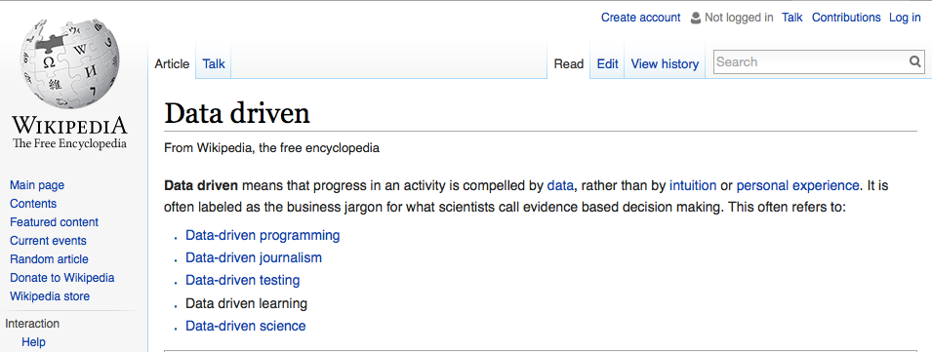
Notes:
Underlying all this excitement is the belief that with Big Data, we can have data-driven health care and we can finally cure cancer, or something. According to Wikipedia, to be data-driven is to be "compelled by data rather than by intuition or personal experience." Sounds good. "Often labeled as the business jargon for what scientists call evidence-based decision making."
Hmm. How many of you think data-driven health care is the same as evidence-based health care. How many think not? Which would you want for yourself?

Slide 26
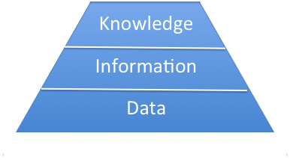
Data – Information - Knowledge
Data
  raw observations, objective facts
Information
  data in meaningful context
Knowledge
  understanding about the world
    explicit, codifiable (e.g. Wikipedia, guideline)
    tacit, not codifiable (e.g. expertise)
  also process knowledge, i.e., riding a bike
  useful for explaining, predicting, and guiding future action
Notes:
To tease apart data and evidence, we first need to understand the important distinctions between data, information, and knowledge.
Data are raw observations, objective facts.
Information is data that is in some meaningful context,
Knowledge is an understanding about the world. It can be explicit, codifiable knowledge like guidelines, or in Wikipedia. Or it might be tacit knowledge that's hard to codify, like the expertise of a seasoned clinician.
There's also process knowledge, about how to do things like ride a bike.
Knowledge is useful for explaining the world, predicting what's going to happen, and guiding future action.

Slide 27
D-I-K Example
Data
  HgbA1C value 10.1%
Information
  occurred last Thursday
  10.1% is above normal
Knowledge
  high HgbA1C occurs in diabetes
  associated with higher risk for cardiovascular outcomes
Evidence?
Notes:
Here's an example: A hemoglobin A1 of 10.1%, for example, is data. It is a raw observation.
It becomes information when we give that data some context, for example when the observation was made, and what the normal range is. The more context we have, the more informative a piece of data becomes.
The knowledge about A1c is that it is high in people with diabetes and is associated with higher risk for cardiovascular outcomes. This knowledge helps us predict what's going to happen, and to guide future action.
So where does evidence fit in?

Slide 28
Evidence : basis for a claim of knowledge
Notes:
Evidence is the basis for a claim of knowledge, evidence supports a statement about the world.

Slide 29
Evidence : data + "study" design + analysis
big, non-traditional data
new machine learning methods
Notes:
And evidence arises from a combination of data, how that data is collected (study design, but doesn't have to be study), and how it is analyzed.
The promise of Big Data and the data sciences is it will introduce big nontraditional data into health studies, and offer new machine learning methods for analysis.
This new future of "data-driven" evidence is…

Slide 30
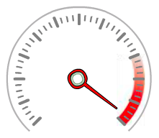
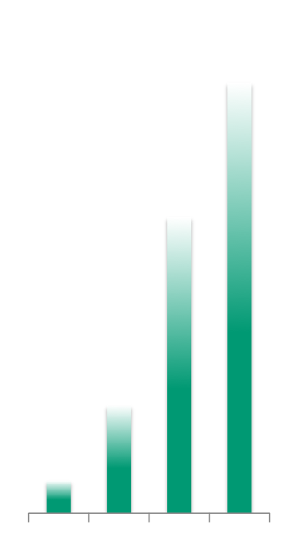
Big Data
1 1 0 10 1
100101
Volume
Velocity
Variety
Notes:
A commonly used term about these changes is "Big Data", which is classically described as being big in the 3 V's: volume, velocity, variety.

Slide 31
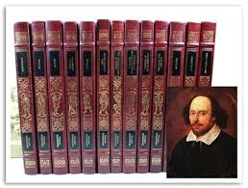
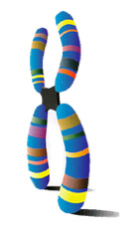
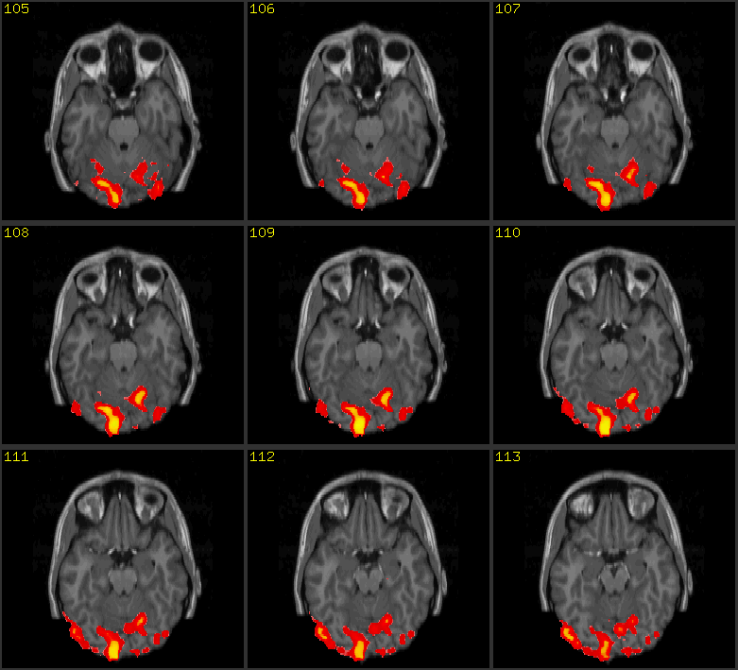
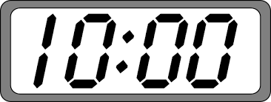
Volume
= 5 GB
1.5 GB
3-5 GB
15 GB
Notes:
Health data is definitely big in volume. Let's use as a metric the complete works of Shakespeare, which is 5 GB.
your genome is about a third of that, about 1.5 gig
if you're middle aged and moderately ill, your EHR will be about 3-5 gigs
but then the volume explodes. There are those chest bands that track your EKG and respiration, can be used for fitness tracking, and wrist sensors like Apple Watch or Microsoft Band. If you wear these sensors, you will generate the data equivalent of 3x all of Shakespeare's collected works in just 10 hours.

Slide 32
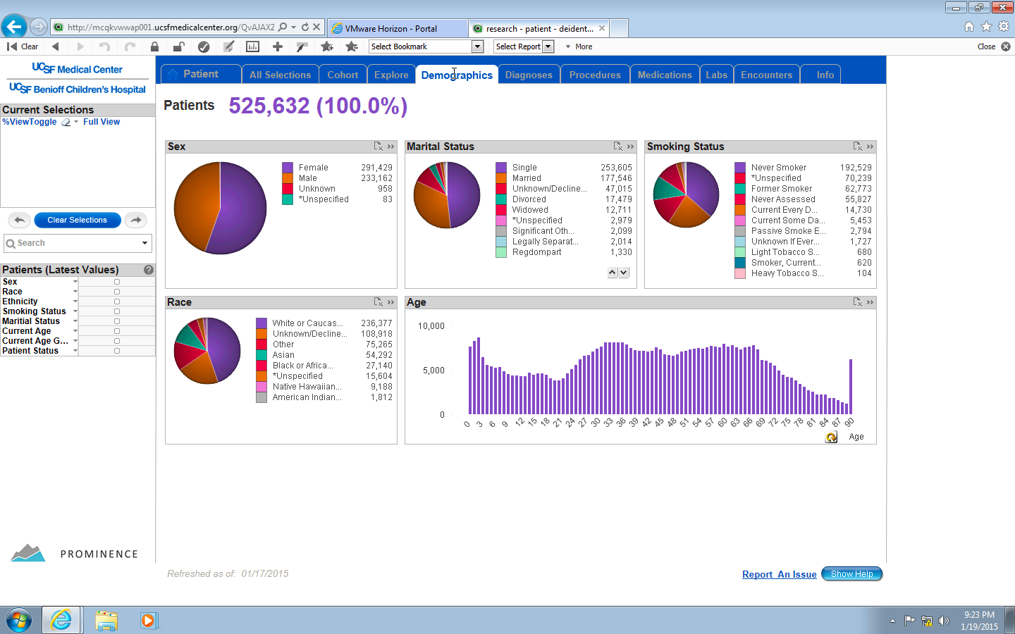
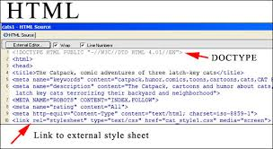



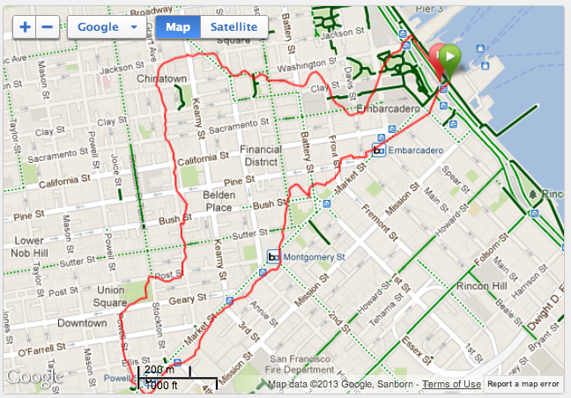

Variety of Data
EHR data
clinical trial data
Internet of Things
public health data
claims data
survey data
Traditional
Non-traditional
Notes:
One way to think about this huge variety of data is as "traditional" health care data that we're more familiar with in EBM, and genomic and imaging that some subgroups of EBMers are. And "non-traditional" data webpages, map data, social media, all that data from the Internet of Things.

Slide 33
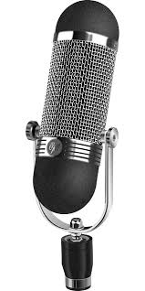
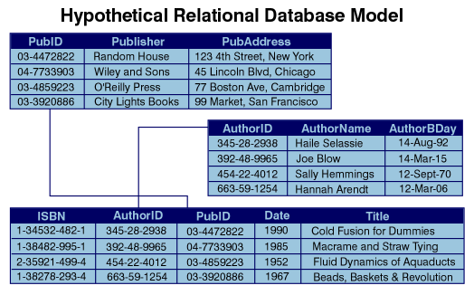


Variety of Data
EHR document
Structured
Semi-structured
Unstructured
Notes:
A more computational way to think about the data is structured – like a relational database, or map data – or semi-structured, like web pages, Facebook posts or notes from an EHR, or unstructured, like voice or video. Different processing is needed for these different kinds of data, and impacts on what can be done with it.

Slide 34
Evidence : data + "study" design + analysis
big, non-traditional data
new machine learning methods
Notes:
And evidence arises from a combination of data, how that data is collected (study design, but doesn't have to be study), and how it is analyzed.
The promise of Big Data and the data sciences is it will introduce big nontraditional data into health studies, and offer new machine learning methods for analysis.
This new future of "data-driven" evidence is…

Slide 35
Outline
Introduction
Course Goals
Overviews
  informatics vs. IT
  data-information-knowledge
  uneven future of EBM
Summary

Slide 36
Taxonomy of Study Designs
Notes:
How should we understand this uneven future? It's probably good to start somewhere familiar, like this tree of study designs from the Center for Evidence-based Medicine.
To review, descriptive studies give a picture of what is happening. Analytic studies are studies that quantify a relationship and are either experimental or observational.
Let's look first at the future of descriptive studies, using the question of

Slide 37
Taxonomy of Study Designs & Big 6
Description
  How frequent/common are risk factors/exposures/conditions/diseases? How often does Y occur?
Causation (“Causal inference”)
  The science of establishing causal relationships among biological, behavioral, environmental (etc.) factors within humans. Does X cause (or prevent) Y?
  Will intervening upon X change occurrence of Y?
Attribution
  What fraction or how many cases of disease Y can be eliminated if a causal exposure X is eliminated or reduced?
Mediation
  Understanding the mechanisms of causation
  How does X cause Y?
Interaction
  When and for whom does X cause/predict Y?
Prediction
  Do A, B, and C predict concurrent presence/future occurrence of Y? e.g., diagnosis or prognosis
Description
Causation
Attribution
Mediation
Interaction
Prediction
Notes:
Let's look first at the future of descriptive studies, using the question of

Slide 38
Taxonomy of Study Designs & Big 6
Description
  How frequent/common are risk factors/exposures/conditions/diseases? How often does Y occur?
Causation (“Causal inference”)
  The science of establishing causal relationships among biological, behavioral, environmental (etc.) factors within humans. Does X cause (or prevent) Y?
  Will intervening upon X change occurrence of Y?
Attribution
  What fraction or how many cases of disease Y can be eliminated if a causal exposure X is eliminated or reduced?
Mediation
  Understanding the mechanisms of causation
  How does X cause Y?
Interaction
  When and for whom does X cause/predict Y?
Prediction
  Do A, B, and C predict concurrent presence/future occurrence of Y? e.g., diagnosis or prognosis
Description
Causation
Prediction
Mediation
Interaction
Interaction
Attribution
Attribution
Mediation
Prediction
Notes:
Let's look first at the future of descriptive studies, using the question of

Slide 39
New Ways to Answer the Big 6:
Uneven Future of EBM
Start here…
Notes:
See how technology is being used to answer the Big 6 questions in new ways. Introduce these approaches to you, then in upcoming classes, we look in more detail at the key informatics issues behind them.

Slide 40
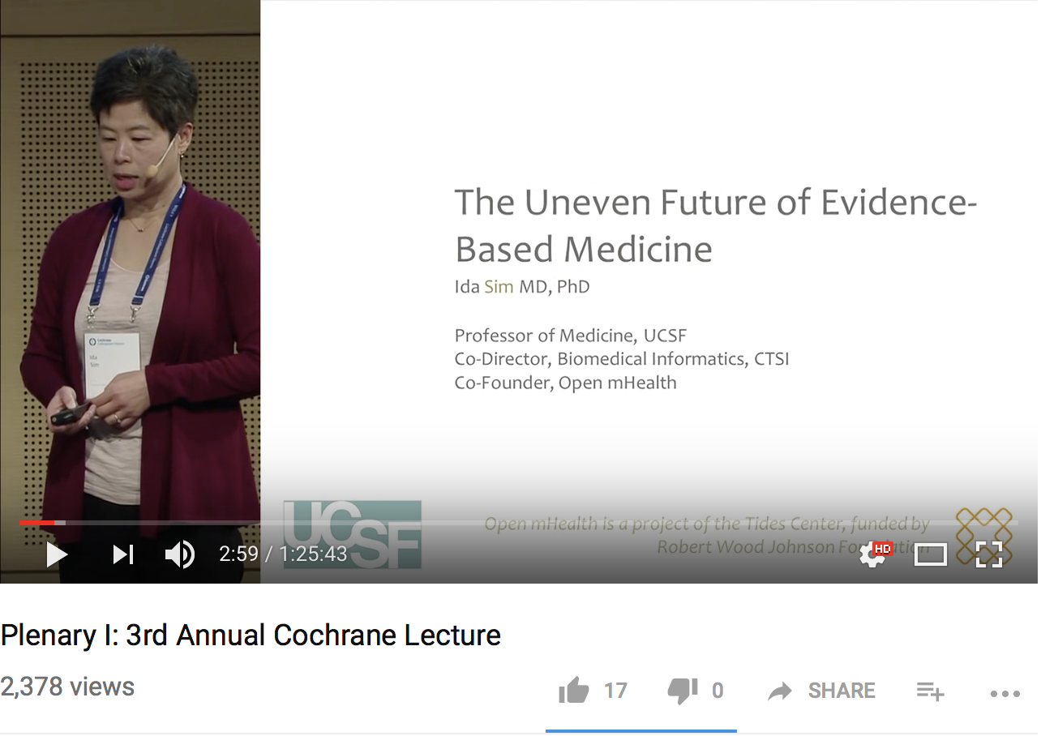

Slide 41
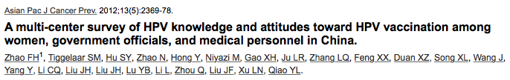
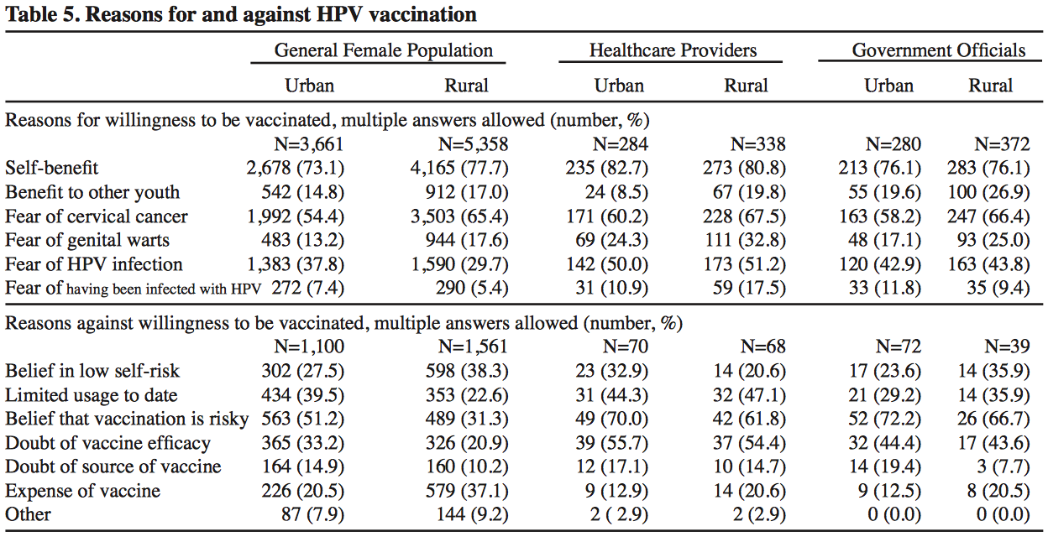
Opinions About HPV Vaccination:
Traditional Survey
Notes:
…opinions about human papilloma virus or HPV vaccination.
A traditional approach, like the one used by Zhao et al in 2012, is to conduct a survey of mostly multiple choice questions. And we get informative reasons for why girls, healthcare providers, and government officials in China are for or against HPV vaccination.

Slide 42
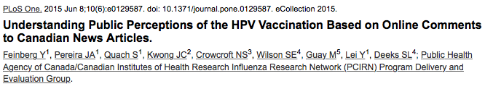
Opinions About HPV Vaccination:
Using "Non-traditional" Data
Non-traditional, unstructured data
  keyword search of all Canadian newspapers –> 71 articles
  3073 comments from 1198 individuals
Manual qualitative analysis
  thematic analysis
  sentiment analysis (positive, negative, neutral)
Notes:
Here's another approach to the same question, this time in Canada. Feinberg et al performed a keyword search on all Canadian newspapers and
identified 71 relevant articles. From this, they collated some 3000 comments from 1200 individuals. They then performed manual qualitative analysis of the comments, including thematic analysis and sentiment analysis, i.e., whether the comment was generally positive, negative, or neutral to HPV vaccination.

Slide 43
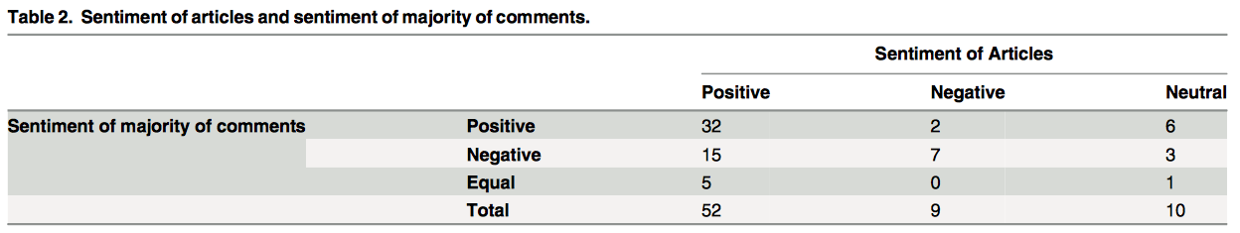
Opinions About HPV Vaccination:
Using "Non-traditional" Data
Notes:
This use of online comments gets around people answering surveys the way the think they should, but of course, these studies have their own set of weaknesses and biases. One weakness is the rather narrow source of data. Why not mine the whole web?

Slide 44

Opinions About HPV Vaccination:
"Non-traditional" Data and Machine Analytics
Non-traditional data
  scanned 130 million English language blogs and media items
  identified 9,656 HPV-related posts over 7 months in 2008-9
Machine learning
  manually labeled set: 157 blog posts as positive or negative sentiment
  training set: 1000 posts
  supervised learning: support vector machine (SVM) method
  overall accuracy of 70%
SVM classifier run on remaining 8500+ posts
Notes:
Corley et al did just that. They scanned 130 million English language blogs and mainstream media posts and identified almost 10,000 HPV related posts. With this number of posts, no way could they perform manual sentiment analysis like the previous study. Instead, they trained a machine to do it. First they found 157 posts with that were strongly positive or negative, and manually classified and labeled them. Then they used this labeled test set along with a training set of 1000 posts to perform supervised learning, basically teaching an algorithm called a support vector machine to tell positive from negative. They achieved an overall accuracy of 70%. The SVM was then let loose on the remaining 8500 or so posts.

Slide 45
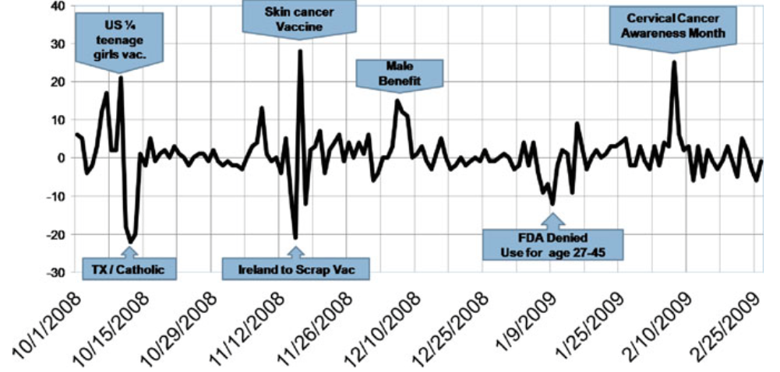
Opinions About HPV Vaccination:
"Non-traditional" Data and Machine Analytics
Notes:
And this is what they found. Sentiment for HPV vaccination was more negative when the Gov of Texas mandated vaccination for all teenage girls, and was more positive during Cervical Cancer Awareness month. Compared to Zhao's study, which was cross-sectional, this one shows the evolution of opinions over time. Compared to the Fineberg study, this one had a far larger sample size.

Slide 46
Descriptive Study Designs: Add Data Mining
Notes:
The availability of huge amounts of both traditional and non-traditional data, combined with new data mining approaches will I think bring about a major expansion in the scope, detail and power of descriptive studies.
Let's turn now to Analytic studies, which aim to quantify a relationship. Rather than splitting analytic studies into experimental and observational study types, I'd like to borrow from the computational field and split first by analytic intent.

Slide 47
Analytic Studies by Analytic Intent
Classification e.g., diagnosis
Prediction: e.g., prognostic rules
Causal inference: e.g., does X cause Y
Explanation, modeling, simulation – biomedical, implementation
Notes:
The intents are Classification, prediction, causal inference, and modeling and simulation.
classification is starting out with a set of categories and identifying which category an observation belongs to. Diagnosis is an example of classification: given a set of diseases, which one does the patient have.
an example of prediction is a prognostic rule.
If you risk stratify someone, you're classifying them into a category with prognostic significance, so for simplicity, I'm going to lump classification and prediction together.
Causal inference we're familiar with: it's asking questions like Does X cause Y? The experimental and observational study designs we know and love address questions of causal inference.
And then there's a broad class of analysis that's about modeling and simulating the world, in order to understand and explain it, whether biological mechanisms, or implementation science. I'm not going to talk more today about modeling/simulation.
All these analyses aim to support a claim of knowledge: a way to diagnose, to predict, to explain something about the world. So they all generate evidence,

Slide 48
Examples of Analytic Studies
Analytic Intent | Data Source | "Study" Design | Analytic Method
Classification/Prediction | Structured
Causal Inference | Semi-structured
 | Unstructured
Notes:
As we defined before: evidence arises from data, how the data are collected or the study design, and how the data are analyzed.
For the next part of this talk, I'm going to give a few examples of classification/prediction and causal inference studies that fill in this table in different ways.

Slide 49

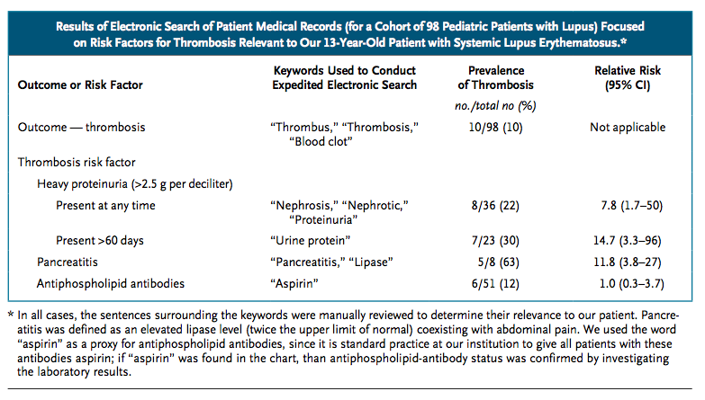
Notes:
In 2011, a 13-year-old girl with a disease called lupus presented to Stanford Hospital quite ill with 3 risk factors for blood clotting: a large amount of protein in her urine, inflammation of the pancreas, and antiphospholipid antibodies. The question was whether they should anticoagulate her to prevent clots, at the risk of causing a bleed. First they looked through PubMed, but didn't find much at all. Next they asked expert colleagues around the country, but they got no consensus. Time was running out. They needed to decide: anti-coagulate and risk bleeding, or don't anticoagulate and risk a clot.
Dr. Frankovich, the treating physician, turned to Stanford's STRIDE database, which holds 20 years of EHR data. Previously they had used natural language processing or NLP to pull out all the data for 98 pedi lupus patients that had been seen at Stanford. Dr. Frankovich fired up this lupus dataset, used her training in epidemiology, and 4 hours later, she had evidence: lupus children with proteniuria had a 14.7 RR of thrombosis. Those with pancreatitis had a RR of 11.8. They anticoagulated the girl.

Slide 50
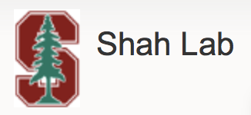
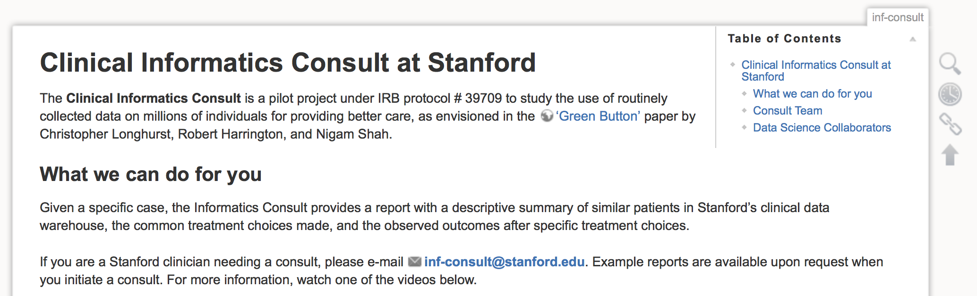
Analytic Intent | Data Source | "Study" Design | Analytic Method
Classification/Prediction | Structured | "Grab and go" | Classical or Bayesian Statistics
Causal Inference | Semi-structured
 | Unstructured
data challenges
  quality of EHR data
  quality of data processing (e.g., NLP)
analysis challenges
  need epi/biostat expertise
  combining with up-to-date evidence
Notes:
This was a case then of trying to predict an outcome, thrombosis, using structured data (lab values) and semi-structured data like Problem Lists and radiology reports, and unstructured clinical notes. The study design was all the data in the EHR, let's call it "grab and go." The analytic method was classical statistics.
Aside from the data challenges, there are analysis challenges. Not every clinician is going to be a trained epidemiologist like Dr. Frankovich. Stanford thought about making a "patients like mine" button to generalize this approach to all their patients. Another analytic challenge is combining results of studies like this with published evidence.
We'll come back to these analytic challenges later, but this is a good example of EBM in the EMR era.

Slide 51
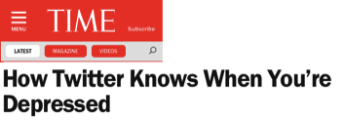

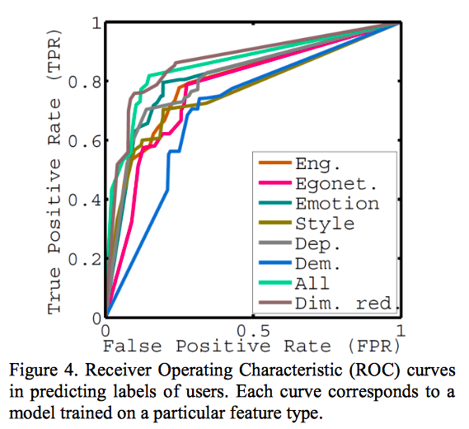
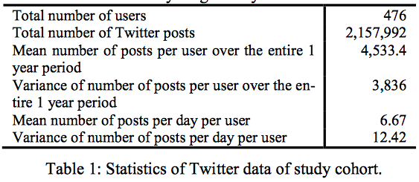
Predicting Depression via Social Media. De Choudhury, M et al. Proceedings of the Seventh International AAAI Conference on Weblogs and Social Media, p 128-137.
Accuracy 70%
PPV 74%
Notes:
Outside of medicine, we seem to be in the Twitter era. Did you know Twitter can tell when you're depressed?
Yes, apparentlhy. de Choudhury et al used Amazon's Mechanical Turk to recruit 476 people recently diagnosed with depression who were willing to give access to their 2.1 million tweets. The researchers did supervised learning on these tweets. The gold standard for depression was the results of CES-D and Beck Depression Inventory surveys on the 476. The best performing classification algorithm was a Support Vector Machine that achieved an accuracy of 70% and a PPV of 74%.
~~~~~~~~~~~
(prevalence about 1/3 of 1500 recruited via Mechanical Turk).
paid them 90 cents each to take CES-D and BDI standardized depression surveys, and history, and share public Twitter feed.1,583 crowdworkers completed our HITs be- tween September 15 and October 31, 2012. 634 agreed to share Twitter, enrolled 554, 476 had MDD diagnosed between 3 and 12 months before.
Feature extraction, network graph metrics, NLP PANAS machine learning, linguistic style. 243 males and 233 females, with a median age of 25, with the two most frequent education levels being “Some college, no degree” and “Bachelor’s degree,” and the most reported income range of “$25,000-$50,000”.

Slide 52
Predicting Depression via Social Media. De Choudhury, M et al. Proceedings of the Seventh International AAAI Conference on Weblogs and Social Media, p 128-137.
Analytic Intent | Data Source | "Study" Design | Analytic Method
Classification/Prediction | Structured | "Grab and go" | Classical or Bayesian Statistics
Causal Inference | Semi-structured |  | NLP, SVM, automated sentiment and affect analysis…
 | Unstructured
Notes:
Aside from the novelty, this study also brings up some interesting issues about who is doing clinical research. This paper was published in the conference proceedings of the American Association for Artificial Intelligence. The authors are engineers and computer scientists from Microsoft Research. Despite that, they did quite a nice job of combining both clinical and machine learning expertise in this paper, in large part because one of the authors is an MD.

Slide 53
Classification/Prediction Study Designs
Notes:
Machine learning methods are very powerful for classification/prediction and I predict we'll be seeing more of these predictive analytic studies where partnerships between data scientists and clinicians and clinical researchers will be very powerful.

Slide 54

Machine Learning for Causality
Notes:
Let’s move on to using machine learning directly for causal inference. Here's an example.

Slide 55

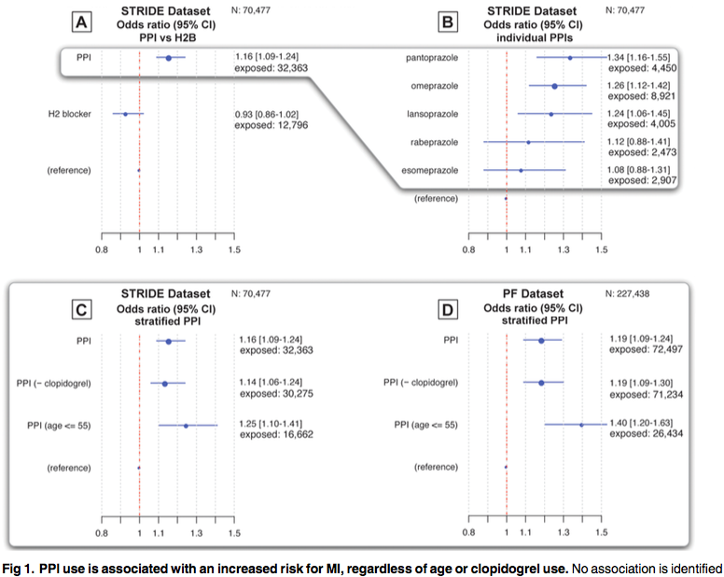
Notes:
At Stanford, the same hospital for the lupus case we discussed earlier, Shah and colleagues looked at 20 years of Stanford's EHR data looking for previously unknown adverse effects of drugs.
They found that PPI use is associated with an increased risk of MI, but this effect was not found with H2 blockers so it doesn't seem to be from acid suppression. They found a class effect across 5 common PPIs, and they found it in both a cohort of Stanford and non-Stanford patients. These types of results are no doubt familiar to you, but let's look at how they generated these results.

Slide 56
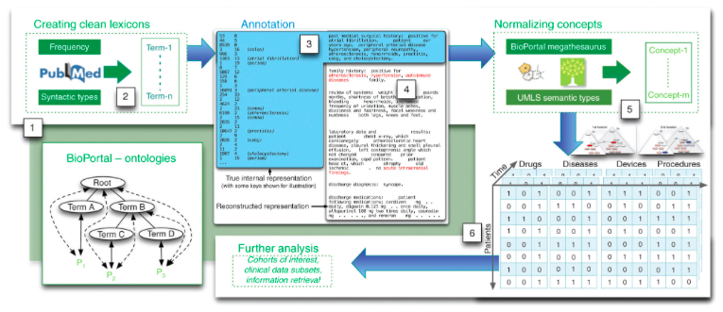
EHR | Patients | Encounters | ICD-9 Diagnoses | Prescriptions | Unstructured Notes
Stanford | 1.8 m | 19 m | 35 m |  | 11 m
Practice Fusion | 1.1 m |  | 5.5 m | 6.8 m | 5.5 m
MI case finding (n=1503): GenePAD study and independently verified
Pharmacovigilance data mining pipeline:
  previously validated with 97.5% sensitivity and 39% specificity
Clin Pharmacol Ther. 2013 Jun;93(6):547-55. doi: 10.1038/clpt.2013.47.
Notes:
Shah and colleagues analyzed quite massive amounts of data as you can see: 2.9 m patients, over 40 m diagnoses, and 16 million clinical notes.
For the Stanford cohort alone, the cross-tab ran to almost a trillion pieces of data.
Their first step was to identify MI cases. For this, they used follow up data for the Genetic Determinants of Peripheral Arterial Disease study and independently verified MI status just to be doubly careful.
Then they fed all this data and the "cases" into a pharmacovigilance data mining pipeline that they had previously built and validated. I put up this figure only to show that data processing and machine learning can involve a very detailed protocol of many many steps. To properly appraise this study, you need be a data scientist.

Slide 57
Analytic Intent | Data Source | "Study" Design | Analytic Method
Classification/Prediction | Structured | "Grab and go" | Classical or Bayesian Statistics
Causal Inference | Semi-structured | Pharmacovigilance workflow | Pharmacovigilance pipeline
 | Unstructured
Can anticipate more studies from reusable analytic platforms and pipelines
  each with their own risks of bias
Notes:
Take home here is that technology is enabling some very complex studies and analyses that are being packaged up into reusable platforms and pipelines. Soon, there'll be more and more studies from such platforms each with own risks of bias.

Slide 58
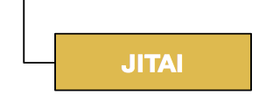
Technology-Enabled Experimental Studies
Notes:
I'd like to finish up today with an example of how sensors and machine learning are enabling some interesting new study designs.

Slide 59
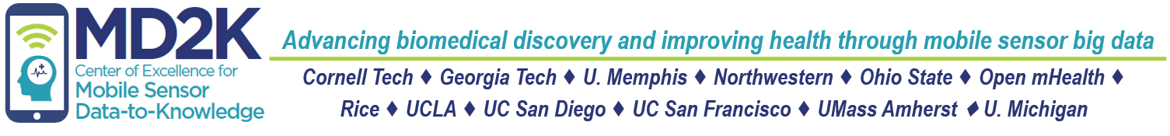
Staying Quit – A JITAI Study
Just-in-time Adaptive Intervention
P: smokers who have just quit
I: just-in-time stress reduction
C: usual care
O: time to first lapse, rate of relapse
Notes:
I'm part of an NIH center on mobile health called Mobile Data to Knowledge. One of our studies is a sensor-powered JITAI or just in time adaptive intervention study.
This study aims to help smokers who have just quit to stay quit, which is pretty hard actually. 60% of quitters will relapse, or smoke again, in the first week. The hypothesis is that stress leads to relapse, so detecting and treating stress "just-in-time" should increase the time to first lapse, and reduce the rate of relapse.

Slide 60
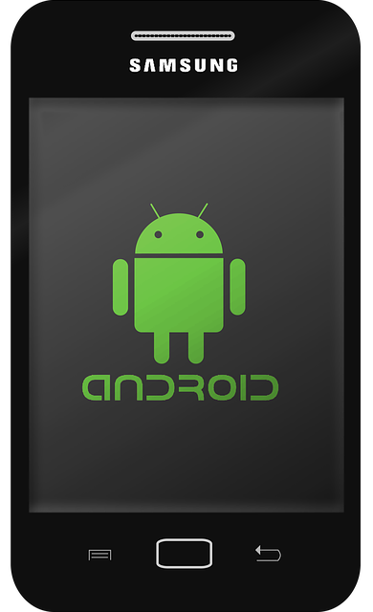

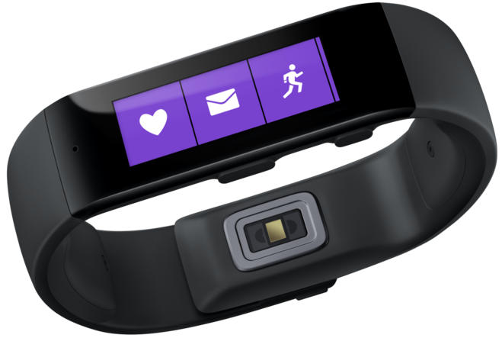

Staying Quit – A JITAI Study
Detect stress
adaptive microrandomization
Detect smoking
geolocation
stress
activity
individualized smoking urge model
individualized efficacy model
MD2K Spark cloud platform
Notes:
To do this study, we must be able to detect stress in real time. We're doing that using a chest band that infers stress from HR, HRV, and respiratory rate and pattern. If stress is detected, the person gets a buzz on their MS Band wristband, and they go to their phone and are microrandomized to a stress reduction exercise – could be music, guided imagery, or meditation. They are then monitored for whether they smoke again, through a wrist sensor to monitor arm and wrist movement correlated with a deep inhalation.
Our real-time computational platform crunches all this real-time data to build individualized models of smoking urge and to drive adaptive randomization through an individualized efficacy model. Remember just 10 hours of this monitoring is 3 Shakespeare's worth of data.
https://methodology.psu.edu/media/techreports/14-126.pdf

Slide 61
Staying Quit – A JITAI Study
Analytic Intent | Data Source | "Study" Design | Analytic Method
Classification/Prediction | Structured | "Grab and go" | Classical or Bayesian Statistics
Causal Inference | Semi-structured | JITAI with micro-randomization | Machine learning
 | Unstructured
Team includes engineers, behavioral psychologists, biostatisticians, data scientists, computer scientists
MD2K platform freely downloadable for running other JITAI studies (e.g., NIH All of Us?)
Enabling rigorous testing of sensor-driven complex behavioral interventions
Notes:
To do this study, we must be able to detect stress in real time. We're doing that using a chest band that infers stress from HR, HRV, and respiratory rate and pattern. If stress is detected, the person gets a buzz on their MS Band wristband, and they go to their phone and are microrandomized to a stress reduction exercise – could be music, guided imagery, or meditation. They are then monitored for whether they smoke again, through a wrist sensor to monitor arm and wrist movement correlated with a deep inhalation. This study combines classification (is the person smoking), prediction (are they going to smoke), and causal inference (will intervening on stress reduce relapse). This has been a challenging project that brings together people who don't normally work together: engineers, behavioral psychologists, biostatisticians, data scientists, computer scientists. There have been some culture clashes which I'll return to later.
The idea of MD2K is that once we iron out the compute platform, we will be offering it to everyone, so you and your engineering friends will be able to download it and run your own JITAI studies. We'd like to enable rigorous testing of sensor-driven complex behavioral interventions.

Slide 62
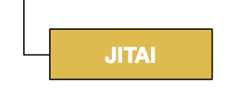
Traditional (Blue) and New (Orange) Approaches
Notes:
Here's our new tree altogether: EBM has traditionally been focused on the blue boxes, but the orange boxes are coming.
Data mining methods will be increasingly valuable for descriptive studies, as will predictive analytics for classification and prediction. There will be a host of new experimental study designs, especially around the evaluation of complex interventions, and there will be a new era of computational causal findings.

Slide 63
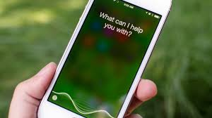

"Watson and Epic software could … intelligently assist doctors and nurses by providing relevant evidence from the worldwide body of medical knowledge. Providers will be able to share patient-specific data with Watson in real time, within workflows, allowing Watson to bring forth critical evidence from medical literature and case studies that are most relevant to the patient’s care” (May, 2015)
http://www-03.ibm.com/press/us/en/pressrelease/46768.wss
Notes:
But is this all passe?

Slide 64
Outline
Introduction
Course Goals
Overviews
  informatics vs. IT
  data-information-knowledge
  uneven future of EBM
Summary

Slide 65
Summary
Reviewed Big 6 Clin Epi questions, most are on problems of organized complexity requiring new frames of mind and analytic methods
As researchers, we ask Big 6 questions to generate evidence (basis for a claim of knowledge)
  data, information, knowledge distinction
Evidence : (big) data + “study” design + (machine) analytics
Big data, mobile technology, social media, and
machine learning enable new potentially far more
powerful ways to generate evidence
What do you need to know to use and apply these
new approaches?

Slide 66
Topics to be covered
Social media
Machine learning
EHRs
Data warehousing
Natural language processing
Clinical decision support
Network graph analytics
Ontologies, data mining
Mobile sensors and apps
Big data compute platforms
Artificial Intelligence
HPV vaccination studies
Lupus nephritis Clinical Informatics Consult
Predicting depression via Twitter
Proton-pump and MI risk
Staying Quit
IBM Watson

Slide 67
Next Classes
January 16: EHRs: data models and vocabularies, data warehouses, etc.
January 23: Accessing UCSF EHR data; clinical decision support systems

