Slide 1
Introduction, Scientific Process, & Study Design
Epidemiology 207 - Epidemiology Methods II
June M. Chan, ScD
Professor & Vice Chair, Epidemiology & Biostatistics
Steven & Christine Burd-Safeway Distinguished Professor & Assoc. Chair, Clinical Research, Urology
Notes:
Welcome & Thank you for being here!

Slide 2
DISCLOSURES
Individual: Research collaborations with GenomeDx
Urology Dept: Research collaborations with Genomic Health Inc. & Mryriad Genetics
Husband: full time employee for GRAIL, formerly for Myriad Genetics

Slide 3
Today’s Topics
Introductions
Why Epidemiology?
Life of a Research Study
Developing a Research Question & Hypothesis
Study Design
  Strengths & Limitations of Clinical Trials
  Observational Studies
    Cohort (continued on 1/24)
    Case Control (covered 2/21)

Slide 4
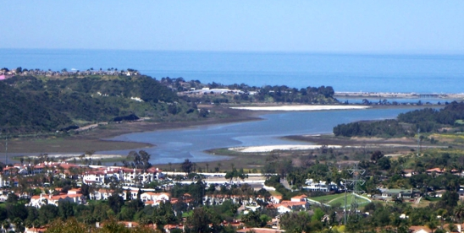

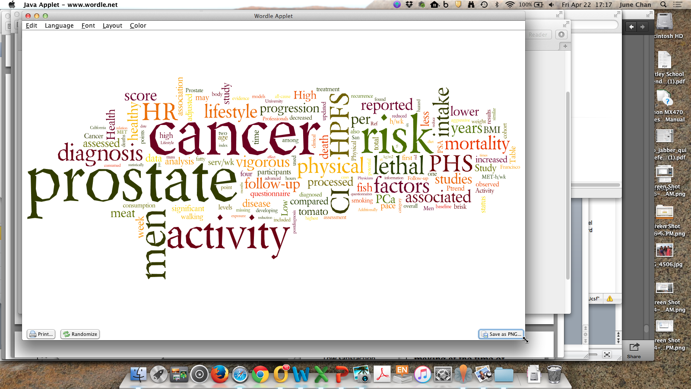

decision
https://urology.ucsf.edu/lifestyle-studies
Notes:
Life-long learning
To be a strong collaborator with folks outside one’s own discipline, we are constantly challenged to toggle bt learning and teaching
I got into public health bc of a topic interest (nutrition, food, prevention (or fear of disease)) and an interest to “serve”… highly rewarding…also stayed bc of the people and opportunities to learn

Slide 5
Notes:
TA’s: Chloe Eng, Alon Vaisman
Ad hoc assistant – Tom Gaither
Name
Program
Food

Slide 6
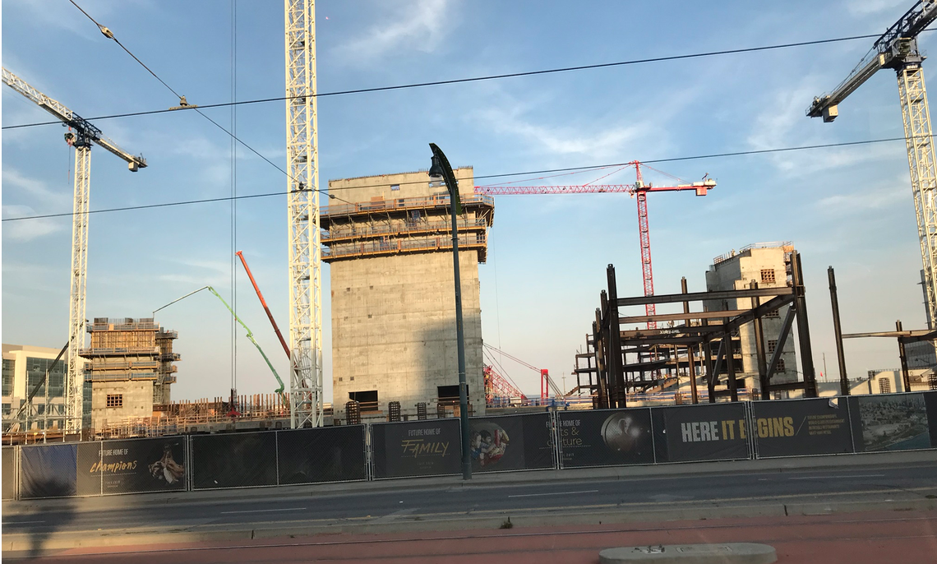
Notes:
Introduction
The Course – There have been a lot of revisions; it is a work in progress. Welcome constructive feedback.
I’m a learner too… may make mistakes… also very open to constructive f/b about course, format, etc.
Thoughts on Active Learning?

Slide 7
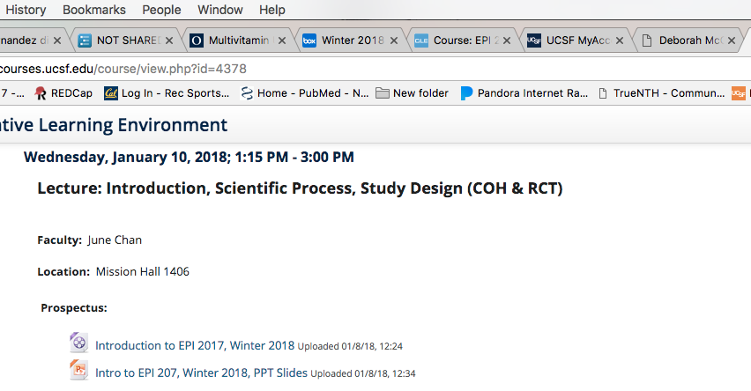
The Course
See Intro Video on CLE for more on logistics etc.

Slide 8
The Course
See Intro Video on CLE for more on logistics etc.
Some Highlights
  7 HW assignments (70% of grade)
    Due each each Wed by 1:15 PM starting 1/17 through 3/7
      (NOTE: none due on 2/21)
    Drop lowest score
  Take-home final assigned 3/14, due 3/21 (30% of grade)
  Main textbook: Rothman, Greenland, Lash (RGL 2008)

Slide 9
EPI 207 Schedule – 2018 Wed, 1:15-3:00 pm
Date | Topic | Lecturer | Mode
Jan. 10 | Lec: Intro, Scientific Process, Study Design (COH & RCT) | Chan | In-Class
Jan. 17 | Small Group: Cohort | Chan, Eng, Vaisman | In-Class
Jan. 17 | Lec: Causal Inference | Chan | Recorded
Jan. 24 | Small Group: Causal Inference | Chan, Eng, Vaisman | In-Class
Jan. 24 | Lec: Person-time, Bias, & Confounding in Cohorts | Chan | Recorded
Jan. 31 | Lec: DAGs | Maria Glymour | In-Class
Feb. 7 | Lec: Quantitative Bias Analysis (QBA)* | Hailey Bannack (special guest) | In-Class
Feb. 14 | Small Group: DAGS, QBA, Bias | Chan, Eng, Vaisman | In-Class
Feb. 14 | Effect Modification (Parts 1 & 2) | Cindy Leung | Recorded
Feb. 21 | Lec: Case-Control Studies | Erin Van Blarigan | In-Class
Feb. 28 | Small Group: Effect Modification | Chan, Eng, Vaisman | In-Class
March 7 | Small Group: Case-Control & Wrap Up | Chan, Eng, Vaisman | In-Class
March 14 | Lec: Geospatial Epidemiology* | Jarvis Chen (special guest) | In-Class
*Lecture will be part of Epi-Tools Workshop, which runs til 4 or 5pm, will be recorded

Slide 10
EPI 207 Schedule – 2018 Homework Schedule
Date Posted | Homework Topics | DUE DATE (by 1:15 PM)
Jan. 10 | Intro to Study Design & Cohort (live lec, RGL Ch. 6, HW) | Jan. 17
Jan. 17 | Causal Inference (recorded lec, RGL Ch 2, (optional Hernán & Robins Ch 1), HW) | Jan. 24
Jan. 24 | Person-time, Bias/Confounding in Cohorts (recorded lec, RGL Ch. 7, Hernán et al J Clin Epid 2016, HW) | Jan. 31
Jan. 31 | DAGS (live lec, reading TBD, HW) | Feb. 7
Feb. 7 | Quantitative Bias Analysis (live workshop; reading TBD, HW). NOTE: review keys for PT/Bias/Conf and DAGs problem sets & bring questions to 2/14 class | Feb. 14
Feb. 14 | Effect Modification (recorded lectures, reading TBD, HW) (due in TWO weeks) | Feb. 28
Feb. 21 | Case-Control (live lec, reading TBD (probably RGL Ch. 8), HW) (due in TWO weeks) | March 7
Mar. 7 | Read for Geospatial Epid (live workshop, readings TBD) | March 14
Mar. 14 | FINAL TAKE HOME EXAM | March 21
HW is generally a chapter from Rothman/Greenland/Lash (RGL), 1-2 articles, & problem set
QUESTIONS?

Slide 11
Survey of epidemiologists about their field
Notes:
Survey sent to ~ 30 individuals in mid-Dec
option to be anonymous
both epidemiologists and non-epidemiologists
Mostly colleagues at Harvard & UCSF

Slide 12
What do you like most about being an epidemiologist?
I love being a medical detective.
I like being the central hub for multidisciplinary research. I like contributing to policy or guideline changes that demonstrably improve health. I appreciate contributing the population perspective
I learn something new most days that I come to work. I'm intellectually engaged. I'm theoretically doing some good in the world.
Lots of opportunity for creative work. Feels like there are opportunities to really help people.
Intellectually stimulating. Might give much knowledge per spent money. Often catalyzes exciting collaborations.

Slide 13
The chance to explore areas where humans have never gone before, and at the same time to be helping people live better lives.
Walter Willett, MD, DrPH
Prof. Nutrition & Epidemiology
Harvard TH Chan School of Public Health (HSPH)
Chair of the Dept. of Nutrition for 30 years
Notes:
One of the “founders” of Nutritional Epidemiology
Leads/led Nurses Health Studies 1-3, Health Professionals Follow-up Study
First epidemiologist I met as part of a summer job scoring/doing manual data entry of diabetes coding sheets for HPFS

Slide 14
Get to spend the majority of your time thinking about questions that are of interest to you. Feel like you are contributing to our understanding of disease, and improving the public's health as a result. In charge of your own time/schedule. Wonderful people.
Erin Van Blarigan, ScD
Asst. Prof. Epidemiology & Biostatistics and Urology UCSF

Slide 15
What tips for success would you give an epidemiology trainee?
Get some real practice in the street. Work hard. Keep your eye on what matters to you most. Read a lot of science every day. Become a self learner.
dedicated training
good mentorship
creative thinking
Find a good mentor, and a good team to work with. Take the time to write well.
Learn as much about epi methods as possible!

Slide 16
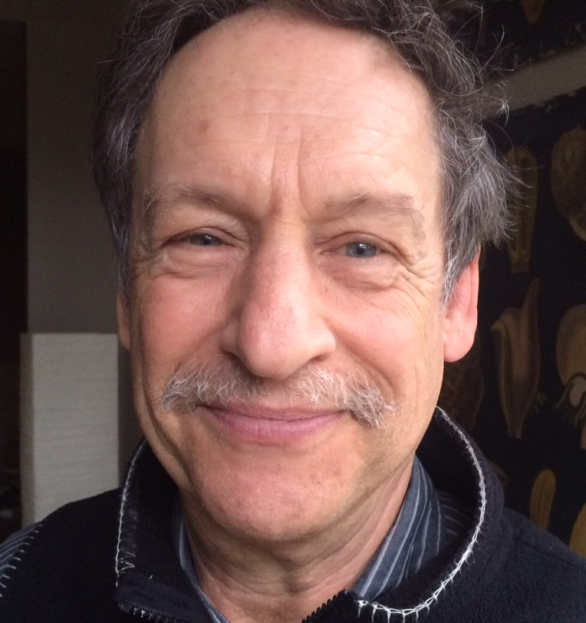
Know as much biology and medicine as possible on your main topic(s) of interest. Learn as much bioinformatics and big data analysis methods as you can. Work on becoming an outstanding writer.
Peter Gann, MD, ScD
Professor, Pathology
University of IL Chicago College of Medicine

Slide 17
Broadly expose yourself to relevant disciplines like biology, statistics, clinical medicine, policy and communications. Start with the policy or guideline you want to change and work backwards to plan your research. Learn how to play well with others because epidemiology is a team sport.
Tina Clarke Dur, MPH, PhD
Research Scientist Cancer Prevention Institute of CA (former)
Senior Staff Scientist, GRAIL (current)

Slide 18
Views on epidemiologists from non-epidemiologists

Slide 19
How would you describe your epidemiology colleagues?
Experts in helping to shape our clinical and translational research questions, project designs, and analyses to get the most reliable, valid answers possible with the resources available.
Indispensable * Invaluable * Essential
Thoughtful big picture thinkers.
Fun * Interesting * Smart
"I wish I did have an epidemiologist to work with"
- William Aronson, MD (Urologist, UCLA)

Slide 20
They are the experts in all of the concepts I struggle with - so they are great colleagues! They help me find meaning in the numbers. They know how to appreciate different disciplines - they seem to naturally absorb information about unfamiliar topics in order to work with others.
Casey Nesbit, PT, DPT, DSc, PCS
San Francisco State University
University of CA San Francisco

Slide 21
What constructive advice would you give to a future epidemiologist to work with others outside their field?
Teach us your ways! I think we take the work epidemiologists do for granted, but giving us some insight into your research methods will make us more appreciative of your work and findings.
The stronger at math and statistics, the better. The more understanding of clinical medicine, patient needs and clinical needs, the better.
Keep it simple. Be patient with those of us who need repetition. Share your background so we know more about how you can be a part of our team.
Be proactive with clinicians. Ask to be involved early and often in research discussions so that questions can be refined and grants written in statistically valid way.

Slide 22
How Epidemiology & Translational Science Support UCSF Mission Statements
UCSF
  advancing health worldwide
  PRIDE values:
    Professionalism, Respect, Integrity, Diversity, Excellence
  https://www.ucsf.edu/about/mission-and-values
School of Medicine (SOM)
  “The UCSF School of Medicine strives to advance human health through a fourfold mission of education, research, patient care, and public service.”
  https://medschool.ucsf.edu/about-school-medicine
Notes:
Medicine involves constant decision making regarding how to improve the health situation of the person in front of you. Epidemiology & Translational Science fuels the evidence base that guides that decision making.
Similarly, to improve public health, we want our choices and actions to have impact – before investing time and money into a new product or public health service, one would like to be guided by evidence that that “thing” is going to work.
Epid is a foundational science that →the research → data → guides decision making/actions/policies etc.

Slide 23
Life of a Research Study

Slide 24
Scientific Process
Figure out what you are really interested in or what you will at least enjoy working on for a while
Develop Research Question & Hypothesis
Identify & Select Team and Expertise Needed
Identify Funding Mechanisms
Design your Study & Make Analysis Plan
Write Proposal & Make a Budget
  Share proposal with colleagues & get feedback
  Review budget with mentors & justify budget
Submit… and revise & resubmit… until funded!
Study Implementation
  Review Team again… now its real, pick good people who are reliable, smart, ethical, and with whom you enjoy working!
Study Reporting – Conferences, Journals, Press, Social Media, Websites, etc

Slide 25
Scientific Process
Figure out what you are really interested in or what you will at least enjoy working on for a while
Develop Research Question & Hypothesis
Identify & Select Team and Expertise Needed
Identify Funding Mechanisms
Design your Study & Make Analysis Plan
Write Proposal & Make a Budget
  Share proposal with colleagues & get feedback
  Review budget with mentors & justify budget
Submit… and revise & resubmit… until funded!
Study Implementation
  Review Team again… now its real, pick good people who are reliable, smart, ethical, and with whom you enjoy working!
Study Reporting – Conferences, Journals, Press, Social Media, Websites, etc
Notes:
During my training, I mainly received experience or formal coursework on only the things in green

Slide 26
Reading & reviewing & writing a scientific manuscript
Title
Abstract
Introduction
Methods
Results
  Tables
  Figures
Discussion
References
Acknowledgements
Author overall recommendations:
  Ask meaningful, interesting and focused questions (i.e., for which both positive or negative result would be of interest)
  Plan a structure for the manuscript
  Writing order: Introduction, Methods, Tables/figures, text of Results, Conclusions, Abstract
  Good first sentence (hook reader), good last sentence (paunch line), and good figure
  One thought per sentence. Related thoughts in paragraphs
  No rambling, no unnecessary words. Active voice
  Logic: the methods should follow from the hypothesis, the results from the methods and the conclusions from the results
Notes:
You have been introduced to broad range of topics and methods in EPI 203.
With those initial tools, one of the best ways to learn epid is now to apply it – by reading/critiquing the peer-reviewed literature and writing your own proposals/ideas.
Would like to spend some time providing some structure for how to read/critique and write scientific reports.
This set of slides is intended to help guide you/give you some checklists/structure, as you will be presented with articles/problems sets in this class

Slide 27
Reading & reviewing & writing a scientific manuscript
Title
Abstract
Introduction
Methods
Results
  Tables
  Figures
Discussion
References
Acknowledgements
Editor (decision maker) and Reviewers look for:
Is the article novel, relevant, informative, valid and ethical ?
Would it affect practice or the way we understand a disease?
Is it the first paper, the best paper to date, or the last word on something ?
Is it well organized and well written?
Would the readers of this specific journal be interested?
Is it going to have a high impact and help my impact factor…

Slide 28
Reading & reviewing & writing a scientific manuscript
Title
Abstract
Introduction
  Background (justification)
    Problem
    Need to fill gap
    Solution
  Research question-hypothesis
  Objectives
Methods
Results
Discussion
References
Acknowledgements
READER
What was the justification for the study?
Which were the main objectives?
Does the significance of the problem justify the study? Can this study answer the question?
AUTHOR recommendations
Summarize key background information that makes the study significant
Make clear the hypothesis you are studying and why is it relevant
State your study aims
No need to provide extensive literature review (<40 references)

Slide 29
Reading & reviewing & writing a scientific manuscript
Title
Abstract
Introduction
Methods
  Design (cohort, case-control, etc)
  Population (study base, exclusion/inclusion)
  Disease (definition, selection, controls?)
  Exposure (definition, data collection)
  Analysis (measures, random error, bias reduction)
Results
Discussion
References
Acknowledgements
READER
What was the design?
What was the study population?
What was the outcome of interest? How did they select the cases?
How were the controls or comparison group selected?
What was the exposure of interest? How did they collect the information?
What measures of frequency or association were used in the study?
How did they account for the role of chance?
AUTHOR recommendations
ALL of the above
Clear description of primary versus secondary aims
IRB approval and informed consent

Slide 30
Reading & reviewing & writing a scientific manuscript
Title
Abstract
Introduction
Methods
Results
  Text
  Tables
  Figures, graphs, photos
Discussion
  Summary of main results
  Comparison with literature (consistent/refutes, why)
  Biologic explanation
  Limitations (internal and external validity)
  Implications and recommendations ?
  Conclusions, interpretation of results in context
References
Acknowledgements
READER or REVIEWER
What was the main result from the study?
Do you think confounding is a problem? If yes, what would be the magnitude and direction of the bias?
Do you think selection bias is a problem? If yes, what would be the magnitude and direction of the bias?
Do you think misclassification of exposure is a problem? If yes, what would be the magnitude and direction of the bias?
What would be the main conclusion from this study?

Slide 31
Reading & reviewing & writing a scientific manuscript
Title
Abstract
Introduction
Methods
Results
  Text
  Tables
  Figures, graphs, photos
Discussion
  Summary of main results
  Comparison with literature (consistent/refutes
  Biologic explanation
  Limitations (internal and external validity)
  Implications and recommendations ?
  Conclusions, interpretation of results in context
References
Acknowledgements
AUTHOR recommendations
Main findings clear in the text, with reference to the tables and figures. But don’t repeat all the numbers in the tables in the text
No claims of order (“We are the first to..”)
Don’t focus on criticizing other studies
  Recognize but don’t be overly defensive regarding limitations. Note available evidence to suggest these are not major flaws
Don’t speculate and don’t over-interpret your results
  Conclusions should follow logically from the results and provide clear take home message

Slide 32

Developing a Proposal
ARTICLE
Introduction
  Background (justification=problem+need+solution)
  Research question-hypothesis
  Objectives
Methods
  Design (cohort, case-control, etc)
  Population (study base)
  Disease (definition, selection, controls?)
  Exposure (definition, data collection)
  Analysis (measures, random error, bias)
Results
Discussion
  Comparison with literature
  Biologic explanation
  Limitations (internal and external validity)
References
PROPOSAL
Introduction
  Background (justification, significance)
  Research question-hypothesis
  Objectives
Methods
  Design (cohort, case-control, etc)
  Population (study base)
  Disease (definition, selection, controls?)
  Exposure (definition, data collection)
  Analysis (measures, random error, bias reduction [confounding control, validation studies] and quantification of impact [sensitivity analyses])
  Power
  Limitations and plans to minimize and quantify them
References

Slide 33
Study Designs

Slide 34
What Kinds of Questions Does Epidemiology Answer? “Big 6”
Description
  How frequent/common are risk factors or exposures & conditions or diseases? How often does Y occur?
Causation
  The science of establishing causal relationships among biological, behavioral, environmental (etc.) factors among humans
  Does X cause Y?
Attribution
  What fraction of disease Y can be eliminated if a causal exposure X is eliminated?
Mediation
  Understanding the mechanisms of causation
  How does X cause Y?
Interaction
  When and for whom does X cause Y?
Prediction
  Do A, B, and C predict occurrence of Y? (e.g., diagnosis or prognosis)
Notes:
JMC: Grouping attribution, mediation, and interaction objectives under the broader objective of causation… each of these are, in some ways, getting at a different aspect of causation

Slide 35
What Kinds of Questions Does Epidemiology Answer? “Big 6”
Description
  How frequent/common are risk factors or exposures & conditions or diseases? How often does Y occur?
Causation
  The science of establishing causal relationships among biological, behavioral, environmental (etc.) factors among humans
  Does X cause Y?
  Attribution
    What fraction of disease Y can be eliminated if a causal exposure X is eliminated?
  Mediation
    Understanding the mechanisms of causation
    How does X cause Y?
  Interaction
    When and for whom does X cause Y?
Prediction
  Do A, B, and C predict occurrence of Y? (e.g., diagnosis or prognosis)
Notes:
JMC: One may see attribution, mediation, and interaction objectives classified under the broader objective of causation… each of these are, in some ways, getting at a different aspect of causation

Slide 36
Recap from Epid Methods I – Study Design
Research Studies Based on Humans
Unit of observation
Group (e.g., geographic area)
Individual
Observational
Experimental
Experimental
Ecologic Studies
Randomized
Non-randomized
Observational
Randomized
Non-randomized
Between-subject
Cohort
Cross-sectional
Case-Control
Within-subject
Case-crossover
Case only
Self-controlled case series

Slide 37
Summary: 4 Key Aspects of Study Designs Using Individuals as Unit of Observation
Recap from Epid Methods I – Study Design
All designs are based on an underlying cohort
  For case-control, focus on primary or secondary study base
Designs are distinguished by different approaches to sampling the experience of the study base
  All/part of cohort (i.e. cohort study), a slice in time (i.e., a cross-sectional study), or by outcome status (i.e., a case-control study)
  If case-control study, pay attention to sampling of controls
Timing of measurements of exposure and outcome, relative to each other, is another key aspect of design.
  Exposure measured (or specimen obtained) before outcome is key
Observational studies: try to emulate target randomized trial
Notes:
You may wish to refresh on Study Design lec from EPI 203
EPI 203, 2017 JM Martin
In summary, there are four main points.
The first is that all study design is based on understanding the study base which underlies the study. A study base, also called a “reference population” by the text, is a defined population whose disease experience during some period of time is the source of the study data. Identifying the study base answers the question: What population gave rise to the disease diagnoses in the study? Understanding the study base concept provides the clearest guidance to understanding valid case-control design, the study design that is most often performed incorrectly. The study base can also help to understand limitations in cross-sectional studies.
The second is that different study designs are simply different ways of sampling the study base. Sampling is the process by which individuals belonging to a larger target population are selected for study. Sampling is obvious in some study designs but less so in others, such as case-control designs, but is the key to understanding a properly designed case-control study.
Measurement of exposure variables and outcome variables is the third key component of study design. There is much confusion around applying the terms “retrospective” and “prospective” to study designs. If you focus on when the measurements were made in relation to when the disease outcome was measured or detected, you will avoid confusion about which came first. The timing of the measurements should be looked at separately from the timing of carrying out the study. A study may be carried out after the disease outcomes have occurred but use measurements that were made before they occurred.
Finally, observational studies should be designed with a target randomized trial in mind. This will force you to be more specific in your research question, avoid some common biases, and have a study result that may be more convincing to observers in terms of influencing public health or clinical practice.

Slide 38
Objectives & Common Study Designs
Objective
  Description
  Causation
    Attribution
    Mediation
    Interaction
  Prediction
Study Design
  Ecological studies, time series
  Cross-sectional studies, surveys
  Randomized trials
  Observational cohorts
  Case-control studies, case-only designs
Notes:
Different study designs can be used for each of the objectives, but certain study designs may have more limitations for the given objective. E.g., harder to infer causation with cross-sectional study.
These arrows depict the more commonly used study designs for the stated objective.

Slide 39
Elements of Study Design
How was the population defined? How was the sample selected?
What is the time-frame (cross-sectional, longitudinal)?
Did we sample using persons or person time?
Was the underlying cohort ‘dynamic’ or ‘fixed’?
How was exposure defined and assessed?
What is the outcome & are we estimating risks, rates, odds, etc.?
Was there non-compliance? How was this handled?
Was there drop-out? Did participants die before the outcome was measured?
Notes:
Many folks at UCSF use the mnemonic “PICO” which stands for Population, Intervention (or Exposure if Obs study), Control (or Comparison group), and Outcome
For any study you are planning, conducting, or if you are reading an article, very good to identify PICO clearly for yourself.
The list above is a little more detailed/comprehensive

Slide 40
Terminology ⚐ - Retrospective vs. Prospective
⚐ This terminology is used differently by different authors
  Definition 1 (old one) – based on study design
    Prospective = cohort study
    Retrospective = case-control
  Definition 2 – based on exposure assessment
    Prospective = exposure history is assessed prior to the outcome
    Retrospective = exposure history is assessed at the same time as, or after, the outcome

Slide 41
Terminology ⚐ - Retrospective vs. Prospective
  Definition 3 – based on start of study/investigation
    Prospective = the outcomes occur after the implementation of the study protocol
    Retrospective = the outcome occurs before the implementation of the study protocol
  Definition 4 – based on person-time accumulation relative to study start
    Prospective = ‘person-time’ (time on the study) is accumulated after the study begins
    Retrospective = person-time is accumulated before the study begins
  Definition 5 (recommended) – based on potential for influence of Disease
    Prospective = exposure measurement cannot be influenced by disease
    Retrospective = exposure measurement can be influenced by disease

Slide 42
Observational Cohort to RCT
& Target Trial to Cohort

Slide 43
Concept of clinical trials or experimental studies guide other study designs
⚐ “Trial” → there is an intervention, distinct from “Obs” studies
Randomized experiments → paradigm for causal inference
Randomized trials provide helpful idealized framework in which to think about other types of study designs
Randomized Clinical Trial attributes:
  Randomization to Exposure (e.g., drug) or a Control (e.g., placebo) addresses known/unknown confounding factors
  Intention to Treat (ITT): “once randomized, always analyzed”, maintains randomization
  Blinding minimizes bias in assessments
Notes:
EPI 205 focuses on clinical trial design/conduct
Be deliberate when you use the word “trial”; this means a study with an intervention… and often “trial” refers to a ”randomized trial”

Slide 44
Clinical Trial Limitations
While RCT’s are often considered ”gold standard” & helpful for guiding other study designs, there are also limitations.
  Time
  Cost
  Generalizability
  Ethical Issues & need for Equipoise
  Issues related to Dose, Duration, & Timing of Intervention
Notes:
Equipoise – the group or tx allocations in the trial must be equally acceptable based on current state of knowledge
There are certain questions that will NEVER be addressed in a trial

Slide 45
Number of “hits” in Pubmed by study design keyword
“clinical trial” 1,052,043
  “RCT” 560,643
“cohort” 18,467,910
“case-control” 1,089,252
Notes:
Cohort is very commonly going to be the “work horse” study design in many epid studies.
More likely to read papers from a cohort

Slide 46
Key Issues in Clinical Trials | Observational
Notes:
RCT typically have…

Slide 47
Key Issues in Clinical Trials | Observational
Clear Objective(s). Primary and secondary endpoints
Notes:
Clear objectives, with primary and secondary endpoints….we should be able to do that in Obs studies as well as RCT’s

Slide 48
Key Issues in Clinical Trials | Observational
Clear Objective(s). Primary and secondary endpoints
Study population. Inclusion/exclusion criteria
Notes:
Inclusion/exclusion criteria should be clear for both types of studies

Slide 49
Key Issues in Clinical Trials | Observational
Clear Objective(s). Primary and secondary endpoints
Study population. Inclusion/exclusion criteria
Longitudinal
longitudinal (versus cross-sectional) studies in which the temporal order of treatment and outcome is clear
Notes:
When the goal is estimating the causal effect of certain treatment on the outcome, longitudinal studies are preferred over non longitudinal (i.e., cross-sectional) ones in which the temporal order of treatment and outcome may be unclear

Slide 50
Key Issues in Clinical Trials | Observational
Clear Objective(s). Primary and secondary endpoints
Study population. Inclusion/exclusion criteria
Longitudinal
Randomized treatment assignment | No
How to achieve comparability (or exchangeability)?
Matching, stratification, restriction, modeling, etc.
Notes:
Longitudinal studies are usually classified as either experiments (the treatment is assigned by the investigators) or observational
studies (the investigators play no role in treatment assignment). Experiments are said to be randomized when the investigators assign the treatment at random.
They randomized the treatments… we cannot do that in obs studies.
This is one of the key differences and leads to CONFOUNDING BIAS
we have tried to achieve comparability (exchangeability) through addressing confounding in the design or analysis phase
Challenge – many methods can only address confounding factors one is aware of…

Slide 51
Key Issues in Clinical Trials | Observational
Clear Objective(s). Primary and secondary endpoints
Study population. Inclusion/exclusion criteria
Longitudinal
Randomized treatment assignment | No
Blinding | No
Not in the same way as RCT, but often assessments can be done by individuals who are “blinded” to exposure or disease status (e.g., lab measurements, or data abstracted from SOC tests, etc)
Notes:
Blinding is another key difference, although some assessments in OBS studies can be done blinded.
we could also perhaps do blinded analysis
Also, many types of clinical trials are NOT blinded (e.g., exercise, diet, etc)

Slide 52
Key Issues in Clinical Trials | Observational
Clear Objective(s). Primary and secondary endpoints
Study population. Inclusion/exclusion criteria
Longitudinal
Randomized treatment assignment | No
Blinding | No
Statistical Power. Sample size & follow up
Notes:
RCT very carefully estimate the adequate sample size… ethical ramifications if we do not properly design RCT

Slide 53
Key Issues in Clinical Trials | Observational
Clear Objective(s). Primary and secondary endpoints
Study population. Inclusion/exclusion criteria
Longitudinal
Randomized treatment assignment | No
Blinding | No
Statistical Power. Sample size & follow up
International, multicenter,…
Notes:
They are often international, multicenter… we can also do that, we can even collaborate… ☺
Cohorts also can be pooled for even larger studies/analyses

Slide 54
Key Issues in Clinical Trials | Observational
Clear Objective(s). Primary and secondary endpoints
Study population. Inclusion/exclusion criteria
Longitudinal
Randomized treatment assignment | No
Blinding | No
Statistical Power. Sample size & follow up
International, multicenter,…
Reference group. Active therapy or placebo
Notes:
Both types of studies have this. In Coh often also have flexibility over definition…

Slide 55
Key Issues in Clinical Trials | Observational
Clear Objective(s). Primary and secondary endpoints
Study population. Inclusion/exclusion criteria
Longitudinal
Randomized treatment assignment | No
Blinding | No
Statistical Power. Sample size & follow up
International, multicenter,…
Reference group. Active therapy or placebo
Loss to follow up & Compliance
Notes:
RCT also face the problem of incomplete compliance and deal with it in the analysis by doing intention to treat (ITT) rather than per protocol.
In obs studies, we sometimes evaluate exposure data from a single timepoint or from updated exposure data; keep in mind that data on time varying exposures and confounding factors can be collected in COHORTS… usage of such data sometimes needs particular attention in analysis phase (IPCW, msm)
Patients who discontinued early, die or are lost to follow up are typically censored at the date of the last contact in both RCT and COH studies

Slide 56
Key Issues in Clinical Trials | Observational
Clear Objective(s). Primary and secondary endpoints
Study population. Inclusion/exclusion criteria
Longitudinal
Randomized treatment assignment | No
Blinding | No
Statistical Power. Sample size & follow up
International, multicenter,…
Reference group. Active therapy or placebo
Loss to follow up & Compliance
Blind adjudication of events
Medical record review
Notes:
Blind adjudication of events (outcomes) can happen in both types of designs

Slide 57
Key Issues in Clinical Trials | Observational
Clear Objective(s). Primary and secondary endpoints
Study population. Inclusion/exclusion criteria
Longitudinal
Randomized treatment assignment | No
Blinding | No
Statistical Power. Sample size & follow up
International, multicenter,…
Reference group. Active therapy or placebo
Loss to follow up & Compliance
Blind adjudication of events
Inscription of Protocols
Notes:
Usage of standardized protocols for data collection and follow-up can be common to both Clinical Trials and obs studies

Slide 58
RCT vs. Cohort
RCT features COHORT equivalents
Randomization
Blinding
ITT
Methods to address confounding in design & analysis phase (restriction, matching, stratification, multivariate modeling, etc.)
Structured (& sometimes blinded) assessments (e.g., medical assessments may be part of SOC; labs can be agnostic)
Do not adjust for post-baseline covariates.
  Cohorts can collect data on time-varying exposures & confounders (may need special attention in analysis phase)
Notes:
As with randomized trials, we should not adjust for post-exposure covariates, only baseline covariates… except if we have time-varying exposures, then we do want data on time varying confounders…
Caution: we don’t want to adjust for something in the causal path or for covariates that are influenced by the exposure → Marginal Structural Models & Inverse Prob Censoring Weights (More in BIO 215)

Slide 59
Relationship bt Obs & Experimental Studies
Recap from Epid Methods I – Study Design
Experimental studies can be viewed as cohort studies where the investigator assigns the exposure
Observational studies should be viewed (and designed) as attempting to emulate a randomized controlled trial (RCT)
When designing an observational study, ask yourself: What is the RCT that I am trying to emulate?
  What is the “target trial”?
Notes:
EPI 203 notes fr J Martin:
A randomized controlled trial (RCT) is the gold standard design for comparing the effectiveness of different interventions to influence an outcome. We pointed out earlier that the RCT design can be thought of as a type of cohort study where the exposure is assigned to participants, rather than just measured as it occurs in nature. We also can turn this around. That is, a useful insight in the understanding of observational studies is that one should strive to have them emulate an RCT. Observational studies that aim to establish causality should be evaluated with respect to how well they emulate an experimental “target” trial (i.e., an RCT).

Slide 60
When can an observational study be conceptualized as a randomized experiment?
Values of treatment under comparison correspond to well-defined interventions that correspond to versions of treatment in the observed data
Conditional probability of receiving every value of treatment, (though not decided by the investigators) depends only on the measured covariates
Conditional probability of receiving every value of treatment > 0

Slide 61
When can an observational study be conceptualized as a randomized experiment?
Consistency: Values of treatment under comparison correspond to well-defined interventions that correspond to versions of treatment in the observed data
Exchangeability: Conditional probability of receiving every value of treatment, (though not decided by the investigators) depends only on the measured covariates
Positivity: Conditional probability of receiving every value of treatment > 0
Hernan & Robins, Causal Inference, Ch. 3, 2017

Slide 62
A historical perspective…

Slide 63
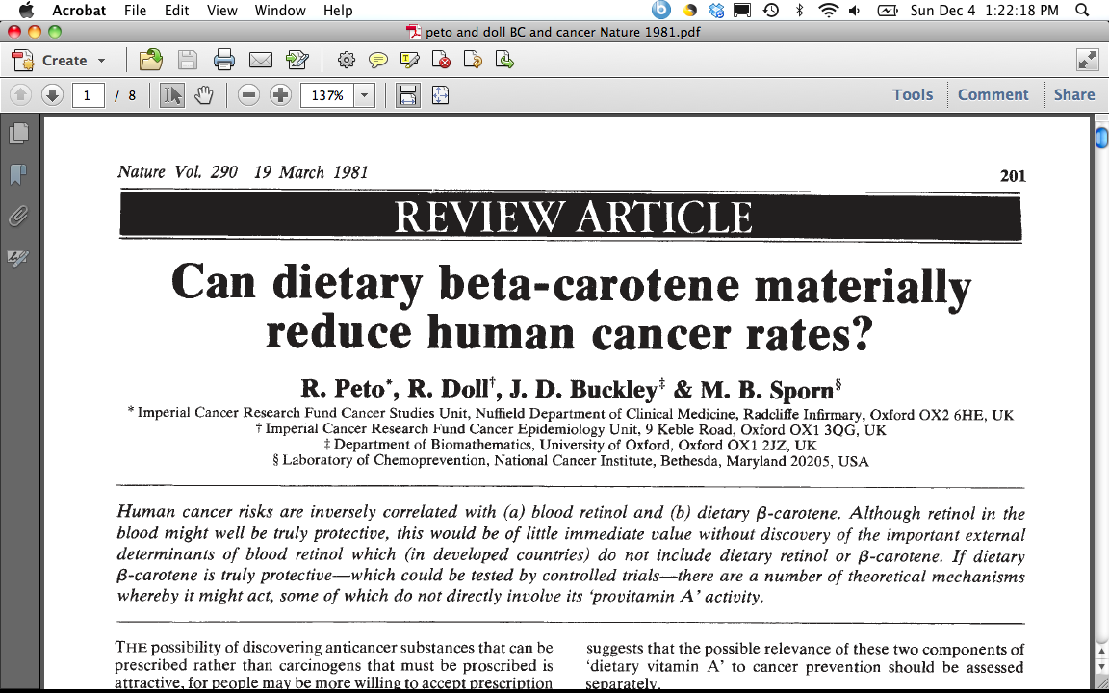
1980’s – Beta-Carotene & Lung Cancer
“This inverse association may, of course, be an artefact, due merely to association of B-carotene ingestion with some truly protective dietary habit(s) or component(s), or to association of B-carotene ingestion with avoidance of some truly harmful dietary habit(s) or component(s).”
“Equally, however, the inverse association between dietary B-carotene and cancer incidence may be due to genuine protective effect of B-carotene against the onset of cancer.”
“Although the evidence thus far available is not compelling that B-carotene is truly protective against cancer (or a fortiori against total mortality) this is not good reason to delay starting controlled trials because even if, as seems probable, a few truly protective agents do await discovery among the dozen or two dietary factors of current interest to the research community, compelling evidence may take decades to emerge without controlled trials.”
CONFOUNDING
TRUTH
Notes:
Ask Class - Who are Doll and Peto?
“Grandfathers of Epidemiology” who Richard Doll and Bradford Hill started the British doctors study in 1951, and published their preliminary and follow-up report in the mid-1950’s providing the earliest evidence that smoking was linked to many serious diseases, first and foremost lung cancer.
30 years later, they published this thoughtful piece on Beta-Carotene and cancer. At the time, the observation had been made that vegetables, in particular those rich in Vit A or carotene seemed to be protective in observational studies, AND some studies that measured retinol and carotene in blood also showed a protective effect, specifically for beta-carotene. At the time, there were only 3 prospective cohort studies that had been done, but these all seemed protective.
1981 Doll & Peto, Nature
ATBC recruited 1985 – 1988

Slide 64
P: 29,133 male smokers in Finland, 50-69 yrs old in 1985-88
I: 50 milligrams (mg) alpha-tocopherol (a form of vitamin E)
OR 20 mg of beta-carotene (a precursor of vitamin A)
OR BOTH
C: Placebo
O: Lung cancer (and other cancers)
Vit E, Beta-Carotene Supplementation and Lung Cancer among Smokers (Albanes et al, JNCI, 1996)
Notes:
http://www.annalsofepidemiology.org/article/1047-2797(94)90036-1/pdf

Slide 65
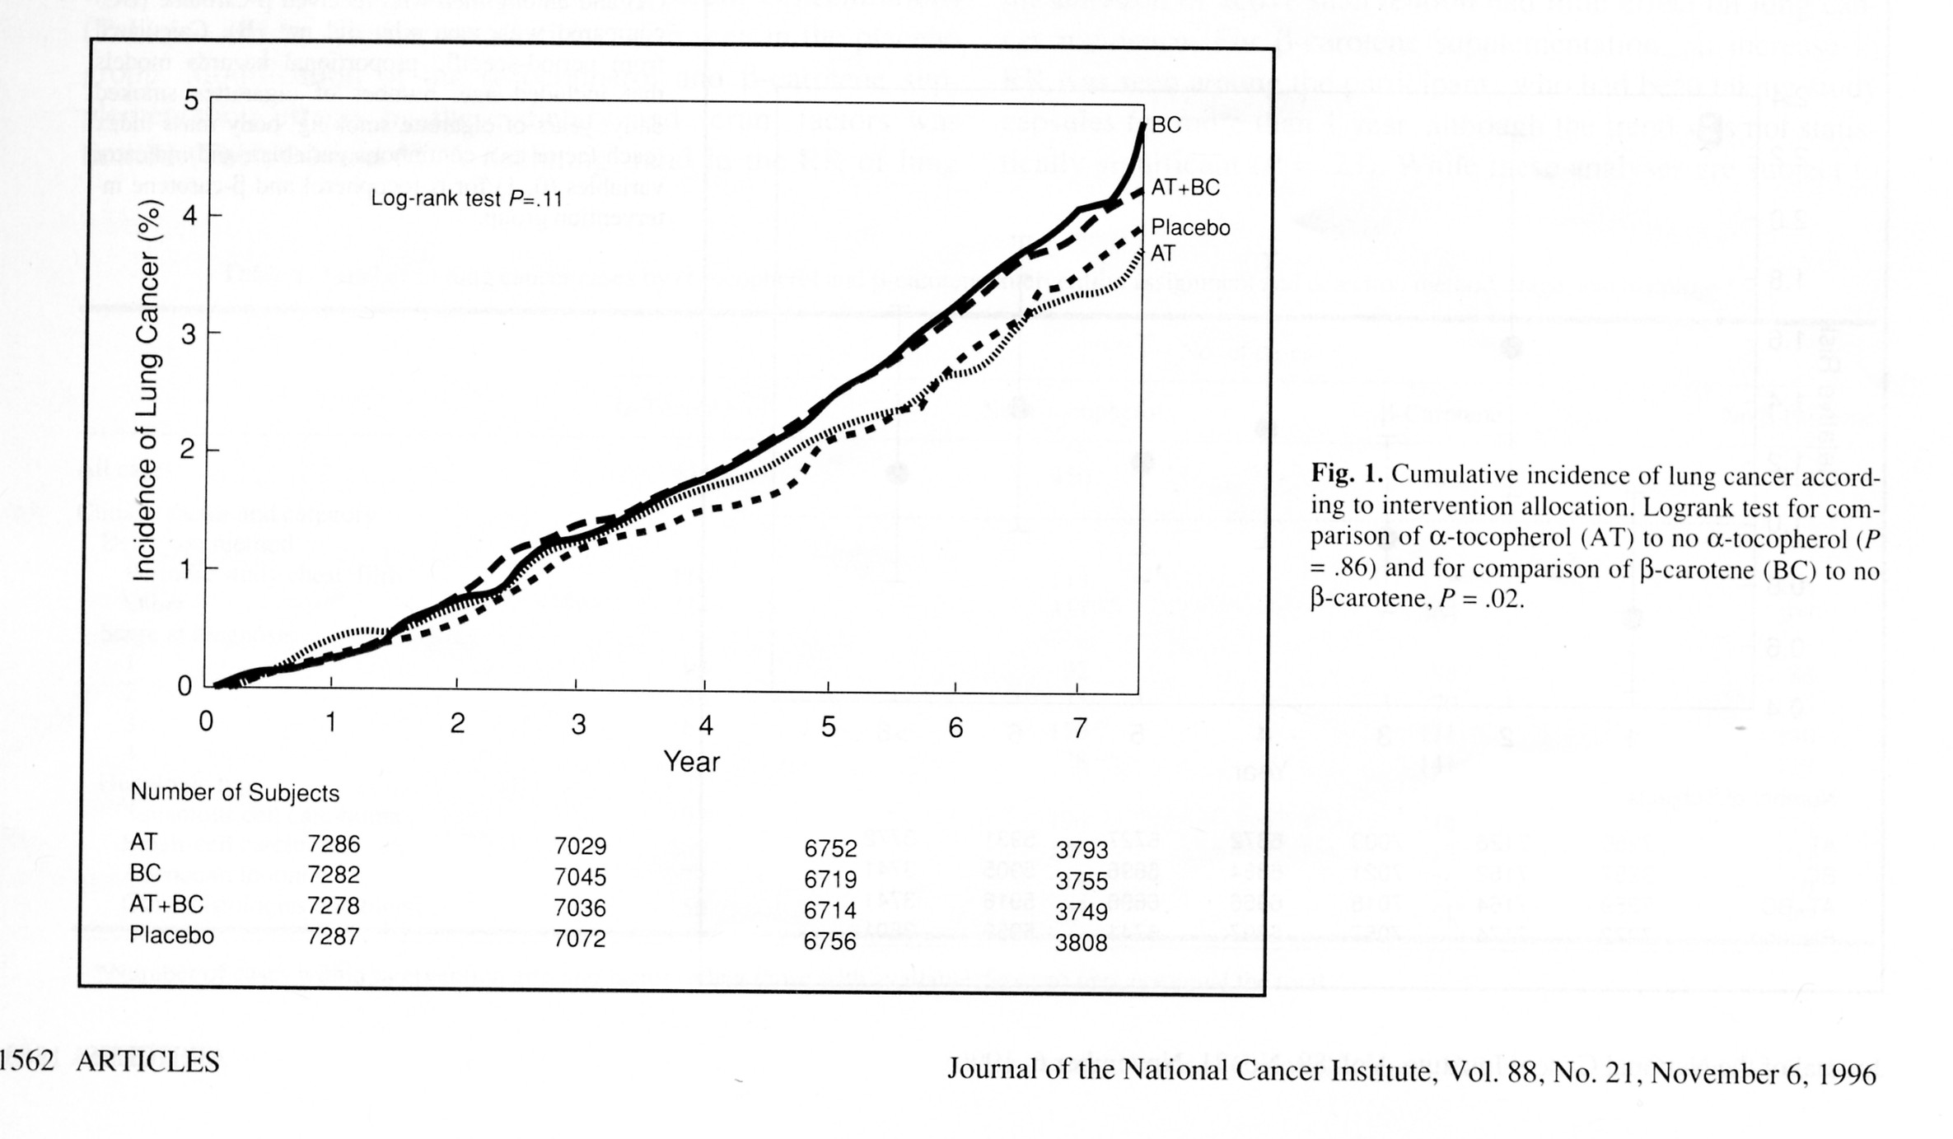
More Lung Cancer occurred among men on supplements
Notes:
Maybe TOO late to intervene with BC or Vit E in a population that has 30 pack years of smoking history
Or… the population was not deficient enough to observe a benefit
For Example…
JNCI 1993 Blot et al, Linxian China RCT combo vit E, BC, and SEL – associated with lower total mortality p=0.03, RR=0.91; esp for cancer RR =0.87 (0.75-1.00)… however baseline BC levels were 3 times LOWER than that in Finland (5.2 ug/dL vs 17 mg/dL)
https://atbcstudy.cancer.gov/

Slide 66
Interpretation Points to Appreciate
Incorrect inference from obs studies on beta-carotene being “causal - Was beta-carotene THE nutrient in fruits/veggies accounting for the inverse associations in the observational studies?
Confounding – the benefit in observational studies might have been due to confounding, which, when removed in the RCTS, revealed NO benefit of BC
“The lack of reduction in the incidence of lung cancer among men given the supplemental beta-carotene may be explained by bias, an inadequate duration of supplementations, the use of the wrong dose, or an inappropriate study population.”
Notes:
Maybe TOO late to intervene with BC or Vit E in a population that has 30 pack years of smoking history
Or… the population was not deficient enough to observe a benefit
For Example…
JNCI 1993 Blot et al, Linxian China RCT combo vit E, BC, and SEL – associated with lower total mortality p=0.03, RR=0.91; esp for cancer RR =0.87 (0.75-1.00)… however baseline BC levels were 3 times LOWER than that in Finland (5.2 ug/dL vs 17 mg/dL)
https://atbcstudy.cancer.gov/
http://www.nejm.org/doi/full/10.1056/NEJM199404143301501#t=article
What happened next? Subsequent trials indicated that BC likely does increase risk of LC in smokers or those with other high risk (asbestos); not associated in general population of non-smokers (physicians health study)

Slide 67
Acknowledgements:
**Sonia Hernandez-Diaz, MD DrPH
Harvard TH Chan School of Public Health
Maria Glymour, PhD, UCSF
Benjamin Cedars, Medical Student, Thomas Jefferson University

Slide 68
Notation or Shorthand I may commonly use…
Ca: cancer
Ca-co: Case control study
Coh: Cohort study
E: exposure or exposed or number exposed
E: unexposed or number unexposed
D: number with disease
D: those without disease
Dbx: Diabetes
Dx: diagnosis
N: total in a group or population count
Obs: Observational
PT: person-time
RCT: randomized controlled trial
SOC: Standard of Care
Tx: treatment

Slide 69
Thank you! Questions?

Slide 70
In-Class Exercise Option

Slide 71
In-Class Exercise
Association of Leisure-Time Physical Activity With Risk of 26 Types of Cancer in 1.44 Million Adults. https://www.ncbi.nlm.nih.gov/pubmed/27183032
“time per week in moderate and vigorous leisure-time physical activities…. Assessed by asking about discrete activities such as walking, running, or swimming, or, alternately, by inquiring about overall weekly participation in moderate- to vigorous-intensity activities. The median activity level was 8 MET-h/wk …. equivalent to 150 minutes of moderate-intensity activity (eg, walking) per week, and comparable to the median activity level for the US population.”
“high vs low levels of leisure-time physical activity were associated with lower risks of 13 of 26 cancers.”
Notes:
Pros/cons?
Strengths/challenges?

Slide 72
Other options for Obs studies to RCT exercise…
Association of Leisure-Time Physical Activity With Risk of 26 Types of Cancer in 1.44 Million Adults. https://www.ncbi.nlm.nih.gov/pubmed/27183032
The Relationship Between Occupational Standing and Sitting and Incident Heart Disease Over a 12-Year Period in Ontario, Canada https://academic.oup.com/aje/article/187/1/27/4081581
Dietary Fat Intake and Fecundability in 2 Preconception Cohort Studies https://academic.oup.com/aje/article/187/1/60/3863377
Notes:
Pros/cons?
Strengths/challenges?

