Slide 1
Electronic Health Records for Clinical Research
Ida Sim, MD, PhD
January 16, 2018
Division of General Internal Medicine
Copyright Ida Sim, 2018. All federal and state rights reserved for all original material presented in this course through any medium, including lecture or print.
Notes:
PMI, PPRN, National Cancer Data Ecosystem – patient-donated data to research
Time for a patient-driven health information economy – Mandl and Kohane, hyperportalosis
Open Notes movement
HUGO to synch with
Ethan Basch, on PROs
Rearchitecting clinical researc hwith people-powered data partnership
www.atsdr.cdc.gov

Slide 2
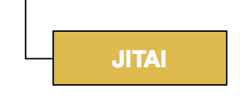
Summary of Last Class
Reviewed Big 6 Clin Epi questions, most are on problems of organized complexity requiring new frames of mind and analytic methods
As researchers, we ask Big 6 questions to generate evidence (basis for a claim of knowledge)
  data, information, knowledge distinction
Evidence : (big) data + “study” design + (machine) analytics
Big data, mobile technology, social media, and
machine learning enable new potentially far more
powerful ways to generate evidence
Need to know about: EHRs, Decision Support, NLP, social
media, sensors, network graph analytics, ontologies, big data,
machine learning

Slide 3
Outline
Historical context: “Meaningful Use” of EHRs
EHR Data Flow and Storage
Naming EHR Data
Getting EHR Data for Research
Summary

Slide 4
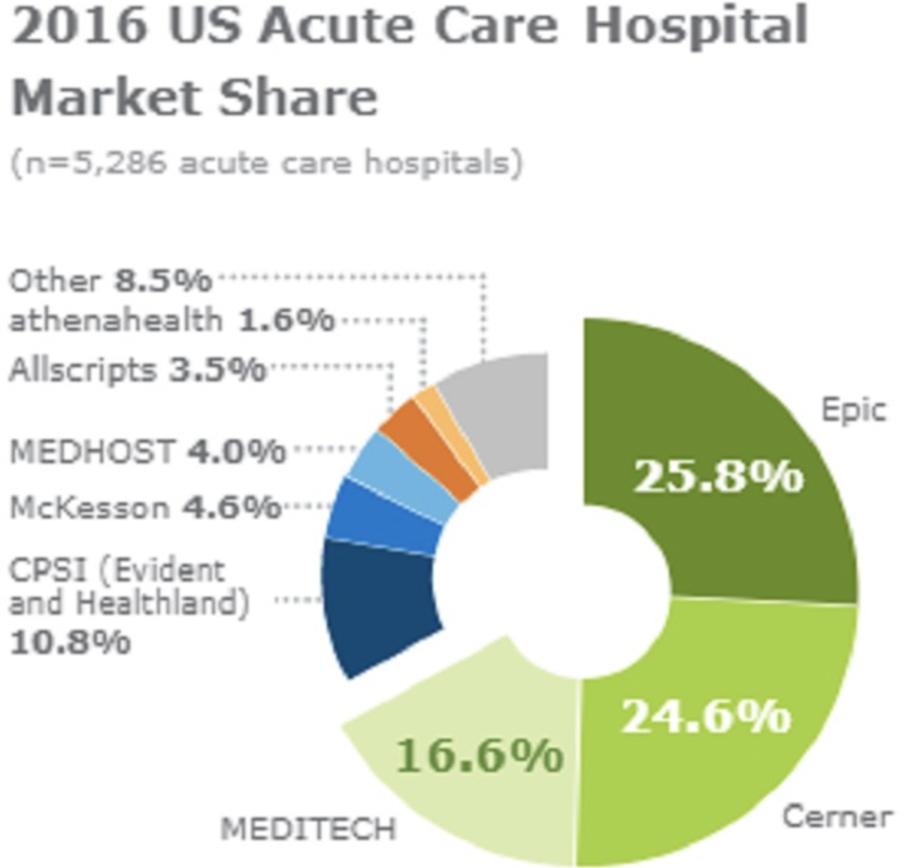
Incentivizing EHR Use
“Stimulus” Act (2009) directed $19 billion to health IT under the Meaningful Use program
  $17.2 billion Medicare/Medicaid incentive payments for meeting
    Stage 1: basic EHR adoption and data gathering
    Stage 2: emphasizes care coordination and exchange of patient information
EHR adoption has risen
  from 17% of office-based doctors in 2008 to 87% in 2015
  to 95% of hospitals in 2016
UCSF spent $50 mil+ on GE's UCare in 2000s; >$100m on Epic/APEX
BUT…
  >50% of eligible providers did not meet Meaningful Use in 2015 and were penalized
  MU Stage 3 (for improving health care outcomes) is delayed from 2017 to 2019
KLAS Research
  https://dashboard.healthit.gov/quickstats/quickstats.php
Notes:
https://www.korchek.com/blog/epic-cerner-beat-out-meditech-in-small-hospital-ehr-adoption/
American Recovery and Reinvestment Act of 2009
2008: http://www.healthit.gov/newsroom/infographic-record-health-information-technology
2014: http://www.merritthawkins.com/uploadedFiles/MerrittHawkings/Surveys/Physicians_Foundation_Merritt_Hawkins_2014_Todays_Physician_Doctor.pdf
2015: http://www.ihealthbeat.org/insight/2015/carrot-to-stick-how-the-meaningful-use-penalties-will-affect-providers

Slide 5
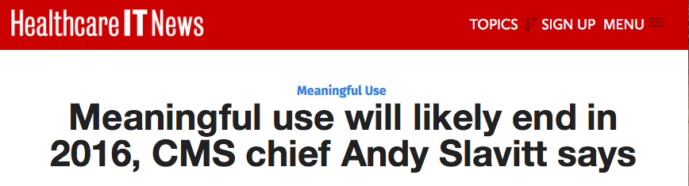
“We have to get the hearts and minds of physicians back. I think we’ve lost them.” – January 13, 2016

Slide 6
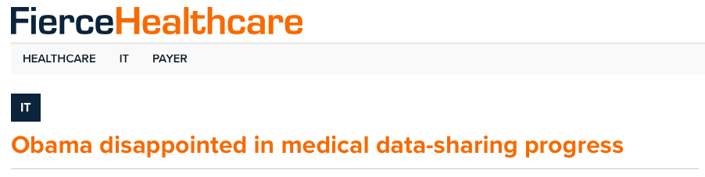
“We put a big slug of money into trying to encourage everybody to digitize.”
“It’s proven to be harder than we expected, partly because everybody has different systems. They don’t all talk to each other.”
-- President Obama, January 16, 2017

Slide 7
Meaningful Use Post-Mortem
Pushed large-scale adoption of technologies that weren’t quite ready
Functionality requirements were both too stringent and ineffective at improving care
  E.g., having to review medication lists
Interoperability was not required at the outset, only the technical ability to share
There were no user interface or safety requirements
Companies were allowed to have non-disclosure and hold harmless clauses on EHR-induced patient errors

Slide 8
Outline
Historical context: “Meaningful Use” of EHRs
EHR Data Flow and Storage
Naming EHR Data
Getting EHR Data for Research
Summary

Slide 9
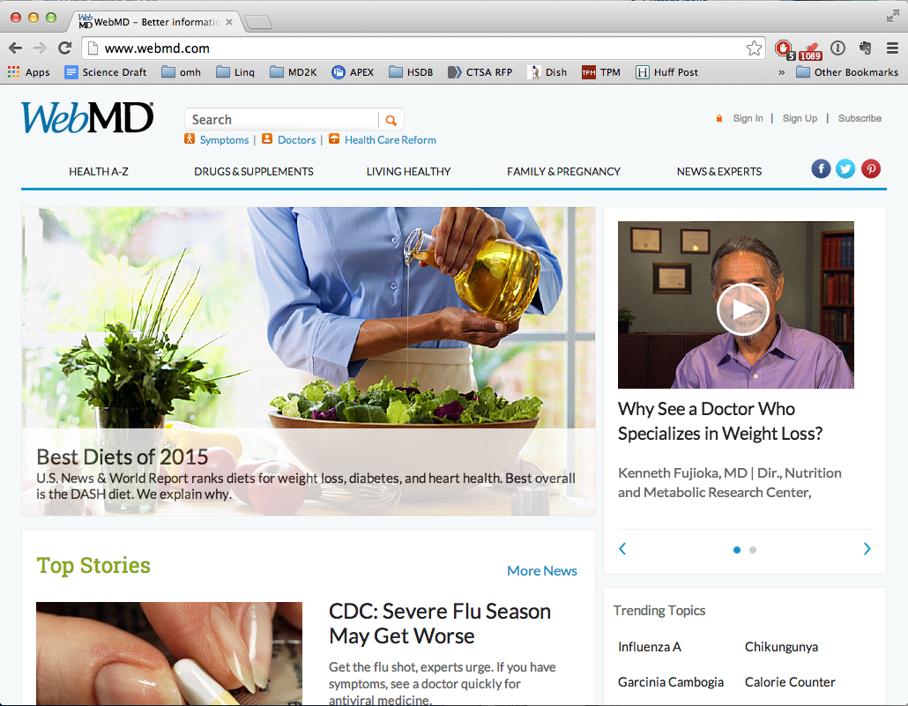
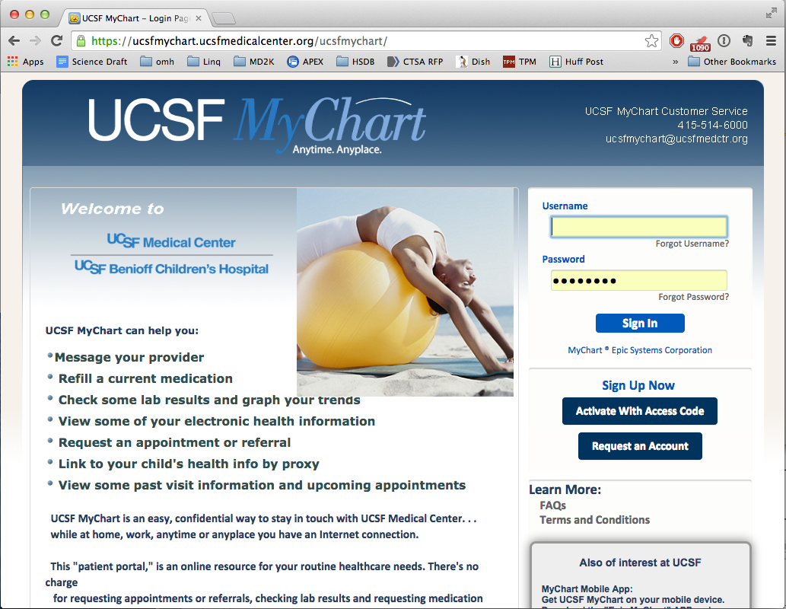
Clinical Information Flow Today
Hill
Clinic
Epic MyChart
Eligibility
Front
Desk
Authorization
APEX
Electronic Health
Record (EHR)
Claims
HealthNet
Archive
Formulary Check
Radiology
Medical
Information
Bureau
Referral
Authorization
(HL-7)
Lab
Prescribing
Pharm Benefit
Manager
Referral
Benefits Check
(RxHub)
Specialist
Quest
Walgreens
Internet
Intranet
Phone/Paper/Fax
Notes:
Lots of naming and data exchanging going on

Slide 10
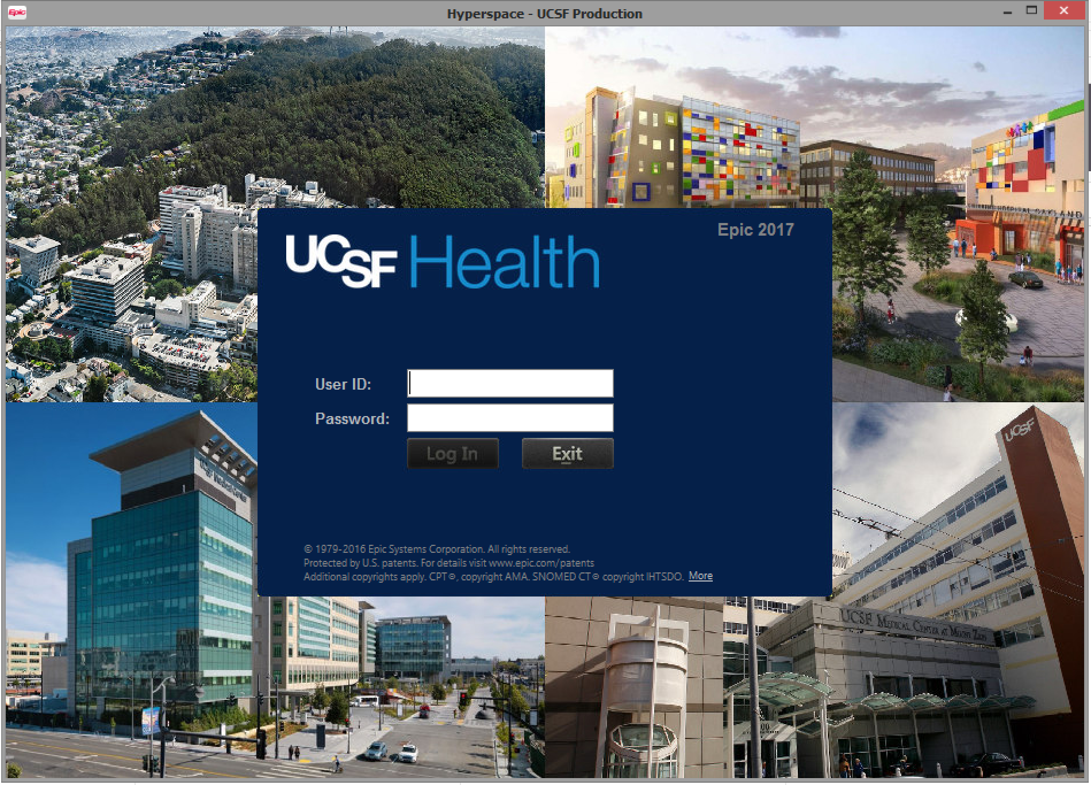

How Epic Holds EHR Data
Extract-Transform-Load (ETL)
Extract-Transform-Load (ETL)
Chronicles
Cache (MUMPS)
Clarity
SQL Server
Cogito Data Warehouse
SQL Server
>95K data elements
>12K tables, >125K columns
19 fact tables, 76 dimensions
  May 2015: 13,994 tables, 48 billion rows
  367 tables
Notes:
Epic's data model is highly complex, with Cache-based Chronicles offering 95K+ data elements, it's Clarity Reporting suite housing 12k+ tables and 125K+ columns, and Cogito BI & Analytical Reporting Data Warehouse consisting of 19 fact tables and 76 dimensions. Epic's PHM initiative, Healthy Planet, -- http://healthitmhealth.com/tag/epic-data-model/
https://www.datasciencecentral.com/profiles/blogs/mumps-the-most-important-database-you-probably-never-heard-of

Slide 11
Patient Care vs. Research Queries
Patient Care Queries
What was Mr. Smith’s last potassium?
Does he have an old CXR for comparison?
What antihypertensives has he been on before?
What did the neurology consult say about his epilepsy?
Research Queries
What proportion of diabetics with AMI admissions were discharged on b-blockers?
What was the average Medicine length of stay in 2017 compared to 2012?
What is the trend in use of head CTs in patients with migraine?

Slide 12
EHR/Data Warehouse Comparison
Data warehouses have an enterprise viewpoint
Data warehouses clean and aggregate data from clinical and/or multiple sources
Notes:
BI example of research query taking down clinical system

Slide 13
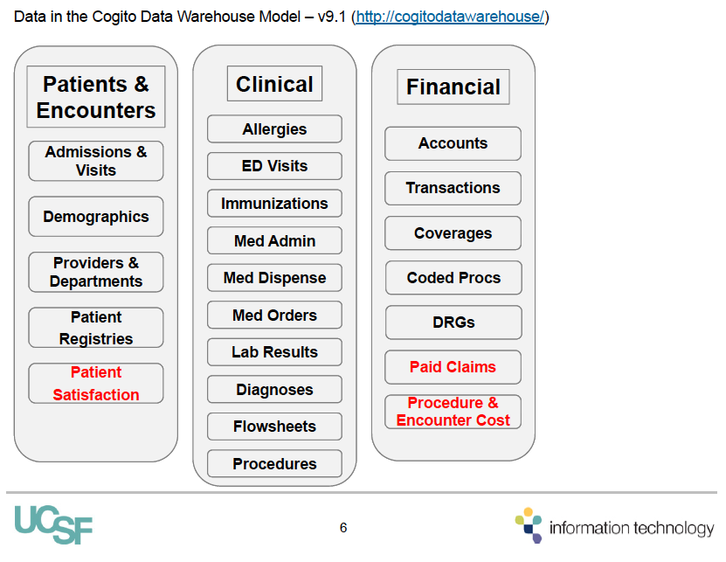

Slide 14
Getting at UCSF EHR Data
Chronicles
Cache (MUMPS)
Clarity
SQL Server
Cogito Data Warehouse
SQL Server
  May 2015: 13,994 tables, 48 billion rows
  367 tables
Epic Clarity Certification requires 2 weeks in Madison, WI
Research Data Browser
De-identified data

Slide 15
Protected Health Information (PHI)
PHI protected under federal HIPAA law and California’s Confidentiality of Medical Information Act
Protected health information (PHI) under US law is any information about health status, provision of health care, or payment for health care that is created or collected by a Covered Entity (or a Business Associate of a Covered Entity), and can be linked to a specific individual
  Covered entities are defined in the HIPAA rules as (1) health plans, (2) health care clearinghouses, and (3) health care providers who electronically transmit any health information in connection with transactions for which HHS has adopted standards
Medical record data is the some of the highest value data to steal
  SSN worth $0.10, credit card number worth $0.25, EHR record worth hundreds to thousands
Notes:
On the black market, the going rate for your social security number is 10 cents. Your credit card number is worth 25 cents. But your electronic medical health record (EHR) could be worth hundreds or even thousands of dollars. https://www.forbes.com/sites/mariyayao/2017/04/14/your-electronic-medical-records-can-be-worth-1000-to-hackers/#4ad6e45d50cf

Slide 16
Privacy vs. Security
Cogito Data Warehouse
SQL Server
Privacy
  the state or condition of being free from being observed or disturbed by other people
Security
  defending information from unauthorized access, use, disclosure, disruption, modification, perusal, inspection, recording or destruction
Notes:
Accessing medical info raises questions of privacy and security.
e.g., your bank transactions are secure, but what if NSA can eavesdrop on it? not private. Or Uber, or Facebook, or ???

Slide 17
Privacy, Security, Anonymity
Privacy
  the state or condition of being free from being observed or disturbed by other people
  requires information security
    defending information from unauthorized access, use, etc
Anonymity: the condition of being anonymous, not having your identity identified with a set of data
  can be achieved via de-identification, a procedure applied to data to reduce the risk of identification
  risk of re-identification and and loss of information must be balanced against costs of de-identification
Secure
Private
Anonymous
Notes:
No one sees my RunKeeper log (private). Everyone sees my RunKeeper log but they don't know it's me. My RunKeeper log is not private but is anonymous.

Slide 18
De-Identification (aka Anonymization)
HIPAA allows two de-identification methods
  Safe Harbor: removing 18 types of identifiers
    but prevents analyses that need PHI (e.g., any dates)
  expert determination: applying statistical or scientific principles
    allows analyses using PHI
    must use documented, generally accepted methods to ensure a "very small risk that recipient can identify individual"
De-identification is never 100% foolproof!
  risk of re-identification depends on what other information is available
    e.g., data from African HIV trial "de-identified" but recipient knows which villages participated in this trial
  with genomic information, de-identification is essentially impossible

Slide 19
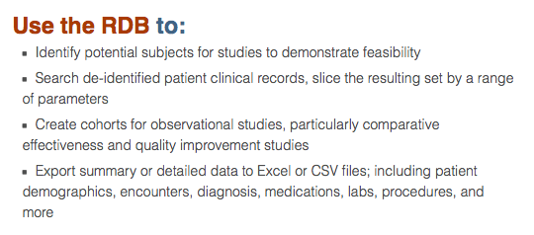
Research Data Browser
Chronicles
Cache (MUMPS)
Clarity
SQL Server
Cogito Data Warehouse
SQL Server
http://rdb.ucsfmedicalcenter.org/ (use your APEX login)

Slide 20
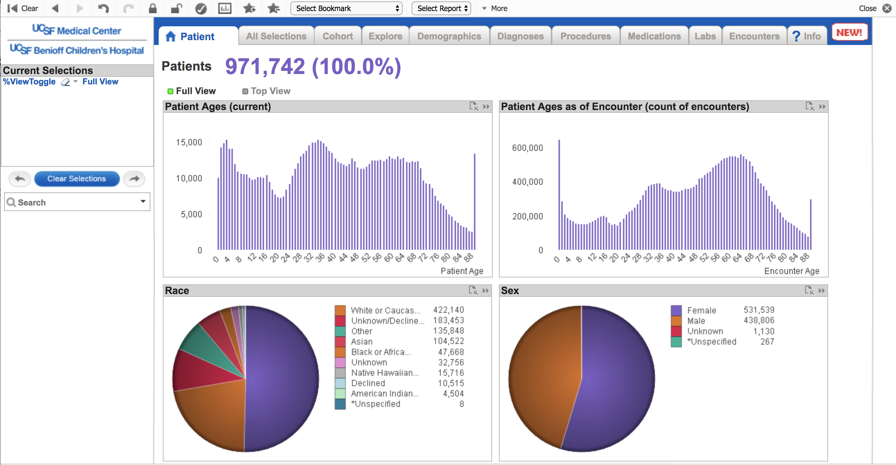
Research Data Browser

Slide 21

https://accelerate.ucsf.edu/consult

Slide 22
Research Data Browser Flat Files
De-identified data underlying RDB
Very large files, can’t just use Excel
Next class: January 23
  Jennifer Creasman will demo STATA code for extracting data on patients with specific diagnosis codes
    describe logical steps
    describe various caveats to working with the data
Notes:
Jennifer Clarke for sensei training

Slide 23
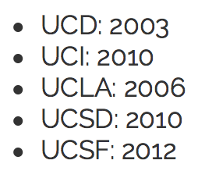

UC-Wide EHR Data Repositories
UC-wide OMOP
UC-wide Cogito
  367 tables
UC Healthcare Data (mid-2018?)
  May 2015: 13,994 tables, 48 b rows
Apply for access via links at MyResearch
15+ million patients across 5 UC med centers
Notes:
Autofeed nightly or weekly to i2b2

Slide 24
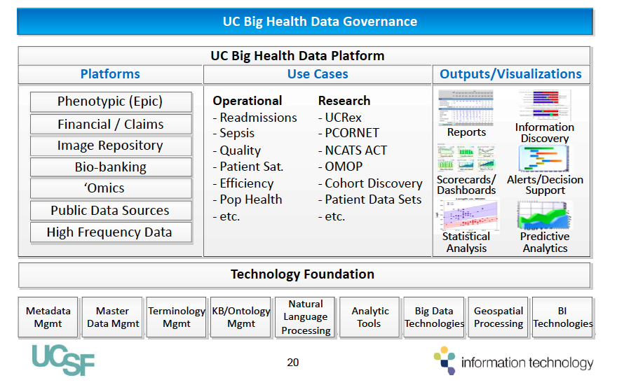

Slide 25
EHR Data Flow and Storage Summary
Clinical information flow is very complex both within, across, and between health care organizations and entities
Epic holds data in a complex internal database for operational use. Periodic ETL copies that data to SQL databases for research/enterprise queries
PHI requires privacy, which requires security. Full anonymization cannot be guaranteed regardless of de-identification method used.
Access to UCSF EHR data
  Research Data Browser and flat files (from Cogito data warehouse)
  Cohort Section Tool selecting de-identified data in i2b2 data warehouse
Access to UC-wide EHR data
  UC Healthcare Data central OMOP-based data warehouse (not yet available)
  UC ReX: 5 campus i2b2 network

Slide 26
Outline
Historical context: “Meaningful Use” of EHRs
EHR Data Flow and Storage
Naming EHR Data
Getting EHR Data for Research
Summary

Slide 27
Naming Data
Computers help us
  store, retrieve, query, compute, and report data
For this to happen, we must describe/name the data in such a way that the computer
  “understands” the data
  can manipulate the data
    e.g., sort them, graph them, add numbers, perform analyses
  can retrieve the data for later use
The computer’s ability to manage data depends on how well the data is described
Notes:
focus today on representing and storing data in computers, you need to know some standard ways for doing this and what their strengths and weaknesses are. later lecture discuss a little about how computers manipulate or “reason” about data
Key point is that Lots of things we take for granted that must be clearly specified for computers;

Slide 28
Free Text isn’t Directly Usable
e.g., want to retrieve all pneumonia admissions
Need natural language processing (NLP) to process free text
  “Mrs. Jones has a left lower lobe pneumonia” = ???
For EHRs to “understand” the clinical content
  need to code concepts into standardized terms
  e.g., ICD-9 486.0 Pneumonia, org unspecified
  e.g., ICD-10-CM J18.1, pneumonia NOS with left lower lobe modifier

Slide 29
“Naming” Data: For Humans
To describe a thought for another human to understand, we use
  symbols (words) with shared meaning
  e.g., English, Chinese, Urdu words; IM lingo
  a system for codifying meaning using those words
  e.g, English grammar, mathematical notation
We must also make the coded message
  concrete
  e.g., skywriting “I LUV U”, drawing graph on beach
  and persistent
  text on paper, an oil painting, lecture on YouTube
142
108
96
3.9
24

Slide 30
“Naming” Data: For Computers
Computers need to be talked to also!
To describe a thought for computers to understand, use
  a controlled vocabulary for a domain, like a dictionary
    e.g., ICD-9, ICD-10, SNOMED
  a data model that stores the “words” together in a standard format
    e.g., relational data model
  an interchange protocol, like a grammar, that codifies the meaning of “words” sent between computers
    e.g., HTTP or FTP
Make the thoughts concrete and persistent by storing as 1’s and 0’s on hard disks, etc.

Slide 31
Standardization of Clinical Terms
A term is a designation of a concept or an object in a specific vocabulary
  e.g., English blood = German blut
  standardization enables predictable, accurate search and retrieval
“Controlled vocabularies” range from simple lists of terms to rich descriptions of knowledge
  terminologies: list of terms corresponding to concrete (e.g., heart) and abstract concepts (e.g., hypertension)
  ontologies: includes concepts, their definitions, various types of relationships among the concepts, and axioms
    data (e.g., lisinopril)
    information (e.g., lisinopril IS-A ACEI)
    knowledge (e.g., ACEIs lower blood pressure)
Notes:
how much you can say, what you’re not allowed to say
Like a language

Slide 32
Notable Clinical Vocabularies
*Target vocabularies for EHR exchange under Meaningful Use
Notes:
SNOMED-RT is emerging de facto standard
http://jama.jamanetwork.com/article.aspx?articleID=1656312&utm_source=Silverchair%20Information%20Systems&utm_medium=email&utm_campaign=JAMA%3AOnlineFirst02%2F25%2F2013

Slide 33
Controlled Vocabs: Issues
Coverage
  is the idea (e.g., SARS) included?
Granularity / specificity
  do you need decompensated heart failure? subendocardial myocardial infarction?
Synonomy
  cervical: does this mean related to the neck or the cervix?
Relationships between terms
  lisinopril IS-A ACE-inhibitor
Atomic concepts vs. “post-coordinated” concepts
  left heart failure vs. left + heart failure
  left lower lobe pneumonia vs left + lower + lobe + pneumonia
Usability
  can you find the “right” code (SNOMED CT has > 357,000 concepts, ICD-10 14,400 base concepts)
Notes:
http://icd9cm.chrisendres.com/index.php?action=child&recordid=2851

Slide 34
Controlled Vocabs: Issues
Versioning
  new terms (e.g., SNP), defunct terms (e.g., dropsy), corrected concepts (e.g., rabies not a psychiatric disorder)
Unambiguousness
  each concept clearly defined (e.g., immunocompromised)
Non-redundancy
  each concept has only one corresponding code
Consistency
  each code has only one meaning in all situations
Concept permanence
  meaning never changes, even with new versions
Notes:
http://icd9cm.chrisendres.com/index.php?action=child&recordid=2851

Slide 35
MeSH Example
http://www.nlm.nih.gov/mesh/MBrowser.html
  navigate from tree top
Terms are arranged in a “tree”, e.g., for “Epilepsy”
  “parent” term (e.g., Brain Diseases) has a broader meaning
  “child” term (e.g., Drug Resistant Epilepsy) has a narrower meaning
PubMed automatically “explodes” your search term to include articles having any child terms

Slide 36
SNOMED-CT “Ontology”
To “help structure and computerize the medical record, reducing the variability in the way data is captured, encoded and used for clinical care of patients and medical research”
  357,000 unique health care concepts
  >800,000 descriptions
  over 1.36 million relationships between concepts, e.g.,
    Diabetes Mellitus IS_A disorder of glucose regulation
    Finger PART_OF hand
SNOMED-CT (USA) Browser
Notes:
to “help structure and computerize the medical record, reducing the variability in the way data is captured, encoded and used for clinical care of patients and medical research.”

Slide 37
SNOMED-CT Status
Best semantic coverage of all existing vocabs
de facto standard for EHR clinical vocabulary
  owned by International Healthcare Terminology Standards Development Organization (Danish, with 9 founding countries)
  site-licensed (i.e., free) in U.S., as a founding country
So why don't we use SNOMED-CT in APEX?
Notes:
Chiang MF, Casper DS, Cimino JJ, Starren J. Related Articles, Links
Abstract Representation of ophthalmology concepts by electronic systems: adequacy of controlled medical terminologies.
Ophthalmology. 2005 Feb;112(2):175-83.
Australia, Canada, Denmark, Lithuania, The Netherlands, New Zealand, Sweden, the United Kingdom, and the United States
$55 million over 5 years from NLM to CAP for SNOMED!!!

Slide 38
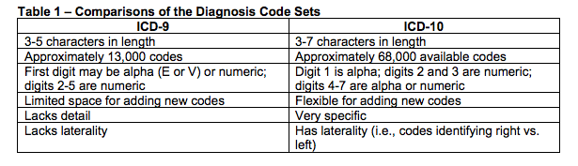
ICD-10
US switched from ICD-9 to ICD-10 October 2015
AMA, 2010 http://www.ama-assn.org/ama1/pub/upload/mm/399/icd10-icd9-differences-fact-sheet.pdf
Notes:
What was ICD originally for?

Slide 39
ICD-10’s Greater Specificity
Insomnia (ICD-10 has 10 insomnia related codes)
  alcohol related insomnia (F10.182, F10.282, F10.982)
  drug-related insomnia F11.182, F11.282, F11.982, F13.182, F13.282, F13.982,F14.182, F14.282, F14.982, F15.182, F15.282, F15.982, …
  idiopathic insomnia (F51.01)
  insomnia due to a mental disorder (F51.05)
  insomnia not due to a substance or known physiological condition (F51.0-)
  nonorganic insomnia (F51.0-)
  insomnia, organic (G47.0)
  primary insomnia (F51.0)
For whose benefit? by whom? when should coding happen?

Slide 40
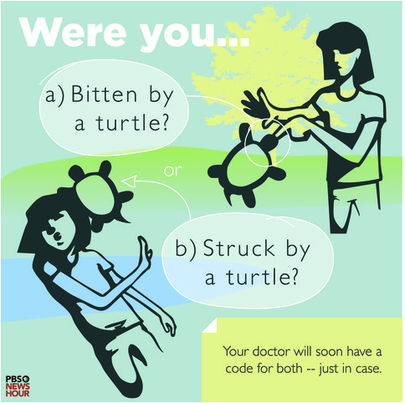
Fun with ICD-10
Notes:
http://www.healthit.gov/newsroom/infographic-record-health-information-technology

Slide 41
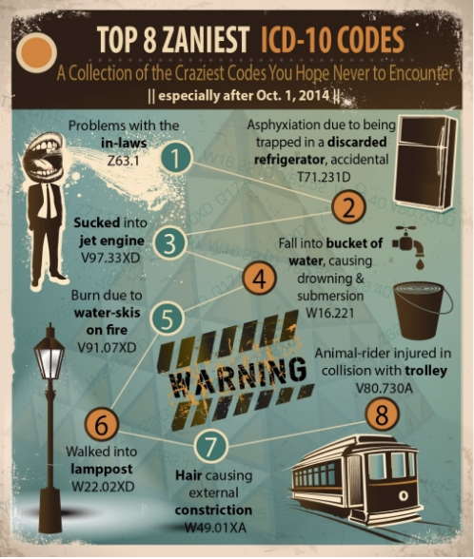
Fun with ICD-10
Notes:
http://www.healthit.gov/newsroom/infographic-record-health-information-technology

Slide 42
Challenge of Naming Data
The more coded your data, the more expressive the vocabulary, the more traditional computing you can do with the data
  because the computer can “understand” more
But coding costs time and effort
  e.g., selecting billing codes
How to make coding easier/cheaper?
  templates
  pay a medical scribe or have the patient do it
  automatic coding from text, voice recognition, etc.

Slide 43
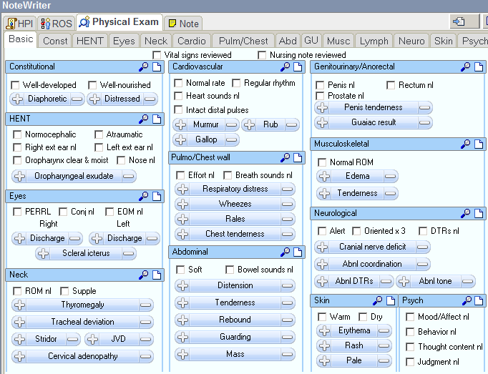

Structured Data $≠$ Coded Data

Slide 44
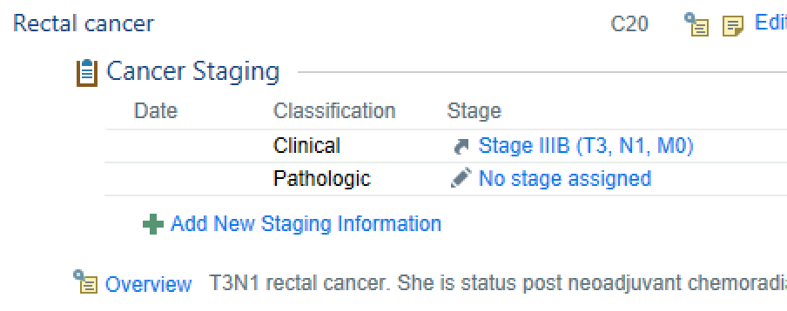
How Coded is the Coded Data?
Availability of coding does not mean coding is used!
e.g., Problem List
  “>80% of patients have > 1 entry in structured data” (MU #1)
  to what vocabulary? who does the coding? gamed”?
Malignant neoplasm of rectum

Slide 45
Coding Accuracy (ICD-9 example)
VBAC uterine rupture rate
  665.0 and 665.1 ICD-9 discharge codes used in study (NEJM 2001;345:3-8)
  letter to editor: in 9 years of Massachusetts data
    716 patients with 665.0 and 665.1 discharged
    reviewed 709 charts
    363 (51.2%) had actual uterine rupture
      others had incidental extensions of C-section incision, or were incorrectly coded or typed
    674.1 (dehiscence of the uterine wound) used to code another 197 ruptures (or 35% of confirmed cases of uterine rupture)
    i.e., sensitivity 65%, specificity 51.2%
Notes:
what dangers are there for using ICD for research?

Slide 46
Naming EHR Data: Summary
Unstructured free text doesn't help much (but wait for NLP discussion later in class)
  the more structured it is (i.e., more defined fields), the better
If just coded sporadically in ICD-10
  problem with gamed codes, poor coding reproducibility, unreliable specificity
Very, very few EHRs coded in SNOMED
  some clinical concepts still not well covered
  SNOMED is essentially unusable by front-line clinicians
Current approach of front-line clinicians coding at specificity is a questionable approach
  Use scribes, use automation, or do “late binding” and code later as need arises

Slide 47
Outline
Historical context: “Meaningful Use” of EHRs
EHR Data Flow and Storage
Naming EHR Data
Getting EHR Data for Research
Summary

Slide 48
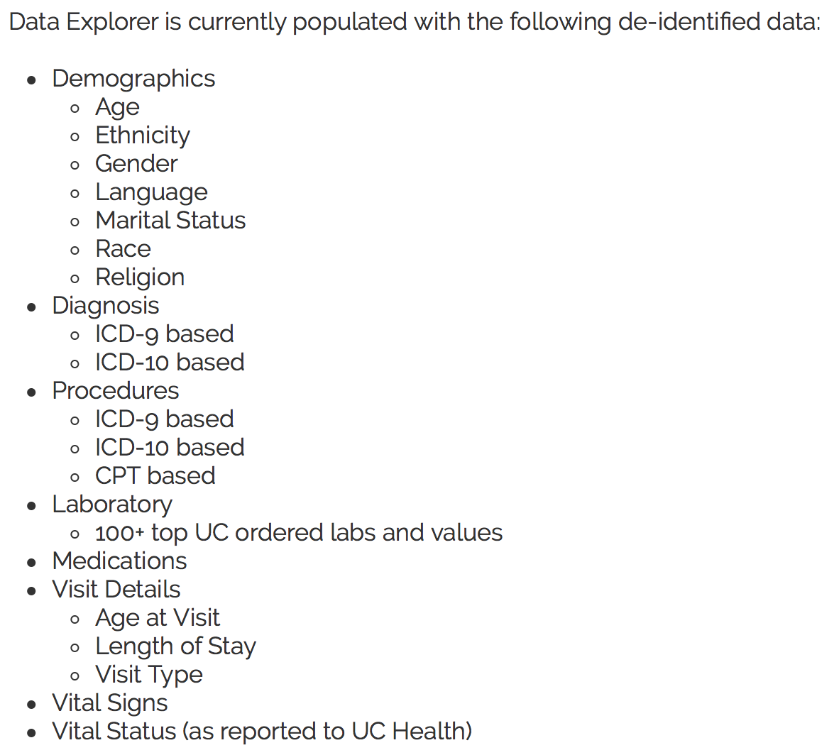
UC ReX Demo
Data from all 5 UC EHRs mapped to common i2b2 ontology, coded in ICD-9 and ICD-10
Specifically for cohort discovery
Sign up at https://myresearch.ucsf.edu/uc-rex
  complete Research Data Tools Request form
  browse/search at https://ucrexi2b2.ucsf.edu/
Notes:
Diabetes, CKD
Diabetes, Female, Native American = 71
Launch VMware from Mac, enter UCSF mail credentials, launch Cohort Selection Tool (RDB won’t launch, login doesn’t work for UC Rex (campus\isim )

Slide 49
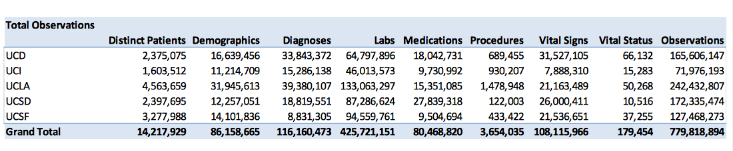
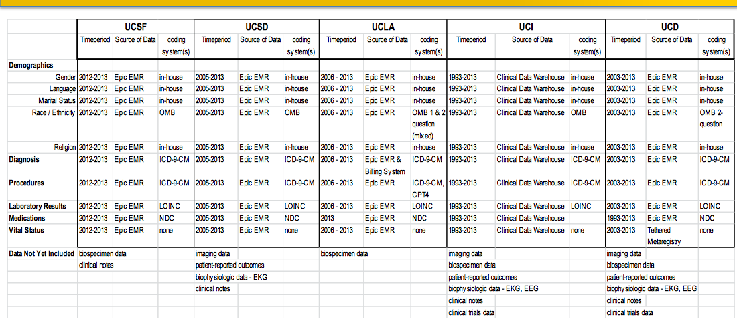
UC ReX November 2015
Notes:
Aug 2015 for top table, Nov 2015 for bottom table.

Slide 50
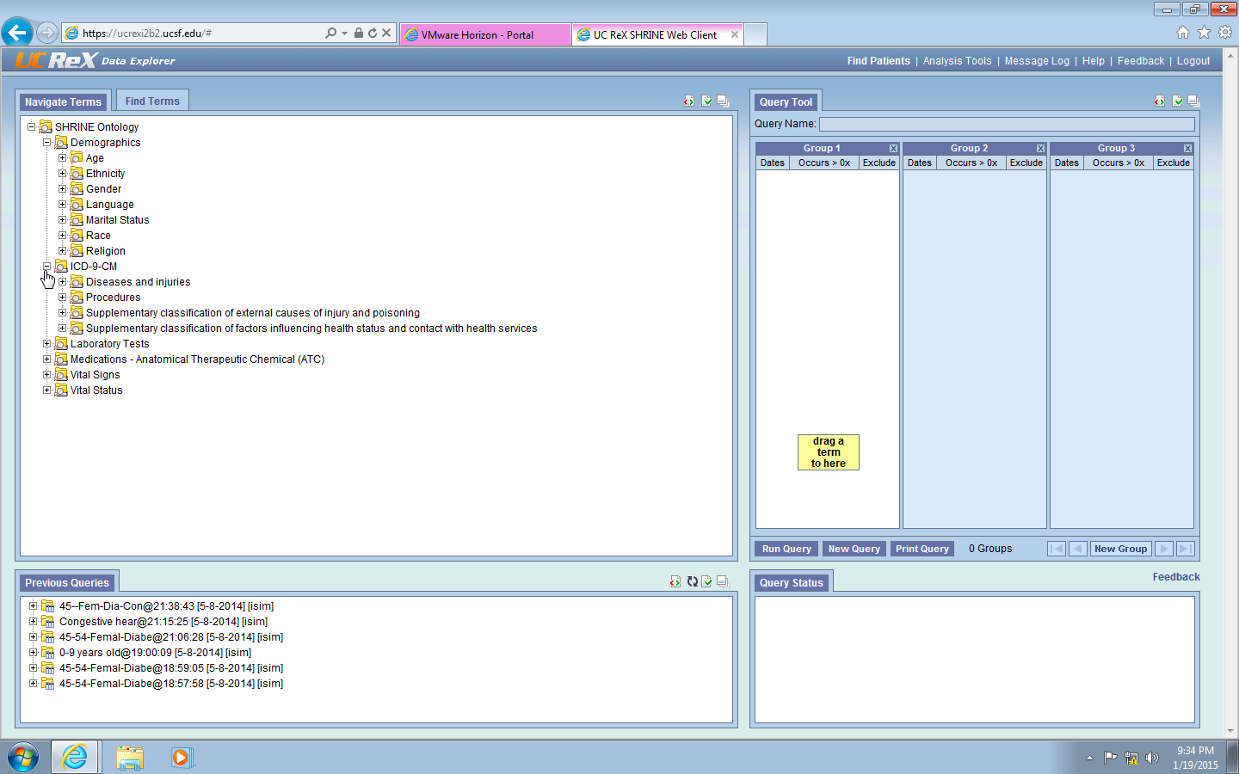

Slide 51
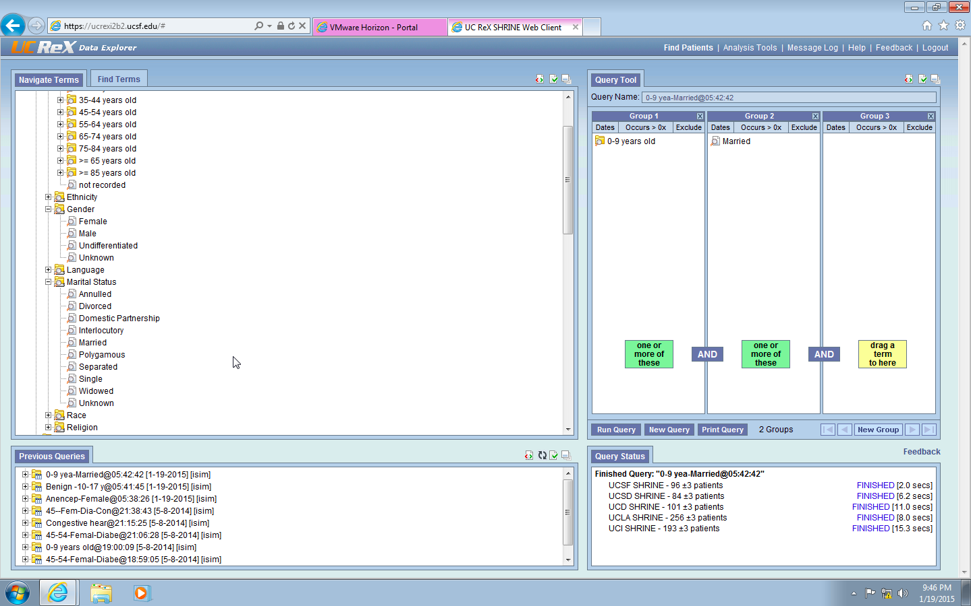

Slide 52
Summary
“Big slug of money” got everyone onto substandard technology where usability is poor
Data coding is difficult, done more for billing than research, and possibly not needed
Getting EHR data for research is not easy, most tools are for cohort discovery only
  UCSF options: Research Data Browser and flat files, Cohort Selection Tool
  UC-wide options: UC ReX, UC Healthcare Data later in 2018?
Still early days at UC and nationally around policies, technology, and governance for making EHR data usefully available for research

