Slide 1
Measures of Disease Association II and Measures of Attribution
Main points to be covered
Measure of association in case-control studies
  If/how the OR estimates other ratio measures depends on type of control sampling & nature of underlying cohort
Strengths and weaknesses of case-control studies
Measures of attribution
  Attribution among the exposed
  Attribution among the entire population

Slide 2
How to measure disease association in case-control designs?
In cross-sectional or cohort study, we compare the occurrence of disease in exposed vs unexposed
  Most intuitive approach to evaluating causal effect of the exposure
In case-control design, we can’t do this

Slide 3
What can we estimate in a case-control study?
Case-control study of TZD use & fracture in diabetes [TZD = thiazolidinedione, a class of diabetes meds]
 | Fracture | No fracture
TZD use | 65 | 198
No TZD use | 955 | 3530
 | 1020 | 3728
Study with 3-4 controls per case. What happens if we try to estimate incidence or odds of fracture in either exposure group?
Meier et al. Arch Intern Med 2008
Notes:
Here’s an example of a case-control study. The investigators selected about four controls per case (1020 to 3728).

Slide 4
Can’t estimate probability of event by exposure status
Case-control study of TZD use & fracture in diabetes Conducted over 10 yrs. 3-4 CONTROLS PER CASE
 | Fracture | No fracture | “Probability of event”
TZD use | 65 | 198 | 65/(65+198) =0.25
No TZD use | 955 | 3530
 | 1020 | 3728
“Probability” of a fracture in TZD users is 0.25 (over 10 years). Seems high but we can make it even higher…
Notes:
If we try to estimate fracture “probability” in the exposed, it appears to be 0.25. But, this number does not make sense. We can alter it simply by changing the number of controls for the study.

Slide 5
Can’t estimate probability of event by exposure status
Case-control study of TZD use & fracture in diabetes REDUCE CONTROLS BY 50%
 | Fracture | No fracture | “Probability of event”
TZD use | 65 | 99 | 65/(99+65) =0.40
No TZD use | 955 | 1765
 | 1020 | 1864
“Probability” of a fracture in TZD users is now 0.40
Illustrates why the probability (or odds) of disease can’t be estimated in a case-control design
Notes:
For example, if the investigators had selected only ~2 controls per case (a total of 1864), the calculated “probability” of a fracture would go up to 0.40. Doing the math in this example illustrates the general principle that disease occurrence cannot be estimated from a case-control design.

Slide 6
What can we estimate in a case-control study?
Case-control study of TZD use & fracture in diabetes
If we try to estimate incidence or odds of fracture in either exposure group, the result is nonsense. It depends on whether the study selected 4 controls per case, or 2 controls per case, etc.
 | Fracture | No fracture
TZD use | 65 | 198
No TZD use | 955 | 3530
 | 1020 | 3728
X
X
Meier et al. Arch Intern Med 2008
Notes:
Since the case-control design starts with the cases and controls and fixes the ratio of the two by selecting one or more controls per case, the investigator cannot assess disease occurrence (probability, rate or odds) within the different exposure groups. All the investigator can do is to work down the table.

Slide 7
Measure of Association in
Case-Control Studies
Can’t measure disease occurrence (prevalence, risk, rate, or odds) in case-control design
But we can measure odds of exposure
  and hence odds ratio of exposure
  not immediately apparent that this is what we want
  until we take advantage of mathematical properties of OR to obtain our desired measure
    the OR of disease
Notes:
Since the case-control design starts with the cases and controls and fixes the ratio of the two by selecting one or more controls per case, the investigator cannot assess disease occurrence within the different exposure groups. However, the odds of exposure in the cases and controls can be estimated from a case-control study. As we will illustrate in the next few slides, the OR of exposure is equal to the OR of disease. This useful property of the OR enables us to analyze disease association in a case-control study.

Slide 8
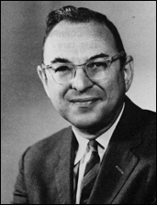
Favorable property of odds ratio #3:
OR is a lifesaver in case-control studies
A useful property of OR:
OR of exposure (what we can get)
= OR of disease (what we want)
Key methodologic advancement in study of smoking and lung cancer, and of epidemiology per se as a field
  Jerome Cornfield’s work in 1951
Notes:
We introduced this concept last week in our discussion of the odds ratio. This property of the odds ratio is crucial to case-control design because it is the odds ratio of exposure in the diseased (cases) and controls that is actually measured in a case-control study, but it is the odds ratio of disease in the exposed and unexposed that we are interested in. Fortunately, they are mathematically identical. This identity was pointed out in 1951 by Jerome Cornfield, a pioneer theorist who at the time was working at the nascent National Cancer Institute. Without the work of Cornfield and others, most of us in the room today would be smoking.

Slide 9
Odds ratio of exposure in diseased and not diseased
Disease
a
Yes
No
a + c
Odds of E in D =
a
b
a
Yes
1 -
a + c
Exposure
b
c
d
Odds of E in not D =
b + d
No
b
1 -
b + d
a + c
b + d
Notes:
So now we are calculating the probabilities of exposure and non-exposure in those with disease and similarly for those without disease and then forming odds and an odds ratio. The odds, with our arrangement of disease across the top, are calculated within the columns rather than within the rows. We are looking at it this way in order to show that the odds ratio for exposure equals the odds ratio for disease.

Slide 10
Odds ratio of exposure in diseased and not diseased
Disease
a
Yes
No
a + c
Odds of E in D =
a
b
c
Yes
a + c
Exposure
b
c
d
Odds of E in not D =
b + d
No
d
b + d
a + c
b + d
Notes:
Further mathematical rearrangment

Slide 11
Odds ratio of exposure in diseased and not diseased
Disease
Yes
No
a
a
b
Yes
c
OR_{exp} =
Exposure
b
c
d
No
d
a + c
b + d
Notes:
So now we are calculating the probabilities of exposure and non-exposure in those with disease and similarly for those without disease and then forming an odds ratio. So the probabilities, with our arrangement of disease across the top, are calculated within the columns rather than within the rows. We are looking at it this way in order to show that the odds ratio for exposure equals the odds ratio for disease.

Slide 12
a
c
b
d
c
b
c
b
a
b
c
d
Important characteristic of odds ratio
ORexp =
= OR_{dis}
=
X
OR for exposure = OR for disease
Notes:
Again some algebra demonstrates that we get the same term as before. This is an important property of the odds ratio and its use in case-control studies. Note that measuring prevalence of exposure (rather than odds) in cases and controls does not give you a prevalence ratio that has any meaningful interpretation.

Slide 13
Favorable property of odds ratio #3:
OR is a lifesaver in case-control studies
We can get OR of disease in a case-control study
Yet, we spoke earlier about some of the problems with ORs (e.g., interpretation, non-collapsibility)
Can we get OR of disease in case-control design to estimate even more useful measures of association (e.g., risk ratio or rate ratio)?

Slide 14
What the OR in a case-control study estimates
Depends on underlying cohort and control sampling
Type of Cohort | Control Sampling Scheme | Interpretation of OR
Fixed | Random sample of everyone at time zero (baseline) “case-cohort” | Unbiased estimate of risk ratio (and hazard ratio)
 | Random sample of non-cases each time a case occurs “incidence density” | Unbiased estimate of rate ratio
 | Random sample of non-cases after cases have been identified “prevalent control”, “cumulative”, “epidemic”, “exclusive” | If disease incidence low: Approximation of risk ratio
Notes:
The answer is yes and these tables (on this slide and the next) give a summary of just what useful measures of association the OR from a case-control study can estimate.
For a long time, it was generally accepted that the OR in a case-control study in a fixed underlying cohort could be thought of as approximating the risk ratio if “the disease was rare.” This is known as the “rare disease assumption”. This idea stems from the properties of odds we discussed in the last lecture; i.e., the odds approximates the probability when the probability is low (say, less than 10%) and therefore a ratio of odds approximates a ratio of probabilities when the probabilities are low. We will illustrate this again later in the lecture.
Current epidemiologic theory has demonstrated that we don’t always need the outcome to be rare in order for the odds ratio to estimate meaningful measures of association. Depending on the sampling design, the odds ratio can give an unbiased estimate of the ratio measures without this “rare disease” assumption.
Specifically, what the OR in a case-control study estimates depends upon the nature of the underlying cohort and the control sampling. This slide focuses on case-control studies in the context of a fixed cohort, and the next slide focuses on dynamic cohorts. In a fixed cohort, we can take a random sample of the cohort at baseline for our control group (case-cohort design). We could also use incidence density sampling, identifying control(s) each time a case occurs. Or, we can take a random sample of non-cases after all cases have been identified.

Slide 15
What the OR in a case-control study estimates
Depends on underlying cohort and control sampling
Type of Cohort | Control Sampling | Assumption Regarding Exposure | Interpretation of OR
Dynamic | Each time a case occurs “incidence density” | None | Unbiased estimate of rate ratio
 | At midpoint of case accumulation period | Steady state or changing linearly over time Changing in a non-linear, unknown way: | Unbiased estimate of rate ratio Uninterpretable odds ratio
 | After all cases identified “prevalent/cumulative epidemic/exclusive” | Steady state Not at steady state | Unbiased estimate of rate ratio Uninterpretable odds ratio
Notes:
In a dynamic cohort, we can also use incidence density sampling by taking control(s) when a case occurs. This is the cadillac approach for an underlying dynamic cohort. However, if we are willing to assume that the dynamic cohort is in “steady state” in terms of the exposure we can also use a random sample of the dynamic cohort taken at one time point, such as the midpoint or after all cases have been identified. However, if exposure is not a steady state, as we will discuss, then we can still have an unbiased estimate of the rate ratio as long as we assume that the exposure is changing linearly over time, which is often a hard assumption to swallow. If are unable to make this assumption, then all you have is an odds ratio which is essentially uninterpretable.

Slide 16
What the OR in a case-control study estimates
Depends on underlying cohort and control sampling
Type of Cohort | Control Sampling Scheme | Interpretation of OR
Fixed | Random sample of everyone at time zero (baseline) “case-cohort” | Unbiased estimate of risk ratio (and hazard ratio)
 | Random sample of non-cases each time a case occurs “incidence density” | Unbiased estimate of rate ratio
 | Random sample of non-cases after cases have been identified “prevalent control”, “cumulative”, “epidemic”, “exclusive” | If disease incidence low: Approximation of risk ratio

Slide 17
To understand what OR in a case-control study estimates, we return to setting of fixed cohort
Some abbreviations/notation:
1= exposed and 0 = not exposed
E1 = Events = cases in exposed group
E0 = Events = cases in unexposed group
N1 = no. of persons in exposed group (at baseline)
N0 = no. of persons in unexposed group (baseline)
Notes:
Some notation we will need to see how the OR estimates other ratio measures. This is the same notation we used previously in illustrating the measures of disease occurrence with the addition of a 1 or 0 subscript to distinguish exposed from unexposed persons.

Slide 18
Notation in a 2x2 table in fixed cohort
Disease
Yes
No
Yes
E₁
N₁
Exposure
No
E₀
N₀
Notes:
This graphic puts our new notation for a cohort study in a 2x2 table.

Slide 19
OR as unbiased estimate of risk ratio
How can the odds ratio in a case-control study, specifically in context of a fixed cohort study base, estimate the risk ratio?

Slide 20
Risk ratio in a cohort study
Risk ratio =
In a fixed cohort study without loss to follow-up.
How can we estimate these two ratios with a case-control design?
Notes:
To simplify the presentation, assume a fixed cohort with complete and equal follow-up on everyone in both groups (i.e., the outbreak example we have talked about). In that case everyone at baseline is present at the end of the study and the risk ratio is calculated simply as shown above. In the situation of the typical cohort with censoring, it is a bit more complicated, but one can easily see that if the assumption of no informative censoring is met, then our demonstration that the OR is an unbiased estimate of the risk ratio will also hold true in a situation with censoring. Note, the meaning of no informative censoring is that the censoring is not related to the event nor to exposure so the four groups above retain their original proportions.
The algebra just rearranges the risk ratio such that we can focus on two separate ratios. The first is the ratio of exposed cases to unexposed subjects. The second is the ratio of unexposed subjects at baseline to exposed subjects at baseline. Also remember that when the risk ratio is reported it has to be reported for some time period (e.g., the risk ratio at 12 months of follow-up), but that time period does not affect the algebra we are illustrating.

Slide 21
Capturing the events with a case-control design
From a well-defined study base:
  Capture all the incident cases (E) that arise, measure exposure. Can then form the ratio
  Or a random sample of the cases will give the same ratio
Notes:
In a fixed cohort, it is often quite feasible to capture all incident cases of a given disease or outcome. If all cases can be captured or even a random sample, then E1/E0 can be formed.

Slide 22
Estimating risk ratio in a case-control study
Risk ratio =
So we have this ratio with the cases,
Now we just need an estimate of this ratio
Notes:
Returning to the earlier slide of how the risk ratio is calculated in a cohort study with complete follow-up and comparing this to the 2x2 table for a case control study, inverting the ratio on the bottom from the 2x2 table slide and multiplying gets the same right-hand term shown above.

Slide 23
Notation in a 2x2 table of a cohort study
Disease
Yes
No
Yes
E₁
N₁
Exposure
No
E₀
N₀
Notes:
Reminder: Here’s the 2x2 table for a cohort, showing N1 and N0. These are just the number of exposed and unexposed participants in the cohort at baseline.

Slide 24
Estimating exposure in the baseline cohort
This is the ratio of unexposed and exposed in the study at baseline (time 0).
Obtain unbiased estimate of this ratio by taking a sample of the study at baseline.

Slide 25
Case-cohort:
N₀ / N₁ is sampled randomly from baseline
CE
Cases
E₁
E₀
N₀
N₁
Controls
Time
Notes:
The answer to finding an unbiased estimate of the N₀ / N₁ ratio is in the case-cohort design. This design is distinguished by taking a random sample of the baseline. Since everyone is eligible to be in this sample and it is taken independently of exposure, the sample will give an unbiased approximation of the ratio N₀ / N₁ . The fraction N₀ / N₁ comes from the sampling everyone in the cohort at random at the baseline thereby obtaining a random sample of the proportions exposed and unexposed in the entire cohort.
The fraction E₁ / E₀ comes from all the cases, some of whom have the exposure and some of whom do not. All of the cases are included in the study (although also could be a random sample), so unbiased estimates of both the ratio of exposed to unexposed cases and the ratio of exposed to unexposed in the original cohort are obtained in a case-cohort design.

Slide 26
Case-Control Notation
To switch from the notation of a cohort to case-control design, the events in a case-control study are the cases.
For the case-cohort design, the controls are a random sample of the baseline cohort,

Slide 27
How OR = Risk ratio in a Case-Cohort design
k=sampling probability
of baseline
OR = a/c =
  b/d
E₁
E₀
N₁
N₀
Cases
Controls
a = E₁
b ≈ k×N₁
Yes
Exposure
c = E₀
d ≈ k×N₀
No
Notes:
This graphic puts the notation from a cohort of exposed and unexposed cases and the proportions of the cohort exposed and unexposed into the notational framework of the 2x2 table we have been using to illustrate the properties of the odds ratio. The critical point is that the controls in the case cohort design estimate the proportions exposed and unexposed in the whole cohort, so cells b and d are unbiased estimates of a sample of N₁ and N₀ , where K = probability with which the exposed and unexposed were sampled from the baseline of the cohort. When the odds ratio of exposure in the cases and controls is formed and the notation from a cohort is substituted for the cells in the 2x2 table (the sampling probability k cancels out), the resulting ratio is the same as the risk ratio as completing the algebra on the next slide shows. Recall that the odds of exposure among those with disease is easily formed simply by taking the ratio of the counts in the cells from the disease column, and the odds of exposure in those without disease is similarly formed. The ratio of the two ratios is the odds ratio.

Slide 28
Odds ratio estimates risk ratio in case-cohort study
Risk ratio =
= Odds ratio
Notes:
Returning to the earlier slide of how the risk ratio is calculated in a cohort study with complete follow-up and comparing this to the 2x2 table for a case control study, inverting the ratio on the bottom from the 2x2 table slide and multiplying gets the same right-hand term shown above. Thus the case-cohort odds ratio estimates the risk ratio.

Slide 29
Case-Cohort Sampling
Control (reference) group is random sample of cohort at baseline
Estimates the odds of exposure in the study base (i.e., estimates N0 / N1)
Control group can be used for >1 outcome
Can use same controls later for more follow-up or other outcome
Relatively new design: first described by Kupper (1986) and extended by Prentice (1986)
Odds ratio estimates the risk ratio
Notes:
The case-cohort design differs from the other approaches to sampling controls by taking a sample of the cohort, or the study base, at time zero. This random sample of the baseline population will estimate the proportion exposed and unexposed in the entire study base. With that ratio, the risk ratio for the study base experience can be estimated without bias.
This design is not very well known as it is relatively new in the scheme of designs. Among its advantages are the use of the same control group for more than one outcome or for additional follow-up at time later than the current study. Examining time-varying exposures can be a problem if only baseline data are available on the controls in contrast to incidence-density sampling that selects controls matching on time.
An example of a situation where case-cohort is an excellent design option is where one may have data from a population-based survey (questionnaires, perhaps biological samples stored) and that population can be tracked for the incidence of a disease outcome. Because the measurements of predictors were made only at one point in time, incidence density sampling is not possible but case-cohort sampling is.

Slide 30
STATA: Case-cohort sampling
Once incident cases are identified, need a random sample of the baseline cohort
Exclude prevalent cases
Take random sample of all other participants
STATA command for random sample:
  Sample #, count
For example, to obtain a sample of 200
  Sample 200, count

Slide 31
Case-cohort design and hazard ratio
For completeness, it is important to note:
Case-cohort design can also provide an unbiased estimate of the hazard ratio
Requires statistical regression models to estimate (e.g., modified form of proportional hazards model)
We won’t derive the proof
Notes:
It turns out that the case-cohort design can also provide an unbiased estimate of the hazard ratio. Indeed, this is the most common method for multivariable-adjusted analyses of case-cohort studies. We will not provide a heuristic proof in this course, as we did with the OR as an unbiased estimate of the risk ratio.

Slide 32
Case-Cohort Study: Serum 25 Hydroxyvitamin D and the Risk of Hip and Non-spine Fractures in Older Men
The present study is a case-cohort study nested within the prospective design of MrOS. Men without sufficient serum for vitamin D assays were excluded from all analyses. Of the 5,908 eligible participants, we randomly selected 1608 men to serve as the sub-cohort. In this subcohort, two participants were excluded: one participant with insufficient serum, and another who had 25(OH) vitamin D levels >3 SD above the mean (75.6 ng/ml). The resulting 1606 men constituted the subcohort for this study.
We observed 435 incident non spine fracture cases (including 81 hip fractures) in the entire cohort over the 5.3 years of follow-up. Among these cases, 112 individuals were also sampled within the subcohort.
Cauley et al. JBMR 2009
Notes:
Here is more detail on the methods for selecting cases and controls in this study. Cases were ALL incident cases of non-spine fracture. It would also be valid to take a random sample of the cases. Investigators might choose this approach if they have a large number of cases. In this study, the investigators wanted to use all available cases. They selected a “sub-cohort” that was about 4 times larger than the cases. The term sub-cohort is often used for the random sample of the baseline population. This illustrates that the subcohort can include subjects that become cases as well as those that remain non-cases during the follow-up period. The authors note that 112 men in the subcohort were also included in the fracture cases.

Slide 33
Case-cohort within MrOS Cohort
Cohort baseline = 5,908 subjects
CE
Cases
435 incident
cases of
non-spine fracture
112 of 435 cases included in 1608
Assays on 1608+435-112 = 1931
1608 men
randomly
sampled for
blood tests
Efficient!
Controls
Time
Notes:
This uses our text graphic to illustrate the case-cohort study from the MrOS study just described. The efficiency of the design is seen in the need to do biological tests on stored serum samples. Questionnaire variables such as age and gender were captured on everyone in the cohort and for questions using on questionnaire variables, the investigators could just use the entire cohort, but for biological measures, that would have been prohibitively expensive and also inefficient since there are far more controls than are needed for 435 cases (4 controls per case is usually considered about the maximum useful number since additional controls add very little to power). Instead of obtaining assays on 5908 participants, the investigators only had to obtain assays on 1608+435-112 (cases also in subcohort) =1931

Slide 34
Serum 25 Hydroxyvitamin D and the Risk of Hip and Non-spine Fractures in Older Men: Results
ABSTRACT
To test the hypothesis that low serum 25-hydroxyvitamin D [(25(OH) vitamin D] levels are associated with an increased risk of fracture we performed a case-cohort study of 435 men with incident non-spine fractures including 81 hip fractures and a random subcohort of 1608 men; average follow-up time 5.3 years. Serum 25(OH) vitamin D2 and D3 were measured on baseline sera… Modified Cox proportional hazards models were used to estimate the hazard ratio (HR) of fracture with 95% confidence intervals. …
Cauley et al. JBMR 2009
Notes:
This particular example was analyzed with a modified version of proportional hazards regression. The modification takes into account the sampling scheme. Use of proportional hazards model allows for multivariable adjustment for confounders. The resulting measure of association is a hazard ratio.

Slide 35
Results
** Per SD decrease in Vitamin D
Notes:
These results give us more practice of how to display measures of association when the exposure is a continuous variable.
(Note: authors appropriately reported the results of this case-cohort study as a “relative hazard.” We prefer hazard ratio, but relative hazard is also clear.)
The authors described vitamin D level, which is natively continuous, in several ways. One way was to break it into quartiles. As we described before, with any categorical variable, it is essential to provide the reference category, as the authors have done here. The 4th quartile is set as the “reference” group or “referent” group. Hazard of fracture in other quartiles is compared to the hazard of fracture in the 4th quartile.

Slide 36
Describing results for quartiles of Vitamin D and fracture
Highest quartile of vitamin D is the reference group. Other quartiles of vitamin D are compared to this reference group.
  Always label reference group, even with dichotomous variable
  Don’t make readers guess/assume the reference group
HR for non-spine fracture, comparing those in the first and fourth quartiles, is 1.21.
“Those in the lowest quartile of serum vitamin D have a rate of non-spine fracture that is 1.21 times as high as those in the highest quartile.”
Notes:
Reporting the exposure-disease association using quartiles of the exposure is an approach that we discussed last week. In this report the highest quartile of vitamin D is the reference group, assigned a HR of 1.00 (i.e. no association). The other quartiles of vitamin D are compared to this reference group. Thus, the hazard ratio for non-spine fracture, comparing those in the first and fourth quartiles, is 1.21. Or, we could say that “Those in the lowest quartile of serum vitamin D have a rate of non-spine fracture that is 1.21 times as high as those in the highest quartile.”

Slide 37
Describing results for continuous measure of vitamin D and fracture
For continuous exposures placed into a regression model in their native form, HR = association for 1 unit increment in the exposure
For exposures with a wide range of values, expressing the measure of association for 1 unit increment in the scale can often produce very small measures of association
  humans find these hard to interpret
As an alternative, measures of association expressed as:
  “per standard deviation”
    e.g., HR = 1.07 is for a SD decrease in vitamin D
  per some larger increment in the scale
    e.g., “The rate of non-spine fracture is 1.11 times as high for each 10 ng/ml decrease in vitamin D”
  In any case, the units must always be clearly labeled
Notes:
For a continuous variable, the hazard ratio estimates the association between a 1 unit change in the exposure and the outcome of interest.
How do we interpret the other results? “per SD” and “per 10 ng/ml”? Per SD stands for “per standard deviation.” In this case the SD is 7.9 ng/ml, and the hazard ratio of 1.07 is for a 7.9 ng/ml decrease in vitamin D. The HR of 1.11 is for a 10 ng/ml decrease in vitamin D. This HR could be described as “The rate of non-spine fracture is 1.11 times as high for each 10 ng/ml decrease in vitamin D.”

Slide 38
Some practical concerns in case-cohort design
What % of baseline have blood (or image, etc.) archived?
Are data missing randomly?
Previous case-cohort or cross-sectional studies of the baseline may have used specimens. Effect on distribution of those remaining?
If baseline accrual was lengthy, will different storage times affect assay?
Notes:
Although the case cohort design is very powerful, it is important in designing these studies to have an up-to-date assessment of the state of the cohort archives for the materials essential to the case cohort study. It may not be possible to obtain a random sample of the baseline cohort because of practical constraints. For example, data may not have been stored, or may have become corrupted, for some of the participants. Need to know if this was random. Or, a more likely source of bias, stored specimens may have been used for previous case control studies that oversampled particular case groups.

Slide 39
What the OR in a case-control study estimates
Depends on underlying cohort and control sampling
Type of Cohort | Control Sampling Scheme | Interpretation of OR
Fixed | Random sample of everyone at time zero (baseline) “case-cohort” | Unbiased estimate of risk ratio (and hazard ratio)
 | Random sample of non-cases each time a case occurs “incidence density” | Unbiased estimate of rate ratio
 | Random sample of non-cases after cases have been identified “prevalent control”, “cumulative”, “epidemic”, “exclusive” | If disease incidence low: Approximation of risk ratio
Notes:
What if we are interested in estimating a rate ratio from a case-control study and cannot do case-cohort sampling.

Slide 40
What the OR in a case-control study estimates
Depends on underlying cohort and control sampling
Type of Cohort | Control Sampling | Assumption Regarding Exposure | Interpretation of OR
Dynamic | Each time a case occurs “incidence density” | None | Unbiased estimate of rate ratio
 | At midpoint of case accumulation period | Steady state or changing linearly over time Changing in a non-linear, unknown way: | Unbiased estimate of rate ratio Uninterpretable odds ratio
 | After all cases identified “prevalent/cumulative epidemic/exclusive” | Steady state Not at steady state | Unbiased estimate of rate ratio Uninterpretable odds ratio
Notes:
This is particularly an issue in a dynamic cohort where there is no time zero to sample.

Slide 41
Estimating a rate ratio in a case-control study
For calculating an incidence rate ratio, what is analogous to estimating the proportion of exposed and unexposed persons in obtaining a risk ratio?
Answer: the proportion of exposed and unexposed person-time
Notes:
The first concept is to remember that when we talk about rates, we are talking about person-time and when we talk about measures of association we are talking about looking at incidence rates within the groups of exposed and unexposed persons. To calculate the risk ratio in a case-control setting we need to get an unbiased estimate of the proportion of persons with and without the exposure. For the rate ratio we need an analogous estimate of exposed and unexposed person-time.

Slide 42
Rate ratio in cohort where = exposed
and = unexposed person-time
Rate Ratio =
So analogous to estimating risk ratio, we need to
estimate the proportion
If we can estimate this proportion in a case-
control study, we can estimate the rate ratio
Notes:
This just does the same algebra we have seen in manipulating the form of the risk ratio for the rate ratio to isolate the crucial proportion we need to estimate in order to get the rate ratio.

Slide 43
Incidence rate notation in a cohort study
Disease
Person-time
Yes
E₁
N₁ T₁
Exposure
E₀
N₀ T₀
No
Notes:
In a cohort study, we calculate the rate in the exposed and the rate in the unexposed, to form the rate ratio.

Slide 44
Incidence density sampling
Controls are sampled from the risk set at the time each case is diagnosed
  Samples person-time experience of the subjects at risk each time a case is diagnosed
Odds ratio estimates the rate ratio
Notes:
A case-control study with incidence density sampling gives an odds ratio that estimates the rate ratio because the sampling method is based on person-time of exposure. Every time a case is diagnosed the person-time of the subjects at risk in the study base (cohort) is sampled randomly.

Slide 45
Incidence density sampling in a fixed cohort study base
Controls are matched to cases on time at risk (same amount of follow-up time)
Sampling non-cases at each time case occurs samples person-time
Someone who is a control at one time can later be a case and/or a control again
Notes:
The key point is that with incidence density sampling in a fixed cohort study base the controls are matched on the amount of follow-up time, so you are sampling both persons and time when you pick the controls and therefore you can conceptualize it as sampling the person-time of the cohort each time a diagnosis is made. As with the case-cohort design, someone who is a control can later become a case but this should not be seen as a problem.

Slide 46
Incidence density sampling within a fixed cohort
CE
Cases
Followup time
Controls
Since controls are matched on follow-up time, sampling controls each
time a case occurs samples the person-time of the cohort to that point.
Notes:
The schematic illustrates how matching on follow-up time would be sampling the person-time follow-up of the cohort as time progresses. Imagine ending the study after the first event occurs. A random sample of those still at risk at that time will give a ratio of exposed and unexposed person-time that is the same as the ratio obtained using everyone in the cohort at that time point (give or take random sampling error). The same reasoning applies to each subsequent event. The sum of all those person-time samplings will approximate the total person-time follow-up of the cohort in the exposed and unexposed provided the control samples were taken independently of exposure (always the key issue!).

Slide 47
New
Residents
Incidence Density Sampling In Dynamic Cohort (e.g., SF County)
CE
CE
Cases
Calendar Time
Controls
Sampling in a dynamic cohort gives unbiased estimate of
person-time in the same way as sampling in a closed cohort

Slide 48
Incidence density sampling
Individual can be sampled as control more than once
Individual sampled as a control can be a case later

Slide 49
How OR = Rate ratio in a case-control study
with incidence density sampling
k=sampling
probability
of person-time
So OR =
a/c =
b/d
E₁
E₀
N₁T₁
N₀T₀
Cases
Controls
Yes
a = E₁
b ≈ k×N₁ T₁
Exposure
c = E₀
d ≈ k×N₀ T₀
No
Notes:
So analogously to showing how the OR in a case-cohort design estimates the risk ratio, using the same graphic shows how the OR in a case-control design with incidence density sampling estimates the rate ratio because the controls are providing an estimate of the proportion of exposed to unexposed person-time.

Slide 50
Rate ratio in cohort where = exposed
and = unexposed person-time
Rate Ratio =
=
= Odds Ratio
Notes:
Completing the algebra shows that this OR is equivalent to the rate ratio.

Slide 51
Incidence density sampling
...In a population-based case-control study in Germany, the authors
determined the effect of alcohol consumption at low-to-moderate levels
on breast cancer risk among women up to age 50 years. The study
included 706 case women whose breast cancer had been newly
diagnosed in 1992-1995 and 1,381 controls matched on date, age,
and residence. In multivariate conditional logistic regression analysis,
the adjusted odds ratios for breast cancer were 0.71 (95% confidence
interval (CI): 0.54, 0.91) for average ethanol intake of 1-5 g/day, 0.67
(95% CI: 0.50, 0.91) for intake of 6-11 g/day, 0.73 (95% CI: 0.51, 1.05)
for 12-18 g/day, 1.10 (95% CI: 0.73, 1.65) for 19-30 g/day, and 1.94
(95% CI: 1.18, 3.20) for > or = 31 g/day. . . These data suggest that
low-level consumption of alcohol does not increase breast cancer risk
in premenopausal women.
Kropp, S; Becher, H; Nieters, A; Chang-Claude, J. Low-to-moderate
alcohol consumption and breast cancer risk by age 50 years among
women in Germany. Am J Epidemiol 2001 Oct 1, 154(7):624-34.
Notes:
This is an example of a study using incidence-density sampling in a dynamic cohort. Matching on calendar date tell you that they used incidence density sampling. The study was carried out in the primary study base of an area of Germany; all new cases of breast cancer during a four-year period were identified; and two controls were selected from the population at the time of each diagnosis (incidence density sampling) who were also matched on area of residence and age group. This has become a very popular design in cancer epidemiology that makes use of a cancer registry to capture nearly all of the cases in a geographic area and the area population becomes a very good primary study base.

Slide 52
Selection of cases and controls
Subjects eligible for participation were German-speaking women with no former history of breast cancer who resided in one of two geographic areas in southern Germany. We attempted to recruit all patients who were under 51 years of age at the time of diagnosis of incident in-situ or invasive breast cancer. We compiled cases diagnosed between January 1, 1992, and December 31, 1995, in the Rhein-Neckar-Odenwald study region and between January 1, 1993, and December 31, 1995, in the Freiburg study region, by surveying 38 hospitals that serve the populations of these two regions.
Controls were selected from random lists of residents supplied by the population registries. For every recruited patient, two controls matched according to exact age and study region were immediately contacted by letter.
There were 1,020 eligible patients, of whom 1,005 were alive when identified. Of these living case subjects, 706 (70.2 percent) completed the study questionnaire. Among the 2,257 eligible controls, 1,381 (61.2 percent) participated.
Notes:
Two controls sampled from the population each time a case of breast cancer was diagnosed. Matching occurred on calendar date, area of residence, and age. Questionnaire was administered to cases and controls as soon after initial contact as possible.

Slide 53
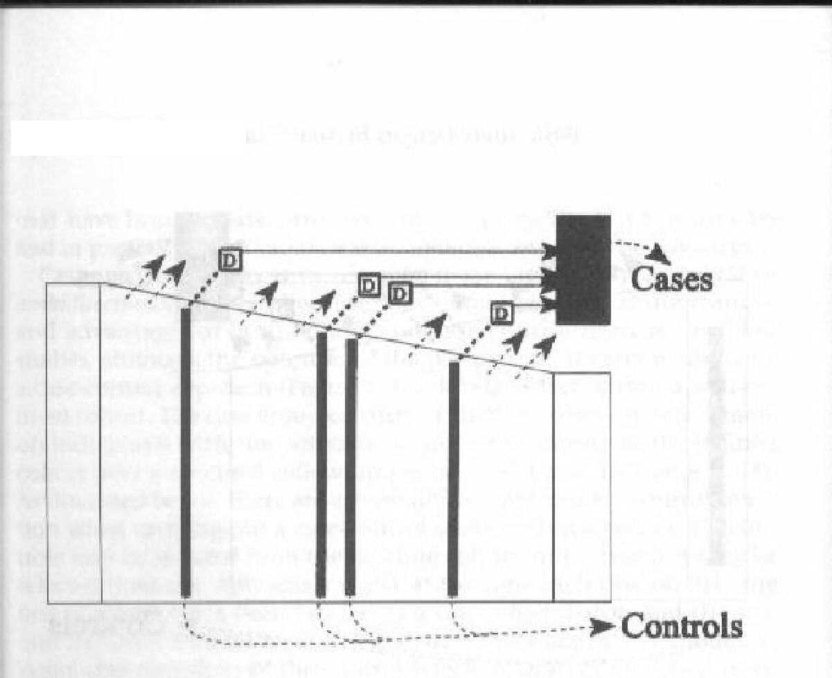
Incidence density sampling within a dynamic cohort (German population 1992-1995)
New residents
D
706 incident
cases of
breast cancer
1,381 age &
residence
matched
Calendar time
Random sample of population each time breast cancer diagnosed
Notes:
We can graph the study as shown here. The underlying cohort, or primary study base, is the German-speaking population of this particular area during 1992-95. Specifically, it was women younger than 51 years old with no previous history of breast cancer. This is an open, or dynamic study base, with women entering and leaving the area during the study period. The goal of case ascertainment was to identify any incident cases of breast cancer that occurred in this cohort during the relevant study period. Note that a control at one point in time could become a breast cancer case at a later point in time, although given the large primary study base, this is unlikely. To take into account the matching that is essential to the incidence density sampling design, the study results were analyzed using conditional logistic regression. This is the standard approach for a nested case-control study with incidence density sampling.
The interview method relies on participant recall, for both cases and controls. As we will discuss in upcoming lectures, this introduces the possibility of error in the measurement of risk factors, in this case alcohol intake.

Slide 54
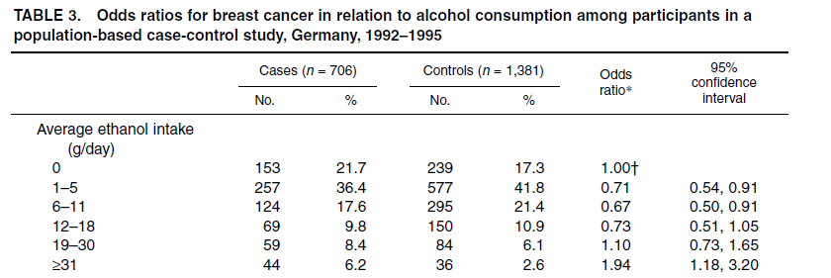
Results reported as odds ratio
Reference group clearly labeled
Rate ratio is easier to understand than an odds ratio.
Notes:
The authors of this report on alcohol intake and breast cancer incidence report an odds ratio. Because this study used incidence density sampling, they could also have reported an incidence rate ratio. To do this, they could have briefly declared in their methods that the OR is an unbiased estimate of the incidence rate ratio, and then reported results as rate ratios.
In this report, the authors provide 6 levels of the outcome. “No alcohol intake” is the exposure level that defines the reference group, and odds ratios are reported for the other levels of alcohol intake compared to this reference group. The reference group is clearly labeled, as it should always be.

Slide 55
Plasma Insulinlike Growth Factor 1 and
Binding-Protein 3 and Risk of
Myocardial Infarction in Women:
A Prospective Study
Case-control study nested in Nurses Health Study, a large cohort. Incidence density sampling.
Appropriately, authors make this statement in the Methods, with citations: “Conditional logistic regression was used to estimate odds ratios, which were taken as direct estimates of rate ratios and 95% CIs.”
Page et al. 2008
Notes:
This study of IGF1 and IGFBP3 and risk of MI in women used a nested case-control design within the Nurses Health Study, a large cohort study. Because the authors used a design with incidence density sampling, the OR is an unbiased estimate of the incidence rate ratio. Appropriately, they note this in their Methods section. A statement like this should include citation(s) as these authors provided. One option is to reference our text Szklo and Nieto. Another good primary reference is Greenland and Thomas “On the need for the rare disease assumption in case-control studies” Am J Epidemiol. 1982;116:547-53.

Slide 56
Report results as rate ratio
Better title: Rate ratio (RR) of myocardial infarction…
Reference group clearly labeled
Notes:
Then, the authors can report the results as rate ratios (abbreviated here as RR in the table heading). The exposure, IGF1 levels in stored plasma, is divided into quartiles.

Slide 57
Practical considerations in incidence density sampling
Specimen availability – similar to case-cohort design
Date that case occurred is key. Not always easy to define.
Frequency of examination of underlying cohort (e.g., every 6 or 12 months) may be important and has cost considerations
Control group cannot be used for other case/disease outcomes

Slide 58
STATA: Incidence density sampling
(in a fixed cohort)
STATA command to identify controls matched to cases on follow-up time:
  sttocc
  sttocc, n(3) [Will identify 3 controls per case]
Adds 3 variables to dataset:
  _case Control = 0, Case = 1
  _set ID that matches case and controls(s)
  _time Follow-up time
Notes:
If you have a dataset from a fixed cohort, STATA can identify controls matched to cases on follow-up time, i.e. identify controls using incidence density sampling. You can specify how many controls per case.

Slide 59
Some other ways to estimate a rate ratio in a case-control study done in a dynamic cohort
Incidence density sampling in a dynamic cohort is the cadillac approach
However, if you can convince yourself and your reviewers about exposure prevalence over time in the dynamic cohort, there are some easier approaches to control sampling which will still produce ORs that estimate rate ratios

Slide 60
What the OR in a case-control study estimates
Depends on underlying cohort and control sampling
Type of Cohort | Control Sampling | Assumption Regarding Exposure | Interpretation of OR
Dynamic | Each time a case occurs “incidence density” | None | Unbiased estimate of rate ratio
 | At midpoint of case accumulation period | Steady state or changing linearly over time Changing in a non-linear, unknown way: | Unbiased estimate of rate ratio Uninterpretable odds ratio
 | After all cases identified “prevalent/cumulative epidemic/exclusive” | Steady state Not at steady state | Unbiased estimate of rate ratio Uninterpretable odds ratio
Notes:
Let’s consider some easier control sampling approaches within a dynamic cohort. Easier because you just have to perform the sample at one slice of time. If sampling occurs at the midpoint of case accumulation, we have to assume that exposure prevalence in the cohort is in steady state or, if changing, is changing linearly over time. If sampling occurs after all cases are identified, then we have to assume that the exposure prevalence was in steady state during the study period. We have not listed it on this slide, but one time sampling in a dynamic cohort that is in steady state could occur at any time during the study period. In these designs, the OR is an unbiased estimate of the rate ratio.

Slide 61
New
Residents
Sampling controls at midpoint in dynamic cohort (e.g. SF county)
CE
CE
Cases
Calendar Time
Sampling in a dynamic cohort at midpoint gives unbiased estimate of exposed person-time IF exposure changing linearly or in steady state
Controls
Notes:
In a dynamic cohort with exposure that is changing in a linear fashion, we can take a sample of controls at the midpoint of the study period to provide an unbiased estimate of exposed and unexposed person-time in the cohort. It can be mathematically proven that the midpoint pattern is a good representation of the entire pattern. With this information, we can calculate an OR that is an unbiased estimate of the rate ratio.
In this illustration, the controls are sampled at the midpoint of the study period. Controls are sampled from those in the cohort who do not currently have the outcome of interest. This also provides an unbiased estimate of exposed and unexposed person-time in this dynamic cohort if the exposure prevalence in the population is in “steady state” during the study period.

Slide 62
New
Residents
Sampling controls after case accrual in a dynamic cohort (e.g. SF County)
CE
CE
Cases
Calendar Time
Sampling in a dynamic cohort at one time point gives unbiased estimate of exposed person-time IF population is in steady state
Controls
Notes:
In a dynamic cohort with steady state exposure, we can take a sample of controls at one time point during the study and obtain an unbiased estimate of the rate ratio. In this illustration, the controls are sampled at the end of accrual of incident cases, but they could also have been sampled at other time points. Controls are sampled from those in the cohort who do not currently have the outcome of interest. For this to be an unbiased estimate of exposed and unexposed person-time in this dynamic cohort, the exposure prevalence in the population has to either be in “steady state” during the study period. Although participants are lost to follow-up and competing events during the study period, there are also new members coming into the population. Assuming those leaving and entering are similar, samples of the population at different points in time will differ only due to chance.

Slide 63
Example: Case-Control study with sampling of controls after case accrual in dynamic cohort
Surveillance for toxic-shock syndrome (TSS) in Wisconsin detected
cases with onsets from September 1975 through June 1980… 35
patients were matched for age and menstruation to 105 controls:
34 of 35 cases (versus 80 of 105 controls) used tampons during every
menstrual period (OR = 10.6, p < 0.01)…
Davis JP et al. N Engl J Med 1980
If tampon use can be assumed to be in steady state over study period, then the odds ratio of 10.6 is a unbiased estimate of the rate ratio.
Notes:
This design sampled “non-case” controls from among all the women of Wisconsin in 1980, after the incident cases of toxic-shock syndrome from 1975-80 were identified. This requires an assumption that the exposure, tampon use with particular commercial brands, did not change much during 1975-1980, key content knowledge for these investigators. The investigators could also have sampled controls from an earlier time point in the study, say 1979, given that the assumption of “steady state” for the exposure is correct.
The strength of the study design also depends on how complete case ascertainment was, i.e. that nearly every case occurring in Wisconsin during those years (or a random sample of all cases) was ascertained.

Slide 64
Hypothetical study of Vitamin D and hip fracture
Incident cases: All hip fracture cases at some HMO have a serum vitamin D shortly after the event. Incident cases for past 10 years are assembled.
Controls sampled at one time point, after all cases:
  Current HMO members without hip fracture history
Is there a potential problem here?
  Temporal trends in vitamin D
Notes:
To illustrate the importance of the assumption of a “steady state” of exposure in a population, consider the implications of different choices for controls in a study of vitamin D and hip fracture. The cases are incident hip fractures, and the standard of care at this HMO is to obtain a serum vitamin D at the time of a hip fracture. Thus, all the cases have a vitamin D obtained close to the time of their fracture. For controls the investigators choose a comparison group of current HMO members, without a history of hip fracture, and obtain measure serum vitamin D levels. Thus, we have a dynamic cohort – a primary study base – of HMO members, but cases took place over 10 years while controls only represent current membership. This can introduce bias if there are temporal trends in vitamin D among HMO members (either changes in the actual serum levels or in the assay). In this setting the OR itself will be biased due to an inappropriate choice of controls; the OR will not provide an unbiased estimate of the rate ratio. Indeed, it will not be possible to interpret the meaning of an OR calculated from this study design.

Slide 65
Risk or rate difference in case control study?
We can obtain an unbiased estimate of the risk ratio or rate ratio in an appropriately designed case-control study.
Can we calculate a similar unbiased estimate of the risk or rate differences from a case control study?
No. Not possible to calculate a difference.
For an estimate, could use external data for absolute incidence in unexposed. From this, you can apply your case-control derived risk or rate ratio to estimate absolute incidence in exposed

Slide 66
What if you weren’t clever enough to perform case-cohort or incidence density sampling in a fixed cohort?
There still may be a salvageable interpretation of the OR

Slide 67
What the OR in a case-control study estimates
Depends on underlying cohort and control sampling
Type of Cohort | Control Sampling Scheme | Interpretation of OR
Fixed | Random sample of everyone at time zero (baseline) “case-cohort” | Unbiased estimate of risk ratio (and hazard ratio)
 | Random sample of non-cases each time a case occurs “incidence density” | Unbiased estimate of rate ratio
 | Random sample of non-cases after cases have been identified “prevalent control”, “cumulative”, “epidemic”, “exclusive” | If disease incidence low: Approximation of risk ratio
Notes:
With incident cases and prevalent non-cases in a fixed cohort, the OR is a close approximation of the risk ratio IF the disease incidence is low in all exposure groups.

Slide 68
Sampling of prevalent non-cases
Sampling only prevalent non-cases in a fixed cohort
Controls are sampled from those without disease, after all the cases are identified, with a cross-sectional sample of the study base
Odds ratio approximates risk ratio only if disease occurrence is rare
Notes:
This is the last of the methods of sampling controls for a case-control study that we have described earlier. It is the least desirable and becoming less common now that researchers are becoming more sophisticated about case-control design.
This sampling is the classic instance of needing the “rare disease” assumption that many text books discuss because the OR will approximate the risk ratio only if the incidence is low or rare in all exposure groups.

Slide 69
Case-control design: incident cases + “prevalent” controls
CE
Cases
Controls
Fixed cohort
Time of the Study
Time
Notes:
This illustrates the selection of prevalent controls in a fixed cohort.
Even if all the cases are captured as in the schematic, the controls are drawn only from those present at the time the study is conducted. So unlike the case-cohort and the case-control with incidence density sampling designs in a fixed cohort, no case can be included in the control group. Because the cases are excluded, the control group can no longer represent the entire baseline population of the cohort. Furthermore, losses to follow-up and deaths also make this group of controls not representative of the person-time of the cohort.
As an example, this design is used in the investigation of diarrheal epidemics after social gatherings. Cases are closely interrogated for what they ate and a sample of controls (non-cases), taken after the dust has settled and no more cases are occurring, is also closely interrogated. Whether the OR will be a close approximation of the risk ratio in this setting depends on the incidence of GI illness in the exposed and unexposed.

Slide 70
Inability to calculate unbiased estimate of risk ratio if controls sampled from non-cases
ratio is known in all case-control designs
But sampling only non-cases at a point in time after cases have occurred cannot get unbiased estimate of
Notes:
The ratio of exposed to unexposed in the whole cohort can only be estimated by a sample of everyone at the beginning of follow-up, not just those who remain non-cases at the end of follow-up.

Slide 71
Notation in a 2x2 table for a cohort study
Disease
Yes
No
Yes
E₁
N₁ - E₁
N₁
Exposure
N₀ - E₀
No
E₀
N₀
Notes:
Back to the 2x2 table notation for a cohort study, now with the “No disease” column values indicated.

Slide 72
Sampling controls after cases identified at the end of a fixed cohort
To estimate the risk ratio, we have E₁ / E₀, and we are trying to estimate the ratio of N₁ / N₀
Sampling only non-cases after all cases identified means sampling from N₁ – E_{1.}(and N₀-E₀)
If E₁ is small, then N₁-E₁ essentially equals N₁ which is what you want. Likewise, if E₀ is small, then N₀-E₀ closely approximates N₀.
Notes:
If the disease only removes a few persons from the original cohort, the ratio of exposure in those remaining will stay close to the original ratio at baseline. It follows that estimating N₀/N₁ by using non-case controls becomes increasingly more valid as the number removed by the disease gets smaller.

Slide 73
Sampling controls after cases identified at the end of a fixed cohort
If controls are selected among those without disease at end of study, the OR approximates risk ratio only with the
rare disease assumption
Rare disease assumption: if disease incidence assumed low in unexposed and exposed (<10%), OR ≅ Risk Ratio
  Exposure in controls ≅ exposure in whole cohort
Notes:
The rare disease assumption says that if the incidence of the disease under study is low the OR from a case-control study with sampling prevalent controls approximates the risk ratio. Although there is no absolute number, less than 10% is often given as a definition of what is meant by “rare.”

Slide 74
Inability to calculate risk ratio if controls sampled from non-cases
In a hypothetical cohort of 200:
 | Case | Non-case
Exposed | 40 | 60 | 100
Unexposed | 10 | 90 | 100
Total | 50 | 150 | 200
Notes:
A numerical example to illustrate who is left to sample for controls using the prevalent controls design.

Slide 75
Inability to calculate risk ratio if controls sampled from non-cases
So in this example:
And:
True risk ratio = 4.0

Slide 76
OR using controls from prevalent non-cases
Cases
Non-cases
Disease
No disease
Exposed
40
60
time
Disease
No disease
Unexposed
10
90
Using all prevalent non-cases in cohort, the OR would be:
OR = 40/10 = 6.0
60/90
A random sample of the non-cases would give the same OR.
OR is not an unbiased estimate of risk ratio. In this example, with high incidence of disease, OR also not a close approximation of risk ratio.
Notes:
One quarter of the cohort has been diagnosed with disease during the cohort follow-up leaving only 150 of the original 200 left from which to select controls using the prevalent control case-control design. Since the original cohort was divided 50/50 by exposure and the odds of disease among exposed versus unexposed cases is 4 to 1, the remaining subjects without disease will have a ratio of 60/90 or 2/3 of exposed to unexposed. In other words, the odds of exposure in the eligible controls will be 2/3 and the odds ratio will be 4 divided by 2/3 = 6.0. These numbers use everyone in the cohort and the case-control study will only use a sample of 150 remaining without disease but as they will be sampled independently of exposure status the ratio of 2/3 also applies to any random sample of controls. Thus the OR in this example is much larger than the risk ratio and cannot be considered even an approximation of it.

Slide 77
OR using controls from prevalent non-cases
when incidence low
Cases
Non-cases
Disease
No disease
Exposed
4
96
time
Disease
No disease
Unexposed
1
99
Using all prevalent non-cases in cohort would be
OR = 4/1 = 4.13
96/99
A random sample from cells b (60) and d (90) will give a ratio equal to 96/99 and therefore an OR = 4.13. With this low incidence of disease, a close approximation to true risk ratio = 4.0 (but not an unbiased estimate).
Notes:
Using the same hypothetical cohort numbers as before but now assuming that the incidence of disease was 2.5% (5 out of 200 developed disease), the OR is only slightly higher than the risk ratio for the simple reason that the ratio of exposure in the remaining non-cases is close to 1.0, which is what it was in the whole cohort at baseline. The somewhat arbitrary rule of thumb of incidence below 10% is sometimes given as what is meant by a “rare disease.” You can work out for yourself how the OR = 4.57 is arrived at if the incidence were 10% (hint: there will be 16 exposed cases and 4 unexposed cases). It might also be debatable whether 4.57 is a good approximation of 4.0, but the point should be clear.

Slide 78
Caveat: Sampling controls after cases identified in a fixed cohort may introduce bias even if disease is rare
Disease may remove few from study base sampled for controls, but other sources of loss can bias control group
Specifically, losses to follow-up and competing events among potential controls from the study base giving rise to the cases affect who is available at time of control selection
Notes:
The rare disease assumption only looks at the effect of removing potential controls who are diagnosed with the outcome. Returning to the setting of a study base that gave rise to those cases over time, some members of the study base population at time zero will not be in the population of non-cases sampled at the end of the time when all the cases have been ascertained. Some will have left the study base or have suffered a competing event, and these changes in the group of non-cases who are sampled can bias the estimate of exposure in the controls. Thus, even though the rare disease assumption is met, the OR from this type of case-control sampling may give a biased estimate of the risk ratio.

Slide 79
Secondary Study Base
So far today, we’ve looked at case-control designs in context of a primary study base. Identity of individuals in study base is known.
Secondary study base:
Identify incident cases
Then attempt to identify study base that gave rise to cases in order to sample controls
Possible to describe conceptually but difficult to identify individual members of that study base in practice.
Notes:
So far today, we have discussed case-control study designs within a primary study base.
In a case-control study with a secondary study base, the investigators first identify a set of incident cases. They then wish to select controls from the study base that gave rise to those incident cases. It is possible to describe this secondary study base conceptually, but usually extremely difficult to delineate the individual members.
Use of a secondary study base is a less desirable study design than a primary study base because of the difficulty to identify the study base in practical terms. This used to be the most common design by far. That may no longer be the case as researchers are becoming more sophisticated about case-control design.

Slide 80
New
members
Case Control Design in Secondary Study Base
CE
CE
Cases
Example in Extra Slides
Hypothetical cohort
Calendar Time
Selection of controls from secondary study base that gave rise to incident cases
Controls
Notes:
This illustrates a case control study with a secondary study base. It is possible to describe this secondary study base conceptually, but usually extremely difficult to delineate the individual members. In theory, IF it is possible to identify this underlying secondary study base, then the design is analogous to sampling a dynamic cohort after the accrual of incident cases. In practice, this is difficult.

Slide 81
What the OR in a case-control study estimates
Depends on underlying cohort and control sampling
Type of Cohort | Control Sampling Scheme | Interpretation of OR
Fixed | Random sample of everyone at time zero (baseline) “case-cohort” | Unbiased estimate of risk ratio (and hazard ratio)
 | Random sample of non-cases each time a case occurs “incidence density” | Unbiased estimate of rate ratio
 | Random sample of non-cases after cases have been identified “prevalent control”, “cumulative”, “epidemic”, “exclusive” | If disease incidence low: Approximation of risk ratio
Notes:
Review of what we’ve covered

Slide 82
Regression models available
Depends on underlying cohort and control sampling
Type of Cohort | Control Sampling Scheme | Regression model
Fixed | Random sample of everyone at time zero (baseline) “case-cohort” | Proportional hazards (modified)
 | Random sample of non-cases each time a case occurs “incidence density” | Conditional logistic regression
 | Random sample of non-cases after cases have been identified “prevalent control”, “cumulative”, “epidemic”, “exclusive” | Logistic regression
Notes:
Here are the names of the regression models that allow for estimation of adjusted measures of association in case-control studies in a fixed cohort.
For case-cohort: proportional hazards regression.
For incidence density sampling: conditional logistic regression. Conditional logistic regression to account for the matching on follow-up time that is intrinsic to this design.
For prevalent case-control: logistic regression (or conditional logistic regression if matching is used). We are not going to teach the mechanics of these approaches (this will come in the Winter/Spring biostat courses) but we just want to associate the techniques with the study designs.

Slide 83
What the OR in a case-control study estimates
Depends on underlying cohort and control sampling
Type of Cohort | Control Sampling | Assumption Regarding Exposure | Interpretation of OR
Dynamic | Each time a case occurs “incidence density” | None | Unbiased estimate of rate ratio
 | At midpoint of case accumulation period | Steady state or changing linearly over time Changing in a non-linear, unknown way: | Unbiased estimate of rate ratio Uninterpretable odds ratio
 | After all cases identified “prevalent/cumulative epidemic/exclusive” | Steady state Not at steady state | Unbiased estimate of rate ratio Uninterpretable odds ratio
Notes:
Review of what we’ve covered

Slide 84
Regression models available
Depends on underlying cohort and control sampling
Type of Cohort | Control Sampling | Assumption Regarding Exposure | Interpretation of OR
Dynamic | Each time a case occurs “incidence density” | None | Conditional logistic regression
 | At midpoint of case accumulation period | Steady state or changing linearly over time Changing in a non-linear, unknown way: | Logistic regression
 | After all cases identified “prevalent/cumulative epidemic/exclusive” | Steady state Not at steady state | Logistic regression
Notes:
Here are the names of the regression models that allow for estimation of adjusted measures of association in case-control studies in a dynamic cohort.
For incidence density sampling: conditional logistic regression.
For “one time” sampling of non-case controls: logistic regression (or conditional logistic regression if matching is used).

Slide 85
Statistical penalties for sampling the study base
Case-control design obtains a sample of the cohort denominator rather than entire denominator
Introduces some sampling error compared to analysis using entire cohort
Reduces precision of the risk ratio, rate ratio or odds ratio estimate
Loss of precision offset by large reductions in cost and time of study

Slide 86
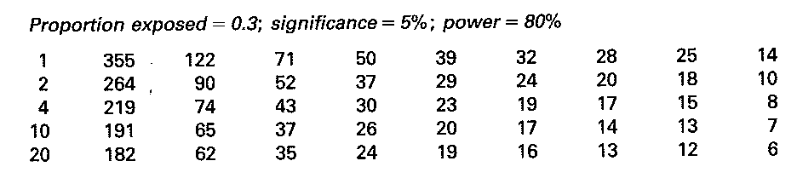
How many controls per case?
Number of case-control sets in a matched design required for the specified power
OR 1.5 2.0 2.5 3.0 3.5 4.0 4.5 5.0 10.0
Power with additional controls per case depends on the prevalence of the exposure and the strength of the disease association, but, in general, more than 4 controls per case is not cost effective.
Notes:
This shows the number of case-control sets required in a matched design to have 80% power to identify a particular odds ratio (assuming that 30% of controls are exposed). For example, to have 80% power to detect an OR of 2.0 with 1 set of matched controls would require 122 cases (and 122 controls), a total of 244 participants. In a case-control study, the limiting factor for sample size is usually the number of cases. Say we have 70 cases. With a 1:1 match (total N=140) we would have 80% power to detect an OR of about 2.5. But, by increasing the number of controls so that we have 4 controls per case (total N = 70x5=350), we would have 80% power to detect an OR of ~2.0.
Another way to think about this is to look down a column. For example, if you want to be able to detect an OR of 2.0 or more in your study, you’ll need 122 cases with a 1:1 match, but only 74 cases with a 1:4 match. Using a 1:10 match will reduce your required sample size only a small amount, to N=65, but at substantially larger cost with a total N of 65x11 =715.

Slide 87
Presenting results in a case-control study
Case-cohort:
  If using OR, describe as odds, or
  Declare OR is unbiased estimate of risk ratio and describe as risk
  If using proportional hazards, report hazard ratio & describe w/rates
In designs where OR estimates rate ratio:
  Describe as odds, or
  Declare OR is unbiased estimate of rate ratio and describe in language of rates
All other situations:
  Only describe as odds
  Mention, if appropriate, if OR is an approximation of the risk ratio
If using OR, language like “X times as likely to” implies a comparison of probabilities, not odds
Abstracts/press releases determine how results are seen by public
Notes:
Regardless of the actual measure of association that was calculated by the study or what measure it validly estimates, most researchers want to use the language of probability or words that suggest probabilities when they discuss their results. As a result, it is rare to hear the appropriate language: “the odds of disease among those who had ever smoked were 3.6 fold greater than among those who never smoked.” The language of probability can be justified if the rare disease assumption is met although we would hope that you will generally avoid the prevalent controls study design in fixed cohort. Preferable is to attempt to use either incidence density sampling of controls or a case-cohort design for a case-control study in fixed cohort and to point out in the methods that the OR from your design is an unbiased estimated of the risk ratio, hazard ratio, or rate ratio, depending on which design and regression model you have used. It then becomes legitimate to use the language of risk ratios or rate ratios in reporting your findings. Similarly, in a case-control study within a dynamic cohort, it is preferable to identify the OR as an unbiased estimate of the rate ratio in your methods, and then it is legitimate to use the language of rate ratios in reporting your findings. If sampling of controls from a dynamic cohort is done at one time point, some discussion of the underlying assumptions regarding exposure prevalence is also needed.

Slide 88
Common misunderstandings about case-control studies
They can only study one disease outcome
Inference is not as valid as from a cohort
“Rare disease assumption” is required for OR from case-control to estimate anything meaningful
In case-control studies it’s not possible to obtain exposure measurement before outcome

Slide 89
What is true about case-control studies
There are typically more opportunities for bias in case-control than in cohort studies
Relative ease with which they can be done has encouraged a lot of badly designed studies
Low cost and shorter time should be an incentive to better, not worse, design

Slide 90
Case-control design recommendations
Look for a primary study base that can be clearly defined and has good case ascertainment
  Know research study bases available in your field
  Use incidence density or case-cohort sampling in fixed cohort
  In dynamic cohort, incidence density sampling if feasible. Know if one time sampling makes sense in your field
Use measurements recorded prior to the diagnosis when possible (medical records, etc.) or perform measurements on stored specimens/records
Notes:
Historically the two chief weaknesses of case-control studies have been inappropriate selection of a control group and poor measurement of exposure. The former has usually occurred in the setting of hospital-based studies with secondary study bases where it is very difficult to determine the study base that gave rise to the cases. This difficulty has been exacerbated by the lack of awareness on the part of many investigators of the study base concept. Poor measurement often occurs from using questionnaire recall of exposures after the event has already happened. If those weaknesses can be avoided, case-control can be a solid valid study design.

Slide 91
Measures of Attribution
So far, we have introduced measures of association that compare occurrence of an outcome by exposure status, using ratio or absolute difference.
We can also ask how relevant the exposure is in causing the outcome, especially in comparison to other exposures causing the outcome.
  i.e., how much would the outcome be reduced if exposure was removed?
Concept known as “attribution” of outcome to exposure

Slide 92
Terminology Alert
No field in epidemiology is so full of ambiguous terminology
  Attributable risk
  Attributable rate
  Attributable risk percent
  Attributable fraction
  Excess fraction
  Etiologic fraction
  Excess caseload due to exposure
  Attributable risk in the exposed
  Percent attributable risk in the exposed
  Population attributable risk
  Population attributable risk percent
  Population attributable fraction
  Percent population attributable risk
  Rate fraction
Terminology is so confusing that you cannot simply choose the term you like and use it. You always need to spell out what you are doing.

Slide 93
Prerequisites & Introductory Comments
Don’t bother to consider measure of attribution until:
  Sure that the exposure is “causally” related to outcome
  Measure of association free of bias (e.g., no selection, measurement or confounding bias)
Measures of attribution can be expressed in the context of risks or rates
All of the terminology boils down to 2 concepts:
  Attribution of exposure among the exposed
  Attribution of exposure in a wider population
    Stata will automatically calculate both in epitab command
      even if not justified

Slide 94
Measures of Attribution:
Terminology we like in context of cumulative incidence (“risk”)**
Scale | Among the exposed | Among a population (exposed and unexposed)
Absolute | “Attributable risk in the exposed” (AR_{exp})* | “Attributable risk in the population” or “Population attributable risk” (AR_{pop} or Pop AR)
Percentage | “Percent attributable risk in the exposed” (%AR_{exp}) | “Percent attributable risk in the population” or “Percent population attributable risk” (% AR_{pop} or %Pop AR)
*We earlier called this “risk difference” ** analogous terms used in context of rates

Slide 95
Attributable Risk in the Exposed
ARexp
Notes:
In this example, risk of the outcome is 0.10 in the unexposed and 0.20 in the exposed. The difference – which we have already encountered as the risk difference - is also called the attributable risk in the exposed. As we show in the next slide, this can also be expressed in a more interesting way as a percent of the risk in the exposed, called the percent attributable risk in the exposed.
Assumes that the exposed would experience the same risk of outcome as the unexposed if the exposure were removed.

Slide 96
Attribution among the exposed
Can be expressed as difference measure, but not insightful
AR_{exp} = risk difference = Inc_{exp}- Inc_{unexp}
Or, even better, as a percent of incidence in exposed:
%AR_{exp} = [(Inc_{exp}- Inc_{unexp})/(Inc_{exp})] x 100
%AR_{exp} can also be calculated from the risk ratio:
[(RR-1)/RR] x 100
  Useful for case-control design where risk ratio is estimated but not incidence

Slide 97
Example: %AR in exposed
One year | MI | No MI | Risk
SBP>180 | 180 | 9,820 | 0.018
SBP<120 | 30 | 9,970 | 0.003
Risk Ratio
0.018/0.003 = 6.0
AR_{exp} = risk difference = 0.018-0.003 = 0.015
% AR_{exp} = [(0.018-0.003)/0.018] x 100 = 83.3%
= [(RR-1)/RR] x 100 = (6-1)/6 x 100
= 83.3%

Slide 98
Percent Attributable Risk in the Exposed: Interpretation
% AR_{exp} = 83%
If we remove exposure, the risk of the outcome in the exposed over one year would be reduced by 83%, from 1.8% to 0.3%.
But, you can’t say that this exposure caused the outcome in only this 83%. Exposure might have been the cause in 100% of the exposed.

Slide 99
Population Attributable Risk
Pop AR
Notes:
As in previous example, risk is 0.10 in the exposed and 0.20 in the unexposed. In the total population, including exposed and unexposed, the risk is 0.17, between 0.10 and 0.20. The population AR is the difference between the risk in the total population and the unexposed.

Slide 100
Attribution in the Population
Pop AR = Inc_{pop}- Inc_{unexp}
Most relevant to express as:
%Pop AR = [(Inc_{pop}- Inc_{unexp})/(Inc_{pop})] x100
Can also be calculated using risk ratio and prevalence of exposure in population:
100 x [p_{e} x (RR-1)]/ [p_{e} x (RR-1) + 1]
To calculate in a case-control study, need knowledge of exposure prevalence in study base
  Can be gleaned from control group when incidence density or case-cohort sampling performed

Slide 101
Example: Attribution in the population
One year | Risk
Exp | 0.20
Unexp | 0.15
Risk Ratio
0.020/0.015 = 1.33
What is the overall risk in the population? Depends on prevalence of exposure.
If 40% is exposed, then the risk of the outcome in that population will be
(0.40 x 0.20)+(0.60 x 0.15) = 0.08 + 0.09 = 0.17

Slide 102
Attribution in the population
One year | Risk
Exp | 0.20
Unexp | 0.15
Risk Ratio
0.020/0.015 = 1.33
Prevalence of exposure = 40%
Risk in popn = 0.17
Pop AR = 0.17-0.15 = 0.02
% Pop AR = (0.02/0.17) x 100 = 12%
= 100 x [p_{e} x (RR-1)]/ [p_{e} x (RR-1) + 1]
= 100 x [0.40x(1.33-1)]/0.40x(1.33-1)+1] = 100x[0.13/1.13]
= 12%

Slide 103
Percent Population Attributable Risk: Interpretation
% Pop AR = 12%
If we removed the exposure, the risk of the outcome in the population would be reduced by 12%, from 17% to 15%.
As was the case for % ARexp, we cannot say the exposure is responsible for 12% of all disease. Exposure might be involved in much more than 12%.

Slide 104
Prevalence of exposure and Population Attributable Risk
Low prevalence of exposure High prevalence of exposure
Higher prevalence of exposure -> larger %Pop AR for same risk ratio
Notes:
Population attributable risk depends on prevalence of exposure. With higher prevalence of exposure, the population AR will be larger for a given risk ratio. This makes sense when we consider that exposure prevalence is included in the calculation of the population attributable risk.

Slide 105
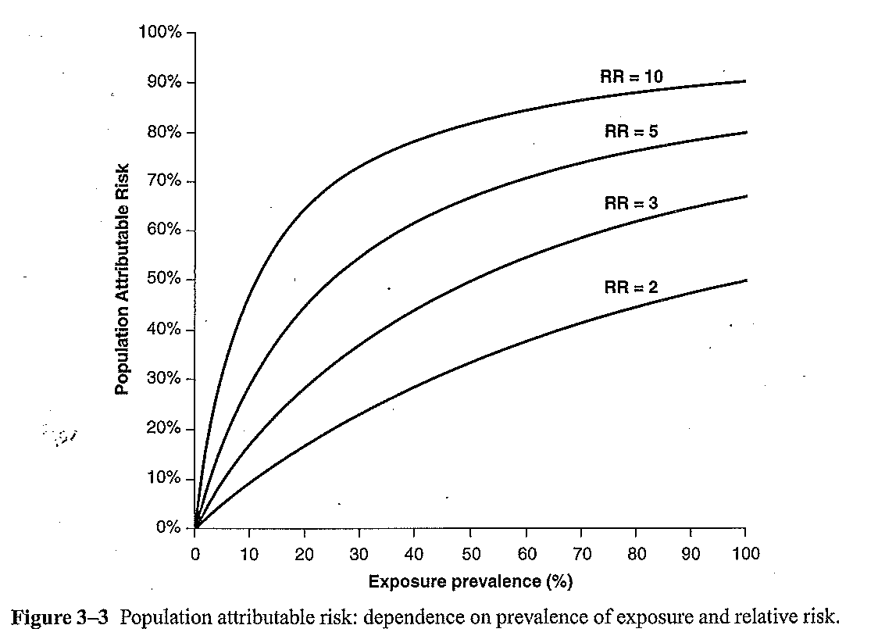
% Population Attributable Risk depends on exposure prevalence and risk ratio
Notes:
% Population AR depends on the risk ratio as well as the prevalence of exposure. This figure shows %Population AR for different combinations of exposure prevalence in a population (x-axis) and different risk ratios, ranging from 2 to 10.

Slide 106
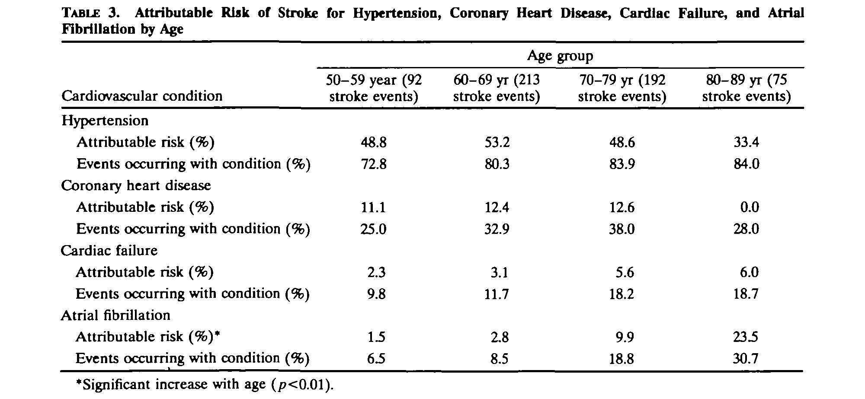
Percent Population Attributable Risk: Example from Framingham
Wolf et al. Stroke 1991
Notes:
Here is an example of a study reporting the percent population attributable risk for the outcome of stroke, stratified by age. For example, atrial fibrillation is associated with a percent population attributable risk of 1.5% in 50-59 year olds and 23.5% in 80-89 year olds. The table also lists “events occurring with condition.” This illustrates a point made in the readings for this week: The % pop AR is not the same as the percent of those with the outcome who had the exposure of interest.

Slide 107
Measures of Attribution
Can be expressed with risks or rates, but take on different meanings depending upon which you use
Main utility: inform where to most efficiently allocate resources
  Prioritize elimination of exposures with highest % pop AR
    assuming they don’t cost a fortune to alter/eliminate
Remind us why we need accurate quantitative measures of association (and not just the qualitative).
  Prior graph: the AR for a RR of 2 is considerably different than an RR of 5
  We cannot blithely think that an OR of 5 is the same as a risk ratio of 5
AR’s across a set of exposures for a given disease typically will sum to more than 100%.
  Explanation is apparent in Rothman’s sufficient component cause model

Slide 108
Measures of Attribution:
Reality Check
This is a theoretical construct
Completely removing an exposure is easier said than done
Even if you removed the exposure today, its prior cumulative effects may last for years
  Thus, idea of removing an exposure today might not fully take effect until everyone alive today has died
Furthermore, these attribution measures assume that removing one exposure would not influence others
  Warning: Among humans, removing one unhealthy volitional behavior might simply be replaced by another

Slide 109
Summary of Measures of Association
Design | Ratio (often easiest to assess for strength of association) | Difference (for public health impact, especially of interventions)
Cross- | prevalence ratio | prevalence difference*
sectional | prevalence odds ratio | prevalence odds difference*
Cohort | risk ratio | risk difference
 | rate ratio hazard ratio | rate difference hazard difference*
 | incidence odds ratio* | incidence odds difference*
Case-control | odds ratio | not available
* Rarely used
Notes:
This is the schematic from the previous lecture, showing all the possible ratio and difference measures that can be calculated from cross-sectional and from cohort data, and now with case-control studies added. Difference measures cannot be calculated directly from case-control data. As we pointed out in calculating the OR, a case control design cannot provide estimates of the odds of disease in different exposure groups. For measures of association, we can measure the odds of exposure and calculate the OR of exposure which is equal to the OR of disease. However, to obtain a difference measure we would need the odds of disease. Since this is unavailable in a case-control design, we cannot calculate the odds difference.
This completes our lectures on disease association. We have covered the basic approach to reporting disease associations (ratio and difference where possible) for the 3 basic designs: cross-sectional, cohort and case-control.

Slide 110
Extra Slides
Example of case-control study in secondary study base
Example of case-control study with prevalent cases and prevalent controls

Slide 111
Controls from Secondary Study Base:
Association of MicroRNA-196a-2 Gene Polymorphism with Gastric Cancer Risk in a Chinese Population
ABSTRACT
Objectives To evaluate the association between genetic polymorphism of miR-196a-2 (rs11614913) and risk of gastric cancer, a hospital-based case–control study was conducted in a Chinese population.
Methods The miR-196a-2 polymorphism was determined using the method of polymerase chain reaction (PCR)– restriction fragment length polymorphism (RFLP) in 213 gastric cancer patients and 213 age- and sex-matched controls.
Results In the present study, we found that a significantly increased risk of gastric cancer in subjects with the variant homozygote CC of miR-196a-2 compared with wild-type homozygote TT and heterozygote CT carriers (adjusted odds ratio (OR) = 1.57, 95% confidence interval (CI) = 1.03–2.39, P = 0.038).
Peng et al. Dig Dis Sci 2009

Slide 112
Methods: Selection of cases and controls
The hospital-based study population included 213 patients with gastric cancer and 213 cancer-free controls.
All cases were inpatients newly diagnosed and histopathologically confirmed gastric cancer. The subjects in this study were unrelated Han Chinese and they were consecutively recruited from the Fourth Affiliated Hospital of Soochow University. The case populations were diagnosed with primary incident gastric cancer and the secondary, recurrent tumors were excluded.
Control subjects had no current or previous diagnosis of cancer and were frequency matched to cases on age (±5 years) and gender.

Slide 113
Gastric Cancer example (cont.)
Secondary study base. How would we describe the study base?
Those who would have been admitted to the Fourth Affiliated Hospital of Soochow University if they developed gastric cancer.
Controls were: 213 cancer-free controls from same hospital as cases. Unrelated Han Chinese. Matched on age, gender.
Possible problem in controls?
  i.e. Are controls from same study base as cases?

Slide 114
Example: Prevalent cases and prevalent controls
Study of high resolution pQCT in older women with fracture
“Subjects were eligible for inclusion as fracture cases if they had a documented history of a low-trauma vertebral or nonvertebral fracture that occurred after menopause… Control subjects had no history of low-trauma fractures and no vertebral deformity on lateral radiographs.”
Can report OR as measure of association, but it’s not an approximation of risk ratio
Why?
Stein et al. 2010
Notes:
This is an example of a study that used prevalent cases and prevalent controls -- essentially a cross-sectional study. This is a common case control design. But, note that the OR is not estimating either a risk ratio or rate ratio. Even if the disease is rare, the OR is not an estimate of the risk ratio since the cases are prevalent, not incident, disease.
If prevalence of disease is low in all exposed groups, then OR is a close approximation of the prevalence ratio.
Can we calculate a prevalence ratio? Not if participants were sampled based on disease status.

