Slide 1
Housekeeping - units
1 or 2 units:
students to decide how many units will be completed before the 3rd week of term.
If the decision gets made later, a Study List Change petition needs to be submitted ($5 fee).
change period ends in the 7th week of the term.
Timing of section to be held on Wednesday
1-2pm
3:15-4:15pm

Slide 2
Multi-level Etiologies of Health Disparities:
Pt 1. social determinants
Salma Shariff-Marco, PhD, MPH
Associate Adjunct Professor
Department of Epidemiology & Biostatistics

Slide 3
Objectives
Social determinants of health (SDOH)
  Socioeconomic status, socioeconomic position
  Racism
  Incarceration
  Neighborhood
Research with SDOH
  Multilevel conceptual approaches/frameworks
  Measurement and methodological considerations

Slide 4
Social determinants of health
The conditions in which people are born, live, work and age.
Neighborhood and Built Environment
Health and Health Care
Social and Community Context
Education
Economic Stability
SDOH

Slide 5

World Health Organization’s Commission on
Social Determinants of Health Framework
Socioeconomic & political context
Governance
Policy (Macroeconomic, Social, Health)
Cultural and societal norms and values
Social Position
Material circumstances
Social cohesion
Psychosocial factors
Behaviors
Biological factors
Distribution of health and
well-being
Education
Occupation
Income
Gender
Ethnicity/Race
Health-Care System
SOCIAL DETERMINANTS OF HEALTH INEQUITIES
SOURCE: Amended from Solar & Irwin, 2007
http://www.who.int/social_determinants/thecommission/finalreport/graphs/en/

Slide 6
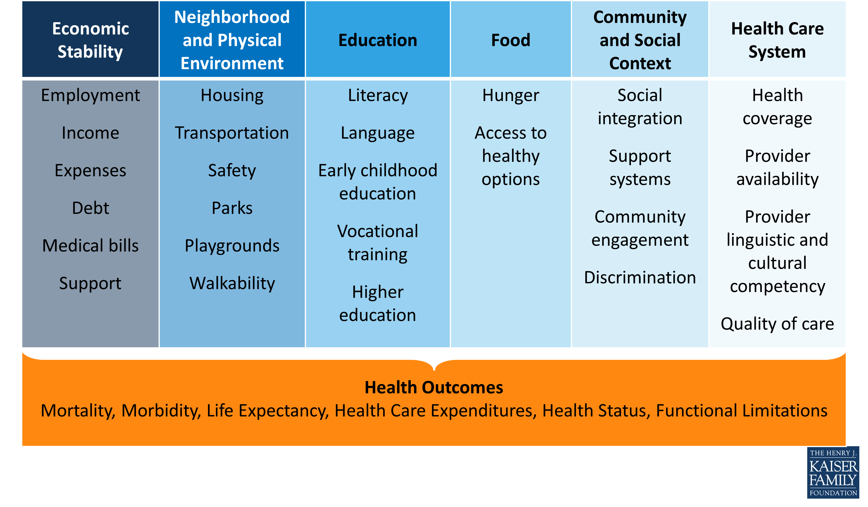
Social Determinants of Health
Beyond Health Care: The Role of Social Determinants in Promoting Health and Health Equity
http://www.kff.org/disparities-policy/issue-brief/beyond-health-care-the-role-of-social-determinants-in-promoting-health-and-health-equity/

Slide 7

Importance of social factors
in any research

Slide 8
Biology:
Reproductive factors 5%
Viruses 8%
Medication 5%
Social (behavioral)
Diet 5%
Tobacco 30%
Alcohol 4%
Physical Environment:
Sun/radiation 2%
Obesity 20%
Sedentary Lifestyle 5%
Environment 4%
From: Colditz and Wei, Annu Rev Public Health, 2012, 33:137-56 (p. 148—Figure 1)

Slide 9
Improving health & reducing disparities by addressing the role of social factors
Economic & Social
Opportunities and Resources
Living & Working Conditions
in Homes and Communities
Behaviors
Medical Care
Interaction with genetic/other biological factors
HEALTH
Adapted from Braveman et al., for Robert Wood Johnson Foundation Commission to Build a Healthier America | www.commissiononhealth.org

Slide 10
Fundamental Cause
Influences multiple disease outcomes;
Affects disease thru multiple risk factors;
Involves access to resources that can assist in minimizing risk once the disease occurs;
Reproduced over time

Slide 11
Race/Ethnicity + SES as Fundamental Causes: Framework for social disparities in health
Diez Roux, Annual Review of Public Health 2012

Slide 12
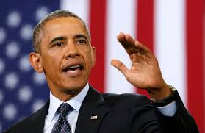


Social status
“the relative rank that an individual holds, with attendant rights, duties, and lifestyle, in a social hierarchy based upon honor or prestige.”
www.brittannica.com
“relations of ownership or control over productive resources (i.e. physical, financial and organizational).”
WHO Social Determinants of Health

Slide 13
Dimensions of social status
Socioeconomic status/position
Race/ethnicity
Sex
Gender
Sexual orientation
Marital status
Religion
Immigration

Slide 14
Socioeconomic position/status
“… the social and economic factors that influence what positions individuals or groups hold within the structure of a society”
Galobardes et al 2006
SES and health
Multidimensional, multilevel construct
Life course perspective
Multiple causal pathways
Interacts with other social status measures (race/ethnicity)

Slide 15
Measures of SES
Education
  years of formal education completed
  ordinal categories
Income
  annual household and factor number of dependents
Occupation
  laborer, technical, professional, business
  manual/non-manual
Neighborhood SES
  % poverty, composite indices

Slide 16
Additional SES Measures
Wealth
  Assets
  Debt
  Ownership (home, car)
Childhood SES
  Parental occupation and education
  Household income, wealth
Self-perceived ‘standing’ on a ladder ranging from 1 to 10

Slide 17
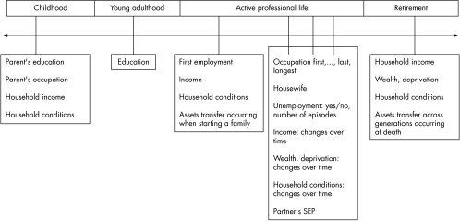
SES across the Life Course
Galobardes et al 2006

Slide 18
SES across the Life Course
Latency/critical period model:
Exposure during sensitive window puts one at risk for development of disease later in life. Exposures encountered after the critical window closes do not influence risk. Focus on early life experiences that do not have a cumulative effect.
Galobardes et al 2006
Notes:
Example is cognitive and socioemotional development

Slide 19
SES across the Life Course
Social trajectory model:
Social disadvantage increases risk of future disadvantage later in life. The initial insult does not necessarily have a harmful effect on the outcome – but the first exposure leads to subsequent exposures that then directly cause the outcome.
Galobardes et al 2006
Notes:
Cumulative effects
Accumulation of risk model

Slide 20
Childhood SES is associated with adult health
Nurses Health Study:
Parental education is associated with the self-rated health of their adult children, after taking into consideration current SES (highest year of schooling, total household income, total net worth)
[Moody-Ayers, et al. 2007]
Health and Retirement Survey:
Parental occupation is associated with cardiovascular disease in middle age, after taking into consideration current SES (highest year of schooling)
[Gliksman et al. 1995]

Slide 21
Stressors
Food insecurity
Job insecurity
Job strain (High demands / Low control)
Housing insecurity/homelessness

Slide 22
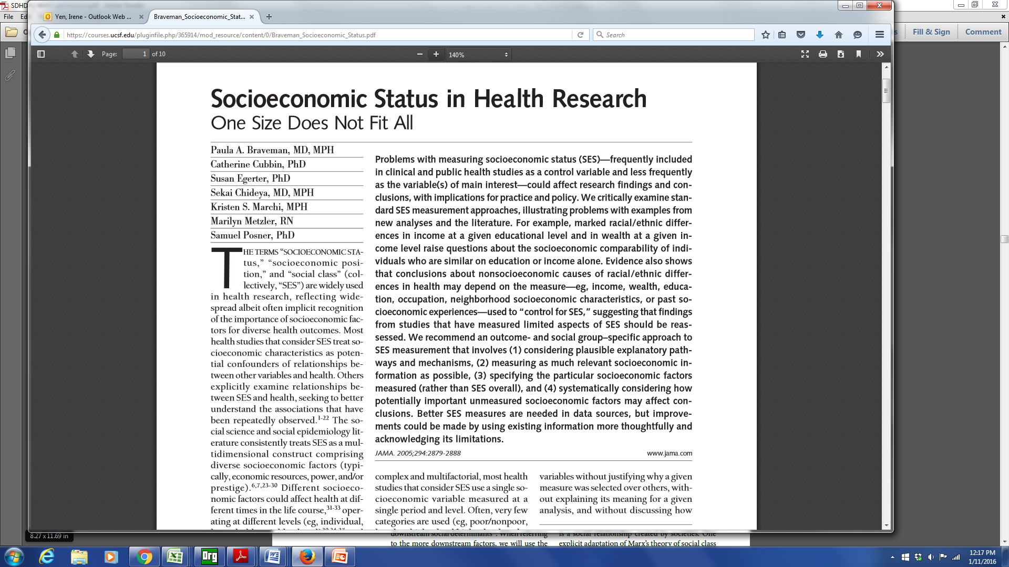

Slide 23
Braveman et al article –
a few of the take home points
Education and income not interchangeable – earnings can vary at similar educ levels.
Income not a proxy for wealth
Importance
  past socioeconomic experiences
  neighborhood socioeconomic conditions
Outcome and social-group specific approach

Slide 24
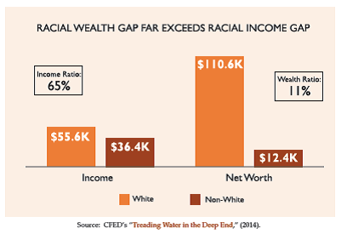

Slide 25
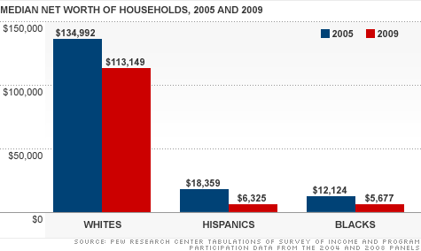

Slide 26
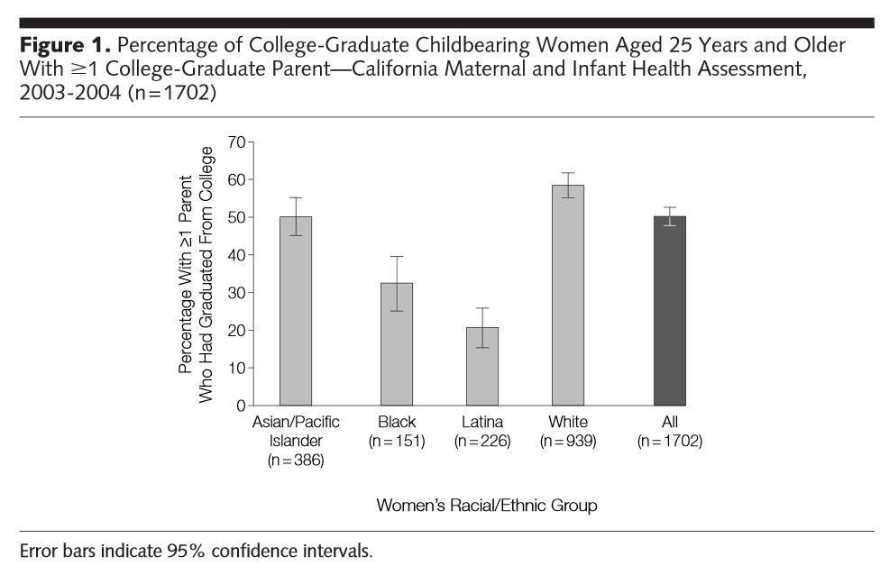

Slide 27
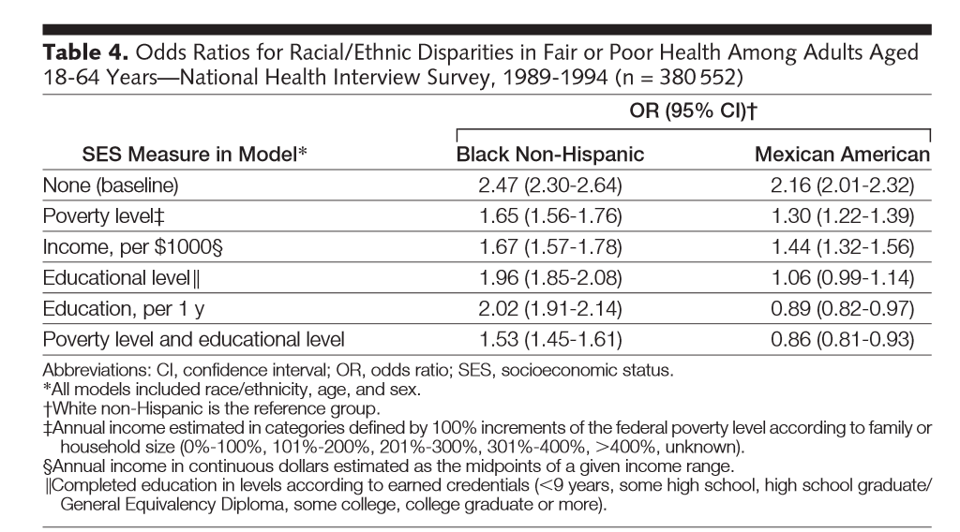
Income not a proxy for wealth
Income not a proxy for wealth

Slide 28
Intersectional Framework & Approach
Social identities and categories should not be viewed as independent variables that capture individual characteristics; instead, they are markers of institutional processes
Intersecting inequalities & multiple vulnerabilities
  Multiple dimensions of social status impact health
Williams et al, Health Services Research 2012

Slide 29
SES associations with mortality after breast cancer by race/ethnicity

Slide 30
Race/ethnicity/SES disparities in mortality after breast cancer in California
Shariff-Marco et al, Journal of Community Health 2015

Slide 31
Measurement of SES
Think about measures that have most relevance to your research question
  May need multiple measures
  Results may depend on what measures you use
Use validated measures
Consider life course perspective
Consider other social status dimensions (e.g., race/ethnicity) as jointly impacting health

Slide 32
Racism, United Nations
“any distinction, exclusion, restriction or preference based on race, color, descent, or national or ethnic origin which has the purpose or effect of nullifying or impairing the recognition, enjoyment or exercise, on an equal footing, of human rights and fundamental freedoms in the political, economic, social, cultural or any other field of public life.”

Slide 33
Racism
Racism
  an organized system that categorizes population groups into ‘races’, and uses this ranking to preferentially allocate societal goods and resources to groups regarded as superior (Bonilla-Silva 1996)
  ideology of inferiority that ranks some racial groups as inherently or culturally superior to others and supports the social norms and institutions that implement this ideology (Jones 1997)
Williams and Mohammed, J Behav Med 2009

Slide 34
Multilevel, multiple dimensions of racism
Institutionalized racism (e.g., residential segregation)
  differential access to goods, services, opportunities and power
  structural, systemic (codified in customs, practices, laws)
Personally mediated racism (e.g., prejudice and discrimination)
  differential assumptions about abilities, motives, and intentions of others by race/ethnicity
  differential actions towards others by race/ethnicity
Jones, APJH 2000

Slide 35
Multilevel, multiple dimensions of racism
Internalized racism
  acceptance by members of stigmatized race/ethnicity of negative messages about their own abilities and intrinsic worth
Jones, APJH 2000

Slide 36
Lessons from the Gardener’s Tale
Interventions at 3-levels of racism
  internalized: Pink is beautiful
  personally mediated: Change gardener’s attitudes/behavior towards pink flowers
  Institutionalized: improve the conditions in which the pink flowers born, grow and live
  Addressing the SDOH/fundamental causes will yield the biggest impact
Jones, APJH 2000

Slide 37
Racism and Health
Multiple pathways (direct)
  economic deprivation, including poor housing and educational opportunities, exposure to dangerous neighborhoods, lack of access to healthy food, riskier work, and a lack of health insurance
  excess exposure to toxins, hazards, pathogens
  social trauma
  targeted marketing of harmful commodities
Muennig & Murphy, Journal of Health, Politics, & Law, 2011
Krieger, AJPH 2012

Slide 38
Racism and Health
Multiple pathways (indirect)
  effectively “stressing” the individual, leading to neuroendocrine disruptions that affect one’s physical and mental health (racism as a stressor)
  health-harming responses (coping via alcohol, smoking, poor diet)
Muennig & Murphy, Journal of Health, Politics, & Law, 2011
Krieger, AJPH 2012

Slide 39
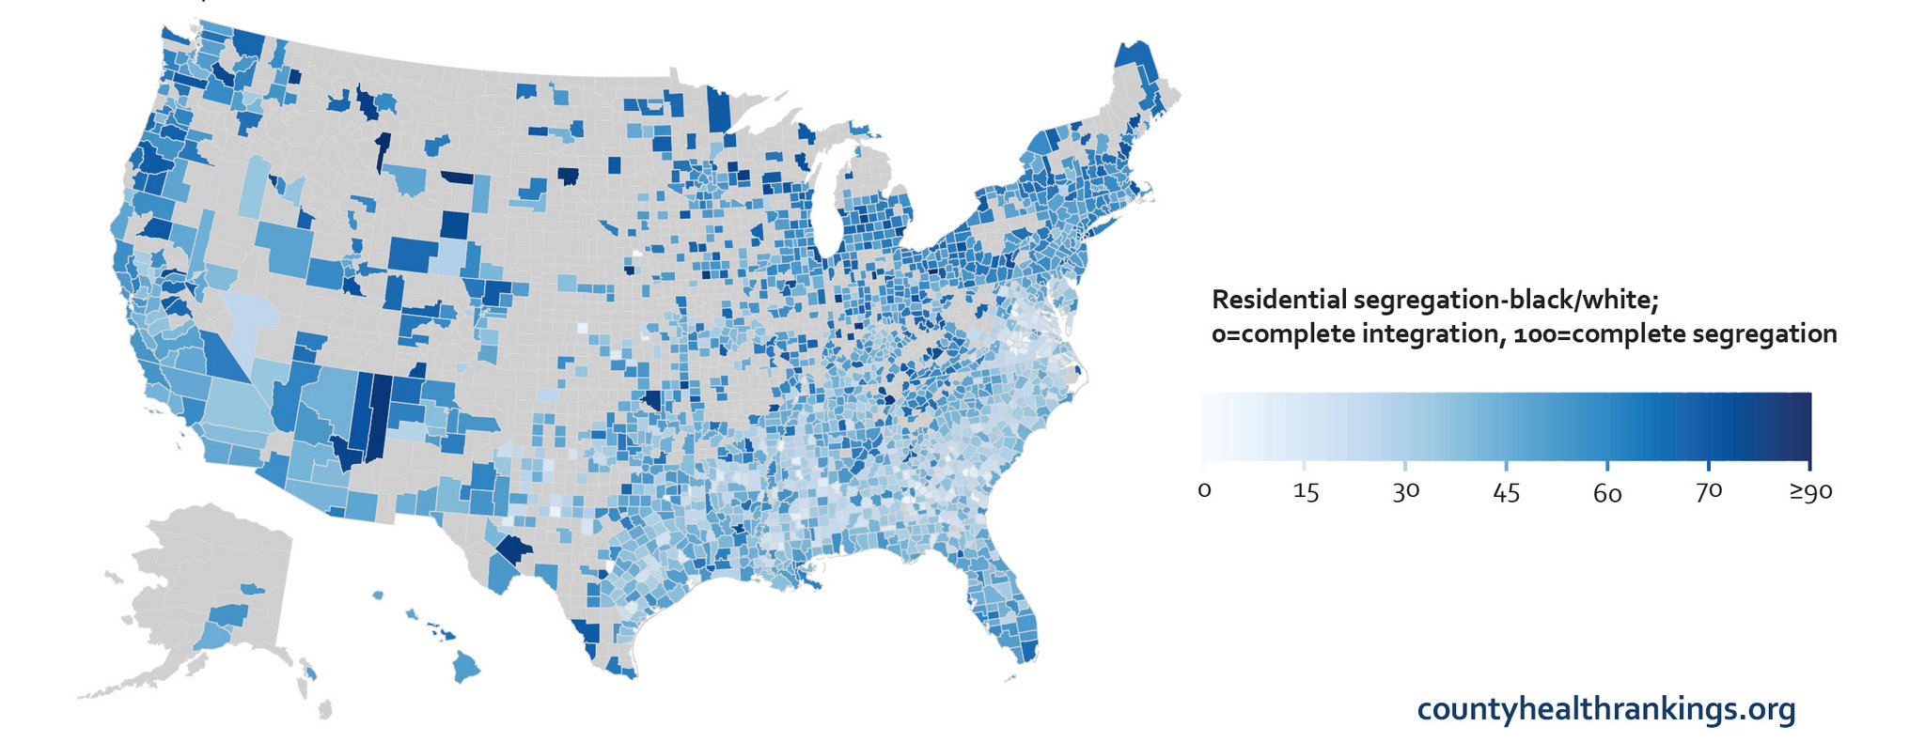
Residential segregation in the US

Slide 44
Hypersegregation
Segregation highest for African Americans
Characterized by not only by racial segregation, but also socioeconomic segregation
Socioeconomic segregation does not account for racial/ethnic segregation
Related to discrimination in housing/ mortgage markets

Slide 45
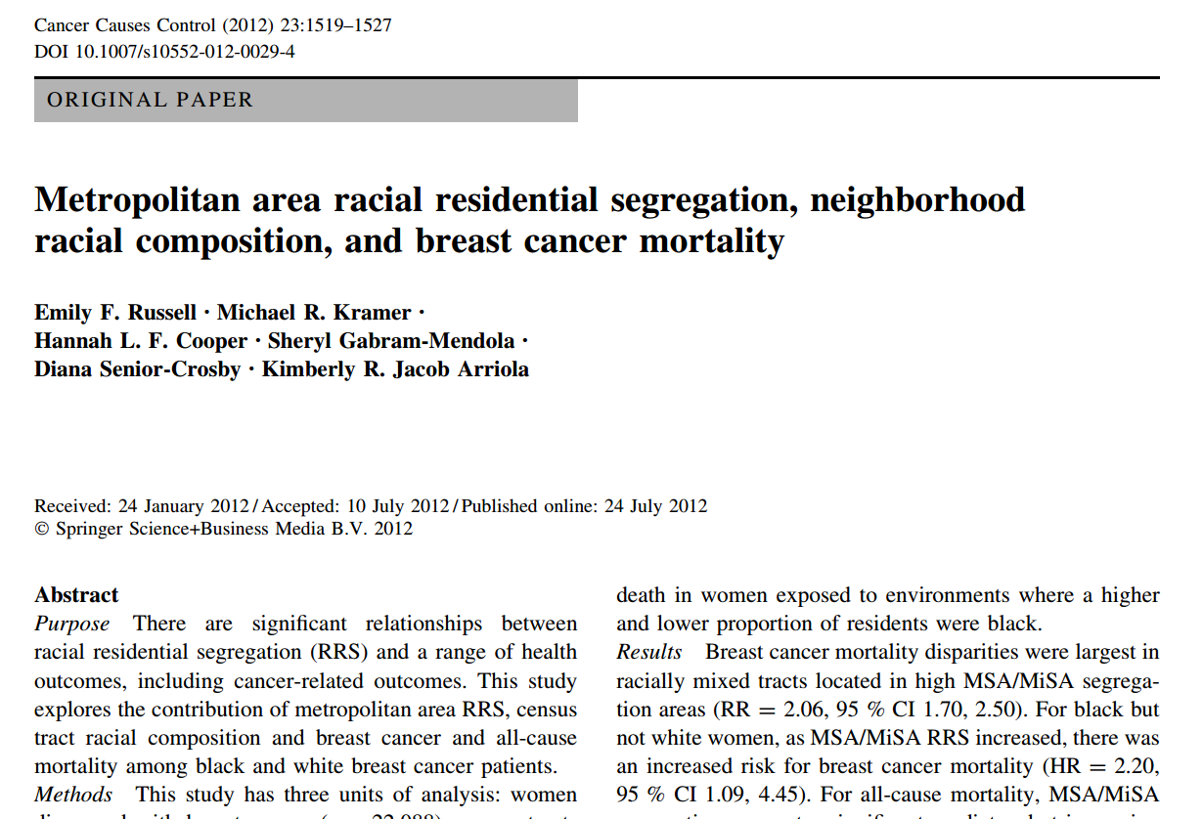

Slide 46
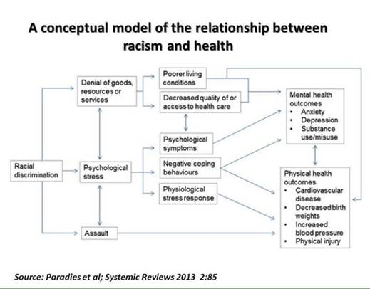

Slide 47
Racial/Ethnic Discrimination
Everyday Experiences of Discrimination
In your day-to-day life, how often have any of the following things happened to you?
1. You have been treated with less courtesy than other people.
You have been treated with less respect than other people.
You have received poorer service than other people at restaurants or stores.
People have acted as if they think you are not smart.
People have acted as if they are afraid of you.
People have acted as if they think you are dishonest
People have acted as if they are better than you are.
You have been called names or insulted.
You have been threatened or harassed.
You have been followed around in stores.
What do you think was the main reason for this/these experience(s)?
Williams et al, Journal of Health Psychology 1997.

Slide 48
Racial/Ethnic Discrimination
Major Discrimination
We are interested in the way other people have treated you or your beliefs about how other people have treated you…have you ever been unfairly:
…fired ?
For unfair reasons, have you ever not been hired for a job?
…denied a promotion?
…stopped, searched, questioned, physically threatened or abused by the police?
…discouraged by a teacher or advisor from continuing your education?
…prevented from moving into a neighborhood because the landlord or a realtor refused to sell or rent you a house or apartment?
Have you ever moved into a neighborhood where neighbors made life difficult for you or your family?
…denied a bank loan?
Have you ever received service from someone such as a plumber or car mechanic that was worse than what other people get?
What do you think was the main reason for this/these experience(s)?
Williams et al, Journal of Health Psychology 1997.

Slide 49
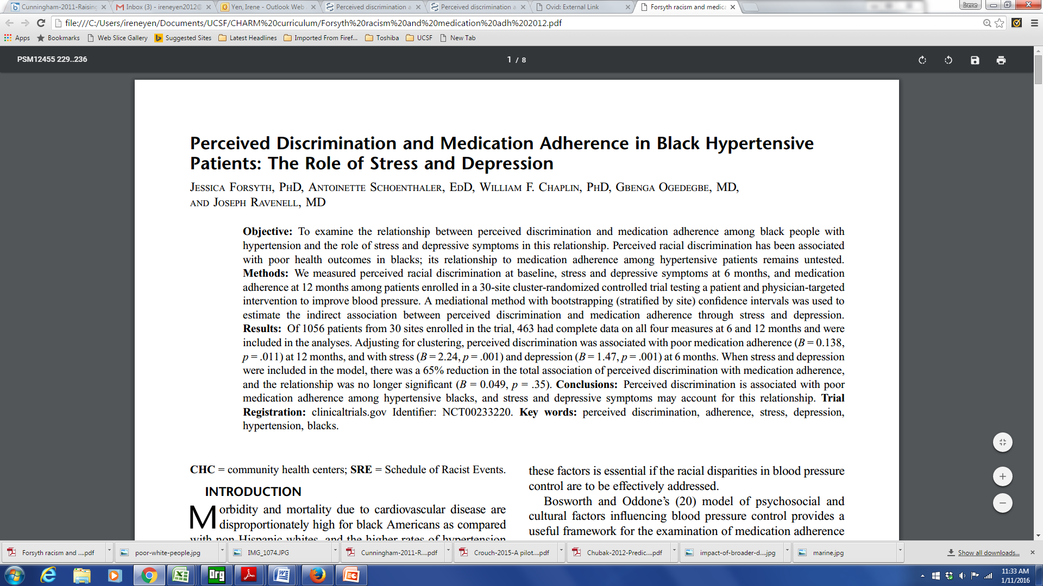
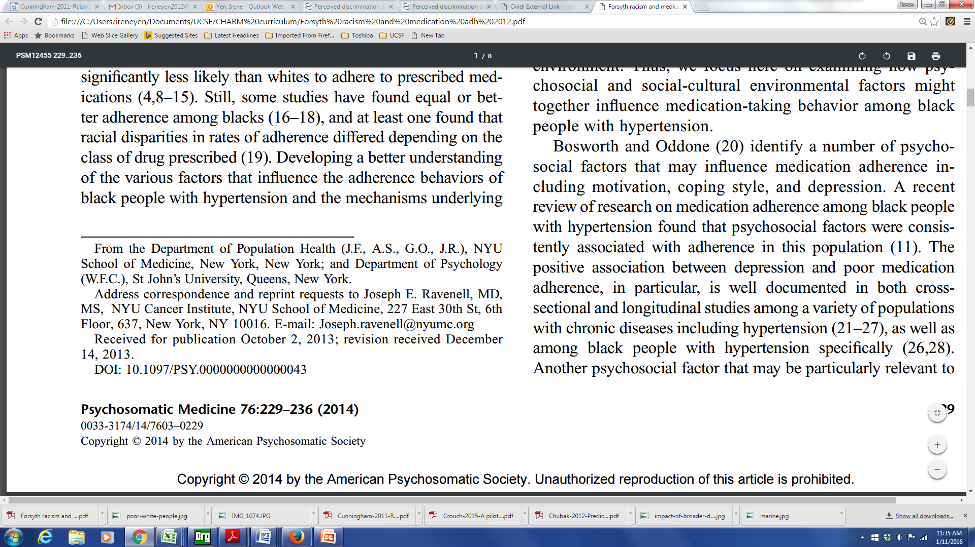

Slide 50
Racism and Medication Adherence
Perceived racial discrimination measured among patients enrolled in a 30-site cluster-randomized controlled trial
A mediational method was used to estimate the indirect association between perceived discrimination and medication adherence through stress and depression
Perceived discrimination was associated with poor medication adherence, and was mediated by stress and depression

Slide 51
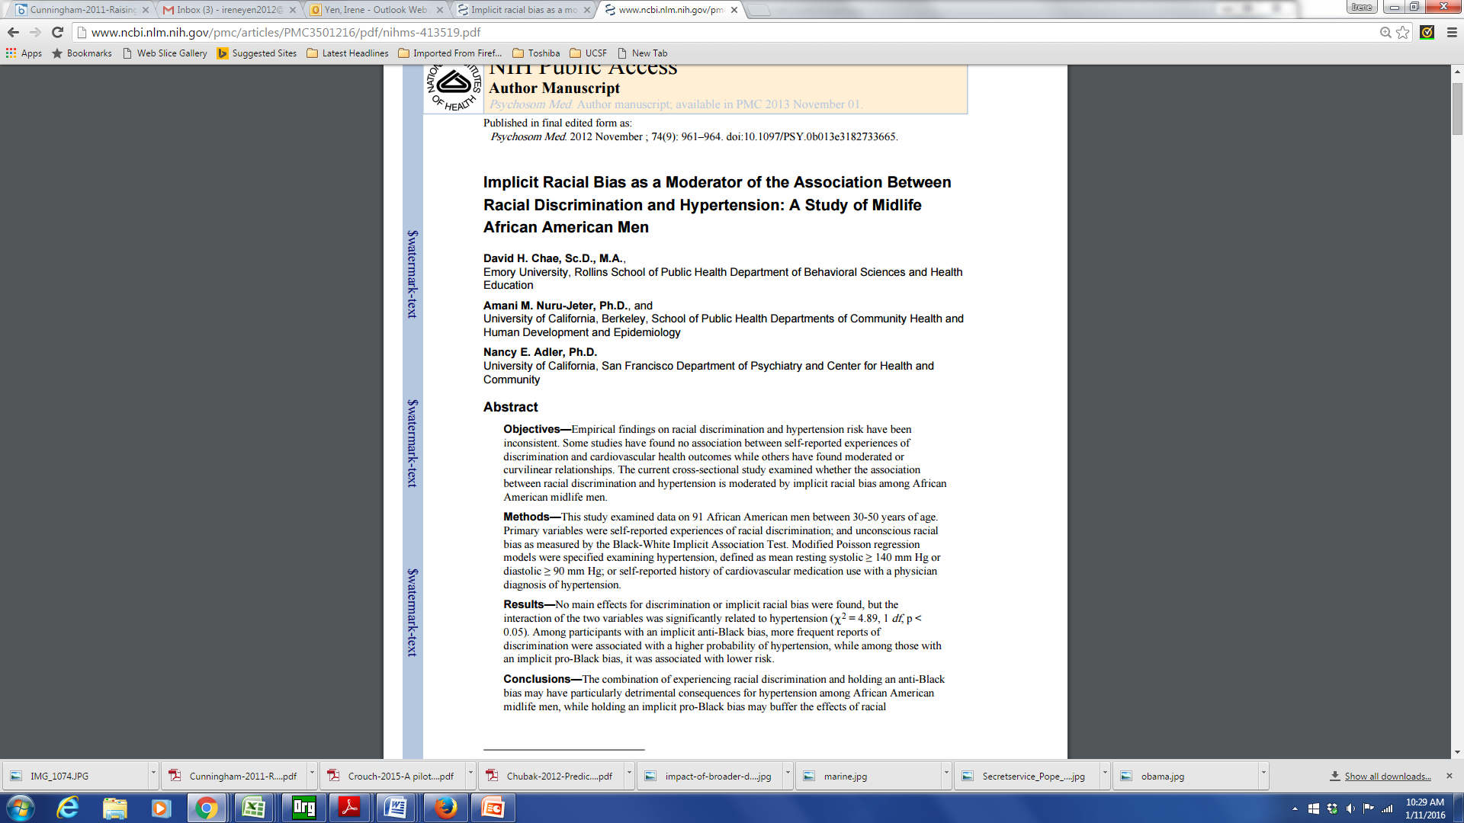
Internalized Racism

Slide 52
Internalized Racism
Implicit association test used to measure implicit (unconscious) racial bias
Among black men with anti-black bias, experiences of discrimination associated with hypertension
  Those with a pro-black bias had lower dx of hypertension

Slide 53
Life course perspective & racism
Gee et al, AJPH 2012

Slide 54
Additional dimensions of racism
Intergenerational impacts
  Historical trauma
  Wealth and inheritance
Discrimination in health care (medical discrimination)
  Institutional policies, practices
  Interpersonal interactions (providers/staff)

Slide 55
Considerations for research on racism
In the US, fundamental cause underlying racial/ethnic disparities in health
Relevant measures
  levels/dimensions
  exposure period
Validated instruments for study population
  measurement approach
  Immigration

Slide 56
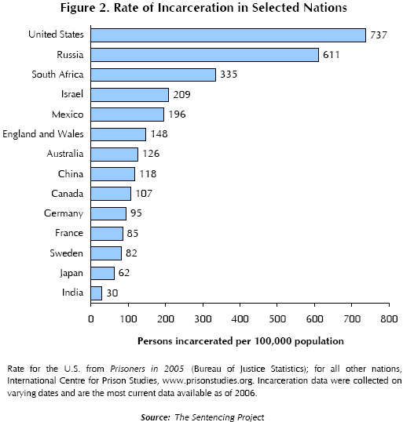
Incarceration

Slide 57
Incarceration
As of 2004, there were approximately six times more inmates and ex-inmates than in the mid-1970s.
Presently, there are more than 16 million felons and ex-felons in the United States (Uggen et al. 2006)

Slide 58
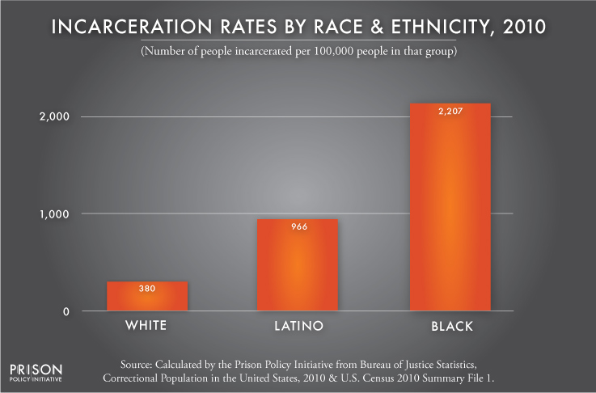
Incarceration

Slide 59
Incarceration
The lifetime cumulative risk (measured to age 34) of imprisonment for all African American males > 20 % (Pettit & Western 2004).
African American males without a high school diploma, the lifetime risk of incarceration is 59 % (5x the rates of comparable whites.)
correctional policies have caused the emergence of a new ‘‘felon class’’ in society.
  8 % of the adult population,
  22% of the black adult population
  33% percent of the black adult male population

Slide 60
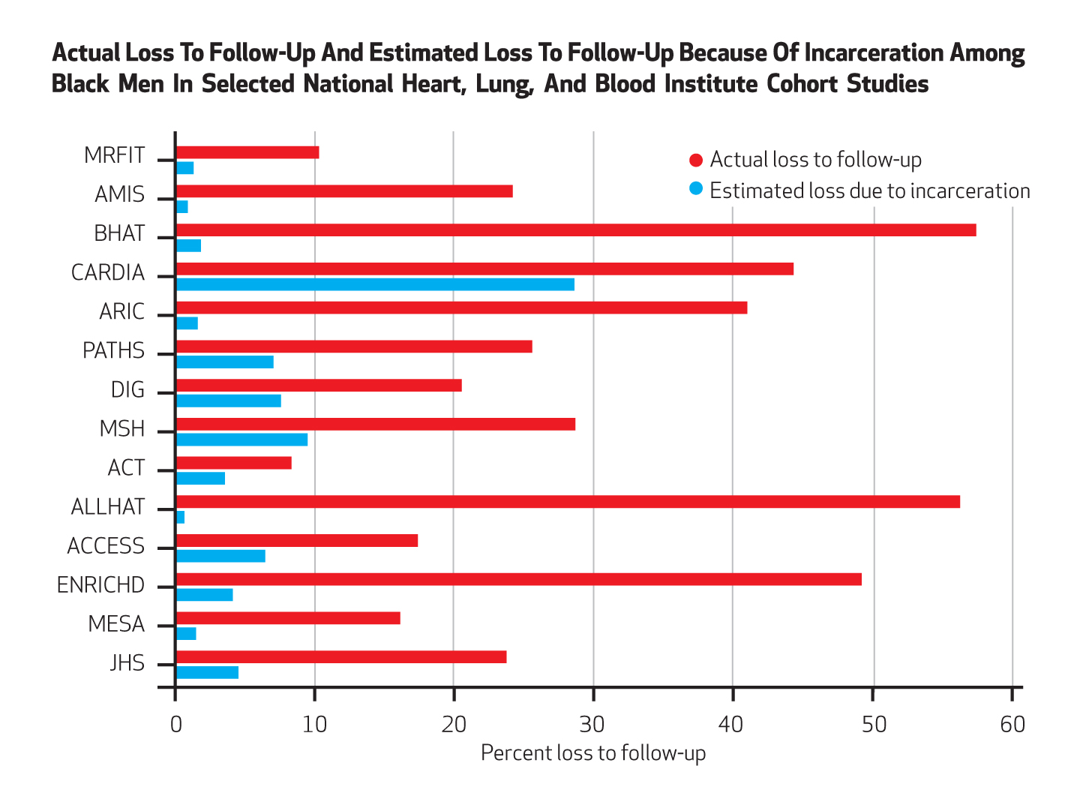
Incarceration
Notes:
Health Affairs 2014

Slide 61
Neighborhood
Pubmed Articles “Neighborhood” in title: 1970 - 2012
61

Slide 62
Place and health
Where you live, work and play impacts your health
  Environmental exposures
  Material deprivation
  Psychosocial mechanisms (stress, social support)
  Lifestyle behaviors (physical activity, diet, smoking & alcohol use)

Slide 63
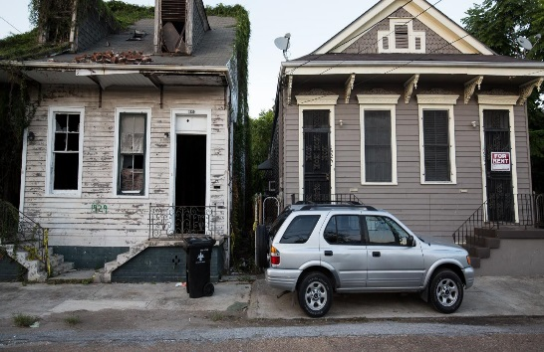
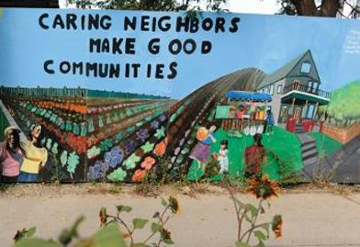

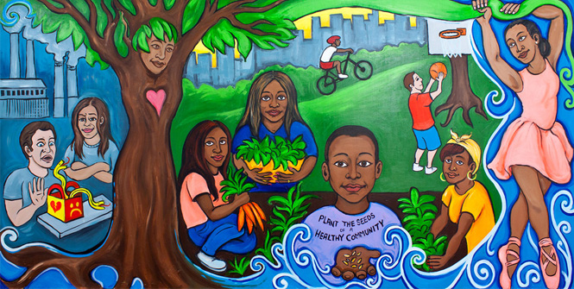

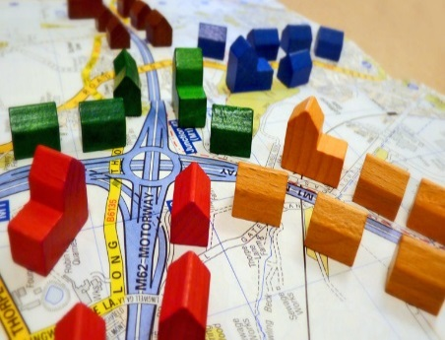

Social Environment Attributes
Social Environment
Socioeconomic status
Crime
Gentrification/ displacement
Ethnic enclave
Segregation
Racial/ ethnic composition
Social cohesion
Socioeconomic Status
Crime
Social Capital/
Social Cohesion
Racial/Ethnic Composition
Gentrification/
Displacement
Ethnic Enclave
Segregation

Slide 64
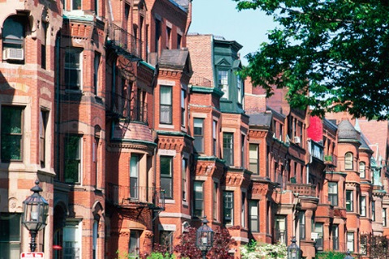
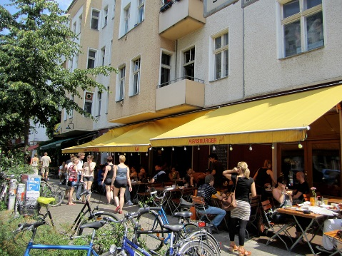
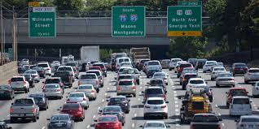
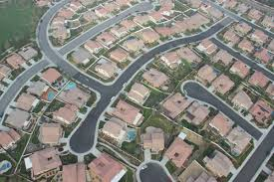
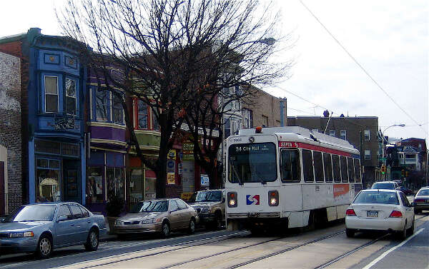

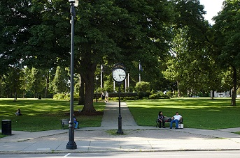

Built Environment Attributes
Population Density
Built Environment
Population density
Housing characteristics
Commuting patterns
Parks/green space
Recreational facilities
Food environment (retail food outlets, restaurants)
Street connectivity
Traffic density
Housing Characteristics
Traffic Density
Street Connectivity
Commuting Patterns
Food Environment
Parks/Green Space
Recreational Facilities

Slide 65
Gomez, Shariff-Marco, et al. Cancer 2015.

Slide 66
Additional neighborhood environments
Physical environment
  Air pollution
  Noise pollution
  Light pollution
  Toxic waste sites
Healthcare Context
  Resources: density of providers, facilities
  % insured/uninsured
  Distance to facilities

Slide 67
Diez Roux et al, Global Heart 2016

Slide 68
Neighborhood / Place research concepts and methods
definitions of neighborhood / geographic unit (scale)
  census block group
  census tract
  zip code
  buffers
measure to characterize the place
  composition
  context
types of measures
  census data
  counts
  density
  distance to
  time / space

Slide 69
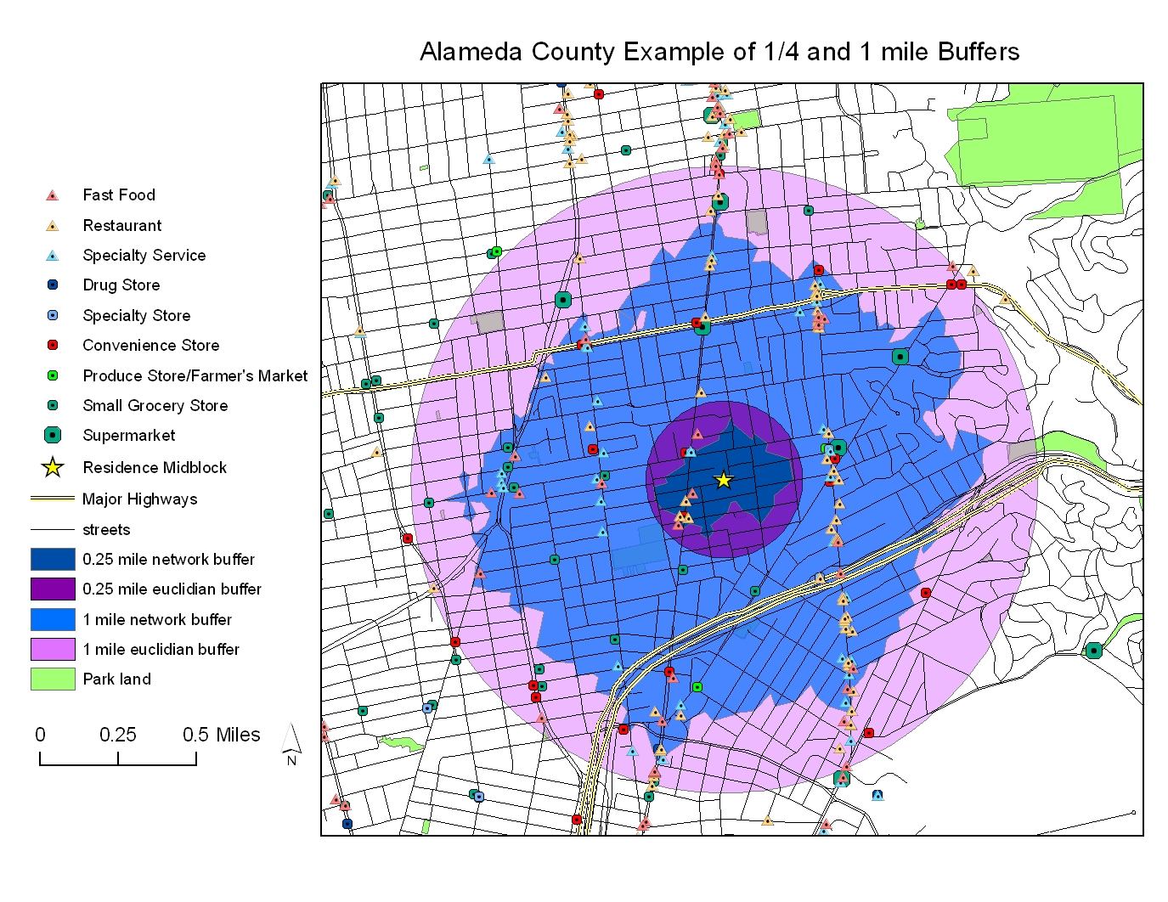

Slide 70
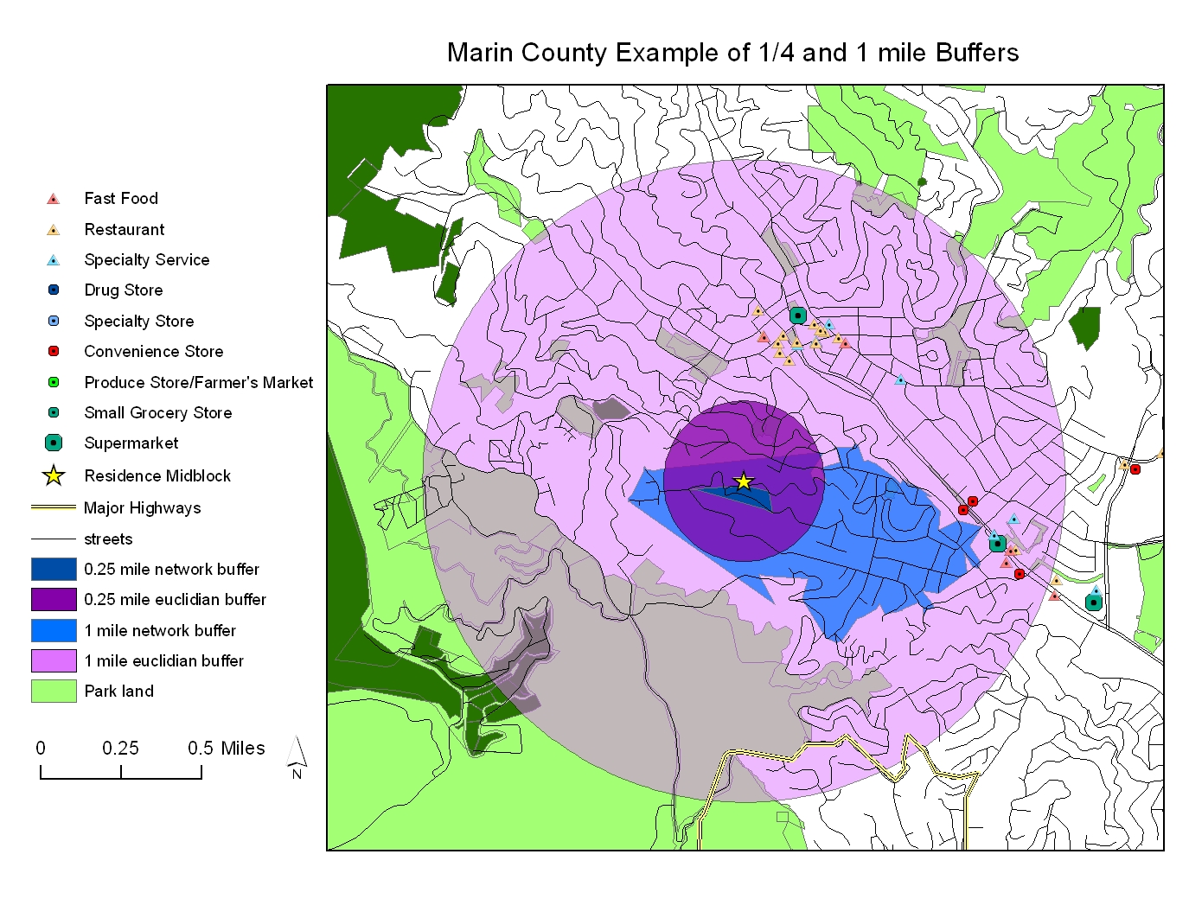

Slide 71
Arcaya et al, Social Science & Medicine 2016

Slide 72
Arcaya et al, Social Science & Medicine 2016

Slide 73
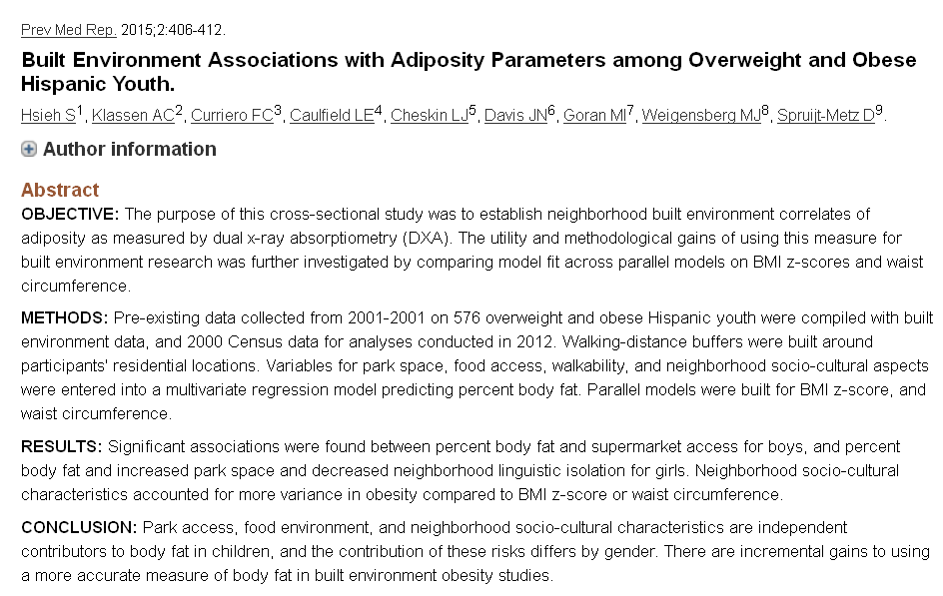

Slide 74
Moving to Opportunity
1994 – 4600 families with children living in public housing – RCT to move to lower poverty neigh
  Vouchers (<10% poverty)
  Section 8
  control
2008-2010 – evaluation studies
http://www.nber.org/mtopublic/

Slide 75
Moving to Opportunity
adults offered housing vouchers
  a lower prevalence of severe obesity and diabetes compared to controls
  fewer physical limitations
  improved mental health in areas such as depression and psychological distress
self-reported health status and rates of hypertension and health-related risk behaviors are similar across groups
little or no effect on economic self-sufficiency

Slide 76
Recommendations for research on neighborhood + health
Consider the complex and dynamic relationships
A life-course perspective
  capture neighborhood environment factors during relevant time periods and account for changes in neighborhood characteristics
Consider neighborhood environments at work
Integration of secondary (objective) and self-report (perception) data
Engage communities in solutions/interventions
Develop analytical approaches and tools
Causal inference
  apply (develop) causal inference methods to allow for calculation of less biased estimates of associations between neighborhood environments and cancer outcomes

Slide 77
Warnecke et al., AJPH 2008

Slide 79
Map of First Four Weeks
Week 2
Week 5
Economic & Social
Opportunities and Resources
Week 3
Living & Working Conditions
in Homes and Communities
Week 4
Behaviors
Medical Care
Interaction with genetic/other biological factors
HEALTH
Adapted from Braveman et al., for RWJ Foundation
Commission to Build a Healthier America | www.commissiononhealth.org

Slide 80
Questions? Comments?
Salma Shariff-Marco, PhD, MPH
sshariff@psg.ucsf.edu

