Slide 1
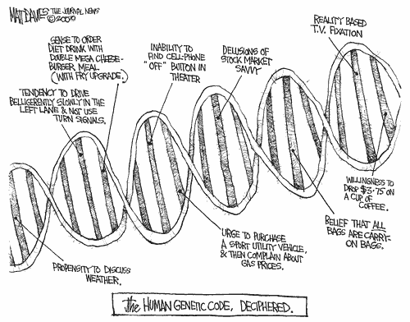
Epidemiology 217
Lecture #2: Population Genetics
Notes:
1

Slide 2
Outline
Several methods to answer the question: Is the trait genetic? [Austin Ch. 2]
  1. Familial Aggregation and recurrence risks
  2. Heritability
Genetic concepts [Austin Ch. 3]
  3. Allele Frequency Estimation
  4. Mendel’s laws & Hardy-Weinberg equilibrium (HWE)
  5. Population Substructure/Stratification

Slide 3
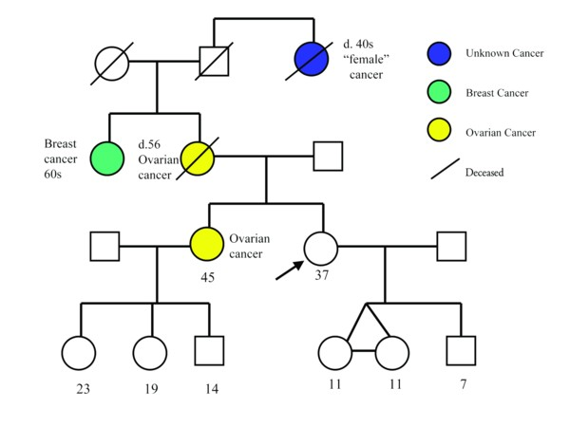
1. Familial Aggregation
Does the phenotype tend to run in families?
Ascertain family members by “probands”, i.e., affected individuals
Notes:
3
For a common disease or one that manifests as a continuous trait, one might simply enroll a random series of families and look at the pattern of correlations in the disease between different types of relatives (e.g., sibling-sibling, parent-offspring, etc.).
For a rare dichotomous disease, one would generally begin with the identification of probands, preferably in some population-based fashion, together with a comparable control series from the same population.
For each subject, one can then obtain a structured family history (i.e., to generate a pedigree), collecting disease and other (e.g., age, time at risk, etc.) information.
One could then consider two approaches to the analysis of such data.

Slide 4
Familial aggregation
“Family case-control” approach
“Family cohort” approach
Relative has disease?
Yes No
# Relatives of a b
Cases
# Relatives of c d
Controls
Relative Risk = RR
= (a/(a+b))/(c/(c+d))
Family history of disease
Yes No
# Cases a b
# Controls c d
Odds Ratio = OR
= (a/b)/(c/d) = ad/bc
- Be careful with “family history”
- E.g., ovarian cancer, only females
- E.g., late onset diseases, relative may not generally have disease
- Generally done by interview (cost reasons), though medical records would be more accurate
Khoury et al., 1993, and in Austin

Slide 5
Familial aggregation (PANSCAN)
 | Cases (%) | Controls (%) | Adjusted OR (95% CI)
Family history of pancreatic cancer in 1st degree relatives
No | 1,107 (93.6) | 1,162 (94.4) | 1.00
Yes | 76 (6.4) | 43 (3.6) | 1.76 (1.19-2.51)
Number of affected 1st degree relatives with pancreatic cancer
One | 70 (92.1) | 42 (97.7) | 1.70 (1.14-2.51)
Two or more | 6 (7.9) | 1 (2.3) | 4.26 (0.48-37.79)
Jacobs et al., 2010; Austin

Slide 6
Recurrence (‘Familial’) Risk Ratios
Compares the probability a subject is affected given they have an affected family member to the population risk:
λ_{R} = K_{R}/K,
where K_{R} is the risk to relatives of type R
K is the population risk
λ_{S} = recurrence risk to siblings of probands versus the general population risk.
(Recurrence Risks are not covered in Austin)

Slide 7
Estimating Recurrence Risk Ratios (RRR)
With case-control data, calculate RRR as:
  Proportion of affected relatives of the cases (observed) /
  Proportion of affected relatives of controls (expected) (assumed to estimate K, the population prevalence of disease)
Using λ_{R} = P(Y₂ = 1 |Y₁ = 1) / K
The higher the value of λ_{R} the stronger the genetic effect

Slide 8
Examples of λ_{s}
Alzheimer Disease 3-4
Rheumatoid Arthritis 12
Schizophrenia 13
Type I Diabetes 15
Multiple Sclerosis 20-30
Neural Tube Defects 25-50
Autism 75-150
Defining the phenotype...!

Slide 9
Limitations of Recurrence Risks
Depend on mode of inheritance and disease frequency.
Single gene diseases have high recurrence risks.
More common complex diseases have lower values (e.g., CHD).
Hard to distinguish genetic versus environmental effects.

Slide 10
Outline
Several methods to answer the question: Is the trait genetic? [Austin Ch. 2]
  1. Familial Aggregation and recurrence risks
  2. Heritability
Genetic concepts [Austin Ch. 3]
  3. Allele Frequency Estimation
  4. . Mendel’s laws & Hardy-Weinberg equilibrium (HWE)
  5. Population Substructure/Stratification

Slide 11
2. Heritability Analysis
Evaluates the genetic contribution to a trait in terms of variance explained.
Phenotype = Mean + Genetics + Environment
P = µ + G + E
Overall variation in Phenotype P
Var(P) = σ²_{P} = σ²_{G} + σ²_{E}
Notes:
11

Slide 12
Broad Sense Heritability
Proportion of the overall phenotypic variance attributable to genetic influences
H²=σ²_{G}/σ²_{P}
Ranges from 0 (little or no genetic influence) to 1 (strong genetic influence)

Slide 13
Narrow Sense Heritability
Proportion of variance explained only by additive genetic effects.
Most commonly calculated estimate since additive explains most variation.
(Recall: σ²_{P} = σ²_{G} + σ²_{E})
σ²_{G} = σ²_{A} + σ²_{D}
A: Additive effect
D: Dominance effect
“Broad sense”: H²=σ²_{G}/σ²_{P}=(σ²_{A} + σ²_{D})/σ²_{P}
“Narrow sense”: h² = σ²_{A} /σ²_{P}

Slide 14
Narrow Sense Heritability
Can estimate from regression:
  Additive: 0, 1, 2 for alleles
  Dominance: 0, 1, 0 for departure
Or estimate from twin studies...

Slide 15
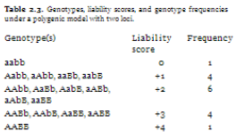
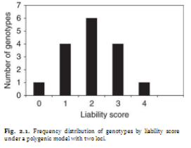
Liability model
Two copies of capital letter (risk allele)
Two unlinked loci, with allele a and risk allele A; and allele b and risk allele B.
Increase the risk by 1 unit on liability scale.
Austin 2013

Slide 16
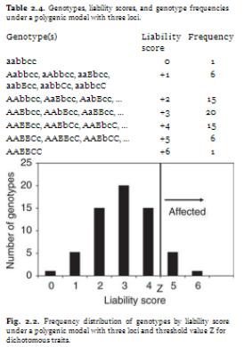
Three unlinked loci Aa, Bb, Cc (capital is risk allele)
Increase the risk by 1 unit on liability scale
If dichotomous, threshold determines disease status

Slide 17
Twin Studies
Compare the phenotype correlation or disease concordance rates of MZ (identical) and DZ (fraternal) twins.
Parents:
Possible offspring

Slide 18
MZ Twins (Identical)
If twin 1 is
Both alleles are shared identical by descent (IBD)
Then twin 2 must be:
Notes:
18

Slide 19
DZ Twins (Fraternal)
Twin 1
Twin 2: any of the four
IBD can be 2, 1, or 0
2 1 1 0
Notes:
19

Slide 20
DZ Twins (Fraternal)
Twin 1
Average sharing is 50%
100% 50% 50% 0%
Notes:
20

Slide 21
IBD Sharing
  # of alleles shared IBD
  2 1 0
  Pr(2) Pr(1) Pr(0) Prop IBD
Relationship
Self, MZ twins 1 0 0 1
Parent, Offspring 0 1 0 1/2
Full siblings 1/4 1/2 1/4 1/2
Gr-child, Gr-prt 0 1/4 3/4 1/4
First cousins 0 1/4 3/4 1/8
Proportion of alleles shared IBD
= # alleles x Pr(# alleles) / 2

Slide 22
Twin Studies
ACE Model: σ²_{P} = σ²_{A} + σ²_{C}+ σ²_{E}
A: Additive genetics
C: Common Environment
E: Unique Environment
Correlation in phenotype (P₁, P₂) among twins:
- Corr_{mz}(P₁, P₂) = r_{mz} = A + C [100% genes + Env]
- Corr_{dz}(P₁, P₂) = r_{dz} = ½A + C [50% genes + Env]
Heritability: h² = 2(r_{mz}- r_{dz} )

Slide 23
Example of Twin Study: Prostate Cancer
Twin registry (Sweden, Denmark, and Finland)
Twin | Concordant pairs (cp) | Discordant pairs (dp) | Concordance 2cp / (2cp+dp)
MZ | 197 | 807 | 0.33 (r_{mz})
DZ | 148 | 1719 | 0.15 (r_{dz})
heritability = 2(r_{mz}- r_{dz} ) = 2(0.33-0.15)
= 0.36
Mucci et al. JAMA 2016;315:68
(actual paper estimate uses Structural Equation Modeling, so differs)
Notes:
23

Slide 24
Heritability Extras
Can also model interactions (see in text)
  ACE model will overestimate the heritability in the presence of interactions
Main point is that the ACE model is based on some assumptions that might not be true, and bias our heritability estimates.

Slide 25
Heritability from GWAS
Extensive recent work using linear mixed models to estimate heritability from GWAS array data.
Called ‘chip heritability.’

Slide 26
Outline
Several methods to answer the question: Is the trait genetic? [Austin Ch. 2]
  1. Familial Aggregation and recurrence risks
  2. Heritability
Genetic concepts [Austin Ch. 3]
  3. Allele Frequency Estimation
  4. Mendel’s laws & Hardy-Weinberg equilibrium (HWE)
  5. Population Substructure/Stratification

Slide 27
3. Allele Frequency Estimation
  Diploid, autosomal locus with 2 alleles: A and a
  Allele frequency is the fraction:
No. of particular allele
No. of all alleles in population
Notes:
27

Slide 28
Allele (Gamete) Frequency
Let p = Freq(A) frequency of the dominant allele
Let q = Freq(a) frequency of the recessive allele
Then, p + q =1
Notes:
28

Slide 29
Genotype Frequency
p² = frequency of homozygous dominant genotype
q² = frequency of homozygous recessive genotype
2pq = frequency of heterozygous genotype
Then, p² +2pq + q² =1
Notes:
29

Slide 30
Estimating Allele Frequencies from Genotype Frequencies
  Genotypes: AA Aa aa
  Frequency: p² 2pq q²
  Frequency of A allele = p² + ½ (2pq)
  Frequency of a allele = q² + ½ (2pq)
Notes:
30

Slide 31
Ex. Calculation: Allele Frequencies
  Assume N=200 in each of two populations
  Pop 1: 90 AA 40 Aa 70 aa (N=200)
  Pop 2: 45 AA 130Aa 25 aa (N=200)
  In Pop 1:
  p = 90/200 + ½ (40/200) = 0.45 + 0.10 = 0.55
  q = 70/200 + ½ (40/200) = 0.35 + 0.10 = 0.45
  In Pop 2:
  p = 45/200 + ½ (130/200) = 0.225 + 0.325 = 0.55
  q = 25/200 + ½ (130/200) = 0.125 + 0.325 = 0.45
Notes:
31
Population 1: p= 0.45+0.1 = 0.55
q = 0.45
Popln 2: p = 0.225+0.325 = 0.55
q = 0.125+0.325 = 0.45

Slide 32
Take home points
  p + q =1 (sum of the allele frequencies = 1)
  p² + 2pq + q² =1 (sum of the genotype frequencies = 1)
  Two populations with markedly different genotype frequencies can have the same allele frequencies
Notes:
32

Slide 33
Outline
Several methods to answer the question: Is the trait genetic? [Austin Ch. 2]
  1. Familial Aggregation and recurrence risks
  2. Heritability
Genetic concepts [Austin Ch. 3]
  3. Allele Frequency Estimation
  4. Mendel’s laws & Hardy-Weinberg equilibrium (HWE)
  5. Population Substructure/Stratification

Slide 34
4. Mendel’s Laws of Inheritance
Key principles of understanding genetic susceptibility of disease:
    Equal Segregation: Two alleles at a genetic locus segregate from one another and are passed to offspring with equal probability
    Independent assortment: Genes on different chromosomes are inherited independently
Notes:
34

Slide 35
Modes of Inheritance
    Autosomal dominant: Gene expression phenotypically in both heterozygoes & homozygotes. One 1 copy of mutant allele required
    Recessive: Both alleles expressed phenotypically only in homozygotes. Two copies of mutant allele required (PKU)
    Co-dominant/additive: Both alleles are expressed in heterozygotes (ABO blood type)
    X-linked: Gene located on X chromosome (red/green colorblindness)
    Y-linked: Gene located on Y chromosome
Notes:
35

Slide 36
Hardy-Weinberg Equilibrium
  Hardy–Weinberg principle:
  Both allele and genotype frequencies in a population remain constant (i.e., in equilibrium) from generation to generation unless specific disturbing influences are introduced.
p² + 2pq + q² = 1
Notes:
36

Slide 37
Hardy-Weinberg Assumptions
Allele frequencies do not vary IF:
    Large population
    Random mating
    No in or out migration
    No isolated groups within the population
    No mutation
    No selection (no allele is advantageous)
Notes:
37

Slide 38
Example: Test of Hardy-Weinberg Equilibrium (HWE)
Assume we have the following observed genotype frequencies: 100 GG, 30 AG, 20AA
Frequency of the G allele:
  p = 100/150 + 0.5(30/150) = 0.767
Frequency of the A allele
  q = 20/150 + 0.5(30/150) = 0.233 = 1-p
Notes:
38

Slide 39
Example
Calculate expected genotype frequencies based on HW: p² + 2pq + q² = 1
GG
p² = 0.767*0.767 = 0.588
n(p²) = 150(0.588) = 88.2
AG
2pq = 2*0.767*0.233 = 0.357
n(2pq) = 150(0.357) = 53.6
AA
q² = 0.233*0.233 = 0.054
n(q²) = 150(0.054) = 8.1
Notes:
39

Slide 40
Example
Compare observed genotype counts (O) to expected genotype counts (E)
 | O | E | (O-E)²/E
GG | 100 | 88.2 | 1.58
AG | 30 | 53.6 | 10.39
AA | 20 | 8.1 | 17.48
 |  |  | 29.9
Chi-square test
= Σ_{i} (O_{i} – E_{i})²/E_{i} = 29.4 (chi square distribution with 1 degree of freedom)
p = 6.6 x 10⁻⁸ > Out of H-W
Notes:
40

Slide 41
Application of HWE
For genetic association studies:
  Used as QC measure to assess the accuracy of the genotyping method
  Expect SNPs to be in HWE among control populations (ethnic-specific)
  Violations of HWE could indicate genotyping errors or bias in data
Notes:
41

Slide 42
HWE can be easily expanded to account for any number of alleles at a locus
- 3 allele case (p₁, p₂, p₃)
  Allele frequencies: p₁ + p₂ + p₃ = 1
  Genotype frequencies:
  p₁² + p₂² + p₃² + 2p₁p₂ + 2p₁p₃ + 2p₂p₃= 1
- 4 allele case (p₁, p₂, p₃, p₄)
  Allele frequencies: p₁ + p₂ + p₃ + p₄= 1
  Genotype frequencies:
  p₁² + p₂² + p₃² + p₄² + 2p₁p₂ + 2p₁p₃ + 2p₂p₃ + 2p₃p₄= 1
Notes:
42

Slide 43
HWE Game
Everyone receives ~5 pairs of cards
Two allele model: Red (R allele) & Black (B allele)
Random Mating: Exchange one card from each pair with another person (keep cards face down)
Determine genotype frequency: RR, RB, BB
Determine allele frequency: R, B
Notes:
43

Slide 44
Outline
Several methods to answer the question: Is the trait genetic? [Austin Ch. 2]
  1. Familial Aggregation and recurrence risks
  2. Heritability
Genetic concepts [Austin Ch. 3]
  3. Allele Frequency Estimation
  4. Hardy-Weinberg equilibrium (HWE)
  5. Population Substructure/Stratification

Slide 45
5. Population Substructure/Stratification
Population stratification:
Confounding due to gene having marked variation in allele frequency across subgroups of a population and these subgroups differ in their baseline risk of disease.
Notes:
45

Slide 46
Population Stratification: Confounding
Exposure
Genotype of Interest
Disease
Confounder
Ethnicity
Notes:
46

Slide 47
Example
Study Population: 4,290 Pima and Papago Native Americans
Genetic Variant: Gm 3;5,13, 15 haplotype (Gm system of human immunoglobulin G)
Outcome: Type 2 diabetes
Question: Is the Gm 3; 5,13, 15 haplotype associated with Type 2 diabetes?
Knowler, AJHG, 1998
Notes:
47

Slide 48
Population Stratification: Gm3;5,13,14 in admixed sample of Native Americans of the Pima and Papago tribes
Full heritage American Indian population
 | + | -
Gm3;5,13,14 | ~1% | ~99%
NIDDM prevalence ~40%
European population
 | + | -
Gm3;5,13,14 | ~66% | ~34%
NIDDM prevalence ~15%
Gm3,5,13,14 haplotype | Cases | Controls
+ | 7.80% | 29.00%
- | 92.20% | 71.00%
Unadjusted for ethnic background
OR = 0.27 (95% 0.18-0.40)
Different genotype frequency,
different phenotype frequency
Notes:
48

Slide 49
Population Stratification: Gm3;5,13,14 in admixed sample of Native Americans of the Pima and Papago tribes
Index of American Indian ancestry | Gm3;5,13,14 haplotype | % Diabetes
0 | 65.8% | 18.5%
4 | 42.1% | 28.5%
8 | 1.6% | 39.2%
Gm3,5,13,14 haplotype | Cases | Controls
+ | 7.80% | 29.00%
- | 92.20% | 71.00%
Adjusted for ethnic background
OR = 0.83 (95% 0.58-1.18)
Previous result just picked out race/ethnicity!
Notes:
49

Slide 50
Ancestry Informative Markers
Polymorphisms with known allele frequency differences across ancestral groups
Useful in estimating ancestry in admixed individuals
Example: Duffy locus (codes for blood group)
  - 100% sub-Saharan Africans vs. other groups
  - Protects against P. vivax (malaria)
Notes:
50

Slide 51
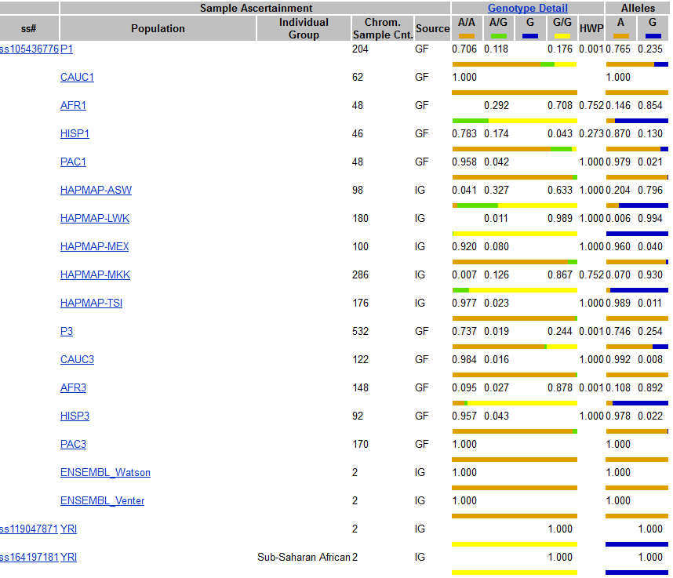
Example AIM: Duffy locus (rs2814778)
http://www.ncbi.nlm.nih.gov/projects/SNP
Notes:
51

