Slide 1

Cohort
Person Time & Bias
June M. Chan, ScD
Professor, Epidemiology & Biostatistics and Urology
Steven & Christine Burd-Safeway Distinguished Professor

Slide 2
Overview
Open vs. Fixed Cohorts
What do we calculate in Cohorts?
Assignment of Person Time
Survivor Cohorts
Bias
  Measurement Error
  Reverse Causation
  Confounding by Indication
  Residual Confounding
  Selection bias
  Immortal person time bias

Slide 3
Selection & Immortal PT Bias

Slide 4
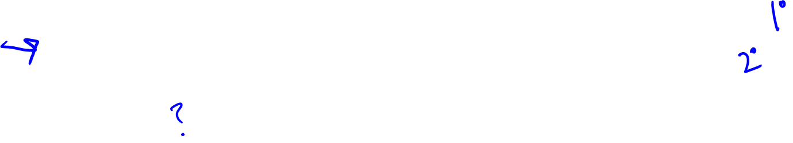
Contrast Questions used in Healthy vs. Patient cohorts
Question | Population | Exposure | Outcome
Is usage of aspirin associated with risk of colorectal cancer (CRC)? | General healthy adults from fixed cohort (e.g., NHS) | Aspirin use during adulthood, prior to diagnosis of CRC | Incidence of CRC, or time to CRC diagnosis
Does aspirin prevent cancer progression or death, in patients with CRC who had Surgery | Cases diagnosed with CRC, 2000 -2010, using hospital cancer registry | Aspirin use after surgery | Time to progression or death
What about aspirin use before surgery? Lifetime use?
When do I start follow-up?

Slide 5
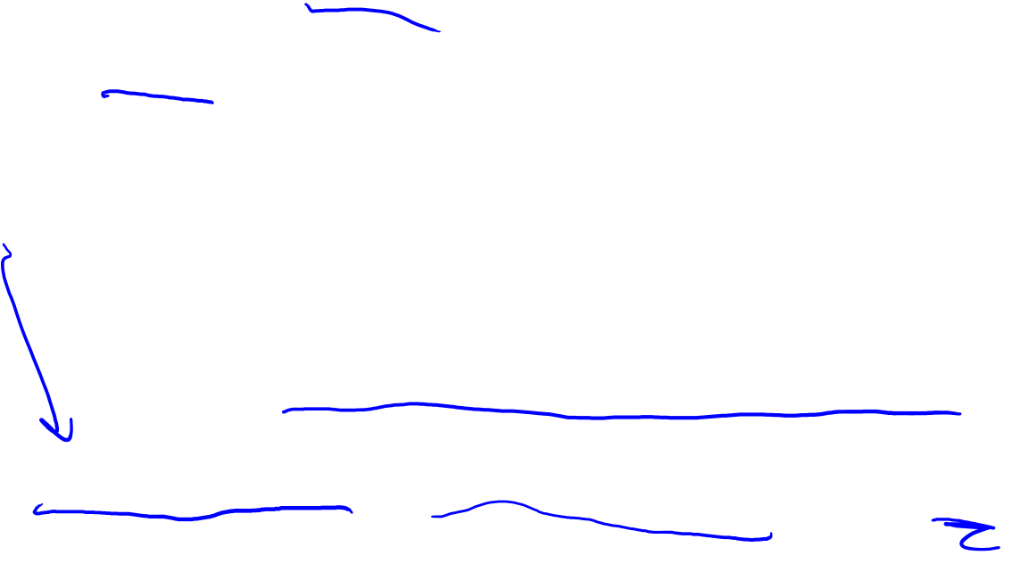
Contrast Questions used in Healthy vs. Patient cohorts
Question | Population | Exposure | Outcome
Is usage of aspirin associated with risk of colorectal cancer (CRC)? | General healthy adults from fixed cohort (e.g., NHS) | Aspirin use during adulthood, prior to diagnosis of CRC | Incidence of CRC, or time to CRC diagnosis
Does aspirin prevent cancer progression or death, in patients with CRC who had Surgery | Cases diagnosed with CRC, 2000 -2010, using hospital cancer registry | Aspirin use after surgery | Time to progression or death
Target Trial: Individuals w/o prior history of regular ASA use, who had surgery for CRC; at 1 month post-op, randomize them to daily ASA or not, then follow for death
Notes:
To help imagine how to structure a cohort study examining ASA use after dx/tx for CRC, imagine a Target Trial.
What would you do to test this if you were doing a RCT?
Why is it important to exclude individuals w/o prior usage of ASA?... Segue to prevalent vs. incident users and selection bias

Slide 6
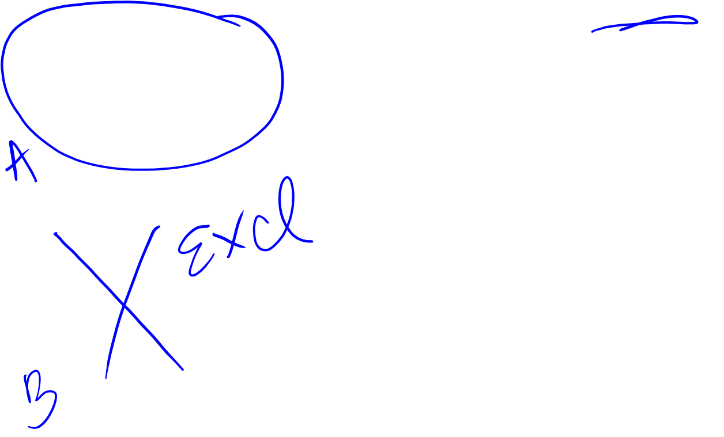
Prevalent or long-term users vs. incident users
Both individuals below are categorized as a post-dx user of ASA, when assessing outcome of Progression or Death
Are these two types of individuals really the same?
Are the tumors arising in these individuals the same?
Inclusion of prevalent users → Selection Bias
86 88 90 92 94 96 98 00 02 04 06 08 10 12 14 16
Surgery
Dx
Progression
Death due to CRC
86 88 90 92 94 96 98 00 02 04 06 08 10 12 14 16
Surgery
Dx
Progression
Death due to CRC
Using Not using
Notes:
Importance of excluding prior users

Slide 7
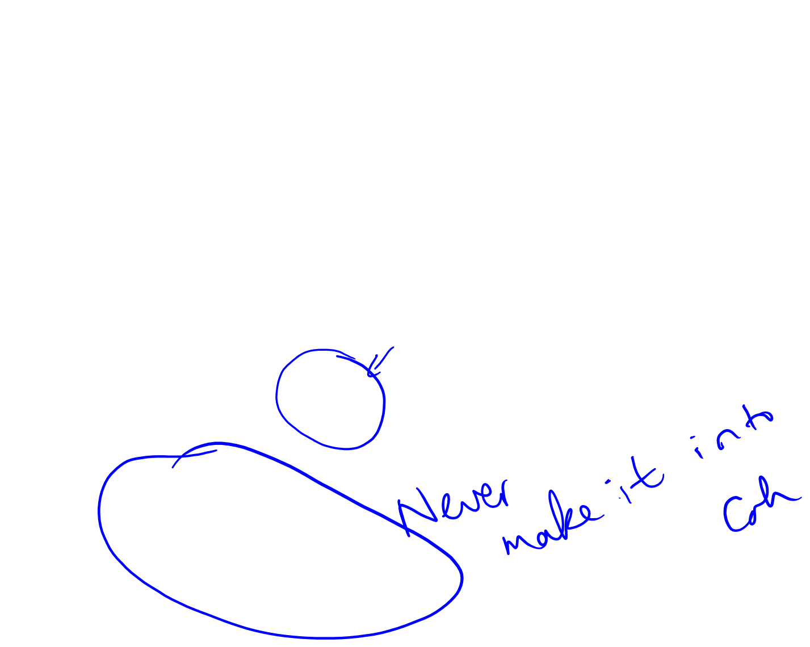
Selection Bias
Assume we get rid of the prevalent users
Now, someone chooses ASA after surgery or not
We assess this via Qx and start T₀ at return of the Qx
Person must survive to return the Qx → Selection Bias
86 88 90 92 94 96 98 00 02 04 06 08 10 12 14 16
Dx
T₀, Qx return
Progression
Death due to CRC
Surgery
86 88 90 92 94 96
Dx
Death due to CRC
Surgery
Using Not using
Notes:
This is an example of Emulation Failure 1 in Hernan J Clin Epid 2016

Slide 8
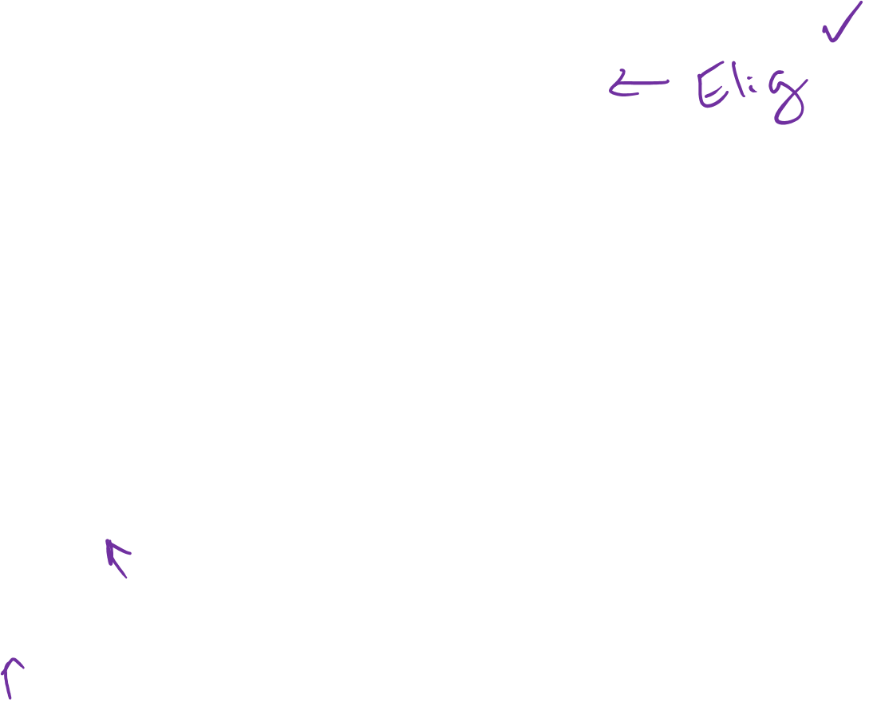
Immortal Person Time
Imagine we restrict only to individuals w/o ASA use before Dx
We start follow-up at 1 month after Surgery (T₀)
Exposure assessed on Qx returned after Surgery
Limit analyses to those with complete data & return the survey
Is this OK?
86 88 90 92 94 96 98 00 02 04 06 08 10 12 14 16
Qx
Dx
Progression
Death due to CRC
Surgery
T₀

Slide 9
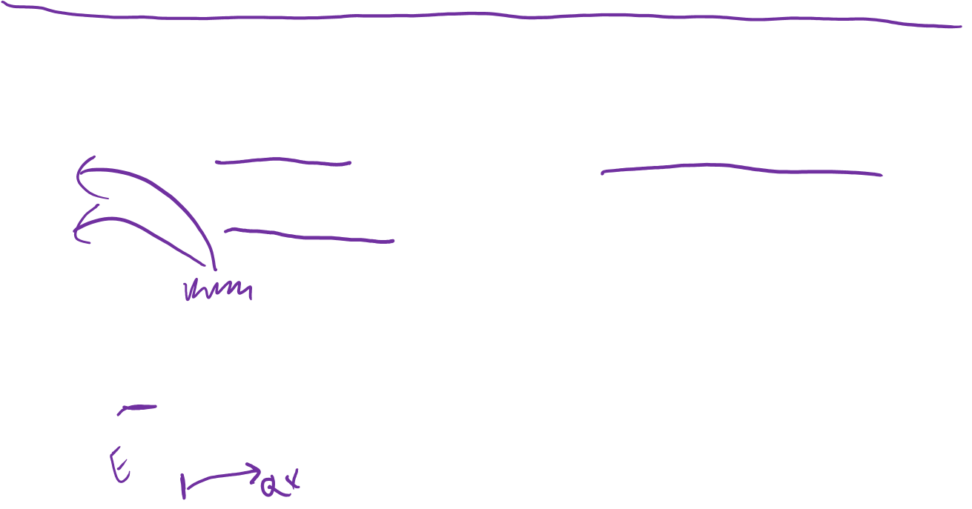
Immortal Person Time
Imagine we restrict only to individuals w/o ASA use before Dx
We start follow-up at 1 month after Surgery (T₀)
Exposure assessed on Qx returned after Surgery
Limit analyses to those with complete data & return the survey
Is this OK?
  NO – we have created immortal PT bt T₀ and return of Qx
  Forced risk to be 0 during this interval → Immortal PT Bias
Immortal PT
86 88 90 92 94 96 98 00 02 04 06 08 10 12 14 16
Qx
Dx
T₀
Progression
Death due to CRC
Surgery
Notes:
Emulation Failure 3, Hernan, J Clin Epid 2016

Slide 10
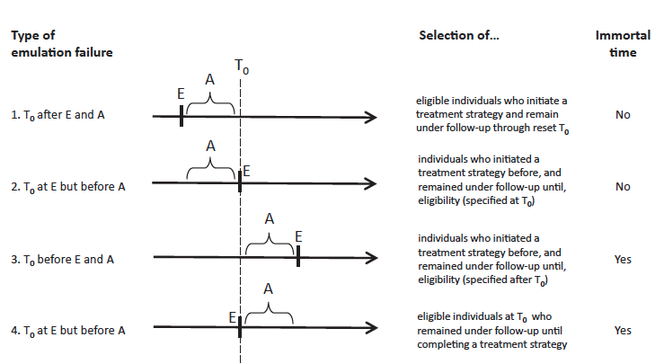
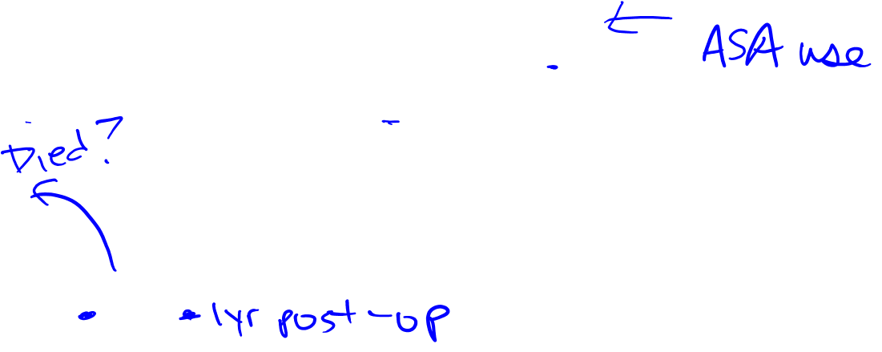
4 examples of emulation failure of target trial using observational data
T0: time zero
E: eligibility
A: period during which Tx assigned
Notes:
Emulation 1 occurs when investigator waits to start T0. This might happen for various reasons that seem only driving by practicality, but could inject bias. Maybe investigator wants to “wait” so that more individuals have the chance to start on ASA bc if you start right at 1m after surgery, there are not many users. Let’s say they are getting data from med chart, and they decide to classify someone as a an ’User’ if there’s any history of usage during the first post-op year; and don’t start T0 until 1 yr after surgery. However, this could cause selection bias bc you are omitting the folks who die or get lost during that first year, and that could happen for reasons associated with ASA use.
Emulation 2 – similar to 1, but now maybe instead of using med records, they decide to survey all the patients to get the med hx, so patients have to also turn in the survey to be in the study. The survey asks about “regular use” in the past 12 months. T0 starts at the time of the interview. Bias may occur bc we are now conditioning on surviving a certain amount of time AFTER initiation of the tx assignment has occurred AND filling out the survey… and this could occur for reasons related to ASA use.
Emulation 3 and 4 both depict instances of immortal person time. In emulation 3, imagine you identify all those folks who are alive at 1 month post-op… then go back to the medchart and classify their exposure status based on aspirin use at the time of dx, and start follow up at the time of dx (since that’s when the exposure starts, right?). Unwittingly, you have created immortal person time bc by definition, no one could have died between dx and 1 month post-op in your sample.
In emulation 4, maybe you define usage of ASA as having had 3 prescriptions for ASA in the first year after surgery. So, you wait until everyone has at least 1 yr’s worth of data, then classify exposure, start follow-up at 1 month post-op. However, you’ve not created immortal person time for all the aspirin “users” bc by definition, they had to live one year. This creates immortal PT bias.

Slide 11
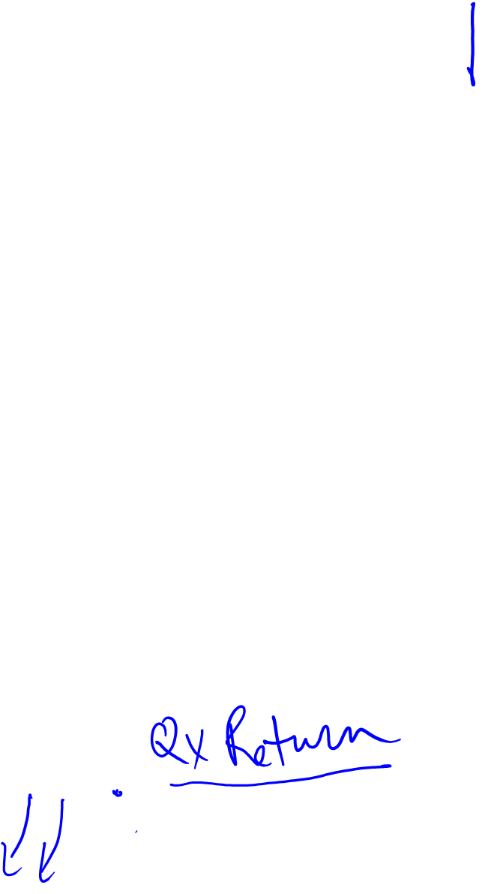
4 examples of emulation failure of target trial using observational data
T0: time zero
E: eligibility
A: period during which Tx assigned
Notes:
Emulation 1 occurs when investigator waits to start T0. This might happen for various reasons that seem only driving by practicality, but could inject bias. Maybe investigator wants to “wait” so that more individuals have the chance to start on ASA bc if you start right at 1m after surgery, there are not many users. Let’s say they are getting data from med chart, and they decide to classify someone as a an ’User’ if there’s any history of usage during the first post-op year; and don’t start T0 until 1 yr after surgery. However, this could cause selection bias bc you are omitting the folks who die or get lost during that first year, and that could happen for reasons associated with ASA use.
Emulation 2 – similar to 1, but now maybe instead of using med records, they decide to survey all the patients to get the med hx, so patients have to also turn in the survey to be in the study. The survey asks about “regular use” in the past 12 months. T0 starts at the time of the interview. Bias may occur bc we are now conditioning on surviving a certain amount of time AFTER initiation of the tx assignment has occurred AND filling out the survey… and this could occur for reasons related to ASA use.
Emulation 3 and 4 both depict instances of immortal person time. In emulation 3, imagine you identify all those folks who are alive at 1 month post-op… then go back to the medchart and classify their exposure status based on aspirin use at the time of dx, and start follow up at the time of dx (since that’s when the exposure starts, right?). Unwittingly, you have created immortal person time bc by definition, no one could have died between dx and 1 month post-op in your sample.
In emulation 4, maybe you define usage of ASA as having had 3 prescriptions for ASA in the first year after surgery. So, you wait until everyone has at least 1 yr’s worth of data, then classify exposure, start follow-up at 1 month post-op. However, you’ve not created immortal person time for all the aspirin “users” bc by definition, they had to live one year. This creates immortal PT bias.

Slide 12
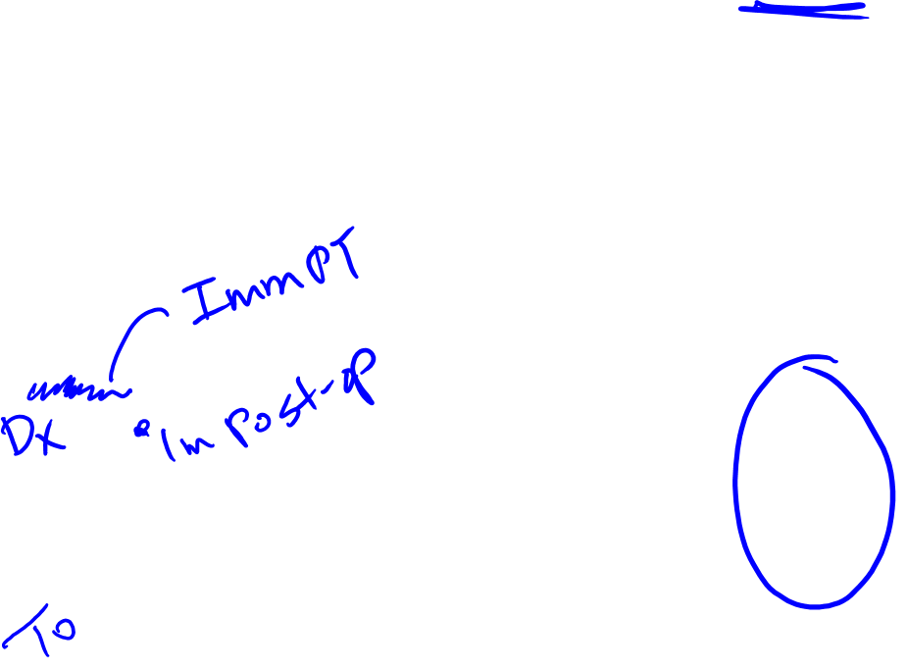
4 examples of emulation failure of target trial using observational data
T0: time zero
E: eligibility
A: period during which Tx assigned
Notes:
Emulation 1 occurs when investigator waits to start T0. This might happen for various reasons that seem only driving by practicality, but could inject bias. Maybe investigator wants to “wait” so that more individuals have the chance to start on ASA bc if you start right at 1m after surgery, there are not many users. Let’s say they are getting data from med chart, and they decide to classify someone as a an ’User’ if there’s any history of usage during the first post-op year; and don’t start T0 until 1 yr after surgery. However, this could cause selection bias bc you are omitting the folks who die or get lost during that first year, and that could happen for reasons associated with ASA use.
Emulation 2 – similar to 1, but now maybe instead of using med records, they decide to survey all the patients to get the med hx, so patients have to also turn in the survey to be in the study. The survey asks about “regular use” in the past 12 months. T0 starts at the time of the interview. Bias may occur bc we are now conditioning on surviving a certain amount of time AFTER initiation of the tx assignment has occurred AND filling out the survey… and this could occur for reasons related to ASA use.
Emulation 3 and 4 both depict instances of immortal person time. In emulation 3, imagine you identify all those folks who are alive at 1 month post-op… then go back to the medchart and classify their exposure status based on aspirin use at the time of dx, and start follow up at the time of dx (since that’s when the exposure starts, right?). Unwittingly, you have created immortal person time bc by definition, no one could have died between dx and 1 month post-op in your sample. The cohort does not include people who may have died between dx and 1 mo post-op, and one can imagine that these individuals may have died for reasons associated with ASA use, and this can create a bias.
In emulation 4, maybe you define usage of ASA as having had 3 prescriptions for ASA in the first year after surgery. So, you wait until everyone has at least 1 yr’s worth of data, then classify exposure, start follow-up at 1 month post-op. However, you’ve not created immortal person time for all the aspirin “users” bc by definition, they had to live one year. This creates immortal PT bias.

Slide 13
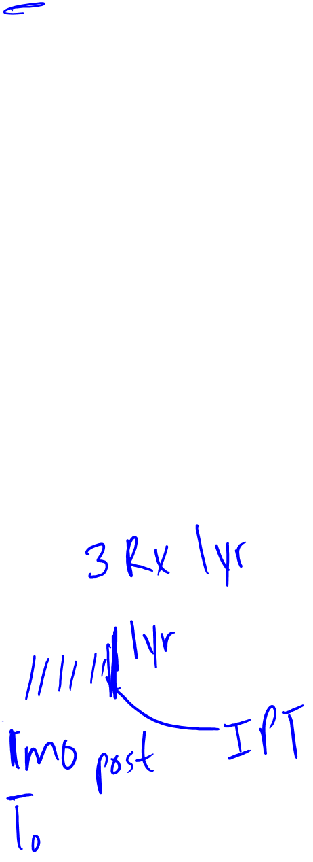
4 examples of emulation failure of target trial using observational data
T0: time zero
E: eligibility
A: period during which Tx assigned
Notes:
Emulation 1 occurs when investigator waits to start T0. This might happen for various reasons that seem only driving by practicality, but could inject bias. Maybe investigator wants to “wait” so that more individuals have the chance to start on ASA bc if you start right at 1m after surgery, there are not many users. Let’s say they are getting data from med chart, and they decide to classify someone as a an ’User’ if there’s any history of usage during the first post-op year; and don’t start T0 until 1 yr after surgery. However, this could cause selection bias bc you are omitting the folks who die or get lost during that first year, and that could happen for reasons associated with ASA use.
Emulation 2 – similar to 1, but now maybe instead of using med records, they decide to survey all the patients to get the med hx, so patients have to also turn in the survey to be in the study. The survey asks about “regular use” in the past 12 months. T0 starts at the time of the interview. Bias may occur bc we are now conditioning on surviving a certain amount of time AFTER initiation of the tx assignment has occurred AND filling out the survey… and this could occur for reasons related to ASA use.
Emulation 3 and 4 both depict instances of immortal person time. In emulation 3, imagine you identify all those folks who are alive at 1 month post-op… then go back to the medchart and classify their exposure status based on aspirin use at the time of dx, and start follow up at the time of dx (since that’s when the exposure starts, right?). Unwittingly, you have created immortal person time bc by definition, no one could have died between dx and 1 month post-op in your sample.
In emulation 4, maybe you define usage of ASA as having had 3 prescriptions for ASA in the first year after surgery. So, you wait until everyone has at least 1 yr’s worth of data, then classify exposure, start follow-up at 1 month post-op. However, you’ve not created immortal person time for all the aspirin “users” bc by definition, they had to live one year. This creates immortal PT bias.

Slide 14
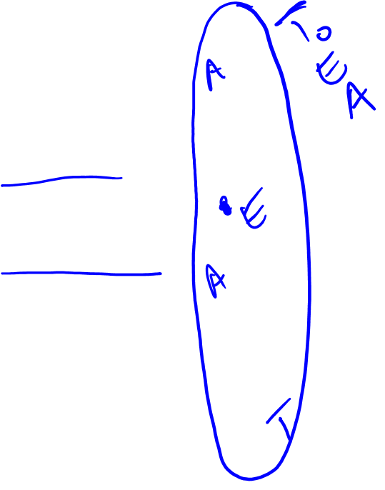
How do we avoid these problems?
Try to simulate the Target Trial
Eligibility, T₀, and Exposure assessment should be aligned
For further details, see Hernan et al, J Clin Epid, 2016
86 88 90 92 94 96 98 00 02 04 06 08 10 12 14 16
Surgery
Dx
Progression
Death due to CRC
86 88 90 92 94 96 98 00 02 04 06 08 10 12 14 16
Surgery
Dx
Progression
Death due to CRC
T₀
Using Not using
Notes:
To avoid these issues, the key is to go back to the target trial idea:
- identify eligibility participants at 1 mo post-op
- exclude individuals who were regular ASA users prior to this point to avoid prevalent use
- then ideally, you would be able to classify exposure status (or assign Tx) at this same time-point. Say you had med-chart data that allowed you to classify usage of ASA right at the point of eligibility.
Then you also start follow-up at this timepoint, so T0, E, and A are all aligned. So the key to avoid the types of selection and IM PT biases we’ve just discussed is to align T0, E, and A.
That is the key.
If you are interested, in the paper, Hernan et al goes over some reasons for why this doesn’t always happen in practice and puts forwards some suggestions/solutions to address these challenges. Many of the methods discussed in the 2nd half of the Hernan paper will be covered in Bio 215.

Slide 15
Summary
How failure to emulate a target trial may lead to:
  Selection Bias
  Immortal PT Bias
Importance of aligning T₀, eligibility, and “Tx assignment” in observational studies

Slide 16
Extra Slides

Slide 17
Selection Bias in a Cohort of Patients with Colorectal Cancer based on conditioning on some censoring that occurs AFTER Tx has been assigned
A: aspirin use prior to study start or eligibility assessment (T₀)
Y: Death
C: Censoring, we condition on C=0
U: Non-cancer, co-morbid conditions (e.g., history of MI, diabetes, etc)
A
C
Y
Selection Bias occurs when you condition on a collider
U

Slide 18
Prevalent Users Bias
Analyses are restricted to eligible individuals who initiate a treatment strategy and remain under follow-up through time T₀, and only time after T₀ is included in the analysis.
Arises in studies that include individuals who initiated one of the treatment strategies of interest before the start of follow-up and who continue to follow the same strategy during the follow-up, i.e., prevalent, current, or persistent users.
This creates a potential collider bias because exposed individuals who do not have the event prior to T₀ may have other characteristics (U) that protected them from an early event and also bias associations with later event rates.
X
Event prior to T₀
Included in the analyses
Event after T₀
U
Provided by: M. Glymour

Slide 19
Prevalent Users Bias
Analyses are restricted to eligible individuals who initiate a treatment strategy and remain under follow-up through time T₀, and only time after T₀ is included in the analysis.
Arises in studies that include individuals who initiated one of the treatment strategies of interest before the start of follow-up and who continue to follow the same strategy during the follow-up, i.e., prevalent, current, or persistent users.
This may also create a bias if people who experience side effects alter treatment status before T_{0.}
X_{T-1}
X_{T0}
Side effects of X
Event after T₀
U
Provided by: M. Glymour

Slide 20
Immortal time bias
“A span of time in the observation or follow-up period of a cohort during which the outcome under study could not have occurred.”
Example: comparing effect of heart transplant receipt on survival time, beginning follow up at the time patient is placed on the wait list. The time from wait list placement to receipt of the transplant is “immortal time” for transplant recipients in that, had they died during this period, they would not have received the transplant (organ donation rules being limited to living recipients).
Sometimes called “survivor treatment selection bias” but that is a very confusing label.
Provided by: M. Glymour

Slide 21
DAGs for the most innocuous variant of immortal time bias
The immortal time is equal for the exposed and unexposed, i.e., neither exposed nor unexposed who had the event during the immortal period are included.
This attenuates all rate estimates (because there’s too much time in the denominator). It will therefore typically bias effect estimates based on the ratios of event rates.
If there is any unmeasured cause of the event which persists from the immortal time to the follow-up time (e.g., U in the DAG), it will also induce collider bias and affect any comparison (e.g., risk differences).
X
Event during immortal period
Participate in the study
Event during follow-up
U
Provided by: M. Glymour

Slide 22
DAGs for the most innocuous variant of immortal time bias
Under the null hypothesis that exposure doesn’t influence the outcome, this type of immortal time shouldn’t create a bias though, because there is no collider.
Note that you would still be calculating event rates incorrectly, but the effect estimate for X should be null regardless.
X
Event during immortal period
Participate in the study
Event during follow-up
U
Provided by: M. Glymour

