Slide 1
Multi-level Etiologies of Health Disparities:
Pt 3. Behavioral
Scarlett Lin Gomez, PhD, MPH
Department of Epidemiology & Biostatistics
Helen Diller Family Comprehensive Cancer Center

Slide 2
Objectives
Conceptual models
Health behaviors - patterned by social determinants, ex:
  Tobacco
  Diet
  Physical activity
  Alcohol / drugs
  Healthcare utilization
Explanatory concepts connecting social determinants with health behaviors

Slide 3
Map of First Four Weeks
Week 2
Week 5
Economic & Social
Opportunities and Resources
Week 3
Living & Working Conditions
in Homes and Communities
Week 4
Behaviors
Medical Care
Interaction with genetic/other biological factors
HEALTH
Adapted from Braveman et al., for RWJ Foundation
Commission to Build a Healthier America | www.commissiononhealth.org

Slide 4
Conceptual models

Slide 5
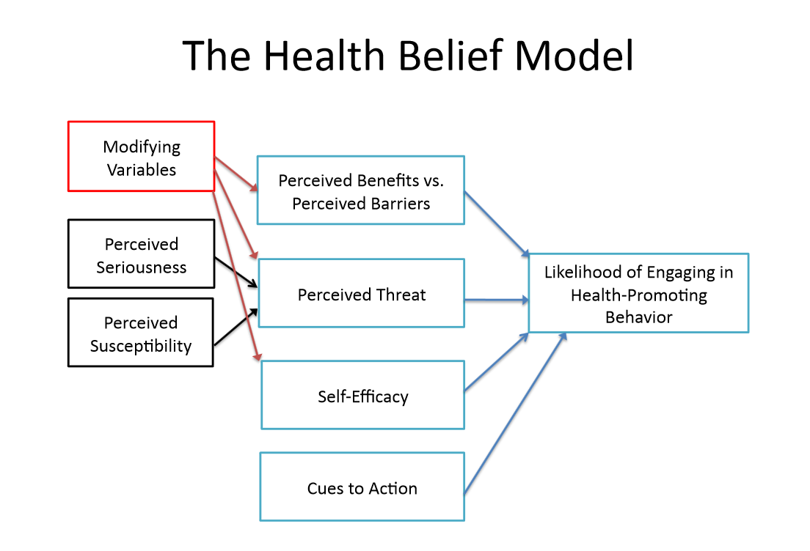
Psychological models of motivation and behavioral change

Slide 6
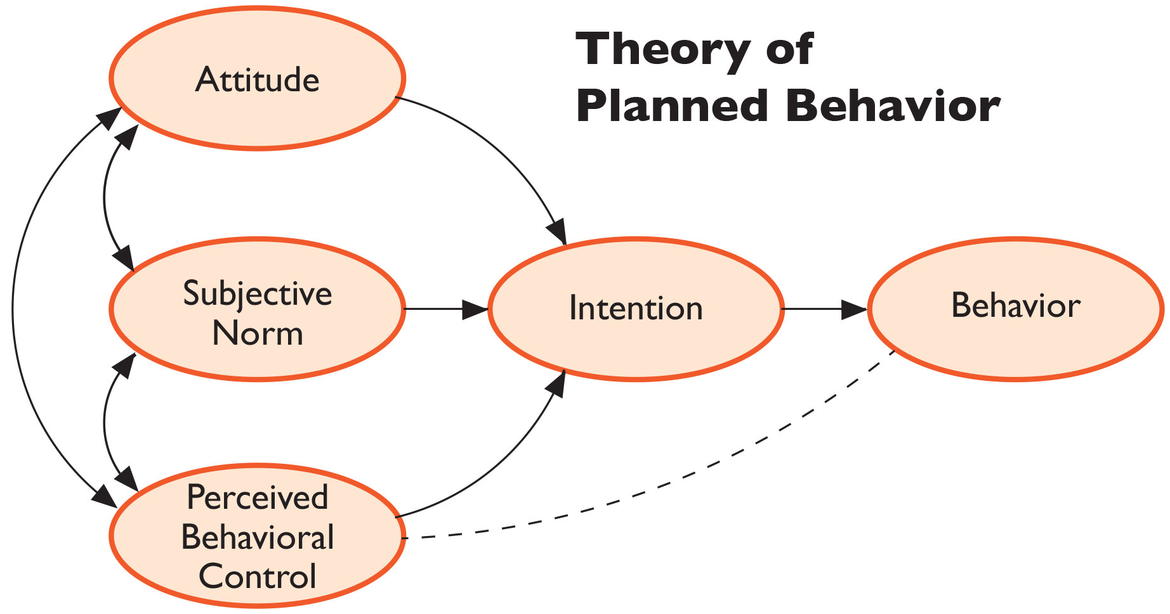
Psychological models of motivation and behavioral change

Slide 7

World Health Organization’s Commission on
Social Determinants of Health Framework
Socioeconomic & political context
Governance
Policy (Macroeconomic, Social, Health)
Cultural and societal norms and values
Social Position
Material circumstances
Social cohesion
Psychosocial factors
Behaviors
Biological factors
Distribution of health and
well-being
Education
Occupation
Income
Gender
Ethnicity/Race
Health-Care System
SOCIAL DETERMINANTS OF HEALTH INEQUITIES
SOURCE: Amended from Solar & Irwin, 2007
http://www.who.int/social_determinants/thecommission/finalreport/graphs/en/

Slide 8
World Health Organization’s Commission on
Social Determinants of Health Framework
Socioeconomic & political context
Governance
Policy (Macroeconomic, Social, Health)
Cultural and societal norms and values
Social Position
Material circumstances
Social cohesion
Psychosocial factors
Behaviors
Biological factors
Distribution of health and
well-being
Education
Occupation
Income
Gender
Ethnicity/Race
Health-Care System
SOCIAL DETERMINANTS OF HEALTH INEQUITIES
SOURCE: Amended from Solar & Irwin, 2007
http://www.who.int/social_determinants/thecommission/finalreport/graphs/en/

Slide 9
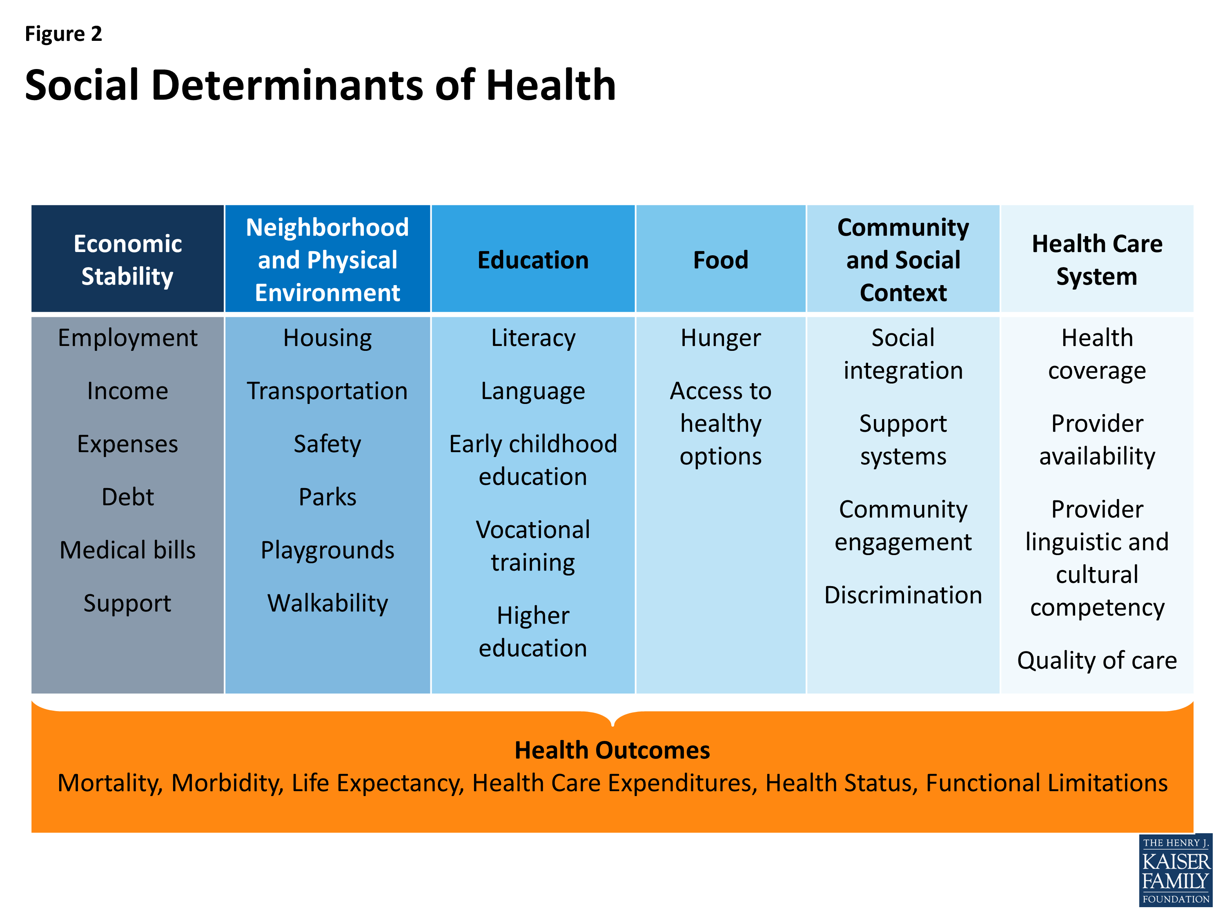
Social Determinants of Health
Beyond Health Care: The Role of Social Determinants in Promoting Health and Health Equity
http://www.kff.org/disparities-policy/issue-brief/beyond-health-care-the-role-of-social-determinants-in-promoting-health-and-health-equity/

Slide 10
Social Determinants of Health
Beyond Health Care: The Role of Social Determinants in Promoting Health and Health Equity
Health behaviors
(one key pathway)
http://www.kff.org/disparities-policy/issue-brief/beyond-health-care-the-role-of-social-determinants-in-promoting-health-and-health-equity/

Slide 11
Cells-to-Society Model
Centers for Population Health and Health Disparities (CPHHD)
“Unnatural Causes. Place Matters” (PBS 2008)
Why is your street address…such a good predictor of your health?
“When we think about health, we usually think about health care and access to health care and the quality of care. But what research clearly shows is that health is embedded in the larger conditions in which we live and work.…
Sometimes, we naively think of improving health by simply changing behaviors. But the choices of individuals are often limited by the environments in which they live.”
(David Williams)
Warnecke et al. AJPH 2008

Slide 12
Cells-to-Society Model
Centers for Population Health and Health Disparities (CPHHD)
“Unnatural Causes. Place Matters” (PBS 2008)
Why is your street address…such a good predictor of your health?
“When we think about health, we usually think about health care and access to health care and the quality of care. But what research clearly shows is that health is embedded in the larger conditions in which we live and work.…
Sometimes, we naively think of improving health by simply changing behaviors. But the choices of individuals are often limited by the environments in which they live.”
(David Williams)
Warnecke et al. AJPH 2008

Slide 13
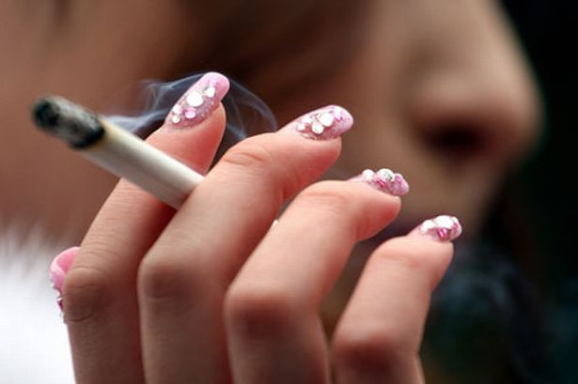
Health behaviors are patterned by social determinants

Slide 14
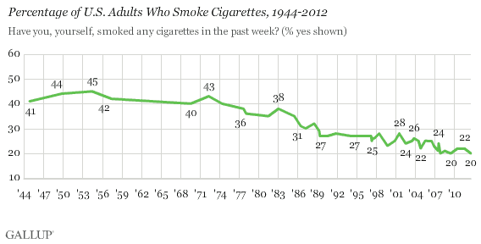
Tobacco

Slide 15
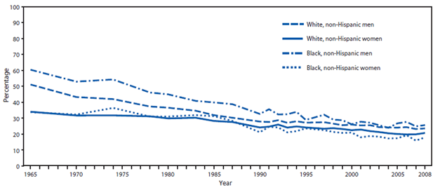
Tobacco – by race/ethnicity and gender

Slide 16
Tobacco – by education

Slide 17
% Current smoker by race/ethnicity,
California Health Interview Survey 2012-2013

Slide 18
% Current smoker by Latino ethnicity,
California Health Interview Survey 2012-2013

Slide 19
% Current smoker by Asian ethnicity,
California Health Interview Survey 2012-2013

Slide 20

For every 10 % increase in the proportion of African-American students at a school, the per-pack price of Newport (the leading brand of menthol cigarettes) was 12 cents lower.
The prices for the leading non-menthol brand weren’t affected by school demographics.
Henriksen, et al. 2011

Slide 21
Obesity Trends* Among U.S. Adults
BRFSS, 2001
(*BMI ≥30, or ~ 30 lbs. overweight for 5’ 4” person)
<10% 10%–14% 15%–19% 20%–24% ≥25%

Slide 22
Obesity Trends* Among U.S. Adults
BRFSS, 2005
(*BMI ≥30, or ~ 30 lbs. overweight for 5’ 4” person)
<10% 10%–14% 15%–19% 20%–24% 25%–29% ≥30%

Slide 23
Obesity Trends* Among U.S. Adults
BRFSS, 2010
(*BMI ≥30, or ~ 30 lbs. overweight for 5’ 4” person)
<10% 10%–14% 15%–19% 20%–24% 25%–29% ≥30%

Slide 24
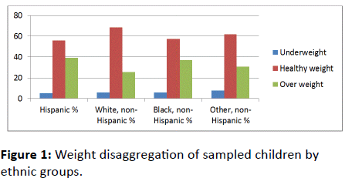
2011 National Survey of Children’s Health
Olusola Asieba J Childhood Obesity 2016

Slide 25
% Obese by race/ethnicity,
California Health Interview Survey 2012-2013

Slide 26
% Obese by Latino ethnicity,
California Health Interview Survey 2012-2013

Slide 27
% Obese by Asian ethnicity,
California Health Interview Survey 2012-2013

Slide 28
Social and built environment associations with body size among breast cancer survivors
Pathways breast cancer survivor cohort (N=4,312), Northern CA Kaiser, racially/ethnically diverse
Higher odds of overweight associated with:
  Lower neighborhood SES, ethnic minority composition, more commuters, higher traffic density, higher ratio of fast food to non fast food, higher ratio of unhealthy to healthy food outlets
Higher odds of obesity associated with:
  Lower neighborhood SES (OR=2.3 Q1 vs. Q5), ethnic minority composition, more commuters, higher traffic density, higher ratio of fast food to non fast food, higher ratio of unhealthy to healthy food outlets, fewer total businesses, fewer recreational facilities
Shariff-Marco et al. CEBP 2017

Slide 29
Social and built environment associations with body size among breast cancer survivors
Adjusting for neighborhood SES greatly attenuated increased odds of overweight and obesity among African Americans and obesity among US-born Hispanics, relative to non-Hispanic whites.
Further adjustment for other neighborhood attributes slightly attenuated increased odds of overweight and obesity among African Americans, but not among US-born Asians, relative to non-Hispanic whites.
Shariff-Marco et al. CEBP 2017

Slide 30
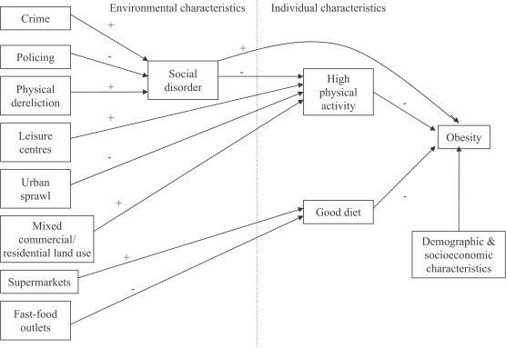
Theoretical model linking social and physical environmental characteristics to obesity
Pathways to obesity: Identifying local, modifiable determinants of physical activity and diet
Mai Stafford , Steven Cummins , Anne Ellaway , Amanda Sacker , Richard D. Wiggins , Sally Macintyre
Social Science & Medicine, Volume 65, Issue 9, 2007, 1882 - 1897

Slide 31
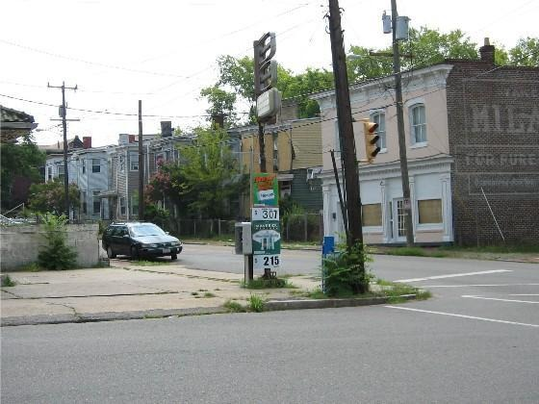
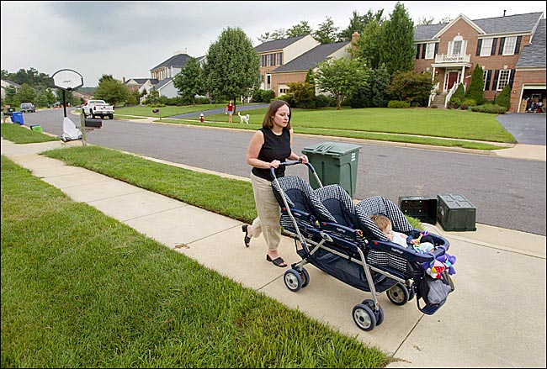

Physical Activity
Only 1 in 3 children are physically active every day.
< 5% of adults participate in 30 minutes of physical activity each day

Slide 32
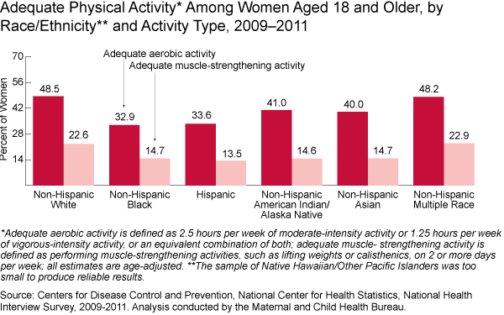
Physical activity by race/ethnicity

Slide 33
% Engaged in regular walking in past week by race/ethnicity,
California Health Interview Survey 2012-2013

Slide 34
% Engaged in regular walking by Latino ethnicity,
California Health Interview Survey 2012-2013

Slide 35
% Engaged in regular walking by Asian ethnicity,
California Health Interview Survey 2012-2013

Slide 36
Multilevel Research: built environment and physical activity in a diverse population
California Teachers Study: population cohort study of ~130,000 teachers and teaching administrators
Analysis included 117,367 women who resided in California at the time of the 1995 baseline survey and for whom residential address could be geocoded
Recursive partitioning was used to identify predictors of physical inactivity (< 25 hrs/wk)
Keegan et al. The association between neighborhood characteristics and body size and physical activity in the California Teachers Study cohort. Am J Public Health, 2012; 102:689-97

Slide 37
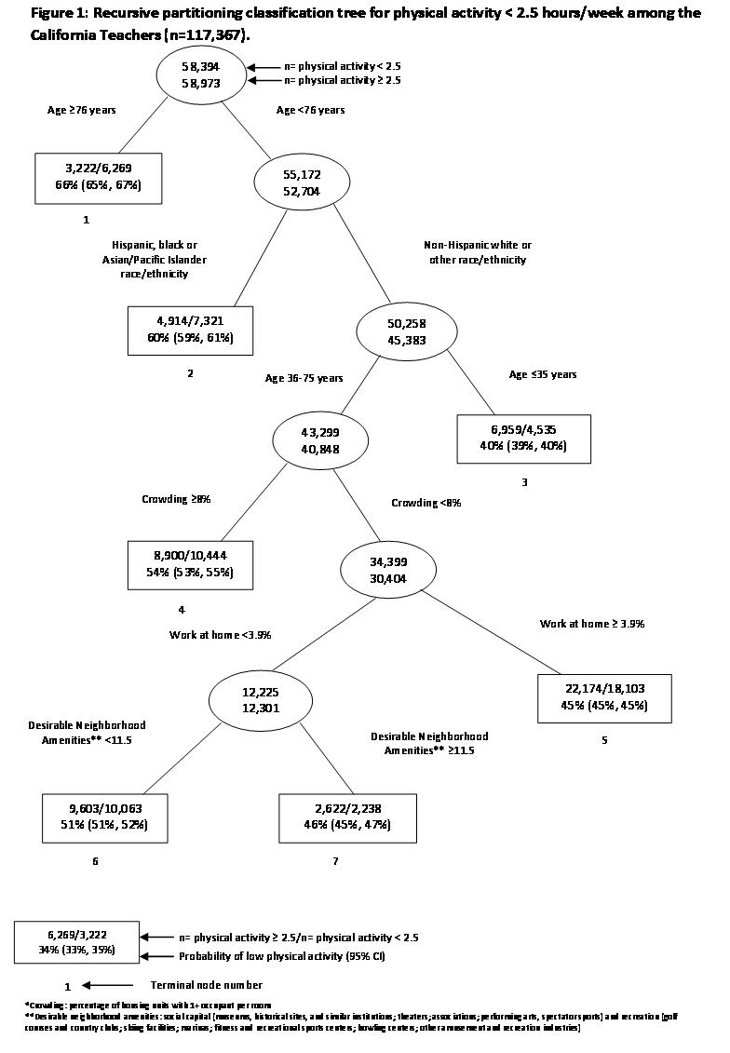

Slide 38
Multilevel Research: built environment and physical activity in a diverse population
Built environment variables associated with physical activity
  Household crowding
  % of population work at home
  N of desirable amenities
But built environment effects seen only among non-Hispanic Whites and “other” race/ethnicity, aged 36-75
Minority groups have low physical activity regardless of built environment

Slide 39
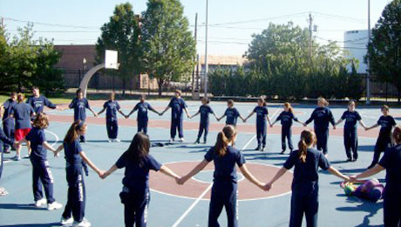
Physical Education – California example
National Association for Sports and Physical Education (NASPE) recommends 150 minutes of PE per week for elementary students;
225 minutes per week for middle and high school students.
Since early 1990s, the California Dept of Education has required:
  grades 1-6 (100 minutes per week) (48%)
  grades 7-12 (200 minutes per week) (24%)
Policy determinants discussed in Week 6

Slide 40
Physical activity - organized sports
Adolescents from more affluent families more likely to participate in organized activities than adolescents from low-income families
Girls in suburban communities participate in sports at a similar rate to boys. However, urban and rural girls, low-income girls and girls from immigrant families all participate in sports at significantly lower rates than their male counterparts
Asian Americans and Latinos are less likely to participate in sports than other ethnic groups

Slide 41
Diet
Meta-analysis of 27 studies - healthy eating costs $1.48 more per day per adult than eating a low-quality diet ($550 more annually per person).

Slide 42
% Consumed 1 or more sodas per day by race/ethnicity,
California Health Interview Survey 2012-2013

Slide 43
% Consumed 1 or more sodas per day by Latino ethnicity,
California Health Interview Survey 2012-2013

Slide 44
% Consumed 1 or more sodas per day by Asian ethnicity,
California Health Interview Survey 2012-201328

Slide 45

Effect of neighborhood scales on the likelihood of development of obesity in the CYGNET Study, 2007-2012 (n=601 observations from 174 girls)
 | Model 1 |  | Model 2
Neighborhood Scale | OR | 95% CI | OR | 95% CI
Food and Service Retail | 2.40*** | 1.44, 4.02 | 2.27*** | 1.42, 3.61
Recreation | 0.97 | 0.55,1.69 | 0.84 | 0.50,1.40
Walkability | 1.02 | 0.63, 1.67 | 0.85 | 0.53, 1.36
Physical Disorder | 2.53** | 1.28, 5.01 | 2.41** | 1.31, 4.44
*** p < .001; ** p < .01; * p < .05
Hoyt Pediatrics 2014
Notes:
When controlling for baseline BMI z score, pubertal development stage, race/ethnicity, number of street segments observed per girl, and year of outcome measure, results indicated food and service retail scale (OR=2.40; P<.001) and physical disorder scale (OR=2.53; P=.008) were predictors of increased odds of obesity during the 4-year transition from late childhood to early adolescence.

Slide 46


Drugs and Alcohol

Slide 47
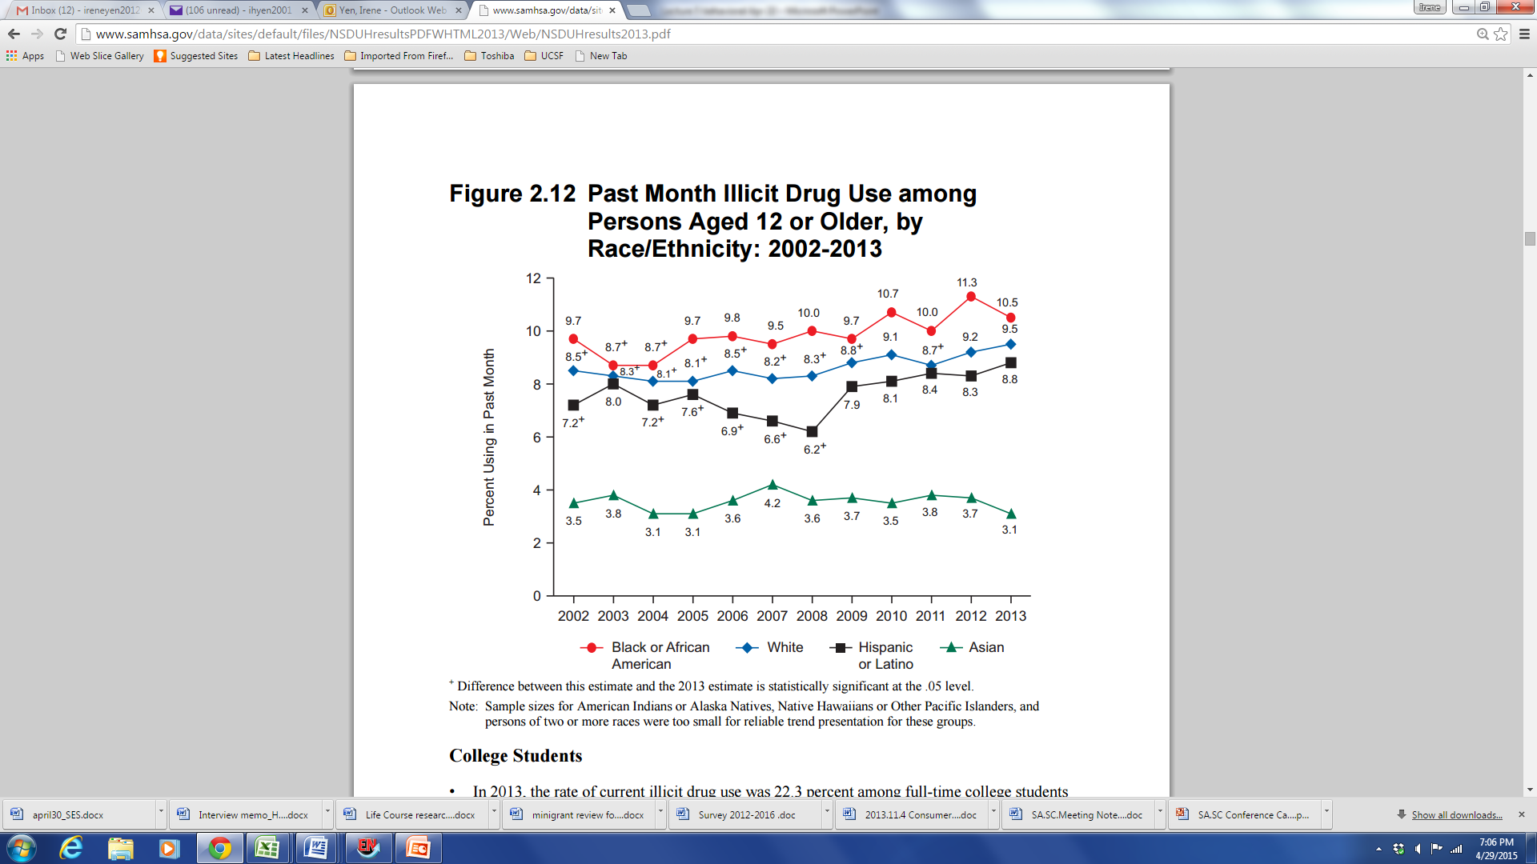
Drugs and Alcohol
2013 National Survey on Drug Use and Health

Slide 48
2013 National Survey on Drug Use and Health
Rates of illicit drug dependence or abuse were associated with levels of education adults (aged 26+):
College graduates: 0.9%
Some college education: 2.1%
High school graduate: 1.9%
Did not graduate from high school: 2.5%

Slide 49
Healthcare utilization
Patients ←→ Providers / healthcare systems
(next week)

Slide 50
% Delayed getting prescription drugs or medical services in past year by race/ethnicity,
California Health Interview Survey 2012-2013

Slide 51
% Delayed getting prescription drugs or medical services in past year by Latino ethnicity,
California Health Interview Survey 2012-2013

Slide 52
% Delayed getting prescription drugs or medical services in past year by Asian ethnicity,
California Health Interview Survey 2012-201328

Slide 53
Adherence to breast cancer treatment guidelines
Insured population
Equal-access integrated health care system
Intersectionality of race/ethnicity x SES

Slide 54
Multivariable model adjusted for age, year dx, race x neighborhood SES, marital status, tumor size, lymph node involvement, grade, ER/PR x endocrine therapy, HER2Neu, comorbidities, distance to facility, surgery
Kurian et al. Br Cancer Res Treat 2013

Slide 55
Multivariable model adjusted for age, year dx, race x neighborhood SES, marital status, tumor size, lymph node involvement, grade, ER/PR x endocrine therapy, HER2Neu, comorbidities, distance to facility, surgery
Kurian et al. Br Cancer Res Treat 2013

Slide 56
Colorectal cancer screening among South Asian Americans
South Asian Americans have among the lowest % of colorectal cancer screening – 60% vs. >70% in other populations
Analysis of CHIS data showed that while immigration and language determinants were important, the factors most strongly associated with screening were being obese and having had a flu shot in the past year
Findings triangulate with qualitative data showing health beliefs, esp in preventive care, is important in this population
Project funded by CDC (Somsouk, Ivey, Gomez)

Slide 57
Explanatory concepts connecting social determinants with behaviors

Slide 58
Potential pathways
Affordance model -> Stress pathway
  Ex. Adverse childhood experiences
Access to resources
Medical mistrust

Slide 59
Environmental Affordances
J. J. Gibson: the actionable properties between the world and a person
relationships between people and their environments that can have an effect on human activity whether or not they are visible, known, or desirable.

Slide 60
Affordances Model (Jackson)
Over the life course, Blacks (and other underserved populations) are more likely to engage in coping strategies (i.e., adverse health behaviors) that “preserve” mental health
However, over time, in concert with social, economic, and environmental stressors, these coping strategies lead to poor physical health in middle age and older life
Jackson et al. AJPH 2010

Slide 61
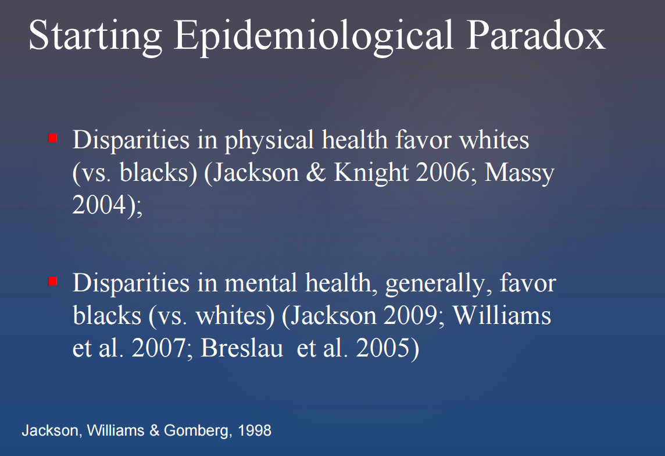

Slide 62
Lifetime prevalence of DSM IV
major depressive disorder
Notes:
National Survey of American Life (2001-2003)
percents

Slide 63
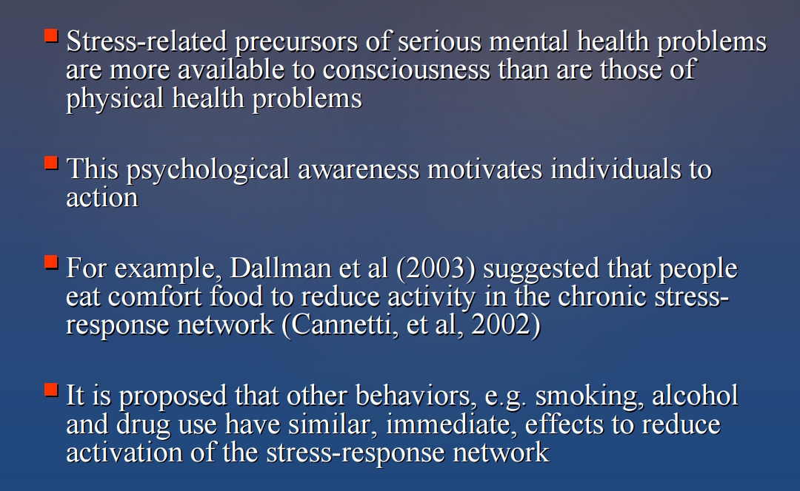

Slide 64
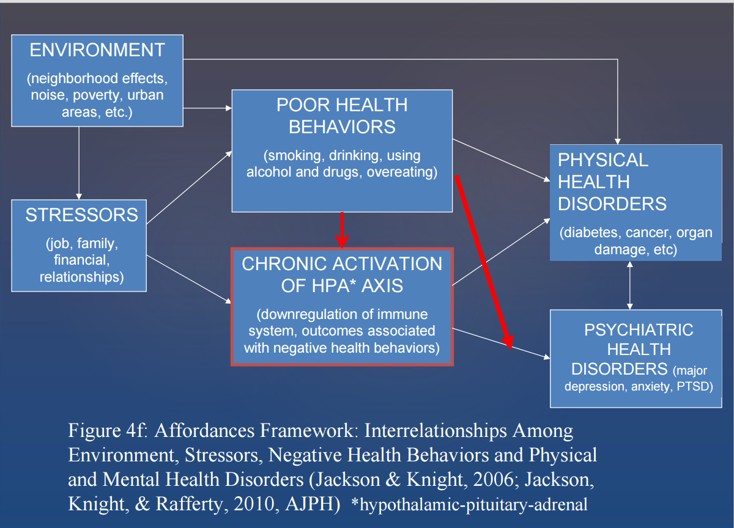

Slide 65
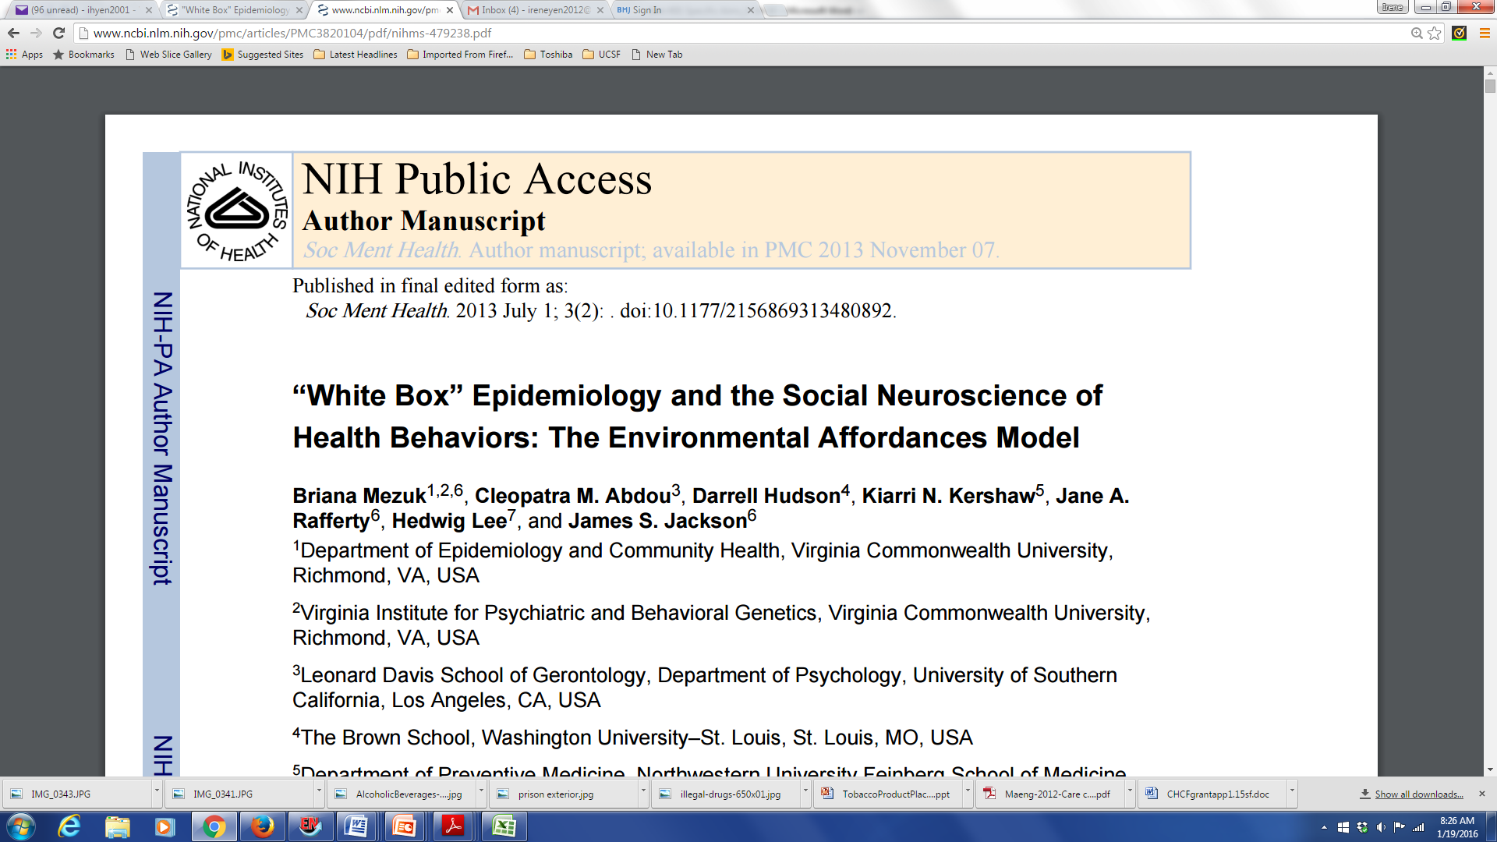

Slide 66
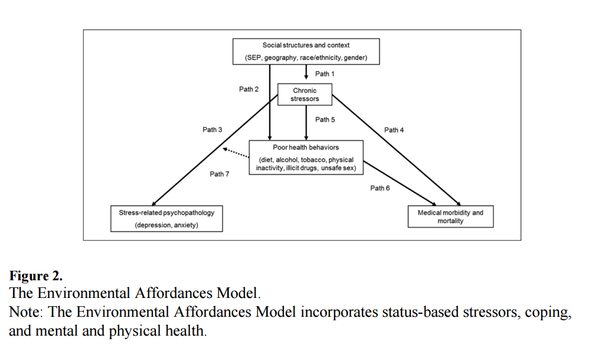

Slide 67
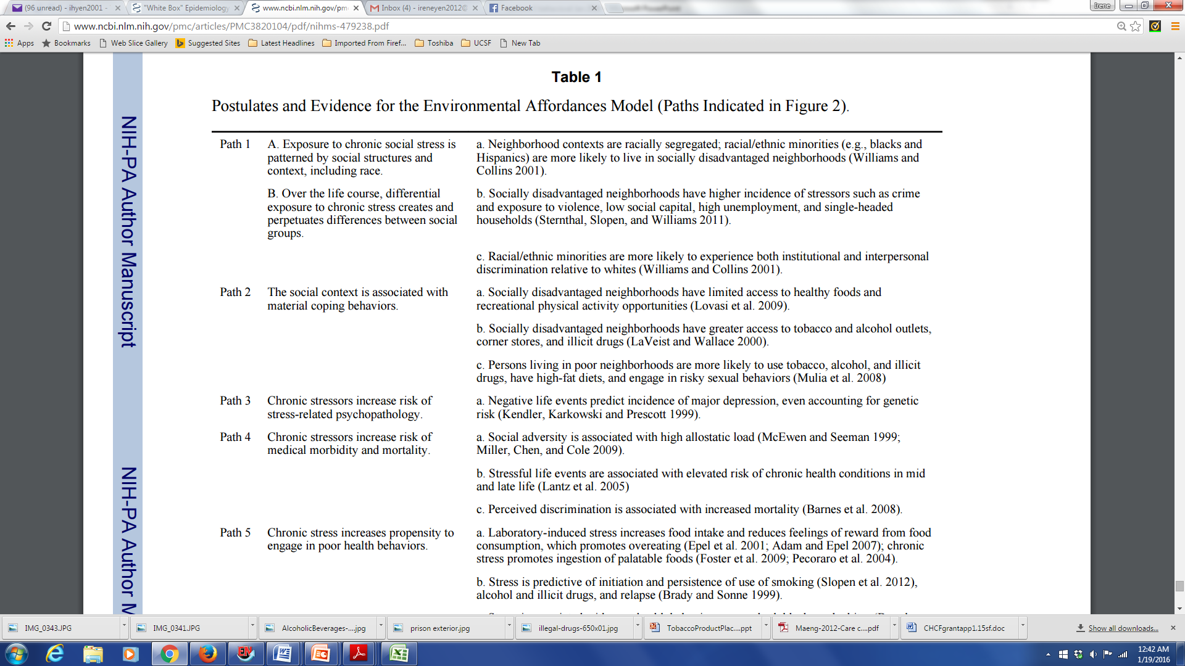

Slide 68
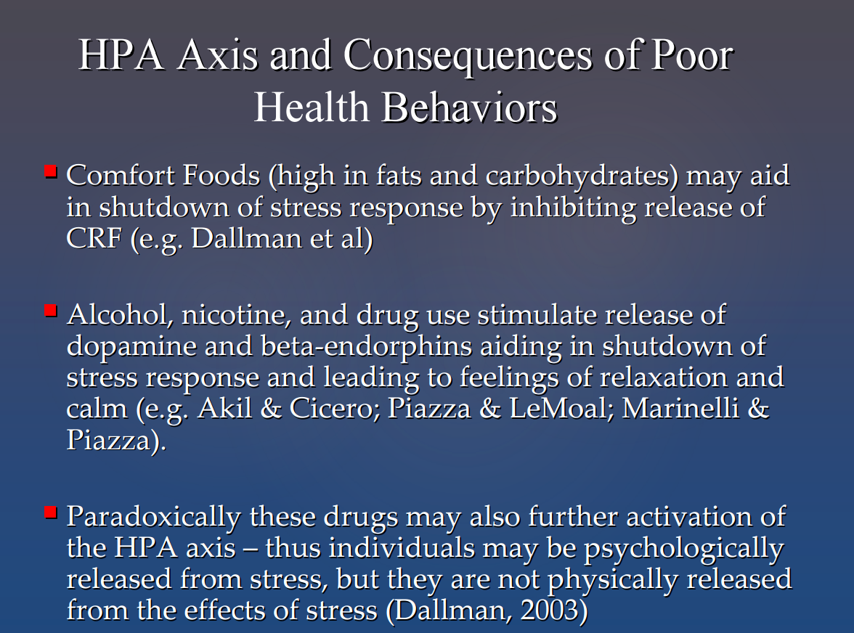

Slide 69
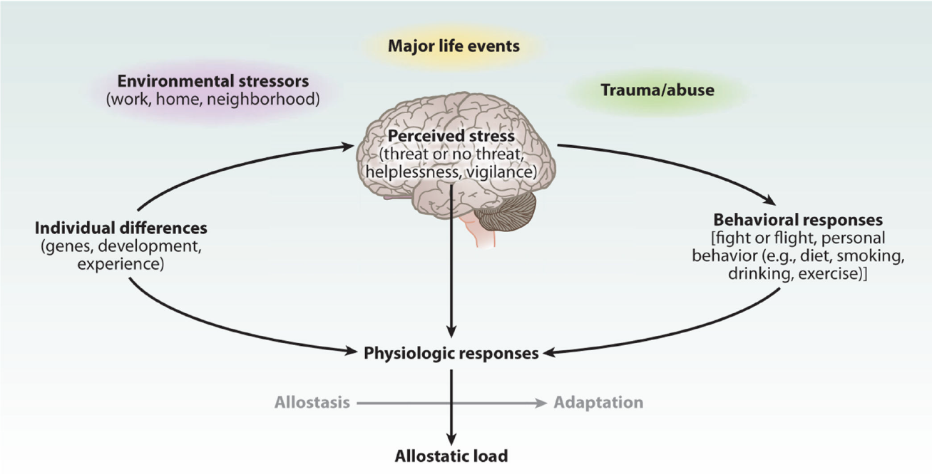
Stress triggers HPA and SNS Response to improve behavioral response
McEwen and Gianaros. Annu Rev Med, 2011

Slide 70
Adverse Childhood Experiences (ACEs) Study - CDC
Before the age of 18:
Live with
  depressed or mentally ill person
  alcoholic
  drug user
  anyone sentenced to prison time
Parents separated or divorced
Exposed to domestic violence
Physical abuse
Sexual abuse

Slide 71
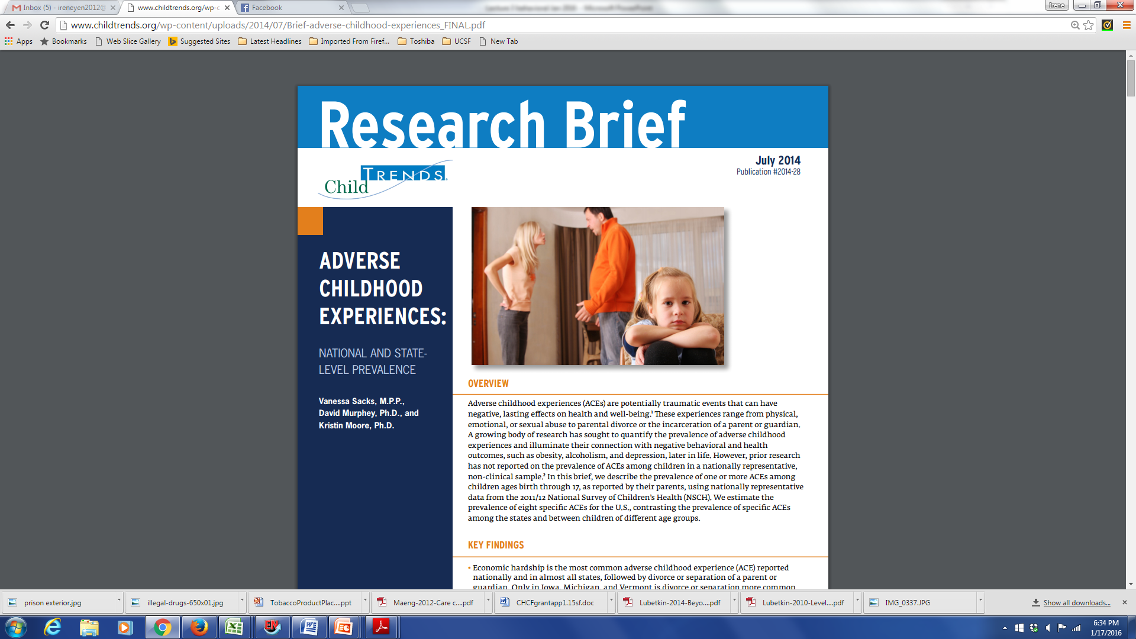
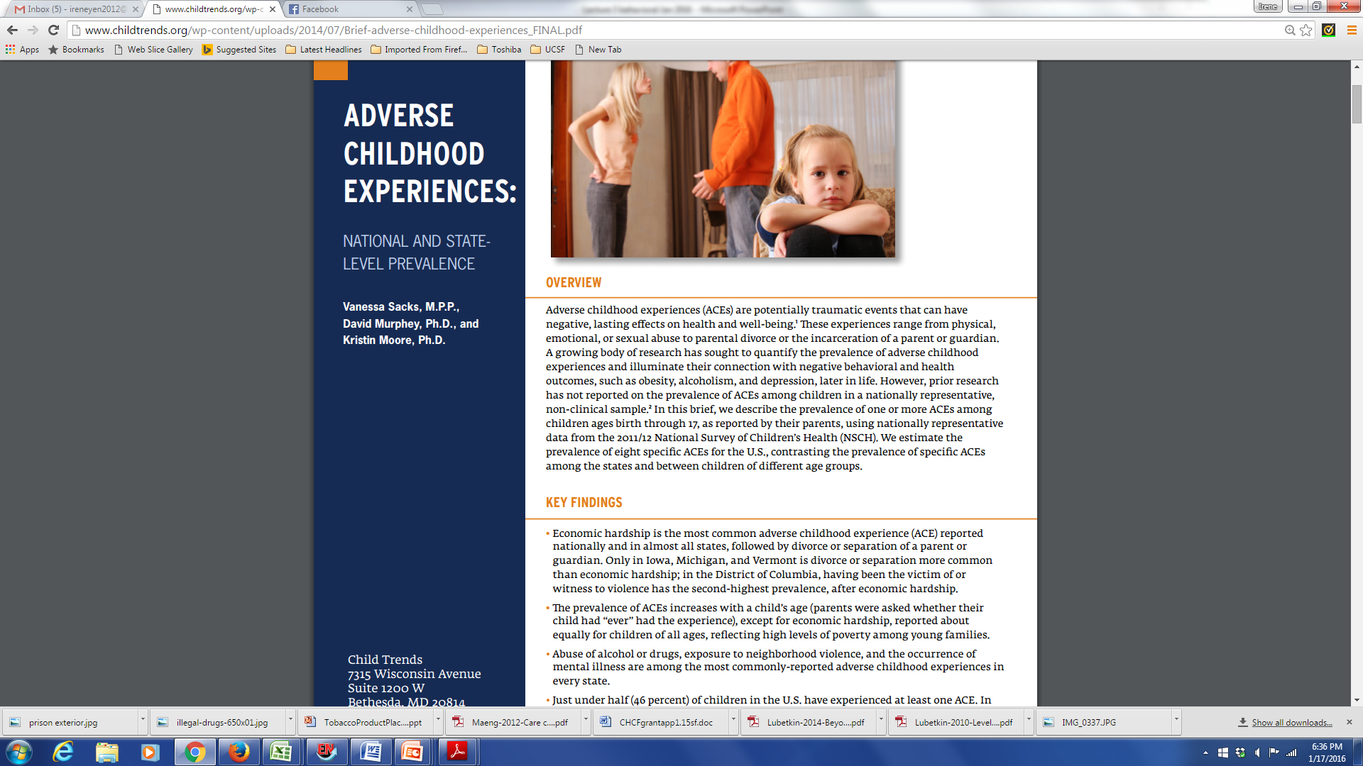

Slide 72
ACEs: Tobacco and Substance Use
Does-response relationship with:
Early initiation of alcohol use
Likelihood of early smoking initiation
Prescription and illicit drug use

Slide 73
ACEs: Obesity
Obese women 27% more likely to report hx of childhood physical or sexual abuse (CA Women’s Health Survey, 2007)
21-22 yr old men with CSA hx, increased risk of overweight / obese (ADD Health, 2009)

Slide 74
Adverse Childhood Experiences and adult health behaviors, UK
Bellis et al. AJPH 2013

Slide 75
Neighborhood context and access to resources
“Unnatural Causes. Place Matters” (PBS 2008)
Why is your street address…such a good predictor of your health?
“When we think about health, we usually think about health care and access to health care and the quality of care. But what research clearly shows is that health is embedded in the larger conditions in which we live and work.…
Sometimes, we naively think of improving health by simply changing behaviors. But the choices of individuals are often limited by the environments in which they live.”
(David Williams)

Slide 76
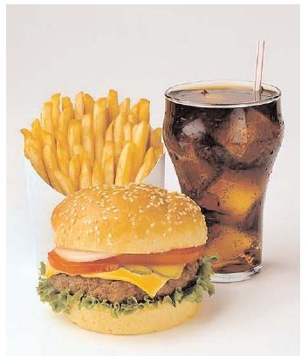
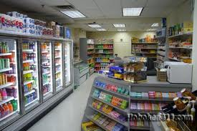
Food environment
Galvez et al 2009:
Children (ages 6-8) living on a block with 1 + convenience stores (range, 1–6) were more likely to have a BMI percentile in the top tertile (odds ratio 1.90, 95% confidence interval, 1.15–3.15) compared with children having no convenience stores
Oreskovic et al 2009:
distance to nearest fast-food restaurant was inversely associated with BMI

Slide 77
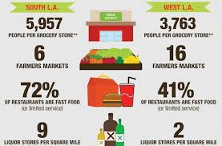
Diet / Food
“Food Desert” - low-income census tract where a large number of residents are more than a mile from a grocery store.

Slide 78
Medical mistrust and healthcare utilization
Institutional and personal experiences with adverse medical experiences may result in mistrust of the medical care system and providers, leading to avoidance of medical care
Medical mistrust index (of healthcare organizations) associated with measures of underutilization of health care (LaVeist et al. Health Serv Res 2009)
Review of 27 studies showed greater medical mistrust associated (in most studies) with lower use of colorectal cancer screening (Adams et al. J Comm Health 2017)

Slide 79
Mezuk, et al. 2013
“Sustained reductions in poor health behaviors will likely not be achieved without addressing the contextual sources of stress and incentivizing healthy self-regulatory behaviors”

Slide 80
Health promotion efforts that … simultaneously
prevent initiation or promote cessation of harmful behaviors,
mitigate sources of stress (e.g., financial strain, exposure to trauma and violence) or reinforce positive resources (e.g., positive social networks), and
act on structural forces (e.g., high concentrations of fast food restaurants or alcohol outlets) that encourage engagement in these behaviors
are more likely to succeed than efforts to modify any of these factors in isolation.

Slide 81
Biopsychosocial approach to behavior change: integrating sociocultural context into patient care
Enhance knowledge of social context factors influencing health
  Social and political structures
  Economic conditions
  Cultural values
  Epidemiology of health behaviors
Build advocacy skills
  E.g., work with healthcare provider to identify resources to improve health outcomes of low-income patient
Chin et al. Education for Health 2000

Slide 82
Biopsychosocial approach to behavior change: integrating sociocultural context into patient care
Implement motivational strategies with patients from diverse backgrounds – learning from the patient
  Use motivational interviewing principles to build rapport
  Interaction discussion with patients to assess readiness to change (Prochaska model)
  Build provider-patient partnership – learn about patients’ previous experiences with healthcare system and preferences for care
Reinforce counseling skills through role-plays
  Include social and cultural information that is relevant to health behavior
Chin et al. Education for Health 2000

Slide 83
Questions / Discussion?
Notes:
Key points: it is not the individual woman’s job to solve public health problem of unintended pregnancy on her own time
It is about informed preferences
Comparison to maternal mortality – our job is to give women the information they need and to think about how it relates to their preferences. In the visit, s not to solve public health problem.
Contraception as preference sensitive – maybe elucidate this a bit more
Challenges around “Shared” – from a feminist perspective
Importance of question “what is important to you about your method”
The public health question – some people really felt like it was okay to have the public health hat on during a visit. I think it is important to say that while affecting public health outcomes may be secondary outcome of your clinical care, it should never be what you are primarily focusing on – it should be about influencing the individual women’s outcome – and this is why the public health level outcome around IUD use goes along with getting women to use IUDs regardless of their preferences.
Really, you should never really have the public heatlh in mind – it should be the individual patient’s goals that matter – i.e. avoiding diabetes related foot amputations.

