Slide 1
Demo: Using RDB Flat Files
Ida Sim / Jennifer Creasman
January 23, 2018
Copyright Ida Sim, 2018. All federal and state rights reserved for all original material presented in this course through any medium, including lecture or print.
Notes:
PMI, PPRN, National Cancer Data Ecosystem – patient-donated data to research
Time for a patient-driven health information economy – Mandl and Kohane, hyperportalosis
Open Notes movement
HUGO to synch with
Ethan Basch, on PROs
Rearchitecting clinical researc hwith people-powered data partnership
www.atsdr.cdc.gov

Slide 2
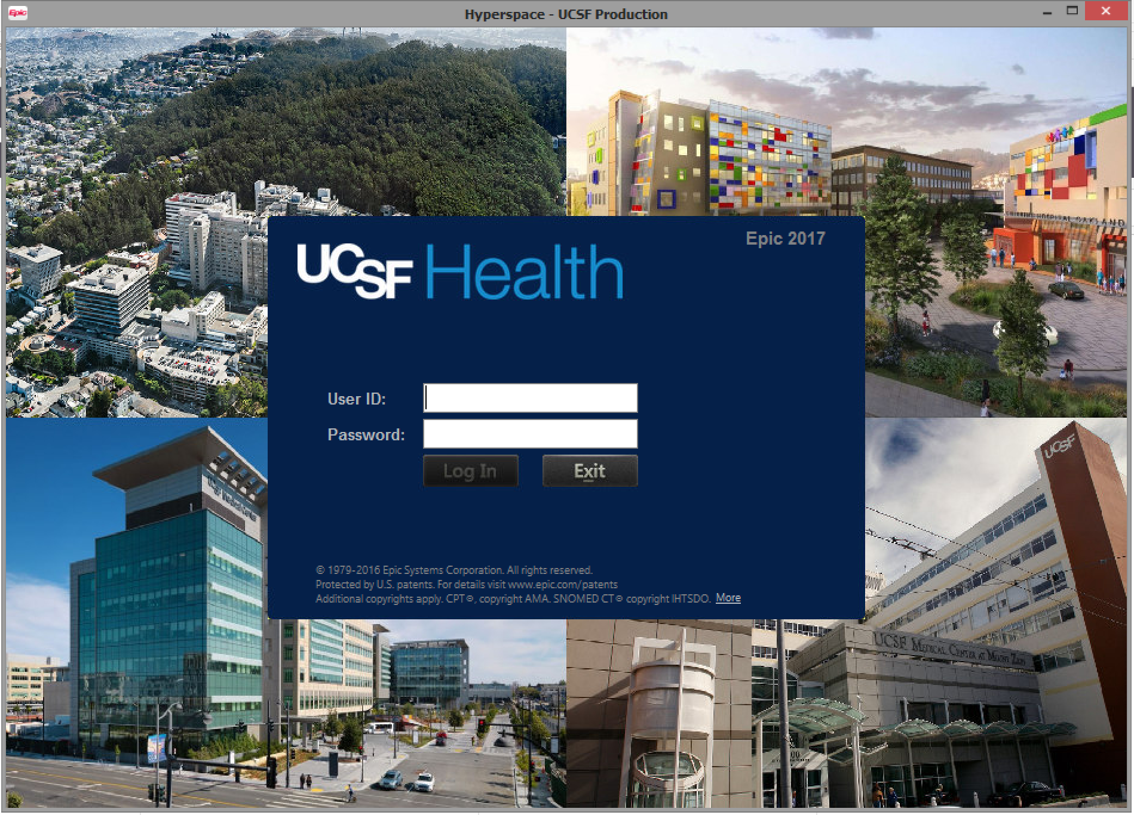

Getting at UCSF EHR Data
Chronicles
Cache (MUMPS)
Clarity
SQL Server
Cogito Data Warehouse
SQL Server
  May 2015: 13,994 tables, 48 billion rows
  367 tables
Epic Clarity Certification requires 2 weeks in Madison, WI
Research Data Browser
De-identified data

Slide 3
Research Data Browser Flat Files
De-identified data underlying RDB
Very large files, can’t just use Excel
Demo STATA code
  for extracting data on patients with specific diagnosis codes
    describe logical steps
    describe various caveats to working with the data
Notes:
Jennifer Clarke for sensei training

Slide 4
Clinical Decision Support Systems
Ida Sim, MD, PhD
January 23, 2018
Division of General Internal Medicine
Copyright Ida Sim, 2018. All federal and state rights reserved for all original material presented in this course through any medium, including lecture or print.
Notes:
PMI, PPRN, National Cancer Data Ecosystem – patient-donated data to research
Time for a patient-driven health information economy – Mandl and Kohane, hyperportalosis
Open Notes movement
HUGO to synch with
Ethan Basch, on PROs
Rearchitecting clinical researc hwith people-powered data partnership
www.atsdr.cdc.gov

Slide 5
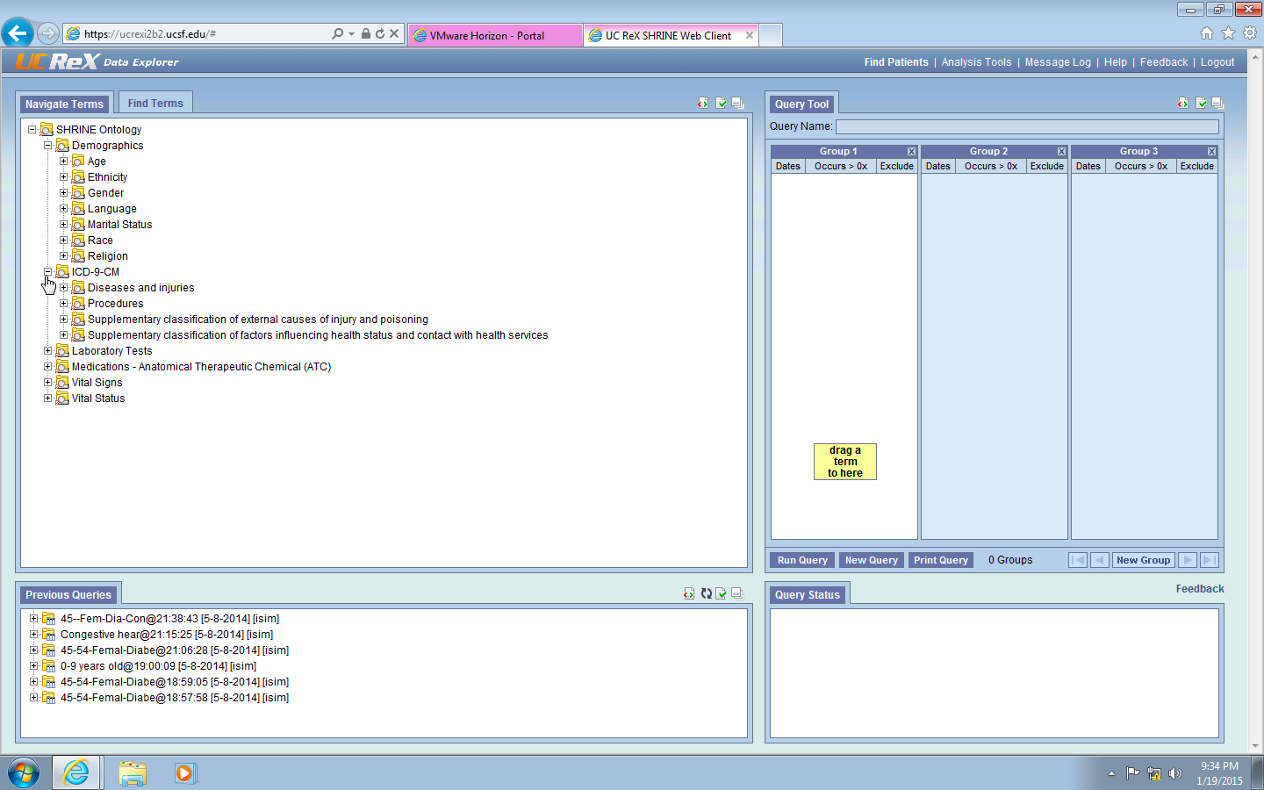
Optional UC ReX / RDB Lab

Slide 6
Outline
Decision support systems
  background, definition
How decision support systems “think”
  rule-based systems
  neural networks
Decision support in the Age of Watson

Slide 7
What is a “Decision”? “Logic”?
Decision is an action that consumes resources in the real world
Logic
  Oxford English Dictionary
    reasoning conducted or assessed according to strict principles of validity
  Merriam Webster
    interrelation or sequence of facts or events when seen as inevitable or predictable
    something that forces a decision apart from or in opposition to reason
Notes:
What is a decision? I decide to have Japanese for dinner tonight.

Slide 8
Decision or Logic?
 | Decision | Logic
Diabetics with hypertension should be started on ACEI, ARB, or other

Slide 9
Decision or Logic?
 | Decision | Logic
Diabetics with hypertension should be started on ACEI, ARB, or other |  | X
I prescribe lisinopril for Mrs. Chan (diabetic, BP 156/92)

Slide 10
Decision or Logic?
 | Decision | Logic
Diabetics with hypertension should be started on ACEI, ARB, or other |  | X
I prescribe lisinopril for Mrs. Chan (diabetic, BP 156/92) | X
I prescribe amlodipine for Mrs. Chan (diabetic, BP 156/92)

Slide 11
Decision or Logic?
 | Decision | Logic
Diabetics with hypertension should be started on ACEI, ARB, or other |  | X
I prescribe lisinopril for Mrs. Chan (diabetic, BP 156/92) | X
I prescribe amlodipine for Mrs. Chan (diabetic, BP 156/92) | X

Slide 12
Clinical Decision Support
Clinical decision support system (CDSS)
  software that is designed to be a direct aid to clinical decision-making
  in which the characteristics of an individual patient are matched to a computerized clinical knowledge base
  and patient-specific assessments or recommendations are then presented to the clinician and/or the patient for a decision (Sim et al, JAMIA, 2001)

Slide 13
Major Target Tasks of CDSSs
Diagnostic support
  DxPlain, QMR, iTriage
Drug dosing
  aminoglycoside, theophylline, warfarin
Preventive care
  reminders for vaccinations, mammograms
Disease management
  diabetes, hypertension, AIDS, asthma
Test ordering, drug prescription
  reducing daily CBCs in hospital, drug allergy checking
Utilization
  referral management, clinic follow up
Notes:
I

Slide 14
What Isn’t a CDSS
Medline
UpToDate
Static guideline repositories
  www.guideline.gov (National Guideline Clearinghouse)
Online laboratory data, test results, chart notes
Retrospective quality improvement reports
  how your vaccination rates compare to your colleagues’

Slide 15
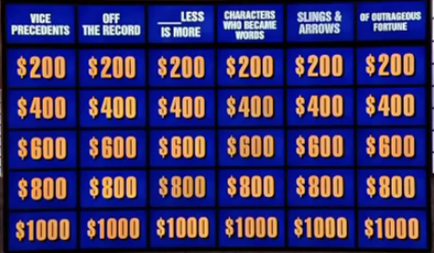
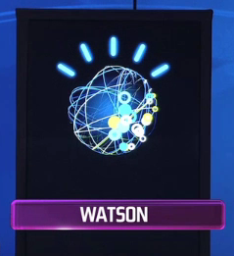
A CDSS?
Chief complaint: “Symptoms for $400 please”
Symptom: Chest pain and shortness of breath
Dr. Watson: What is pulmonary embolism!

Slide 16
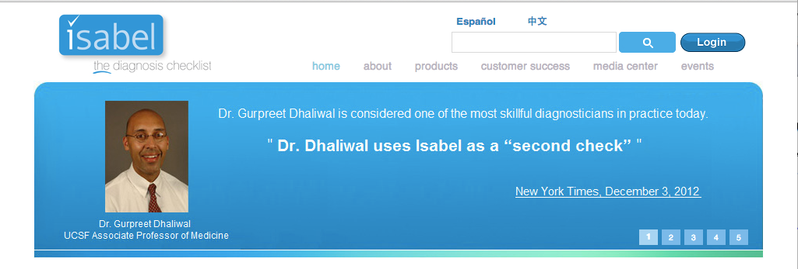
Example Diagnostic Systems
Consumer-facing diagnostic support systems
  e.g., AskMD, iTriage app downloaded > 15 million times, bought by Aetna now merged with WellMatch
Literature support
  AskHermes (“automatically analyzes large sets of documents pertaining to specific questions and generates short text output”)
Diagnostic support
  DxPlain (rule-based)
  Isabel (applies “AI pattern recognition software onto a hand crafted database of over 10,000 diagnosis presentations”)
Notes:
Aetna bought iTriage
Click on AskMD and AskHermes
Isabel works by applying artificial intelligence pattern recognition software onto a hand crafted database of over 10,000 diagnosis presentations. Integrated into Cerner with NLP and APIs.

Slide 17
Outline
Decision support systems
  background, definition
How decision support systems “think”
  rule-based systems
  neural networks
Decision support in the Age of Watson

Slide 18
Basic Decision Support Task
Decision support
  given starting conditions and a defined set of action choices, recommend or rank action choices for user
Requires some “thinking” to recommend or rank
  strictly deterministic thinking
  thinking with fuzziness and probabilistic features
    in the starting data or the reasoning procedure
    in the outcomes (e.g. prob. of adverse reaction)
  often involves thinking about abstract concepts (e.g., “abnormal”) as well as numbers
    symbolic vs. quantitative computing

Slide 19
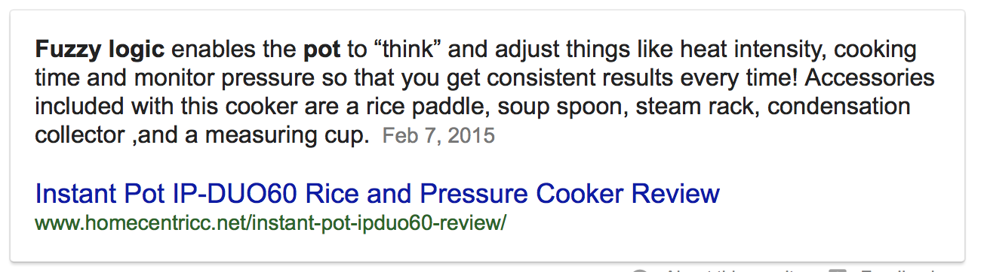
Decision Support “Thinking”
Strictly deterministic, e.g.,
  first-order logic rule-based systems
  ad hoc rule-based systems (non-mathematical reasoning about probability)
    e.g., if high WBC AND cough AND fever AND abn. CXR then likelihood of pneumonia is 4 out of 5
Probabilistic/fuzzy, e.g.,
  bayesian networks
    formal probabilistic reasoning, extension of decision analysis
  neural networks, deep learning
  fuzzy logic, genetic algorithms, case-based reasoning, etc., or hybrids of these
Notes:
If interested i n this, I teach another class in the fall on this stuff
ad hoc dxplain qmr

Slide 20
Forward Chaining Rules
Forward chaining/reasoning (data-driven)
  start with data, execute applicable rules, see if new conclusions trigger other rules, and so on
  example
    if HIGH-WBC and COUGH and FEVER and ABN-CXR => PNEUMONIA
    if PNEUMONIA => GIVE-ANTIBIOTICS
    if GIVE-ANTIBIOTICS => CHECK-ALLERGIES
    if PNEUMONIA and GIVE-ANTIBIOTICS and NOT (ALLERGIC-DOXYCYCLINE) => GIVE-DOXYCYCLINE
  use if sparse data

Slide 21
Backward Chaining Rules
Backward chaining/reasoning (goal-driven)
  start with “goal rule,” determine whether goal rule is true by evaluating the truth of each necessary premise
  example
    patient with lots of findings and symptoms
    is this lupus? => are 4 or more ACR criteria satisfied?
      malar rash?
      discoid rash?
      skin photosensitivity? etc
    if 4 or more ACR criteria true => systemic lupus
  use if lots of data

Slide 22
Problems w/ Rule-Based Reasoning
Combinatorial explosion of rules
  need rule for each contingency
    if MOD-WBC and COUGH and FEVER and ABN-CXR => PNEUMONIA
Rules may be contradictory
  if COUGH and ABN-CXR => INTERSTITIAL-LUNG-DZ
Rules may be circular

Slide 23
Representational Challenges
Need to use standard vocabulary terms
  need to manage evolution of vocabularies (e.g., changing terminologies in psychiatry: no Asperger’s in new DSM-V)
Rules may involve complex semantic relationships
  if NEPHROPATHY caused-by DIABETES
    caused solely by? predominantly by?
    what if I’m not sure? 20% sure? 80% sure?
  if SINUSITIS greater than 6 months
    representing temporal relationships requires 2nd order logic
Need knowledge engineering and clinical expertise to build and maintain the knowledge base over time
  need to keep rules up-to-date with latest evidence
Notes:
Aspergers replaced by Autism Spectrum Disorder

Slide 24
Sharing Rules
Why not have libraries of rules?
Reusable, central upkeep, evidence-based...
Many attempts, none yet successful
  AHRQ library of e-recommendations
  Morningside public-private partnership, from early 2010s
    included VA, Kaiser, DoD, AMIA, Partners, Intermountain, ASU, etc.
  Epic users
    difficult to share rules and CDSSs across Epic installations

Slide 25
Summary of Rule-Based Systems
Deterministic, relatively simple reasoning
Combinatorial explosion even for small domains
Requires extensive knowledge engineering and clinical expertise to curate rules
Rules are difficult to share
But remain most widely used method due to simplicity for small problems

Slide 26
Outline
Decision support systems
  background, definition
How decision support systems “think”
  rule-based systems
  neural networks
Decision support in the Age of Watson

Slide 27
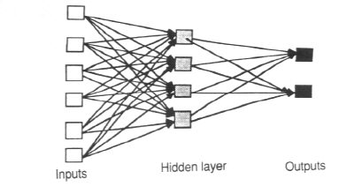
Neural Networks
Finds a non-linear relationship between input parameters and output state
Structure of network
  usually input, output, and 1-2 hidden fully connected layers
  each connection has a “weight”

Slide 28
NN for MI Diagnosis
Inputs (e.g., all patient characteristics in the EHR)
    EKG findings (ST elevation, old Q’s)
    rales (Yes, No)
    JVD (in cm)
Outputs are the set of possible outcomes/diagnoses
EKG findings
Acute MI
Rales
JVD
No Acute MI
Response to TNG

Slide 29
Training the Neural Network
Network gets “trained" (aka supervised learning)
  give examples of known patients and diagnoses
    can handle missing data
  system iteratively adjusts connection weights to find the network “pattern” that associates sets of input variables (patients) with right output state (MI or not)
Test accuracy on another set of patients
In Baxt’s MI neural network
  training set: 130 pts with MI, 120 without
  test set: 1070 UCSD ER patients with anterior chest pain

Slide 30
Baxt’s Acute MI Neural Net
Evaluation results: prevalence of MI 7% (Lancet, 1996)
Results were driven by non-standard predictors
  rales, jugular venous distention
Why wasn’t this neural network used more widely?
  “black box” nature limits explanatory ability and lessens acceptance
  users have to input the variables manually
    interfacing to EHRs would increase adoption
      need to define and code “rales” and other input terms

Slide 31
Outline
Decision support systems
  background, definition
How decision support systems “think”
  rule-based systems
  neural networks
Decision support in the Age of Watson

Slide 32
Deep Learning Methods
A set of machine learning algorithms characterized by
  multiple (2-10) hidden layers in a neural network
    “learned” by unsupervised methods to find new patterns in inputs
  can do supervised or unsupervised (unlabelled) learning
    example of unsupervised learning: inferring that dead patients don't generate more data
  unsupervised learning of multiple levels of feature representation
    which patients had an MI, which died, and won't come back
aka "neural networks on steroids"
  used in speech recognition, computer vision, etc
  Facebook open sourced some of their deep learning algorithms
Notes:
Watson uses deep learning. 16,000 processor to detect cats on the internet, using neural network
https://vimeo.com/84717424
https://www.youtube.com/watch?v=Q9Z20HCPnww

Slide 33
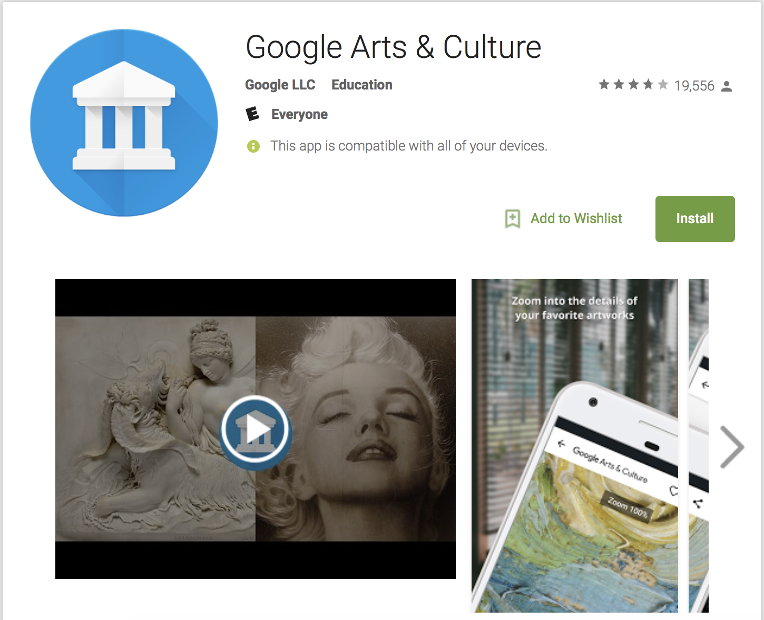
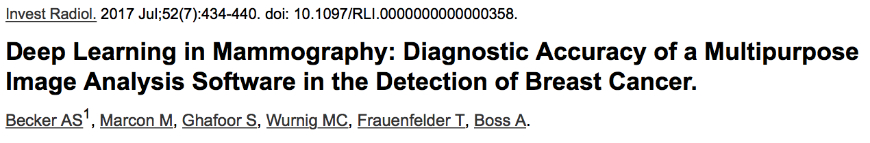
Image Recognition with Deep Learning
Faceprint, features of your face
  e.g., distance between eyes, shape of nose
  pose, illumination, expression (PIE)
Google FaceNet algorithm 99.63% accurate on reference dataset
  trained on 100-200 million thumbnail images of 8 million different identities
Align your FacePrint and FacePrint of artworks from 1200 museums, adjust for PIE, return highest scoring match and the score
Notes:
Labeled Faces in the Wild (LFW)
Privacy issues

Slide 34
Artificial Intelligence Holy Grail
Machine intelligence, like HAL-9000 in 2001 A Space Odyssey, or Data in Star Trek
IBM’s Deep Blue beat chess grandmaster Gary Kasparov (1997)
  chess is a highly structured game with defined rules and solutions (just a lot of them)
  but Deep Blue didn’t help solve protein folding problems
Watson beat all time Jeopardy! winner in 2011

Slide 35
The Jeopardy! Problem
  Jeopardy, like chess, is a narrow game
  a “question answering” game requiring “natural language” processing” (= NLP)
Question answering is a specific kind of intelligence
  A: "The antagonist of Stevenson's Treasure Island” – Q: “Who is Long-John Silver?,” vs.
  Book the cheapest, most convenient transportation for a 4-city trip to Spain this summer vs.
  “Why did Brexit win?” “What causes Chronic Fatigue Syndrome?”

Slide 36
Example Jeopardy! Process
Step One: Parses sentence "The antagonist of Stevenson's Treasure Island” to get some logical structure describing the answer
  X is the answer.
  antagonist(X).
  antagonist_of(X, Stevenson’s Treasure Island).
  modifies_possesive(Stevenson, Treasure Island).
  modifies(Treasure, Island)
http://blog.reddit.com/2011/02/ibm-watson-research-team-answers-your.html

Slide 37
Example Jeopardy! Process
Step Two: Generates Semantic Assumptions
  island(Treasure Island)
  location(Treasure Island)
  resort(Treasure Island)
  book(Treasure Island)
  movie(Treasure Island)
  person(Stevenson)
  organization(Stevenson)
  company(Stevenson)
  author(Stevenson)
  director(Stevenson)
  person(antagonist)
  person(X)

Slide 38
Example Jeopardy! Process
Step Three: Builds different semantic queries based on phrases, keywords and semantic assumptions.
Step Four: Generates 100s of answers based on passage, documents and facts returned from Step 3. Hopefully Long-John Silver is one of them.
http://blog.reddit.com/2011/02/ibm-watson-research-team-answers-your.html

Slide 39
Example Jeopardy! Process
Step Five: For each answer formulates new searches to find evidence in support or refutation of answer — score the evidence. e.g., positive examples:
  Long-John Silver the main character in Treasure Island…..
  The antagonist in Treasure Island is Long-John Silver
  Treasure Island, by Stevenson was a great book.
  One of the great antagonists of all time was Long-John Silver
  Robert Louis Stevenson’s book, Treasure Island features many great characters, the greatest of which was Long-John Silver.

Slide 40
Example Jeopardy! Process
Step Six: Generate, get evidence and score new assumptions
  Positive Examples: (negative examples would support other characters, people, books, etc associated with any Stevenson, Treasure or Island)
    Stevenson = Robert Louis Stevenson
    “by Stevenson” –> Stevenson’s
    main character –> antagonist

Slide 41
Example Jeopardy! Process
Step Seven: Combine all the evidence and their scores. Based on analysis of evidence for all possible answer compute a final confidence and link back to the evidence.
Watson’s correctness will depend on evidence collection, analysis and scoring algorithms and the machine learning used to weight and combine the scores.

Slide 42
Similarities/Differences
Jeopardy!
Clinical decision support
very large scope
natural language full of puns, ambiguities
corpus is free text only
all fact based
there exists one and only one right answer
right answer is in the corpus somewhere, requiring only syntactic (ie grammatical) processing to get at
is “one shot”
very large scope
clinical notes and literature highly idiosyncratic natural language
corpus includes text, numbers, images (MRIs), video (eg echo)
not only facts (should pt. be on warfarin to prevent stroke?)
often no single right answer, best answer requires semantic (I.e., meaning) processing
  e.g., “azithromycin,” critical appraisal of literature
often requires back and forth (e.g., to clarify context, values, constraints)

Slide 43
Is Watson “Intelligent”?
Deep learning algorithms are "black boxes"
  do not represent causal explanations (Baxt neural network doesn't explain MIs)
Doesn’t perform logical inference
  e.g., modus ponens: if X → Y, and X is true, then Y is also true
Doesn't do Strong Artificial Intelligence
  e.g., doesn't "really know" what an MI is, or what a cat is and how it typically behaves
Does it matter if Watson doesn’t “know” anything?
Would we know an intelligent machine if we saw it?
  Turing Test
Notes:
http://en.wikipedia.org/wiki/Deep_learning#cite_note-markoff2012-48
http://www.wired.com/2016/02/the-best-ai-still-flunks-8th-grade-science/

Slide 44
Dr. Watson
Went to medical school in 2011
  ingested textbooks, PubMed. Took board exam questions, solved NEJM cases
Went to “residency” in 2012 with Memorial Sloan Kettering’s cancer patient records
  analyzed 605,000 pieces of medical evidence, 2 m pages of text, 25,000 training cases, assisted by 14,700 clinician hours
    Computational approach: short STAT video on “How does Watson for Oncology work?”
  unsupervised learning on PubMed, and Cochrane systematic reviews
    does not do critical appraisal of published studies (as of late 2015)
  supervised learning for specific oncology treatment regimens based on MSK clinicians
  also mining practice patterns to guide future care
    how do we stop doing the wrong thing?
Notes:
The hardware is jammed into 10 refrigerator-sized racks filled with Power7 server blades. To be exact, there are 90 Power750 servers filled with four processors each -- and each processor has 8 cores, for a total of 2,880 cores altogether.

Slide 45
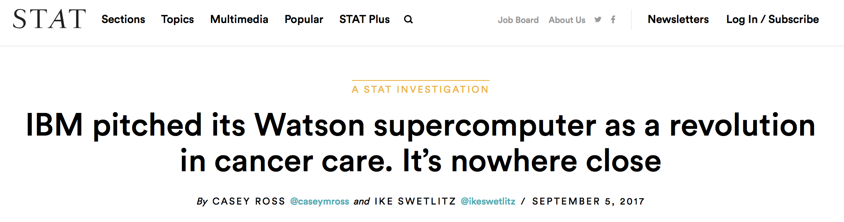
Watson: Hype vs. Reality
Does not come up with new regimens; picks from a fixed list
Based on expert opinion from Memorial Sloan Kettering only (“eminence-based medicine”)
Does not mine outcomes to adjust new recommendations
No publications evaluating performance

Slide 46
Summary: CDSS Conundrum
Better quality care <-- better decision support
Better decision support <-- “smarter” systems
  “know” more about the patient, evidence, context
“Smarter” systems <-- more richly coded D-I-K
  for EHR: SNOMED, standard EMR structure
  for knowledge: coding, structures for guidelines, RCTs…
Coded data <-- Coding of data entry
Coding of data entry <-- Greater physician time
Greater physician time --> no play --> no gain

