Slide 1
Biostatistics 226, Winter 2018
Course Overview
Jan 9 – Design of RCTs: How to avoid bias and achieve valid results
Jan 16 – Analyses: Baseline, Efficacy, and Safety
Jan 23 – Monitoring trials for efficacy, futility, and patient safety
Jan 30 – Cluster Randomized Trials
Feb 6 – Precision medicine I: SMART (Adaptive) Trials
Feb 13 – Precision medicine II: N-of-1 Trials
Textbook References
Lawrence Friedman, Curt Furburg, David DeMets. Fundamental of Clinical Trials, 5th edition, 2015.
e-copy is available online to UCSF community
ADDED! DeMets, Furberg, Friedman. Data Monitoring in Clinical Trials, A Case Studies Approach, 2006.
https://doi-org.ucsf.idm.oclc.org/10.1007/0-387-30107-0
Vittinghoff, Glidden, Shiboski, McCulloch, Regression Methods in Biostatistics. 2012.
e-copy: http://www.springer.com/us/book/9781461413523

Slide 2
Review: Jan 16 – Analyses: Baseline, Efficacy, and Safety
HW Readings
Austin 2010
  Baseline Data –
    Altman writes that ‘‘performing a significance test to compare baseline variables is to assess the probability of something having occurred by chance when we know that it did occur by chance.”
    Although randomization will, on average, balance covariates between treated and untreated subjects, it need not do so in any particular randomization.
  Adjustment -- Should adjusted regression model be used when estimating the effect of the treatment on the outcome?
    To adjust for chance imbalance in prognostically important baseline covariates (selected a priori).
    To increase precision when estimating the treatment effect.
Vickers Altman 2013 ChangeScores –
  Continuous outcomes: Analyzing within-PPT changes over time does not control for baseline imbalance, but repeated measures (ANCOVA) model does.
Lineberry Berlin 2016 Safety Data --
HW Exercise – Overview of a single RCT selected by each student
62% of interventions were therapeutic; 38% were behavioral

Slide 3
Jan 23 – Monitoring trials for efficacy, futility, & patient safety
Table: Outcomes of RCTs and corresponding analysis methods, with examples presented by students
* These binary events typically can only occur once per participant; is an “absorbing” state. Timing of event is key, hence design is longitudinal. Other outcome types are “transient” levels/states that could be assessed once or repeatedly during study follow-up, thus definition of primary outcome should include a time/deadline for occurrence.
Outcome Type | Distribution | Within- & Between-arm parameters | Outcomes from students (Behavioral, Therapeutic, Other)
Continuous | Normal (or Normalizable) | δ = μ_{E} - μ_{C} | 6-mo changes in dietary intake # minutes of physical activity
Binary | Binomial | δ = π_{E} - π_{C} RR = π_{E}/π_{C} OR = [π_{E}/(1-π_{E})] / [π_{C}/(1-π_{C})] | 24-hr cessation of symptoms 48-dy mortality 60-dy mortality 16-wk ACR20 response 36-mo malaria parasitemia (clustered-R)
(Ordered) Categorical | (Ordinal) Multinomial | {π_{E1},π _{E2},π _{E3},π _{E4}}, {π_{C1},π _{C2},π _{C3},π _{C4}} Within arm: Categories are mutually exclusive and represent all outcomes, thus probabilities sum to 1. | Best clinical response levels = {progressed, stable, partial response, complete response}
Counts Can use offset to account for differing lengths of follow-up | Poisson (or Negative Binomial) | RR = λ _{E}/λ_{C} | # unprotected marital sex encounters, past 30 days # days with substance use, past 90 days (clustered-R) # symptom-free days, per 2-wk period (repeated measure)
Binary with censoring* | Exponential (or other) | HR = λ _{E}/λ_{C} | Time to first positive HIV test Incidence of cancer Time to recurrent VTE / bleeding
Notes:
Sometime Normal distribution can be used instead of Poisson and vice versa.

Slide 4
Time-frames of RCTs, with examples presented by students
Enrollment / Accrual | Outcome Assessment | Study Design & Outcomes (Behavioral, Therapeutic, Either) | Trial Duration
Non-sequential RCT Simultaneous for all PPTs | Y = Single value per PPT, collected simultaneously for all. → No f’up period. | Cross-sectional | All accrual and follow-up on the same day
Sequential RCT Staggered over time | Y = Single value per PPT, collected after fixed follow-up period for all. → Fixed f’up duration for all. | Cross-sectional 9 examples provided by students, excluding 4 listed below | From accrual of initial PPT to assessment of final PPT.
Sequential RCT Staggered over time | {Y,date} = Multiple values per PPT, collected over minimum intervals. → All PPTs should achieve minimum f’up; those accrued early could contribute longer f’up. | Longitudinal: Repeated measures # symptom-free days, per 2-wk period Time-to-event First positive HIV test Cancer Recurrent VTE or major bleeding | From accrual of initial PPT to final assessment of final PPT.
Notes:
As is common: No example of simultaneous accrual was presented, although 1 of 2 cluster randomized trials accrued blocks of PPTs.
Note:

Slide 5
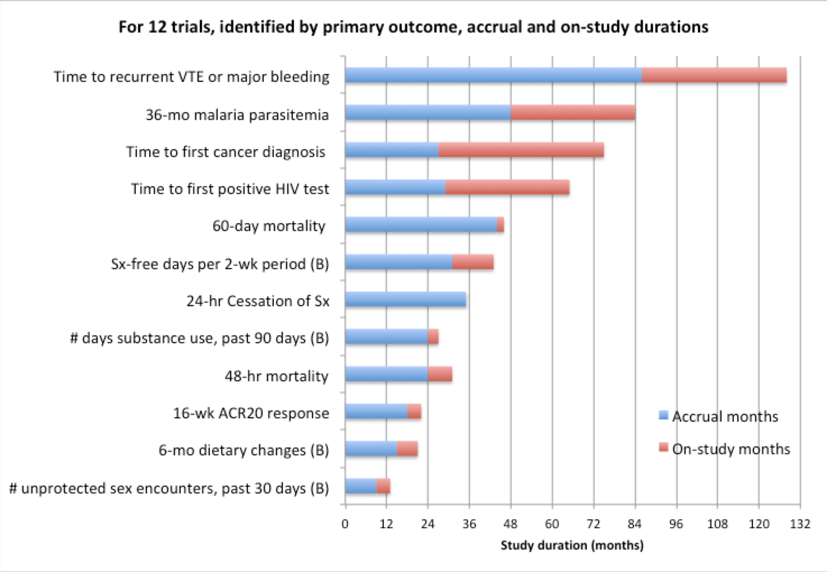
Time-frames of RCT examples presented by students; (B) denotes behavioral outcome
Accrual period accounts for a large proportion of overall study time. What are drivers of accrual duration?
“On-study” months: exposure and assessment periods can be distinct or overlap. How decided?
Of 4 longest trials, 3 use time-to-event settings (when events are rare and longer follow-up time is used reduce # PPTs) and 1 targeted a long-term public health intervention (with a small intervention effect).
Many RCTs fail to complete planned accrual. They then do not achieve planned power to detect hypothesized intervention effect.
Notes:
Drivers of accrual: Available PPT pool; consent rate

Slide 6
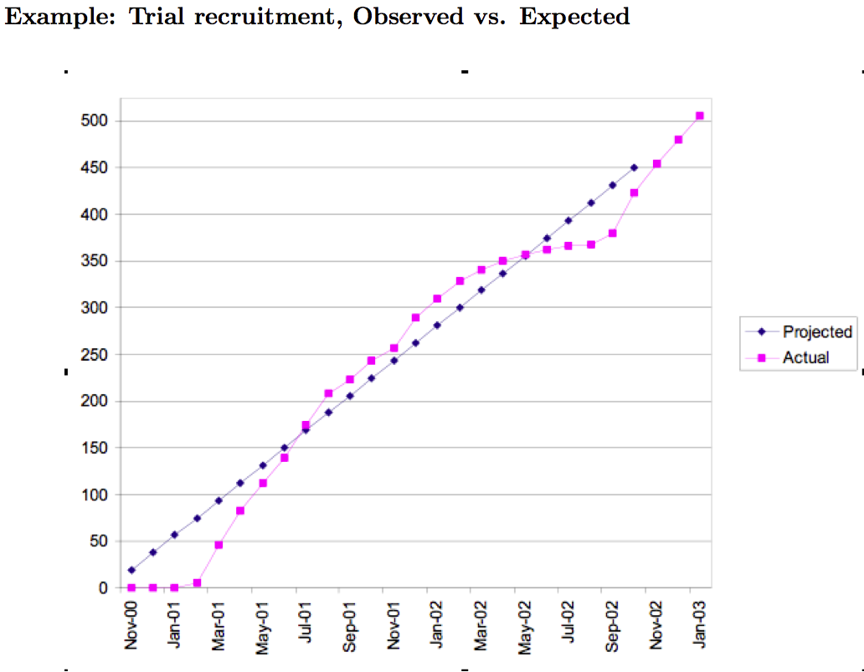

Slide 7
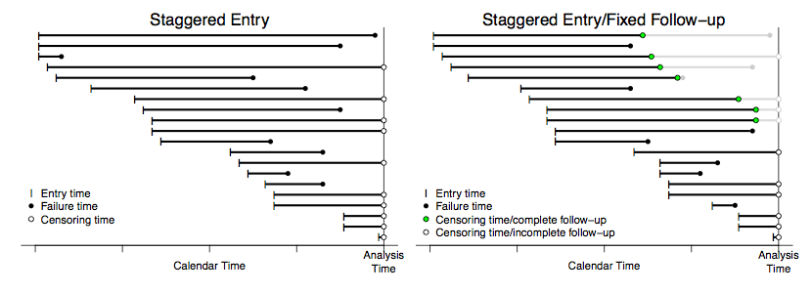
Sequential RCT: If accrual is staggered over time, outcomes become available over time too.
Plots: Calendar dates of {accrual, last follow-up} for selected participants and analysis date for all.
Left: Time to event outcome with no loss to f’up during study period; only censoring mechanism is end of RCT. Right: (a) Time to event outcome with some loss during minimum f’up period; or (b) fixed f’up times for all PPTs was planned, and was only partially achieved in some PPTs.
Data Monitoring: Plots show that at any date during the trial, investigators can capture
the number of participants enrolled and
the number of events that have occurred.
→ These trial characteristics can be monitored over time, by arm.

Slide 8
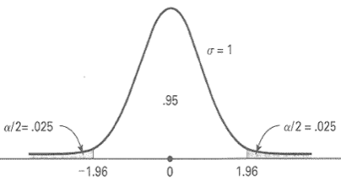
Review: Recall that a plot of the distribution of d shows a one-to-one relationship between data scale (x-axis) and probability scale (y-axis). Here, d represents the observed mean difference between active and control arms (data) and δ₀ represents the H₀ value the mean (parameter).
Standard normal probability density function (mean = 0, standard deviation = 1).
Horizontal axis: d-δ₀. Vertical axis: Pr{|d-δ₀|}. Shaded areas: Pr{|d-δ₀|> c_{n} } = α .
Correspondence between common benchmarks: When α = 0.05, z_{1-α/2}= 1.96 and z_{1-α}= 1.645.
A statistical test is conducted via comparison with either the x-axis or an area of the probability distribution.
For 2-sided test:
On data scale: Reject H₀ if |z_{obs}|=|d-δ₀|/ (2σ/n) > z_{1-α/2}.
Equivalent test on probability scale: Reject H₀ if p-value < α .
Note that the test assumes H₀ is true; the results (data) reject or do not reject H₀.

Slide 9
At the end of the RCT, we want to be able to draw a firm conclusion: “reject H₀” or “do not reject H₀.”
→ However, our conclusion will be based on data, and errors can occur. ←
    When H₀ is true: Specificity = 1-α = Pr{Do no reject H₀, when H₀ is true}
    When H_{A} is true: Sensitivity = 1-β = power = Pr{Reject H₀, when H₀ is false}
Risk of false-positive finding is α.
Its consequence: Claim that an intervention is effective when it isn’t.
Changes standard from Control mode to Experimental mode in broader population.
We work hard to minimize this important error.
Statistical test | Two possible true states
 | H_{A}: δ ≠ 0 | H₀: δ = 0
|z_{obs}|≠ 0: Reject H₀ … “positive trial” | TP = 1-β | FP = α
|z_{obs}|= 0: Do not reject H₀ … “negative trial” | FN = β | TN = 1-α
Notes:
As is common: No example of simultaneous accrual was presented, although 1 of 2 cluster randomized trials accrued blocks of PPTs.
Note:

Slide 10
Clinical considerations in support of interim monitoring:
Ethics:
  Stop early to avoid exposing patients to an inferior treatment (safety or efficacy) – considering both trial participants (cut accrual target / cut treatment period) and future patients
  Stop early to provide patients with a superior treatment
Rapidly disseminate results:
  As early as possible if a treatment change is indicated.
  Keep co-investigators abreast of progress; maintain motivation.
  Planning subsequent trial.
  Natural curiosity: Investigators like to look at the data to see if there is a treatment difference.
For large RCTs, to minimize bias an Independent DATA MONITORING COMMITTEE is assembled.
Experts not affiliated with the trial with no conflicts of interest. Typically unblinded.
  Clinicians
  Biostatisticians
  Other experts
Role: Advise the sponsor (funder):
  to ensure the safety of trial participants
  to recommend stopping the trial once experimental treatment is shown beneficial or harmful, or no longer likely to have clinically relevant efficacy
  if accrual target is being achieved
  if design modifications should be made

Slide 11
Resources
DeMets, Furberg, Friedman textbook, especially Chapter 2 (HW3) – overview of 29 case studies (therapeutic trials; prevention and treatment)
NIH : Overall policy and guidance by Institute/Center on data and safety monitoring.
https://humansubjects.nih.gov/data_safety
  Code of Federal Regulations (CFR) Title 45 Part 46
  FDA Guidance for Industry E6 Good Clinical Practice: Consolidated Guidance :
    5.5.2 The sponsor may consider establishing an independent data monitoring committee (IDMC) to assess the progress of a clinical trial, including the safety data and the critical efficacy endpoints at intervals, and to recommend to the sponsor whether to continue, modify, or stop a trial. The IDMC should have written operating procedures and maintain written records of all its meetings.
  NIDDK – addresses statistical issues related to efficacy monitoring → My role on independent DSMBs, including for NIAID, reflects this description.
  NCI -- discusses site monitoring for protocol compliance; emphasizes safety over efficacy monitoring → My role on UCSF HDFCCC DSMB reflects this description.
  NIAID – see flowchart (next slide) on reporting requirements for safety

Slide 12
Last reviewed October 5, 2010
Relevant Extramural SOPs: Human Subject Resources
NIAID: Clinical Trial Safety Monitoring and Reporting Requirements
After peer review
NIAID commits funds.
Before enrolling patients
As part of the completed protocol, PI details safety monitoring plans and procedures including assessing, documenting, and reporting adverse events.
PI sends to program officer or medical officer for approval.
Program officer or medical officer review
Does the PO or MO have concerns about patient safety?
Yes, concerned
PO or MO sends recommendations to the PI for collaborative revisions.
No concerns → Approval
PO or MO approves safety plan and adverse event reporting plan.
IRB, FDA, and NIAID address DSMB and SAE reports
PO must email or fax PI within 10 days and send official letter within 30 days of receipt.
NIAID can terminate award or take other action if PI does not comply with monitoring plan.
Patients may be enrolled once the trial meets all approval requirements.
Needs IRB approval of complete protocol as well as approval by other parties such as the DSMB, FDA, and division regulatory staff.
Serious adverse events
PI provides reports of serious adverse events following Guidance for Complying with the NIAID Clinical Terms of Award.
For multi-site trials, PI also sends DSMB summary reports to all IRBs and program officer.
During a clinical trial
PO monitors compliance with monitoring plan and adverse event reporting requirements.

Slide 13
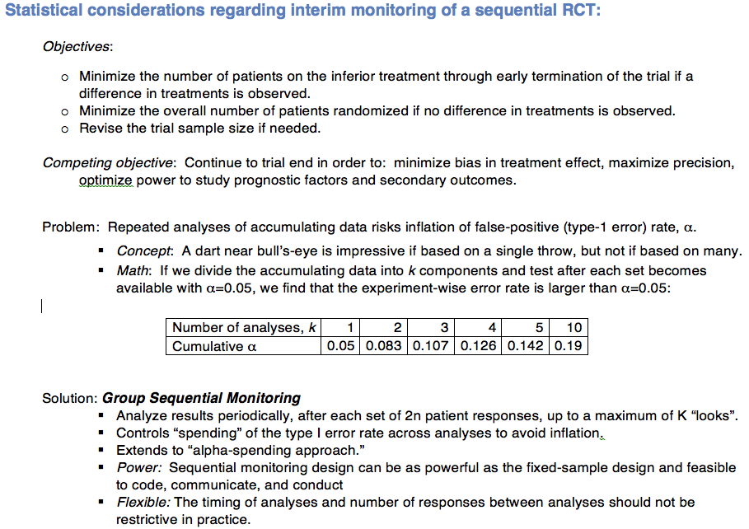

Slide 14
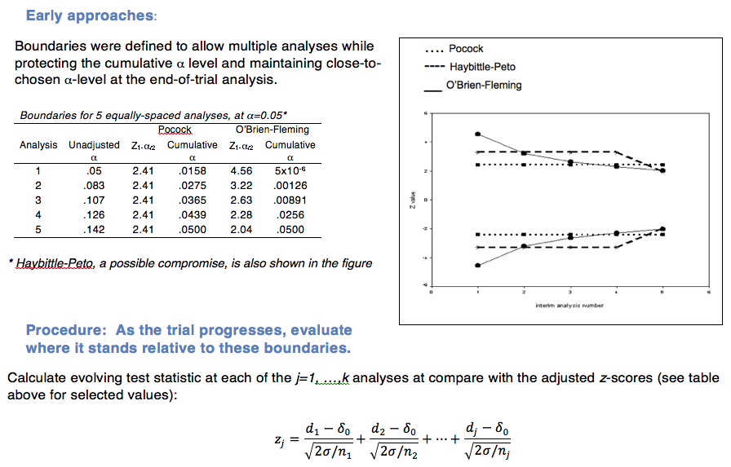

Slide 15
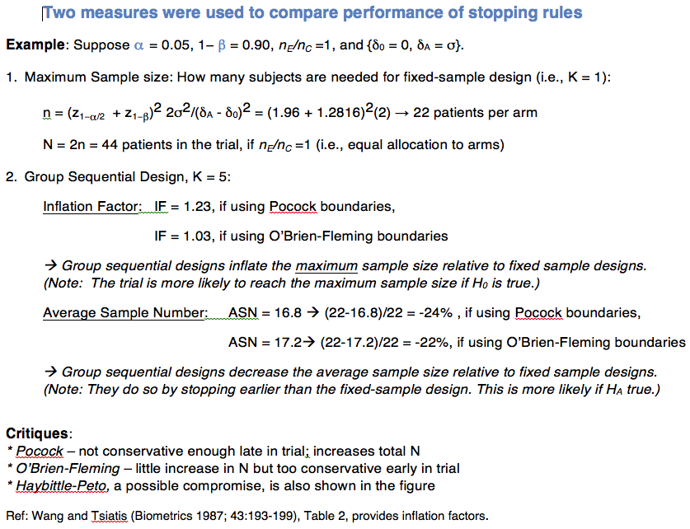

Slide 16
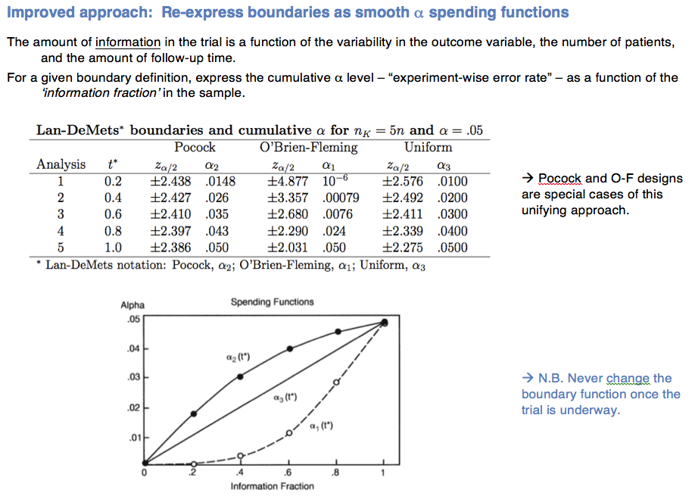

Slide 17
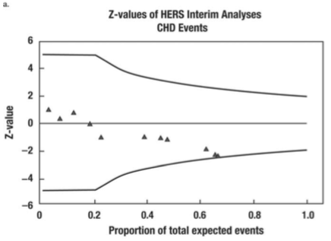
Example, from DFF textbook, Case 17 – HERS Trial:
Figure 1. Lan and DeMets plots of Z-values over the first two-thirds of the study for interim looks at the relative hazard comparing hormone treatment to placebo for CHD deaths. Positive values represent lower event rates in the hormone treatment group.

Slide 18
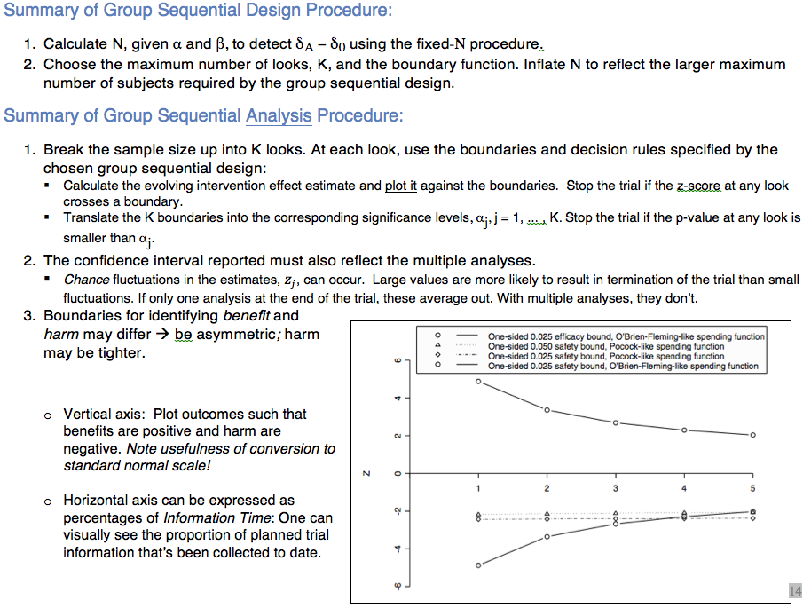

Slide 19
More comments on efficacy monitoring:
A formal significance test is only one factor in the decision to continue or stop a trial. DSMB may recommend stopping an arm or the whole trial or may choose to watch and wait.
Estimated efficacy is just that – an estimate, that is subject to variation. At a particular interim analysis, it may be on a high or low “bounce.”
Stopping for evidence in favor of H_{A} (efficacy or harm): controls spending of α. Stopping for evidence in favor of H₀ (futility): controls spending of β.
Evidence in support of benefit and harm needn’t be symmetrical.
  The trial seeks to “prove” benefit: direction of interest is one-sided, using one primary endpoint.
  The trial seek to “detect” harm: direction of concern is one-sided, based on multiple measures of harm (eg, organ/system classes of adverse events).

Slide 20
Monitoring Safety is Statistically Challenging
Adverse event (AE) definitions must be consistent
  MedDRA = Medical Dictionary for Regulatory Activities is an adverse event classification dictionary used in the USA, European Union, and Japan, endorsed by the International Conference on Harmonisation (ICH)
AEs may be disease-related or treatment-related
  Adverse events that are rare and unexpected may signal harm → relies heavily on medical judgment.
  AEs vary in frequency and in severity (mild to life-threatening). The threshold for harm depends on the context.
    The threshold in a prevention study is lower than in a treatment trial.
    Healthy people may be less willing to tolerate drowsiness than patients with metastatic cancer.
  AEs may arise earlier or later than efficacy outcomes → thus f’up periods for efficacy and safety outcomes can differ.
    CHD versus breast cancer (WHI Trial).
    Diabetes versus death (ACCORD Trial).
… Thus A Structured Approach Helps Identify Harm
A pre-specified safety boundary helps a DSMB make judgments about the endpoint of interest when the data are showing harm.
  It allows earlier termination of the study with a statistically based conclusion of harm.
Estimates of mean differences (95% CIs) are more useful than tests of differences between arms. Within-arm reference is expected prevalence in study population.

Slide 21
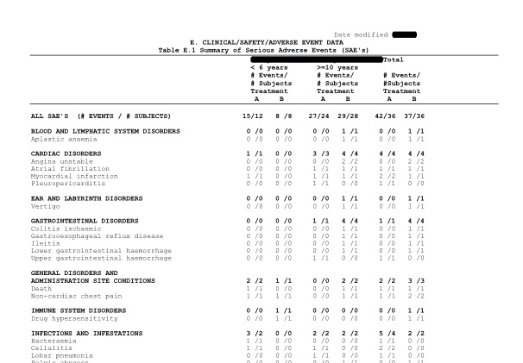

Slide 22
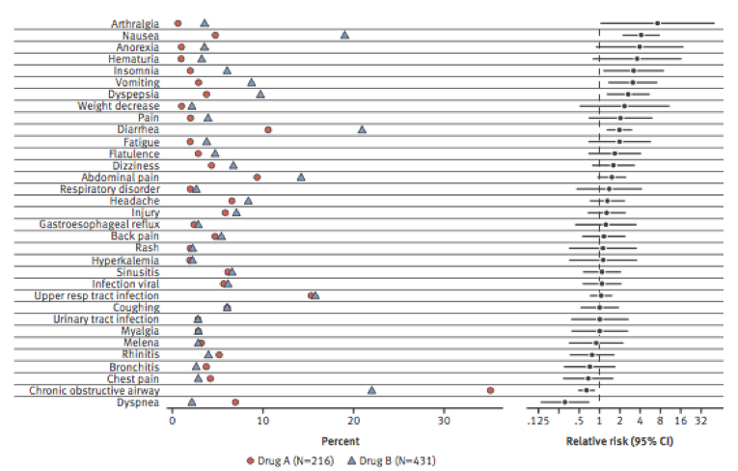
Notes:
Lineberry

