Slide 1
Clinical Research with De-identified Flat Files
January 23, 2018
Jennifer M. Creasman
Director, Data Management Unit, Consultation Services

Slide 2
Questions for class
Who attended the UCSF Data Colloquium May 2017?
Who has worked with large EHR data?
data.ucsf.edu

Slide 3
Outline
Review – APeX data
Research Goal
Working with EHR Data
Practical Guidance
Data Processing
data.ucsf.edu

Slide 4
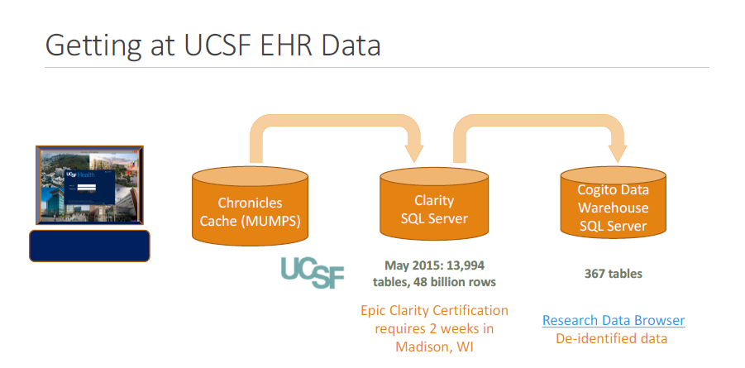
data.ucsf.edu

Slide 5
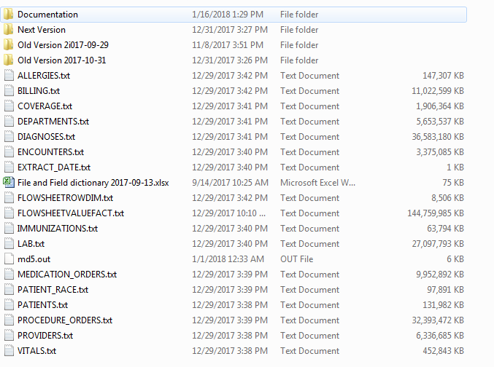
data.ucsf.edu

Slide 6
data.ucsf.edu

Slide 7
De-identification Methods (DEID Method) and definitions
DEID METHOD CODE | Description of Method
SHOW | Data element is not PHI and is displayed as-is
RANDOM ID | Data element is a potential patient identifier and has been replaced with a randomly generated identifier. Within a given type of identifier (e.g., Patient_ID or Encounter_ID), the same random ID will be used to replace the same original identifier across all records and files. For instance, if the original Patient_ID is Z12345, and the random identifier replacing it is 123412341234123, then this same randomly generated identifier will be used for all occurrances of Z12345 throughout all files.
DATE SHIFT | The data element is a patient-related date, that can be no more precise than one year. Therefore the date is shifted into the past by a random number of days between 0 and 364. The same number of days is used for all data for the same patient
FLOW VALUE | This method is used exclusively for deidentifying the value field in the table FLOWSHEEVALUEFACT.txt. When the ValueType (shown in FLOWSHEETROWDIM.txt) is "Date", then the value is date shifted as in "DATE SHIFT" above. When the ValueType is "String", the value is replaced with the string "DEID", because string values have been shown to occasionally contain PHI
LAB VALUE | This method is used exclusively for de-identifying the Lab_Value field in the LAB.txt file. If the value is an number for which the number of digits before the decimal place is 7 or fewer (that is, not an MRN) then it is displayed. If larger than 7, it is hidden. If the remaining values are equal to one of our "white list" of values known to not be PHI, then they are shown. Otherwise they are hidden and replaced with the string "DEIDENTIFIED"
AGES | For dates of birth and ages, this method replaces any age over 90 years old with the age 90. In the case of birth date, it changes the year of birth such that the patient over 90 years old will appear to be 90 years old at the time of the build
data.ucsf.edu

Slide 8
Outline
Review – APeX data
Research Goal
Working with EHR Data
Practical Guidance
Data Processing
data.ucsf.edu

Slide 9

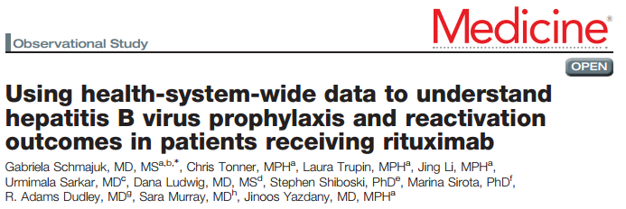
Research Goal
Publication
data.ucsf.edu

Slide 10
Research Goal
(Big) data
Study Design
Analytics
Publication
data.ucsf.edu

Slide 11
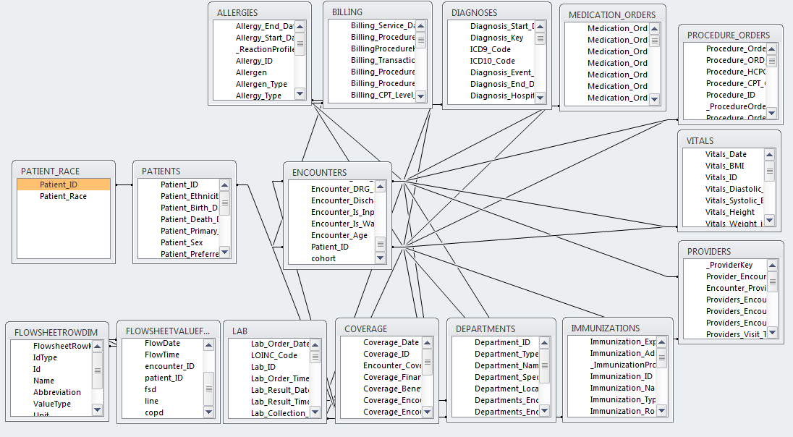
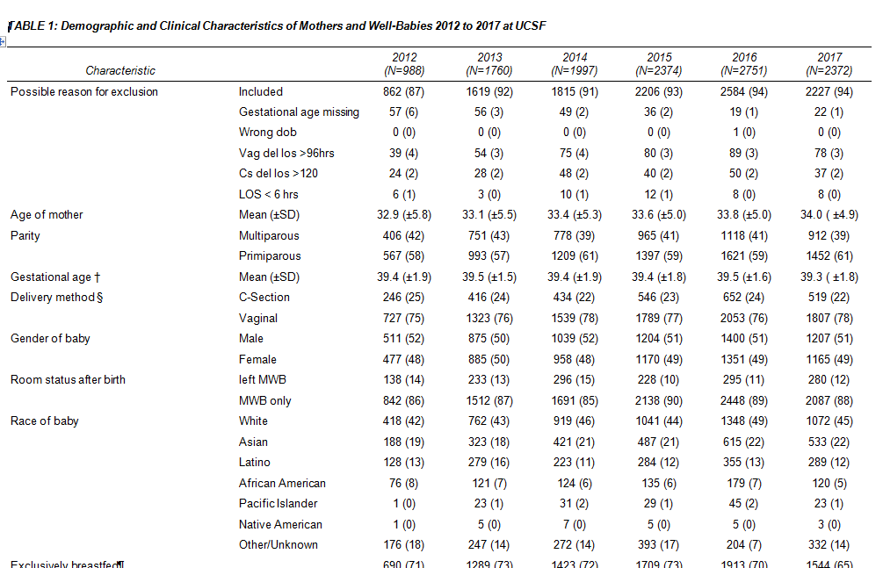
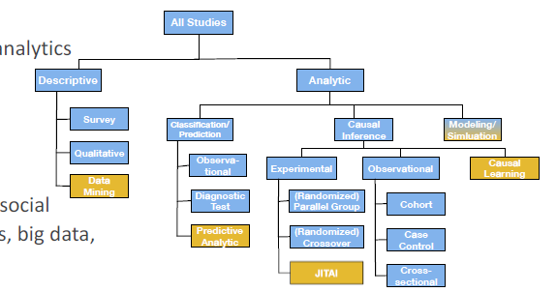
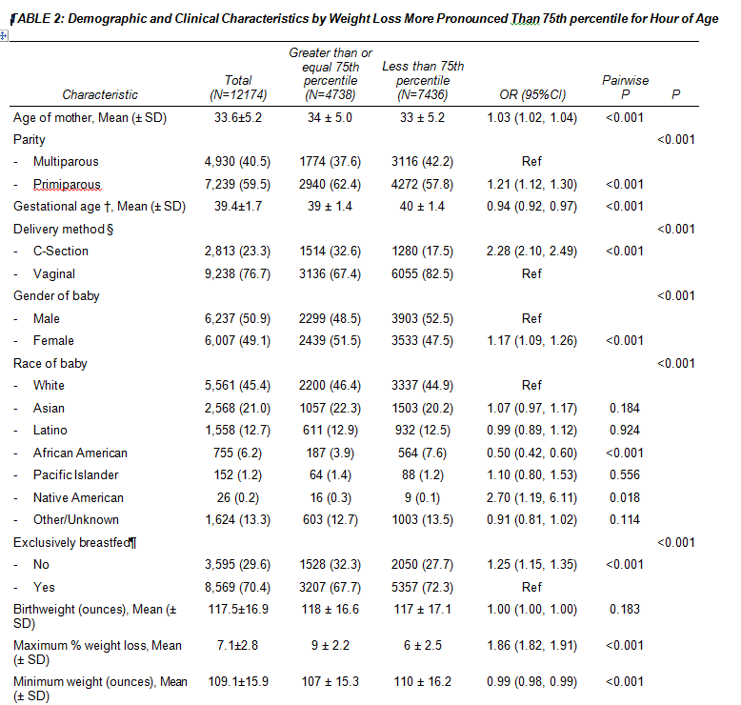
Research Goal
(Big) data
Study Design
Analytics
Publication
data.ucsf.edu

Slide 12
Outline
Review – APeX data
Research Goal
Working with EHR Data
Practical Guidance
Data Processing
data.ucsf.edu

Slide 13
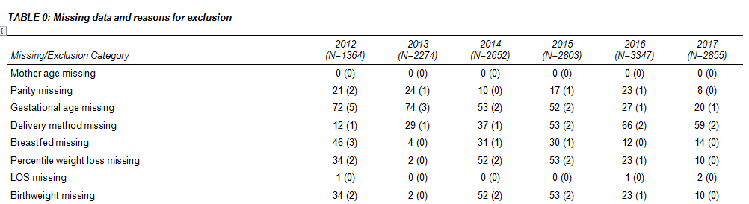
Working with EHR
Inherent Limitations – Big Picture
Lack standard methods to ensure data quality, completeness and provenance
Data from comprehensive healthcare system (Kaiser) vs tertiary hospital (UCSF)
  Absence of data
    Follow-up visits
    Filled prescriptions
    Adherence
    Missingness
Yearb Med Inform. 2014; 9(1): 215–223. Published online 2014 Aug 15. doi: 10.15265/IY-2014-0009
data.ucsf.edu

Slide 14
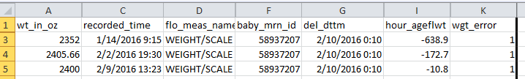

Working with EHR
There are errors!
data.ucsf.edu

Slide 15
Working with EHR
Recorded weight occurred before delivery data
There are errors!
Mother’s DOB same as delivery date
data.ucsf.edu

Slide 16
Outline
Review – APeX data
Research Goal
Working with EHR Data
Practical Guidance
Data Processing
data.ucsf.edu

Slide 17

RDB De-identified Flat Files, reduced EHR data but…
Still A Tidal Wave of Data
Number of Tables: 16
Total File Size: 267 GB
  …and growing
You can’t read these into MExcel or MSAccess – you need other tools..
My laptop has capacity of 238 GB.

Slide 18
Ten Practical Steps to Staying on Top of a
Tidal Wave of EHR Data
Assumptions:
You have a clearly defined research question
You have clinical expertise in the area of research
If you decide to work with a Data Scientist /Programmer --
All steps still apply

Slide 19







Step 1: Find the Right Tool for You!
Language-oriented Software Programs
UCSF Licenses
https://it.ucsf.edu/services/licensed-software
MyResearch Platform
Single-user license option

Slide 20



Step 2: Develop Your Programming Skills
How Do I Become a Better Programmer?
10,000 hours rule: Deliberate Practice
Data Science Courses
https:// www.coursera.org/data-science
Join a group
https://www.meetup.com/topics/computer-programming/

Slide 21
Step 3: Understand Your data
Multiple diagnoses per encounter
Working with RDB De-identified Flat Files
Review the RDB documentation
Study the relationships between the tables
Open the files
Look at the data!

Slide 22
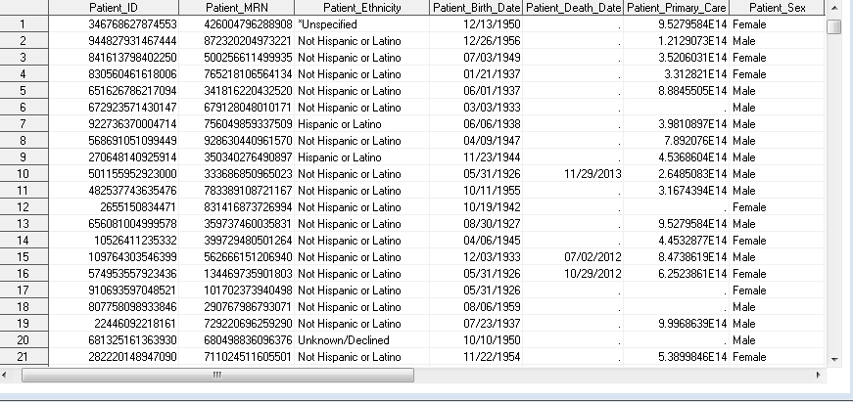
De-identified: Patient File
Observations: One record per patient
Introductory sentence Arial – 18pt font – Picture of patient file
First bullet point
  Secondary bullet point
    Tertiary bullet point

Slide 23
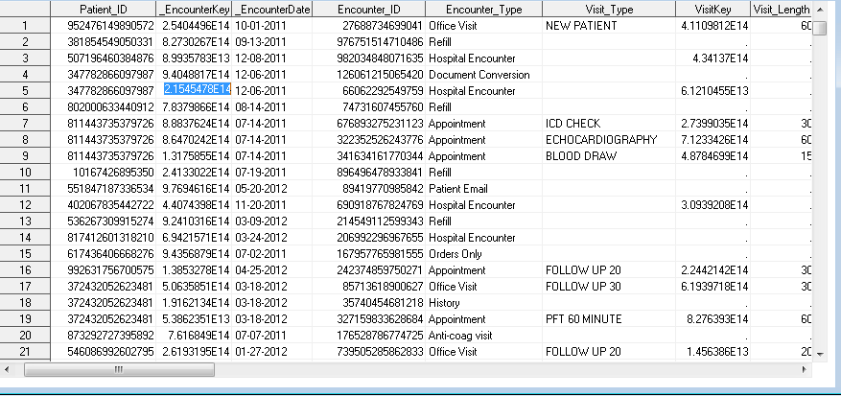
De-identified: Encounter File
Observations: Multiple encounters per patient
Introductory sentence Arial – 18pt font – picture of encounter file
First bullet point
  Secondary bullet point
    Tertiary bullet point

Slide 24
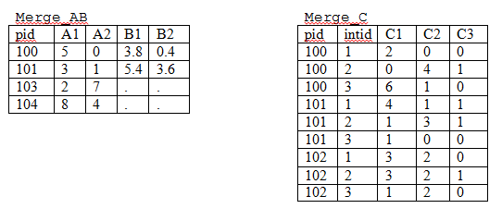
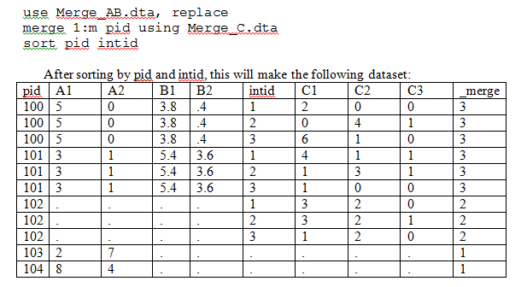
1:many merge
From
How to merge datasets.doc

Slide 25
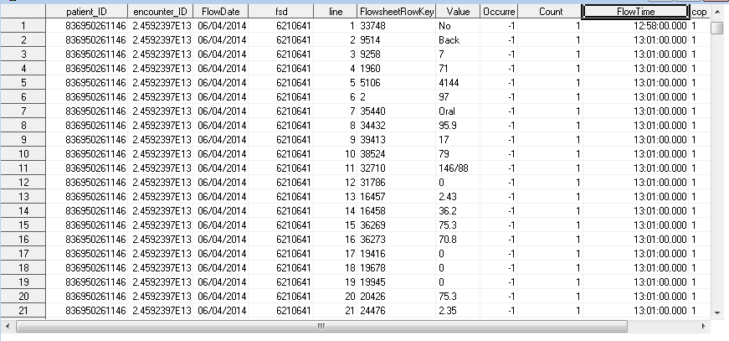
De-identified: Flowsheet Data
Observations: Multiple values per encounter
Introductory sentence Arial – 18pt font – Picture of flowsheet data
First bullet point
  Secondary bullet point
    Tertiary bullet point

Slide 26
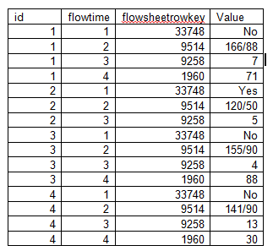
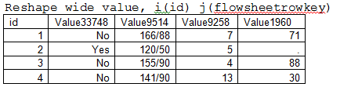
Transpose data -- long to wide
Adapted from
How to reshape your data.doc

Slide 27

Step 4: Don’t Drown in Your Data!
Reduce the files to only include your study cohort
  SAS programs available for your use
  Easy to use if identifying patients using ICD9/10 codes and/or patient’s demographic data
  Otherwise, complex programming might be required
  Start with a smallest set of variables

Slide 28

Step 5: Get Dirty!
Own and drive the research
Review the literature: What variables are expected to be there?
Develop an explicit instructions on how outcomes and covariates should be derived from the available data
Provide an explicit and exact recipe for new calculated variables -- this may be iterative
Understand limitations of the data

Slide 29
Step 6: Develop Project Specific Documentation
Table 1. Characteristics of inpatient PAD populations with and without depression
Calculated Variable | Description
reinsertion | whether a foley catheter was reinserted during the hospitalization for any reason with any time period
new foley during hospitalization | placement time is after hospital admission time for patients that we admitted without a foley catheter
qmonth change | new placement time minus previous placement time >25 days
Plan Ahead
Variable | Dp | No Dp | P
Age [Patient_Age]
Gender [Patient_Sex]
BMI [Vitals_BMI]
Race [Patient_Ethnicity]
Smoking [Patient_smoking]
Create a mock tables
Start with word descriptions
Specify variable names, don’t leave anything open to interpretation

Slide 30
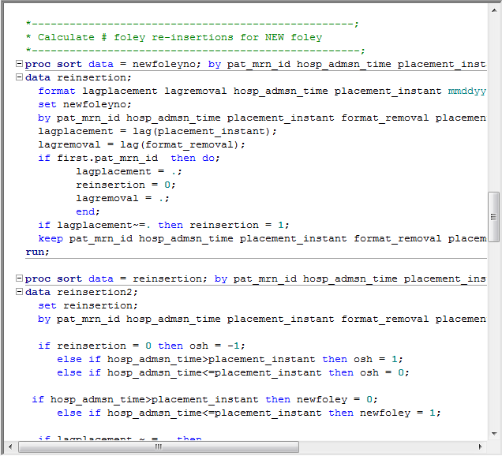
Each variable might require a separate calculation
Calculated Variable | Description
reinsertion | whether a foley catheter was reinserted during the hospitlization for any reason with any time period
new foley during hospitalization | placement time is after hospital admission time for patients that we admitted without a foley catheter
qmonth change | new placement time minus previous placement time >25 days

Slide 31
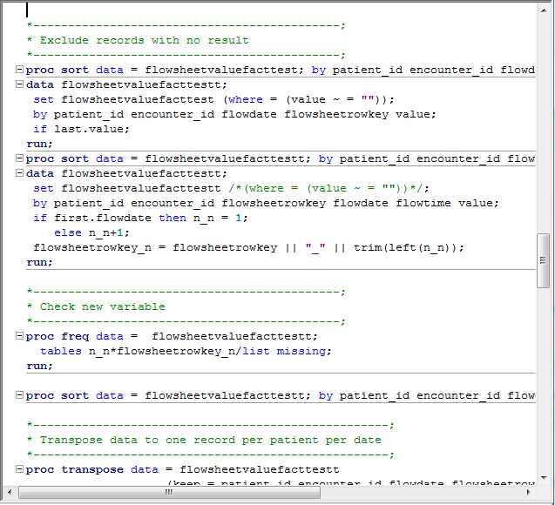
Step 7: Create Reproducible Code
Tips for Easy Reproducibility
Read raw de-identified files directly into programming software
Use only the program to manipulate the data -
NO HARD CODING
Add text to describe the purpose of the program at a high level and embed it in the code to describe the specific task
Have an organized file structure
  /Data
  /Documents
  /Programs
  /Archive

Slide 32

Step 8: Ask for Help
UCSF Resources
Library https://www.library.ucsf.edu/
  Workshops & Special Events
  Data Science Training Opportunities
CTSI’s Consultation Services
  Study design experts to help define covariates and outcomes from EHR
  Programming experts to help translate your recipe into code
Image: http://4riise.org/riise-guest-blog-raise-your-hand-three-reasons-why-class-participation-is-important/

Slide 33
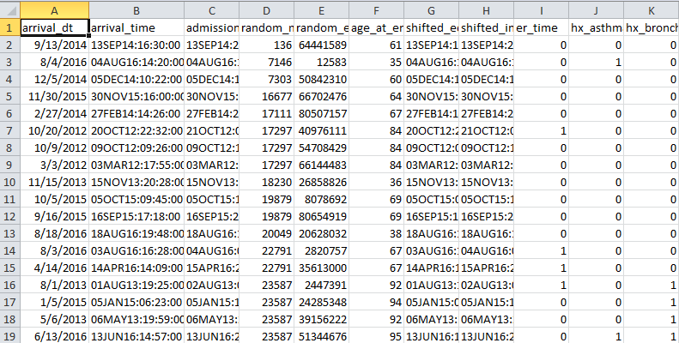
Step 9: Prepare an Analytical Dataset and Codebook
Merge study variables into one nice data frame
Each row represents a different a observation, with potentially repeated observations for individual patients
Each column represents a different variable in your dataset

Slide 34
Step 10: Analyze and Publish Your Results
Easier said than done!
Project started 1/2015, submitted 4/2016 and published 4/2017
Project started 6/2016 and was published 3/2017

Slide 35
Outline
Review – APeX data
Research Goal
Working with EHR Data
Practical Guidance
Data Processing
data.ucsf.edu

Slide 36
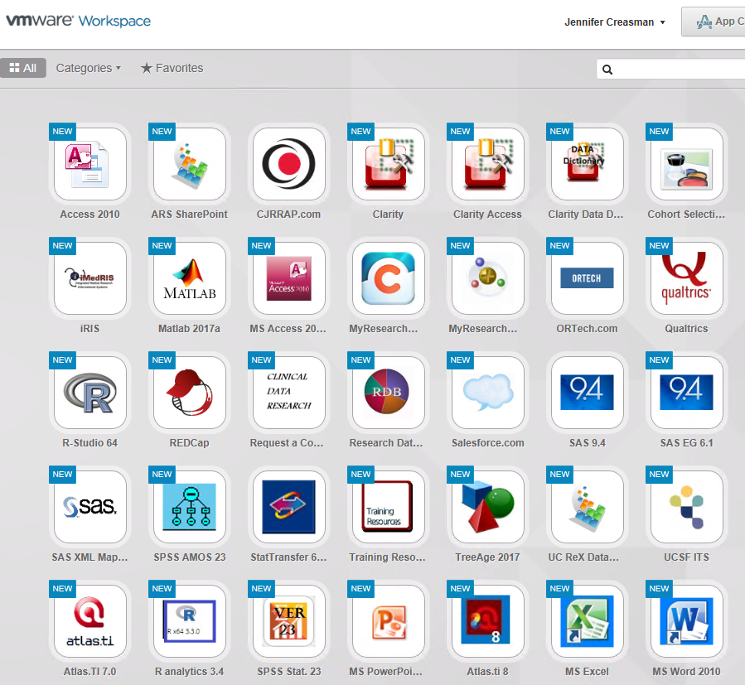
Upload
Highly recommend using VMWare Horizon Client and working in the MyResearch environment
  You can map directly to the RDB directory.
    LAN connection -- OK
    Wireless too slow
  Files are 267 GB.
Please give us feedback re: MyResearch.

Slide 37
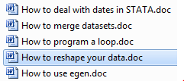
Data Processing
Check
Transform
Define
Summarize
Define
Check data in new environment
Date issues
Text/Numeric issues
Iterative process, especially with flowsheet measurements
Use literature as a guide
Ex. most recent, max, minimum, set threshold
By year, perhaps
Check prevalence with literature
Stratify

Slide 38
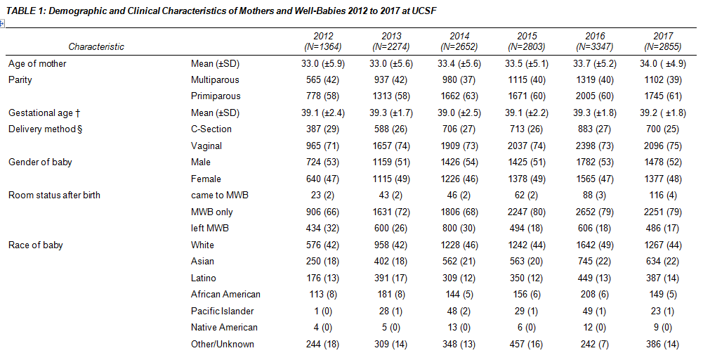
Summarize

Slide 39
Validate
With IRB approval, Academic Research Services can provide real MRNs
Look up MRN in hyperspace -- check stored values, confirm data reflects hyperspace
Caboodle pulls data from multiple sources. It’s a more difficult to locate the source of the error
Make a decision re: errors
  What percent of the records have errors?
  Are they random?

Slide 40
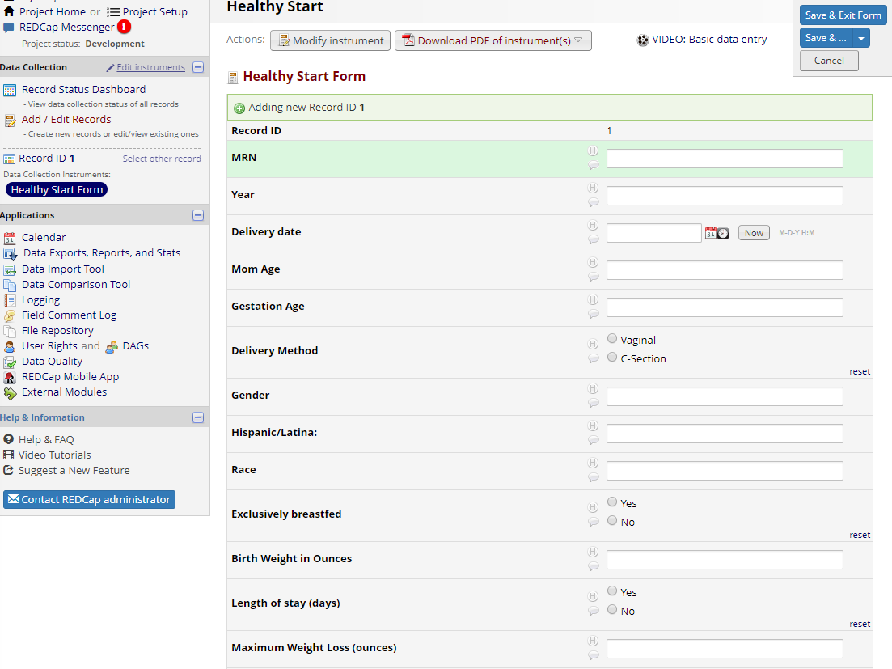
Archive
Healthy Start Database 2012 - 2017
Create study database in REDCap
Upload data “transformed” data into project
Manually update missing values/errors from Apex Chart -- from narrative
Review
Append new to existing project

Slide 41

Questions?
https://accelerate.ucsf.edu/consult

