Slide 1
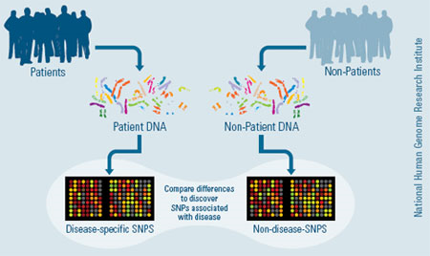
Association Studies

Slide 2
Overview
1. Association Studies
2. Association Analysis
3. Candidate Gene Studies
4. Statistical Power

Slide 3
1. Association Studies
Have rapidly expanded recently
Reflects a number of good properties, including:
  Ease, since no large pedigrees
  Potential for being more powerful than older linkage-based approaches
Risch & Merikangas, Science 1996

Slide 4
Association Study Approaches
Direct vs. Indirect
Candidate genes: hypotheses about biological mechanisms.
  Functional
  All common variants
  Exome arrays
All common variants in genome (GWAS)
All variants in genes/genome (sequencing)
  Expensive

Slide 5

Direct vs Indirect Association
Hirschhorn & Daly, Nat Rev Genet 2005
Candidate Gene or GWAS
Key concept: Linkage Disequilibrium
Notes:
5
Card Trick: Phenomenon of recombination.
genotype variants in LD with the variant of interest

Slide 6
Association Study Design:
Control Selection
Controls should be:
  Selected from the cases’ source population
  those individuals who, if they were diseased, would become cases

Slide 7
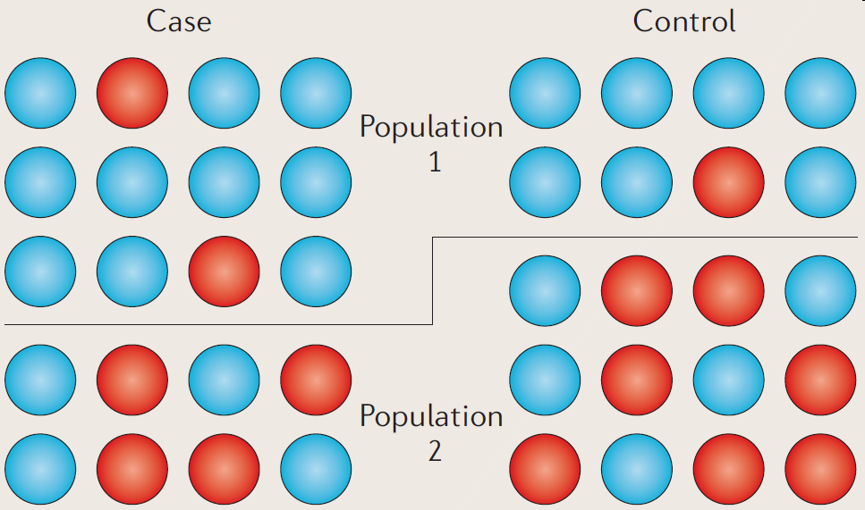
Population Stratification
Two populations have different allele frequencies and background rates of disease.
Can lead to biased association results.
Balding, Nature Reviews Genetics 2010

Slide 8
How can we address the potential bias due to population stratification?

Slide 9
Addressing Population Stratification
Match on self-reported ethnicity
  (Wacholder et al., / Thomas & Witte, CEBP 2002)
Family-based studies
  (Witte et al., AJE 1999)
Genomic control
  (Devlin and Roeder, Biometrics, 1999)
  Adjust test statistics for ‘inflation’ (bias) using empirical χ² distribution, comparing median observed to expected (χ²_{new} = χ²_{old}/λ).
Principal Components
  (Price et al., Nat Genet 2006)
    Adjust regression for PCs as a proxy for genetic ancestry.

Slide 10
Addressing Population Stratification
Match on self-reported ancestry.
Undertake family-based study
Genomic control (PMID: 11315092)
  Non-central chi-square λ = median of all χ² tests in the sample
  Adjust all test statistics for inflation due to empirical chi-square distribution (χ²_{new} = χ²_{old}/λ)
  Critiques: An average across the genome, and may over or under correct for individual tests
Ancestry Principal Components (more in GWAS lecture)
  Eigenstrat (PMID: 16862161)
  Adjust regression model for principal component values which serve as a proxy for ancestry
Mixed model (more in GWAS lecture (PMID 20562875))
Idea is to condition on the rest of the genome

Slide 11
Family-Based Association Studies
Siblings
Parents
G
G
G
G
G
Cousins
G
G
G
Termed “pseudo”-controls (the hypothetical other mendelian transmissions)

Slide 12
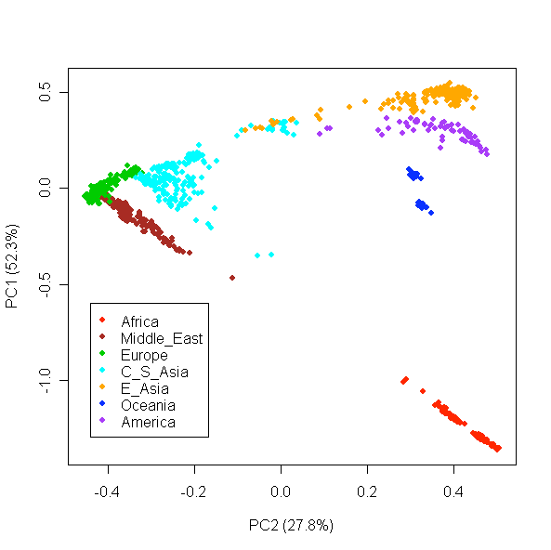
Adjusting for Principal Components
Maximize variance between subjects using all SNPs.
Clusters individuals from different populations.
Li et al., Science 2008

Slide 13
Continuum of Assoc Study Designs
Population-based
“Ethnicity” Matched
Structured Assoc
Family-based
Population Stratification
Overmatching
(Bias (maybe)……………versus…............. less efficient)
Subpopulation
↑ Sharing of genes & envt.
Efficiency
Also, recruitment issues
Gene
Disease

Slide 14
Overview
1. Association Studies
2. Association Analysis
3. Candidate Gene Studies
4. Statistical Power

Slide 15
Association Analysis
Genotype | Cases | Controls | OR
CC | A | D | AF/DC
CT | B | E | BF/EC
TT | C | F | 1
Simple chi-square test comparing genotype frequencies (2 d.f.)
Called a co-dominant analysis

Slide 16
Chi squared test for Association
Observed: Expected
Geno Case Control Total OR Case Control
CC A D A+D=nCC AF/DC nCC*nCase/n nCC*nCont/n
CT B E B+E=nCT AE/BD nCT*nCase/n nCT*nCont/n
TT C F C+F=nTT 1 nTT*nCase/n nTT*nCont/n
Total A+B+C D+E+F A+B+C+D+E+F
=nCase =nCont =n
Sum (Observed – Expected)^2/Expected. Chi squared with 2 degrees of freedom.
Expected cell count = row_total * column_total / total

Slide 17
Example: Testing for Association
Observed: Expected
Geno Case Control Total OR Case Control
CC 20 5 25 12 25*35/65=13.5 25*30/65=11.5
CT 10 10 20 3 20*35/65=10.8 20*30/65=9.2
TT 5 15 20 1 20*35/65=10.8 20*30/65=9.2
Total 35 30 65
=nCase =nCont =n
Sum (Observed – Expected)^2/Expected
= (20-13.5)^2/13.5 + (10-10.8)^2/10.8 + (5-10.8)^2/10.8
+ (5-11.5)^2/11.5 + (10-9.2)^2/9.2 + (15-9.2)^2/9.2
= 13.7
P-value = 0.0011
Co-dominant model

Slide 18
Testing for Association
2 df Genotype Recessive (G) Dominant (G)
Genotype Case Control Case Control Case Control
CC A D CC A D CC or CT A+B D+E
CT B E CT or TT B+C E+F TT C F
TT C F
~chi_sq(2df) ~chi_sq(1df) ~chi_sq(1df)
Genotype Case Control Case Control Case Control
CC 20 5 CC 20 5 CC or CT 30 15
CT 10 10 CT or TT 15 25 TT 5 15
TT 5 15
P=0.0011 P=0.0020 P=0.0045
What model should we use here?

Slide 19
Genetic Model
If genetic model known:
  Collapse genotypes into 2x2 table, 1 d.f. test
  Or trend test for log additive
  Use logistic regression: coding; covariates, odds ratios
If genetic model unknown?
Log-additive is default. Why?
Could use all three models (dom, rec, log additive).
Compare fit with the co-dominant (2d.f.) model (LR test).
Can’t use LR test to compare models since not nested.
Model with best fit and smallest P is best?
Use permutation test (MAX test).

Slide 20
Overview
1. Association Studies
2. Association Analysis
3. Candidate Gene Studies
4. Statistical Power

Slide 21
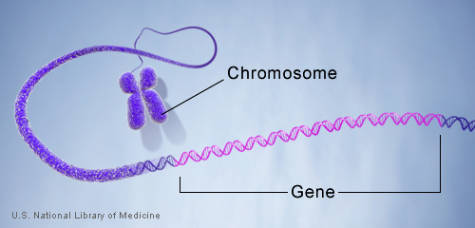
3. Candidate Gene Studies
Selection of candidates
Known regions?
Biological support?
“I am interested in a candidate gene and have samples ready to study. What SNPs do I genotype?”
Notes:
21

Slide 22
Candidate Genes: Where do I Start?
1. Location:
  What chromosome? What position on the chr?
2. Exons/UTR:
  How many exons? UTR regions?
3. Size of gene?
Use UCSC genome browser: https://genome.ucsc.edu/
Notes:
22

Slide 23
Selecting SNPs to Genotype:
Things to Consider
Validation
  What is the quality of the SNPs?
Informativity
  Are these SNPs informative in my population?
  How common are they? Location?
Potentially Functional
  Do these SNPs have a potential biological impact?
  Missense variants?
Previously Associated
  Have previous studies found SNPs in the candidate gene associated with the outcome?
Notes:
23

Slide 24
If Too Many SNPs: Use TagSNPs
A/T
1
G/A
2
G/C
3
T/C
4
G/C
5
A/C
6
Pairwise Tagging:
SNP 1
SNP 3
SNP 6
3 tags in total
Test for association:
SNP 1
SNP 3
SNP 6
A
A
G
G
G
T
G
A
C
C
C
C
C
C
C
C
T
T
A
A
G
G
C
C
high r²
high r²
high r²
SNPs are correlated (aka Linkage Disequilibrium)
Carlson et al. (2004) AJHG 74:106
Notes:
24

Slide 25
Coverage: Measurement Error in TagSNPs
Want to compute coverage of all SNPs in the area, we start with this one, and look at pairwise correlation with each of the genotyped SNPs.
Genotyped SNPs
Notes:
25
Complete set
Subset of these make up the genotyping set
For a given SNP
Get r2 between that SNP and SNPs in the genotyping set
Take the highest r2 value
Called maximum r2

Slide 26
Common Measures of Coverage
Threshold Measures
  e.g., 73% of SNPs in the complete set are in LD with at least one SNP in the genotyping set at r² > 0.8
Average Measures
  e.g., Average maximum r² = 0.84
Notes:
26

Slide 27
Coverage and Sample Size
Sample size required for Direct Association, n
Sample size for Indirect Association
n* = n/ r²
For r² = 0.8, increase is 25%
For r² = 0.5, increase is 100%
Notes:
27

Slide 28
Overview
1. Association Studies
2. Association Analysis
3. Candidate Gene Studies
4. Statistical Power

Slide 29
4. Statistical Power
Probability a test will reject a null hypothesis when alternative is true
1-Prob(Type II error, false negative)
Type II error = false positive

Slide 30
Statistical Power
CaTs: http://csg.sph.umich.edu/abecasis/cats/gas_power_calculator/index.html

