Slide 1
Internet Technologies and Health Care
Ida Sim, MD, PhD
January 30, 2018
Division of General Internal Medicine
Copyright Ida Sim, 2018. All federal and state rights reserved for all original material presented in this course through any medium, including lecture or print.
Notes:
PMI, PPRN, National Cancer Data Ecosystem – patient-donated data to research
Time for a patient-driven health information economy – Mandl and Kohane, hyperportalosis
Open Notes movement
HUGO to synch with
Ethan Basch, on PROs
Rearchitecting clinical researc hwith people-powered data partnership
www.atsdr.cdc.gov

Slide 2
Summary of Class So Far
Big 6 Clin Epi questions are questions of organized complexity, can be answered using
  Evidence : (big) data + “study” design + (machine) analytics
  Big data, mobile technology, social media, and machine learning enable new potentially far more powerful ways to generate evidence
Epic EHR data stored in a variety of databases
Need to be aware of data coding and other issues to properly query and use EHR data
Decision support systems do symbolic reasoning
  approaches include rules, statistical models, and machine learning
  deep learning is one form of machine learning underlying AI

Slide 3
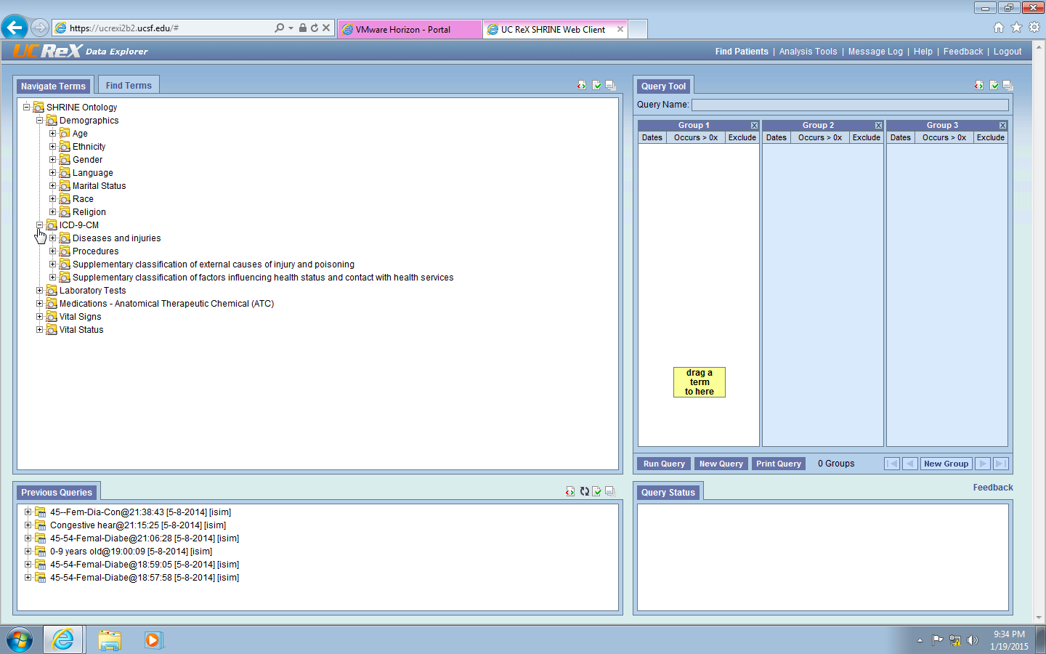
Optional UC ReX Lab

Slide 4
Outline
Overview of The Internet
Health Information Exchange and Query
Web X.0 to Internet of Things
Summary

Slide 5
Heads Up
Will be covering many different websites, projects, approaches
Look for themes, look for approaches that might be relevant to your own work (for Final Problem Set)
Be critical about risks, unmerited assumptions, etc.
We can visit any of these sites if interested
Disclosures: No financial or other relationship to these companies or projects unless otherwise stated
Notes:
Reviewing Internet stuff, lots probably new to you. Just soak up the impression, think which of these might apply to you.
What is the Internet?

Slide 6
Internet = Network of Networks
long-distance fiber-optic cables carry Internet data across the US
Notes:
https://www.technologyreview.com/s/540721/first-detailed-public-map-of-us-internet-backbone-could-make-it-stronger/ Sept 2015

Slide 7
Internet = Network of Networks
And across the world
Notes:
https://medium.freecodecamp.org/inside-the-invisible-war-for-the-open-internet-dd31a29a3f08

Slide 8
E.g., Japan - US Cable
comes up at Point Arena, about 2 hours north of San Francisco
via undersea cables
http://www.surfacing.in/
Notes:
https://www.wired.com/2015/10/undersea-cable-maps/
http://www.surfacing.in/

Slide 9
Clients and Servers
Server
myhome.com
nci.nih.gov
“the cloud”
local trunk cable
through Berkeley
Main Trunk Cables
Comcast
or
XFINITY
medicine.ucsf.edu
Internet Service Provider (ISP)
ucsfmedicalcenter.org
Client
at home

Slide 10
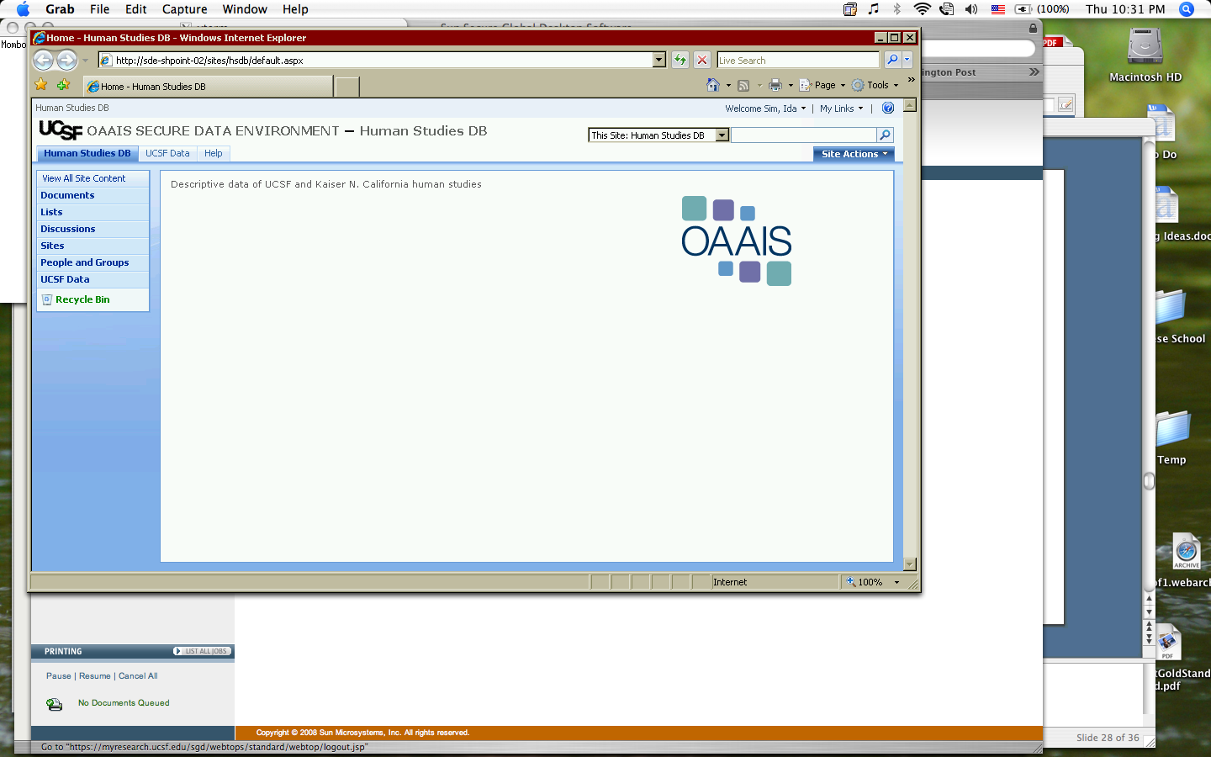
Example Thin Client and Server
Server
UCSF research PHI stored in FISMA level secure database
Data never physically leaves MyResearch
Your browser is a “dumb” window, acting as a thin client, to the MyResearch computer
  R, STATA, etc. runs on your data on MyResearch server
  you see pixels only, no data is copied onto your local computer
Server is at Minnesota St. with offsite backup
STATA, R, SAS
MyResearch DB
Firewall
Pixels only
Client
MyResearch
Secure Global Desktop
Notes:
Federal Informatoin Management Security Act, 2002

Slide 11
Cloud Computing
Storing and accessing data and programs over the Internet instead of your computer's hard drive
  you don’t need to install and maintain the software
  you don’t need to host and secure the data
  upgrades can happen in the background
  server capacity and maintenance is shared among many customers, so is cheaper
Examples
  iCloud
  Google Photos, etc.
Server
“the cloud”
e.g., Amazon Web Services (AWS)
Main Trunk Cables
Comcast
Internet Service Provider (ISP)
Thin Client

Slide 12
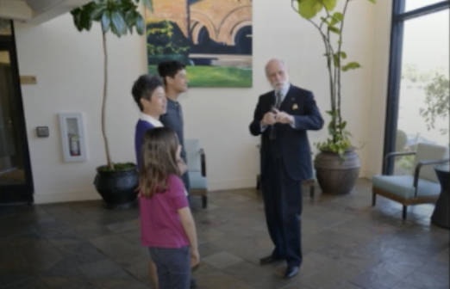
What Happens over the Cables
Internet = network of networks
  computers and cables all linked to one another and talking to one another using protocols
  supports lots of different internet protocols
Protocol = “grammar” for machines talking to each other
  e.g., hypertext transfer protocol http for web
    http://ticr.ucsf.edu/courses/schedule/med_informatics.html
  e.g., ftp file transfer protocol, smtp, https, etc. etc.
  all sit on top of basic Internet networking protocol TCP/IP
Routers route redundant data packages across the Internet
Vint Cerf, TCP/IP co-creator
https://www.youtube.com/watch?v=Xmi_UhKKcwE
Notes:
At the Crown Plaza Cabana

Slide 13
Internet vs. Web
Web is the internet traffic that uses http
  servers send out information in HTML (Hypertext Markup Language)
  web browsers can decode HTML and display it
Lots of other types of data go over the Internet too, e.g.,
  email, e.g., via IMAP (Internet Message Access Protocol)
  phone, e.g., via VoIP (voice over IP)
<html>
<head>
<title>TICR Medical Informatics</title>
<meta http-equiv="Content-Type" content="text/html; charset=iso-8859-1">
<link rel="stylesheet" href="/courses/ticr.css" type="text/css">
</head>
<body background="/courses/images/blue_background2.gif" marginheight="0" marginwidth="0" leftmargin="0" topmargin="0" bgcolor="#ffffff" >
Notes:
The grammar or transmission
Health-specific standards needed “on top of” http or TCP/IP
a “grammar" for how to exchange health-related data
.

Slide 14
Outline
Overview of The Internet
Health Information Exchange and Query
Web X.0 to Internet of Things
Summary

Slide 15
Two “Use Cases”
A use case is used in software engineering to identify, clarify, and organize system requirements. It starts with a story and includes actors, goals, specific actions, specific outcomes.
Use Case #1: accessing EHR data at another health care institution
  E.g., UCSF accessing Sutter data
Use Case #2: accessing EHR data at multiple other health care institutions
  E.g., FDA monitoring for any unsuspected adverse events of marketed drugs (SENTINEL)
  E.g., how many patients across UC have lupus nephritis? Across all ~60 CTSAs?
Core need: access and query data that is held at different servers connected by the Internet

Slide 16
Health-Specific Data Interchange
Health-specific standards needed “on top of” http or TCP/IP
  need a “grammar” (i.e., a protocol) and vocabulary (e.g., SNOMED) for exchanging health-related data
For exchanging EHR data
  C-CDA (consolidated clinical document architecture) part of Meaningful Use certification
    implemented in Epic’s Care Everywhere
  HL7 organization defines health data interchange standards
    v2 is a common ad hoc approach
    FHIR is set to be new standard
For exchanging radiology studies (e.g., machine used, type of study, # of images, etc.)
  DICOM
For mobile health data (i.e., data from sensors, apps)
  Open mHealth* (I’m co-founder)
Notes:
Like need for English grammar and vocab on top of cups and a string

Slide 17
Interoperation
Ability of two or more systems or components to exchange information and to use the information that has been exchanged [IEEE Standard Computer Dictionary, 1990]
  syntactic: grammar, composition of what is said
    e.g., using an exchange protocol over networks
    e.g., HL7, DICOM, XML Document Type Definition (DTD)
  semantic: meaning of what is said
    e.g., using a controlled vocabulary aka dictionary
    e.g., SNOMED, ICD-10

Slide 18
Use Case #1: EHR Health Info Exchange (HIE)
UCSF accessing Sutter data, between installations of one vendor system
  same use of C-CDA
  Epic imposed governance, policies, and charges
Deliberate “information blocking” is/was a problem
  Senate Committee on Health, Education, Labor, and Pensions held hearings in March 2015
    “The creating the connection to begin with to that other system can wary widely. We charge for that based on an hourly fee," and "We charge on a per-patient, per-year basis — … $2.35” (Epic Systems Dir. of Interoperability)
  UCSF had ~3.25 m distinct patients in our EHR in 2015; Epic and others stopped charging by April 2015
  legislation against info blocking is part of 21st Century Cures Act
Dedicated HIEs include Manifest MedEx (11.7m claims from BC/BS, and 5m Inland Empire patients)
UCSF Epic
C-CDA
Sutter Epic
TCP/IP
Notes:
"when persons or entities knowingly and unreasonably interfere with the exchange or use of electronic health information” – Office of National Coordinator (ONC) for Health IT.
Cures Act: they have laid out up to $1 million in penalties for vendors found guilty of data hoarding, and as-yet-unspecified ramifications for providers caught doing the same.

Slide 19
Use Case 2: Querying Multiple EHRs
e.g., FDA wants to monitor many/most EHRs, in close to real time, for adverse events
Two approaches
EHR #2
EHR #2
EHR #1
EHR #3
EHR #1
EHR #3
Cerner
Cerner
Epic
Allscripts
Epic
Allscripts
Central Database
Query Broker
Query
Query
Centralized Approach
Data comes to the query
Federated Approach
Query goes to the data

Slide 20
Examples of Query Models
Centralized Approach
UC-wide OMOP-based DB
Federated Approach
Notes:
"when persons or entities knowingly and unreasonably interfere with the exchange or use of electronic health information” – Office of National Coordinator (ONC) for Health IT.
Cures Act: they have laid out up to $1 million in penalties for vendors found guilty of data hoarding, and as-yet-unspecified ramifications for providers caught doing the same.

Slide 21
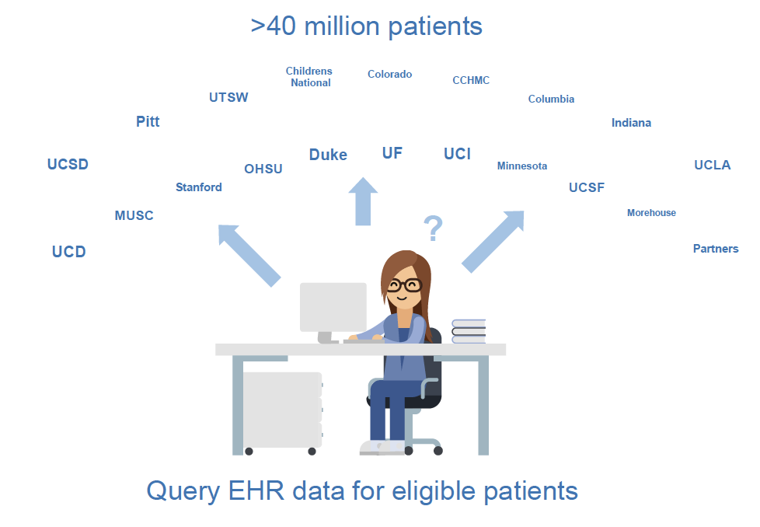
CTSA Accrual for Clinical Trials (ACT) Network
Each database must map to the common model
Data should be coded in a common terminology
Big overhead in privacy, security, identity management
Supports only limited types of queries
  counts are easy
  privacy-preserving, row-level data, is much harder
ACT query to launch in 2019
CTSA #2
CTSA #1
CTSA #3
Common Data Model
(e.g., i2b2)
i2b2 SHRINE
Common Terminology
(e.g., ICD-9, ICD-10)
Query
Notes:
same signon as web mail
also do standard variables

Slide 22
Personal Health Records (PHRs)
Prior efforts to enable patients to get at their own EHR data (aka PHRs) outside of EHR
  Google Health, Microsoft HealthVault, Healthbanking.org, …
  Blue Button: veterans get their EHR via a “blue button”, as text file 2010-2012, then in CCDA format
  Synch for Science (S4S): FHIR-based mechanism for patients to donate their EHR data to All of Us
Apple Health Record: beta launched last week
Hopkins
Cedars-Sinai
Penn Medicine
Geisinger
UC San Diego
UNC
Rush
Dignity Health
Ochsner
MedStar
OhioHealth
Cerner Healthe Clinic
EHR
FHIR
TCP/IP
Notes:
One-way only, FHIR based so should also work for Android, dependent on health org to agree and open FHIR endpoint, now can build apps on top of Health Record.

Slide 23
Summary: Health Info Exchange and Query
EHR and other data often in multiple heterogeneous databases, requiring query over the Internet
Two basic query approaches
  centralized: send data to the query. Most organizations not willing to copy their data elsewhere.
  federated: send query to the data. Difficult and expensive to manage.
    require common data model and vocabulary
    offer only limited analytic capability (counts, basic regression)
Greater adoption of modern data exchange standards (FHIR, Open mHealth), rules against information blocking, and entry of non-health entities (e.g., Apple) should increase effective data exchange

Slide 24
Outline
Overview of The Internet
Health Information Exchange and Query
Web X.0 to Internet of Things
Summary
Notes:
Reviewing Internet stuff, lots probably new to you. Just soak up the impression, think which of these might apply to you

Slide 25
Web X.0
Web 1.0: web of links to static information with simple links between them
  e.g., Wikipedia
Web 2.0: people are as important as computers in the network
  Facebook, Twitter, Google +, Instagram, Tumblr…
Web 3.0 (Semantic Web)
  each data item is “tagged” with ontology terms so computer can “understand” everything on the web
  I.e., the contents of HTML “buckets” are standardized, using RDF (Resource Description Framework), OWL (Web Ontology Language), etc.
Internet of Things (IoT)
Virtual and augmented reality
Notes:
http://www.thefigtrees.net/lee/sw/sciam/semantic-web-in-action#single-page

Slide 26
Web 1.0
Websites that present information, deliver video, etc.
Research sites
  U-Can-Poop-Too Study
    http://ucp2.bht.virginia.edu/interest/study
Hierarchical information sources
  NIH MedlinePlus
  WebMD.com
Notes:
Games for Health Journal: Research, Development, and Clinical Applications,

Slide 27
Web 2.0 Principles
User-generated content
Harness power/wisdom of crowds
Openness
Niche markets
Architecture of participation
P. Anderson, What is Web 2.0? JISC Tech and Standards Watch, Feb 2007

Slide 28
User-Generated Content
Anyone anywhere is a source of content
  YouTube, Flickr, Wikipedia, Instagram, Tumblr, citizen journalism, blogs
Medical examples
  http://PatientsLikeMe.com/
  http://www.ganfyd.org/index.php?title=Main_Page (many pages are 3-5 years old)

Slide 29
Power/“Wisdom” of Crowds
Use distributed machine and people resources
  parallel computing for cheap: Einstein@home
    searching for weak pulsar signals to discover neutron stars
  FoldIt for protein folding
    A protein causing AIDS in rhesus monkeys that hadn't been solved for 15 years was resolved by Foldit players in 3 weeks and confirmed (2011) by x-ray crystallography
  AsthmaMD mapped PEFR of thousands of users in real-time during Icelandic volcanic explosion in 2011
Crowdsourcing
  http://wiki.answers.com/Q/FAQ/431
    196,700 questions answered about health in 2017, was 620,400 in 2013
  Wikipedia is as accurate as Encyclopedia Britannica
Notes:
Einstein@Home uses idle computer to search for weak astrophysical signals from pulsars to discover new neutron stars
A protein causing AIDS in rhesus monkeys that hadn't been solved for 15 years was resolved by Foldit players and confirmed by x-ray crystallography. That paper was named "Article of the month" by Nature Structural & Molecular Biology in October 2011.

Slide 30
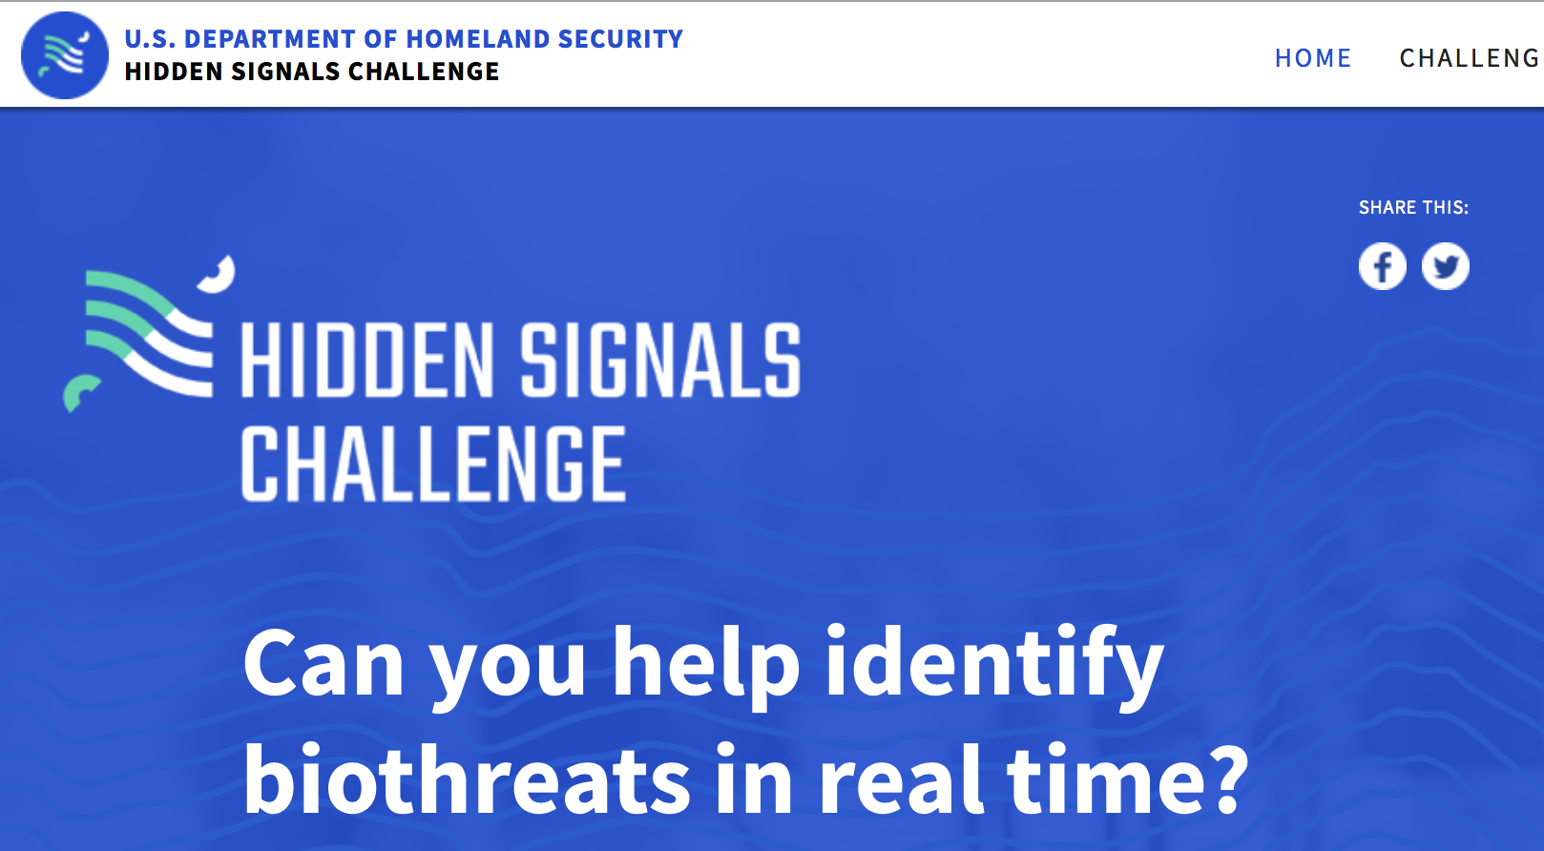
“Wisdom” of Crowds?
Tapping into distributed intelligence/opinion
  prediction markets, e.g., predictit.org
  digital epidemiology/syndromic surveillance
    HealthMap Zika Timeline
    Google Flu (but it was inaccurate) due to “big data hubris” and media-stoked panic
    mining Twitter, Facebook, Instagram, etc for biothreats?
Enabling and combating distributed truthiness / fake news
  Google, Democracy and the Truth about Internet Search, The Guardian, December 2016
* I am a judge for this challenge
Notes:
Talk to Urmi Sakar for social media mining, etc.

Slide 31
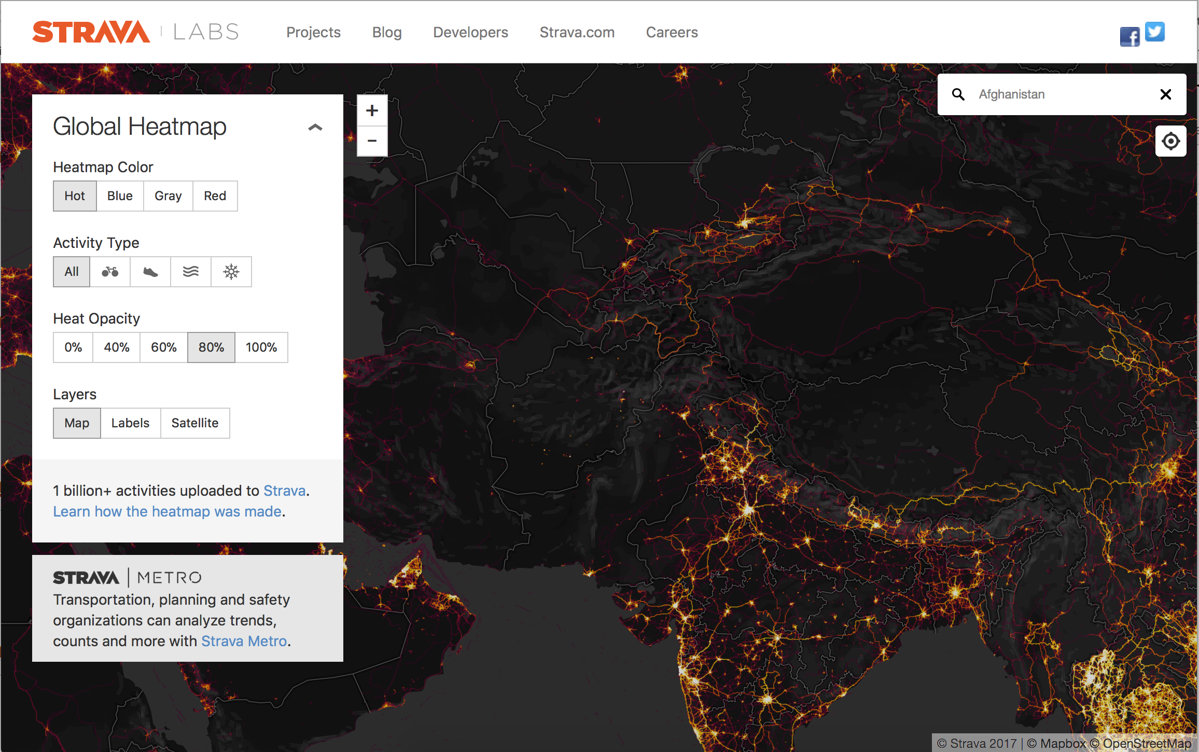
Openness
Dimensions of openness
  open source code: community improvement (e.g., VistA VA EHR system)
  open access: no restrictions on use or distribution of content
  open participation: everyone can participate
    communal management, flat hierarchies, emergent decisions
Allows "mash-ups” of freed data
  e.g., HealthData.gov
  Strava data and military movements
Notes:
http://www.nature.com/avianflu/google-earth/index.html
http://fluapp.challenge.gov/

Slide 32
Niche Markets
“The web” is unlimited resource
  can service even extremely small market niches
Shape of the web: the “long tail”
where traditional focus is
# people
with infinitely long tail, majority of action is here
market niche/things being done

Slide 33
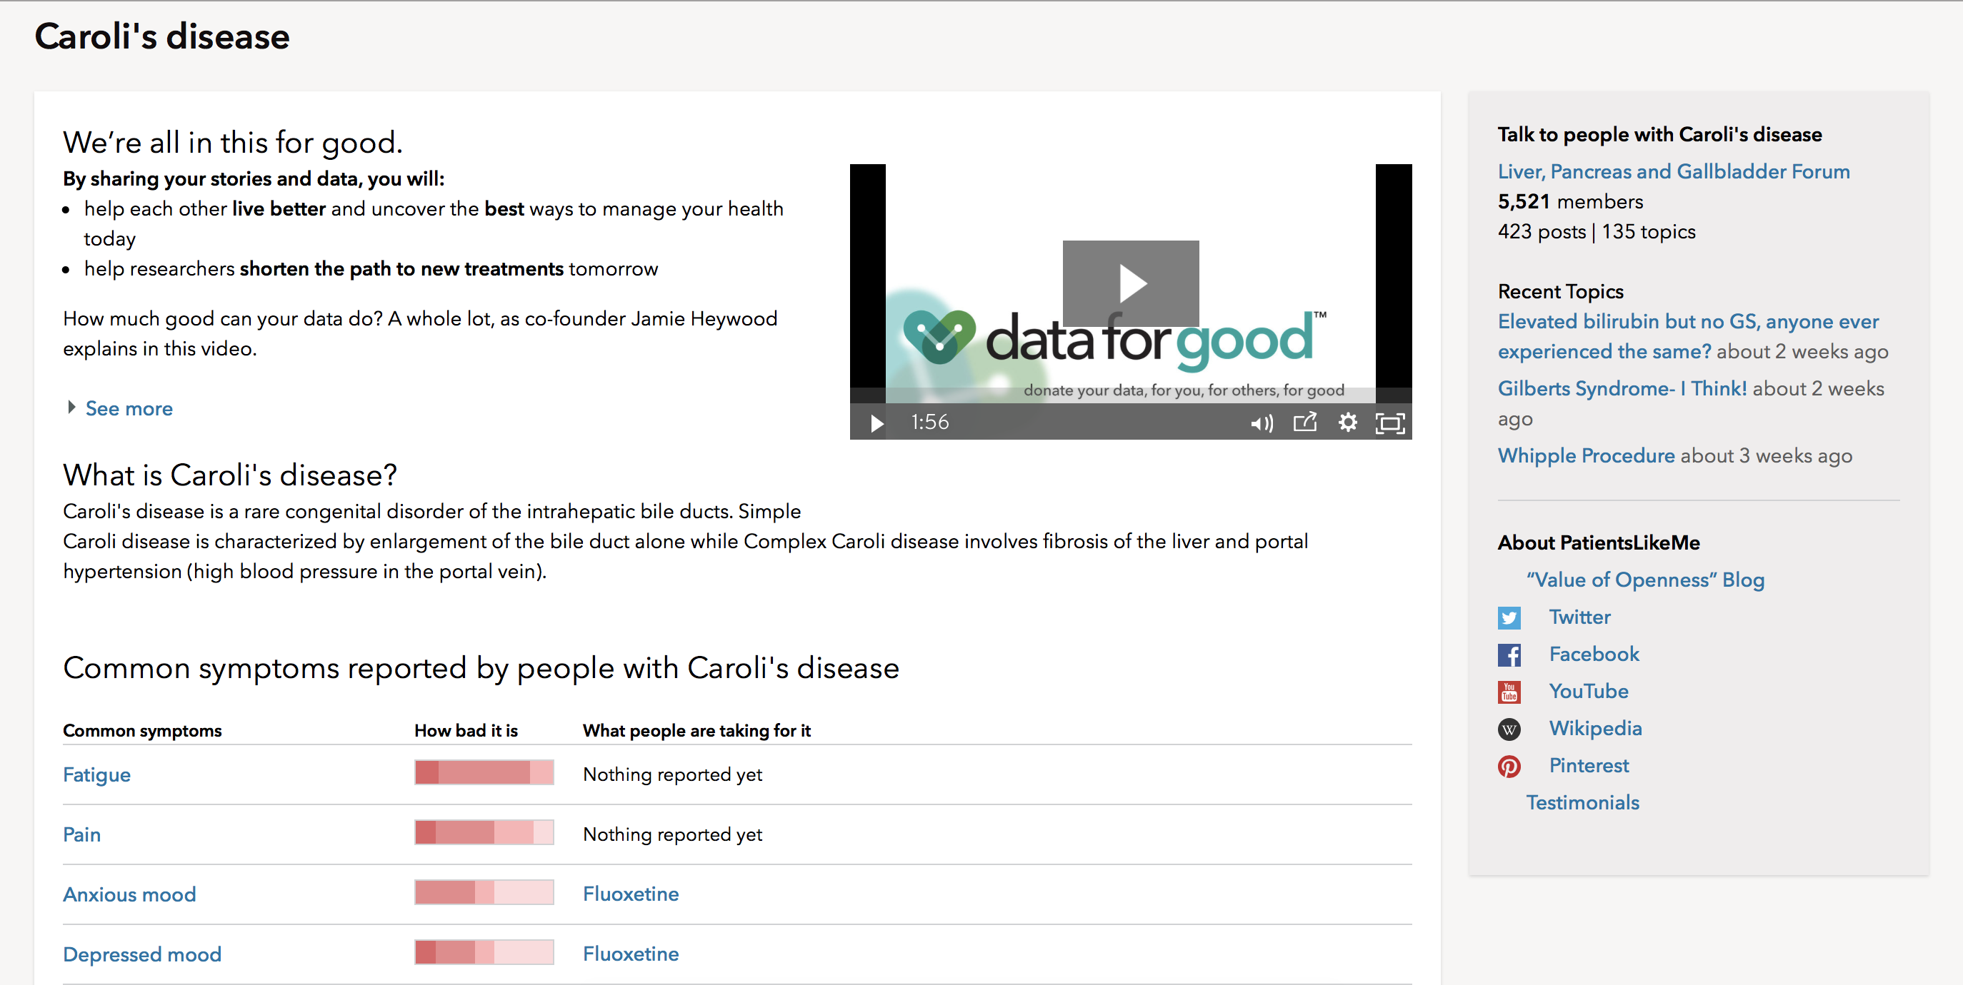
Niche Markets in Health
Rare diseases
  E.g., PatientsLikeMe

Slide 34
Architecture of Participation
Network externalities: “the service automatically gets ‘better’ the more people use it” e.g.,
  fax machines, cell phones...the more the better
  Google search: the more “link paths” people tread, the richer the data for the Google search algorithm
  Amazon book ratings, Netflix ratings
What does architecture of participation look like for health and health research?
Notes:
How important is anonymity for this in healthcare?
http://www.curetogether.com/

Slide 35
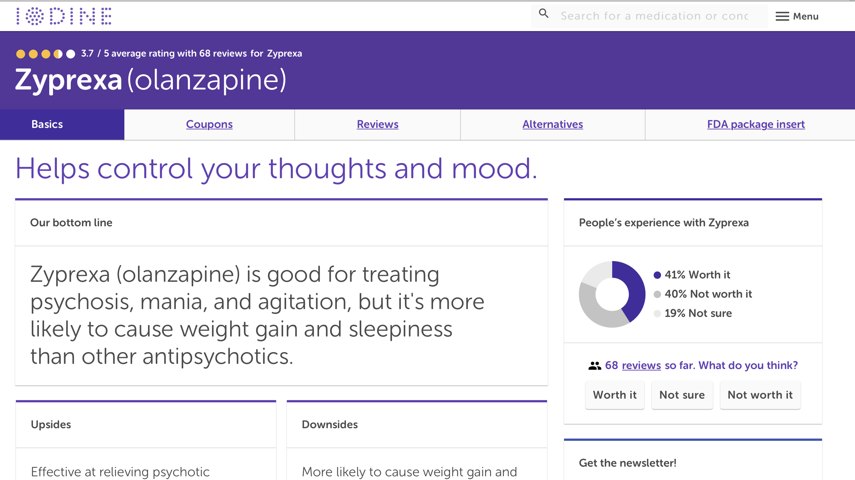
Participatory Health/Research
Patient-driven data sharing
  CureTogether (patient treatment experiences), PatientsLikeMe, Iodine (med experiences)
  MyGene2 (genetics of rare conditions)
Patients as research partners / data donors
  EHR data opt-in
    1-3% adults refuse to share clinical data for research
  PatientsLikeMe, PCORI Patient Powered Research Networks
  All of Us enrolling 1 million with data return to sustain long-term participation in the cohort
  Open Humans
Scientist and public participation
  nextstrain.org, OpenAQ (see NIH/Wellcome Trust Open Science Prize)* I was a judge

Slide 36
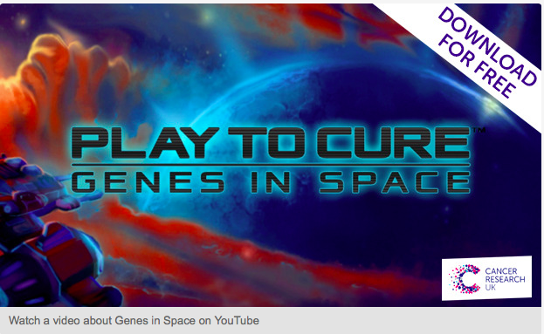
Web 2.0 Research
Games and simulation for health and research
  http://healthcaregames.wisc.edu/
  Second Life and Play to Cure: Genes in Space
PatientsLikeMe.com on lithium for ALS
  observational study prompted by a small Italian study, negative results published in Nature Biotech
Crowdscience
  DIY Genomics correlating personal genome with outcomes of personal interest (e.g,. empathy)
  mining Twitter, GPS locations, online social status for predictors of health
    only ~1% of tweets are geotagged, 2-3% of Instagram, ~30% Facebook
Ethics and informed consent are evolving
Notes:
https://dev.twitter.com/rest/public
Second Life launched in 2003

Slide 37
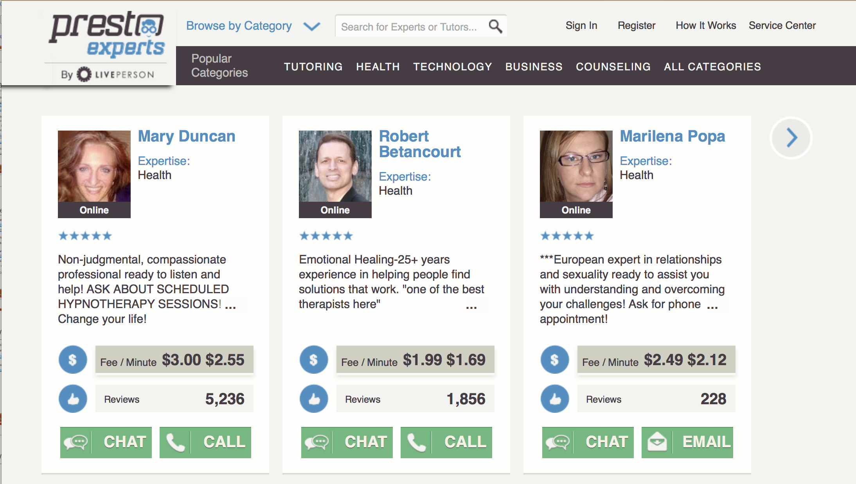
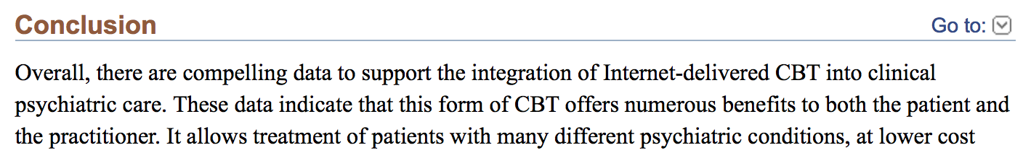
Web 2.0 Interventions
Virtual visits and virtual care
  with established provider: over half of all Kaiser visits are virtual (phone or video)
  virtual care not by traditional health care providers: e.g., HealthLoop, 98point6* (I’m on Medical Board of Advisors)
Counseling
  E.g., Presto Experts
Cognitive behavioral therapy
  for sleep: Shuti (recent supportive RCT)
  iCBT review, 2016

Slide 38
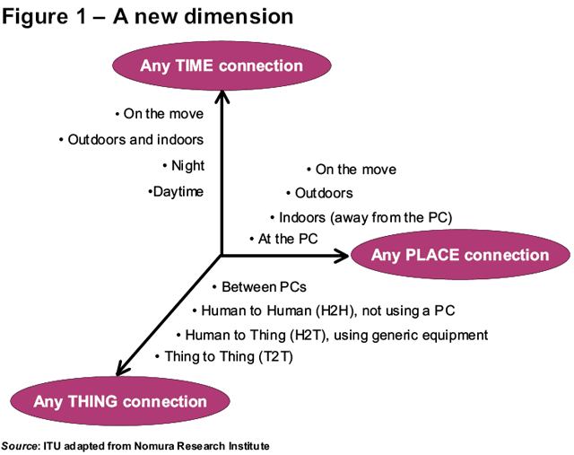
Web +1: Internet of Things (IoT)
25 billion “things” on the Internet worldwide now
75 billion by 2020
Notes:
http://www.wired.com/2015/01/ftc-warns-huge-security-risks-internet-things/
http://theconnectivist-img.s3.amazonaws.com/wp-content/uploads/2014/05/Unknown.png

Slide 39
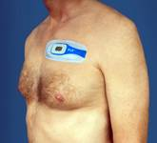
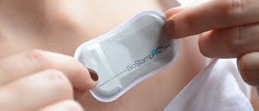
Health Sensor Things
FitBit: steps, distance, calories burned
Sleep: FitBit, SmartAlarm app
AliveCor ECG
Wearable sensors
  Corventis Piix: holter sticker
  MC10 Biostamp for temp, hydration, acceleration
Mood sensors:
  Affectiva (defunct) skin impedance, voice stress analysis
  Xpression app analyses 200 millisecond long acoustic snapshots for voice stress (calms, happy, sad, angry, or anxious/frightened)
Near-patient testing
  Ucheck checking urinalysis via your iPhone and camera
  iBGStar glucometer
Notes:
http://www.jneuroengrehab.com/content/9/1/21
http://www.mc10inc.com/ BioStamp
Affectiva q sensor stopped to put resources into facial recognition of emotion
http://www.mobihealthnews.com/content/california-hospital-becomes-first-us-prescribe-ingestible-sensors-proteus

Slide 40
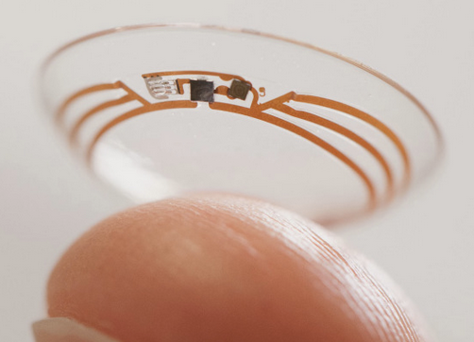
Internet of Things for Health
Small, cheap, highly networked devices, distributed everywhere doing everything (everyware), e.g.,
  in the home: Kaiser Garfield Innovation Center
  printable RFID tags, sensors in fabric
  Smart clothes; GoogleLens (overhyped) and tattoo for glucose
Advanced engineering things
  e.g., pressure plate at foot of toilet could measure urine output, identity, balance
  e.g., SpiroSmart, PFTs using your smart phone
Social computing things
  Microsoft Twitter depression detector
  UCSD looking at community levels of depression (M. Conway)
Notes:
http://www.mc10inc.com/
Shwetak Patel, University of Washington. Google bought Shwetak’s company Senosis in August 2017

Slide 41
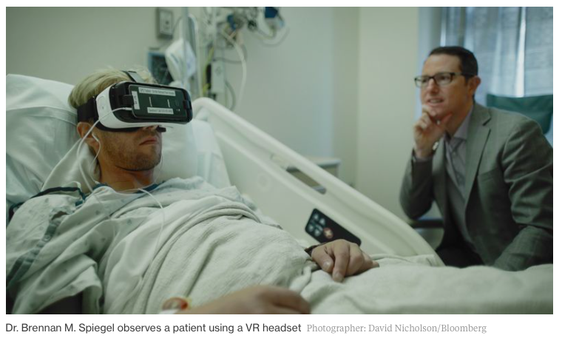
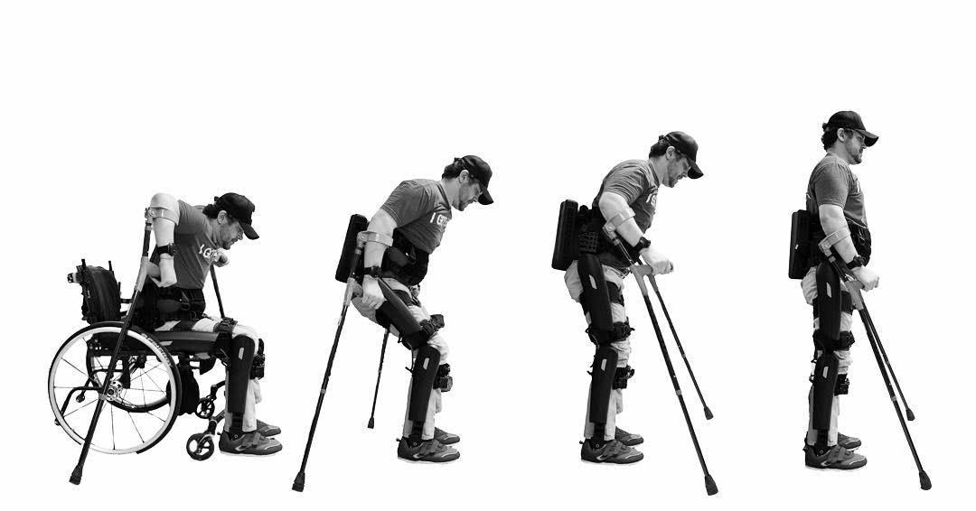
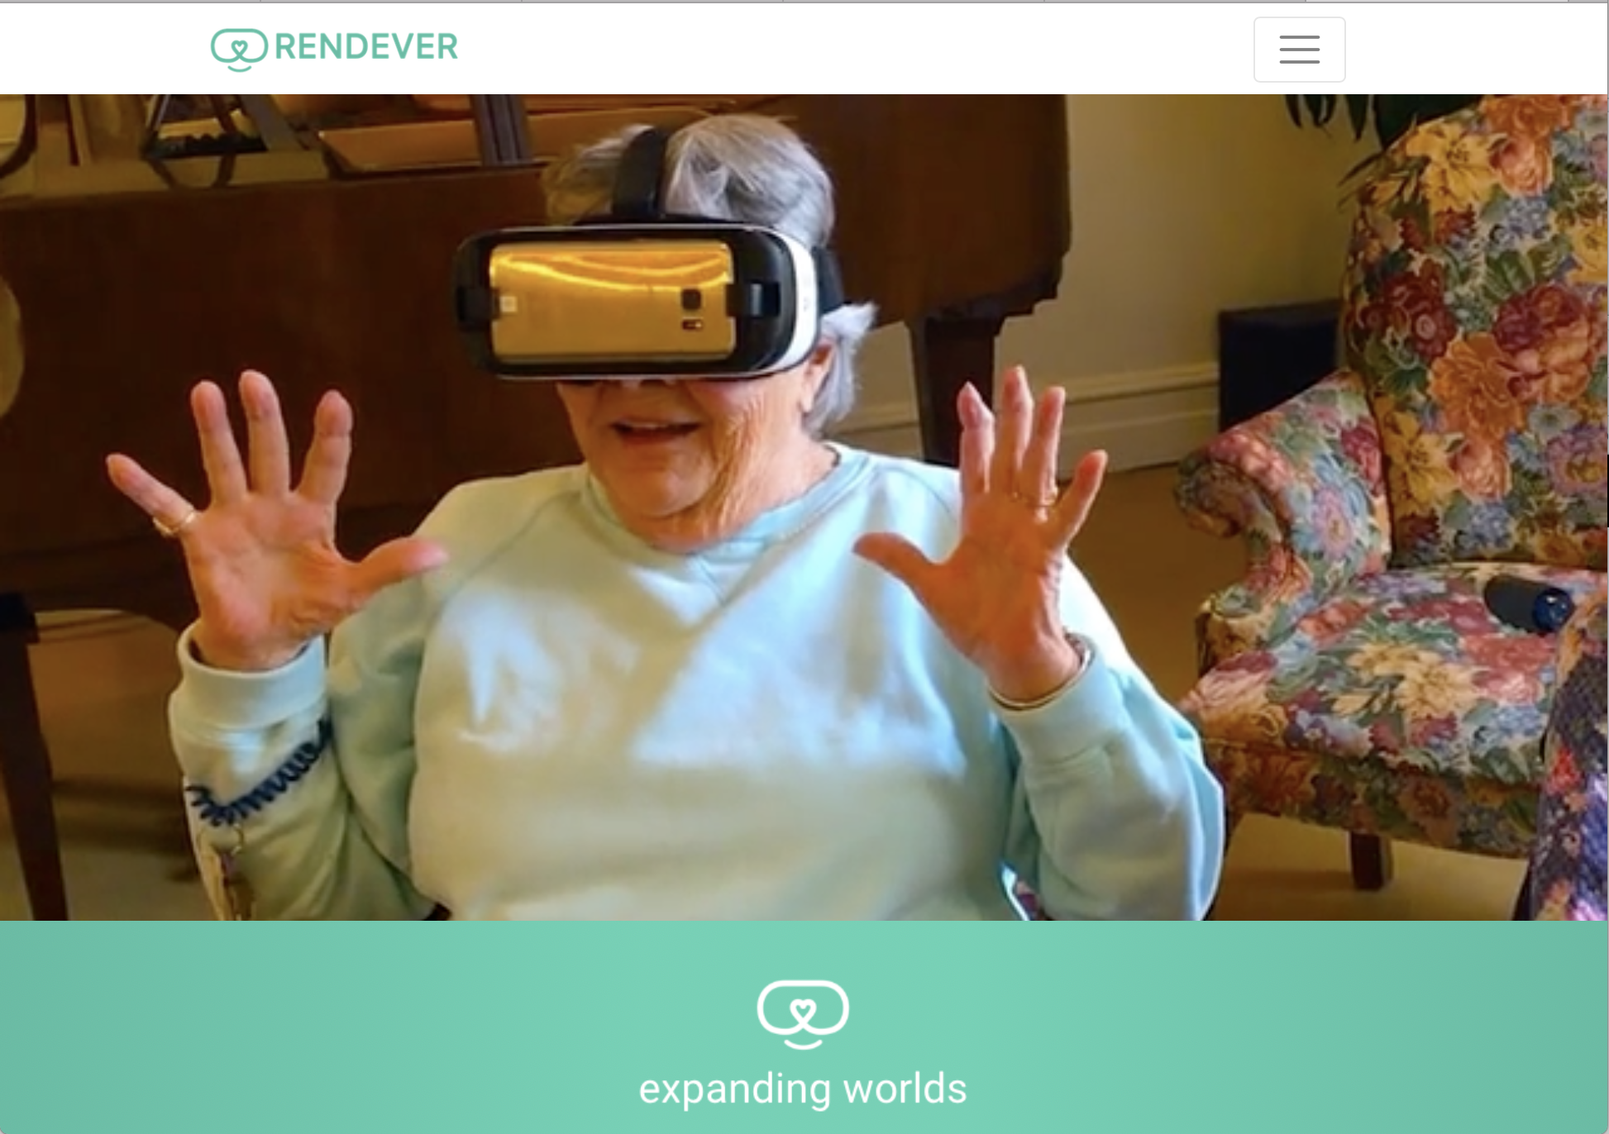
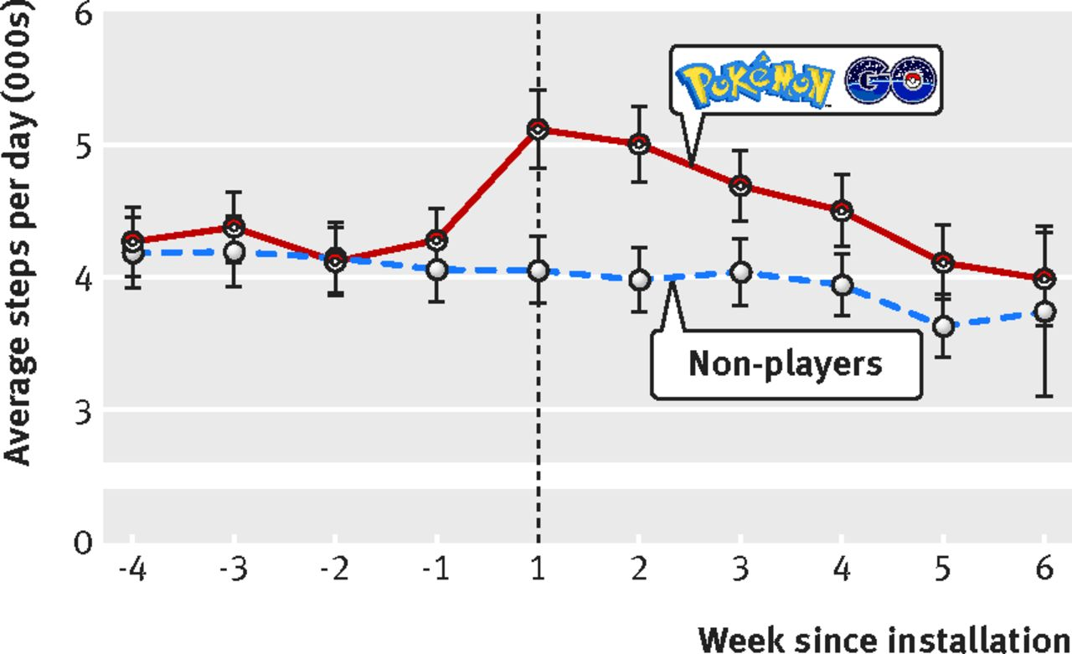
Other Technologies
Virtual reality
  VR consultation service to help manage pain, anxiety, escape “the "bio-psycho-social jail cell” of the hospital
  Rendever VR for nursing home residents
Neurotech
  restoring touch in amputees
  restoring sight
  restoring ambulation
  augmenting function?
Augmented reality
  Pokemon Go increased steps
BMJ 2016;355:i6270
Notes:
https://www.bloomberg.com/news/articles/2016-08-29/hospitals-try-giving-patients-a-dose-of-vr
http://www.wired.co.uk/article/darpa-arati-prabhakar-humans-machines?utm_source=Rock+Weekly&utm_campaign=f889bdb158-Rock_Weekly_2-6&utm_medium=email&utm_term=0_e44ef774d4-f889bdb158-90860265&mc_cid=f889bdb158&mc_eid=70ea9a8116
http://news.mit.edu/2017/virtual-reality-elderly-sloan-health-care-innovations-prize-0224

Slide 42
Web X.0 to IoT Summary
Web 2.0 participatory architectures emerging in mainstream consumer health
Sensors and Internet of Things still very early without strong case for value
Focus on framing the clinical problem, using technology to add clinical value, address the informatics issues (naming, exchanging, reasoning), anticipating and laying foundation for sociotechnical and organizational change
  if going commercial, define or create the business case early
Notes:
Companies now have all the data. Used to be academics

Slide 43
Non-Traditional Health Players
CVS Minute Clinics, CVS bought Aetna for $69 billion last month
ZocDoc Open Table for booking doctors
Castlight price transparency for expenditures
Oscar “hipster” health insurance
AT&T ForHealth platform
IBM Watson, @Walmart, Cisco, Intel, CableLabs…
Amazon, Berkshire Hathaway, and JP Morgan Chase joint healthcare initiative
  “the ballooning costs of healthcare act as a hungry tapeworm on the American economy” – W. Buffett
Notes:
476 twitter users, 171 seriously depressed. Going back a year, trained on 2.2 million tweets. 70% sens, 90% spec. Community level depression – UCSD.
http://www.bbc.co.uk/news/technology-26065991?goback=%2Egde_2181454_member_5837316516126670848 Watson made $100m 2010-2013

Slide 44
Non-Traditional Research Players
Sony Genomics
Google Verily
  collaboration with Biogen on multiple sclerosis
IBM
  collaboration with Pfizer on immuno-oncology
Notes:
476 twitter users, 171 seriously depressed. Going back a year, trained on 2.2 million tweets. 70% sens, 90% spec. Community level depression – UCSD.
http://www.bbc.co.uk/news/technology-26065991?goback=%2Egde_2181454_member_5837316516126670848 Watson made $100m 2010-2013

Slide 45
Summary
Interoperation = meaningful exchange of data among computers
  syntactic: how things are said, the grammar
  semantic: what is said, the meaning
Computing across data
  centralized data is ideal but often unrealistic
  can only do basic queries over federated databases
Web 2.0 participatory architectures starting to go mainstream in research
Sensors, Internet of Things, other technologies are exploding into health
Many new players in health and research – your competitors are not (only) other academics
Notes:
Companies now have all the data. Used to be academics

Slide 47
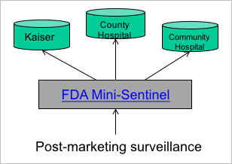
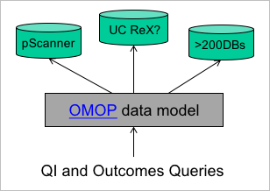
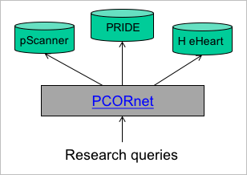
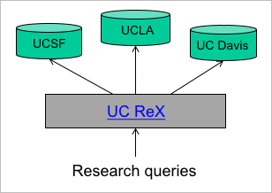
Examples of Federated Query
UCLA
UCSF
UCI
UC Healthcare Data
Query
Notes:
Observational Medical Outcomes Partnership: The Observational Medical Outcomes Project (OMOP) is a public-private partnership between the FDA, the Pharmaceutical Research and Manufacturers of America, and the Foundation for the National Institutes of Health. This interdisciplinary research group is tackling the surprisingly difficult task of identifying the most reliable methods for analyzing huge volumes of data drawn from heterogeneous sources. The problem is critical to enabling comparative effectiveness research, which requires data from all sources to be in the same format.
Observational Health Data and Informatics (OHDSI) offers international access to 600 million patient records with a common data model, with open software for search and studies. http://www.ohdsi.org

