Slide 1
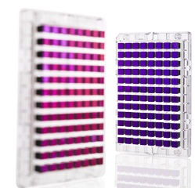

Genome-wide association studies (GWAS) – continued!

Slide 2
Outline for GWAS
Analysis
  QC [last lecture]
  Prostate cancer example [last lecture]
  Imputation
  Replication & Meta-analysis
More analysis
  Locus characterization
  eQTLs
  Limitations, heritability, & “missing heritability”
  Gene/pathway tests
  Polygenic models

Slide 3
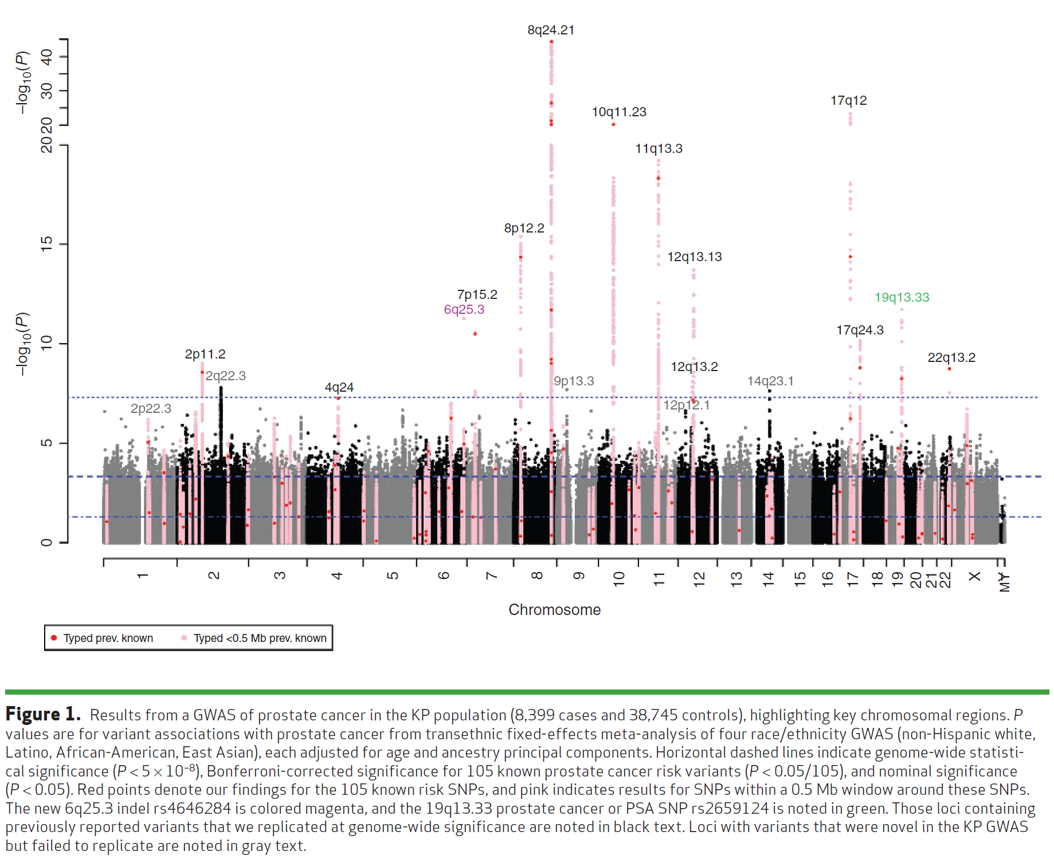
Recap: Manhattan plot example:
Kaiser GWAS of Prostate Cancer
Hoffmann et. Al, Cancer Discovery 2015

Slide 4
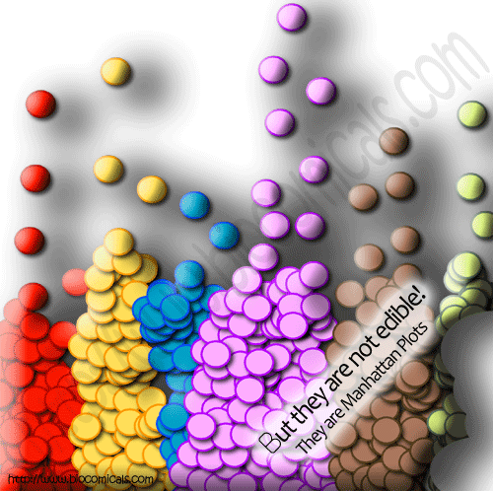

Slide 5
Replication, Replication, Replication
To replicate:
  Association test for replication sample significant at 0.05/{Number of SNPs replicating} alpha level
  Same genetic model (e.g. additive, dominant)
  Same direction
  Sufficient sample size for replication!
    [e.g., do a power calculation]
Non-replications not necessarily a false positive
  LD structures, different populations (e.g., flip-flop)
  covariates, phenotype definition, underpowered
  Winner’s curse

Slide 6
Meta-analysis
Combine multiple studies to increase power
Either combine p-values (Fisher’s test),
or coefficient estimates + standard error (much better)

Slide 7
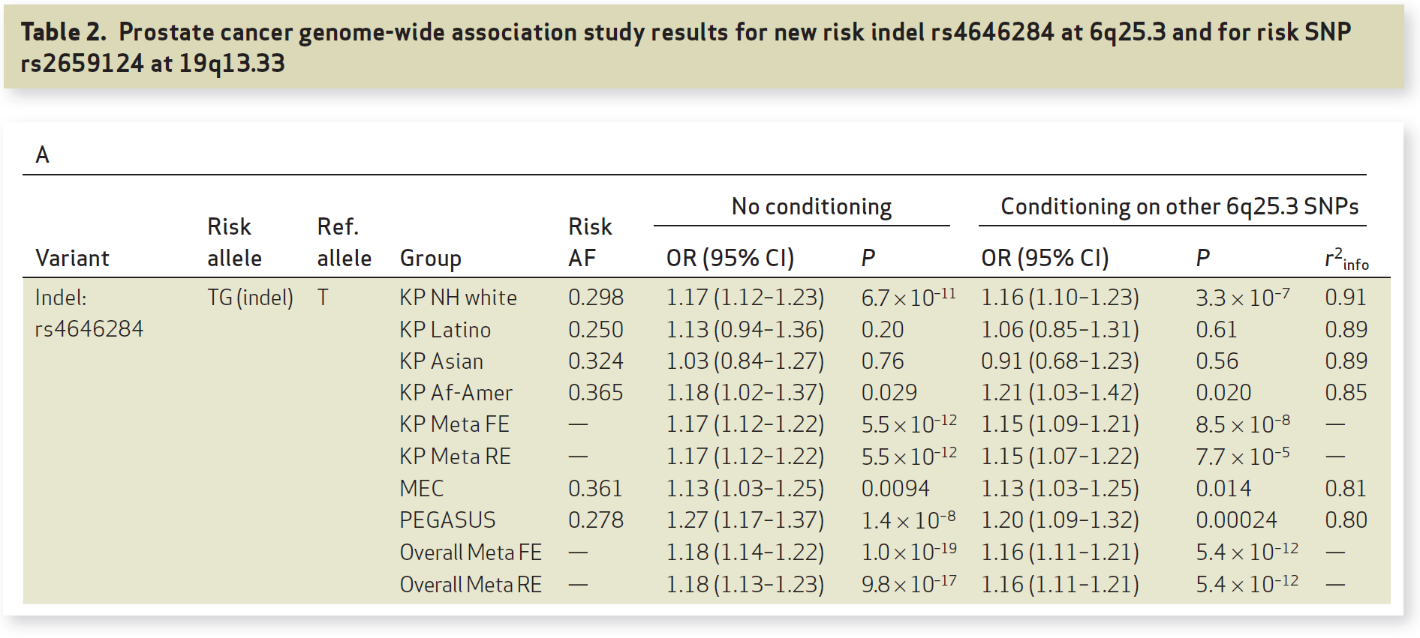
Replication & Meta-analysis
Hoffmann et. Al, Cancer Discovery 2015`

Slide 8
Beyond Genotyped SNPs:
Imputation of SNP Genotypes
Combine data from different platforms (e.g., Affy & Illumina) (for replication / meta-analysis).
Estimate unmeasured or missing genotypes.
Based on measured SNPs and external info (e.g., haplotype structure of HapMap).
Increase GWAS power (impute and analyze all), e.g. Sick sinus syndrome, most significant was 1000 Genomes imputed SNP (Holm et al., Nature Genetics, 2011)
HapMap as reference, now 1000 Genomes Project; UK10K, Haplotype reference consortium?
Hybrid sequencing/genotyping approaches

Slide 9
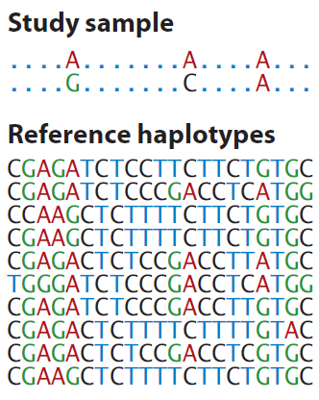
Generalization of Tag SNPs: Imputed SNPs using a Reference Panel
Generalization of pairwise r² of tagSNPs to multi-marker correlation
Class Exercise!
How would you fill in the remaining genotypes of this study sample individual, given the reference haplotypes?
http://www.shapeit.fr/, http://mathgen.stats.ox.ac.uk/impute/impute_v2.html
http://faculty.washington.edu/browning/beagle/beagle.html
http://www.sph.umich.edu/csg/abecasis/MACH/download/
Li et al., Ann Rev Human Genet, 2009

Slide 10

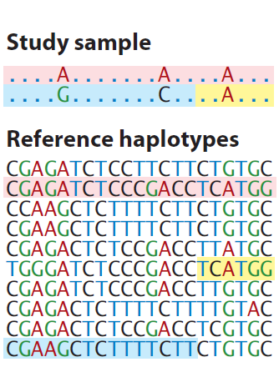
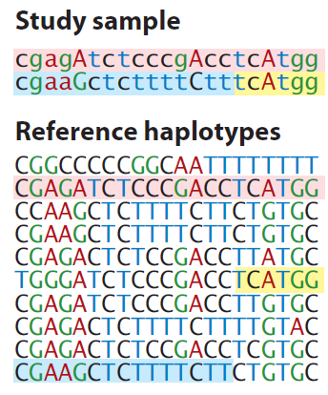
Generalization of Tag SNPs: Imputed SNPs using a Reference Panel
Generalization of pairwise r² of tagSNPs to multi-marker correlation
http://www.shapeit.fr/, http://mathgen.stats.ox.ac.uk/impute/impute_v2.html
http://faculty.washington.edu/browning/beagle/beagle.html
http://www.sph.umich.edu/csg/abecasis/MACH/download/
Li et al., Ann Rev Human Genet, 2009

Slide 11
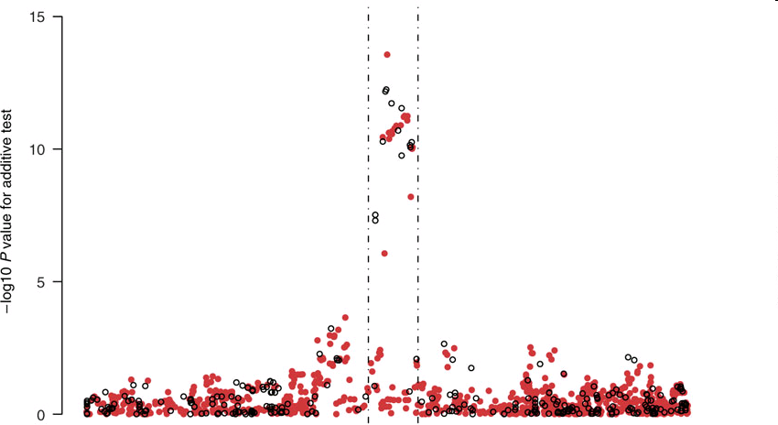
Imputation Application
TCF7L2 gene region & T2D from the WTCCC data
Observed genotypes black
Imputed genotypes red.
Imputed SNP more significant than typed SNP!
Chromosomal Position
Marchini Nature Genetics2007
http://www.stats.ox.ac.uk/~marchini/#software
Notes:
11

Slide 12
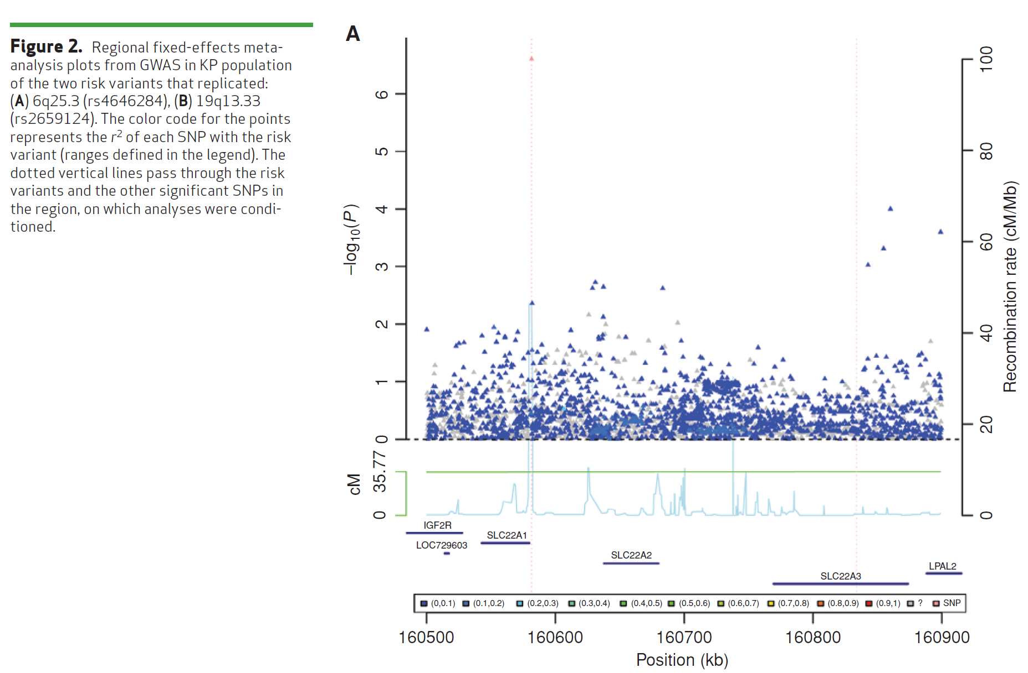
Imputation Application #2 – Do not always see a jet of points, even for common SNP…
(Same SNP as 4 slides ago)
Hoffmann et. Al, Cancer Discovery 2015`

Slide 13
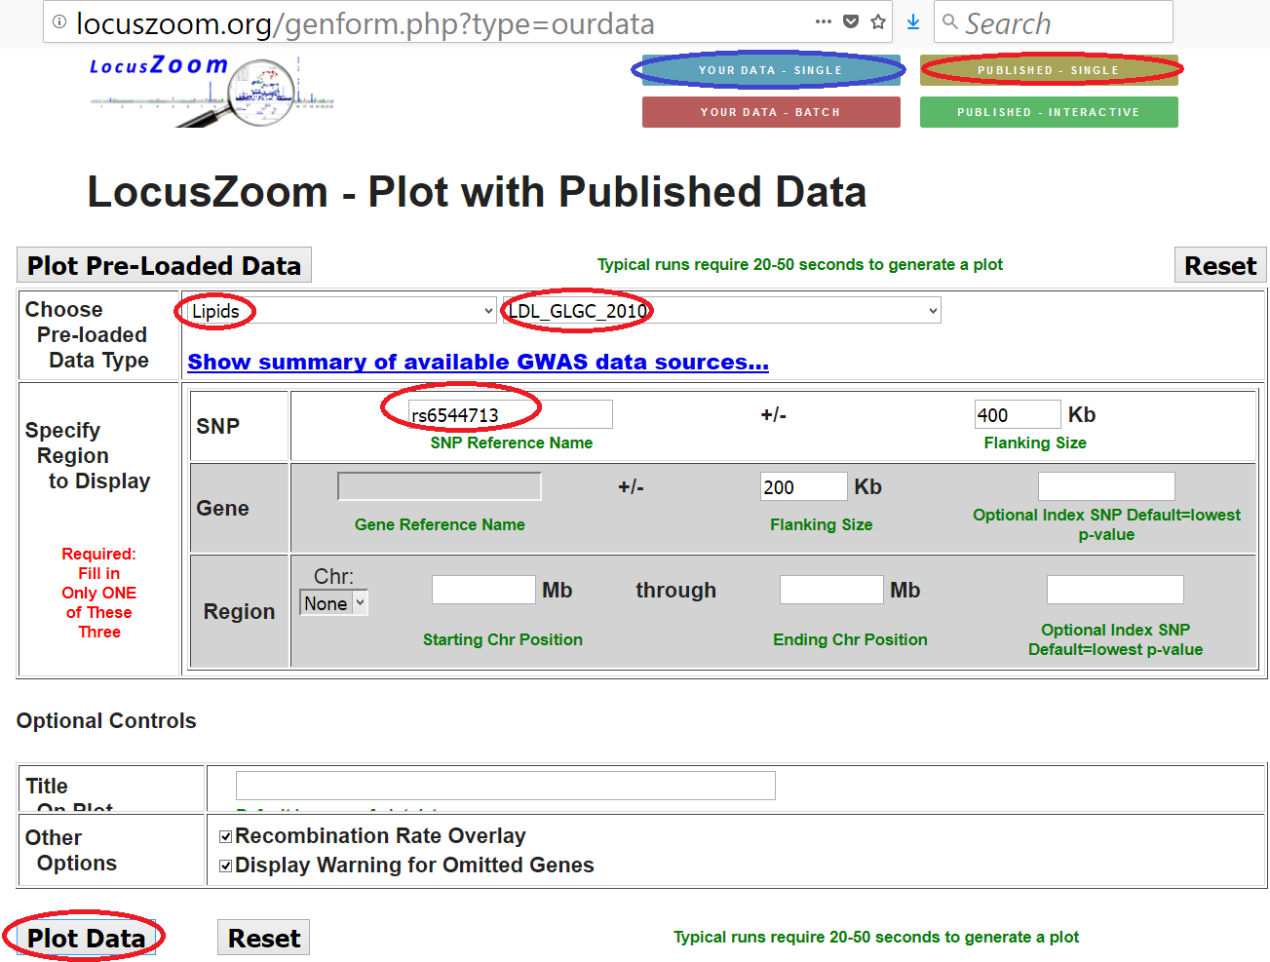
LocusZoom plot: LDL, rs6544713

Slide 14
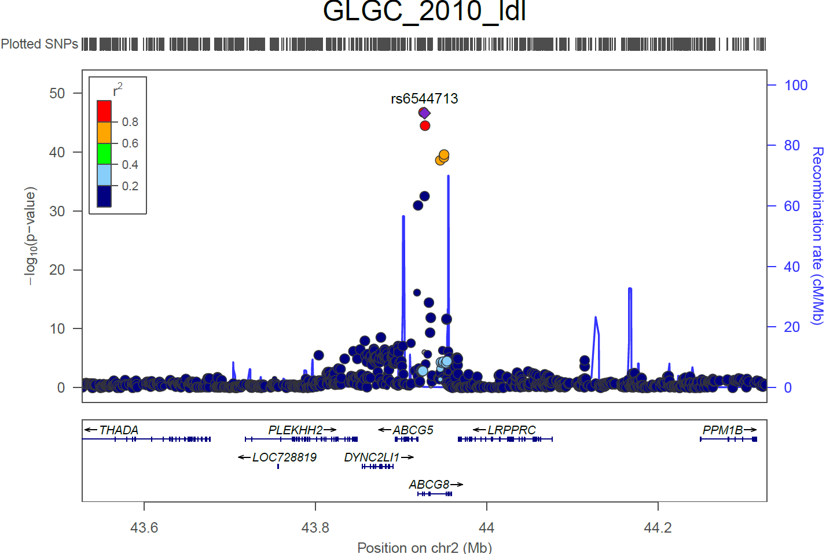
LocusZoom plot: LDL, rs6544713

Slide 15
Imputation QC – r_{info}² value
Similar to pairwise tagging r² value, but multi-marker r² value
  More than pairwise r², why it can beat pairwise tagging r² value
Rules of thumb
  r²>0.8: very good
  0.5<r²<0.8: not as good, maybe include
  0.3<r²<0.5: not great, maybe include
  r²<0.3: probably exclude from analysis

Slide 16
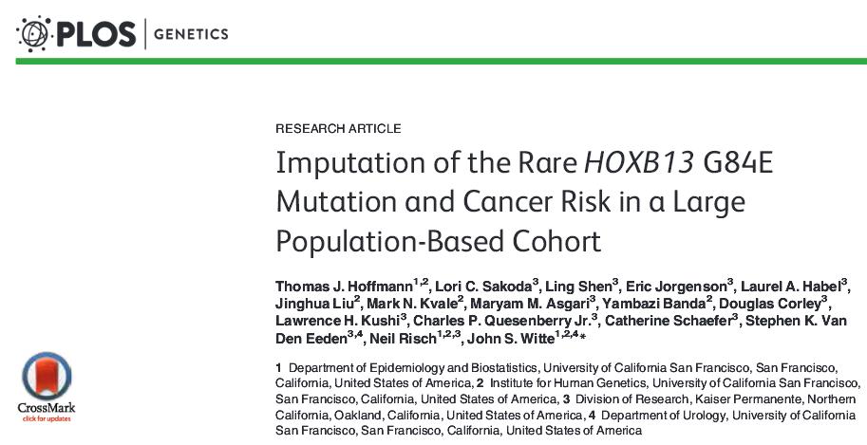
Imputation example: How rare can you go?
G84E example talked about in Austin pg. 62
MAF 0.0034 in European ancestry. r²=0.57.
In general, a moving target, still unknown how rare is possible

Slide 17
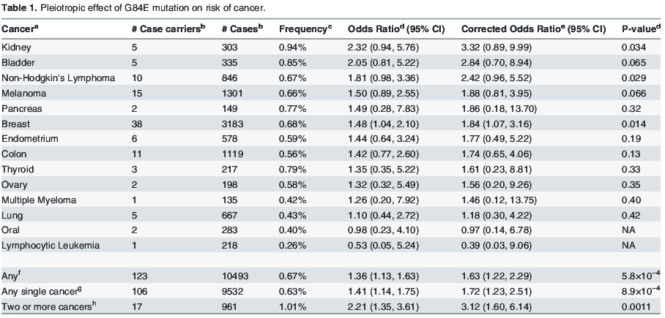
HOXB13 G84E (continued)

Slide 18
Outline for GWAS
Analysis
  QC [last lecture]
  Prostate cancer example [last lecture]
  Imputation
  Replication & Meta-analysis
More analysis
  Locus characterization
  eQTLs
  Limitations, heritability, & “missing heritability”
  Gene/pathway tests
  Polygenic models

Slide 19

What after we’ve discovered (and replicated) a novel variant?
Recall that we may not have the true causal locus
Fine mapping vs. imputed genotypes
Discovery not enough these days, want a tie-in to biology
A lot of work has been done to characterize SNPs and prioritize what should be followed up on
Functional studies

Slide 20
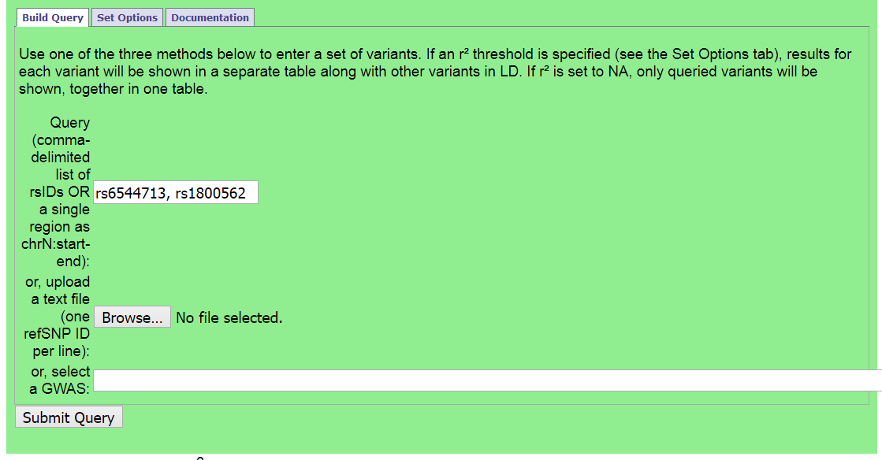
Refining GWAS SNPs: Haploreg
http://archive.broadinstitute.org/mammals/haploreg/haploreg.php

Slide 21
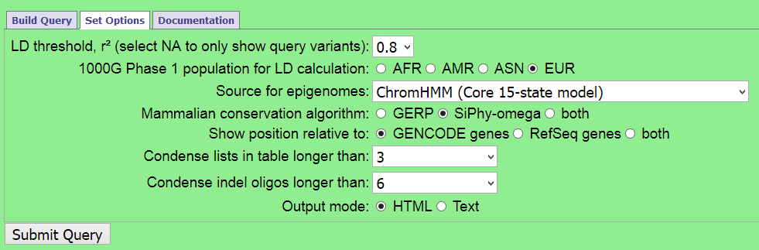
Haploreg further options
(r², 1000 Genomes population)

Slide 22
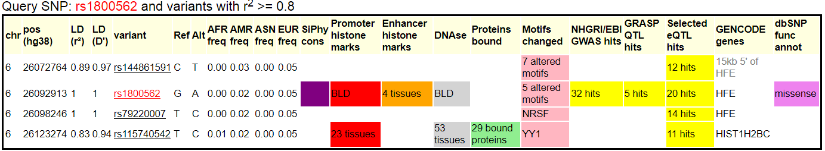
Which one is causal / biological mechanism?
Don’t know for certain, can do some exploration:
Likely will not know for certain, may prioritize for functional work

Slide 23
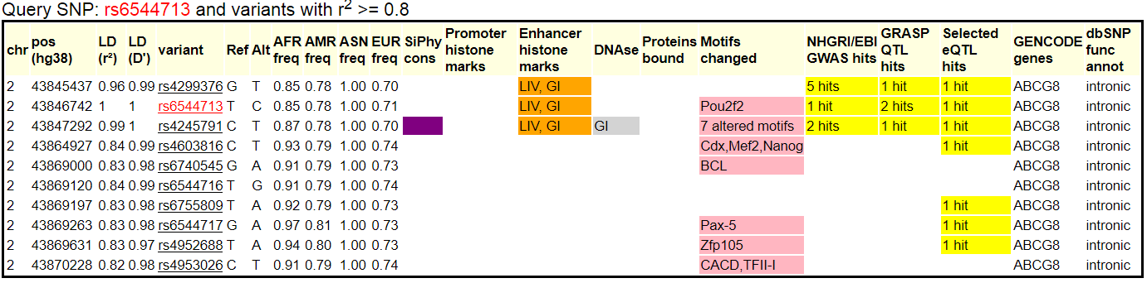
Which one is causal / biological mechanism?
?

Slide 24
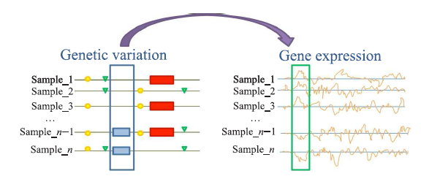
What is an eQTL?
Tian Lu et al., Tsinghua Science and Technology, 2014, 19(6): 624-634.

Slide 25
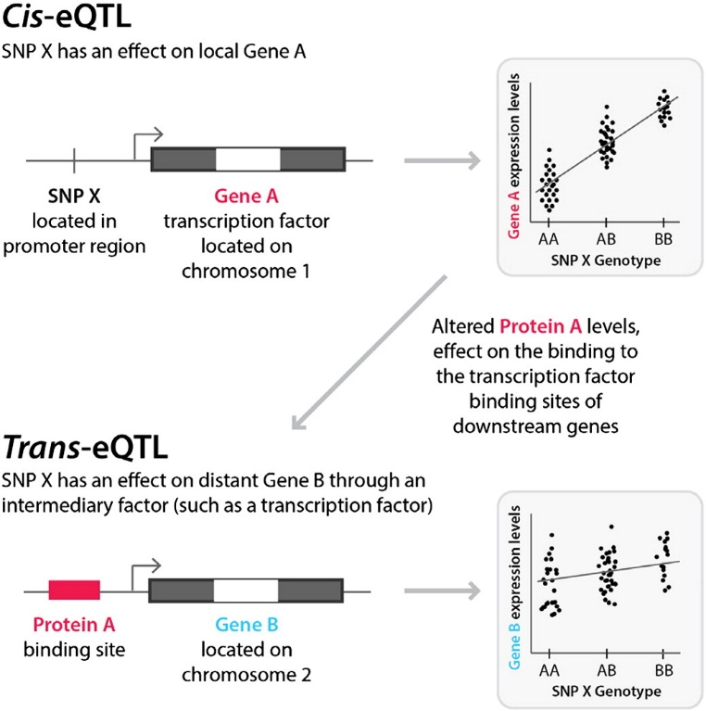
What is an eQTL?
Harm-Jan Westra & Lude Franke, Bichimica et Biophysica Acta – Molecular Basis of Disease 1842(10):1892-1902

Slide 26
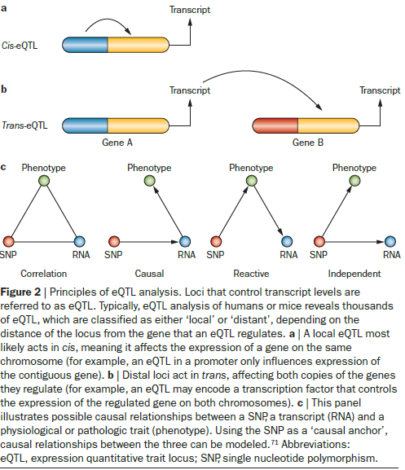
What is an eQTL?
E.g. of cis-eQTL – transcription factor
W. Robb MacLellan et al, Nature Reviews Cardiology, 9:172-184

Slide 27
What is an eQTL?
CLASS EXERCISE
Design an eQTL study!
(Assume that the expression of each gene has been quantified. Or sort of. This is expensive.)
Harm-Jan Westra & Lude Franke, Bichimica et Biophysica Acta – Molecular Basis of Disease 1842(10):1892-1902

Slide 28
What is an eQTL?
CLASS EXERCISE
Design an eQTL study!
(Assume that the expression of each gene has been quantified. Or sort of. This is expensive.)
What kind of genotyping method?
Advantages / Disadvantages to testing only cis, only trans, both? How many tests?
How far up/downstream of each gene?
Harm-Jan Westra & Lude Franke, Bichimica et Biophysica Acta – Molecular Basis of Disease 1842(10):1892-1902

Slide 29
What is an eQTL?
The expression of a gene can be viewed as a quantitative trait.
Test the SNPs around the gene for association with the expression of the gene.
Does the SNP affect expression?
The same problem still applies, don’t know causal locus!
Might differentiate between which gene expression is being altered, if between or amongst more than one.

Slide 30
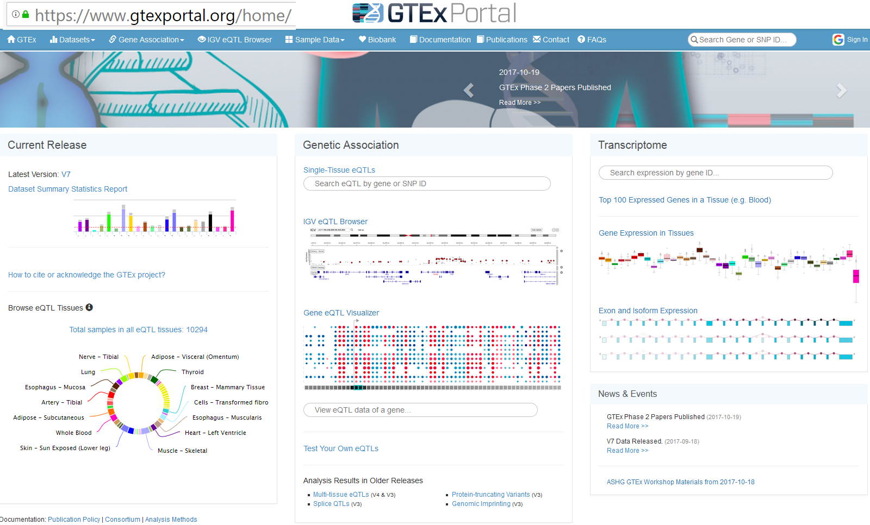
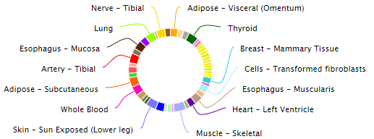
cis eQTLs: GTeX
Database of SNP associations with gene expression in humans

Slide 31
Limitations of GWAS
Not very predictive
Explain little heritability, generally, but improving
Focus on common variation, but getting rarer
Many associated variants are not causal

Slide 32
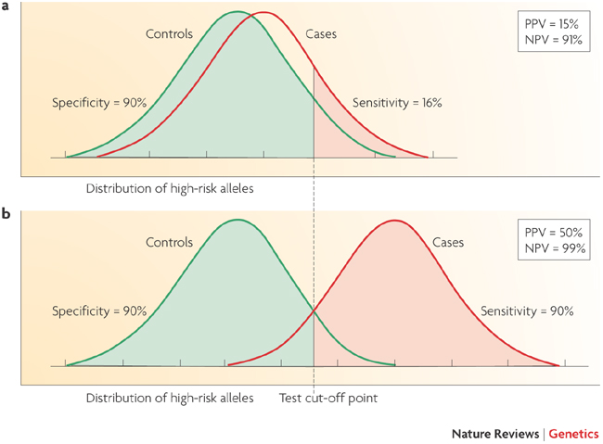
Limitations of GWAS
Example:
AUC for Breast Cancer Risk
58%: Gail model (# first degree relatives w bc, age menarche, age first live birth, number of previous biopsies) + age, study, entry year
58.9%: SNPs
61.8%: Combined
Wacholder et al., NEJM 2010
Not very predictive
Witte, Nat Rev Genet 2009
Notes:
32

Slide 33
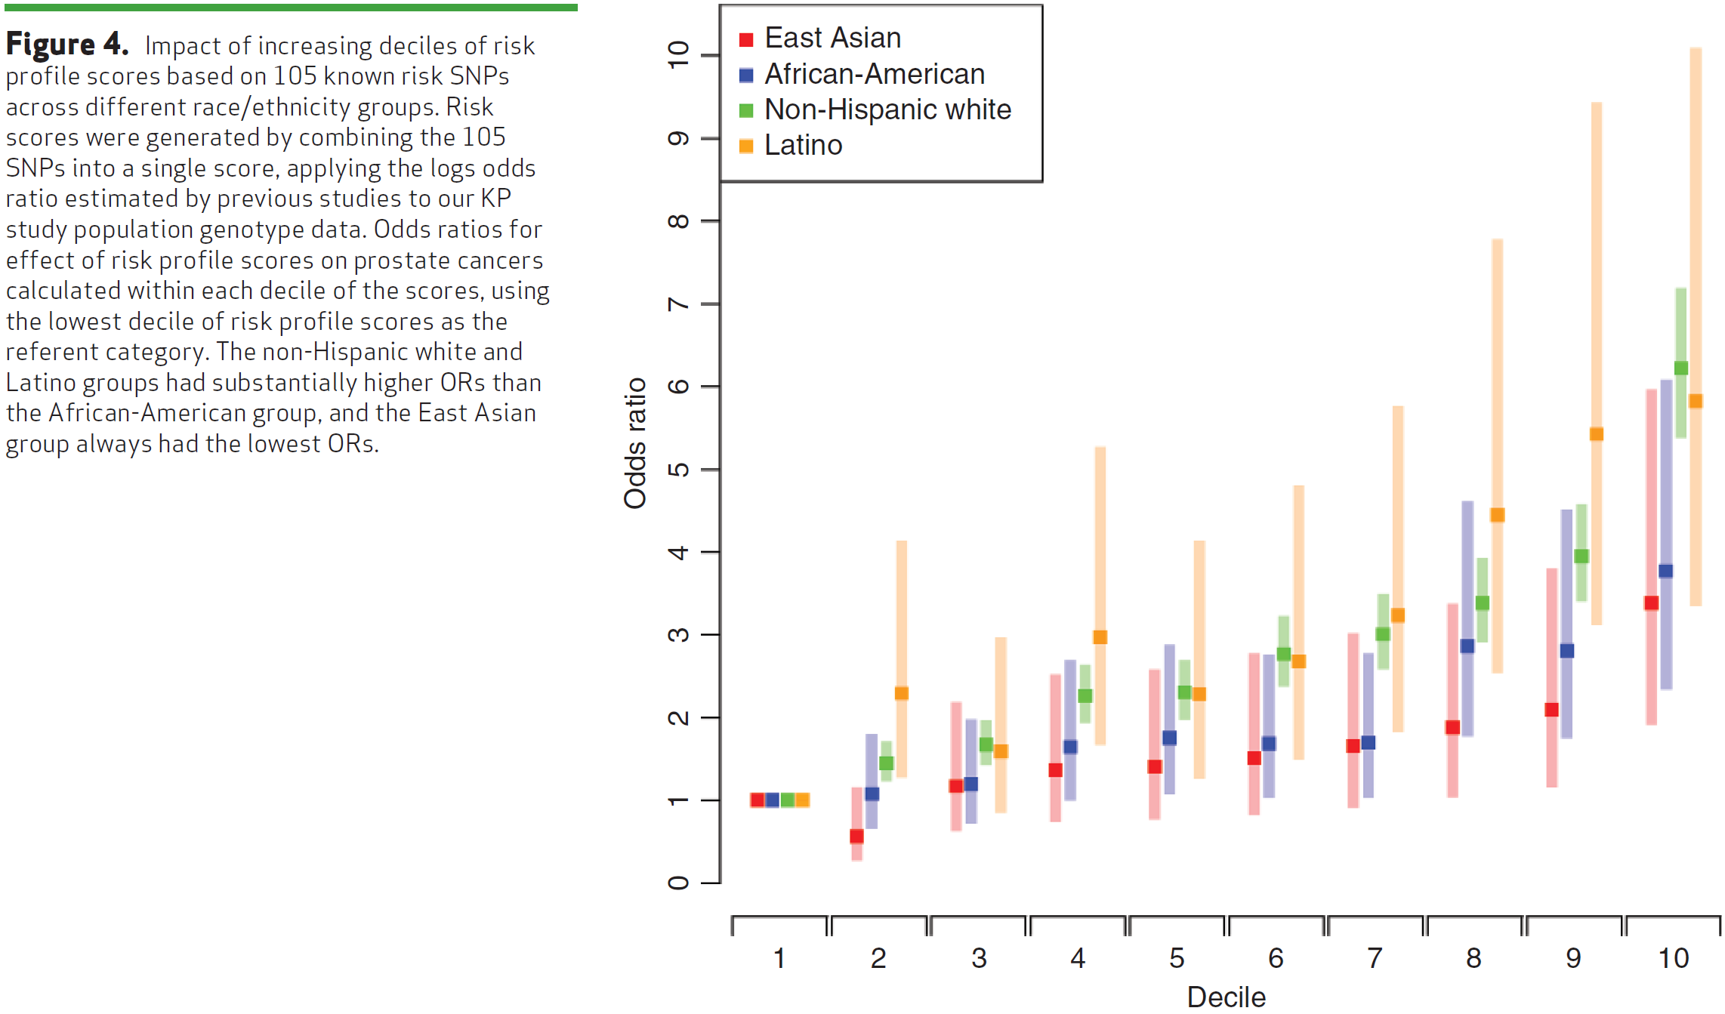
Risk variant tails
-> More predictive?
Hoffmann et. Al, Cancer Discovery 2015

Slide 35
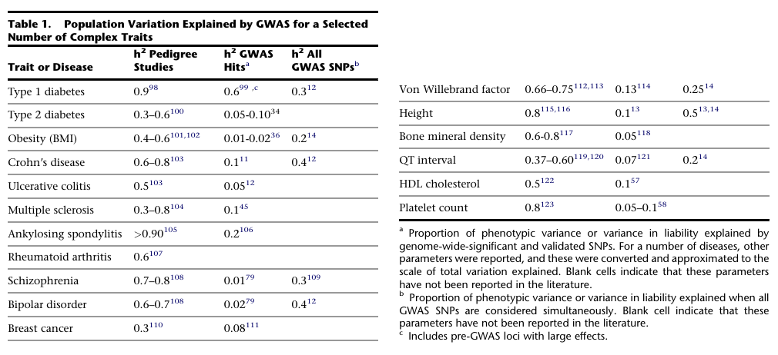
What does it mean to explain little of the heritability, and where is it?
Visccher, AJHG 2011

Slide 36
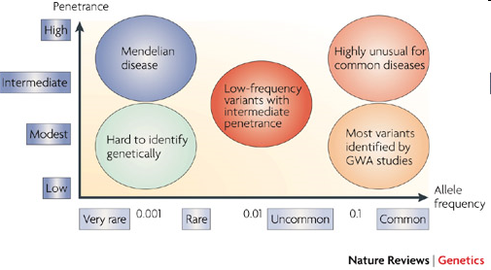
Where’s the heritability?
Common disease rare variant (CDRV) hypothesis: diseases due to
multiple rare variants with intermediate penetrances (allelic heterogeneity)
Many more
of these?
See: NEJM, April 30, 2009
McCarthy et al., 2008

Slide 37
Will GWAS results explain
more heritability?
Possibly, if…
Causal SNPs not yet detected due to power issues – weak effects
  Previous GWAS designed/powered for MAF>0.05/0.10; lower MAFs for newer arrays and larger reference panels
More complicated modeling necessary, e.g. gene-gene interaction (epistasis), gene-environment interaction, etc.
Notes:
37

Slide 38
How much is left to discover?
“Array” heritability
Compute heritability using all SNPs
  Be careful with QC, esp. case-control
If you adjust for the known hits, how much remains yet to be found?
Restricted to narrow sense heritability
E.g.,
Lecture 2:
“Broad sense”: H²=σ²_{G}/σ²_{P}=(σ²_{A} + σ²_{D})/σ²_{P}
“Narrow sense”: h² = σ²_{A} /σ²_{P}
http://www.complextraitgenomics.com/software/gcta/

Slide 39
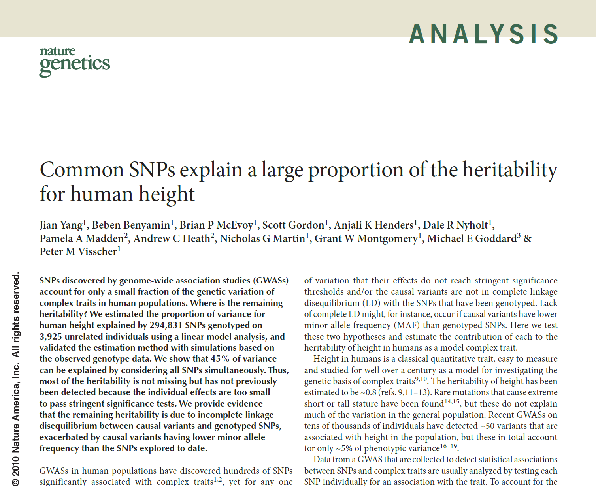

Slide 40
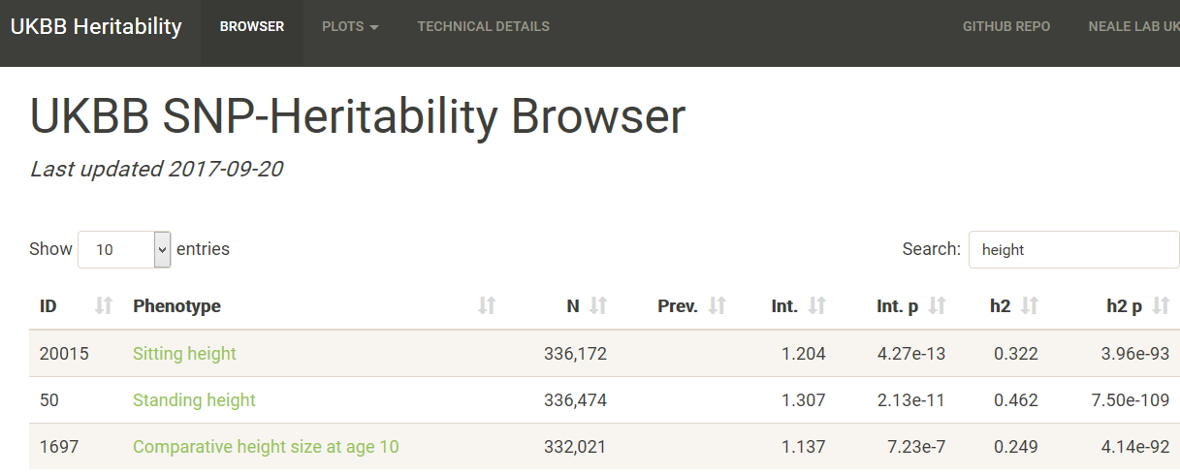
UK Biobank h² for height
https://nealelab.github.io/UKBB_ldsc/

Slide 41
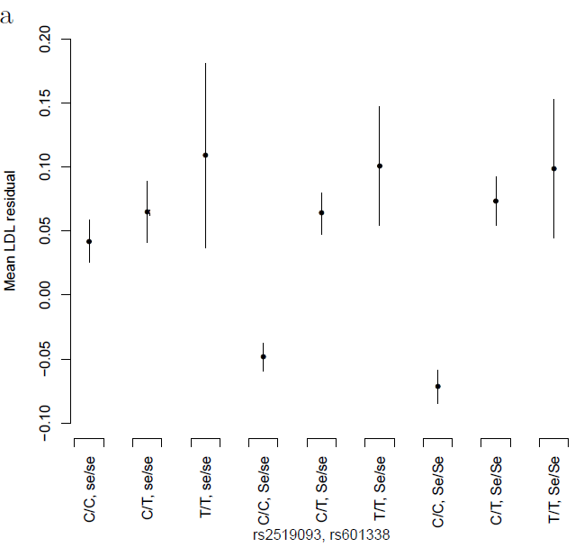
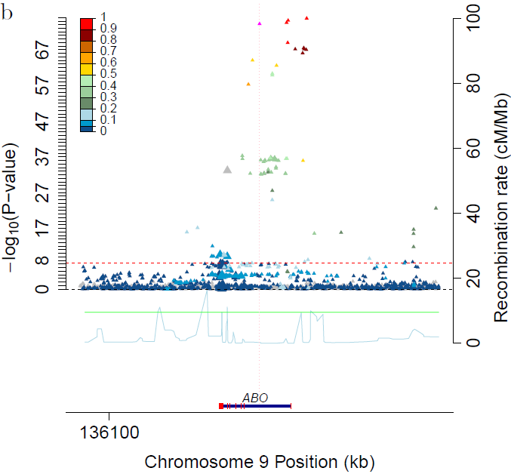
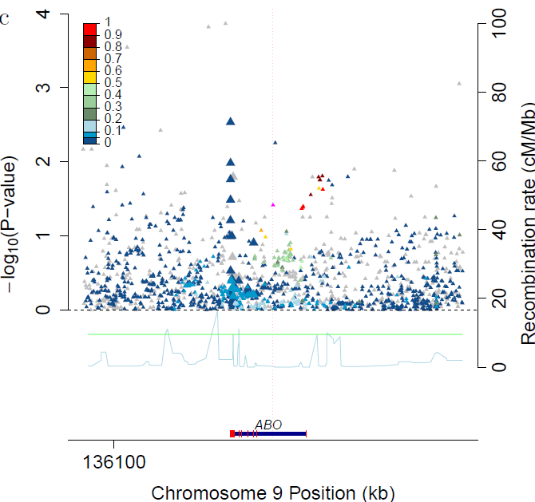
Other sources - Epistasis
Serum lipids: ABO x FUT2 interaction
Rs2519093 (ABO) x rs492602 (FUT2): Interaction P_{LDL}=8.1x10⁻¹⁰
Rs492602 has r²=0.992 with rs601338, a nonsense dominant variant determining FUT2 non-secretor status
Residual LDL by genotype ABO locus for secretors (Se/Se or Se/se) ABO locus plot for non-secretors
Notes:
. The SNP in ABO is *not* blood type.

Slide 42
Other things than SNPs
Copy number variants (CNVs)
Epigenetics, e.g., methylation, histone modification
Gene expression (RNA levels)
Proteomics (measures of proteins in cells)
...

Slide 43
Ways to enrich weak signals?:
Gene/pathway-based tests
Various ways of collapsing the genotype information in multiple genes
  Less multiple comparison adjustment
logit (Prob(y=1| x, c)) = α + βx + γc
e.g.=α+β₁x₁+…+β₁₂x₁₂+{PC’s, other covariates}
  y: disease status)
  x is a vector of genotypes (e.g., a gene, or a pathway)
  c is a vector of covariates
H₀: β=0
Rare variant “burden” tests are along these lines
  Make a lot of assumptions

Slide 44
Pathways - how to define?
Many websites / companies provide ‘dynamic’ graphic models of molecular and biochemical pathways.
Examples: GO (Gene Ontology), KEGG, BioCarta, Reactome
May be interested in potential joint and/or interaction effects of multiple genes in one pathway.

Slide 45
Other Extreme: Polygenic Models
Many weak associations combine to risk?
Score model (use all GWAS SNPs):
where
  ln(ORi ) = ‘score’ for SNPi from ‘discovery’ sample
  SNPij = # of alleles (0,1,2) for SNPi, person j in ‘validation’ sample.
  Large number of SNPs (m)
xj associated with disease?
ASIDE: Genetic risk score this idea, but only on known hits
ISC / Purcell et al. Nature 2009

Slide 46
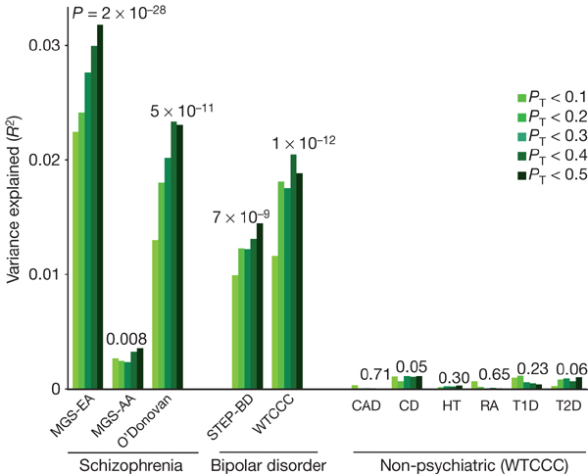
Application of Model
Purcell / ISC et al. Nature 2009

