Slide 1
Lecture 5:
Health CARE Disparities
Christine Dehlendorf, MD MAS

Slide 2
Objectives
Differentiate disparities in health care from inequities in health
Recognize common explanations of disparities
Discuss approaches to decreasing health care disparities

Slide 3
Toxic exposures, developmental, stress, etc.
Epigenetic modification/
neurocognitive, etc.
Economic & Social
Opportunities and Resources
Living & Working Conditions
in Homes and Communities
Behaviors
Medical Care
Interaction with genetic/other biological factors
HEALTH
Adapted from Braveman et al., for Robert Wood Johnson Foundation Commission to Build a Healthier America | www.commissiononhealth.org

Slide 4
What are Health Disparities?
“A particular type of health difference that is closely linked with economic, social, or environmental disadvantage. Health disparities adversely affect groups of people who have systematically experienced greater social or economic obstacles to health based on their racial or ethnic group, religion, socioeconomic status, gender, age, or mental health; cognitive, sensory, or physical disability; sexual orientation or gender identity; geographic location; or other characteristics historically linked to discrimination or exclusion.”
Healthy People 2020 (HealthyPeople.gov)

Slide 5
Health CARE Disparities
Differences in quality of health care that are not due to access-related factors or clinical needs, preferences and appropriateness of intervention.
Financial access, a known problem in US health care, is often not included in disparities studies
IOM, Unequal Treatment, 2003

Slide 6
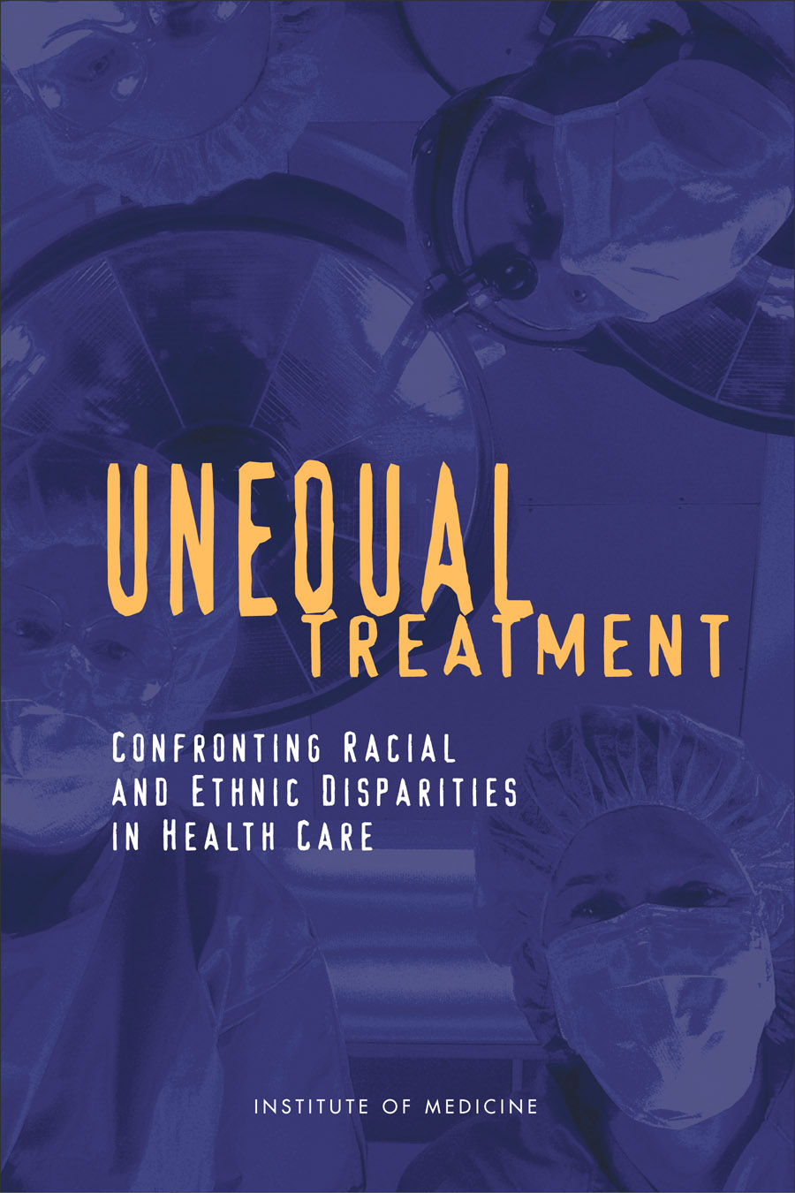

Slide 7
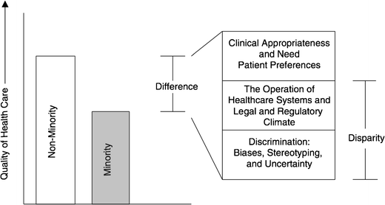
Differences, Disparities, and Discrimination: Populations with Equal Access to Health Care

Slide 8
Evidence Shows Disparities Exist
  The evidence is “remarkably consistent across a range of illnesses and healthcare services”
    Best studied in cardiology
    Also well documented in oncology, HIV care, etc.
  Lead to worse outcomes among disadvantage populations
  Source: Unequal Treatment: Confronting Racial and Ethnic Disparities in Healthcare, March 2003.
Notes:
In 2002, the Institute of Medicine conducted a review of the published literature that assessed the quality of healthcare for various racial and ethnic minority groups.
Racial and ethnic minorities tend to receive lower-quality health care than whites do, even when insurance status, income, age, and severity of conditions are comparable.
The vast majority of studies found that minorities received fewer clinically necessary procedures.
In contract to whites, minorities are more likely to receive certain less-desirable procedures, such as lower limb amputations for diabetes and other conditions.

Slide 9
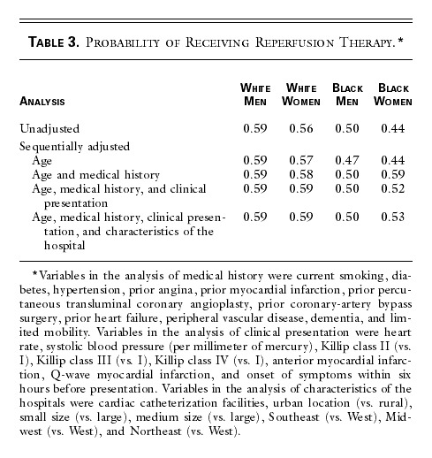
Disparities in Cardiac Treatment
Canto, NEJM, 2000
Notes:
https://www.ncbi.nlm.nih.gov/pubmed/15778634

Slide 10
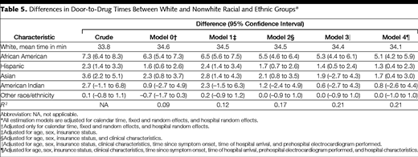
Door to Drug Time in AMI
Bradley, JAMA, 2004

Slide 11
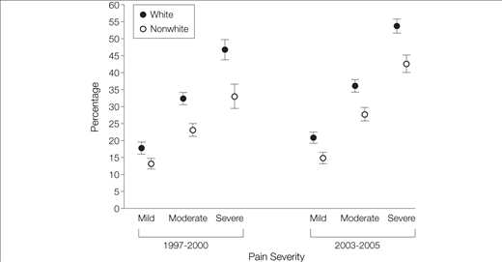
Percentage of Emergency Department Visits at Which an Opioid Was Prescribed, by Pain Severity and Period, NHAMCS 1997-2000 and 2003-2005
Pletcher, JAMA, 2008

Slide 12
What about Latinos? Or Asians? Or Native Americans? Or Others?
Far fewer studies
More complex: differences in health care not always associated with expected differences in health outcomes (Latino paradox)
Latinos in UCLA ER were less likely to be prescribed pain meds than whites with long bone fractures. (Todd, JAMA, 1993)
Language and ethnicity appear to be independent risk factors

Slide 13
What about SES?
Less research/focus in the US
Does appear to be independently predictive of treatment
  Guideline concordant treatment after AMI
  Valve replacement in aortic stenosis
  Less likely to receive cardiac procedures
Both race/ethnicity and SES matter
Hanley, JGIM, 2011
Sleder, JERHD, 2016
Notes:
Mostly in Canada

Slide 14
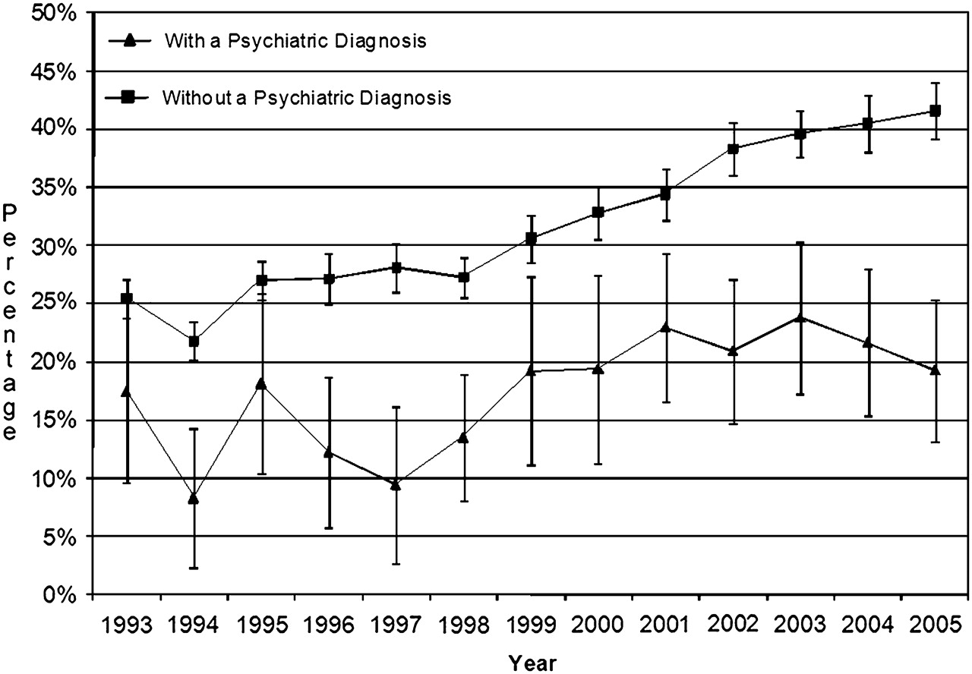
Weighted percentage of pain-related visits for psychiatric and non-psychiatric patients at which an opiate was prescribed, for visits with and without a psychiatric diagnosis
Lorna J Simon et al. Emerg Med J 2012;29:201-204
Notes:
Weighted percentage of pain-related visits for psychiatric and non-psychiatric patients at which an opiate was prescribed, for visits with and without a psychiatric diagnosis.

Slide 15

How big an effect do health care disparities have?

Slide 16
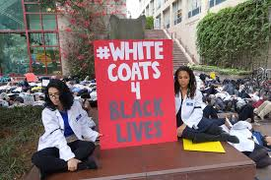
How big an effect do health care disparities have?
Focusing on relative impact misses an important ethical component
Health care should be a tool for social justice/equity, not the opposite

Slide 17
Do Differences in Insurance Explain Racial/Ethnic Differences?
Access mediated by insurance explained differences seen in national datasets
But many studies have examined procedure rate within an insurance/care system, such as Medicare, VA studies or Kaiser studies

Slide 18
Racial Differences Not Completely Explained by Insurance
Cardiac Procedure Use in Chronic Renal Disease Patients, by Race and Gender, 1986-1992
Equally likely as white men
*Difference is statistically significant after adjustment.
NOTE: Odds ratios are adjusted for age, health insurance, sociodemographic characteristics, and clinical factors.
DATA: Daumit and Powe, 2001.
SOURCE: Kaiser Family Foundation, Key Facts: Race, Ethnicity and Medical Care, June 2003.
Notes:
Though insurance coverage diminishes disparities in cardiac care, it does not eliminate them. For example, a nationwide study examined patients with chronic renal failure who, when they progress to end-stage renal disease (ESRD), acquire Medicare coverage.
Before qualifying for Medicare, male and female African American patients with chronic renal failure were 32% and 30% as likely to receive catheterization, angioplasty and bypass surgery as white men (the study reference group).
After enrolling in Medicare and entering into a comprehensive system of care, there was no difference in the cardiac procedure use between African American women and white men.
However for African American men, the disparity persisted even after enrolling in Medicare.

Slide 19
Do Patient Factors Explain Differences?
“The studies that the IOM reviewed suggest that racial differences in patients’ attitudes, such as their preferences for treatment, do not vary greatly and cannot fully explain racial and ethnic disparities in healthcare.”
          IOM, Unequal Treatment, 2003

Slide 20
What Else Explains Differences?
- System Related Issues?
  Non-financial access
  Hospital and provider characteristics
  Literacy, numeracy and language issues
Doctor/Clinician Issues?
  Bias
  Statistical discrimination
Patient Issues?

Slide 21
Other Possible Explanations…
Overuse in whites? or Underuse in blacks?
Some overuse in whites, particularly in cases when procedure indication has larger subjective component
Substantive underuse in blacks

Slide 22
What Causes Health Care Disparities?

Slide 23
48% of Physicians Treat 82% of All Minority Patients
Source HSC Community Tracking Study Physician Survey, 2004-05.

Slide 24
Primary Care Provided to Medicare Patients
% of MDs
Bach, NEJM; 2004

Slide 25
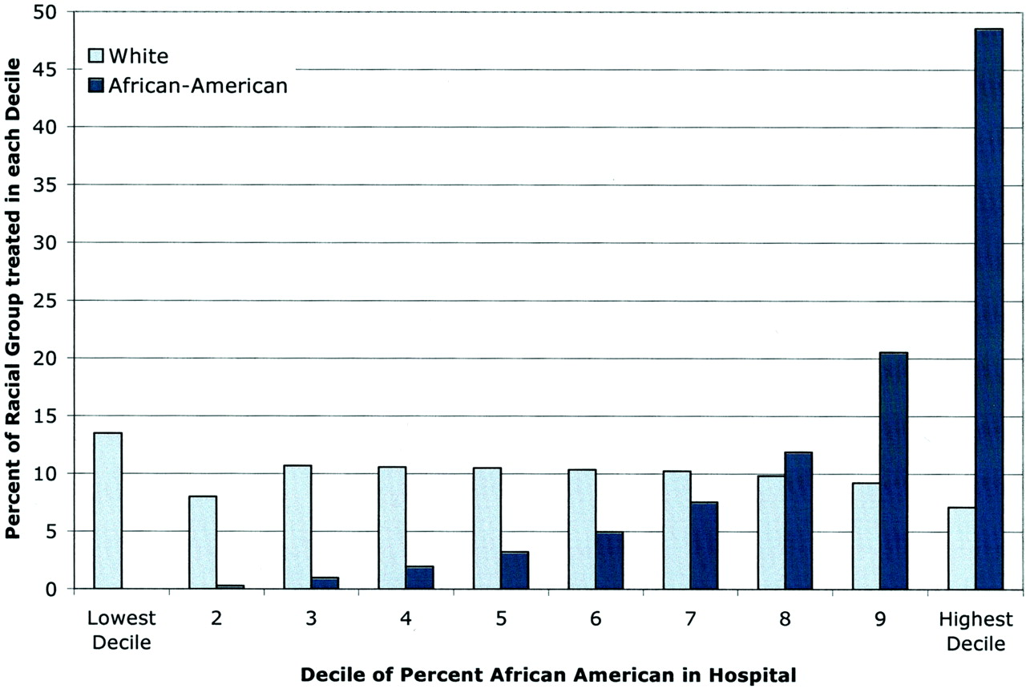

Blacks with MI Disproportionately Treated in a Subset of Hospitals Nationally
Skinner, J. et al. Circulation 2005;112:2634-2641
Copyright ©2005 American Heart Association

Slide 26
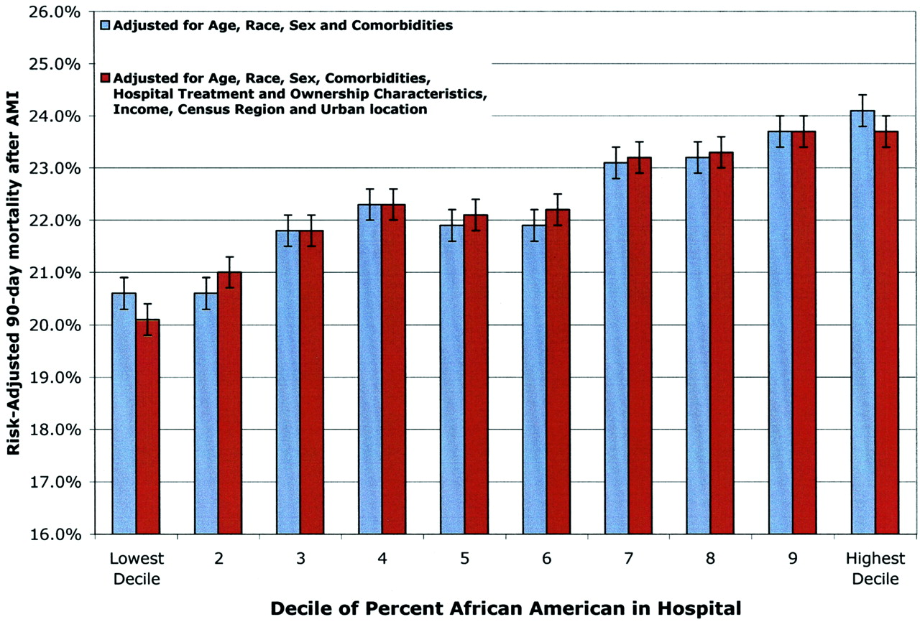
Hospitals that Disproportionately Treat Blacks with AMI Have Higher Mortality Rates
Skinner, J. et al. Circulation 2005;112:2634-2641
Copyright ©2005 American Heart Association

Slide 27
How do Fragmented Systems of Care Contribute to Disparities?
System deficits affect all segments of society, but especially non-white patients
Disadvantaged patients “fall through the cracks” in complex system of care
Small disparities in multi-step processes create moderate to large disparities overall
Disparities arise even when providers well intentioned
Ayanian, 2009

Slide 28
What About Health Literacy and Numeracy?
Low health literacy and numeracy associated with worse health outcomes
Have been found to be a mediating factor for health disparities
Is this a social determinant or a indication of health care disparities? Or both?
Berkman, Ann Int Med, 2011
Mantwill, PLOS One, 2015

Slide 29
Health Literacy and Numeracy
Clearly impacts ability to access and understand health care
But is this ONLY a social issue, or does it also reflect failures of the health care system?
Health care system should be responsive to patient’s needs for information and access

Slide 30
Language Concordance
Even among insured, language barriers associated with:
  Decreased patient satisfaction with care
  Increased problems with medication comprehension
  Decreased receipt of health services

Slide 31
Language Concordance
LEP among Latinas associated with worse glycemic control
  Mediated by patient-provider language concordance
Disparities in colon cancer screening between whites and Asians
  Explained by LEP and LHL in Asians
Disparities related to language services are a systems-issue that leads to racial/ethnic disparities in health
Fernandez, JGIM, 2010
Sentell, J Health Comm, 2013

Slide 32
Differences, Disparities, and Discrimination: Populations with Equal Access to Health Care

Slide 33
Do Physician Factors Explain Procedural Differences?
Differences persist even when controlling for the following factors:
  Hospital: teaching vs community
  Provider specialty
  Region

Slide 34
Door to Drug Time in AMI
Bradley, JAMA, 2004

Slide 35
Schulman Summary
Videotaped vignettes with 8 actors representing men/women, AA/whites, 55y/70y
Convenience sample of physicians at ACP and ACC meetings
All “patients” had identical script describing chest pain – outcome was decision to refer for angiography
Schulman, et al. NEJM 1999

Slide 36
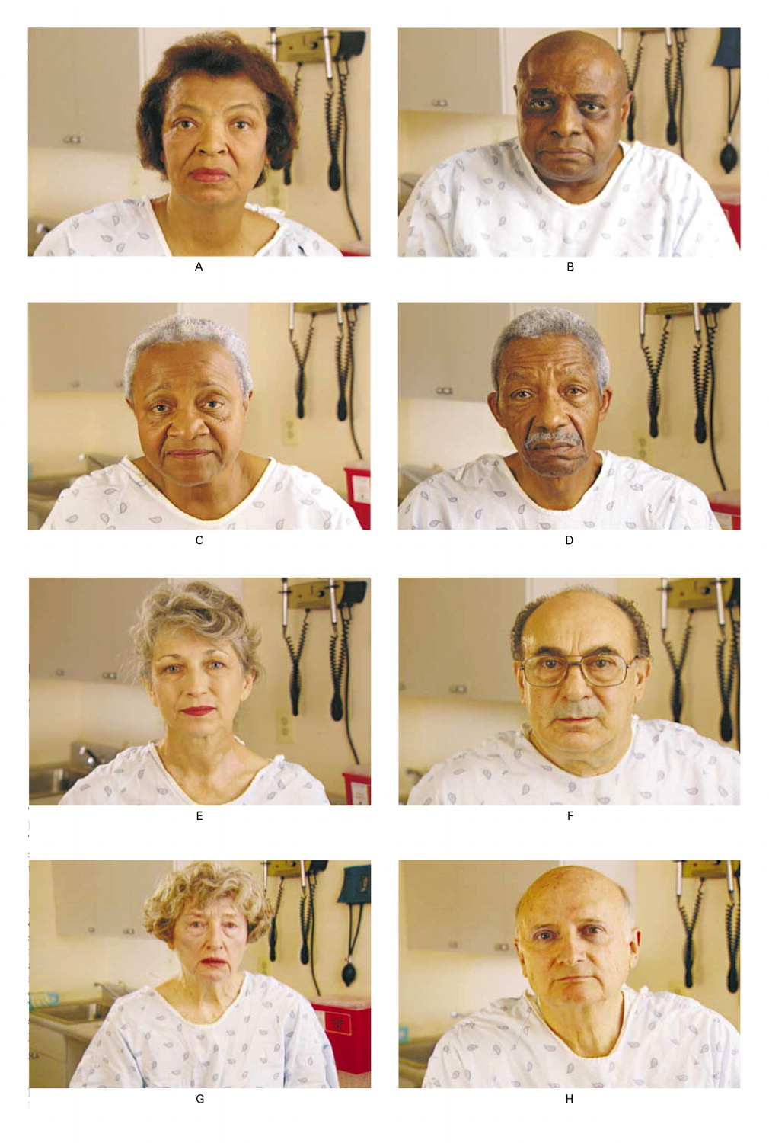

Slide 37
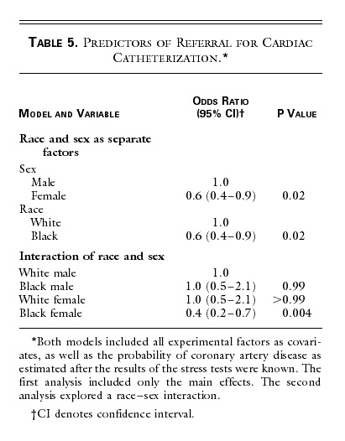

Slide 38

Provider-Level Disparities in Reproductive Health
History of reproductive abuses by family planning providers towards women of color and poor women
Are there disparities in counseling about the IUD?
  RCT using videos of standardized patients presenting for contraceptive advice
  Shown to participants at national meetings of ACOG and AAFP
Dehlendorf: Am J Obstet Gynecol, 2010
Notes:
Check about income in Harrison study.

Slide 39



The “Patients”
Notes:
Just to give a sense of the videos, here are snapshots of the standardized patients. This slide is of the high SES patients…
As you can imagine, planning an directing these videos, including the hiring of models was a challenge for someone with no background in this area.

Slide 40

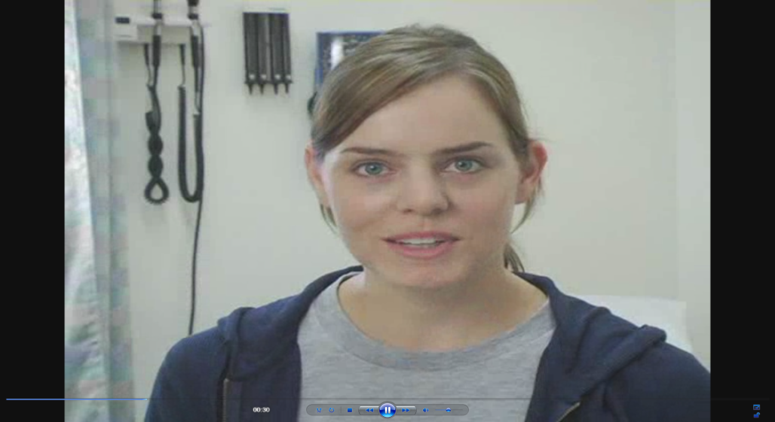

The “Patients”
Notes:
And these are the low SES patients
As you can imagine, planning and directing these videos, including the hiring of actresses as a challenge for someone with no background in this area, so it was definitely a learning experience.

Slide 41
Dehlendorf, et al. AJOG, 2010
Notes:
We interpreted this to indicate concern about pid in this group

Slide 42
Differences in Health Communication
Patient experience is a critical part of the Triple Aim, and is associated with outcomes
  Providers have less positive affect and are more dominant with minority patients
  African Americans report less participation in clinical decision making
  Hispanics experience less patient-centered communication
  In general, racially discordant care results in less information and less patient participation
Beach, AIDS Behav, 2011 Gordon, Cancer, 2016
Beach, JGIM, 2010

Slide 43
Audiotaped Conversations After Angiography
Less information given to AA patients
Fewer questions asked by AA patients
Less social or bonding type statements
→Cycle: less information, fewer questions, less social comfort
Less Information
Fewer Questions
Less Social Comfort
Gordon, Soc Sci Med, 2005

Slide 44
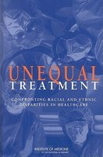
Can well-intentioned providers be biased?
“…biases may exist…often unconsciously, among people who strongly endorse egalitarian principles and truly believe that they are not prejudiced. There is considerable empirical evidence that even well-intentioned whites…who do not believe that they are prejudiced demonstrate unconscious implicit negative racial attitudes and stereotypes [which] significantly shape interpersonal interactions….Evidence suggests that bias, prejudice, and stereotyping on the part of healthcare providers may contribute to differences in care.”

Slide 45
Can well-intentioned providers be biased?
“…biases may exist…often unconsciously, among people who strongly endorse egalitarian principles and truly believe that they are not prejudiced. There is considerable empirical evidence that even well-intentioned whites…who do not believe that they are prejudiced demonstrate unconscious implicit negative racial attitudes and stereotypes [which] significantly shape interpersonal interactions….Evidence suggests that bias, prejudice, and stereotyping on the part of healthcare providers may contribute to differences in care.”

Slide 46
Health Care Disparities
Systematic review of 15 studies found that all but one found that providers have pro-white bias
  Similar to general population
Physicians judge Black patients to be:
    Less intelligent
    Less likely to comply
    More likely to abuse drugs
Stone, AJPH, 2014
Notes:
Both about how we interact with patients and the bias we bring in

Slide 47

The Effect of Patient Race/Ethnicity on Physicians' Ratings of Patients
63
All p ≤ 0.01
%
Adjusted for SES, age and sex (both physician and patient) and health risk status
Van Ryn and Burke. Soc. Sci. Med. 2000

Slide 48
Trust in Family Planning Patients
Table 3. Multivariate analysis for Providers’ Trust in Patient Scale (PTPS) Scores *
 | Difference in Provider trust in patient score | ^{ǂ}p-value
Patient race/ethnicity
White | ref | ref
African-American | -2.3 | 0.05
Latina | -1.2 | 0.3
Asian Pacific Islander | 1.1 | 0.5
Native American | -14.9 | 0.016
Multi-racial/Other | -.6 | 0.8
Provider age | -0.06 | 0.6
Provider type
Nurse Practitioner | -2.1 | 0.5
Physician | ref | ref
*Includes all patient and provider demographics with p-value <0.05 in bivariate analysis
Jackson, unpublished data

Slide 49
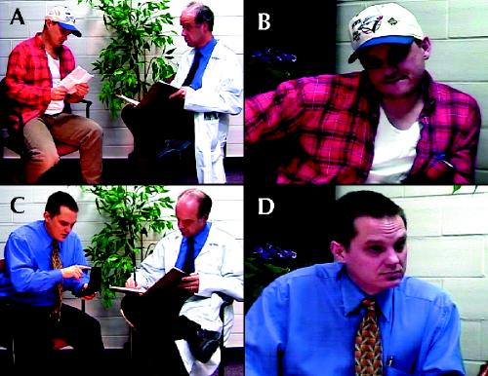
Unconscious Bias by SES
Woo, CMAJ, 2004
Notes:
Of medical students specifically

Slide 50
Unconscious Bias by SES
Low SES patients perceived as less likely to:
  Adhere to medications
  Follow up as recommended
  Second year students were less likely to report wanting the low SES patients in their practice
    But less true among low SES medical students
Woo, CMAJ, 2004

Slide 51
Stereotyping is necessary and unavoidable
Stereotyping
  Fixed and oversimplified image or idea of a particular type of person or thing
  Not necessarily negative
  Cognitive psychology demonstrate it is used to organize our complex world
  United States has a long history of racism that makes racial and ethnic stereotyping impossible to avoid

Slide 52
How is stereotyping used in medicine?
Two learning and memory systems
Slow learning
  Information is extracted and applied rapidly, automatically and unconsciously→ implicit beliefs
Fast binding
  Information is extracted and applied consciously and deliberate
  When there is ample time to determine the answer for a complex question →explicit beliefs
Which type of memory system do you think clinicians most often use? And why?

Slide 53
How we naturally process information -> unequal care
When we are tired, distracted, stressed or under time pressure → automatic, slow-learning process are used to make decisions
These conditions are typical of many clinical settings
Regardless of intention or motivation we all fall prey to using automatic cognitions (stereotypes)
Burgess, D. J Gen Intern Med 2004

Slide 54
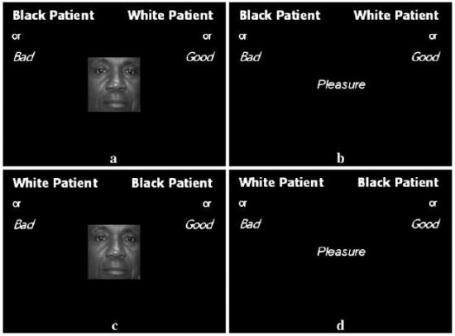
Implicit associations can be measured
    Implicit association test (IAT): https://implicit.harvard.edu/
  Assesses speed and accuracy of responses to linking concepts together, varying values across two dimensions
  Done rapidly so that your slow-
  learning (unconscious) decision
  making is in play
  Various areas
    Race, substance abuse,
    sexual orientation
Notes:
Describe the test(s)
My results
How I felt
Quote from Christine

Slide 55
Implicit bias results in unequal care
Implicit attitudes affect verbal communication and non-verbal behavior (eye contact, indicators of friendliness)
Physicians who implicitly favored whites have:
    Less patient-centered communication
    More negative tone during the visit
    Poorer ratings of care by black patients
    Black patients with worse treatment adherence and worse health outcomes
Burgess, D. J Gen Intern Med 2004 Stone, AJPH, 2015
Van Ryn, M. JAMA 2011

Slide 56
Statistical Discrimination
Making assumptions about individuals based on the probabilistic application of data about their demographic group
For example:
  Differences in recommendations for IUD could be related to considering population rates of unintended pregnancy
  Differences in diagnosis of PID vs. appendicitis related to STI demographics
Fails to consider individual differentiating information
Balsa, HSR, 2005

Slide 57
How important are differences in systems of care?
151 Medicare managed care plans
4 HEDIS quality measures
  DM control; Lipids in DM, Lipids in CVD, BP control
Performance measures 7-14% lower among blacks than whites
70% of the differences due to differentiation within plans rather than concentration of Blacks in lower quality plans
Trivedi, JAMA 2006

Slide 58
How important are differences in physicians?
Study of claims for Medicare fee-for-service, assessed disparities in cancer care
Overall, between-physician differences explained 15-21% of the variation in treatments for breast cancer, and 14-17% of variance for treatment for colorectal cancer.
  Most of the effect was within-physician

Slide 59
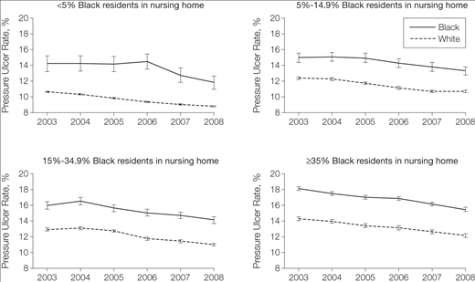
Both site and race contribute to disparities in pressure ulcers
Li, JAMA, 2005

Slide 60
Patient Factors
Black patients known to have less trust in the medical system
  But shouldn’t the medical system be addressing this?
May have different preferences for care that are not reflected in guidelines
Real question is how can the system adapt to accommodate/address these factors

Slide 61
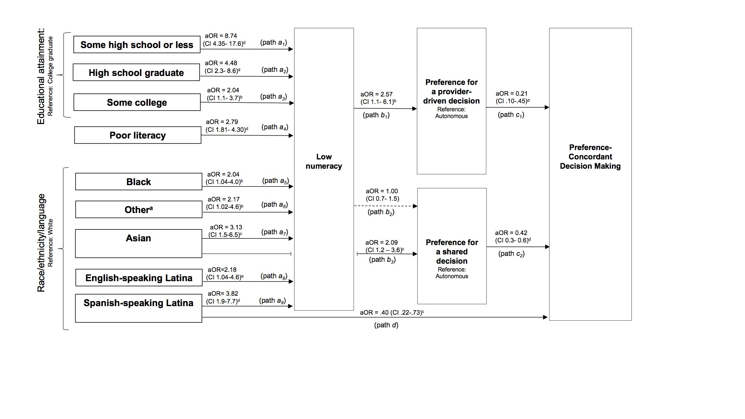
Preference-Concordant Decision Making about Prenatal Genetic Testing (Molina)

Slide 62
Summary of Causes of HCD
Health Care system:
  Segregated and inferior
  Fragmented and challenging for all
  Language barriers
  “Literacy” and “Numeracy”
Provider:
  Unconscious bias
  Statistical discrimination
Patients?
So what can we do about it?

Slide 63
Interventions to Eliminate Disparities in Healthcare
Systems:
  Better systems
  Tailored support
Providers:
  Address unconscious bias
  Change the provider workforce
Bring together clinical care and public health

Slide 64
Quality Improvement and Health Disparities

Slide 65
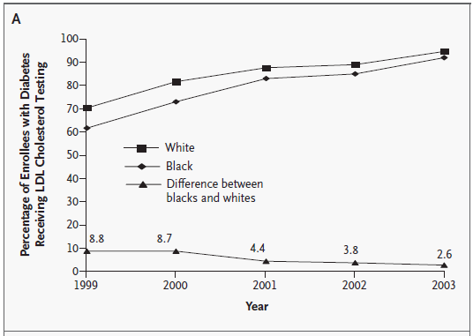
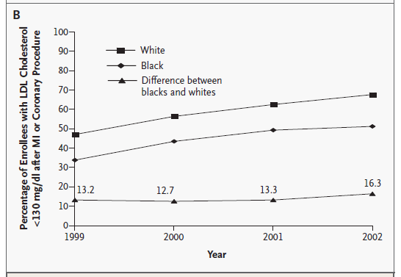
Trends in Receipt of Two HEDIS Measures for Enrollees in Medicare Managed-Care Plans, by Race
LDL TESTING
LDL CONTROL
Trivedi, A. N.; NEJM, 2005
Notes:
Figure 1. Trends in Receipt of Two HEDIS Measures for Enrollees in Medicare Managed-Care Plans, by Race. Panel A shows large overall improvements in the quality of care by year and a significant narrowing of the disparity between blacks and whites in testing for levels of low-density lipoprotein (LDL) cholesterol among patients with diabetes (P

Slide 66
Quality Improvement and Disparities
QI works
Variable effect on disparities
Generic programs probably less useful for addressing disparities
Weak correlation between overall quality of care and size of disparities for a given system of care
Pay for performance may worsen disparities
Shakir, JGIM, 2018

Slide 67
Patient Portals
May increase care coordination and access to information
  Safety net patients indicate interest in electronic communication
However, internet access and computer literacy can lead to exacerbation of disparities
Schickendaz, JGIM, 2013
Lyles, PLoS Med, 2015

Slide 68
Other Interventions
Address barriers to care related to numeracy/literacy
  Decision support tools
Promote ease of access to services and information
  Reducing co-payments (Lewey et al.,2015)
Adequate interpreter services used by trained providers

Slide 69
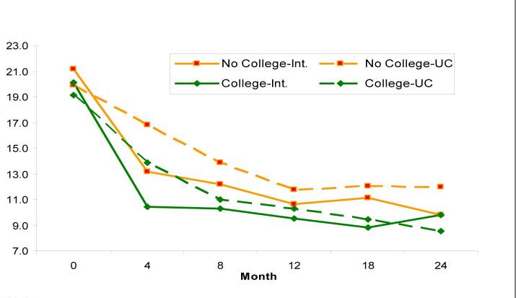
Addressing Disparities Through Collaborative Care Management - Depression
Bao, Arch Gen Psychiatry, 2011
Angstman, Medical Care, 2015
2
Notes:
Maybe both about social determinants and health care did not have an effect on race

Slide 70
Provider Interventions
Make provider population more representative of patients served
  Race and language concordant interactions associated with more patient-centered care
Change the philosophy of care
  Patient-centered attitudes associated with fewer disparities in communication among medical students
What about implicit bias itself?
Beach: Acad Med, 2007
Shen, J Racial Ethn Health Disparities, 2017

Slide 71
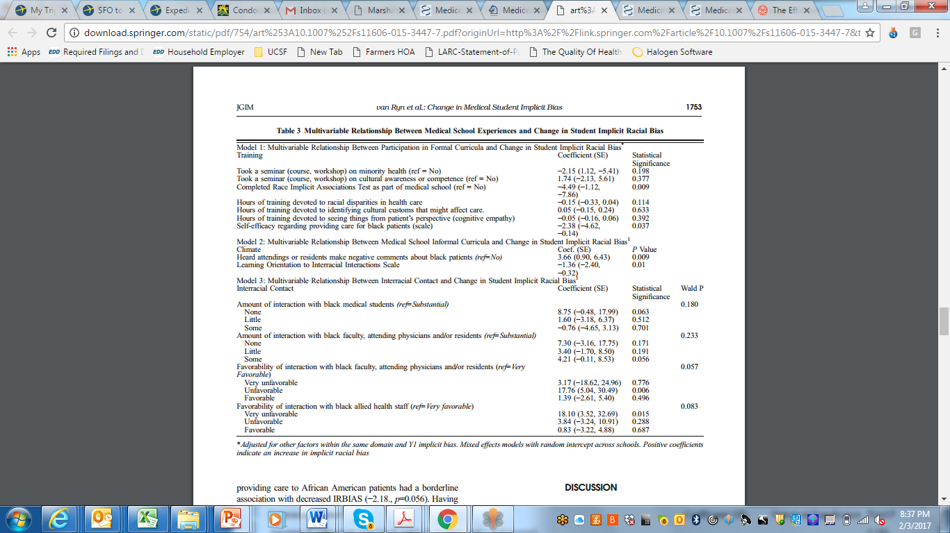
Implicit Association Test?
Van Ryn, JGIM, 2015

Slide 72
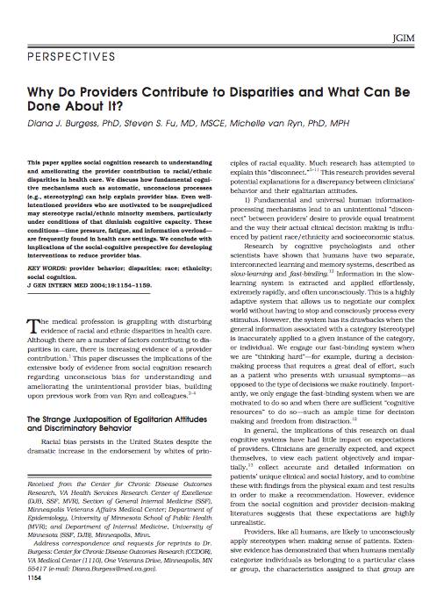
Addressing Implicit Racial Bias
Focus on individual qualities
  Individuation v. categorization
Enhance individual motivation
  IAT/ what would/should I do?
Open discussion of stereotypes
Improve confidence in interacting with dissimilar group
Empathy – perspective-taking
Partnership building with patients
Burgess, JGIM, 2004
Notes:
Perspectives from Psych Literature

Slide 73
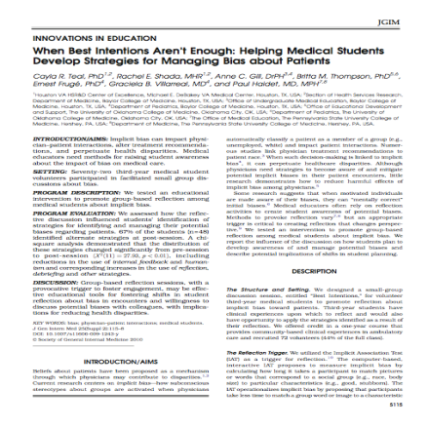
Effects of Implicit Bias Workshop
    Workshop using Implicit Attitude Test
    Facilitated small group discussion
      Discussion
        Reactions, clinical experiences, and strategies
      Noted differences after sessions in strategies
        Focus on recognition of bias
        Shift from self-reliance to talking with others
        Consider possible bias before seeing patient
Teal, JGIM, 2010

Slide 74
Facing Outward
Social screening is gaining prominence – e.g. collecting social variables in EHR
Benefit for linkages to social resources
Can also help inform treatment and care by addressing barriers to treatment
HOWEVER, important to prevent stereotyping
  Some health care disparities arise from assumptions about preferences or abilities based on social variables

Slide 75
Group Activity
Talk in groups of three about study design(s) you could use to investigate structural or interpersonal causes of health care disparities for your area of interest

