Slide 1
Biostat 202: Opportunities and Challenges of “Big Data”
- Causal Inference
Charles E. McCulloch,
Division of Biostatistics,
Department of Epidemiology and Biostatistics
Biostat 202

Slide 2
Outline
Introduction: prediction versus causation
Threats to causal conclusions
Causal methods in (very) brief
Interpretability of machine learning methods
Some uses of big data and machine learning in causal inference
Summary

Slide 3
Outline
Introduction: prediction versus causation
Threats to causal conclusions
Causal methods in (very) brief
Interpretability of machine learning methods
Some uses of big data and machine learning in causal inference
Summary

Slide 4
Prediction versus causality
Everyone in the science community understands the difference between causation and correlation.
Data-mining and machine learning algorithms are only based on associations.
Often interested in causation, i.e., understand the cause of illness or develop interventions that cause improvement.
And I have often seen even senior researchers have lapses and over-interpret correlations causally.

Slide 5
Which of these are prediction versus causation questions?
Effect of Abaloparatide on fractures in postmenopausal women.
Estimating fetal risk of screening or not screening for genetic disease.
Effect of cerebral protection device on brain lesions following aortic valve implantation.
Estimation of temporal trends in preterm birth rates and their association with obstetric interventions.
Survival for children with trisomy 13 and 18.
Notes:
All recent JAMA articles.

Slide 6
Prediction vs Causation
Bona fide prediction problems:
Early detection of cancer.
Identifying high risk patients for closer monitoring.
Prediction of disease epidemics.
Key aspects of prediction: Not concerned with causal interpretation of the effect of variables included in the model or interpreting presence of absence of the variable in the model causally. No interest in p-values – focus on prediction accuracy.
Notes:
Key words: effect, intervention = causal, estimate, predict = prediction.

Slide 7
Which of these are prediction versus causation questions?
Effect of Abaloparatide on fractures in postmenopausal women.
Estimating fetal risk of screening or not screening for genetic disease.
Effect of cerebral protection device on brain lesions following aortic valve implantation.
Estimation of temporal trends in preterm birth rates and their association with obstetric interventions.
Survival for children with trisomy 13 and 18.
Notes:
Abaloparatide = treatment for osteoporosis. Trisomy 13 and 18 are genetic disorders that cause birth defects; babies with these defects often die by age 1.

Slide 8
Which of these are prediction versus causation questions?
Effect of Abaloparatide on fractures in postmenopausal women.
Estimating fetal risk of screening or not screening for genetic disease.
Effect of cerebral protection device on brain lesions following aortic valve implantation.
Estimation of temporal trends in preterm birth rates and their association with obstetric interventions.
Estimation of survival for children with trisomy 13 and 18.

Slide 9
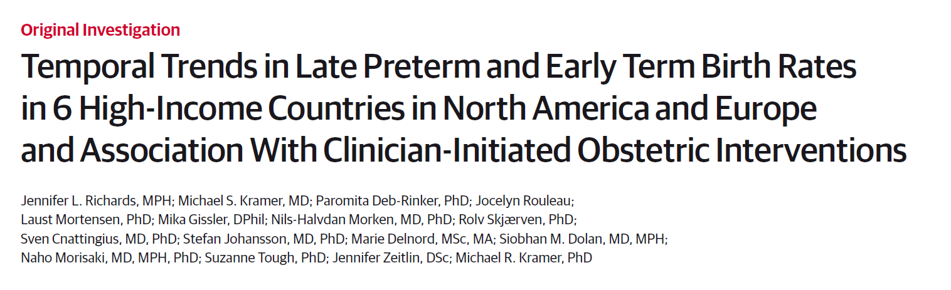
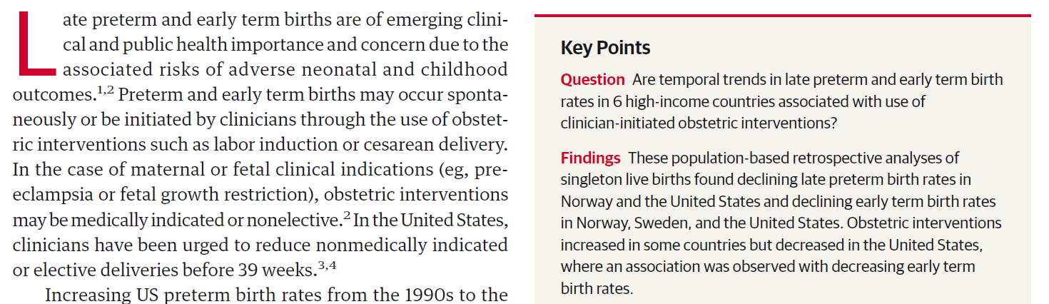
Notes:
All recent JAMA articles.

Slide 10
Over the line?

Slide 11
Outline
Introduction: prediction versus causation
Threats to causal conclusions
Causal methods in (very) brief
Interpretability of machine learning methods
Some uses of big data and machine learning in causal inference
Summary

Slide 12
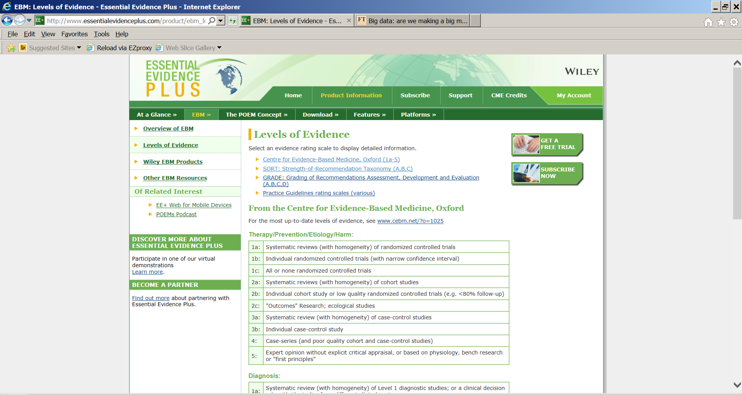
Why are these types of studies rated so lowly?
Electronic health record based study
Notes:
Many venues of science rate the “quality” of evidence. Here is a typical classification of the type of study.
Most of the examples of big data are observational studies not designed for research purposes. That puts us way down on the list and suggests we need to take care.
Why? Observational study (but cohort study is 2b), poor data quality, selection bias.

Slide 13
Example: Ann Landers/Newsday surveys
Many years ago, the help columnist, Ann Landers, asked her readers “If you had it do to over again, would you have children?” She received about 10,000 responses, 70% of which said no.
Shortly thereafter, Newsday commissioned a nationwide random telephone survey.
9%
said no.
Samples:
10,000 write-ins; 1,373 random telephone contacts
Population:
U.S. households with children
Moral: Big data doesn’t overcome selection bias.

Slide 14
Example: More realistic
Suppose you are going to conduct a research study using electronic health records and want the results to generalize to all similar patients in the Bay Area?
Would you prefer to use data from UCSF or Kaiser? Why?
UCSF
~Ann Landers
Kaiser
~Random telephone survey

Slide 15
Example: Phototherapy and Cancer
Phototherapy (exposing the infant to bright fluorescent light) is widely used to treat jaundice in newborns. Jaundice is caused by a build up of bilirubin levels before the newborn’s liver starts working. High levels can cause brain damage. The light breaks down the bilirubin and allows it to be excreted.
Does phototherapy cause cancer?
We studied about 500,000 infants born in Kaiser Northern CA between 1995 and 2011.
Newman, et al Pediatrics, 2016

Slide 16
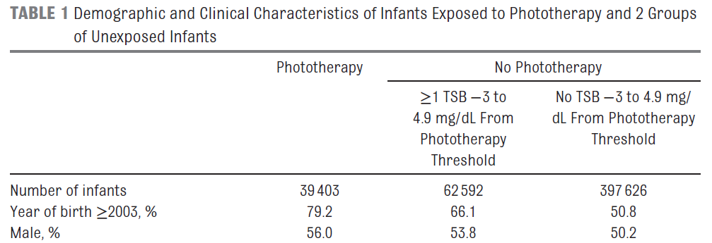
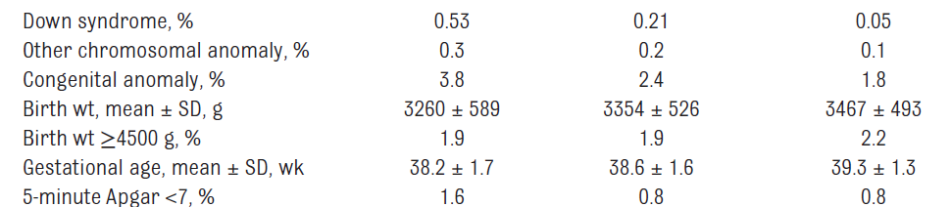
Example: Excerpt from Table 1
Concerns comparing the phototherapy and non-phototherapy groups?

Slide 17
Example: Phototherapy and Cancer
Possibly different on:
Race, birth year, sex, Down’s syndrome, chromosomal or other congenital anomaly, birth weight, gestational age, Apgar score, direct antiglobulin test positive, maternal age, delivery mode, multiple birth, jaundice and more. Full richness of the electronic health record system at Kaiser available.
As well as two-way interactions of all variables (e.g., cross-combinations of categorical variables) and nonlinear components of numeric variables. When totaled up, over 2,000 predictors.

Slide 18
Outline
Introduction: prediction versus causation
Threats to causal conclusions
Causal methods in (very) brief
Interpretability of machine learning methods
Some uses of big data and machine learning in causal inference
Summary

Slide 19
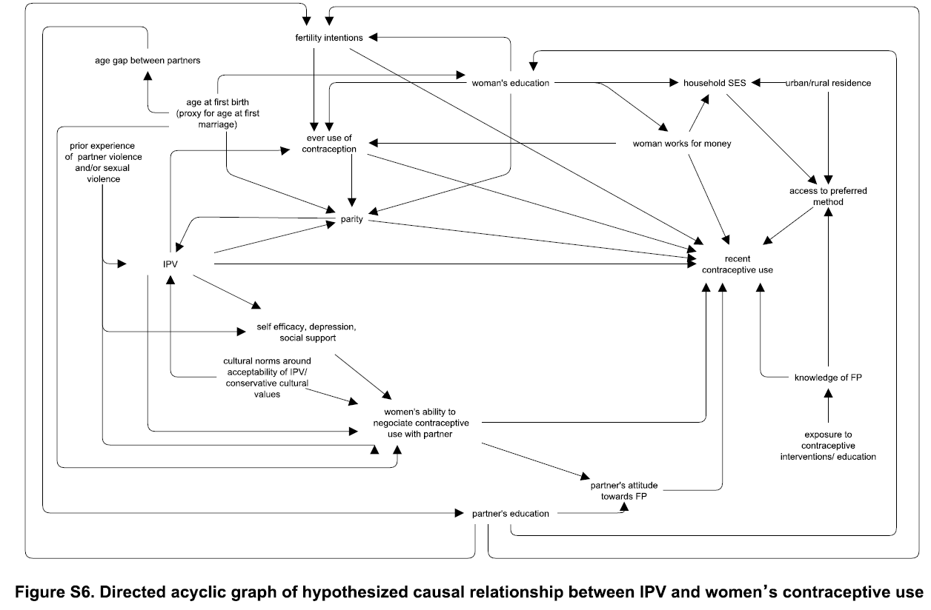
Causal inference
Maxwell, et al ,PLoS One. 2015; 10(2): e0118234.

Slide 20
Causal inference – the 5¢ tour
Down’s syndrome
Maximum Bilirubin
Phototherapy
Cancer
Adapted from Newman, et al Pediatrics, 2016
Biostat 215 covers these topics in detail
Notes:
Biostat 215 covers these topics in detail. I just want to give you an exposure so you can see how big data methods may or may not help.

Slide 21
Epidemiologists have long studied the pitfalls of using observational studies to infer causation.
A fundamental idea in causal inference is to compare the same person with and without an intervention or condition. Can’t usually measure the person under both conditions.
For example, observe the same person with and without a history of knee injury to understand its impact on later osteoarthritis.
Or recording the outcomes in a catchment area of a trauma center with and without its closure.

Slide 22
Potential outcomes
Imagine a hypothetical experiment in which you get to observe each participant under both the treatment and control conditions holding all else the same: Y_{trt}, Y_{ctl}. Like a perfect cross-over experiment.
Often, we only get to observe one of Y_{trt} or Y_{ctl}, depending on whether the participant is in the treatment or control condition.
Sometimes described as the “fundamental problem in causal inference.”
Notes:
Called potential outcomes or counterfactuals.
And this is not a new idea: I learned this in 1978 ….
From a book written in 1959 ….
Quoting a result from a 1923 paper by Jerzy Neyman – a contemporary and hated rival of R.A. Fisher.

Slide 23
Hypothetical example: treatment of depression
Does addition of an internet based cognitive behavioral component aid in treatment of depression?
Outcome = improvement in Beck Depression Inventory.
Control group treatment is team care approach, which has proven especially effective in the elderly.
Observational study based on clinical data.

Slide 24
Potential outcomes
 |  | Outcome under
Patient | Group | Ctl | Trt | Difference
1 | Trt | 4 | 8 | 4
2 | Ctl | 0 | 3 | 3
3 | Trt | 4 | 3 | -1
4 | Trt | 3 | 4 | 1
…
Ave in popl’n |  |  |  | 1.02 = Average Causal Effect
 |  | Outcome under
Patient | Group | Ctl | Trt | Difference
1 | Trt | 4 | 8 | 4
2 | Ctl | 0 | 3 | 3
3 | Trt | 4 | 3 | -1
4 | Trt | 3 | 4 | 1
…
Ave in popl’n |  |  |  | 1.02 = Average Causal Effect
Notes:
Entries in table are improvement in BDI. So the first patient was in the Trt group and improved by 8 points. But if they had been in the Ctl group, they would also have improved, by only by 4 points.
Patient 3 improved by 3 points. But if they had been in the Ctl group they would have done better and improved by 4 points.
Notes:
Causal effect need not be the same in each patient.
Need not even be the same direction.
Could be different in different subgroups of the population, e.g., women, or those who would choose the treatment.
(Advance) We only get to see what is in blue, not what is in grey.

Slide 25
Thought #5 (from lecture 1)
If you are interested in causation you can’t measure it all.
You can, at most, measure half of it all and that half is subject to selection bias. (Unless you have run a well-conducted randomized experiment).

Slide 26
Potential outcomes are sometimes called “counterfactuals”
Counter – factual
Against – the truth
=Lying
I like “Potential outcomes framework”
or “Hypothetical outcomes framework” better
Notes:
Statisticians have enough bad press without such technical definitions.

Slide 27
Potential Outcomes
– Average Causal Effect
Often, a reasonable quantity to estimate is the average causal effect (ACE): the average of the individual causal effects across the entire population.
Or perhaps the ACE in a subset of the population. E.g., the causal effect of a smoking cessation program among smokers.

Slide 28
Example: Depression Data
Notes:
Explain carefully: Y axis is delta BDI. Red is treatment group, blue is control.
Change in BDI values for blue and red are well interspersed. So average values are about the same. No treatment effect?
Perhaps there is confounding by age. Older participants are less likely to adopt the internet intervention (very few red dots on right of graph). And older participants do better in either treatment group.
And, for a given age the treatment group seems to do better.
In the older age range, we have very few comparators. This lack of overlap makes it almost impossible to understand the relationship between age and delta BDI (among the older ages) in the treatment group. So difficult to model.

Slide 29
Simple analysis: t-test
Average change in Treatment group = 5.0,
Average change in Control group = 4.6
Estimated difference =0.4,
p=0.57, via t-test,
So not statistically significant.

Slide 30
Non-comparable groups
The issue:
Estimation of the causal effect of treatment (the predictor of interest) is confounded by age (another predictor) since
a) age is associated with the outcome (change in BDI) and
b) age is associated with treatment
A traditional solution:
Include age in a multipredictor linear regression model along with treatment.

Slide 31
Example
Treatment effect
1.4 (95% CI 0.6, 2.3)
Notes:
(Advance) We fit a regression model. (Advance) The black double-headed arrow line shows the treatment effect for a given age. So this is the estimated difference between treatment groups at a given age. Stat sign treatment difference.
Sometimes described as adjusting for age or holding age constant. If differences in age are the only reason why the groups are non-comparable and if we believe the simplistic regression model then this estimates the causal effect of treatment. Two BIG “if”s.
Being careful, neither nonlinearity in the relationship nor the need for different slopes in the two groups are even close to statistically significant, so we stick with the basic model, which is what many people would fit solely.

Slide 32
Issues with regression adjustment
Causal estimate is defined by using regression model (contrast the ACE).
What if model is wrong? As examples: assumption of a linear relationship when it is not. Left out variables? Interactions between variables?
How will we know?
(Lack of overlap/extrapolation.)
Lack of comparison group for older ages (plenty of controls, not many treated).
Notes:
Lack of overlap is a serious concern because it is difficult to determine if differences are causal or due to the incorrect model.
Can see the lack of overlap here, but wouldn’t be able to in a more realistic example with many predictors.

Slide 33
Issues with regression adjustment (true model)
Notes:
Here is the true model from which I generated the (made-up) data.
Observations:
I fit the wrong model
There is little or no treatment effect in the older age group
Since most of the data for comparison is in the younger age group (where the treatment effect is larger), I overestimated the average effect across all ages.
Note: data generating model was 4+(age-30)*3.5/40 for treatment and 2+(age-30)*6/40 for control. So average causal effect at a given age is the difference, or 3.875-age*0.0625. and the ACE is 3.875-\bar(age)*0.0625 or 3.875-45.65*0.0625 = 1.02.

Slide 34
Issues with regression adjustment (fit interaction)
Treatment effect
3.2 (95% CI -.6, 7.1)
Previously:
1.4 (95% CI 0.6, 2.3)
Notes:
Here is the estimated model. (Advance)
What!? Treatment effect is now estimated to be 3.2! And not statistically significant. What is going on?
When you enter the interaction (Advance), the treatment effect is the estimated (extrapolated) value at age=0. Need to center variables so a value of 0 is a value of interest.

Slide 35
Regression adjustment
To fix the issue in this linear regression situation can just center age. Use
cage = age-Ave(age) = age-42.7
as a predictor instead of age in the model.
Then the treatment effect is estimated to be 1.4 (95% CI 0.5, 2.2).
But this points out the danger in using a statistical model to define the causal effect.

Slide 36
Outline
Introduction: prediction versus causation
Threats to causal conclusions
Causal methods in (very) brief
Interpretability of machine learning methods
Some uses of big data and machine learning in causal inference
Summary

Slide 37
Interpretability
Example: Prediction of healthy aging. Data source: Health ABC – a long running cohort study that enrolled about 3,000 healthy individuals in their 70s.
Outcome: Survival free of major diseases and disability.
Predictors: About 100 predictors including demographics, BP, medical history, physical performance (e.g., gait speed), and serum markers (e.g., IL-6).

Slide 38
Intepretability
Model selection strategy: Calculated Akaike Information Criterion (AIC) values, which are similar to cross-validated errors, for a large number of Cox survival analysis models. Exhaustively searched for models with about the optimal number of predictors.

Slide 39
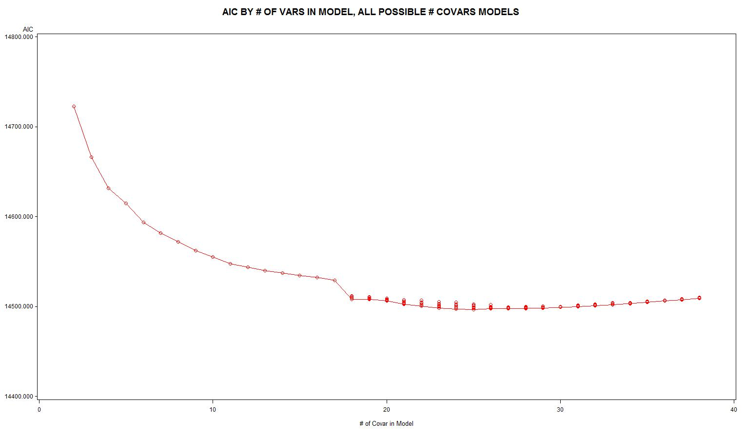
Example: Disease free-survival AIC plot
Number of predictors
Notes:
You see the same sort of plot as John showed you with error in the test set. At first models improve, up to about 25 predictors. Then start getting worse.

Slide 40
Example: Disease free-survival AIC plot – zoom in near optimal
Top models of that size
Number of predictors

Slide 41
Machine learning/causal inference
Results: About 120 models were within 10 of the model with the lowest (best) AIC. (Rule of thumb: statistically speaking AIC larger by 10 is a worse fitting model).
Observation: Possible to get nearly the same quality of prediction using very different models.
Predictor selection: Prediction algorithms cannot be depended upon to identify the “best” predictors. Which predictors get included or excluded from the model will vary with small perturbations in the dataset or analysis method.
Notes:
With large numbers of predictors it is quite common to get many models that perform nearly as well as the “best” model.

Slide 42
Example: Two models
For example, these two models were virtually identical in performance:
19 variable model: BLAGE WTK HGT WGTPDB HGTDB PULSE BESFEV BPAAIT CESD PACE400 PACE20 GRIP SEMITND TANDSTD COMP FALL RDW ALBUMIN STPCK
29 variable model: BLAGE WHITE WTK HGT WGTPDB HGTDB PULSE FAT BESFVC FEV1R BPAAIT TENG DSS CESD PACE400 PACE6 PACE20 GRIP SEMITND TANDSTD STANDY FFHIP COMP FALL CYSTC LDL RDW ALBUMIN STPCK
Cognition variables
Red indicates not in the other model
Notes:
For example, FFHIP is Ever fractured hip, TENG is a mental status test (3MS), DSS is the digit symbol score (cognition). So adopting the second model might lead you to believe cognitive ability is important.

Slide 43
Machine learning/causal inference
And this is with a standard statistical analysis approach (Cox regression). Many other machine learning methods are worse because they don’t give interpretable coefficients.

Slide 44
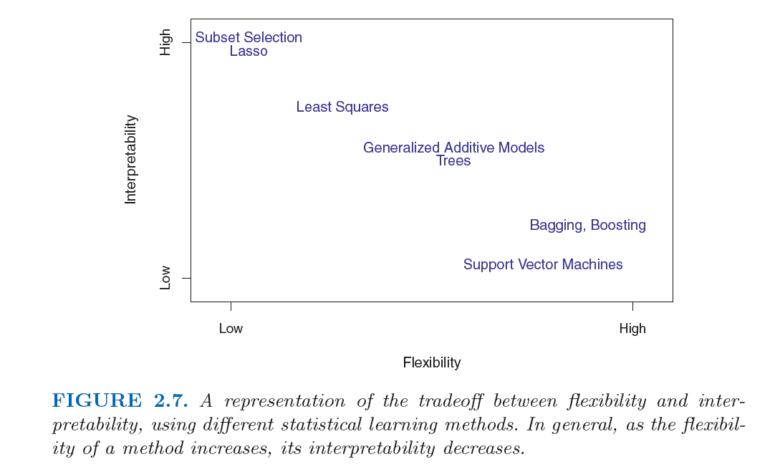
Machine learning/causal inference
From Introduction to Statistical Learning, James, et al., 2013

Slide 45
Outline
Introduction: prediction versus causation
Threats to causal conclusions
Causal methods in (very) brief
Interpretability of machine learning methods
Some uses of big data and machine learning in causal inference
Summary

Slide 46
Outline
Some uses of big data and machine learning in causal inference
  Conduct an RCT using large scale data
  Propensity scores
  Potential outcomes estimation
  Subgroup analyses

Slide 47
One use of big data for causal inference:
Pragmatic randomized clinical trials
See lecture from a previous year by Mark Pletcher.

Slide 48
Outline
Some uses of big data and machine learning in causal inference
  Conduct an RCT using large scale data collection systems (Mark Pletcher’s lecture)
  Propensity scores
  Potential outcomes estimation
  Subgroup analyses

Slide 49
Propensity scores:
Define prop(x) be the probability of being on treatment as a function of x, all the variables that determine treatment.
In our depression example, suppose temporarily that the probability of selecting treatment only depends on age.

Slide 50
Propensity scores: example
Notes:
Assume likelihood of choosing the intervention only depends on whether age<50 or not.

Slide 51
Propensity scores: theory
Very important theoretical property: Consider individuals with the same value of prop(x). The ones receiving treatment have the same distribution of x as do those who do not. So all values of the predictors are completely balanced between the two groups (for a given value of the propensity score).
Therefore you only need to adjust for prop(x) to balance the groups.
Notes:
Doesn’t tell you how to adjust.

Slide 52
Propensity scores:
Adjusting for propensity score categories and using a linear regression model:
Estimated difference =1.4, CI [0.4, 2.3],
Contrast previous result:
No adjustment for propensity score categories: Estimated difference = 0.4, (p=0.57, via t-test)

Slide 53
Propensity scores: practical issues
Often divide propensity scores into quintiles in order to adjust.
What if not all the variables that determine treatment are measured? Or included correctly in the model?
Suggests being more inclusive with both predictors and interactions.
And to handle continuous predictors with flexible functional forms.
So something that is easier with large databases and machine learning.

Slide 54
Propensity score estimation using IBM SPSS Modeler
Getting estimates of the propensity score is a prediction problem.
So use your favorite machine learning algorithm to predict the probability of treatment. (use a Type Node to set Treatment as the Target variable temporarily).
The propensity scores are these predicted probabilities.

Slide 55
Propensity score estimation using IBM SPSS Modeler
Use the predicted probabilities in a standard statistical analysis:
For example, bin the propensity scores into five equal categories using a Bin Node (bin method = Tiles (equal count), quintiles ) and then use a logistic regression node (for a binary outcome) or a linear regression model node (for a numeric outcome).
The only predictors are the propensity score bins (as a nominal variable) and treatment.
Notes:
We used machine learning methods and propensity scores in the phototherapy and cancer paper to winnow down the >2,000 predictors.

Slide 56
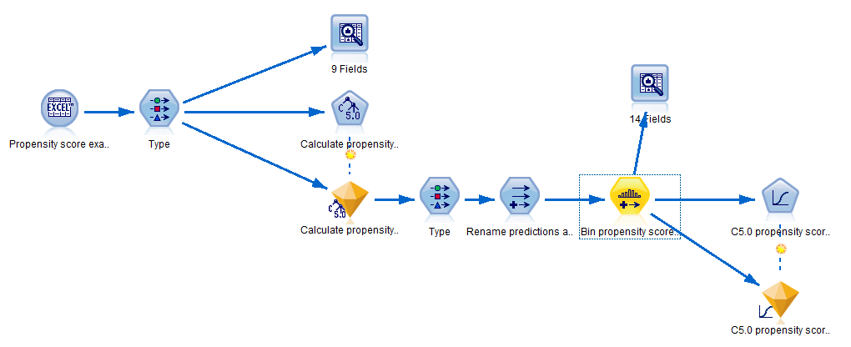
Propensity score example
I have posted an example Modeler stream and dataset on the website.

Slide 57
Outline
Some uses of big data and machine learning in causal inference
  Conduct an RCT using large scale data collection systems (Mark Pletcher’s lecture)
  Propensity scores
  Potential outcomes estimation
  Subgroup analyses

Slide 58
Regression estimation
In the depression example, we used a linear regression model. We can use that to get an estimate of the causal effect for each person. Then we could calculate the average causal effect.
Also called G-computation in the causal literature and marginal estimates in economic statistics.
Can get marginal estimates for subpopulations, e.g., causal effect in users of the intervention or in younger participants.

Slide 59
Regression estimation
Predicted causal effect for a ctl subject
Predicted causal effect for a trt subject
ACE estimated to be 1.2 (CI 0.4, 2.1)
Notes:
The filled circles represent the (model-based) predicted value for a participant in the treatment or control groups.
The open circles represent the (model-based) predicted potential outcome for the participants. So, for example, a participant in the treatment group has a predicted potential outcome in the control group. And vice versa.
Now have an estimate of the individual causal effect, which you can average to get ACE. Can either compare predicted potential outcome with predicted value or with the real value.

Slide 60
Potential outcomes estimation using IBM SPSS Modeler
Create duplicate rows of data with the treatment assignment switched and missing outcome data:

Slide 61
Potential outcomes estimation using IBM SPSS Modeler
Want to end up with a predicted outcome under treatment and under control:

Slide 62
Potential outcomes estimation using IBM SPSS Modeler
Read the data using a Source Node.
Read in a duplicate version of the data using another Source Node. In this part of the stream, switch the coding of treatment and control and recode the outcome variable to missing.
Append the duplicate data to the original data. So now the dataset is twice as large as the original and has a copy of every person under control and under treatment (though only one of them has the outcome – the other is missing).

Slide 63
Potential outcomes estimation using IBM SPSS Modeler
Separate the data into data for the treatment group and control groups.
Fit your favorite machine learning method to predict the outcome in the treatment group and do the same for the control group. This will give predictions for the data that were missing previously.
Merge the datasets together so everyone has a predicted outcome under the treatment and under the control conditions.

Slide 64
Potential outcomes estimation using IBM SPSS Modeler
Average all the differences between the under-treatment and under-control conditions to estimate the average causal effect (ACE).
Or the ACE in different subgroups.

Slide 65
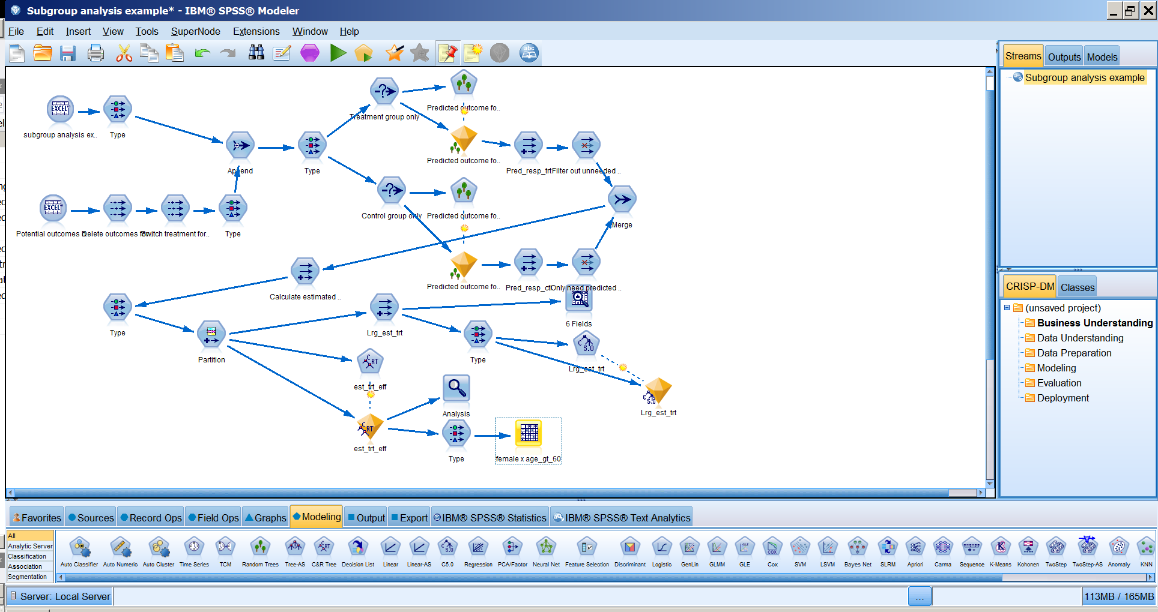
Potential outcomes estimation
I have posted an example Modeler stream and dataset on the website illustrating the idea for this and the next section (subgroup analysis).

Slide 66
Potential outcomes estimation
Looks complicated, but let’s break it down.
1. Create duplicate records

Slide 67
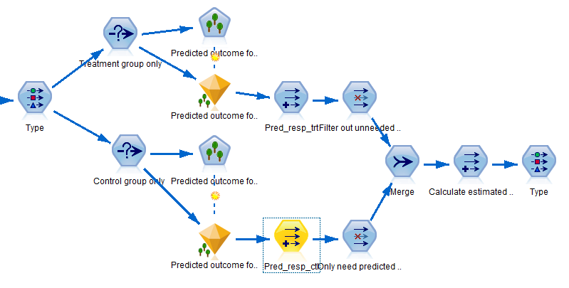
Potential outcomes estimation
Looks complicated, but let’s look at the steps.
2. Estimate effects in treatment and control
3. (Next) Use potential outcomes to get ACE

Slide 68
Potential outcomes estimation using IBM SPSS Modeler
Issues
(+) Can use flexible models in each condition to help avoid issues with incorrectly specifying the model.
(-) Requires large sample sizes in treatment and in control groups.
(0) Does not solve the problem of “unmeasured confounders”. Not surprisingly, you can only adjust for measured quantities.

Slide 69
Outline
Some uses of big data and machine learning in causal inference
  Conduct an RCT using large scale data collection systems (Mark Pletcher’s lecture)
  Propensity scores
  Potential outcomes estimation
  Subgroup analyses

Slide 70
Subgroup effects and precision medicine
Since the causal effect is not the same for everyone, are there subgroups for which the treatment is more or less efficacious (or even harmful)?
If we can identify the subgroups we can tailor treatment (precision medicine).
How many subgroups might there be?
Let’s consider the phototherapy/cancer example.

Slide 71
Subgroup problem
Race (5 categories), birth year (say 3), sex (2), Down’s syndrome (2), chromosomal (2) or other congenital anomaly (2), birth weight (6), gestational age (say 3), Apgar score (2), direct antiglobulin test positive (2), maternal age (2), delivery mode (2), multiple birth (2), jaundice (2).
So 5×3×2×2×2×2×6×3×2×2×2×2×2×2
=276,480 subgroups
(for 500,000 babies)

Slide 72
Subgroup analysis issues
Insufficient data in each subgroup.
Huge multiple testing problem (if we test each one at  = 0.05 and there are no effects we expect 0.05×276,480 = 13,824 false positives.

Slide 73
Subgroup problem – proposed solution
Use the potential outcomes estimation approach in the previous section (and your favorite machine learning algorithm) to get an estimated treatment effect for each person using all the possible subgroup variables as predictors.
Use a recursive partitioning algorithm to find subgroups with different treatment effects (variation: code treatment effects as large/not).
  Reference for using this idea in RCTs: Foster, Taylor and Ruberg, Statistics in Medicine, 2011.

Slide 74
Summary
Distinguish questions by whether they can be answered by prediction only or require more detailed analysis.
Machine learning methods are not designed for drawing causal conclusions.
However, aspects of causal analyses may be prediction problems for which we can use the methods in the class
  Estimating propensity scores
  Predicting potential outcomes
  Identifying subgroups on the basis of different estimated treatment effects

