Slide 1
Tech-Enabled Clinical Research: Part 2
Ida Sim, MD, PhD
February 13, 2018
Division of General Internal Medicine
Copyright Ida Sim, 2018. All federal and state rights reserved for all original material presented in this course through any medium, including lecture or print.
Notes:
PMI, PPRN, National Cancer Data Ecosystem – patient-donated data to research
Time for a patient-driven health information economy – Mandl and Kohane, hyperportalosis
Open Notes movement
HUGO to synch with
Ethan Basch, on PROs
Rearchitecting clinical researc hwith people-powered data partnership
www.atsdr.cdc.gov

Slide 2
Final Problem Set
2-pager: (re-)imagine "version 2.0" of your current research project, or can imagine a new project
Due: Monday, February 26, 5pm

Slide 3
Last Class
Learning Health(care) System is a useful concept for breaking out of care vs. research silos
Digital divide exists in older, rural, poorer populations; internet access is often tenuous in those who access the Internet only through smartphones
Increasing number of platforms available for running digital cohorts and trials, but diversity and retention are difficult
Build vs buy vs customize priorities: know your specs, ensure a good user experience
Develop and test apps using agile participatory methods
Notes:
Companies now have all the data. Used to be academics

Slide 4
Outline
Digital research platforms
Digital divide
Tech-enabled clinical research
  Screening, recruitment, enrollment and consent
  Retention
  Outcomes assessment and Engagement
  Interventions and interventional design
Notes:
Talked about basic networking, how machines connect to one another, and how we can run computation across data stored in distributed databases. This is all happening on the backdrop of the Web.

Slide 5
“Big 6” Questions
Description
  How frequent/common are risk factors/exposures/conditions/diseases? How often does Y occur?
Causation (“Causal inference”)
  The science of establishing causal relationships among biological, behavioral, environmental (etc.) factors within humans. Does X cause (or prevent) Y?
  Will intervening upon X change occurrence of Y?
Attribution
  What fraction or how many cases of disease Y can be eliminated if a causal exposure X is eliminated or reduced?
Mediation
  Understanding the mechanisms of causation
  How does X cause Y?
Interaction
  When and for whom does X cause/predict Y?
Prediction
  Do A, B, and C predict concurrent presence/future occurrence of Y? e.g., diagnosis or prognosis
Notes:
Start with Big 6 questions.

Slide 6
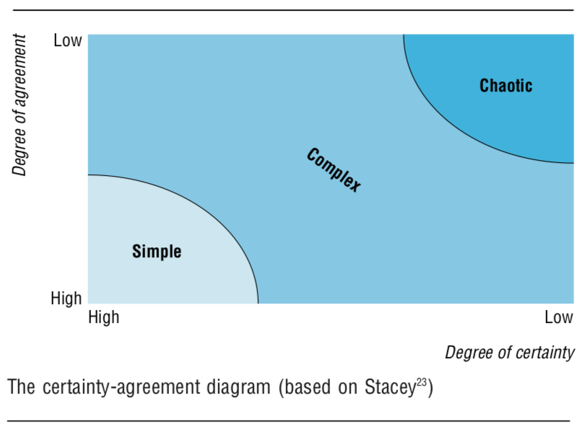
Complexity
Problems of simplicity
  1 or 2 variables, linear relationships, eg., orbiting planet, apple falling off a tree
  Use classical mechanics, linear equations
Problems of disordered complexity
  Random motion of molecules
  Use statistics, probabilities
Problems of organized complexity
  Sizeable number of variables interconnected in a complex but organized organic whole system, e.g., growth of the apple tree, opioid crisis
  What to use?
Stacey RD. Strategic management and organizational dynamics. London: Pitmann Publishing, 1996.
Notes:
Dougnut econ, page 117

Slide 7
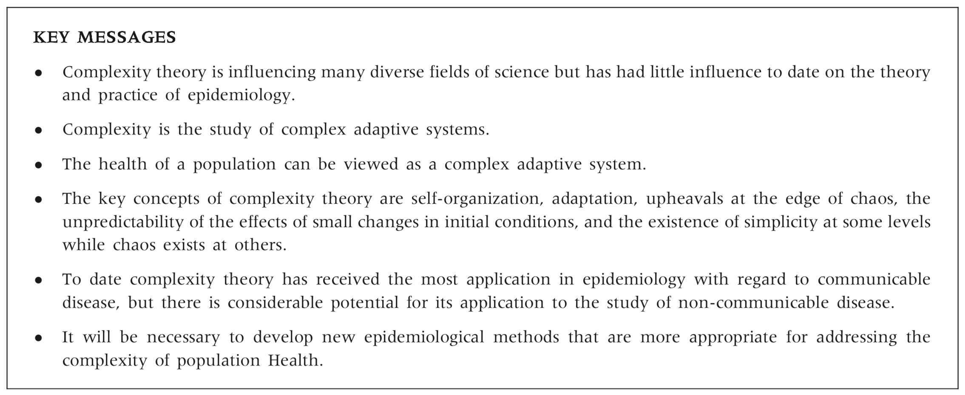
“Complexity, Simplicity, and Epi”
Pearce and Merletti, International Journal of Epidemiology 2006;35:515–519

Slide 8
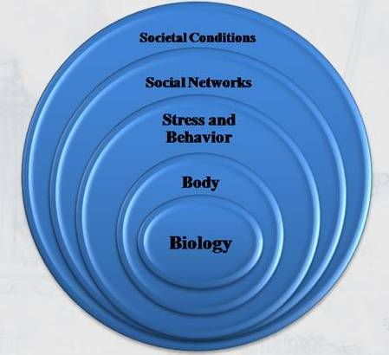
Biomarkers of Ordered Complexity
Measuring variables across 5 rings of health
Measuring variables more frequently
Measuring variables “in the wild” rather than in controlled clinic or lab visit
Dimensions of variables
  passive vs. active collection
  quantitative vs. qualitative
  objective vs subjective
Five Rings of Health
Schatz, BR, et al. Healthcare Infrastructure: Health Systems for Individuals and Populations. Springer, 2013.
Notes:
First let’s define mHealth: mHealth is …
mHealth operates across all five of what Bruce Schatz calls the Five Rings of Health, from bio to… which is really valuable for managing chronic diseaes, because Practically all chronic diseases -- like diabetes, dementia, inflammatory bowel – also operate across all 5 rings.

Slide 9
Types of “Digital Biomarkers” Facilitated by Tech
Biophysiologic
  Blood pressure, blood glucose, heart rate, heart rate variability, respiratory rate, weight
  Physical activity, mobility, gait, tremor
  Lung water congestion, cardiac wall motion, spirometry, eye gaze, voice, urine output
Subjective
  Pain, fatigue, stress, mood, depression, nausea, dyspnea, dizziness,…
Behavioral
  Sleep, smoking, eating, tooth brushing, phone usage, app usage,…
  Craving, stress, social interactions,…
Environmental
  temperature, pollen, humidity, PM2.5, noise, traffic, population density, pedestrian movement,…
  Public health: e.g., daily rat count in NYC, violence, crime, sales of antidiarrheals,…

Slide 10
Outline
Digital research platforms
Digital divide
Tech-enabled clinical research
  Screening, recruitment, enrollment and consent
  Retention
  Outcomes assessment and Engagement
    CDEs
    PROs
    EMAs
  Interventions and interventional design
Notes:
Talked about basic networking, how machines connect to one another, and how we can run computation across data stored in distributed databases. This is all happening on the backdrop of the Web.

Slide 11
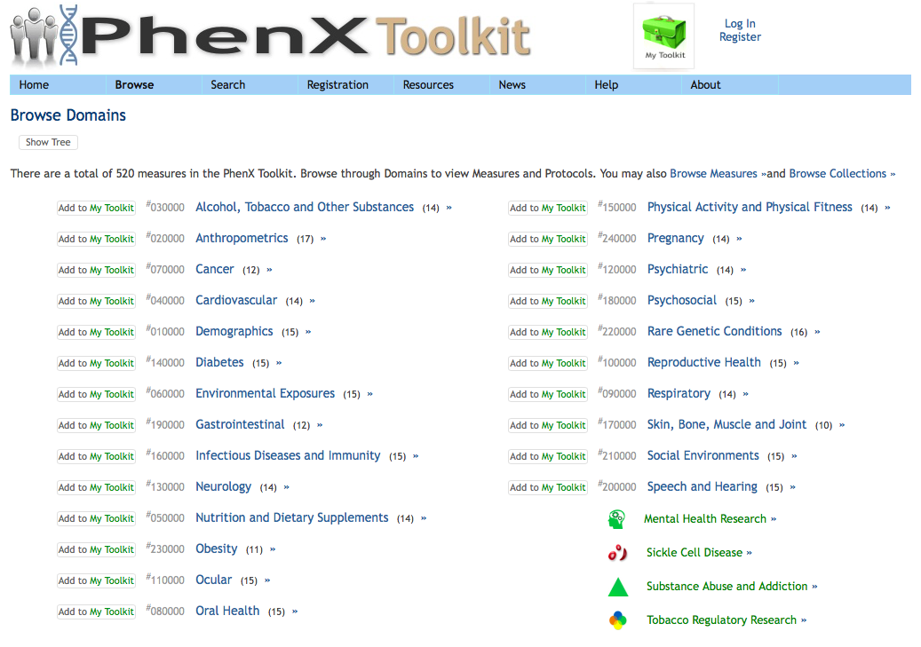
Common Data Elements (CDEs)
Common data elements / study variables would make research more comparable, reproducible, and meta-analyzable
  should measure same elements in care process to enable learning health system
CDEs may be variable definitions or surveys
  NIH Common Data Elements repository (>20,000 items)
  PhenX (520 measures)
  ICHOM measures covering 47% of global disease burden
Few CDEs of digital biomarkers yet
Notes:
International Consortium for Health Outcomes Measurement

Slide 12
What is a Digital Biomarker?
“Physiological and behavioral measures collected through connected digital tools”
Digital biomarkers are computed from raw sensor data
  E.g., accelerometry (x-y-z acceleration), gyroscopy (orientation and angular velocity), GPS trace, heart rate, heart rate variability, and respiratory rate from photoplethysmography (PPG)
  Raw data need to be processed into biomarkers that are clinically descriptive and/or predictive
Examples of commercially available dbiomarkers
  steps, activity classification (running, walking, driving), total distance run
  HR, HRV, core sleep, dream sleep
* I’m on the Editorial Board
Notes:
http://www.mc10inc.com/
Shwetak Patel, University of Washington

Slide 13
Example MD2K Biomarkers
Biomarker | Input | Output
Smoking event | Wrist motion | Begin and end timestamps of when four or more smoking puffs are detected | Validated in lab and field. Not trained to detect e-cigarettes. May confuse with drinking or eating popcorns
Stress episode | Wrist PPG for HR, RR, HRV | Begin and end timestamps of stress episodes (i.e., probability of “stressed” is >85%) | Model was trained against these values during standard stressors (cold pressor, mental math, and public speaking); validated against self-report in field
Conversation | Wrist PPG for Respiration | Begin and end timestamps of conversations (at breath cycle level) | Model was trained with video and audio recorded lab data; similar accuracy as audio on field data (i.e., 72%).

Slide 14
Multi-modal passive dbiomarker for depression
N=28 people, carrying a smartphone for 2 weeks
collected geolocation (GPS) readings and phone usage data every 5 minutes
derived digital biomarkers correlated with PHQ-9 scores
  circadian movement (regularity in 24-hour rhythm; r =-.63, P =.005)
  normalized entropy (mobility between favorite locations; r =-.58, P =.012)
  location variance (GPS mobility independent of location; r =-.58, P =.012)
  phone usage features, usage duration, and usage frequency were also correlated (r =.54, P =.011, and r =.52, P =.015, respectively)
Accuracy – 86.5% for predicting PHQ-9 score of 5 or greater
Saeb S, et al. J Med Internet Res 2015;17(7):e175
Notes:
Let’s look at an example of a digital biomarker, for depression.
Saeb and colleagues had 28 people carry a smartphone for 2 weeks and collected their geolocation and phone usage every 5 minutes. From this, they identified digital biomarkers that correlated with PHQ-9 scores. These biomarkers included the regularity of 24 hour activity, how much variation there was in travel patterns, or how often and long someone used their phone.
Using a logistic regression classifier, they achieved an accuracy of 86.5% for predicting PHQ-9 scores of 5 or higher.
Here, PHQ-9 is treated as the gold standard, and the biomarker Is meant to replace the PHQ-9 for differentiating no depression from mild depression. But this may not be the best biomarker for identifying more severe depression.

Slide 15
What are the “right” digital biomarkers?
smoking event
fall risk
pulmonary edema (lung water congestion)
  via radiofrequency transcutaneous sensor
smoking urge
fear of falling
dypsnea
http://md2k.org/
Notes:
In fact, for many things, we don’t know what the right biomarkers are to help manage chronic disease. We can use sensors to detect a smoking event -- using wrist accelerometer – or fall risk measured by gait and balance, or directly measuring pulmonary edema via an RF sensor.
But maybe it’s more useful clinically to collect PROs on smoking urge, fear of falling, dypsnea. Just as mobile technologies offer powerful new sensors for objective quantitative digital biomarkers, they also offer a new approach to PROs.
http://slideplayer.com/slide/10650231/

Slide 16
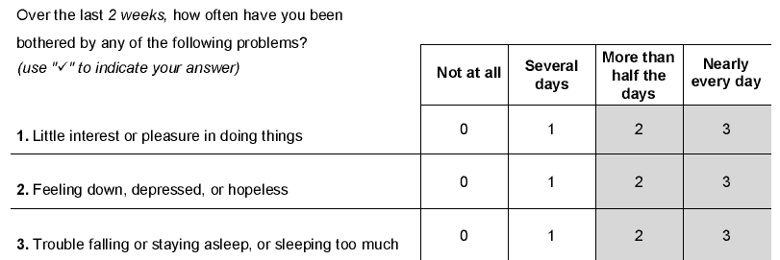
Patient-Reported Outcomes (PROs)
Paper-based
  e.g., PHQ-9, Beck, AUA BPH, SF-12, NeuroQOL, etc.
ePROs, via telephone or smartphone/computer
  guidelines for validating e-versions of paper forms
  computer adaptive testing (CAT) can build in branching logic to minimize number of questions patients have to answer, e.g., PROMIS
Notes:
Talked about basic networking, how machines connect to one another, and how we can run computation across data stored in distributed databases. This is all happening on the backdrop of the Web.

Slide 17
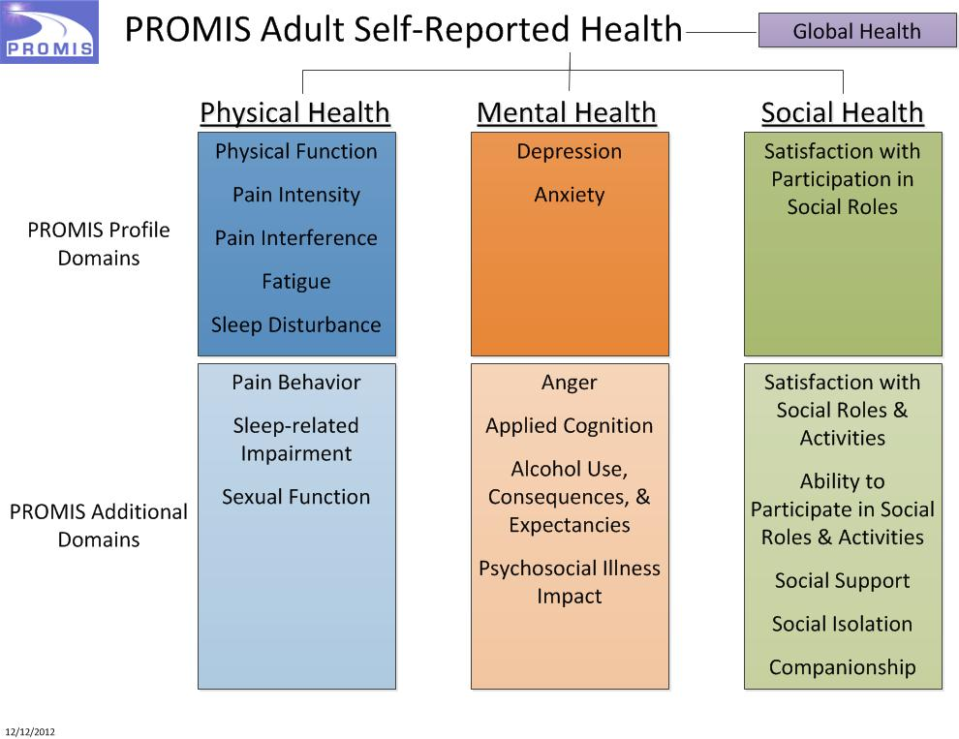
PROMIS Population-Normed PROs
  PROMIS®: brief, precise, valid, reliable fixed or tailored measures of patient-reported health status in physical, mental, and social well-being for adult & pediatric populations
  Standardized: One metric (T-score, Mean=50, SD=10; ref US pop)
  Advantages: disease-agnostic, flexible, adaptable (using computer-adaptive testing), comparable
  Disadvantages: boring, long, patients don’t like them, not useful to patients

Slide 18
PROs into the EHR
Standard PROs like PHQ-9
  can be built into Epic/MyChart as a form (see PCORI User Guide)
  PROMIS being built into APEX for mid-late 2018
Example: GI PROMIS at the VA
  patients complete GI PROMIS 1 week before visit
  computer generates heatmap and HPI
  doc and patient see this on “e-portal” or tablet
Important component of the Learning Health System
Almario, et al. Am J Gastroenterol 2 August 2016; doi: 10.1038/ajg.2016.305

Slide 19
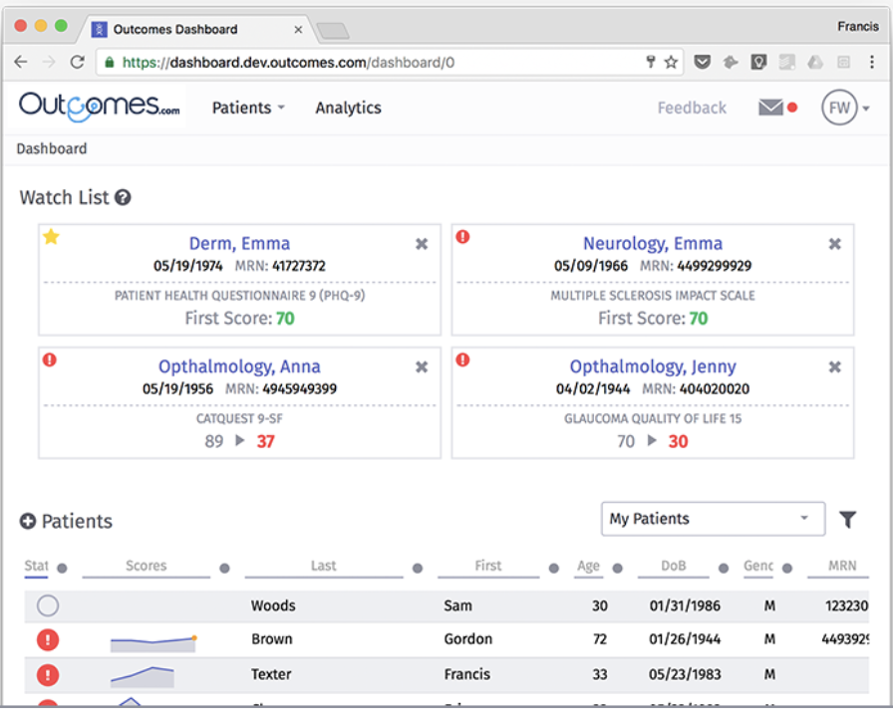
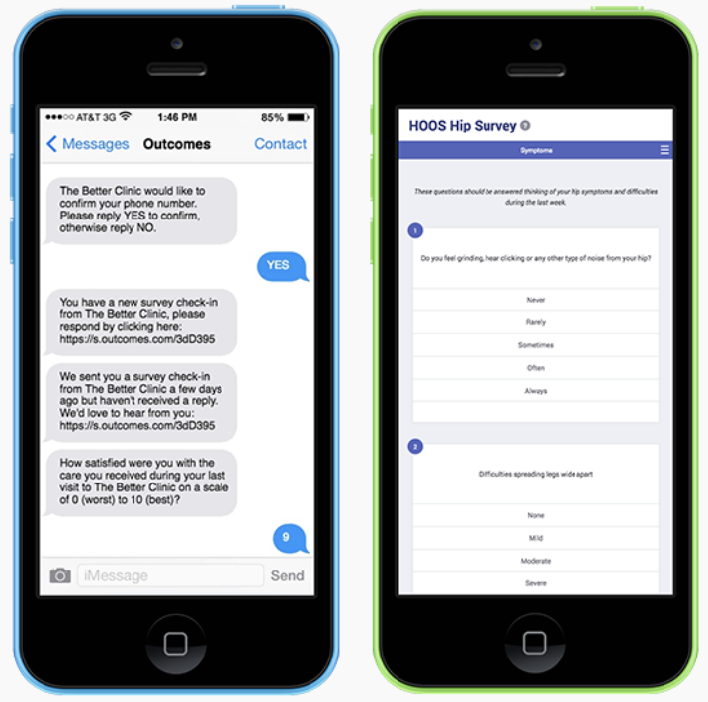
ePRO Platforms
Digital care/research platforms support PRO collection
E.g., Outcomes.com: user-friendly for the patient, dashboard for the clinician

Slide 20
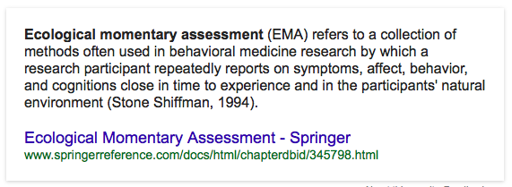
PROs vs. EMAs
Standard PROs
  infrequent assessments
  recall bias
  hard to answer “average” over period of report
  interviewer bias
  assessments are often in clinic
Notes:
The standard PRO approach has some weaknesses. Assessments are infrequent, so people have forgotten how they felt weeks or months ago, and it’s hard to average out and report on feelings you’ve forgotten. For PROs administered by an interviewer, there is interviewer bias, which can be compounded with assessments performed in the unnatural environment of a clinic.
In contrast, mobile technologies have made ecological momentary assessments, or EMAs, widely possible. EMAs are when a person repeatedly reports on symptoms, affect, behavior, and cognitions close in time to experience and in the person’s natural environment.

Slide 21
PROs vs. EMAs
Standard PROs
Ecological Momentary Assessments
  infrequent assessments
  recall bias
  hard to answer “average” over period of report
  interviewer bias
  assessments are often in clinic
assessments as frequently as necessary and appropriate
patient reports in real-time
less recall bias
direct self-report
assessments in native environment
Notes:
Compared to standard PROs, EMAs can occur as frequently as needed, real-time reports have less recall bias, there is no interviewer bias, and assessments are in the person’s native environment. EMAs are very attractive

Slide 22
Yang C, et al. JMIR mHealth uHealth 2015;3(2):e67
Notes:
Here’s from the eMocha study, the participant is offered individualized questionnaires that ask assessments “in the moment”. Where are you right now? Who did you drink with? Ubiquitous mobile technologies have revolutionized EMAs but fo the rest of my talk I’m going to leave active sensing and focus only on …

Slide 23
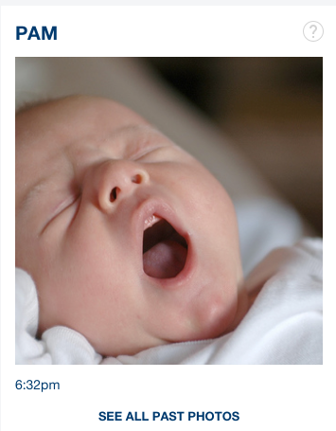
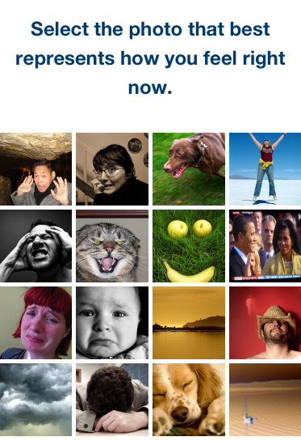
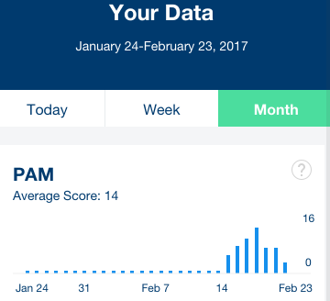
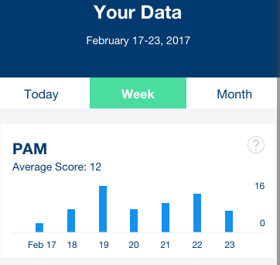

Photographic Affect Meter
EMA of mood freed from Likert scale
Validated against PANAS gold standard
Patients love using PAM!
Provides engagement, may help with retention
http://idl.cornell.edu/files/2013/09/PAM-1gnjegn.pdf

Slide 24
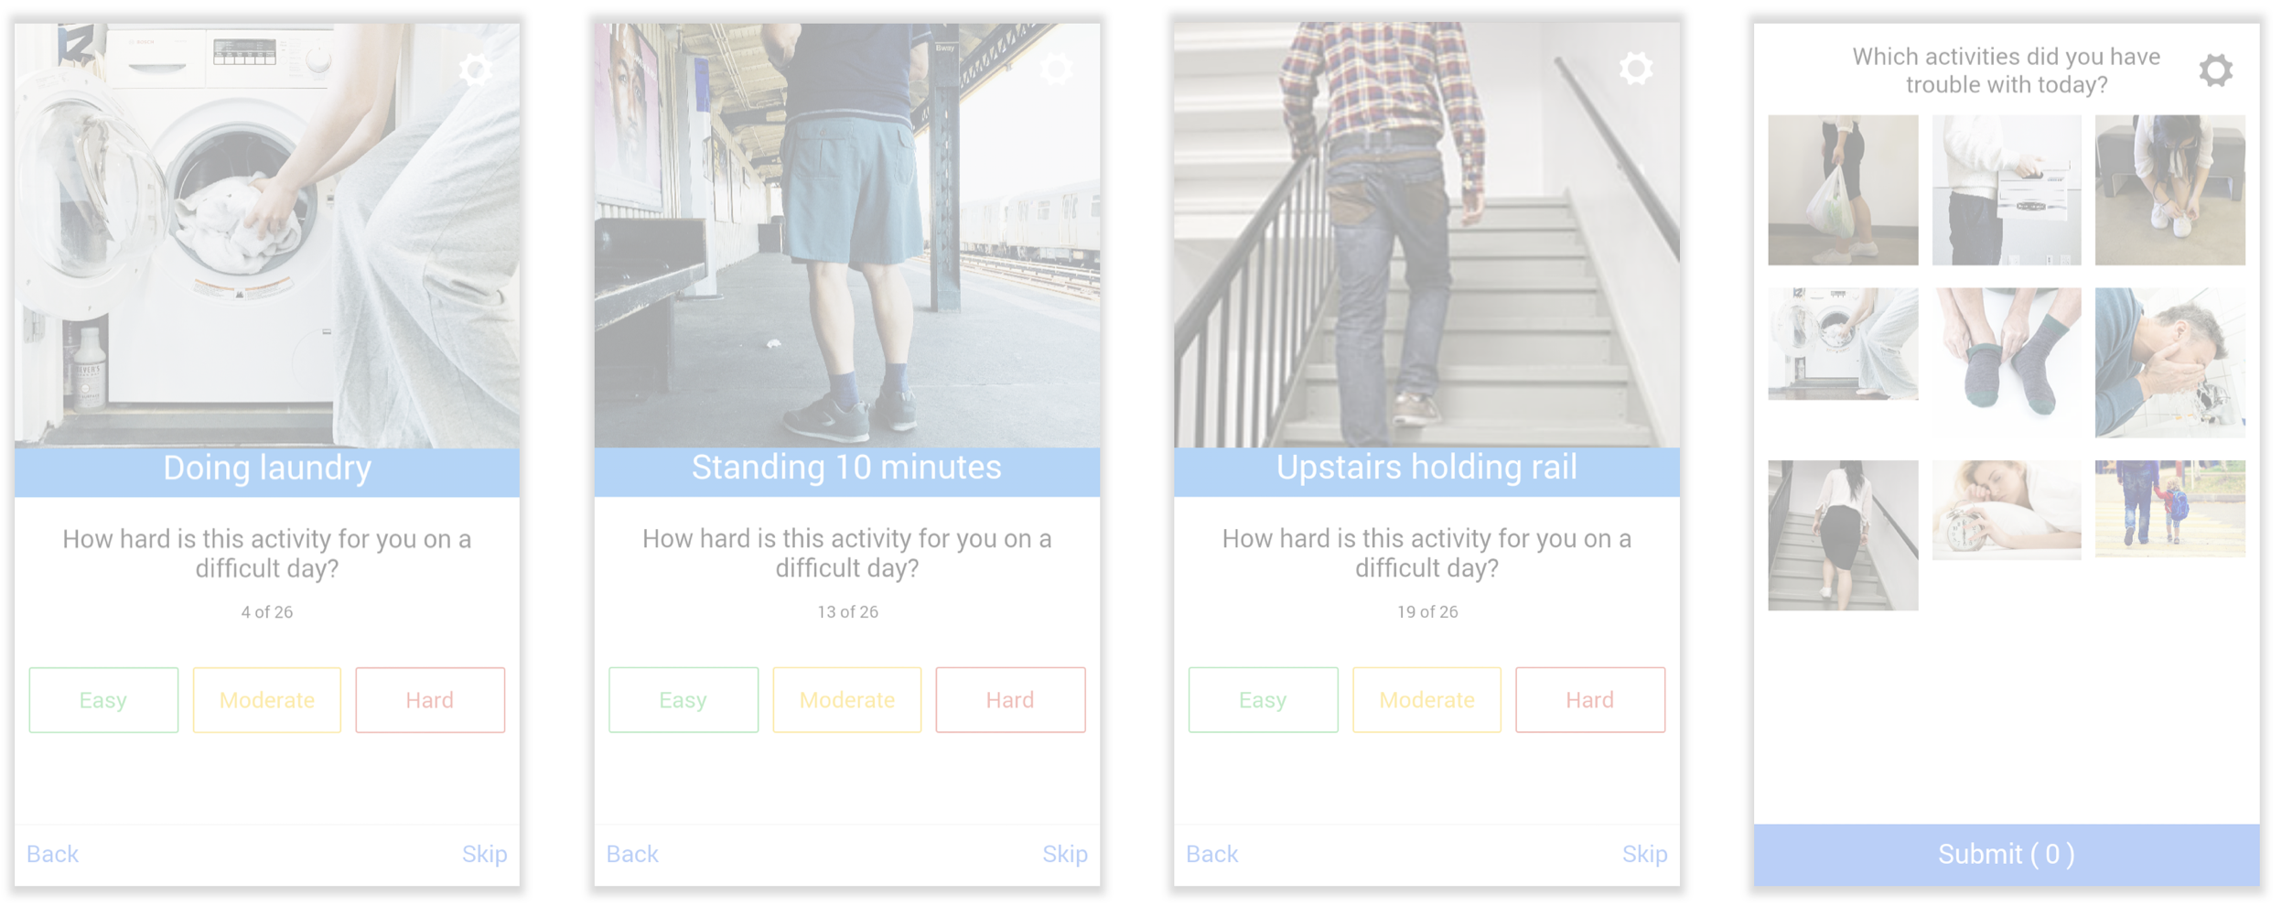
YADLs (Your Activities of Daily Living)
http://yadl.smalldata.io
Notes:
Longqi Yang, Diana Freed, Alex Wu, Judy Wu, JP Pollak, Deborah Estrin, Your Activities of Daily Living (YADL): An Image-based Survey Technique for Patients with Arthritis. 10th International Conference on Pervasive Computing Technologies for Healthcare (PervasiveHealth), 2016.

Slide 25
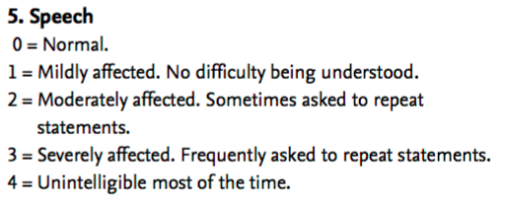
“Active Tasks”
activities under semi-controlled conditions, using sensors to collect data
can be used for outcomes assessment or disease detection
Unified Parkinsons Disease Rating Scale
mPower ResearchKit study
Notes:
Talked about basic networking, how machines connect to one another, and how we can run computation across data stored in distributed databases. This is all happening on the backdrop of the Web.

Slide 26
“Hybrid” PROs
Can we build individualized models combining passively sensed data with active self-report?
  instead of hip pain
    individualized models of mobility correlated to self-reported pain level
  instead of self-reported loneliness
    social network topology and activity correlated to perceived loneliness
  instead of frailty
    home mobility patterns, gait, balance correlated to fear of falling
Need platforms to collect sensor and PRO data together
Notes:
I’m particularly excited about the possibilities for what I call hybrid PROs that combine passively sensed data with active self-report.
For example, instead of asking about hip pain, can we build individualized models of mobility correlated to subjective pain level? We all know people who rate any pain a 9 or a 10 but can still do their daily activities, versus others who are limping but say their pain is a only 3 or 4. I’m sure you can think of many other examples of potential hybrid PROs. To develop this field, we need platforms that can collect sensor and PRO data together.

Slide 27
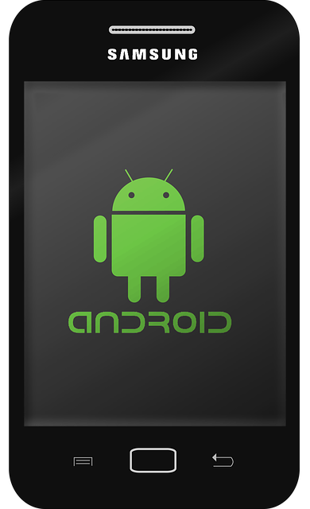

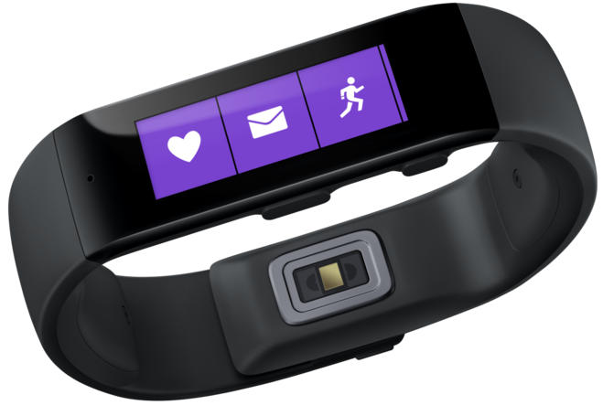

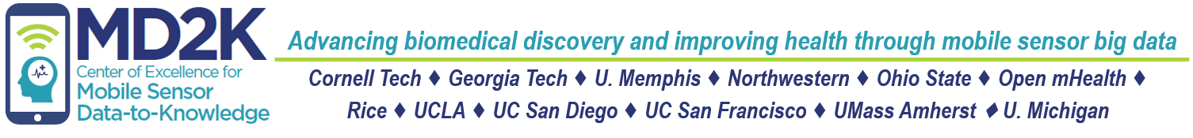
Staying Quit – Passive and Active dBiomarkers
Detect stress
adaptive microrandomization
Detect smoking
geolocation
stress
activity
individualized smoking urge model
individualized efficacy model
MD2K Spark cloud platform
February 13, 2018: I. Sim
Tech-enabled clinical research: Part 2
Epi 206 Medical Informatics
Notes:
To do this study, we must be able to detect stress in real time. We're doing that using a chest band that infers stress from HR, HRV, and respiratory rate and pattern. If stress is detected, the person gets a buzz on their MS Band wristband, and they go to their phone and are microrandomized to a stress reduction exercise – could be music, guided imagery, or meditation. They are then monitored for whether they smoke again, through a wrist sensor to monitor arm and wrist movement correlated with a deep inhalation.
Our real-time computational platform crunches all this real-time data to build individualized models of smoking urge and to drive adaptive randomization through an individualized efficacy model. Remember just 10 hours of this monitoring is 3 Shakespeare's worth of data.
https://methodology.psu.edu/media/techreports/14-126.pdf

Slide 28
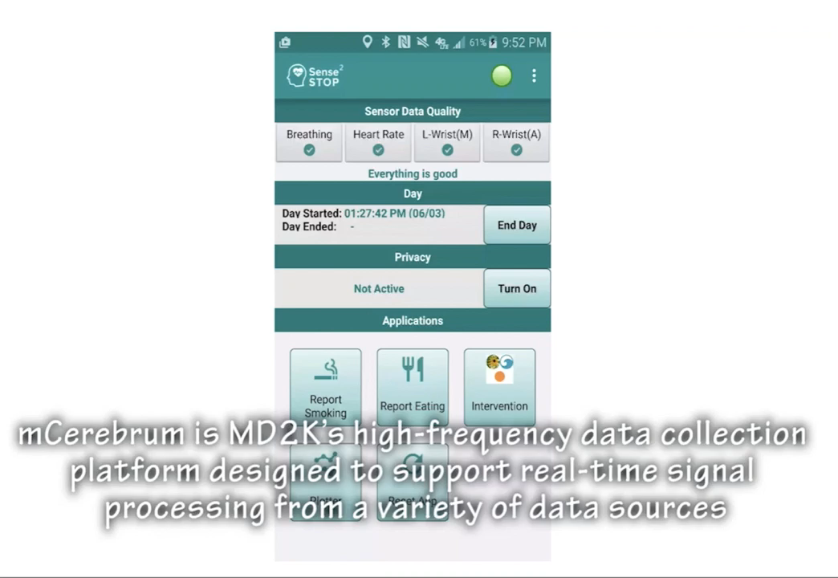
Notes:
I have a short video of MD2K’s data collection platform.
For example, a deep breath can be part of stress release or a conversation.
Gyroscopic data from a smartwatch records the roll of wrist as happens during eating or smoking.
Now if this system was tracking mobility, and the computational model detects that mobility has changed, it can trigger say a Brief Pain Inventory survey on pain interference, but otherwise leave the patient alone. MD2K is a primarily an engineering project, and it would be great if we could bring in the right PRO.

Slide 29
New Science: Digital Biomarkers & Hybrid PROs
What phenomena and constructs can now be measured?
How can tech and design be used to go beyond Likert-like scales?
How should passive sensing and active PROs be combined to increase accuracy while reducing respondent burden?
What are the measurement characteristics of these new individualized digital biomarkers and PROs?
How can these measures be integrated into self care and chronic disease management?
Etc etc
Notes:
For a new science of digital biomarkers, and hybrid PROs, where there are many questions.
And well, I’m just going to leave it right there. Thank you.

Slide 30
Validation Challenges
What is the gold standard?
  is PHQ-9 administered weekly the same as “mood” assessed daily?
  need new measurement science for e-measures
Can we measure more directly what we’re interested in? passively instead of actively?
  instead of pain: mobility, and individualized models of mobility vs pain level
  instead of UPDRS: voice, ability to trace on iPhone
  instead of self-reported loneliness: social network topology
  instead of frailty: home mobility patterns, gait, balance
  instead of PHQ-9…

Slide 31
Outline
Digital research platforms
Digital divide
Tech-enabled clinical research
  Screening, recruitment, enrollment and consent
  Retention
  Outcomes assessment and Engagement
    Data standardization
  Interventions and interventional design
Notes:
Talked about basic networking, how machines connect to one another, and how we can run computation across data stored in distributed databases. This is all happening on the backdrop of the Web.

Slide 32
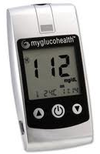
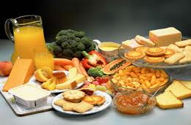
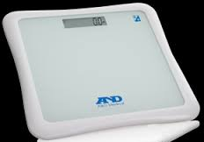
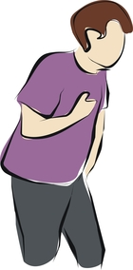
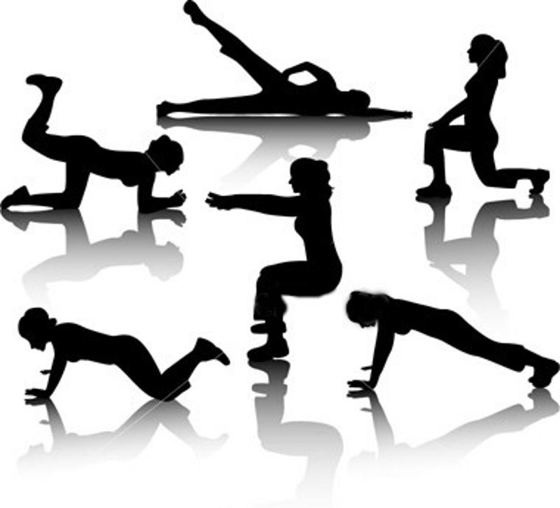
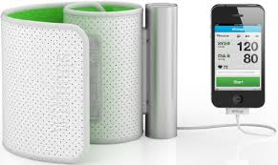
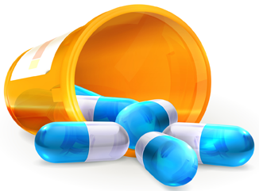
Data for Hypertension Management
blood glucose
nutrition
weight
chest pain
med adherence
physical activity
blood pressure, HR
Notes:
Some objective, some subjective
Some active report, some passively sensed

Slide 33
Obtaining the Data: APIs
API = Applications Programming Interface
  a piece of software that sets requirements on how one application can talk to another
Data repositories can expose their data via APIs
  21st Century Cures Act requires EHRs to expose APIs, need to be FHIR APIs by end of 2018
Modern Internet APIs are usually RESTful and use JSON (but not always)
Many sensor and app companies offer APIs for other systems to access their data
  e.g., 23&Me, Jawbone, FitBit, GoogleFit, Apple HealthKit

Slide 34
Example API: GoogleFit
Your app (e.g., in the Eureka platform) has to connect to the GoogleFit cloud
You have to let it know who you are (identification), prove that you are who you are (authentication) and be given appropriate access (authorization)
  this is usually done using OAuth 2.0
https://developers.google.com/fit/rest/v1/reference/parameters lists a bunch of commands you can now issue to get at data, e.g.,
  GET https://www.googleapis.com/fitness/v1/users/userId/dataSources/dataSourceId

Slide 35
Obtaining the Data: Schemas
e.g., https://www.googleapis.com/fitness/v1/users/"me"/dataSources/dataSourceId
You can get data about instantaneous or aggregated readings using their schemas (which are templates for describing data)
  e.g., com.google.heart_rate.bpm
    bpm (float—bpm)
  com.google.heart_rate.summary
    average (float—bpm)
    max (float—bpm)
    min (float—bpm)

Slide 36
Every Sensor Uses Different Schemas
GoogleFit
Activity Type
GoogleFit API
Android Wear
Duration
METS
X
AHA / WHO / CDC Guidelines:
At least 150 minutes of moderate intensity activity (i.e.,3-6 METS) per week
Fairly Active Minutes
FitBit
FitBit API
FitBit

Slide 37
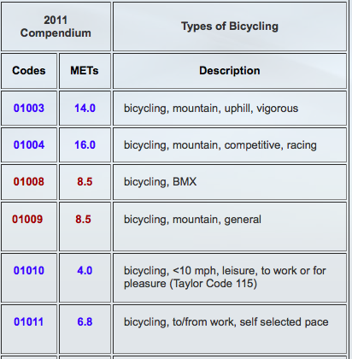
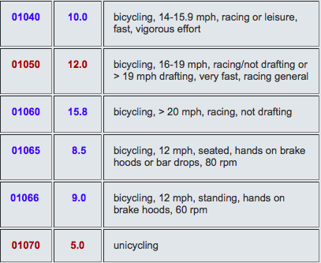
Minutes of Moderate Activity
Device | Data Element Name | Data Type/Value List
FitBit | Fairly active minutes | Number
GoogleFit | Activity | Aerobics, baseball, jogging, running, road biking, etc
 | Duration | Integer (milliseconds)
infer METS by type of activity, add up minutes at 3-6 METS
2011 Compendium of Physical Activities
Notes:
What about Google? Google Fit provides activity type and duration, so we could infer the METS by looking up the type of activity in for example the 2011 Compendium of Physical Activities. But road biking is anywhere from 4 METS if you're cycling leisurely at under 10 mph to over 15 METS if you're racing over 20 mph, and not drafting, or it's 5 METS if you're unicycling at any speed. So just knowing you're road biking isn't enough.
~~~~~~~~~~~~
Android FIT has Distance delta, Distance covered since the last reading, in meters

Slide 38
Minutes of Moderate Activity
Device | Data Element Name | Data Type/Value List
FitBit | Fairly active minutes | Number
GoogleFit | Activity | Aerobics, badminton, baseball, jogging, running, road biking, etc
 | Duration | Integer (milliseconds)
Health Kit | Workout Activity Type | Elliptical, running, hiking, walking, cycling, etc.
 | startDate | Number (a time value relative to an absolute reference date—the first instant of 1 January 2001, GMT)
 | endDate | Number (a time value relative to an absolute reference date—the first instant of 1 January 2001, GMT)
 | Total Distance (m, in, ft, or mi) | Number
Can convert duration and distance to METS (ml/kg/min) and add up minutes at 3-6 METS
Notes:
And HealthKit from Apple? We can calculate the duration of a workout using their definitions of start and endDate, and use known equations to calculate METS and add up the minutes at 3-6 METS. I've presented here a simplified story to make the point that something seemingly easy like getting at minutes of moderate activity isn't at all, and we're haven't gotten into more challenging data blood glucose (is it random, fasting or after a meal), or complicated variables to self-report and standardize like mood, or stress.
Birth of the Apple Universe

Slide 39
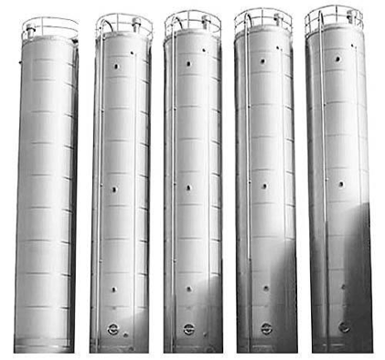
Déjà Vu
SNOMED
RxNORM
ICD-10
CPT
ICD-9
LOINC
Notes:
This is looking like déjà vu all over again. Silos, standards, headache!

Slide 40
Why Can't Health Data Work Like an ATM?
Banking
ISO 8583 standard has 128 data items, <80 used
No ambiguities in meaning (e.g., a dollar)
Only about 10 standard tasks (e.g., deposit)
20 years for ATMs to interoperate widely
Health care
ICD10 has 68,000 codes
Concepts (e.g., diseases) not well understood
Many complex, varying tasks
Each “customer” is different, many “tellers”

Slide 41
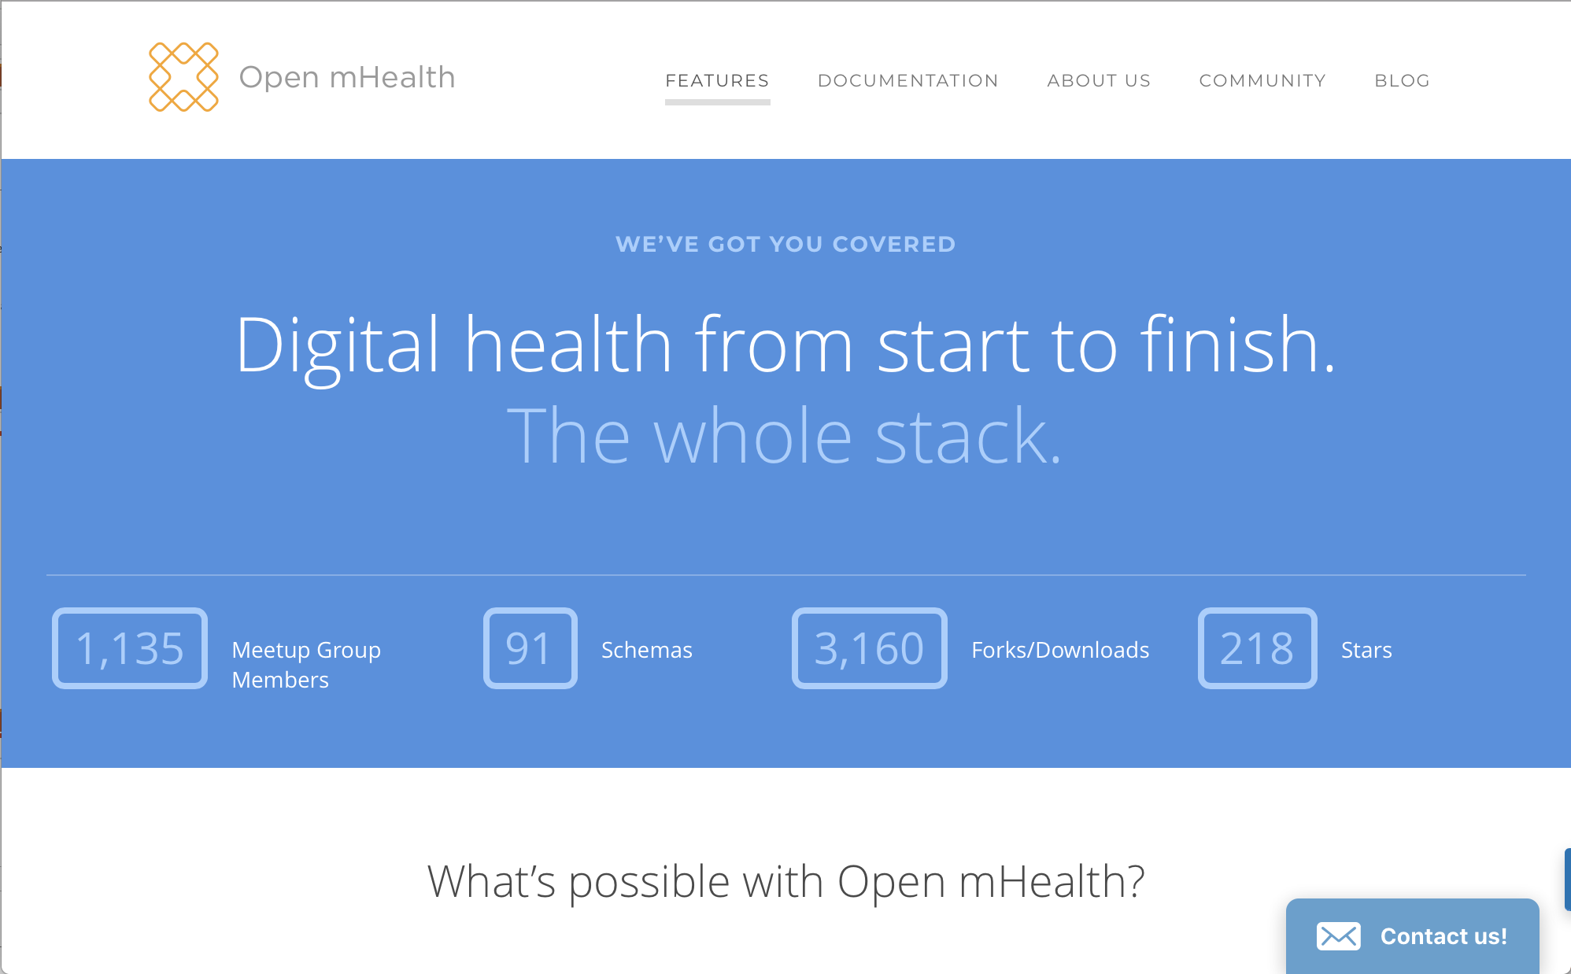

Slide 42
65+ Published Schemas
Utilities, e.g.,
time, units
descriptive statistics
Physical activity, e.g.,
physical activity, activity name
step count
minutes of moderate activity
Medication, e.g.,
med prescription, adherence percent
patient med schedule
Physiologic, e.g.,
BMI, height, weight
body temp, BP, BG, HR, RR interval, O2 sat
sleep episode, sleep duration
Environmental, e.g.,
ambient temp
Breathing, e.g.,
inspiratory time, expiratory time
breath carbon monoxide

Slide 43
P1752 Open mHealth Working Group Meeting
Sponsored by IEEE Engineering in Medicine & Biology (EMB) Standards Committee
Making Open mHealth an international standard
  65 schemas
  standard mHealth API
5 Feb 2018
Teleconference

Slide 44
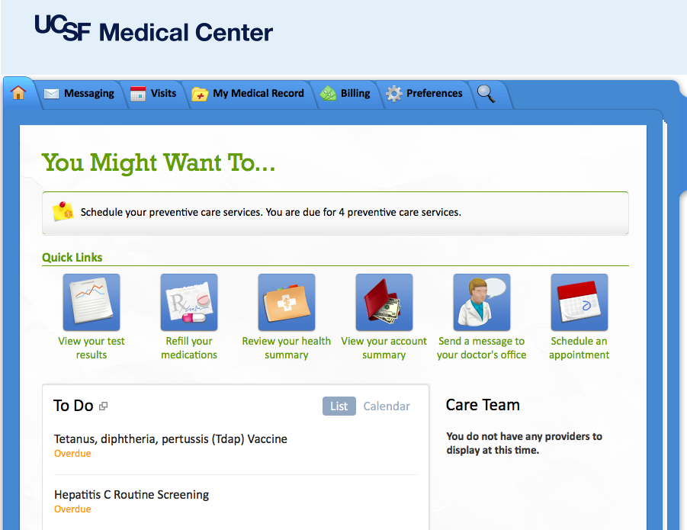
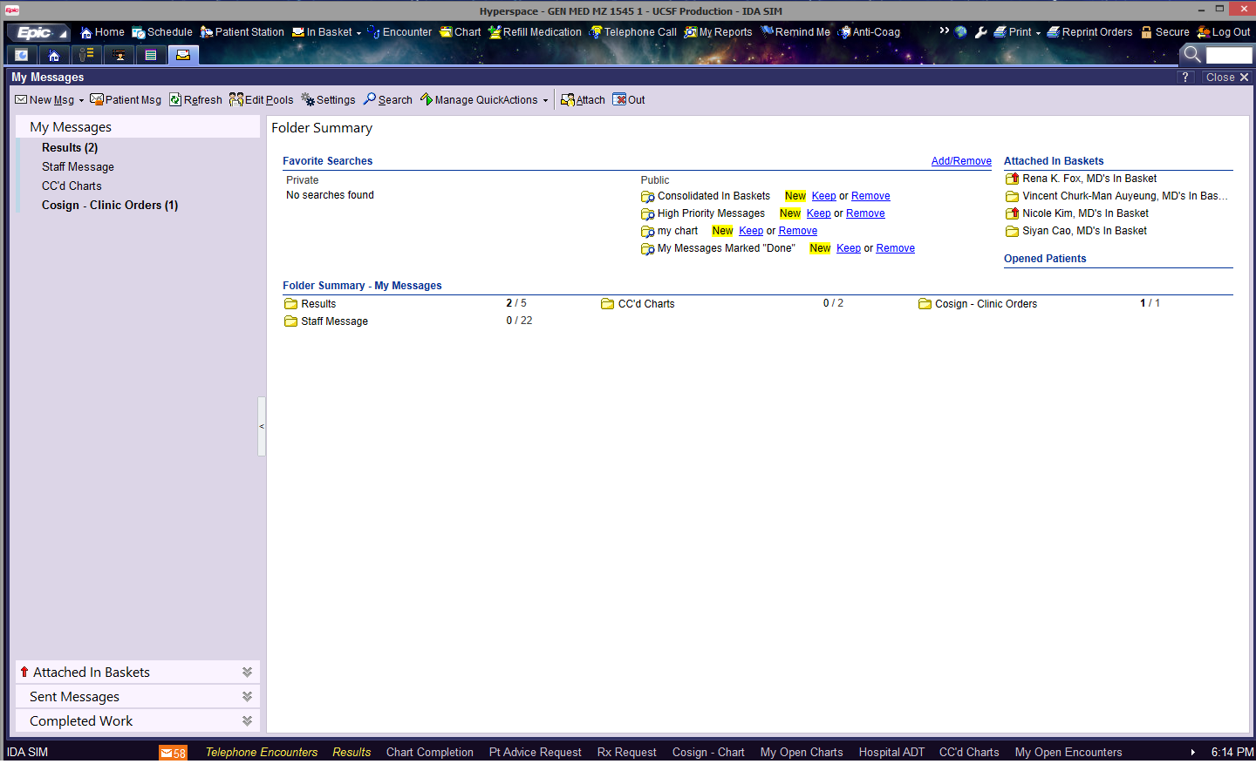
Epic/Apple-based Outcomes Assessment for LHS
completely dependent on Apple and Epic
Requires use of MyChart
FitBit doesn’t talk to HealthKit
stuck with Epic’s user interface
MyChart
PROs
Omron BP
Epic interface
X
Health
Record
FHIR
Epic Chronicles DB
FitBit
Notes:
No FitBit, no Android

Slide 45
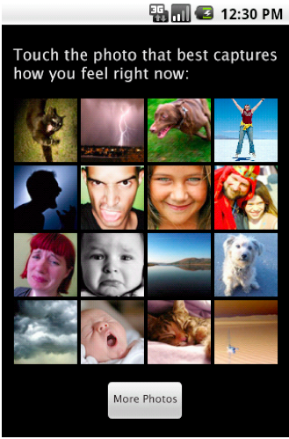
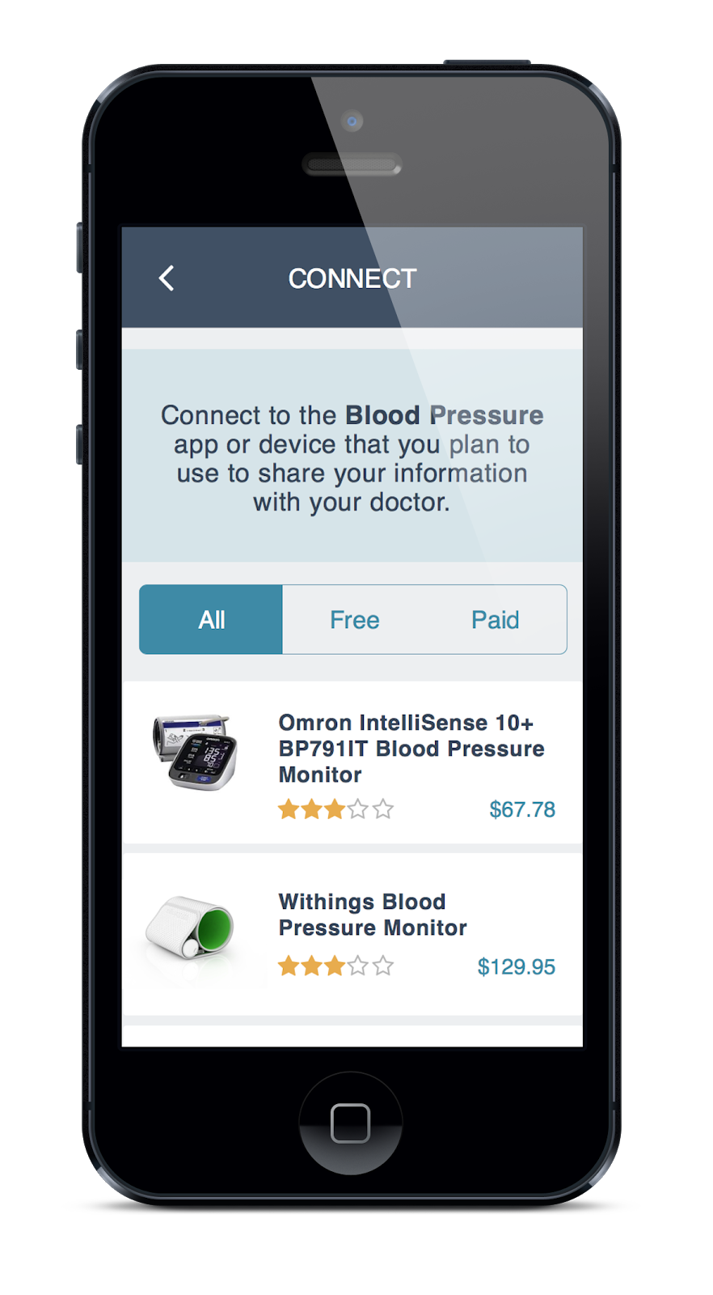
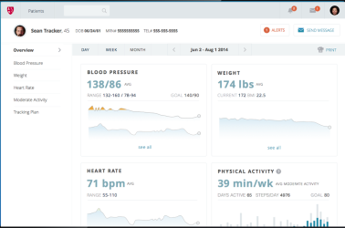
Open mHealth/FHIR-Based LHS
iOS or Android
Bring Your Own Device (BYOD)
PROs/EMAs
Active Tasks
Omron cloud
Feedback and viz to patient
Shimmer
FitBit cloud
OmH schemas
FHIR/OmH
PGHD data
FitBit
Displays in window within Epic workflow

Slide 46
Outcomes Assessment Summary
Assessment can be active, passive, or hybrid
Active assessments can involve ePROs, computer-adaptive testing, ecological momentary assessments, and active tasks
BYOD assessments can be facilitated by Open mHealth data standards
Various approaches possible and in play for getting outcome data and actionable recommendations back to patients and into the clinical workflow
  patient-generated health data do not necessarily have to go into the EHR database
  should avoid vendor trap
Notes:
Talked about basic networking, how machines connect to one another, and how we can run computation across data stored in distributed databases. This is all happening on the backdrop of the Web.

Slide 47
Outline
Digital research platforms
Digital divide
Tech-enabled clinical research
  Screening, recruitment, enrollment and consent
  Retention
  Outcomes assessment and Engagement
  Interventions and interventional design
Notes:
Talked about basic networking, how machines connect to one another, and how we can run computation across data stored in distributed databases. This is all happening on the backdrop of the Web.

Slide 48
Technology-enabled Interventions
Education (e.g., post-natal self-care)
Reminders (e.g., med adherence, sit less!)
Tracking (e.g., diet)
Feedback (e.g., activity, BP at goal?)
Reflection (e.g., gratitude)
Goal setting (e.g., physical activity)
Incentives and rewards (e.g., points, leaderboard)
Social network (e.g., peer counselling)
Cognitive exercises (e.g., urge surfing, mindfulness)
Active tasks (e.g., practicing eye contact)
…
Notes:
Talked about basic networking, how machines connect to one another, and how we can run computation across data stored in distributed databases. This is all happening on the backdrop of the Web.

Slide 49
Therapeutic Precision
Genomics will help make biological therapies more precise
  but there will still be heterogeneity of treatment response
“Behavioral medicine is the blockbuster ‘drug’ of the 21st century”
  different mix of app/tech functions are needed for each person and each context

Slide 50
Mismatched "Metabolic Rate" of Technology and Evaluation
Riley et al. Clinical and Translational Medicine 2013, 2:10

Slide 51
LHS Interventional Designs: Does it Work?
Observational studies
  traditional and Big Data
Experimental
  JITAI
  MOST
  embedded RCTs (e.g., COPD order sets)
  PORT
  Stepped wedge
  N-of-1
Notes:
Observational studies, embed RCTs in care like CTSI COPD order sets and

Slide 52
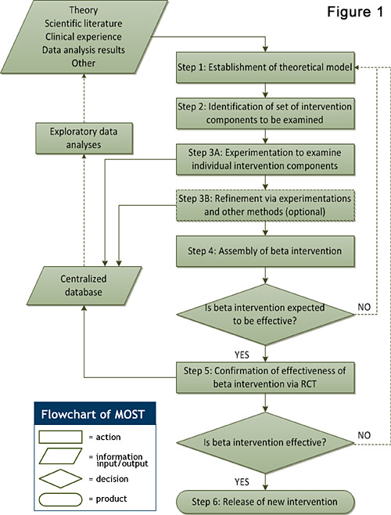
Multiphase Optimization Strategy (MOST)
JITAI studies can be combined with MOST studies
http://methodology.psu.edu/ra/most/research
Notes:
http://methodology.psu.edu/ra/most/research

Slide 53
Prompted Optional Randomized Trial
If enough docs switch when prompted, known and unknown confounders are washed out
  i.e., lower precision can be overcome with larger sample size
Prompt is an instrumental variable
  quite strongly associated with treatment assignment
  not directly associated with outcome of interest
  not associated with potential confounding variables
venlafaxine
sertraline
venlafaxine
sertraline
venlafaxine
venlafaxine
venlafaxine
sertraline
sertraline
sertraline
Flory, Karlawish. Am J Public Health 2012;102:e8–e10. doi:10.

Slide 54
Stepped Wedge
Technology, behavioral and QI interventions often have to be rolled out in stages
  e.g., EHR roll out, limited $ for online chat staffing, have only one team of anti-smoking counsellors, limited number of sensors available
You may suspect large temporal confounding
  e.g., change in reimbursement policies, changes in background technology
Using only single historical or parallel-group control may not be enough

Slide 55
Stepped Wedge Design
parallel controls
historical controls
http://www.biomedcentral.com/1471-2288/6/54
Notes:
randomly assigned to row
- esp good for more good than harm (e.g., EHR) where everyone gets the intervention in the end (unethical not to let them use it)

Slide 56
which works better: venlafaxine or sertraline?
sertraline
Mood, social activity
100 people
50 people
venlafaxine
Mood, social activity
50 people
population
tells us on average whether sertraline or venlafaxine is better at improving mood, depression
Notes:
56
The standard thing to do would be to run an RCT, and we will see on average if oxycodone works better than say Percocet.
The problem though is that none of us are average.

Slide 57
none of us are average
sertraline better
venlafaxine better
Notes:
57
The standard thing to do would be to run an RCT, and we will see on average if oxycodone works better than say Percocet.
The problem though is that none of us are average.

Slide 58
which works better for you?
N-of-1 study design: testing both in you for the outcomes that matter to you
sertraline
venlafaxine
sertraline
You
venlafaxine
sertraline
venlafaxine
individual
http://effectivehealthcare.ahrq.gov/index.cfm/search-for-guides-reviews-and-reports/?productid=1844&pageaction=displayproduct
Notes:
58
The only formal method for answering "does it work for me" is the N-of-1 study design.
In which there's only 1 person, 1 "n" in the study. So I would be randomized first to PTSD Coach, then usual care, and back and forth a few cycles, assessing my depression symptoms along the way.
This method is not widely known and is statistically complicated, but offers the kind of personal evidence we need to drive systematic but personalized learning across mHealth

Slide 59
there you are!
sertraline better
venlafaxine better
Notes:
59
The standard thing to do would be to run an RCT, and we will see on average if oxycodone works better than say Percocet.
The problem though is that none of us are average.

Slide 60
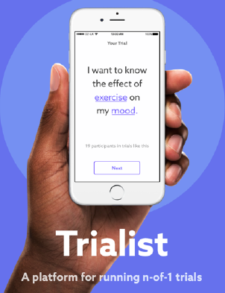
mHealth-enabled N-of-1 (“ultimate design for precision medicine”)
Trialist from Open mHealth is a generalizable platform for n-of-1 studies
v 1.0 used to optimize chronic pain med use (PREEMPT), n = 215
  no change in 6-month pain interference (p=0.09)
  88% patients assigned to n-of-1 completed their self-designed n-of-1 trial (95/108)
Text-based n-of-1 study in works with WNYC/NY Times
  n = up to 15,000+

Slide 61
Interventions Design Summary
Technology promises “21st century” primarily behavioral interventions
Enables and requires novel interventional designs
  adaptive, just-in-time, and individualized
  embedded into care processes via EHR and self-care processes via personal technologies
  includes observational and more expensive/complicated experimental designs depending on the strength of evidence needed
Notes:
Talked about basic networking, how machines connect to one another, and how we can run computation across data stored in distributed databases. This is all happening on the backdrop of the Web.

Slide 62

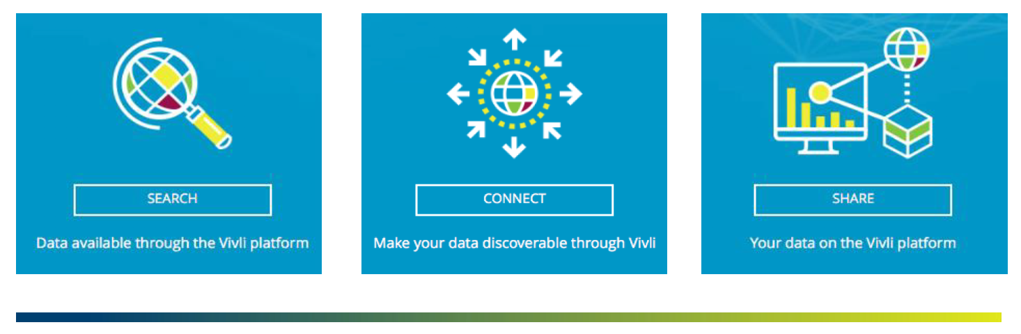
Vivli
*I’m co-founder
Global neutral platform for listing, requesting, sharing and analyzing participant-level clinical trial data – launching July 19
Infrastructure for more open, shared, reusable clinical research that respects participant and researcher rights and interests

Slide 63
Vivli Benefits for Academic Data Contributors
Study Type | Study will be curated and listed on Vivli | IPD Storage | Data already Anonymized | IRP required | Cost
Clinical Study ready for sharing | Yes | Not req’d | Yes | No | No Cost
Clinical Study ready for sharing requires storage | Yes | Yes req’d | Yes | No | $2,000
Clinical Study ready for sharing requires IRP and storage | Yes | Yes req’d | Yes | Yes | $4,000
Clinical Study ready for sharing, requires Anonymization | Yes | Yes req’d | No | No | Vivli Phase 2
Contingent upon agreeing to the harmonized data contributor agreement
BENEFITS – meets ICMJE publishing requirements, DOI provides ability to track use of data in publications, secure storage and IRP process
Notes:
Have to have a multiple currency system for collecting small fees—requires CRM and ecommerce system
PAD A % ON THE IRP
COST +

Slide 64
Class Summary
Informatics necessary for making sense of data into information and knowledge
Tech-enabled evidence for ordered complexity = (big) data + (novel) study designs + (machine) analytics
Learning Health(care) System is a useful concept for breaking out of care vs. research silos
EHR data increasingly obtainable at UCSF, across UCs, and beyond
Key informatics points to keep in mind
  data representation and standards are vital for ensuring meaning
  technology must be designed for humans to use and engage with
  some of the hardest challenges are sociotechnical: privacy, organizational change, digital divide

Slide 65
Take Home Message
At the cusp of something transformative
  be open to partnering with computer scientists, patients, companies, etc.
To guard against hype and to maximize value
  stay grounded in what is clinically useful and important
  know as much as possible of the underlying informatics
  don't forget to apply epi/biostats principles, but be open to new methods for studying ordered complexity
  help develop new tech, digital biomarkers, methods for evaluation -- bring clinical research science to the digital age
Course evaluation
  please fill out when you get it!

