Slide 1
Interaction and effect measure modification
Cindy Leung, ScD, MPH
Formerly: Center for Health and Community, UCSF
Current: Asst. Prof. University of Michigan, School of Public Health
Notes:
Welcome to this lecture on interaction and effect measure modification. This is the first of two lectures on this topic, where we will explore why interaction and effect measure modification matters, methods to assess effect modification, and how to present results of interaction and effect modification in analyses.

Slide 2
For Students in EPI2017 in 2018:
Please ignore the first 5 minutes of the recorded lecture by Dr. Leung (this lecture was recorded March 2017, and she starts by summarizing “last week’s highlights” which are not relevant for you).
Please fast-forward to time-point 4:53 (slide 6) in Part 1 of the Interaction & Effect Mod lecture. We have left these slides here as placeholders such that the slide number aligns with that in the recorded lecture.
- JM Chan 2/13/18

Slide 3
For Students in EPI2017 in 2018:
Please ignore the first 5 minutes of the recorded lecture by Dr. Leung (this lecture was recorded March 2017, and she starts by summarizing “last week’s highlights” which are not relevant for you).
Please fast-forward to time-point 4:53 (slide 6) in Part 1 of the Interaction & Effect Mod lecture. We have left these slides here as placeholders such that the slide number aligns with that in the recorded lecture.

Slide 4
For Students in EPI2017 in 2018:
Please ignore the first 5 minutes of the recorded lecture by Dr. Leung (this lecture was recorded March 2017, and she starts by summarizing “last week’s highlights” which are not relevant for you).
Please fast-forward to time-point 4:53 (slide 6) in Part 1 of the Interaction & Effect Mod lecture. We have left these slides here as placeholders such that the slide number aligns with that in the recorded lecture.

Slide 5
For Students in EPI2017 in 2018:
Please ignore the first 5 minutes of the recorded lecture by Dr. Leung (this lecture was recorded March 2017, and she starts by summarizing “last week’s highlights” which are not relevant for you).
Please fast-forward to time-point 4:53 (slide 6) in Part 1 of the Interaction & Effect Mod lecture. We have left these slides here as placeholders such that the slide number aligns with that in the recorded lecture.

Slide 6
Learning Objectives
Review effect modification
Explain the concept of biologic interaction
  Defined under the counterfactual approach
  Defined under the sufficient cause approach
Measures of interaction
Describe methods to assess effect modification
  Graphical assessment
  Stratification
  Comparing expected vs. observed joint effects
  Estimating interaction magnitude
Notes:
Today, we will focus on the following learning objectives.
First, we will review what effect modification is.
Then, we will describe common methods to assess effect modification, including stratification, comparing expected vs. observed joint effects, and graphic representation. We will also discuss estimating interaction magnitude and statistical tests for interaction.
And finally, we will review the concept of biologic interaction, both under the sufficient cause approach and the counterfactual approach.

Slide 7
Learning Objectives
Looking ahead:
Learn how to estimate attributable fraction and other indices
Discuss ways of presenting the results of analyses for interaction and for effect modification
Notes:
As this is the first of two lectures on this topic, next week, we will cover attributable fractions and other indices, and discuss ways to present results of interaction and effect modification,.

Slide 8
Learning Objectives
Review effect modification
Explain the concept of biologic interaction
  Defined under the counterfactual approach
  Defined under the sufficient cause approach
Measures of interaction
Describe methods to assess effect modification
  Graphical assessment
  Stratification
  Comparing expected vs. observed joint effects
  Estimating interaction magnitude
Notes:
Let’s first review the concept of effect modification,.

Slide 9

Effect modification – an example
Causal effect of interest depends on the characteristics of study population
Consider example from Hernan and Robins, Chapter 4:
  What is the average causal effect?
    Pr[Y^{a=1} = 1] = 10 / 20 = 0.5
    Pr[Y^{a=0} = 1] = 10 / 20 = 0.5
    Causal risk ratio = Pr[Y^{a=1} = 1] / Pr[Y^{a=0} = 1] = 0.5 / 0.5 = 1
    Causal risk difference = Pr[Y^{a=1} = 1] - Pr[Y^{a=0} = 1] = 0.5 - 0.5 = 0
Notes:
In many prior examples and studies, we’ve focused on the causal effect in the entire study population of interest. But, it’s important to remember that there is no one causal effect of interest.
The decision to calculate causal effects in the whole population or certain subgroups depends on your goals for inference.
For example, if you’re considering a public health intervention of a tax on sugary beverages, you may be interested in the average causal effect in all of San Francisco but you may also want to know if certain subgroups, for example, low-income populations or racial/ethnic minority groups or children might be affected differently. If you’re testing the effects of a drug on systolic blood pressure, you may be interested in knowing whether the effect is different among men or women, or among younger vs. older patients.
The data in this Table comes from the Hernan and Robins textbook and is an example of heart transplant, A, on death, Y, in 20 individuals. In this unique example, we see each individual’s two counterfactual outcomes. Y superscript 0 is the outcome if they had not received the heart transplant. Y superscript 1 is the outcome if they had received the heart transplant.
To compute the average causal effect, we need two pieces of data. First, we need the probability of death if everyone had received treatment. In this data set, there would be 10 deaths out of 20 individuals, so the risk if everyone had been exposed is 0.5. The second piece of data we need is the probability of death if everyone had been unexposed. In this data set, there would be 10 deaths out of 20 individuals, so the risk if everyone had been unexposed is 0.5.
Now we can calculate the causal risk ratio, which is 0.5 divided by 0.5 or 1. This means there is no causal effect of heart transplant on the risk of death on the multiplicative scale..
We can also calculate the causal risk difference, which is 0.5 minus 0.5 or 0. This means there is no causal effect of heart transplant on the risk of death on the additive scale.

Slide 10
Effect modification – an example
  What is the average causal effect in men?
    Causal risk ratio: Pr[Y^{a=1} = 1 | M=0] / Pr[Y^{a=0} = 1 | M=0] = 0.4 / 0.6 = 0.667
    Causal risk difference: Pr[Y^{a=1} = 1 | M=0] - Pr[Y^{a=0} = 1 | M=0] = 0.4 - 0.6 = -0.2
  What is the average causal effect in women?
    Causal risk ratio: Pr[Y^{a=1} = 1 | M=1] / Pr[Y^{a=0} = 1 | M=1] = 0.6 / 0.4 = 1.5
    Causal risk difference: Pr[Y^{a=1} = 1 | M=1] - Pr[Y^{a=0} = 1 | M=1] = 0.6 - 0.4 = 0.2
Notes:
But what if we consider the average causal effect of A on Y in men and women separately?
Now we can calculate the same numerator and denominator, but restricted to our two subpopulations. In men, the probability of death had all men been exposed is 4/10 or 0.4. The probability of death had all men been unexposed is 6/10 or 0.6. Thus, the causal risk ratio in men is 0.4 divided by 0.6 or 0.667. This means that the exposure, heart transplant, lowers the risk of death in men.
In women, the probability of death had all women been exposed is 0.6. The probability of death had all women been unexposed is 0.4. The causal risk ratio is 0.6 divided by 0.4 or 1.5. This means that the exposure, heart transplant, increases the risk of death in women.

Slide 11
Effect modification – an example
Take-away points:
The average causal effects are different from the stratum-specific causal effects.
The causal effect of A on Y is different for men and women.
Notes:
This example is meant to illustrate two points.
First, the average causal effect is 1, implying no effect of heart transplant on the risk of death in the entire study population. However, the sex-specific causal effects tell a different story, leading me to the second point.
The second point is the causal effect of A on Y is different for men and women. And not different like comparing a risk ratio of 1.5 to 1.7. The effects are of the same magnitude but in the opposite direction so that when the population is examined as a whole, the sex-specific effects cancel out.

Slide 12
Effect modification - definitions
Effect modifier: M is a modifier of the effect of A on Y when the average causal effect of A on Y differs across levels of M.
Effect measure modification: dependent on the measure being used
  Sex (M) is an effect modifier of the effect of A on Y on the multiplicative scale because the causal risk ratio (0.667 vs. 1.5) differs across levels of M.
  Sex (M) is an effect modifier on the effect of A on Y on the additive scale because the causal risk difference (0.2 vs. -0.2) differs across levels of M.
  Effect modification on one scale does not guarantee effect modification on another scale.
Qualitative effect modification: The average causal effects within levels of M are in opposite directions.
  In presence of qualitative effect modification, additive effect modification implies multiplicative effect modification, and vice versa.
Notes:
This brings us to some definitions.
An effect modifier, M, is a variable where the average causal effect of A on Y differs across levels of M.
Effect modification also depends on the measure being used. This is why we use the term effect measure modification, rather than effect modification, to show how the concept is dependent on the effect measure. Most estimates of effect are based on multiplicative models with relative measures, so most effect modification is examined on the multiplicative scale.
In this example, Sex is an effect modifier of A on Y on the multiplicative scale because the causal risk ratio differs between men and women. In men, the causal risk ratio was 0.667. In women, the causal risk ratio was 1.5.
Sex is also an effect modifier on the effect of A on Y on the additive scale because the causal risk difference differs between men and women. In men, the causal risk difference was negative 0.2. In women, the causal risk difference was positive 0.2.
However, effect modification on one scale does not guarantee effect modification on another scale.
In this unique example, we have evidence of qualitative effect modification. Qualitative effect modification is when the average causal effects within levels of the effect modifier are in opposite directions. In women, heart transplant was associated with higher risk of death. In men, heart transplant was associated with lower risk of death. When there is qualitative effect modification, effect modification on the additive scale implies effect modification on the multiplicative scale, and vice versa.

Slide 13
Effect modification
What if there is no effect modification on either of the two scales?
  Then, one of the two exposures has no effect on the outcome at all.
Notes:
Now what if there is no effect modification on either the additive or the multiplicative scales?
You can pause the video here if you want to think about your answer.
What if there is no effect modification on either the additive or the multiplicative scales?
(Click) That means that one of the two exposures had no effect on the outcome at all.

Slide 14
Effect modification - definitions
Surrogate effect modifier: an effect modifier that is likely not involved in the mechanisms of effect modification, but used as a marker for a causal effect modifier
  E.g. Nationality in the effect of heart transplant on the risk of death
Causal effect modifier: an effect modifier that is involved in the mechanisms of effect modification
  E.g. Quality of care in the effect of heart transplant on the risk of death
Heterogeneity of effects: a neutral term to characterize when effect estimates differ across strata of M, without attributing a causal role of the effect modifier
Notes:
Let’s review some more definitions now.
A surrogate effect modifier is a variable that meets our earlier definition of an effect modifier but is likely not involved in the mechanisms of effect modification. It is sometimes used as a marker for a causal effect modifier. An example of this is nationality in the effect of heart transplant on the risk of death.
It’s very likely that your nationality has little causal effect on how a heart transplant affects one’s risk of death. Perhaps it is a marker of quality of care or other health factors that play a role.
These variables are called causal effect modifiers. They are effect modifiers that are involved in the mechanisms of effect modification.
And finally, we have the term heterogeneity of effects.
This is a more neutral term that has often been used in place of effect modification to denote when effect estimates differ across strata of M but does not indicate that this variable acts as a causal effect modifier.

Slide 15
Effect modification – why care?
If the causal effect varies within levels of an effect modifier, M, then the average causal effect will differ in populations with different distributions of M.
  Improves transportability of causal inferences in the population
Understanding effect modification is helpful to identify which populations may benefit most from public health interventions
Helps to understand mechanisms linking exposure and outcome
Notes:
There are several reasons why we care about identifying effect modification.
(click) First, if the causal effect varies within levels of an effect modifier, M, then the overall causal effect that we’re trying to estimate will differ in populations with different populations of M. In the first example of the heart transplant, we saw that the treatment was harmful in women but protective in men. It just so happened that 50% of our study population were men and 50% were women, so the average causal effect was null – the risk ratio was 1.
But, if we conducted our study in a population with 75% women, we would have observed a different causal effect – one that suggests the exposure is harmful.
Previously, we said there is no such thing as the average causal effect – that the causal effect of interest depends on the characteristics of the study population, and particularly, the population with a specific distribution of effect modifiers.
(click) For causal inference, we care about the transportablility of our effect estimates. The extrapolation of our causal effect in one study population to a second study population is called the transportability of causal inferences cross populations. This can be improved if we know that the average causal effect is different between men and women and thus the sex-specific causal effects may be more transportable than the total effect.
(click) Another reason why we care about effect modification is that it helps us identify which groups of subjects would benefit the most from a public health intervention. In the heart transplant example, if a physician knows that a heart transplant has a beneficial effect for men but a harmful effect for women, then just based on that knowledge, they might be more inclined to give a heart transplant to a male patient than a female patient.
(click) The last reason why we car about effect modification is that it may improve our understanding of the mechanisms linking exposure and outcome. This is particularly true in terms of biological, social, or other mechanisms. For example, if neighborhood violence increases the risk of cardiovascular disease more so in men than women, it may provide some insight into the sex-specific mechanisms that are driving these associations. Perhaps men are more prone to psychological stress stemming from neighborhood violence or they accumulate allostatic load differentially than women. This effect modification may act as a first step to understanding the biology behind certain exposures.

Slide 16
Learning Objectives
Review effect modification
Explain the concept of biologic interaction
  Defined under the counterfactual approach
  Defined under the sufficient cause approach
Measures of interaction
Describe methods to assess effect modification
  Graphical assessment
  Stratification
  Comparing expected vs. observed joint effects
  Estimating interaction magnitude
Notes:
Now that we’ve covered effect modification, let’s move on to the concept of biologic interaction.

Slide 17
Interaction vs. Effect modification
Effect modification: The average causal effect of exposure on outcome differs across levels of a third variable, M.
  Focus is on the causal effect of A on Y
  The independent causal effect of M on Y is not a primary focus
Interaction: Joint causal effects of two (or more) treatments on the outcome
  Focus is equally on the effects of A and E on the outcome.
Notes:
Although interaction and effect modification are terms that are used interchangeably, these are two different concepts from a causal standpoint.
As we defined earlier, effect modification is when the average causal effect of exposure on outcome differs across levels of a third variable. In these types of analyses, the focus is on the causal effect of A on Y. We include M, the effect modifier, in our analyses but we generally don’t interpret or pay much attention to the independent causal effect of M on Y.
On the other hand, interaction involves the examination of the causal effects of two or more treatments on the outcome. It’s a joint intervention of two or more treatments interact to bring about the outcome. Both or all treatments are given equal focus.

Slide 18
Interaction – an example
Consider example from Hernan and Robins, Chapter 5:
  Outcome (Y): Death
  Treatment 1 (A): Heart transplant
  Treatment 2 (E): Taking multivitamin complex
Four treatment groups:
  A = 1, E = 1: Heart transplant and vitamins
  A = 1, E = 0: Heart transplant and no vitamins
  A = 0, E = 1: No heart transplant and vitamins
  A = 0, E = 0: No heart transplant and not vitamins
Each treatment group corresponds to one potential counterfactual outcome
Each individual has four counterfactual outcomes

Slide 19

Interaction– an example
    Pr[Y^{a=1,e=1} = 1] - Pr[Y^{a=0,e=1} = 1] $≠$ Pr[Y^{a=1,e=0} = 1] - Pr[Y^{a=0,e=0} = 1]
    Pr[Y^{a=1,e=1} = 1] - Pr[Y^{a=1,e=0} = 1] $≠$ Pr[Y^{a=0,e=1} = 1] - Pr[Y^{a=0,e=0} = 1]
Causal risk difference of heart transplant on risk of death if everyone takes vitamins
Causal risk difference of heart transplant on risk of death if no one takes vitamins
Causal risk difference of vitamins on risk of death if everyone had a heart transplant
Causal risk difference of vitamins on risk of death if no one had a heart transplant
Notes:
With these two treatments or interventions, we can now provide a definition of interaction.
(click) Interaction on the additive scale exists when the causal risk difference of heart transplant on the risk of death if everyone takes vitamins (E=1) is not equal to the causal risk difference of heart transplant on the risk of death if no one takes vitamins (E=0).
This can also be written vice versa.
(click) Interaction on the additive scale exists when the causal risk difference of vitamins on the risk of death if everyone had a heart transplant (A=1) is not equal to the causal risk difference of vitamins on the risk of death if no one had a heart transplant (A=0).
In order to estimate causal effects and because we have two interventions, assumptions of exchangeability, positivity, and consistency also need to hold for both interventions

Slide 20
Interaction – counterfactual response types
In the case of one intervention or treatment:
 | Y^{a=0} | Y^{a=1} | Examples
Doomed | 1 | 1 | Artemis, Athena, Persephone, Ares
Preventative | 1 | 0 | Hebe, Kronos, Poseidon, Apollo, Hermes, Dionysus
Causative | 0 | 1 | Rheia, Leto, Aphrodite, Zeus, Hephaestus, Cyclope
Immune | 0 | 0 | Demeter, Hestia, Hera, Hades
Notes:
Individuals can be defined by their counterfactual responses.
In the first and simpler example with only one treatment, there are four types of people. Those who die regardless of whether or not they are given the heart transplant are classified as doomed. In the table to the right, examples include Artemis, Athena, Persephone, and Ares.
Those who die only if not given the heart transplant but survive if they are given the heart transplant are classified as preventative. In this table, examples include Hebe, Kronos, Poseidon, Apollo, Hermes, Dionysus.
Those who die only if given the heart transplant but survive if they are not given the heart transplant are classified as causative. This would include Rheia, Leto, Aphrodite, Zeus, Hephaestus, and Cyclope.
And finally, those who survive regardless of whether or not they are given the heart transplant are classified as immune. Examples from the table include Demeter, Hestia, Hera, and Hades.

Slide 21
Type | Y^{a=1,e=1} | Y^{a=0,e=1} | Y^{a=1,e=0} | Y^{a=0,e=0}
1 | 1 | 1 | 1 | 1
2 | 1 | 1 | 1 | 0
3 | 1 | 1 | 0 | 1
4 | 1 | 1 | 0 | 0
5 | 1 | 0 | 1 | 1
6 | 1 | 0 | 1 | 0
7 | 1 | 0 | 0 | 1
8 | 1 | 0 | 0 | 0
9 | 0 | 1 | 1 | 1
10 | 0 | 1 | 1 | 0
11 | 0 | 1 | 0 | 1
12 | 0 | 1 | 0 | 0
13 | 0 | 0 | 1 | 1
14 | 0 | 0 | 1 | 0
15 | 0 | 0 | 0 | 1
16 | 0 | 0 | 0 | 0
Notes:
For one binary exposure, we have four potential counterfactual outcomes for each study participant.
If we have two binary exposures, that number jumps to 16.
This table shows the 16 potential counterfactual outcomes for each study participant under heart transplant or no transplant, A, and under vitamins or no vitamins E.

Slide 22
Counterfactual types
Type | Y^{a=1,e=1} | Y^{a=0,e=1} | Y^{a=1,e=0} | Y^{a=0,e=0}
1 | 1 | 1 | 1 | 1
16 | 0 | 0 | 0 | 0
For Type 1 individuals, they would die if treated or untreated with heart transplant or vitamins
For Type 16 individuals, they would survive if treated or untreated with heart transplant or vitamins
Neither A nor E had a causal effect on Y
Notes:
Let’s talk about these different types and what they mean.
(click) First, there are type 1 individuals. They would die if treated or untreated with heart transplant or vitamins. Their counterfactual outcome is 1 in every scenario.
(click) On the flip side, type 16 individuals would survive if treated or untreated with heart transplant or vitamins. Their counterfactual outcome is 0 in every scenario.
(click) For both Type 1 and Type 16 individuals, neither A nor E had a causal effect on Y.

Slide 23
Counterfactual types
Type | Y^{a=1,e=1} | Y^{a=0,e=1} | Y^{a=1,e=0} | Y^{a=0,e=0}
4 | 1 | 1 | 0 | 0
6 | 1 | 0 | 1 | 0
11 | 0 | 1 | 0 | 1
13 | 0 | 0 | 1 | 1
Type 4 individuals would die only if treated with vitamins. Heart transplant has no effect on Y.
Type 13 individuals would die only if untreated with vitamins. Heart transplant has no effect on Y.
Type 6 individuals would die only if treated with heart transplant. Vitamins have no effect on Y.
Type 11 individuals would die only if untreated with heart transplant. Vitamins have no effect on Y.
Causal effect of A on Y is independent of E. Causal effect of E on Y is independent of A.
Notes:
Now, let’s look at individuals with types 4, 6, 11 and 13.
Type 4 individuals would die only if treated with vitamins. The heart transplant had no effect on Y because both contrasts of A=1 to A=0 for the same level of E are the same.
Type 13 individuals would die only if untreated with vitamins. Just like type 4, the heart transplant had no effect on Y because both contrasts of A=1 to A=0 for the same level of E are the same.
Type 6 individuals would die only if treated with a heart transplant. Vitamins had no effect on Y because both contrasts of E=1 to E=0 for the same level of A are the same.
And finally, Type 11 individuals would die only if untreated with a heart transplant. Vitamins had no effect on Y.
If study population was only comprised of individuals with types 4, 6, 11 and 13, we would conclude that: causal effect of A on Y is independent of E and the causal effect of E on Y is independent of A. There would be no evidence of interaction between A and E on the risk of Y.

Slide 24
Counterfactual types
Type | Y^{a=1,e=1} | Y^{a=0,e=1} | Y^{a=1,e=0} | Y^{a=0,e=0}
8 | 1 | 0 | 0 | 0
12 | 0 | 1 | 0 | 0
14 | 0 | 0 | 1 | 0
15 | 0 | 0 | 0 | 1
Type 8 individuals would die only if treated with both heart transplant and vitamins
Type 12 individuals would die only if treated with vitamins and no heart transplant
Type 14 individuals would die only if treated with heart transplant and no vitamins
Type 15 individuals would die only if treated with no heart transplant and no vitamins
Individuals would only develop outcome under one of four treatment combinations.
Notes:
Now how about types 8, 12, 14 and 15?
Type 8 individuals would die only if treated with both heart transplant and vitamins
Type 12 individuals wolud die only if treated with vitamins and no heart transplant
Type 14 individuals would die only if treated with heart transplant and no vitamins
Type 15 individuals would die only if treated with no heart transplant and no vitamins
These are examples of individuals who would develop the outcome under one of four treatment combinations.

Slide 25
Counterfactual types
Type | Y^{a=1,e=1} | Y^{a=0,e=1} | Y^{a=1,e=0} | Y^{a=0,e=0}
7 | 1 | 0 | 0 | 1
10 | 0 | 1 | 1 | 0
Type 7 individuals would die only if treated with both heart transplant and vitamins, or treated with no vitamins and no heart transplant
Type 10 individuals would die only if treated with vitamins and no heart transplant, or treated with heart transplant and no vitamins
Individuals would only develop outcome under two of four treatment combinations.
Notes:
Moving on to types 7 and 10.
Type 7 indviiduals would die only if treated with both heart transplant and vitamins, OR treated with no vitamins and no heart transplant
Type 10 individuals would die only if treated with vitamins and no heart transplant, or treated with heart transplant and no vitamins
These are examples of individuals who would only develop the outcome under two of four treatment combinations.

Slide 26
Counterfactual types
Type | Y^{a=1,e=1} | Y^{a=0,e=1} | Y^{a=1,e=0} | Y^{a=0,e=0}
2 | 1 | 1 | 1 | 0
3 | 1 | 1 | 0 | 1
5 | 1 | 0 | 1 | 1
9 | 0 | 1 | 1 | 1
Type 2 individuals would survive only if treated with no heart transplant and no vitamins
Type 3 individuals would survive only if treated with heart transplant and no vitamins
Type 5 individuals would survive only if treated with no heart transplant and vitamins
Type 9 individuals would survive only if treated with heart transplant and vitamins
Individuals would only develop outcome under three of four treatment combinations.
Notes:
And finally, we have individuals of types 2, 3, 5, and 9.
Type 2 individuals would survive only if treated with no heart transplant and no vitamins
Type 3 individuals would survive only if treated with heart transplant and no vitamins
Type 5 individuals would survive only if treated with no heart transplant and vitamins
Type 9 individuals would survive only if treated with heart transplant and vitamins
These are examples of individuals who would develop the outcome under three of four treatment combinations.

Slide 27
Interaction under counterfactual model
The presence of additive interaction between A and E means individuals in at least one of the three classes:
  Individuals develop disease only under one of four treatment conditions (Types 8, 12, 14, 15)
  Individuals develop disease only under two of four treatment conditions (Types 7, 10)
  Individuals develop disease only under three of four treatment conditions (Types 2, 3, 5, 9)
If no additive interaction, then no individual in the study population belongs to these classes (or in rare cases, perfect cancellation)
Notes:
So what does this all mean?
Well, if we detect there is additive interaction between A and E in our study, that means there are individuals in at least one of the three classes. Either there are individuals who develop disease under one treatment condition, two treatment conditions, or three treatment conditions.
If there is no evidence of additive interaction, then no individual in the study population belongs to these three classes. Or, in rare cases, it can result from a perfect cancellation of equal deviations from additivity of opposite signs. But again, that’s a rare scenario.

Slide 28
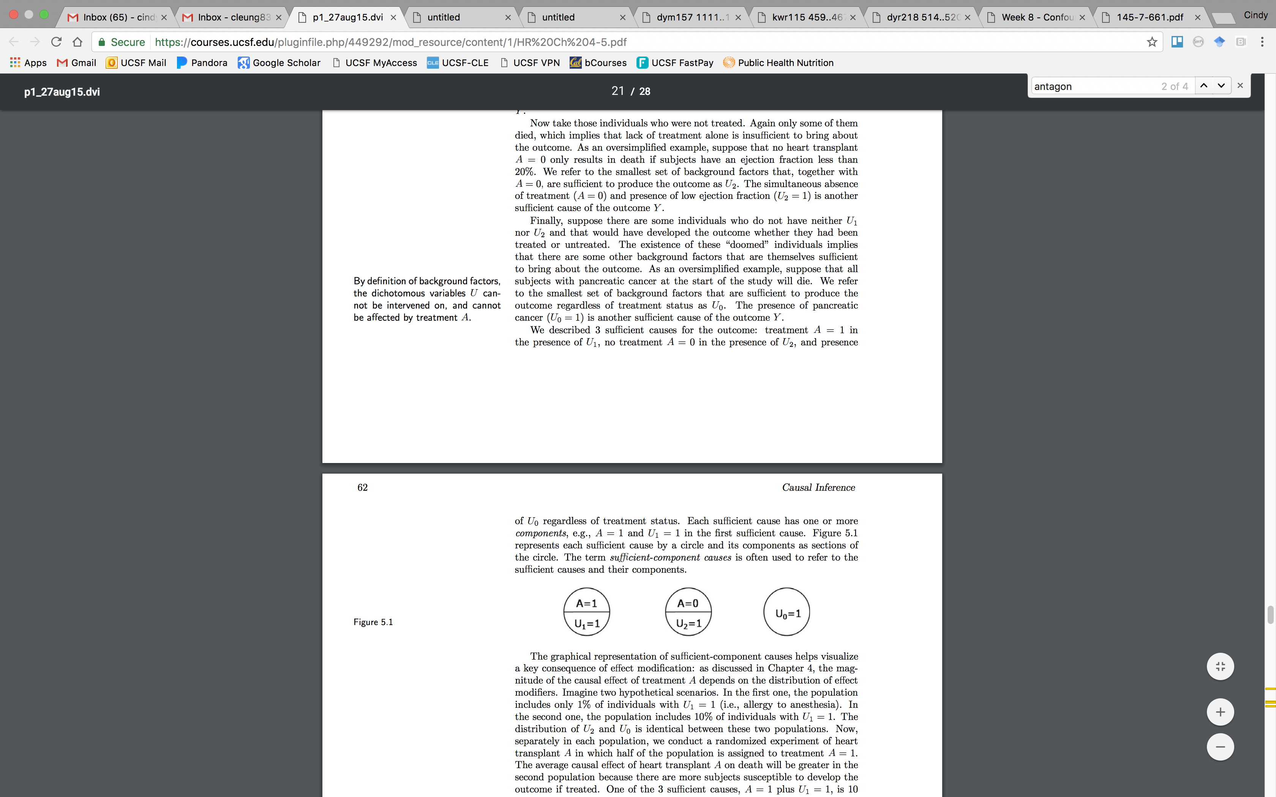
Interaction under the sufficient cause approach
  Interaction between component causes is implicit in the sufficient cause model
  Each component cause requires the presence of the others to act, their action is interdependent
Notes:
Let’s go back to our simpler example of one treatment, heart transplant, on the risk of death.
Here are three sufficient causes of the outcome
In the first causal pie, A equals 1, so perhaps heart transplant only causes death if there is medical negligence or poor quality of care. These factors could comprise U1. In the presence of both A=1, a heart transplant, and poor quality of care, U1, the individual dies.
In the second causal pie, A equals 0, so perhaps not receiving a heart transplant only causes death if one has an ejection fraction less than 20%, which is represented by U2. In the presence of both A=0, not receiving a heart transplant, and U2, a low ejection fraction, the individual dies.
In our counterfactual model, there were some individuals that had the doomed counterfactual type – that is, they will die regardless of the outcome. The presence of these individuals shows that there are factors other than the treatment, U1 and U2 that are affecting the risk of the outcome. We can call these factors U0.
Now there are three sufficient causes for our outcome.
This approach helps to illustrate an additional point about interaction. Interaction between component causes is implicit in the sufficient cause model. This is because each component cause requires the presence of the others to act. Therefore, their actions are interdependent.

Slide 29
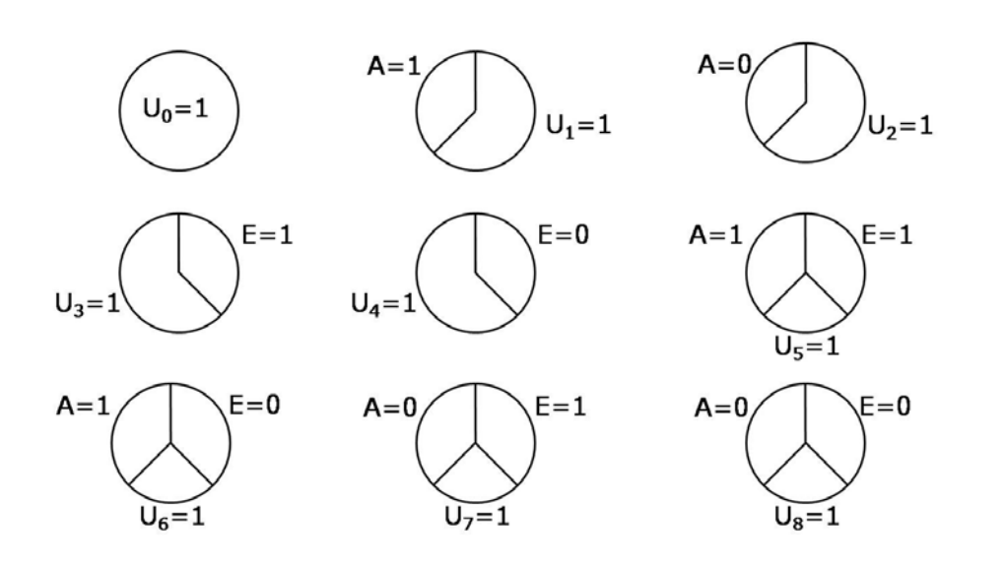
Interaction under the sufficient cause approach
Notes:
Let’s revisit now our second example, which was the joint effect of heart transplant, A, and vitamins, E, on the risk of Y. Now that we have 2 binary outcomes, there are nine potential sufficient causes for two dichotomous exposures.
These range from only A equals 1 present, only A equals 0 present, only E equals 1 present, only E equals 0 present, both A equals 1 and E equals 1 present, both A equals 1 and E equals 0 present, both A equals 0 and E equals 1 present, both A equals 0 and E equals 0 present, and neither A nor E are relevant.
These sufficient causes also have U’s ranging from U0 to U8, which denote a set of background factors that are necessary to bring about the outcome.

Slide 30
Interaction under the sufficient cause approach
At the individual level, individual is susceptible to sufficient cause, k, if they have U_{k} factors present
  An individual can be at risk of 0, 1 or many sufficient causes
On population level, not all 9 sufficient component causes may exist in your study population.
  If no one with E=1 develops outcome, independent of A, then sufficient causes with E=1 do not exist
X
X
X
Notes:
We often talk about sufficient causes from the individual level. At the individual level, one is considered susceptible to any of these sufficient causes if they have the corresponding U present. At any time, one person can be at risk of 0, 1 or many sufficient causes simultaneously.
On the population level, not all 9 sufficient component causes have to exist in our study population. For example, if there is no one with E=1 who develops the outcome, independent of A, then we can eliminate sufficient causes with E=1. (click)

Slide 31
Interaction – more definitions
  Synergism: Individual would get disease only if exposed to both treatments. Individual would not get disease if only exposed to A or E.
    Sometimes called biologic interaction
    Causal synergism: Both treatments work to cause the outcome
    Preventive synergism: Both treatments work to prevent the outcome
  Antagonism: Individual would only get the disease if exposed to one treatment but not the other, and vice versa. One treatment blocks the effect of another treatment.
    Causal antagonism: Treatment 1 blocks harmful effect of Treatment 2
    Preventive antagonism: Treatment 1 blocks preventative effect of Treatment 2
Notes:
Two other terms often used to describe interaction are synergism and antagonism.
Synergism means individuals would only develop the outcome if they are exposed to both treatments. They would not develop the outcome if exposed to only A or only E.
This is sometimes referred to as biologic interaction and happens when both components are present in the same sufficient cause.
Synergism can also be called causal or preventive.
Causal synergism means both treatments work to cause the outcome.
Preventive synergism means both treatments work to prevent the outcome.
Synergism
On the other hand, antagonism means individuals would only get the disease if exposed to one treatment but not the other and vice versa. One treatment effectively blocks the effect of another treatment.
From a sufficient cause perspective, this happens when one component is present and another component is absent in the same sufficient cause.
Like synergism, antagonism can also be causal or preventive.
Causal antagonism means treatment 1 blocks the harmful effect of Treatment 2, or vice versa.
Preventive antagonism means treatment 1 blocks the preventative effect of treatment 2, or vice versa.

Slide 32
Type | Y^{a=1,e=1} | Y^{a=0,e=1} | Y^{a=1,e=0} | Y^{a=0,e=0} | Description of Causal Type
1 | 1 | 1 | 1 | 1 | Doomed (no effect)
2 | 1 | 1 | 1 | 0 | Single plus joint causation
3 | 1 | 1 | 0 | 1 | Preventive antagonism
4 | 1 | 1 | 0 | 0 | A has causal effect. E has no effect
5 | 1 | 0 | 1 | 1 | Preventive antagonism
6 | 1 | 0 | 1 | 0 | E has causal effect. A has no effect
7 | 1 | 0 | 0 | 1 | Preventive antagonism (mutual blockage)
8 | 1 | 0 | 0 | 0 | Causal synergism
9 | 0 | 1 | 1 | 1 | Preventive synergism
10 | 0 | 1 | 1 | 0 | Causal antagonism (mutual blockage)
11 | 0 | 1 | 0 | 1 | E has causal effect. A has no effect
12 | 0 | 1 | 0 | 0 | Causal antagonism
13 | 0 | 0 | 1 | 1 | A has causal effect. E has no effect.
14 | 0 | 0 | 1 | 0 | Causal antagonism
15 | 0 | 0 | 0 | 1 | Single plus joint prevention
16 | 0 | 0 | 0 | 0 | Immune (no effect)
Notes:
We can put all of this together now. Before, we discussed the 16 potential counterfactual outcomes that can happen when there are two binary exposures. Let’s go through these now and describe the causal type.
For types 1 and 16, there is no effect of A or E (click). Type 1 individuals would have died under any treatment combination. Type 16 individuals would have survived under any treatment combination.
For types 4, 6, 11, and 13, these are cases where either A had a causal effect of Y independent of E or E had a causal effect on Y independent of A. Types 4 and 13 are examples of where A has a causal effect but E has no effect. Types 6 and 11 are examples where E has a causal effect but A has no effect. Thus, for these types, there is no interaction between A and E on the effect of Y.
For types 8 and 9, these are examples of synergism, where individuals would only develop the outcome if exposed to both treatments. Type 8 is an example of causal synergism, where individuals only develop the outcome in the presence of both A and E.
Type 9 is an example of preventive synergism, where individuals are prevented from developing the outcome in the presence of both A and E.
Types 3, 5, 7, 9, 12, and 14 are examples of antagonism, where individuals would only develop the outcome if exposed to one treatment but not the other.
Types 3, 5 and 7 are examples of preventive antagonism. For Type 3, E blocks the preventive effect of A. These individuals only survive if they received the heart transplant but not the vitamins. For Type 5, A blocks the preventive effect of E. These individuals only survive if they received the vitamins but not the heart transplant. For Type 7, this is mutual blockage of A and E, so individuals treated with either heart transplant or vitamins survive but not individuals treated with both or neither.
Types 10, 12 and 14 are examples of causal antagonism. For Type 12, A blocks the harmful effect of E. These individuals only die if they received vitamins but no heart transplant. For Type 14, E blocks the harmful effect of A. These individuals only die if they received a heart transplant but no vitamins. For Type 10, this is a mutual blockage of A and E, so individuals treated with either heart transplant or vitamins die but not individuals treated with both or neither.
And finally, we have type 2 and 15. These are examples of single and joint effects. Type 2 is an example of single and joint causation, so these individuals develop the outcome if they have A, E or A and E. Type 15 is an example of single and joint prevention so these individuals are prevented from developing the outcome if they have A, E, or A and E.

Slide 33
Sufficient cause vs. counterfactual models
Sufficient cause model considers actions, events, or states of nature which act together to bring about the outcome of interest
  Requires detailed knowledge about mechanisms underlying effects
  “Given a particular effect, what are the various events that could have caused it?”
Counterfactual model considers one cause/intervention and the various effects it could have
  Does not require detailed knowledge of mechanisms
  “What would have occurred if a particular factor was intervened upon?”
Notes:
Now, how do we bring these sufficient cause and counterfactual models together?
Both models useful to think about the concept of interaction.
The sufficient cause model considers actions, events or states of nature which act together to bring together the outcome of interest
It requires detailed knowledge about mechanisms underlying effects and effectively asks, “Given a particular effect, what are the various events that could have caused it?”
The counterfactual model considers one cause or intervention and the various effects it could have
Unlike the sufficient cause model, it does not require detailed knowledge of mechanisms
This model asks “What would have occurred if a particular factor was intervened upon?”
The counterfactual approach addresses what happens. The sufficient cause model addresses how does it happen.

Slide 34
Learning Objectives
Review effect modification
Explain the concept of biologic interaction
  Defined under the counterfactual approach
  Defined under the sufficient cause approach
Measures of interaction
Describe methods to assess effect modification
  Graphical assessment
  Stratification
  Comparing expected vs. observed joint effects
  Estimating interaction magnitude
Notes:
Let’s move on to the next learning objective, which is to describe measures of interaction.

Slide 35

Review measures of association
Effect measures vs. measures of association
  Can never achieve counterfactual ideal
  Logically impossible to observe population under both conditions and to estimate true effect measures
Measures of association
  Compares what happens in two distinct populations
  Constructed to equal the effect measure of interest
Notes:
The example we’ve been using has been useful for conceptualizing the idea of effect measure modification, but these data would never exist in real life. That’s because we can never achieve the counterfactual ideal.
We can’t observe a whole population or subpopulation under two different exposure levels in order to compare their counterfactual outcomes. That is what we try to achieve but realistically, we observe two distinct populations, the exposed and the unexposed, and we compute a a measure of association.
Under a set of assumptions, we assume this measure of association can approximate the causal effect measures under counterfactual conditions.

Slide 36
Review measures of association
Measures of association
  Absolute: differences in occurrence measures (rate or risk difference)
    Risk difference: -1 to 1
    Rate difference: - to +  (units of 1/time)
  Relative: ratios of occurrence measures (rate or risk ratio, odds ratio)
    Risk ratio: 0 to 
    Rate ratio: 0 to 
Notes:
The measures of association that we calculate from our data are either absolute measures or relative measures.
Absolute measures refer to differences in occurrence measures and are risk differences (ranging from negative 1 to positive 1) or rate differences, ranging from negative infinity to positive infinity.
Relative measures refer to ratios of occurrence measures and include rate ratios, risk ratios, and odds ratios. These range from 0 to infinity.

Slide 37
Measures of interaction – on the additive scale
Assume a binary outcome Y and two binary exposures of interest:
(p₁₁ – p₀₀) – [(p₁₀ – p₀₀) + (p₀₁ – p₀₀)]
p₁₁ – p₁₀ – p₀₁ + p₀₀
If greater than 0, interaction is positive or super-additive.
If less than 0, interaction is negative or sub-additive.
Effect of both exposures
Effect of exposure #1
Effect of exposure #2
Notes:
A natural way to assess interaction is to measure the extent to which the effect of the two exposures exceeds the effect of each exposure individually. Let’s assume we have a binary outcome Y and two binary exposures of interest.
The measure of interaction on the additive scale can be written as the effect of both exposures (click) minus the sum of effect of exposure #1 (click) and the sum of effect of exposure #2 (click).
By rewriting the terms in this equation, you end up with this simplified equation (click). This equation is meant to contrast the effects of both exposures together versus the sum of each exposure considered separately.
If this difference is nonzero, then we would say there is effect modification on the additive scale.
If this difference is greater than 0, we can also say that the interaction is positive or super-additive.
If this difference is less than 0, we can say that the interaction is negative or sub-additive.

Slide 38
Measures of interaction – on the additive scale
 | No Asbestos | Asbestos
Non-Smoker | 0.0011 | 0.0067
Smoker | 0.0095 | 0.0450
p₁₁ – p₁₀ – p₀₁ + p₀₀
0.0450 – 0.0095 – 0.0670 + 0.011
= 0.0299
Evidence of positive or super-additive interaction
Notes:
Let’s consider this example from the VanderWheele text of data presented in a 1986 study concerning effects of smoking on lung cancer and how this varied by previous exposure to asbestos. The numbers provided in the cells represent the risk of lung cancer within the different groups.
The risk of lung cancer among smokers with asbestos exposure is 0.0450.
The risk of lung cancer among smokers without asbestos exposure is 0.0095.
The risk of lung cancer among non-smokers with asbestos exposure is 0.0067.
And the risk among non-smokers without asbestos exposure is 0.0011.
We can insert these risks into the equation to compute our additive measure of interaction.
This gives us an additive risk of 0.0299, which provides evidence of positive or super-additive interaction, which suggests that on the additive scale, the risk of lung cancer from both smoking and asbestos exposures is greater than the risk of lung cancer from smoking or asbestos alone.

Slide 39
Measures of interaction – on the multiplicative scale
Assume a binary outcome Y and two binary exposures of interest:
RR₁₀ = p₁₀ / p₀₀
RR₀₁ = p₀₁ / p₀₀
RR₁₁ = p₁₁/ p₀₀
RR₁₁ p₁₁p₀₀
RR₁₀RR₀₁ p₁₀p₀₁
If greater than 1, interaction is positive or super-multiplicative.
If less than 1, interaction is negative or sub-multiplicative.
=
Notes:
Instead of using risk differences to measure effects, we may decide to use risk ratios or odds ratios. We can assess measures of interaction on the multiplicative scale. Assuming the same binary outcome and two binary exposures, we have the following risk ratios comparing each exposure separately and then the risk ratio for both exposures.
A measure of interaction on the multiplicative scale would be written as the risk ratio of both exposures divided by the product of the risk ratio of exposure #1 and the risk ratio of exposure #2. This measure of interaction can be simplified to this equation (click).
If this value is nonzero, then we would say that there is effect modification on the multiplicative scale.
If this value is greater than 1, then there is a positive or super-multiplicative interaction.
If this value is less than 1, then there is a negative or sub-multiplicative interaction.
Note that here, the comparison is to 1 and not 0 because this measure of interaction is a ratio and not a difference.

Slide 40
Measures of interaction – on the multiplicative scale
(0.0450/0.011)
(0.0095/0.011) X (0.0067 / 0.0011)
= 0.78
Evidence of negative multiplicative interaction
 | No Asbestos | Asbestos
Non-Smoker | 0.0011 | 0.0067
Smoker | 0.0095 | 0.0450
Notes:
Using the same example of smoking and asbestos, we can insert these risks into the equation to compute our muiltiplicative measure of interaction.
This gives us a multiplicative risk of 0.78, which provides evidence of negative interaction. This suggests that on the multiplicative scale, the risk of lung cancer from both smoking and asbestos exposure is lower than the risk of lung cancer from smoking or asbestos alone.

Slide 41
Measures of interaction – on the multiplicative scale
Assume a binary outcome Y and two binary exposures of interest:
OR₁₀ = [p₁₀ / (1- p₁₀)] /[ p₀₀/ (1- p₀₀)]
OR₀₁ = [p₀₁ / (1- p₀₁)] /[ p₀₀/ (1- p₀₀)]
OR₁₁ = [p₁₁ / (1- p₁₁)] /[ p₀₀/ (1- p₀₀)]
OR₁₁
OR₁₀OR₀₁
If greater than 1, interaction is positive.
If less than 1, interaction is negative.
Notes:
This formula can also be adapted to be used with odds ratios.
This measure is interpreted similarly to that using risk ratios.
If this value is nonzero, then we would say that there is effect modification on the multiplicative scale.
If this value is greater than 1, then there is a positive interaction.
If this value is less than 1, then there is a negative interaction.

Slide 42
Measures of interaction – scale dependent
Positive/ super-additive interaction on additive scale
  Effect of both exposures together exceeds sum of effects individually on the risk difference scale
Negative interaction on multiplicative scale
  Effect of both exposures together is less than the product of the effects of the two exposures on the multiplicative scale
If both exposures have independent effect on the outcome, there must be interaction on some scale.
 | No Asbestos | Asbestos
Non-Smoker | 0.0011 | 0.0067
Smoker | 0.0095 | 0.0450
Notes:
From this example, we see how measures of interaction are scale dependent.
We may have a positive or super-additive interaction on the additive scale but a negative interaction on the multiplicative scale. This means that the effect of both exposures together on the risk difference scale exceeds the sum of the effects on the risk difference scale of each exposure considered separately.
But, on the multiplicative scale, the effect of both exposures together is less than the product of the effects of the two exposures considered separately.
If both exposures have independent effects on the outcome, then there has to be interaction on some scale.

Slide 43
Measures of interaction - RERI
RR₁₁ – RR₁₀ – RR₀₁ + 1
RERI = Relative excess risk due to interaction (Rothman 1986)
ICR = Interaction contrast ratio (Greenland 2008)
  If RERI_{RR} > 0 only if p₁₁ – p₁₀ – p₀₁ + p₀₀ < 0
  If RERI_{RR} < 0 only if p₁₁ – p₁₀ – p₀₁ + p₀₀ < 0
  If RERI_{RR} = 0 if p₁₁ – p₁₀ – p₀₁ + p₀₀ = 0
RERI_{RR} gives direction of additive interaction, but not magnitude
Notes:
Suppose you want to assess additive interaction from a study but the researchers only reported relative risks. Although you don’t have the individual risks to assess the additive measure of interaction that we covered earlier, you can calculate the RERI or the relative excess risk due to interaction.
The RERI is also sometimes referred to as the interaction contrast ratio or ICR.
Using the RERI, we can access whether additive interaction is positive, negative, or zero using risk ratios and the RERI formula for RR.
We cannot use RERI RR to make statement about the relative magnitude of the underlying additive interaction of risks. RERIRR depends on the baseline risks so it’s possible to have a larger RERI in one subpopulation but the additive interaction for risks is larger than the other.
If you’re trying to decide which group to treat for an intervention, the RERI can provide information on which group would benefit more from a targeted intervention on the exposure.

Slide 44
Learning Objectives
Review effect modification
Explain the concept of biologic interaction
  Defined under the counterfactual approach
  Defined under the sufficient cause approach
Measures of interaction
Describe methods to assess effect modification
  Graphical assessment
  Stratification
  Comparing expected vs. observed joint effects
  Estimating interaction magnitude
Notes:
Let’s move on to the next learning objective, which is to describe methods of assessing effect modification.
Some of these we’ve already encountered in prior homework assignments and lecture examples.

Slide 45
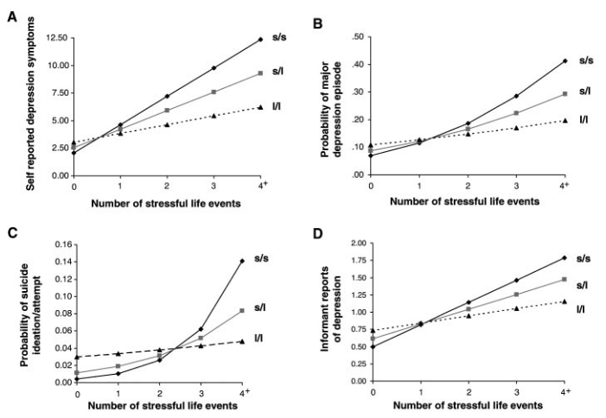
Assessing interaction by graphic representation
Caspi et al. Science 2003
Notes:
One way of assessing interaction is by graphic representation. This is a powerful method. For example, you can say there is a biological interaction between age or developmental stage and exposure. We often say that children who are exposed to specific carcinogens are at higher risk of poor health outcomes than adults who are exposed to the same carcinogens. Children may more vulnerable to environmental contaminants or hazards due to the sensitive nature of their DNA in their stage of development. In a large study, it would be prudent to analyze your data by different age groups.
Here is another example of biological interaction illustrated using graphic representation. This was a study by Caspi and colleagues, published in Science, that examined the influence of life stress on depression and effect modification by a polymorphism in the 5-HTT gene, a serotonin receptor gene, that is supposed to indicate genetic susceptibility to depression. This is an example of a gene-environment interaction. The data came from a birth cohort study of 1037 children, assessed repeatedly throughout childhood, with the last visit at 26 years.
Each of these panels shows different outcomes in relation to stressful life events occurring before participants were age 21. Events or experiences related to employment, finances, housing, health, and relationship stressors. The researchers also assessed three 5-HTT genotype groups: short/short (or s/s) homozygotes, short/long (or s/l) heterozygotes, and long/long (or l/l) homozygotes, with the hypothesis that short alleles are associated with lower transcriptional efficiency of the promoter compared to long alleles.
The top left panel shows self-reported depression symptoms, the top right panel shows probability of major depression episodes, the bottom left panel shows probability of suicide ideation and attempts, and the bottom right panel shows informant reports of depression. In each panel, one of the line corresponds to the relation between stressful life events and depressive outcomes for one genotype group.
In all of these panels, we see a similar pattern. The adverse effect of stressful life events on risk of depression is strongest among those with two copies of the short allele, followed by those with one copy of the short allele, followed by those with no copies of the short allele. This dose response relationship was found with multiple outcomes related to depression, showing how one’s genetic profile can interact with environmental exposures to exacerbate poor health outcomes.

Slide 46
Assessing interaction by stratification
Effect modification by presence of short allele G on the association between stressful life events E and risk of depression
  When G is present:
    RD = 0.33 – 0.10 = 0.23
    RR = 0.33 / 0.10 = 3.3
  When G is absent:
    RD = 0.17 – 0.10 = 0.07
    RR = 0.17 / 0.10 = 1.7
4+ Stressful life events | Genotype with short allele
 | Yes | No
Yes | 33% | 17%
No | 10% | 10%
Notes:
Another method to assess interaction is by stratification.
We can use the same example of stressful life events and risk of depression, with modification by the short allele G.
Here is a 2x2 table with data from the same study. Starting from the bottom right corner, without the short allele genotype and with fewer than 4 stressful life events, the risk of depression is 10%. On the bottom left is the risk of depression with the short allele genotype and with fewer than 4 stressful life events, which is also 10%. Without the short allele genotype and with 4 or more stressful life events, the risk of depression is 17%. And with both the short allele genotype and 4 or more stressful life events, the risk of depression is 33%.
We can calculate the stratified effect measures now.
In the absence of the short allele, the risk difference is 0.07 and the relative risk is 1.7. So there is a 70% higher risk of depression from having 4 or more stressful life events.
In the presence of the short allele G, the risk difference is 0.23 and the relative risk is 3.3. So there is 3.3 times higher risk of depression from having 4 or more stressful life events and having the short allele.

Slide 47
Assessing interaction by stratification
Effect modification by presence of short allele G on the association between stressful life events E and risk of depression
  When G is present:
    RD = 0.33 – 0.10 = 0.23
    RR = 0.33 / 0.10 = 3.3
  When G is absent:
    RD = 0.17 – 0.10 = 0.07
    RR = 0.17 / 0.10 = 1.7
Not to be confused with stratification to adjust for confounding
  Cannot be used to estimate average causal effects
  Restriction = another form of stratification
Both RDs and RRs are heterogeneous: for both measures of association, the effect of E when G is present is larger than the effect of E when G is absent
Notes:
(click) Both the risk differences and the relative risks are heterogeneous here. For both measures of association, the effect of stressful life events on risk of depression is greater in the presence of the short allele than in the presence of the long allele.
But stratification is not always synonymous with effect modification. Although we use stratification as one method to assess effect modification, in practice, standardization is also widely used to adjust for confounding.
Suppose I asked you to examine the effect of aspirin use on the risk of myocardial infarction and to adjust for sex to compute the average causal effect. A common practice would be to stratify the data into men and women and provide sex-specific effect measures. Under the assumption of conditional exchangeability, the effect measures would demonstrate the effect of aspirin use on the risk of MI in men and women separately – they are conditional effect measures specific to a subset of the population.
Adjusting for confounding by stratification is fine for estimating conditional causal effects but it cannot be used to estimate average causal effects or population-wide causal effects because we have one causal effect for each stratum. This is why we interpret these as conditional effect measure and not average effect measures.

Slide 48
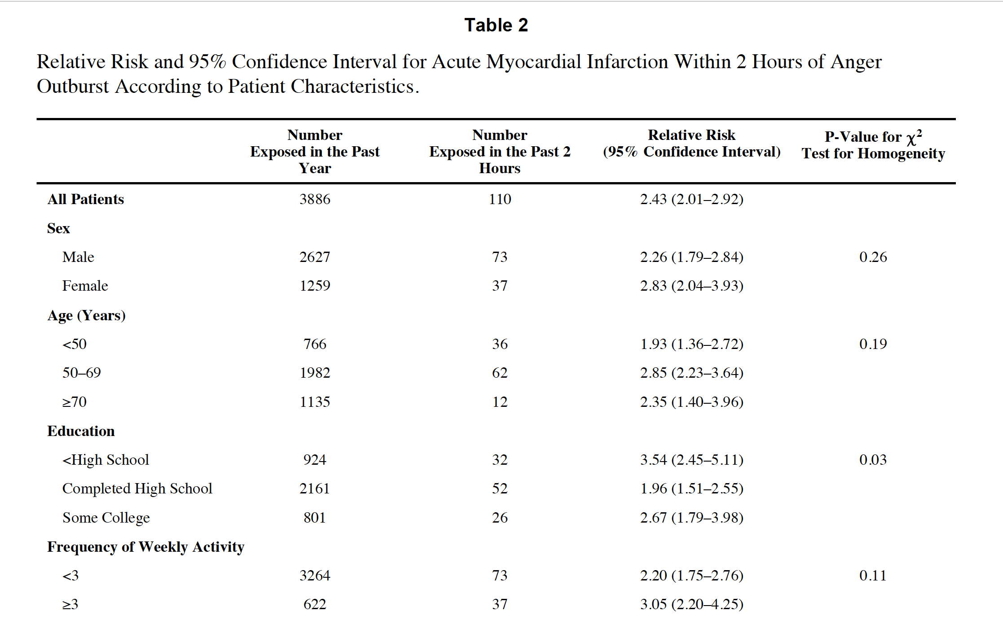
Assessing interaction by stratification
Mostofsky et al. AJC 2013
Notes:
Here is another example of stratification from a previous homework assignment. In this study by Mostofsky and colleagues, the authors examined anger outbursts and risk of acute myocardial infarction using a case-crossover design.
In the analyses, the authors considered multiple variables as potential effect modifiers. They then presented their results by showing the entire study population first and then all of the stratified estimates. From these four effect modifiers, sex, age, education, and physical activity, the relation between anger outbursts and acute MI was strongest in men, in adults aged 50-69 years, in those with less than a high school education, and adults with higher levels of physical activity.

Slide 49
Assessing interaction by comparing expected vs. observed joint effects
What is the individual effect of cause A in the absence of exposure to cause B?
What is the individual effect of cause B in the absence of exposure to cause A?
What is the observed joint effect of A and B?
What is the expected joint effect of A and B in the absence of interaction?
Is the observed joint effect similar to the expected joint effect in the absence of interaction?
Notes:
Let’s now take a look at the observed and expected joint effects.
We should ask ourselves the following questions.
What are the individual effects of A in the absence of B?
What are the individual effects of B in the absence of A?
What are the observed joint effects of A and B?
What are the expected joint effects of A and B on Y in the absence of interaction?
And finally, is the observed joint effect similar to the expected joint effect in the absence of the interaction?

Slide 50
Assessing interaction by comparing expected vs. observed joint effects
RD_{E,-}=0.17-0.10=0.07
RD_{-,G}=0.10-0.10=0
RD_{OBSERVED E,G}=0.33-0.10=0.23
RD_{EXPECTED E,G}=0.07+0=0.07
RD_{OBSERVED E,G} > RD_{EXPECTED E,G,}
additive interaction
(superadditivity)
What is the individual effect of cause A in the absence of exposure to cause B?
What is the individual effect of cause B in the absence of exposure to cause A?
What is the observed joint effect of A and B?
What is the expected joint effect of A and B in the absence of interaction?
Is the observed joint effect similar to the expected joint effect in the absence of interaction?
Notes:
We can answer these questions from our study using the risk difference scale.
Number 1 - What is the individual effect of stressful life events on depression in absence of the short allele? Data from the 2x2 table shows that the risk difference is 0.07.
Number 2 – what is the individual effect of the short allele on depression in absence of stressful life events? Well it’s 0.10 minus 0.10 so the answer is 0. The allele does not independently increase the risk of depression.
Number 3 – What is the observed joint effect of both stressful life events and short allele on the risk of depression? People who had stressful life events and short alleles had a risk of 33%. People who had neither exposure had a risk of depression of 10%. So the observed joint effect is 0.33 – 0.10 which equals 0.23.
Number 4 – What is the expected joint effect of A and B in the absence of interaction? We can look at our responses above. The expected effect of stressful life events was 0.07. The expected effect of the short allele was 0. So the expected joint effect of both in the absence of interaction is 0.07 plus 0, which equals 0.07.
Number 5 – Is the observed joint effect similar to the expected joint effect in the absence of interaction? No, the observed is 0.23 but the expected is 0.07. Thus, this is an example of additive interaction or superadditivity.

Slide 51
Assessing interaction by comparing expected vs. observed joint effects
RR_{E,-}=0.17/0.10=1.7
RR_{-,G}=0.10/0.10=1.0
RR_{OBSERVED E,G}=0.33/0.10=3.3
RR_{EXPECTED E,G}=1.7*1.0=1.7
RR_{OBSERVED E,G} > RD_{EXPECTED E,G,}
multiplicative interaction
What is the individual effect of cause A in the absence of exposure to cause B?
What is the individual effect of cause B in the absence of exposure to cause A?
What is the observed joint effect of A and B?
What is the expected joint effect of A and B in the absence of interaction?
Is the observed joint effect similar to the expected joint effect in the absence of interaction?
Notes:
We can also answer these questions on the relative risk scale.
Number 1 – The individual effect of stressful life events in the absence of the short allele is 1.7.
Number 2 – The individual effect of the short allele in absence of stressful life events is 1.0.
Number 3 – The observed joint effect of stressful life events and the short allele is 0.33 divided by 0.10, which is 3.3.
Number 4 – The expected joint effect of A both exposures is 1.7 times 1.0, which is 1.7.
Number 5 – Is the observed joint effect similar to the expected joint effect in the absence of interaction? No, the observed joint effect is 3.3 but the expected joint effect is 1.7. Thus, this is an example of multiplicative interaction.

Slide 52
Assessing interaction by comparing expected vs. observed joint effects
What is the individual effect of cause A in the absence of exposure to cause B?
What is the individual effect of cause B in the absence of exposure to cause A?
What is the observed joint effect of A and B?
What is the expected joint effect of A and B in the absence of interaction?
Is the observed similar to the expected in the absence of interaction?
What is the interaction magnitude?
RR_{E,-}=0.17/0.10=1.7
RR_{-,G}=0.10/0.10=1.0
RR_{OBSERVED E,G}=0.33/0.10=3.3
RR_{EXPECTED E,G}=1.7*1.0=1.7
RR_{OBSERVED E,G} > RD_{EXPECTED E,G,}
RR_{E/ G IS PRESENT} / RR_{E/ G IS ABSENT}
= 3.3 / 1.7 =1.9
Interaction Contrast Ratio
RD_{E,-}=0.17-0.10=0.07
RD_{-,G}=0.10-0.10=0
RD_{OBSERVED E,G}=0.33-0.10=0.23
RD_{EXPECTED E,G}=0.07+0=0.07
RD_{OBSERVED E,G} > RD_{EXPECTED E,G,}
RD_{E/ G IS PRESENT} – RD_{E/ G IS ABSENT}
= 0.23 - 0.07 =0.16
Interaction Contrast
Notes:
Still, just saying that the observed risk difference or relative risk is different from the expected is not very helpful. We can then calculate the interaction magnitude, which shows how big the interaction is on each of these scales.
To calculate the interaction contrast on the risk difference scale, we subtract the expected joint effect from the observed joint effect to estimate how much of the effect is due to the interaction. In this case, it’s 0.23 minus 0.07, which gives us 0.16.
Similarly on the risk ratio scale, we can calculate the interaction contrast ratio. We divide the expected joint effect by the observed joint effect. In this case, it’s 3.3 divided by 1.7, which gives 1.9.

Slide 53
Assessing interaction by estimating interaction magnitude
How is this related to RERI?
  Same for relative scale!
On the risk difference scale:
  Interaction contrast: RD_{E/ G IS PRESENT} – RD_{E/ G IS ABSENT} = 0.23 - 0.07 = 0.16
  RERI: p₁₁ – p₁₀ – p₀₁ + p_{00n} = 0.33 – 0.17 – 0.10 + 0.10 = 0.16
On the relative risk scale:
  Interaction contrast ratio: RR_{E/ G IS PRESENT} / RR_{E/ G IS ABSENT} = 3.3 / 1.7 = 1.9
  RERI: (RR₁₁)/ (RR₁₀RR₀₁₎= (3.3) / (1.0*1.7) = 1.9
Notes:
So how is the interaction contrast related to the RERI?
It’s the same for the relative scale!
On the risk difference scale, we calculated the interactino contrast to be 0.23 – 0.07 which is equal to 0.16
Using the formula for RERI for the risk difference scale, we take the risk from both exposures, subtract the risks from each exposure in the absence of the other, and add the risk in absence of both exposures. 0.33 minus 0.17 minus 0.10 plus 0.10, which gives 0.16
On the relative risk scale, the interaction contrast ratio was 3.3 divided by 1.7, which is 1.9
Using the formula for RERI from the relative risk scale, we take the relative risk from both exposures and divide by the product of the risks of each exposure in the absence of the other. 3.3 divided by 1.0 times 1.7, which is 1.9

Slide 54
Summary
There is a distinct difference between biological interaction and effect (measure) modification
In epidemiology, we are interested in biological interaction on an additive scale
Various methods exist to evaluate biological interaction and to estimate the magnitude of interaction

