Slide 1
Interaction and effect measure modification
Cindy Leung, ScD, MPH
Formerly: Center for Health and Community, UCSF
Current: Asst. Prof. University of Michigan, School of Public Health
Notes:
Welcome to this second lecture on interaction and effect measure modification. This lecture will build on concepts we covered last week and explore in more detail commonly used measures of interaction, statistical modeling of interaction, and also how to present interaction analyses in scientific papers.

Slide 2
Highlights from Interaction & Effect Mod Lecture 1
Review effect modification
Explain the concept of biologic interaction
  Defined under the counterfactual approach
  Defined under the sufficient cause approach
Measures of interaction
Describe methods to assess effect modification
  Graphical assessment
  Stratification
  Comparing expected vs. observed joint effects
  Estimating interaction magnitude
Notes:
Let’s briefly review the learning objectives of last week.
First, we reviewed what effect modification is. We looked at an example using counterfactual data that examined the causal effect of heart transplant on the outcome of death in the population and then separately in men and women. In this example, we found that there was no causal effect of heart transplant in the entire population, in other words the causal risk ratio was 1 and the causal risk difference was 0. But, there were significant causal effects in men and women. In men, heart transplant had a protective effect on death. In women, heart transplant had a harmful effect on death.
We defined effect modifier as a variable M when the average causal effect of treatment on outcome differs across levels of M.
This example demonstrated how in the presence of effect modification, the average or population-wide causal effects can be misleading.
We care about effect modification because it improves the transportability of causal inferences across different populations and may also shed insight as to the mechanisms underlying exposure and outcome relationships.
.

Slide 3
Highlights from Interaction & Effect Mod Lecture 1
Review effect modification
Explain the concept of biologic interaction
  Defined under the counterfactual approach
  Defined under the sufficient cause approach
Measures of interaction
Describe methods to assess effect modification
  Graphical assessment
  Stratification
  Comparing expected vs. observed joint effects
  Estimating interaction magnitude
Notes:
Next, we talked about two concepts of biologic interaction.
Where effect modification usually examines the effect of one exposure on one outcome across levels of a third variable, M, interaction is used to describe the joint causal effects of two or more treatments of equal interest on one outcome.
We discussed interaction in a hypothetical example of heart transplant and multivitamin use on the risk of death. Using the counterfactual approach, we saw how there were 4 counterfactual response types for one binary treatment: doomed, preventative, causative, and immune. But in the case of 2 binary treatments, there were 16 potential counterfactual outcomes for each study subject. And we discussed in detail about what each of these counterfactual types mean. We will also come back to this later today when we discuss mechanistic interaction.
Under the sufficient cause approach, we discussed how two component causes need to be present in the same sufficient cause model in order to affect the outcome. Their actions are interdependent. Therefore, the concept of biological interaction is implicit in the sufficient cause approach.

Slide 4
Highlights from Interaction & Effect Mod Lecture 1
Review effect modification
Explain the concept of biologic interaction
  Defined under the counterfactual approach
  Defined under the sufficient cause approach
Measures of interaction
Describe methods to assess effect modification
  Graphical assessment
  Stratification
  Comparing expected vs. observed joint effects
  Estimating interaction magnitude
Notes:
Next, we talked about measures of interaction. We showed formulas for measures of interaction on the additive scale and on the multiplicative scale using risk differences, risk ratios, and odds ratios. We also reviewed the RERI or the relative excess risk due to interaction.
The RERI is also sometimes referred to as the interaction contrast ratio or ICR.
Using the RERI, we can access whether additive interaction is positive, negative, or zero using risk ratios and the RERI formula for RR.
We’ll come back to this today as well as review some other measures of interaction used in practice.

Slide 5
Highlights from Interaction & Effect Mod Lecture 1
Review effect modification
Explain the concept of biologic interaction
  Defined under the counterfactual approach
  Defined under the sufficient cause approach
Measures of interaction
Describe methods to assess effect modification
  Graphical assessment
  Stratification
  Comparing expected vs. observed joint effects
  Estimating interaction magnitude
Notes:
And finally, we covered a few methods to assess interaction. These include graphical assessment, stratification, comparing expected vs. observed joint effects, and estimating interaction magnitude. We’ll build upon this today by showing how to assess interaction using statistical modeling.

Slide 6
Learning Objectives
Measures of interaction
Mechanistic Interaction
Statistical Modeling
Presentation of interaction analyses
Notes:
Here are the learning objectives for today’s lecture.
First, we’ll review and discuss additional measures of interaction.
Next, we’ll discuss the concept of mechanistic interaction.
Then, we’ll talk about statistical modeling of interaction.
And we will conclude with the presentation of interaction analyses in scientific manuscripts.

Slide 7
Learning Objectives
Measures of interaction
Mechanistic Interaction
Statistical Modeling
Presentation of interaction analyses
Notes:
Let’s first review our measures of interaction.

Slide 8
Interaction vs. Effect modification
Effect modification: The average causal effect of exposure on outcome differs across levels of a third variable, M.
  Focus is on the causal effect of A on Y
  The independent causal effect of M on Y is not a primary focus
Interaction: Joint causal effects of two (or more) treatments on the outcome
  Focus is equally on the effects of A and E on the outcome.
  Ex: gene-environment interactions, gene-gene interactions, environment-environment interactions, behavior-behavior interactions, and more
Notes:
As we said last week, interaction and effect modification are terms that are often used interchangeably, but these are two different concepts from a causal standpoint.
As we defined earlier, effect modification is when the average causal effect of exposure on outcome differs across levels of a third variable. In these types of analyses, the focus is on the causal effect of A on Y. We include M, the effect modifier, in our analyses but we generally don’t interpret or pay much attention to the independent causal effect of M on Y.
On the other hand, interaction involves the examination of the causal effects of two or more treatments on the outcome. It’s a joint intervention of two or more treatments interact to bring about the outcome. Both or all treatments are given equal focus.

Slide 9
Interaction – another example
 | No alcohol | Moderate alcohol | High alcohol
High folate | 1.0 | 1.01 (0.84-1.21) | 1.10 (0.90-1.33)
Low folate | 1.08 (0.78-1.49) | 1.37 (0.89-2.11) | 1.45 (0.95-2.23)
Alcohol increases risk for breast cancer. Folate plays role in DNA methylation and repair.
Objective was to study interaction between alcohol and folate intake in risk of breast cancer
Prospective cohort analysis of 34,387 postmenopausal women from Iowa Women’s Health Study
Sellers et al. Dietary folate intake, alcohol, and risk of bresat cancer in a prospective study of postmenopausal women. Epidemiology 2001.
Notes:
Here’s one example of interaction.
This was a prospective cohort study by Sellers and colleagues of 34,387 postmenopausal women in the Iowa Women’s Health Study. Because of prior studies indicating the higher risk of breast cancer due to alcohol intake, and the role that folate and other B vitamins play in DNA methylation and repair, the authors led this analysis to study the interaction between alcohol and folate intake in the risk of breast cancer.
What these this study showed among women with high folate intake was a slight increased risk of breast cancer among those with high alcohol intake compare to no alcohol intake. In this high folate group, the relative risk was 1.10 compared to 1.0.

Slide 10
Interaction – another example
 | No alcohol | Moderate alcohol | High alcohol
High folate | 1.0 | 1.01 (0.84-1.21) | 1.10 (0.90-1.33)
Low folate | 1.08 (0.78-1.49) | 1.37 (0.89-2.11) | 1.45 (0.95-2.23)
Alcohol has a moderate increase in the risk of breast cancer among women with high folate.
Alcohol has a high increase in the risk of breast cancer among women with low folate.
Sellers et al. Dietary folate intake, alcohol, and risk of bresat cancer in a prospective study of postmenopausal women. Epidemiology 2001.
Notes:
However, among women with low folate intake, there was a much higher risk of breast cancer among those with high alcohol intake compared to no alcohol intake. The relative risk was 1.45 in the joint high alcohol and low folate group compared to 1.08 in the no alcohol and low folate group or compared to 1.0 in the no alcohol and high folate group.
Thus, these results show the highest risk group for breast cancer are women with adverse levels of both exposures – high alcohol and low folate, suggesting a biologic interaction between these two exposures on the risk of breast cancer..

Slide 11
Hunter DJ. Gene-environment interactions in human diseases. Nature Review Genetics 2005
Notes:
There has been a lot of interest in gene-environment interactions in the risk of disease. This review by David Hunter shows some samples of gene-environment interactions observed in at least two studies for various outcomes. Some of the most studied relationships are the interactions between genes for skin pigmentation and sunlight exposure on the risk of skin cancer, genetic variation in the beta-2 adrenergic receptor and asthma drugs on the response to albuterol, and genetic variation in the alcohol dehydrogenase 1c enzyme and alcohol intake on the risk of myocardial infarction.

Slide 12
Gene-Environment Interactions
Obtain a better estimate of PAR for genetic and environmental risk factors by accounting for joint interactions
Strengthen association between environmental factors and disease by examining these factors in genetically susceptible individuals
Help to dissect disease mechanisms in humans by using information on susceptibility genes to focus on the biologic pathways most relevant to disease, and environment factors most relevant to pathways
Determine which specific compounds in complex mixtures of compounds that humans are exposed to cause disease
Use information on biological pathways to design new preventive and therapeutic strategies
Offer tailored preventive advice based on knowledge if an individual carries susceptibility or resistance alleles
Hunter DJ. Gene-environment interactions in human diseases. Nature Review Genetics 2005
Notes:
In this study, Dr. Hunter provides multiple reasons why we should study gene environment interactions. For example, if we don’t consider interactions between genes and environment and only focus on independent effects, our estimates of the population attributable risk will be wrong. This also strengthens the associations between environmental factors and disease outcomes by examining these factors in individuals who may be more genetically susceptible to certain exposures, which helps us understand that these associations are not due simply to chance. Candidate gene studies that identify susceptibility or resistance alleles improves our understanding of the biologic pathways from exposure to disease. And finally, understanding gene-environment interactions may be used to offer personalized treatment to patients by specifying preventive advice before disease incidence, and personalized advice after disease diagnosis.

Slide 13
Measures of interaction – on the additive scale
Assume a binary outcome Y and two binary exposures of interest:
(p₁₁ – p₀₀) – [(p₁₀ – p₀₀) + (p₀₁ – p₀₀)]
p₁₁ – p₁₀ – p₀₁ + p₀₀
If greater than 0, interaction is positive or super-additive.
If less than 0, interaction is negative or sub-additive.
Effect of both exposures
Effect of exposure #1
Effect of exposure #2
Notes:
Last week, we discussed measures of interaction on the additive and the multiplicative scale. Let’s briefly review these now.
The measure of interaction on the additive scale can be written as the effect of both exposures (click) minus the sum of effect of exposure #1 (click) and the sum of effect of exposure #2 (click).
By rewriting the terms in this equation, you end up with this simplified equation (click). This equation is meant to contrast the effects of both exposures together versus the sum of each exposure considered separately.
If this difference is nonzero, then we would say there is effect modification on the additive scale.
If this difference is greater than 0, we can also say that the interaction is positive or super-additive.
If this difference is less than 0, we can say that the interaction is negative or sub-additive.

Slide 14
Measures of interaction – on the additive scale
 | No Asbestos | Asbestos
Non-Smoker | 0.0011 | 0.0067
Smoker | 0.0095 | 0.0450
p₁₁ – p₁₀ – p₀₁ + p₀₀
0.0450 – 0.0095 – 0.0670 + 0.011
= 0.0299
Evidence of positive or super-additive interaction
Notes:
In this example from Chapter 9 of the VanderWheele text, data was presented from a study concerning effects of smoking and asbestos exposure on lung cancer.
The additive interaction measure can be computed as follows and gives an estimate of 0.0299, which provides evidence of positive or super-additive interaction, which suggests that on the additive scale, the risk of lung cancer from both smoking and asbestos exposures is greater than the risk of lung cancer from smoking or asbestos alone.

Slide 15
Measures of interaction – on the multiplicative scale
Assume a binary outcome Y and two binary exposures of interest:
RR₁₀ = p₁₀ / p₀₀
RR₀₁ = p₀₁ / p₀₀
RR₁₁ = p₁₁/ p₀₀
RR₁₁ p₁₁p₀₀
RR₁₀RR₀₁ p₁₀p₀₁
If greater than 1, interaction is positive or super-multiplicative.
If less than 1, interaction is negative or sub-multiplicative.
=
Notes:
We also discussed measures of interaction on the multiplicative scale.
A measure of interaction on the multiplicative scale would be written as the risk ratio of both exposures divided by the product of the risk ratio of exposure #1 and the risk ratio of exposure #2. This measure of interaction can be simplified to this equation (click).
If this value is nonzero, then we would say that there is effect modification on the multiplicative scale.
If this value is greater than 1, then there is a positive or super-multiplicative interaction.
If this value is less than 1, then there is a negative or sub-multiplicative interaction.

Slide 16
Measures of interaction – on the multiplicative scale
(0.0450/0.011)
(0.0095/0.011) X (0.0067 / 0.0011)
= 0.78
Evidence of negative multiplicative interaction
 | No Asbestos | Asbestos
Non-Smoker | 0.0011 | 0.0067
Smoker | 0.0095 | 0.0450
Notes:
Using data from the same example of smoking and asbestos, we calculate a measure of interaction of 0.78, which provides evidence of negative interaction. This suggests that on the multiplicative scale, the risk of lung cancer from both smoking and asbestos exposure is lower than the risk of lung cancer from smoking or asbestos alone.

Slide 17
Measures of interaction – on the multiplicative scale
Assume a binary outcome Y and two binary exposures of interest:
OR₁₀ = [p₁₀ / (1- p₁₀)] /[ p₀₀/ (1- p₀₀)]
OR₀₁ = [p₀₁ / (1- p₀₁)] /[ p₀₀/ (1- p₀₀)]
OR₁₁ = [p₁₁ / (1- p₁₁)] /[ p₀₀/ (1- p₀₀)]
OR₁₁
OR₁₀OR₀₁
If greater than 1, interaction is positive.
If less than 1, interaction is negative.
Notes:
This formula can also be adapted to be used with odds ratios.
(click) This measure is interpreted similarly to that using risk ratios.
If this value is nonzero, then we would say that there is effect modification on the multiplicative scale.
If this value is greater than 1, then there is a positive interaction.
If this value is less than 1, then there is a negative interaction.

Slide 18
Measures of interaction – scale dependent
Positive/ super-additive interaction on additive scale
  Effect of both exposures together exceeds sum of effects individually on the risk difference scale
Negative interaction on multiplicative scale
  Effect of both exposures together is less than the product of the effects of the two exposures on the multiplicative scale
If both exposures have independent effect on the outcome, there must be interaction on some scale.
 | No Asbestos | Asbestos
Non-Smoker | 0.0011 | 0.0067
Smoker | 0.0095 | 0.0450
Notes:
Measures of interaction are scale dependent, as this erxample shows.
We may have a positive or super-additive interaction on the additive scale but a negative interaction on the multiplicative scale. This means that the effect of both exposures together on the risk difference scale exceeds the sum of the effects on the risk difference scale of each exposure considered separately.
But, on the multiplicative scale, the effect of both exposures together is less than the product of the effects of the two exposures considered separately.
If both exposures have independent effects on the outcome, then there has to be interaction on some scale.

Slide 19
Measures of interaction – scale dependent
Interaction on one scale doesn’t always imply interaction on another scale
Measure of additive interaction:
  = p₁₁ – p₁₀ – p₀₁ + p₀₀
  = 0.10 – 0.05 – 0.07 + 0.02 = 0
  No evidence of additive interaction
Measure of multiplicative interaction:
= p₁₁p₀₀ / p₁₀p₀₁
= (0.10*0.02) / (0.05*0.07) = 0.57
Evidence of negative multiplicative interaction
 | E=0 | E=1
G=0 | 0.02 | 0.05
G=1 | 0.07 | 0.10
Notes:
Let’s build on these concepts now.
Just because there is interaction on one scale doesn’t necessarily imply interaction on another scale.
Here’s another data table of an environmental exposure, E, and a genetic exposure G.
We compute the measure of interaction on the additive scale using the previous formula: 0.10 – 0.05 – 0.07 + 0.02, which equals 0.
This means there is no evidence of interaction on the additive scale.
But, we can also compute the measure of interaction on the multiplicative scale. (0.10*0.02) divided by the product of 0.05 and 0.07, which gives 0.57. Although there is no additive interaction here, there is evidence of negative multiplicative interaction.

Slide 20
Measures of interaction – scale dependent
Interaction on one scale doesn’t necessarily imply interaction on another scale
Measure of additive interaction:
  = p₁₁ – p₁₀ – p₀₁ + p₀₀
  = 0.10 – 0.05 – 0.04 + 0.02 = 0.03
  Evidence of positive additive interaction
Measure of multiplicative interaction:
= p₁₁p₀₀ / p₁₀p₀₁
= (0.10*0.02) / (0.05*0.04) = 1
No evidence of multiplicative interaction
 | E=0 | E=1
G=0 | 0.02 | 0.05
G=1 | 0.04 | 0.10
Notes:
What about if we had slightly different risks in another
Again, we compute the measure of interaction on the additive scale : 0.10 – 0.05 – 0.04 + 0.02, which equals 0.03
This means there is evidence of positive interaction on the additive scale.
But, we can also compute the measure of interaction on the multiplicative scale. (0.10*0.02) divided by the product of 0.05 and 0.04, which gives 1. In this example, there is evidence of positive interaction on the additive scale, but no evidence of interaction on the multiplicative scale.

Slide 21
Measures of interaction – scale dependent
 | E=0 | E=1
G=0 | 0.02 | 0.05
G=1 | 0.07 | 0.10
 | E=0 | E=1
G=0 | 0.02 | 0.05
G=1 | 0.04 | 0.10
If both exposures have an effect on the outcome, then there must be interaction on some scale (Greenland, VanderWheele)
  No interaction on the additive scale implies interaction on the multiplicative scale.
  No interaction on the multiplicative scale implies interaction on the additive scale.
Exception: In the presence of qualitative interaction, there is interaction on both scales.
Notes:
What does this all mean then?
According to Greenland and Vanderwheele, if both exposures have an independent effect on the outcome, then there must be interaction on some scale. In other words, if there’s no interaction on the additive scale, then there must be interaction on the multiplicative scale. If there’s no interaction on the multiplicative scale, then there must be interaction on the additive scale.
The exception is, as we discussed last week, in the presence of qualitative effect modification, that is in one group, the exposure is harmful and in the other group, the exposure is protective, there is interaction on both scales. This was what we saw in the case of the heart transplant and death example from the Hernan and Robins textbook.
And what if there is interaction on neither scale? Then it means that one of the exposures had no independent effect on the outcome at all.

Slide 22
Importance of Additive Interaction
 | E=0 | E=1
G=0 | 0.02 | 0.05
G=1 | 0.04 | 0.10
Relevant for public health practice!
  Among G=0, RD_{E} is 0.03
  Among G=1, RD_{E} is 0.06
    RD shows treating G=1 group has a bigger absolute impact
  Among G=0, RR_{E} is 2.5
  Among G=1, RR_{E} is 2.5
    RR shows no difference between groups
  Using RR over RD would lead to different conclusions
Notes:
Although we oftentimes report and see interaction on the multiplicative scale, interaction on the additive scale is more important for public health practice.
Consider this example here, we have a 2x2 table with one binary environmental exposure and one binary genetic exposure.
The risk difference among the G=0 group is 0.03 and among the G=1 group is 0.06.
This means that there are 6 cases for every 100 people with G=1 due to E and 3 cases for every 100 people with G=0 due to E. If you had 100 doses of a drug and you had to decide which group to treat, then the risk difference shows that you could cure 6 people by giving the drug only to G=1 but only 3 people by giving the drug to G=0. Thus, the risk difference shows which group would have the bigger impact upon treatment.
On the other hand, if you had calculated risk ratios instead of risk differences, the risk ratio among the G=0 group is 2.5. The risk ratio among the G=1 group is also 2.5. The risk ratio shows there is no difference between groups. Using the risk ratio, you cannot see evidence of additive interaction, which would lead to different outcomes about which group to treat.

Slide 23
Additive or Multiplicative Interaction?
Additive interaction more relevant for public health practice!
  Informs which group would benefit most from treatment
Most published epidemiologic studies report only interaction on the multiplicative scale
  1 in 50 studies reported interaction on the additive scale (Knol 2009)
  Easier to estimate from statistical models
If interaction is primary objective, report interaction on both scales!
Notes:
So which scale should you use to calculate interaction?
As we discussed, additive interaction is more relevant for public health practice because it informs you which group would benefit more from treatment.
However, most published studies report only interaction on the multiplicative scale. This is because, as we’ll see in the next section, it’s easier to estimate from statistical models. The effect estimates and confidence intervals are estimated directly in a regression model and don’t require further manipulations.
The take-home message is that if interaction is the primary objective of the study, then it would be most useful to report interaction on both additive and multiplicative scales.

Slide 24
Measures of interaction - RERI_{RR}
RR₁₁ – RR₁₀ – RR₀₁ + 1
RERI = Relative excess risk due to interaction (Rothman 1986)
ICR = Interaction contrast ratio (Greenland 2008)
  If RERI_{RR} > 0 only if p₁₁ – p₁₀ – p₀₁ + p₀₀ < 0
  If RERI_{RR} < 0 only if p₁₁ – p₁₀ – p₀₁ + p₀₀ < 0
  If RERI_{RR} = 0 if p₁₁ – p₁₀ – p₀₁ + p₀₀ = 0
RERI_{RR} gives direction of additive interaction, but not magnitude
Notes:
Last week, we covered the RERI or the relative excess risk due to interaction. This is a measure of interaction on the additive scale that can be estimated from relative risks or other measures of association on the multiplicative scale.
Using the RERI, we can access whether additive interaction is positive, negative, or zero using risk ratios and the RERI formula for RR.
We cannot use RERI RR to make statement about the relative magnitude of the underlying additive interaction of risks. RERIRR depends on the baseline risks so it’s possible to have a larger RERI in one subpopulation but the additive interaction for risks is larger than the other.
If you’re trying to decide which group to treat for an intervention, the RERI can provide information on which group would benefit more from a targeted intervention on the exposure.

Slide 25
Measures of interaction – Attributable Proportion
RR₁₁ – RR₁₀ – RR₀₁ + 1
RR₁₁
Proportion of risk in the doubly exposed group that is attributable to the interaction itself
If AP > 0 then RERI_{RR} > 0. If AP < 0 then RERI_{RR} < 0.
Notes:
Related to the RERI is the attributable proportion. The attributable proportion is defined as the proportion of risk in the doubly exposed group that is attributable to the interaction itself. The formula used to calculate the attributable proportion is as follows. The numerator is the same as the RERI. The denominator is the risk of the outcome in the doubly exposed group.
So if the AP is greater than 0, then RERI RR is greater than 0. If the AP is less than 0, then the RERI RR is less than 0.

Slide 26
Measures of interaction – Synergy Index
RR₁₁ – 1
(RR₁₀ – 1) + (RR₀₁ + 1)
Numerator represents extent to which RR for both exposures exceeds 1
Denominator represents sum of the extent to which each of the risk ratios considered separately each exceeds 1
If S>1 then RERI_{RR} >0. If S<1 then RERI_{RR} <0.
Notes:
There is also the synergy index, which can be used to assess additive interaction. The synergy index measures the extent to which the risk ratios for both exposures is exceeds 1 compared to the sum of the extent to which each of the risk ratios considered separately each exceeds 1.
If the synergy index is greater than 1, then the RERI RR is greater than 0. If the synergy index is less than 1, then the RERI RR is less than 0.

Slide 27
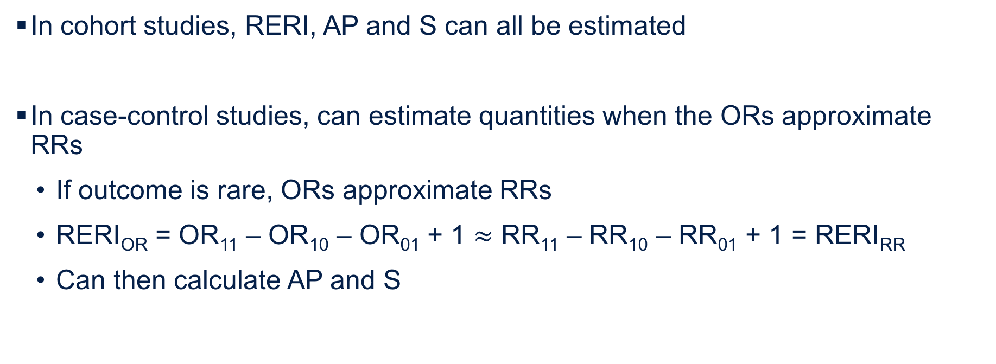
Application in studies
In cohort studies, RERI, AP and S can all be estimated
In case-control studies, can estimate quantities when the ORs approximate RRs
  If outcome is rare, ORs approximate RRs
  RERI_{OR} = OR₁₁ – OR₁₀ – OR₀₁ + 1 $≈$ RR₁₁ – RR₁₀ – RR₀₁ + 1 = RERI_{RR}
  Can then calculate AP and S
Notes:
It’s straightforward to apply these to studies. In cohort studies, all of these measures, the RERI, the attributable proportion and the synergy index can be estimated.
In case-control studies, under the rare disease assumption, you can estimate the RERI using odds ratios, assuming that the odds ratios approximate the risk ratios. Therefore, the RERI using odds ratios is an approximation of the RERI from risk ratios had you conducted a cohort study. From there, you can also calculate the attributable proportion and the synergy index.
When the outcome is not rare, the RERI for odds ratios does not approximate that with risk ratios. And we’ll review in the statistical modeling section how to handle these data.

Slide 28

Published measures of interaction
Joshi et al. Additive interactions between susceptibility SNPs identified in GWAS and breast cancer risk factors in Breast and Prostate Cancer Cohort Consortium. AJE 2014.
Notes:
Here’s an example of how studies reported these measures of interaction.
This was a study of multiple gene-environment interactions from Joshi and colleagues. They took cases and matched controls from 8 prospective cohort studies in the US, Europe and Australia. The objective of the study was to test departures from additivity on the absolute risk scale between 9 established risk factors for breast cancer and 23 GWAS-identified SNPs that increased susceptibility to breast cancer.
In the table shown here, the authors examined the interaction between body mass index and the RAD51L1 SNP (click). The results shown in green, highlights excess risk of breast cancer for various combinations and the SNP genotype, with the reference group of women with BMI over 30 and the AA genotype.
In the footnotes, the authors actually define RERI as a measure of departure of additivity on the absolute risk scale (click). They calculated RERIs and confidence intervals using unconditional logistic regression models adjusting for baseline age and cohort. Then, they calculated measures of interaction for 4 combinations of BMI and genotype in these footnotes (click). For each exposure combination, the authors present the RERI and synergy index. Because the RERIs are all below 0and similarly the synergy indices are below 1, there is evidence of negative interaction on the additivity scale.

Slide 29
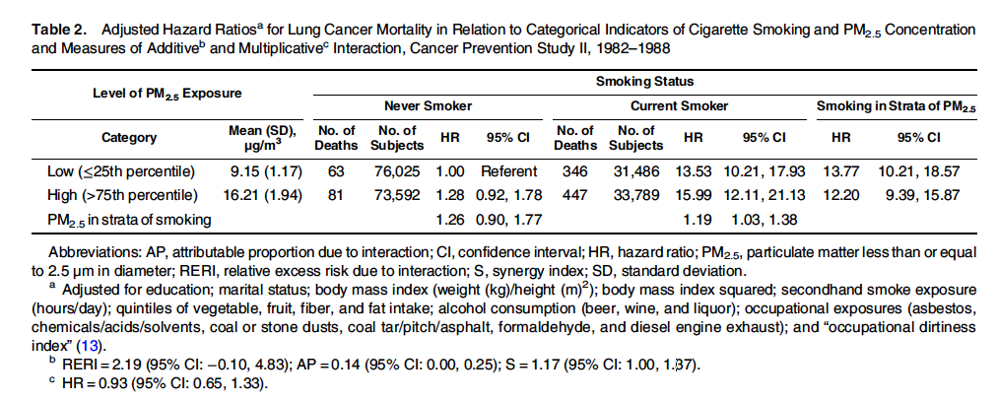
Published measures of interaction
Turner et al. Interactions between cigarette smoking and fine particulate matter in the risk of lung cancer mortality in Cancer Prevention Study II. AJE 2014.
Notes:
Here’s another example of a study that reported their measures of interaction. This study by Turner and colleagues was to examine the interactions on the additive scale between cigarette smoking and exposure to PM2.5 in relation to lung cancer mortality iin the cancer prevention study II, a prospective cohort study of almost 1.2 million participants.
In the table shown, the authors stratified results by high and low fine particulate matter exposure and by smoking status. (click). We see very high hazard ratios of lung cancer among current smokers and particularly those exposed to high PM2.5 levels.
In the footnotes, the authors present 3 measures of interaction on the additive scale: the RERI, the attributable proportion, and the synergy index. The RERI of 2.19 is greater than 1. The synergy index of 1.17 is also greater than 1. This suggests positive or super-additive interaction.
The attributable proportion of 0.14 tells us that 14% of the risk in the current smoker and high PM2.5 exposed group is due to the interaction.

Slide 30
Learning Objectives
Measures of interaction
Mechanistic Interaction
Statistical Modeling
Presentation of interaction analyses
Notes:
Let’s now review further the concept of mechanistic interaction.

Slide 31
Sufficient cause vs. counterfactual models
Sufficient cause model considers actions, events, or states of nature which act together to bring about the outcome of interest
  Requires detailed knowledge about mechanisms underlying effects
  “Given a particular effect, what are the various events that could have caused it?”
Counterfactual model considers one cause/intervention and the various effects it could have
  Does not require detailed knowledge of mechanisms
  “What would have occurred if a particular factor was intervened upon?”
Notes:
Last week, we discussed the sufficient cause approach and the counterfactual approach to interaction. We said that the sufficient cause model considers the factors or causes that come together to bring together the outcome of interest. On the other hand, the counterfactual model considers one cause or intervention and the various effects it could have.

Slide 32
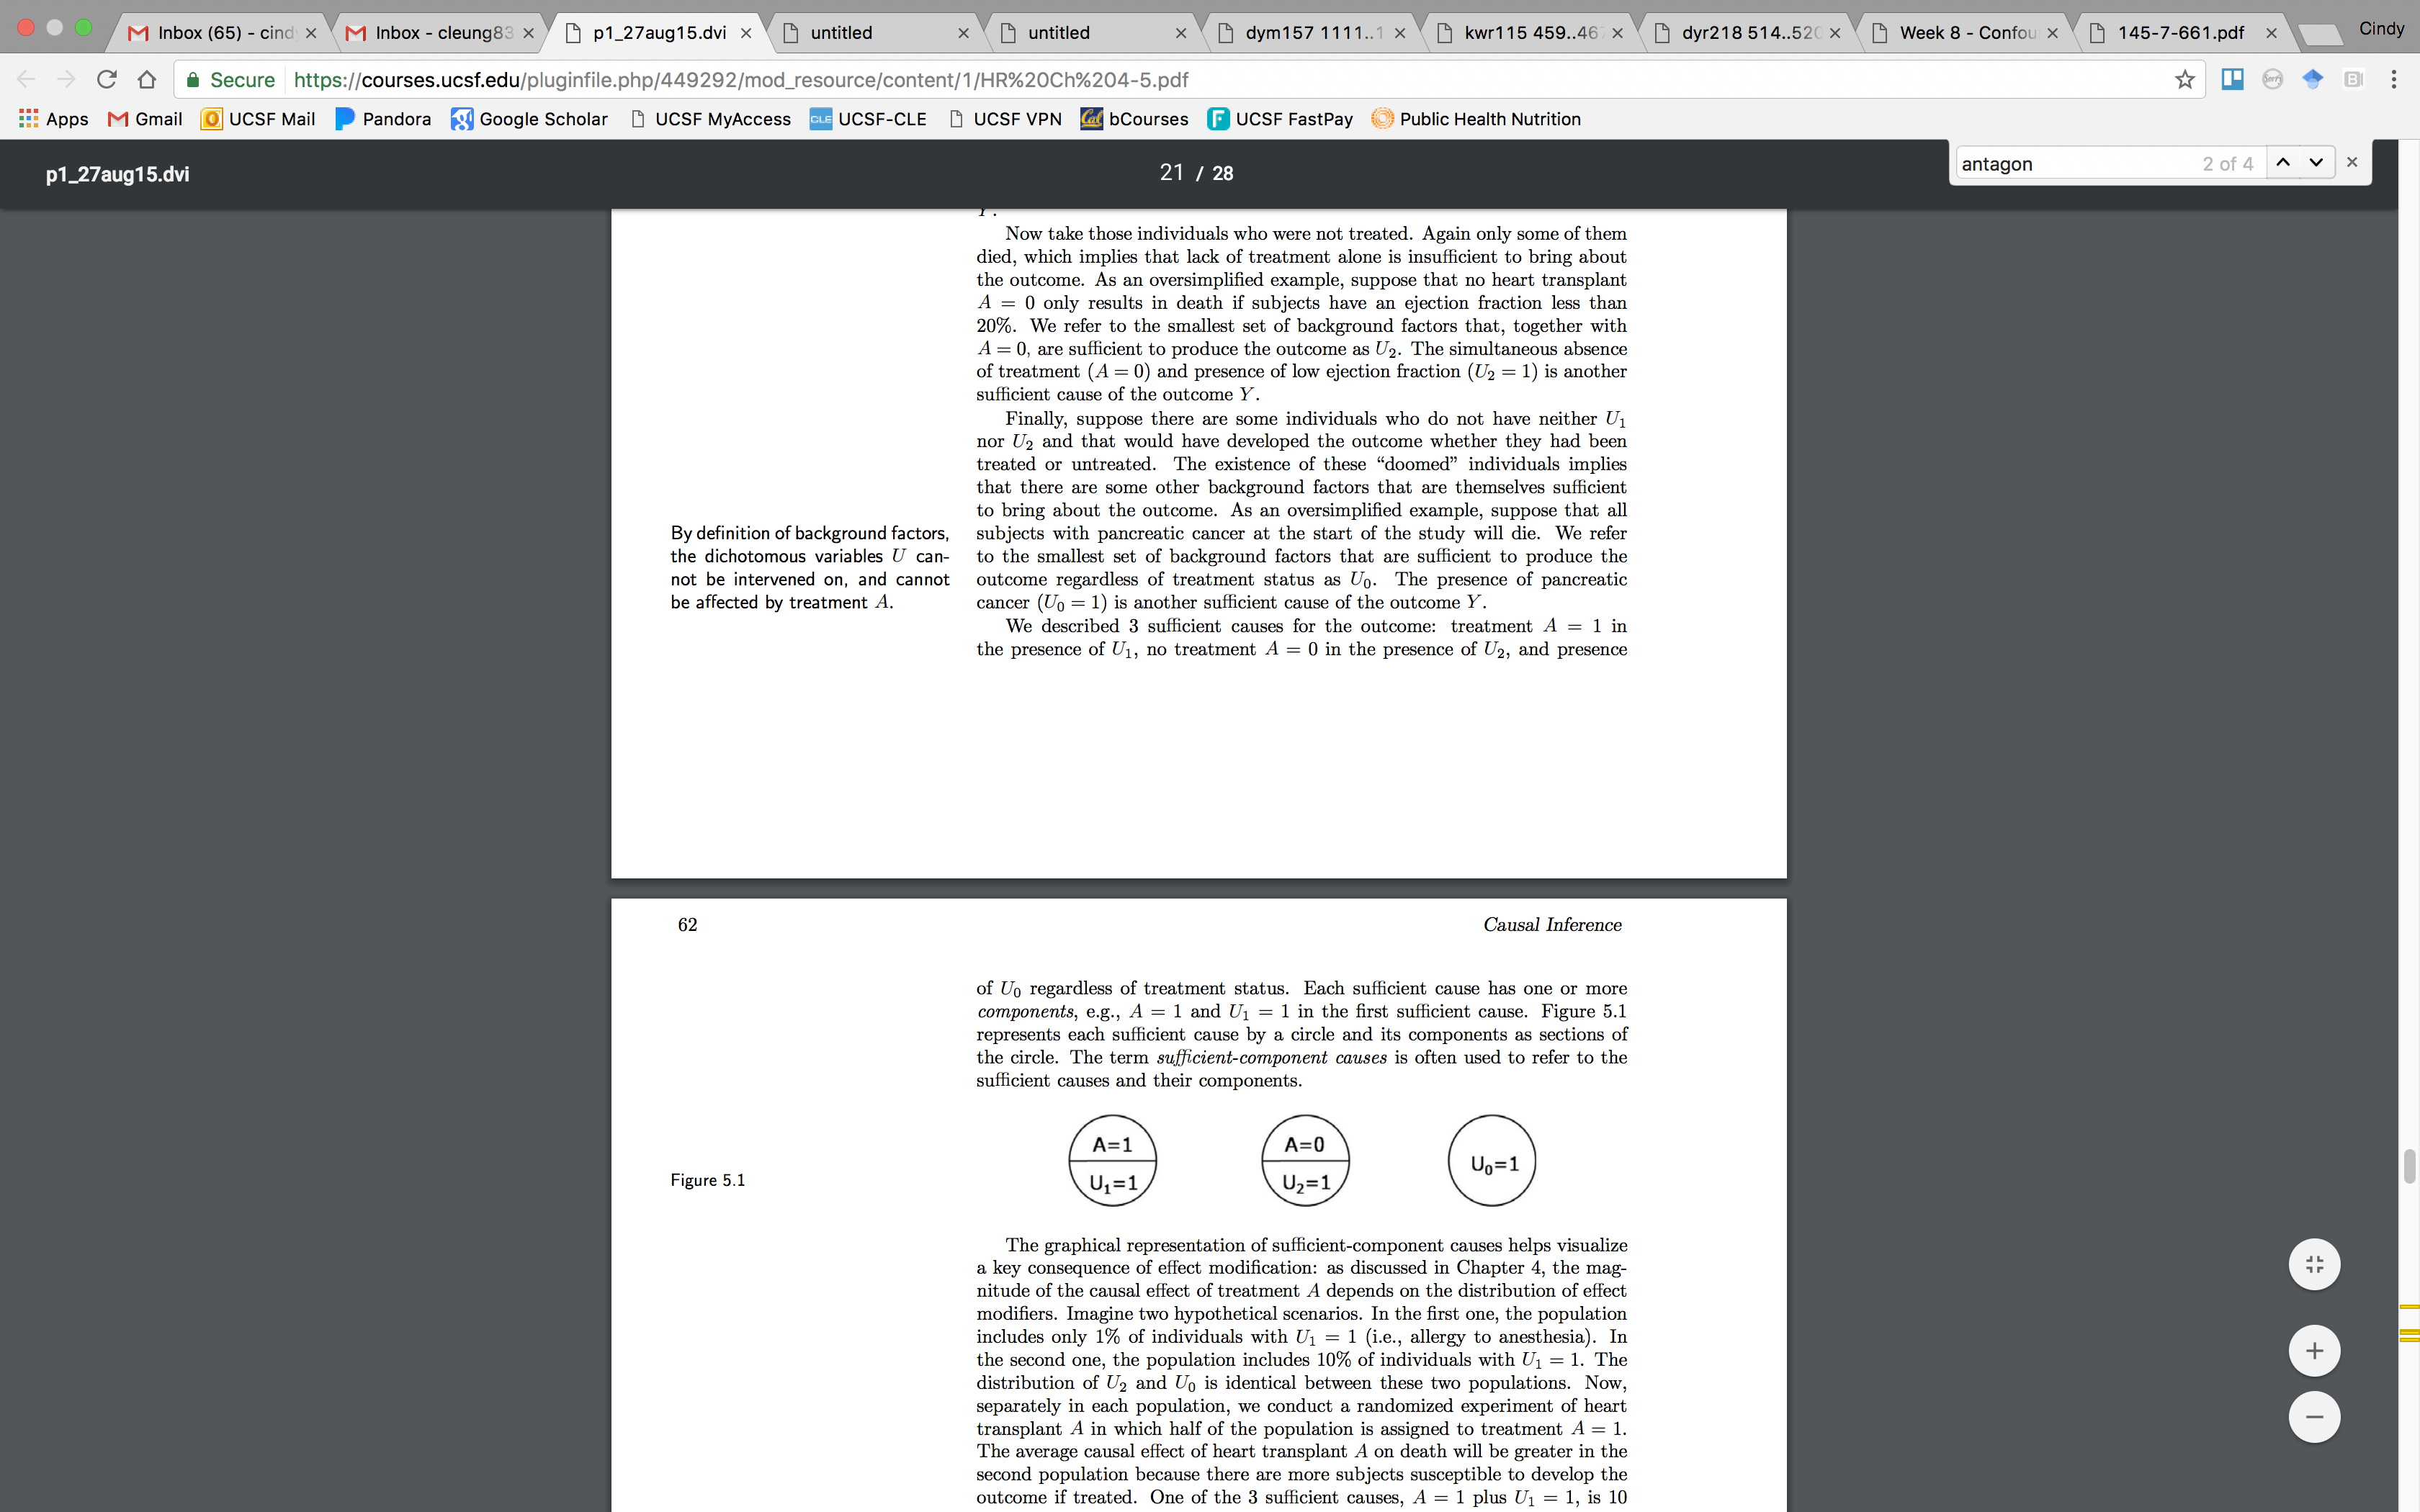
Interaction under the sufficient cause approach
  Interaction between component causes is implicit in the sufficient cause model
  Each component cause requires the presence of the others to act, their action is interdependent
  Component cause = INUS – “an insufficient but necessary part of a condition which is itself unnecessary but sufficient for the result”
Notes:
Last week, we introduced interaction under the sufficient cause approach. Just as a refresher, each of these sufficient causes represents one way for the individual to get the outcome of interest. If an individual has A=1 and U1=1 or A=0 and U2=1 or U0=1 alone, then the outcome occurs. And it’s only when all of the component causes are present in each causal pie does the the outcome occur. Thus, we can see how interaction between these components is implicit under this approach.
It’s also been said that a cause can be known as an insuffiicent but necessary part of a condition which is itself unnecessary but sufficient for the result, or sometimes called INUS.

Slide 33
Interaction – more definitions
  Synergism: Individual would get disease only if exposed to both treatments. Individual would not get disease if only exposed to A or E.
    When both exposures are present in the same component cause
  Antagonism: Individual would only get the disease if exposed to one treatment but not the other, and vice versa. One treatment blocks the effect of another treatment.
    When one exposure is present and one is absent in the same component cause
Notes:
We also covered the concepts of synergism and antagonism.
Synergism, we said, is when an individual would only get the disease if exposed to both treatments. Individuals would not get the disease if only exposed to A or E. From a sufficient cause model, this means that both exposures would have to be present in the same component cause. Therefore, the first causal pie with A=1 and U1=1 shows synergy between these factors.
Antagonism, on the other hand, is when an individual would only get disease if exposed to one treatment but not the other or vice versa. This is what happens when one treatment blocks the effect of another treatment. In the second causal pie, A =0 so the individual is unexposed but U2=1. This is an example of antagonism.
This can also be extended to multiple component causes in one causal pie. In this case, we can say there is synergy between two exposures but antagonism between two other exposures.

Slide 34

Another representation of mechanistic interaction
Only three mechanisms for developing Y
  A₁ and G
  A0
  A₂ and E
G and E do not exist in the same causal pie
A₁ and A₂ do not exist in the same causal pie
No synergism (interaction) between G/E or A₁/A₂ in a mechanistic sense
Notes:
Suppose there are just three mechanisms for outcome Y
One requiring A1 and G
One requiring A0
And one requiring A2 and E
From this depiction, we see that G and E do not exist in the same causal pie. Similarly, A1 and A2 do not exist in the same causal pie. Therefore, there is no interaction, specifically, no synergism, between G and E or A1 and A2 in a mechanistic sense. You could also think of it as because A0, A1 and A2 are all independent of G or E, A0, A1 and A2 do not confound the effects of G and E on Y.

Slide 35
Statistical interaction with no mechanistic interaction
G | E | Total | Cases | RR
G=0 | E=0 | 3980 | 20 | 1
G=1 | E=0 | 980 | 20 | 4.0
G=0 | E=1 | 3920 | 80 | 4.0
G=1 | E=1 | 965 | 35 | 7.0
Multiplicative interaction: RR₁₁ / (RR₁₀ * RR₀₁)
  = 7.0 / (4.0 * 4.0) = 0.44 = Negative Multiplicative Interaction!
RERI = 7.0 – 4.0 – 4.0 + 1 = 0
Can occur with both positive or negative interaction
Notes:
Now let’s apply real numbers. We have this simple table of two binary variables, G and E. We also know the number of individuals in each strata, the number of cases, and the risk ratio.
In this case, we calculate our measure of interaction on the multiplicative scale and obtain 0.44. This is less than 1, which woud signify negative multiplicative interaction.
We can also calculate the RERI, but this gives us 0.
Now we have an instance where have negative multiplicative interaction but no mechanistic interaction.
In this case, negative statistical interaction does not tell us anything about synergism or mechanistic interaction. This can also be extended to positive statistical interaction. This is where the counterfactual approach can come be useful.

Slide 36
Counterfactuals and causal interactions
Counterfactuals: Y^{g,e} represents one’s counterfactual outcome for an individual if G=g and E=e
Causal interaction: Exists if Y^{g=1,e=1} = 1 and Y^{g=1,e=0} = Y^{g=0,e=1} = 0
In the presence of causal interaction, there must be synergism in Rothman’s sufficient cause framework
Notes:
SO when can we conclude that there is a mechanism that requires both exposures?
Let us go back to the definition of the counterfactual. Here, Y superscript g and e represents one’s counterfacutal outcome if an individual has G equals one level of g and E equals one level of e.
Causal interaction exists when one’s counterfactual outcome under both exposures g=1 and e=1 differs from one’s counterfatual outcome under each exposure alone
It can be shown then that if there is a causal interaction, there must be synergism under Rothman’s sufficient cause framework, meaning that there is a sufficient cause with both G and E.

Slide 37
Mechanistic Interaction
Assumptions for mechanistic/ sufficient cause interaction:
  Monotonicity: the effect of each exposure on the outcome always operates in the same direction for all individuals (e.g. the effect of smoking on lung cancer is always harmful)
    G has a positive “monotonic effect” on the outcome if Y^{g,e} is non-decreasing in g and e
    Both exposures need to be monotonic
    Cannot be verified empirically
  Unconfoudedness: confounding for both exposures is controlled for
    The effects of G and E on Y are unconfounded if P(Y^{g,e}=1) = P(Y=1 | G=g, E=e)
Notes:
Statistical interaction is different from mechanistic or sufficient cause interaction. We’ve seen how we can observe statistical interaction even in the absence of mechanistic interaction
But to test for sufficient cause interaction, there are additional assumptions we need to make about the relation between exposures and the outcome.
First, is the assumption of monotonicity. This means that the effect of each exposure on the outcome always operates in the same direction for all individuals. For example, the effect of smoking on lung cancer is always harmful. Or the effect of asbestos exposure on lung cancer is always harmful. This can be more easily assumed for some exposures like smoking but may be trickier for other exposures like alcohol intake.
Another way to say this is that G has a positive monotonic effect on the outcome if the counterfactual outcome under levels of g and e does not decrease. This also has to apply to both exposures – we need to assume monotonicity for both exposures. And unfortunately, this is an assumption that cannot be verified empirically.
Another important assumption that we need for mechanistic interaction is unconfoundedness. This essentially means that confounding for both exposure-outcome relationships are controlled for in some way. Formally, we say that the effects of G and E on the outcome Y are unconfounded if the counterfactual outcomes Y superscript g and e are independent of the actual exposures.

Slide 38
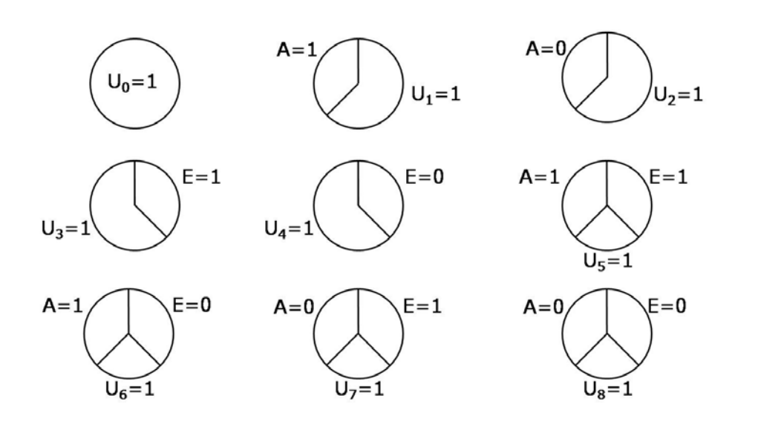
Mechanistic Interaction
synergism
antagonism
antagonism
Notes:
Going back to the sufficient component cause models we showed last week, there are 9 sufficient causes for two binary exposures.
If there is a sufficient cause where A=1 and E=1 present (click), then that would be a case for synergism.
If there is a sufficient cause where A=1 and E=0 present, or A=0 and E=1 present, then that would be a case for antagonism.

Slide 39
Mechanistic Interaction
Rothman and Greenland 1998:
Assuming both monotonicity and unconfoundedness, mechanistic interaction can be evaluated by:
  p₁₁ – p₁₀ – p₀₁ + p₀₀ > 0
  RERI > 0
  If this quantity is greater than 0, then there is positive additive interaction
Notes:
Rothman and Greenland initially showed that under both assumptions of monotonicity and unconfoundedness, mechanistic interaction can be evaluated by the same expression used to evaluate interaction on the additive scale. If the risk under both exposures minus the risk from exposure A minus the risk from exposure B plus the risk under no exposures is greater than 0, then there is evidence of mechanistic interaction. In other words, the effects of both exposures combined exceeds the sum of the effects of each considered separately.
This is also equivalent to the RERI being greater than 0.

Slide 40
Mechanistic Interaction
VanderWeele and Robins 2007:
Assuming both monotonicity and unconfoundedness, mechanistic interaction can be evaluated by:
  p₁₁ – p₁₀ – p₀₁ > 0
  RERI > 1
  If this quantity is greater than 0, then there is positive additive interaction
  Stricter criteria than Rothman and Greenland but does not require monotonicity assumption
Notes:
However, more recently, Vanderweele and Robins concluded that mechanistic interaction can be evaluated without the monotonicity assumption using a stricter criteria.
In this case, if the risk under both exposures minus the risk from exposure A minus the risk from exposure B is greater than 0, then there is evidence of mechanistic interaction. Unlike the previous slide, this formula does not add back the risk under no exposures. This condition can also be expressed as the RERI greater than 1. Because of these differences, these are stronger criteria than the regular test for additive interaction.

Slide 41
Learning Objectives
Measures of interaction
Mechanistic Interaction
Statistical Modeling
Presentation of interaction analyses
Notes:
Let’s now talk about another method of assessing interaction through statistical modeling.

Slide 42
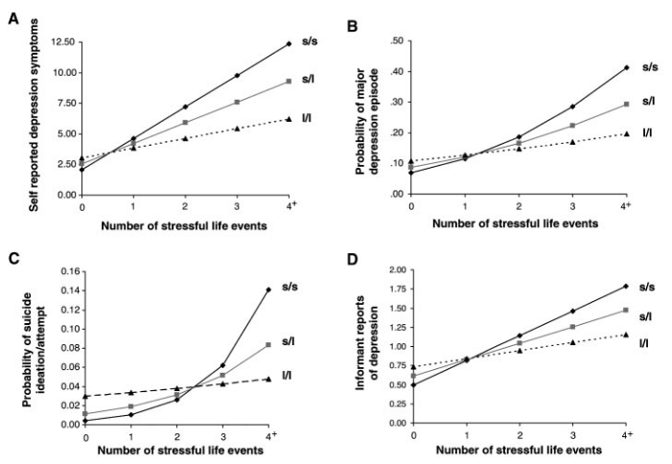
Assessing interaction by graphic representation
Caspi et al. Science 2003
Notes:
Last week, we reviewed several methods of assessing interaction.
One method is through graphic representation. The study we reviewed last week was an example of a gene-environment interaction last week. This study examined the influence of life stress and a polymorphism on the 5-HTT gene on the risk of depression. In this graphical representation of the results, we see a similar pattern across four outcomes of depression. There is an interaction between those with one or two copies of the short allele and stressful life events on the risk of depression.

Slide 43
Assessing interaction by stratification
Interaction by presence of short allele G on the association between stressful life events E and risk of depression
  When G is present:
    RD = 0.33 – 0.10 = 0.23
    RR = 0.33 / 0.10 = 3.3
  When G is absent:
    RD = 0.17 – 0.10 = 0.07
    RR = 0.17 / 0.10 = 1.7
4+ Stressful life events | Genotype with short allele
 | Yes | No
Yes | 33% | 17%
No | 10% | 10%
Notes:
Another method we covered is stratification. This is also how we’ve presented our data in previous slides. Using the same example on stressful life events and the short allele G, we can see how the stratified risk differences and risk ratios are different from each other. In this case, we stratified by G, presence of the short allele, and examined the effect of stressful life events on depression. Alternatively, we could have stratified by stressful life events, and examined the effects of the short allele on depression.

Slide 44
Assessing interaction by comparing expected vs. observed joint effects
What is the individual effect of cause A in the absence of exposure to cause B?
What is the individual effect of cause B in the absence of exposure to cause A?
What is the observed joint effect of A and B?
What is the expected joint effect of A and B in the absence of interaction?
Is the observed similar to the expected in the absence of interaction?
What is the interaction magnitude?
RR_{E,-}=0.17/0.10=1.7
RR_{-,G}=0.10/0.10=1.0
RR_{OBSERVED E,G}=0.33/0.10=3.3
RR_{EXPECTED E,G}=1.7*1.0=1.7
RR_{OBSERVED E,G} > RD_{EXPECTED E,G,}
RR_{E/ G IS PRESENT} / RR_{E/ G IS ABSENT}
= 3.3 / 1.7 =1.9
Interaction Contrast Ratio
RD_{E,-}=0.17-0.10=0.07
RD_{-,G}=0.10-0.10=0
RD_{OBSERVED E,G}=0.33-0.10=0.23
RD_{EXPECTED E,G}=0.07+0=0.07
RD_{OBSERVED E,G} > RD_{EXPECTED E,G,}
RD_{E/ G IS PRESENT} – RD_{E/ G IS ABSENT}
= 0.23 - 0.07 =0.16
Interaction Contrast
Notes:
Another method we covered is assessing interaction by comparing expected vs. observed joint effects. This was a series of steps where we calculated the observed joint effect of both exposures. Then, we calculated the expected joint effects of both exposures and compared that to the observed. From there, we can calculate the interaction contrast or interaction contrast ratio, which we showed is identical to the RERI.

Slide 45
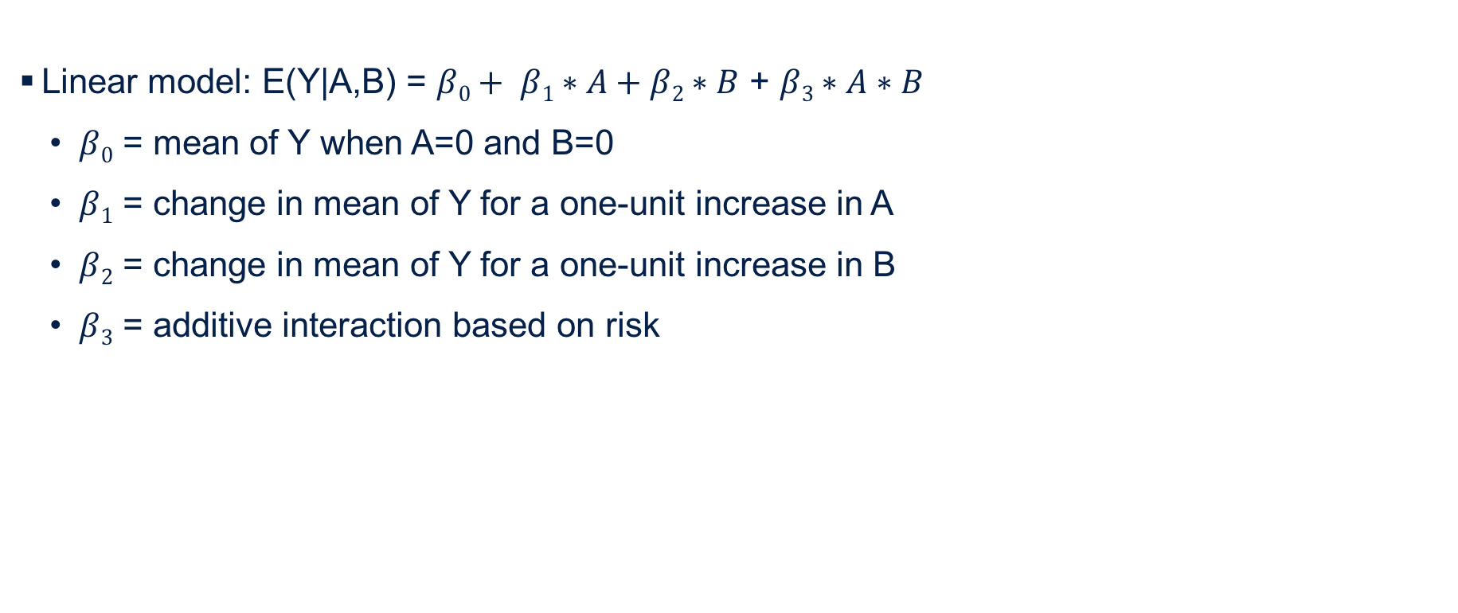
Assessing interaction by statistical modeling
Linear model: E(Y|A,B) = $β0+ β1∗A+β2∗B$ + $β3∗A∗B$
  $β0$ = mean of Y when A=0 and B=0
  $β1$ = change in mean of Y for a one-unit increase in A
  $β2$ = change in mean of Y for a one-unit increase in B
  $β3$ = additive interaction based on risk
Notes:
Now let’s move on to interaction by statistical modeling, which is probably one of the most commonly used methods for assessing interaction.
Here, we have a linear model where Y is a continuous outcome, and we have two exposures, A and B.
This model shows that the expected value of Y given A and B is beta 0 + beta 1 times A + beta 2 times B, + beta 3 times A and B. From your biostatistics courses, this model should look familiar to you.
Now let’s interpret each of these coefficients.
Beta 0 is the mean of Y when A= 0 and B = 0.
Beta 1 is the change in the mean of Y for a one-unit increase in A or for a dichotomous A, when A=1 compared to when A=0.
Beta 2 is the change in the mean of Y for a one-unit increase in B or for a dichotomous B, when B=1 compared to when B=0.
And beta 3 is the coefficient representing the joint effect of A and B on Y. This is sometimes called the additive interaction based on risk.

Slide 46
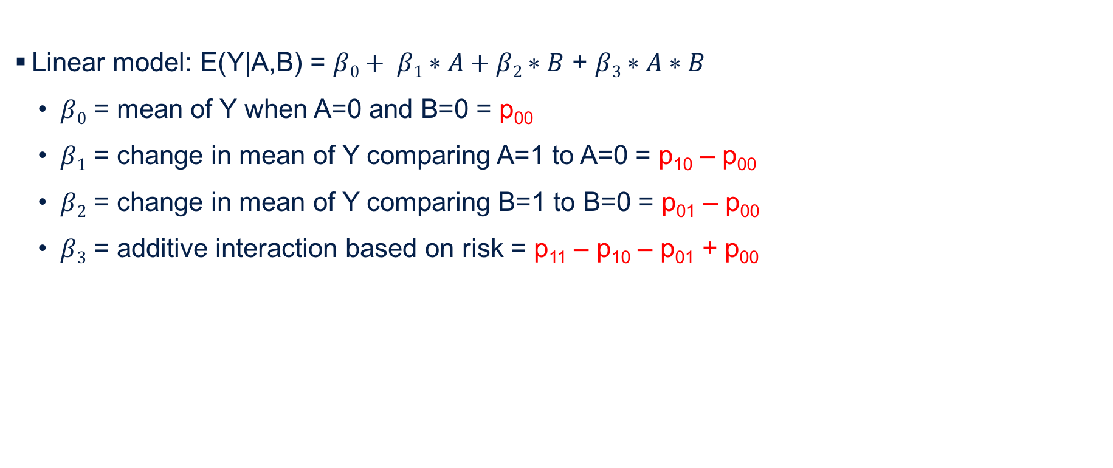
Assessing interaction by statistical modeling
Linear model: E(Y|A,B) = $β0+ β1∗A+β2∗B$ + $β3∗A∗B$
  $β0$ = mean of Y when A=0 and B=0 = p₀₀
  $β1$ = change in mean of Y comparing A=1 to A=0 = p₁₀ – p₀₀
  $β2$ = change in mean of Y comparing B=1 to B=0 = p₀₁ – p₀₀
  $β3$ = additive interaction based on risk = p₁₁ – p₁₀ – p₀₁ + p₀₀
 | A=0 | A=1
B=0 | p₀₀ | p₁₀
B=1 | p₀₁ | p₁₁
Notes:
We can see how this might match up to a 2x2 table looking at the outcome under levels of A and B.
Beta 0 is the mean outcome when A=0 and B=0, which in this 2x2 table is estimated by p00.
Beta 1, the change in the mean of Y comparing A=1 to A=0 can be estimated by p10 – p00
Beta 2, the change in the mean of Y comparing B=1 to B=0 can be estimated by p01 – p00
And beta 3 the additive interaction based on risks, can be computed by p11 – p10 – p01 + p00. Thus, Beta 3 is equal to the measure of interaction on the additive scale.

Slide 47
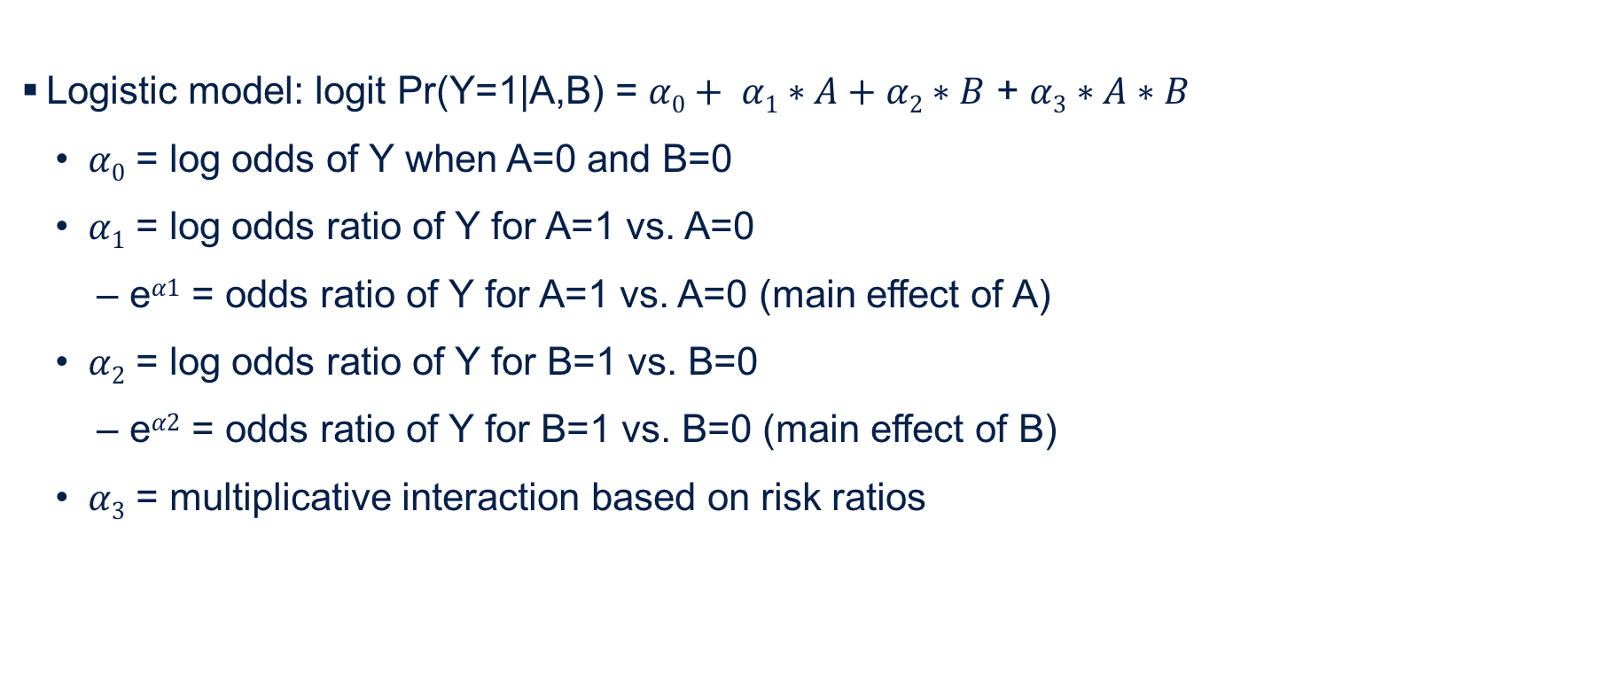
Assessing interaction by statistical modeling
Logistic model: logit Pr(Y=1|A,B) = $α0+ α1∗A+α2∗B$ + $α3∗A∗B$
  $α0$ = log odds of Y when A=0 and B=0
  $α1$ = log odds ratio of Y for A=1 vs. A=0
    e$α1$ = odds ratio of Y for A=1 vs. A=0 (main effect of A)
  $α2$ = log odds ratio of Y for B=1 vs. B=0
    e$α2$ = odds ratio of Y for B=1 vs. B=0 (main effect of B)
  $α3$ = multiplicative interaction based on risk ratios
Notes:
This can also be applied to a logistic model. This type of model is commonly fit with case control data.
So now we have a logistic model where Y is a dichotomous outcome and we have two exposures, A and B.
This model shows that the logit of Y given A and B is beta 0 + beta 1 times A + beta 2 times B, + beta 3 times A and B. Again, hopefully this looks familiar from your prior coursework.
Now let’s interpret each of these coefficients for this logistic model
Alpha 0 is the log odds of Y when A= 0 and B = 0.
Alpha 1 is the log odds ratio of Y when A=1 compared to when A=0. If we exponentiate this, then we have the odds ratio of Y for A=1 vs A=0 otherwise known as the main effect of A.
Alpha 2 is the log odds ratio of Y when B=1 compared to when B=0. If we exponentiate Alpha 2, then we have the odds ratio for Y for B=1 vs B=0, or the main effect of B.
And alpha 3 is the coefficient representing the joint effect of A and B on the log odds of Y. This is sometimes called the multiplicative interaction based on risk ratios

Slide 48
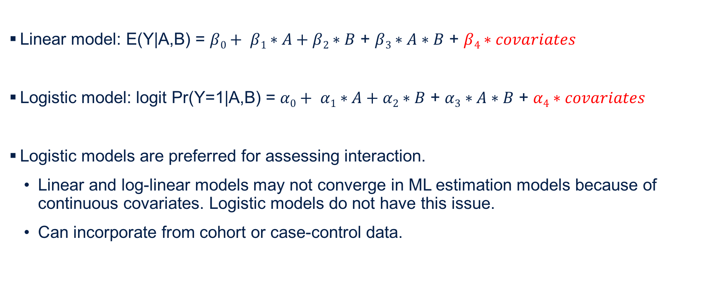
Assessing interaction by statistical modeling
Linear model: E(Y|A,B) = $β0+ β1∗A+β2∗B$ + $β3∗A∗B$ + $β4∗covariates$
Logistic model: logit Pr(Y=1|A,B) = $α0+ α1∗A+α2∗B$ + $α3∗A∗B$ + $α4∗covariates$
Logistic models are preferred for assessing interaction.
  Linear and log-linear models may not converge in ML estimation models because of continuous covariates. Logistic models do not have this issue.
  Can incorporate from cohort or case-control data.
Notes:
The models that I showed you only include the main effects of both exposures.
However, these models can be extended to control for other covariates in the model. These are represented in these models by beta4 or alpha 4, which represent a vector of covariates used to control for confounding or other biases in these models.
(click) In practice, logistic models are preferred for assessing interaction. This is because linear or log-linear models may have issues with convergence if estimated using maximum likelihood estimation especially in the presence of continuous covariates. But logistic models don’t suffer from this issue.
Logistic models can also handle data from cohort or case-control studies.

Slide 49
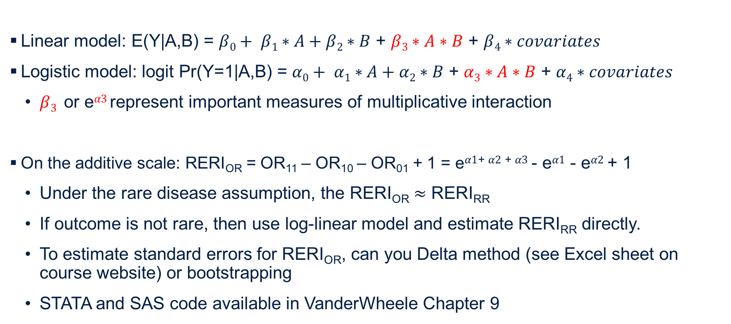
Assessing interaction by statistical modeling
Linear model: E(Y|A,B) = $β0+ β1∗A+β2∗B$ + $β3∗A∗B$ + $β4∗covariates$
Logistic model: logit Pr(Y=1|A,B) = $α0+ α1∗A+α2∗B$ + $α3∗A∗B$ + $α4∗covariates$
  $β3$ or e$α3$represent important measures of multiplicative interaction
On the additive scale: RERI_{OR} = OR₁₁ – OR₁₀ – OR₀₁ + 1 = e$α1$⁺ $α2$ ⁺ $α3$ - e$α1$ - e$α2$ + 1
  Under the rare disease assumption, the RERI_{OR} $≈$ RERI_{RR}
  If outcome is not rare, then use log-linear model and estimate RERI_{RR} directly.
  To estimate standard errors for RERI_{OR}, can you Delta method (see Excel sheet on course website) or bootstrapping
  STATA and SAS code available in VanderWheele Chapter 9
Notes:
In these linear and logistic models, the terms beta 3 or the odds ratio that we get when we exponentiated alpha 3, are important measures of multiplicative interaction. They can provide both effect estimates and confidence intervals. It’s easy to make statistical inferences based on these measures.
But as we discussed earlier, it can be more useful to present interaction on the additive scale rather than on the multiplicative scale. How then do we calculate interaction on the additive scale with this data?
For the logistic model, we can use the RERI for the odds ratio. Our statistical output will provide us necessary information to calculate this quantity. The OR if under both exposures is the alpha 1 plus alpha 2 plus alpha 3 exponentiated. The OR under exposure A only is alpha 1 exponentiated. The OR under exposure B only is alpha 2 exponentiated. With these parameters, we can estimate the RERI OR even after adjusting for covariates in the model.
Thus, in the presence of a rare outcome, the OR approximates the risk ratio so the RERI OR approximates the RERI RR.
If the outcome is not rare, then the RERIOR may not be appropriate to assess additive interaction. In this case, it would be better to fit a log-linear model to the same data and estimate the RERIrr directly.
To estimate standard errors for the RERI OR, one common approach is to use the Delta method, developed by Hosmer and Lemeshow. We have included an Excel spreadsheet on the course website that walks you through how to do this. There is also sample Stata and SAS code in the VanderWheele text that shows how to estimate standard errors. If this is something you’re interested in pursuing for your own research, I urge you to become more familiar with these resources.

Slide 50
Learning Objectives
Measures of interaction
Mechanistic Interaction
Statistical Modeling
Presentation of interaction analyses
Notes:
Our last learning objective is the presentation of interaction analyses.

Slide 51
Presenting stratum-specific effects
  What is the average causal effect in men?
    Causal risk ratio: Pr[Y^{a=1} = 1 | M=0] / Pr[Y^{a=0} = 1 | M=0] = 0.4 / 0.6 = 0.667
    Causal risk difference: Pr[Y^{a=1} = 1 | M=0] - Pr[Y^{a=0} = 1 | M=0] = 0.4 - 0.6 = -0.2
    Reference group: unexposed men
  What is the average causal effect in women?
    Causal risk ratio: Pr[Y^{a=1} = 1 | M=1] / Pr[Y^{a=0} = 1 | M=1] = 0.6 / 0.4 = 1.5
    Causal risk difference: Pr[Y^{a=1} = 1 | M=1] - Pr[Y^{a=0} = 1 | M=1] = 0.6 - 0.4 = 0.2
    Reference group: unexposed women
Notes:
One common way to present the results of effect modification or interaction is to present stratum-specific effects. This is especially true when considering effect modification, so in the case of a third variable, M, we examine whether the stratum-specific effect measures are different within levels of M. This is what we did when we first started off the Interaction lecture with the heart transplant example.
In this case, we have two separate reference groups: unexposed men and unexposed women.

Slide 52

Presenting stratum-specific effects
Examining effects of asbestos within levels of smoking?
Examining effects of smoking within levels of asbestos?
Which group has highest risk of outcome?
YES
NO
NO
Notes:
We also see this presented in the Vanderwheele text.
This presentation is helpful for seeing that asbestos exposure is related to greater risk of lung cancer among non-smokers than among smokers. It can also be used to calculate multiplicative interaction.
But, there are limitations with this approach as well. This approach is only useful for examining the effect of asbestos within levels of smoking. (click) It’s not useful for examining the effects of smoking within levels of asbestos. (clikc) If we look at the E=0 group, we can’t compare a reference group of 1 to 1. Even by looking at the E=1 group, we can’t compare the risk ratios of 6.09 to 4.74 to see who has the higher risks of the outcome. (click)
For this reason, it’s argued that this presentation is uninformative. (click)

Slide 53

Using a common reference group
Current guidelines recommend a common reference group for presentation of effect modification and interaction analyses
Examining effects of asbestos within levels of smoking?
Examining effects of smoking within levels of asbestos?
Which group has highest risk of outcome?
YES
YES
YES
Notes:
The solution to this is to use a common reference group, which is the current guideline for presentation of effect modification and interaction analyses.
In this case, we can still examine the effects of asbestos within levels of smoking (click). For non-smokers, risk ratio is 6.09 divided by 1 or 6.09. For smokers, the risk ratio is 40.91 divided by 8.64 or 4.74, as shown in the previous slide.
We can also examine effects of smoking with levels of asbestos (click). For those without asbestos exposure, E=0, the risk ratio is 8.64 divided by 1. For those with asbestos exposure, the risk is 40.91 divided by 6.09 or 6.72.
Which group has the highest risk of the outcome? We can tell by the magnitude of the risk ratios (click). The lowest risk is in the G=0, E=0 group, followed by the E=1, G=0 group, followed by the E=0 and G=1 group. And the highest risk is in the E=1 and G=1 group.
Contrasted with the previous slide, this approach is called informative presentation (click)

Slide 54
Using a common reference group
In practice, code two exposures into one categorical exposure variable representing different exposure combinations
  Rather than having two binary variables, E and G
  Create a new 4-level categorical variable that represents each exposure combinations
    EG_new =1 if E==0 and G==0
    EG_new =2 if E==1 and G==0
    EG_new =3 if E==0 and G==1
    EG_new = 4 if E==1 and G==1
Notes:
One simply way you could apply this in practice is instead of having two exposure variables and you enter both into the model separately with a product term, you could create a categorical exposure variable with every exposure combination.
In the case of 2 binary variables, E and G, you could create a new 4-level categorical variable called EG_new. In this, you would code EG_new = 1 for individuals with E=0 and G=0. EG_new = 2 for individuals with E=1 and G=0, and so forth. Then, by entering this new variable into your regression model, you can get separate effect estimates for every combination of exposure using a common reference group.

Slide 55
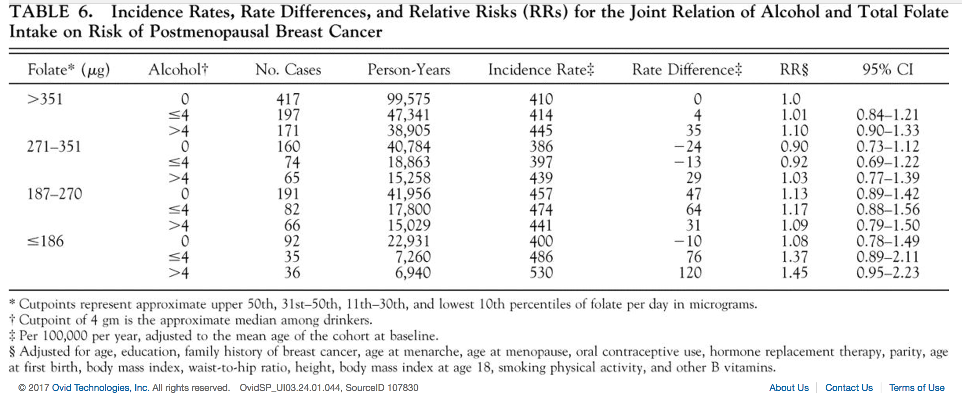
Using a common reference group
Sellers et al. Dietary folate intake, alcohol, and risk of bresat cancer in a prospective study of postmenopausal women. Epidemiology 2001.
Notes:
This was also exactly the case in the first example I showed you in this lecture. In the study that looked at alcohol intake, folate intake and risk of postmenopausal breast cancer, I initially showed a simplified table that examined high and low folate and high and no, moderate and high alcohol intake on the risk of breast cancer. This is the real table from the study.
As you’ll notice, the authors show folate level as rows, stratified into quartiles (click).
Within each quartile, they then stratified by alcohol consumption ranging from none, moderate to high (click). They then show the incidence rate of breast cancer for each group (click), the corresponding rate difference, (click) and the incidence rate ratios (click). All of these comparisons are made to the lowest risk group – so women with high folate and low alcohol.
From this example, you can see how this presentation facilitates the comparison of results across levels of folate and alcohol, as well as which group has the lowest and highest risks of the outcome.

Slide 56


Using a common reference group
Leung et al. Household food insecurity is associated with depression in low-income SNAP and non-SNAP participants. J Nutrition 2015.
Notes:
Here’s an example from my own research.
In this study, I used data from NHANES to examine the associations between two exposures, household food insecurity and participation in the Supplemental Nutrition Assitance Program (SNAP), also known as the food stamp program, on the outcome of depression. This analysis was restricted to low-income individuals and I used multivariable logistic regression models to estimate odds ratios adjusted for several sociodemographic and health factors.
In the panel on the left, I estimated stratum-specific effects. The first set of columns show the odds ratios for food insecurity and depression among SNAP nonparticipants. The second set of columns show the odds ratios for food insecurity and depression among SNAP participants.
Although we’ve seen the criticisms of using separate reference groups, in this case, I felt it was important to show the group-specific associations because it’s been argued by many in my field that SNAP participants and nonparticipants differ across many observable and unobservable characteristics so it’s not always fair to compare the two.
In this table, we can see the higher odds of depression due to low food security and very low food security in both groups.
In the panel on the right, I estimated associations using a common reference group. From this figure, which are the predicted probabilities of depression adjusting for all potential confounders, we can see which group has the highest risk of depression as well as comparisons across level of SNAP participation and within levels of food insecurity status.
So, sometimes it’s useful to show both stratum-specific associations and associations using a common reference group. It’s also not uncommon to present results from interaction or effect modification analyses in multiple ways – in a table so you can show the magnitude of the effects as well as confidence intervals and other useful information, but also graphically to paint a clear picture of how these associations differ across groups of multiple exposures.

Slide 57
Presentation of results – key points
Present RRs, ORs, or RDs, with confidence intervals for each stratum of the exposures with a single reference category (often the lowest risk group)
Present measures of interaction on both the additive (e.g. RERI) and multiplicative scales with CIs and P-values
List the confounders for which the relations between both exposures and outcomes were adjusted for.
Notes:
So the key points to take away for the presentation of results are;
Using a single reference category, present the risk ratios, odds ratios, or risk differences, including confidence intervals, for each level of the exposures.
Present measures of interaction on both the additive and multiplicative scales (such as the RERI, attributable proportion or synergy index) with appropriate confidence intervals and p-values
And finally, in the presence of interaction, consider exchangeability, positive, and consistency for both exposures and select your confounders as if you have two independent exposures affecting your outcome. List those variables in a footnote for your table or figure.

Slide 58
Summary
There is a distinct difference between biological interaction and effect (measure) modification
In epidemiology, we are interested in biological interaction on the additive scale
  Additive interaction most relevant for public health
  Though sometimes it may be helpful to present biologic interaction on additive and multiplicative scales
Various methods exist to evaluate biological interaction and to estimate the magnitude of interaction
  Statistical modeling is a popular approach
  RERI, AP, and S are measures that can be applied to cohort and case-control data
Mechanistic interaction is distinct from statistical interaction
When presenting interaction analyses, it is recommended to use a common reference group to facilitate comparison of main effects and joint effects
Notes:
In summary, we’ve had two lectures on interaction now to conclude this course.
Last week, we started a summary of the take-home points and today we elaborated on several of those same concepts.
First, there is a distinct difference between biological interaction and effect modification. If it is believed that one exposure affects another to influence the outcome, then there is biologic or mechanstic interaction.
Second, in epidemiology, we are more concerned with biologic interaction on the additive scale. Additive interaction is most relevant for public health purposes and can provide insight on which group will benefit most from intervention. Even so, for interaction analyses, it is useful to present interaction on both the additive and multiplicative scales.
Third, there are various methods to evaluate biological interaction and to estimate the magnitude of the interaction.
Statistical modeling is one popular approach. Related to this, the RERI, the attributable proportion and synergy index are all measures that can be estimated from cohort and case-control data. As we saw in some examples, it is not uncommon to estimate 2 or all 3 of these measures together.
Fourth, mechanistic interaction, via the sufficient cause approach, is different from statistical interaction. As we saw, it is possible to have statistical interaction without mechanistic interaction. In order to conclude mechanistic interaction, we need to make assumptions about the monotonicity of exposures or use stricter criteria to test quantities of interaction.
And finally, when presenting interaction analyses, it is recommended to use a common reference group to help facilitate comparisons of main effects and joint effects.

