Slide 1
Doing Research to Reduce Health Disparities
Christine Dehlendorf, MD MAS
Associate Professor
March 13, 2017

Slide 2

Course Objectives
Identify the meaning and measurement of race/ethnicity, SES, and other core concepts
Understand a multi-level and longitudinal framework for the etiologies of differences in health by race/ethnicity and SES
Understand the application of different study designs to health disparities research

Slide 3
Course Objectives
Describe the essential role of community engagement
Incorporate a rigorous approach to measurement and apply analytic methods to research in diverse populations
Incorporate an understanding of how to do strategic science in health disparities research
Recognize leading debates and areas of uncertainty, as well as priority areas of research, in health disparities research

Slide 4
Final Project
Share with us something about how the material in this class has or will inform your work.
  e.g., Application of the socioecological model to your area of research, measurement or analytic issues, how to think strategically about your area
Each presenter will have ~5 minutes, with a few minutes for questions
Also 1-2 page paper where you can expand a bit more on this topic

Slide 5
Today’s Objectives
Understand the three generations of health disparities research
Be aware of potential pitfalls when performing work within each generation, including failure to acknowledge socioecological contexts
Become familiar with a toolkit of research approaches for health disparities research

Slide 6
Phases of Disparities Research
Detect:
Define health disparities and vulnerable populations
Understand:
Identify determinants and mechanisms of disparities
Reduce:
Intervention research
Translation/dissemination
Policy change
Adapted from Kilbourne et al., 2006

Slide 7

First Generation Health Disparities Research

Slide 8
The First Generation of First Generation Research
The Black Report
  1970s, Secretary of Health of Britain concerned about class disparities in health
  Documented widespread inequalities in health

Slide 9
Death Rates per 1000 population England and Wales 1971
Social (occupational) class | Males (all) | Females (married, by husbands occupation) | Ratio M/F
I (Professional) | 3.98 | 2.15 | 1.85
II (Intermediate) | 5.54 | 2.85 | 1.94
IIIn (Skilled non-manual) | 5.80 | 2.76 | 1.96
IIIm (Skilled manual | 6.08 | 3.41 | 1.78
IV (Partly Skilled) | 7.96 | 4.27 | 1.87
V (Unskilled) | 9.88 | 5.31 | 1.86
Ratio V/I | 2.5 | 2.5

Slide 10
Occupational Class and Birth Weight
Birth weight | Class (mother’s husband) |  |  | Fatherless
% who were | (I II) | III | (IV and V)
Less than 2500 grams | 4.5 | 5.6 | 8.2 | 9.5
More than 3000 grams | 81.0 | 76.3. | 72.7 | 66.7

Slide 11
Impact of Black Report
“Although the problems of inequalities in health were well known to researchers, the Black Report summarized the evidence, gave it focus, reached conclusions and hence brought it to public attention”.
Led to an assessment by the Office for Economic Cooperation and Development and by WHO of health inequalities in 13 countries, and ongoing interest in health inequities
Marmot, Int J Epi, 2001

Slide 12
First Generation of First Generation of Research, US
1973 Kitagawa and Hauser published data from the “1960s Matched Records Study”
  First study to link death certificates to census data
Found independent relationships between all cause mortality and education, income and occupation
Called attention to issues of class in US
Notes:
Repeated in 1993 and found to be stronger (pappas NEJM)

Slide 13
First Generation of First Generation of Research, US
Margaret Heckler, Secretary of DHHS, convened Secretary's Task Force on Black and Minority Health in 1985
Documented extent of racial/ethnic health disparities
  60,000 excess deaths per year among minorities
  Cancer, CVD, cirrhosis, diabetes, homicide and accidents, and infant mortality accounted for more than 80 percent of the excess deaths

Slide 14

Impact of the Heckler Report
Report pushed minority health issues onto the national research and health policy stage
In 1985, Department of Health and Human Services established in 1985 the Office of Minority Health
  Ultimately led to National Institute on Minority Health and Health Disparities
Majority of states have agencies or groups responsible for minority health

Slide 15
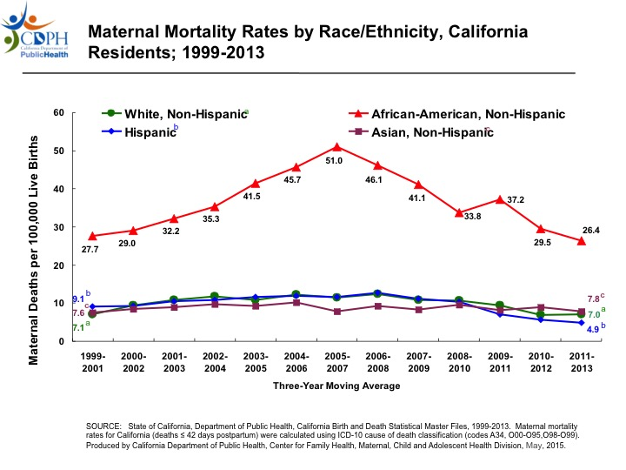

Slide 16
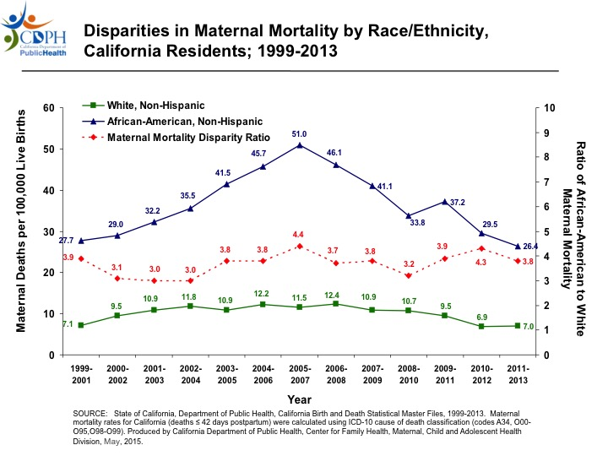

Slide 17
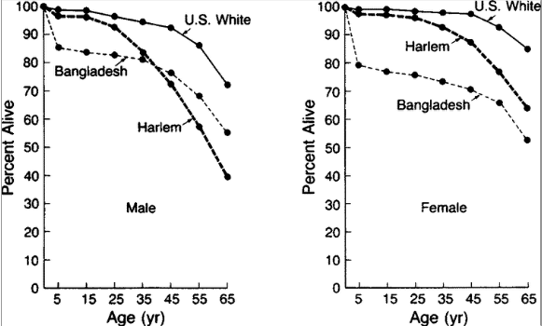
First Generation Research:
Novel Approaches to Data
McCord and Freeman, NEJM, 1990

Slide 18
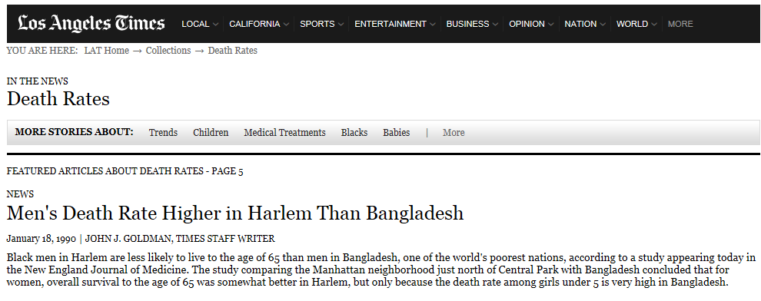

Slide 19
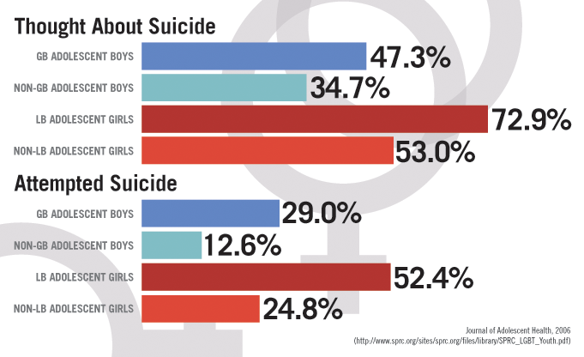
First Generation Research:
Drawing Attention to Populations

Slide 20
First Generation Research:
Drawing Attention to Specific Issues
Social conception of infertility as being a greater issue for white women
  82% of doctors believe it most common among “European Americans”
In fact, 12% of black women, compared to 6.9% of white women experience infertility
Disparity masked by social context
Ceballo, Fert Steril, 2010

Slide 21
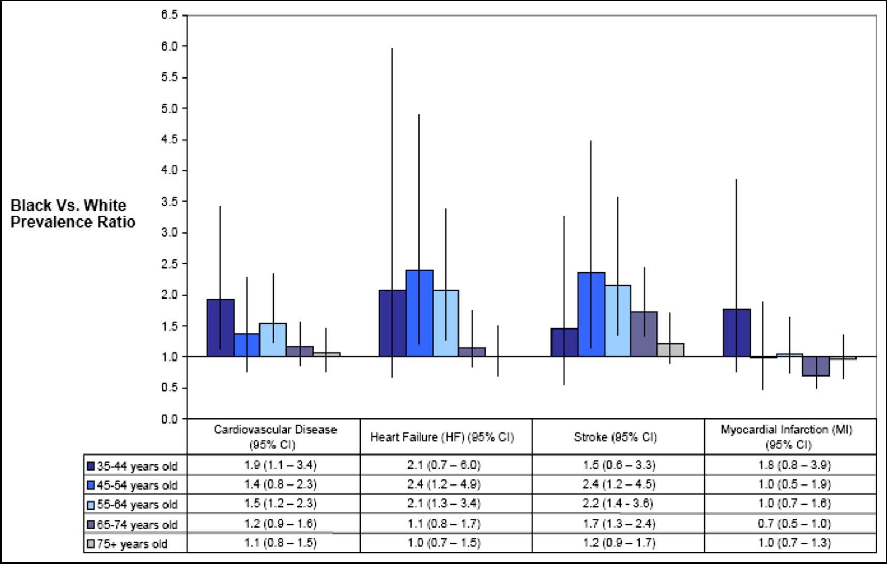
The Details: CVD Disparities by Age

Slide 22
Should I Do First Generation Research?
Depends on the area of interest
  How much work has been done?
  Is greater granularity needed?
If you wrote a grant, would you be able to make your case?

Slide 23
Considerations when doing 1^{rst} Generation research
If first generation research needed, look for pre-existing data sources
Consider evaluating changes in disparities over time
  Relative vs. absolute measures
Consider whether can answer second generation questions simultaneously (or at least generate hypotheses)

Slide 24
Considerations for 1rst Gen Research
Be deliberate in choices about measurement:
  Predictor
    How to categorize race/ethnicity
    How to define socioeconomic status
  Outcome – i.e. latent variables, patient centered outcomes, validity across groups
  Measures of association
  Caution when designing analytic approach
    Do not control for variables that are mediators (or be explicit about what question you are asking)
    Consider interactions between race and SES

Slide 25
Who is doing first generation research?

Slide 26

2nd Generation Health Disparities Research

Slide 27
Second Generation Health Disparities Research
What are the causes of documented disparities in health outcomes?
Goal of laying groundwork for interventions
Often necessitates successive layers of studies to understand phenomena
Need to be explicit about what which level(s) of influence from socioecological model is being considered

Slide 28
Multi-Level Framework for Health Disparities
Economic & Social
Opportunities and Resources
Living & Working Conditions
in Homes and Communities
Behaviors
Medical Care
Interaction with genetic/other biological factors
HEALTH
Adapted from Braveman et al., for RWJ Foundation
Commission to Build a Healthier America | www.commissiononhealth.org

Slide 29
Example of 2nd Generation Research: Cardiovascular disease
Are there racial/ethnic differences in risk factors?
  Poorer control of dyslipidemia
  Higher HbA1c
  Higher prevalence of hypertension
  Higher prevalence of obesity
Mensah G A et al. Circulation. 2005

Slide 30
Example of 2nd Generation Research: Cardiovascular disease
Behavioral differences?
  What are the behavioral causes of differences in risk factors?
Blacks more likely to be sedentary
Dietary differences
  Concentrated sugar
  Fruits and vegetables
Access to and use of health care services

Slide 31
Whitehall Study and Second Generation Research
Assessed contribution of health behaviors to excess mortality in lower levels of civil servants
29-72% attenuation with control for health behaviors (diet, physical activity, smoking, alcohol)
Behaviors explain some, but not all of differences

Slide 32
Example of 2nd Generation Research: Cardiovascular disease
Genetic causes:
  Do biologic differences underlie individual differences?
Often assumed there has to be a genetic component:
  “Given the strong racial disparities in the clinical manifestations of insulin resistance, genetic variants must be operative at some level.”
Kramer, Semin Nephrol, 2013

Slide 33
Example of 2nd Generation Research: Cardiovascular disease
Need for caution in interpretation of genetic research
  Finding of an association of outcomes with a disease does not equal causation
  Need to control for socio-environmental variables to avoid confounding

Slide 34
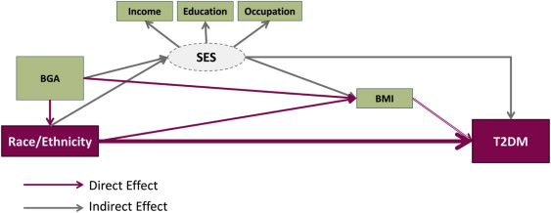

Slide 35
Example of 2nd Generation Research: Cardiovascular disease
Social determinants:
  What are the causes of individual differences in risk behaviors?
  What influence do social determinants have on health outcomes directly?

Slide 36
Multi-Level Framework for Health Disparities
Economic & Social
Opportunities and Resources
Living & Working Conditions
in Homes and Communities
Behaviors
Medical Care
Interaction with genetic/other biological factors
HEALTH
Adapted from Braveman et al., for RWJ Foundation
Commission to Build a Healthier America | www.commissiononhealth.org

Slide 37
Social Determinants:
Access to Food
Food-insecure individuals with diabetes reported poorer adherence to blood glucose monitoring (RR=3.5, p=.008) and more hypoglycemia-related emergency department visits (RR=2.2, p=.007).
Mean hemoglobin A1c was 9.2% among FI and 7.7% among FS participants (p=.08).
Seligman, JHCPU, 2010

Slide 38
Social Determinants:
Housing
Housing Opportunities for People Everywhere (HOPE VI) is redeveloping public housing
  Improved physical space
  Improved community infrastructure/support services
Children in non-HOPE public housing in SF had 39% greater odds of use of acute health services than those in HOPE housing
Kersten, Health Affairs, 2014

Slide 39
Racism as a Cause of Health Disparities
But what is racism?
  Interpersonal racism
  Structural racism
  Internalized racism
How does it cause health disparities?

Slide 40
Interpersonal Racism
Racism-related vigilance and hypertension investigated using the Chicago Community Adult Health Study
For blacks, each unit increase in vigilance was associated with a 4% increase in the odds of hypertension
Hispanics showed a similar but nonsignificant association and whites showed no association
Hicken, AJPH, 2014

Slide 41
Racism and Medication Adherence
Perceived racial discrimination measured among patients enrolled in a 30-site cluster-randomized controlled trial
A mediational method was used to estimate the indirect association between perceived discrimination and medication adherence through stress and depression
Perceived discrimination was associated with poor medication adherence, and was mediated by stress and depression
Forsyth, Psychosom Med, 2014

Slide 43
Structural Racism
Measured systematic exclusion of blacks from resources and mobility in society by state
Used the National Epidemiologic Survey on Alcohol and Related Conditions for data on MI
Controlling for individual demographics and state level disparities in poverty, Blacks in states with higher structural racism had greater risk for MIs than blacks in states with low scores
Lukachko, Soc Sci Med, 2014

Slide 44
Internalized Racism
Implicit association test used to measure implicit (unconscious) racial bias
Among black men with anti-black bias, experiences of discrimination associated with hypertension
  Those with a pro-black bias had lower risk of hypertension
Chae, Psychosom Med, 2012

Slide 45
Considerations when doing 2nd Generation research
Be deliberate in choices about measurement and analysis:
  Predictor
  Outcome
  Measures of association
  Models
What is the ecological context of causal pathway you are considering?
  Conceptual model can be helpful

Slide 46
Considerations when doing 2nd Generation research
Be creative and thoughtful about possible mechanisms
  Engage the community
  Think in a multidisciplinary fashion
  Consider use of qualitative methods
  Take into account influences across the life course
When do you know enough to do an intervention?

Slide 47
Who is doing 2nd generation research?

Slide 48
Thinking Beyond Generations
Development of measures relevant to health disparities research
  Discrimination, etc.
  Ensure measures are valid across groups
Studies of how to optimize community engagement
  Recruitment/retention
  Collaboration

Slide 49

Moving the Needle on Health Disparities:
3rd Generation Research

Slide 50
3rd Generation Research
What level of the socioecological model are you interested in/able to address?
How do you optimize community engagement – for you and for the community?
How do you factor in considerations about larger scale dissemination?
What measure of disparity are you interested in?

Slide 51
Behavioral Interventions
Most common
Can take into account ecological context of behavior
Can be designed to address disparities in different ways:
  Targeting of intervention
  Tailoring of intervention
  Assuming most in need will benefit the most

Slide 52

Targeting of Intervention
Problem: Worse hypertension control in blacks than in whites
Potential solution: Use black-owned barber shops to increase access to monitoring and motivate follow up with health care providers

Slide 53
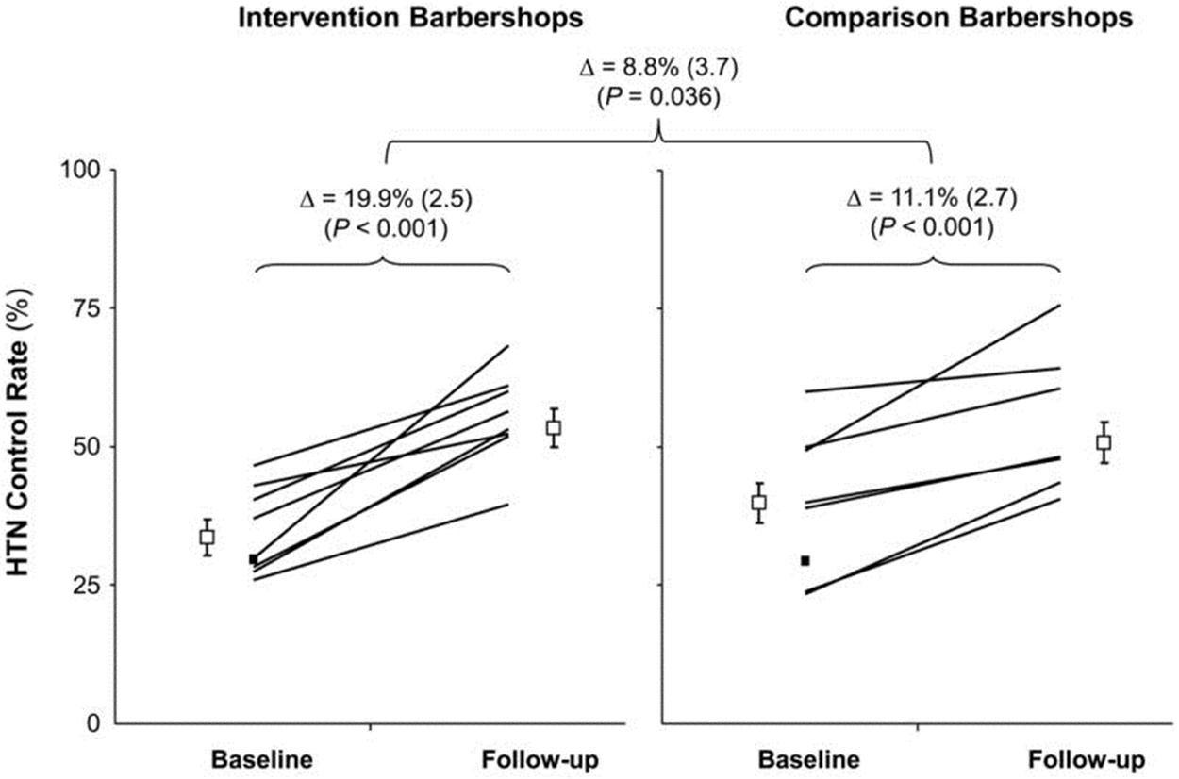
Victor, Arch Int Med, 2011

Slide 54
Tailoring of Intervention
Problem: African American women are less likely to have mammograms
Potential solution: Cultural and/or behavioral tailoring of messages, delivered in a magazine
  Cultural tailoring (spirituality, collectivism, racial pride)
  Behavioral constructs tailoring (knowledge, perceived risk, perceived barriers)
Women receiving BCT + CRT magazines were more likely than those in the BCT, CRT, and control groups to report getting a mammogram
(Kreuter et al, Prev Med, 2005)

Slide 55
Tailoring of intervention
Problem: Disparities in smoking among young adults
Potential Solution: Social Branding for tobacco cessation
  Ongoing study in San Francisco targeting bar and night club patrons using tailoring – i.e. “Hip hop” subculture
  Similar study among “Hipsters” in San Diego resulted in significant decrease in smoking

Slide 56
What about focusing on health overall?
Does improving health overall reduce disparities?
Potential to exacerbate disparities (Fundamental cause theory)
Example of Digital Divide
  Blacks and Latinos with diabetes less likely to use patient portals
  But tailored use of IT has promise
Sarkar, J Am Med Inform Assoc, 2011

Slide 57
Interventions for Health Care Disparities
Health systems: Focus on improving care for low SES individuals and communities of color
  Provider education
  Reminder systems
  Health coaches
Interpersonal Care: Training in communication (“cultural competency”), language services etc.
Often measure outcomes, not disparities

Slide 58
Interventions for Health Care Disparities
Problem: Higher mortality among Latinos after pediatric ICU admission
Solution: Multilevel health care delivery intervention
  Increased bilingual staff and 24-hour interpreter services; cultural competency training
  Outreach efforts with the Latino community to remove barriers to health care access
  Expanded preventive services
Anand JAMA Ped, 2015

Slide 59
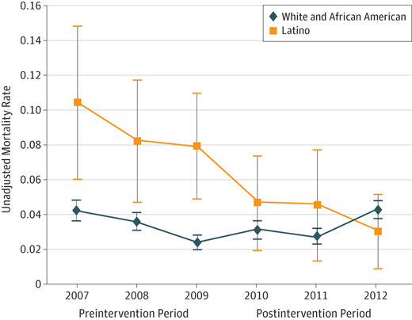

Slide 60
Critique of 3rd Generation Research
Largely interventions focused on one disease outcome
Often focus on individual behaviors
  Limited attention to social determinants
Lack of attention to race and racism as structural influence
Thomas et al, Ann Rev Pub Health, 2011

Slide 61
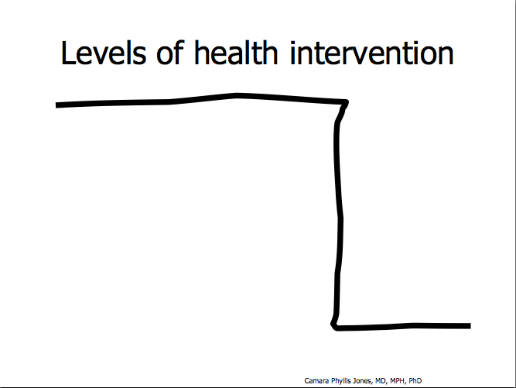
Notes:
61

Slide 62
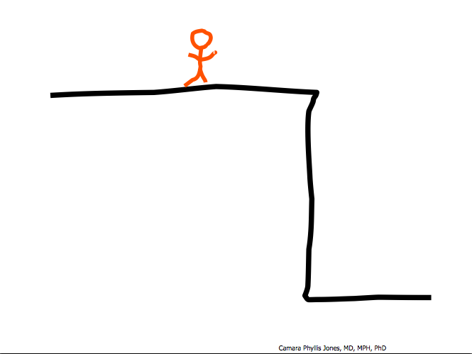

Slide 63
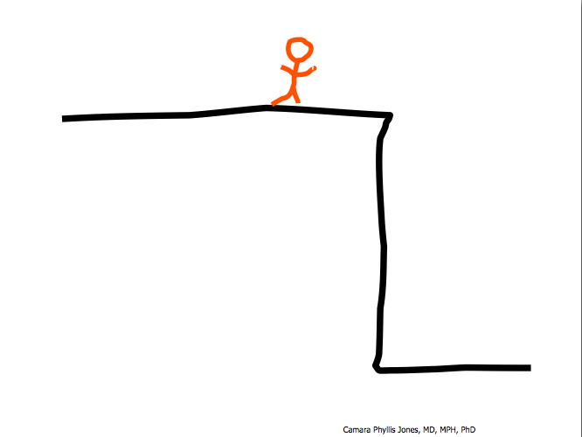

Slide 64
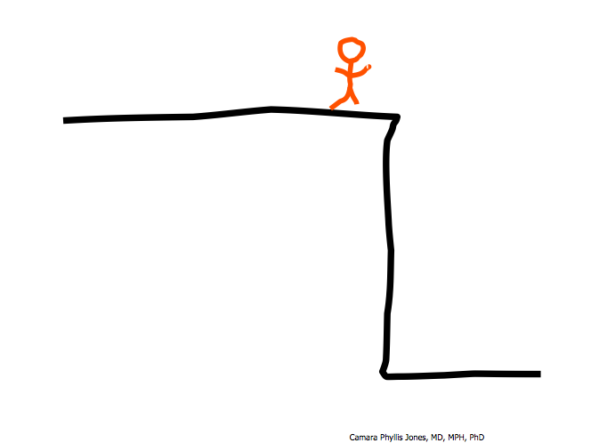

Slide 65
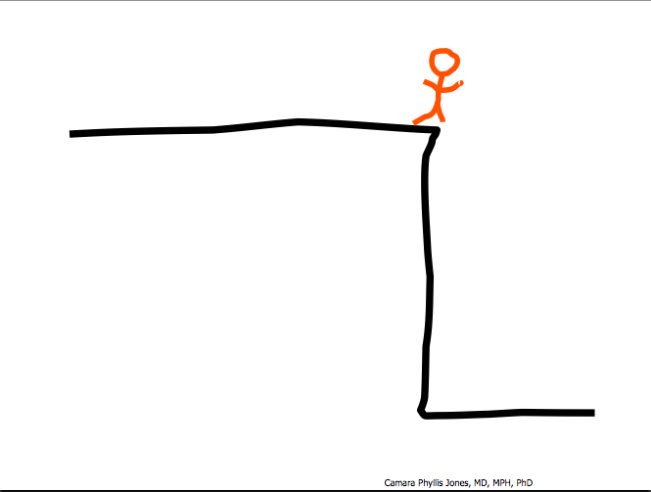

Slide 66
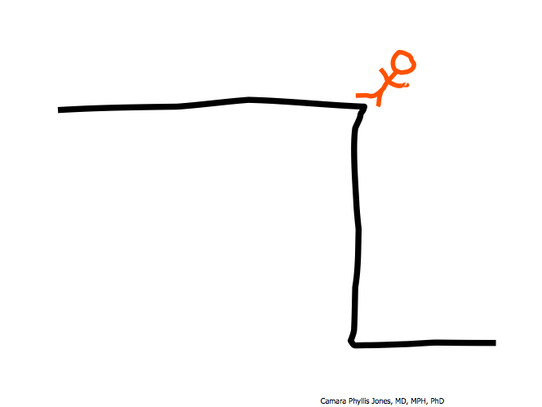

Slide 67
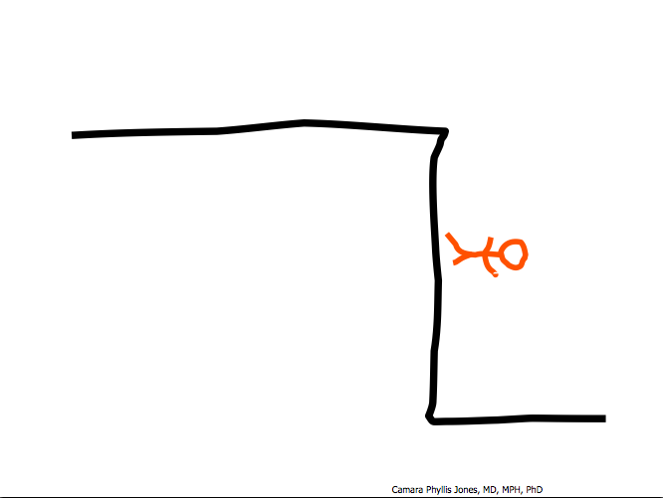

Slide 68
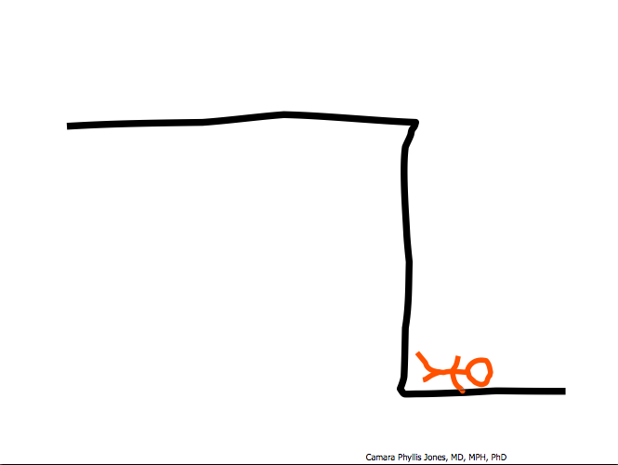
Notes:
68

Slide 69
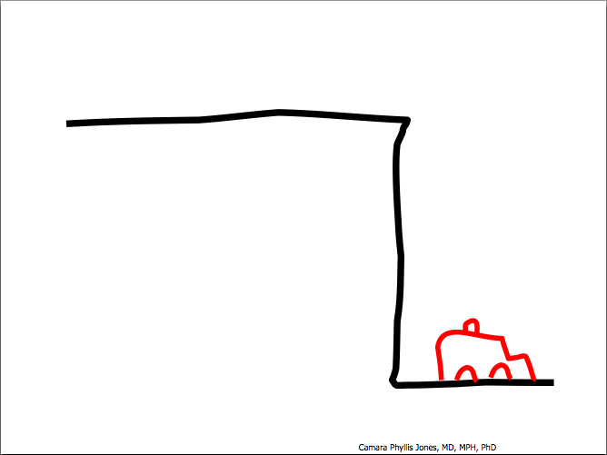
Notes:
69

Slide 70
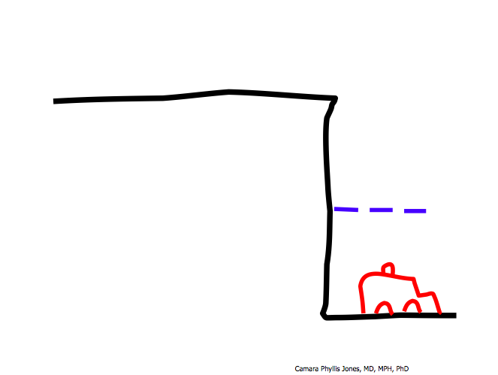
Notes:
70

Slide 71
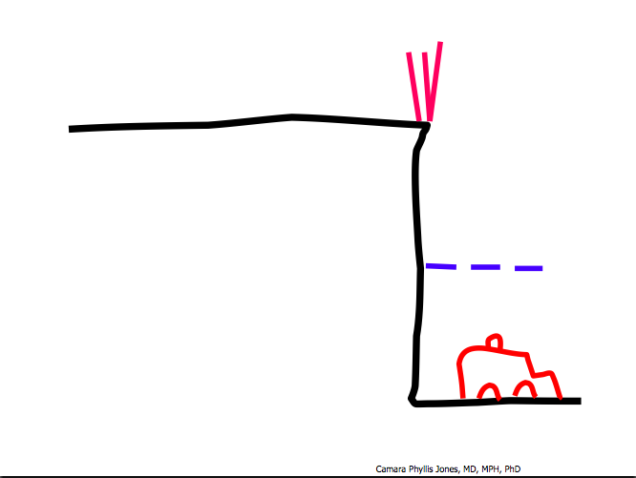
Notes:
71

Slide 72
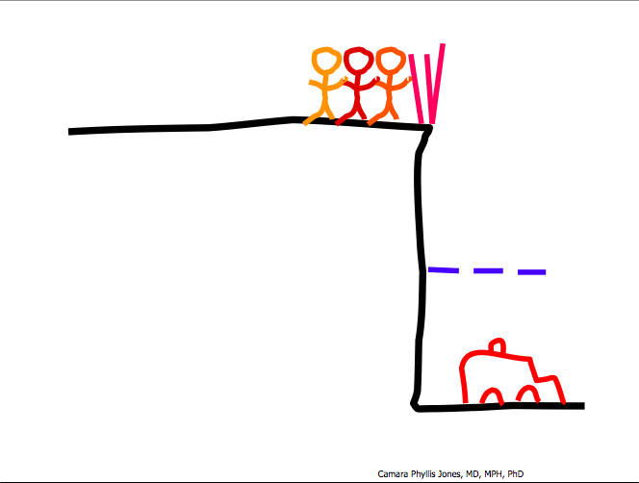
Notes:
72

Slide 73
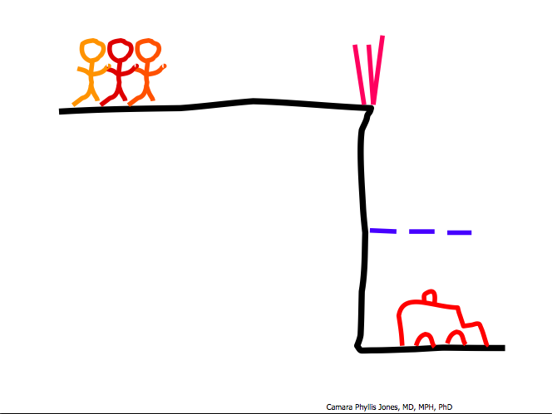
Notes:
73

Slide 74
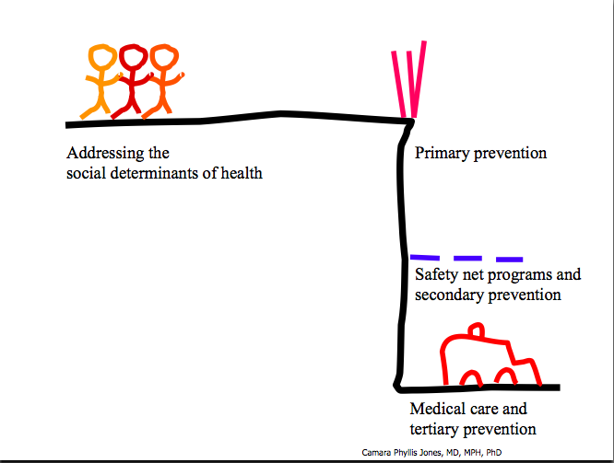
Notes:
74

Slide 75
A Broader Approach: Addressing Social Determinants
Improve access to healthy food and physical spaces
  Playground renovations in areas of high deprivation in the UK resulted in statistically significant effect on physical activity
  Retail supermarket intervention had no effect on healthy diet; was economically not sustainable
Ridger, Prev Med, 2007
Sadler, Int J Res Pub Health, 2013

Slide 76
A Broader Approach: Addressing Social Determinants
Moving to Opportunity Study
Low-income families living in public housing in disadvantaged urban neighborhoods randomized to three groups:
  Vouchers to move to private-market housing in much less distressed communities
  Section 8 voucher
  Control group
90% of families headed by black or Latina woman

Slide 77
Addressing Social Determinants: Moving to Opportunity Results
Follow up 10-15 years after randomization
Women given low-poverty vouchers had:
  Lower prevalence of diabetes
  Lower prevalence of obesity
  Decreased depression
  Improved subjective well-being
Decreased mental health problems for female youth

Slide 78
Addressing Social Determinants
Earned Income Tax Credit
  Associated with decreased rates of low birth weight, with larger effects for blacks
Early childhood intervention programs
  Perry Preschool -> age 40 better economic and health outcomes
Social needs navigation program in pediatric clinics led to decrease social needs and improvement in health
Williams, Am Behav Sci, 2013
Gottleib, JAMA Pediatr, 2016

Slide 79
Is every cliff made equal?
Notes:
79

Slide 80
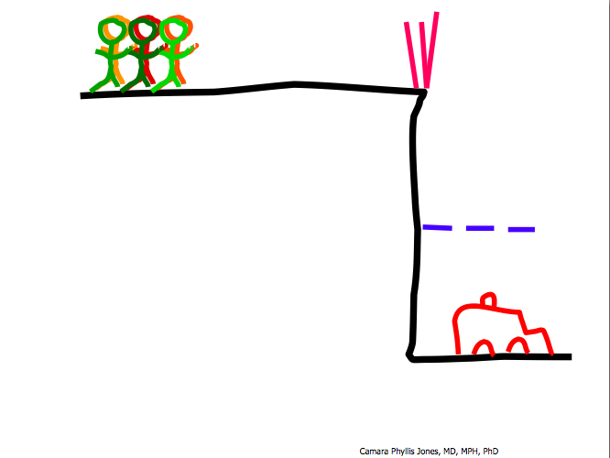
Notes:
80

Slide 81
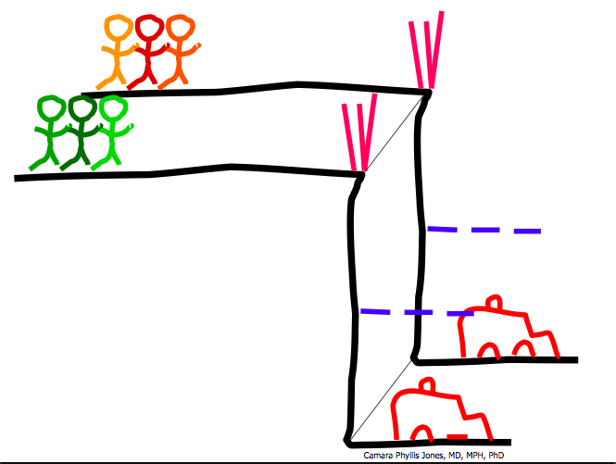
Notes:
81

Slide 82
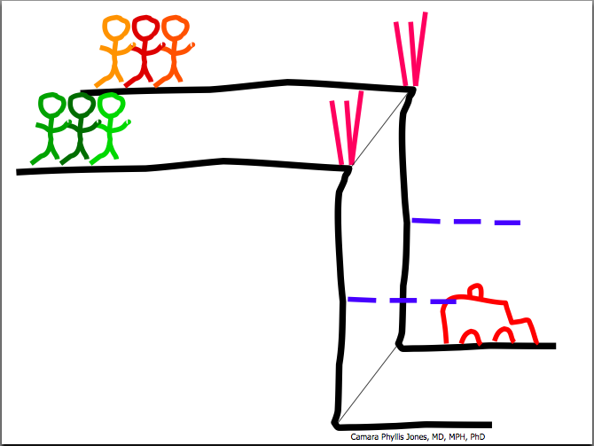
Notes:
82

Slide 83
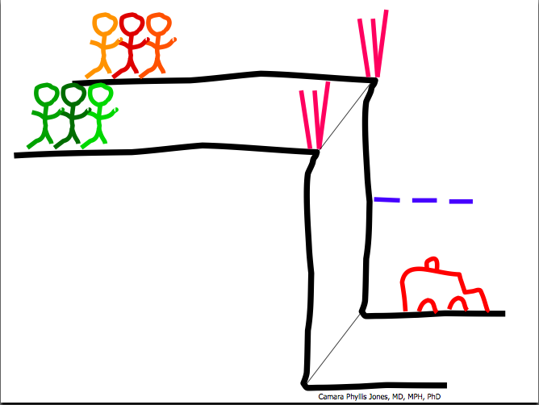
Notes:
83

Slide 84
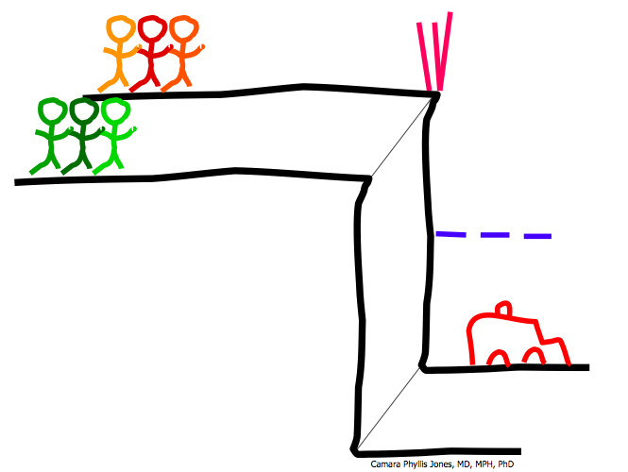
Notes:
84

Slide 85
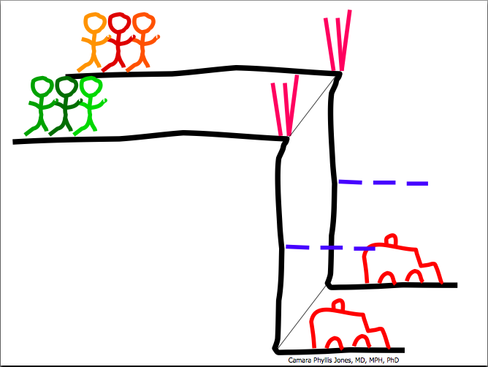
Notes:
85

Slide 86
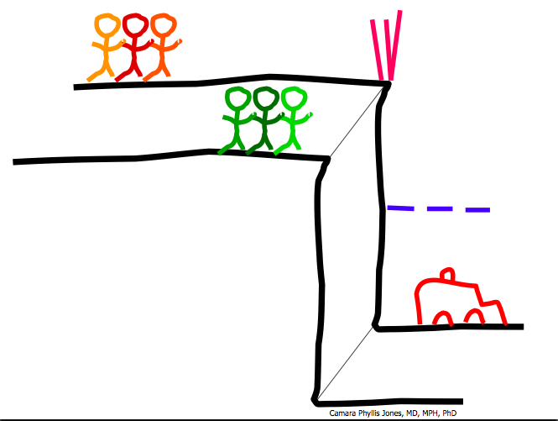
Notes:
86

Slide 87
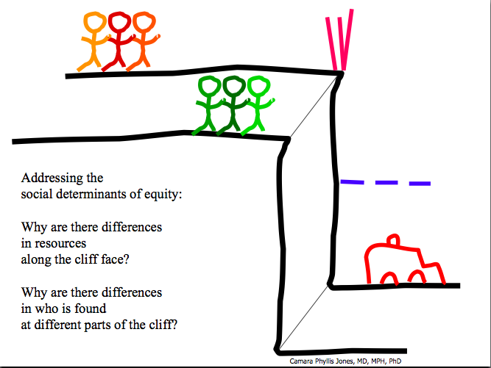
Addressing the social determinants of health (where we are born, live, learn, work and play):
Addressing the social determinants of equity - Making sure all people have the same opportunity to stay away from the cliff edge.
(Root Causes)
Notes:
87

Slide 88
What is Critical Race Theory?
Critical race theory (CRT) is an iterative methodology for helping investigators remain attentive to equity while carrying out research, scholarship, and practice. CRT incorporates the four basic features of race consciousness, contemporary orientation, centering in the margins rather than in the mainstream, and praxis (i.e., theory-informed action).

Slide 89
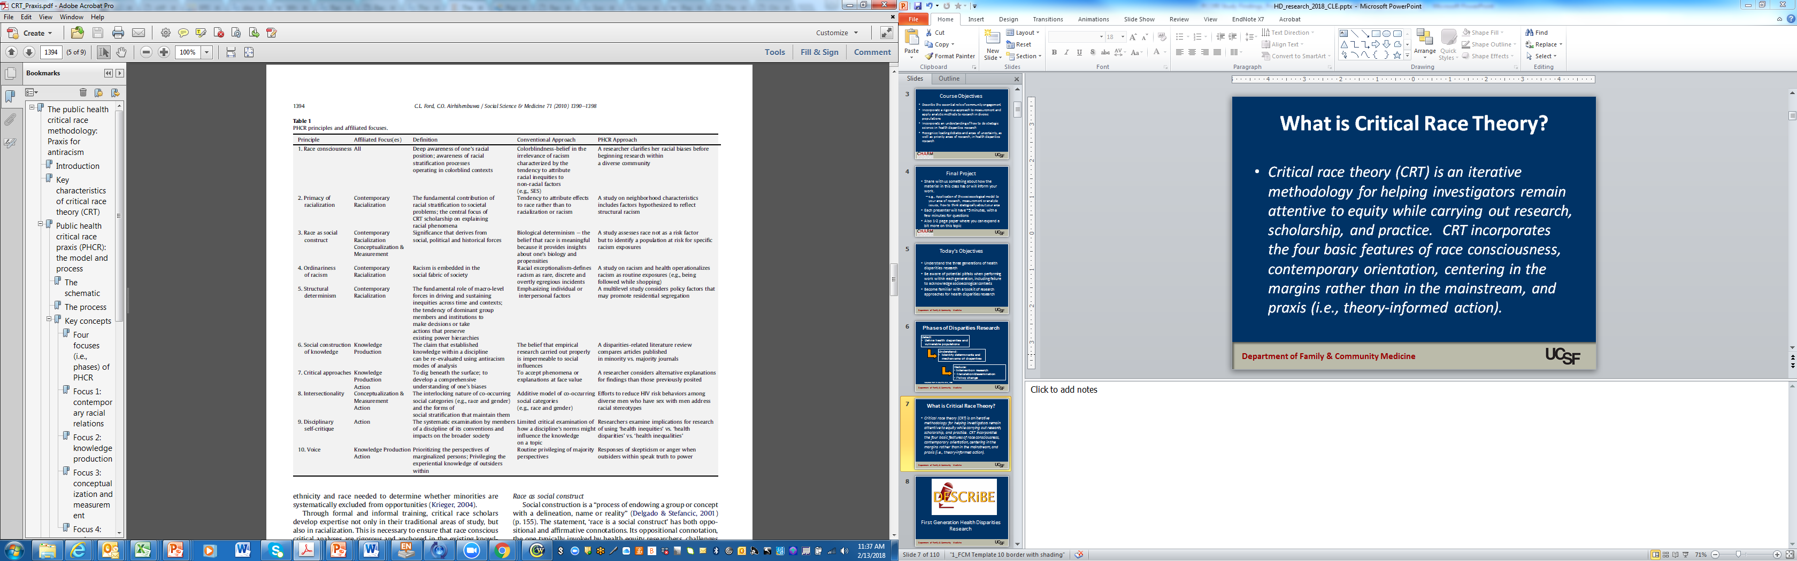

Slide 90
Feedback
Is the concept of critical race theory/public health CR praxis new to you?
Are there ways you can apply it to your research?
How can this perspective/framework be made more mainstream?

Slide 91
Addressing Racism
Increasing access to socioeconomic opportunities and resources
Reducing cultural racism and its associated negative images, stereotypes, prejudice, and discrimination,
Minimizing racism’s adverse effects
  Mitigating impact on individuals
  Decreasing health care disparities
  Appropriately tailored behavioral interventions
Williams and Mohammed, Am Behav Sci, 2013

Slide 92
Addressing Racism:
Enhancing Resources
Policy interventions to enhance equity, including:
  Income support
  Decrease residential segregation
  Enhance educational opportunity

Slide 93
Addressing Racism:
Reducing Cultural Racism
Media exposure – i.e. TV characters (Will and Grace)
Educational campaigns

Slide 94
Reducing Cultural Racism
CBPR intervention, including
  Undoing Racism Workshops
  Community dialogues
Intervention participants more aware of racism and better health outcomes
Carty, J Urban Health, 2011

Slide 95
Decreasing Interpersonal Racism
Person-centered attitudes of health care providers associated with decreased disparities in care
Contact theory of prejudice -> studies to enhance exposure to diverse groups
  Can promote exceptionalist thinking if not well executed

Slide 96
Addressing Racism:
Mitigating Racism’s Impacts
Brief social belonging intervention delivered to college students
Positive impact on trajectory of grades for Black students, but no effect on Whites
  Decreased negative reaction to adversity, self belonging uncertainty, accessibility of negative stereotypes
Also had impacts on self-reported health and happiness
Walton, Science, 2011

Slide 97
Addressing Racism:
Mitigating Racism’s Impacts
Intervention for women of reproductive age designed to mitigate the impact of social class, racism and stress
  Social and behavioral case management designed to build resilience and promote goal setting for addressing social and economic challenges
Promising, but not significant, effects on infant mortality and other outcomes
Livingood, MCHJ, 2010

Slide 98
Addressing Racism:
Mitigating Racism’s Impacts
Problem: Racism has negative impacts on health, especially when internalized
Potential solution: Facilitate conscious consideration about the existence and impact of racism among blacks, with goal of improving coping and resilience
  Outdoor advertising in predominately black community

Slide 99
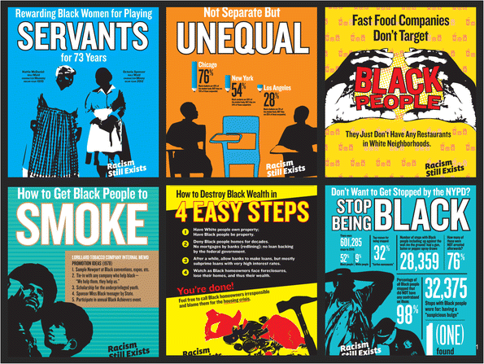

Slide 100
Addressing Racism:
Mitigating Racism’s Impacts
Assessed individuals before and after the intervention
Statistically significant difference in change in psychological distress for those who were exposed to the intervention
No change in health outcomes

Slide 101
Considerations when doing 3rd (4th?) Generation Research
Importance of dissemination to move the needle
  Balance between tailoring and ability to disseminate
Community engagement is essential
Regardless of socioecological level addressed, need to be aware of larger context

Slide 102
Toolkit for Health Disparities Research
Qualitative methods
Secondary data analysis
Patient-centered outcomes research
Community engaged research
Implementation science

Slide 103
Qualitative Research
Important method that allows researchers to hear from populations themselves about problems and potential solutions
Can be integrated into intervention research
Can be challenging for biomedical researchers to maintain open-minded perspective and questioning

Slide 104
Secondary Data Analysis
Many people have collected data with relevance to health disparities
  Don’t be afraid to ask
Nationally representative surveys are rich data sources
  https://aspe.hhs.gov/basic-report/guide-hhs-surveys-and-data-resources
Can be limited by questions asked/how they are asked

Slide 105
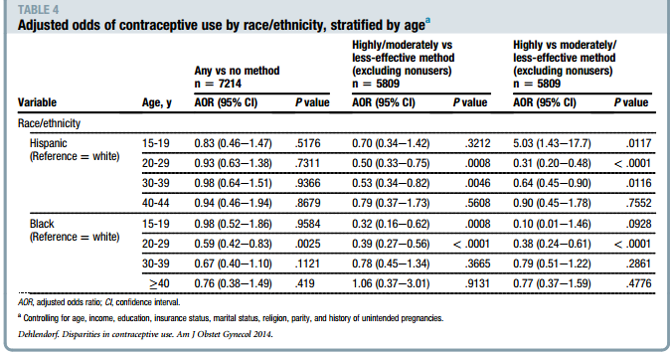

National Survey of Family Growth
Racial/ethnic differences appear to be concentrated among younger ages
Dehlendorf: Am J Obstet Gynecol, 2014

Slide 106
Patient-Centered Outcomes Research
Patient-Centered Outcomes Research helps people and their caregivers communicate and make informed health care decisions, allowing their voices to be heard in assessing the value of health care options. (PCORI)

Slide 107
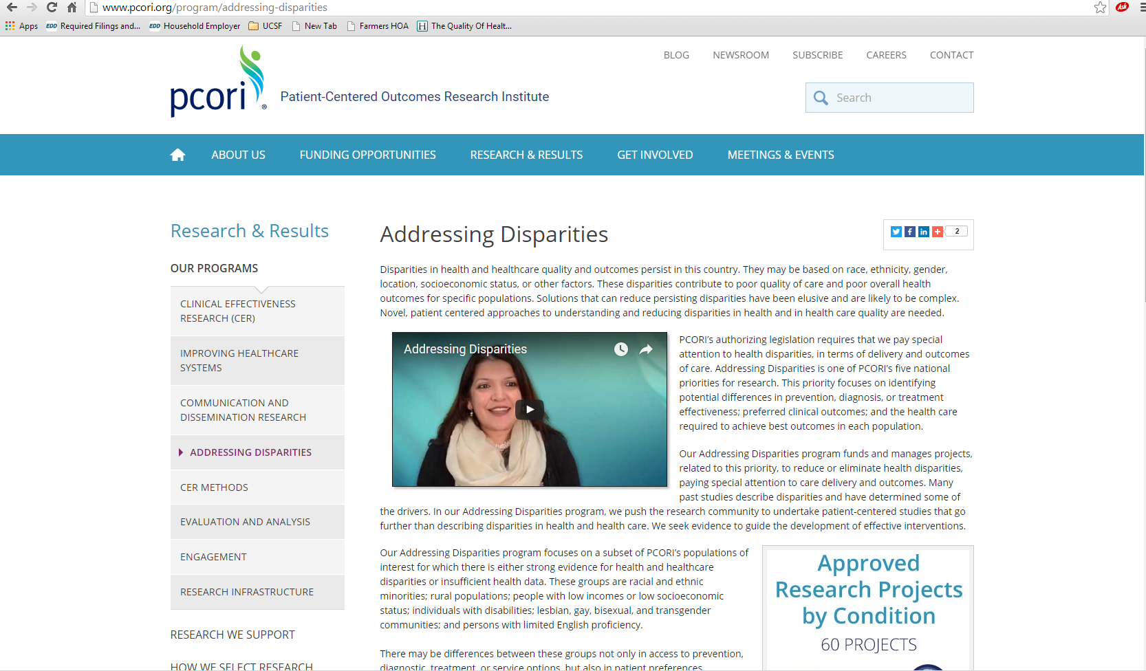

Slide 108
Community Engaged Research
“The process of working collaboratively with and through groups of people affiliated by geographic proximity, special interest, or similar situations to address issues affecting the well-being of those people” – CDC
Occurs across continuum, from consultation to CBPR
Helps to ensure ask relevant questions, get relevant answers, and disseminate in appropriate manner

Slide 109
Resources
http://oprs.usc.edu/about/initiatives/cm/
http://ctsi.ucsf.edu/about-us/programs/community-engagement-health-policy

Slide 110
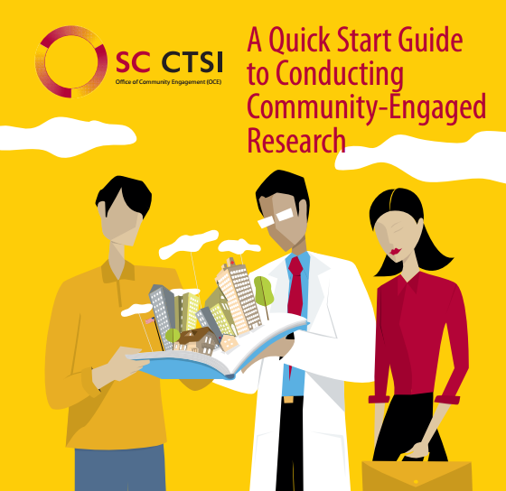

Slide 111
Implementation Science
The study of methods to promote the integration of research findings and evidence into healthcare policy and practice. It seeks to understand the behavior of healthcare professionals and other stakeholders as a key variable in the sustainable uptake, adoption, and implementation of evidence-based interventions.

Slide 112
NIMHD Implementation Questions
What are the dissemination and implementation science approaches that will lead to effective practice and sustained policy intervention to reduce and eventually eliminate health disparities?
What criteria should be used to determine whether a health disparities intervention is ready for dissemination and implementation?
How do we ensure that interventions are tailored to the needs of various health disparity populations, while maintaining adequate fidelity of the intervention to a tested model?

Slide 113
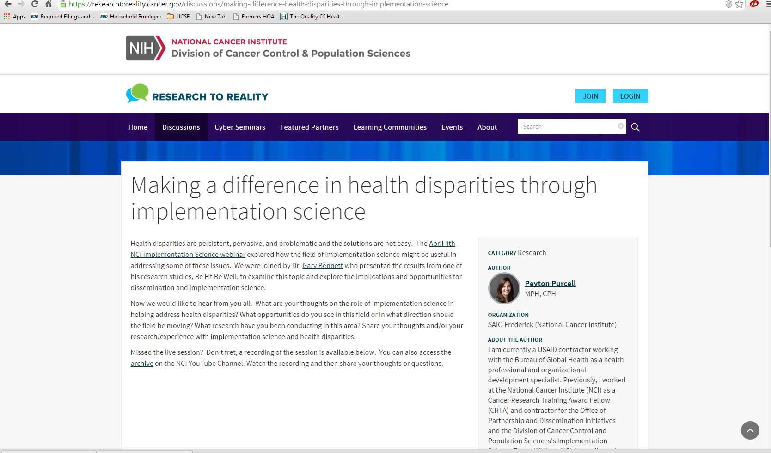

Slide 114
Questions?

