Slide 1
Tech-Enabled Clinical Research: Part 1
Ida Sim, MD, PhD
February 6, 2018
Division of General Internal Medicine
Copyright Ida Sim, 2018. All federal and state rights reserved for all original material presented in this course through any medium, including lecture or print.
Notes:
https://ww2.kqed.org/futureofyou/2018/01/29/digital-medicine-may-have-just-hit-the-trough-of-disillusionment/?utm_campaign=CHL:%20Daily%20Edition&utm_source=hs_email&utm_medium=email&utm_content=60314010&_hsenc=p2ANqtz--HSKTnLxIIQZBGoFs2ga0PPvFTnt4fr6weBhbyTsrueu0YJ_PhyQxusXTmiJiolH5cJV2v0OfuCIQNRPyoDkhVX7UOlw&_hsmi=60314010
Open Notes movement
HUGO to synch with
Ethan Basch, on PROs
Rearchitecting clinical researc hwith people-powered data partnership
www.atsdr.cdc.gov

Slide 2
Problem Set #2
Reflections on building your own clinical decision support system?

Slide 3
Final Problem Set
2-pager: (re-)imagine "version 2.0" of your current research project, or can imagine a new project
Email me by Tuesday February 13 with your rough idea, to check in on appropriate scope and content
Due: Monday, February 26, 5pm

Slide 4
Disclosures
Research affiliations
  PERCEPT project, co-PI
  Eureka project, chair of Data Standards Committee
Other
  Overlap, Inc – contractor to PERCEPT, and is a spin-off company from Open mHealth. CEO of Overlap (David Haddad is co-founder of Open mHealth with me)
  All of Us – I am a co-investigator with MD2K which is pitching a partnership with Vibrent Health, the All of Us Participant Technology Center
No financial or other relationship to other companies or projects

Slide 5
Informatics Trends for 21st Century Science
Lage scale distributed data collection using mobile, Internet, and social computing technologies
Secure, private data sharing and querying over distributed databases
Machine-driven data analytics, a new epistemology
  hybrid of EBM and Big Data
Participatory science
  recruitment and longitudinal engagement of patients, non-patients, citizen scientists
Knowledge sharing, open and distributed science

Slide 6
Learning Health (Care) System
“that is designed to generate and apply the best evidence for the collaborative health care choices of each patient and provider; to drive the process of discovery as a natural outgrowth of patient care” (IOM Evidence-Based Medicine Roundtable)
Friedman, et al. Achieving a Nationwide Learning Health System. Sci Transl Med 2010; 2(57):57cm29
Notes:
LHC not as popular as PMI

Slide 7
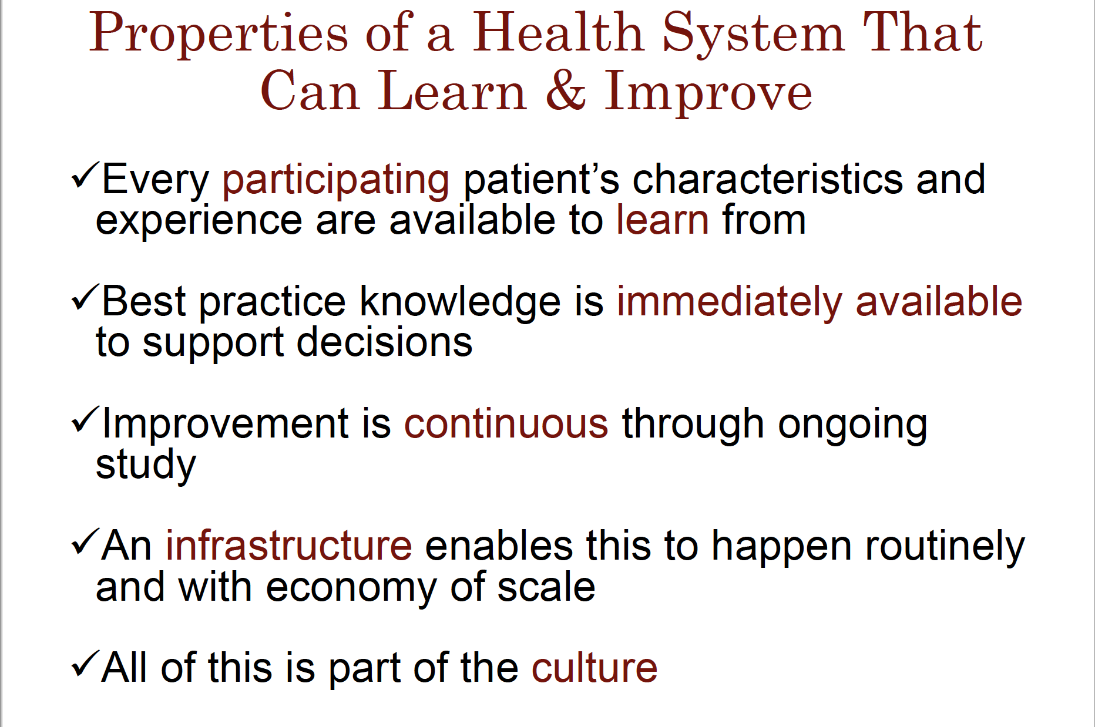
C. Friedman, Opening Remarks.
Mobilizing Computable Biomedical Knowledge Conference, 30 Jan 2018.

Slide 8
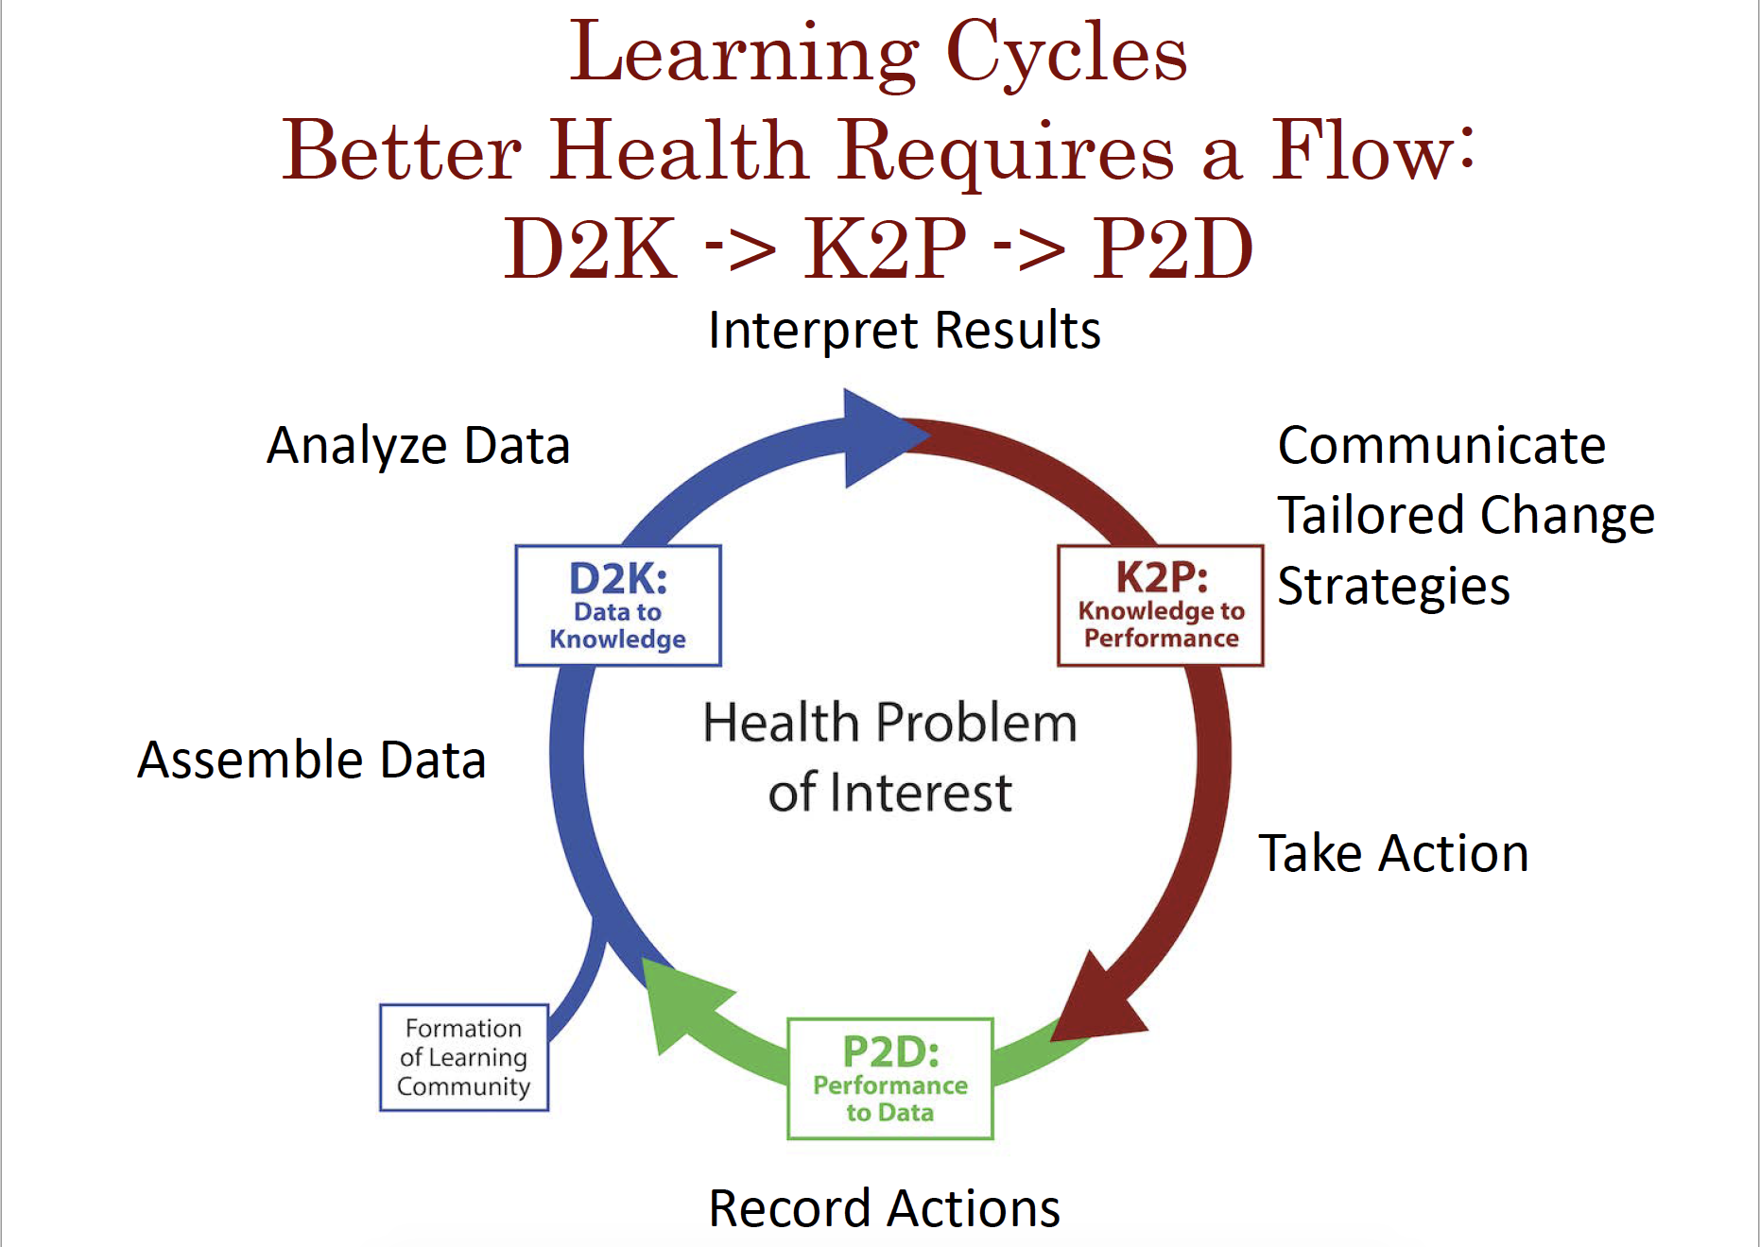
C. Friedman, Opening Remarks.
Mobilizing Computable Biomedical Knowledge Conference, 30 Jan 2018.

Slide 9
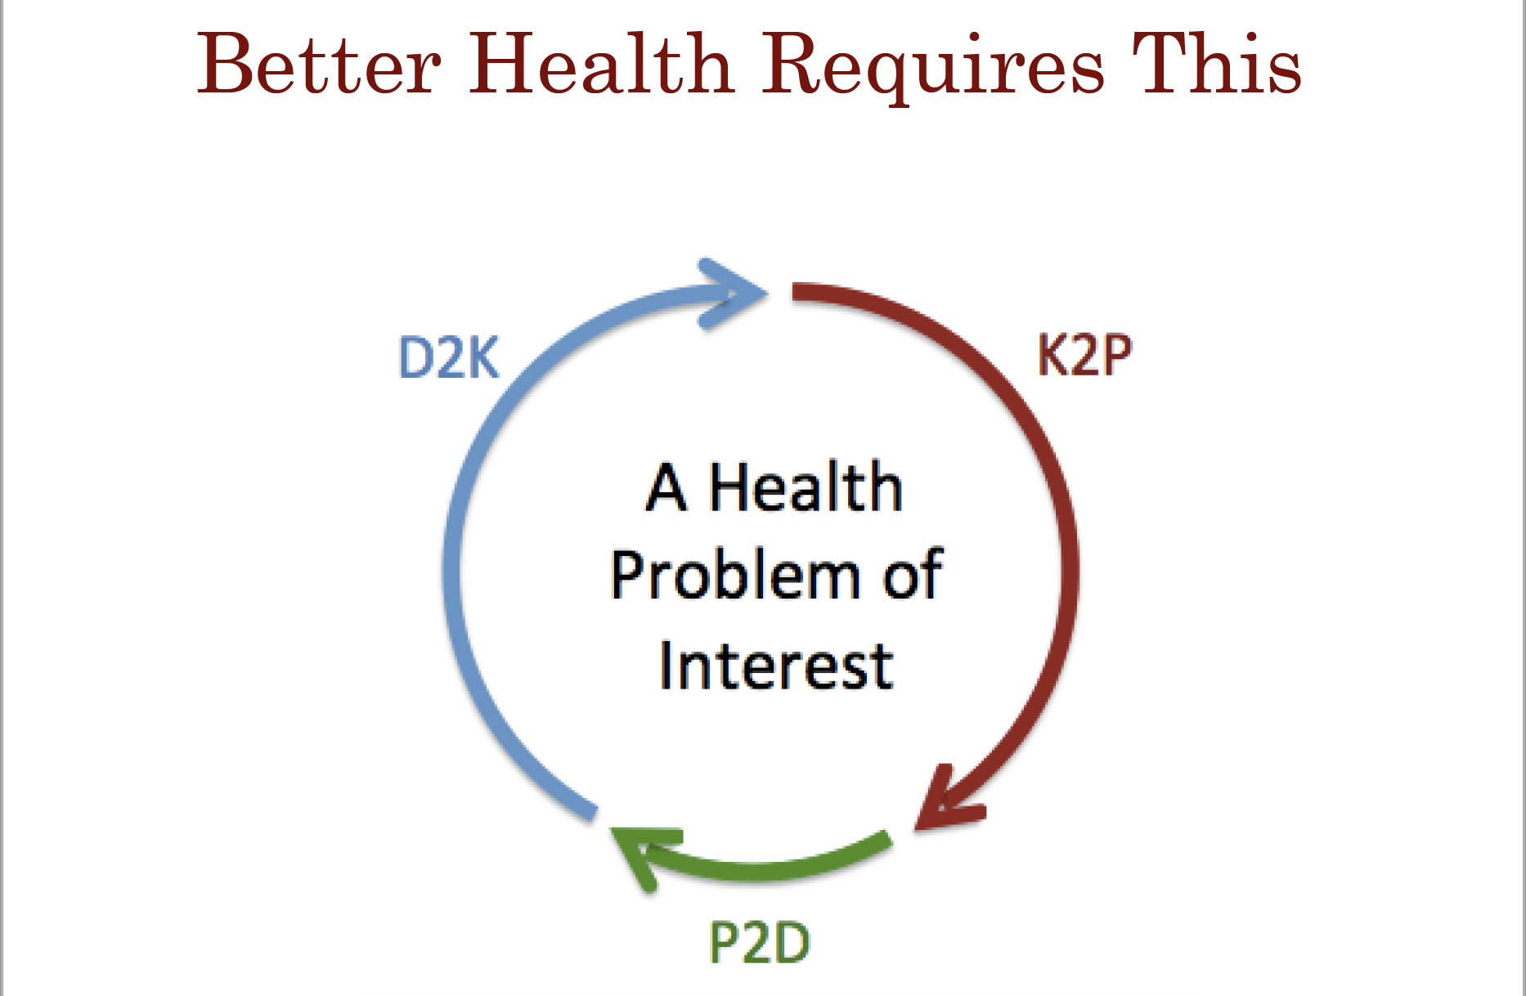
C. Friedman, Opening Remarks.
Mobilizing Computable Biomedical Knowledge Conference, 30 Jan 2018.

Slide 10
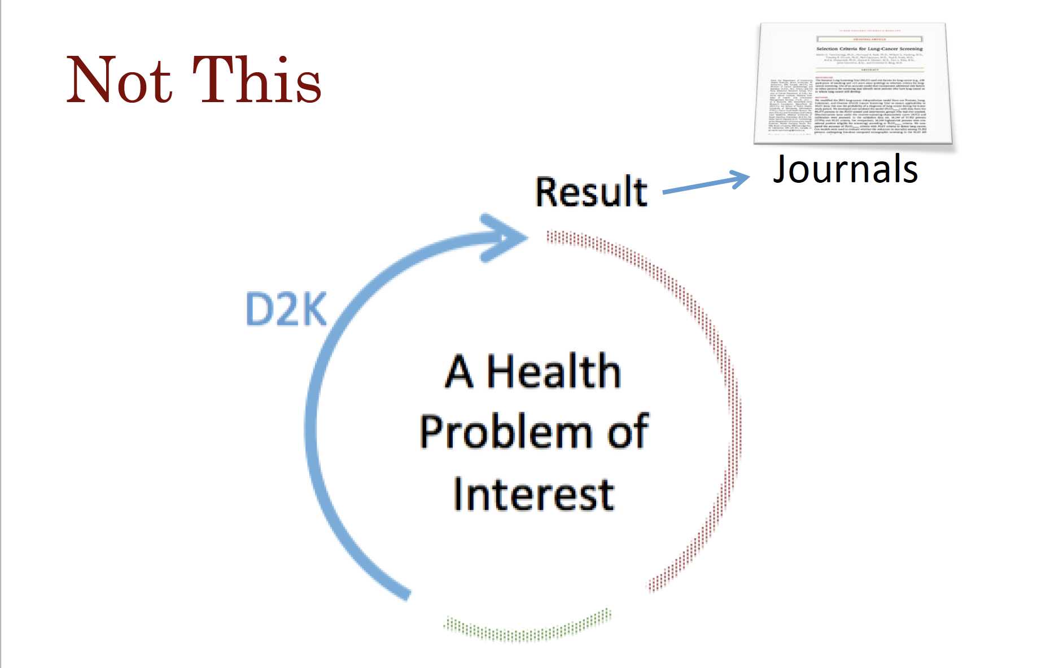
C. Friedman, Opening Remarks.
Mobilizing Computable Biomedical Knowledge Conference, 30 Jan 2018.

Slide 11
Outline
Digital care/research platforms
Digital divide
Tech-enabled clinical research
  Screening, recruitment, enrollment and consent
  Retention
  Outcomes assessment and Engagement
  Interventions and interventional design
Notes:
Easier Recruitment, Harder Retention
Now: One of the biggest challenges in clinical research is participant recruitment.
New: One of the biggest challenges in clinical research is participant retention.
Participatory Research
Now: Researchers rarely involve participants except as “subjects.”
New: Participants are involved throughout the research process.
Convergence of Research&Care
Now: Research operates independently of care.
New: Research and care converge into a continuously learning loop.
A Learning Research System
Now: Research evolves slowly and researchers have limited methods.
New: Research evolves quickly and researchers have diverse methods.
Multi-Dimensional Health Insights
Now: Researchers and patients have access to limited health insights.
New: Researchers and patients have access to multi-dimensional health insights (cluster insights by mPower)
https://lillypad.lilly.com/entry.php?e=8706

Slide 12
Digital Care/Research Platforms
Screening
Enrollment and Consent
Engagement
Outcomes Assessment
Surveys
Devices
Digital Therapeutics
For supplementing traditional off-line studies (e.g., like Framingham) or for fully virtual cohorts (e.g., Health ePeople)
Want a seamless, user-friendly, flexible, secure, cheap platform
Have very similar requirements for providing digital care without any research component

Slide 13
Digital Care/Research Platforms
Platform | Screening | Enrollment/Consent | Engagement | Outcomes Assessment |  | Digital Therapeutics | Learn/Adapt
 |  |  |  | Surveys | Devices
Research focused
ResearchKit/Sage
Eureka
Evidation
Koneksa
Care focused
Outcomes
LHS focused
Overlap
Vibrent

Slide 14
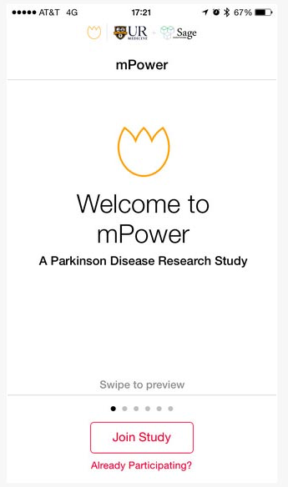
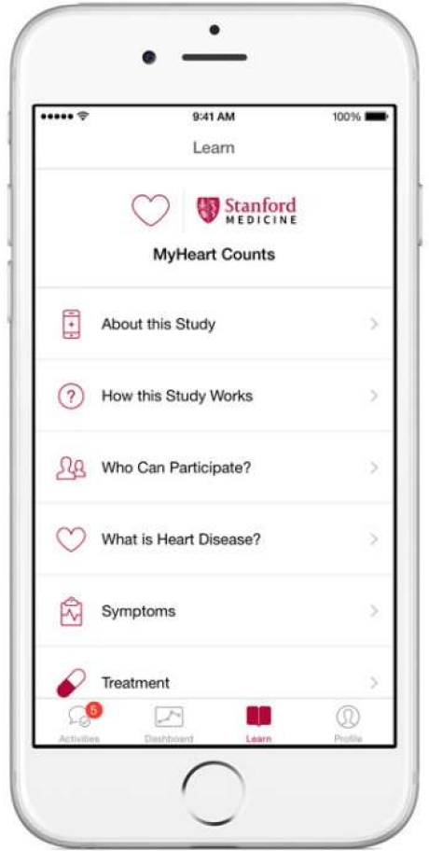
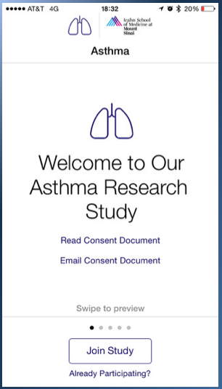
Apple ResearchKit
ResearchKit
  an open source set of code for iPhone-based informed consent, survey collection, sensor collection (via HealthKit activity, steps, etc), and data storage and data sharing (with Sage Bionetworks)
ResearchStack (from Open mHealth, Cornell and RWJF)
  Android version of ResearchKit that accesses GoogleFit for on-board sensors

Slide 15
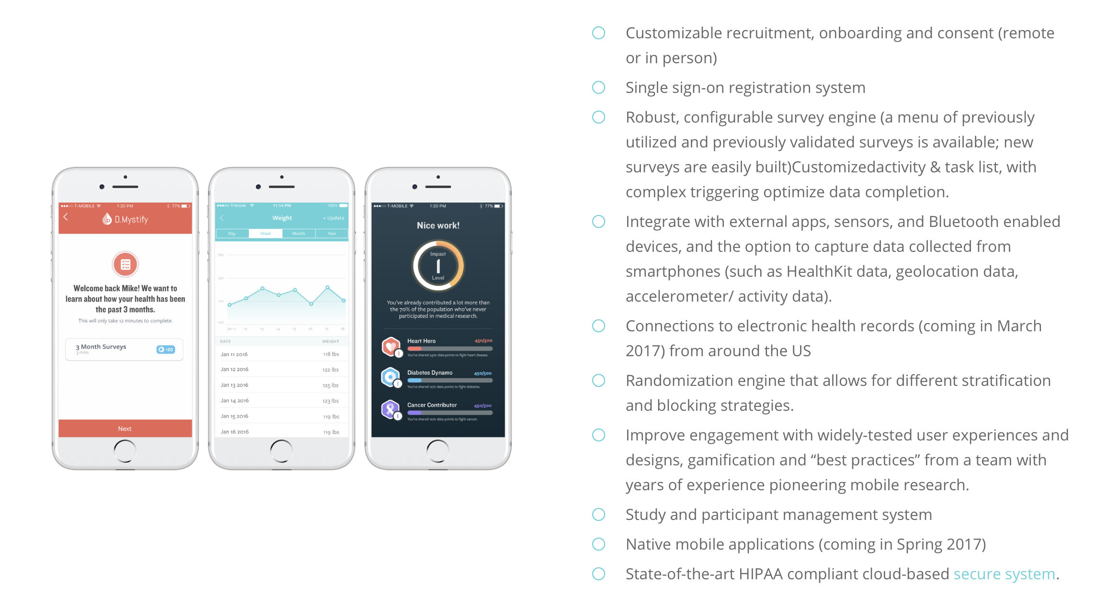
Eureka Platform
Notes:
We connect to multiple devices and apps. The list is constantly growing, with new integrations occurring regularly. Our technology team can also integrate with new apps and devices as needed. Contact the Eureka team to find out more.
You will work with our Data Analyst on the best way to receive your study data. Reports can be automatically generated on a regular basis (e.g., nightly) and data can easily be obtained for offline analyses.
Yes, you will need to obtain and maintain your own separate IRB approval for your study. The Eureka Platform is covered by an IRB approval that allows us to collect data on behalf of another investigator team, but the details of that project need to be covered separately. If your team decides to launch a study on the Eureka Platform, our staff has the resources to guide you through the IRB process as well as provide template materials for your IRB application.

Slide 16
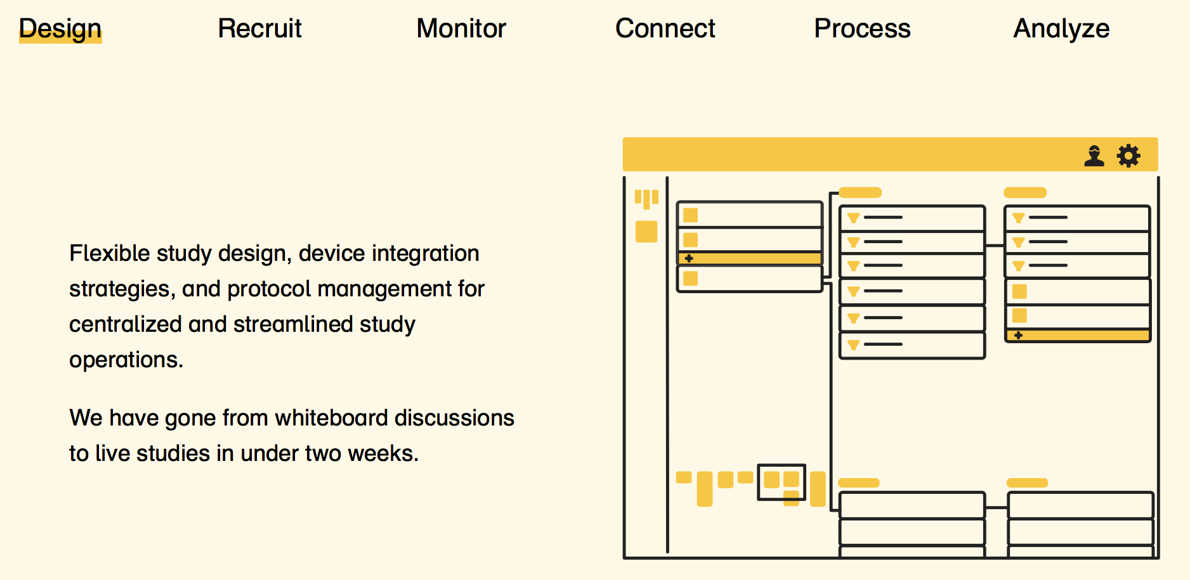
Evidation Health

Slide 17
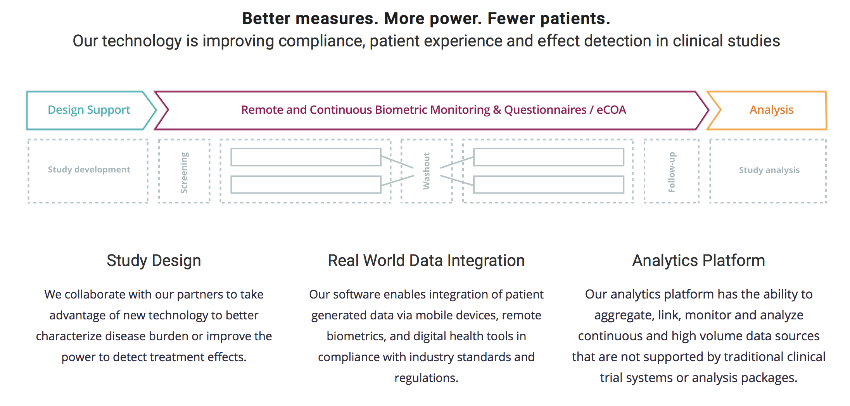
Koneksa Health

Slide 18
Vibrent Health: SaaS for LHS
“Software as a Service” for a Learning Health System
  SaaS: client-server model, where the software/service is in the cloud and you don’t need a lot of hardware or software on your own thin client
Emphasizes both protocol-driven data collection and therapeutics as well as using data in real-time clinical care
Vibrent is the Participant Technology Center for the NIH All of Us 1,000,000 person cohort

Slide 19
Outline
Digital research platforms
Digital divide
  Internet usage
  Mobile and social media usage
Tech-enabled clinical research
  Screening, recruitment, enrollment and consent
  Retention
  Outcomes assessment and Engagement
  Interventions and interventional design

Slide 20
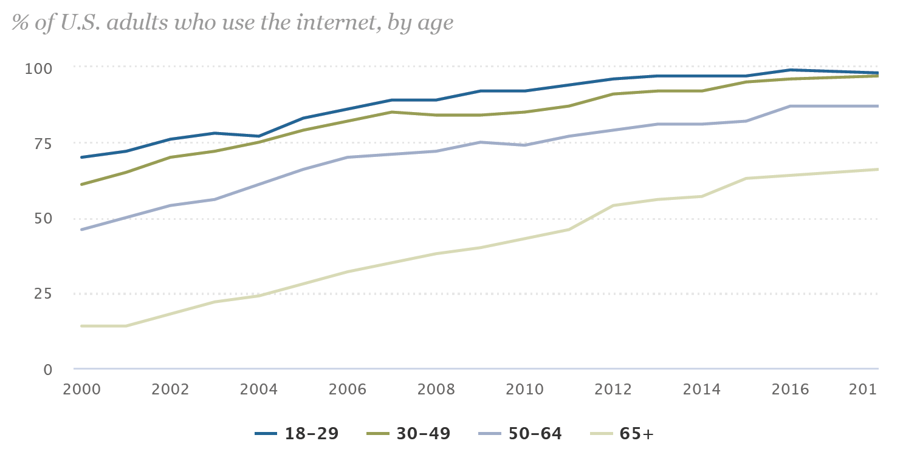
Internet Use by Age
Internet use is > 60% in those over 65 years of age
http://www.pewinternet.org/fact-sheet/internet-broadband/

Slide 21
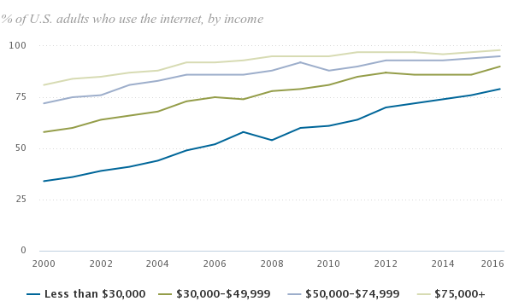
Income and Internet Use
Higher income predicts higher internet use

Slide 22
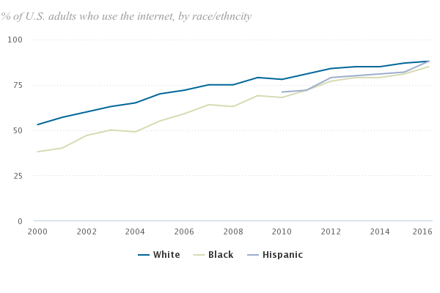
Internet Usage by Race
In 2015, White and Hispanic Internet usage was the same. Asian usage was 97%

Slide 23
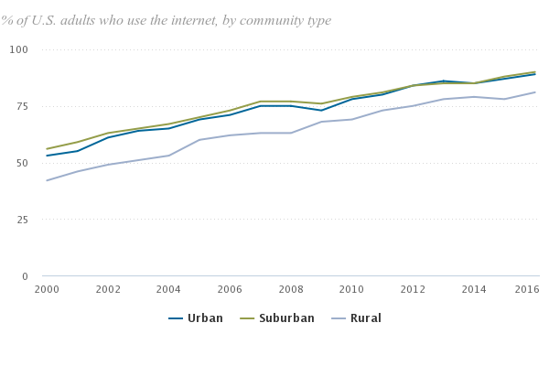
Rural vs. Urban Divide
In 2016, rural people less likely to use Internet
Notes:
Rural less likely to use Internet

Slide 24
Internet Digital Divide
Where gap is the largest
  age: 98% of age 18-29; 64% age > 65
  education: college+ 98%; less than HS 68%
  income: over $75K 98%; less than $30K 79%
  race: Asian American 97%; blacks 85%
Language is strong predicator of Internet use
  foreign-born Latinos much lower use of Internet, English-speaking Latinos equal to whites
Where there is no race/ethnicity gap
  among the young (age 18-29), college educated, income over $75K

Slide 25
Outline
Digital research platforms
Digital divide
  Internet usage
  Mobile and social media usage
Tech-enabled clinical research
  Screening, recruitment, enrollment and consent
  Retention
  Outcomes assessment and Engagement
  Interventions and interventional design
Notes:
Talked about basic networking, how machines connect to one another, and how we can run computation across data stored in distributed databases. This is all happening on the backdrop of the Web.

Slide 26
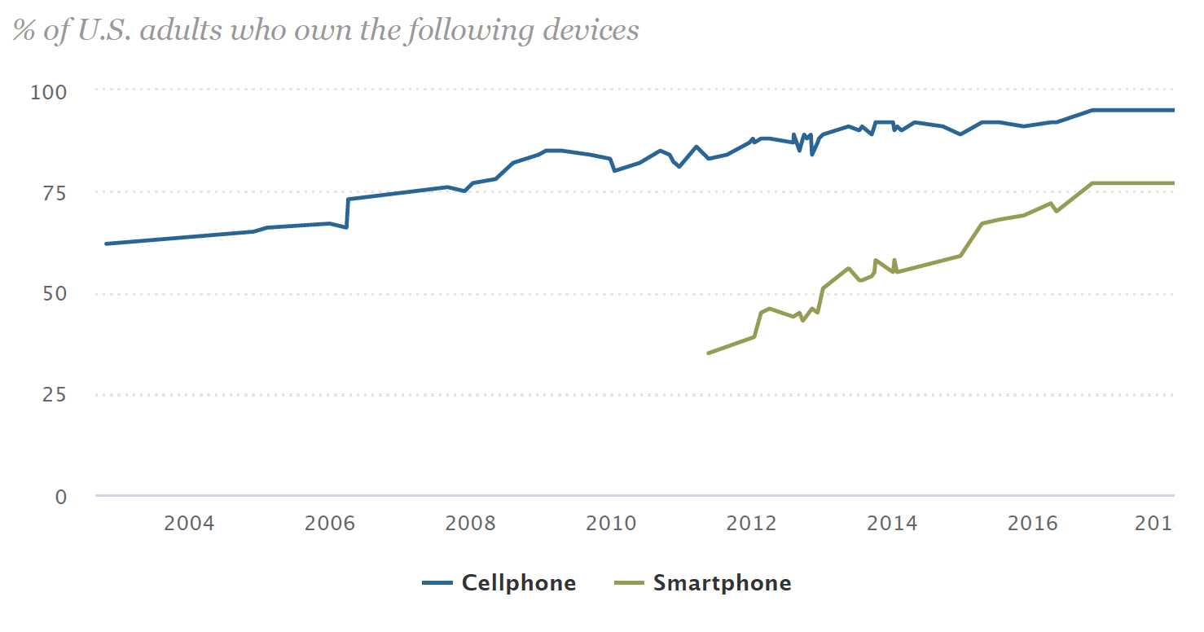
Cell and Smartphone Ownership
The vast majority of Americans – 95% – now own a cellphone of some kind. The share of Americans that own smartphones is now 77%, up from just 35% in Pew Research Center’s first survey of smartphone ownership conducted in 2011.
Notes:
http://www.pewinternet.org/fact-sheet/mobile/

Slide 27
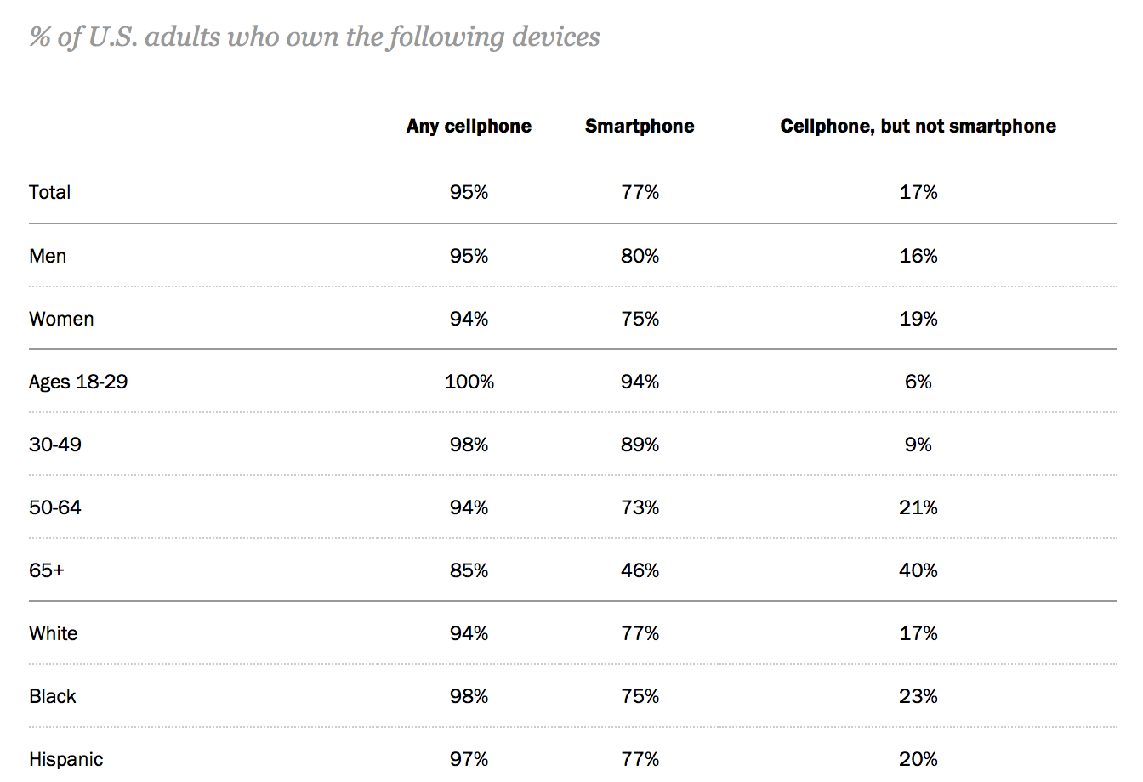
Notes:
http://www.pewinternet.org/fact-sheet/mobile/

Slide 28
Notes:
http://www.pewinternet.org/fact-sheet/mobile/

Slide 29
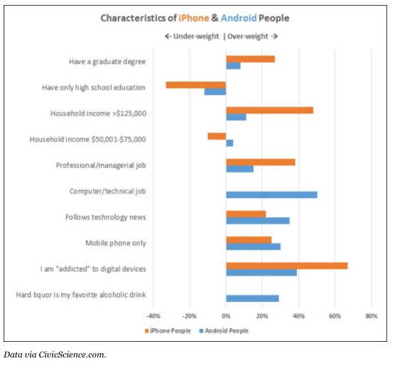
2014 data – needs updating!
http://www.forbes.com/sites/toddhixon/2014/04/10/what-kind-of-person-prefers-an-iphone/#243ab1e3e5a6

Slide 30
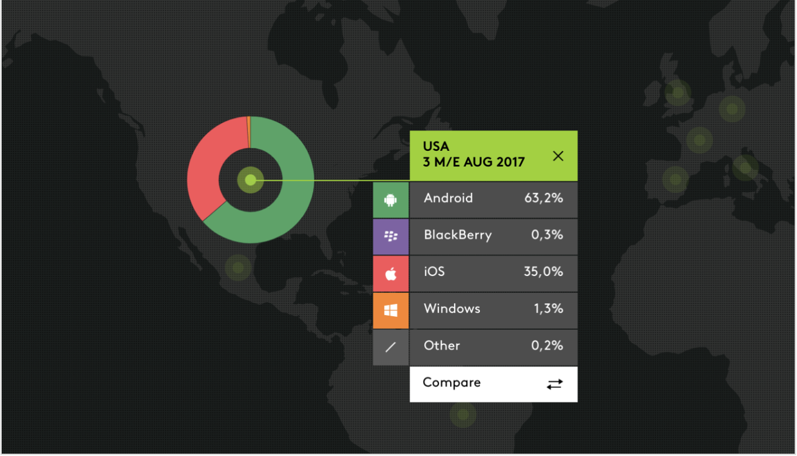
Android vs. IOS Market Share
https://techcrunch.com/2017/10/13/ios-and-samsung-market-share-now-tied-in-the-u-s/

Slide 31
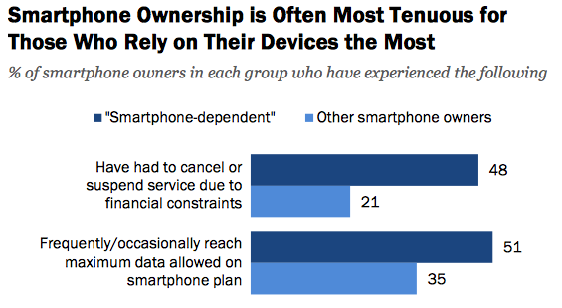
2015 Pew Internet Data

Slide 32
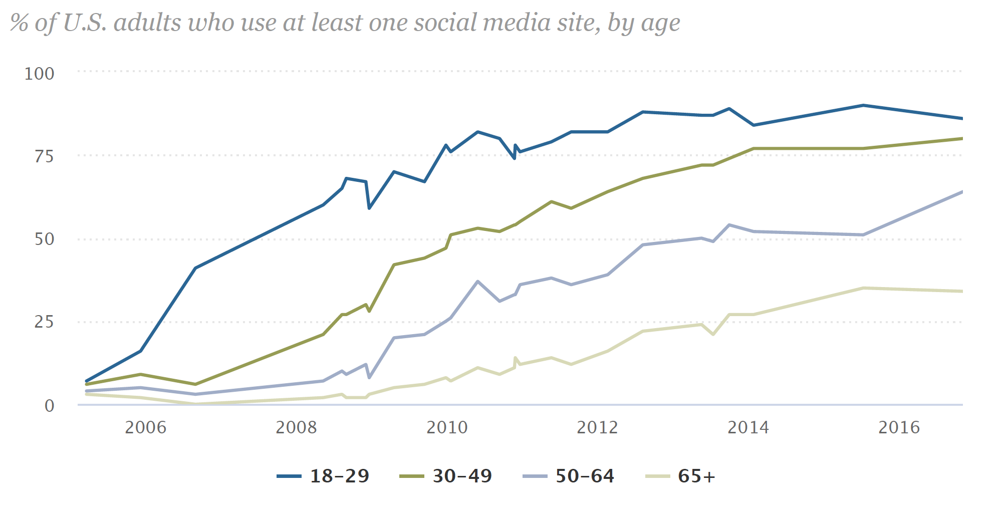
Social Media Usage by Age
Most usage is Facebook (70% of all social media usage)

Slide 33
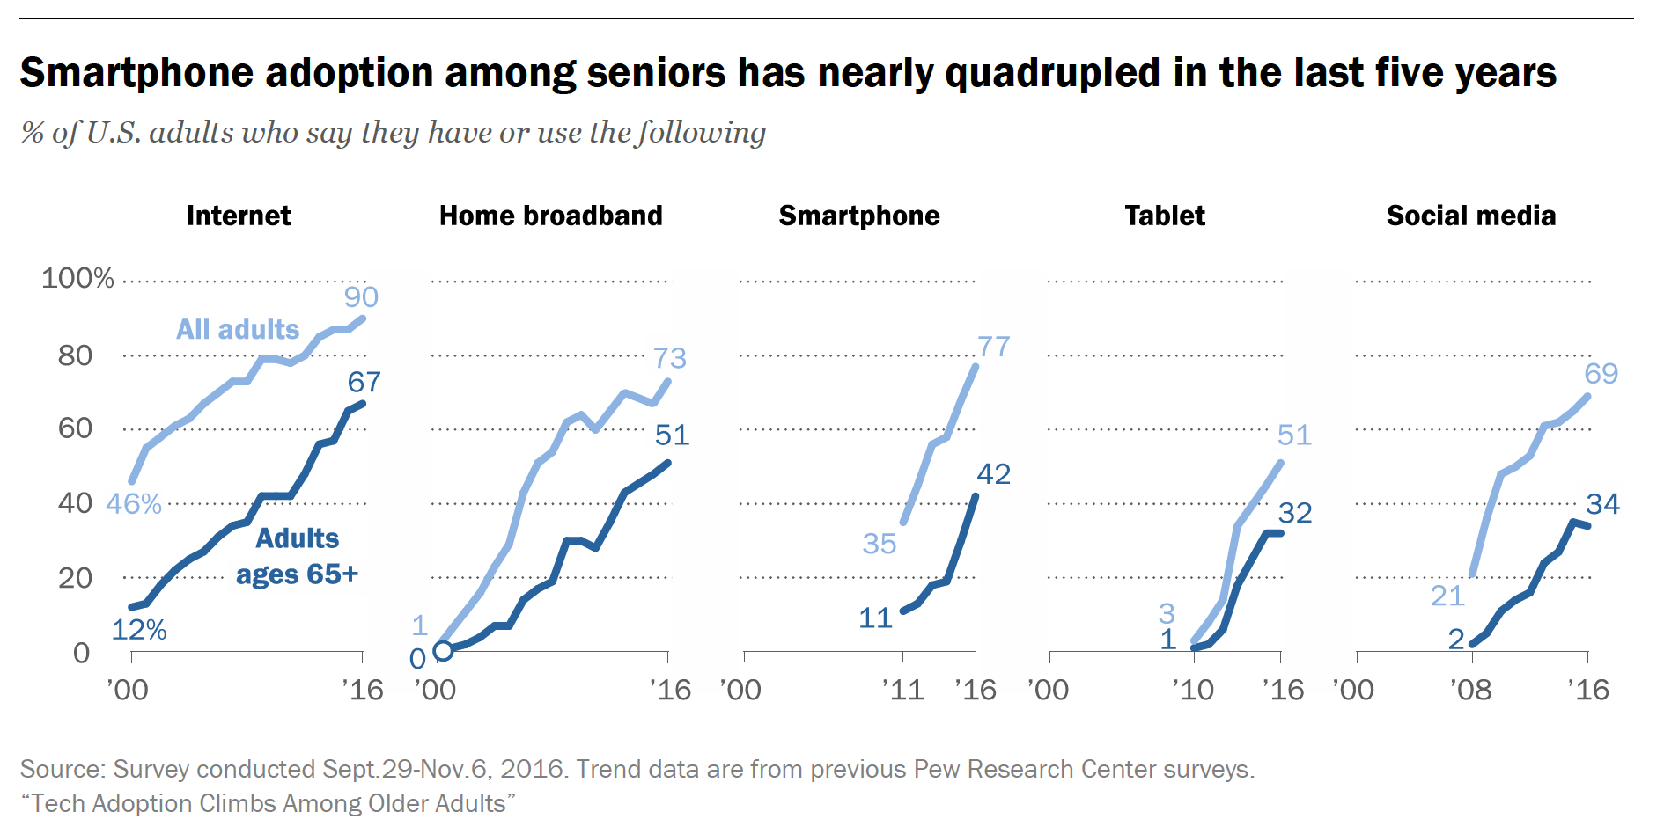
Tech Use by the Elderly

Slide 34
Digital Divide Still Exists
Divide is with minorities having higher cell usage, more cell-only households, more tenuous Internet access
Elderly increasing use technology, but only about half do
iOS users are generally (still?) wealthier and more educated
Intersects with health literacy divide
  low health literacy predicts lower e-health use (Sakar, J Health Commun, 2010)
Don't automatically apply old assumptions/data from the “real” world to the virtual world
Notes:
Cost of home computer, broadband service, etc. is high. Smartphone is Swiss army knife: phone, internet, etc. all in one.

Slide 35
Outline
Digital research platforms
Digital divide
Tech-enabled clinical research
  Screening, recruitment, enrollment and consent
  Engagement and retention
  Outcomes assessment
  Interventions and interventional design
Notes:
Talked about basic networking, how machines connect to one another, and how we can run computation across data stored in distributed databases. This is all happening on the backdrop of the Web.

Slide 36
APEX-based Recruitment and Enrollment
Use RDB flat-files, Cohort Selection Tool, UC ReX, etc for cohort ID
Enrollment via APEX
  can push recruitment info to MyChart
  no other provision for using APEX for consent or study enrollment
2016 CTSI Learning Health System Projects
  An APEX COPD Pathway (A. Hoffman): RCT of COPD order sets to presumed COPD patients, customized to admissions info
    building real-time prediction algorithm using Caboodle and/or Clarity data
  Predicting inpatient hypoglycemic events (R. Rushakoff): RCT of risk prediction algorithm that triggers Careweb alert to reduce hypoglycemic meds
    real-time algorithm running on Clarity and Chronicles data

Slide 37
Consent for LHS studies?
Eligible patients are identified on admission using algorithms running on Clarity data
Is informed consent necessary?
  Waivers permissible according to federal regulations when
    the study presents only minimal risk to participants
    the waiver does not adversely affect the rights and welfare of participants
    the research could not practicably be carried out without the waiver
UCSF IRB waived consent for LHS projects
  considered both research and QI
  low-risk intervention and low risk control (usual care)
  if successful, implementation will mean only changing randomization ratio from 1:1 to 1:0
Randomization ratio 1:0
COPD Order Sets
Randomization ratio 1:1
Hypoglycemia Prediction
Pletcher, et al. Informed Consent in Randomized QI Trials, JAMA Int Med, 2014; 174(5):668-670
Notes:
Intervention could have been deployed without randomization. Would that still require consent?

Slide 38
Sending APEX patients to Digital Research Platforms
Contact eligible patients, send them a link for further screening, enrollment, consent. E.g.,
Health eHeart / Eureka studies
All of Us – “second phase of the human genome project” Francis Collins
  Health Provider Organizations (HPOs) consent their members and expose their EHR data via Synch for Science FHIR
  Send patients to participant-facing All of Us mobile and website
Personal Mobile and Contextual Precision Health (PI Anderson, co-PI Sim)
  Demonstrate use of mobile data collection to inform population-level care of HTN and depression patients
    100 HTN and 100 depression patients from UCSF and UC Davis
    bluetooth BP cuffs, activity sensing, EMA of affect, GPS-prediction of depression
    scalable platform integrating Epic, i2b2, FHIR, and Open mHealth technology
    Patient-facing dashboard of mobile data

Slide 39
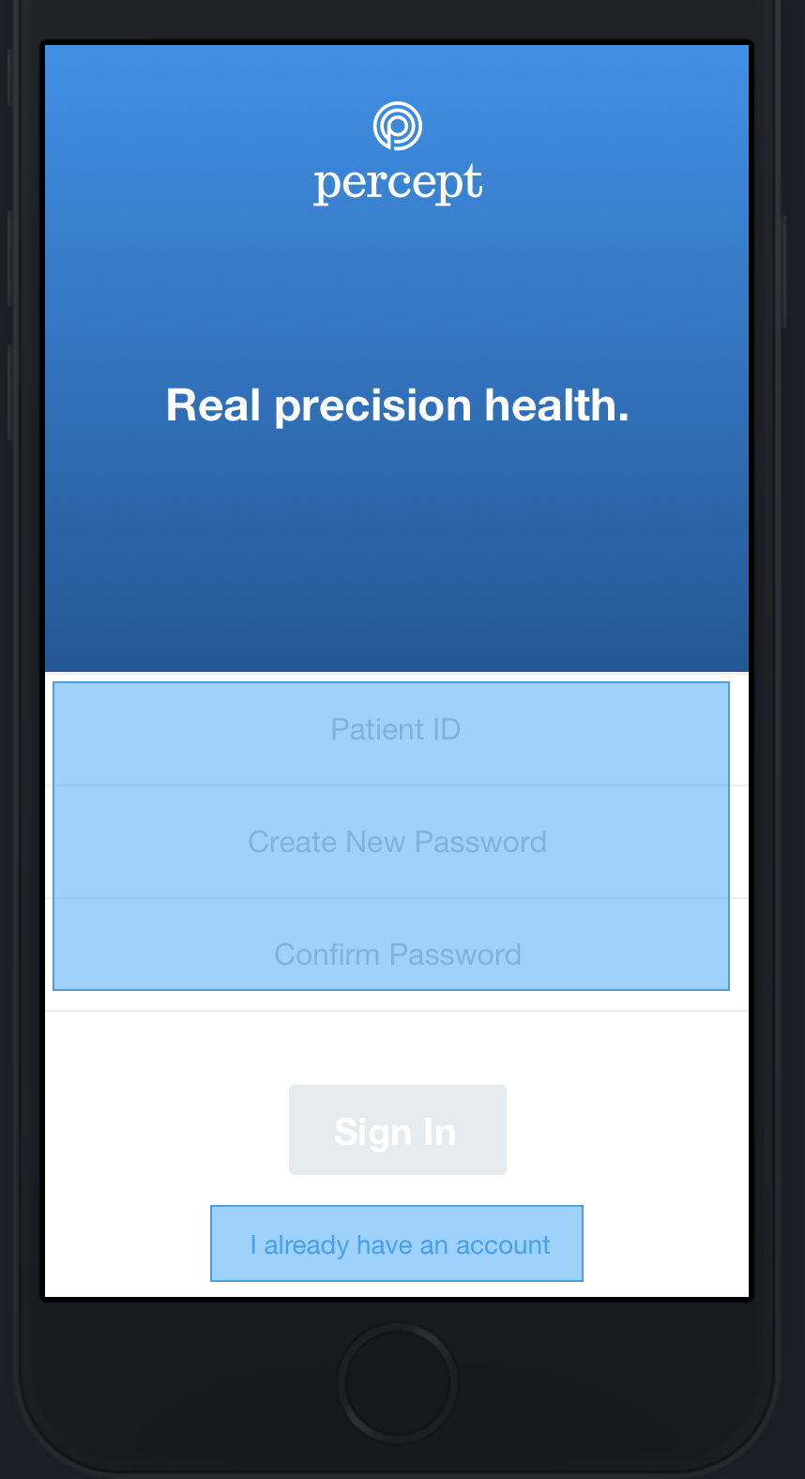
PERCEPT Recruitment Considerations
Have to offer Android and iOS app but app development is much more challenging for Android
  will recruit iOS users first, then Android
Data usage: pay participants to offset data usage costs
  but hard to prove amount of data used
Loss to follow-up will be higher in those with tenuous Internet access
  but hard to identify them and that population may be the one that remote monitoring can help most
Battery usage is a concern for e.g, GPS monitoring
  if require latest phone models, will introduce bias
Notes:
But isn’t it easy to recruit tons of patients really quickly now?

Slide 40
Mobile Enrollment and Consent
Simple, understandable, easy to use, i.e., consumer-grade
Notes:
But isn’t it easy to recruit tons of patients really quickly now?

Slide 41
Data Sharing
ResearchKit
  All ResearchKit studies send the data to Sage Bionetworks (which is also the backend for All of Us)
  mPower study: recruited 12,201 Parkinsons patients in first 6 months. 78% participants opted to share their data broadly with qualified researchers. Data shared here and granted to over 50 researchers
  Data sharing is all-or-none for each participant’s data
Health ePeople
  “You will own the data generated by your study, but our default policy is to ALSO include your study’s data in a de-identified platform-wide data warehouse that is publically available through a Data Use Agreement. This policy is negotiable under certain circumstances. Please let us know if you have questions about this.”
All of Us
  Data to be shared with qualified researchers and citizen scientists. Data return to participants themselves.

Slide 42
Outline
Digital research platforms
Digital divide
Tech-enabled clinical research
  Screening, recruitment, enrollment and consent
  Retention
  Outcomes assessment and engagement
  Interventions and interventional design
Notes:
Talked about basic networking, how machines connect to one another, and how we can run computation across data stored in distributed databases. This is all happening on the backdrop of the Web.

Slide 43
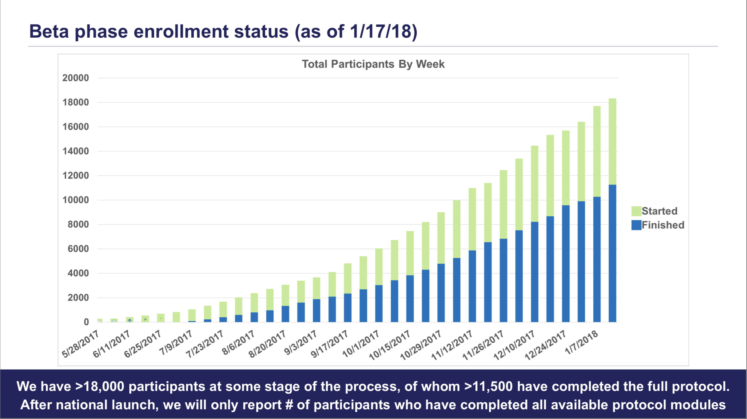
Rapid Enrollment Possible
ResearchKit projects
  My Heart Counts: enrolled over 40,000+ (first 22K in 5 days), recruiting in UK and Hong Kong too
  PRIDE study enrolled 11,000 in first week (2015)
All of Us now at over 21,000 participants
Notes:
https://allofus.nih.gov/sites/default/files/advisory_panel_f2f_011918_open_session_all_slides.pdf

Slide 44
Retention Problem
My Heart Counts
  biased samples: 49K enrolled in first 6 months in 2015, 82% male, mean age 36, only 7,000 had any disease
  huge drop-off: only 9% completed initial 7-day motion detection, 10% did 6MWT, 3% did Heart Age Questionnaire
Need outreach and dedicated recruitment of under-represented populations
  All of Us has specific funded teams on this
Long-term “engagement” is critical
  To maximize data collection rates and quality, to reduce drop-out
  THE problem in large, long-term virtual cohorts like All of Us (aiming for “surprise, delight, smile”)

Slide 45
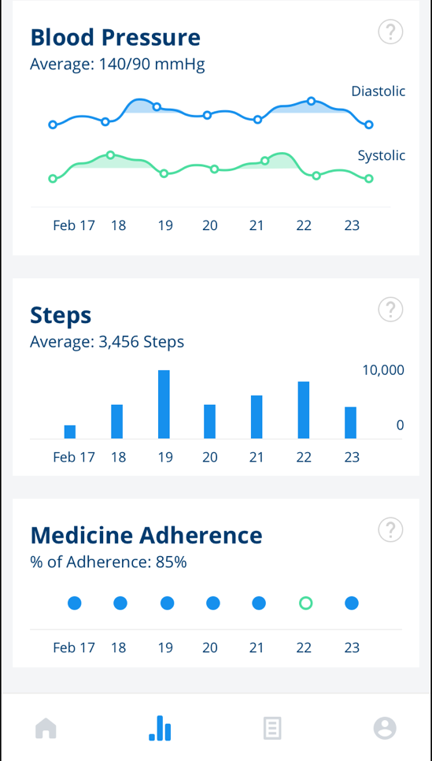

Engagement Strategies Beyond Payment
(Based on marketing, social psychology, HCI, positive psychology)
Reciprocity – getting a reward just because induces desire to give back (delight)
Scarcity – time limited rewards
Giving – you can give reward to someone else (e.g., altruism)
Distraction – fun facts, jokes (delight, smile)
Reinforcement – “good job!”
Feedback – sources of insight into your own health/life (surprise)
Consensus – social modeling: other people are providing data, I will too
Variability and variety – providing bounded novelty to avoid boredom (e.g., gamification)

Slide 46
Outline
Digital research platforms
Digital divide
Tech-enabled clinical research
  Screening, recruitment, enrollment and consent
  Retention
  Outcomes assessment and Engagement
    Build vs. buy
  Interventions and interventional design
Notes:
Talked about basic networking, how machines connect to one another, and how we can run computation across data stored in distributed databases. This is all happening on the backdrop of the Web.

Slide 47
Outcomes Assessment
Traditional assessments: patient comes in for directed observations of function, anatomy, or physiology for care or research
  physical exam by study staff, labs, imaging
Moving outcomes assessment beyond walls of clinic and hospital
  active self-reports and sensing
    patient fills out a survey or instrument (e.g., PHQ-9)
    patient uses device to collect data (e.g., BP cuff)
    patient completes an activity that is sensed by some technology (e.g., 6 minute walk test via smartphone)
  passive sensing
    a wearable or IoT thing senses the outcome without the patient’s active involvement
Complete, unbiased outcomes assessment depends on high retention of participants
Notes:
What is state-of-the-field? How do outcomes data get back into the clinical workflow?

Slide 48
So you need an app?
For outcomes assessment and/or digital therapeutics, and for engagement for retention
An app is not a uni-dimensional therapeutic like a drug
  multi-modal (e.g., attention focus, education, information)
  reminders (e.g., text prompts, notifications, calendar)
  rewards (e.g, leaderboard, badges, in-app purchases)
Different phone platforms yield different experiences
Many digital health interventions are behavioral (diet, exercise, stress, etc)
  life context (social network, work, physical environment) is very important and very variable

Slide 49
Modern Software Development
Traditional Development
Agile Development
Develop idea and prototype on your own
Get it programmed
Pilot test on a small group of patients
Run an RCT
Years later, results are negative, technology is far advanced, and/or "everything's changed"
Participatory design
  develop idea and prototype with users and programmers
Mock up and test iteratively
Evaluate with increasing rigor
  qualitative
  observational
  interventional
Never stop developing, never stop testing, never stop evaluating

Slide 50
Build or Buy or Customize?
Define your “specs” (specifications)
  what is your system supposed to do? for whom? who will pay for/sustain it in the long run?
  what specific functions will it have?
  do use case scenarios (step-by-step, storyboards, etc) – prioritize user experience
Do you need a full service digital research platform?
  If so, check out ResearchKit, Eureka, etc. Can they customize to your needs?
  If need only FitBit support, check out Fitabase
Find a developer
  External: contact Center for Digital Health Innovation for referrals and standard contracts
  Internal: UCSF Mobile Services or Telemedicine
  See http://drupal.ucsf.edu for website development

Slide 51
User Interaction (UX) Design
Thanks to Apple, consumers expect beautiful software
Prioritize the explicit design of interactive digital experiences
  more than user interface, is the whole user experience, i.e., how iPhone feels different than Android
User interaction design expertise
  e.g., http://www.coroflot.com/ search for "user interaction” People
  contact Beth Berrean BerreanB@MEDSCH.UCSF.EDU, UCSF Mobile Services
  Or Urmimala Sakar at Center for Vulnerable Populations, ZFGH
Participatory design
  involve your users in design right from the beginning

Slide 52
Summary
Learning Health(care) System is a useful concept for breaking out of care vs. research silos
Digital divide exists in older, rural, poorer populations; internet access is often tenuous in those who access the Internet only through smartphones
Increasing number of platforms available for running digital cohorts and trials, but diversity and retention are difficult
Build vs buy vs customize priorities: know your specs, ensure a good user experience
Develop and test apps using agile participatory methods

Slide 53
Next Class
Digital research platforms
Digital divide
Tech-enabled clinical research
  Screening, recruitment, enrollment and consent
  Retention
  Outcomes assessment and Engagement
  Interventions and interventional design
Class Summary

