Slide 1

Population Genetic Structure, Race/Ethnicity and Disease
Molecular and Genetic Epidemiology
EPI 217, Winter 2018

Slide 2
Outline
Genetic variation & Race/Ethnicity
Genetic admixture, admixture analysis and admixture mapping
Example: Breast cancer in Latinas

Slide 3
Genetic diversity: variation in the genomes of organisms within (or among) populations
Genetic structure: Refers to the patterning of genetic diversity across multiple groups

Slide 4
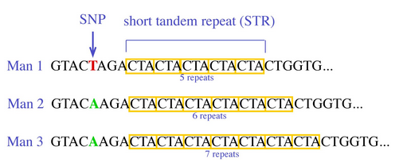
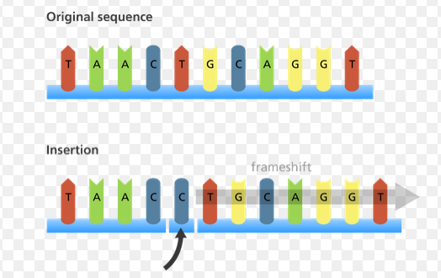
Genetic variation
Repeats
Single nucleotide polymorphism (A/T)
Indels (C/-)
Structural variants
  Copy number variants
  Alu insertions
  Inversion
Notes:
Briefly, there are different types of genetic variation: short tandem repeats, single nucleotide polymorphisms (the most common), insertion/deletion, and larger structural variants such as copy number variants, Alu insertions and inversions.

Slide 5
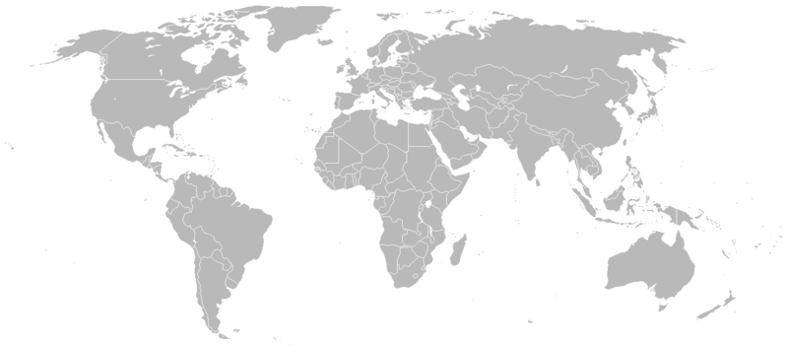
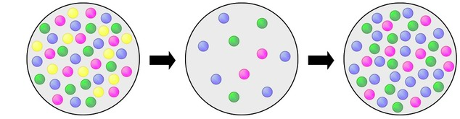
Origins of population structure
~30,000yrs ago
~40,000yrs ago
~50,000yrs ago
~100,000yrs ago
Notes:
The origin of population structure or patterns in the distribution of genetic variation around the globe goes back to the dispersion of modern humans out of Africa about 100,000 years ago. This dispersion can be thought of as a sampling process from a diverse source population. By chance, not all variants would be represented in the new samples.

Slide 6
Allele frequency differences
    Mutation → genetic drift (founder effect, population bottleneck), gene flow, selection
SNP | Group A | Group B
 | Allele Frequency
1 (T/C) | 0.25T | 0.75T
2 (G/A) | 0.50A | 0.55A
3 (G/A) | 0.90A | 0.75A
4 (C/T) | 1.00T | 0.00T
Notes:
Microevolutionary mechanisms such as mutation, genetic drift and selection all contribute to differentiation.

Slide 7
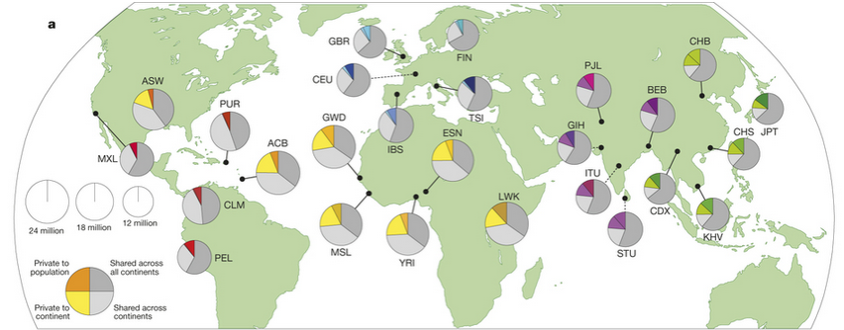
Human genetic diversity
2,504 individuals from 26 populations
84.7 million SNPs
3.6 million indels
60,000 structural variants
Nature 2015, 1000 Genomes Project Consortium
Notes:
Most of variation is shared between all or at least two continents. But there are variants that are only present in one continent as well as variants present only in a particular population within that continent.
Esan in Nigeria (ESN)
Gambian in Western Division, Mandinka (GWD)
Luhya in Webuye, Kenya (LWK)
Mende in Sierra Leone (MSL)
Yoruba in Ibadan, Nigeria (YRI)
African Caribbean in Barbados, Barbadian (ACB)
People with African Ancestry in Southwest USA (ASW)
Colombians in Medellin, Colombia (CLM)
People with Mexican Ancestry in Los Angeles, CA, USA (MXL)
Peruvians in Lima, Peru (PEL)
Puerto Ricans in Puerto Rico (PUR)
Chinese Dai in Xishuangbanna, China (CDX)
Han Chinese in Beijing, China (CHB)
Southern Han Chinese (CHS)
Japanese in Tokyo, Japan (JPT)
Kinh in Ho Chi Minh City, Vietnam (KHV)
Utah residents (CEPH) with Northern and Western European ancestry (CEU)
British in England and Scotland (GBR)
Finnish in Finland (FIN)
Iberian Populations in Spain (IBS)
Toscani in Italia (TSI)
Bengali in Bangladesh (BEB)
Gujarati Indians in Houston, TX, USA (GIH)
Indian Telugu in the UK (ITU)
Punjabi in Lahore, Pakistan (PJL)
Sri Lankan Tamil in the UK (STU)

Slide 8
Relationships between populations based on genetic variation
Tree diagrams can be created based on genetic distances between populations
    Absence/presence of mutation
    AAA ATA ATT TTT
    Distances based on population allele frequencies
    0.1 0.15 0.50 0.60
Notes:
Genetic variation information can be used to established relationships between populations. And there are different approaches to quantify and visualize those relationships.

Slide 9
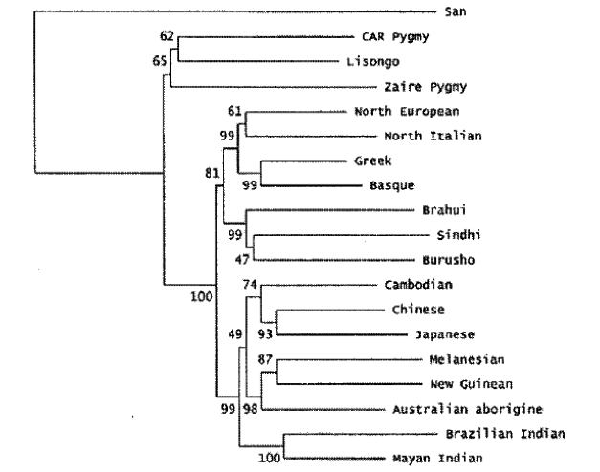
Neighbor-joining tree
182 autosomal microsatellite markers and 168 individuals
Ayub et al. Am. J. Physical Anthrop. (2003)
Notes:
Ayub et al. (2003) published a study where they used 182 autosomal microsatellite markers and 168 individuals representing 19 different human populations.
The Neighbor-Joining algorithm minimizes the overall tree branch length. Bootstrapping (sampling with replacement, assumes no correlation between columns) is usually used to assign certainty to the nodes.

Slide 10
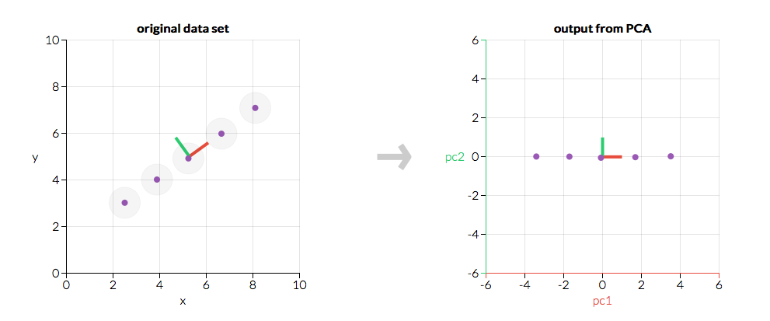
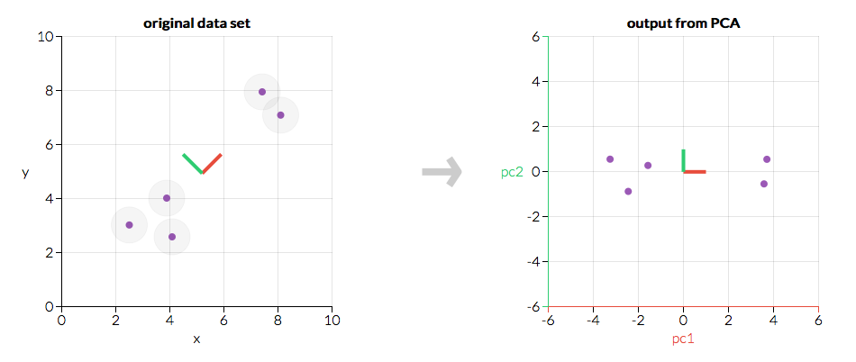
Principal Components Analysis
Notes:
Example with two dimensions (x and y).
Defines a small number of orthogonal dimensions that explain the variability in a sample.
Uses the variance/covariance matrix obtained from a raw matrix of N individuals and M SNPs. You end up with a Matrix that has N rows and N columns.

Slide 11
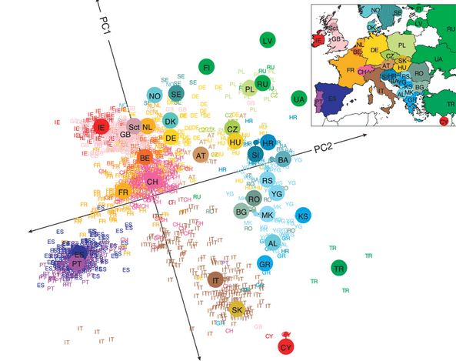
Population structure within Europe
3,192 Europeans
500K SNPs
J Novembre et al. Nature 000, 1-4 (2008) doi:10.1038/nature07331
Notes:
Principal component analysis of genome wide genotypes for a large sample of European populations reproduced the map of Europe.
AL, Albania; AT, Austria; BA, Bosnia-Herzegovina; BE, Belgium; BG, Bulgaria; CH, Switzerland; CY, Cyprus; CZ, Czech Republic; DE, Germany; DK, Denmark; ES, Spain; FI, Finland; FR, France; GB, United Kingdom; GR, Greece; HR, Croatia; HU, Hungary; IE, Ireland; IT, Italy; KS, Kosovo; LV, Latvia; MK, Macedonia; NO, Norway; NL, Netherlands; PL, Poland; PT, Portugal; RO, Romania; RS, Serbia and Montenegro; RU, Russia, Sct, Scotland; SE, Sweden; SI, Slovenia; SK, Slovakia; TR, Turkey; UA, Ukraine; YG, Yugoslavia

Slide 12
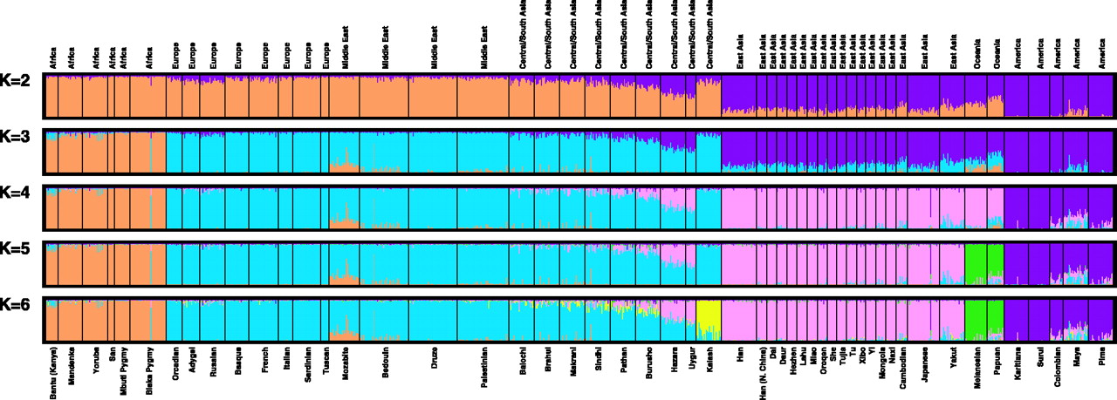
Model-based clustering
377 Autosomal microsatellite loci in 1056 individuals from 52 populations
Oceania
American continent
Middle East
Central/South Asia
Asian
African
European
Noah Rosenberg et al, Science, 2002
Notes:
Assumptions are made: Hardy-Weinberg and linkage equilibrium within populations. Ancestral allele frequencies and cluster assignment are estimated based on observed genotypes. Probabilistic assignment of individuals to groups.
Clusters approx. continental origin of individuals. This paper revived the debate around the concept of “RACE” as a biological entity.

Slide 13
How are race and ethnicity defined?
U.S. Census Race Categories:
  African/African American/Black
  European/White
  Asian
  Pacific Islander
  Native American/Alaskan Native
  2 or More Races
U.S. Census Ethnicity Category:
  Hispanic/Latino

Slide 14
How are race and ethnicity defined?
Race is a social construct very often linked to ancestry
Ancestry defined in terms of continental origin of ancestors
Ethnicity: cultural heritage, ancestry, origin myth, history, homeland, language and/or dialect, symbolic systems such as religion, mythology and ritual, cuisine, dressing style, art, and physical appearance

Slide 15
Summary
The primary source of genetic structure in the human population is based on continent of origin
These groupings are not perfectly discrete: 5 major groups (?)
An additional level of structure exists between national groups within the major continental groupings
What does “race” mean?

Slide 16
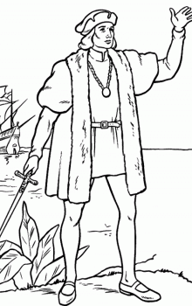

Admixed populations
~30,000yrs ago
~40,000yrs ago
~50,000yrs ago
~100,000yrs ago

Slide 17
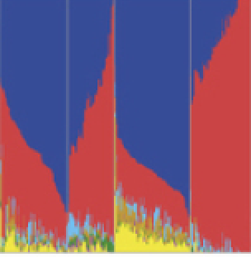
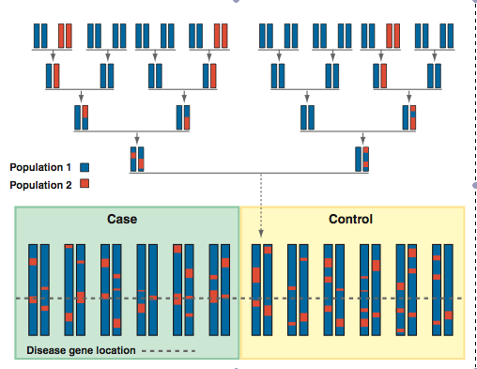
Genetic ancestry and admixture
Nature 2015, 1000 Genomes Project Consortium
Darvasi & Shifman Nat. Genet. (2005)

Slide 18
Genetic Admixture Estimation
SNP | Group A | Group B
 | Allele Frequency
1 (T/C) | 0.25T | 0.75T
2 (G/A) | 0.50A | 0.55A
3 (G/A) | 0.90A | 0.75A
4 (C/T) | 1.00T | 0.00T
Panel of ancestry informative markers (AIMs)
p_{admix}=p_{a}*m + p_{b}*(1-m)
m = p_{admix}-p_{b} / p_{a}-p_{b}
P(A|a_{ij}) = [P(a_{ij}|A)*P(A)] / [P(a_{ij}|A)*P(A) + P(a_{ij}|E)*P(E)]

Slide 19
Admixture estimation
(model-based clustering approach)
FRAPPE
http://med.stanford.edu/tanglab/software/frappe.html
ADMIXTURE
http://www.genetics.ucla.edu/software/admixture/index.html
STRUCTURE
http://pritch.bsd.uchicago.edu/structure.html
Notes:
STRUCTURE models the probability of observed genotypes given the individual ancestry proportions and ancestral population allele frequencies and uses Bayesian methods. ADMIXTURE and frappe: maximum likelihood estimation

Slide 20
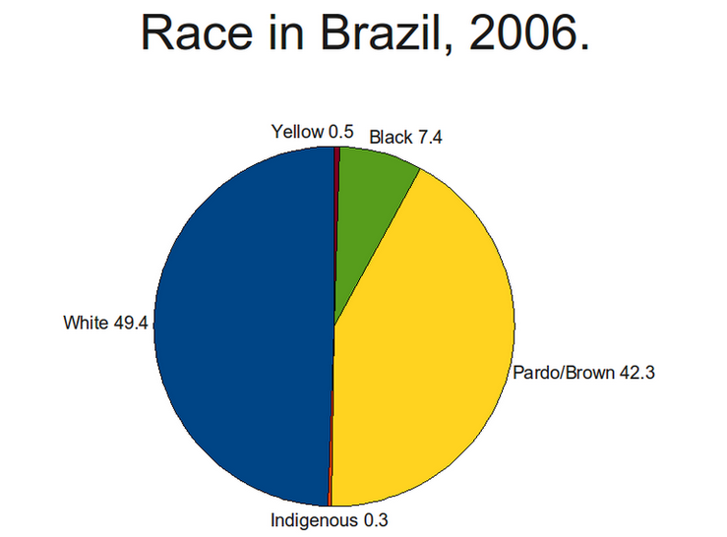
Race/ethnicity in admixed populations
Brazilian Institute of Geography and Statistics

Slide 21
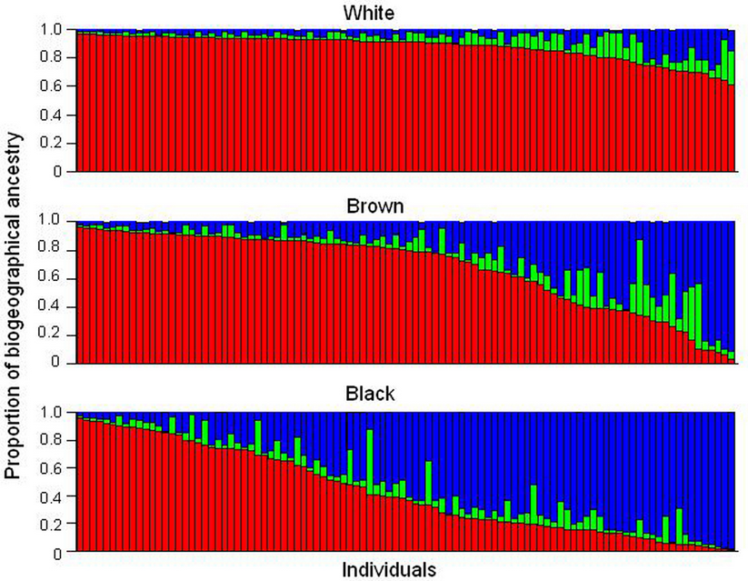
Brazilians
Suarez-Kurtz Front. Pharmacol., 2010

Slide 22
Why is genetic admixture important in medical research?
Genetic association studies are susceptible to false-positive results if there are differences in genetic ancestry between cases and controls
Population
Cases
Controls
Freq. M
100% | 0%
M=0.75
M=~0.25
Notes:
One reason genetic ancestry is important in medical research is that genetic association studies are susceptible to false-positive and false-negative results if there are differences in genetic ancestry between cases and controls. Example: imagine a population in which a subgroup has a particular trait. IN addition, this population is actually composed of individuals from two different subpopulations. And the trait is more common in one of the subpopulations compared to the other. Imagine there is a candidate variant that you want to evaluate for association with the trait (Allele M vs. m). This allele is very frequent in one of the subgroups and not so frequent in the other. When you sample cases and controls without taking into account the genetic ancestry of the individuals, you will end up observing an association with marker M which is not due to its causal relationship with the trait but to the fact that your cases and your controls are from different subpopulations.

Slide 23
Genetic Admixture: Unique opportunity to find disease predisposing genes
1st ➔ Disease that has different frequency in dissimilar populations
CASES
2nd ➔ Do cases differ from controls in terms of genetic ancestry? If yes, strong basis for…
3rd ➔ Admixture mapping
Notes:
Genetic admixture offers a unique opportunity to identify genomic regions that underlie population differences in disease risk.
If a disease is more common in one particular population compared to another, that difference could be due to differences in exposure to risk factors (non genetic) or to the combination of exposure differences and genetic differences. A way to evaluate the possibility that there is a genetic component is to test the association between genetic ancestry and disease risk in an admixed population such as African Americans or Latinas.
Genetic ancestry can be estimated using what we call Ancestry informative markers (AIMS). Ancestry informative markers are markers that have very different frequency in different populations and therefore carry information about the probable population origin of the variant one observes.

Slide 24
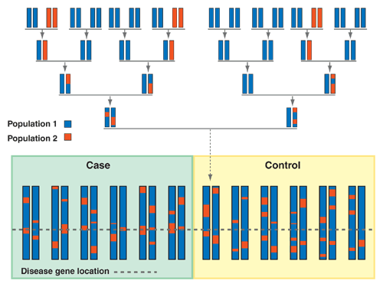
Admixture mapping
Specific genetic regions with ancestry difference between cases and controls might harbor disease predisposing or protective variants

Slide 25
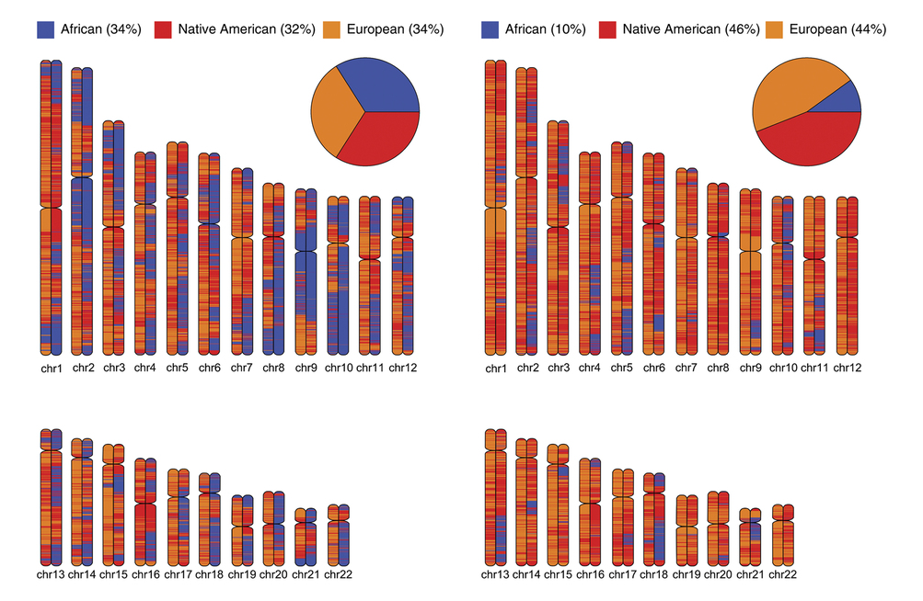
Locus-Specific Ancestry
Rishishwar et.al. Sci Rep. 2015

Slide 26
Locus-Specific Ancestry
LAMP
http://lamp.icsi.berkeley.edu/lamp/
HAPMIX
http://www.stats.ox.ac.uk/~myers/software.html
SABER
http://med.stanford.edu/tanglab/software/saber.html
RFMix
http://med.stanford.edu/bustamantelab/
Notes:
STRUCTURE modeled local-ancestry correlations due to common ancestry by using Hidden Markov Models (HMMs) instead of explicitly modeling linkage disequilibrium (LD)
STRUCTURE used unlinked loci, and did not model the linkage disequilibrium explicitly.
LAMP/HAPMIX/SABER are all variations of Hidden MM and rely on having really good ancestral data since inference is based on the haplotype information obtained from the ancestral chromosomes.

Slide 27
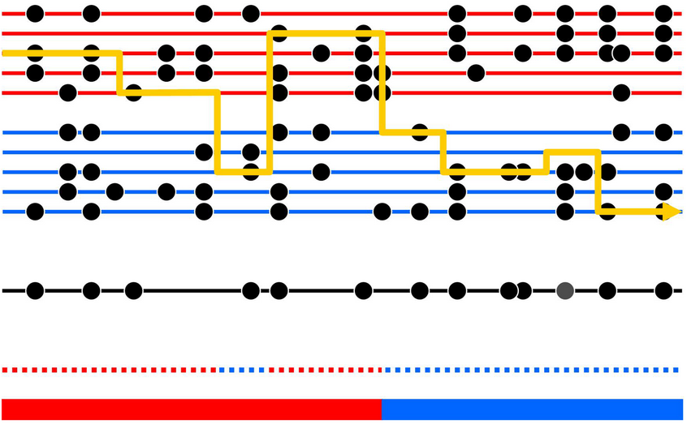
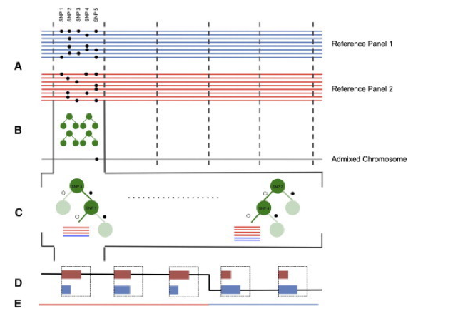
HAPMIX
RFMix
Notes:
At each position in the genome, HAPMIX estimates the likelihood that a haplotype from an admixed individual is a better statistical match to one reference population or the other. A Hidden Markov Model (HMM) is used to combine these likelihoods with information from neighboring loci, to provide a probabilistic estimate of ancestry at each locus. Underlying ancestry are hidden states.
All models before RFMix, use an explicit probabilistic model for the observed variables (the alleles) and unobserved variables (the ancestry) is fitted to the data via a HMM or an extension thereof.
RFMix, is a discriminative approach (use in machine learning) that models ancestry along an admixed chromosome given observed haplotype sequences of known or inferred ancestry. It estimates P(Y|X) without estimating the joint probability P(X,Y).
Incorporating the ancestral tracts inferred in the admixed samples into the reference panels is advantageous for at least three reasons.
haplotypes in the admixed populations are direct descendants from the actual ancestral populations rather than of a proxy population and thus should be able to better resolve ancestral haplotype patterns.
by augmenting the reference panel with chromosomes from admixed individuals, we increase the total number of observed haplotypes and, thus, the training panel size.
identity-by-descent (IBD) information across individuals in the admixed population can be directly leveraged for ancestry inference.
RFMix generalization that jointly models phasing errors and local ancestry.

Slide 28
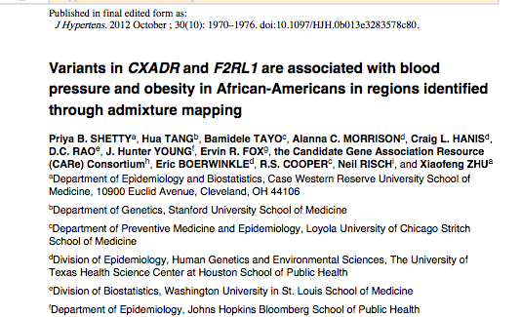
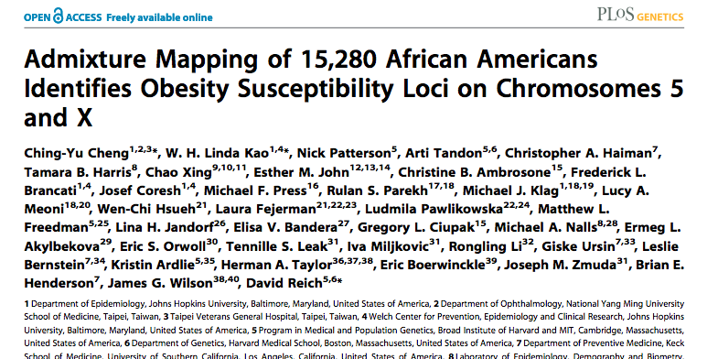
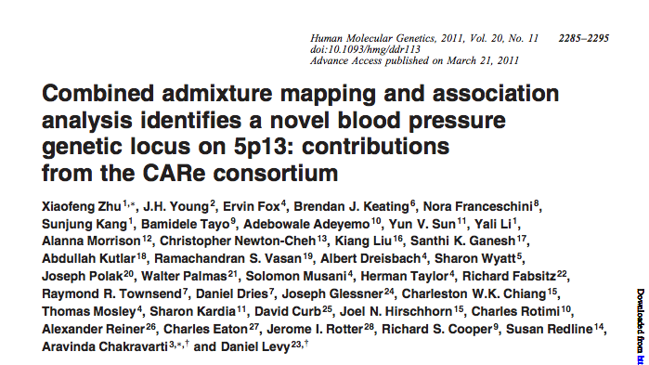
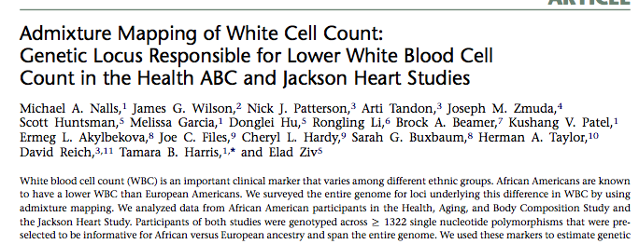
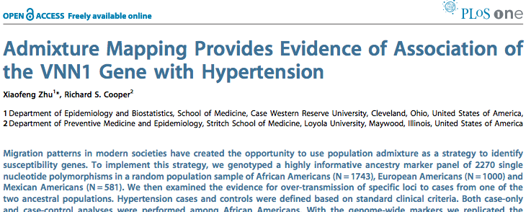
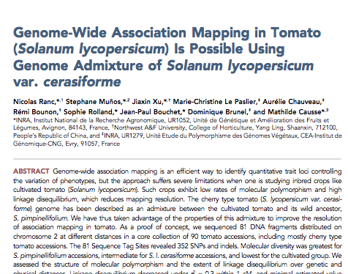
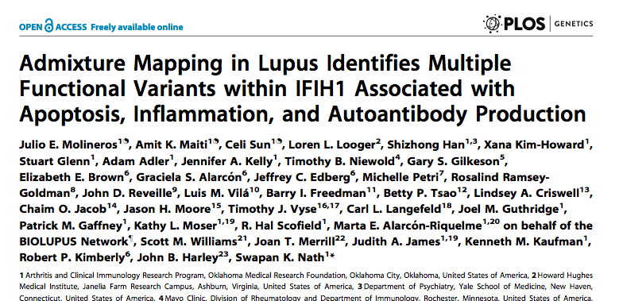
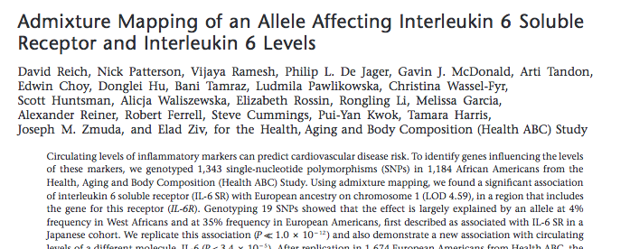
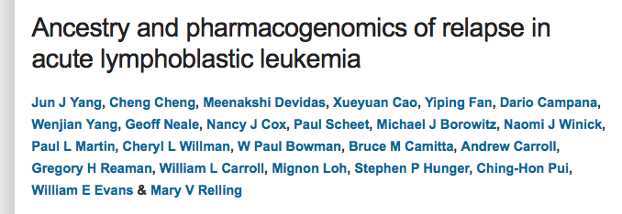
Cancer/Hypertension/BMI/Tomato/etc.

Slide 29
Summary
Admixed populations
  Latin Americans
  African Americans
Global genetic ancestry estimation
  To adjust in genetic studies
  As main predictor
Locus specific ancestry estimation:
  Admixture mapping to find disease causing
  genes

Slide 30
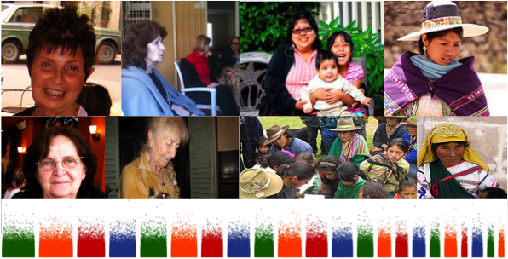
Illustrative example:
Breast Cancer in Latinas

Slide 31
U.S. breast cancer incidence by population group
U.S. Cancer Statistics Working Group. United States Cancer Statistics (USCS): 1999–2008 Incidence and Mortality Web-based Report. Atlanta: U.S. Department of Health and Human Services, Centers for Disease Control and Prevention and National Cancer Institute; 2012. Available at: www.cdc.gov/uscs.
Notes:
A typical statement about bc risk is that 1 in 8 women will develop breast cancer in their lifetime. However that is not the case for all women. For example, among women who identify as Hispanic/Latina, the lifetime risk is about 1 in 10.

Slide 32
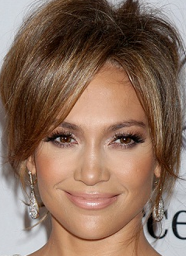

European genetic ancestry is associated with increased risk of breast cancer among Latinas
BC Risk
BC Risk
25% IA
0% IA
US Latinas | OR | 95% CI | P value
Ind. Am. ancestry | 0.56 | 0.36-0.78 | <0.001
Fejerman et al. Cancer Research 2008; Fejerman et al. CEBP 2010
Notes:
In a study published 8 years ago, we reported that among Latinas, those with higher Indigenous American ancestry had a lower risk of developing breast cancer. Example with Alexis Bledel and Jennifer Lopez.

Slide 33
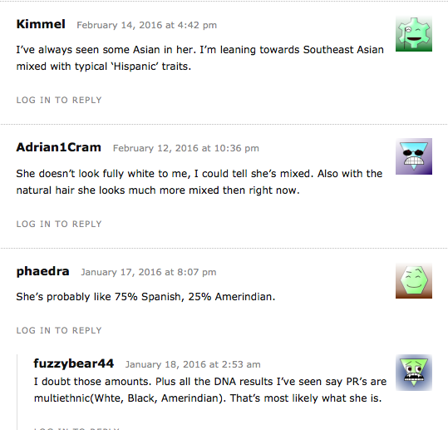
http://ethnicelebs.com/jennifer-lopez

Slide 34
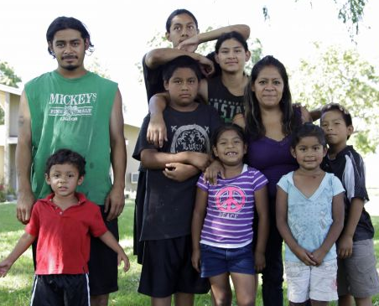

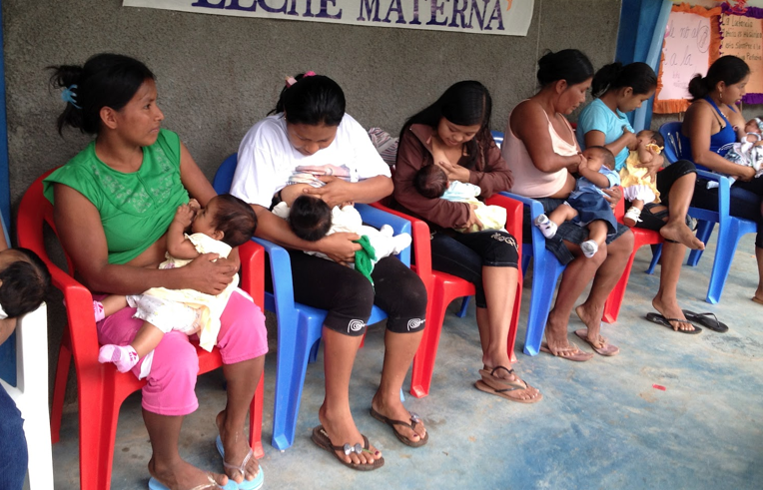


Risk factor exposure in Latinas and Non-Latina White women
Latin American women
Non-Latina White women
US Latinas | OR | 95% CI | P value
Ind. Am. ancestry | 0.72 | 0.47-0.94 | 0.013
Notes:
We know that genetic ancestry is correlated with certain behaviors and exposures that are associated with BC risk. Latin American women tend to have more children at younger age and breast feed them longer, while non Latina white women tend to have one or two children at an older age. Also, alcohol intake, a known BC risk factor, is higher in non-Latina white women. When Latinas move to the US, they become more similar to the non-Latina white women, but ancestry is correlated with the behavioral changes. So if we adjust the analysis by the known factors that correlate with ancestry we see a more moderate, but still significant association between genetic ancestry and breast cancer risk.

Slide 35
Breast Cancer Admixture Mapping
Samples
US Latinas: 1,461 cases and 1,280 controls
Genotyping
Genome wide array
LSA estimation
~60,000 SNP
Ancestral populations: African, Indigenous American and European
Statistical analysis
Logistic regression: case/control, LSA, global ancestry

Slide 36
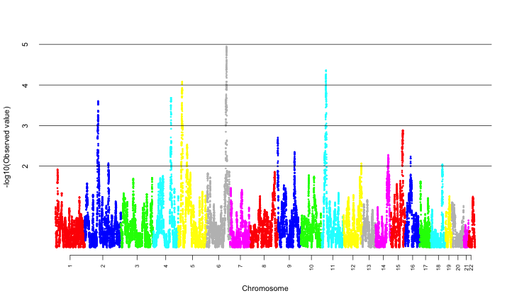
Admixture mapping results
(Indigenous component)
6q25, p=1*10⁻⁵
P_{corrected}=0.02
OR ~0.75 per Indigenous American chromosome
Fejerman et al. Human Molecular Genetics (2012)

Slide 37
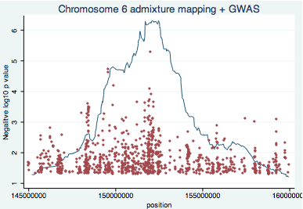
ESR1

Slide 38
Genome Wide Association Analysis
Discovery analysis: 1500 cases/3000 controls
Northern California (SFBCS, NC-BCFR)
Southern California (MEC)
Replication analysis: 1700 cases/5000 controls
Mexico
Colombia (COLUMBUS consortium)
Women’s Health Initiative (WHI)

Slide 39
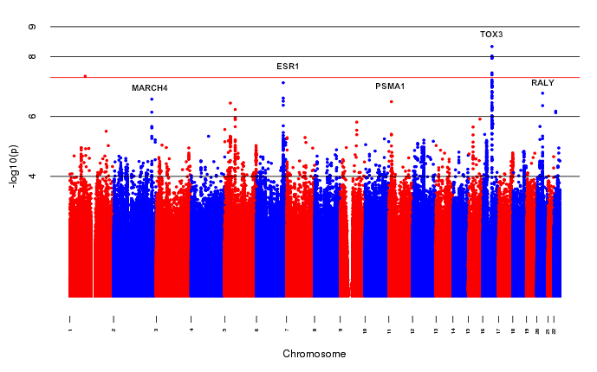
Latinas GWAS results
P =5*10-8
Fejerman et al. Nature Communications 2014
Notes:
These are the results from the discovery phase of the GWAS. The strongest signal came from the TOX3 region, which was previously associated with BC risk. There were also other signals, that were almost GWAS significant, and decided to replicate in an independent sample.

Slide 40
ESR1 region: rs140068132/rs147157845
Phase (N cases/N controls) | OR | 95%CI | P Value | MAF
Discovery (1500/3000) | 0.60 | 0.49-0.72 | 3x10⁻⁷ | 9%
Mexicans (1000/1100) | 0.63 | 0.53-0.75 | 3x10⁻⁷ | 15%
Colombia (540/440) | 0.54 | 0.41-0.71 | 1x10⁻⁵ | 10%
WHI (120/3000) | 0.61 | 0.31-1.22 | 0.16 | 7%
Meta-Analysis (3000/8000) | 0.60 | 0.53-0.67 | 9x10⁻¹⁸
Fejerman et al. Nature Communications 2014

Slide 41


rs140068132-G allele only observed in Latin American populations
African Latin American Asian European South Asian
Colombia
Mexico
Peru
Puerto Rico

Slide 42
Global Indigenous American (IA) ancestry, local IA ancestry and rs140068132
 | OR | 95% CI | P value
Model 1
Global IA ancestry | 0.74 | 0.65–0.86 | 3.47 × 10⁻⁵
Model 2
Global IA ancestry | 0.86 | 0.74–1.00 | 0.056
Local IA at 6q25 | 0.74 | 0.65–0.85 | 1.87 × 10⁻⁵
Model 3
Global IA ancestry | 0.86 | 0.74–1.01 | 0.06
Local IA at 6q25 | 0.82 | 0.71–0.95 | 0.009
rs140068132 | 0.63 | 0.50–0.80 | 1.6 × 10⁻⁴

Slide 43
Breast Cancer Incidence and genetic ancestry in Latin America
Uruguay
Argentina
Trinidad Tobago
Puerto Rico
Jamaica
Chile
Paraguay
Peru
Cuba
Colombia
Mexico
Guatemala
Bolivia
Ecuador
El Salvador
Globacan 2002
Notes:
There is variation in BC incidence across all Latin America. And it correlates with proportion of Indigenous American ancestry, which correlates with the frequency of the G allele in the population.

Slide 44
Main Implications
Genetic studies need to include diverse populations
Risk prediction and stratification in Latinas cannot be based on European/Asian/African findings
6q25 region and tumor biology in Latinas (TCGA 29 Hispanic/Latinas, 1 heterozygous)

Slide 45
Genetic ancestry and BC mortality
Population | BC Inc. | HR* (95%CI)
White | 124 | 1 (ref.)
Afr. Am. | 113 | 1.5 (1.4-1.6)
Asian | 82 | 0.9 (0.8-1)
Latinas | 90 | 1.3 (1.2-1.6)
Native | 67 | 1.7 (1.3-2.3)

Slide 46
Average ancestry by clinical characteristics
Radiation

Slide 47
Average ancestry by socio-demographic characteristics
Obese

Slide 48
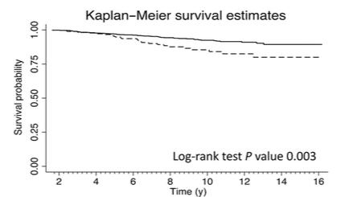
Does genetic ancestry contribute to disparities in mortality?
Adjusted
>50% IA ancestry: HR: 1.91, p=0.018
Fejerman et al. 2013
Notes:
A previous study has looked at the association between Indigenous American ancestry and breast cancer-specific mortality in a population-based sample of women from Northern California and found that women with higher IA were at increased risk of breast cancer specific-mortality. Even after adjusting for potential mediating effects of education, SES and tumor characteristics, there was a roughly two-fold higher rate of breast cancer death in women with higher than 50% native ancestry relative to women with less than 50% native ancestry. This remaining effect of ancestry on breast cancer outcomes may indicate that there is a true genetic component more common in women with high Indigenous Ancestry, or that the study was unable to completely control for potential social mediators of the effect.

Slide 49
Genetic or socioeconomic?

Slide 50
Indigenous ancestry is not associated with study outcomes in Kaiser cohort
Breast Cancer Recurrence | HR | 95% CI | P value
IA ancestry, Unadjusted (10% unit) | 0.99 | 0.85, 1.16 | 0.99
IA Ancestry, Adjusted* | 0.98 | 0.83, 1.15 | 0.82
Breast Cancer-Specific Survival | HR | 95% CI | P value
IA Ancestry, Unadjusted (10% unit) | 0.95 | 0.77, 1.17 | 0.65
IA Ancestry, Adjusted* | 0.99 | 0.81, 1.22 | 0.95
*Models adjusted for age at diagnosis, stage at presentation and treatment for hormone therapy.
Natalie Engmann (unpublished)
Notes:
Here are results from proportional hazards models of breast cancer recurrence (53 events) and breast cancer-specific mortality (31 events). The Indigenous American ancestry variable is scaled so that the hazard ratio reflects an increase in ancestry of 10%. There is no total or unadjusted effect of IA on recurrence and survival, and adjustment for potential mediating factors did not alter the effect of ancestry.

Slide 51
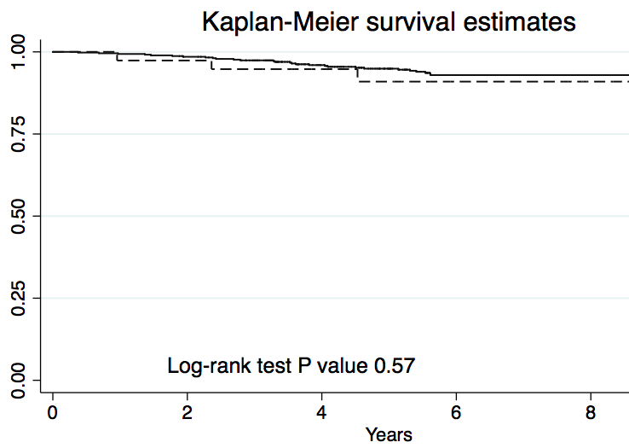
Limitations
Previous study
(Fejerman 2013)
Current study
(Engmann …)
Notes:
The Kaiser study had a maximum follow-up time of 9.5 years, but the mean follow up time was about 6 years due to the staggered enrollment of the study. This suggests that IF in fact there are disparities in breast cancer survival outcomes, they may well not become apparent until later on, and would not be captured by the Kaiser study given the length of follow-up time.

Slide 52
Conclusion
Population differences in disease prevalence are highly confounded between genes and environment
A group difference alone does not indicate a source for that difference
Locus specific ancestry results are likely to be less confounded

Slide 53
Summary
Population diversity & population structure
Genetic structure and how it relates to the concepts of race and ethnicity
Genetic structure as a possible confounder and as an opportunity for gene discovery
Example: using genetic ancestry to explain observed differences in BC risk and mortality

Slide 54
Questions?
Laura.fejerman@ucsf.edu

