Slide 1
Combining Tests
Michael A. Kohn, MD, MPP
10/25/2018

Slide 2
Outline: Combining Tests
Evaluating Predictions/Decision Curves Addendum
Independence Conditional on D+/D- (Hard!)
Classification Trees
Logistic Regression
  Digression: Natural Logarithms
Variable (Test) Selection
Validation separate from derivation
NLST Risk Model
Low-Risk Appendicitis Rule

Slide 3
Combining Tests
Example
Prenatal sonographic Nuchal Translucency (NT) and Nasal Bone Exam as dichotomous tests for Trisomy 21*
*Cicero, S., G. Rembouskos, et al. (2004). "Likelihood ratio for trisomy 21 in fetuses with absent nasal bone at the 11-14-week scan." Ultrasound Obstet Gynecol 23(3): 218-23.

Slide 4
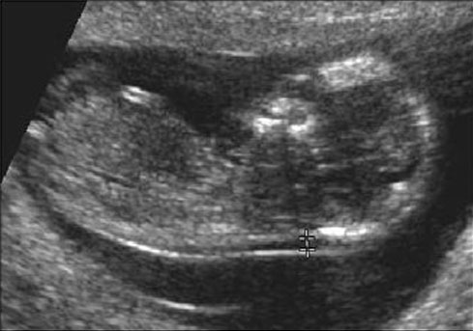
If NT ≥ 3.5 mm Positive for Trisomy 21*
*What’s wrong with this definition?

Slide 6
In general, don’t make multi-level tests like NT into dichotomous tests by choosing a fixed cutoff
I did it here to make the discussion of multiple tests easier
I arbitrarily chose to call ≥ 3.5 mm positive

Slide 7
One Dichotomous Test
Trisomy 21
Nuchal D+ D- LR
Translucency
≥ 3.5 mm 212 478 7.0
< 3.5 mm 121 4745 0.4
Total 333 5223
(212/333)/(478/5223)

Slide 8
NT Positive
Pre-test Prob = 0.06
LR(Result) = 7.0
Post-Test Prob = ?

Slide 9
Clinical Scenario – One Test
Pre-Test Probability of Down’s = 6%
NT Positive
Pre-test prob: 0.06
Pre-test odds: 0.06/0.94 = 0.064
LR(+) = 7.0
Post-Test Odds = Pre-Test Odds x LR(+)
= 0.064 x 7.0 = 0.44
Post-Test prob = 0.44/(0.44 + 1) = 0.31

Slide 10
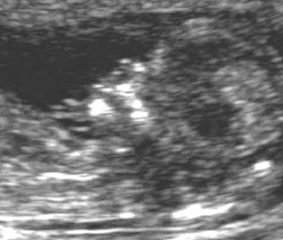
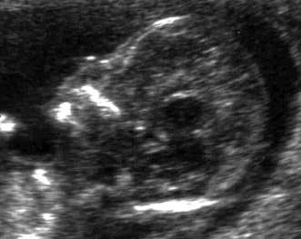
Nasal Bone Seen
NBA=“No”
Neg for Trisomy 21
Nasal Bone Absent
NBA=“Yes”
Pos for Trisomy 21

Slide 11
Second Dichotomous Test
Nasal Bone Tri21+ Tri21- LR
Absent
Yes 229 129 27.8
No 104 5094 0.32
Total 333 5223
(229/333)/(129/5223)

Slide 12
Pre-Test Probability of Trisomy 21 = 6%
NT Positive for Trisomy 21 (≥ 3.5 mm)
Post-NT Probability of Trisomy 21 = 31%
Nasal Bone Absent
LR(NBA) = 27.8
Post-NBA Probability of Trisomy 21 = ?
Clinical Scenario –Two Tests
Using Probabilities

Slide 13
Clinical Scenario – Two Tests
Using Odds
Pre-Test Odds of Tri21 = 0.064
NT Positive (LR = 7.0)
Post-Test Odds of Tri21 = 0.44
Nasal Bone Absent (LR = 27.8?)
Post-Test Odds of Tri21 = .44 x 27.8
= 12.4?
(P = 12.4/(1+12.4) = 92.5%?)

Slide 14
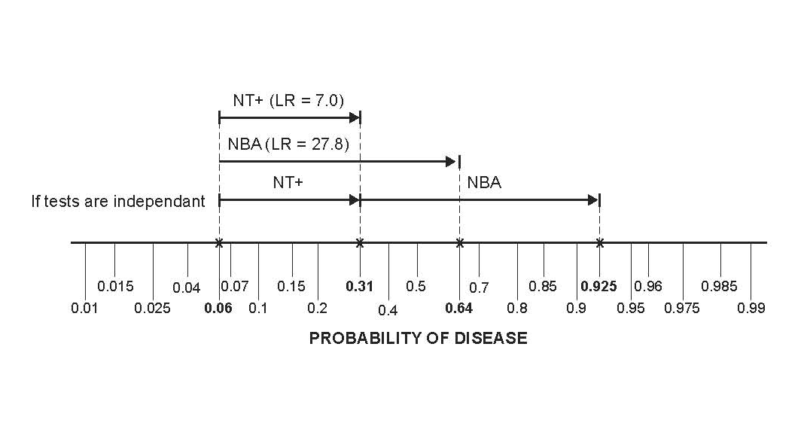
Clinical Scenario – Two Tests
Pre-Test Probability of Trisomy 21 = 6%
NT ≥ 3.5 mm AND Nasal Bone Absent

Slide 15
Question
NT “positive” and Nasal Bone Absent. What is probability of Trisomy 21?
< 92.5%
= 92.5%
> 92.5%
Cannot say

Slide 16
Answer
NT | NBA | Tri21+ | Tri21- |  | Post Test Prob*
Pos | Pos | 158 | 36 | 158/(158+36) | 81%
Pos | Neg | 54 | 442 | 54/(54+442) | 11%
Neg | Pos | 71 | 93 | 71/(71+93) | 43%
Neg | Neg | 50 | 4652 | 50/(50+4652) | 1%
Total | Total | 333 | 5223 | 333/(333+5223) | 6%
*Assumes pre-test prob = 6%

Slide 17
Question
Can we use the post-test odds after a positive Nuchal Translucency as the pre-test odds for the positive Nasal Bone Examination?
i.e., can we combine the positive results by multiplying their LRs?
LR(NT+, NBA +) = LR(NT +) x LR(NBA +) ?
= 7.0 x 27.8 ?
= 194 ?

Slide 18
Answer = No
NT | NBA | Trisomy 21 + | % | Trisomy 21 - | % | LR
Pos | Pos | 158 | 47% | 36 | 0.7% | 69
Pos | Neg | 54 | 16% | 442 | 8.5% | 1.9
Neg | Pos | 71 | 21% | 93 | 1.8% | 12
Neg | Neg | 50 | 15% | 4652 | 89% | 0.2
Total | Total | 333 | 100% | 5223 | 100%
Not 194
158/(158 + 36) = 81%, not 92.5%

Slide 19
Non-Independence
Absence of the nasal bone does not tell you as much if you already know that the nuchal translucency is ≥ 3.5 mm.

Slide 20
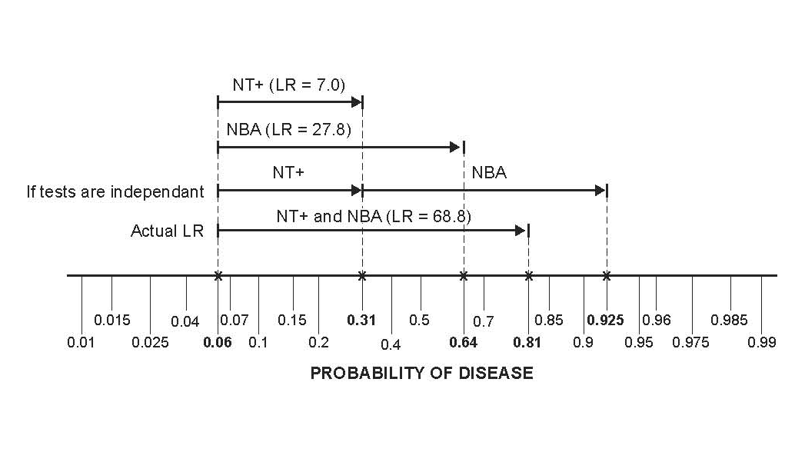
Non-Independence

Slide 21
Non-Independence of NT and NBA
In chromosomally normal (D-) fetuses, a false positive on the NT makes a false positive on the NBA more likely.
Some (but not all) of this may have to do with ethnicity. In this London study, chromosomally normal fetuses of “Afro-Caribbean” ethnicity had both larger NTs and more frequent absence of the nasal bone.
In Trisomy 21 (D+) fetuses, normal NT was associated with the presence of the nasal bone, so a false negative on the NT was associated with a false negative on the NBA.
Notes:
8-8 (d)

Slide 22
Non-Independence of NT and NBA
Of normal (D-) fetuses with NT ≥ 3.5 mm, 7.5% had nasal bone absent. Of normal (D-) fetuses with NT < 3.5 mm only 2.0% had nasal bone absent.
P(NBA+|NT+ & D-) = 0.075
P(NBA+|NT- & D-) = 0.020
Notes:
Among D- fetuses, NBA+ increases the odds of NT+ by a factor of 0.075/0.02 = 3.25.
Odds(NT+|NBA+&D-) = Odds(NT+|D-) * 3.25
They are not independent.

Slide 23
Non-Independence of NT and NBA
If independent,
P(NBA+|NT+&D-) = P(NBA+|NT-&D-) = P(NBA+|D-)
But,
P(NBA+|NT+ & D-) = 0.075
P(NBA+|NT- & D-) = 0.020
Notes:
If conditional independence, Odds(NT+|NBA+&D-) = Odds(NT+|D-), but Odds(NT+|NBA+&D-) = Odds(NT+|D-)*3.25

Slide 24
Non-Independence
Instead of looking for the nasal bone, what if the second test were just a repeat measurement of the nuchal translucency?
A second positive NT would do little to increase your certainty of Trisomy 21. If it was false positive the first time around, it is likely to be false positive the second time.

Slide 25
Reasons for Non-Independence
Tests measure the same aspect of disease.
One aspect of Down’s syndrome is slower fetal development; the NT decreases more slowly and the nasal bone ossifies later. Chromosomally NORMAL fetuses that develop slowly will tend to have false positives on BOTH the NT Exam and NBA.

Slide 26
Reasons for Non-Independence
Heterogeneity of Disease (e.g. spectrum of severity)*.
Heterogeneity of Non-Disease.
(See EBD-2 Chapter 7 first 3 pages)
*In this example, Down’s syndrome is the only chromosomal abnormality considered, so disease is fairly homogeneous

Slide 27
Unless tests are independent (conditional on D+/D-), we can’t combine results by multiplying LRs.
Notes:
“Naïve Bayes” is assuming that tests are conditionally independent, so that you can multiply LRs.

Slide 28
Independence Conditional On Disease Status
In D+ patients,
a false negative on Test 1 does not affect the probability of a false negative on Test 2.
In D- patients,
a false positive on Test 1 does not affect the probability of a false positive on Test 2.

Slide 29
Ways to Combine Multiple Tests
On a group of patients (derivation set), perform the multiple tests and (independently*) determine true disease status (apply the gold standard)
Measure LR or PV for each possible combination of results
Classification Trees
Logistic Regression
*Beware of incorporation bias

Slide 30
Determine LR for Each Result Combination
NT | NBA | Tri21+ | % | Tri21- | % | LR | Post Test Prob*
Pos | Pos | 158 | 47% | 36 | 0.7% | 69 | 81%
Pos | Neg | 54 | 16% | 442 | 8.5% | 1.9 | 11%
Neg | Pos | 71 | 21% | 93 | 1.8% | 12 | 43%
Neg | Neg | 50 | 15% | 4652 | 89.1% | 0.2 | 1%
Total | Total | 333 | 100% | 5223 | 100%
*Assumes pre-test prob = 6%

Slide 31
Sort by LR (Descending)
NT | NBA | Tri21+ | % | Tri21- | % | LR
Pos | Pos | 158 | 47% | 36 | 0.70% | 69
Neg | Pos | 71 | 21% | 93 | 1.80% | 12
Pos | Neg | 54 | 16% | 442 | 8.50% | 1.9
Neg | Neg | 50 | 15% | 4652 | 89.10% | 0.2
Notes:
8-7 (a)

Slide 32
Apply Chapter 4 – Multilevel Tests
Now you have a multilevel test (In this case, 4 levels.)
Have LR for each test result
Can create ROC curve and calculate AUROC
Given pre-test probability and treatment threshold probability (C/(B+C)), can find optimal cutoff.

Slide 33
Create ROC Table
NT | NBA | Tri21+ | Sens | Tri21- | 1 - Spec
 |  |  | 0% |  | 0%
Pos | Pos | 158 | 47% | 36 | 0.70%
Neg | Pos | 71 | 68% | 93 | 3%
Pos | Neg | 54 | 84% | 442 | 11%
Neg | Neg | 50 | 100% | 4652 | 100%

Slide 34
AUROC = 0.896

Slide 35
Optimal Cutoff
NT | NBA | LR | Post-Test Prob
Pos | Pos | 69 | 0.81
Neg | Pos | 12 | 0.43
Pos | Neg | 1.9 | 0.11
Neg | Neg | 0.2 | 0.01
Assume
Pre-test probability = 6%
Threshold for CVS is 2%
Notes:
8-7 (b)

Slide 36
Determine LR for Each Result Combination
2 dichotomous tests: 4 combinations
3 dichotomous tests: 8 combinations
4 dichotomous tests: 16 combinations
Etc.
2 3-level tests: 9 combinations
3 3-level tests: 27 combinations
Etc.

Slide 37
Determine LR for Each Result Combination
How do you handle continuous tests*?
Not always practical for groups of tests.
*Nuchal Translucency is really a continuous measurement.
Notes:
The “Curse of Dimensionality”. Common dimension reduction techniques from Machine Learning (Principal Components Analysis, Factor Analysis) do not appear to be appropriate to apply in this context.

Slide 38
Classification Tree
Measure NT First

Slide 39
Classification Tree
Examine Nasal Bone First
Notes:
Note that the probabilities at the nodes are P(D+|node), not the proportion of the population that the node represents This will help with at least one of the homework problems. 7.10 (a)

Slide 40
Do Nasal Bone Exam First
Better separates Trisomy 21 from chromosomally normal fetuses
If your threshold for CVS is between 11% and 43%, you can stop after the nasal bone exam
If your threshold is between 1% and 11%, you should do the NT exam only if NBA is negative.

Slide 41
Classification Tree
Examine Nasal Bone First
CVS if P(Trisomy 21 > 5%)

Slide 42
Classification Tree
Examine Nasal Bone First
CVS if P(Trisomy 21 > 5%)
Notes:
Note that the probabilities at the nodes are P(D+|node), not the proportion of the population that the node represents This will help with at least one of the homework problems. 7.10 (a)

Slide 43
Classification Tree
Same as Recursive Paritioning
Don’t have to work out probabilities (or LRs) for all possible combinations of tests, because of “tree pruning”
Notes:
Note: Random forests does not utilize pruning, but Random Forests is for machine learning, not for building clinical decision rules.

Slide 44
Classification Trees
May not deal well with continuous test results*
Results in rules or algorithms, i.e. trees, not scores or formulas
Evaluation with calibration plots, ROC curves, net benefit calculations, and decision curves more difficult
*when there is a monotonic relationship between the test result and the probability of disease
*that have a monotonic relationship with the risk of the outcome.
Notes:
Ch07.57 a(ii)

Slide 45
Logistic Regression
ln(Odds(D+)) =
a + b_{NT}NT+ b_{NBA}NBA + b_{interact}(NT)(NBA)
“+” = 1
“-” = 0

Slide 46
Natural Logarithms
10^{b} = a; b = log(a)
e^{b’} = a’; b’ = ln(a’)
ln(10) = 2.3
ln(a’) = 2.3×log(a’)

Slide 47
ln(a) = 2.3×log(a)
a | Log(a) | Ln(a)
1 | 0 | 0
2 | 0.30 | 0.69
3 | 0.48* | 1.10
4 | 0.60 | 1.38
5 | 0.70 | 1.61
6 | 0.78* | 1.79
7 | 0.85 | 1.96
8 | 0.90 | 2.07
9 | 0.95 | 2.19
10 | 1.00 | 2.3

Slide 48
ln(xy) = ln(x) + ln(y) ln(x/y) = ln(x) – ln(y)
Notes:
The logarithm of the product is the sum of the logarithms

Slide 49
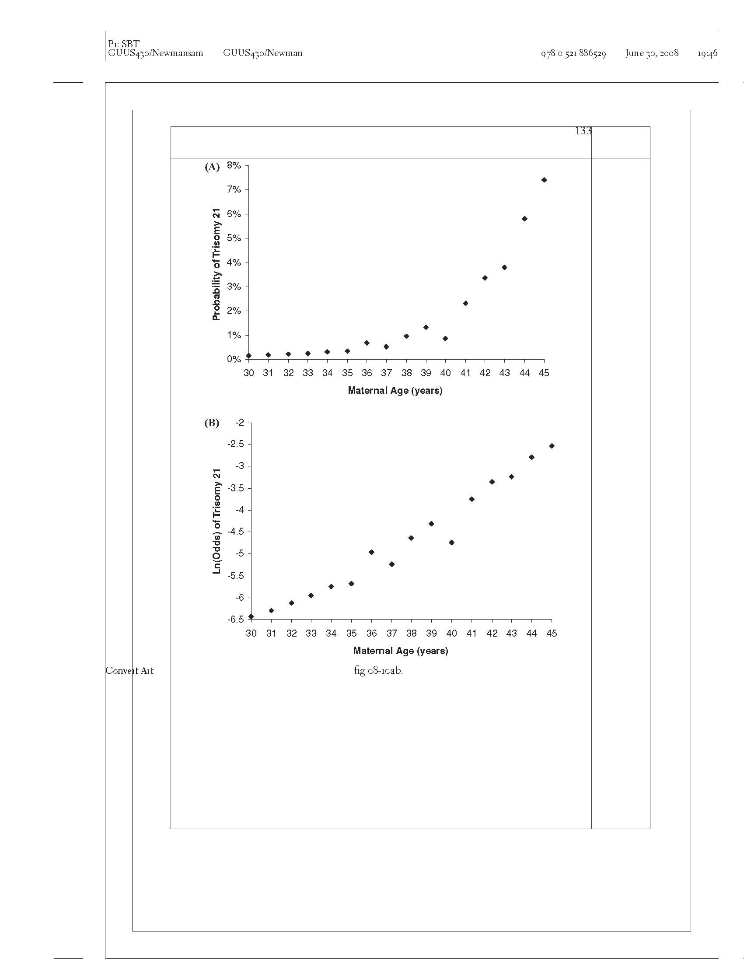
Probability of Trisomy 21 vs. Maternal Age
Notes:
TN: You could put the data source on the slide. I wonder what happened at age 40?

Slide 50
Ln(Odds) of Trisomy 21 vs. Maternal Age

Slide 51
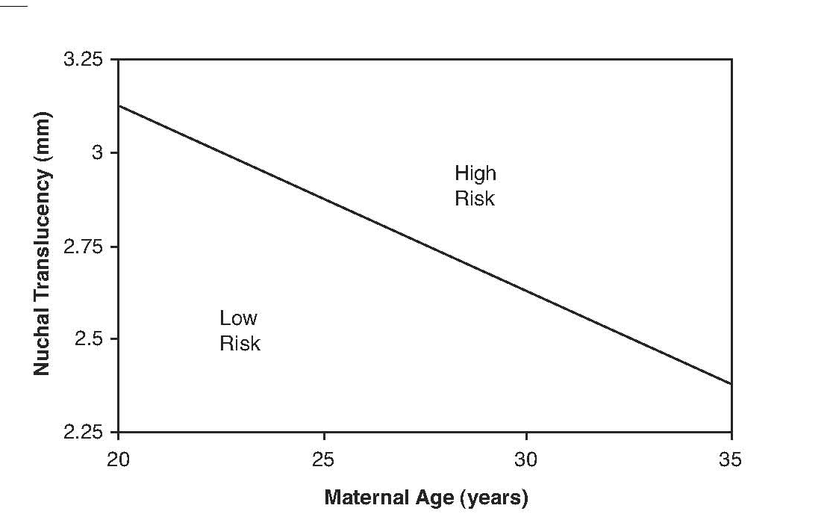
Combining 2 Continuous Tests
> 1% Probability of Trisomy 21
< 1% Probability of Trisomy 21
Notes:
Note, you couldn’t represent this with a tree.

Slide 52
Logistic Regression
ln(Odds(D+)) =
a + b_{NT}NT+ b_{NBA}NBA + b_{interact}(NT)(NBA)
Used to create risk scores, formulas,or nomograms, not trees.
Evaluation with calibration plots, ROC curves, net benefit calculations, and decision curves is natural

Slide 53
Logistic Regression Coefficients
ln(Odds(D+)) =
a + b_{NT}NT+ b_{NBA}NBA + b_{interact}(NT)(NBA)
Coefficient b_{NBA}= ln(OR_{NBA})
e^{b} = OR_{NBA}
OR_{NBA} = Odds(D+|NBA+) / Odds(D+|NBA-)
Notes:
This would be very tough for people who had never had logistic regression before.

Slide 54
Choosing Which Tests to Include in the Decision Rule
“Use well-established theory, past research, clinical observations, preliminary statistical analysis, or some sensible combination of these ….”
Stoltzfus, J. C. (2011). "Logistic regression: a brief primer." Acad Emerg Med 18(10): 1099-1104.
Notes:
Machine learning algorithms tend to use the whole dataset (all variables). In random forests, variable selection is done randomly and then all the rules are combined in an ensemble. The records are also selected randomly, which is called bootstrap aggregation. Bootstrap aggregation is different from cross-validation, because it is random sampling of records with replacement.

Slide 55
Need for Validation
Develop prediction rule by choosing a few tests and findings from a large number of candidates, based on which work the best.
Takes advantage of chance variations in the data.
Predictive ability of rule will probably decrease or even disappear when you try to validate on a new dataset.
Can be referred to as “overfitting.”

Slide 56
Need to Test the Rule in a Separate Dataset
Derivation → Validation
Training → Test
Beware of Tweaking the Rule

Slide 57
Validation Dataset
Measure all the variables needed for the model.
Determine disease/outcome status (D+ or D-) on all subjects.

Slide 58
NLST Lung CA Mortality
Risk Prediction Model
Regression model converts the following variables* into a risk of lung cancer death within 5 years
Age
BMI
Family history of lung cancer
Pack-years of smoking
Years since smoking cessation
Emphysema diagnosis
*Sex and Race were not included in the model (?)

Slide 59
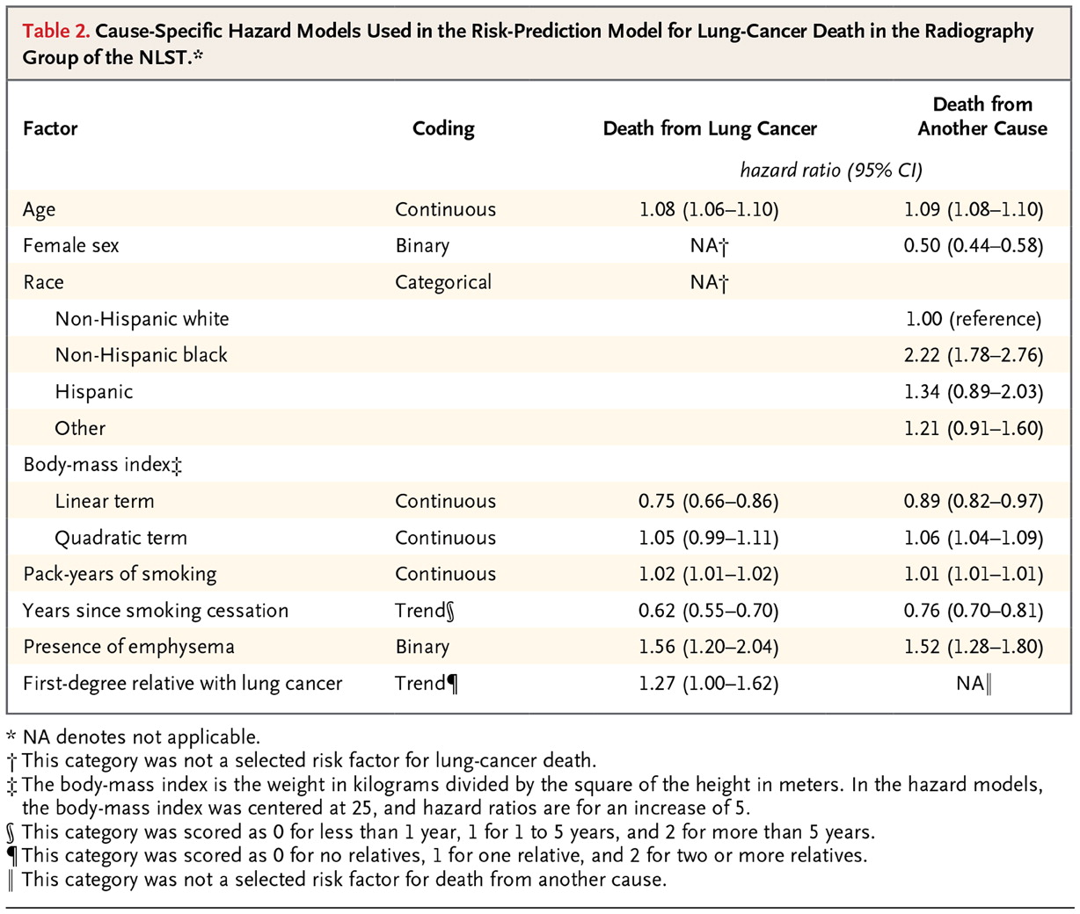

Kovalchik SA et al. N Engl J Med 2013;369:245-254.
Notes:
Hazard ratios, not odds ratios.

Slide 60
NLST Lung CA Mortality
Risk Prediction Model
Risk Group | 6.5-year Mortality Risk
ALL | 1.66%
1 | 0.4%
2 | 0.85%
3 | 1.1%
4 | 2.0%
5 | 4.0%

Slide 61
NLST Lung CA Mortality
Risk Prediction Model
Notes:
9:59 here
The distinction between goodness of fit and calibration was not clear to me. If a logistic model fits well won’t it be well calibrated? Although I’m not sure that bad fit would always show up as poor calibration.

Slide 62
NLST Lung CA Mortality Risk Prediction Model
Both AUROC reported as 0.72 (0.69-0.75) Type III Error?

Slide 63
Binary Decision: CT Yes/No
Assume CT scanning one who will die of lung CA in the next 5 years is worth CT scanning 100 who will not die
Threshold mortality risk =1%

Slide 64
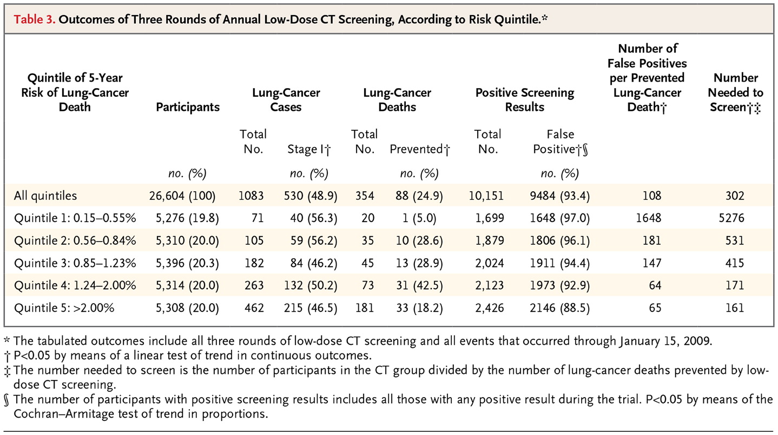
Kovalchik SA et al. N Engl J Med 2013;369:245-254.

Slide 65
Net Benefit of Risk Model
 | Total Scans | TP | FP | (TP - FP/100)/N
CT None | 0 | 0 | 0
CT Risk Groups 3,4,5 | 16018 | 376 | 15642 | 8.3/1000
CT w/o risk stratification (Treat All) | 26604 | 442 | 26162 | 6.8/1000

Slide 66
NLST Risk Model Decision Curve
Notes:
This is approximate. MAK.
TN: Do you do these in Excel? I downloaded the DCA software for Stata but have not used it yet.

Slide 67
Example of Recursive Partitioning: Kharbanda Low Risk Appendicitis Rule
Multivariable rule to determine which children to CT scan for appendicitis
Objective: Identify patients at low risk
2005: Derivation (N=425) and initial validation (N=176)
2012: Repeat validation (N=2390) and “refinement” (N=2625)

Slide 68
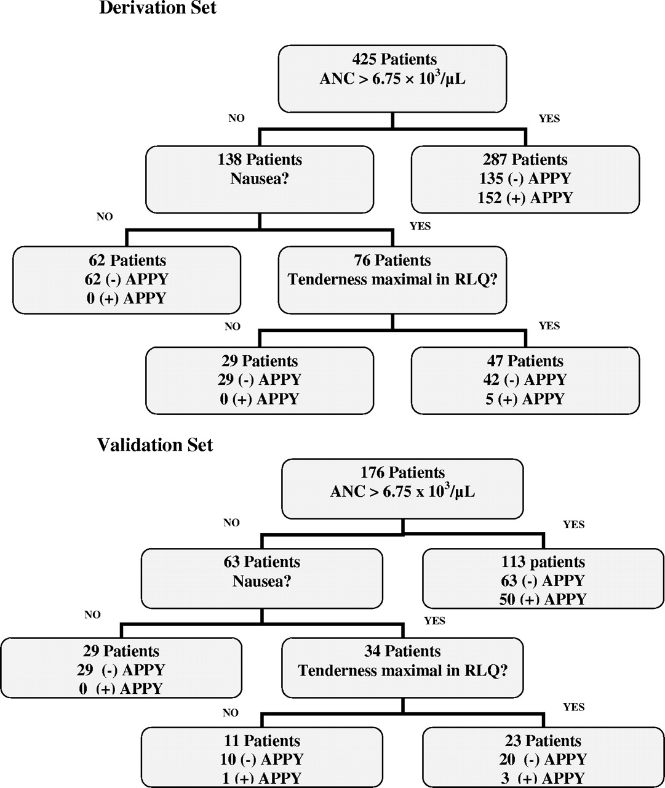
Low-risk decision tree that was created using classification trees
21% assigned to Low Risk
Low Risk Group: 0%
Higher Risk Group: 47%
Overall Risk: 37%
Anupam B. Kharbanda et al. Pediatrics 2005;116:709-716
©2005 by American Academy of Pediatrics
Notes:
Low-risk decision tree that was created using recursive partitioning. APPY indicates appendicitis.

Slide 69

Low-risk decision tree that was created using classification tree.
23% assigned to Low Risk
Low Risk Group: 1/40 = 2.5%
Higher Risk Group: 39%
Overall Risk: 31%
Anupam B. Kharbanda et al. Pediatrics 2005;116:709-716
©2005 by American Academy of Pediatrics
Notes:
Low-risk decision tree that was created using recursive partitioning. APPY indicates appendicitis.

Slide 70
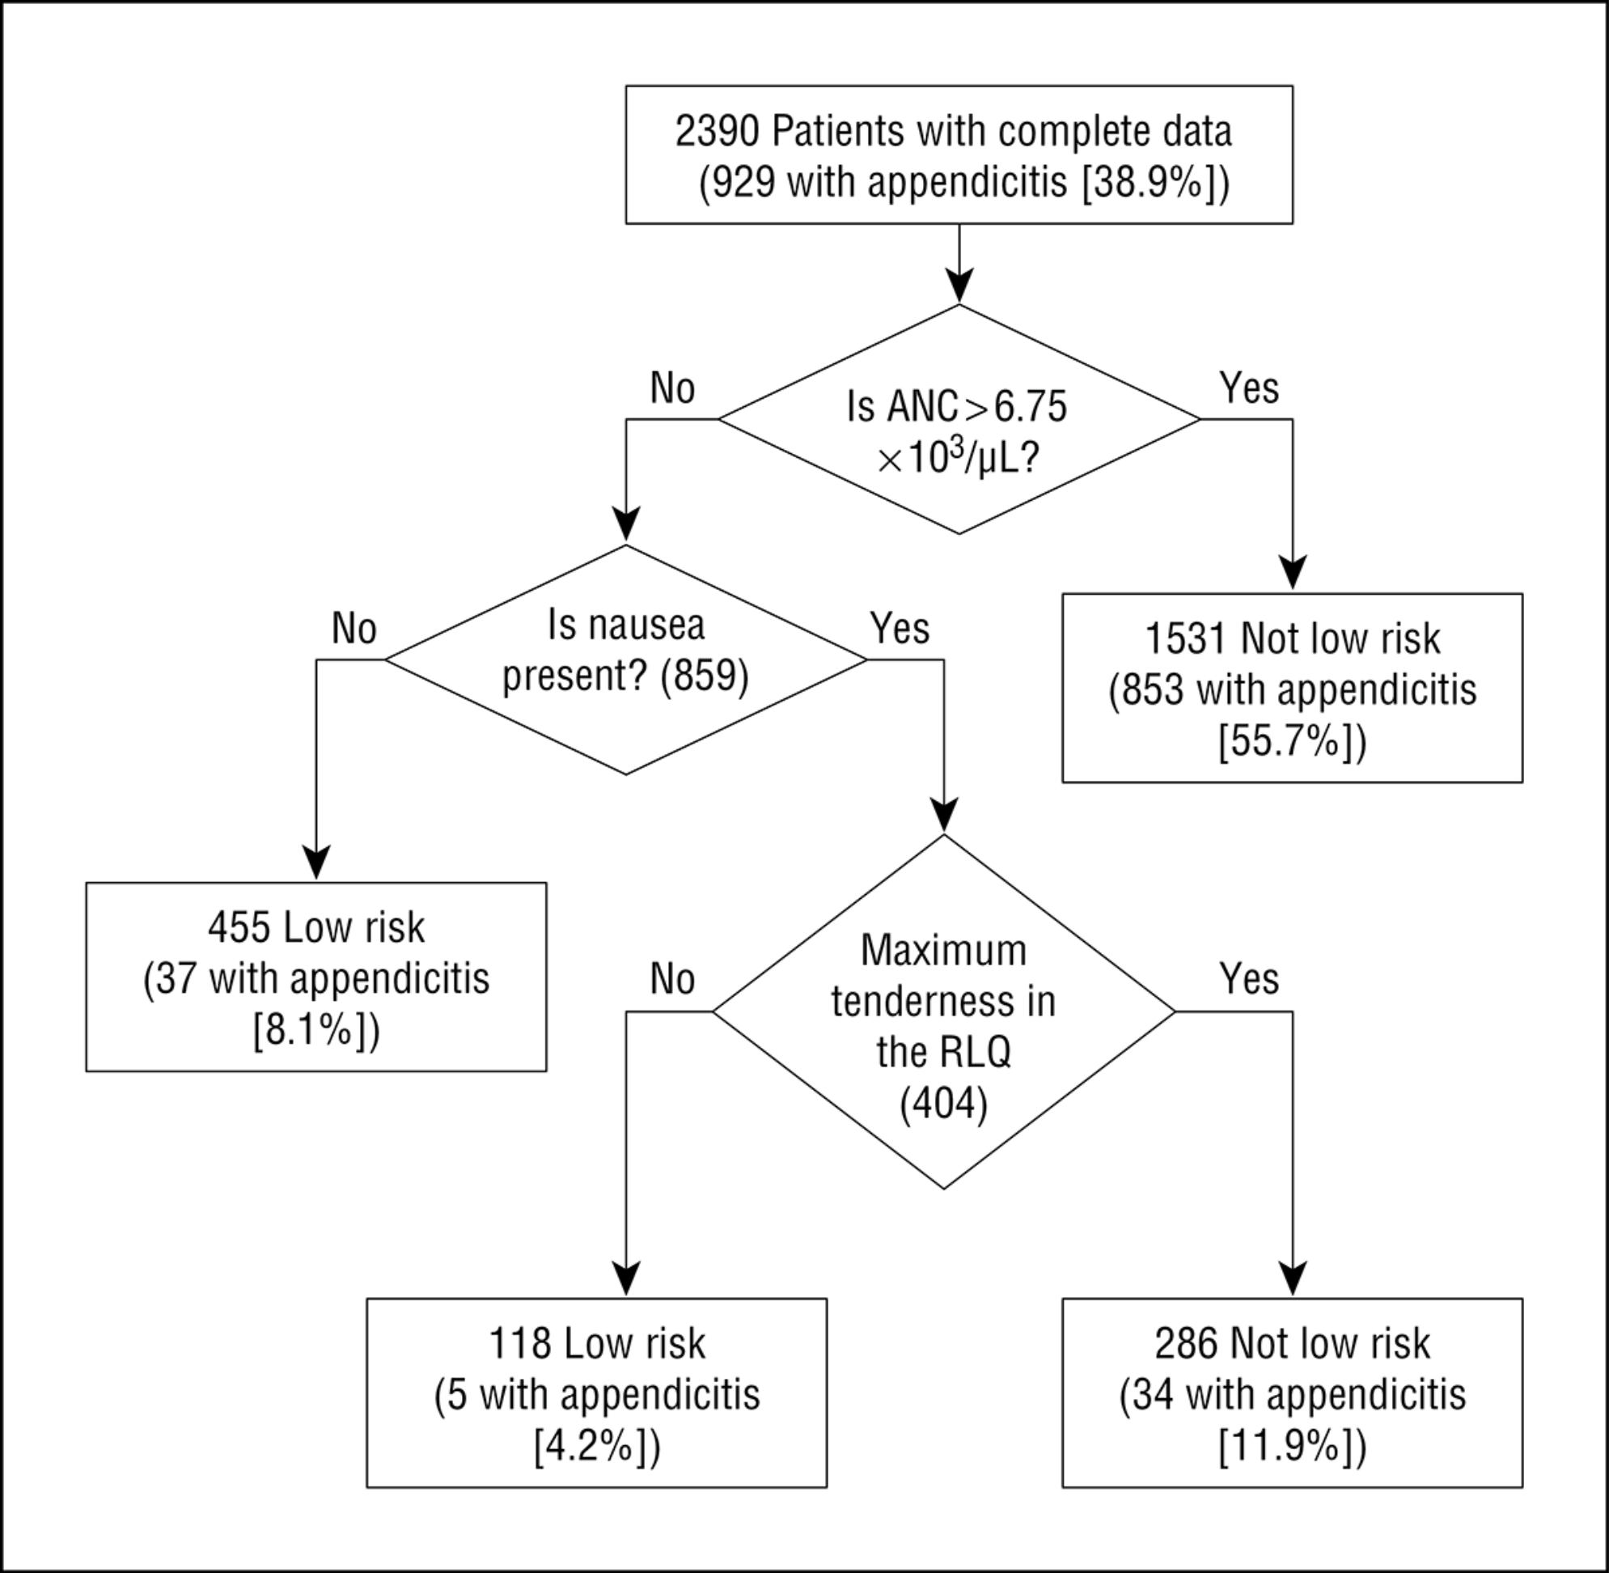
From: Validation and Refinement of a Prediction Rule to Identify Children at Low Risk for Acute Appendicitis
Arch Pediatr Adolesc Med. 2012;166(8):738-744. doi:10.1001/archpediatrics.2012.490
2012 Validation:
24% assigned to Low Risk
Low Risk Group: 42/573 = 7.3%
Higher Risk Group: 49%
Overall Risk: 39%
2005 Validation:
23% assigned to Low Risk
Low Risk Group: 1/40 = 2.5%
Higher Risk Group: 39%
Overall Risk: 31%
Figure 2. Effect of hypothetical application of the Low-Risk Appendicitis Rule. ANC indicates absolute neutrophil count (to convert count to ×10⁹ per liter, multiply by 1); RLQ, right lower quadrant.
Copyright © 2015 American Medical Association. All rights reserved.

Slide 71
Notes:
Calibration plots and ROC Curves not that useful for recursive partitioning models.
Reminder that
Points on calibration plot correspond to intervals on ROC curve
Low left on calibration plot corresponds to high right on the ROC curve

Slide 72
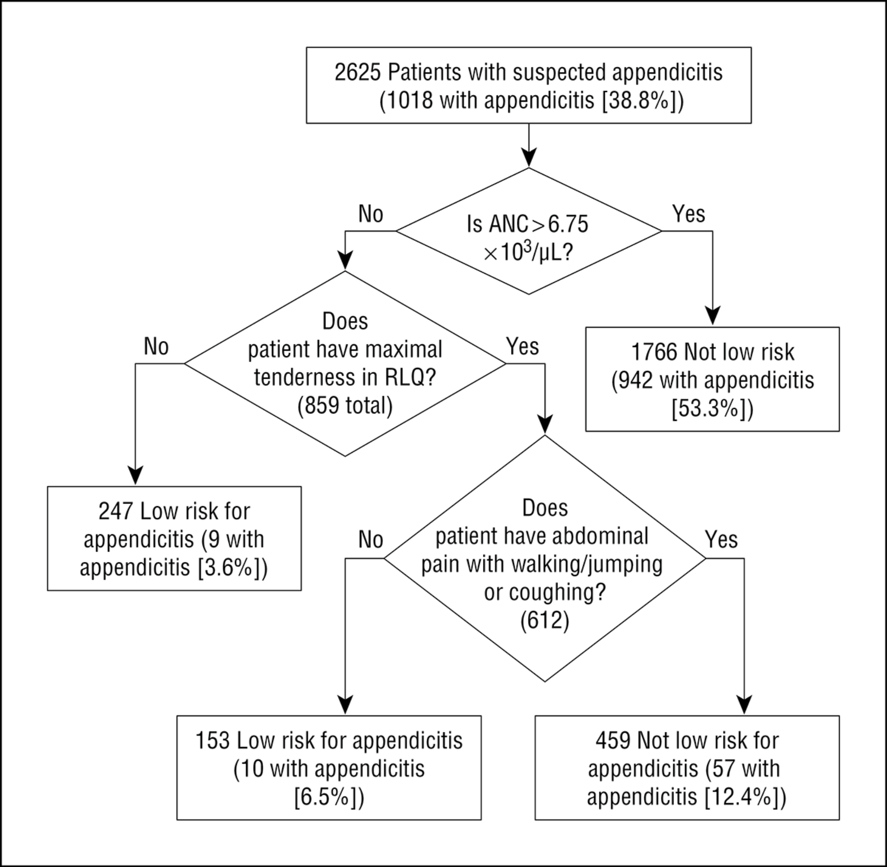
From: Validation and Refinement of a Prediction Rule to Identify Children at Low Risk for Acute Appendicitis
Arch Pediatr Adolesc Med. 2012;166(8):738-744. doi:10.1001/archpediatrics.2012.490
2012 Validation:
24% assigned to Low Risk
Low Risk Group: 42/573 = 7.3%
Higher Risk Group: 49%
Overall Risk: 39%
2012 Refinement:
15% assigned to Low Risk
Low Risk Group: 19/400 = 4.8%
Higher Risk Group: 45%
Overall Risk: 39%
Figure 3. Refined Low-Risk Appendicitis Rule and rule performance. ANC indicates absolute neutrophil count (to convert count to ×10⁹ per liter, multiply by 1); RLQ, right lower quadrant.
Copyright © 2015 American Medical Association. All rights reserved.

Slide 73
Outline: Combining Tests
Evaluating Predictions/Decision Curves Addendum
Independence Conditional on D+/D- (Hard!)
Classification Trees
Logistic Regression
  Digression: Natural Logarithms
Variable (Test) Selection
Validation separate from derivation
NLST Risk Model
Low-Risk Appendicitis Rule

