Slide 1
Epi 204, Lecture #10
Cognitive Biases, Course Review
Michael Kohn
29 November 2018

Slide 2
Announcements
Read EBM-2 Chapter 12
Take-home final will be posted by Thursday 11/29 by 6 PM.
Due ON PAPER in class Thursday, 12/6/18 at 8:45 AM
  If you will not be here, upload to the CLE website by 8:30 AM.
  Your own work only, no collaboration, no copying from textbook or web
  Suspected honor code violations reported to TICR disciplinary committee

Slide 3
Diagnosis
Identification of a disease by careful investigation of its symptoms and history.
The Oxford English Dictionary (2nd Edition 1989, accessed online)
Notes:
Diagnosis is naming a patient’s illness. We assign names to distinct illnesses, just as we name distinct animals, vegetables, minerals, cloud formations, personality types, …. So we can talk about them and maybe study them. Two distinct diseases can have the same treatment; other distinct diseases have no treatment; and yes, some distinct diseases have distinct treatments. But, assigning a disease name to a patient’s illness doesn’t necessarily imply a treatment decision.

Slide 4

Diagnosis: Complex cognitive process
Notes:
The cognitive process of diagnosis involves integrating information from history, observation, exam, and testing using an ill-defined combination of knowledge, experience, pattern recognition, and intuition to name a patient’s illness. We won’t be talking about this cognitive process and the errors to which it is prone until the last lecture.

Slide 5
Heuristics Used in Probability Estimation
Representativeness
Availability
Adjustment from an anchor
These heuristics can lead to biased estimates. See Chapter 12 for details.

Slide 6
Representativeness
If patient has typical features of a disease, we assign the disease high probability, even if prior probability was very low
Examples:
  Chest pain radiating to the back → aortic dissection
  “Worst headache of my life” → subarachnoid hemorrhage

Slide 7
Which of the following presenting complaints has the highest probability in a 65-year-old man with dissection of the thoracic aorta?
a) Passing out when standing up
b) Shortness of breath
c) Chest pain
d) Shortness of breath on exertion
e) Tearing chest pain radiating between the shoulder blades
f) Passing out
Notes:
The conjunction fallacy

Slide 8
Which of the following presenting complaints is more probable in a 65-year-old man with dissection of the thoracic aorta?
--Chest pain
--Tearing chest pain radiating between the shoulder blades
Notes:
The conjunction fallacy

Slide 9
Linda is 31years old, single, outspoken, and very bright. She majored in philosophy. As a student, she was deeply concerned with issues of discrimination and social justice, and also participated in antinuclear demonstrations.
Which alternative is more probable?
-- Linda is a bank teller.
-- Linda is a bank teller and is active in the feminist movement.
Kahneman, Daniel (2011-10-25). Thinking, Fast and Slow (p. 156-8). Farrar, Straus and Giroux.
Notes:
The conjunction fallacy

Slide 10
Availability
The more easily you can imagine something happening, the higher the probability you assign it
Most recent and worst cases stand out
Examples:
  Surgeons’ estimates of hospital-wide surgical mortality
  Plastic surgeons and tissue adhesive
Consequences of making an error factor into the probability estimation

Slide 11
Anchoring
People tend to estimate probabilities by starting some place and revising probability up or down
This happens even if anchor is irrelevant
Probability of pulmonary embolism study*
  “Do you think it is > or <1%?” OR “Do you think it is > or < 90%?”
  What do you think it is?
  Average estimate 23% vs 53%
Importance of triage room
*Brewer et al. Med Decis Making 2007;27:203-11

Slide 12
Another bias
Example: I have a rule that allows me to say whether any sequence of 3 numbers is golden
The series 2, 4, 6 is golden
Class write down other series of 3 numbers to test hypotheses about my rule
See how quickly you can guess my rule
Confirmation bias and premature closure
* Mlodinow L. The Drunkard's Walk. Random House, 2008

Slide 13
Failing to keep looking for another cause of chest pain when the Troponin I (a marker of heart attacks) was slightly positive, even though the ECG was normal. -- The patient had aortic dissection. [Premature closure.]
Diagnosing of biliary colic (gallstone pain) as the cause of right-sided abdominal pain, because of an ultrasound ordered by a colleague that showed gallstones and gallbladder wall thickening. This, despite being informed by the nurse of shortness of breath on exertion – The patient returned 2 days later with myocardial infarction (heart attack) and congestive heart failure. [Premature closure and confirmation bias.]

Slide 14
Continuing with the discharge of a febrile patient after a negative workup for sepsis, despite the son’s belated mention of a severe headache. --The patient died 8 hours later of a brain abscess. [Premature closure.]
Discharging a syncope (fainting) patient with a low hematocrit (red blood cell count), because she said she had a history of anemia, despite not having any old hematocrits available. — She had a ruptured spleen. [Confirmation bias.]

Slide 15
Course Review
Tests (“Prediction 0”)
  Theory (Using tests to guide decisions)
  Inter-rater reliability (Kappa)
  Dichotomous tests (Sensitivity, Specificity, PVs)
  Multilevel tests (ROC Curves, iLRs)
  Studies of tests (biases in test accuracy studies)
  Risk Prediction (calibration, discrimination, NB, decision curves)
  Combining tests (logistic regression, CART, …)
Treatments
  Randomized trials (ARR, NNT)
  Alternatives to randomized trials
Screening programs
P-values and confidence intervals
Cognitive process of diagnosis

Slide 16
Kappa (EBD-2 Chapter 5) Kappa.xlsx
Especially when there is no gold standard, it may be helpful to measure reproducibility
Concordance may be misleading if both raters know prevalence and it is not close to 50%
Kappa measures agreement beyond that expected based on the marginals
Balanced and unbalanced disagreement
Weighted kappa for ordinal variables
Quadratic weighted kappa- more partial credit
Custom weights may be reasonable

Slide 17
Dichotomous Tests (Chapter 2)
Definitions of sens, spec, accuracy
Prior prob, posterior prob, PV+, PV-, LR+, LR−
Importance of sampling scheme
Bayes’ theorem
C, B and treatment thresholds
No treat/test and test/treat thresholds
Use spreadsheet for more complicated calculations including T

Slide 18
Multi-level and Continuous Tests (Chapter 3) (CalFRAST)
Dichotomizing multi-level tests wastes information
  WBC in joint fluid, BNP
ROC curves
  How to draw- start with most abnormal
  Meaning of area
  Walking man
Interval LR= slope of ROC
  Direct calculation vs subtracting adjacent sensitivity and specificity to get interval LR

Slide 19
Biases in Studies of Test Accuracy (Chapter 4)
Incorporation bias
Partial Verification bias
  Sensitivity up, Specificity down, but PPV and NPV may be OK
  Differential Verification Bias (Double Gold Standard bias)
Spectrum bias
  Broader term than verification bias, can go in any direction
Copper Standard bias

Slide 20
Risk Prediction (Chapter 6)
Incident outcomes vs prevalent conditions
Discrimination (ROC curve)
Calibration (Calibration plots)
Net Benefit, Decision Curves

Slide 21
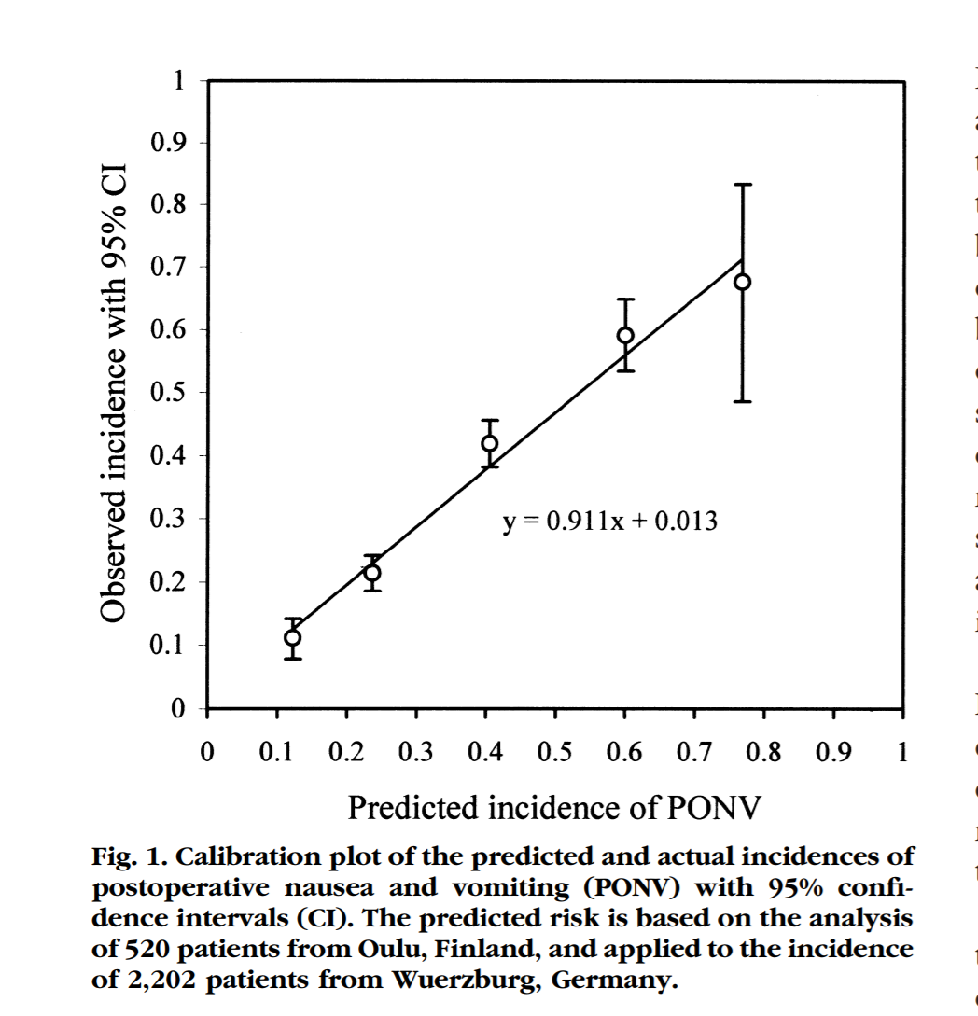
Anesthesiology, V 91, No 3, Sep 1999

Slide 22
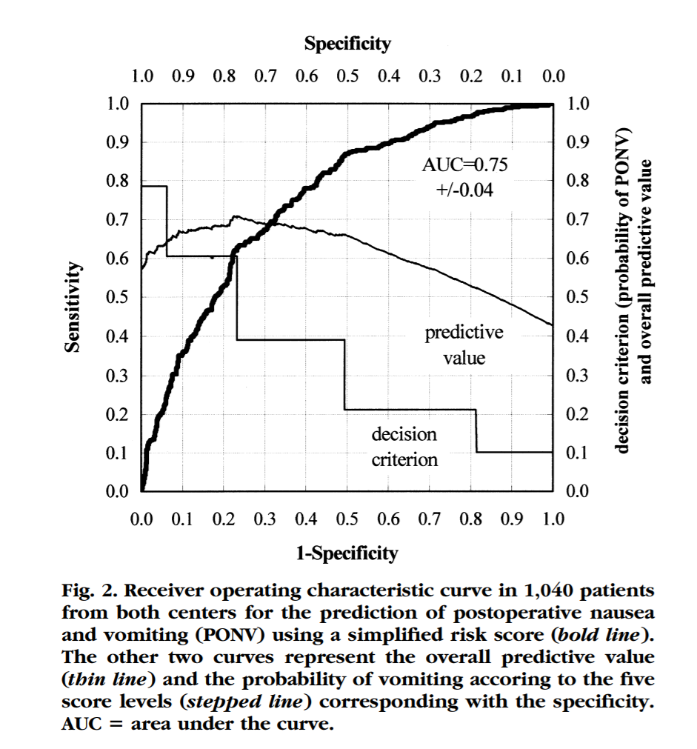

Slide 23
How do you assess the validity of the predictions?
(N = 12)

Slide 24
PatientID | Onc. 1's Predicted Probability | Mastate Cancer within 5 years
1 | 20% | 0
2 | 50% | 0
3 | 35% | 0
4 | 50% | 1
5 | 35% | 0
6 | 20% | 0
7 | 20% | 0
8 | 20% | 0
9 | 35% | 1
10 | 50% | 0
11 | 50% | 1
12 | 35% | 0
Mean | 35% | 25%

Slide 25
PatientID | Onc. 1's Predicted Probability | Mastate Cancer within 5 years | Onc 1's Error
1 | 20% | 0 | 20%
2 | 50% | 0 | 50%
3 | 35% | 0 | 35%
4 | 50% | 1 | -50%
5 | 35% | 0 | 35%
6 | 20% | 0 | 20%
7 | 20% | 0 | 20%
8 | 20% | 0 | 20%
9 | 35% | 1 | -65%
10 | 50% | 0 | 50%
11 | 50% | 1 | -50%
12 | 35% | 0 | 35%
Mean | 35% | 25% | 10%

Slide 26
PatientID | Onc. 1's Predicted Probability | Mastate Cancer within 5 years | Onc 1's Error
1 | 50% | 0 | 50%
2 | 20% | 0 | 20%
3 | 35% | 0 | 35%
4 | 20% | 1 | -80%
5 | 35% | 0 | 35%
6 | 50% | 0 | 50%
7 | 50% | 0 | 50%
8 | 50% | 0 | 50%
9 | 35% | 1 | -65%
10 | 20% | 0 | 20%
11 | 20% | 1 | -80%
12 | 35% | 0 | 35%
Mean | 35% | 25% | 10%
Notes:
Swap the 20% predictions and the 50% predictions We now have predictions off by 80%, but the mean bias remains the same.

Slide 27
PatientID | Onc. 1's Predicted Probability | Mastate Cancer within 5 years | Onc 1's Error | Absolute Error
1 | 20% | 0 | 20% | 20%
2 | 50% | 0 | 50% | 50%
3 | 35% | 0 | 35% | 35%
4 | 50% | 1 | -50% | 50%
5 | 35% | 0 | 35% | 35%
6 | 20% | 0 | 20% | 20%
7 | 20% | 0 | 20% | 20%
8 | 20% | 0 | 20% | 20%
9 | 35% | 1 | -65% | 65%
10 | 50% | 0 | 50% | 50%
11 | 50% | 1 | -50% | 50%
12 | 35% | 0 | 35% | 35%
Mean | 35% | 25% | 10% | 38%
Notes:
Calculate MAE, Mean Absolute Error
Not discussed at all: 1- ABS(Error) = Likelihood = (risk estimate)^(outcome) X (1 – risk estimate)^(1-outcome) so r when outcome is 1 and 1- r when the outcome is 0. Take logs and sum to get log likelihood. Maximize to get maximum likelihood estimates for Logit coefficients alpha (bias) and beta (calibration slope)

Slide 28
PatientID | Onc. 1's Predicted Probability | Mastate Cancer within 5 years | Onc 1's Error | Absolute Error
1 | 50% | 0 | 50% | 50%
2 | 20% | 0 | 20% | 20%
3 | 35% | 0 | 35% | 35%
4 | 20% | 1 | -80% | 80%
5 | 35% | 0 | 35% | 35%
6 | 50% | 0 | 50% | 50%
7 | 50% | 0 | 50% | 50%
8 | 50% | 0 | 50% | 50%
9 | 35% | 1 | -65% | 65%
10 | 20% | 0 | 20% | 20%
11 | 20% | 1 | -80% | 80%
12 | 35% | 0 | 35% | 35%
Mean | 35% | 25% | 10% | 48%
Notes:
Then if you switch the 20% and the 50% predictions MAE increases from 38% to 48%.
Not discussed at all: 1- ABS(Error) = Likelihood = (risk estimate)^(outcome) X (1 – risk estimate)^(1-outcome) so r when outcome is 1 and 1- r when the outcome is 0. Take logs and sum to get log likelihood. Maximize to get maximum likelihood estimates for either Probit or Logit coefficients.

Slide 29
PatientID | Onc. 1's Predicted Probability | Mastate Cancer within 5 years | Onc 1's Error |  | Onc 1's Error^2
1 | 20% | 0 | 20% |  | 4%
2 | 50% | 0 | 50% |  | 25%
3 | 35% | 0 | 35% |  | 12%
4 | 50% | 1 | -50% |  | 25%
5 | 35% | 0 | 35% |  | 12%
6 | 20% | 0 | 20% |  | 4%
7 | 20% | 0 | 20% |  | 4%
8 | 20% | 0 | 20% |  | 4%
9 | 35% | 1 | -65% |  | 42%
10 | 50% | 0 | 50% |  | 25%
11 | 50% | 1 | -50% |  | 25%
12 | 35% | 0 | 35% |  | 12%
Mean | 35% | 25% | 10% |  | 0.1625
Notes:
Mean Squared Error = Brier Score = Calibration + Refinement Onc 1 CAL = 0.0167 REF = 0.1458
Not Shown: Mean Absolute Error = 38% for Oncologist 1
Not discussed at all: 1- ABS(Error) = Likelihood = (risk estimate)^(outcome) X (1 – risk estimate)^(1-outcome) so r when outcome is 1 and 1- r when the outcome is 0. Take logs and sum to get log likelihood. Maximize to get maximum likelihood estimates for either Probit or Logit coefficients.

Slide 30
PatientID | Onc. 1's Predicted Probability | Mastate Cancer within 5 years | Onc 1's Error |  | Onc 1's Error^2
1 | 20% | 0 | 20% |  | 4%
2 | 50% | 0 | 50% |  | 25%
3 | 35% | 0 | 35% |  | 12%
4 | 50% | 1 | -50% |  | 25%
5 | 35% | 0 | 35% |  | 12%
6 | 20% | 0 | 20% |  | 4%
7 | 20% | 0 | 20% |  | 4%
8 | 20% | 0 | 20% |  | 4%
9 | 35% | 1 | -65% |  | 42%
10 | 50% | 0 | 50% |  | 25%
11 | 50% | 1 | -50% |  | 25%
12 | 35% | 0 | 35% |  | 12%
Mean | 35% | 25% | 10% |  | 0.1625
 | Brier Score = Mean Squared Error
Notes:
Mean Squared Error = Brier Score = Calibration + Refinement Onc 1 CAL = 0.0167 REF = 0.1458
Not Shown: Mean Absolute Error = 38% for Oncologist 1

Slide 31
Combining Tests (Chapter 7)
Test independence
Clinical prediction rules
Overfitting; derivation and validation datasets
CART vs logistic regression

Slide 32
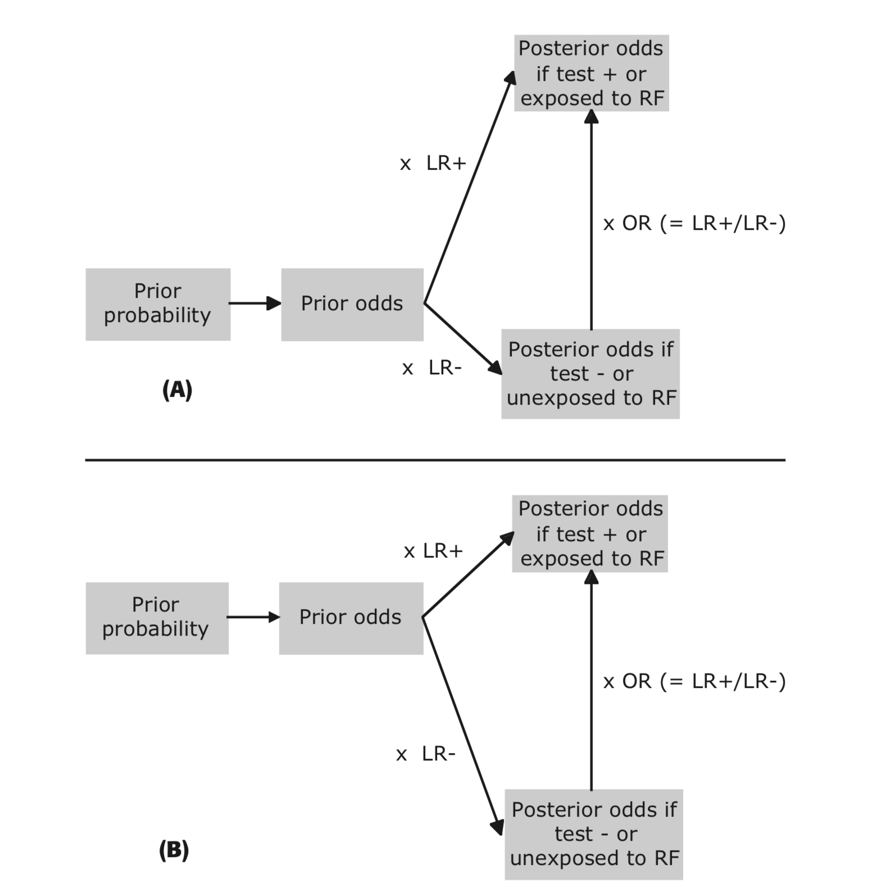
Relationship between prior odds, LRs (LR+ and LR−), posterior odds, and the OR. (A) Low prevalence of strong risk factor. (B) High prevalence of strong risk factor. The length and direction of an LR arrow correspond to the logarithm of the LR; the LR− points downward because its logarithm is negative. The LR magnitudes change depending on the prevalence of the risk factor, whereas their ratio, the OR, remains the same.

Slide 33
RCTs (Chapter 8)
OR, RR, RRR, ARR, NNT
Intention to treat, per protocol and as treated analyses
Blinding- 3 levels
Composite outcomes
Surrogate outcomes
BOE-CEA – NNT x cost

Slide 34
Screening (Chapter 10)
Volunteer effect* (screened vs. unscreened)

Slide 35
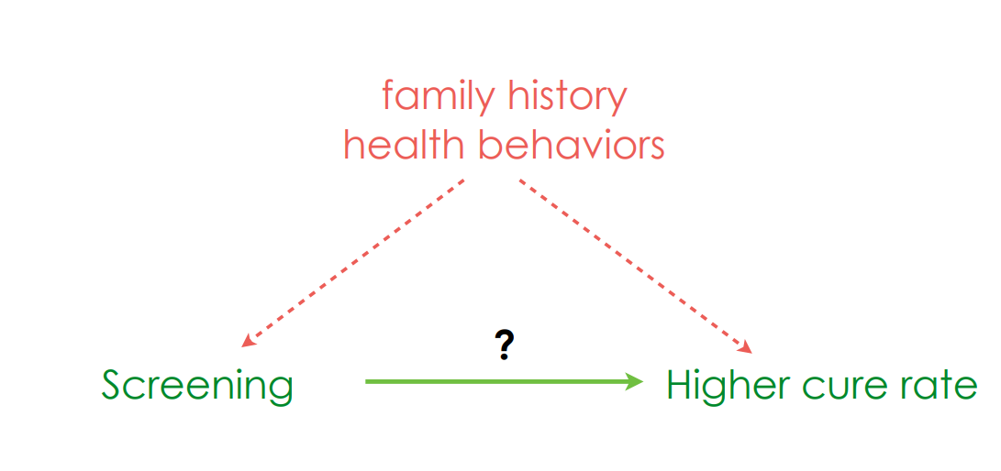
Volunteer Effect (Confounding)

Slide 36
Screening (Chapter 10)
Lead time bias (screened and D+ vs. unscreened and D+)
Length Bias (Diagnosed by screening vs. diagnosed by symptoms)
Overdiagnosis/pseudo disease screened and D+ vs. unscreened and D+

Slide 37
Screening (Chapter 10)
Survival (among D+) vs mortality (in the population)
Sticky diagnosis bias (compare screened vs unscreened on cause-specific mortality)
Slippery linkage bias (compare screened vs unscreened on cause-specific mortality)
Stage migration bias (stage-specific survival)

Slide 38
Alternative to RCTs (Chapter 9)
Instrumental variables and natural experiments
  Can be used to get Complier Average Treatment Effect
Prespecified falsification hypotheses
  Predictor
  Outcome
Today’s section

Slide 39
P-Values and CIs (Chapter 11)
P-value and CI meanings
Multiple hypothesis testing and Bonferroni correction
Reporting negative studies- 5 belts
Confidence intervals for small numerators (or numerators close to denominators)
Today’s section

