Slide 1

The Ethical Foundation of Cost-Effectiveness Analysis in Resource Allocation for Global Health
Epi 213
March 1, 2018 - UCSF
Elliot Marseille, DrPH, MPP
Health Strategies International

Slide 2
The Case of Antiretroviral
Treatment for HIV in Developing Countries

Slide 3
The Argument
Insufficient $ to do both treatment and prevention (~$10 billion)
Funding is a zero-sum game.
  Trade-offs are real
Prevention more CE than treatment.
  Highly robust to alternative input estimates
  We tried to err on side of unfavorable CE, (e.g., no risk compensation).
Statistical life has same value as identified life

Slide 4
Cost effectiveness ratios
Prevention: ~ $12.50 per DALY averted
Treatment: ~$350 per DALY averted
Thus, can deliver ~28 x more health benefit per dollar spent with prevention
Marseille E, Hofmann PB, Kahn JG. HIV prevention before HAART in sub-Saharan Africa. Lancet, Vol. 359: p. 1851-6, May 25, 2002

Slide 5
IF:
Objective is generating most health benefit with the funds available
Then:
Bulk of available $$ should be devoted to prevention.

Slide 6
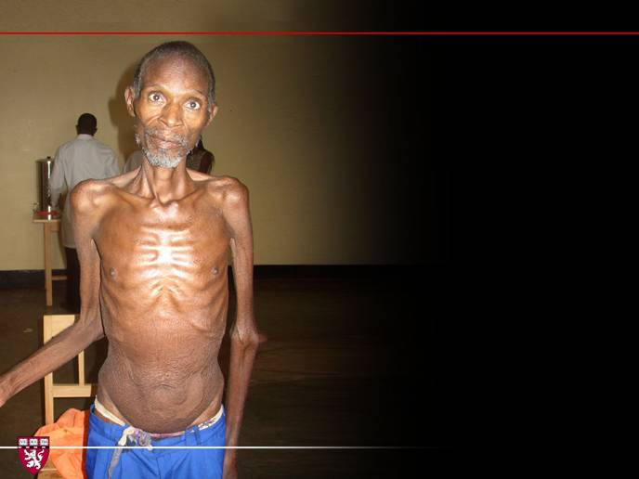
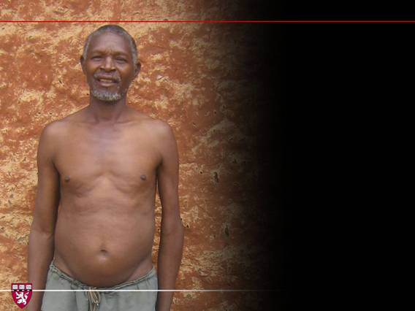
Notes:
6
6

Slide 7
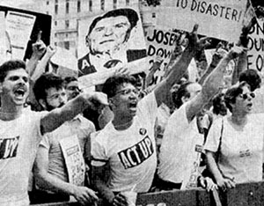

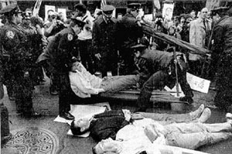
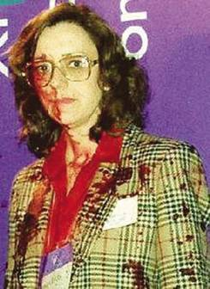
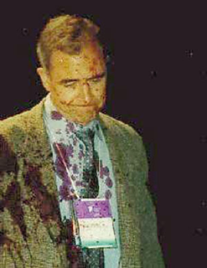
Act Up and Initial AIDS Protest Efforts
Notes:
7
http://www.positivenation.co.uk/issue120/treatments/treatment3/treatment3.htm
Paul Volberding and Margaret Fischl appear with fake blood spilt on them by activists at the Vancouver International AIDS Conference in 1996
Initial Act Up efforts in the US, including a die-in

Slide 8
Arguments and Counter-Arguments
Our position
Insufficient $ to do both treatment and prevention. Funding is zero-sum.
Versus
Counter-arguments
Positive spillover to health infrastructure.
Treatment will leverage more total HIV $$
For rich countries the ~$10 billion is a rounding error.
Notes:
A central concern of economics is how best to use available resources in a world where desires, if not needs, always exceed the capacity to fulfill them. The key concept informing consideration of this issue is “opportunity cost”. Opportunity cost refers to the simple truth that use of resources one place precludes their use elsewhere. It is concerned with real resources consumption, rather than with mere financial effects. Thus, the real cost of a particular expenditure is the best alternative use of those funds, now foreclosed. These statements may seem trivial because they devolve to the truism that money spent here can’t be spent there. But, like the prospect of being hanged in the morning ‘opportunity cost’ focuses the mind wonderfully, and therein lies its utility. It can counteract the bureaucratic tendency to unthinkingly continue this year what worked last year. Thinking about opportunity cost can thus stimulates creativity about the best use of resources given current needs and alternatives.
The opportunity cost concept suggests that it is not enough to do something useful with the resources available. Action with a net positive effect is still wasteful if the foregone alternative would have had higher value. It prompts the question, “Because money is limited (budgets are constrained), what is its best use at the margin (the next available dollars)”? But budgets are always constrained and the margin is our permanent residence, so opportunity cost and the challenge to allocate resources rationally are always present. Opportunity costs and rigorous thinking about resource allocation inoculate decision makers against the kind of thinking that prompts statements such as, “We are concerned with saving children’s lives. Money cannot be a determining factor.” What such statements overlook is that “money” is not “mere money” to be subordinated to the saving of lives. Cost is another name for an unrealized benefit somewhere else. That benefit might result in the saving of more children’s lives than the use being defended.
The problem of resource allocation then becomes, “Where can the greatest benefit be obtained for a given expenditure?” Cost-effectiveness analysis provides a conceptual framework and practical tools to assist with that determination. It is purely instrumental. As with economics generally, cost- effectiveness analysis is value-neutral regarding goal selection. One must look elsewhere to decide what is worth having. Once a goal is determined (e.g., reduced HIV incidence), the role of cost- effectiveness analysis is to help reach it with as small an expenditure (opportunity cost) as possible. It is concerned, in other words, with efficiency.

Slide 9
G7 Military Spending and Foreign Aid, 2006
Notes:
9
Center for Arms Control and Non-Proliferation and OECD

Slide 10
More Arguments and Counter-Arguments
Our position
Prevention more CE than treatment.
versus
We underestimate benefits of treatment
    Reduced orphanhood
    Reduced OI medical costs
    Suppressed VL => Reduced transmission
    Unofficial treatment program => Resistant virus

Slide 11
And finally . . .
CEA is an inhumane technique in service of an immoral stance. You cannot withhold life-saving treatment from those in need!
Deny the premise: There is no trade-off; plenty of money.
(Jeffery Sacks, Earth Institute, Columbia University)
Notes:
.

Slide 12
Wisdom of hindsight
Resistant virus? Not a major problem, hard to know what would have happened in absence of official program
Risk compensation? Not a major problem
Treatment = prevention? Strong evidence in favor, but doesn't render treatment more CE than prevention.
Leveraging more HIV $? Almost certainly! But probably not enough to move the balance in favor of treatment.
Infrastructure strengthening? Equivocal.
ART siphons $ from more CE programs? Probably.
If politics is the ART of the possible the right question might not be treatment versus prevention; but treatment versus nothing.

Slide 13
Does Cost-Effectiveness Analysis Rest on a Sound Ethical
Foundation for Resource Allocation in Global Health?

Slide 14
What’s the problem?
Decision makers sometimes led to diverge from maximizing health outcomes because of ethical concerns:
CEA-bases life / death decisions on mathematically-derived ROI criteria.
Thus, technocratic, cold, lacks empathy.
Often violates every day ethical intuitions.
  Empathy
  Compassion
  Decisions based on “mere” efficiency criteria are suspect.
Many technical concerns regarding CEAs accuracy or reliability.
This talk confined to ethical concerns.

Slide 15
Goals of this presentation
Introduce you to the ethical foundations of cost-effectiveness analyses (CEA), namely utilitarianism.
Stimulate you to think critically about ethical arguments pertaining to resource allocation.
  Theoretical validity
  Practical implications
Persuade you that utilitarianism as expressed in CEA is usually the right basis for resource allocation decisions.
#3: Well, not exactly . . . rather it is to stimulate you to engage with my argument. If you reject or modify it, be explicit about your reasoning.

Slide 16
Utilitarianism - or “Deep pragmatism”:
Philosophy Underlying CEA
Stems from Consequentialism: Judge actions by outcomes not by intentions or by fidelity to abstract moral principle.
Utilitarianism: First articulated by Jeremy Bentham and John Stuart Mills
  Mills’ “Utilitarianism” published in 1863
  Joshua Greene – Moral Tribes (2013)
  Many others
Maxim of utilitarianism is, “Act in such a way as to generate the maximum quantum of well-being, happiness, or utility.”
In the context of global health, this implies:

Slide 17
Implications of Deep Pragmatism for Global Health
Allocate resources consistent with maximizing overall benefit, such as deaths averted or quality-adjusted life-years gained.
All lives have the same value. No basis for distinguishing between identified and statistical lives.
No special claim accrues to alleviation of inequality, except to the extent that privileging the poor, or those with less access to care is an efficient means to achieving #1, above.

Slide 18
Competing ethical principles
According to what principle(s) should funds for antiretroviral be divided between prevention (PrEP) and treatment?¹
Not enough $ to serve all who could benefit.
The trade-off is real.
1. Macklin R, and Cowan E, “Given Financial Constraints, It Would Be Unethical to Divert Antiretroviral Drugs from Treatment to Prevention”, Health Affairs, 2012.

Slide 19
Competing ethical principles
Macklin R, and Cowan E, “Given Financial Constraints, It Would Be Unethical to Divert Antiretroviral Drugs from Treatment to Prevention”, Health Affairs, 2012
Utilitarianism: Maximize health benefit
Rule of rescue: Identified lives get first claim
Urgent need: Greater urgency = greater claim on resources.
Equal worth: Since all lives have equal worth same care must be offered to all.
Equity: Divide resources so outcomes are distributed as equitably as possible; reduce disparities in health status.
Prioritarian: Resources provided to the least advantaged members in society.
Rights¹: Certain freedoms, process under law or material goods are due all human beings qua human beings.
1. E. Marseille’s addition; not from Macklin and Cowan, 2012.
In allocating resources, what weight do we assign to each?
Should ”balance” be the goal?

Slide 20
That’s okay if these claims complement each other, but . . .

Slide 21
Where does that leave us?
“When principles conflict, it becomes necessary to balance competing concerns. There is no correct way of achieving this balance.” ¹
Why “balance”? And if balance, in what proportion?
“The ultimate goal, of course, is to achieve a utilitarian outcome tempered by considerations of equity and urgent need.” ¹
Why “of course”?
How does this help us?
It does not.
1. Macklin R, and Cowan E, “Given Financial Constraints, It Would Be Unethical to Divert Antiretroviral Drugs from Treatment to Prevention”, Health Affairs, 2012

Slide 22
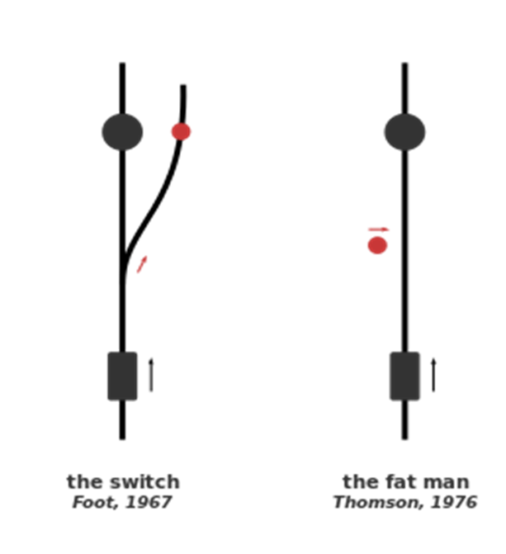
More trouble - Insights from “Trollyology”
One death if active vs five if passive.
Pull switch vs push someone onto tracks.
Is the anti-push intuition absolute?
Is visceral repulsion a sound basis for moral reasoning?

Slide 23
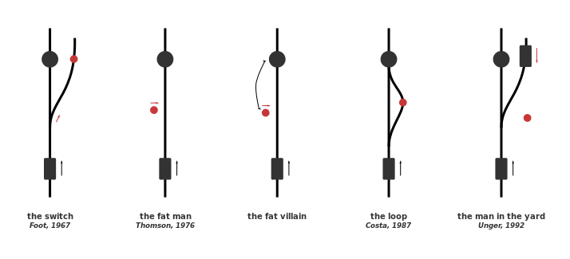
More Trollyology

Slide 24
Still more Trollyology
Do these thought experiments undermine your confidence in
everyday ethical intuitions?

Slide 25
Wait there’s more . . .
Are our ethical intuitions derived from
evolutionary pressures and cultural contingency?

Slide 26
“Is a statistical life worth less than an identified life?”
For example, are people who need treatment in a different ethical class from those who need prevention?

Slide 27

Or, is preferential treatment of identified lives a function of the evolution of ‘moral brains’ based on community affiliation?
One person’s statistical life = another person's identified life.
Might preference for identified lives thus be due to a failure of imagination?

Slide 28
The case against empathy¹ and the virtues of cold blood
Evidence that empathy is associated with
Narrow-minded / Parochial perspective
Innumeracy
Short-term thinking
Vindictiveness
Perhaps empathy makes us want to feel good rather than to do good.
1. Bloom P. Against Empathy: The Case for Rational Compassion: Barnes and Noble; 2016.

Slide 29
What I am not saying
Efficiency-based, CEA criteria are always best
for resource allocation.
Who wants to live in a world where a child is left to drown in a well, because rescue is not cost-effective?

Slide 30
What I am saying
If deviating from “Deep pragmatism” and efficiency,
confront the trade-off.
How many lives of richer people are you willing to trade off for the life of a poor person?
How many statistical versus identified lives?
Promotion of other values such as “Women’s rights and empowerment” versus immediate health benefit?

Slide 31
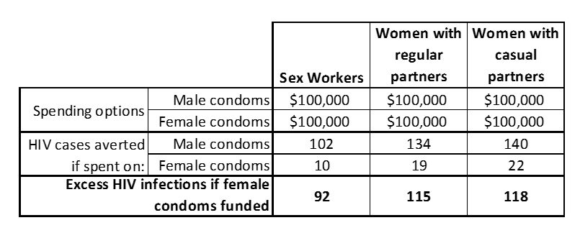
Confronting the trade-off between efficiency and a rights or equity-based resource allocation decision
Efficiency is not merely one criterion among many. It has its own ethical dimension.

Slide 32

Resolve the conflict between efficiency and other criteria?
Two sides of our nature.
  “Fast brain”: Emotional, empathic, small numbers
  “Slow brain”: Rational, calculating, large numbers
Undesirable and futile to deny our emotional, empathic natures. Expressed in:
  Clinical medicine.
  Many other areas of society pertaining to family and community.
“Global health” and “public health” pertain to populations and thus more abstract modes of reasoning are appropriate.

Slide 33
Thank you

