Slide 1
Epidemiology 245 – Introduction to the Course for Spring 2018
Elvin Geng
Associate Professor
Department of Medicine

Slide 2
Course Objectives
Understand current thinking about the nature of implementation science.
Familiarity with motivation for as well as distinctive characteristics of implementation science
Understand how to analyze barriers to implementation
Understand how to conceptualize and propose solutions to overcome those barriers
Understand conceptual and practical challenges with designing and carrying out implementation science – including sampling, measurements and analytic issues

Slide 3
Course Overview - Processes
TA’s
  Timothy Andersen
Lectures
  Synthesis of key areas
  Guest speakers
  Material posted on course website
  Dialogue
Readings
  One or two required per week
  More available on website
Homework
  Write parts of a grant proposal
  Students to post to course website by Tuesday
  Comment on 2 other students’ writing by Thursday
Final proposal presentation
Discussion section
  Discuss assignment
  Open forum

Slide 4
Week 1:
Mon
Tues
Wed
Thur
Fri
Lecture 1 - “Motivation for a Science of Implementation”
Assignment 1 given out - “Describe a gap between knowledge and practice”
Week 2:
Mon
Tues
Wed
Thur
Fri
Students post assignment 1 – “Describe a gap between knowledge and practice” to course website
Each student comments on two of classmates content before coming Thursday
Teaching staff also comments
Lecture 2 – “Understanding Reasons for the Gap”
Assignment 2 given out – “Gap analysis”
Small group – discuss Assignment 1 - “Describe a gap between knowledge and practice”

Slide 5
Grading
Students enrolled to receive either a pass or a fail will be considered to have passed the class if they complete two of the three following:
  Attended more than 6 small group visits
  Turned in more than 6 assignments on time.
  Complete a final project
For those enrolled to receive a letter grade, the grade with be determined by:
  The timeliness, completeness and quality of the homework (25%)
  The timeliness and quality of commenting (25%)
  The quality of the final presentation (25%)
  The extent of small group and class participation (25%)

Slide 6
Assumptions
Assume (many) of you have expertise in two things…
  (don’t worry if this doesn’t apply)
Clinical knowledge
  School
  You know what is supposed to be done
Practical experience – implicit knowledge in professional training or practice
  Practice
  You know (some? many?) of the problems with getting it done
Double edged sword…
Notes:
Political scientist who has held elected office
Rare – contextual knowledge
Blinders –
If you have touched the American health system, you will understand in your bones that we do not do what we know is good
So even though you know about this problem, re-look at it with a scientific lens

Slide 7
Goals for today…
Convince you of the need for a ”Science of Implementation”
Nature of Implementation Science
  What people are saying
  What my opinion is
Hallmarks of good implementation science
  For academics
  For implementers

Slide 8
Part I: Motivation
Why a science of implementation

Slide 9
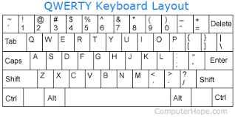
Notes:
1868 patent
christopher sholes

Slide 10
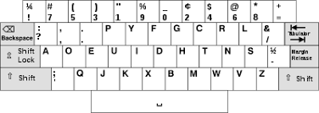
Notes:
60% of letters on home row
Double the speed?
1936

Slide 11
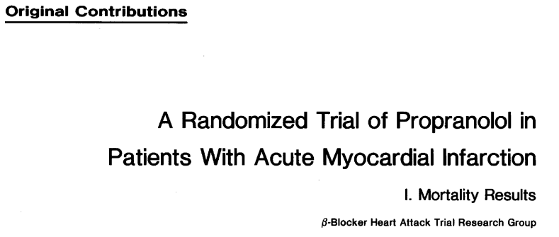

Notes:
In 1982, a randomized trial was done to evaluate the effect of beta-blockers on mortality after MI’s
There were half a dozen or so studies – some observational that beta blockers had a role after MI
Some as early as 1977
Beta-blocker heart attack trial (BHAT)
Population
30-69 years with acute MI
Not very highly selected population (already on beta blocker, living too far from study site, 18% because of perceived contraindications)
Years of study: 1978 – 1980
2827 total individuals randomized
180 to 240 mg daily of propranolol vs. placebo

Slide 12
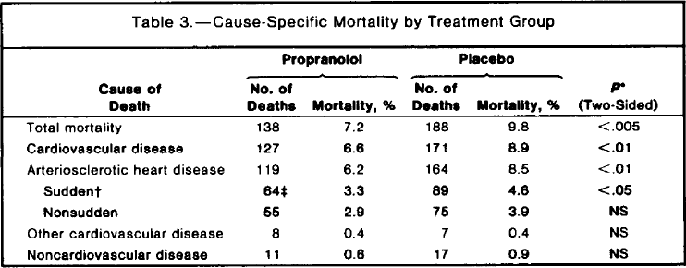
Notes:
2.6 total mortality
2.3 in cardiovascular disease

Slide 13

Notes:
About 15 years later, however, a large observational study in the NEJM using national Medicare data suggested that only 34% of persons admitted with an MI received a BB on discharge
Predictors of receipt: healthier, younger, shorter hospital stay, lower creatinine, more likely to have gotten thrombolytics
1997 NEJM publication
Nationwide observational study of 201,752 individuals with MI’s (ICD-9 – 410) from Medicare records
34% discharged with beta blocker
Beta blocker reduced mortality by 40% when prescribed, adjusted for other characteristics
Effect similar across subgroups
Momentum built, however, over the next 10 years – and guidelines, incentives, quality improvement activities often focused on this issue
In 2007, Thomas Lee, wrote a commentary when the National Committee for Quality Assurance retied this indicator – discharged after MI with prescription for BB

Slide 14
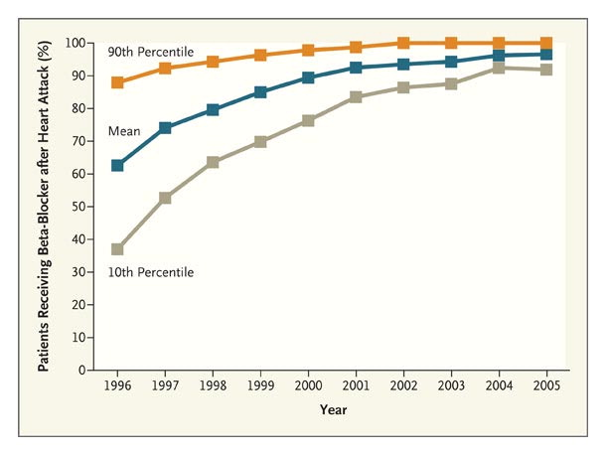
Eulogy for a Quality Measure
Lee, NEJM 2007
Notes:
ACC/AHA 1996 guidelines
1997 Joint commission quality indicator
1996 HEDIS (Health Plan Employer Data and Information Set) indicator
Incentives
Quality improvement
Example of success or failture?

Slide 15
Pervasive Gap Between Knowledge and Routine Use
Variable | No. Indicators | No. Eligible | No. Times Indicator Eligibility | Percentage of Recommended Care Received
Overall care | 439 | 6712 | 98,649 | 54.9 (54.3–55.5)
Type of care
Preventive | 38 | 6711 | 55,268 | 54.9 (54.2–55.6)
Acute | 153 | 2318 | 19,815 | 53.5 (52.0–55.0)
Chronic | 248 | 3387 | 23,566 | 56.1 (55.0–57.3)
Function
Screening | 41 | 6711 | 39,486 | 52.2 (51.3–53.2)
Diagnosis | 178 | 6217 | 29,679 | 55.7 (54.5–56.8)
Treatment | 173 | 6707 | 23,019 | 57.5 (56.5–58.4)
Follow-up | 47 | 2413 | 6,465 | 58.5 (56.6–60.4)
McGlynn NEJM 348;26, 2003
Notes:
Approximately 6700 patients from 12 metropolitan areas

Slide 16
Global Implementation Gap: HIV Treatment
Clinical Advancement and Investments
10
5
Billions of dollars
2000
2010
94%
96%
Transmission reduction with ART
Cohen NEJM2011; 365:493-505
Of normal lifespan expected with ART
Helleberg CID 2013 Mar;56(5):727-34.
44%-96%
Transmission reduction with PrEP
Grant NEJM2011
95%
Reduction in vertical transmission
Mofeson MMWR 2013 Mar;56(5):727-34.
Notes:
Globally these problems are not well documented but often far worse
In most countries in Africa, for example, there are no primary health care systems that are widely available and so many chronic diseases go untreated
HIV is an exception to this – in the med 2000 when it was prevalence was 15 to 30%, life expectancies
In 1995 life expectance in Botswana was 65 years
In 2005 it was 35 years
PEPFAR…

Slide 17
The Global HIV Treatment Cascade

Slide 18
Science to Address the Gap
Each year, billions of U.S. tax dollars are spent on research and hundreds of billions are spent on service delivery and community health programs. However, relatively little is spent on, or known about, how best to ensure that the lessons learned from research are relevant to, and, inform and improve the quality of health, delivery of services and the utilization and sustainability of evidence-based tools and approaches.
The National Institutes of Health has recognized that closing the gap between research discovery and clinical and community practice through scientific inquiry is both a complex challenge and an absolute necessity if we are to ensure that all populations benefit from the Nation’s investments in scientific discoveries
http://grants.nih.gov/grants/guide/pa-files/PAR-13-056.html
Notes:
Tinkle, Mindy, et al. "Dissemination and implementation research funded by the US National Institutes of Health, 2005–2012." Nursing research and practice 2013 (2013).

Slide 19
What is this science?
Implementation science
Knowledge translation
Implementation research
Mode 2 knowledge
T-2
T-3
Dissemination and implementation research
Program science

Slide 20

Gaps in Your Respective Fields?
Notes:
How did you get into implementation science?

Slide 21
Part II: What is implementation science?
A different elephant?

Slide 22
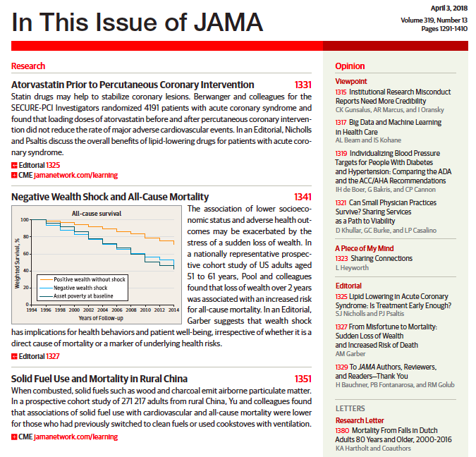

Slide 23
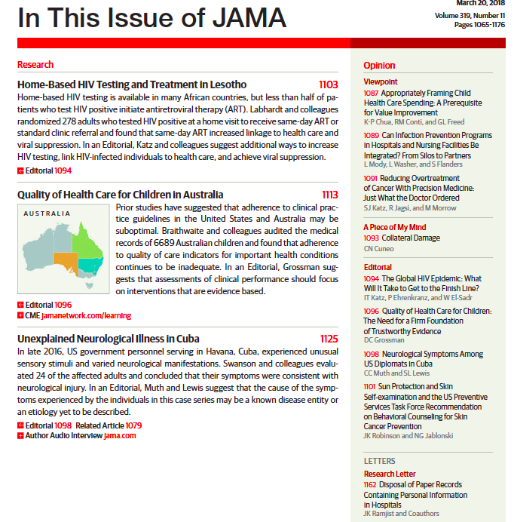

Slide 24
Implementation Science
What is it?
  ”Randomized trials can’t be implementation science”
How do you do it?
  “Use of existing data”
How is it different from other areas of research?
  How is it related to… Marketing? Economics? Sociology? Psychology?
What methods are distinctive in this area of research?
  ”What about M and E?”
Are there foundational perspectives? Unifying theories?
  “CFIR”
Who are the foundational thinkers in implementation science?
Does it matter?
Notes:
Science to address this gap – implementation science – is it new?
Behavior of individuals
Behavior of organizations
Behavior of systems
Behavior of governments
Is it a new elephant and if so what are it’s defining characteristics?
Is it important? Depends on the conversation

Slide 25
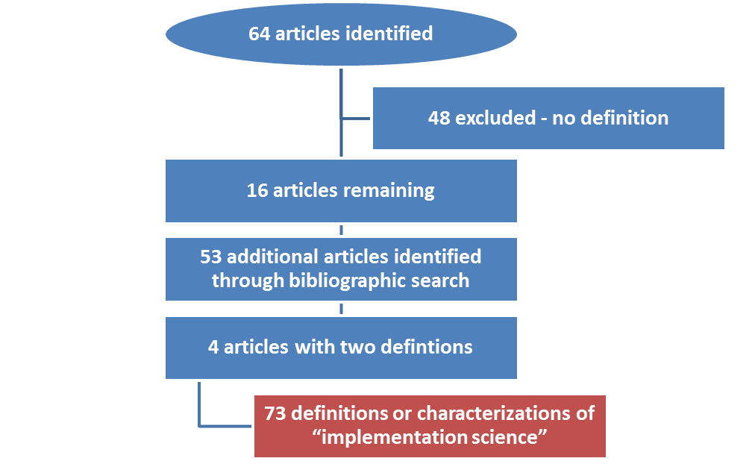
Defining Implementation Research: A Review
Odeny Lancet HIV 2015
Notes:
2014 Strategic Use of Antiretroviral Therapy
WHO HIV Department
Definitions
PubMed search in April 2014 to identify articles containing using the terms “delivery science”, “implementation science”, “implementation research”, “dissemination research”, “dissemination science” and “knowledge translation” with Medical Subject Headings terms “HIV” and “AIDS”.
Measurements
Extracted key characteristics of definitions (eg, publication year, author) and references
Analysis
Tabulated characteristics of definitions
Network graph of definitions linked by their chain of references
Coded content themes
Offer an empiric “synthetic” working definition of implementation science

Slide 26
Publication Dates of Identified Definitions (N=73)
Date of Publication

Slide 27
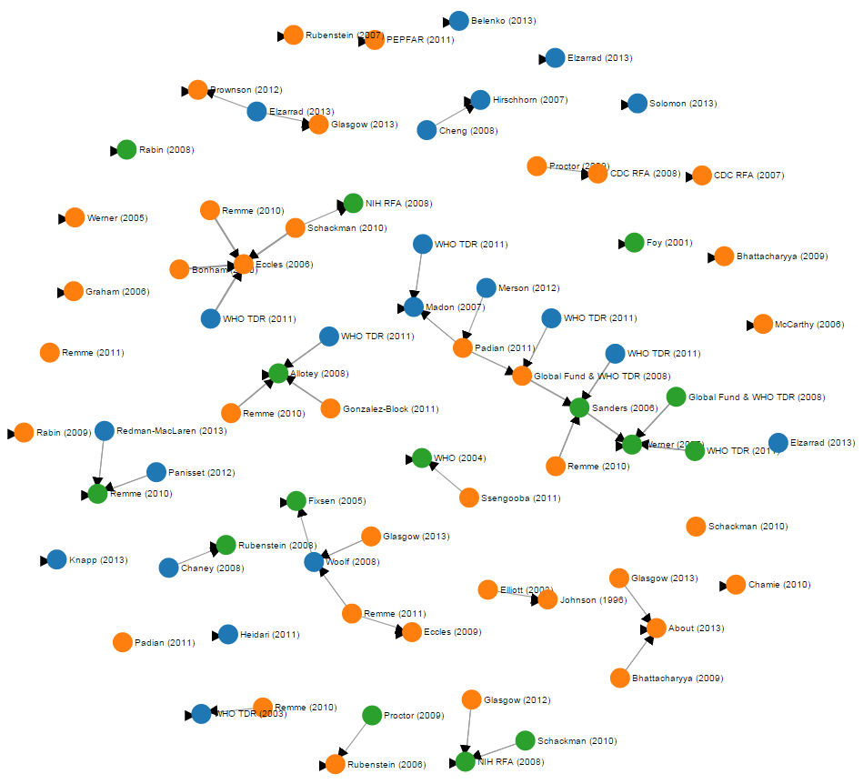

Slide 28
Understand the Nature of the Gap
Theoretical
Practiced
“Evidence”
“Knowledge”
“Research findings”
“Use”
“Delivery”
“Practice”
“Uptake”
GAP
Notes:
Understand nature of the gap
Generalizable
“Getting evidence into practice”
Generalizable understanding of how to do his
Broad agreement that implementation science seeks to understand the gap between something theoretical (knowledge, evidence) and something practical and concrete (practice, delivery)

Slide 29
Understand Reasons for the Gap
  “…the study of the processes and variables which determine/influence the adoption of health promotion and disease prevention-related knowledge.”
                Eliot 2003
  “…implementation researchers focus on understanding… why health care providers do what they do….”
  Rubenstein 2006

Slide 30
Interventions to Close the Gap
  Implementation science aims to “…develop strategies for available or new health interventions in order to improve access to and use of these interventions.”
            Remme, PLoS Medicine 2013
  “Implementation research is the scientific study of methods to promote the systematic uptake of research findings and other evidence-based practices into routine practice, and, hence, to improve the quality and effectiveness of health services.”
            Eccles, Implementation Science, 2007

Slide 31
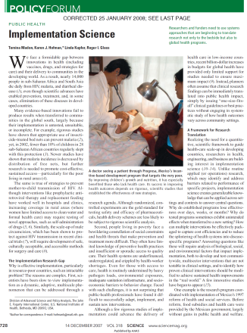

Tension between Generalizability…
  “Implementation science creates generalizable knowledge that can be applied across settings and contexts to answer central questions.”
                Madon, Science 2007
                http://science.sciencemag.org/content/318/5857/1728
  “Although related to operations research, implementation research differs in that it aims to produce generalizable knowledge that can be applied across settings and contexts”
                David Peters, World Health Organization and Health Alliance
                http://who.int/alliance-hpsr/alliancehpsr_irpguide.pdf
Notes:
51%

Slide 32


…and Context
  “Implementation Research …[is] concerned with the adaptation of the implemented intervention to local context.”
                Rabin 2008
                http://www.ncbi.nlm.nih.gov/pubmed/18287916
  “Implementation research does not isolate the effects from the context – rather it focuses precisely on the interaction between the intervention and the context”
                Allotey TDR 2011
                http://www.who.int/tdr/publications/documents/access_report.pdf?ua=1

Slide 33
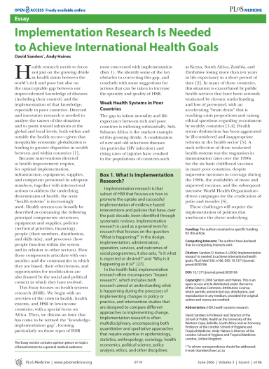
The Approach: Interdisciplinary
“Implementation research is often multidisciplinary, encompassing both quantitative and qualitative approaches that require expertise in epidemiology, statistics, anthropology, sociology, health economics, political science, policy analysis, ethics, and other disciplines
              Saunders PLoS Med
“Implementation science is an inherently interdisciplinary research area”
              Implementation Science Journal (Editors Statement 2013)

Slide 34
Insights?
Widely recognized need
  Rising number of definitions
Poorly linked in a network map
  Discourse is not fully mature
Tension between generalizability and context
Summary of definitions is also notable for what is absent
  Consolidated Framework for Implementation Research
  Epidemiological methods

Slide 35


Slide 36
What is implementation science…
Implementation science is defined by the nature of learning in the knowledge generation exercise
  Nature, Part 1: At least somewhat generalizable (the “science part”)
  Nature, Part 2: Based on efficacious intervention (therefore worth implementing)
  Nature, Part 3: Concerned with use (and effects) in real world settings (hence implementation)

Slide 37
Understanding spread of running shoes (potentially marketing)
Spread of vaccine refusal (Implementation Science)
Addresses use or effects in real world setting
The role of children as caregivers to chronically ill adults in Africa (perhaps anthropology)
Length of therapy for osteomyelitis (clinical research)
Potential impact of intervention on health outcome

Slide 38
Corollary
Corollary 1: The nature of learning is supposed to be, but not always, aligned with the explicit research question
  So yes, we can say your study is implementation science even if you didn’t know it
  Like art
Corollary 2: There is no method or analysis approach that categorically makes something implementation science or not
  But there are methods that make something bad, or even really bad, implementation science)
  Aligning research design with what you want

Slide 39
Anchored on an evidence based intervention
Implementation
Intervention
Use of an evidence based
intervention
Health
outcome
Still on a efficacy-effectiveness spectrum
For example: Small SMS study for health care worker compliance with malaria guidelines in capital city of African country (selected and controlled setting)
Notes:
This makes implementation science a health science

Slide 40
Examples of research?
Notes:
How did you get into implementation science?

Slide 41
Part III: What is good implementation science?

Slide 42
4 P’s
Pedantic
Pragmatic
Rigor
Purile
Populist
Relevance for routine practice settings
Andersen 2004
Notes:
Although define the magnitude and understanding reasons is important, we focus on interventions to day.
David Aron – used a heuristic to define the kind of research that we want implementation science to be through two axes - internal validity and relevance →
Example
Pedantic – DOT
Populist – CAGs
Desirable qualities of impactful, pragmatic implementation research
Generalizable
Accumulatable
Transport
Robustly impactful
All of this enhances scale up.

Slide 43
Relevance and Rigor
Attention to science that has relevance in real world means two things
More relevance
  Academics
More rigor
  Implementers

Slide 44
Rules for Rigor
Counterfactual
Sampling
Measurements
Analyses
(epi 203)

Slide 45
Rules for Relevance?
?
?
?
?
?
?

Slide 46
Candidate Interventions for ART Uptake in Africa
PEPFAR 2004 – Global enterprise to treat HIV
Doubts about success and uptake of treatment
  Adherence, retention and resistance?
  Doubts
    Distance and opportunity costs
    Health care workforce
    “African’s don’t understand time” – Andrew Natsios (BMJ 2004)
    Weak primary care infrastructure, supply chain
    Stigma
Strategies to promote use of HIV treatment?
  DOT; home based care; community distribution groups; SMS

Slide 47
Public Health Impact: REAIM
RE-AIM ELEMENT | Definition | Questions
REACH | Reach is an individual-level measure (e.g., patient or employee) of participation. | Can the practice attract large and representative percent of target population / communities?
EFFICACY | Magnitude of effect among those successfully treated | Does the practice produce large effects ?
ADOPTION | The proportion and representativeness of settings that adopt a given policy or program. | Is the practice feasible for majority of real-world settings (costs, expertise, time, resources, etc.)?
IMPLEMENTATION | The extent to which a program is delivered as intended. | Can the program be consistently implemented across program elements, different staff, time, etc.?
MAINTENANCE | Sustainability in a given governance, policy, economic and funding context | Can the settings sustain the program over time without added resources and leadership?
Glasgow AJPH 1998
Notes:
http://www.ncbi.nlm.nih.gov/pmc/articles/PMC1508772/pdf/amjph00009-0018.pdf
One way to understand impact, or generalized impact

Slide 48
Public Health Impact: REAIM
RE-AIM ELEMENT | DOT | Home based care | CAG | SMS
REACH | Low-1 | Low-medium-2 | Medium-high-4 | High-3
EFFICACY | High-5 | High-5 | Medium-high-4 | Low-2
ADOPTION | Low - 1 | Low -1 | Medium-3 | Medium-3
IMPLEMENTATION | Low-1 | Low-medium-2 | Medium-3 | High-5
MAINTENANCE | Low-1 | Low-1 | Medium-3 | High-5
Total | 9 | 11 | 17 | 19
Glasgow AJPH 1998
Notes:
Heuristic
Exercise
Highly efficacious but of little impact - DOT

Slide 49
RCT of full service, home based care
Pragmatic RCT of
community ART groups
Internal validity
Observational study of community ART groups
Case series of DOT
Relevance
Notes:
HIV treatment to be rolled out in Africa
Bush administration the President’s Emergency Fund for AIDS Relief
3 RCT of DOT but no RCT or CAG (until now)

Slide 50
Randomized trials…
”Highest form of evidence”
GRADE
WHO policy making

Slide 51
…and their discontents
Often makes environment artificial
Can be used to study unusable interventions
Bias toward analysis of private goods as opposed to public goods.
  “Universally important things like genuine public goods (think about clean air or national defense) are very hard to study because you can’t tell who’s getting them and who’s not.” (Jeffry Hammer)
Notes:
RCT are not sufficient

Slide 52

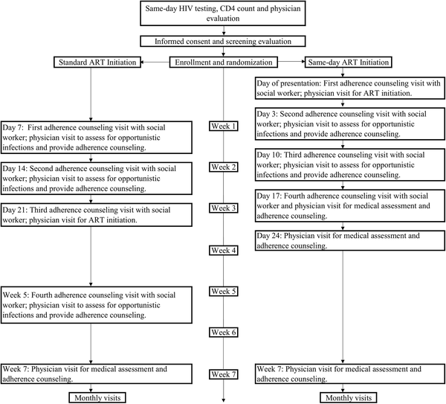
Koenig SP,. PLOS Medicine 14(7): e1002357. https://doi.org/10.1371/journal.pmed.1002357

Slide 53
Conclusions
Implementation science
  Emerging
  Unique tensions between internal and external validity
  Interdisciplinary
Directions
  Explore different perspectives on analysis of this gap
  Identify interventions to targets
  Understand challenges of doing research in this space
Can we create research that is relevant but also rigorous?
  Topic of this course

Slide 54
Homework…

Slide 55
Framing the Gap
Settle on an implementation problem
  To get the most out of this class
What is the role of warfarin in the era of direct thrombin inhibitors?
  Not an “implementation science” question (doesn’t mean it’s not a good question)
  Consider: strategies to enhance the use of anticoagulation now that there are multiple options…
What is the consequence of delay of colonoscopy after positive FIT
  Not an “implementation science” question
  Consider: Explaining delays between positive FIT and colonoscopy

Slide 56
Framing the Gap
Often there is an activity that we know we should do for good health outcomes
  What if there is an obvious thing we should do but it’s direct link to health outcomes is unclear
  Gap statement becomes tricky…
    Can’t state efficacy
    Can’t talk about consequences of lack of use
Contextualize this activity as one set in use of an efficacious intervention
  Bring the bigger picture into focus
  For anticoagulation…
Notes:
(move this to first lecture)

Slide 57
A “Cascade” Approach to Characterizing the Implementation Gap
gap?
Or is this the gap?
With condition
Diagnosed
Ever started
Offered treatment
Controlled
Retained or adherent
Notes:
Depends on how much of the gap is due to this step (is it the critical problem or a small one?)
Depends on whether there is data about this step’s contribution to non-treatment consequences

Slide 58
“Treatment of peri-partum depression reduces poor birth outcomes by 50%”
Strategy A – Focus on Screening
Strategy B –Screening Part of a Larger Story
Gap: Even though screening for depression during pregnancy has been shown to improve birth outcomes, only 12% of women screened. As a result, uncontrolled depression leads to X, Y and Z in maternal and child outcomes.
Analysis: Even though providers of antenatal care have opportunities to intervene and are motivated to address depression, they do not feel comfortable with discussing treatment options (e.g., CBT or anti-depressive medications) and therefore they are reluctant to raise the topic.
Intervention: We propose an opinion leader led training – led by a prominent OB GYN rather than a psychiatrist – on an automated screening and referral package
Gap: The CDC estimates that only 12% of women with peri-partum depression receive any treatment. As a result, uncontrolled depression leads to X, Y and Z in maternal and child outcomes.
Analysis: Existing data suggest only 12% of women who are pregnant are screened, even though virtually 100% of them visit health care providers during pregnancy. At the same time efficacious treatments exist: the bottleneck is underdiagnoses and therefore improving screening and referral represents a high-yield target for improving birth outcomes.
Intervention: We propose an opinion leader led training – led by a prominent OB GYN rather than a psychiatrist – on an automated screening and referral package
Notes:
Let’s say
Screening one step in the cascade of care, but making it a part of the analysis to motivation

