Slide 1
Systematic Review: Developing a Protocol
Stephen Bent, MD
Professor of Medicine, Epidemiology and Biostatistics, Psychiatry
University of California, San Francisco

Slide 2
Should I do a systematic review?
Is it too simple or too complex? (will I have enough studies?)
Did someone already publish one on the same topic?
How long will it take?

Slide 3
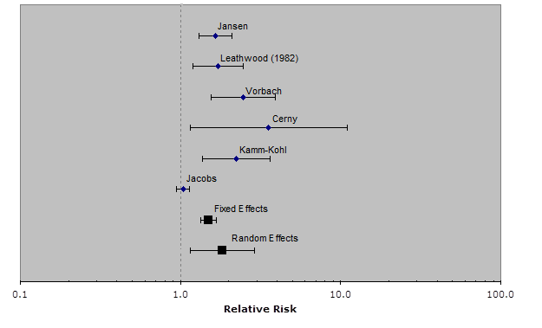
Simple or Complex?
Simple example: Valerian for Sleep: a systematic review and meta-analysis
Bent S, Padula A, Moore D, Patterson M, Mehling W. Valerian for sleep: a systematic review and meta-analysis.
American Journal of Medicine. 2006:119:1005-1012

Slide 4
Safety and Efficacy of Citrus Aurantium for
Weight Loss
Stephen Bent, MD,* Amy Padula, MS, and John Neuhaus, PhD
To examine the safety and efficacy of citrus aurantium, an herb now commonly used as a substitute for ephedra in dietary supplements marketed to promote weight loss, we conducted a systematic review. An extensive search of MEDLINE, EMBASE, BIOSIS, and the Cochrane Collaboration Database identified only 1 eligible randomized placebo controlled trial, which followed 20 patients for 6 weeks, demonstrated no statistically significant benefit for weight loss, and provided limited information about the safety of the herb. 2004 by Excerpta Medica, Inc. (Am J Cardiol 2004;94:1359–1361)

Slide 5
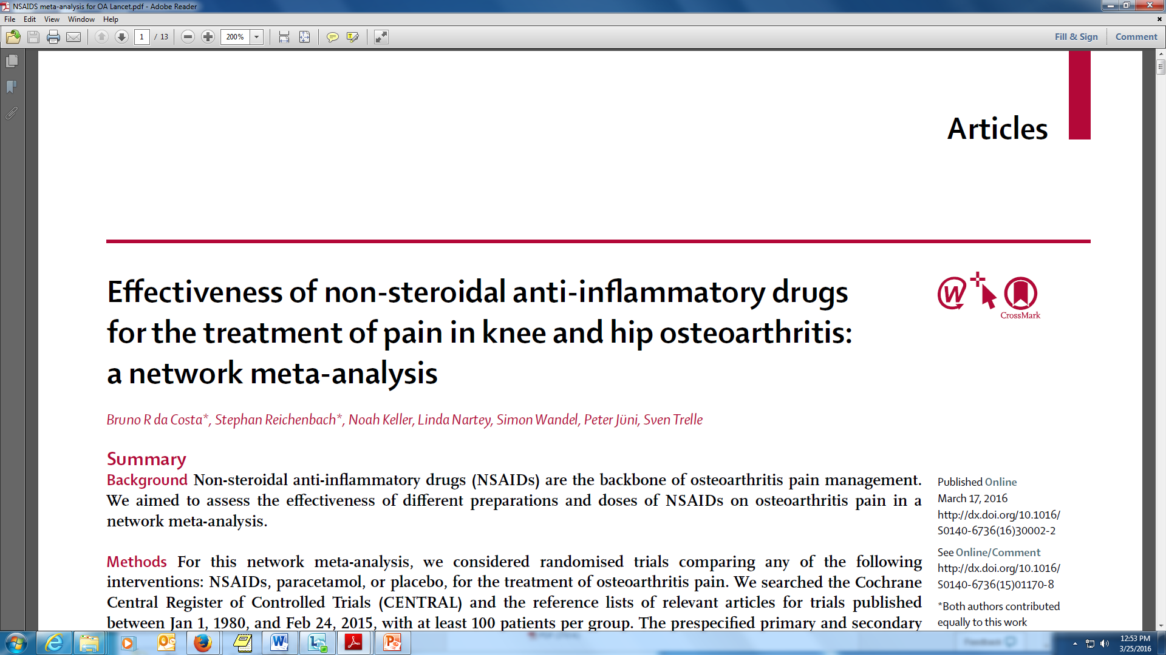
Complex

Slide 6
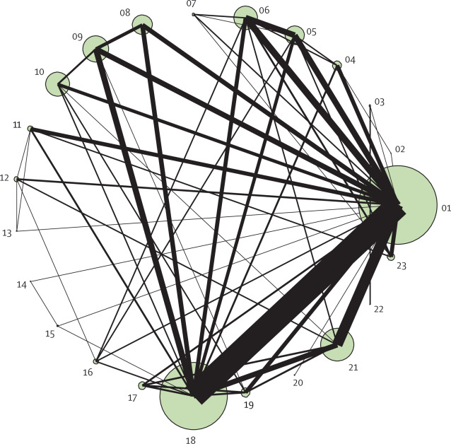
Figure 1. Network of comparisons included in the analyses. The size of every circle is proportional to the number of randomly assigned patients and indicates the sample size. The width of the lines corresponds to the number of trials. 01=placebo. 02=paracetamol ...

Slide 7
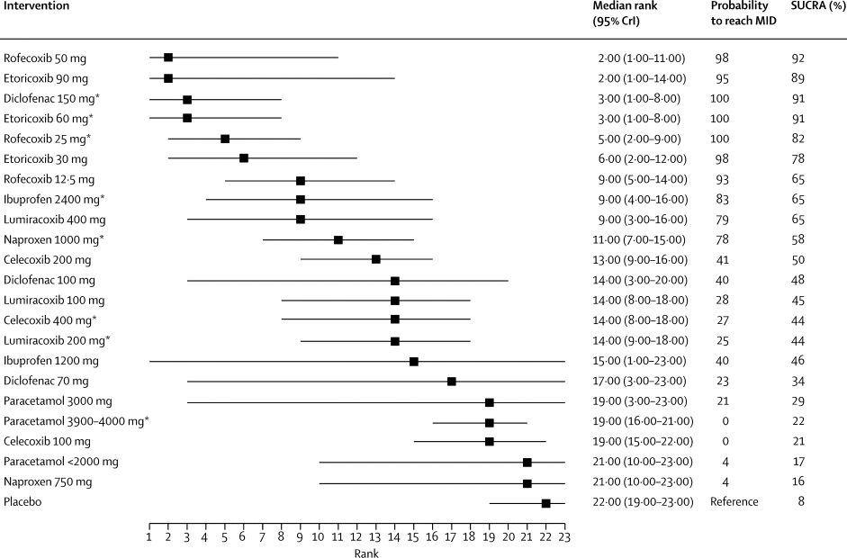
Figure 3. Median rank, probability of reaching MID, and SUCRA values of competing interventions and daily dosesMID=minumum clinically important difference. SUCRA=surface under the cumulative ranking curve. CrI=credibility interval. *Maximum daily dose

Slide 8
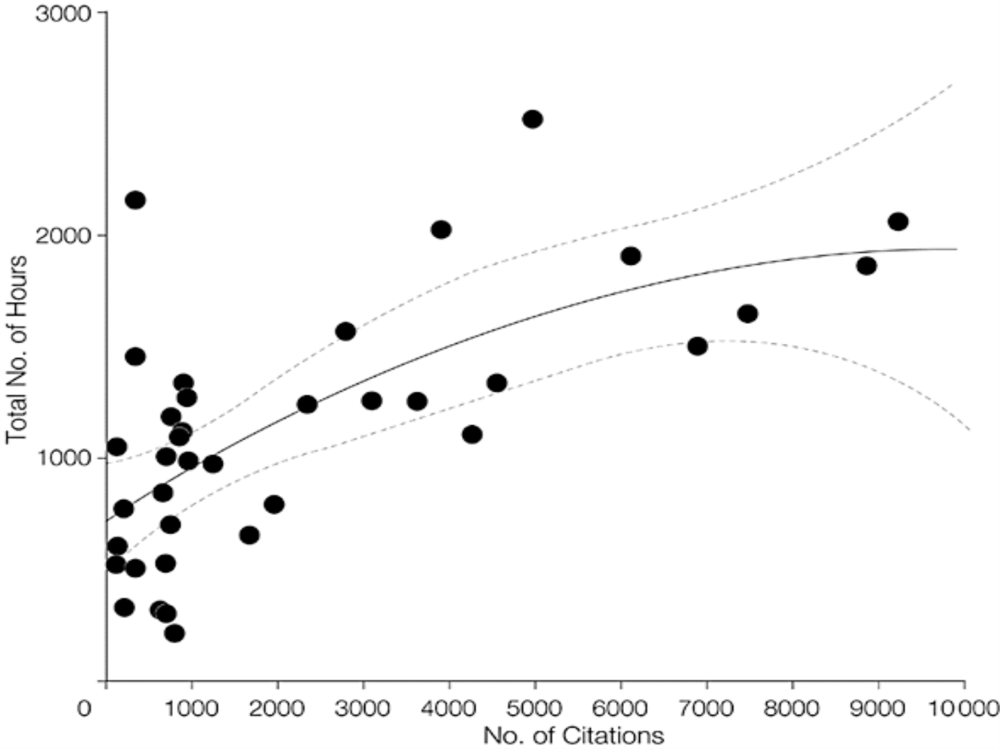
*IE Allen & I Olkin: JAMA. 1999;282(7):634-635. doi:10-1001/pubs.JAMA-ISSN-0098-7484-282-7-jbk0818
How long will it take?*
The mean total number of hours was 1139 (median, 1110), with a wide range from 216 to 2518 hours.
Pre-analysis search, retrieval, and database development: 588 (337) hours;
statistical analysis & validation: 144 (106) hours;
report and manuscript writing: 206 (125) hours;
other (administrative): 201 (193) hours.
Total time=721 + 0.243x − 0.0000123x², where x is the number of citations before exclusion criteria are applied.
Notes:
This is a study conducted by our course Statistical Director, Elaine Allen, which shows that the time required to complete a systematic review depends on the number of citations. You can see that – in general – the more citations, the longer it takes. Ideally, you want to pick topics in this area, whit a few hundred citations, which will take a few hundred (not thousands) of hours of work.

Slide 9
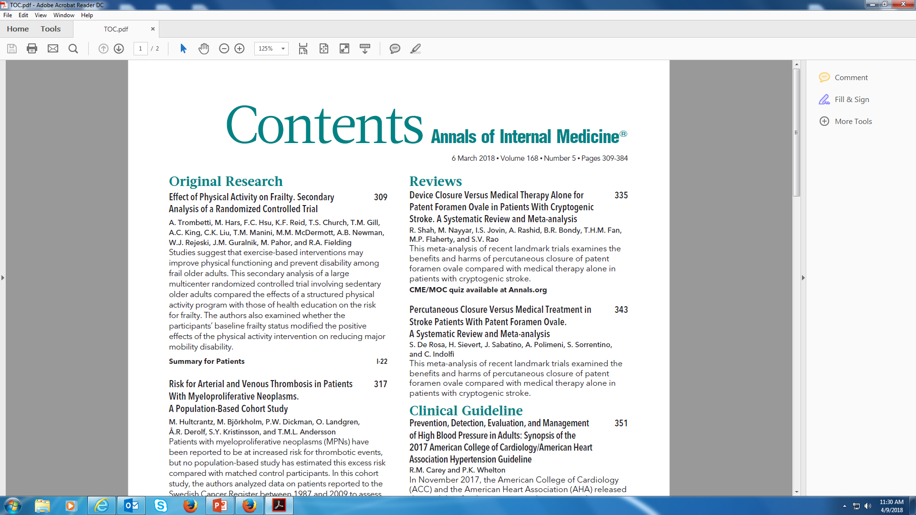
Did someone already publish my SR?

Slide 10
So….
Simple or complex…
You can do a systematic review on just about any topic
And with any study design

Slide 11
Why do some fail?
Too broad a search (> 1000 references)
Too broad a topic (so, too many studies)
  e.g., Beta-blockers for hypertension
  “sweet spot” for residents/fellows is 5-15
Pauses - get all the way up to analysis!
Concern that findings are not novel
Notes:
In the many years that I have worked with students doing Systematic Reviews, the most common reasons that students are not able to complete them are

Slide 12
8 Steps to Systematic Review
1. Research Question
2. Protocol
3. Search
4. Study selection (inclusion/exclusion)
5. Quality assessment
6. Data abstraction
7. Analysis
  A) Create summary measure
  B) Assess for heterogeneity
  C) Assess for publication bias
  D) Conduct sensitivity/subgroup analyses
  E) Advanced issues/techniques
8. Interpretation
Notes:
So, what are the goals for this lecture – well, we have already discussed the skills for “setting up” a systematic review and meta-analysis, by devising a question, writing a protocol, conducting a search, selecting studies, performing quality assessment, and doing data abstraction – these issues were discussed in the last lecture and section. NOW, we have reached the analysis portion of a systematic review, and under this portion, there are 4 major steps – summary measure, heterogeneity, publication bias, and sensitivity/subgroup analyses. We will focus on these 4 steps today, and then during your homework, you will gain practical experience in performing these steps. We will also briefly discuss some advanced techniques.

Slide 13
Why Have a Protocol?
Limit Bias – by requiring investigators to document their plans before identifying and reviewing data
Roadmap / Recipe for your work
  Anticipate needs ahead of time (e.g., what do I need to abstract)
  Prepare for a target journal
  Allot appropriate time

Slide 14
Bias
Definition – a consistent distortion of an observation from the true clinical state
Consistent and Untrue
Examples:
  Blood pressure readings in patients on Meds
  Hawthorne effect (subject bias)
  Review articles

Slide 15
Suggested Protocol Elements
1. Research Questions
2. Background
3. Methods
  Search strategy
  Inclusion / exclusion criteria
  Quality Assessment
  Data abstraction
  Analysis plan
4. Potential Implications
  Sample tables

Slide 16
Research Question
In patients with ________X_________, does the use of ______Y_____ result in ____Z______?
In patients with condition / characteristic ___X_____, is risk factor / predictor ______Y_____ associated with outcome ____Z_____?

Slide 17

Introduction/Background Funnel for ALL Papers and Grants
1. Background
2. Previous research
3. Limitations of prior research
4. How you will address those limitations
Warren Browner: Publishing and Presenting Clinical Research. 1999
Notes:
As Dr. Browner summarized in his excellent book, Publishing and Presenting Clinical Research, every introduction to a paper or grant should have 4 parts, Background, A Description of previous research, a Discussion of the Limitations of Prior Research, and THEN the authors – you – should tell your audience how your NOVEL research will address those limitations. If you have an outstanding and COMPELLING introduction, by the end of the funnel, the reader – or grant reviewer – should be begging for the study to be revealed to them or funded. THIS is where you will CAPTURE and ENGAGE your audience, or lose your readers…

Slide 18
Introduction/Background Funnel
1. Depression is common /debilitating
2. Prior studies have shown that computer delivered CBT is possible, effective.
3. Shockingly, no studies compared computer to in-person.
4. We will fix that…
Notes:
YOU HIGHLIGHT THE GRAVITY OF THE PROBLEM SO THAT YOU READER, OR GRANT REVIEWER, SHOULD LITERALLY BE BEGGING FOR YOUR PROJECT TO BE FUNDED!

Slide 19
Protocol Methods
Search Strategy
  Pubmed, Embase, Cochrane
  Meet with an expert Librarian
  If appropriate, review meeting abstracts, contact experts, use other resources.
Inclusion / Exclusion criteria
  Include everything relevant
  Interventions (easy): RCTs
  Observational studies: may want to only include ones with appropriate adjustment for confounders
  In general, better to be inclusive (and you can always do subgroup analysis)

Slide 20
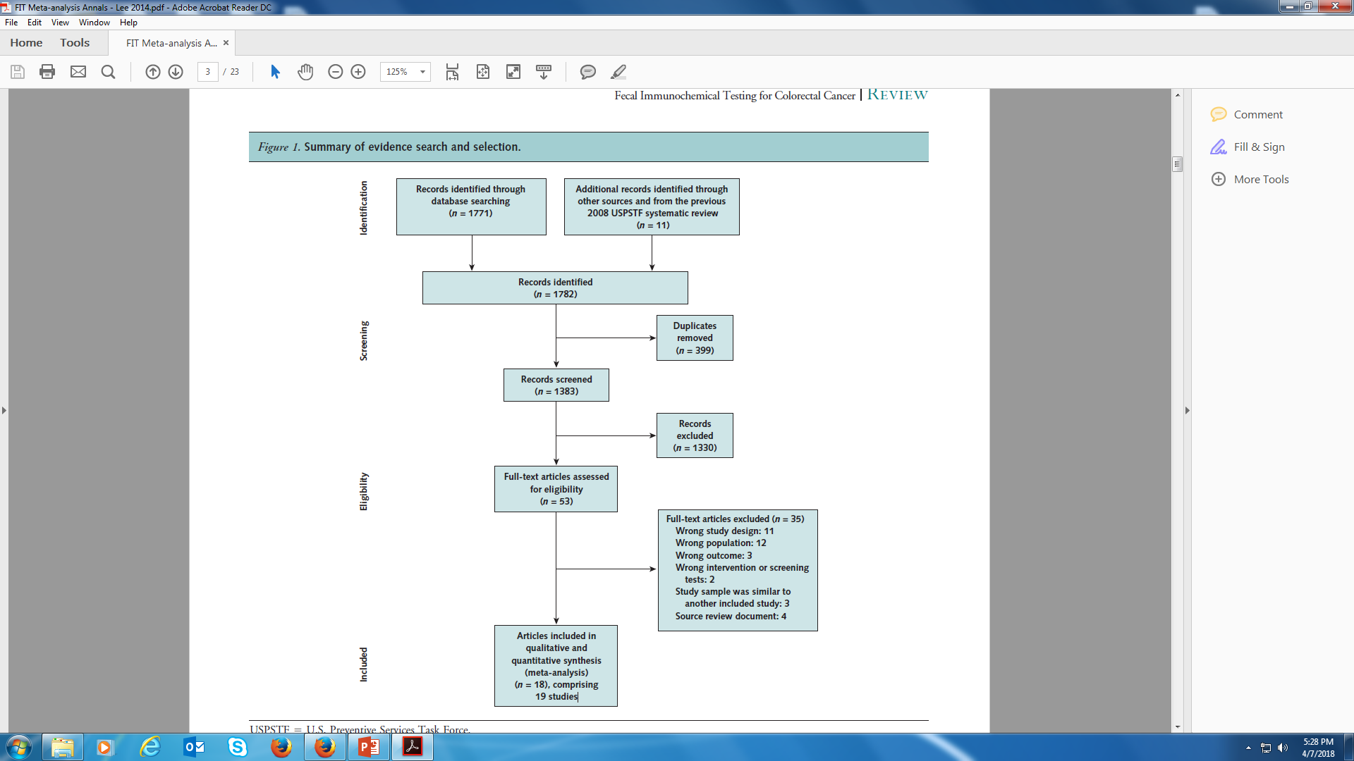
Keep track of reasons for exclusion

Slide 21
Quality Assessment
Previously a “quality score” was common (Jadad score)
However, Juni et al. found that quality scoring may introduce bias
Currently, recommendation is to perform a quality assessment and present the findings (usually in a table or graph).
Refer to Cochrane Collaboration Handbook: http://handbook-5-1.cochrane.org/

Slide 22
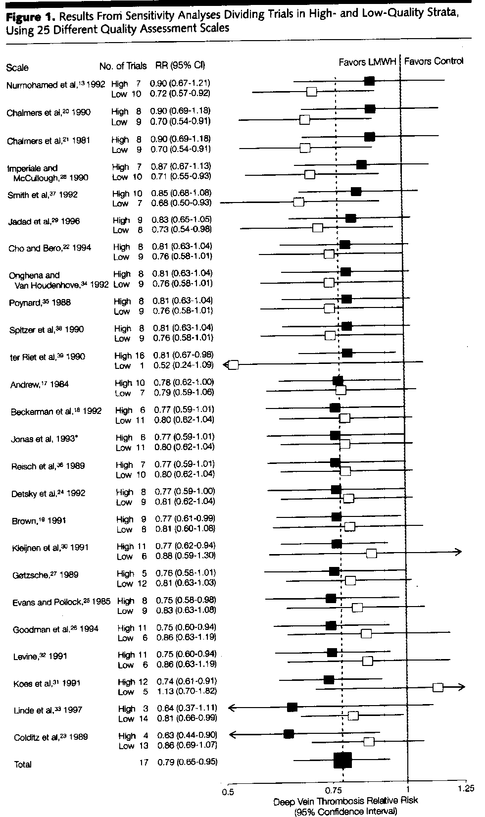
Juni et al, Hazards of
scoring the quality of
clinical trials.
JAMA. 1999;282:1054-60.
Notes:
Quality assessment scales and change in summary measure, when quality scores are used to exclude studies. Relative risks (RRs) for deep vein thrombosis with 95% confidence intervals (CIs) are shown. LMWH indicates low-molecular-weight heparin. Blacksquares indicate estimates from high-quality trials and open squares indicate estimates from low-quality trials. Arrows indicate that the values are outside the range of the x axis. Broken line indicates combined estimate from all17 trials. Solid line indicates null effect line. The scales are arranged in decreasing order of the RRs in trials deemed to be of high quality. Asterisk indicates unpublished scale.

Slide 23
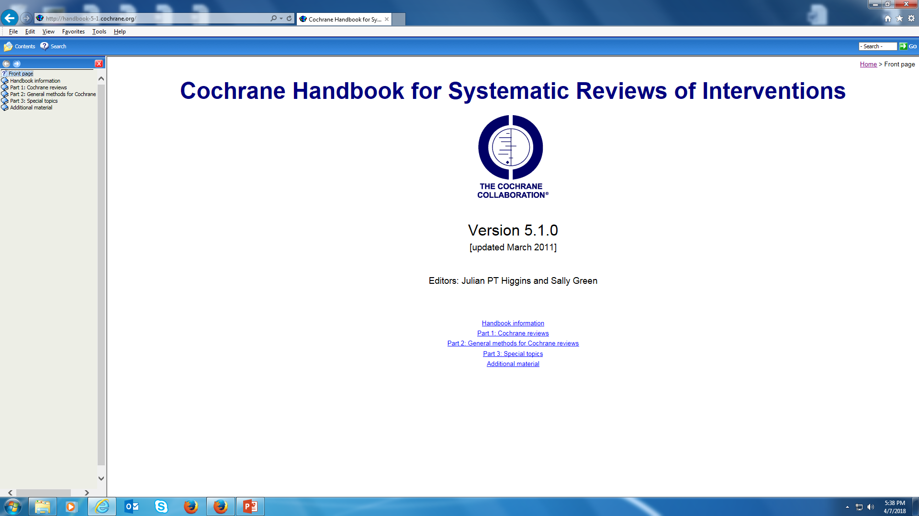

Slide 24
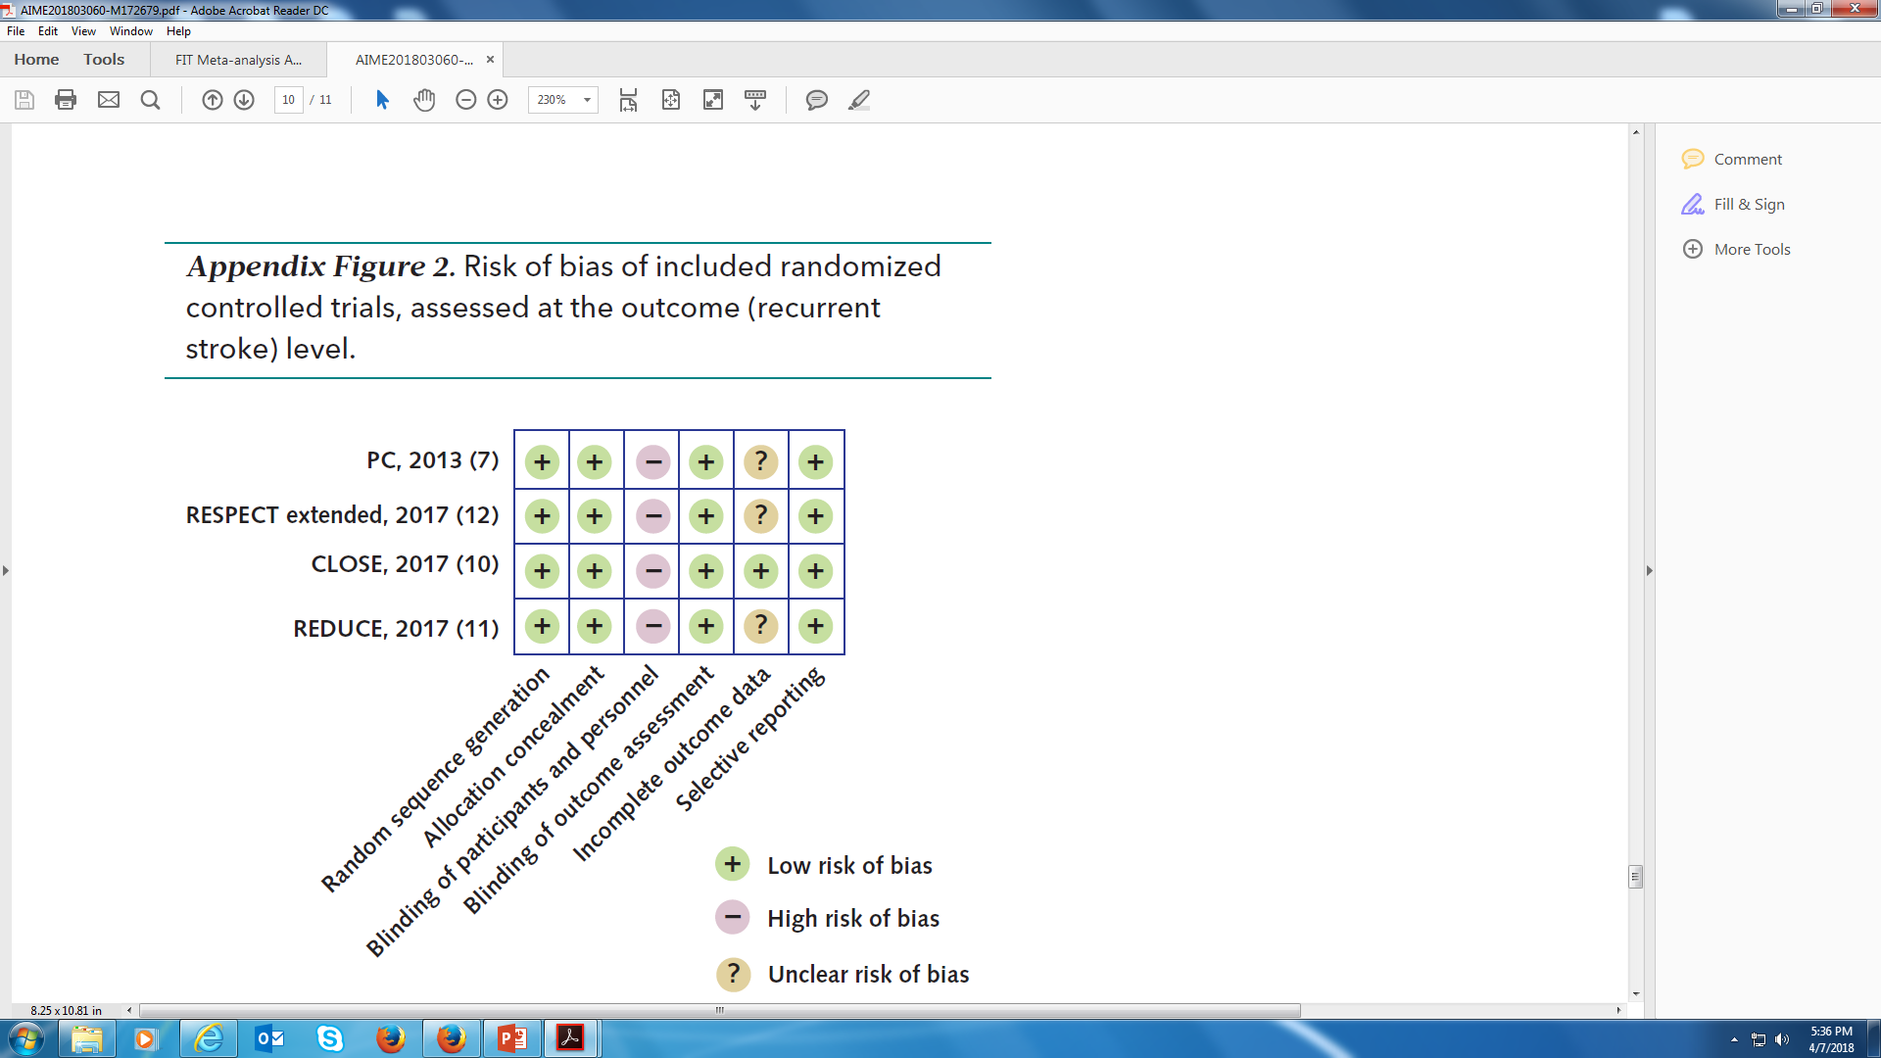

Slide 25
Data Abstraction
Plan your Tables – include everything in data abstraction form that you MIGHT want to have in your tables.
Better to OVER abstract than under abstract (within reason)
On-line data abstraction possible (but more set-up time)
  Covidence: https://www.covidence.org/
  SRDR: Systematic Review Data Repository: https://srdr.ahrq.gov/
  Lots of detail in Li et al (Annals 2015;162:287-294)

Slide 26
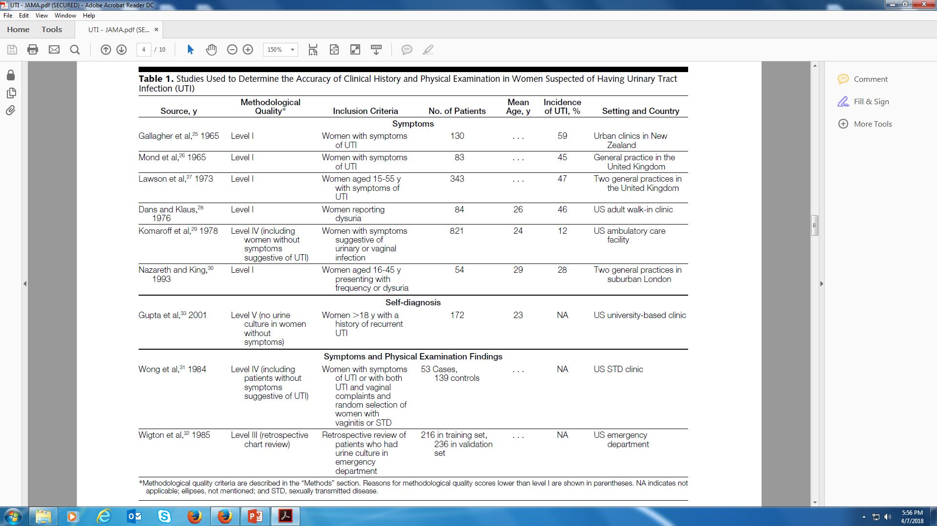

Slide 27
Potential Implications
Your chance to think about what your results might mean
Outline for your results section
  Four points! (Browner et al)
  One of the points is limitations
Warren Browner: Publishing and Presenting Clinical Research. 1999

Slide 28
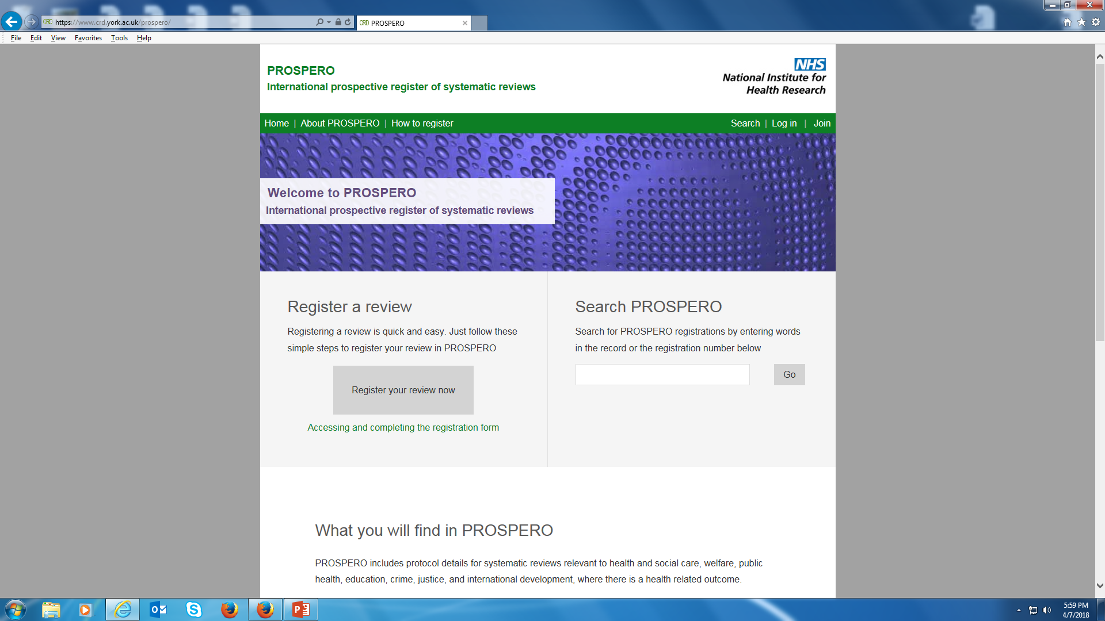
Register

Slide 29
Questions about your own protocols?

