Slide 1
Systematic Review
Practicalities of Search and Reference Management
Evans Whitaker, MD, MLIS
UCSF Medical Library
evans.whitaker@ucsf.edu

Slide 2
Pre-work
Bookmarks
Bookmarklet
Set up and configure your MyNCBI account
Sign up and set up RefWorks
What questions do you have??
Link to a document: https://goo.gl/3Fh8SQ
  Contains links to slides
  Contains a template for next steps
Notes:
Do you want them to use EndNote, vs others that are free to them?

Slide 3
UCSF Library Global Search
Database with “everything” to which UCSF has access
Search “understands” AND, OR, ( ), “ “
  AND, OR must be all capital letters
Like Google Scholar = a really good place to start
Can export finds to reference manager
Notes:
Do you want them to use EndNote, vs others that are free to them?

Slide 4
Goals for today
Hands on, parallel play
Ask questions!!
We will use one simple question to work through the process..

Slide 5
Database searching… approach each one the same way
Clarify your question
Identify concepts in the question
Where will you search?
  Pick a database to begin with
  Orient yourself → how is database structured/organized?
    Look for one page search summary
    Is there a dictionary or glossary for the database?
First concept → Find your words
Repeat for each concept
Assemble search using AND, OR, ( )
Try it out and then fix it!
Test your search vs. “knowns”; sort by relevance/scan 50
Translate your search to work in other databases
Add results to RefWorks (or equivalent)
  PubMed for today
“Controlled Vocabulary”
  Use Search History

Slide 6
Question
You are on call.
Somewhere in the middle of the night you receive a call from a worried parent about her 3 y.o. son. He has a fever of 39º C and is cranky. The fever has been present for most of the day today, but went up tonight. Based on your conversation you convince yourself that there is nothing that requires a visit to the ED tonight .
She has both liquid Tylenol and Advil at home. She asks which to use…
You provide your stock answer and advice and end the call
Afterwards you realize that you aren’t sure which drug is better in this case…
What is the question you are asking?
What are the concepts in this question

Slide 7
Concepts using PICO(TT)
P: Fever in children
I: Tylenol
C: Advil
O: Outcomes (many are possible…)
  Duration of fever decrease
  Amount of fever decrease
  Decreased irritability
  Parental satisfaction
  Adverse effects of treatment
TT: Question type: this is a therapy question
Publication type: RCTs, SRs are best for this question type.

Slide 8
Find terminology
SRs require a sensitive search with an attempt to decrease the irrelevant results in order to decrease your work
To ⬆ sensitivity (FYI: sensitivity = recall)
  Find all the different ways an author might phrase the same thing (synonyms)
  (Most) Databases use a “controlled vocabulary” to get around this problem
  Think of a “controlled vocabulary” as a dictionary or glossary for a database
  A “controlled vocabulary” helps you find the best words to use in your search.
Notes:
Medical Subject Headings (MeSH)
search MEDLINE for all known synonyms for a concept at the same time.

Slide 9
Use multiple databases to increase sensitivity
Numbers of journals (approximate) | Description
20,000 | Estimated number biomedical journals worldwide
10,000 | Number of well-established, believable biomedical journals world wide
10,000 | Journals in Web of Science, however this database covers arts and humanities, social sciences as well as biomedicine and other sciences. Biomedicine accounts for about 6,000 journals
8,700 | Embase includes MEDLINE
5,700 | PubMed/MEDLINE
4,000 | PsycINFO

Slide 10
Name | Pros | Cons | Articles
PubMed MEDLINE | Biomedicine New content Precise indexing (MeSH) Free global access | Two parts Most difficult to use well | 28 M 24 M
Embase | Biomedicine Adds 8-10 M to MEDLINE Intuitive Emtree | Picky search interface Cost | 34 M
Web of Science | Arts, humanities, Social sciences, sciences Cited reference searching | No controlled vocabulary Cost | 37 M
PsycINFO | Focused on psychology Thesaurus | Cost | 4.5 M
CINAHL | Focused on nursing and allied health. Has CINAHL Headings | Search interface not user-friendly Cost | 5.4 M
ERIC | Focused on education. Freely available government version | UCSF buys a version | 1.5-2 M
Cochrane Library | Curated set of systematic reviews (CDSR) and the clinical trials used for them (CENTRAL) | Strange search interface | 9 K-SysRev 1 M- CENT
What about Google?
GoogleScholar good for beginning and ending your SR search
  Set Preferences to increase usefulness
  Use it to find words and get a quick sense of how much is out there about your topic
Google with domain limits can be good for grey literature

Slide 11
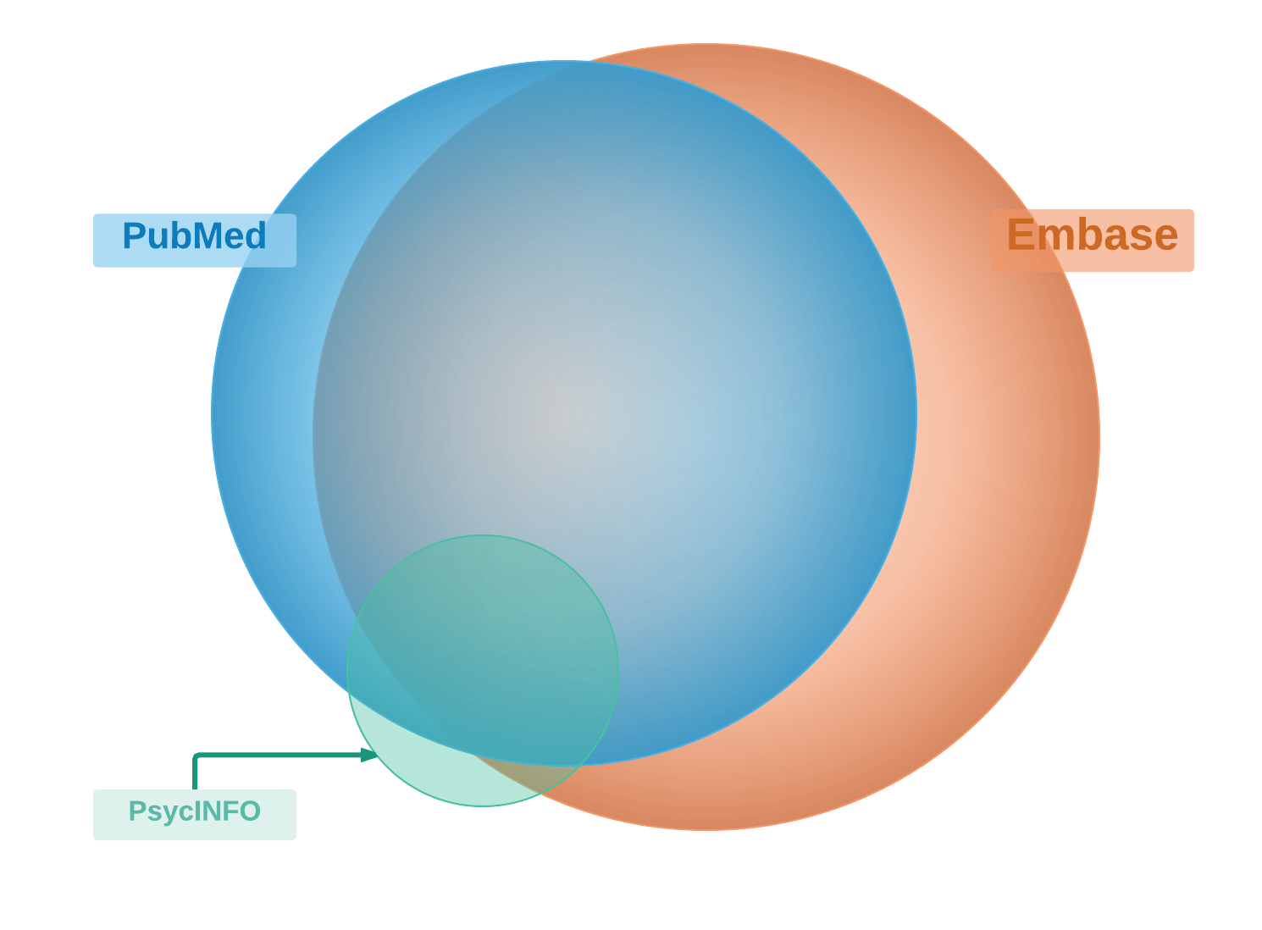

Slide 12
Pick Resources Depending on Your Topic and Available Resources
Biomedical question: PubMed, Embase, BiosisPreviews(?)
Psychosocial component: PsycINFO, Sociological Abstracts, Web of Science
Educational component: ERIC
Cost Analysis/Economic component: Business databases e.g., Business Source Complete
Nursing and allied health: CINAHL
Cited reference searching: Web of Science

Slide 13

Some punctuation
systematic review
“systematic review”
“systematic review”[ti]
“systematic review”[tiab]
Some punctuation
MEDLINE vs. PubMed/MeSH
Complex Searches
Save your work

Slide 14
MEDLINE vs. PubMed
PubMed
28.3M
MEDLINE
24.8M
Publishers supply
information
Indexers
add MeSH
Notes:
PubMed is unique due to its two part structure
This makes PubMed harder to use
You will have it wherever you go, it covers a large percentage of the world’s biomedical literature and may contain newer material than the others, so we will start here.

Slide 15
Complex Search Construction
Problem, Scenario or Question:
Identify key concepts (usually 2-4)
  → Call them A, B, C
Identify MeSH and synonyms for each concept
Assemble with AND, OR and ( )
Result: (A_{mesh} OR A_{syn1} OR A_{syn2} OR …. ) AND
(B_{mesh} OR B_{syn1} OR B_{syn2} OR …. ) AND
(C_{mesh} OR C_{syn1} OR C_{syn2} OR …. )

Slide 16
Creating a Complex Search
Is Tylenol or Motrin better for fever control in children?
Concept 1 | Concept 2 | Concept 3 | Concept 4
Tylenol | Motrin | fever | children
acetaminophen | ibuprofen | pyrexia | toddler
paracetamol |  | hyperpyrexia | infant
(Tylenol OR acetaminophen OR paracetamol) AND (Motrin OR ibuprofen)
AND (fever OR hyperpyrexia OR pyrexia)
AND (children OR infants OR toddlers)

Slide 17
Save the Search and Results
Create alert in PubMed = save search
Add results to RefWorks
  Create a PubMed results folder
  Note the date of search and the results numbers in your “diary”

Slide 18
Two Additional PM Tools
Advanced is you search history and a place to edit and mix-and-match results
Search details is a place to see what PM did with your search and troubleshoot/fix

Slide 19
Embase
Exactly the same approach…

Slide 20
PsycINFO
The same approach…

Slide 21
Web of Science
Broad content → Everything
No controlled vocabulary
Use same search as PubMed but take out the PM specific punctuation → MeSH, [ti], etc.
Best use may be cited reference searching
  Look up title of article you like (WoS won’t have everything)
  Notice citation patterns and related articles

Slide 22
RefWorks
Hopefully you signed up and set it up?
Import → we have talked about as we went
Organization and writing we will talk about now.

Slide 23
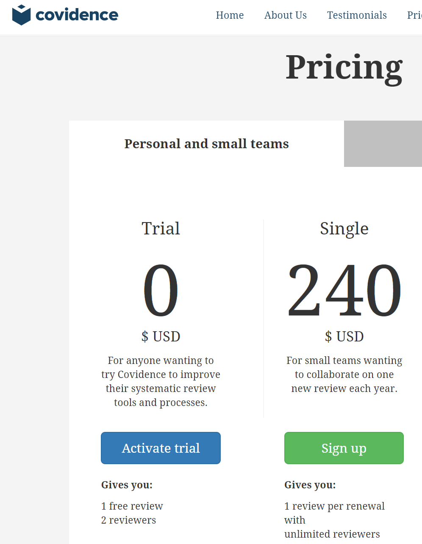
Covidence
Purpose built software to help with
  Title and abstract screening
  Full text screening
  Data abstraction
Don’t use if you are doing a SR with qualitative data
Free Trial does 1 systematic review for 1 person
  Good way to see what this software does
Alternatives → Excel, database programs.

Slide 24

Distiller SR
Purpose built software to help with
  Title and abstract screening
  Full text screening
  Data abstraction
Alternatives → spreadsheet programs, database programs.

Slide 25

(https://rayyan.qcri.org/)
Purpose built software to help with
  Title and abstract screening
Qatari
Free, works well
Export to spreadsheet, database for data extraction.

Slide 26

Don’t let this happen…
…call a librarian!

