Slide 1
Theories and Frameworks for Implementation Science: Approaches to Analysis of Gaps between Evidence and Practice
Epidemiology 245
Spring 2018

Slide 2
Framing the Gap
Settle on an implementation problem
  To get the most out of this class
What is the role of warfarin in the era of direct thrombin inhibitors?
  Not an “implementation science” question (doesn’t mean it’s not a good question)
  Consider: strategies to enhance the use of safer anticoagulation options…
What is the consequence of delay of colonoscopy after positive FIT
  Not an “implementation science” question
  Consider: Explaining delays between positive FIT and colonoscopy

Slide 3
Minimum ingredients
You do have to have an EBI
Frame the gap

Slide 4
Example: how to frame
Food insecurity – it’s not good
You want them to screen, but they don’t
What’s the EBI?
What’s the gap?
Need EBI to conceptualize gap…

Slide 5
A “Cascade” Approach to Characterizing the Implementation Gap
Gap? Not all of it…
Or is this the gap? This is the sum total of the motivation for your problem statement
With condition
Diagnosed
Ever started
Offered treatment
Controlled
Retained or adherent
Notes:
Depends on how much of the gap is due to this step (is it the critical problem or a small one?)
Depends on whether there is data about this step’s contribution to non-treatment consequences

Slide 6
Focus on one gap (sometimes there are many)
Addressing depression has many benefits
  In and of itself
  HIV outcomes
  Longevity/suicide
What is your cascade?
  Focus on one

Slide 7
From Intervention to Gap
Gap: Weight loss, exercise, diet (using DPP) → reduce diabetes by 50%, but not done
Apply cascade:
  Who is at risk? How do you know who they are? Who is eligible for an intervention? How many do you get and how many stay?
Yes, you can work your way backwards from intervention to problem statement (but beware when you do so)

Slide 8
Objectives for Today
Describe theory for understanding an implementation problem
Make the case for its importance
Show how it can be applied
Go through a number of prominent theories and frameworks

Slide 9
Case Study: Pre-exposure Prophylaxis for HIV Prevention
PrEP is highly efficacious
  95% if highly adherent, up to 50% with moderate adherence
PrEP is underused
  1,230,000 persons in US eligible for PrEP (MMWR 11/27/15)
PrEP uptake is far from optimal

Slide 10
Why?

Slide 11
“Why do these Gaps Exist?” Trial and Error Approach
“Why is there a gap between evidence and practice?”
Apply your personal experience (which might be very good!!!)
Propose formative research instead – some interviews
Call your friend who you think is smart (WWTBM approach)
Find that it has sub-optimal impact or score
Good case scenario: reviewers raise something you didn’t think of.
Worse case scenario: you finish the formative research and realize that there were factors you should have considered finding out more about
Try something – write a proposal or do a project
Realize you need to systematically assess what others have said about how to approach the problem

Slide 12
Doctors understand this with regard to clinical problems
But seem refractory to this when it comes to implementation problems

Slide 13
“Why do these Gaps Exist?” Theory-Based Approach
Why is there a gap between evidence and practice?
Invest in a formulation of a diagnosis
Consult frameworks and theories in implementation science
Apply your own contextual knowledge, local network, consult stakeholders to further shape your diagnosis
Propose research which is embedded in existing discourse; builds on what is known; adds to body of knowledge
Consult relevant frameworks and theories in a particular area of social science or psychology
Peruse primary literature to sharpen your understanding of the problem

Slide 14
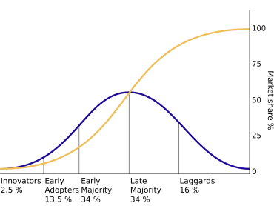
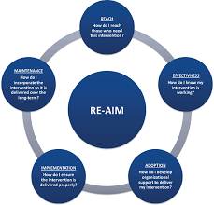
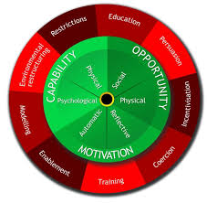
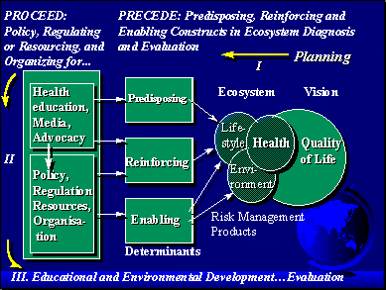
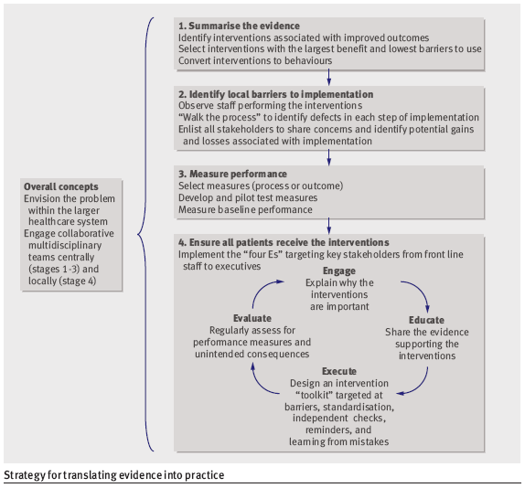
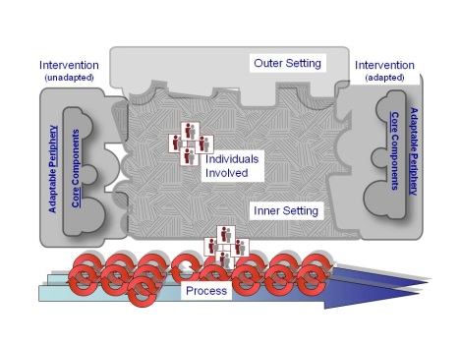
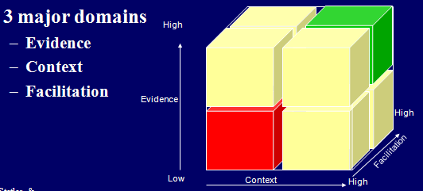
Framework, Models, Theories in Implementation Science
Notes:
On a practical level, how do you engage with framework, models or theories?
Theory seems obscure, esoteric or academic to many practioners…

Slide 15
What is Theory?
“An explanation of a phenomenon arrived at through examination and contemplation of the relevant facts” (Oxford English Dictionary)
Critical ideas about facts

Slide 16




Slide 17
Theory gives your question / findings context
Theory unifies findings – its what all the findings mean together
Dual process
  New findings influence theory
  Theory influences how you go about looking for findings.
  Theories can be unsubstantiated or extensively substantiated

Slide 18
Fact
Fact
Fact
Fact
Your observation or fact
Fact
Fact
Fact
Fact
Fact
Fact
Fact
Fact
Connect your observations with other thinking
Contribute to a discourse (don’t be an isolated node)

Slide 19
Good news and bad news
You need to know them to be a part of the implementation science conversation
  Bad news: there are a ton of them!!!
  Good news: a few basic theories will get you 90% of the way there.

Slide 20
One Way to Look at Theory in Implementation Science
CFIR
Behavior change wheel
Broad (mapping) – Have you thought of everything?
Health belief model
Characteristics of interventions (DOI)
Explanatory – Are there causal relationships for this type of thing that have been previously articulated (and does your problem fit?)
Adapted from Grol, Bosch et al., 2007

Slide 21
Frail, confused, sun-downing; tries to get out of bed to go bathroom and has a fall
Becomes combative and agitated; given haldol
MERT called; everyone is annoyed, sitter ordered; keeps trying to get out of bed
Hospital stay goes up; cost goes up; outcomes worsen
88 year old, community dwelling, admitted for pneumonia
“I know that nurse, he’s slow and lazy, didn’t respond on time. What a jerk.”
Restructure the environment (ACE unit); home based care; policy change
“Unit manager is too lenient, the nurses get away with anything”
Managerial
Review admission criteria; set up committee to do root cause analysis on all falls
Implementation
Science
Apply CFIR – consider policy, systems, environment; interventions, etc.
That intern is terrible – he’ll order haldol on anyone just so he can go back to bed
Quality
Improvement
Understand health worker psychology – look at TDF
Restrict use of restraints; require sign off for any sedating agents from chief resident
We need to start measuring the number of falls
Notes:
What’s the problem?

Slide 22
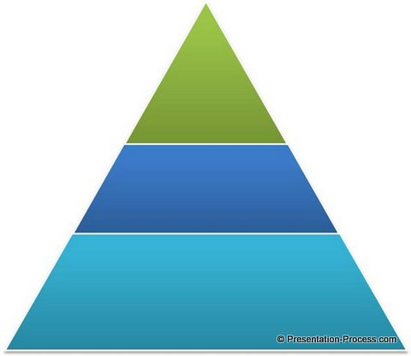
Ways of Solving Problems with Implementation
Science
  Generalizable inferences
  Public knowledge
  Use of theories and framework links to a larger and longer discourse
  Draw from and contribute to general, public knowledge
Organized strategies based on systematic assessments
  Quality improvement
  Incentivization
  McKinsey
Day to day managerial practices
  Business world
  “Leadership”

Slide 23
Socio-Ecological Models
Socio-economic and cultural context
Community
Organization
Individual
Smedley BD, Institute of Medicine. Promoting Health 2000.

Slide 24
?
?
PrEP Use
?
?

Slide 25
Policies: health insurance
SES
PrEP Use
Community relations
Individual motivation

Slide 26
Diffusion of Innovation
Diffusion is the process in which an innovation is communicated among members of a social system
Four main elements
  Innovation
  Communication
  Time
  Social system
You can identify these in every problem with diffusion
Rogers, Everett M. Diffusion of innovations. Simon and Schuster, 2010.

Slide 27
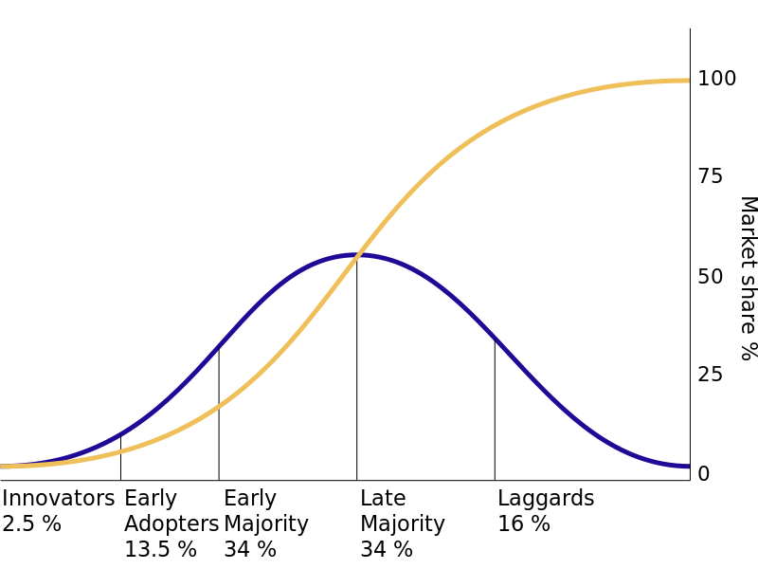
Quantifying the Gap: Rogers’ Diffusion of Innovations
Quantify the gap numerically
  50% of people doing X
Quantify the gap socio-behaviorally
  Innovators
  Early adopters
  Early majority
  Late majority
  Laggards
Rogers, Everett M. Diffusion of innovations. Simon and Schuster, 2010.
Notes:
Maybe you know that nothing has been done – how do you kick start? Target the innovators.
Adding a layer of information to the gap.
50% of the people are doing it, then you can try and hit the early majority…
START – rapid start was being practiced by some providers – the innovators and the early adopters – but not yet by the early majority – this tell you where a practice is al

Slide 28
Innovation Characteristics
Relative advantage
  Is it better than what you are doing?
Compatibility
  Does it fit with the processes (and practices) and skills in place? (Dvorak)
Complexity
  How hard is it to use?
Trialability
  Can you try it out before committing?
Observability
  Can you (and others) see the benefits of adopting the new practice?
Rogers, Everett M. Diffusion of innovations. Simon and Schuster, 2010.

Slide 29

Trialability…
Typewriter

Slide 30
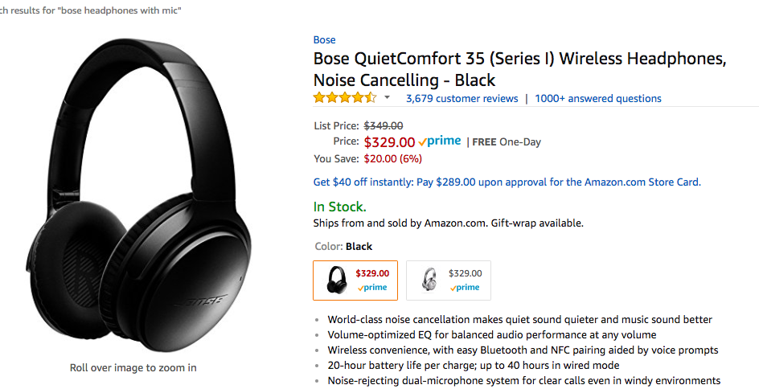
Observability…

Slide 31
Wil you be happy or sad?
Cost so much…!
But looks good!

Slide 32
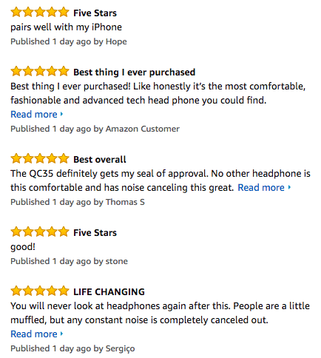
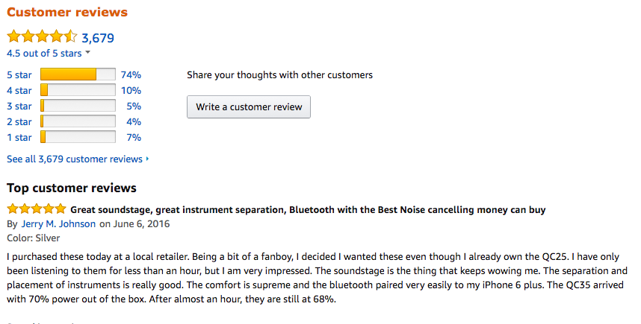
Observability…

Slide 33
?
?
PrEP Use
?
?
?

Slide 34
Apply Diffusion of Innovations to the PrEP Problem
Relative advantage over condoms, abstinence and serosorting?
Compatibility with life in general and my sexual health practices (requirement to see doctors, get lab tests, etc.) as well as sexual practices (vs. on-demand PrEP?)
PrEP Use
Complexity (a pill with potential side effects) and monitoring
Observability - HIV acquisition rare and hidden? How about benefits? What about “freedom”
Trialability: Can stop anytime? High start up costs?
Notes:
Gives you a way to analyze the problem…

Slide 35


Slide 36


Slide 37









Elucidate and Explain: COM-B
Michie et al (2011) Implementation Science
Notes:
Broad in the sense that it is comprehensive, but does not attempt to enumerate all subcategories
Also offers causal relationships between these constructs
Use it to map and to explain
Example of a behavioral problem: throwing garbage out the window in Qinghai – its not motivation – its opportunity

Slide 38

Physical skills
Knowledge
Cognitive and Interpersonal skills
Memory, Attention and Decision processes
Behavioural regulation
Environmental Context and Resources Social Influences
Professional/Social Role & Identity – my responsibility?
Beliefs about Capabilities
Optimism
Beliefs about Consequences
Intentions
Goals
Reinforcement
Michie Imp Sci 2011

Slide 39
Apply COM-B to the PrEP Problem
Capability (for providers: knowledge and interpersonal skills to assess)
PrEP Use
Opportunity (are there ways to screen to know who to offer it to? Are there insurance issues?)
Motivation– Beliefs about behavioral risk compensation?

Slide 40
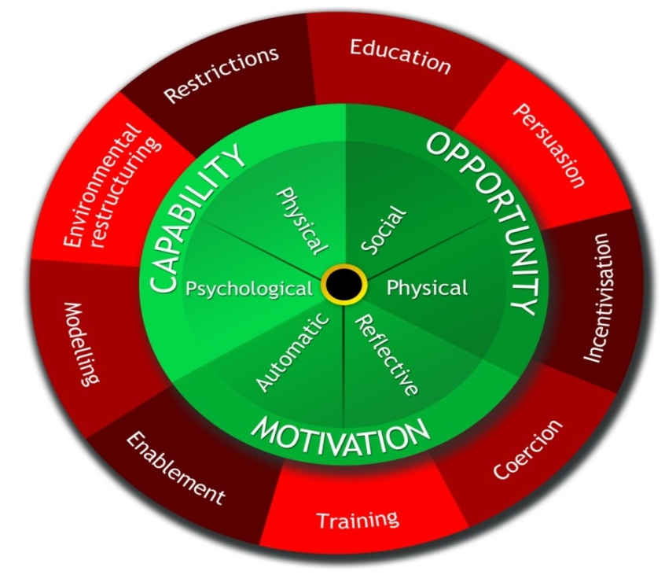
Using rules to reduce the opportunity to engage in the
behaviour (or to increase
behaviour by reducing
opportunity to engage
in competing
behaviours)
Increasing knowledge or understanding
Using communication to induce positive or negative feelings to stimulate action
Changing the physical or social context
Creating an expectation of reward
Provide an example for people to aspire to or emulate
Increasing means
or reducing barriers to
increase capability (beyond
education or training) or opportunity
(beyond environmental restructuring)
Creating an expectation of punishment or cost
Imparting skills
Michie Imp Sci 2011

Slide 41
Health Belief Model
Perceived susceptibility
  Do you think the disease will happen to you?
Perceived severity
  Do you think the outcome is bad?
Perceived benefits of a particular behavior
  If you do X to avoid it, will it work?
Perceived barriers
  What is getting in your way of it
Cues to action
Self efficacy

Slide 42
Health Belief Model
Perceived benefits and barriers
Perceived seriousness
Desired behavior
Perceived susceptibility
Self Efficacy
Cues to action

Slide 43
Example
Notes:
Patients testing HIV + often don’t come back to pick up CD4 results in Swaziland
Mobile phone penetration is high – 80%
SMS messages are inexpensive, but still cost money.
Free intervention: at time of blood draw for CD4 testing, the counselor puts a number with name “Go Back to Clinic”
Receive a “buzz” before appointment
No difference in follow-up before and after the intervention (80.1% versus 83.3%, p = 0.401)

Slide 44
Use of an Implementation Science Approach: Swaziland Study
Assessment of the “gap analysis”
  Is there reason to believe that “forgetfulness” drives non pick-up?
  Structural barriers? (can’t afford transport) Psychosocial ones (denial)? Facility? (Inconvenient hours?)
Assessment of “Intervention design”
  Suboptimal diagnosis of the problem led to testing of a strategy that has little chance of being effective
  Motivated by technology (great opportunity) rather than a systematic approach to the implementation problem

Slide 45

Example: Formal “Behavioral Diagnosis”
Gap analysis (qualitative interviews)
  Perceived susceptibility, severity was high, perceived benefits were high – needed que to action –feeling cared for
Formulation of action and action target
  “Everybody would wish to be loved”
  “A positive message and a personal touch”
  “Should not mention HIV”
Improved post partum retention for women (relative risk 1.66, 95% confidence interval 1.02–2.70).
Improved EID (relative risk 1.08, 95% confidence interval 1.00–1.16)
Notes:
Consequences….
Implications for generalizability? Coming into more focus.

Slide 46
Apply Health Belief Model to the PrEP Problem
Perceived benefits – Do they know about? Believe in it? Do they think it’s a conspiracy?
Perceived susceptibility – What do patients think will happen to them in terms of HIV risk?
Desired behavior – Use PrEP
Self Efficacy – do they know where to go? How to pick it up? How to ask for it?
Cues to action – do they need a reminder? Are there competing priorities?
Notes:
What is missing?

Slide 47
CFIR: Have you captured the universe of considerations?
A “meta-theory” perhaps?
The CFIR comprises five major domains
  Intervention characteristics
  Outer setting: policy, economic, political and social context
  Inner setting: organizational characteristics
  Individuals: actors in the system
  Process: behavior change blueprint
(Damschroeder Imp Sci 2009)

Slide 48
Intervention Characteristics
Outer Setting
Inner Setting
Intervention source
Evidence strength perception
Relative advantage
Adaptability
Trialability
Complexity
Design quality and packaging
Patient needs and resources
Cosmopolitanism
Peer pressure
Policy environment
Structural characteristics of organization
Networks and communications
Culture
Implementation climate (tension for change)
Readiness of implementation
People
Processes
Knowledge and beliefs about the intervention
Self efficacy
Individual stages of change
Individual identification with the organization
Planning
Engaging
External change agents
Execution
Reflecting and evaluating

Slide 49
Apply CFIR to the PrEP Problem
Intervention characteristics (source? (CDC and experimentation), other characteristics from diffusion of innovations
Outer setting – insurance coverage, ”PrEP Stigma”
PrEP Use
Inner setting (are providers, culture, leadership in STI clinics ready to embrace PrEP?)
People – Knowledge and beleifs among target population about PrEP?
Processes: Is there a managed process for change and how it is managed, planned, executed?

Slide 50
Theory of Change PRECEDE
Predisposing, Reinforcing and Enabling Constructs in Educational Diagnosis and Evaluation
Predisposing:
  Knowledge or information that inclines or influences a person to a particular behavior
Enabling:
  Materials or skills that facilitate the desired behavior
Reinforcing:
  Anticipated rewards to consequences of behavior
A “theory” in that PRECEDE makes a causal claim:
  interventions that make use of these three domains are more effective
    Davis, David A., et al. "Evidence for the effectiveness of CME: a review of 50 randomized controlled trials." Jama 268.9 (1992): 1111-1117
  A way of delivering a “sufficient cause”
.
Green, Lawrence W., and Marshall W. Kreuter. "Health program planning: An educational and ecological approach." (2005).

Slide 51
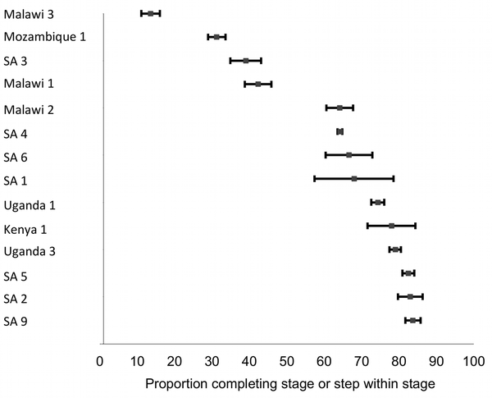
Delays in Antiretroviral Therapy Initiation among ART Eligible Patients
ART Initiation among Eligible Patients
Fox and Rosen PLoS Medicine 2011
Systems Barriers to ART Initiation
Providers
  Perception that “ART is not an emergency”
  Slow diffusion of new research (Zolopa PLoS One 2009, Havlir NEJM 2011)
  Unaware of loss to follow-up between eligibility and initiation
Structural
  Overnight CD4 processing - failure to return for second visit
Organizational
  Standard three pre-ART adherence and “treatment supporters”
Median 68%
(range 14%–84%)
Notes:
51

Slide 52
Intervention Based on PRECEDE Framework
BARRIERS
PRECEDE DIMENSIONS
THEORY – BASED INTERVENTIONS
Provider knowledge and beliefs
Predisposing
Opinion leader led teaching and coaching
Multiple pre-therapy counseling visits standard
Revised counseling protocol
Enabling
Multiple visits (overnight CD4 processing)
PIMA
Provider motivation
Reinforcing
Feedback to clinics

Slide 53
Apply PRECEDE to the PrEP Problem
Predisposing (for providers – how will you change what they want to do? Change knowledge, attitude, motivation?)
PrEP Use
Reinforcing (How can you create incentives to offer PrEP? Make PrEP perscription rates reported? Dashboards?)
Enabling – How can you make it easier for doctors to prescribe PrEP? Decision support? Order bundles? Through an app (rather than in person?)

Slide 54
Theory No-No’s
Don’t fetishize them
They are necessary but not sufficient for a good diagnosis
They give you the map, but you still have to pick a route

Slide 55
Conclusions
Use theory when you seek to understand the reasons for a gap between evidence and practice
Use your practiced based and contextual knowledge
Different theories are like different tools – what do you need to build?
Get to know the toolbox

