Slide 1
Epidemiology 245 (2018)
Lecture 3 – Understanding the Gap Using Perspectives from the Social Sciences
Elvin Geng

Slide 2
Lecture 1 and 2 - Redux
Conceptualizing the Gap
  Reformulate problem
  Make it bigger and more general

Slide 3
Making implementation problems research-y by putting them into context
False documentation of allergy
An app or training to facilitate classification
A tool to help classify
Self report of allergies and misclassification
Principal-agent problem
Decision support

Slide 4
Making implementation problems research-y by putting them into context
No fluids for Ebola patients
A device or a technology to delivery, or a rule for deciding
Emergency responses
A package for rapid deployment and delivery
Humanitarian and emergency response

Slide 5
Genotyping HBV before treatment
Cost of untreated HBV
Retention and adherence
HBV treatment
HBV diagnosis
HIV linkage to care

Slide 6
Frail, confused, sun-downing; tries to get out of bed to go bathroom and has a fall
Becomes combative and agitated; given haldol
MERT called; everyone is annoyed, sitter ordered; keeps trying to get out of bed
Hospital stay goes up; cost goes up; outcomes worsen
88 year old, community dwelling, admitted for pneumonia
“I know that nurse, he’s slow and lazy, didn’t respond on time. What a jerk.”
Restructure the environment (ACE unit); home based care; policy change
“Unit manager is too lenient, the nurses get away with anything”
Managerial
Review admission criteria; set up committee to do root cause analysis on all falls
Implementation
Science
Apply CFIR – consider policy, systems, environment; interventions, etc.
That intern is terrible – he’ll order haldol on anyone just so he can go back to bed
Quality
Improvement
Understand health worker psychology – look at TDF
Restrict use of restraints; require sign off for any sedating agents from chief resident
We need to start measuring the number of falls
Notes:
What’s the problem?

Slide 7
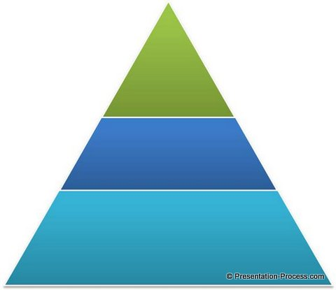
Ways of Solving Problems with Implementation
Science
  Generalizable inferences
  Public knowledge
  Use of theories and framework links to a larger and longer discourse
  Draw from and contribute to general, public knowledge
Organized strategies based on systematic assessments
  Quality improvement
  Incentivization
  McKinsey
Day to day managerial practices
  Business world
  “Leadership”

Slide 8
Drill down on the diagnosis
Conceive of the nature of the problem grandly
Offer a nuanced, compelling understanding of the problem – does not have to be the whole problem
Magnitude
Tractability
Opportunity
New analysis
Also need to specify who the barriers apply to…
  The relative advantage of a multi-component support intervention for dementia (advantage to who?)

Slide 9
The implementation gap: what can we learn from perspectives from the social sciences…?

Slide 10
Outline
The Econ
  DCE
The Human
  Temporal discounting
  Endowment (give people something of some value?)
  Defaults
  Norms
  Commitments
Caveats
  Nudges vs. a stiff kick

Slide 11
Homo Economicus
You have a limited budget
You want to get stuff that makes you happy
Whether you choose something depends on how much you want it and how much it costs
You make rational choices

Slide 12
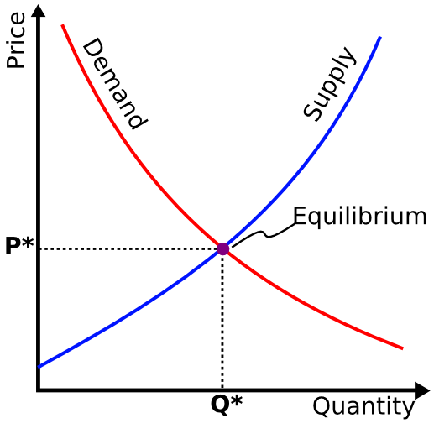
Supply and demand
Wikipedia image bank
Notes:
Laws
Demand: how much consumers want
Supply: how much producers make
This theory says that the market will allocate supply and demand in most efficient way
That is to say, that for a given demand and a given supply,

Slide 13
Medicine and public health
We tend to think mostly of supply
Take a poll of student projects
  Supply ?
  Demand ?

Slide 14
If you build it, they will come….
…or maybe not
We have highly efficacious biomedical tools
We know that people want to be healthy
What’s the problem?

Slide 15
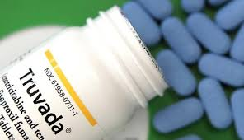
Exhibit A…
Notes:
PrEP Pill

Slide 16

Exhibit B…

Slide 17
What’s the differential diagnosis…?
Don’t know about it (unlikely – most people know about ART)
Can’t get it (most people have geographical access)
Don’t want it (or don’t want it that much)
…How can we find out more about the preferences of a population of persons living with HIV want?
Notes:
What do you want
What kinds of things do you like
What attributes of things do you like
How much do you value those things?
Want to find out quickly
What do you want?
What kinds of things do you like?
What attributes of things do you like
How much do you value those things?
Shift the demand curve

Slide 18
Choice experiments: Understanding the Econ
Patient preferences are inadequately understood and used in public health practice
Demand is neglected
A solution: the “utility”
Choice experiments
  A choice experiment in Zambia for retention in HIV care

Slide 19
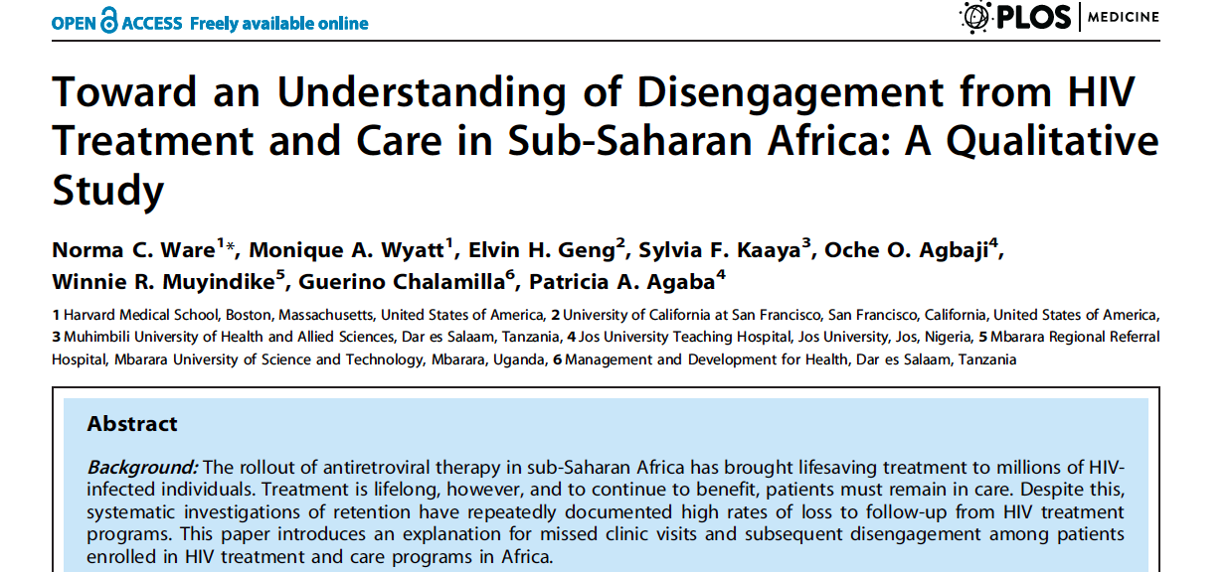
Alternative 1: Qualitative interviews
Notes:
Revealing, but not what we want because….. Not sure sample, no quantification of strength, etc… depth but sacrific representativeness

Slide 20
Alternative 2: Surveys…
(N = 603)
Structural
Psychosocial
Clinic-based
Notes:
In addition to assessing outcomes such as mortality and vital status – we solicited reasons for stopping among those patients we found in person – we asked an open ended question, recorded responses, mapped to codes,

Slide 21
Alternative 3: Quasi-experimental or experimental
Randomize? Expensive, time consuming….
Quasi experimental? Hard to capture all the variability

Slide 22

Notes:
Pretend UCSF covers your vacation every year
Imagine something (three pictures)
What you feel if you were there is a utility
What you think you might feel is what we wold be getting at – stated preference
The utility
A concept about what you want
What you feel when you get something
Happiness
Satisfaction

Slide 23

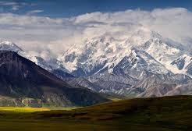
Some assumptions about preferences
Notes:
Image of something desirable – two vacations – one to someplace hard and exotic and one to a beachy type place
You want one of these things because you believe that if you were there it would make you feel a certain way (food, where you stay, how much it costs)
1. You can always decide which one you want or are indifferent - completeness
2. It has a quantity but it is ordinal not cardinal
3. If you like something - more is better (two weeks is better than one)- monotonicity
4. If you like A more than B and B more than C you like A more than C – rationality (or transitivity in our language)

Slide 24
Choice experiment
If utilities exist, can we measure them?
  Can’t ask about it
Revealed by our choices
So, mimic the processes of choosing
With a choice experiment

Slide 25
Choice experiment
Widely used in marketing research
Series of choice tasks
  Rapid
Tells you both what and how much people prefer certain attributes
Standardize against money and allow estimates of “willingness to pay” (how much additional someone would pay to get something)
  Pay 1000 extra dollars to get luxurious over rustic

Slide 26
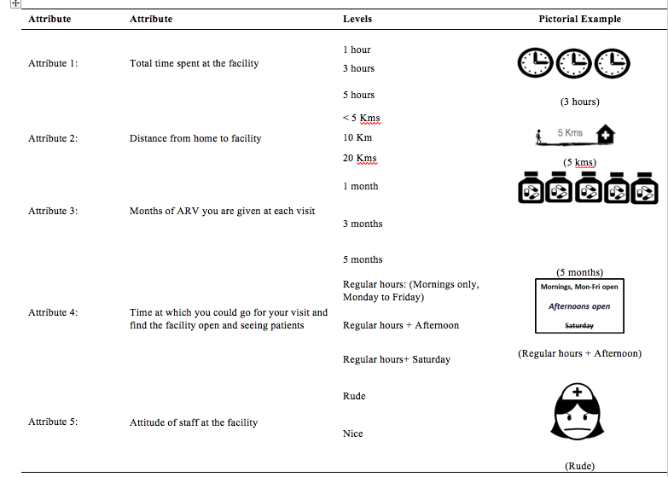
Notes:
Random sample of lost patients

Slide 27
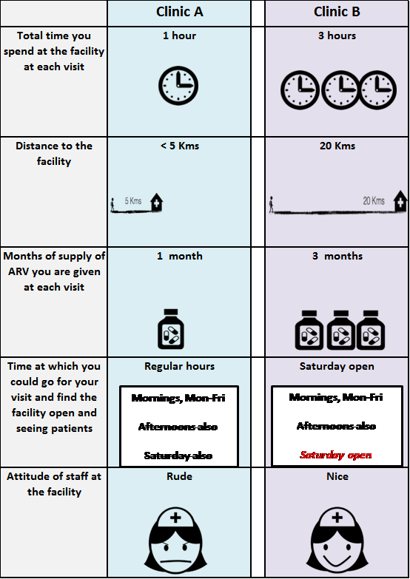
“Do you prefer going to Clinic A, Clinic B, or would you rather not go to either one?
Notes:
In a further attempt to quantify preferences, In a sub sample of the patients we sought, we also conducted a choice experiment, which can provide further information about relative strength of patient preferences. In this choice experiment patients were provided with a series of two clinics based on five attributes: time spent at the facility, distance, supply or ART, hours, attitude…

Slide 28
Choice Experiment Results (N=279)
Notes:
Here the actual numbers aren’t crucial, but rather we want to look at the relative magnitude. For example, staff is nice is the most important quality of a clinic according to patients’ stated preferences.
Next in line is longer refill lengths. So, patients preferred receiving a refill every 3 months versus every month and also every 5 months was preferred to every 3 months. Additional opening hours and shorter distance and wait time were also preferable, but not nearly as much as nice staff and longer refill periods.
This was not an altogether expected finding and really brought our attention to this issue
Model was Mixed logit.

Slide 29
Willingness to Wait Analysis
 | Coefficient | Std. Error | WT Wait
Wait (additional hour)* | -0.20 | 0.09
Distance (additional Km)*** | -0.07 | 0.02 | -0.3
Refill is every month (vs 3 months)*** | -3.10 | 0.53 | -15.5
Refill is every 5 months (vs 3 months)*** | 1.51 | 0.40 | 7.6
Open in the afternoon (vs regular hours) | 0.16 | 0.18
Open also on Saturday (vs regular hours) | 0.42 | 0.26
Staff is nice** | 3.15 | 1.20 | 15.8

Slide 30
DCE for implementation science
A technique for understanding patient perspectives
A philosophy that what people wants matters
A big change in paradigm for public health
Broadening our disciplinary lens can be useful
Examples
  Place of childbirth Tanzania
  https://www.ncbi.nlm.nih.gov/pmc/articles/PMC2724466/
  https://www.ncbi.nlm.nih.gov/pubmed/26262840
Standards
  https://www.ispor.org/ValueInHealth/ShowValueInHealth.aspx?issue=3551E3F3-83A8-4895-9415-5272AF29A9DF
  https://www.ispor.org/Conjoint-Analysis-Statistical-Methods-Guidelines.pdf

Slide 31
From Econ to Human

Slide 32
Econ vs. Human
Even though basic economic theory is powerful, there is a lot of interest in a new understanding of behavior
Predictably irrational – more useful than economic “laws”
Review salient concept
Review applications in health

Slide 33
Problem: we don’t do what we want to do
General issue in health….
Exercise
Obesity
Smoking cessation
Drug use
Medication adherence
Etc….

Slide 34
Temporal discounting
500 in six months or 200 today
500 in six months or 300 today
500 in six months or 400 today
500 in six months or 450 today
500 in six months or 475 today
500 in six months or 490 today

Slide 35
Temporal discounting: Hyperbolic
95 today vs. 100 in one week
95 on April 16 2019 vs. 100 on April 21, 2019
Notes:
Point out how this means people would change their minds
Inconsistent

Slide 36
Temporal discounting
Everyone discounts
Different people have different discount rates
That discount rate is not exponential but rather hyperbolic

Slide 37


Thursday
Friday
Far future
Saturday
Stressful week for a 19 year old in college
Be healthy and smart and fit and buff!!
Plan to go on a trail running in morning to be fit and then goto cross fit after
Friends are going drinking and partying all night – but you decide to stay home and be healthy and study

Slide 38
Delayed but bigger reward (be healthy and fit and smart)
Sooner but smaller reward (get drunk and have fun)
Value to you
Thursday
Friday
Saturday
Sunday and beyond
Notes:
That means that the way it looses value to you is the same for now you and future you
But in reality we are willing to wait for things in the future, that future you is not willing to wait for when you almost get there
Let’s say you plan today, that on Friday you will not go drinking and on Saturday morning you will go on a long run
Today, deferring bar hopping with your friends on Friday seems like a good idea – and overall will make you happiest
From today’s vantage point you think you are willing to give up cake for a day to go exercise (because waiting another day for cake doesn’t look that bad from your vantage point)
But when you get to tomorrow, the way the

Slide 39
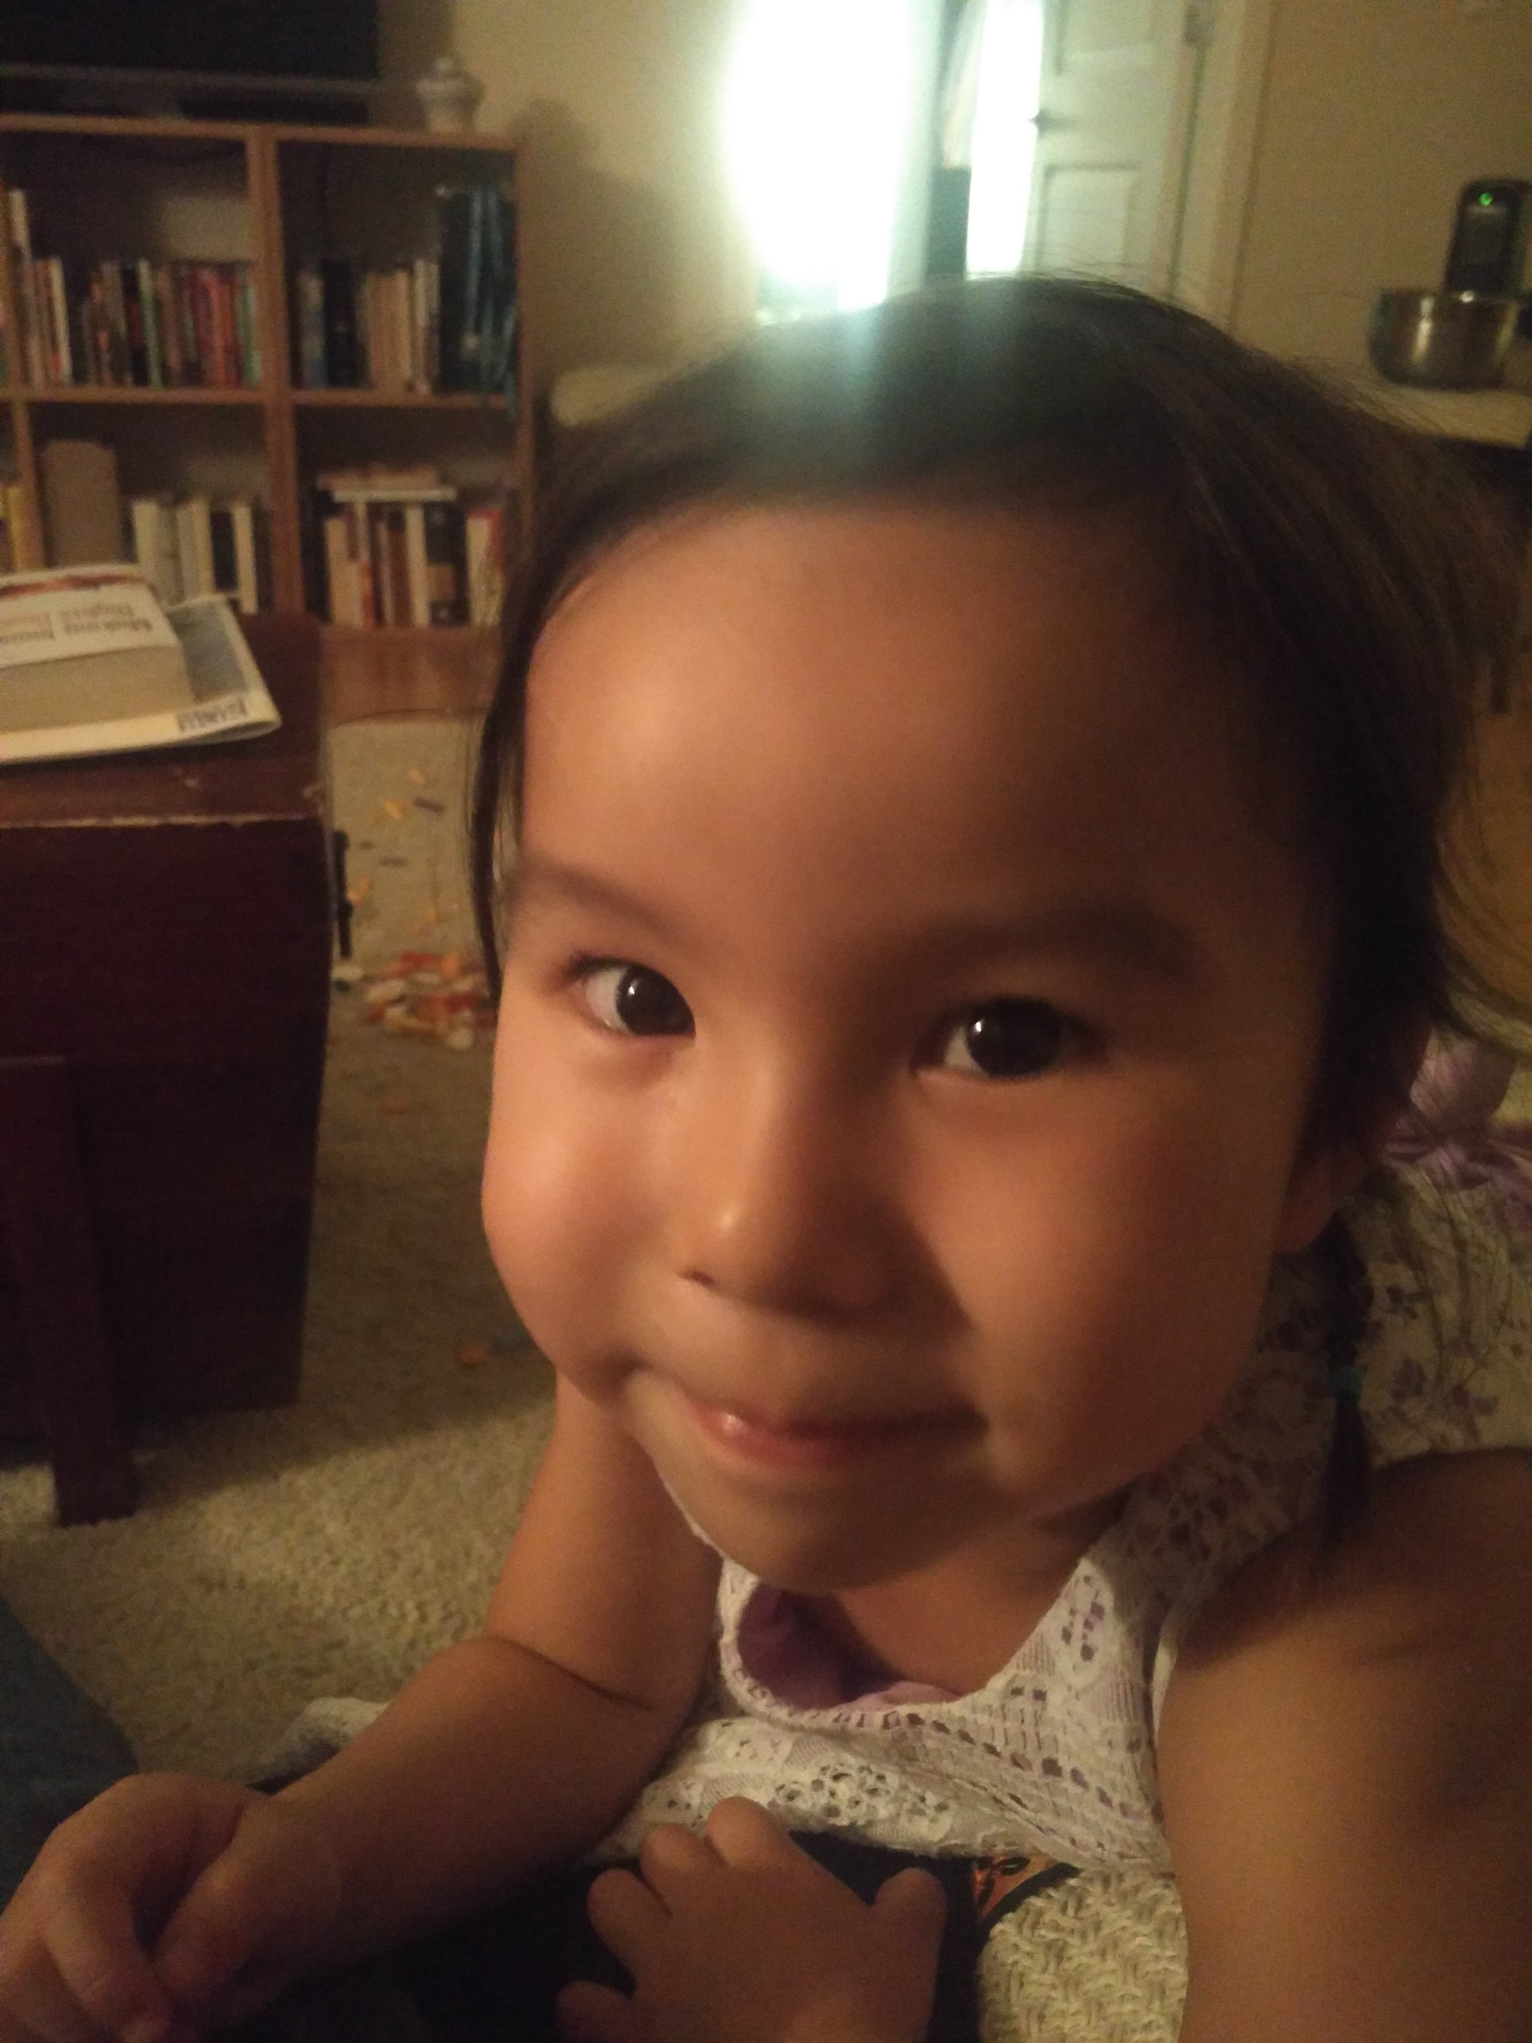
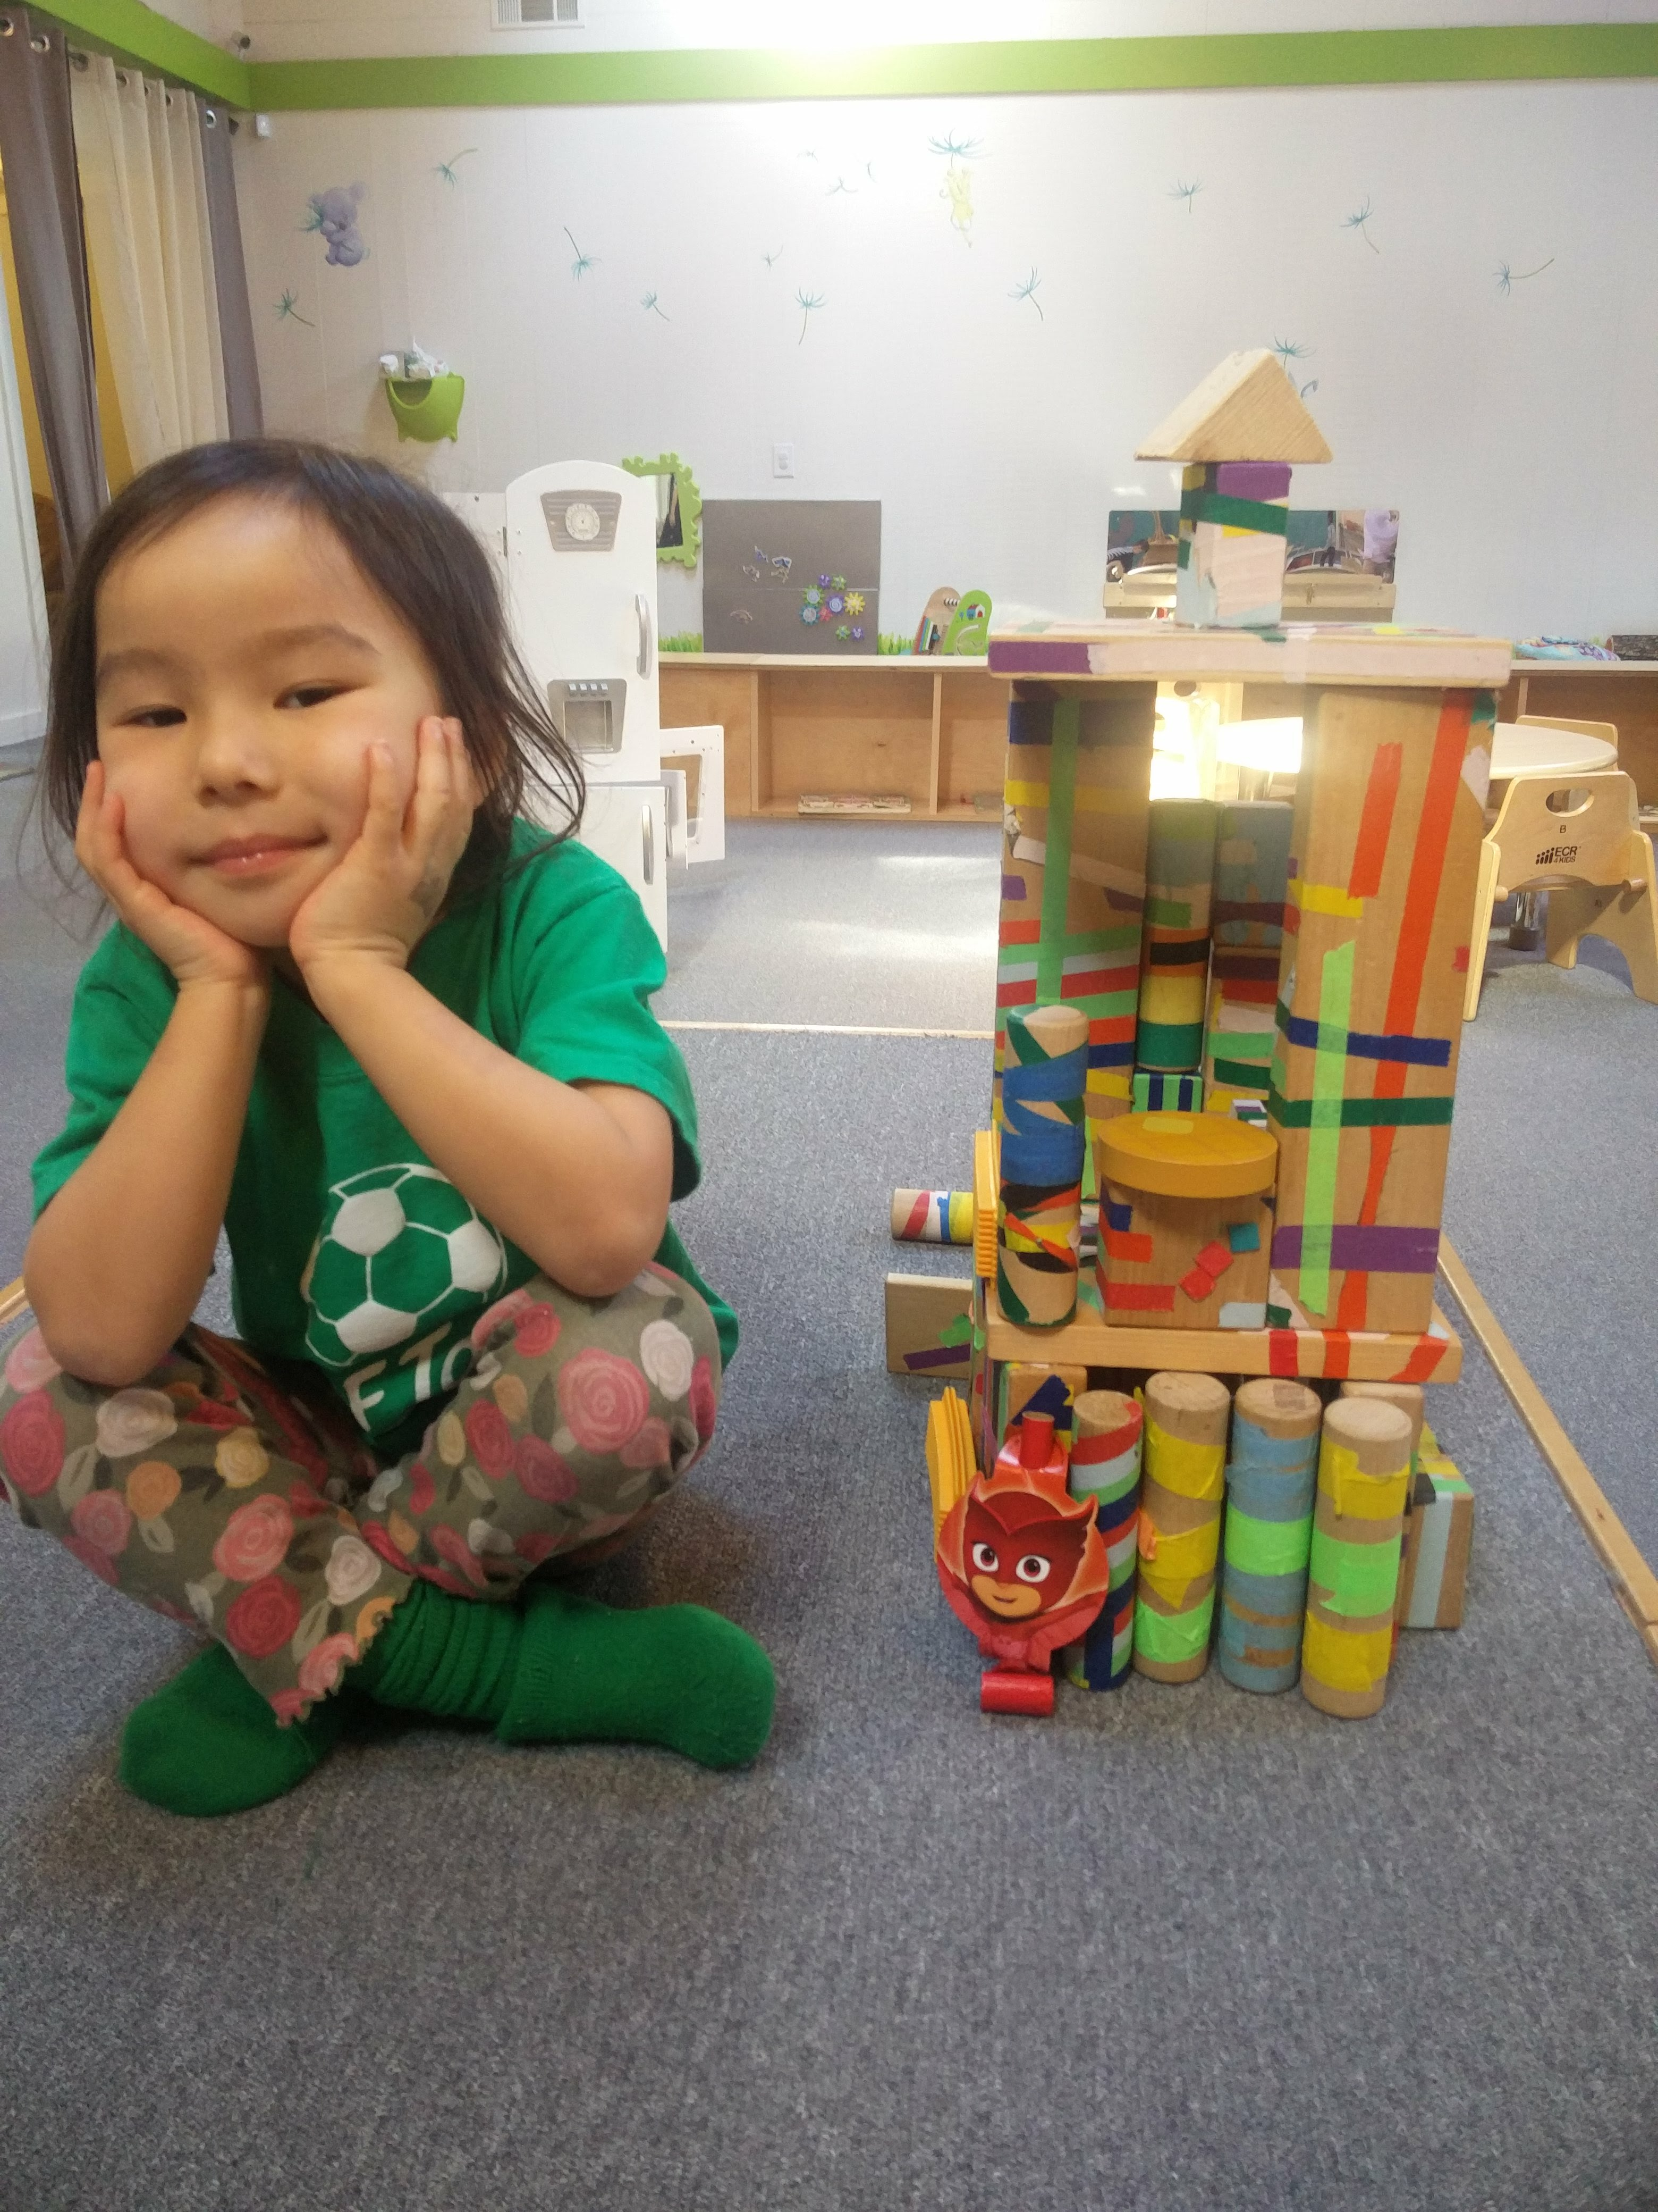
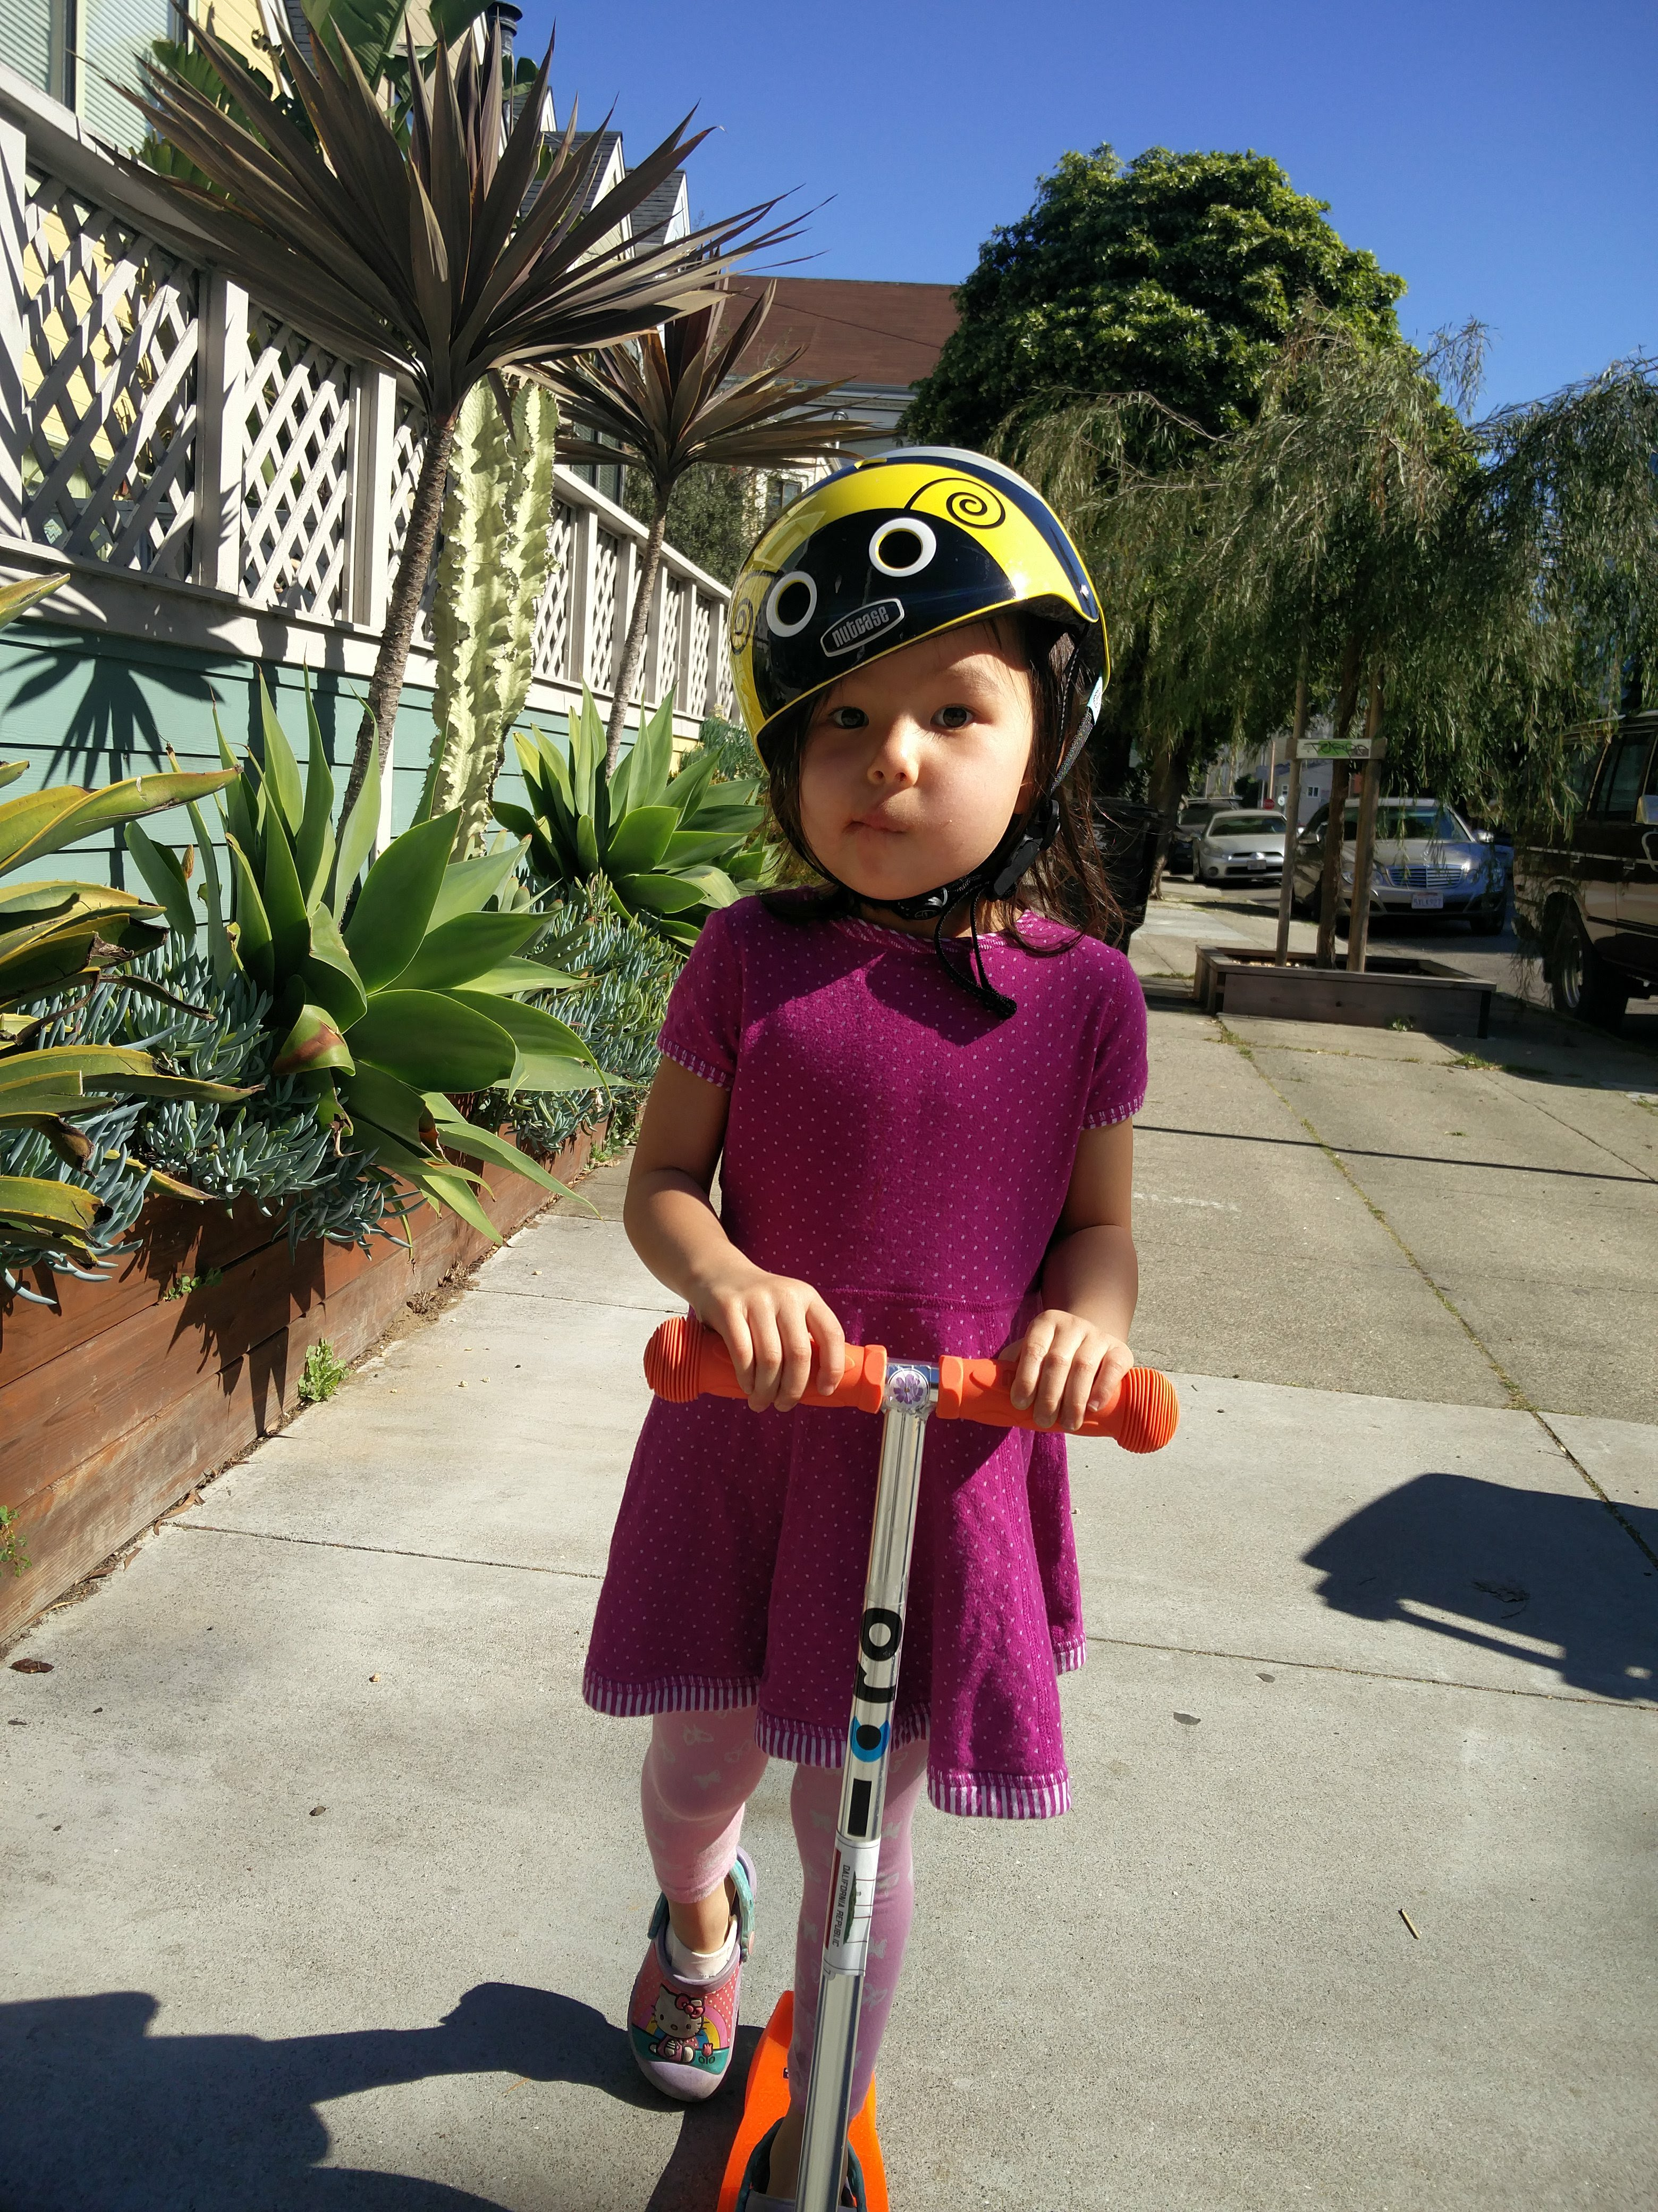

Explaining real world behavior

Slide 40
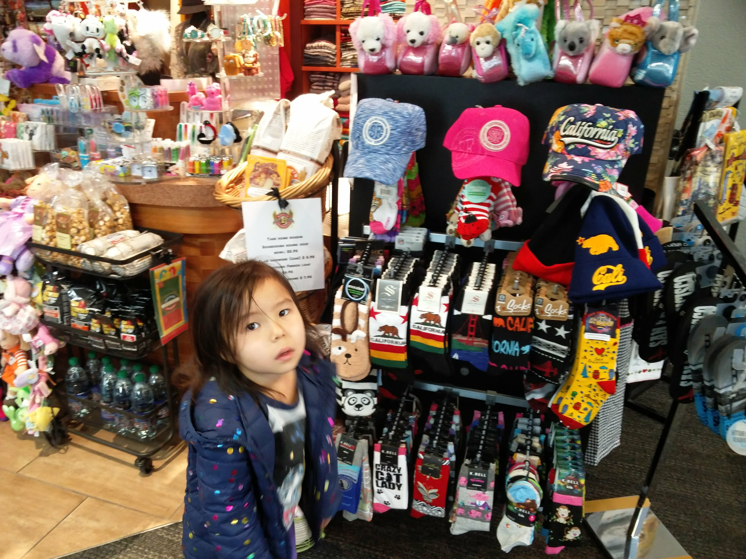

“If you get me one of these stuffies, I promise I will never want to get another one. I PROMISE!”
Notes:
Threw her reward chart away

Slide 41
Explanation
First, there is absolutely no way that statement is true
But, she is not lying to me
What is she saying?
  I want something now (vs. later)
  If it is later, it doesn’t matter what it is worth, it’s value is zero
How do we explain this?
….Hyperbolic temporal discounting

Slide 42
Delayed but bigger reward (more stuffed animals)
Sooner but smaller reward (one stuffed animal)
Value
Thursday
Friday
Saturday
Sunday and beyond

Slide 43
Interpretation…
She’s really saying
  From where I stand, getting something now has higher utilities (better) than any thing of any value in the future
  The curve is flat until the time of the event
Something now is worth more than something else (of infinitely higher value) at any later time

Slide 44
Examples…
Incentives for weight loss
  Kullgren, Jeffrey T., et al. "Individual-versus group-based financial incentives for weight loss: a randomized, controlled trial." Annals of internal medicine 158.7 (2013): 505-514.
Incentives for male circumcision
  Thirumurthy, Harsha, et al. "Effect of providing conditional economic compensation on uptake of voluntary medical male circumcision in Kenya: a randomized clinical trial." Jama 312.7 (2014): 703-711.
Incentives for stopping smoking
  Volpp KG, Troxel AB, Pauly MV, Glick HA, Puig A, Asch DA, Galvin R, Zhu J, Wan F, DeGuzman J, Corbett E. A randomized, controlled trial of financial incentives for smoking cessation. New England Journal of Medicine. 2009 Feb 12;360(7):699-709.

Slide 45
Norms

Slide 46
People look to others for cues
People tend to do what they think other people are doing (or thinking)
If you are in a room with smoke alone – you report it, but if you are in a room with two other people doing nothing you won’t
Latane Journal of Personality and Social Psychology, Vol 10(3), Nov 1968, 215-221

Slide 47
Confession….

Slide 48
Social norms in Tanzania
Circumcision
50% risk reduction in HIV acquisition for men
Like a vaccine…. (except not really)

Slide 52
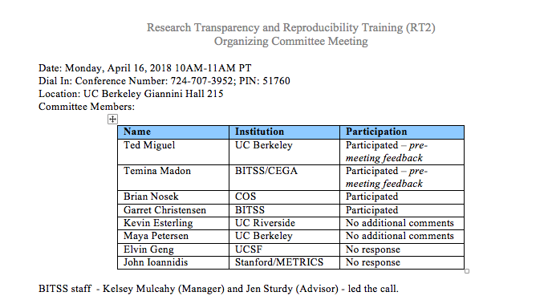

Slide 53
88% of people did the optional readings

Slide 54
Norms…
Cialdini’s error
  Statement: Drunk drivers are everywhere! It’s and urgent problem! We need to stop it!
  Subtext: Everyone is doing it.
What’s wrong with the following public health messages?
“Syphilis rates are out of control! Use a condom!”
“Young African-American MSM are at high risk (i.e., having condomless sex) for HIV so use PrEP!”

Slide 55
From Norms to Social Networks

Slide 56
Sociometric mapping
Name generators to identify ties
  “If you had a problem with [X], whose value or opinion do you most value?”
Yields “nodes” and “edges” (which can be directed or non directed)
Node characteristics
  How many nodes is a given node connected to
Network characteristics
  The characteristics of the network

Slide 57
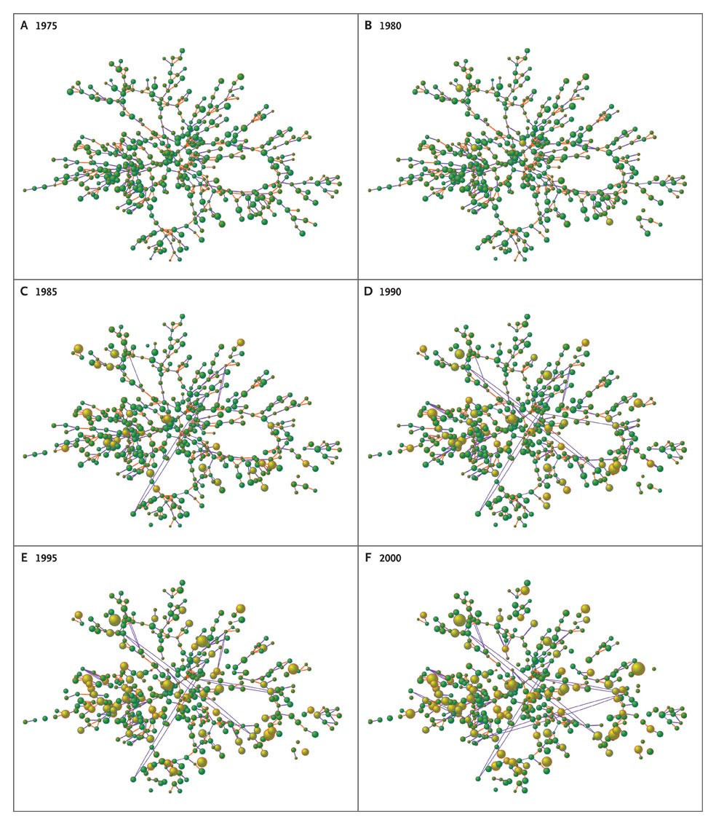

Christakis NA, Fowler JH. N Engl J Med 2007;357:370-379.
Part of the Social Network from the Framingham Heart Study with Information about Body-Mass Index According to Year.
Notes:
Figure 2. Part of the Social Network from the Framingham Heart Study with Information about Body-Mass Index According to Year. Each circle (node) represents one person in the data set. Circles with red borders denote women, and circles with blue borders denote men. The size of each circle is proportional to the person's body-mass index. The interior color of the circles indicates the person's obesity status: yellow denotes an obese person (body-mass index, ≥30) and green denotes a nonobese person. The colors of the ties between the circles indicate the relationship between them: purple denotes a friendship or a marital tie and orange denotes a familial tie. The disappearance of a circle from one year to another indicates the person's death, and the disappearance of a tie between the circles indicates that the relationship between the two persons no longer exists. The largest connected subcomponent of the whole network and the change in obesity over the 32-year study period are shown in an animation that is available with the full text of this article at www.nejm.org.
A person's chances of becoming obese increased by 57% (95% confidence interval [CI], 6 to 123) if he or she had a friend who became obese in a given interval. Among pairs of adult siblings, if one sibling became obese, the chance that the other would become obese increased by 40% (95% CI, 21 to 60). If one spouse became obese, the likelihood that the other spouse would become obese increased by 37% (95% CI, 7 to 73). These effects were not seen among neighbors in the immediate geographic location.

Slide 58
Defaults

Slide 59
Eric Johnson Science

Slide 60
Halpern, Scott D., et al. "Default options in advance directives influence how patients set goals for end-of-life care." Health Affairs 32.2 (2013): 408-417.
Notes:
Halpern, Scott D., et al. "Default options in advance directives influence how patients set goals for end-of-life care." Health Affairs 32.2 (2013): 408-417.

Slide 61
Limitations
A nudge vs. a stiff kick
Organizational vs. individual behavior

Slide 62
Examples
https://www.science.gov/topicpages/i/implementation+research+cfir
https://www.ncbi.nlm.nih.gov/pubmed/29297401

Slide 63
Conclusions
If you want to change behavior
Think demand side
Consider using insights about behaviors from behavioral economics
For homework, revisit diagnosis.

