Slide 1
Repeated Measures, Part 3
Charles E. McCulloch,
Division of Biostatistics,
Dept of Epidemiology and Biostatistics,
UCSF

Slide 2
Outline
More on xtgee
Examples
Robust standard errors
Binary outcomes
Changing the link function
Modeling practice
Summary

Slide 3
Using xtgee: 5 things to specify
What is the distributional family (for fixed values of the covariates) that is appropriate to use for the outcome data? Normal, binary, binomial (other?).
Which predictors are we going to include in the model? (Nothing new here).
In what way are we going to link the predictors to the data? (Through the mean? Through the logit of the risk?)
What correlation structure will be used or assumed temporarily in order to form the estimates?
Which variable indicates how the data are clustered?

Slide 4
xtgee: syntax
Example: Fecal Fat
xtgee fecfat i.pilltype i.sex, i(patid) t(pilltype) family(gaussian) corr(exch)
which can be shortened using defaults to
xtgee fecfat i.pilltype i.sex, i(patid)

Slide 5
More on xtgee
Here are the commonly used options:
Family
binomial
Gaussian (i.e., normal) default
gamma
nbinomial
Poisson
Notes:
Examples: binomial – readmission within 30 days, Gaussian – BMI, gamma – cost, Poisson, negative binomial – number of hospital days

Slide 6
More on xtgee
Link
identity (model mean directly) default for Gaussian
log default for Poisson
logit default for binomial
power
probit

Slide 7
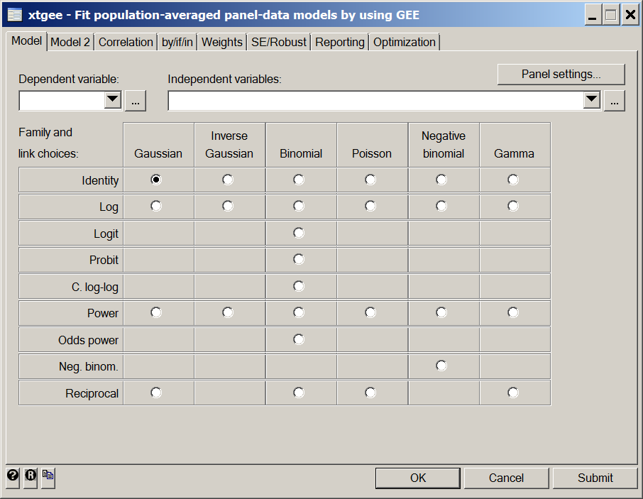
More on xtgee: main menu
Notes:
The menu interface for xtgee in Stata.

Slide 8
More on xtgee
Correlation structure
independent
exchangeable default
ar #
unstructured

Slide 9
Examples
Let’s try this on the birthweight data.
. xtgee bweight birthord initage, family(gaussian) link(identity) corr(exchangeable) i(momid)
. xtgee bweight birthord initage, fam(gau) link(i) corr(exch) i(momid)
. xtgee bweight birthord initage, i(momid)
all give the same output:

Slide 10
Examples
Iteration 1: tolerance = 7.180e-13
GEE population-averaged model Number of obs = 1000
Group variable: momid Number of groups = 200
Link: identity Obs per group: min = 5
Family: Gaussian avg = 5.0
Correlation: exchangeable max = 5
Wald chi2(2) = 30.87
Scale parameter: 324458.3 Prob > chi2 = 0.0000
------------------------------------------------------------------------------
bweight | Coef. Std. Err. z P>|z| [95% Conf. Interval]
---------+--------------------------------------------------------------------
birthord | 46.608 9.944792 4.687 0.000 27.11657 66.09943
initage | 26.73226 8.957553 2.984 0.003 9.175783 44.28874
_cons | 2526.622 162.544 15.544 0.000 2208.042 2845.203

Slide 11
Examples
The command
. xtcorr
Estimated within-momid correlation matrix R:
c1 c2 c3 c4 c5
r1 1.0000
r2 0.3904 1.0000
r3 0.3904 0.3904 1.0000
r4 0.3904 0.3904 0.3904 1.0000
r5 0.3904 0.3904 0.3904 0.3904 1.0000
gives the estimated correlation structure.

Slide 12
Examples: variation I
. xtgee bweight birthord initage, i(momid) corr(uns)
GEE population-averaged model Number of obs = 1000
Group and time vars: momid birthord Number of groups = 200
Link: identity Obs per group: min = 5
Family: Gaussian avg = 5.0
Correlation: unstructured max = 5
Wald chi2(2) = 30.43
Scale parameter: 324495.1 Prob > chi2 = 0.0000
------------------------------------------------------------------------------
bweight | Coef. Std. Err. z P>|z| [95% Conf. Interval]
---------+--------------------------------------------------------------------
birthord | 44.70366 9.935604 4.499 0.000 25.23023 64.17708
initage | 28.07164 8.79559 3.192 0.001 10.83261 45.31068
_cons | 2505.539 159.0359 15.755 0.000 2193.834 2817.243
------------------------------------------------------------------------------
. xtcorr
Estimated within-momid correlation matrix R:
c1 c2 c3 c4 c5
r1 1.0000
r2 0.1905 1.0000
r3 0.2977 0.4714 1.0000
r4 0.2475 0.4326 0.6417 1.0000
r5 0.3641 0.3814 0.4286 0.4487 1.0000
The estimated correlations are a bit different, but the coefficients and SEs have remained almost unchanged

Slide 13
Examples: variation II
. xtgee bweight birthord initage, i(momid) corr(uns) robust
Iteration 1: tolerance = .04763573
Iteration 2: tolerance = .00062083
Iteration 3: tolerance = .00001004
Iteration 4: tolerance = 1.668e-07
GEE population-averaged model Number of obs = 1000
Group and time vars: momid birthord Number of groups = 200
Link: identity Obs per group: min = 5
Family: Gaussian avg = 5.0
Correlation: unstructured max = 5
Wald chi2(2) = 29.05
Scale parameter: 324495.1 Prob > chi2 = 0.0000
(standard errors adjusted for clustering on momid)
------------------------------------------------------------------------------
| Semi-robust
bweight | Coef. Std. Err. z P>|z| [95% Conf. Interval]
---------+--------------------------------------------------------------------
birthord | 44.70366 9.84746 4.540 0.000 25.40299 64.00432
initage | 28.07164 9.141285 3.071 0.002 10.15506 45.98823
_cons | 2505.539 161.11 15.552 0.000 2189.769 2821.308
------------------------------------------------------------------------------
Robust doesn’t change the coefficients, but recalculates the SEs

Slide 14
Robust standard errors
The “robust” option asks Stata to estimate the standard errors empirically from the data. This has the significant advantage that it gives valid standard errors even when the assumed correlation structure is wrong. It is also better than assuming an unstructured variance-covariance structure, because it bypasses the estimation of the correlations over “time” to directly get an estimate of the standard errors.
The robust option works well when there are many “subjects” and not too much data per subject and not much missing data. So, for example, it would work very well when there are 2,000 subjects most measured yearly for four years. It would not work well if the “subjects” were 8 centers in a multi-center trial, each with 1,000 patients enrolled.

Slide 15
Examples: variation III (mixed)
mixed bweight birthord initage || momid:, reml
Mixed-effects REML regression Number of obs = 1000
Group variable: momid Number of groups = 200
Obs per group: min = 5
avg = 5.0
max = 5
Wald chi2(2) = 30.75
Log restricted-likelihood = -7649.3763 Prob > chi2 = 0.0000
------------------------------------------------------------------------------
bweight | Coef. Std. Err. z P>|z| [95% Conf. Interval]
-------------+----------------------------------------------------------------
birthord | 46.608 9.951014 4.68 0.000 27.10437 66.11163
initage | 26.73226 9.002678 2.97 0.003 9.08734 44.37719
_cons | 2526.622 163.3387 15.47 0.000 2206.484 2846.76
------------------------------------------------------------------------------
------------------------------------------------------------------------------
Random-effects Parameters | Estimate Std. Err. [95% Conf. Interval]
-----------------------------+------------------------------------------------
momid: Identity |
sd(_cons) | 358.1759 23.71804 314.5797 407.8139
-----------------------------+------------------------------------------------
sd(Residual) | 445.0229 11.13253 423.7298 467.386
------------------------------------------------------------------------------
LR test vs. linear regression: chibar2(01) = 209.20 Prob >= chibar2 = 0.0000
Notes:
mixed gives additional information. But it does assume that the correlation structure is exchangeable. So gives almost the same answers as xtgee with exch and robust turned off.

Slide 16
Binary outcomes/logistic regression
Now let’s take a look at the use of xtgee for clustered logistic regression. I took the Georgia babies data set and artificially dichotomized it as to whether birthweight was above or below 3000 grams.
What options do we use now?
    family =
    link =
    corr =
Notes:
Family = binomial
Link = logit
Corr=exchangeable

Slide 17
Binary outcomes: low birthweight
xtgee lowbirth birthord initage, i(momid) family(binomial)
GEE population-averaged model Number of obs = 1000
Group variable: momid Number of groups = 200
Link: logit Obs per group: min = 5
Family: binomial avg = 5.0
Correlation: exchangeable max = 5
Wald chi2(2) = 11.30
Scale parameter: 1 Prob > chi2 = 0.0035
------------------------------------------------------------------------------
lowbirth | Coef. Std. Err. z P>|z| [95% Conf. Interval]
---------+--------------------------------------------------------------------
birthord | -.0829363 .0390214 -2.125 0.034 -.159417 -.0064557
initage | -.089028 .0337755 -2.636 0.008 -.1552267 -.0228293
_cons | 1.267884 .6036077 2.101 0.036 .0848346 2.450933
------------------------------------------------------------------------------
How does this compare to the continuous data fit?
OK to assume exchangeable?
Notes:
Much less statistically significant. Reflects the loss of information in making a numeric outcome binary. Original data exchangeable, so probably OK here. Can check by comparing to xtgee with robust.

Slide 18
Binary outcomes: robust option
xtgee lowbirth birthord initag, i(momid) family(bino) robust
GEE population-averaged model Number of obs = 1000
Group variable: momid Number of groups = 200
Link: logit Obs per group: min = 5
Family: binomial avg = 5.0
Correlation: exchangeable max = 5
Wald chi2(2) = 10.64
Scale parameter: 1 Prob > chi2 = 0.0049
(Std. Err. adjusted for clustering on momid)
------------------------------------------------------------------------------
| Semi-robust
lowbirth | Coef. Std. Err. z P>|z| [95% Conf. Interval]
-------------+----------------------------------------------------------------
birthord | -.0829363 .0384829 -2.16 0.031 -.1583614 -.0075113
initage | -.089028 .0341776 -2.60 0.009 -.1560149 -.0220412
_cons | 1.267884 .6099252 2.08 0.038 .0724524 2.463315
------------------------------------------------------------------------------

Slide 19
Binary outcomes: low birthweight
. xtgee lowbirth initage birthord, i(momid) link(logit) family(binomial) robust ef
GEE population-averaged model Number of obs = 1000
Group variable: momid Number of groups = 200
Link: logit Obs per group: min = 5
Family: binomial avg = 5.0
Correlation: exchangeable max = 5
Wald chi2(2) = 10.64
Scale parameter: 1 Prob > chi2 = 0.0049
(Std. Err. adjusted for clustering on momid)
------------------------------------------------------------------------------
| Robust
lowbirth | Odds Ratio Std. Err. z P>|z| [95% Conf. Interval]
-------------+----------------------------------------------------------------
birthord | .9204098 .03542 -2.16 0.031 .8535413 .9925168
initage | .9148199 .0312663 -2.60 0.009 .8555464 .9781999
_cons | 3.553325 2.167263 2.08 0.038 1.075142 11.74368
------------------------------------------------------------------------------
Notes:
Would usually like odds ratios, which are available with the ef (exponential form) option.

Slide 20
Low birthweight: mixed effects model
. meglm lowbirth initage birthord ||momid:, link(logit) family(binomial) or
Mixed-effects GLM Number of obs = 1000
Family: binomial
Link: logit
Group variable: momid Number of groups = 200
Obs per group: min = 5
avg = 5.0
max = 5
Integration method: mvaghermite Integration points = 7
Wald chi2(2) = 11.90
Log likelihood = -588.05261 Prob > chi2 = 0.0026
------------------------------------------------------------------------------
lowbirth | Odds Ratio Std. Err. z P>|z| [95% Conf. Interval]
-------------+----------------------------------------------------------------
initage | .8808697 .0404965 -2.76 0.006 .804969 .9639271
birthord | .8872647 .0500711 -2.12 0.034 .7943597 .9910354
_cons | 6.00727 4.979094 2.16 0.031 1.183486 30.49236
-------------+----------------------------------------------------------------
momid |
var(_cons)| 2.595213 .5419826 1.723489 3.907845
------------------------------------------------------------------------------
LR test vs. logistic regression: chibar2(01) = 123.25 Prob>=chibar2 = 0.0000
ORs are further from 1 for mixed effects models, though p-values are usually similar. Slightly different interpretation (subject specific).
Notes:
Now compare the use of a mixed model.

Slide 21
Changing the link function
What kind of model would this command fit?
xtgee bweight birthord initage, i(momid) link(log)
GEE population-averaged model Number of obs = 1000
Group variable: momid Number of groups = 200
Link: log Obs per group: min = 5
Family: Gaussian avg = 5.0
Correlation: exchangeable max = 5
Wald chi2(2) = 30.56
Scale parameter: 324595.5 Prob > chi2 = 0.0000
------------------------------------------------------------------------------
bweight | Coef. Std. Err. z P>|z| [95% Conf. Interval]
---------+--------------------------------------------------------------------
birthord | .0147553 .0031742 4.648 0.000 .0085339 .0209767
initage | .008179 .0027336 2.992 0.003 .0028212 .0135368
_cons | 7.862211 .0503139 156.263 0.000 7.763598 7.960825
------------------------------------------------------------------------------
Interpretations:

Slide 22
Changing the link function
Notes:
So this model is useful if we know we want to describe the effects of predictors in terms of relative change.

Slide 23
Changing the link function
You can ask Stata to exponentiate for you using the eform option:
xtgee bweight birthord initage, i(momid) link(log) eform
GEE population-averaged model Number of obs = 1,000
Group variable: momid Number of groups = 200
Link: log Obs per group:
Family: Gaussian min = 5
Correlation: exchangeable avg = 5.0
max = 5
Wald chi2(2) = 30.56
Scale parameter: 324595.5 Prob > chi2 = 0.0000
------------------------------------------------------------------------------
bweight | exp(b) Std. Err. z P>|z| [95% Conf. Interval]
-------------+----------------------------------------------------------------
birthord | 1.014865 .0032214 4.65 0.000 1.00857 1.021198
initage | 1.008213 .0027561 2.99 0.003 1.002825 1.013629
_cons | 2597.258 130.6783 156.26 0.000 2353.357 2866.437
------------------------------------------------------------------------------
Notes:
What is the interpretation of the age coefficient?

Slide 24
Changing the link function
What kind of model would this command fit?
xtgee lowbirth birthord initage, i(momid) family(bino) link(log)

Slide 25
Changing the link function (cont.)
To fit a relative risk model for binary data with or without clustering (think of the same question using cross-sectional data) some people recommend the following model. Why should this work?
xtgee lowbirth birthord initage, i(momid) family(poisson) robust
Notes:
Log link doesn’t constrain probabilities to be within (0,1). So change the distribution, but use robust to fix the incorrect SEs due to the Poisson model.

Slide 26
Changing the link function
Output for binary outcome, log link:
xtgee lowbirth birthord initage, i(momid) family(poisson) robust eform
GEE population-averaged model Number of obs = 1,000
Group variable: momid Number of groups = 200
Link: log Obs per group:
Family: Poisson min = 5
Correlation: exchangeable avg = 5.0
max = 5
Wald chi2(2) = 10.44
Scale parameter: 1 Prob > chi2 = 0.0054
(Std. Err. adjusted for clustering on momid)
------------------------------------------------------------------------------
| Robust
lowbirth | IRR Std. Err. z P>|z| [95% Conf. Interval]
-------------+----------------------------------------------------------------
birthord | .9500198 .0227377 -2.14 0.032 .9064839 .9956465
initage | .9426217 .0219578 -2.54 0.011 .900553 .9866557
_cons | 1.197149 .4797687 0.45 0.653 .5457846 2.625882
------------------------------------------------------------------------------
Notes:
What is the interpretation of the birthord coefficient?
With each increase in birth order by 1, the risk of a low birthweight baby decreases by about 5%.

Slide 27
Modeling practice 1
Epileptics were randomly allocated to a placebo or an anti-seizure drug (Progabide) group. The number of seizures was recorded during a baseline period and for four periods after beginning treatment.
Is the drug effective at reducing the number of seizures?
    family =
    link =
    corr =
    predictors =
Notes:
Family = Poisson
Link = log
Corr = exch (but use robust)
Predictors = treatment period, treatment group and interaction

Slide 28
Modeling practice 2
A quality improvement program was designed to reduce prescription of antibiotics for antibiotic resistant infections in emergency departments. 16 hospitals were randomized to the program or control group. Is the program effective?
    family =
    link =
    corr =
    predictors =
Notes:
Family = binomial (yes/no antibiotic)
Link = logit
Corr = exch
Predictors = treatment group (and/or before/after + before/after X treatment)

Slide 29
Modeling practice 3
The OAI is a longitudinal cohort study of osteoarthritis. ~5000 participants were studied yearly for 5 years. Is gender, presence of a lesion on the MRI, or race associated with the change in pain over time? Pain is assessed using a numerical scale called the WOMAC.
    family =
    link =
    corr =
    predictors =
Notes:
Family = Gaussian
Link = identity
Corr = exch (but use robust)
Predictors = gender, MRI lesion, race, time, gender X time, race X time

Slide 30
Notes on xtgee
xtgee is a flexible regression command
Handles a single level of clustering
Handles a wide variety of distributions, links and correlation structures
Five questions: distribution, predictors, link, correlation structure, cluster variable
Not designed for inferences about the correlation structure
Doesn’t give predicted values for each cluster

Slide 31
Summary
Hierarchical data structures are common.
Lead to correlated data.
Ignoring the correlation can be a serious error.
xtgee can handle single level of clustering and a variety of outcome types.
mixed can handle multiple levels for normally distributed data.
Not discussed in class: melogit and mepoisson can handle multiple levels of clustering for binary and Poisson outcomes. Random effects models and robust SEs are also available for time-to-event data.
GEE methods have the advantage of robust SEs.
Mixed effects models have the advantage of being able to handle more general types of designs and partition variability.

