Slide 1
Implementation Interventions
Elvin Geng
Epidemiology 245
Spring 2017

Slide 2
From an analysis…
Opportunity
Insurance issues
Routine clinic visits don’t identify those at risk
Capability
HCW don’t know about drug
Doctor Perscribes PrEP
Motivation
Prioritization
Giving HIV prophylaxis is not “my job”
“I’ll take care of this next time”

Slide 3
…to Diagnosis?
Something in between
Less formed – more inductive
More formed – something deductive

Slide 4
PrEP Case
Problem: PrEP not used
Diagnosis:
  To date, people have tried to word on patients, but doctors are the barrier.
  Doctors know about PrEP and believe in it
  Doctors say they intend to prescribe PrEP, but they do not.
  We believe insights about temporal discounting explain this behavior.

Slide 5

Delayed but bigger reward (keep patient protected)
Sooner but smaller reward (get through panel)
Value to you
Thursday
Friday
Saturday
Sunday and beyond
Notes:
That means that the way it looses value to you is the same for now you and future you
But in reality we are willing to wait for things in the future, that future you is not willing to wait for when you almost get there
Let’s say you plan today, that on Friday you will not go drinking and on Saturday morning you will go on a long run
Today, deferring bar hopping with your friends on Friday seems like a good idea – and overall will make you happiest
From today’s vantage point you think you are willing to give up cake for a day to go exercise (because waiting another day for cake doesn’t look that bad from your vantage point)
But when you get to tomorrow, the way the

Slide 6
Is there evidence that doctors intend but do not prescribe?
Is there evidence that the shape of the discount is different for the agent (vs the principal)

Slide 7
Overview: Week 3
Describe distinctive challenges to conceptualization of implementation interventions and strategies
Describe a framework for understanding implementation interventions and strategies
Illustrate use of this framework to dissect interventions and strategies
Describe consequences of inadequate conceptualization of implementation interventions

Slide 8
What are Implementation Interventions or Strategies?
Proctor
  “Implementation strategies…constitute the ‘how to’ component of changing healthcare practice”
  “…the specific means or methods for adopting and sustaining interventions…”
Something done to close the gap between evidence and practice
  Evidence-based clinical intervention might be dolutegravir and Truvada for HIV infection (non-toxic, potent)
  An “implementation intervention” might be adherence counseling using motivational interviewing techniques to increase adherence to that medication

Slide 9
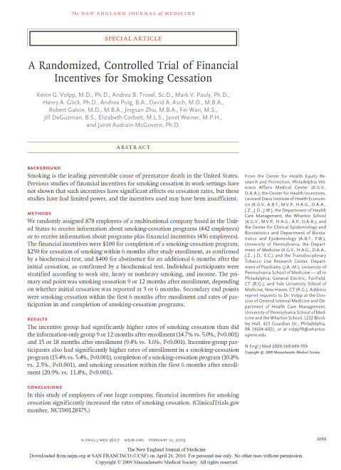
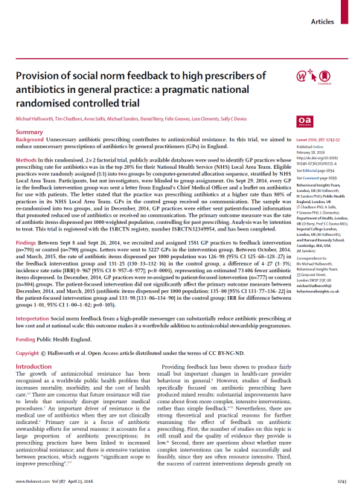

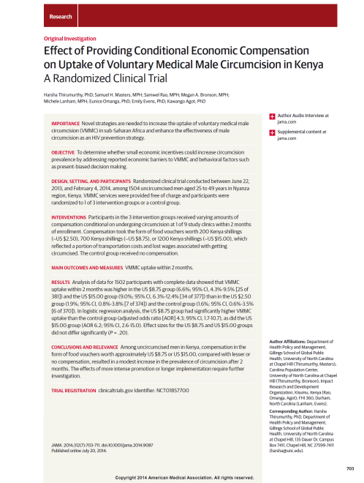
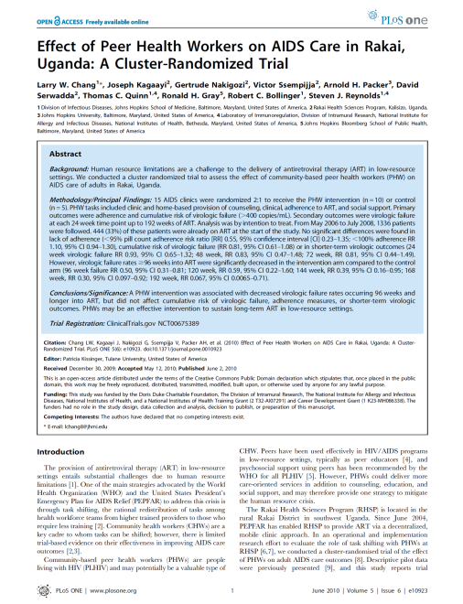
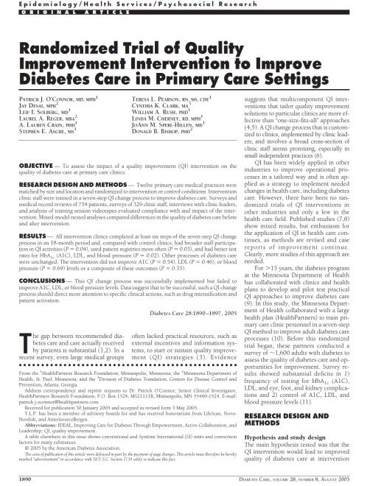
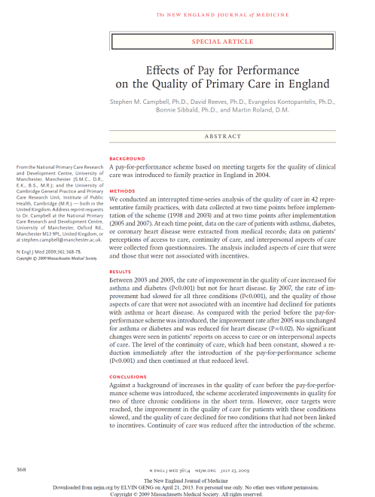

Implementation Strategies and Interventions: Examples…
Incentives
Social Networks
Quality Improvement
Notes:
Of course not all RCT’s

Slide 10
Why are Implementation Interventions Tricky?
Traditional Clinical Intervention
(often a pharmacologic intervention)
Implementation Strategy
(often a behavioral intervention)
Bench and animal research : identify a
compound; understand mechanism
Draw from existing practices to design an intervention
Settle on a precise formulation: dose, frequency, monitoring requirements
Phase 1 and 2 trials: determine safety, dosage, side effects…
Use the intervention as designed in a study (or in practice) – including adaptive ones
Use the drug in a clinical trial (selected population; controlled measurements)
Intervention as delivered in that study
Intervention as delivered in that trial (adherence)
Intervention effects - efficacy
Intervention effects – effectiveness; unintended effects (i.e., side effects)
Notes:
In drug development – there is a lot that goes into understanding the intervention before you can use it in people. They are working with a firmer grasp of underlying mechanisms.

Slide 11
Distinctive Challenges for Implementation Interventions
Implementation interventions are often not fully conceptualized nor specified
  Dose, frequency, intensity are not “prerequisites”
How implementation interventions work is less understood
  “Mechanism” of effect incompletely known a priori
Difference between interventions as (originally) designed and as delivered
  Sometimes that is good - adaptivity
  Sometimes not good - fidelity
There is more uncertainty about effects
  intended and unintended effects

Slide 12
From Gap, to Gap Analysis, to Implementation Intervention
We have identified a gap and
analyzed the reasons for it…
You want to change the behavior
of the health system, organization,
health care worker, patient or community to close that gap
Still has ACE
Leadership wants ACE
Ever successfully started
ACE
Hospital that serves elderly
An approach to conceptualize the interventions or strategies to close this gap?

Slide 13
Conceptualizing and specifying implementation interventions (example)
Still has ACE
Leadership wants ACE
Ever successfully started
ACE
Hospital that serves elderly
(Or gap)
Proctor et al. Implémentation Science 2013, 8:139

Slide 14
Actor
Generalizable characterization of “actor”
Socio-demographics
Training, education (e.g., nurse)
Position (e.g., middle manager)
Identity (e.g., peer)
Sociometrically (e.g., opinion leader)
Knowledge / motivation gap: Leadership does not know or care about ACE – “actor” might be an advocacy organization or a branch of an advocacy organization (AARP).
Technical gap: Leadership wants it but doesn't know how to get it done – “actor” could be a professional with X training who occupies a new “seconded” position (e.g., QI for HIV - HRSA)
Hospital that
serves elderly
Leadership
wants ACE
Ever successfully
started ACE
Still has ACE
Notes:
Describe the actor in general terms.
The actor depends on your gap analysis.

Slide 15
The Actor
Who is the actor?
  The stakeholder or actor in an implementation eco-system who would carry out the intervention in reality
  Often some title, unit, organization
    Facilitates “translatability” into reality
  Can also be a “new” position / person / unit
    QI focal person in African Ministries of Health AIDS Programs
    Need to take care that it is “realistic”

Slide 16
Researcher (carrying out research) and actor in an implementation ecosystem
NGO
Department of Health
?
Public Hospital
Researcher
?
Health care workers
Patients
?
Community
Notes:
In implementation science think of yourself (the researcher) as manipulating one of any number of actors in a system.

Slide 17
Integration of Researcher with Actor
Whatever you seek to do as a researcher should be through “native” actor
The extent to which the researcher acts as or through an actor implies the amount of change you want to introduce into a system
No right answer
  Too much change: unrealistic and “pedantic”
  Too little: unlikely to have notable effects compared to present standard practice
Example
  Work with program management to influence the behavior of peer educators in an HIV program in Africa
  Use existing relationships (technical support teams)

Slide 18
Action
“An active verb statements to specify the specific actions, steps, or processes that need to be enacted” (e.g., train, educate, persuade, motivate) (BCW)
Knowledge / motivation gap: Leadership does not know or care about ACE – “actor” might be an advocacy organization or a branch of an advocacy organization (AARP) which seeks to persuade through petition letters and reputational incentive (website that shows facilities with and without ACE)
Technical gap: Leadership wants it but doesn't know how to get it done – “actor” could be a professional with X training who occupies a new “seconded” position (e.g., QI for HIV - HRSA seconds) which seeks to engage, motivate and train colleagues on a committee
Hospital that
serves elderly
Leadership
wants ACE
Ever successfully
started ACE
Still has ACE
Notes:
QI for HIV services in Africa as an example
Gap A: inadequate capacity at the level of the national leadership to develop a program
Actor A: QI expert secunded to the ministry by USAID
Actoin A: Engaged, train, and motivate leadership to institutionalize QI practices
Gap B: Facility take up is poor because there is no buy in from the in charges and weak managerial links because facilities are geographically remote
Actor B: District health officers
Action B: text messages What about prep among reproductive health specialists...
Action... What is the actor suppose to do? The seconded person changes the capability and motivation of the organization through leading, convening a committee, engaging decision makers, maybe that is how you envision their role?

Slide 19
NGO
Department of Health
Public Hospital
Researcher
Health care workers
Patients
Community
Notes:
How close is the action to what people do in reality or what they do now?

Slide 20
Dose and Temporality of Action
Knowledge / motivation gap: Leadership does not know or care about ACE – “actor” might be an advocacy organization or a branch of an advocacy organization (AARP) which seeks to persuade through petition letters and reputational incentive (website that shows facilities with and without ACE) (which are delivered monthly and available continuously, respectively)
Technical gap: Leadership wants it but doesn't know how to get it done – “actor” could be a professional with X training who occupies a new “seconded” position (e.g., QI for HIV - HRSA seconds) which seeks to engage, motivate and train colleagues on a committee - delivered at weekly meetings and prn as opportunities arise
Notes:
A QI coach who makes 2-hour, weekly visits to a clinic in order to train health care workers
The AARP ACE campaign unit sends letters with petitions to hospital CMO’s once monthly to show growing support
A teaching campaign using opinion leaders to give talks at free dinners about PrEP – seeks to target each provider only once.
It matters for Amoxicillin, prednisone and ibuprofen, does dose matter for behavioral interventions?
Weekly SMS enhances adherence, daily does not – even if message content is the same
Incentives

Slide 21
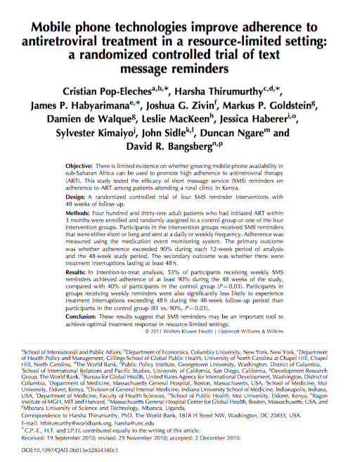
Dose Matters?
431 patients HIV on ART
Randomized to text messages that were weekly or daily
MEMS
90% adherence by week 48
  40% in control
  41% in daily (p = NS)
  53% in weekly (p < 0.05)

Slide 22
Dose Matters? Incentives
Larger incentives
  Small therapeutic window (gaming)
  More ability to crowd out
  Larger short term effect
Why
  Price point vs. present bias?
  Ibuprofen
Examples

Slide 23
Action Target
The “receptor”
The determinant of behavior
Cannot directly act on behavior
Action target mediates between intervention actions and behaviors
One schema: capability, opportunity, motivation (COMB)
Actor
Action
ActionTarget
Behavior
Achan NEJM 2012;367:2110-8.
Notes:
Example of a study where there was no mechani
Generalizability - Transportability
The ability to use results in one setting to infer about another
A function of what you have measured in the initial setting and what you know about the new settings
Age standardization
More complex when interventions have an effect on mediators of effects
Generalizability – Robustness
Stability of effects across different settings
Generalizability is the way you study the intervention
Both depend on understanding mechanism
sm, so implications about generaliabiltiy unclear

Slide 24
Examples
  A QI coach makes 2-hour visits each week to a clinic in order to train and thereby enhance capabilities of health care workers to
  The AARP ACE campaign unit sends petitions monthly to motivate hospital CMO’s
  A state offered tax relief each year for the next five years to incentivize facilities to create analytic database tools

Slide 25
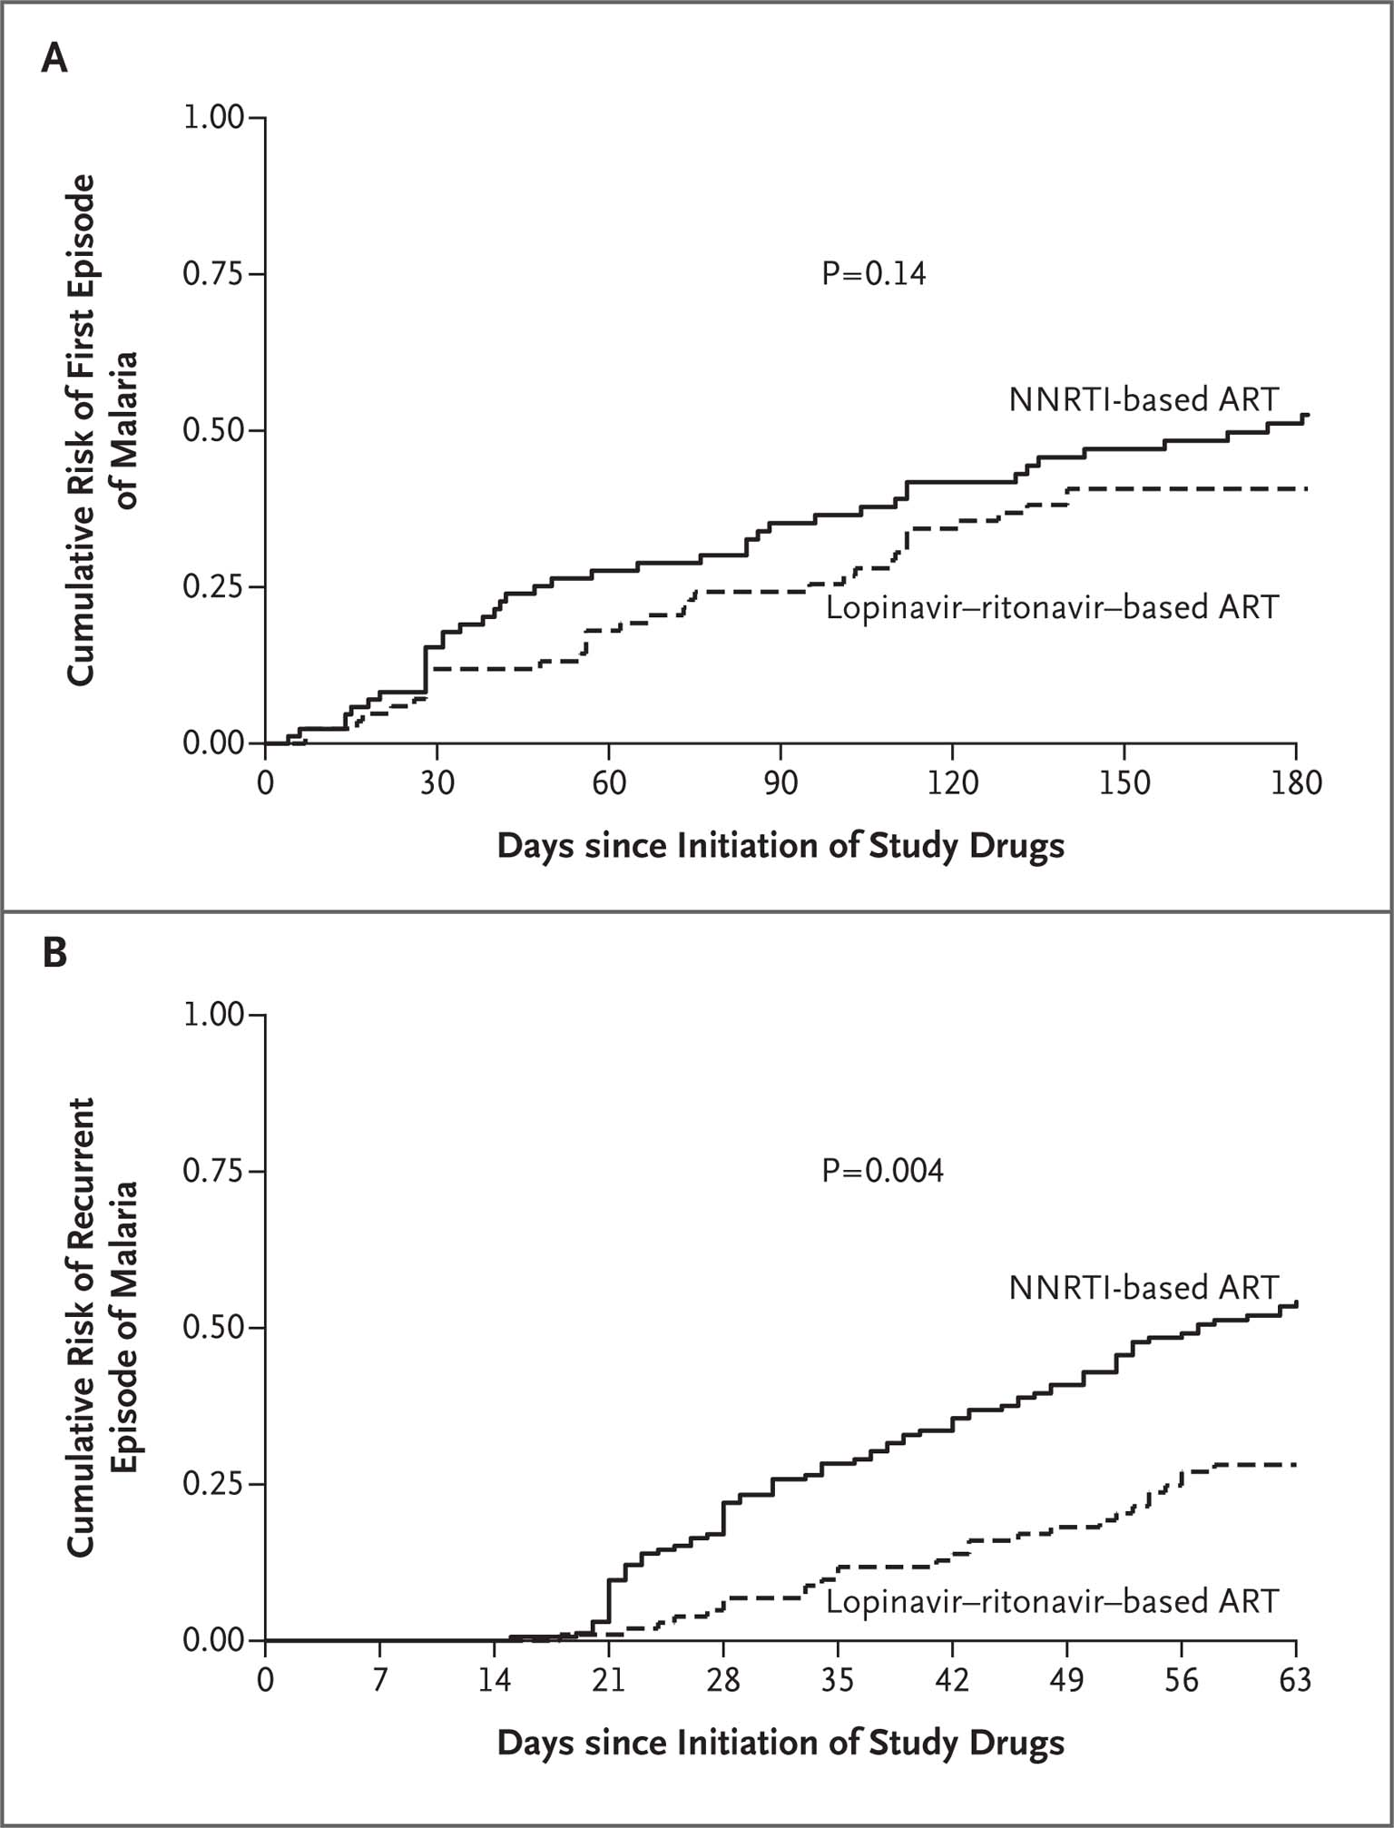
Action Target: Transportability
Understanding action target (s) enables inference about results in one setting in another
Illustration from clinical medicine
  Protease inhibitors have anti p. falciparum effect
  Protease inhibitors alter kinetic of anti-malarial drugs
Mechanism informs generalizability
  Direct anti-plasmodium effect → can expect the same effect in low prevalence areas
  Boosting coartem → not transportable to low prevalence settings
First episode of malaria
Recurrent malaria
Achan NEJM 2012;367:2110-8.
Notes:
Example of a study where there was no mechani
Generalizability - Transportability
The ability to use results in one setting to infer about another
A function of what you have measured in the initial setting and what you know about the new settings
Age standardization
More complex when interventions have an effect on mediators of effects
Generalizability – Robustness
Stability of effects across different settings
Generalizability is the way you study the intervention
Both depend on understanding mechanism
sm, so implications about generaliabiltiy unclear

Slide 26
Example from Implementation Studies
Community adherence groups from Mozambique (Decroo JAIDS 2011)
Problem: too many visits and clinics too crowded
Solution
  6 members
  Rotate clinic visit
Reduces clinic visits from 12 to 2
Where else will this work?

Slide 27
What if you live close?
What if you don’t need social support?

Slide 28
Behavioral Target
Behavior that you seek to change
Necessary component but usually insufficient cause of closing cascade step
Proctor offers acceptability, sustainability, adoptability, etc.
Examples:
  A QI coach makes 2-hour visits each week to a clinic in order to train and thereby enhance capabilities of health care workers to operate a quality committee
  The AARP ACE campaign unit sends petitions monthly to motivate hospital CMO’s to allocate an FTE to leading an ACE scale up
  A state offered tax relief each year for the next five years to incentivize facilities to create analytic database tools that systematically reports incident kidney dysfunction

Slide 29
Implementation outcomes
Acceptability
Adoption
Appropriateness
Costs
Feasibility
Fidelity
Penetration
Sustainability
Implementation outcomes
  Indicators of the implementation success.
  Proximal indicators of implementation processes.
  Key intermediate outcomes in relation to service system or clinical outcomes in treatment effectiveness
Proctor 2011

Slide 31
Example
TA in China for HIV care
Non-evidence based practices
  Mannitol for crypotoccal meningitis
6 months intervention
  International scholars, model evidence based practices, etc
  Round with team
  Doctor-to-doctor
Measure mortality before and after
No difference

Slide 32
Fidelity – I didn’t teach EBM
“This is how we do it”
I believe you but I have other incentives

Slide 33
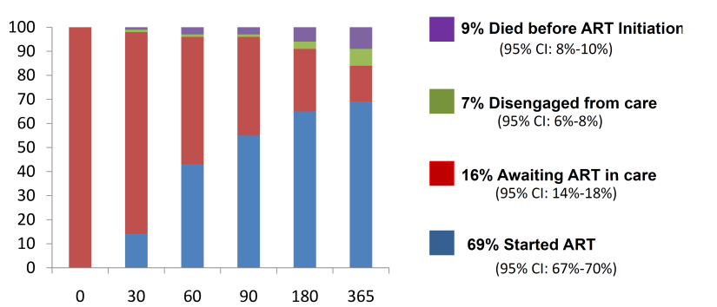
Example: ART Initiation in Uganda
Structural
  Overnight processing of CD4 testing
    Failure to return for second visit
Organizational
  One size fits all counseling
    “treatment supporter” and three pre-ART adherence visit requirements
Providers
  Slow diffusion of new clinical research findings
    Unaware of new data suggesting timing matters (Zolopa 2009, Havlir 2011)
    “ART is not an emergency”
Days since ART eligibility

Slide 34
Amanyire Lancet 2015

Slide 35
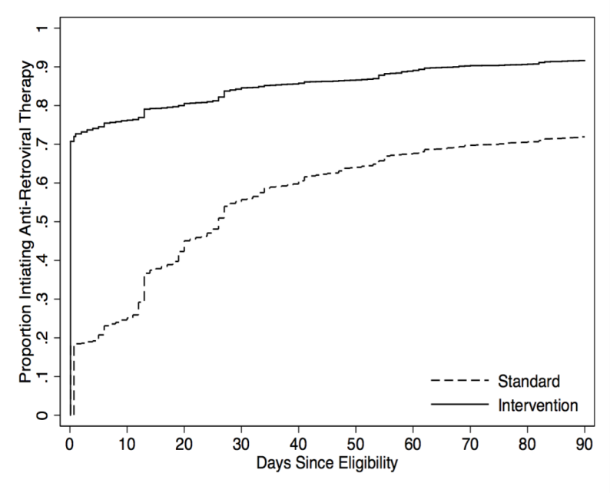
Primary outcome: ART initiation by 14 days after ART eligibility (N=12,024)
Cumulative Incidence of ART Initiation
Notes:
Among 12,024 treatment eligible patients 79.6% met the primary outcome of ART initiation two weeks after eligibility in the intervention condition vs. 37.7% in the control condition (risk ratio of 2.11 (95% CI of 2.03 to 2.20) and a risk difference of 41.9%, (95% CI: 40.1%-43.8%). The p value was less than 0.0001
Subgroup analysis found this effect to be consistent across sex, age, although an attenuation in effect over each intervention wave was observed.
The full distribution of ART initiation times shows that the probability of initiation on the same day as eligibility rose from 18.30% to 70.80%, for a risk ratio of 3.87 (95% CI: 3.64 - 4.11, P < 0.0001).
At 90 days, 70.40% had started in the control condition and 89.70% in the intervention condition, for a risk ratio of 1.27 (1.25 - 1.30), p value <0.0001
The cumulative incidence was estimated with the Aalen-Johansen competing risk method

Slide 36
Implementation Interventions and Intervention Outcomes
Intervention
Implementation outcome
Process outcome
Health status outcome

Slide 38
https://implementationscience.biomedcentral.com/articles/10.1186/s13012-017-0630-8

Slide 41
Post Script
Must conceptualize and specify adequately
This isn’t “normal” yet
Movement toward full concpetualization and reporting of interventions
Journal reviewers and editors do not value implementation outcomes

