Slide 1
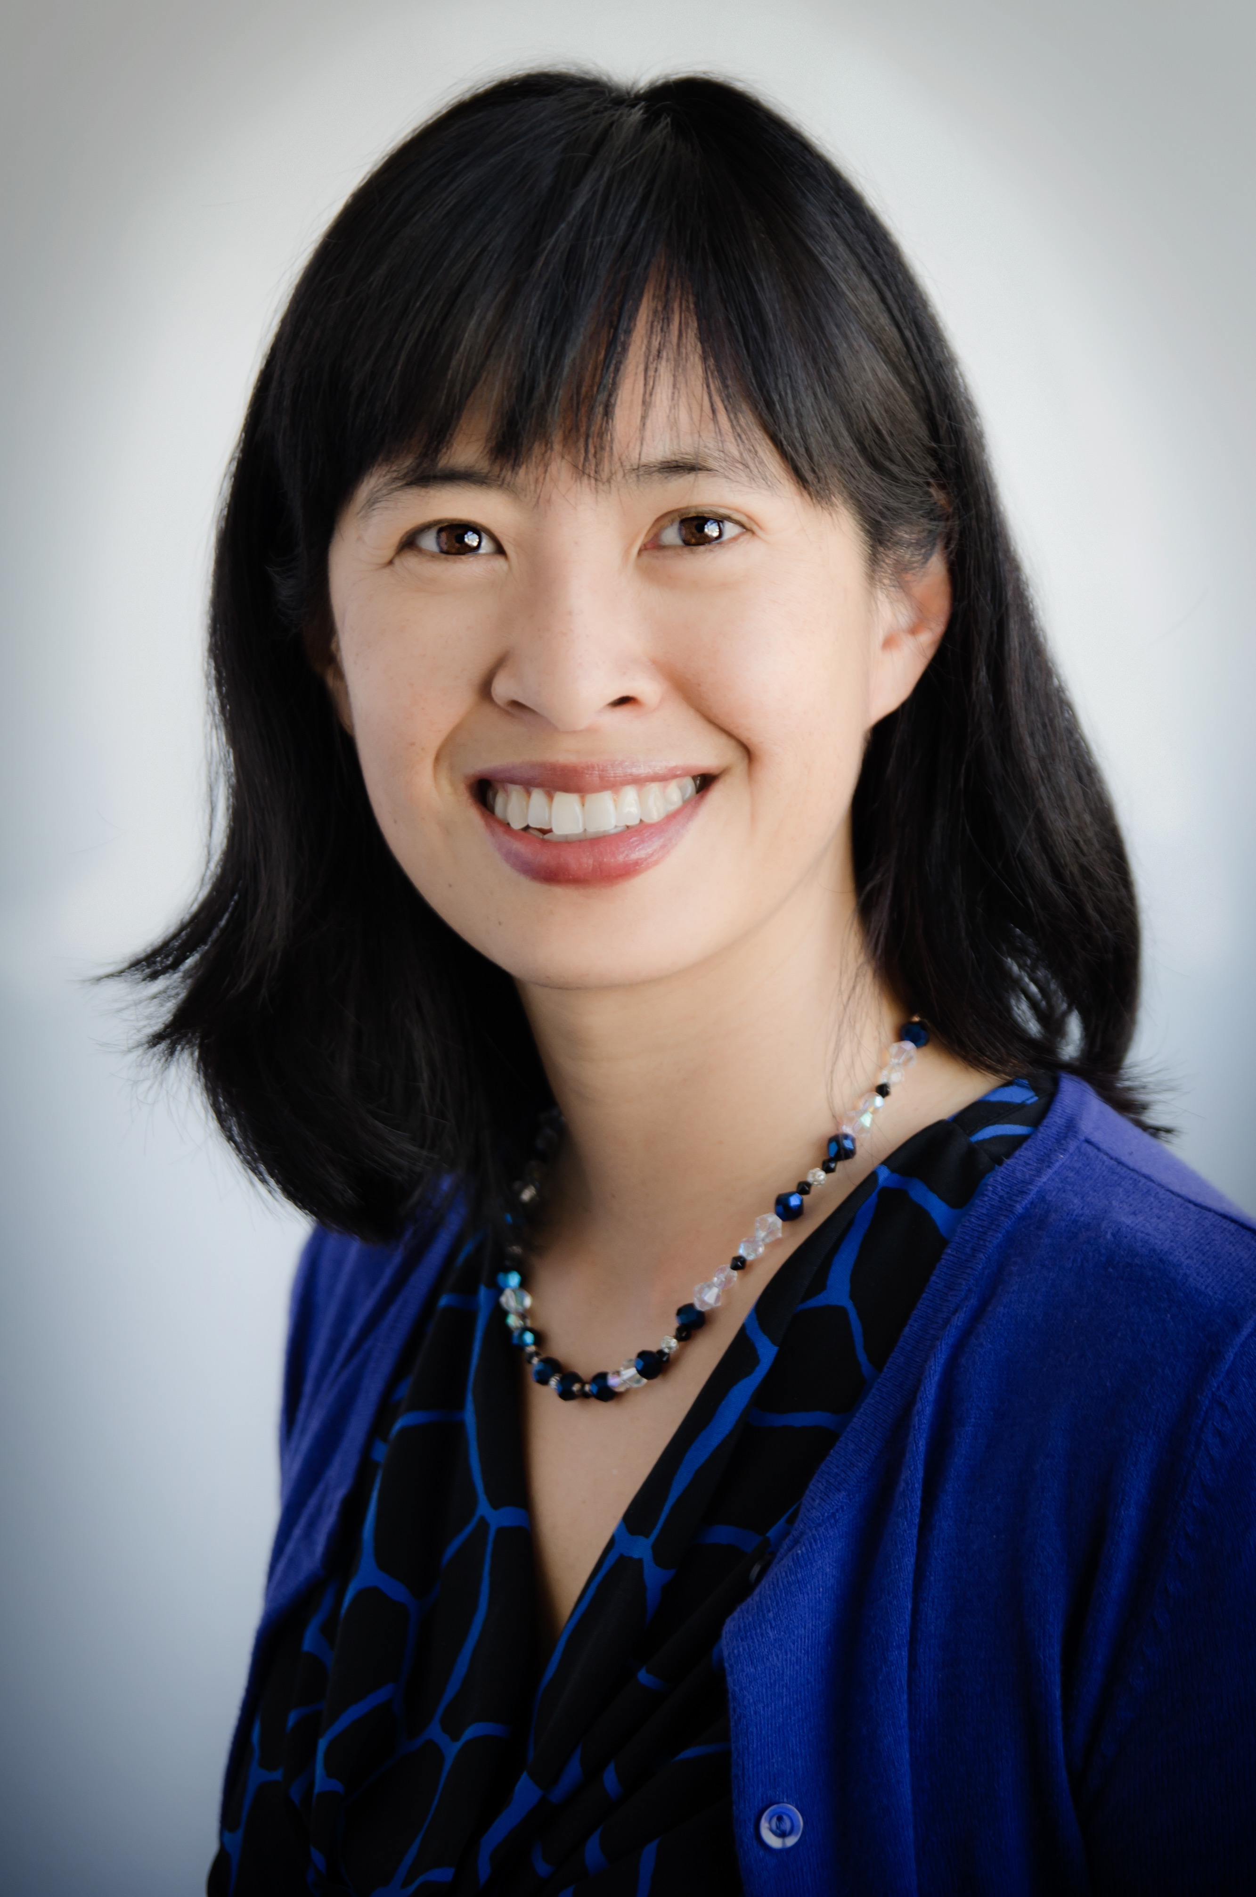
Perspectives on Causal Inference
Epidemiology 207 - Epidemiology Methods II
June M. Chan, ScD
Professor, Epidemiology & Biostatistics and Urology
Steven & Christine Burd Safeway Distinguished Professor

Slide 2
Learning Objectives
What is causal inference and why do we use it?
Theories of causal inference
Causal models and heuristics
  Causal guidelines (Hill)
  Sufficient-component cause model (Rothman)
  Counterfactual model (Hernan & Robins)
  {Graphical models (e.g., causal diagrams, DAGs) – see Dr. Glymour’s lecture}

Slide 3
Causal inference
Goal of epidemiology:
  identify causes of diseases and factors that could prevent or delay disease development
Causal inference:
  a process of determining causal and preventive factors for diseases or health conditions

Slide 4

What Kinds of Questions Does Epidemiology Answer? “Big 6”
Description
  How frequent/common are risk factors or exposures & conditions or diseases? How often does Y occur?
Causation
  The science of establishing causal relationships among biological, behavioral, environmental (etc.) factors among humans
  Does X cause Y?
Attribution
  What fraction of disease Y can be eliminated if a causal exposure X is eliminated?
Mediation
  Understanding the mechanisms of causation
  How does X cause Y?
Interaction
  When and for whom does X cause Y?
Prediction
  Do A, B, and C predict occurrence of Y? (e.g., diagnosis or prognosis)
Notes:
NOTES fr Dr. Martin Epid Methods 1 2017
Before we get started with today’s material, we should review the kinds of questions that epidemiology answers?
First, is description….
Lastly, is prediction. Can we identify a factor or set of factors that predicts the occurrence of disease or some outcome in a diseased person. Doing this prediction concurrently is basically diagnosis. Using prediction to predict the future is prognosis.
I’m guessing that each of you is working at least one of these questions. If true, then this is course is for you.

Slide 5
Theories of causal inference
Deductive vs. Inductive reasoning
Refutationism
Consensus
Bayesianism
RGL2008 Ch 2

Slide 6
Inductivism
Observations → General Laws of Nature
  Francis Bacon, Novum Organum, 1620
  Example from Epid Methods I – “Children under age 2 who slept with a nightlight were 3+ times more likely to become nearsighted, therefore nightlights cause myopia…."
Limitations
  Post hoc ergo proctor hoc ~ “after this therefore on account of this”
  Criticized by David Hume, Scottish philosopher, early 1700’s
    “observers cannot perceive causal connections, but only a series of events"

Slide 7
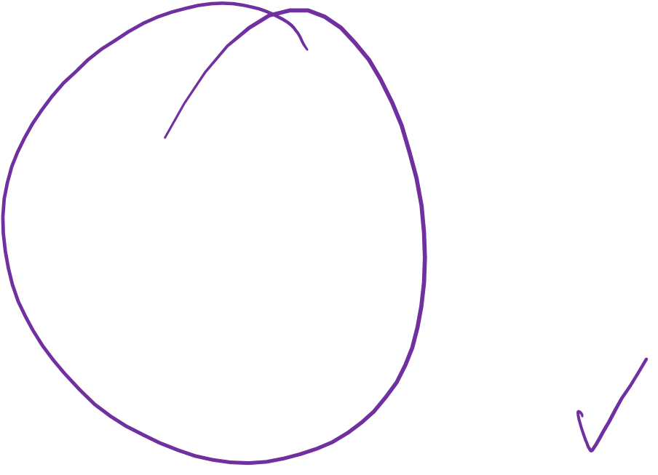
Deductive reasoning
0
Arthur Conan Doyle’s Sherlock Holmes
Pull the clues together, arrive at generalization, i.e. deduct the answer

Slide 8
Deductive reasoning
0
Observe facts to deduce other facts.
General premises assumed to be true → Facts
Greek philosopher Aristotle is sometimes considered “father of deductive reasoning”:
  All men are mortal.
  Socrates is a man.
  Therefore, Socrates is mortal.
Deductive reasoning ~ solving algebraic equations.
Limitation: Challenging, especially in medicine and biology, to have full confidence in our “premises”.

Slide 9

Refutationism
First half of the 20th century – Nonidentification
  “scientific statements can only be found to be consistent with observation, but cannot be proven or disproven in any “airtight” logical or mathematical sense.”
Conjecture & Refutation and “advancement of science”
  Form hypothesis
  Deductive logic → Inferred Predictions about the hypothesis
  Compare observations with the predictions
  Hypotheses whose predictions agree with observations → confirmed
    Those NOT corroborated by observations are “refuted”
  Hypotheses that have been corroborated can be refuted at any time and alternative hypotheses are generated.

Slide 10

Consensus
Science is “peer-reviewed”
  We as part of the scientific community often judge what is standard and what is refuted
Medicine & Public Health involve constant decision-making about what to do to prevent or manage health conditions
Epidemiology is one of the foundations of “evidence-based medicine”
How do we know WHEN to change our decisions based on the evidence?
Notes:
Examples:
Smoking/Lung cancer
Screening for prostate cancer
Role of professional bodies and those who pay for health care
Role of communication, journalists, social media
Where will YOUR study fit in? what is YOUR role in guiding the field?
Recognize that while there is some infrastructure and rules, medicine is an “art” and people make choices that impact their health on a hourly basis (consciously or not)

Slide 11
Bayesianism
Assign a prior probability to the premise of your argument, then apply rules of probability theory to derive posterior probability for your conclusion
Do not confuse beliefs for evidence, but use evidence to modify beliefs
Discussed more in Epid Methods III (Epid 265)
Limitation:
  Your personal prior probability may differ from a colleague’s, so your posterior probability could be very different, even if you followed all rules and logic of probability theory

Slide 12
One summary perspective…
In practice, we use each of these…
  Inductive reasoning helps us develop our hypothesis
  Deductive reasoning helps formulate ideas ~ causal pathways or biological mechanisms
  Refutationism comes into play when we test a null hypothesis
  Bayesianism comes into play when we start thinking about p-values and confidence intervals to ”test” the hypothesis
  Consensus shapes how we move a field forward, decide what grant proposal to write, and where to put our effort
RGL2008 Ch 2

